Slide 1
Preet Mann July 22, 2024
pfRICH Mirror Evaporation Process

Slide 2
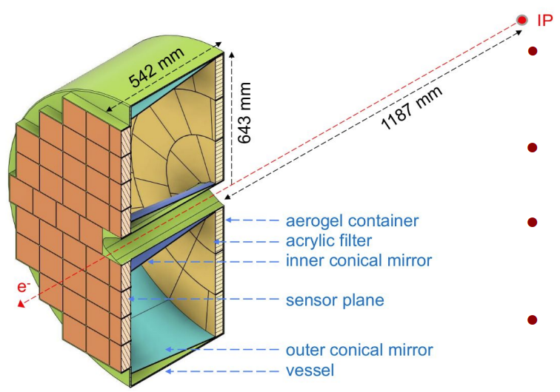
Overview
pfRICH: Proximity Focusing Ring Imaging Cherenkov detector; PID detector [pion, kaon and proton]
Covers the backward region between -3.5 < η ≤ −1.5
Cherenkov photons are formed by interaction with aerogel radiator.
Conical mirrors line the inner and outer diameter to direct photons towards the HRPPD sensor plane.
Mirrors cover 300 - 700 nm wavelength region at 90% reflectivity.

Slide 3
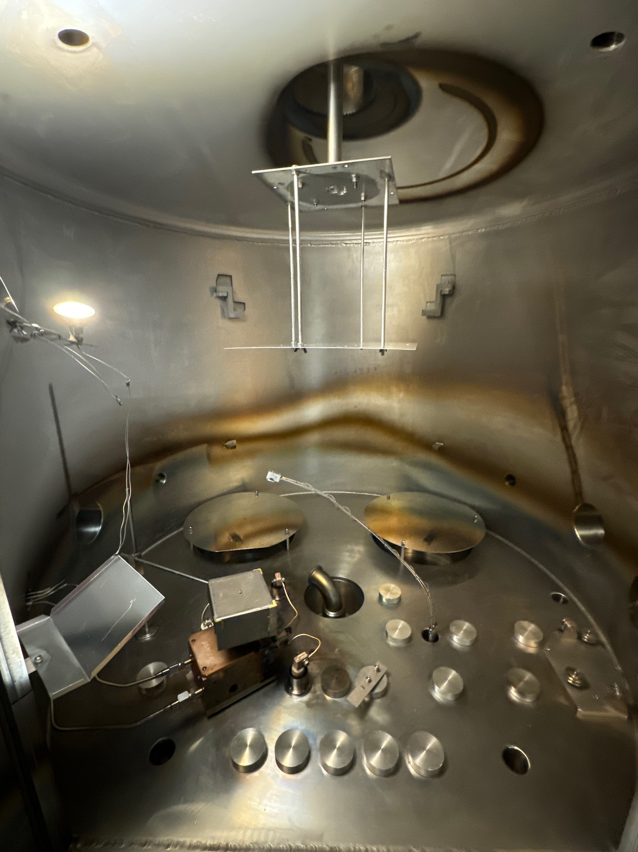
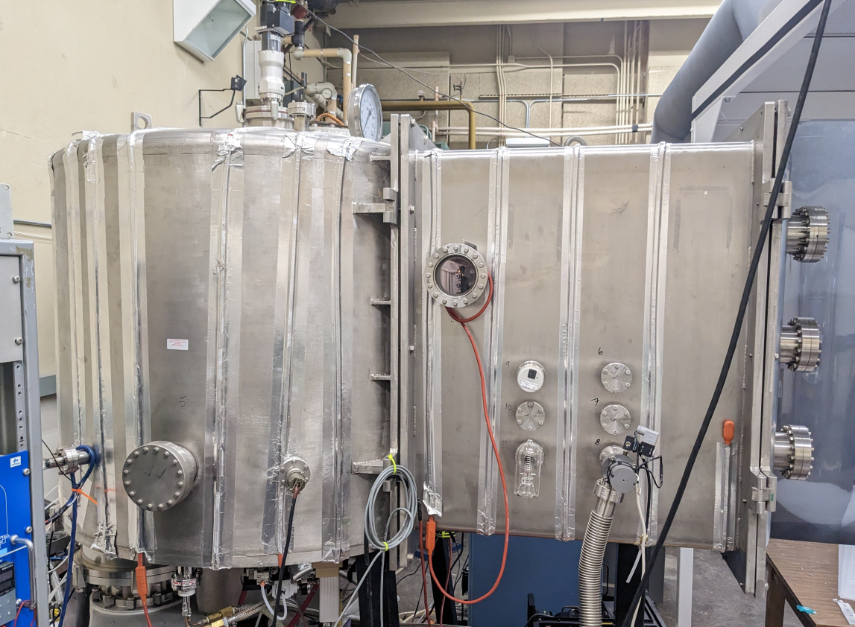
Chamber
Rotating Fixture
Quartz Crystal Microbalance
Remote Shutter
Evaporator Exterior
Electron Gun

Slide 4
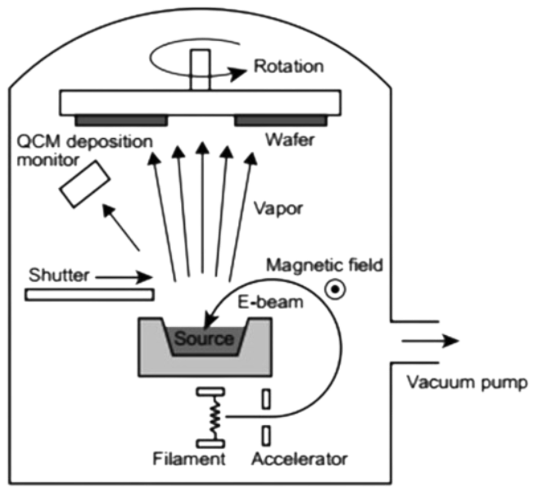
Evaporation / PVD
Thin film deposition occurs via two main processes, PVD / CVD :
PVD (physical vapor deposition) is a process in which the vaporization of a solid material occurs
techniques including E-Beam and Sputtering
CVD (chemical vapor deposition) is a process in which one or more materials are applied to a substrate to decompose or react in a film
techniques include plasma reactions or liquid chemical reactions.
SBU-pfRICH deposition occurs via E-Beam.
E-gun heats up material into a vapor which travels isotropically and condenses upon the substrate to create a reflective film.

Slide 5
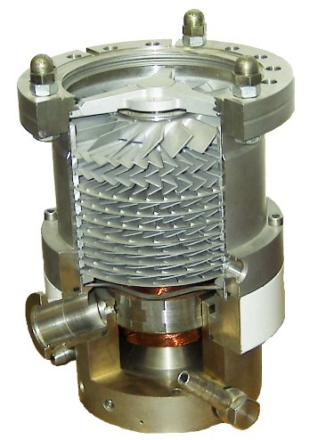
Vacuum State
E-Beam evaporation necessitates a high quality vacuum (10⁻⁶ torr)
An environment in which convection is not possible and an increase in the mean free path of evaporated particles.
Lesser vacuums introduce film contamination as well as an unstable environment for E-Beam operation.
Conventionally, turbomolecular pumps (right) and cryogenic pumping are used to achieve adequate states.

Slide 6
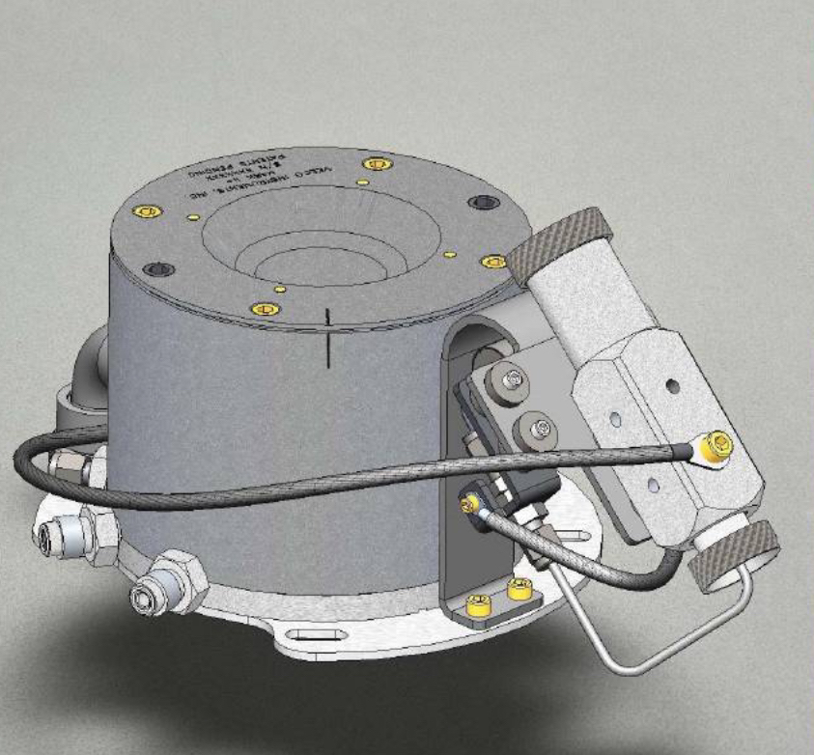
Ion Source
IAE (ion assisted evaporation) involve a Ion source shooting ionized gasses - typically oxygen or argon for improved film quality
Treats the substrate to a bombardment of low energy ions to vaporize any contamination.
Gas ions impart energy into the evaporant atoms, resulting in greater surface mobility as well as increasing the arrival energy and grain structure of the deposited film, leading to more uniform deposition
SBU mirrors will employ ionized argon gas for improved film consistency and reflectivity.

Slide 7
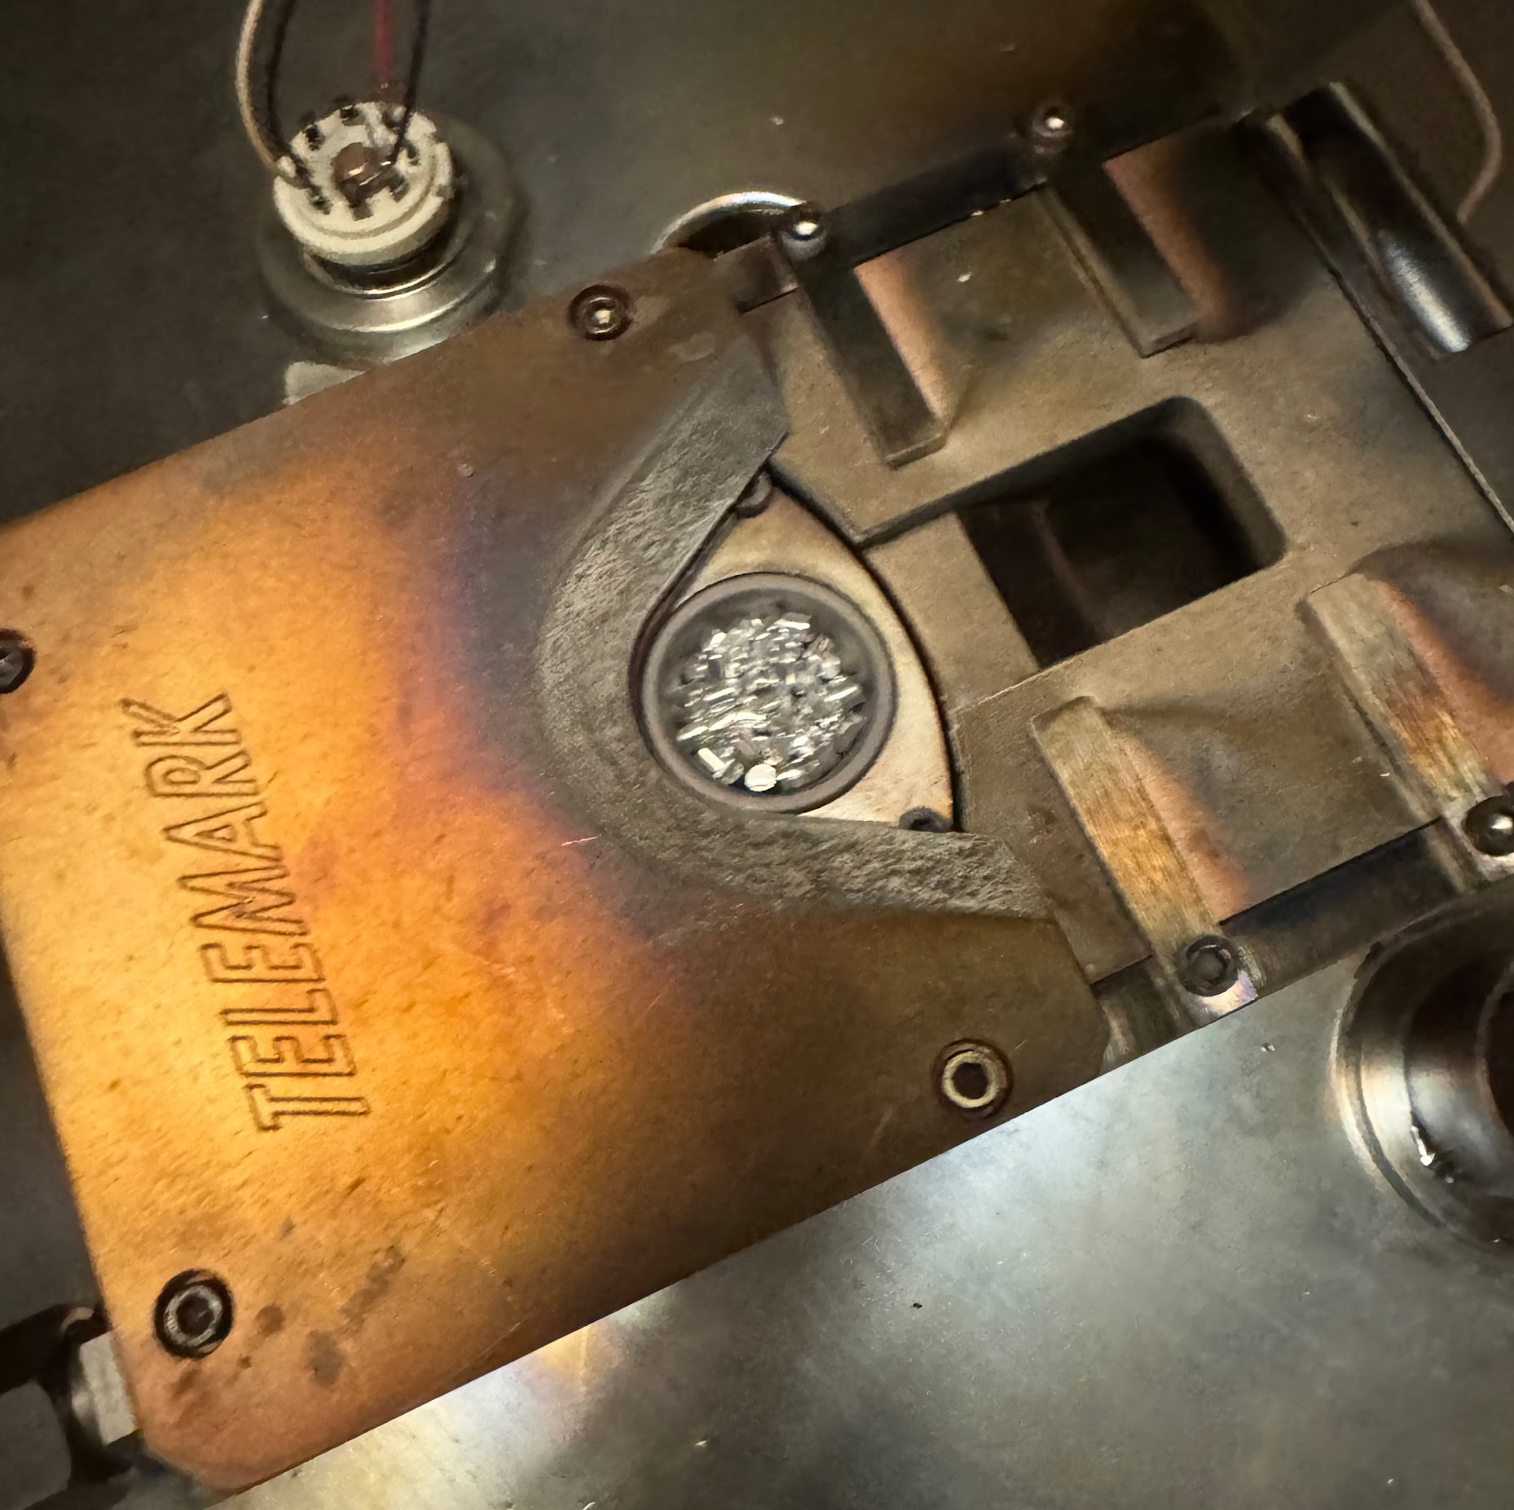
Material Properties
Graphite crucibles containing the relevant materials are loaded into the rotating carousel of the e-gun for evaporation.
Substrate is created by co-bonding lexan to carbon fiber.
Chromium is then deposited to serve as a primer.
Subsequently an aluminum layer is deposited for a reflective film. Aluminum reaches an evaporation state at 821 ℃ with 10⁻⁶ torr Chromium reaches a sublimation state at 977 ℃ with 10⁻⁶ torr

Slide 8
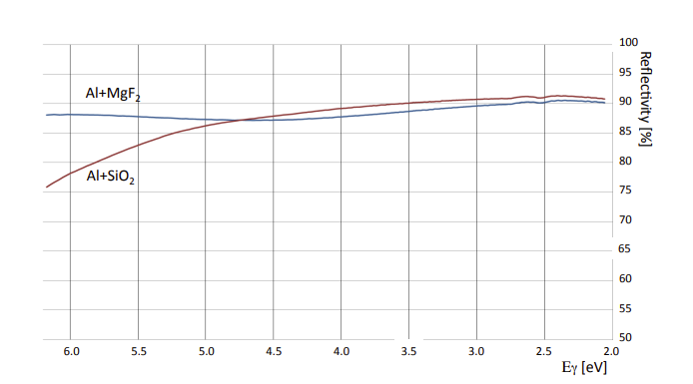
Dielectric Protective Coatings
Chromium-Aluminum mirrors oxidize over time and are prone to contaminants on the film - i.e. scratches. Dielectric top coatings are employed to mitigate the damage from these effects.
Typical coatings of magnesium fluoride MgF2 are applied to optical mirrors, providing a low UV enhancement and protective coat on the surface.
MgF2 requires the heating of a substrate to ~ 200 ℃ at which Lexan would deform, SBU mirrors instead will work with SiO2, silicon dioxide, protective coatings to ensure longevity.

Slide 9
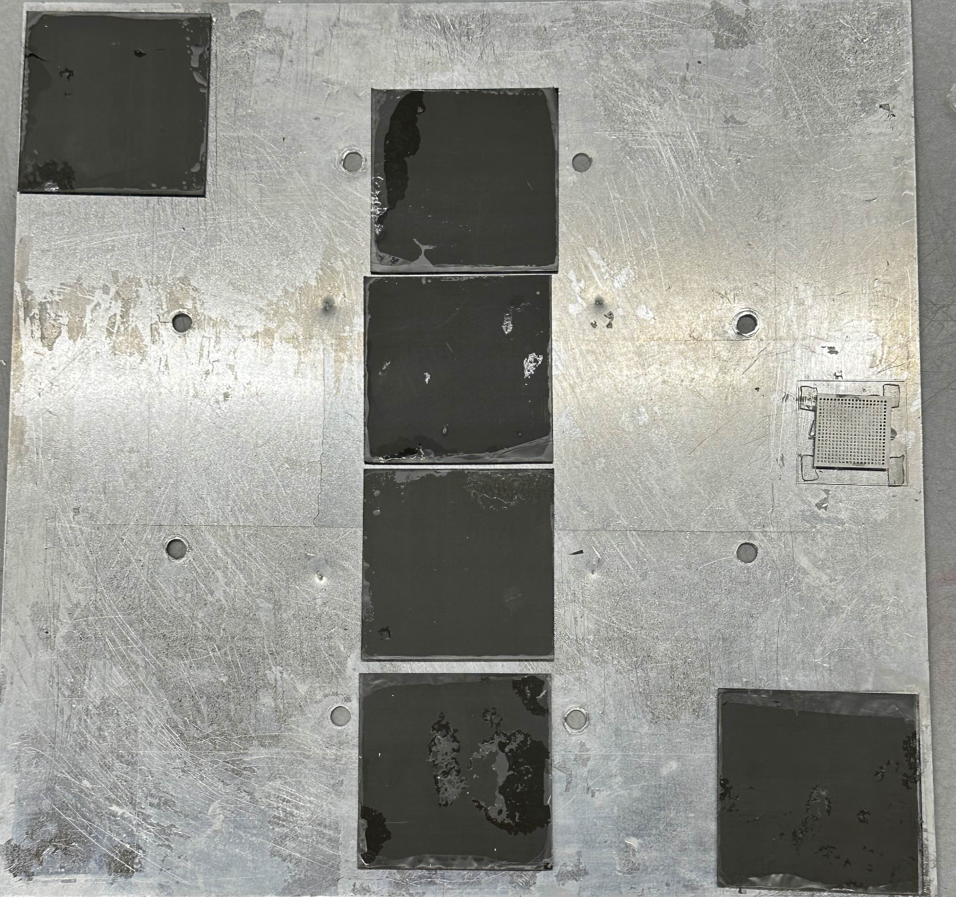
Substrate Mounting
An aluminum plate serves as a mounting point for substrate samples, fixed deposition distance.
Tests for uniformity across different positions in the chamber.
This fixture is then fixed to a rotating motor shaft at the top of the chamber. As the e-gun is off axis, a rotation of the fixture further improves uniformity.
A clear lexan witness piece covered by a shadow mask is attached in every coating to determine total true thickness.

Slide 10
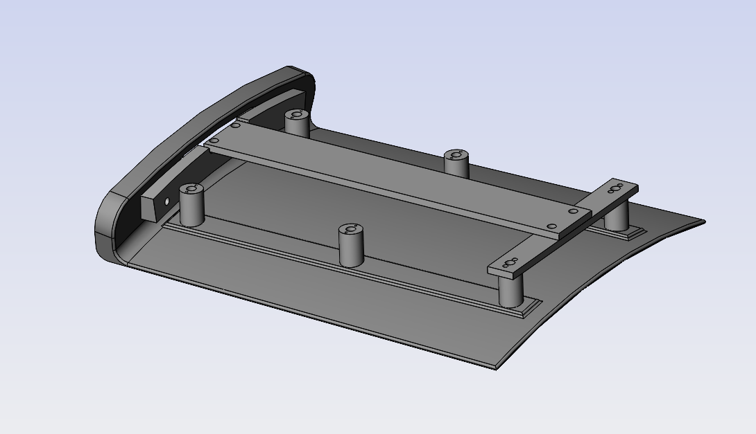
Full Scale Mount

Slide 11
Relative vs. Absolute Deposition
Real time deposition values rely heavily upon a quartz crystal microbalance: (QCM) which measures the the frequency of oscillation of a quartz crystal which varies as a function of mass on the crystal’s face.
Determines the rate of mass deposition as well as total deposition at a given position
Post deposition analysis of the coating thickness can be done via stylus profilometer / confocal microscope which provides a ratio between QCM deposition and true deposition for future coatings.
Old Crystal New Crystal
QCM

Slide 12
Initial Coatings
Coating #1
Coating #5
Coating #7

Slide 13
Substrate Variation:
Large Scale Mirrors
Curved Mirrors

Slide 14
Evaporation Results:
Evaporation Number | Coating Recipe (Values at QCM) | Procedural Changes | Reflectivity
7 | Cr: 5.19 KAng Al: 12.03 KAng | Decrease in total deposition amount from previous coatings 70 KAng → 17 KAng | 88%
10 | Cr: 4.66 KAng Al: 22.24 KAng | Increased Aluminum Coating | 86%
11 | Cr: 5.08 KAng Al:12.36 KAng | Consistency Check Repeat of #7 | 89%
12 | Cr: 5.17 KAng Al:12.27 KAng | Substrate Waviness Test + Rotation Decrease 60 RPM → 30 RPM | 88%
13A | Cr: 0.11 KAng Al: 0.93 KAng | NA62 / COMPASS recipe | 20%
13B | Cr: 1.13 KAng Al: 2.578 KAng | Account for QCM to Substrate deposition ratio [rough estimate of distance discrepancy] | 74%

Slide 15
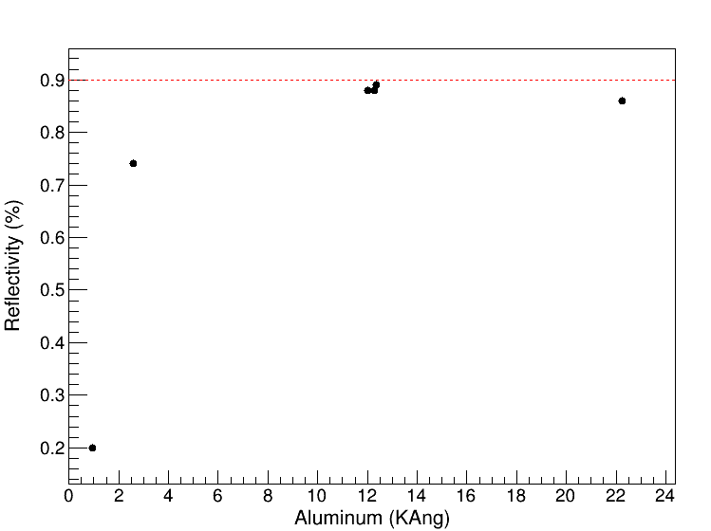
Relative Aluminum Deposition vs Reflectivity:
Evaporation | Average reflectivity (300-600 nm) | Al (KAng)
7 | 0.880914 | 12.03
10 | 0.868409 | 22.24
11 | 0.89305 | 12.36
12 | 0.880803 | 12.27
13 | 0.74114 | 3.51
14 | 0.873327 | 7.34

Slide 16
Profilometer Analysis
True thickness values are determined via profilometer or confocal microscope
Stylus or laser glides across the surface of a substrate, rising and falling with the variations in height to create a thickness map.
~15.3375x ratio was determined between the QCM and substrate for SBU mirrors at 50 cm

Slide 17
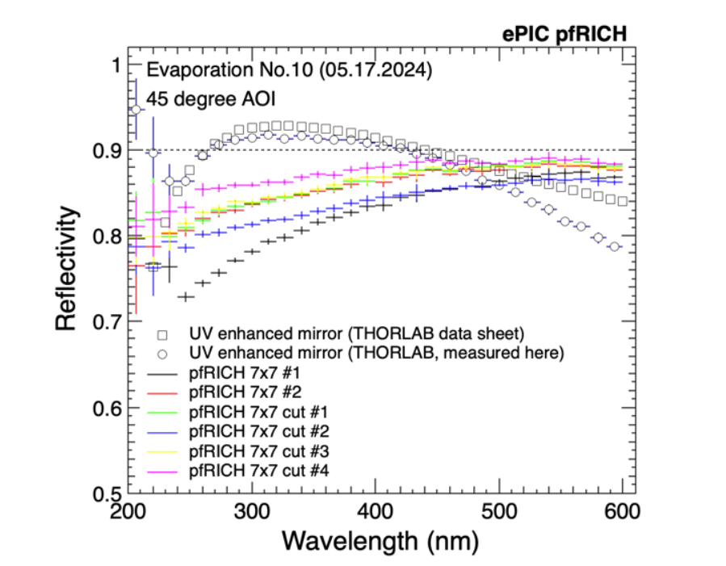
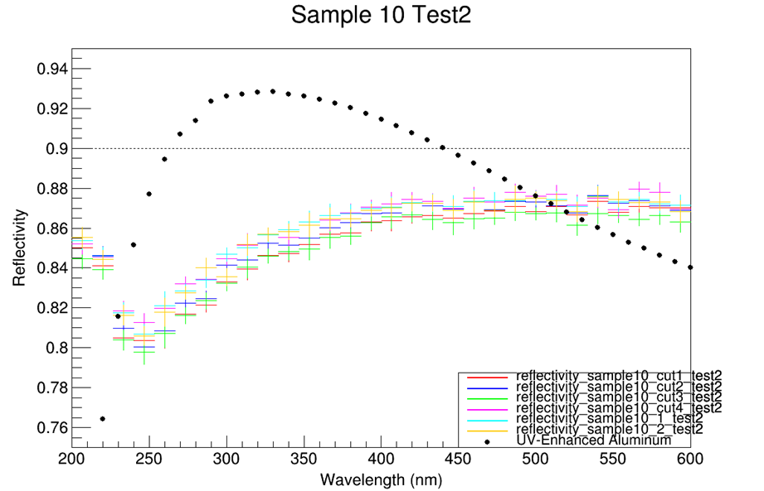
Coating uniformity

Slide 18
Summary
E-Beam coatings at SBU have been largely successful with 14 conducted mirror coatings.
Small mirror samples’ consistently reaching reflectivity ~90% reflectivity between 300-700 nm with a uniformity of 1-2%
An absolute value nearing ~ 90 nm of aluminum, paired with 10 nm of chromium has been shown to approach a 90% peak reflectivity.

Slide 19
Back Up:

Slide 20
Deposition Process / Modeling

