Slide 1
DOE National Laboratories: History & Structure presented by Douglas Higinbotham (Jefferson Lab)
EICUG Student Lecture 22 July 2024
Special Thanks the Oppenheimer Program (https://oselp.org/ )

Slide 2
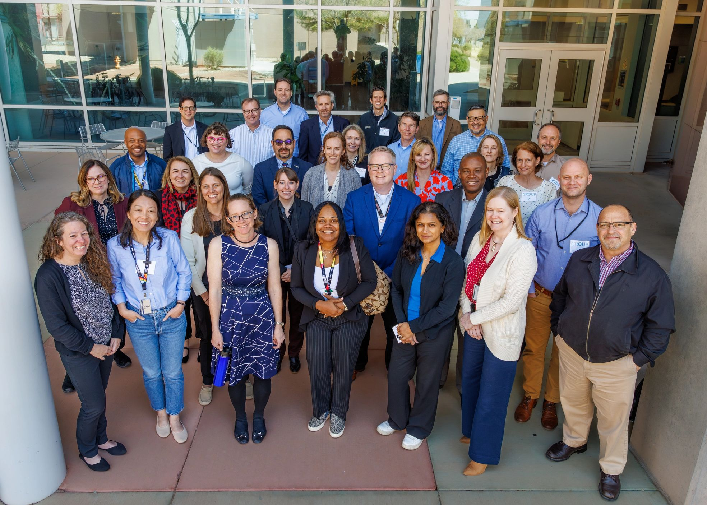
National Laboratory Director’s Council (NLDC) Oppenheimer Science & Energy Leadership Program (OSELP) Cohort 7

Slide 3
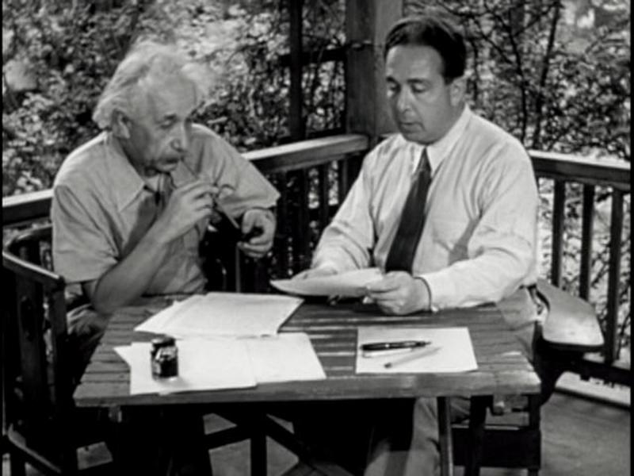
DOE’s Programmatic Heritage
In August 1939, Albert Einstein wrote to President Franklin D. Roosevelt, informing him that a nuclear chain reaction might make possible the construction of “extremely powerful bombs” (Einstein Szilard letter)
In 1942, the Army Corps of Engineers established the Manhattan Engineer District to design and produce the first atomic bomb.
Los Alamos, Oak Ridge and Hanford were subsequently created.
https://ahf.nuclearmuseum.org/ahf/key-documents/einstein-szilard-letter/

Slide 4
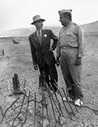
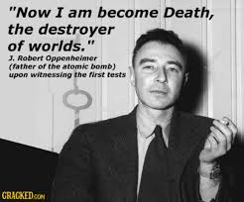
J. Robert Oppenheimer
1904 - 1967
Professor - theoretical physics at Berkeley
Wartime head of the Los Alamos Laboratory, scientific Director of the Manhattan Project and "father of the atomic bomb“
July 16, 1945 – after Trinity test in New Mexico – quoted Bhagavad Gita: "Now I am become Death, the destroyer of worlds."
Chairman of the influential General Advisory Committee of the newly created United States Atomic Energy Commission.
With sparse evidence at best - security clearance revoked in a much-publicized hearing in 1954
Winner of the Enrico Fermi Award
Director of the Institute for Advanced Study at Princeton
Major Motion Picture in 2023
And in many ways the father of the National Lab system.
Oppenheimer with General Groves. Groves Oversaw Both the Pentagon Construction and the Manhattan Project

Slide 5
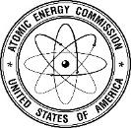
The Cold War
Following the war, Congress passed the Atomic Energy Act of 1946 and created the Atomic Energy Commission (AEC), which took over the Manhattan Project’s sprawling scientific and industrial complex.
Initially, the AEC focused on designing and producing nuclear weapons and developing nuclear reactors for naval propulsion
The Atomic Energy Act of 1954 ended exclusive government use of the atom and began the growth of the commercial nuclear power industry, giving the AEC authority to regulate the new industry.

Slide 6
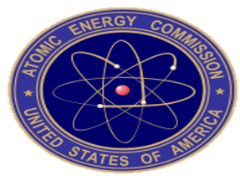
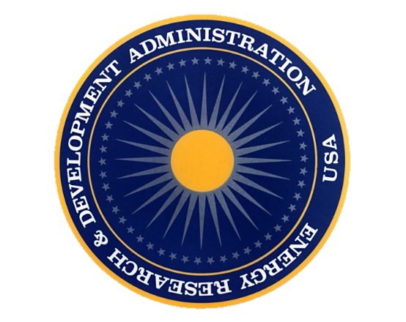
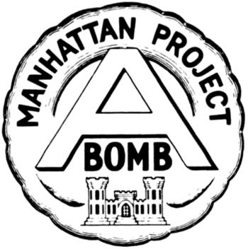
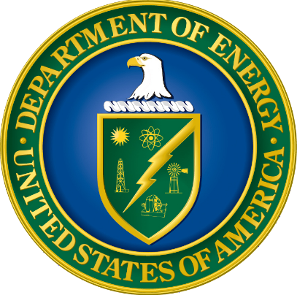
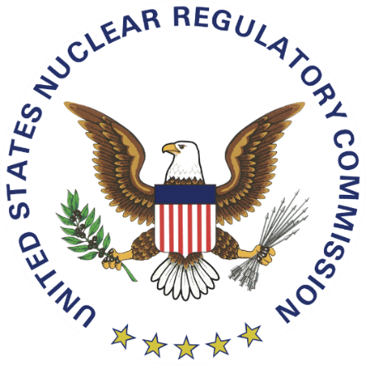
From the Manhattan Project to the Department of Energy
Manhattan Engineering District (1942)
Atomic Energy Commission (1946)
Energy Research & Development Administration (1974)
Department of Energy (1977)
Nuclear Regulatory Commission (1974)

Slide 7
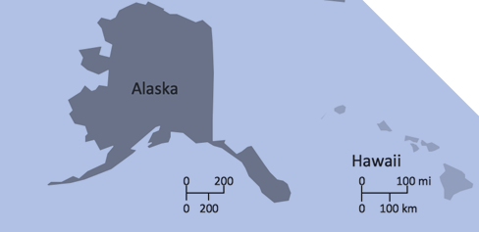
Sandia is also in HI and NETL in AK!

Slide 8
FFRDCs
Federally Funded Research and Development Centers:
Meet special long-term national research and development needs of considerable complexity that cannot be met as effectively by in-house government or contractor resources;
Have access to information beyond what is common to the normal contractual relationship;
Cannot use special access to compete with the private sector;
Are required to operate in the public interest, free from organizational conflict of interest;
Anticipate a long-term relationships with the government;
Provide the continuity that will attract high-quality personnel;
Maintain currency in field(s) of expertise;
Maintain objectivity and independence;
Preserve familiarity with the needs of its sponsor(s);
Provide a quick response capability.
The National Science Foundation keeps a list of FFRDCs by name, sponsoring agency, administrator type, location, and activity type.
16 of the 17 DOE National Labs are FFRDCs
Notes:
There are 43 FFRDCs as of February 2023. Doe has 16 FFRDCs, NETL is not an FFRDC.
Federally Funded Research and Development Centers (FFRDCs) trace their origins to World War II, when new institutions were needed to address new challenges. The extraordinary science and engineering problems posed by the war called for a sustained R&D effort that combined independent and highly technical capabilities with the kind of long-term funding commitment that only the government could make.
Early precursors to today’s FFRDCs included the Applied Physics Laboratory at Johns Hopkins University, the Jet Propulsion Laboratory at the California Institute of Technology, and the Radiation Lab at MIT. These facilities offered first-rate R&D capabilities from the private sector underpinned by federal funding, the very essence of the FFRDCs.
As Sandia President and Labs Director Paul Hommert notes, the iconic predecessor and model for FFRDCs was Los Alamos Scientific Laboratory, where the nation invested substantial resources to develop the atomic weapons that ended World War II.
Paul recounts that Gen. Leslie Groves, who headed the Manhattan Project, initially envisioned Los Alamos as a pure government operation. Robert Oppenheimer, tapped by Groves to lead the Los Alamos lab for the project, convinced Groves that a more effective approach — and one more likely to succeed in drawing the top scientists and engineers that project demanded — would be to have an outside entity manage the lab, backed by government investment. Groves agreed and the results validated the approach.
The successes of Los Alamos and the other wartime labs offered a compelling model for FFRDCs, a structure that was formalized in the post-war era with the establishment of the RAND Corporation and several Atomic Energy Commission laboratories, including Sandia. Today there are 41 FFRDCs sponsored by agencies from across the government.

Slide 9
GOGOs and GOCOs
GOCO (Government Owned/Contractor Operated) operated laboratories are owned by the Federal Government, but managed by contractors.
Contractors may be individual universities, university consortia, private companies, or nonprofits. GOCO dates back to the original laboratories of the Manhattan Project.
Most Federal laboratories are GOGOs (GovernmentOwned/Government Operated); all but one of DOE’s laboratories (NETL) are GOCOs.
GOCO researchers are not Federal employees and have more freedom than GOGO scientists. GOCO employees can assert copyrights, consult with industry, and participate in start-ups based on technology developed at the laboratory.
Even at the GOGO lab, ~2/3 of the people who work there are contractors forming what is basically a GOCO within the one GOGO lab.
Notes:
Slide from Dimitri Kusnezov presentation to CRENEL on July 18, 2014 “The DOE’s National Lab Complex)

Slide 10
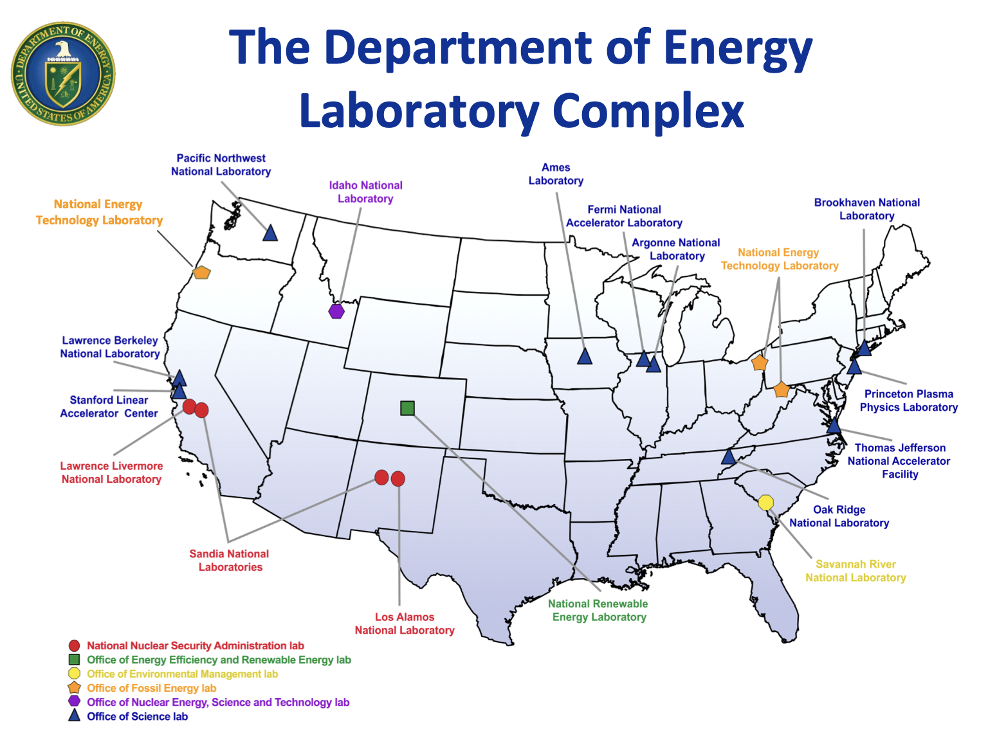
17 DOE
National Labs:
16 GOCO, &
1 GOGO

Slide 11
DOE’s M&O Contracts
DOE’s FFRDCs operation under M&O contracts – a special Federal Acquisition Regulation (FAR) designation for GOCO facilities
Origin is in character of work done through the Manhattan Project, but designation dates back to a Secretary of Energy Memo in 1983
M&O contracts are “an agreement under which the Government contracts for the operation, maintenance, or support, on its behalf, of a Government-owned or –controlled research, development, special production, or testing establishment wholly or principally devoted to one or more major programs of the contracting federal agency.” (FAR 17.601)
Notes:
Slide from Dimitri Kusnezov presentation to CRENEL on July 18, 2014 “The DOE’s National Lab Complex)

Slide 12
Recent M&O Bid Processes
SNL (Sandia)
On 1 May 2017, Sandia National Laboratories acquired a new administrator (National Technology and Engineering Solutions of Sandia, LLC, a subsidiary of Honeywell International, Inc.). The previous administrator was Sandia Corporation, a subsidiary of Lockheed Martin Corp.
LANL (Los Alamos)
On 9 June 2018, Los Alamos National Laboratory acquired a new industrial firm administration (Triad National Security, LLC). Between June 2006 and June 2018, Los Alamos National Laboratory was administered by Los Alamos National Security, LLC. Prior to June 2006, the administrator was the University of California.
SRNL (Savanna River)
On 22 December 2020, Savannah River National Laboratory acquired a new nonprofit administrator, Battelle Savannah River Alliance, LLC. The previous administrator, Savannah River Nuclear Solutions, continues to administer the Savannah River Site.
FNAL (Fermi)
In progress with the new contract expected to be in place by Jan 2025.
Three people MAY be replaced. ( Director, CSO/Deputy, COO )
TJNAF (Jefferson Lab)
In progress with proposals are due by 5:00 p.m. Eastern Time on September 30, 2024, new contract Jun 2025.
Seven people MAY be replaced. (above plus CPO, CIO, Accel. AD, Safety Head)
Reference: https://science.osti.gov/Acquisition-Management/M-and-O-Competitions
Notes:
Talking points
How bid teams organize are wildly different (SNL took off top layer of execs, LANL was a mix)
DOE went through a period of recompeting, seems to be backing off now
Every M&O contract is different (an often creates challenges in working or moving between labs)

Slide 13
DOE Laboratory | M&O Administrator | M&O Members
Ames Laboratory | Iowa State University | Iowa State
Argonne National Laboratory (ANL) | UChicago Argonne, LLC | University of Chicago, Universities Research Association (URA)
Brookhaven National Laboratory (BNL) | Brookhaven Science Associates, LLC | Stony Brook University, Battelle, 6 core universities
Fermi National Accelerator Laboratory (FNAL) | Fermi Research Alliance, LLC | University of Chicago, Universities Research Association (URA)
Idaho National Laboratory (INL) | Battelle Energy Alliance, LLC | Battelle
Lawrence Berkeley National Laboratory (LBNL) | University of California | University of California
Lawrence Livermore National Laboratory (LLNL) | Lawrence Livermore National Security, LLC | Bechtel, University of California, BWXT, Battelle
Los Alamos National Laboratory (LANL) | Triad National Security, LLC | Battelle, Univ of California, Texas A&M University
National Energy Technology Laboratory (NETL) | N/A (DOE GOGO)
National Renewable Energy Lab (NREL) | Alliance for Sustainable Energy, LLC | Battelle, MRI Global
Oak Ridge National Laboratory (ORNL) | UT-Battelle, LLC | Battelle, University of Tennessee
Pacific Northwest National Laboratory (PNNL) | Battelle Memorial Institute | Battelle
Princeton Plasma Physics Laboratory (PPPL) | Princeton University | Princeton University
Sandia National Laboratories (SNL) | National Technology and Engineering Solutions of Sandia, LLC | Honeywell, URA
Savannah River National Laboratory (SRNL) | Battelle Savannah River Alliance, LLC | Battelle
SLAC National Accelerator Laboratory | Stanford University | Stanford
Thomas Jefferson National Accelerator Laboratory (TJNAF) | Jefferson Science Associates, LLC | Southeastern Universities Research Association
Notes:
Talk about what happens when contracts come up for bids

Slide 14
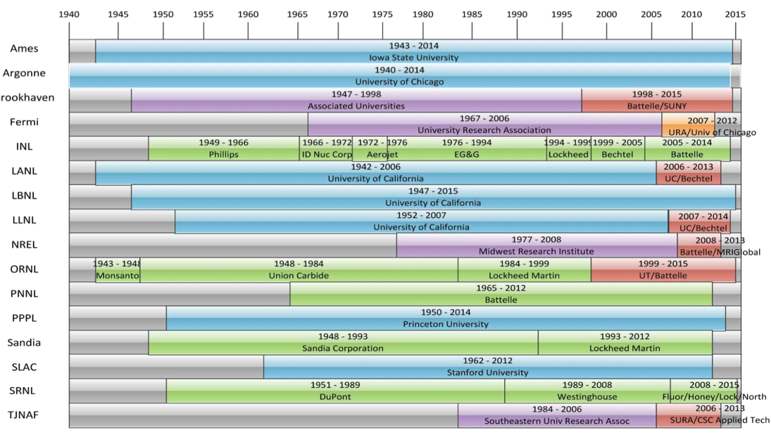
Historic M&O Management
Notes:
Slide from Dimitri Kusnezov presentation to CRENEL on July 18, 2014 “The DOE’s National Lab Complex)

Slide 15
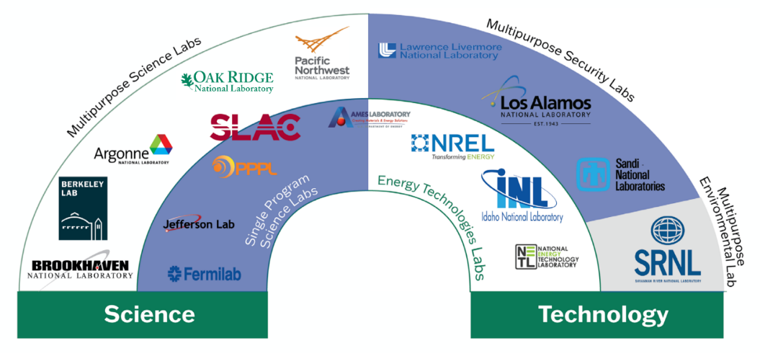
What does it mean JLab is becoming a multi-purpose laboratory?

Slide 16
How would you explain what the U.S. Department of Energy does?!

Slide 17
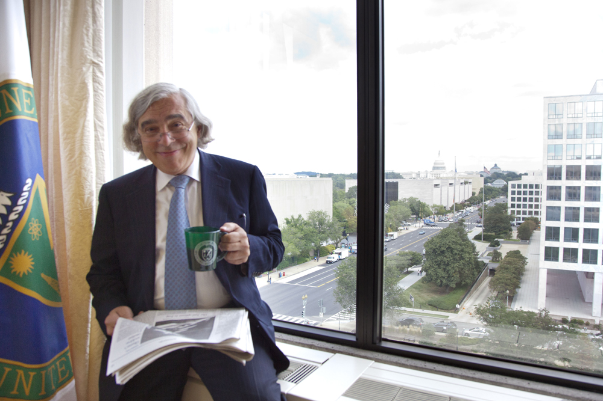
Ernest Moniz’s Answer To The Question Is Amazing
NOTE: Moniz was secretary of energy for the Obama administration, professor at MIT and a Nuclear Physicist with many excellent papers.

Slide 18
Quarks
Quagmires
Weapons
Windmills
Credit to former DOE Secretary of Energy Ernest Moniz for coming up with this very concise explanation of what DOE does.

Slide 19
Quarks
Quagmires
17.69%
19.21%
Weapons
Windmills
14.63%
48.47%

Slide 20
NNSA = National Nuclear Security Administration, EERE = Energy Efficiency and Renewable Energy
FECM = Fossil Energy and Carbon Management, ARPA-E = Advanced Research Projects Agency-Energy
CESER = Cyber Energy Security and Emergency Response

Slide 21
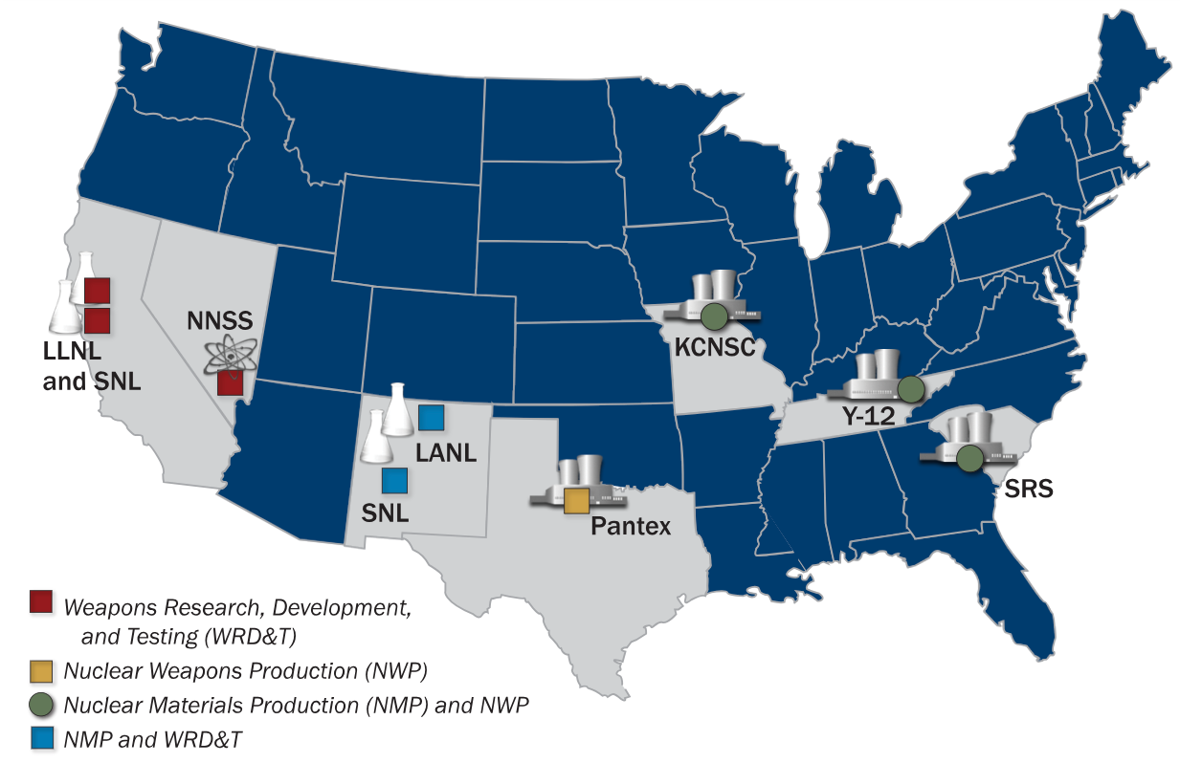
The DOE NNSA’s Nuclear Security Enterprise
( history dates back to the Manhattan project )

Slide 22
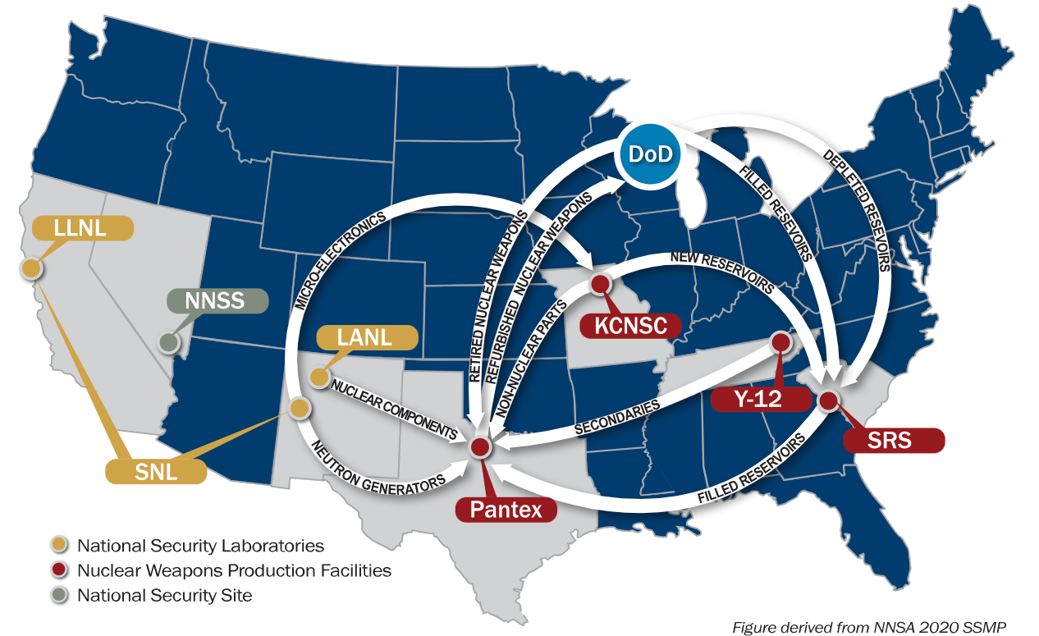
A Quick Detour: The system has more than just National Labs . . .
NNSA’s Nuclear Security Enterprise

Slide 23
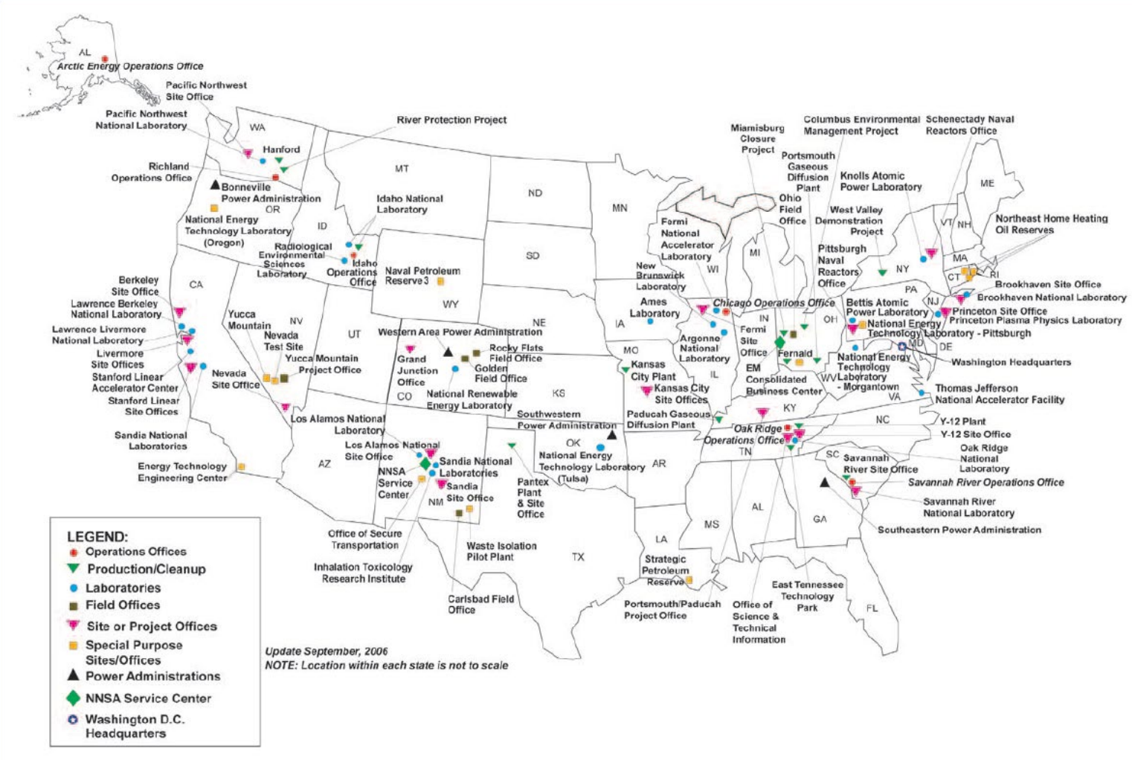
An illustrative “full system” view of the DOE complex
~15k Federal Employees
~80k National Lab Employees
~50k NNSA Non-Lab Employees
140k+ people

Slide 24
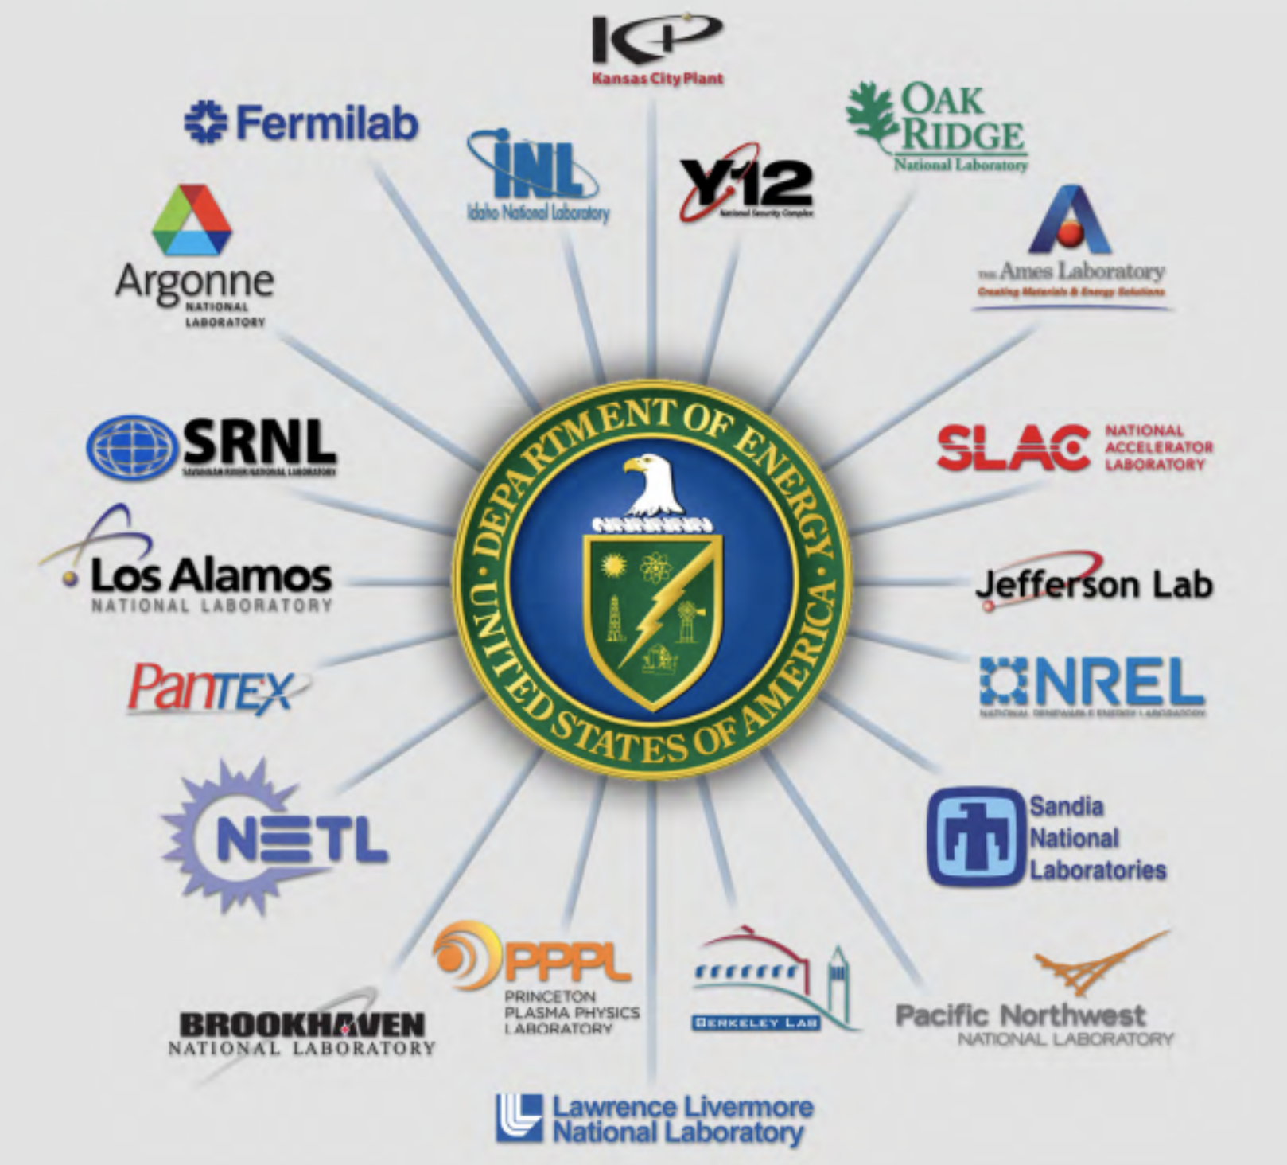

Slide 25
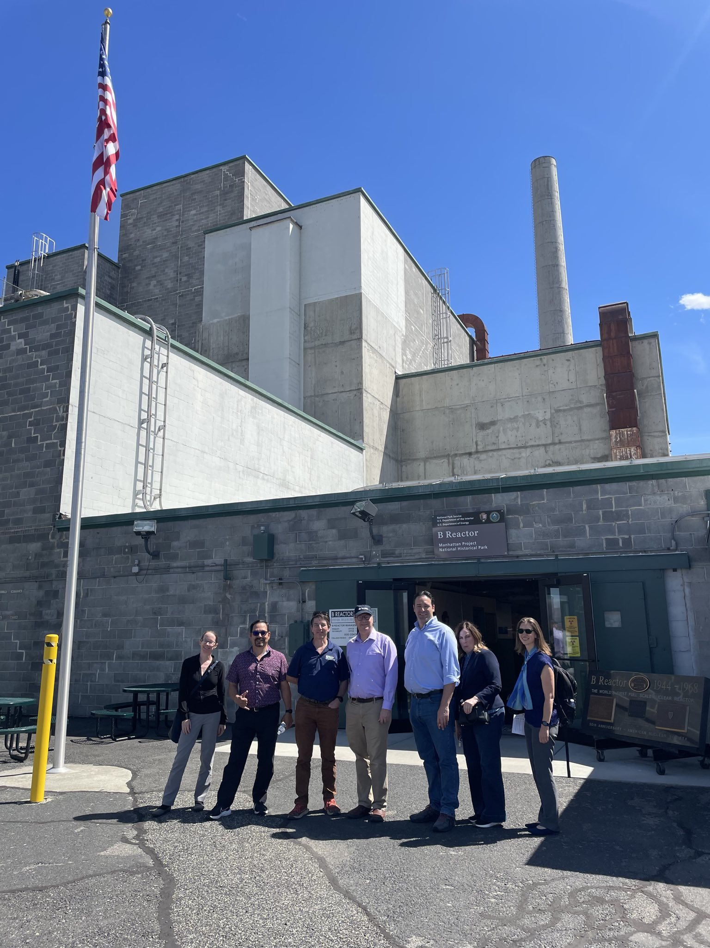
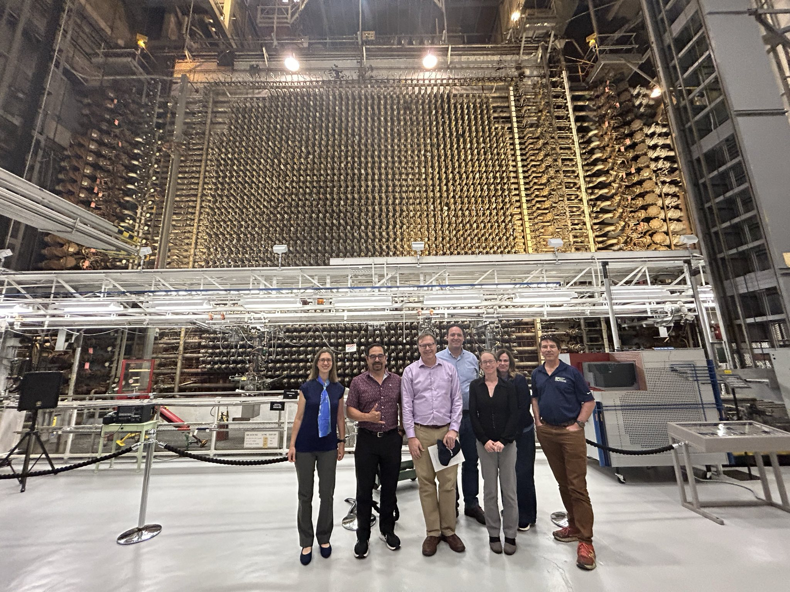
Hanford Reactor B which made the Plutonium for both the Trinity device and the Fat Man during WWII.

