Slide 1
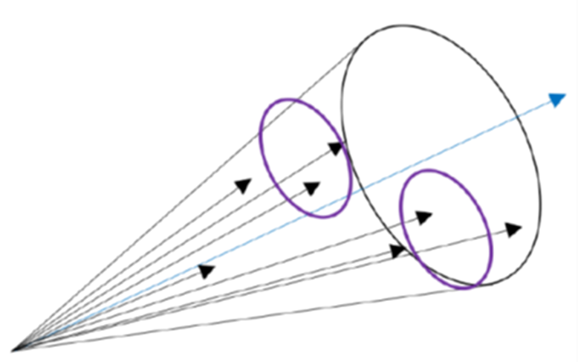

Jets at the EIC: A Primer
Brian Page
EICUG Early Career Workshop
July 22, 2024

Slide 2
Outline
Introduction to Jets
Jet Considerations for the EIC: Subprocesses, Kinematics, etc
Physics with Jets at the EIC
Beam Crossing Angles
Jet Finding at ePIC

Slide 3



Jets at the EIC: A Brief History
Initially, jets did not receive much attention and were only mentioned in passing in the initial EIC Whitepaper
  EIC a relatively low energy machine – will jets be a useful probe?
  SIDIS is well established and understood – will jets be redundant?
Last ~10+ years have seen a significant uptick in interest in jet physics at the EIC as evidenced by:
  Increasing number of papers
  Dedicated treatment in EICUG Yellow Report
  Dedicated WGs in EIC proto-collaborations and current project detector collaboration - ePIC
All this activity is driven by the realization that jets will have a robust and unique role to play in the EIC science program

Slide 4
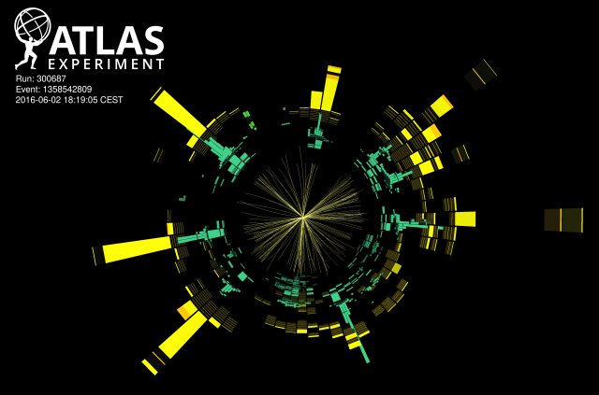
ChatGPT: In particle physics, a jet is a narrow cone of particles produced by the hadronization of a quark or gluon. When high-energy quarks or gluons are produced in particle collisions, such as those in a particle accelerator, they cannot exist freely due to a phenomenon called color confinement. Instead, they fragment and hadronize, forming a shower of hadrons (particles composed of quarks bound together by the strong force) that travel in roughly the same direction. This collection of hadrons is what is observed as a jet.
What is a Jet?

Slide 5
What is a Jet?
The above definition is not very useful from a physics standpoint. A more precise statement is that a jets is the result of applying a jet definition to a set of final state objects

Slide 6
What is a Jet?
The above definition is not very useful from a physics standpoint. A more precise statement is that a jets is the result of applying a jet definition to a set of final state objects
Jet Definition
Jet Algorithm
Recombination Scheme

Slide 7
What is a Jet?
A jet algorithm is a recipe for mapping a set of constituents into a set of jets
Broadly divided into cone and sequential recombination type algorithms
Cone: Midpoint-cone & SIScone
S.R.: (Anti)k_T
The above definition is not very useful from a physics standpoint. A more precise statement is that a jets is the result of applying a jet definition to a set of final state objects
Jet Definition
Jet Algorithm
Recombination Scheme

Slide 8
What is a Jet?
A jet algorithm is a recipe for mapping a set of constituents into a set of jets
Broadly divided into cone and sequential recombination type algorithms
Cone: Midpoint-cone & SIScone
S.R.: (Anti)k_T
The above definition is not very useful from a physics standpoint. A more precise statement is that a jets is the result of applying a jet definition to a set of final state objects
Jet Definition
Jet Algorithm
Recombination Scheme
A recombination scheme tells us how to add together the energy and momenta of the jet constituents into that of the jet
E-scheme: constituent 4-momenta are simply added – is by far the most common
Winner-Take-All: adds energies but sets direction to lay along hardest constituent – thrust axis insensitive to soft radiation

Slide 9
What is a Jet?
A jet algorithm is a recipe for mapping a set of constituents into a set of jets
Broadly divided into cone and sequential recombination type algorithms
Cone: Midpoint-cone & SIScone
S.R.: (Anti)k_T
The above definition is not very useful from a physics standpoint. A more precise statement is that a jets is the result of applying a jet definition to a set of final state objects
Jet Definition
Jet Algorithm
Recombination Scheme
A good jet definition should
  Be applicable to experimental measurements, parton-shower MC, and theory calculations
  Be “well behaved” theoretically
  Be relatively insensitive to “non-jet” contributions like underlying event or pile-up
A recombination scheme tells us how to add together the energy and momenta of the jet constituents into that of the jet
E-scheme: constituent 4-momenta are simply added – is by far the most common
Winner-Take-All: adds energies but sets direction to lay along hardest constituent – thrust axis insensitive to soft radiation

Slide 10
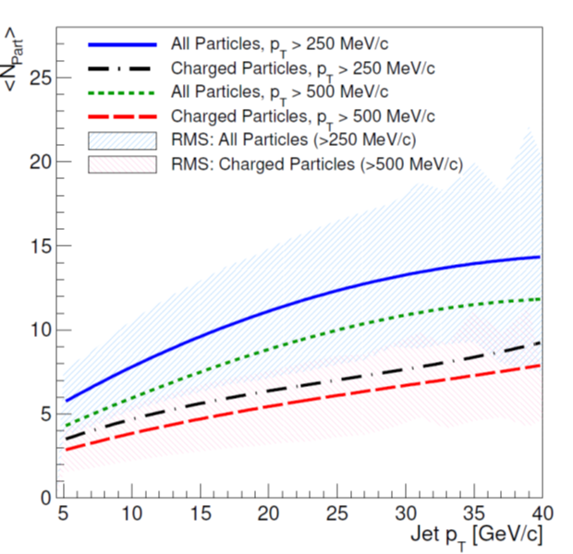
Jets at the EIC
Jet analyses at the EIC will in many ways be similar to those at hadron colliders, but there are several aspects one should be aware of:
Relevant subprocesses: there are many subprocesses which give rise to final state jets in ep collisions. Each can have different kinematic dependencies and probe different physics
Reference frames: the lab frame is generally the only useful reference frame in hadron colliders, but the properties of ep collisions allows us to define and access other useful frames
Kinematics: the asymmetric nature of collisions at the EIC and strong correlations between kinematic variables means jets in different parts of the detector can have very different energies and probe different areas of phase space
Jet Algorithms: jet algorithms besides the standard anti-kT prevalent at hadron colliders will be useful in many cases
Jet environment: ep collisions are ‘cleaner’ than hadron-hadron collisions meaning underlying event contamination won’t be as much of an issue. Pile-up will also be rare. EIC jets will be relatively sparse objects, with few charged particles spread over a wide cone

Slide 11
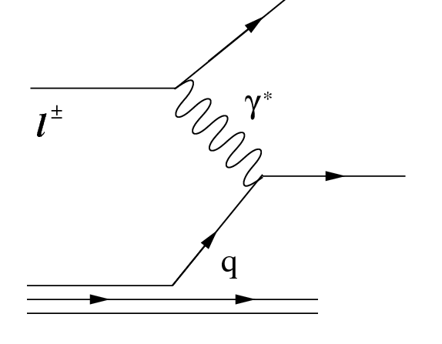
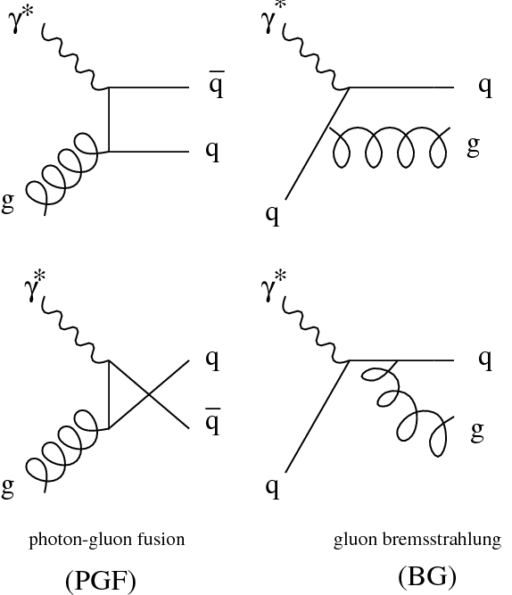
Relevant Subprocesses
DIS
QCD-Compton (QCDC)
Leading order process gives rise to a single jet (not counting target remnant) whose kinematics are largely determined by the underlying event kinematics
Higher-order corrections to this process can give rise to back-to-back jet configurations (dijets) which break the dependencies on event kinematics
At low Q2, the hadronic (resolved) nature of the virtual photon becomes important and parton – parton (2 -> 2) scattering can give rise to dijet states
Jets can also arise from diffractive events and charged current interactions
Photon-Gluon Fusion (PGF)
Resolved

Slide 12
A Note on Frames
As is the case with hadron-hadron colliders, some EIC jet measurements will be carried out in the detector or lab frame (this is complicated somewhat by the presence of a crossing angle between the beams)
For many measurements, it will be convenient to measure momenta with respect to the direction of the virtual photon
Can define a set of these frames all related by longitudinal boosts
Of particular interest is the Breit (or Brick Wall) frame in which the scattered quark has equal but opposite momentum as the incoming quark – event separated into current and target hemispheres
Leading order jets will have 0 transverse momentum in these frames and will not be properly clustered by standard (anti)kT algorithms (although energy based algos like Centauro can) but dijets arising from higher order processes will be back-to-back with significant pT

Slide 13
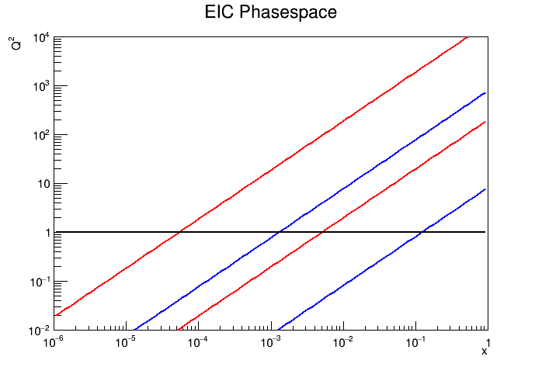
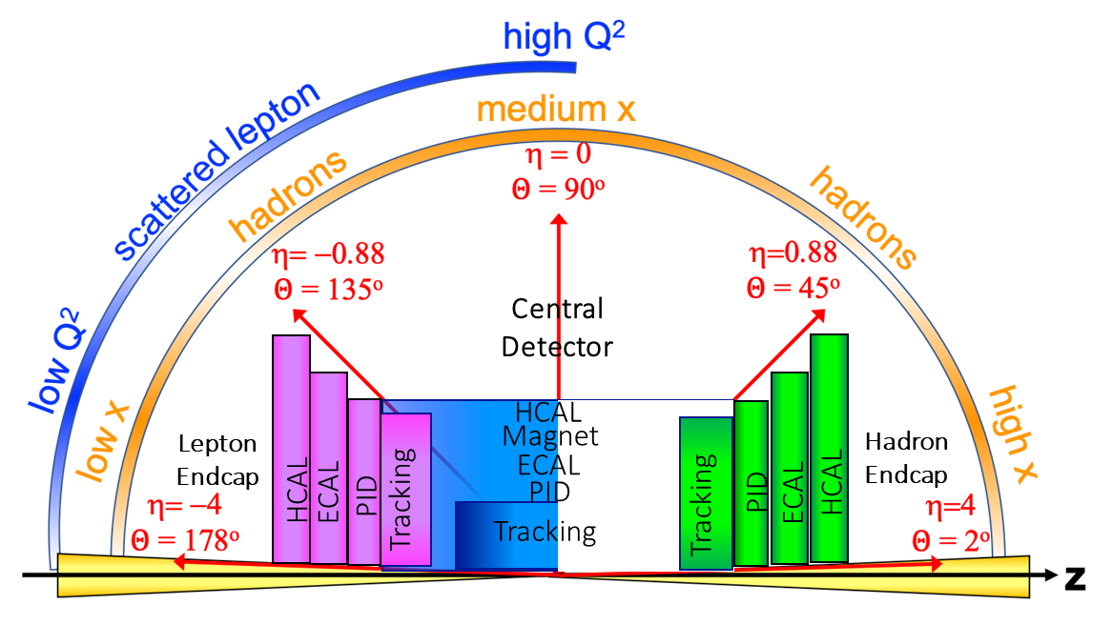
DIS Event Kinematics
18x275
5x41
y = 0.95
y = 0.01
Pert
Non-Pert
y = 0.95
y = 0.01
For the leading order process, jet location and energy are dictated by the event kinematics (x, Q², y)
For a given Q², inelasticity determines x value probed and pseudorapidity of the jet
  Low y -> high x, jet at positive pseudorapidity
  High y -> low x, jet at negative pseudorapidity

Slide 14
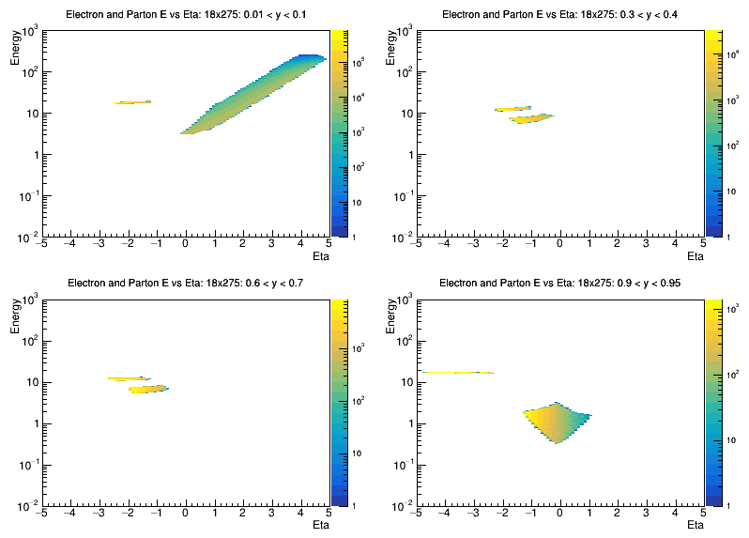
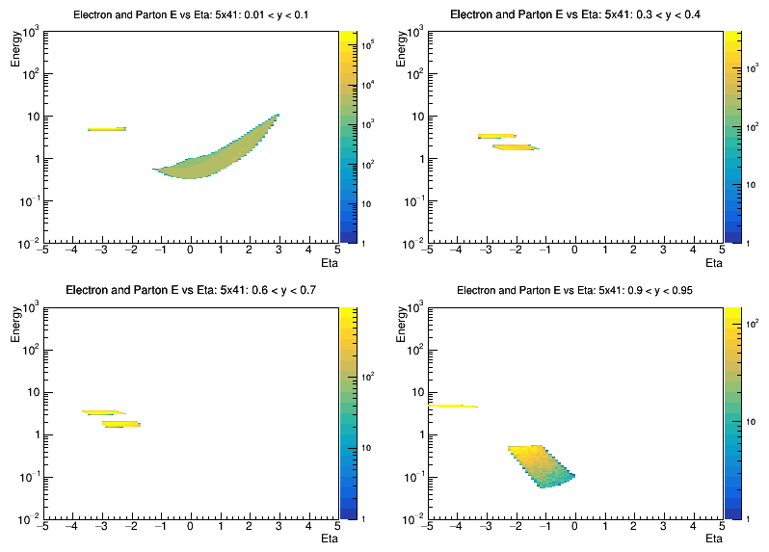
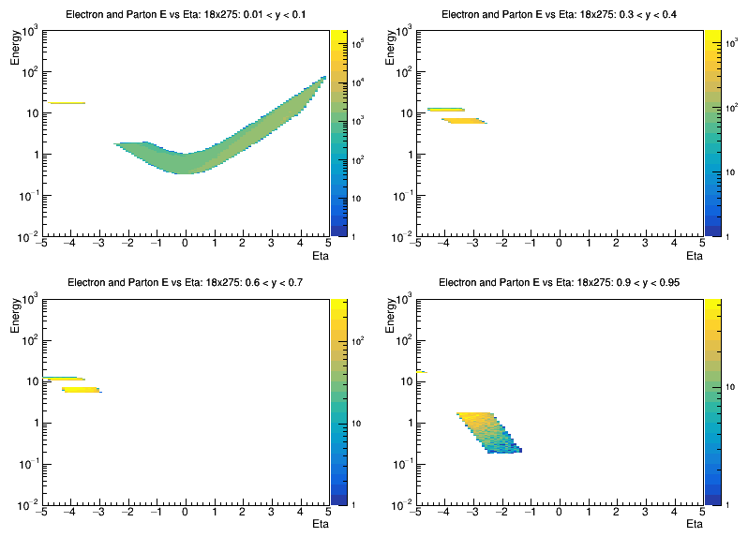
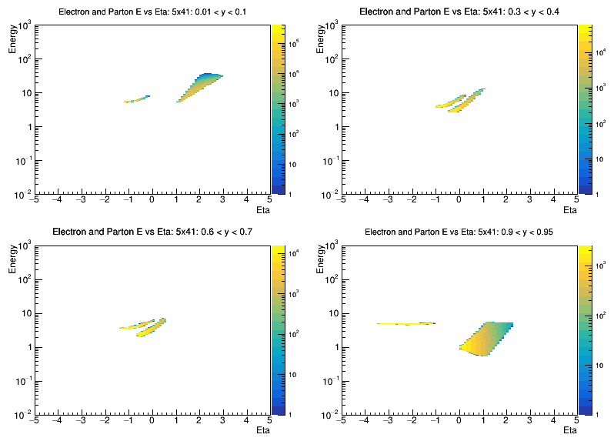
Electron and Struck Quark (18x275)
Look at energy vs pseudorapidity of the scattered electron and struck quark as a function of y and Q²
For fixed Q², as y increases, electron eta increases while parton eta decreases
0.01 < y < 0.1
0.3 < y < 0.4
Electron
Electron
Quark
10 < Q² < 100
Quark
0.01 < y < 0.1
0.3 < y < 0.4
Electron
Electron
Quark
Quark
0.6 < y < 0.7
0.9 < y < 0.95
Quark
Quark
Electron
Electron
0.6 < y < 0.7
0.9 < y < 0.95
Quark
Quark
0.1 < Q² < 1.0
As y -> 0, the struck quark can take the full ion beam energy
As y -> 1, the struck quark takes the full electron beam energy
Different detector considerations in forward and backward regions
Electron
Electron

Slide 15
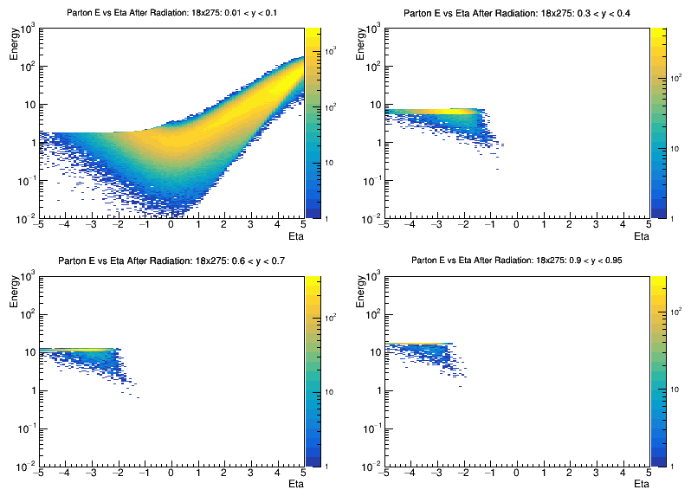
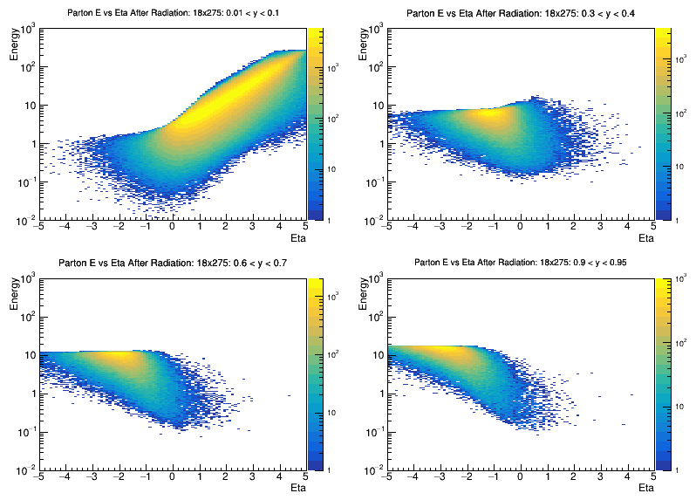
Struck Quark + FSR (18x275)
For Born-level process, struck quark kinematics are correlated with event kinematics
Final state radiation can alter quark kinematics significantly
0.01 < y < 0.1
0.3 < y < 0.4
10 < Q² < 100
0.01 < y < 0.1
0.3 < y < 0.4
0.6 < y < 0.7
0.9 < y < 0.95
0.6 < y < 0.7
0.9 < y < 0.95
0.1 < Q² < 1.0

Slide 16
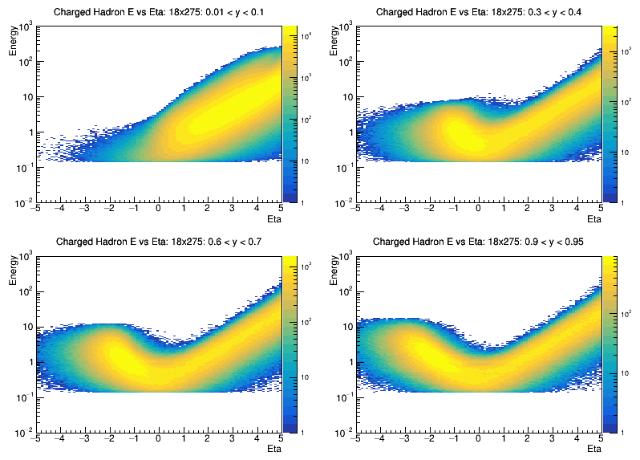
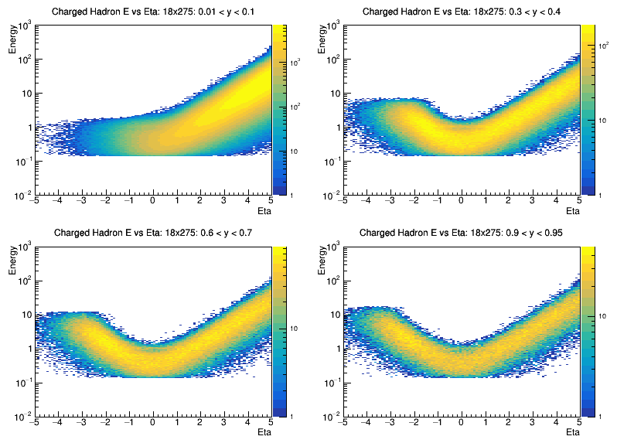
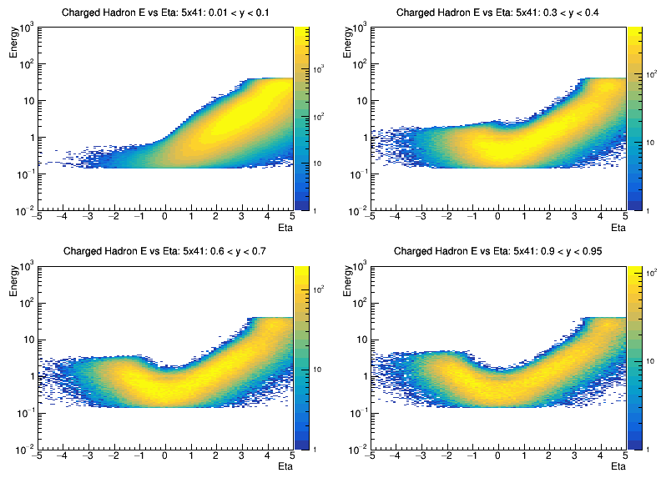
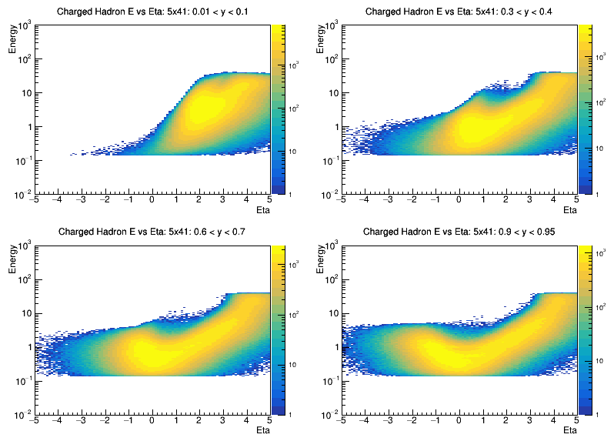
(Charged) Particle Distributions (18x275)
Higher energy extends energy range somewhat, but basic distributions are similar
0.01 < y < 0.1
0.3 < y < 0.4
10 < Q² < 100
0.01 < y < 0.1
0.3 < y < 0.4
0.6 < y < 0.7
0.9 < y < 0.95
0.6 < y < 0.7
0.9 < y < 0.95
0.1 < Q² < 1.0
How well can we reconstruct the parton kinematics from these particles?
Can we form jets away from the struck parton?

Slide 17


Jet Algorithms Revisited
Sequential recombination algorithms, especially Anti_k_{T}, have been the “industry standard” at hadron colliders for a number of years
Is this appropriate for very forward jets or Born-level jets in the Breit frame where transverse momenta are by definition small?
Look at alternative distance measures such as spherically invariant and symmetric EE_k_{T} or longitudinally invariant and anti-symmetric centauro algorithms
Anti_k_{T}
$$d_{ij}=min⁡[p_{ti}^{−2},p_{tj}^{−2}]{∆R}_{ij}/R$$
EE_kT (Spherically Invariant)
$d_{ij}=2∗min⁡[E_{i}^{2},E_{j}^{2}](1−\cos{∆_{ij})}$
Centauro

Slide 18
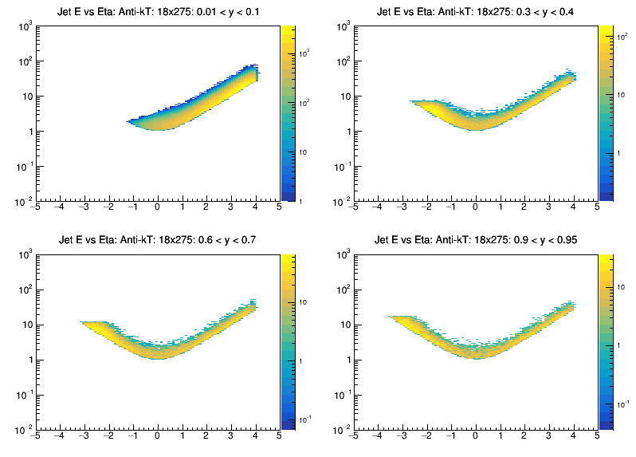
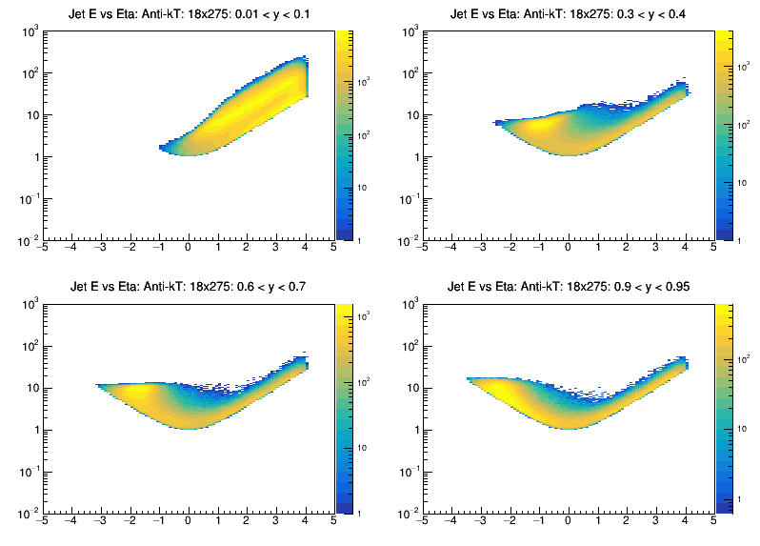
Jet Distributions: Anti_k_{T} (18x275)
Run inclusive Anti_k_{T} on all stable particles (|eta| < 4) with 1 GeV minimum p_{T} cut
Jets roughly follow particle distributions
0.01 < y < 0.1
0.3 < y < 0.4
10 < Q² < 100
0.01 < y < 0.1
0.3 < y < 0.4
0.6 < y < 0.7
0.9 < y < 0.95
0.6 < y < 0.7
0.9 < y < 0.95
0.1 < Q² < 1.0

Slide 19
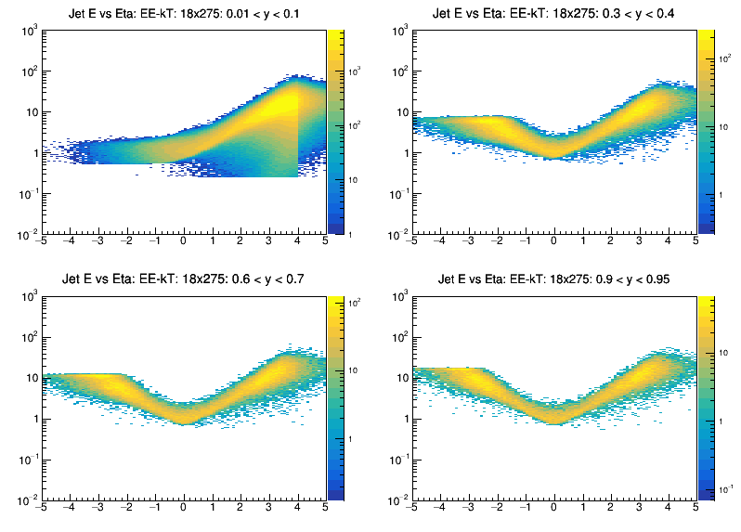
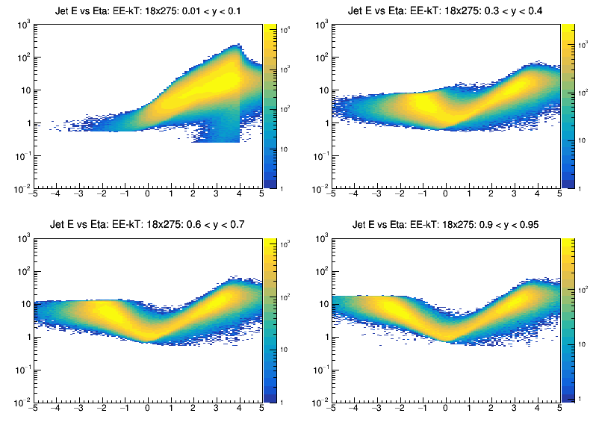
Jet Distributions: EE_k_{T} (18x275)
Overall distributions are similar for EE_k_{T} algorithm
In general, see larger number of jets, more jets at higher eta, and more jets away from struck quark
0.01 < y < 0.1
0.3 < y < 0.4
10 < Q² < 100
0.01 < y < 0.1
0.3 < y < 0.4
0.6 < y < 0.7
0.9 < y < 0.95
0.6 < y < 0.7
0.9 < y < 0.95
0.1 < Q² < 1.0
Need to understand the artifact around eta = 4, must be related to particle eta cut

Slide 20
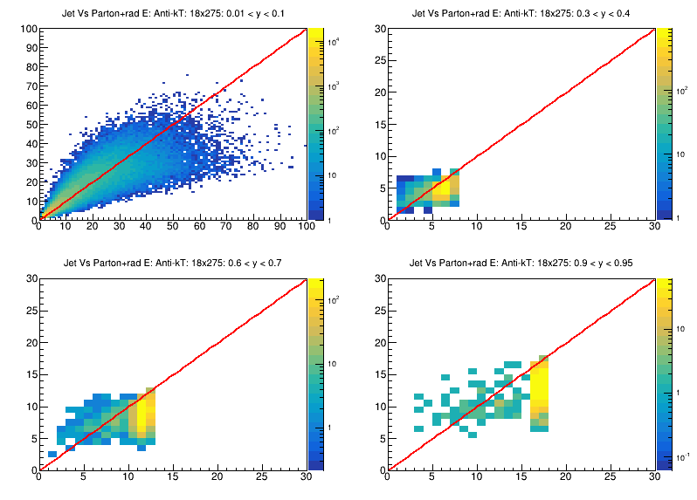
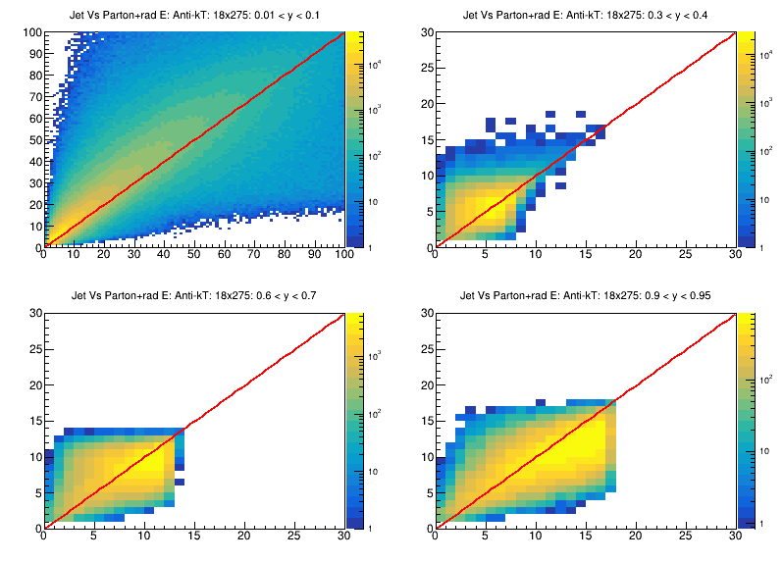
Jet – Parton Energy Comparison: Anti_k_{T} (18x275)
How well do jets represent the parton?
Plot jet energy vs parton+FSR energy for different Q² and inelasticity
0.01 < y < 0.1
0.3 < y < 0.4
10 < Q² < 100
0.01 < y < 0.1
0.3 < y < 0.4
0.6 < y < 0.7
0.9 < y < 0.95
0.6 < y < 0.7
0.9 < y < 0.95
0.1 < Q² < 1.0
Performance degrades somewhat at larger y (backward jets)

Slide 21
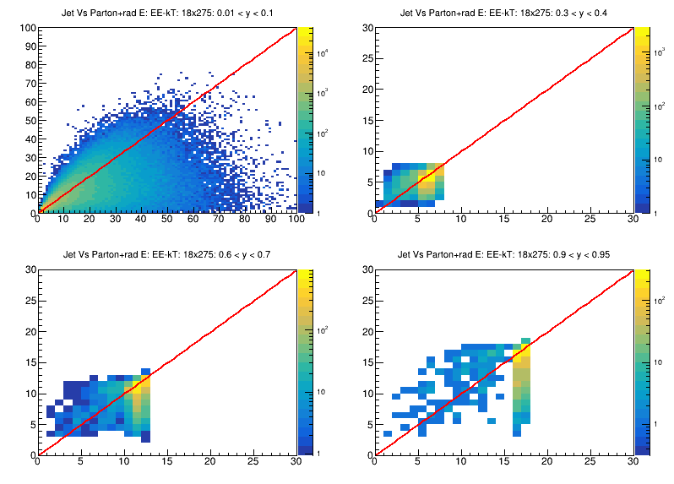
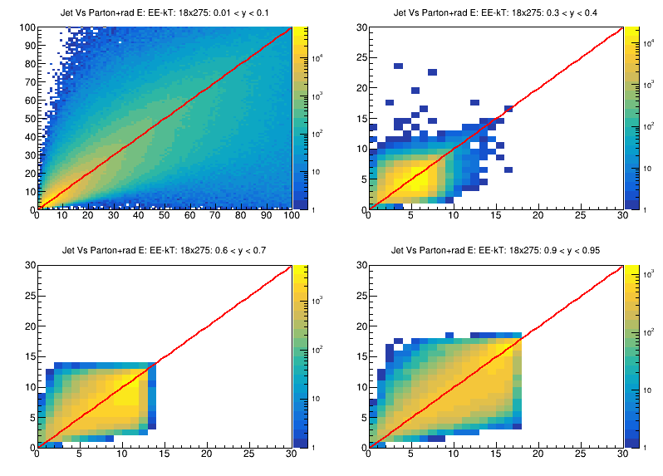
Jet – Parton Energy Comparison: EE_k_{T} (18x275)
Better agreement between parton and jet seen with EE_kT algorithm, especially at high y
0.01 < y < 0.1
0.3 < y < 0.4
10 < Q² < 100
0.01 < y < 0.1
0.3 < y < 0.4
0.6 < y < 0.7
0.9 < y < 0.95
0.6 < y < 0.7
0.9 < y < 0.95
0.1 < Q² < 1.0

Slide 22
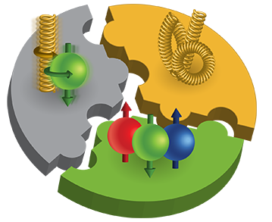
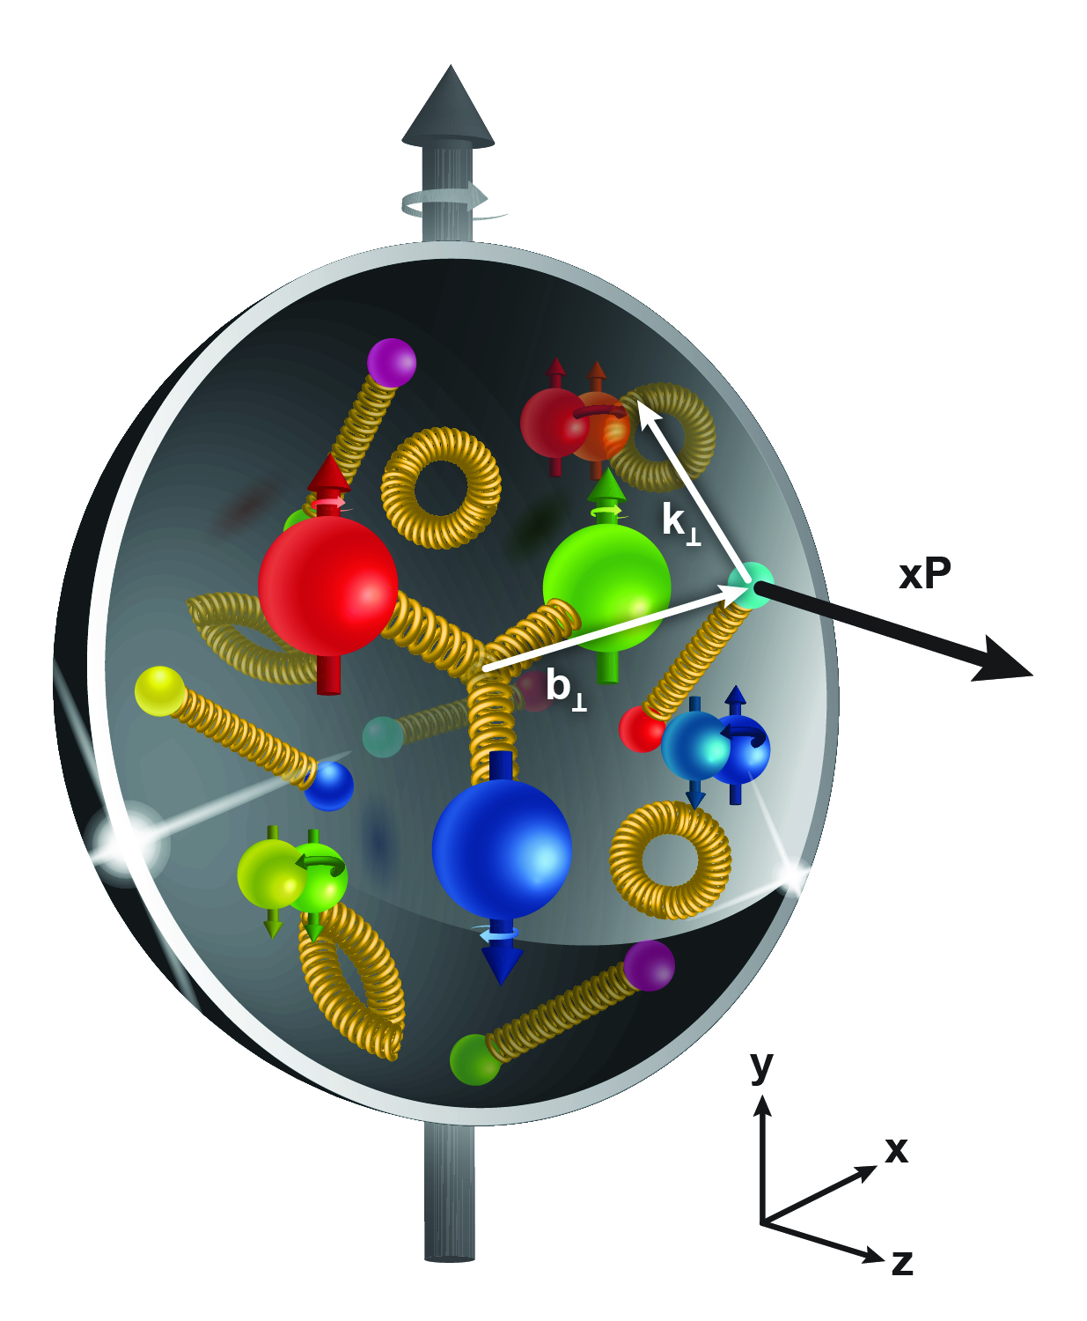

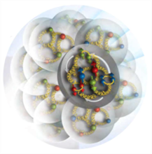
The EIC Physics Pillars
How are the sea quarks and gluons, and their spins, distributed in space and momentum inside the nucleon?
How do the nucleon properties emerge from them and their interactions?
How do color-charged quarks and gluons, and colorless jets, interact with a nuclear medium?
How do the confined hadronic states emerge from these quarks and gluons?
How do the quark-gluon interactions create nuclear binding?
How does a dense nuclear environment affect the quarks and gluons, their correlations, and their interactions?
What happens to the gluon density in nuclei? Does it saturate at high energy, giving rise to a gluonic matter with universal properties in all nuclei, even the proton?
?
=

Slide 23
Jet Physics at the EIC
Jets have several properties which will make them important tools for realizing the EIC physics program
Well understood theoretically and experimentally
Excellent proxies for the underlying parton kinematics
Showers probe QCD from hard interaction to hadronization scale within the same event – can explore dynamics at different time (angular) scales
Precision tools exist to probe these shower properties - substructure

Slide 24
Jet Physics at the EIC
The importance of jet probes was reflected in the EIC Yellow Report where they touched on nearly every major physics topic (Nucl. Phys. A, Vol 1026, 122447)
Jets have several properties which will make them important tools for realizing the EIC physics program
Global properties and parton structure of hadrons
Well understood theoretically and experimentally
Borsa, de Florian, Pedron `20
Excellent proxies for the underlying parton kinematics
Multi-dimensional imaging of nucleons, nuclei and mesons
Arratia, Kang, Prokudin, Ringer `20
Showers probe QCD from hard interaction to hadronization scale within the same event – can explore dynamics at different time (angular) scales
The nucleus: a laboratory for QCD
Precision tools exist to probe these shower properties - substructure
J. Adam et al 2022 JINST 17 P10019
Understanding hadronization

Slide 25
Jet Physics at the EIC
The importance of jet probes was reflected in the EIC Yellow Report where they touched on nearly every major physics topic (Nucl. Phys. A, Vol 1026, 122447)
Jets have several properties which will make them important tools for realizing the EIC physics program
Global properties and parton structure of hadrons
Well understood theoretically and experimentally
Borsa, de Florian, Pedron `20
Excellent proxies for the underlying parton kinematics
Multi-dimensional imaging of nucleons, nuclei and mesons
Arratia, Kang, Prokudin, Ringer `20
Showers probe QCD from hard interaction to hadronization scale within the same event – can explore dynamics at different time (angular) scales
The nucleus: a laboratory for QCD
Precision tools exist to probe these shower properties - substructure
J. Adam et al 2022 JINST 17 P10019
Understanding hadronization

Slide 26
Jet Physics at the EIC
The importance of jet probes was reflected in the EIC Yellow Report where they touched on nearly every major physics topic (Nucl. Phys. A, Vol 1026, 122447)
Jets have several properties which will make them important tools for realizing the EIC physics program
Global properties and parton structure of hadrons
Well understood theoretically and experimentally
Borsa, de Florian, Pedron `20
Excellent proxies for the underlying parton kinematics
Multi-dimensional imaging of nucleons, nuclei and mesons
Arratia, Kang, Prokudin, Ringer `20
Showers probe QCD from hard interaction to hadronization scale within the same event – can explore dynamics at different time (angular) scales
The nucleus: a laboratory for QCD
Precision tools exist to probe these shower properties - substructure
J. Adam et al 2022 JINST 17 P10019
Understanding hadronization

Slide 27
Jet Physics at the EIC
The importance of jet probes was reflected in the EIC Yellow Report where they touched on nearly every major physics topic (Nucl. Phys. A, Vol 1026, 122447)
Jets have several properties which will make them important tools for realizing the EIC physics program
Global properties and parton structure of hadrons
Well understood theoretically and experimentally
Borsa, de Florian, Pedron `20
Excellent proxies for the underlying parton kinematics
Multi-dimensional imaging of nucleons, nuclei and mesons
Arratia, Kang, Prokudin, Ringer `20
Showers probe QCD from hard interaction to hadronization scale within the same event – can explore dynamics at different time (angular) scales
The nucleus: a laboratory for QCD
Precision tools exist to probe these shower properties - substructure
J. Adam et al 2022 JINST 17 P10019
Understanding hadronization

Slide 28
Jet Physics at the EIC
The importance of jet probes was reflected in the EIC Yellow Report where they touched on nearly every major physics topic (Nucl. Phys. A, Vol 1026, 122447)
Jets have several properties which will make them important tools for realizing the EIC physics program
Global properties and parton structure of hadrons
Well understood theoretically and experimentally
Borsa, de Florian, Pedron `20
Excellent proxies for the underlying parton kinematics
Multi-dimensional imaging of nucleons, nuclei and mesons
Arratia, Kang, Prokudin, Ringer `20
Showers probe QCD from hard interaction to hadronization scale within the same event – can explore dynamics at different time (angular) scales
The nucleus: a laboratory for QCD
Precision tools exist to probe these shower properties - substructure
J. Adam et al 2022 JINST 17 P10019
Understanding hadronization

Slide 29
Jets in the Yellow Report
Global properties and parton structure of hadrons
Multi-dimensional imaging of nucleons, nuclei and mesons
  Unpolarized parton structure of the proton and neutron
  Spin structure of the proton and neutron
  Inclusive and hard diffraction
  Global event shapes and the strong coupling constant
  Imaging of quarks and gluons in momentum space
  Wigner functions
The nucleus: a laboratory for QCD
Understanding hadronization
  High parton densities and saturation
  Particle propagation in matter and transport properties
  Special opportunities with jets and heavy quarks
  Hadronization in the vacuum
  Hadronization in the nuclear environment

Slide 30
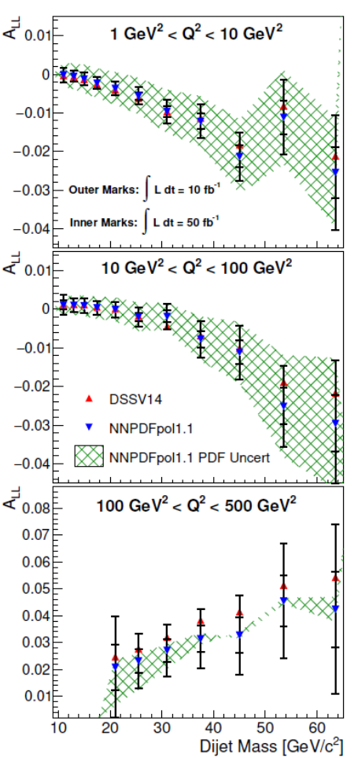
Longitudinal Spin Structure
Recent results on inclusive jet A_{LL} at NLO and NNLO both with and without tagged lepton
Will place strong constraints on helicity distributions
Feasibility study for dijet A_{LL} in the Breit frame also performed – access to gluon via PGF process
Page, Chu, Aschenauer `20
Boughezal, Petriello, Xing `18
Borsa, de Florian, Pedron `20

Slide 31
Strangeness PDF: Charm Jets
Arratia, Furletova, Hobbs, Olness, Sekula `20
Tension exists between neutrino DIS and SIDIS measurements of strange content and LHC extractions
EIC is sensitive to strange content via charm production in charged-current DIS
Charm is tagged within a jet via the presence of displaced tracks – good charm efficiency is seen, and methods are being refined
Charm jet measurements at EIC should be able to discriminate between low and high strangeness scenarios

Slide 32
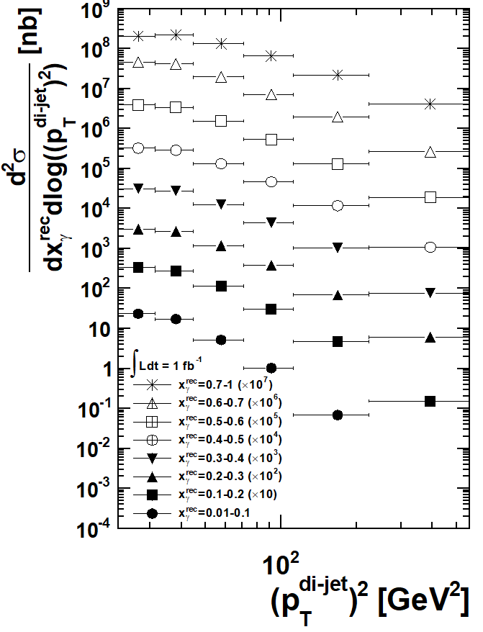
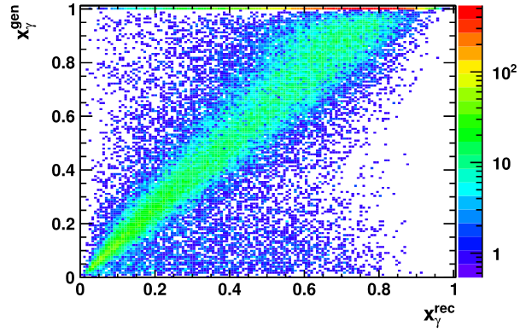
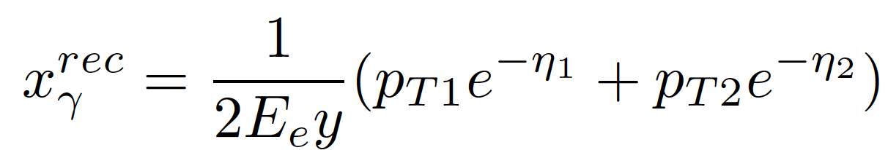
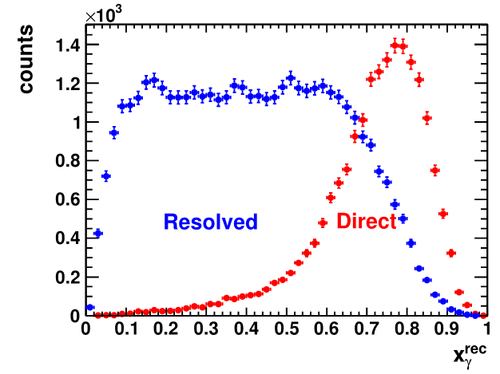
(Polarized) Photon Structure
Phys.Rev.D 96 (2017) 7, 074035
At low Q2, virtual photon can behave hadronically and initiate 2->2 type scattering events
Results in a quark/anti-quark final state with high transverse momentum
Dijet allows to reconstruct event characteristics to separate signal and background and characterize the structure of the photon

Slide 33
Global Event Shapes
Global event shapes offer possibility of very high precision measurements for extractions of non-perturbative parameters such as the strong coupling constant
Detailed feasibility studies of 1-jettiness observable were carried out as part of the Yellow Report effort taking into account uncertainties on tracking efficiency and calorimeter resolution
At N³LL, roughly 1% precision is possible, challenging experimental problem, but recent studies show promise

Slide 34
Jets in the Yellow Report
Global properties and parton structure of hadrons
Multi-dimensional imaging of nucleons, nuclei and mesons
  Unpolarized parton structure of the proton and neutron
  Spin structure of the proton and neutron
  Inclusive and hard diffraction
  Global event shapes and the strong coupling constant
  Imaging of quarks and gluons in momentum space
  Wigner functions
The nucleus: a laboratory for QCD
Understanding hadronization
  High parton densities and saturation
  Particle propagation in matter and transport properties
  Special opportunities with jets and heavy quarks
  Hadronization in the vacuum
  Hadronization in the nuclear environment

Slide 35
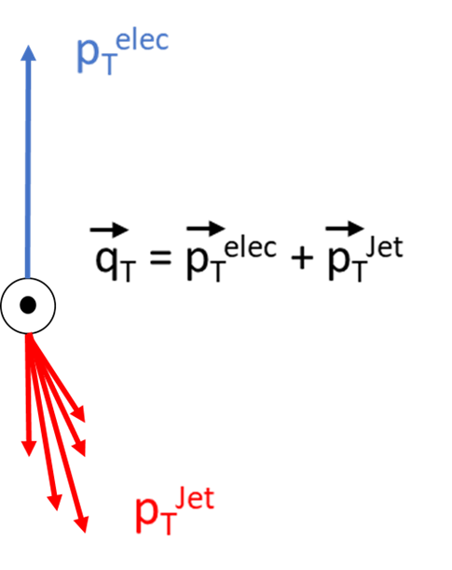
Lepton-Jet Correlations: Sivers TMD
Jet measurements for 3D imaging of nucleons at the EIC is emerging as a fruitful field
Jets are complementary to standard SIDIS extractions of TMDs and provide better surrogates for parton kinematics while allowing cleaner separation of target and current fragmentation regions
Jet measurements allow independent constraints on TMD PDFs and FFs from a single measurement
Azimuthal correlation between jet and lepton sensitive to TMD PDFs (Sivers)
Arratia, Kang, Prokudin, Ringer `20

Slide 36
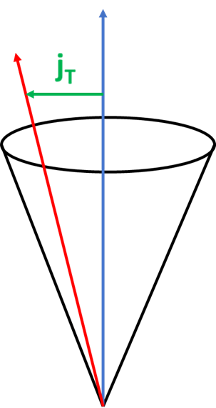
Hadron-in-Jet: Collins TMD
Measurement of hadrons within jet give access to TMD FFs
Relevant variables are j_{T} – transverse momentum of the hadron with respect to the jet and z – fraction of jet momentum carried by hadron
Collins asymmetry correlates proton spin vector with j_{T}
Identified hadrons allow for flavor separation of Collins FF
Arratia, Kang, Prokudin, Ringer `20

Slide 37
Charged Current Lepton-Jet Correlations
Phys. Rev. D 107, 094036 (2023)
Previous lepton-jet and hadron-in-jet measurements can also be carried out in charged current DIS where the outgoing neutrino is deduced via missing transverse energy
Charge conservation leads to flavor separation
Chiral odd nature of interaction means Collins asymmetries vanish at leading order

Slide 38
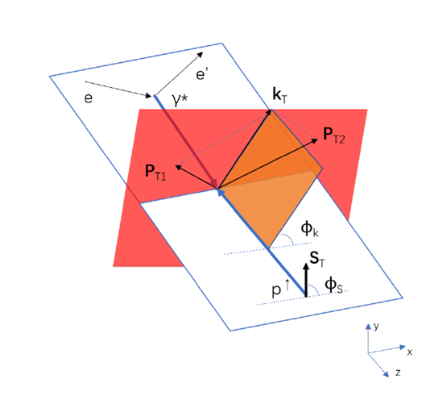
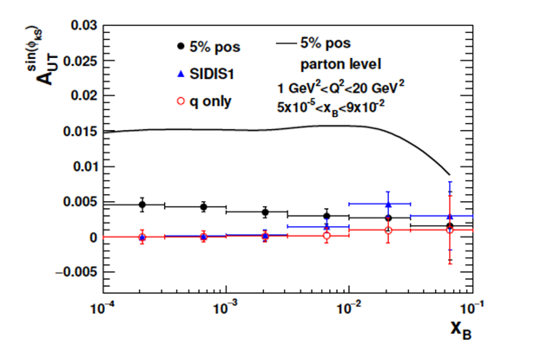
Dijet Correlations: Gluon Sivers TMD
Phys. Rev. D 98, 034011 (2018)
Modulations of the angle between the proton spin vector and the sum of the di-parton system provide access to gluon sivers function
Use of dijets has several advantages over di-hadrons including lower dilution of asymmetry and better separation between models of gluon sivers effect
Jets don’t suffer from uncertainties arising due to fragmentation (although hadronization still a concern)
Di-Hadrons
Dijets

Slide 39
Jets in the Yellow Report
Global properties and parton structure of hadrons
Multi-dimensional imaging of nucleons, nuclei and mesons
  Unpolarized parton structure of the proton and neutron
  Spin structure of the proton and neutron
  Inclusive and hard diffraction
  Global event shapes and the strong coupling constant
  Imaging of quarks and gluons in momentum space
  Wigner functions
The nucleus: a laboratory for QCD
Understanding hadronization
  High parton densities and saturation
  Particle propagation in matter and transport properties
  Special opportunities with jets and heavy quarks
  Hadronization in the vacuum
  Hadronization in the nuclear environment

Slide 40
Jets in the Medium: CNM Properties
Many opportunities to study the properties of cold nuclear matter with jets
Simple comparisons of jet yields in ep vs eA will be informative – double ratio R_{eA}(R)/R_{eA}(R = 1.0) will reduce impact from nPDFs and enhance final state effects
Lepton – Jet correlations in Born level DIS can be thought of as analogous to boson – Jet measurements with the lepton as the tag and the jet as the probe of the medium
Dijets and gamma-dijet correlations also expected to be powerful probes of saturation / small-x dynamics
Li & Vitev ‘20
Arratia, Song, Ringer, Jacak ‘20

Slide 41
Jets in the Yellow Report
Global properties and parton structure of hadrons
Multi-dimensional imaging of nucleons, nuclei and mesons
  Unpolarized parton structure of the proton and neutron
  Spin structure of the proton and neutron
  Inclusive and hard diffraction
  Global event shapes and the strong coupling constant
  Imaging of quarks and gluons in momentum space
  Wigner functions
The nucleus: a laboratory for QCD
Understanding hadronization
  High parton densities and saturation
  Particle propagation in matter and transport properties
  Special opportunities with jets and heavy quarks
  Hadronization in the vacuum
  Hadronization in the nuclear environment

Slide 42
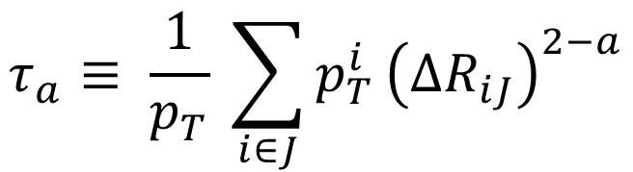
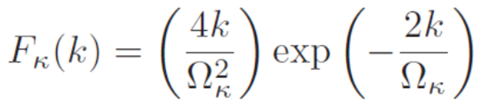
Jet Substructure: Angularity
Jet angularity are a family of one-parameter substructure observables correlating momentum and radial distance of particles in a jet
Different choices of ‘a’ parameter interpolate between familiar substructure observables such as mass and broadening
Sensitive to hadronization effects via convolution with the non-perturbative shape function Ω₁
Aschenauer, Lee, Page, Ringer `20 & ATHENA Proposal
NP Effects

Slide 43
Leading Di-hadron Correlations
Quantify distributions of charge, flavor, spin, etc within a jet -> study hadronization process
Define the ratio r_{c} to explore the charge and flavor correlations between leading hadrons within a jet
See differences in how charge and flavor are distributed vs jet p_{T} and formation time between different hadronization models
$t_{form}=\frac{z\left(1−z\right)p}{k_{⊥}^{2}};p=p_{1}+p_{2};z=\frac{p_{2}}{p}; k_{⊥}$= rel trans mom
Phys.Rev.D 105 (2022) 5

Slide 44
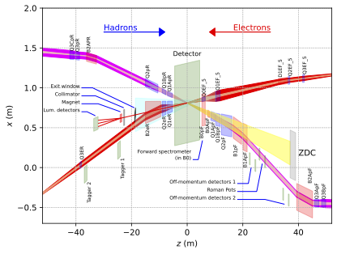
Beam Crossing Angle
Both interaction regions at the EIC will feature significant beam crossing angles (25 mRad for IP6 and 35 mRad for IP8)
Crossing angles needed to avoid parasitic collisions which would degrade beams
Presence of crossing angle will affect acceptance and detector design in the proton-going endcap – a region of great importance for many jet measurements
A summary of beam effects, including crossing angle, bunch crabbing, divergence, etc as well as methods for simulating these can be found in the technical note here: https://zenodo.org/record/6514605#.ZETiIOzMJAY

Slide 45
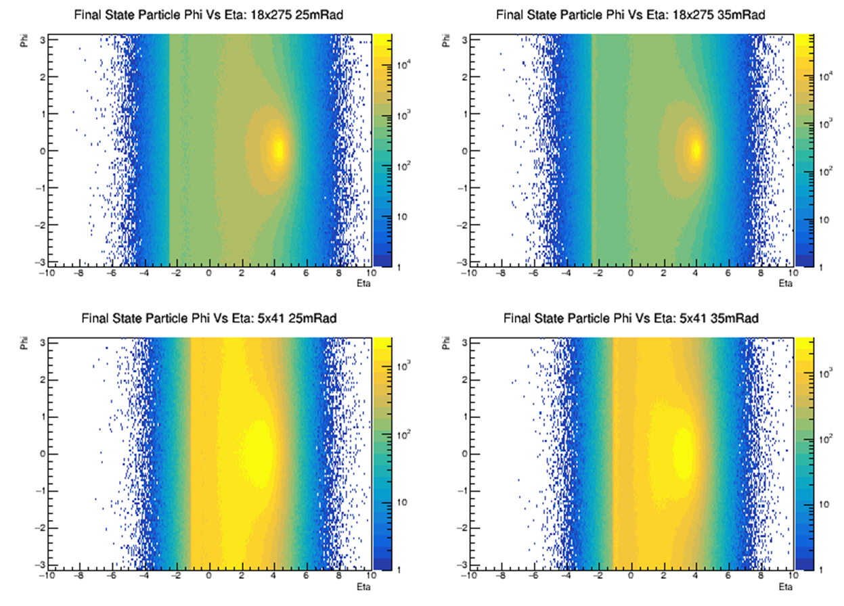
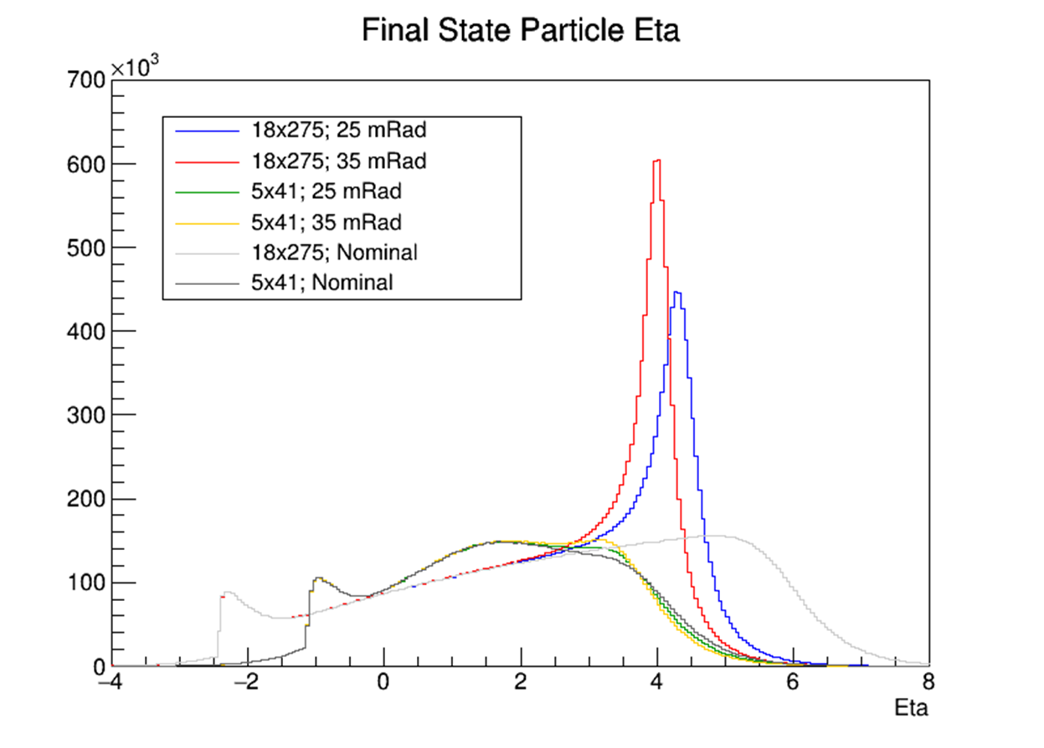
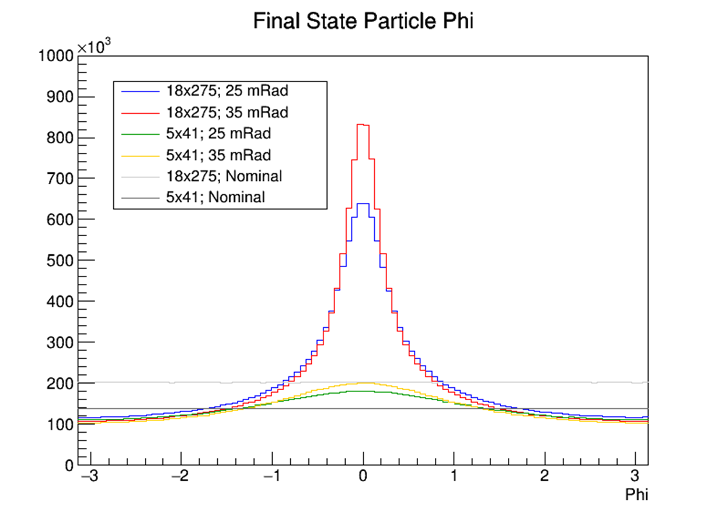
Final State Particle Distributions
Detector solenoid must align with electron beam to minimize synchrotron radiation: “lab frame” -> electron beam = z-axis
When measuring in lab frame coordinates – see a hot spot in eta/phi corresponding to the beam direction
More pronounced for more relativistic beams
How do we mitigate these features?

Slide 46
Head-On (Minimum Boost) Frame
Proton
1
Boost Vector
Can boost and rotate into a frame in which the beams are collinear (no crossing angle) and energies are very close to the original (minimum boost)
This should give an undistorted distribution of particles at high and low eta simultaneously
Electron
2
3
Initial Configuration in the Lab Frame includes a relative angle between the beams
Boost by sum of beam 4-momenta to get to CM Frame
Rotate about y-axis to eliminate x-component of momentum
Boost back along z to (nearly) restore original beam energies
4

Slide 47
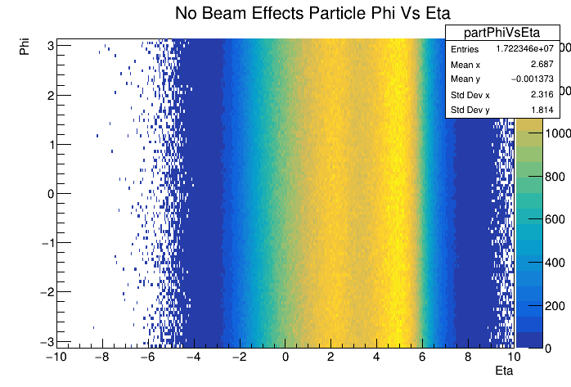
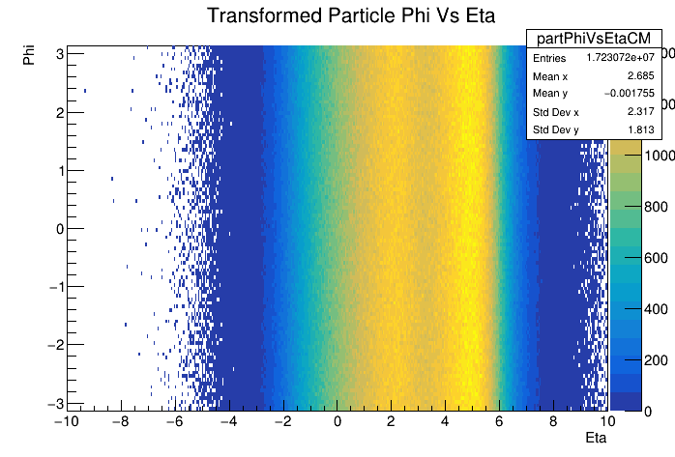
Head-On Frame Particle Distributions
No Crossing Angle
Lab Frame Distribution
Head-On Frame
Transform
to Head-On
Transformation to the head-on frame removes all features in the final state particle distribution for forward and backward regions simultaneously
Resulting distribution matches that from default simulation with no crossing angle introduced

Slide 48
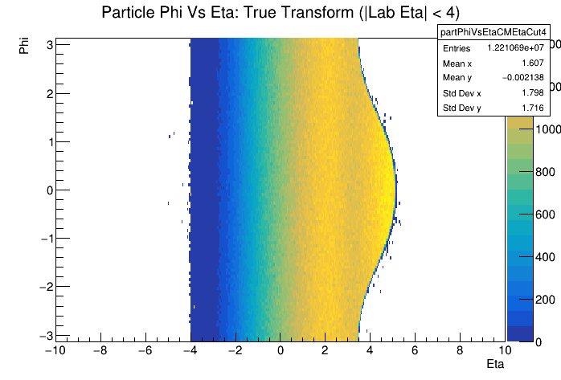
Detector Acceptance Considerations
The head-on frame distributions shown previously assumed infinite acceptance – what effect will finite detector acceptance have?
Displacement between beams means that acceptance cuts in the lab frame (w.r.t. the electron beam) will introduce phi-dependent acceptance features in head-on frame
Try defining acceptance cuts w.r.t. the hadron beam instead
Figure by Barak Schmookler
arXiv:2208.05472

Slide 49
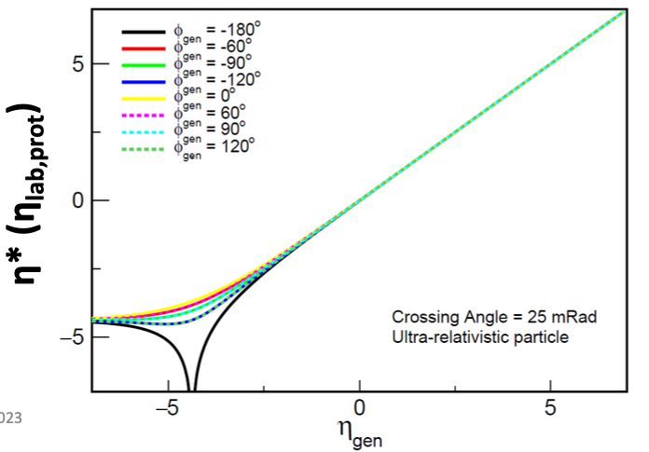
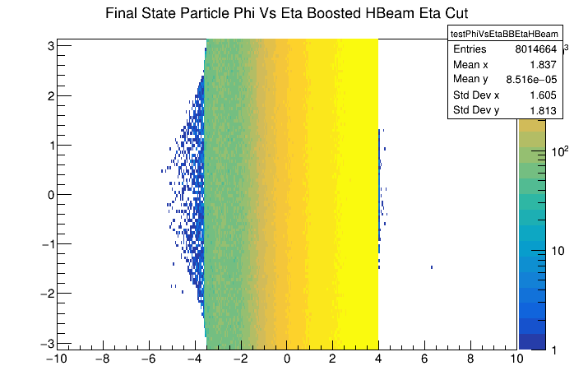
Defining Acceptance Cuts
The beam line shape in the endcap region is complicated, but mostly follows the hadron beam direction
The z-axis in the head-on frame corresponds to the direction of the lab frame proton beam -> defining detector acceptance w.r.t. the hadron beam should eliminate the phi-dependent artifact
Both plots on the right show the phi vs eta distribution where these quantities are defined in the head-on frame
  Top plot applies a cut for |eta| < 4 where eta is defined relative to the electron beam
  Bottom plot applies a cut for |eta| < 4 where eta is defined relative to the hadron beam

Slide 50
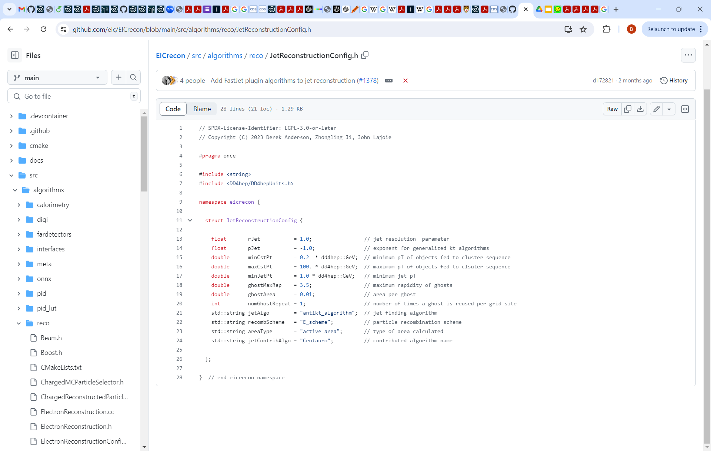
Jet Reconstruction at ePIC
ePIC EICrecon output contains several jet branches using both the anti_kT and Centauro algorithms
The most vetted outputs are based on the charged particles collection (track-only jets): ReconstructedChargedJets & GeneratedChargedJets
Example demonstrating how to read and analyze the jet branches can be found in the snippets repository: https://github.com/eic/snippets/tree/main/JetsAndHF/jetReaderExamples

Slide 51
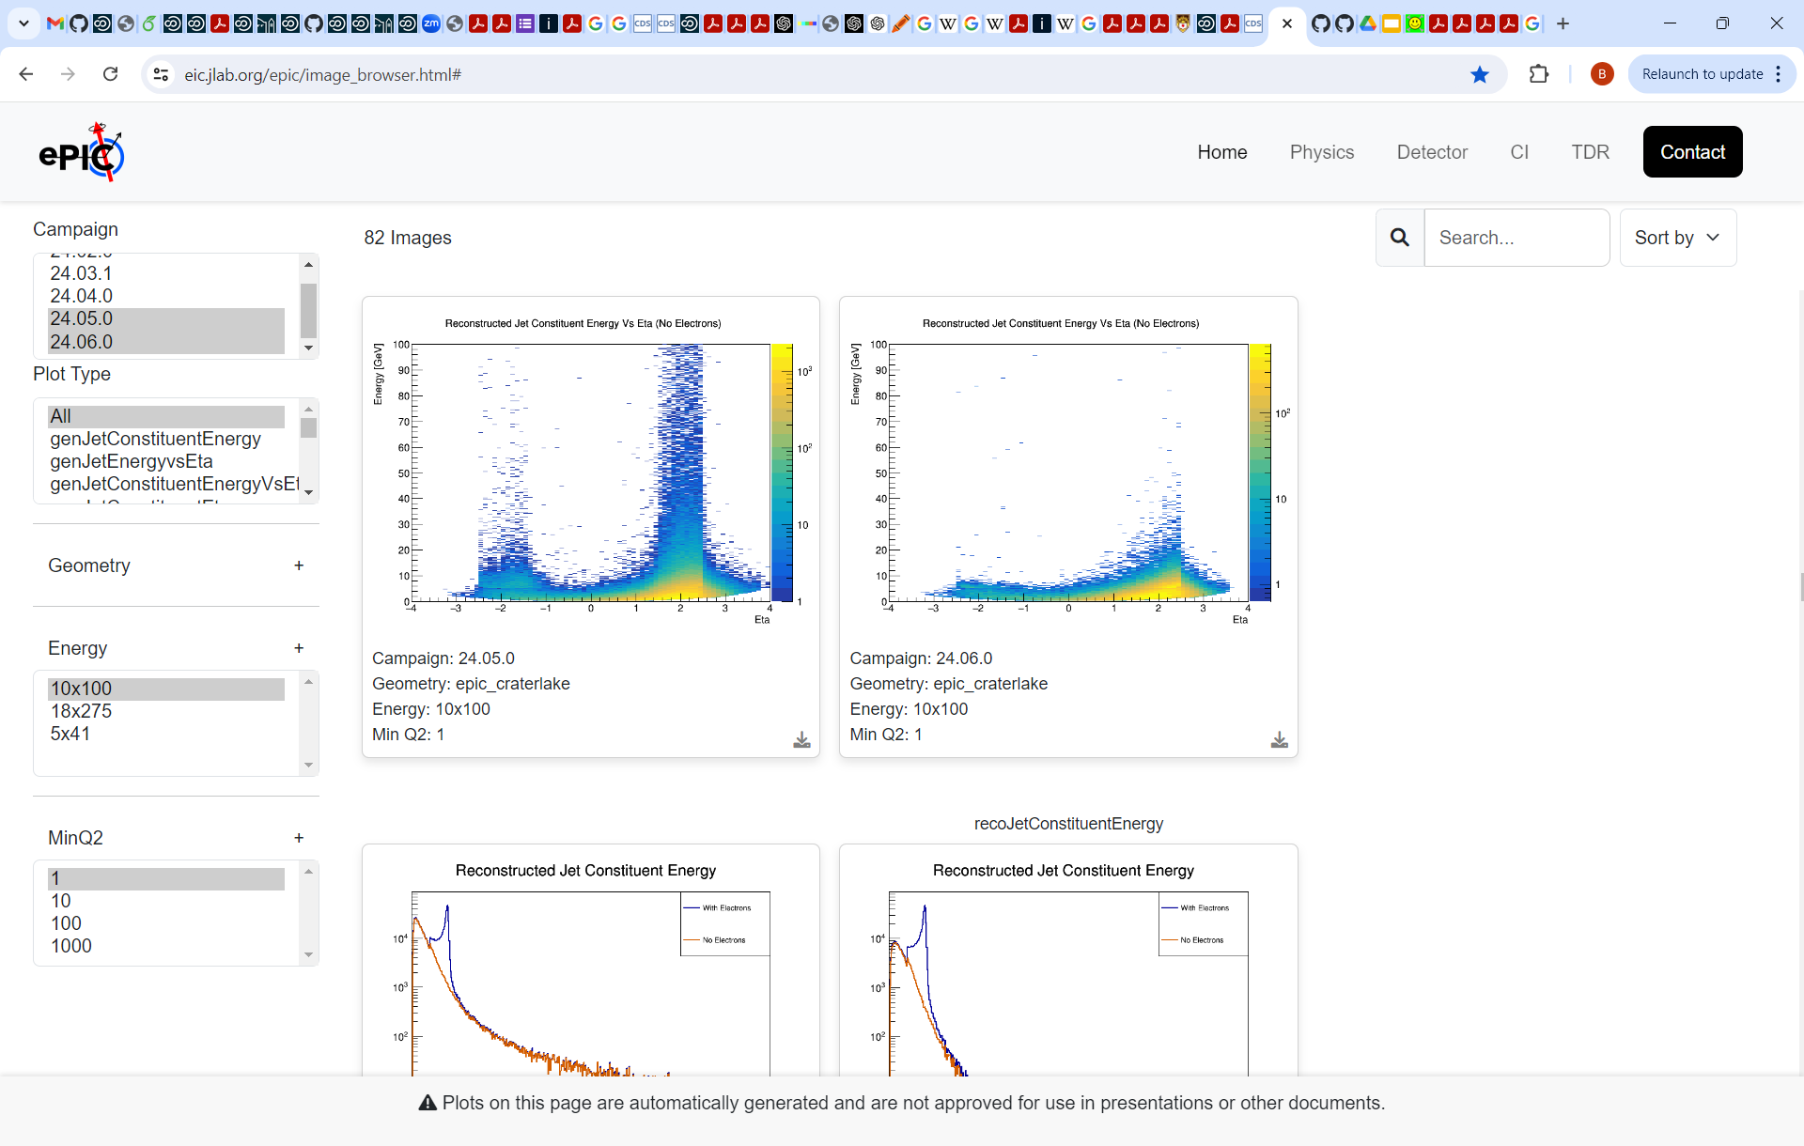
Jet Validation at ePIC
A set of jet performance plots has been developed and run automatically over the monthly productions
Plots are displayed on a web based interface allowing easy comparison of jet quantities between different simulation campaigns
Browser: https://eic.jlab.org/epic/image_browser.html#
Navigate to Physics -> Jets and Heavy Flavor

Slide 52
Summary
The last ~10 years have seen a rapid increasing in the amount of theoretical and experimental work exploring the use of jets at the EIC
The variety of subprocesses, kinematic dependencies and ability to work in different frames will make jets exceedingly versatile probes at the EIC
Jet observables will contribute to nearly every area of the EIC science program, both complementing more traditional inclusive and semi-inclusive measurements and providing unique capabilities of their own
The ePIC Collaboration is making strong progress developing the software tools necessary to implement and validate jet measurements

Slide 53
Backup

Slide 54



The Ultimate QCD Microscope
Understanding internal dynamics of QCD bound states will require precision measurements over a wide kinematic regime – the EIC fits the bill
Equally important will be high resolution, hermetic detectors with good PID and far-forward detection capabilities to fully characterize the final states of collisions
Finally, need observables which are well understood theoretically, and which connect to the properties we want to explore
This talk will focus on the unique capabilities jet observables will bring to the EIC science program

Slide 55
Electron and Struck Quark (5x41)
Look at energy vs pseudorapidity of the scattered electron and struck quark as a function of y and Q²
For fixed Q², as y increases, electron eta increases while parton eta decreases
0.01 < y < 0.1
0.3 < y < 0.4
Electron
Electron
10 < Q² < 100
Quark
Quark
0.01 < y < 0.1
0.3 < y < 0.4
Electron
Electron
Quark
Quark
0.6 < y < 0.7
0.9 < y < 0.95
Quark
Quark
Electron
Electron
0.6 < y < 0.7
0.9 < y < 0.95
Quark
Quark
0.1 < Q² < 1.0
Electron
As Q² increases, both the scattered electron and struck quark move to larger eta for all values of y
Electron

Slide 56


Struck Quark + FSR (5x41)
Behavior as a function of Q², y, and beam energy is still seen
0.01 < y < 0.1
0.3 < y < 0.4
10 < Q² < 100
0.01 < y < 0.1
0.3 < y < 0.4
0.6 < y < 0.7
0.9 < y < 0.95
0.6 < y < 0.7
0.9 < y < 0.95
0.1 < Q² < 1.0

Slide 57
(Charged) Particle Distributions (5x41)
Of course, it is final state hadrons which are measured
Differences with y and Q2 are now somewhat less pronounced
0.01 < y < 0.1
0.3 < y < 0.4
10 < Q² < 100
0.01 < y < 0.1
0.3 < y < 0.4
0.6 < y < 0.7
0.9 < y < 0.95
0.6 < y < 0.7
0.9 < y < 0.95
0.1 < Q² < 1.0
Particle production not associated only with struck parton
Gammas and neutrals follow same pattern

Slide 58


(Charged) Particle x-Feynman (18x275)
Define xF as 2*particle_pZ/W in the hadron-boson center of mass frame
Z-axis defined w.r.t. the virtual photon
10 < Q² < 100
0.01 < y < 0.1
0.3 < y < 0.4
0.01 < y < 0.1
0.3 < y < 0.4
0.6 < y < 0.7
0.9 < y < 0.95
0.1 < Q² < 1.0
Positive xF indicates particles more associated with the struck quark
0.6 < y < 0.7
0.9 < y < 0.95

Slide 59


(Charged) Particle x-Feynman (5x41)
Larger negative xF particles come into the detector acceptance for lower beam energies
10 < Q² < 100
0.01 < y < 0.1
0.3 < y < 0.4
0.01 < y < 0.1
0.3 < y < 0.4
0.6 < y < 0.7
0.9 < y < 0.95
0.1 < Q² < 1.0
Study differences in fragmentation in these regions
Look at correlations between these regions
0.6 < y < 0.7
0.9 < y < 0.95

Slide 60
Jet Kinematics
Bulk of jets produced at the EIC will be low energy / low pT
Pushing to analyze the lowest energy jets will provide access to the lowest x values, which will be important for spin structure and saturation studies
In addition to being relatively low energy, jets will be quite broad and have few particles
Must ensure theory and MC can make robust predictions for low energy jets and hadronization models can handle low multiplicity jets

Slide 61


Coordinates W.R.T. Hadron Beam
”Physics” in the forward region should be consistent around the hadron beam regardless of where the beam is pointing
In some sense, the features seen above are simply artifacts of measuring about the ”wrong” axis -> instead, define eta and phi with respect to the hadron beam direction (Eta*, Phi*)
Phi*
Phi Counts in Eta Slices
High Eta
Eta*
When defined w.r.t. the hadron beam, the concentrations in eta and phi disappear
However, because there is no common beam axis, the particle distribution along the electron-going direction becomes distorted
Can avoid these distortions by boosting to a frame in which the beams are collinear
Low Eta

