Slide 1
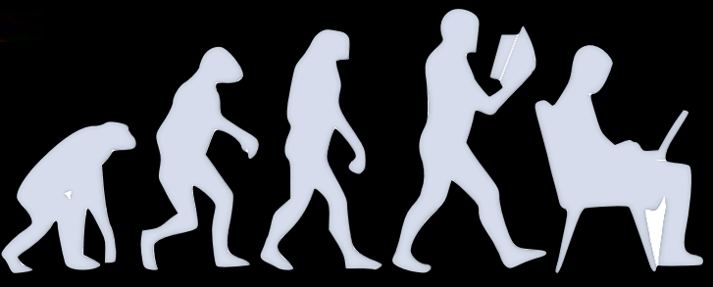
Generative modelling for CLAS analysis
Marco Spreafico
on behalf of A(i)DAPT Working Group
Marco Spreafico
Generative modelling for CLAS analysis

Slide 2
A(i)DAPT motivation
NP/HEP experiments are affected by the following problems:
Data are affected by detector effects
Multidimensional problems reduced in lower-dimensional spaces for simplicity
Large datasets are difficult to manipulate and preserve
Can AI support NP/HEP experiments and allow to extract physics form data in a more efficient way?
Develop AI-supported procedures to:
Unfold detector effects
Accurately fit data in multiD space
Preserve data in a more compact format
Collaborative effort:
ML experts (ODU, JLab)
Experimentalists (JLab Hall-B)
Theorists (JPAC, JAM)
1 – Marco Spreafico
Generative modelling for CLAS analysis

Slide 3
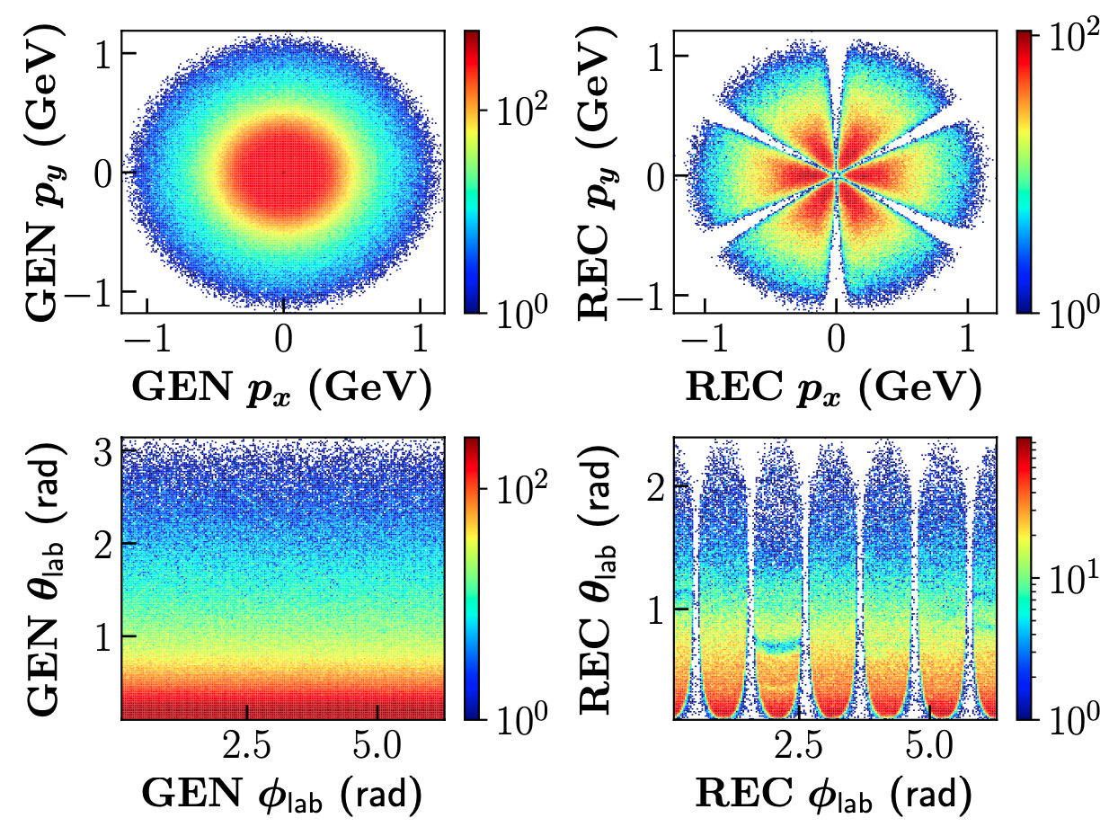
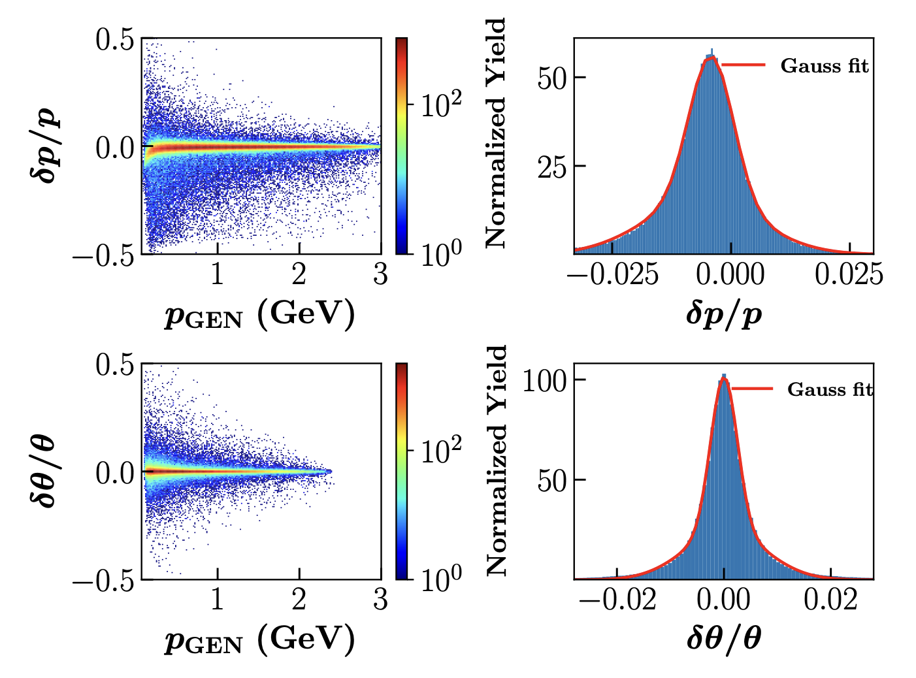
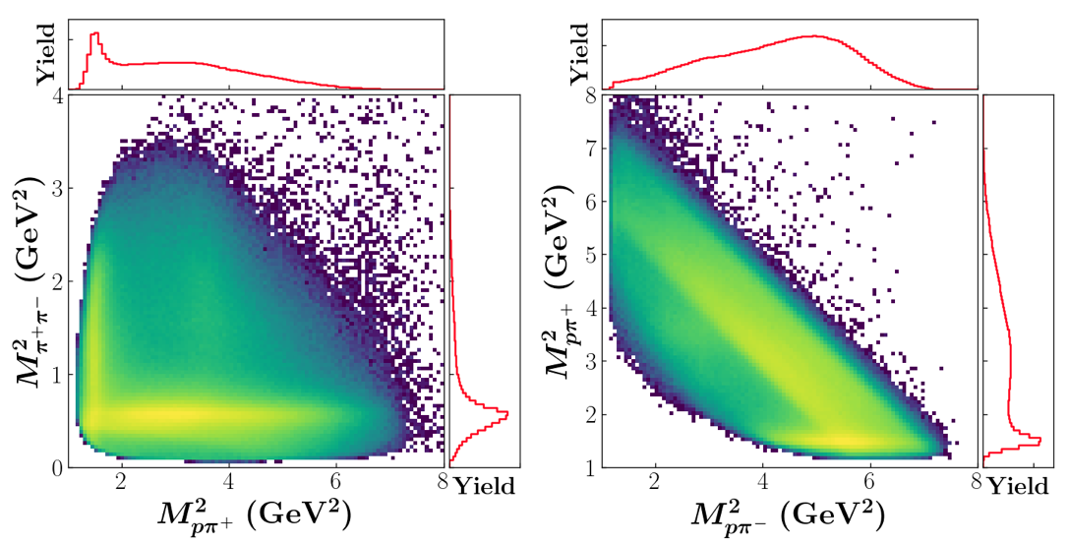
A(i)DAPT motivation
DETECTOR EFFECTS
Acceptance: measurements only access a limited portion of phase space
Resolution: limited resolution may lead to interesting effects being washed out
DIMENSIONALITY
When reducing a high-dimensionality problem to a lower dimensionality, resonances may become less clear
$$Δ^{++}(1232)$$
$$ρ^{0}(770)$$
AI could provide a new way to look at data and to extract observables and physics interpretation
2 – Marco Spreafico
Generative modelling for CLAS analysis

Slide 4
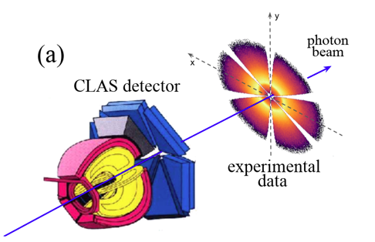
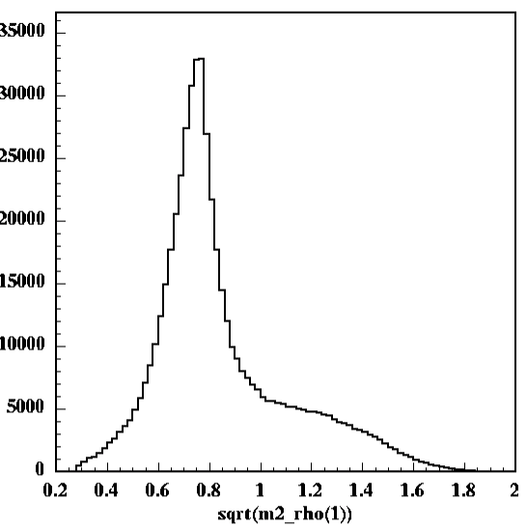
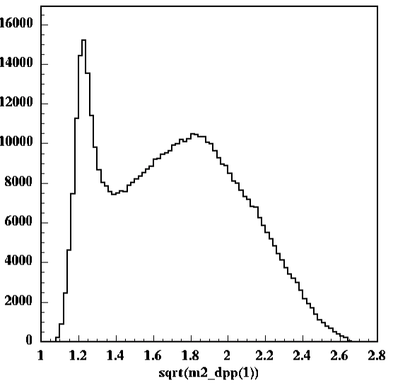
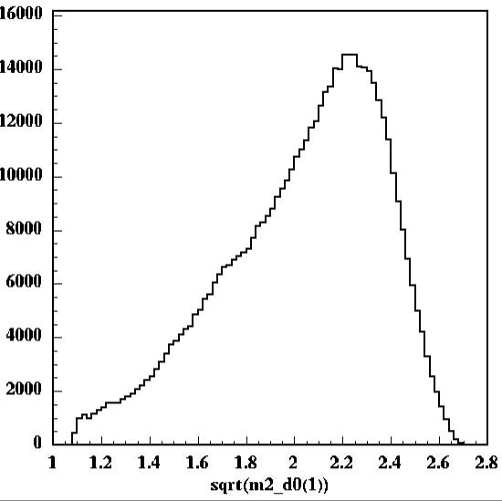
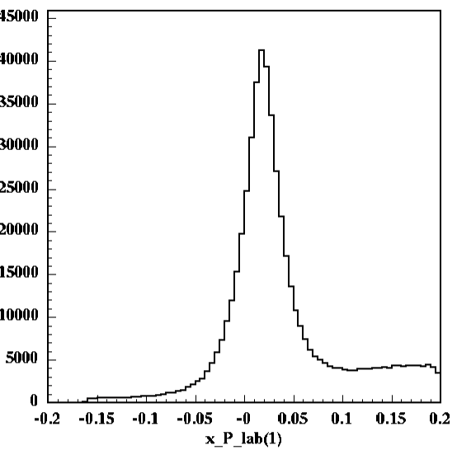
Exclusive $2π$ photoproduction
M. Battaglieri et al. (CLAS Collaboration) Phys. Rev. Lett. 102, 102001
M. Battaglieri et al. (CLAS Collaboration) Phys. Rev. D 80, 072005
CLAS g11 kinematics
Focus on $γp→pπ^{+}\left(π^{−}\right)$
$E_{γ}=\left(3−4\right)$ GeV
Missing $π^{−}$ measured as missing momentum
Multi $π$ background from $γp→pω→pπ^{+}π^{−}π^{0}$
$ρ^{0}$ electroproduction: $γp→pρ^{0}$
$Δ^{++}$ resonance excitation: $γp→Δ^{++}π^{−}$
$$M_{ππ}$$
$$M_{pπ^{+}}$$
$$M_{pπ^{−}}$$
$$M_{X}$$
$$γp→p^{′}π^{+}(X)$$
$$Δ^{++}(1232)$$
$$ρ^{0}(770)$$
$$M_{missing ππ}$$
3 – Marco Spreafico
Generative modelling for CLAS analysis

Slide 5
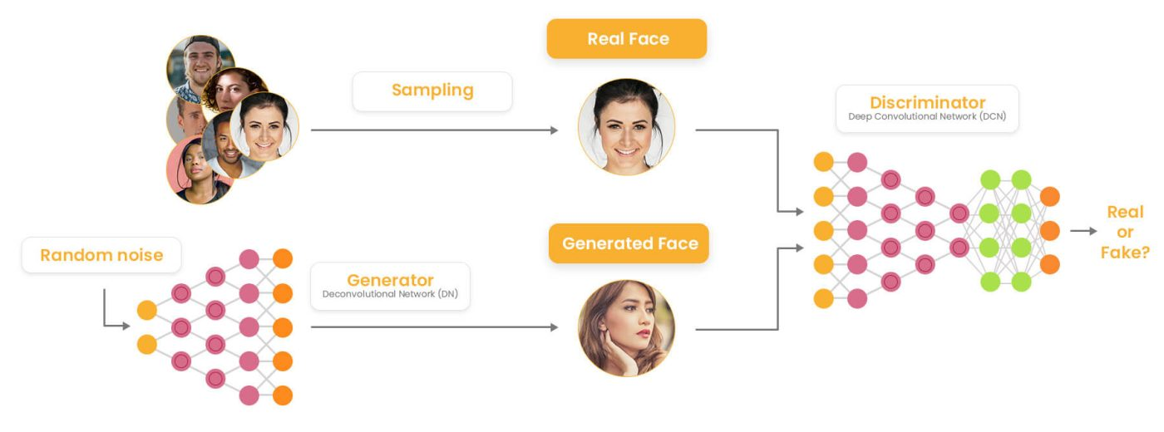
Generative Adversarial Networks (GAN)
Generator
Produce synthetic data that mimic real data
Can retain high dimensional correlations
Can produce realistic pseudo-data quickly
Discriminator
Distinguish between synthetic and real data
Forces generator to generate synthetic data indistinguishable from real data
VS
Credit: T.Alghamdi et al, Phys. Rev. D 108, 094030
4 – Marco Spreafico
Generative modelling for CLAS analysis

Slide 6
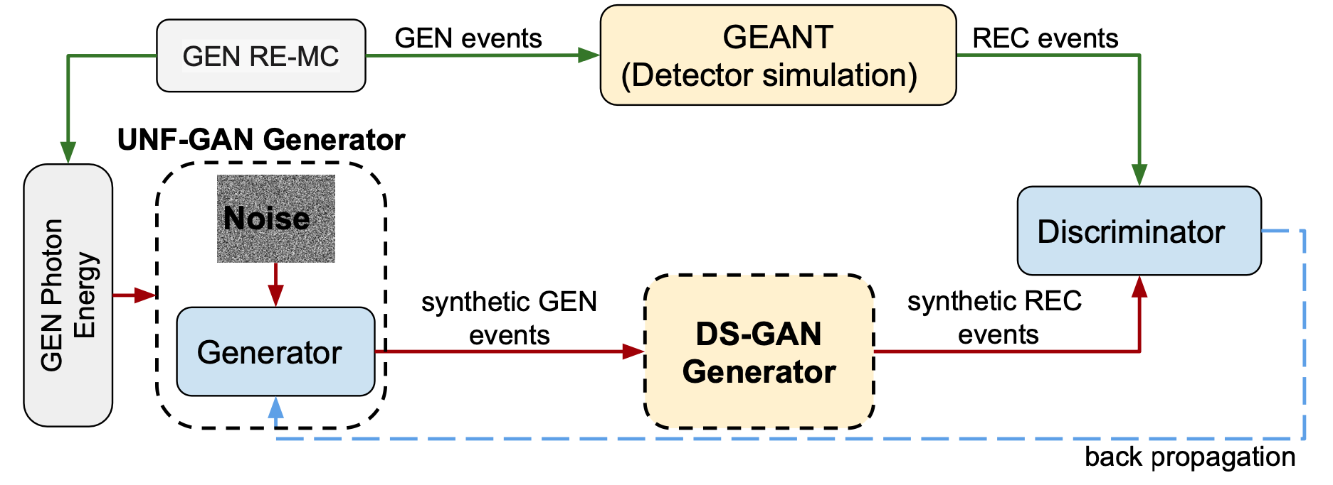
$2π$ photoproduction closure test
CLOSURE TEST
Can an AI-based model learn underlying features of (pseudo-)data while unfolding detector effects?
Credit: T.Alghamdi et al, Phys. Rev. D 108, 094030
5 – Marco Spreafico
Generative modelling for CLAS analysis

Slide 7
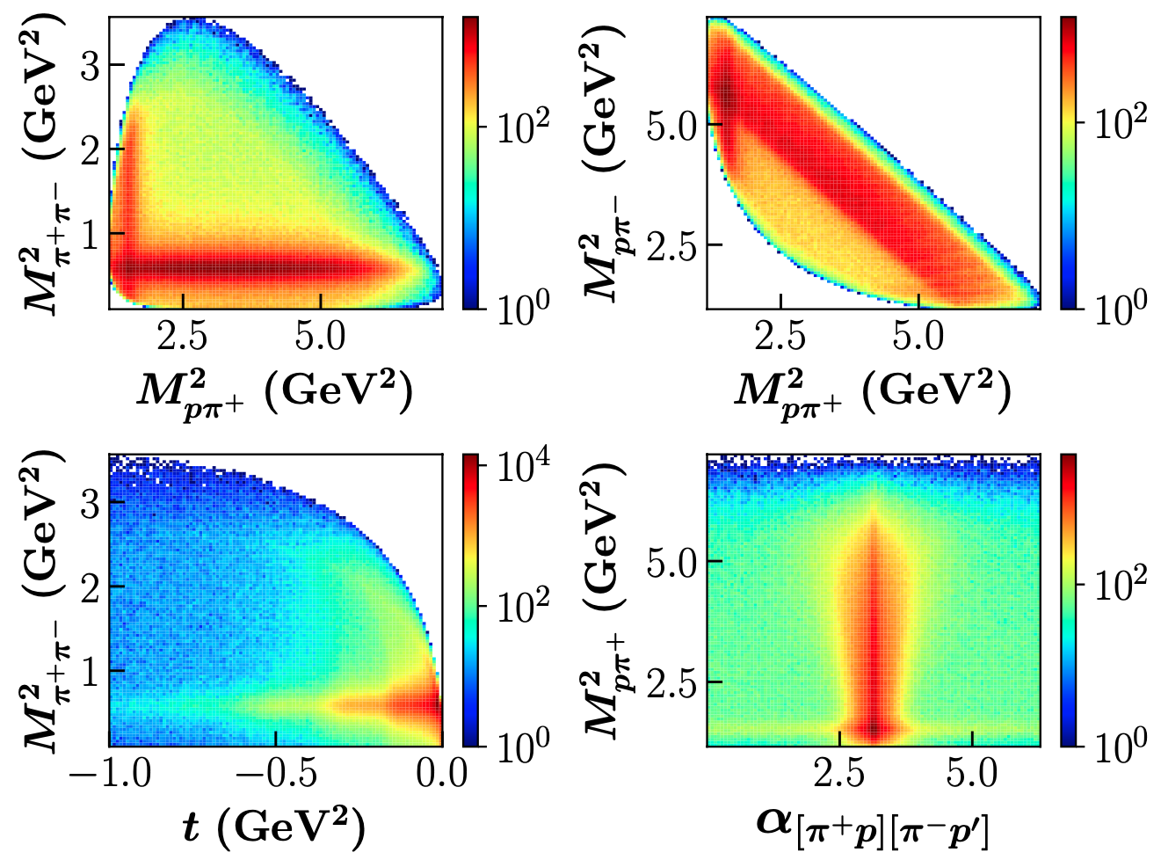
$2π$ photoproduction closure test
Generate events with a MC model
Include measured cross sections, angular distributions, main resonances and decay ($ρ^{0},Δ^{++}, Δ^{0}$)
Simulate detector smearing
Simulation of detector effects (acceptance and resolution) using GSIM-GEANT
Credit: T.Alghamdi et al, Phys. Rev. D 108, 094030
6 – Marco Spreafico
Generative modelling for CLAS analysis

Slide 8
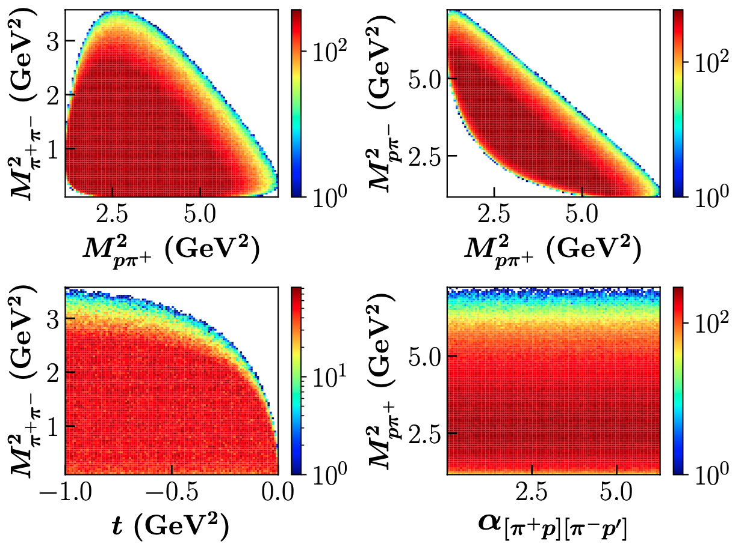
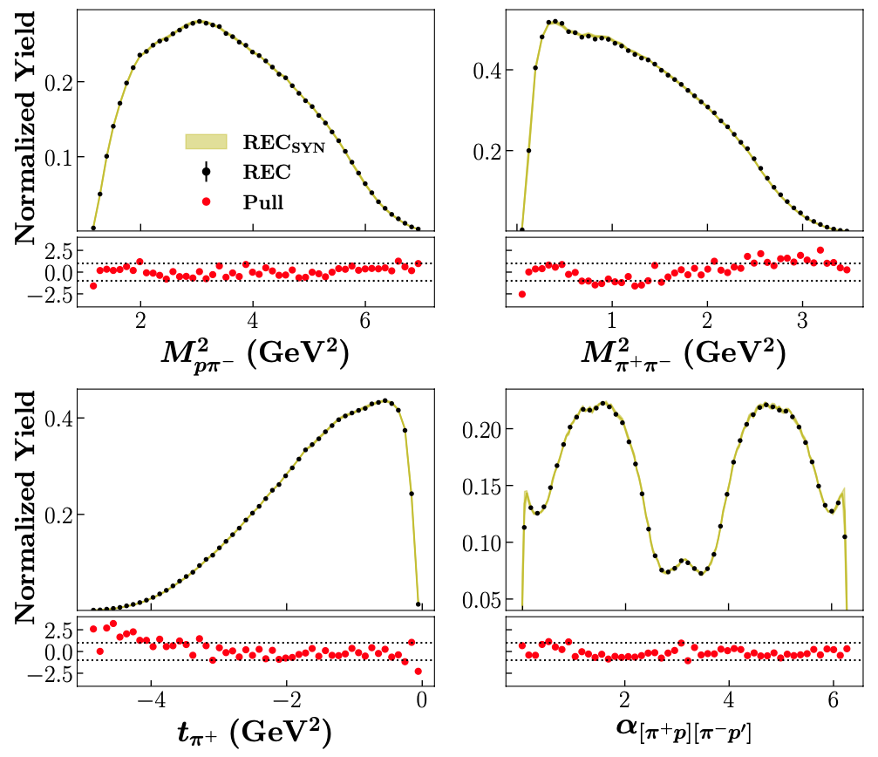
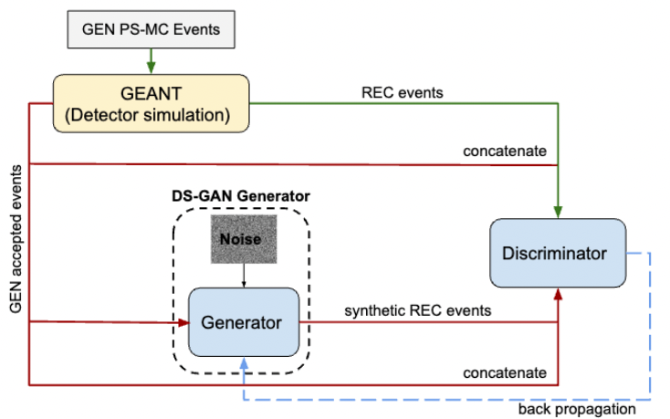
$2π$ photoproduction closure test
Detector Simulation GAN (DS-GAN)
AI-based detector proxy
Train over phase space data to avoid model dependance
Uncertainty evaluated training 10 independent GANs
Credit: T.Alghamdi et al, Phys. Rev. D 108, 094030
7 – Marco Spreafico
Generative modelling for CLAS analysis

Slide 9
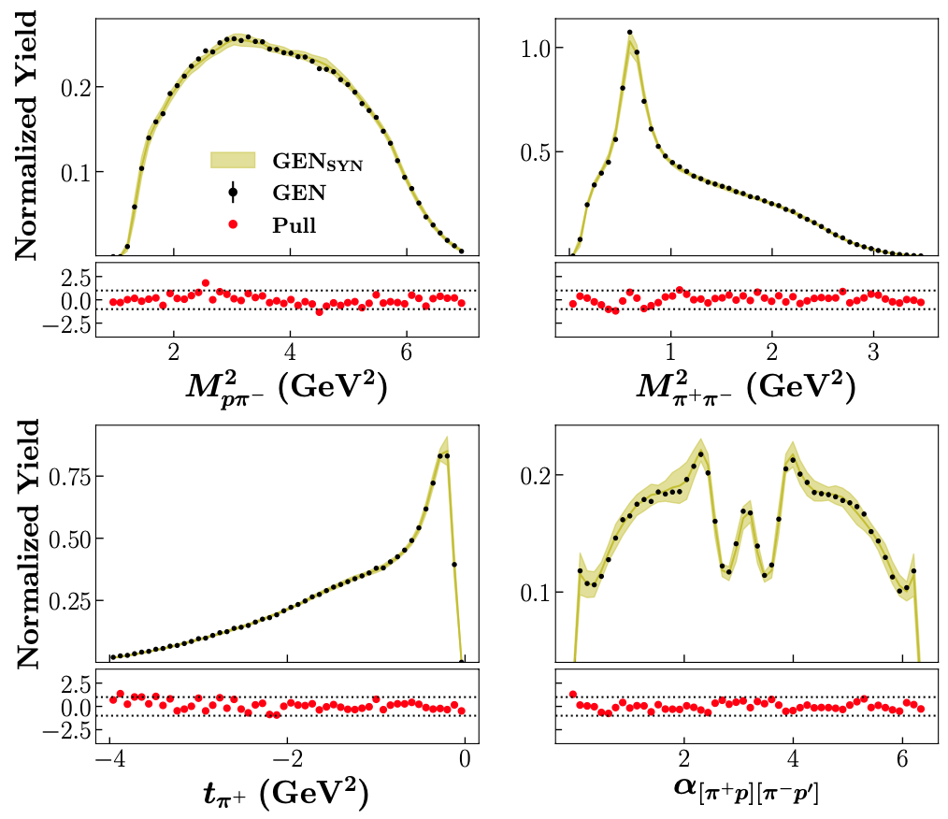
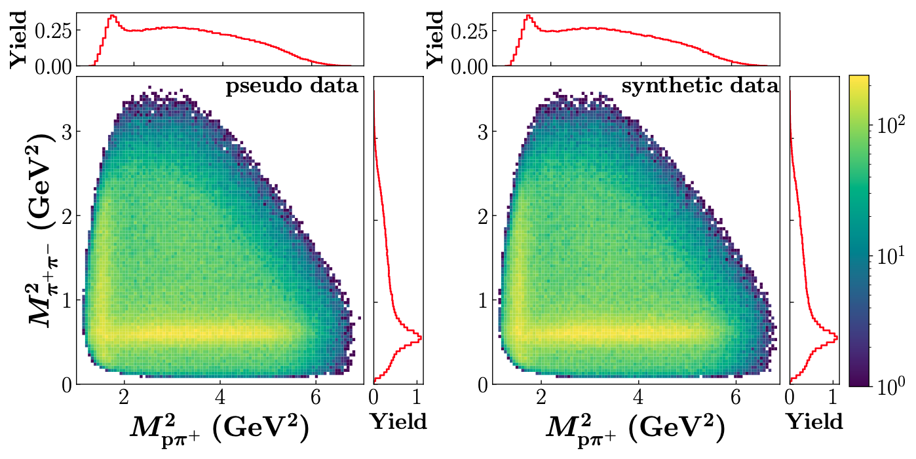
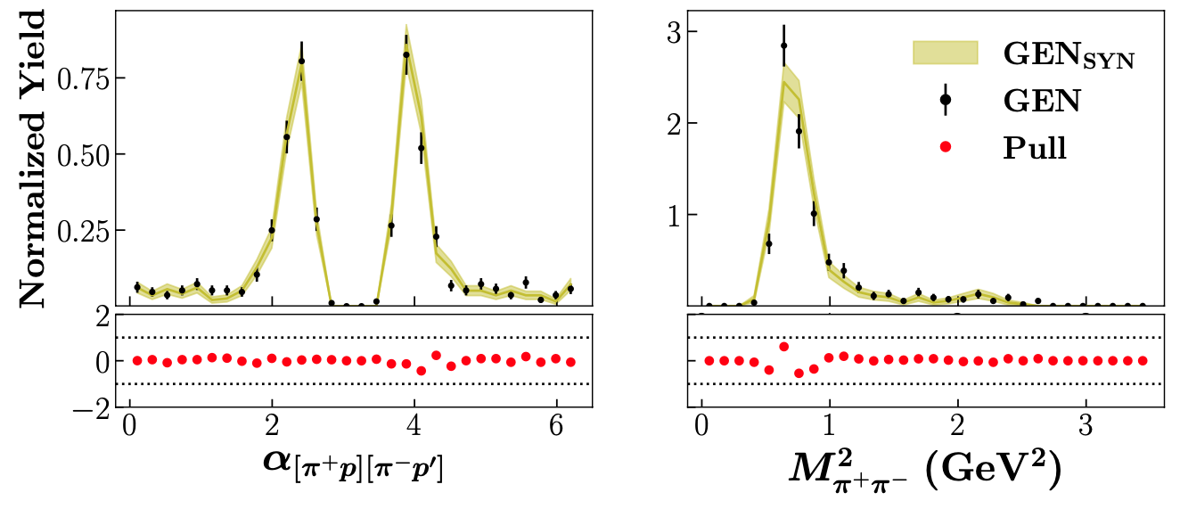
$2π$ photoproduction closure test
Training of the UNF-GAN with pseudo-data
Trained on MC pseudo-data
Generated synthetic vertex-level data
Detector effects applied with DS-GAN
Uncertainty estimated with pull quantification
1D
2D
4D
UNF-GAN can reproduce detector level pseudo-data within $±1σ$
Correlations are preserved both in 2D and in 4D distributions within $±1σ$
8 – Marco Spreafico
Generative modelling for CLAS analysis

Slide 10
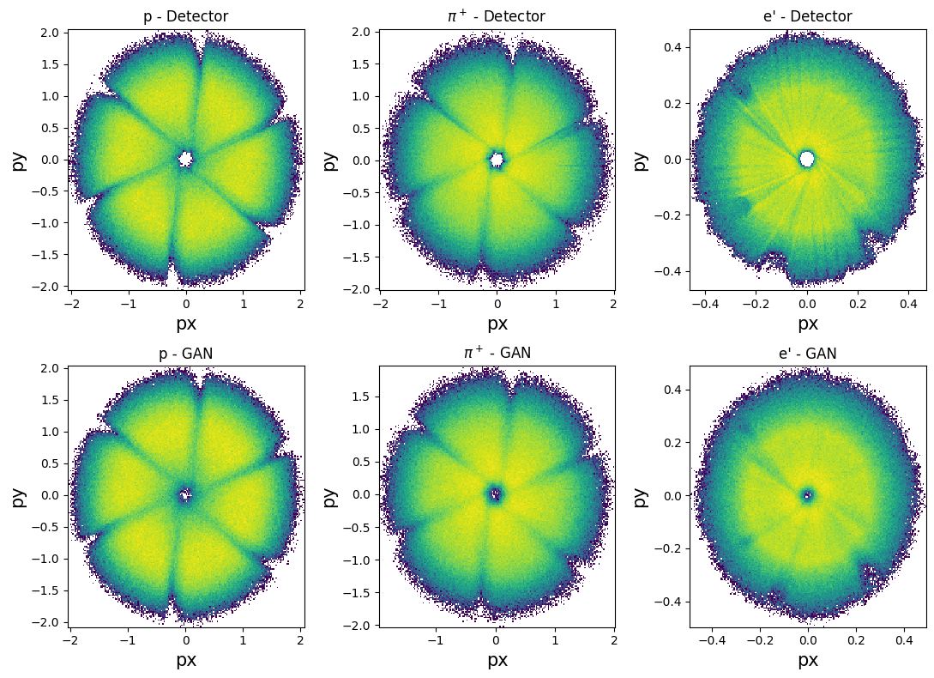
Work in progress
The next step to achieve A(i)DAPT goals:
Application to real data
Train UNF-GAN using CLAS g11 data
Assess GAN capability learn real data features
Application to CLAS12 detector and physics
Train DS-GAN on CLAS12 pseudo-data
Apply UNF-GAN to electroproduction data
Extrapolation of scattering amplitudes
Extract amplitudes from differential cross-sections exploiting theoretical constraints
Preliminary
Our goal is to develop a new tool accessible to everyone and that can be used to improve any analysis
9 – Marco Spreafico
Generative modelling for CLAS analysis

Slide 11
Summary
A(I)DAPT program aims to demonstrate a novel way to extract and interpret physics observables
We aim at creating AI-powered algorithms to address NP/HEP challenges:
Unfold detector effects
Preserve data in an alternative and efficient way
Performed closure test on 2$π$ photoproduction :
GAN can mimic realistic pseudo-data
GAN synthetic data retain multi-dimensional correlations
Proven algorithm robustness:
It can reproduce different detector layouts (CLAS, CLAS12)
It can simulate different processes (photoproduction, electroproduction)
We are working on:
Application on real data (CLAS and CLAS12 2$π$ data)
Use of AI to extract scattering amplitudes from cross-section data
10 - Marco Spreafico
Generative modelling for CLAS analysis

Slide 12
Thank you!
11 - Marco Spreafico
Generative modelling for CLAS analysis

