Slide 1
Proton Form Factor Measurement Using Recoil Polarization Method
Jacob McMurtry
N. Liyanage, H. Nguyen, and the SBS collaboration
University of Virginia
Hampton University Graduate School
June 14, 2024

Slide 2
Outline
Discussion of the proton electromagnetic form factor
Refresher from previous lectures
The experiment
How will we make this measurement?
The detectors
How do the polarimeter and tracking detectors work?

Slide 3
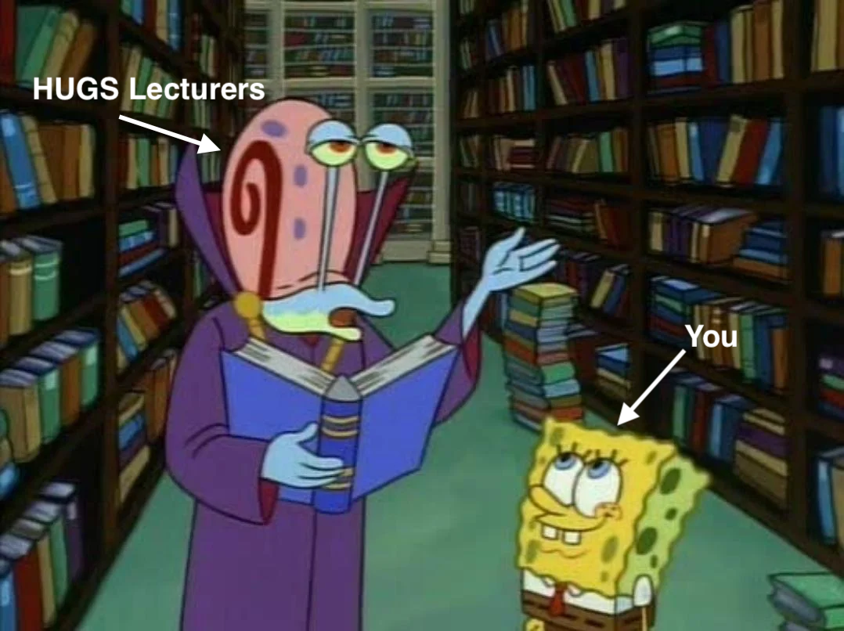
Previous Discussions
[1] Y. Roblin, “A positron beam at Jlab”, Slides 5,6,7,8,11, May 28 2024
[2] P. Rossi, ”JLab now and in the future”, Slides 21,22,23, May 29 2024

Slide 4
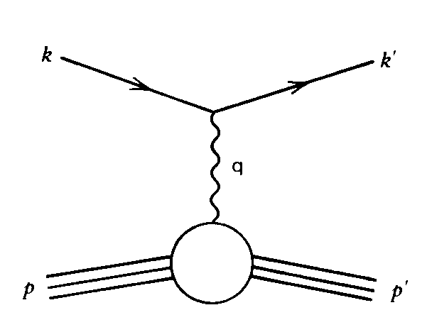
Nucleon Elastic Form Factors
Form Factors describe internal structure of the nucleon
Elastic ⟹ Ground state structure
Charge and magnetization distributions ⟹ Nucleon Transition Current
Use Sach’s form factors:
Fourier transforms of the electric and magnetic moments distributions in the Breit frame
Scalar functions of $Q^{2}$ which parameterize the unknown nucleon structure
Notes:
Nucleon Elastic Form Factors represent fundamental observable quantities which are related to the internal ground state structure of the nucleon. This includes the charge and magnetization distributions of the nucleon which can be obtained from the Nucleon transition current described in this equation. Rather than looking at F1 and 2 the dirac and pauli form factors, we instead look at the Sach’s form factors.

Slide 5
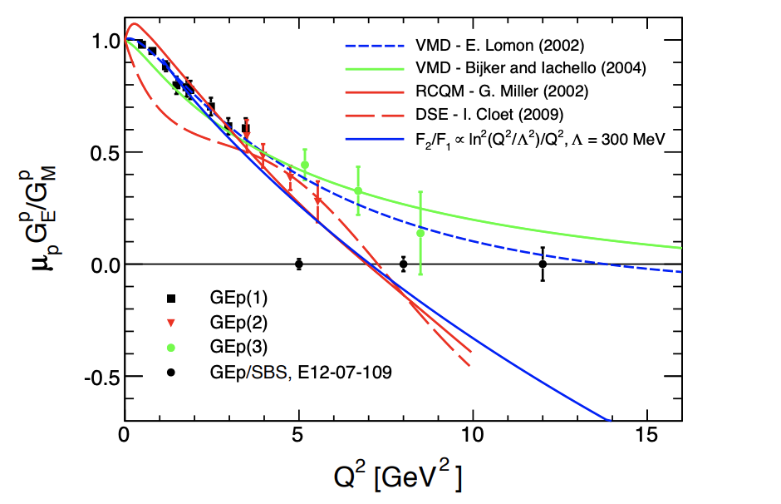
Brief Theoretical Background
Theory originally predicted $\frac{{\text{G}}_{E}}{{\text{G}}_{M}}=1$
Instead dies off rapidly at high $Q^{2}$
Models since differ greatly at high $Q^{2}$
Two-photon exchange likely culprit!
Cross sections don’t account for this
[3] L. Pentchev (contact) et al., “Large Acceptance Proton Form Factor Ratio Measurements at 13 and 15 (GeV) Using Recoil Polarization Method.” Jefferson Lab Experiment E12-07-109, 2007
Notes:
These form factors appear in the cross section, so early experiments focused on this measurement to extract the form factors
20 years ago the expectation was that the ratio of GE/GM would be 1, but further measurements began to differ from theory, leading physicists to explore other avenues.
A major problem is that the relativistic quark model incorporates different elements of QCD, but there is too much going on in the nucleon to calculate form factors from scratch. We need to understand which elements need to be incorporated
The two-photon exchange is a higher order correction to these form factors that offers the most likely path to explain this discrepancy. We want to make these precision measurements at high Q^2 where models differ greatly in order to help constrain the effect of the two-photon exchange.

Slide 6
The Experiment: E12-07-109 (GEp-V)
The Bigbite Spectrometer
Poly shield
Scintillators
Calorimeter
The Super Bigbite Spectrometer
Large dipole magnet
Polarimeter
GEM tracking layers
CH₂ polarimeter analyzer
GEM tracking layers
Hadron Calorimeter
Both sides are on a track and can be rotated to different angles
$$\frac{G_{E}^{P}}{G_{M}^{P}}=−\frac{P_{t}}{P_{l}}\sqrt{\frac{τ\left(1+ε\right)}{2ε}}$$
Notes:
So how does the experiment actually work? We do what is called the polarization transfer method in which a polarized electron beam is scattered off an unpolarized proton target resulting in partial polarization transfer. In this method we can write the ratio of the form factors as being proportional to the ratio of the scattered hadron polarization.
So if we refer to the diagram; Our beam comes in, hits our liquid hydrogen target, and the scattered electron and proton our detected in our spectrometer. Our spectrometer is broken into two parts: On the top here we have the “Bigbite” spectrometer where our scattered electrons enter. This helps us find coincidence to all the relevant proton events we detect in the hadron side. In the Super Bigbite side, the protons momentum, energy, and most importantly polarization are detected, all quantities we need in our analysis. NOTE: The spectrometers are not fixed and can rotate.

Slide 7
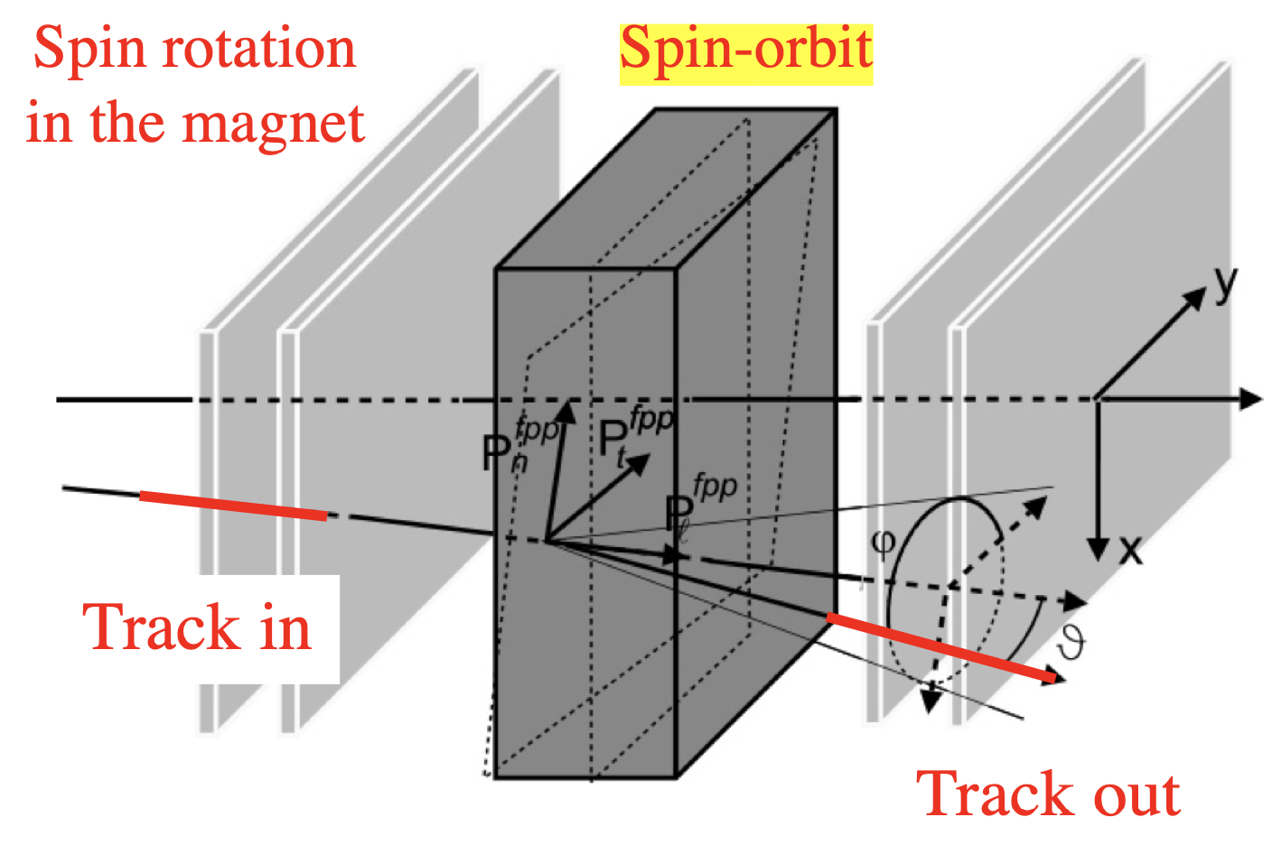
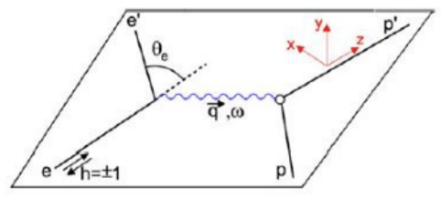
Experimental Measurement
Experimentally we relate FF ratio to polarization ratio
$P_{x}$/$P_{t}$ ⟹ Polarization transverse to momentum
$P_{y}$/$P_{l}$ ⟹ Polarization longitudinal to momentum
$$\frac{G_{E}^{P}}{G_{M}^{P}}=−\frac{P_{t}}{P_{l}}\sqrt{\frac{τ\left(1+ε\right)}{2ε}}$$
[4] B. Wojtsekhowski et al., “GEp Experimental Readiness Review 2023.” https://hallaweb.jlab.org/wiki/index.php/ERR#Agenda, 2023
Notes:
How does the polarimeter measure the polarization? Strictly speaking, it doesn’t exactly give us the actual polarization value of the protons, rather what we measure is an asymmetry which is related to the polarization.
What ends up happening is that the incident proton undergoes secondary scattering in the polarimeter analyzer block which will give the proton a preferential scattering direction dependent on its polarization.
One major catch is that to get this asymmetry, the polarization vector must be perpendicular to the momentum of the proton.
But I’ve said that the form factor ratio requires this longitudinal polarization component that is parallel to the protons momentum. This is where the dipole magnet comes in, the proton undergoes spin orbit precession in the field rotating the longitudinal component out of the scattering plane.

Slide 8
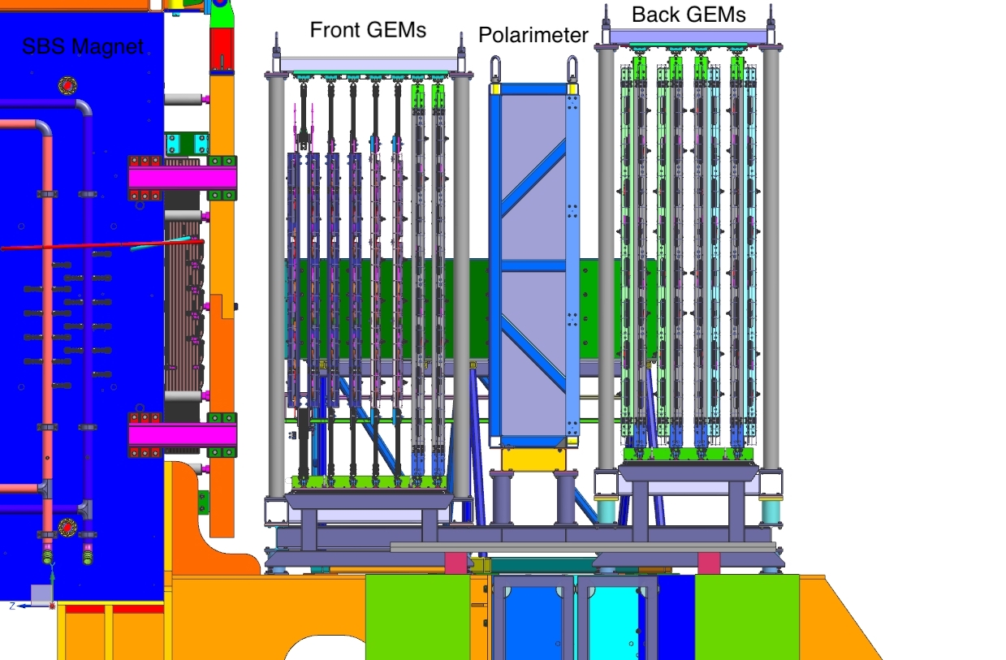
The Hadron Arm
GEM tracking detectors
Scattering angle, position, direction, etc.
8 GEM layers in forward and back trackers
Front – 4 UV, 2 XW, 2 XY
Back – 8 XY
All built by UVa group
[5] H. Szumila-Valnce et al., “GEp Experimental Readiness Review 2023.” https://hallaweb.jlab.org/wiki/index.php/ERR#Agenda, 2023
Notes:
Now, how are we going to make these measurements really? I mean, really, how do these detectors work. Let’s zoom in on the hadron arm. As is shown in the diagram, we have our SBS magnet on the right here to select out all our protons. Next we find our polarimeter flanked by a series of GEM tracking detectors. Why do we need these tracking detectors? They provide us with spatial information about the scattered proton such as the scattering angle and direction. Note that we have many different GEMs in this schematic; There are 3 different types, but all were built by the Uva GEM group and have all been tested in pervious SBS experiments. We put the “smaller” GEMs in front to allow for the spread of particles as they pass through the spectrometer.

Slide 9
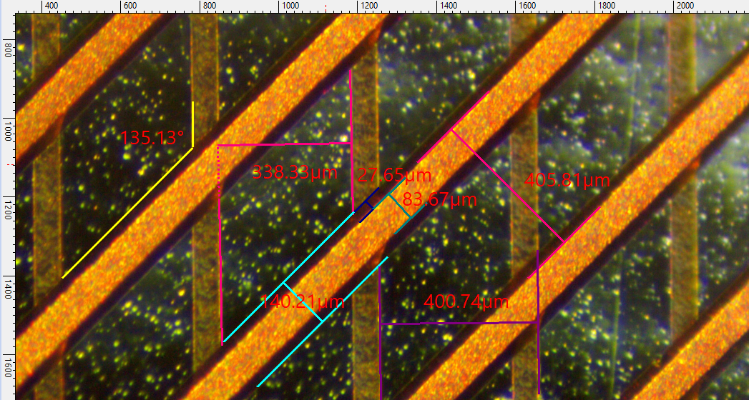
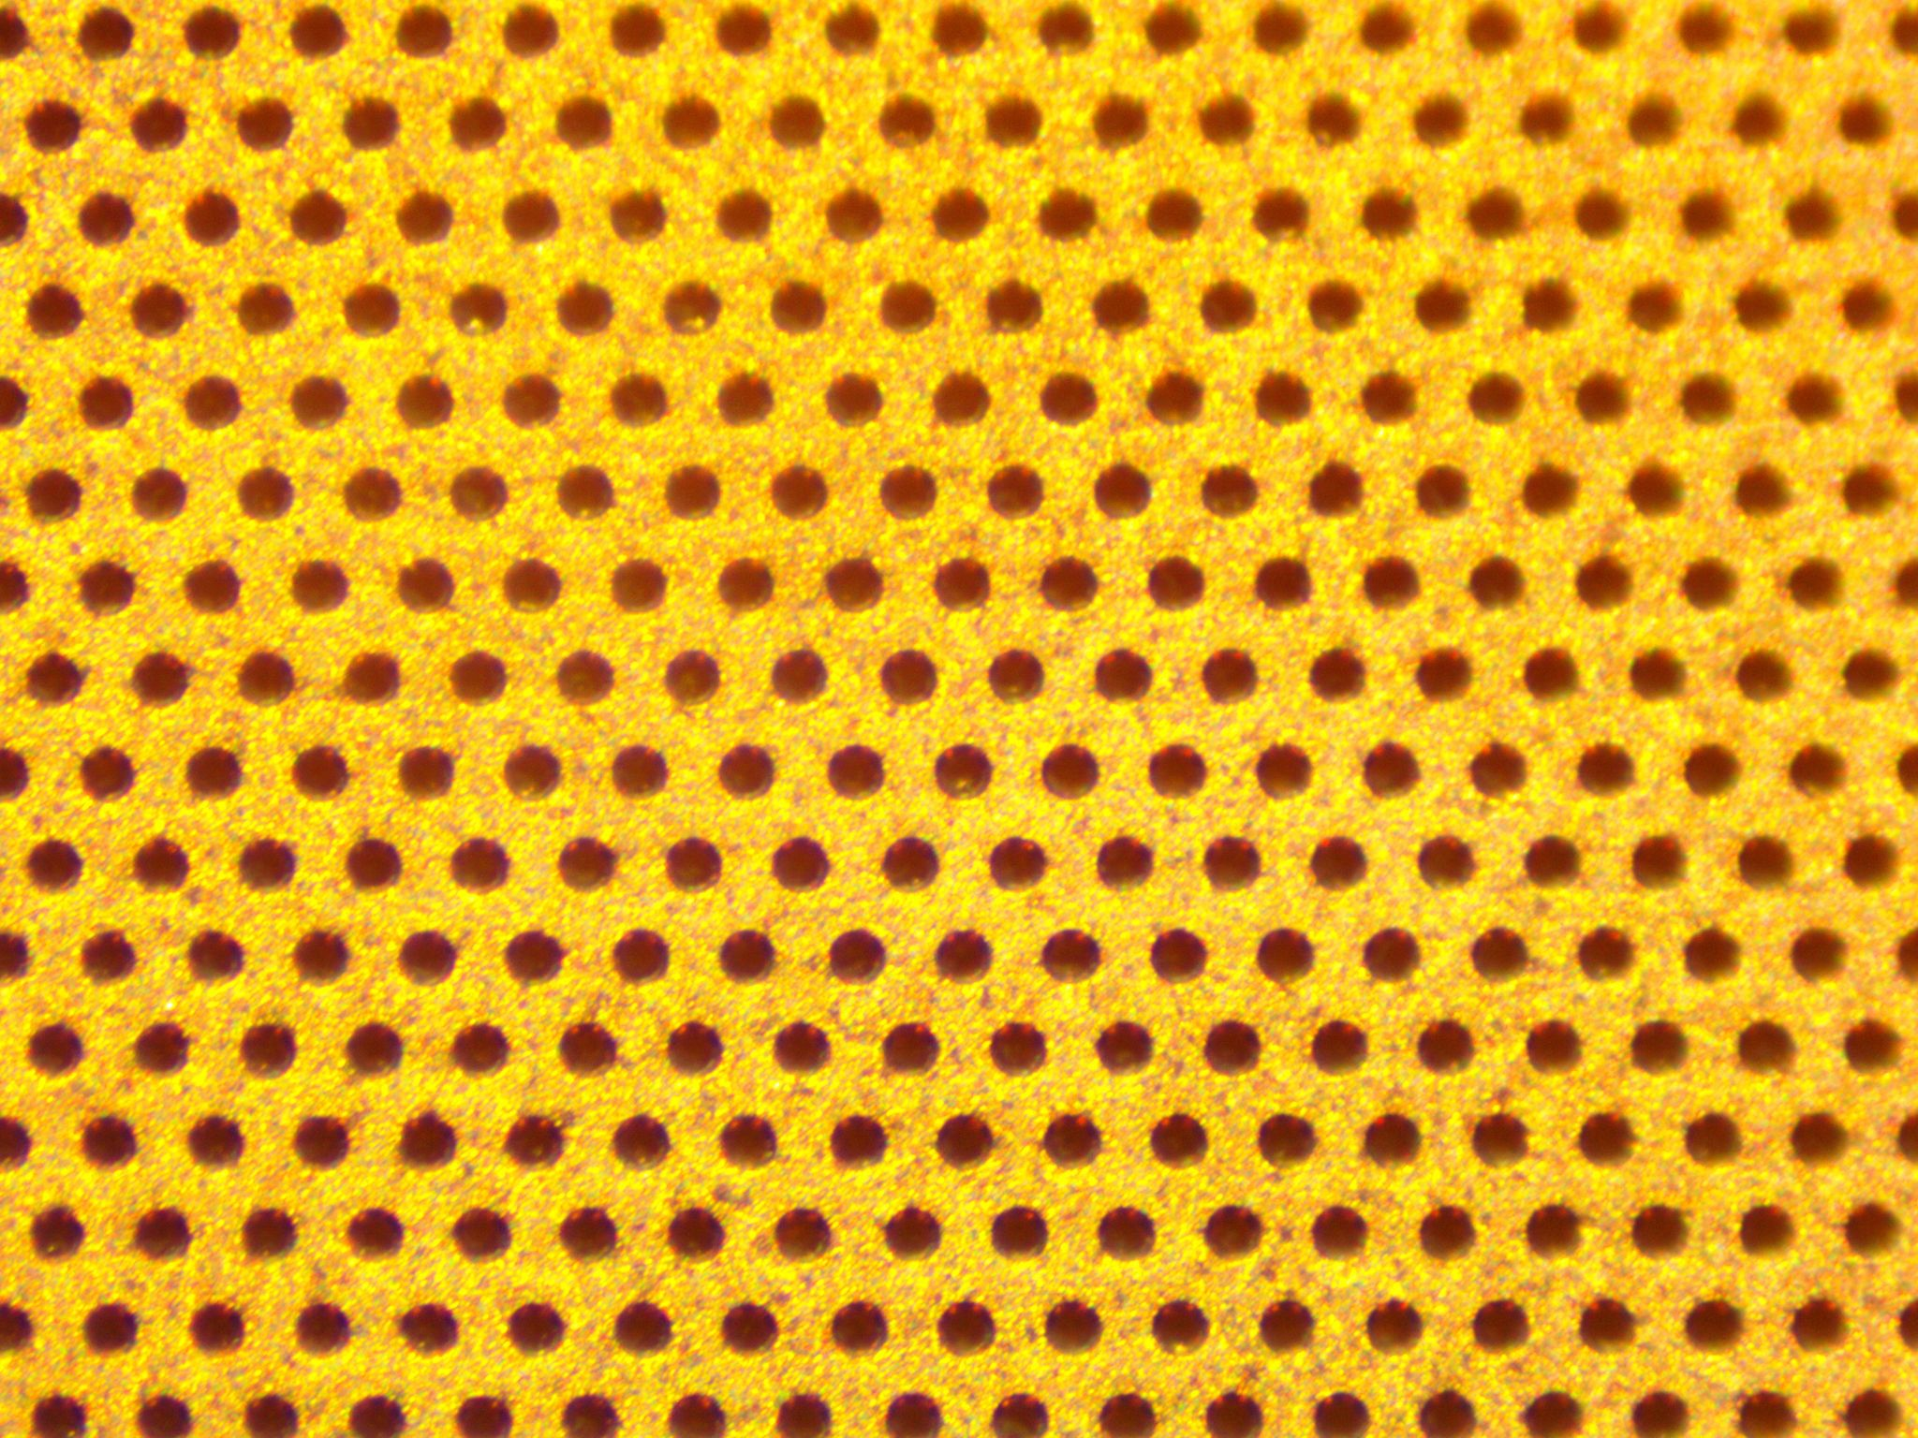
GEM Detectors
Gas Electron Multiplication
Incident particles ionize gas
Electrons accelerated across Drift field
Avalanche Multiplication in GEM regions
Charge deposited on readout board (crossing wire strips or sometimes pixels)
APV25 cards read signals and provide ADC values
Mixture of Argon (70-75%) and CO2 (30-25%)
[6] F. Sauli, Development and applications of gas electron multiplier detectors, Nucl. Instrum. Meth. A 505 (2003) 195–198.
Notes:
(Analog Pipeline Voltage)
What exactly is a GEM detector? GEM stands for Gas electron multiplication, for those familiar these are a subset of MPGDs or micro pattern… If we follow the diagram here, we have this entire region filled with an ionizing gas. Each of these layers, including the top and the bottom of these internal layers, are held at a different potential that cascades from top to bottom. When in incident particle (say, a proton) enters the chamber it will ionize gas in this top region. The resulting ionized electrons drift through the field until they reach the first GEM layer, where they are amplified by a factor of roughly 20. Those electrons then drift, are amplified, and so on. Finally, the charge is deposited on a readout board made of a bunch of wire strips spaced on the order of roughly 400 microns. The signals from these wires are then readout by our electronics and use coincidence in the two directions to map out a hit.

Slide 10
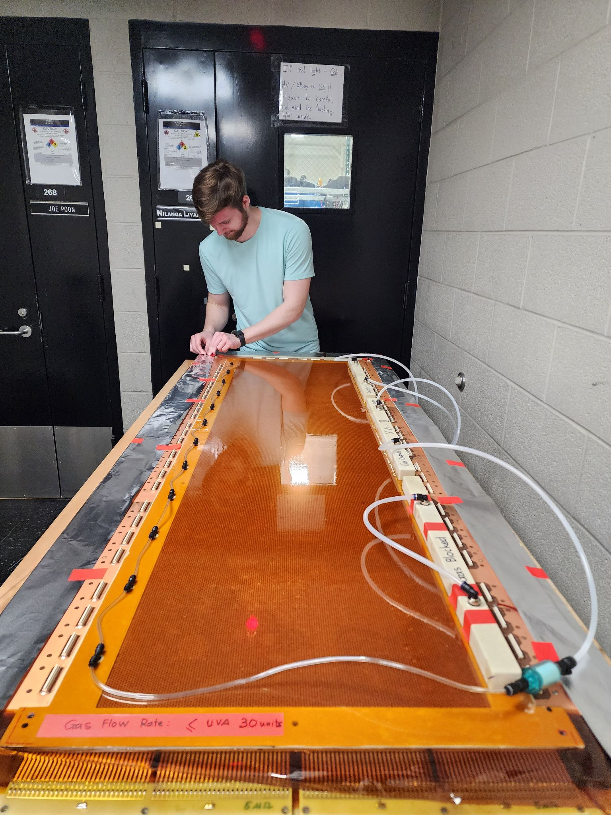
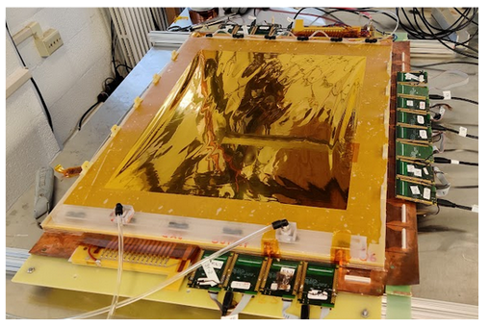
GEM Characteristics
3 mm spaced triple GEMs
GEM hole diameter/pitch: 70/140 μm
Readout wire spacing:
Resolution: 70 μm
Wire Pitch:
XW: 35°
UV: 45°
XY: 90°
Active Area:
XW/UV: 150x40 cm²
XY: 50x60 cm²

Slide 11
Summary and Outlook
SBS experiment E12-17-004 (GEn-RP) completed May 2024
SBS currently being reconfigured for GEp-V
Nominal start date of October 24th, 2024
Completion in April 2025 with subsequent analysis

Slide 12
Acknowledgements
The UVa Group: Prof. Nilanga Liyanage, Huong Nguyen, Xinzhan Bai, Asar, Ahamed, Anuruddha Rathnayake, John Boyd, Sean Jeffas, Bhashitha Thuthimal Dharmasena, Vimukthi Gamage, and Minh Dao
The SBS Collaboration
JLab Staff who have helped and contributed to the program
US Department of Energy, Office of science, Office of Nuclear physics award number DE-FG02-03ER41240
HUGS Program & Coordinators!

Slide 13
References
[1] Y. Roblin, “A positron beam at Jlab”, Slides 5,6,7,8,11, May 28 2024
[2] P. Rossi, ”JLab now and in the future”, Slides 21,22,23, May 29 2024
[3] E. Cisbani, N. Liyanage, L. Pentchev (contact), A. Puckett, M. Jones and B. Wojtsekhowski (spokespersons), “Large Acceptance Proton Form Factor Ratio Measurements at 13 and 15 (GeV) Using Recoil Polarization Method.” Jefferson Lab Experiment E12-07-109, 2007 with 2019 update.
[4] B. Wojtsekhowski et al., “GEp Experimental Readiness Review 2023.” https://hallaweb.jlab.org/wiki/index.php/ERR#Agenda, 2023
[5] H. Szumila-Valnce et al., “GEp Experimental Readiness Review 2023.” https://hallaweb.jlab.org/wiki/index.php/ERR#Agenda, 2023
[6] F. Sauli, Development and applications of gas electron multiplier detectors, Nucl. Instrum. Meth. A 505 (2003) 195–198.

Slide 14
Backup Slides

Slide 15
SBS GEM Types

Slide 16
UV GEM

