Slide 1
Study of Photonuclear Reaction in Jefferson Lab Hall D
Bhesha Devkota
HUGS
June 13 ,2024
Notes:
Good Afternoon everyone. My name is Bhesha and today I am excited to share with you my work on the study of photonuclear reactions in jlab.

Slide 2
Outline
Introduction
Previous experiments
SRC/CT experiment at Hall D JLab
Photoproduction of Rho meson
Results
Future work
Notes:
Here is general outline of my talk which includes motivation behind this work . Someof the early work done in CT

Slide 3
Introduction: Color Transparency
Introduced by Muller and Brodsky, 1982
Strong force can be understood using two distinct theories at low and high energies.
The transition from the low-energy scale to the high-energy scale has not been definitively established.
Color transparency (CT), a key prediction of (QCD) is used to investigate the transition from nucleon-meson degree of freedom to that of quark-gluon degree of freedom
Color transparency refers to the suppression of final state interactions of hadrons with the nuclear medium.
This occurs in exclusive processes at high momentum transferred squared.
Squeezing: At high momentum transfer the preferential selection of small configuration of quarks. :- Point like Configuration(PLC)
Freezing: The PLC maintains its small size enough to cross the nucleus before it returns to regular size.
Color-screening: Reduced interaction with hadrons in the surrounding nuclear medium.
Notes:
Colortransparency (CT), a key prediction of Quantum Chromo Dynamics (QCD) is to investigate this transition .Color transparency is a phenomenon in particle physics where hadrons, such as protons or neutrons, produced in high-energy exclusive reactions, pass through a nucleus with little or no interaction with the nucleus' constituents. At large momentum transfers, small-sized configurations of the hadrons are preferentially selected, allowing the color charges of the quarks and gluons to be screened from the nuclear medium. This screening effect permits the hadrons to pass through with minimal interaction.
Squeezing , freezing and color screening are the three criteria for the onset of CT. Squeezing is experimentally controlled through the choice of the momentum transfer whereas freezing is de-
scribed by the energy transfer of the reaction. It is the interplay between squeezing and freezing that is important to observing the onset of CT.
EXtra: In QCD, quarks carry color charge (color is strong interaction or QCD analog to charge in the
electromagnetic force), on the other hand gluon carry color and anticolor charge.Even though meson’s
and baryon’s constituent quarks carry color, they themselves are color neutral.

Slide 4
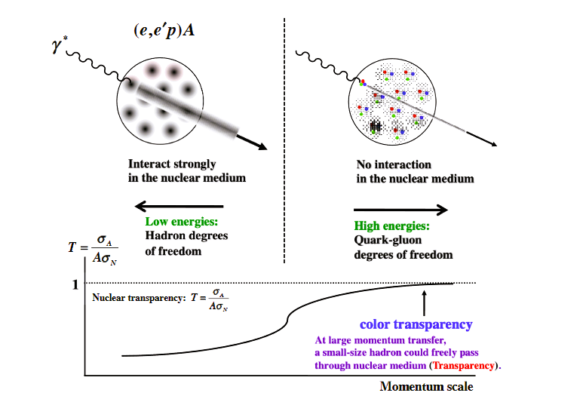
Introduction: Nuclear Transparency
Nuclear Transparency is an observable to search for CT
Nuclear Transparency is defined as the ratio of the cross section per nucleon for a process in the nucleus to that of a free nucleon.
The onset of CT would involve the rise in the nuclear transparency as a function of energy.
The onset of CT indicates the transition from nucleon-meson(low energies) picture to quark-gluon picture (high energies)
Kumano, S. Physics,4,565-577(2022)
$Nuclear Transparency=TA=\frac{σA}{AσN}$
$$(nuclear cross section)$$
.
($free cross section of nucleon)$
Notes:
The onset of color transparency can be observed by measuring the nuclear transparency T. Here, σA and σN are nuclear and nucleon cross sections, respectively, and A is the mass number of the nucleus The (e,e′p)A reaction is illustrated in Figure together with the expectation on the nuclear transparency. At low energies, hadrons interact strongly with nucleons in the nucleus, so that the nuclear transparency is small. As the energy increases, it becomes larger, and T should become one in the high-energy limit according to the color transparency. Typically T is less than 1. In traditional nuclear physics T is independent of energy and four momentum transfer squared on the other hand qcd pedicts a rise in nuclear transparency till it reaches 1.

Slide 5
Previous experiments
CT is well established at high energies.
Baryons:
A(p,2p): BNL
A(e,e’ p): SLAC, JLAB
Study of CT at JLab:
E94139 : Quasi_elastic A(e,e’,p) electron scattering on nuclei
E94104 : Pion photoproduction in Hall A
E01107 : Pion electroproduction in Hall A
E02110 : Rho0 meson electroproduction in Hall B
E1206107: Quasi elastic A(e,e’,p) electron scattering on nuclei
☹
Mesons
A( п, di_jet): FNAL
A(ɣ, п⁻p):Jlab
A(e, eп⁺):Jlab
A(e, e⍴⁰):DESY & JLab
☺
Onset on CT has been measured in Mesons but not in Baryons
Notes:
There has been a tremendous amount of experimental effort devoted to finding the onset of color transparency (CT). Although CT is well-established at high energies, the onset of CT is interesting because we are looking for the transition from the nucleon meson to quark-gluon picture. The first set of searches looked for CT in protons. These experiments were carried out at BNL and SLAC and were later explored with higher precision at JLab. However, no sign of the onset of CT was found in protons. At the same time, efforts to look for CT in mesons succeeded in finding the onset of CT. Here is a list of experiments that has been conducted over last decade in Jlab which includes high precision experiments to search for CT in protons, and photo production of mesons,followed by several electoproduction of mesons which found the onset of CT.

Slide 6
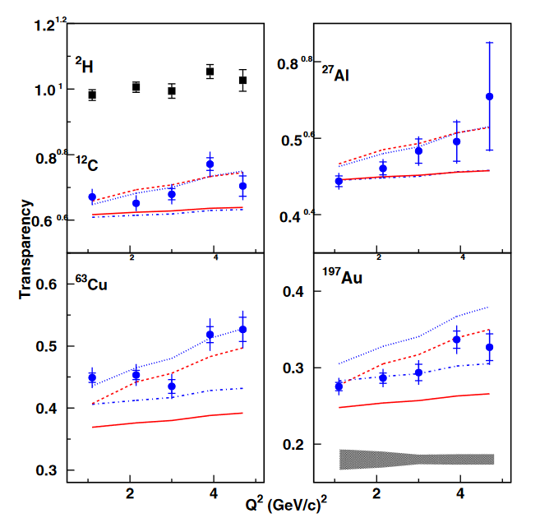
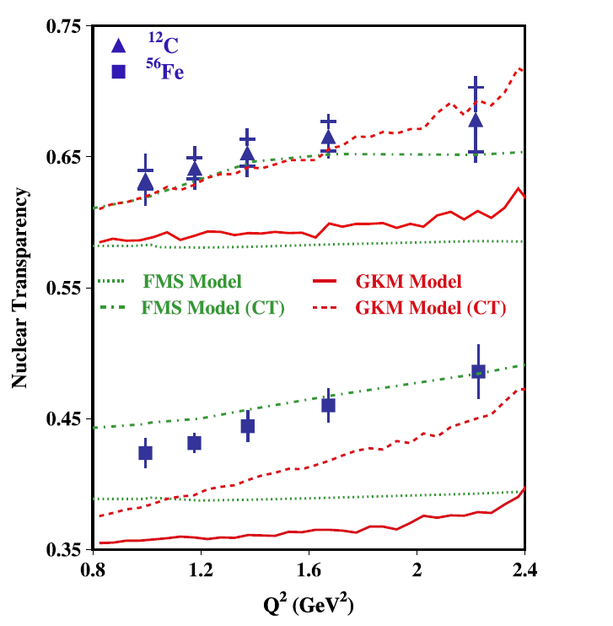
Previous experiments at JLab
Quasielastic C(e,e’,p) scattering didn’t find CT in baryons
Quasielastic C(e,e’,p) scattering didn’t find CT in baryons
Pion and Rho electroproduction found onset of CT in mesons
D. Bhetuwal et al., Phys. Rev. Lett.126, 082301(2021).
B. Clasie et al., Phys. Rev. Lett. 99, 242502(2007)
L. El Fassi et al. (CLAS), Phys. Lett. B712, 326(2012)
Notes:
here are some of those result’s from the experiment at Jlab. Using the quasi elastic knockout of proton from Carbon it has been shown that there is no on set of CT upto momentum transfer square of 14 Gev 2.
At the same time electroproduction of pion and rho meson show the onset of CT at relativitaly low momentum transfer squared of 1 Gev2. This a very puzzling situation.

Slide 7
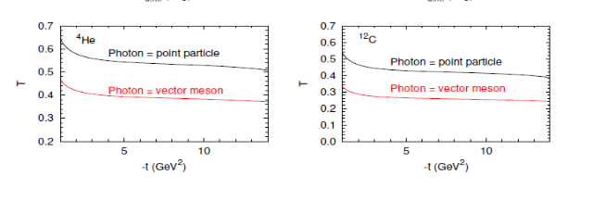
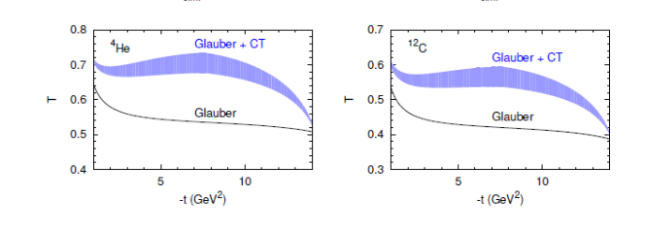
Previous experiments at JLab and theoretical study
Pion photoproduction didn’t find clear signature for onset of CT(uncertainty was too large)
More data are required for photoproduction from nuclei.
An experiment was conducted in Hall D with additional reaction channel and an extended |t| range, including more nuclei to address this need.
D. Dutta et al., Phys. Rev. C 68, 064603(2003)
A. B. Larionov et al. Phys. Lett. B760, 753(2016)
Notes:
And here is a results from photoproduction on He4 using pinus channel in the photon energy range of 1.6-4.5 GeV at theta cm = 70 and 90 degree where the evidence for onset of CT is not as clear because of the large uncertainties in the experiments. This was the first measure of nuclear transparency using photoproduction. The interpretation of CT phenomenon depends heavily on the experimental data which are either sparse or subject to large uncertainties. However ,it is clear that more data is needed to improve the situation. This is why a new experiment was conducted in Hall D using 12 GeV electron beam to precisely measure the on set of CT in photoproduction from nuclei.
Many detailed aspects of the nature of the photonuclear interaction are still largely unknown. At
low momentum transfers, the photon is usually treated as superposition of hadronic (vector-meson)
states while, at higher momentum transfers, it is treated as a point-like particle
The transition between the two regimes is expected to occur at relatively moderate values of momentum transfer of a few GeV2, but has never been mapped. The experimental discovery of this transition will help clarify the different interaction mechanisms of photonuclear reactions, the origin of constituent quark counting rules, and more. The top two plot shows the Calculated transparency for pion photo-
production reaction off a neutron (γn → π−p) in 4He and 12C as a function of momentum transfer
. The different lines correspond to calculations describing the photon interaction as
a superposition of vector mesons (red) and as a point-like particle (black), In addition, there have been several predictions of a large impact of the CT effect in photoproductions reactions at large |t|. The primary motivation of the hall D experiment was to probe a large range in |t| in photoproduction from he4 and carbon using the high energy tagged photon beam

Slide 8
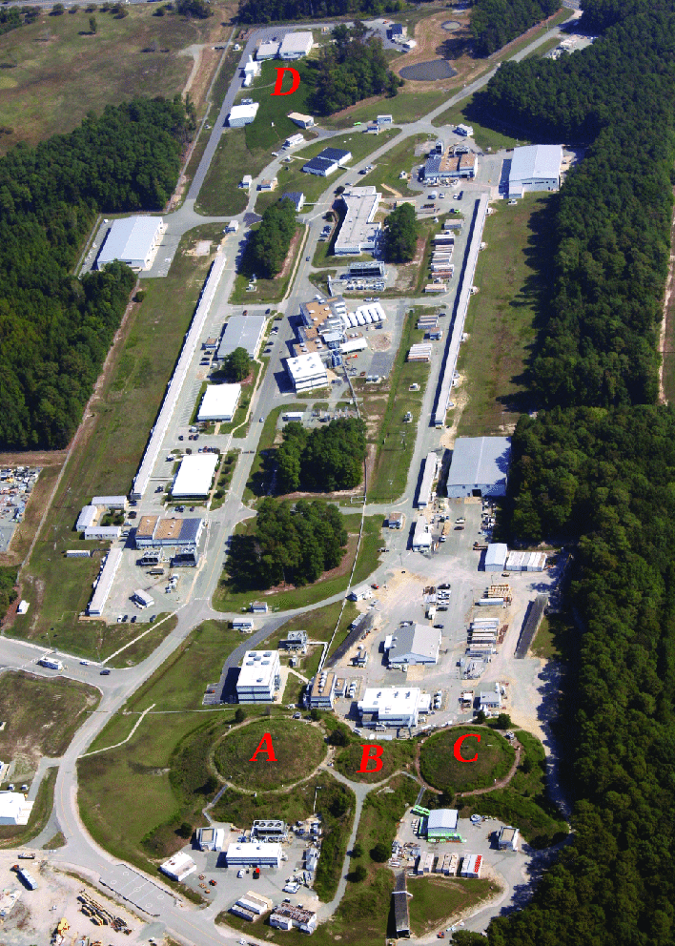
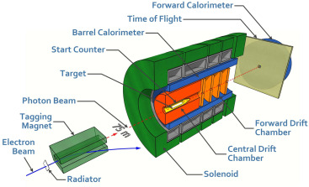
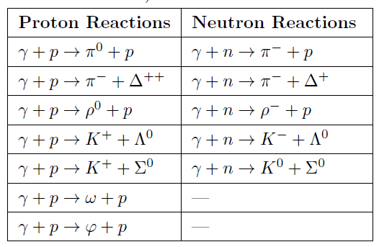
Jefferson Lab Hall D
The experiment was conducted in Nov-Dec 2021 in Hall D of Jefferson Lab.
Used photon beam on deuterium, helium, and carbon targets.
Primary objectives are to study short-range correlations, color transparency at large momentum transfers, and the bound structure of nucleus
S. Adhikari, et al. Nucl.Instrum.Meth.A 987,164807(2021)
Notes:
The GlueX experiment studies the photoproduction processes of light mesons and baryons, to understand the nature of QCD. The experiment is located in Hall-D at Jefferson Lab in Newport News, VA, using the electron beam delivered by the Continuous Electron Beam Accelerator Facility of JLab. It provides continuous wave electron beams with energy up to 12 GeV. The GlueX detector is designed as a fixed target particle experiment. The schematic diagram of gluex detector is shown in the figure . The GlueX detector is composed of target in the center, surrounded by a superconducting solenoid magnet, electromagnetic calorimeters, and drift chambers for charged particle detection.
Hall D includes large acceptance detector for charge and neutral particle. Another big advantage of hall D is that it allow the study of a large number of hard exclusive reaction channel listed in table simultaneously. Here are the list of possible exclusive reactions off proton and neutron that are within the capability of the GlueX detector. and we intend to study nuclear transparency using many of these channels but my dissertation project is to study nuclear transparency of rho0 photoproduction from helium and carbon.

Slide 9
Event Selection: Rho0 meson
Selection Criteria | Range
Confidence level of fit | > 0.001
Beam Energy | 6.5 < Eɣ < 10.8 GeV
Extra tracks | 0
Numbers of Shower | 5
Proton Vertex | [52,78] cm
Missing Momentum | <300 MeV/c
|t| | >1
Polar angles of Proton >20
п⁺
⍴⁰
п⁻
ɣ
p
p
A
X
$ɣA$ $→п$⁺ $п$⁻pX
Kinematic fit constraint enforce on conservation of four momentum and energy.
Constraint on vertex: Decaying pions originates from same point in space.
four beam bunches on each side of the primary bunch.
Table: Summary of event selection cuts
Notes:
On this slide, we present the event selection criteria we used to identify rho0 mesons To select these events, we applied a series of selections cuts to our data in order to filter out background events and select only those events that are likely to contain a rho0 meson. Specifically, we required that the four-momentum and vertex of the pi+pi- pair were kinematically fitted, Additionally, we subtracted accidental photon events,. By applying these cuts, we were able to isolate a sample of events that are likely to contain rho0 mesons. Overall, the event selection process is critical for ensuring that our data is of high quality and free from background events

Slide 10
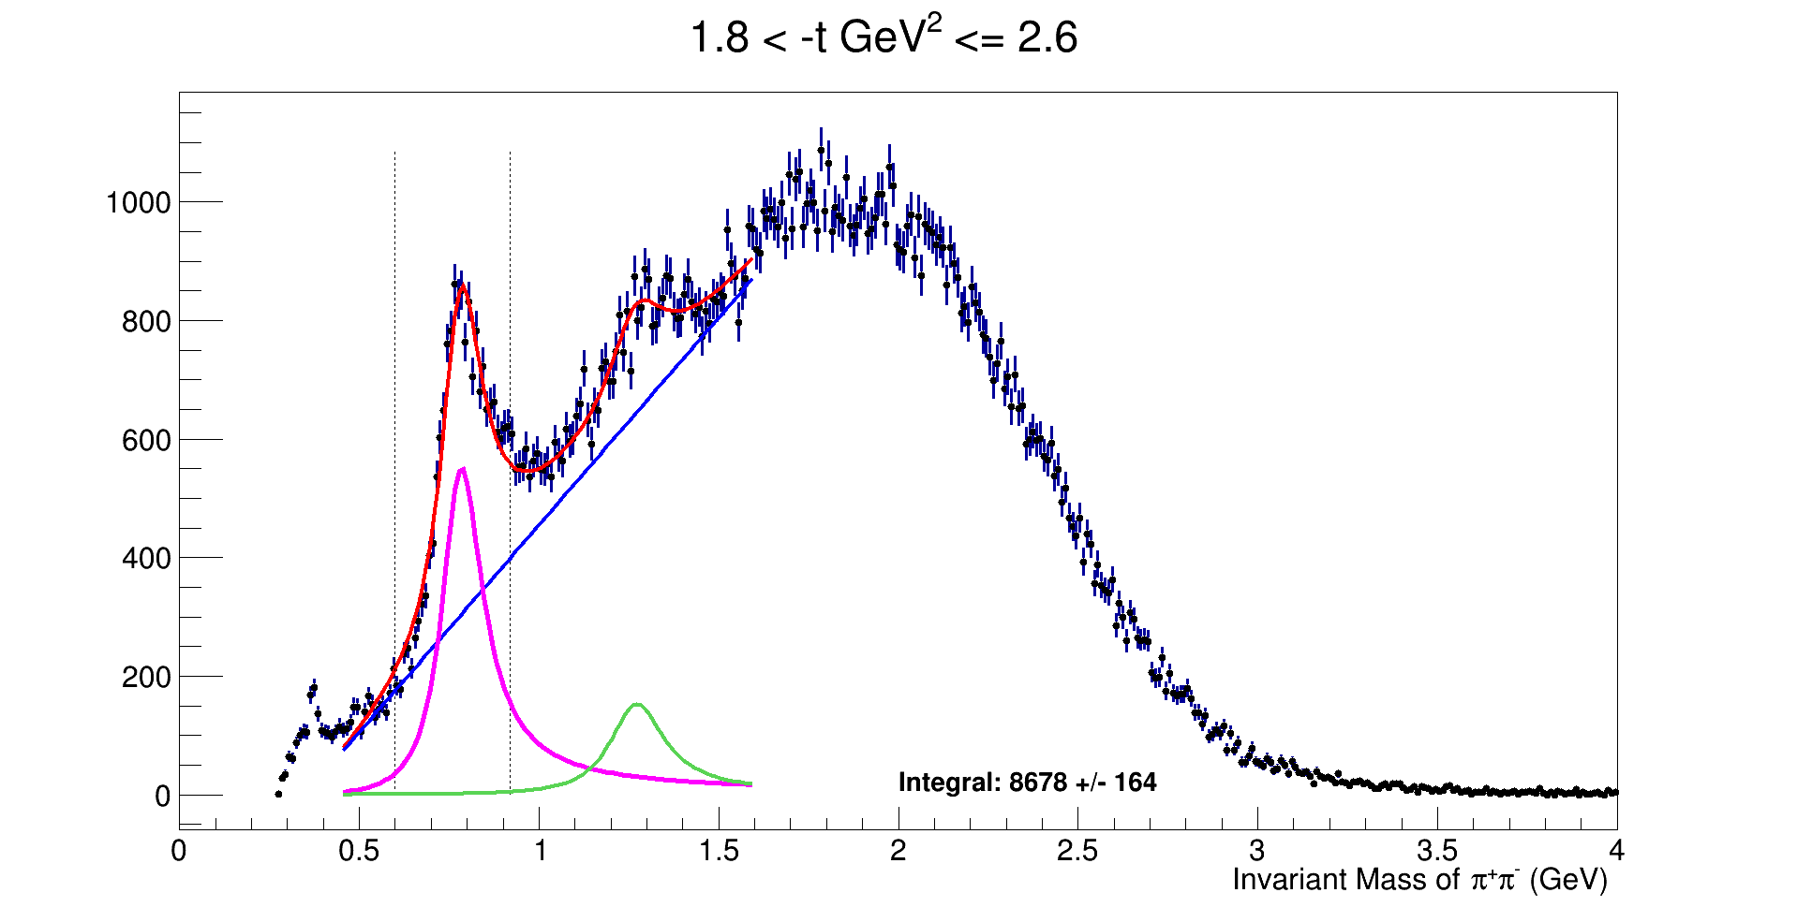
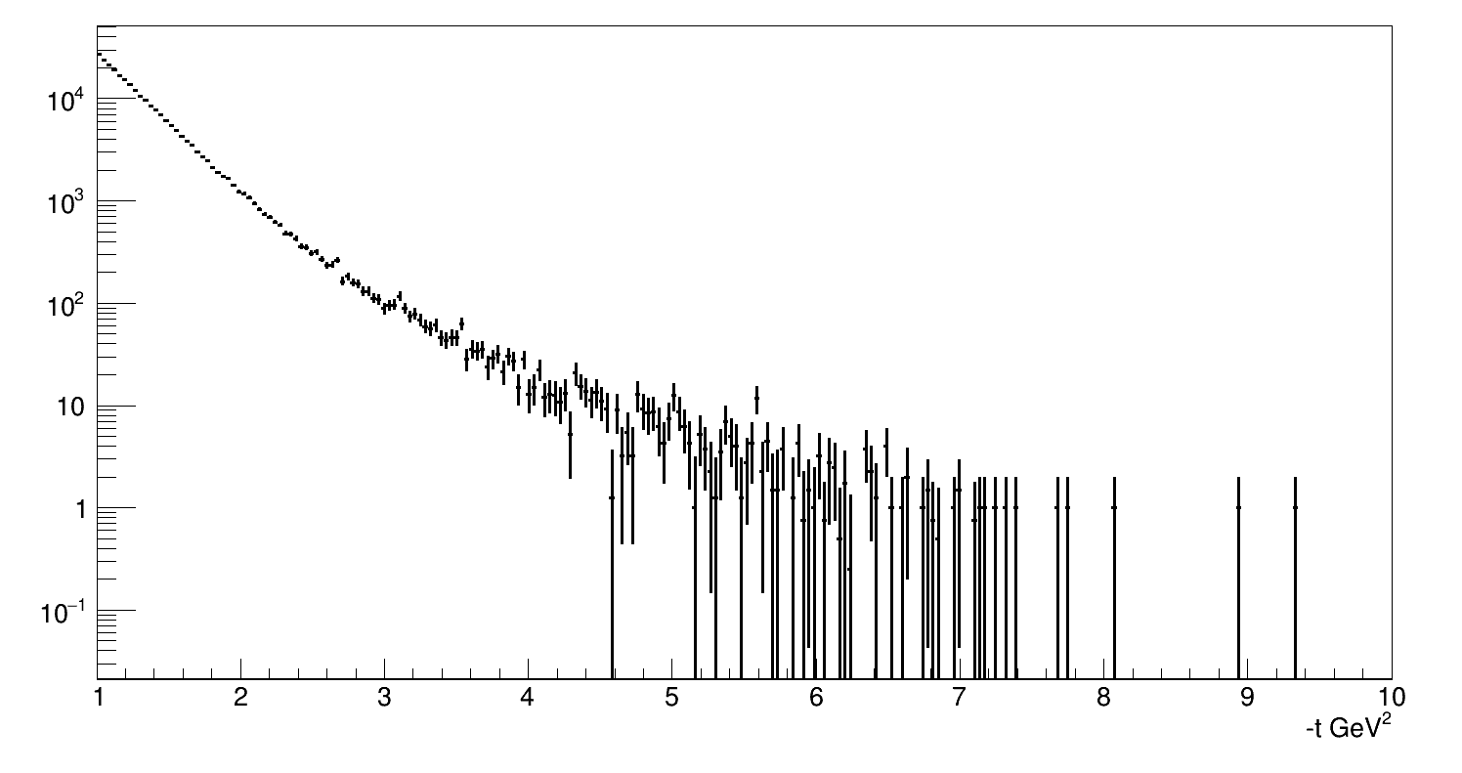
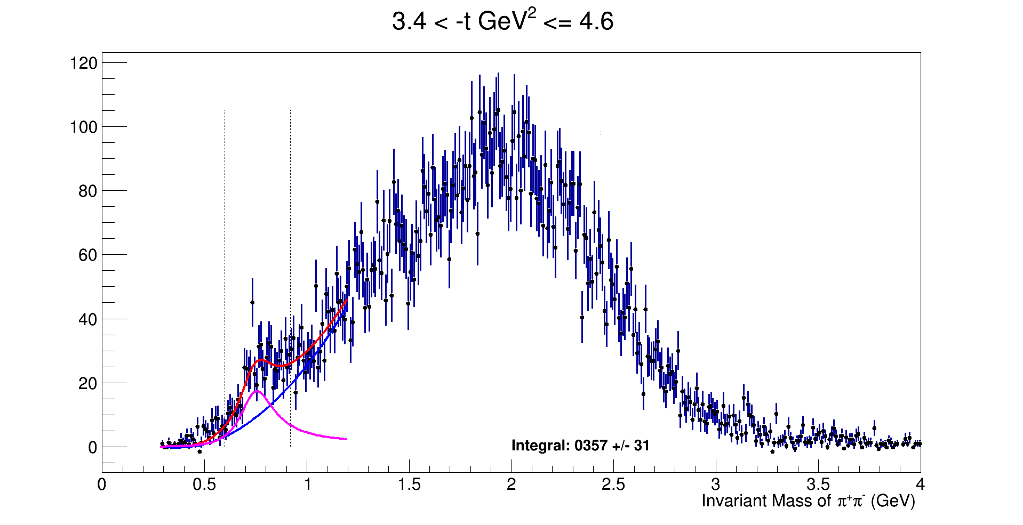
Results: Mandelstam variable and Invariant mass of Rho0 meson
Mandelstan variable |t| in Deuterium
|t| (GeV/C)²
M_{Rho} = 0.775 GeV/c²
Relativistic Breit–Wigner and 2nd order polynomial combination in fitting invariant mass (п⁺ п⁻)

Slide 11
Efficiency
Efficiency
Efficiency for deuterium is slightly higher than those for helium and carbon.
For 1.0 < |-t| GeV² ≤1.2 efficiency is approximately 33%.
For 3.4 < |-t| GeV² ≤4.6 efficiency is approximately 10%.
Tagged Luminosity (pb⁻¹.nucleon
²D: 33.98
⁴He: 63.80
¹²C: 97.93
|- t| GeV²
Plot: A plot of efficiency vs momentum distribution |-t| GeV²
Notes:
The efficiencies, are reaction-dependent as shown in Fig. as distinct
reaction topologies require varied momentum and angular distributions, resulting in
contributions from different detector systems with diverse reconstruction efficiencies
of particle tracks and showers.

Slide 12
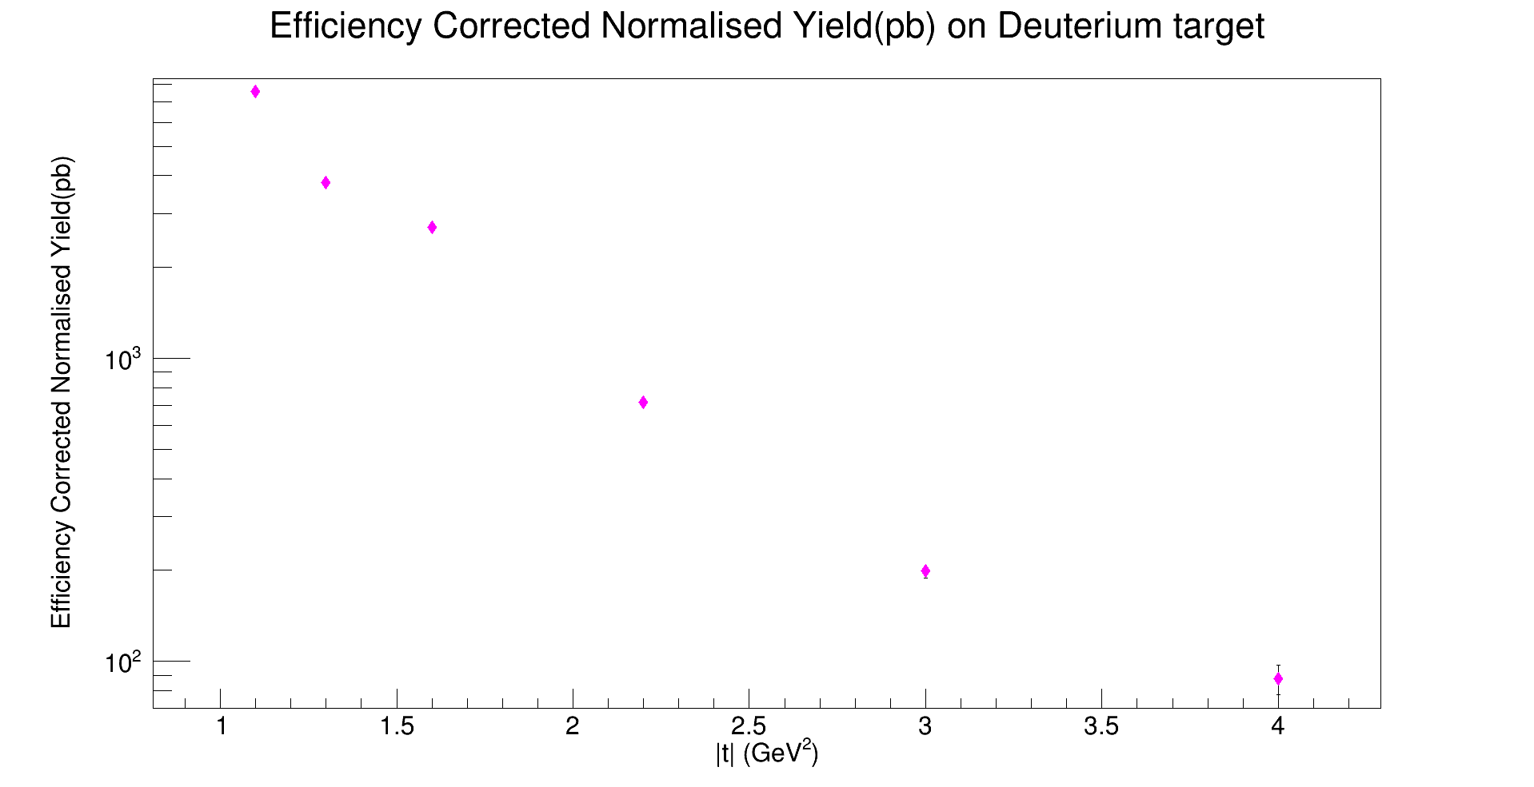
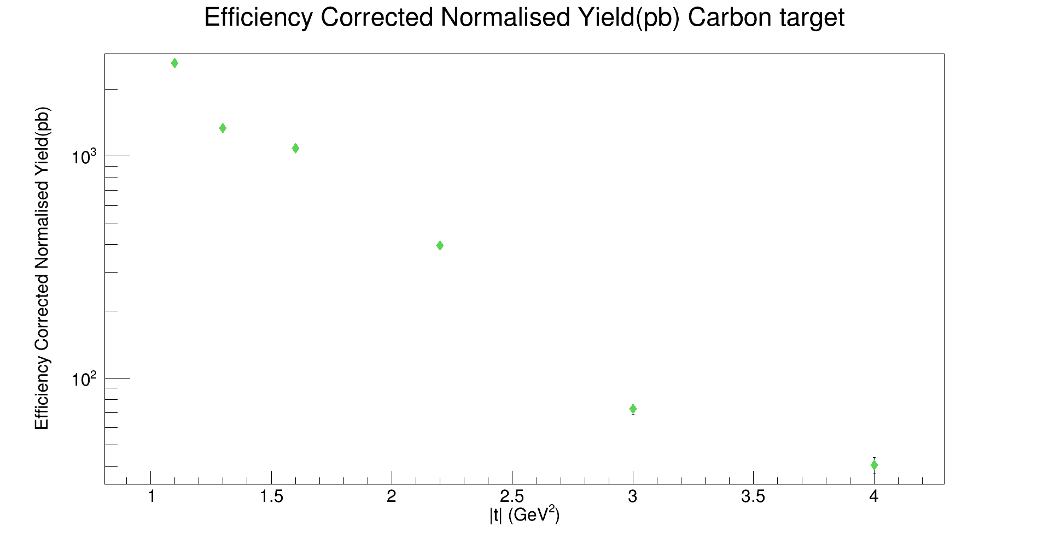
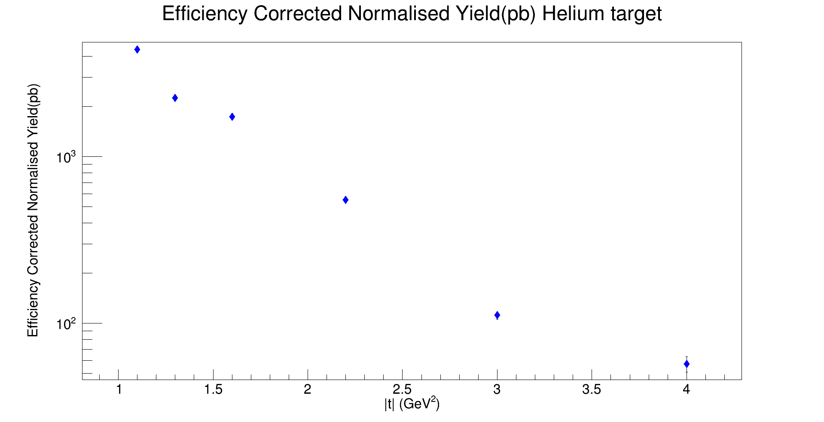
Preliminary Absolute Cross Section
Uncertainties in cross section were solely based on data yields.
Rigorous study of the background.
Efficiency Corrected Normalised Yield (pb)
|- t| GeV²
|- t| GeV²
Plot: Cross section for ⍴⁰ →п⁺п⁻for Deuterium, Helium and Carbon.
|- t| GeV²
Notes:
we summarize our total cross section measurements. These figure presents a summary of total cross section measurements as a function of momentum transfetr |t| for the photoproduced rho0 mesons. The magenta points represent the data for deuterium, blue point represents the data for helium and the green points represents the data point for carbon. The data points exihibits exponential tails at higher momentum transfers . Here the reaction mechanism is with lower acceptance.

Slide 13
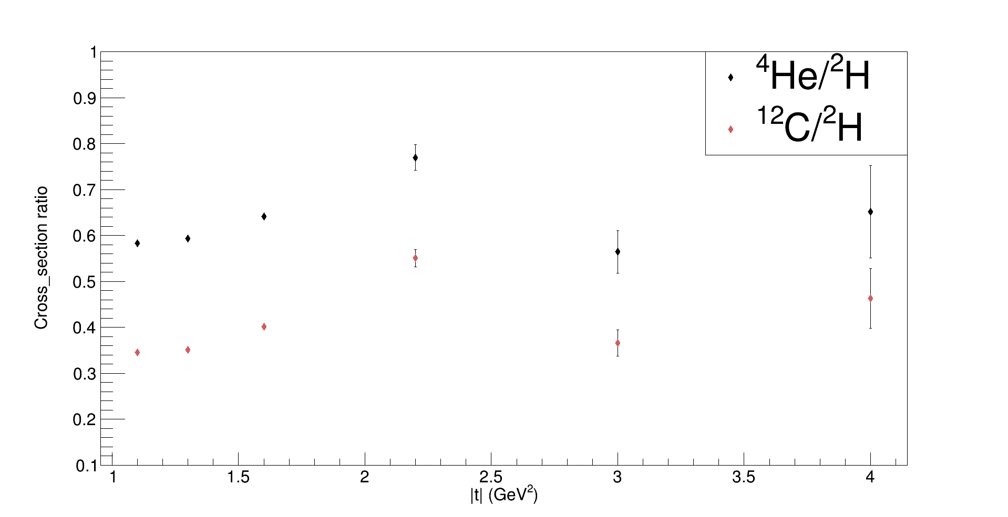
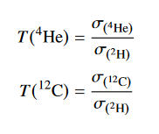
Preliminary Nuclear Transparency
Cross Section Ratio
Only preliminary statistics uncertainty from data yield is shown.
|- t| GeV²
Plot: Nuclear Transparency as a function of momentum transfer.
Notes:
we present the computed ratio of the measured total cross sections between helium and deuterium targets as well as carbon and deuterium targets

Slide 14
Future works
Study the background of data by using the background model simulation from GlueX.
Work on systematic uncertainties associated with the cross-section ratio.
To extract photon transparency to look for the transition of photon vector meson to that of point like configuration.
Study the onset of CT by comparing against theoretical calculations.
Notes:
Moving forward, our research team has several important objectives that we plan to achieve in the coming months. Firstly, we will be conducting Monte Carlo studies to better understand detector acceptance and efficiency. Secondly, we will be measuring the cross section in bins of |t| for three different target particles: D, He4, and C12. Lastly, we will be calculating the Nuclear Transparency of He4/D and C/D. We are optimistic that we will be able to achieve these objectives within the timeframe of our project, and we expect to have preliminary results by the end of the year. We are excited to share our findings with the particle physics community, and we look forward to continuing our research in this exciting area.

Slide 15
Acknowledgements
Dipangkar Dutta, Anatoli Afanasjev, Ben Crider, Jeff Winger, Holly Szumila-Vance
Jackson Pybus, Tim Kolar, Phoebe Sharp, Bo Yu, Or Hen, Eli Piasetzky, Nathaly Santiesteban, Axel Schmidt, Alexander Somov, Yotam Soreq
Shankar Adhikari , Alexander Austregesilo, Carlos Ayerbe Gayoso, Rebecca Barsotti, Vladimir Berdnikov, Hem Bhatt, Deepak Bhetuwal, Timothy Black, Duane Byer, Eugene Chudakov, Phil Cole, Olga Cortes Becerra, Mark-Macrae Dalton, Alexandre Deur, Rupesh Dotel, Hovanes Egiyan, Sergey Furletov, Liping Gan, Tyler Hague, Douglas Higinbotham, Mark Ito, Igal Jaegle, Torri Jeske, Abishek Karki, Bishnu Karki, Mariana Khachatryan, Tim Kolar, Daniel Lersch, Dave Mack, Hrachya Marukyan, Michael McCracken, Keigo Mizutani, Carmel Neuburger, Dien Nguyen, Afroditi Papadopoulou, Zisis Papandreou, Peter Pauli, Lubomir Pentchev, Hang Qi, Sara Ratliff, Susan Schadmand, Erin Seroka, Andrew Smith, Elton Smith, Igor Strakovski, Karthik Suresh, Simon Taylor, Wenliang Wenliang, Benedikt Zihlmann, Seans Dobbs
Work Supported by DOE office of science U.S. DOE Grant Number: DE-FG02-07ER41528
SRC/CT Collaboration

Slide 16
THANK YOU !

Slide 17
Cross Section Calculation
$$Luminosity=flux ∗Target Length∗Number Density$$
Table :Tagged flux and luminosity for each target, with beam photons having energies between 6.5 and 10.8 GeV
$Number Density$ =
Source: Hao Li’s Dissertation (Glue X)
Notes:
The total cross section provides an absolute measure of the probability for the reaction
to occur at a specific momentum transfer. In this measurement our data allow us to determine the cross section within the momentum transfert t from 1.1 t0 4.6 GeV2. The total cross section is defined as:
σ = Nsignal… where Nsignal is the number of observed signal events, B is the branching ratio if any
decay mode is specified, and e is the global acceptance, which accounts for the loss
of signal events due to inefficiency of the detection method. In addition, L is the
integrated luminosity, which is a measure of the possible occurrence of reactions
based on the flux of photons incident on the target with specific density and length. The proton number density in the target, ρN :represents the number of protons per unit volume. For convenience, it was
computed in units of photons/(barns·cm):

Slide 18
Detector’s Resolution
Charged particle momentum::1-3%.
Forward high momentum particle:8-9%.
Proton.P() <250 MeV are not detected.
Pions reconstruction:: challenging for momenta<200 MeV
Looking the energy deposited at CDC :: proton and pions can be separated up to energies of ~800 MeV.
TOF can separate pions and kaon up to energies ~2GeV.
Fcal can detect photons for E_{ɣ} > 100 MeV.
Energy is lost in calorimeter due to 11⁰ gap between calorimeters.

