Slide 1


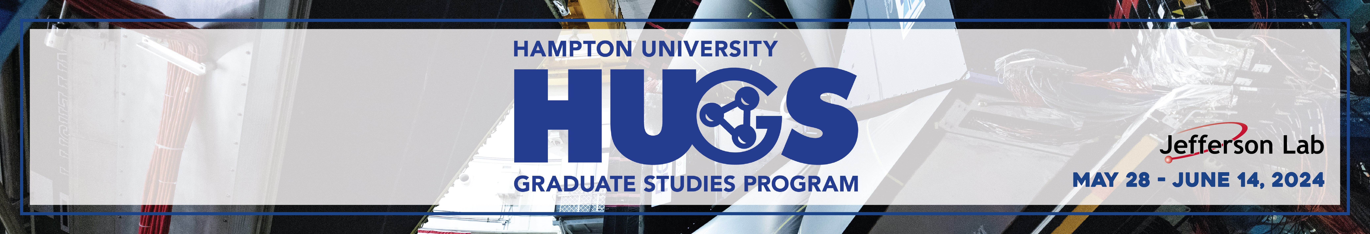

Towards $γ^{∗}γ^{∗}→ππ$ on the Lattice
Intermediate results on the $O(3)$ nonlinear sigma model
Iván Mauricio Burbano Aldana (supervised by Raúl A. Briceño and Christian W. Bauer)

Slide 2
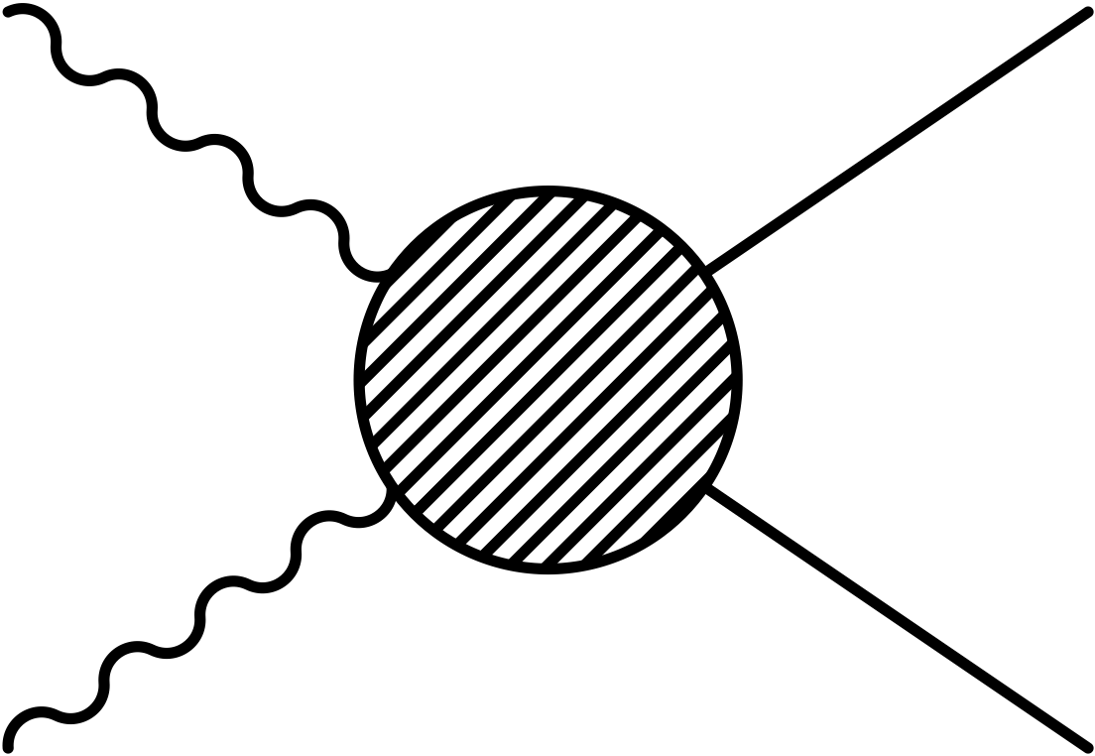

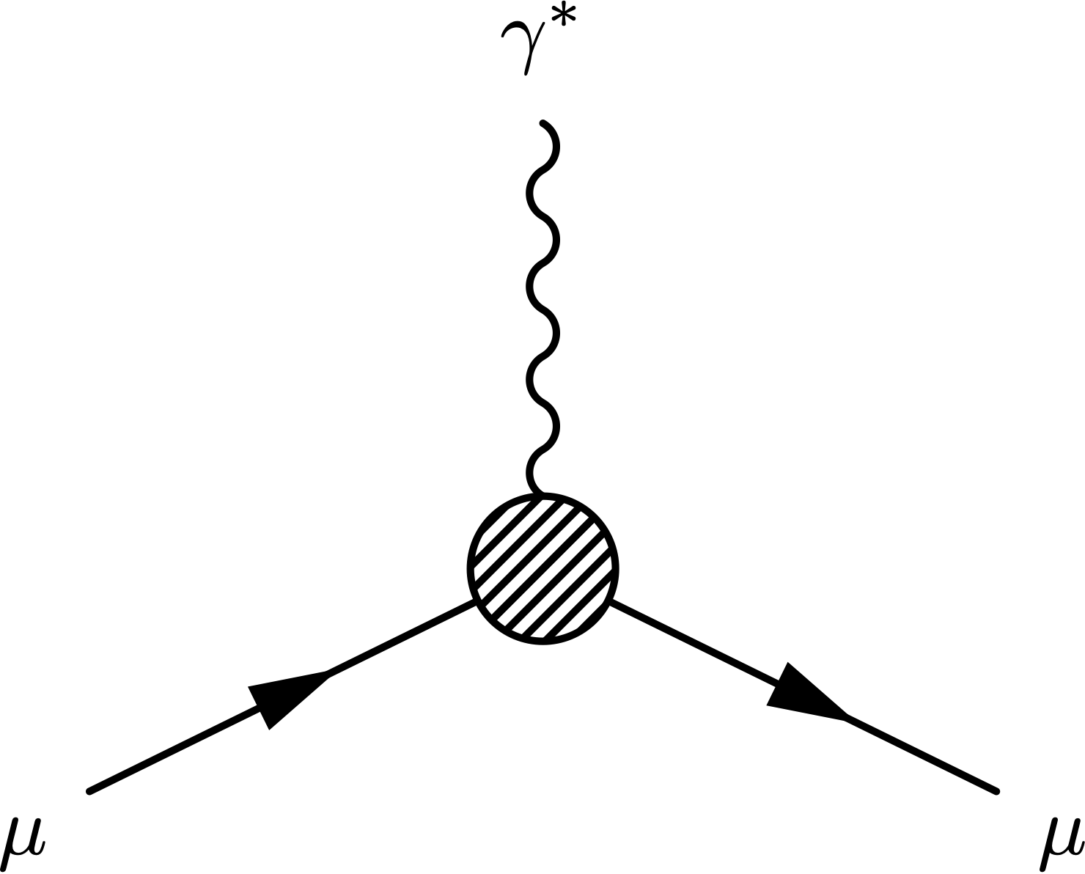
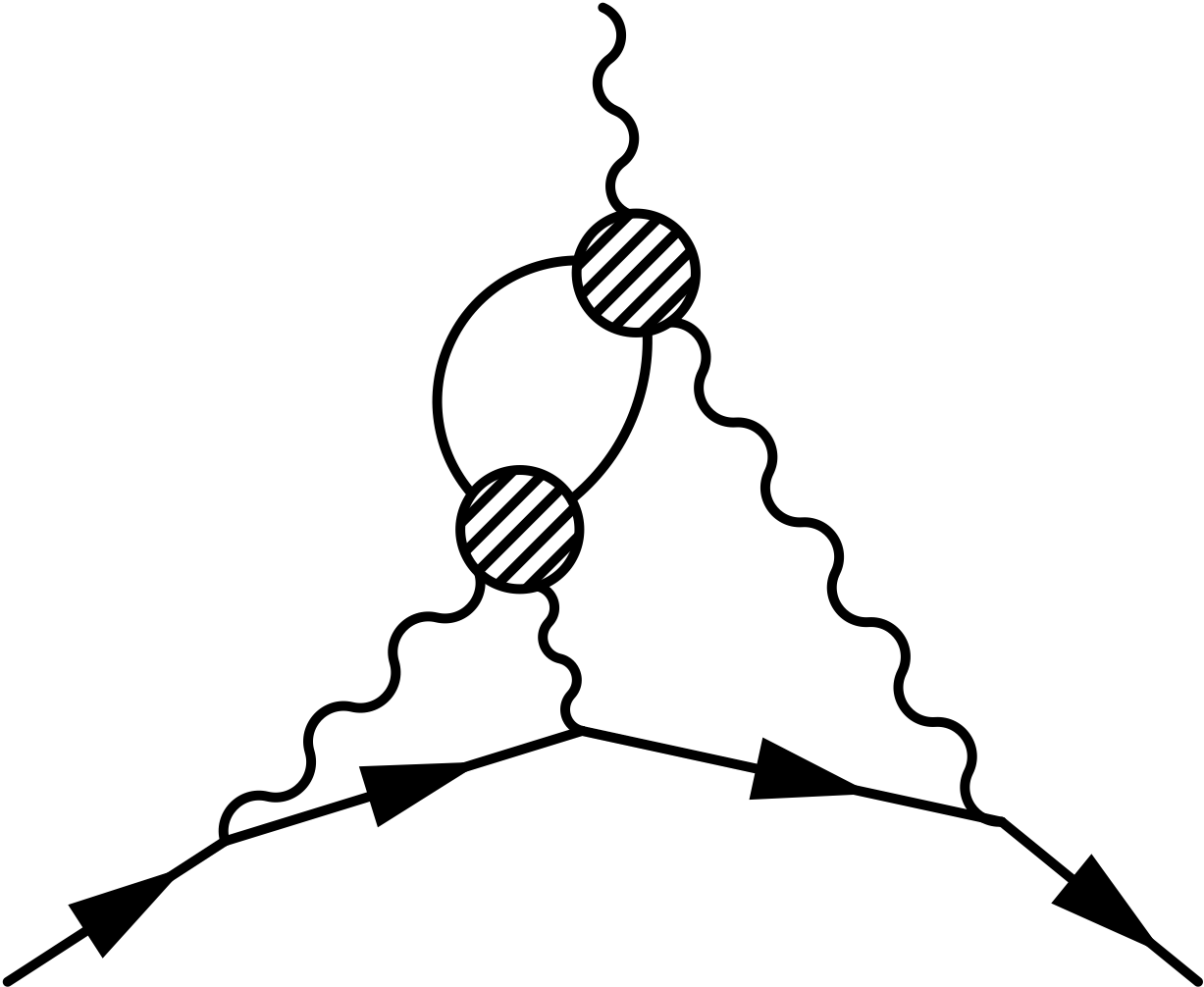
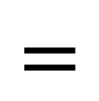


Where’s $γ^{∗}γ^{∗}→ππ$?
$$=$$
Muon $g−2$
$$⊇$$

Slide 3
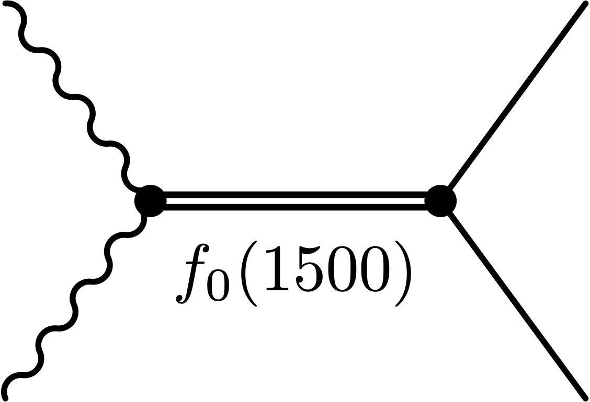

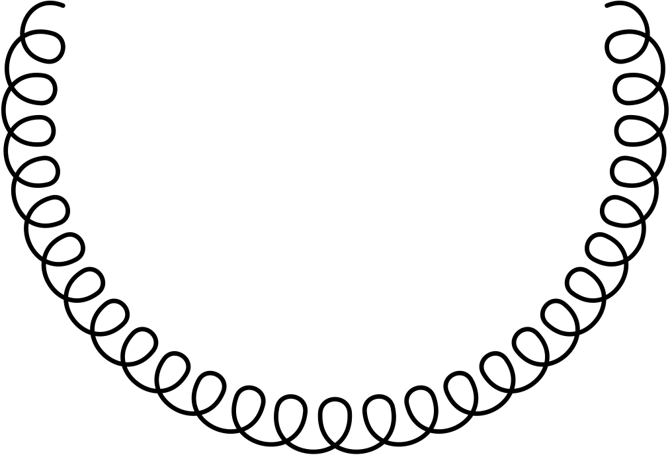
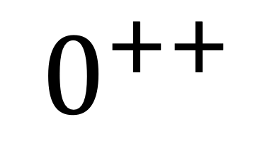

Where’s $γ^{∗}γ^{∗}→ππ$?
$$=$$
Glueball candidate form factors:
$$0^{++}$$
$$∼$$
?
Amsler, Claude and Close, Frank. “Is $f_0(1500)$ a Scalar Glueball?” Physical Review D 53, no. 1 (January 1, 1996): 295–311. https://doi.org/10.1103/PhysRevD.53.295.

Slide 4
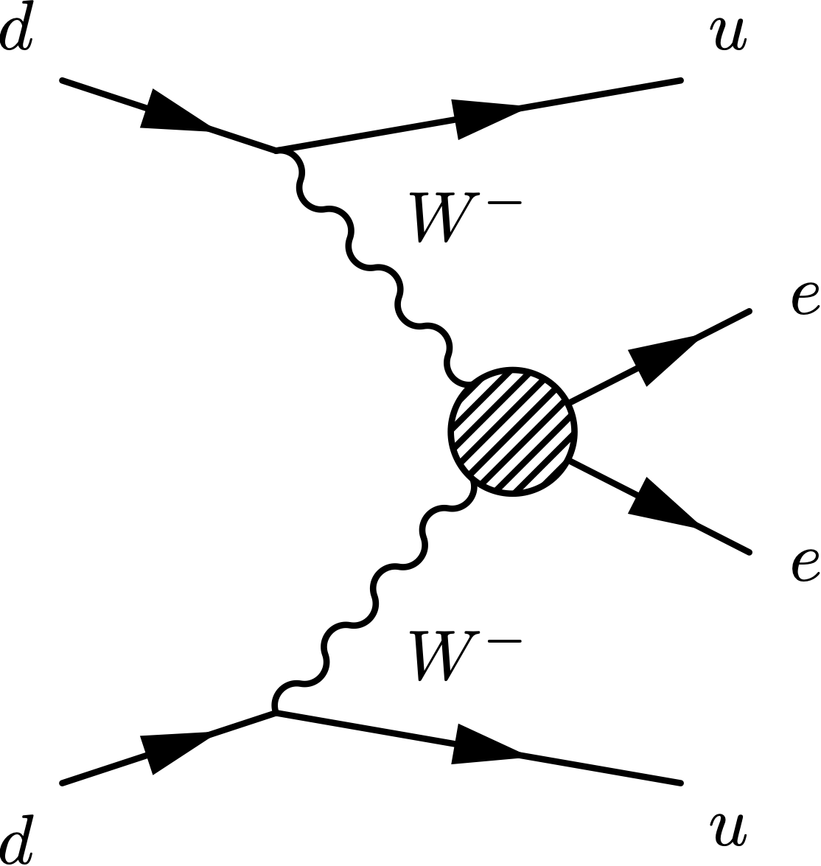
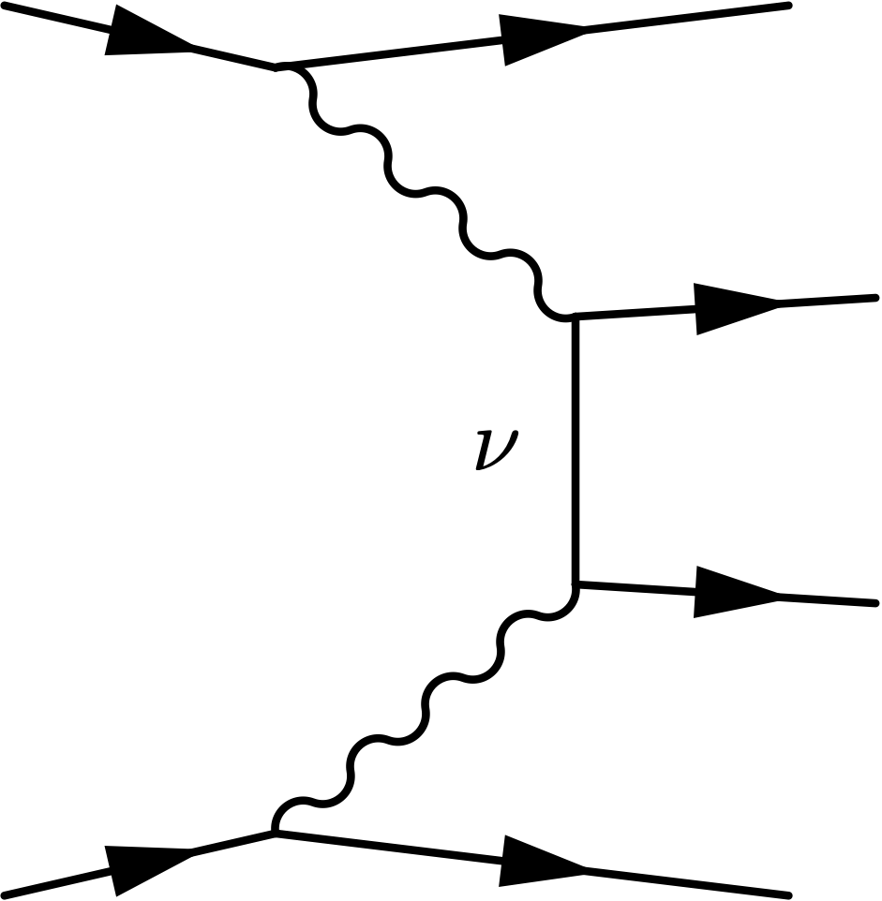

Where’s $γ^{∗}γ^{∗}→ππ$?
$$=$$
Stepping Stone Towards Beyond Standard Model
Neutrinoless double beta decay
$$∼$$

Slide 5
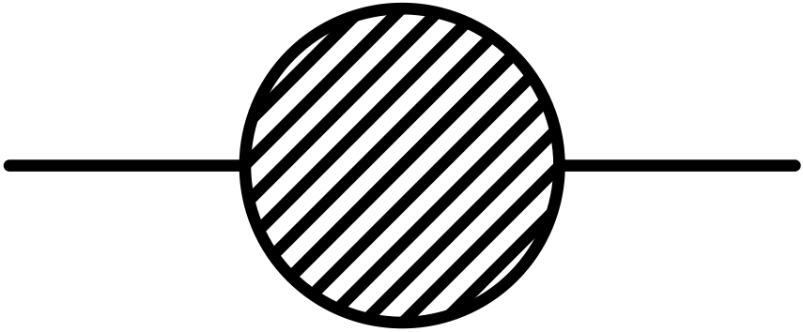
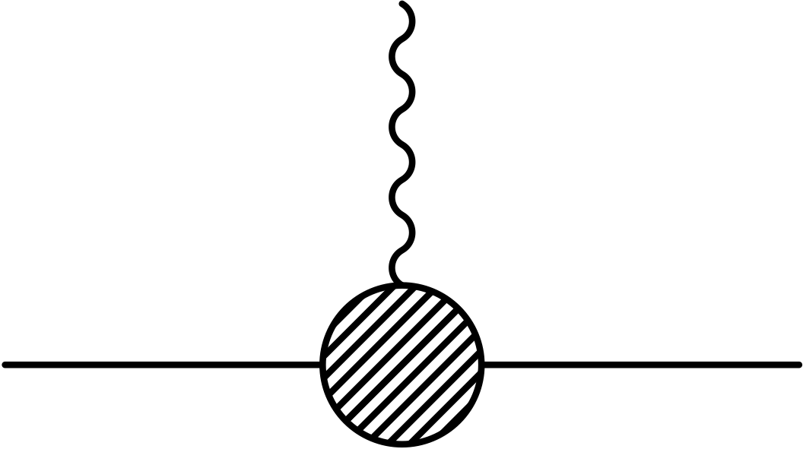
Outline

Slide 6
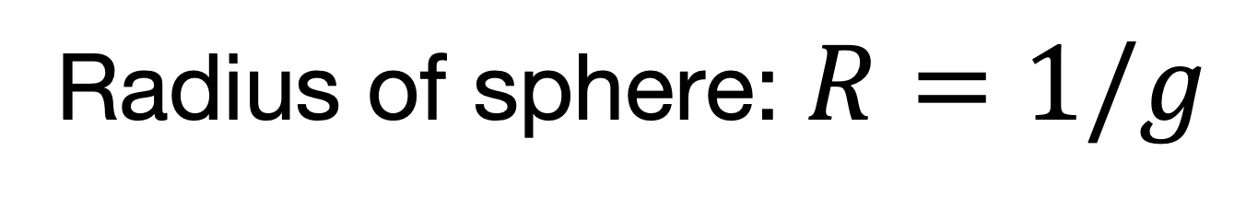
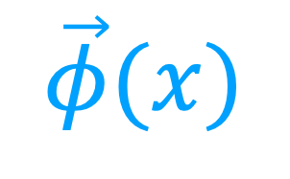
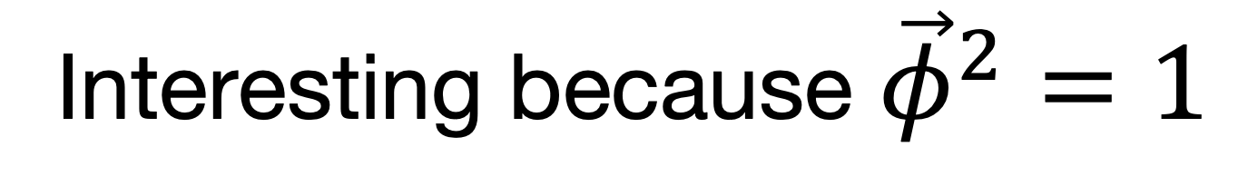
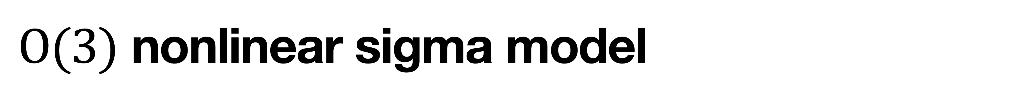
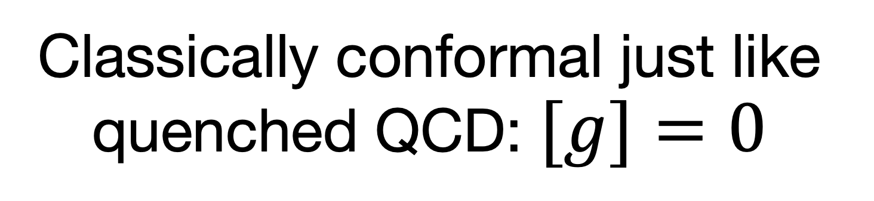
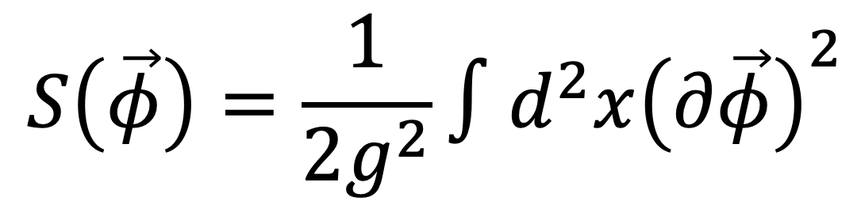
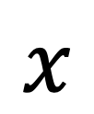

$O(3)$ nonlinear sigma model
Classically conformal just like quenched QCD: $[g]=0$
$$\vec{φ}(x)$$
Time
$$x$$
$$S\left(\vec{φ}\right)=\frac{1}{2g^{2}}∫d^{2}x{\left(∂\vec{φ}\right)}^{2}$$
Interesting because ${\vec{φ}}^{2}=1$
Radius of sphere: $R=1/g$
Space

Slide 7
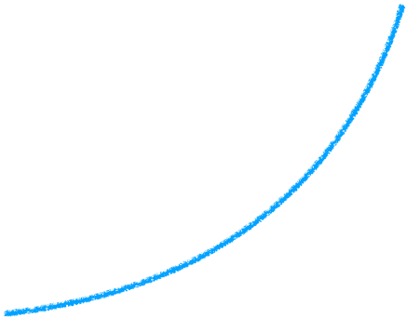
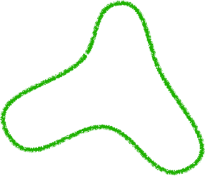
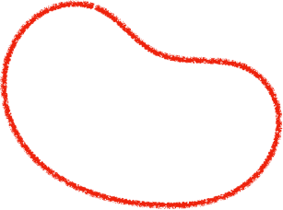
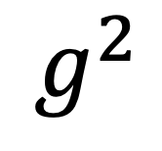
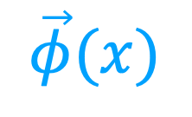
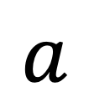
Asymptotic Freedom
A connection to strings
$$\vec{φ}(x)$$
Lower energies
$$g^{2}$$
distance
$$a$$

Slide 8
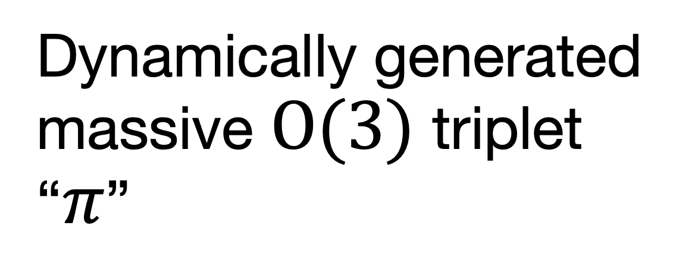
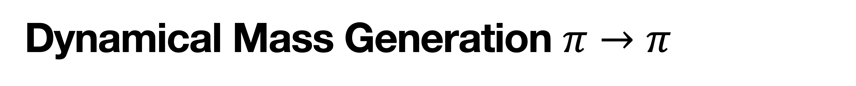
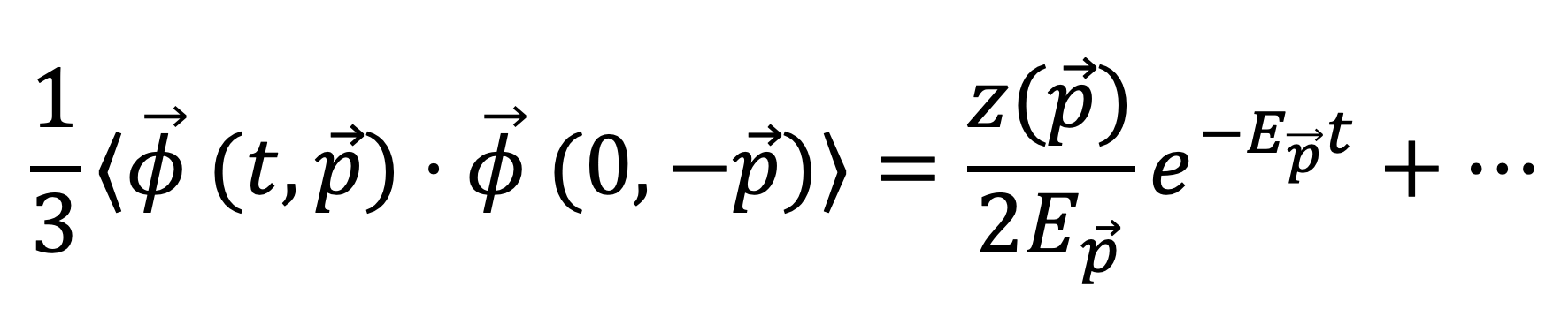
Dynamical Mass Generation $π→π$
$$\frac{1}{3}⟨\vec{φ} (t,\vec{p})⋅\vec{φ} (0,−\vec{p})⟩=\frac{z(\vec{p})}{2E_{\vec{p}}}e^{−E_{\vec{p}}t}+⋯$$
Two massless Goldstone bosons
Dynamically generated massive $O(3)$ triplet “$π$”

Slide 9
Dispersion Relation
Relativistic!

Slide 10
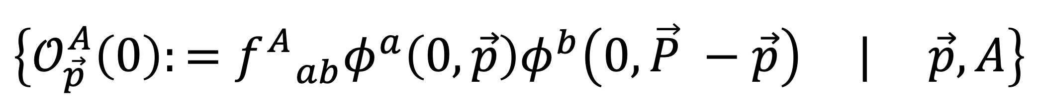
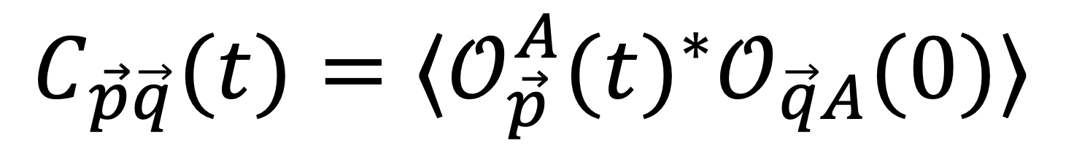

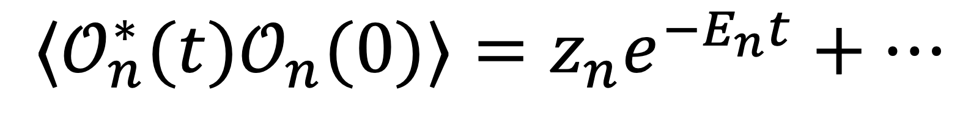
Where’s $ππ$?
Total momentum $\vec{P}$ and in a definite $O(3)$ representation $f_{ ab}^{A}$
$$\left\{𝒪_{\vec{p}}^{A}\left(0\right):=f_{ ab}^{A}φ^{a}\left(0,\vec{p}\right)φ^{b}\left(0,\vec{P} −\vec{p}\right) | \vec{p},A\right\}$$
Which linear combination $𝒪_{n}$ of these generates two particle energy eigenstates?
$$⟨𝒪_{n}^{∗}(t)𝒪_{n}(0)⟩=z_{n}e^{−E_{n}t}+⋯$$
Answer: Generalized Eigenvalue Problem!
$$C_{\vec{p}\vec{q}}(t)=⟨𝒪_{\vec{p}}^{A}(t)^{∗}𝒪_{\vec{q}A}(0)⟩$$

Slide 11
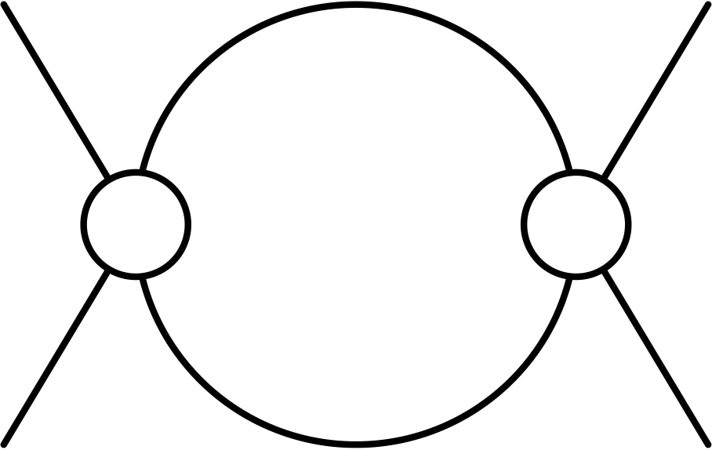

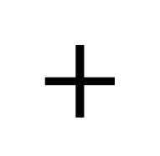
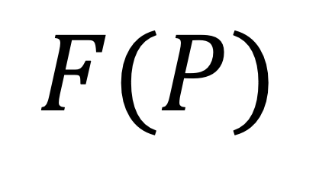
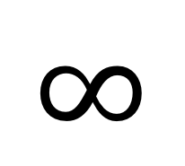
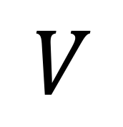
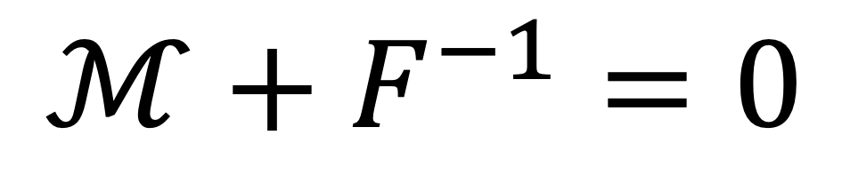
Finite Volume Formalism
On a finite volume there are no asymptotic states!
$$=$$
$$∞$$
$$+$$
$$F(P)$$
$$V$$
Relation between the finite volume energies and the scattering amplitude $ℳ$
$$ℳ+F^{−1}=0$$

Slide 12

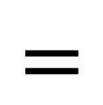
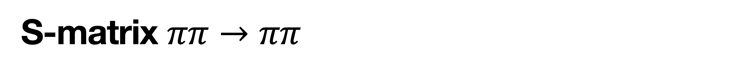
S-matrix $ππ→ππ$
$$=$$

Slide 13
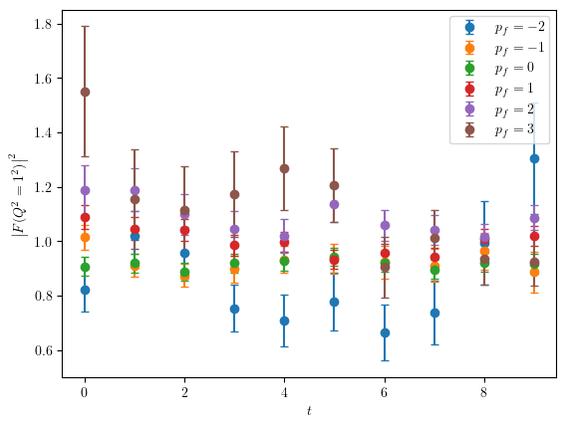

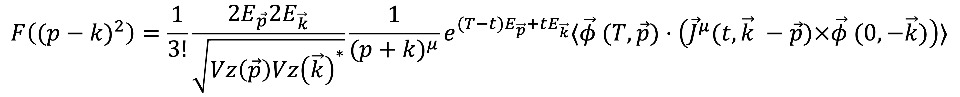
Spatial Form Factor $πγ^{∗}→π$
$$F\left((p−k)^{2}\right)=\frac{1}{3!}\frac{2E_{\vec{p}}2E_{\vec{k}}}{\sqrt{Vz\left(\vec{p}\right)Vz{\left(\vec{k}\right)}^{∗}}}\frac{1}{(p+k)^{μ}}e^{(T−t)E_{\vec{p}}+tE_{\vec{k}}}⟨\vec{φ} (T,\vec{p})⋅\left({\vec{J}}^{μ}(t,\vec{k} −\vec{p})×\vec{φ} (0,−\vec{k})\right)⟩$$

Slide 14
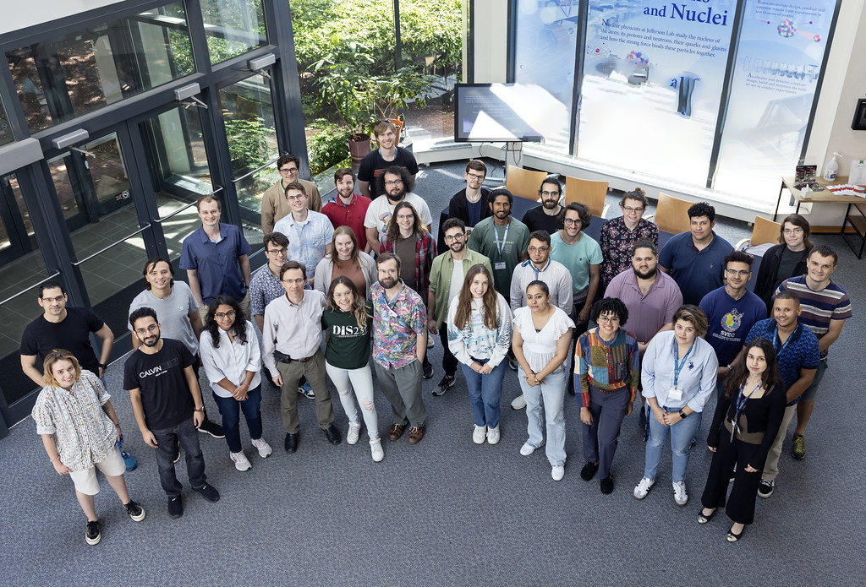
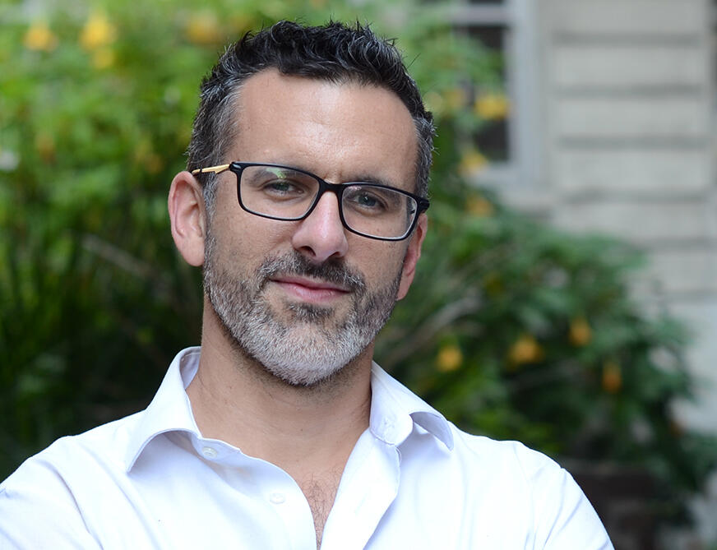
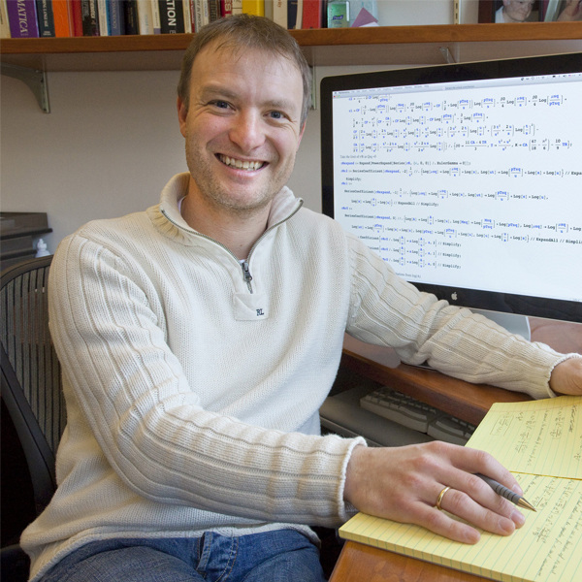
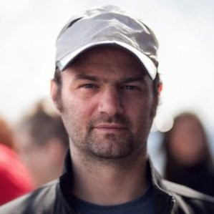
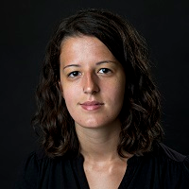
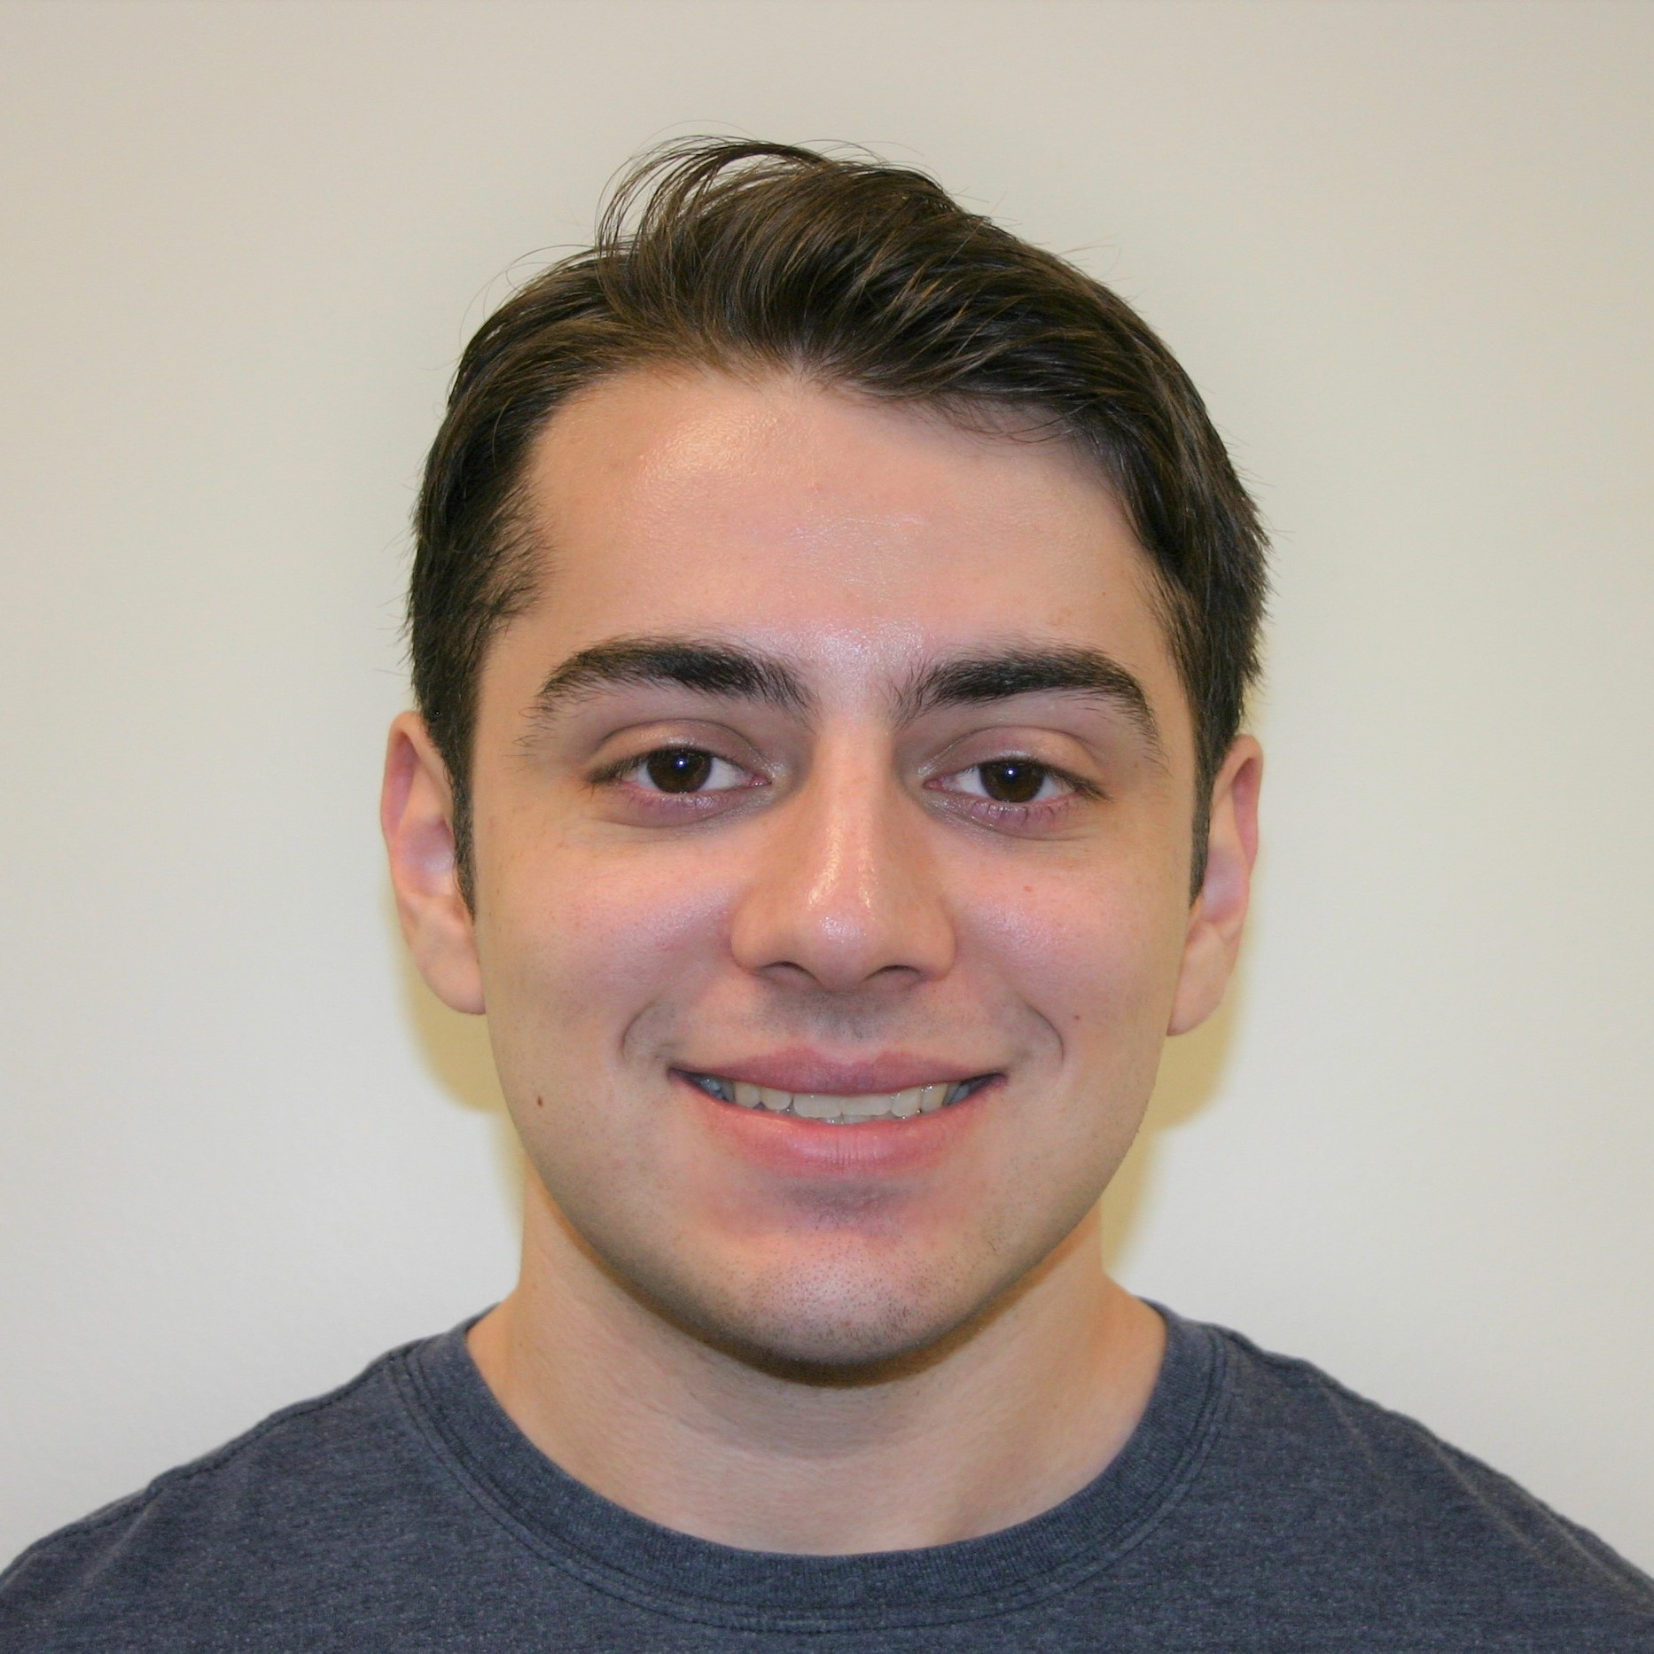
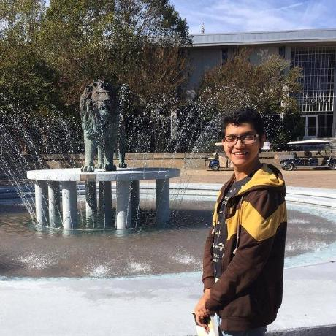
Thanks!
Raúl Briceño
Christian Bauer
André Walker-Loud
Dimitra Pefkou
Wyatt Smith
Marco Carrillo
Yonggang Ren

