Slide 1
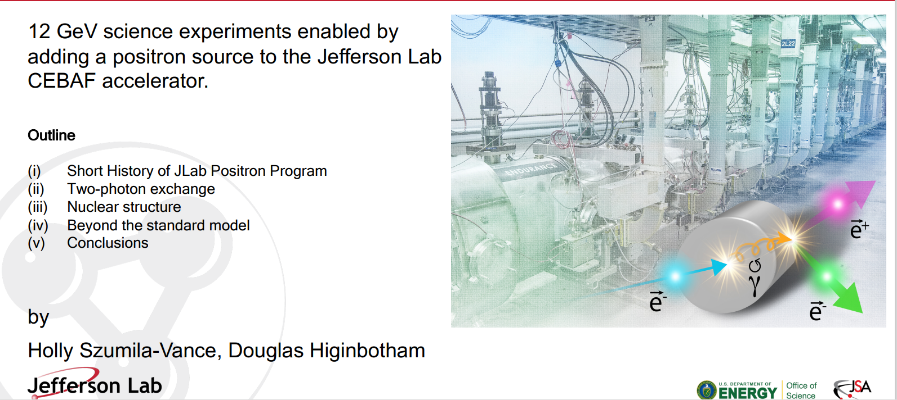
Science case for e+ experiments

Slide 2


Polarized Electrons for Polarized Positrons (PEPPo)
https://doi.org/10.1103/PhysRevLett.116.214801
Photo of the PEPPo setup in the injector area of CEABF.
Notes:
We have made polarized positrons ( PEPPo experiment )
When a longitudinally polarized e⁻ beam strikes matter, e⁺ produced in the shower carrying >50% of the e⁻ beam energy are significantly longitudinally spin polarized…
The JLab positron source built on the PEPPo (Polarized Electrons for Polarized Positrons) experiment which demonstrated the feasibility of using bremsstrahlung radiation of MeV Polarized Electrons for producing Polarized Positrons. Demonstrated polarizations up to 82%.
-----------------------------
Taking advantage of advances in high polarization, high intensity electron sources [13] exploits the polarized photons generated by the bremsstrahlung radiation of low energy longitudinally polarized electrons within a high-Z target to produce polarized eþe−-pairs. It is expected that the PEPPo concept can be developed efficiently with a low energy (∼5–100 MeV=c), high intensity (∼mA), and high polarization (> 80%) electron beam driver, opening access to polarized positron beams to a wide community
pe = 8.2 MeV/c, Pe = 85%, I_e = 1 µA, t_W = 1 mm, P < 10 W -> demonstrated positron polarization of up to 82% (D. Abbott et al. PRL 116 (2016) 214801)

Slide 3
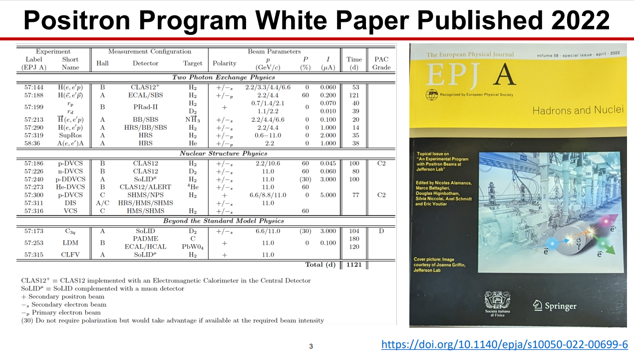
The Ce+BAF program
Notes:
We showed that there is a physics interest. ( white paper )
The PWG was created in 2017 after JPos17 (International Workshop on Physics with Positrons at Jefferson Lab) to promote the physics case of positron beams at JLab. It now gathers about 250 physicists from 70 institutions supporting an ambitious experimental program.
The EPJ A Topical Issue about an experimental positron program at CEBAF has been released and will be distributed by Jefferson Lab.
This document constitutes the final JLab Positron White Paper, gathering 19 single contributions and a summary article, all peer-reviewed.
TPE Physics in elastic scattering globally asks for low beam energies.
Nucleon Structure Physics and Beyond the Standard Model Physics ask for high beam energies.
--------------------------
Experimental scenarios for DIS, VCS ( g∗p → gp ), and CLFV ( e^+N → mu^+ X ) need further evaluation. (311,316 & 317)
Opportunities for polarized target experiments would deserve more considerations.

Slide 4
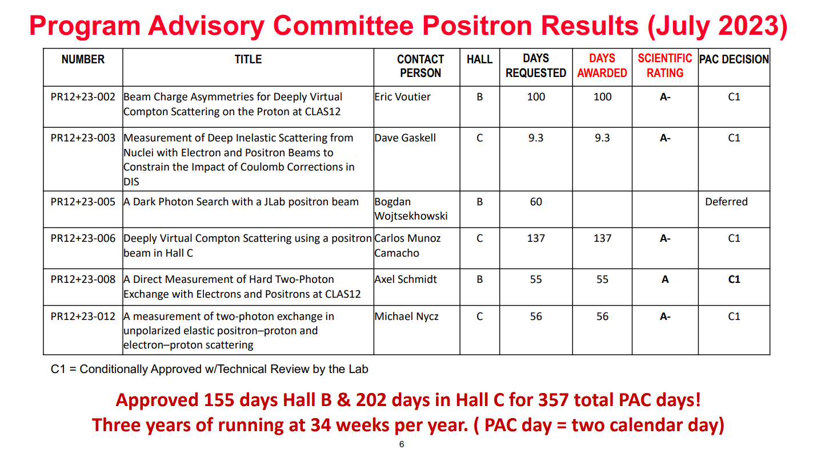
PAC approved e+ experiments
Notes:
Currently approved experiments. Fall into several main categories. TPE, Nuclear Structure, beyond the standard model.

Slide 5
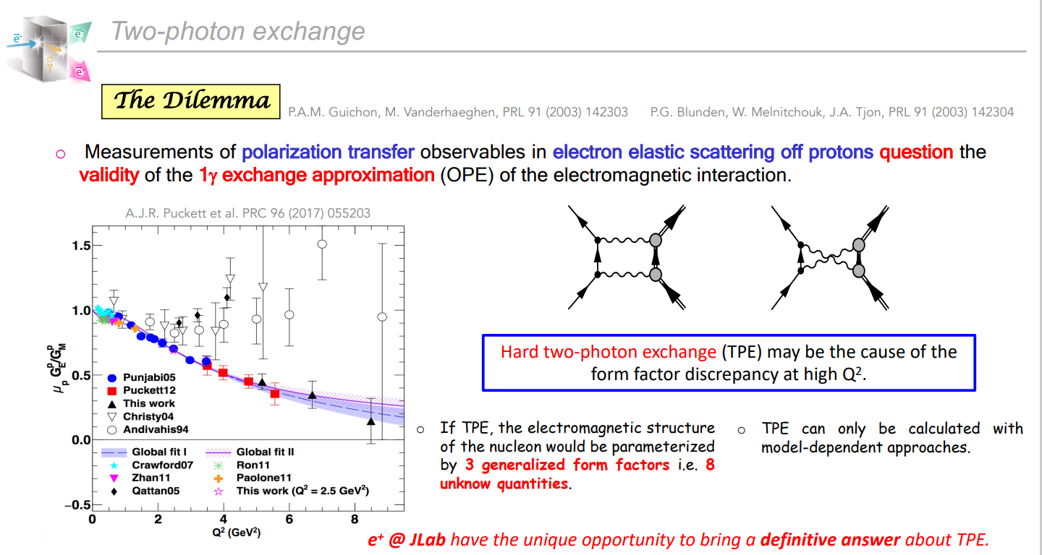
Two photon exchange
Notes:
Measurements of the proton’s form factors are discrepant (Rosenbluth vs Polarization Transfer).
The current status of two-photon exchange is uncomfortable. Difficulties in calculations. Recent experiments inconclusive. Positron facilities world-wide are turning off.
The one “missing” radiative correction is hard two-photon exchange.
The discrepancy is most prominent between Q2 values of approximately 2–7 GeV2/c2 where there is a clear gap between the polarized and unpolarized data.
Calculations of two-photon exchange come with model dependency.
Need for a large enough set of independent and sensitive observables.

Slide 6
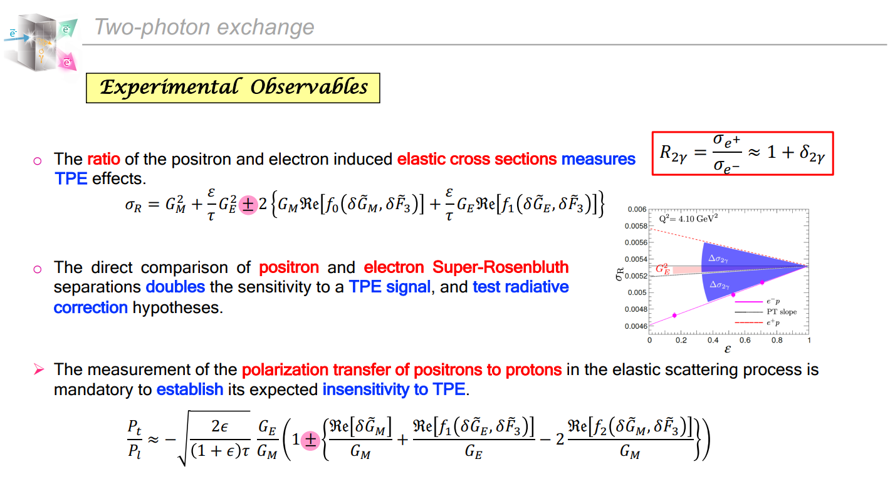
Impact of using a positron beam
Notes:
Plot shows the epsilon dependence of the reduced XS as predicted by the polarization transfer results for GE/GM (dashed black). The ep Super Rosenbluth (super means measured proton for higher precision) are the data (pink). Assuming the difference is entirely from TPE, the RED shaded region indicates the slope from the GE contribution to the XS (large Q2, GE contributes small epsilon dependence to XS). The blue shaded region indicates the impact of TPE normalized to match the electron data at ε = 1, were TPE contributions go to zero. Since TPE contributions change sign for positrons, the dotted red line shows the expected results for positron measurements, assuming a linear TPE contribution
The main effect of TPE on the cross section comes from the interference between the one-photon and TPE amplitudes. Because the sign of the correction depends on the lepton charge, the ratio of positron to electron scattering is very sensitive to TPE effects.
If the polarization transfer represents the true form factors, TPE yields more than half of the ε dependence at 2.64 GeV2 , and 85% at 4.1 GeV2
TPE produces an asymmetry between electron and positron scattering.
Sigma_R is reduced XS including the TPE correction
Theory predictions for σe+p/σe−p are not in agreement
The polarization transfer results are not necessarily correct.
Calculations of two-photon exchange come with model dependency:
-Hadronic Approaches Treat off-shell propagator as collection of hadronic states.
-Partonic Approaches Treat interaction of γγ with quarks, distributed by GPDs
-Phenomenology Assume the discrepancy is caused by TPE, estimate the effect

Slide 7
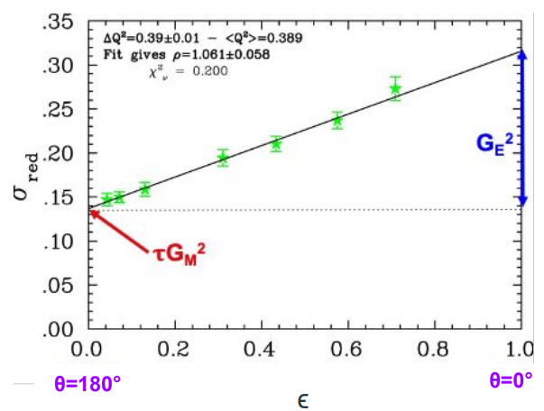


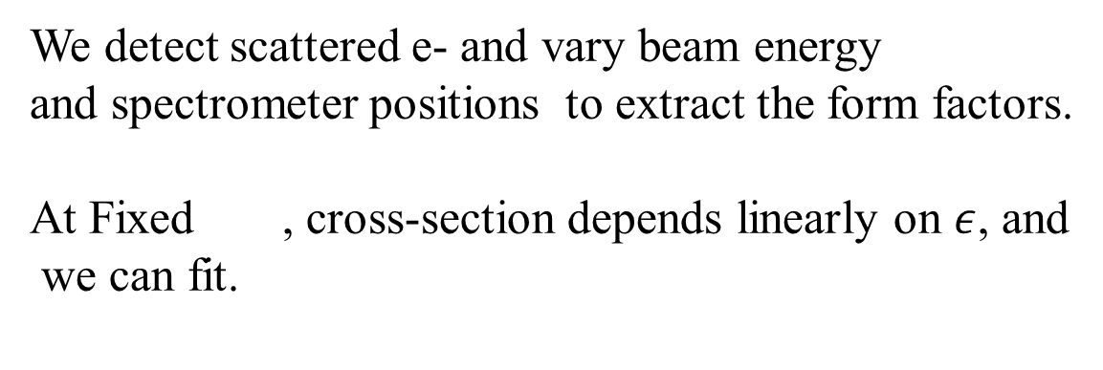

Rosenbluth method
We detect scattered e- and vary beam energy
and spectrometer positions to extract the form factors.
At Fixed , cross-section depends linearly on $ε$, and
we can fit.
$$Q^{2}$$
However, $G_{E}\left(Q^{2}\right)$ is suppressed at higher , rendering the method sensitive to experimental
errors.
$$Q^{2}$$
Notes:
Ge is prop to1/Q^2 so its suppressed at high Q^2 rendering the extraction difficult. The cross-section depends linearly on e at fixed Q^2. It is smaller than the cross-section when one detects the proton making it necessary to increase current, which in turn makes momentum dependent corrections on the scattered e- bigger, and target heating corrections too.

Slide 8
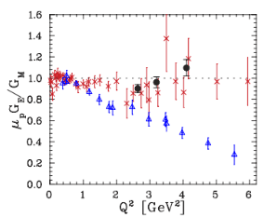
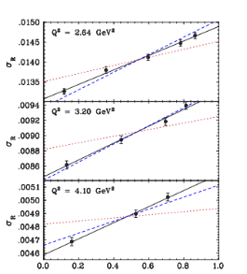
Super Rosenbluth, detecting elastic proton
I.A Qattan et al. Phys. Rev. Lett. 94 142301 (2005)
Black: super rosenbluth from E01-001
Notes:
In 2005,the results of E01-001 experiment were published. This was a super-rosenbluth experiment where one detects the struck proton instead of the e-.

Slide 9
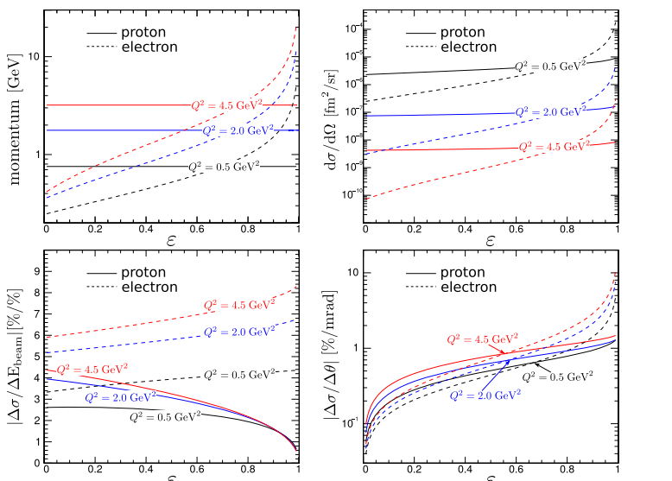
Detecting e- vs detecting p
PR12+23-012
M. Nycs, J. Arrington, S. Santiesteban, M. Yurov et al.
Notes:
Taken from PR12-23-012 proposed for Hall C. This illustrates the advantage of super-rosenbluth.
Top left, the proton momentum varies little along the epsilon range. This results in smaller momentum dependent corrections
Bottom left the cross-section sensitivity to uncertainties in beamenergy, bottom right is for particle angle.
Top right is cross-section. The one for proton detection is bigger and also constant over epsilon, meaning we do notneed to raise current and incurr target corrections.

Slide 10
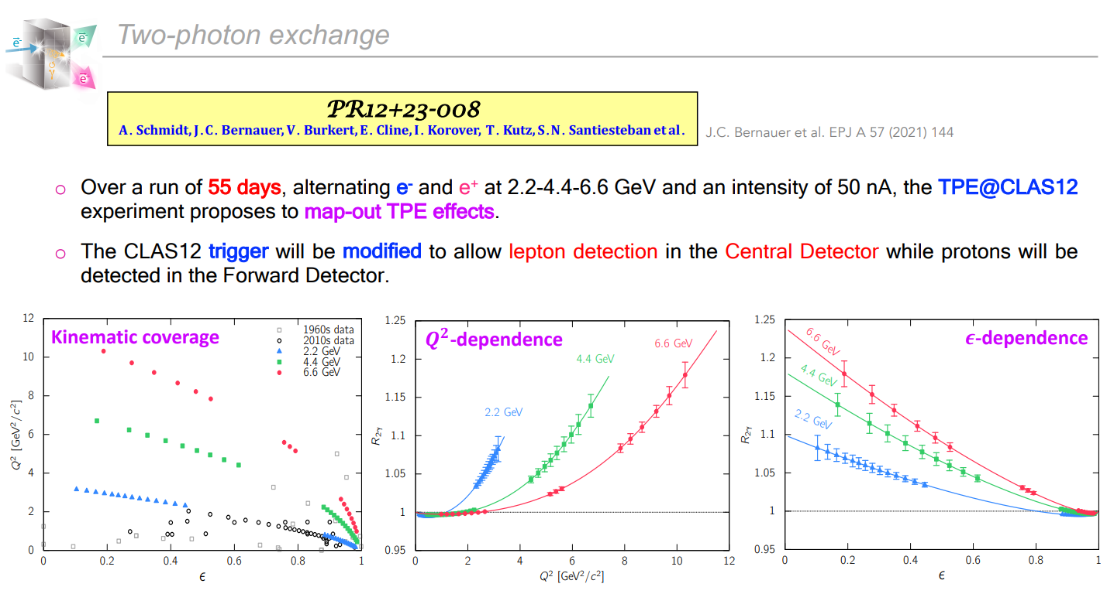
Hall B proposed experiment
Notes:
Why so much effort is spend studying TPE ?
There are implications beyond elastic scattering on nucleon. In inclusive DIS off nuclei, there are multi photon effects. Precisely determining this has implications for the nuclear radii or coulomb sum rule tests.
Likewise, for the study of the EMC effect.

Slide 11
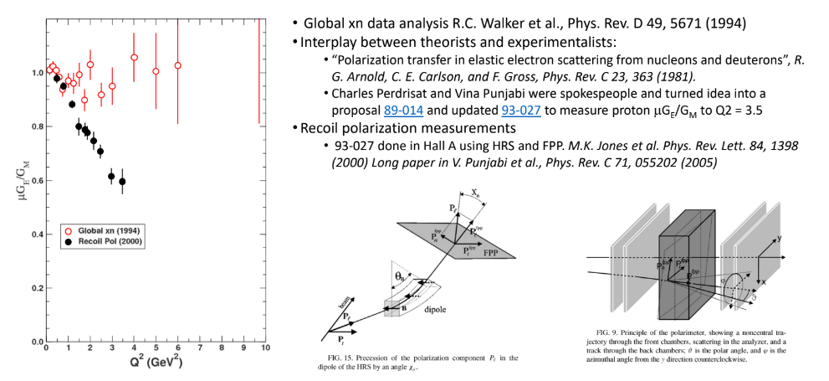
Direct measurement of recoil polar.
Courtesy: Mark Jones
Notes:
For this, you need a polarimeter. Essentially, the scattered proton hits a nuclear target which provides means to measure an azimuthal dependence, from which we can get the polarization. FPP is that polarimeter.

Slide 12
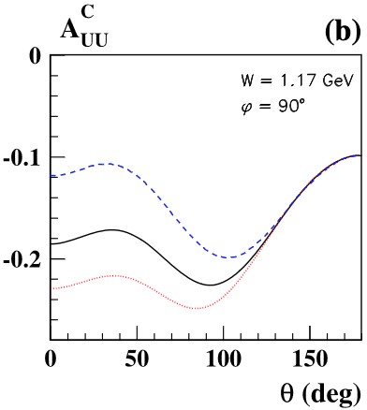
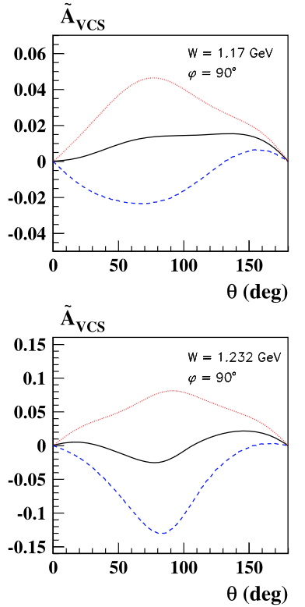
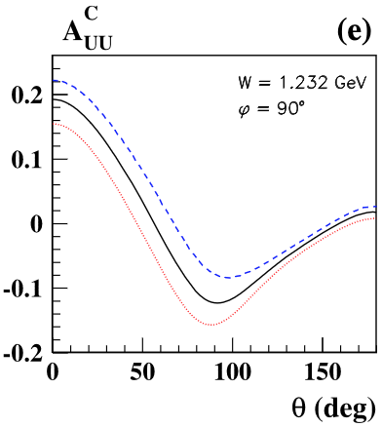

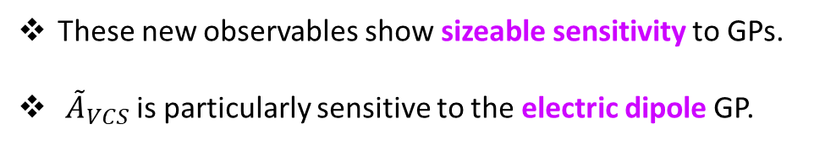


Nuclear structure
Virtual Compton Scattering
B. Pasquini, M. Vanderhaegen, EPJ A 57 (2021) 316
The comparison of unpolarized/polarized electrons and positrons provides an independent path to access Generalized Polarizabilities (GPs).
$${dσ}_{P}^{e}={dσ}_{BH}+{dσ}_{VCS}+Pd{\tilde{σ}}_{VCS}+e \left[{dσ}_{INT}{+ Pd\tilde{σ}}_{INT}\right]$$
BCA
$$A_{UU}^{C}=\frac{dσ_{INT}}{dσ_{BH}+dσ_{VCS}}$$
BSA
$$A_{LU}^{e}=\frac{d{\tilde{σ}}_{VCS}+ed{\tilde{σ}}_{INT}}{dσ_{BH}+dσ_{VCS}+edσ_{INT}}$$
$${\tilde{A}}_{VCS}=A_{LU}^{+}\left(1+A_{UU}^{C}\right)+A_{LU}^{−}\left(1−A_{UU}^{C}\right)=\frac{2 d{\tilde{σ}}_{VCS}}{dσ_{BH}+dσ_{VCS}}$$
These new observables show sizeable sensitivity to GPs.
${\tilde{A}}_{VCS}$ is particularly sensitive to the electric dipole GP.
An experimental scenario is under study.
LOI12+23-001 N. Sparveris et al.
13/26
Notes:
Compton process, which y*p->yp was studied in the early 50’s. Its accessed via exclusive photoproduction with e- or e+ beams. At sufficiently low energy, one can expand the spin dependent part of this cross-section. At first order,it’s the anomalous magnetic moment of the system. If one expands to higher order,one gets the generalized polarizabilities which is what VCS measures.
We have measured these for years. The advent of positron opens up more possibilities and new observables.

Slide 13
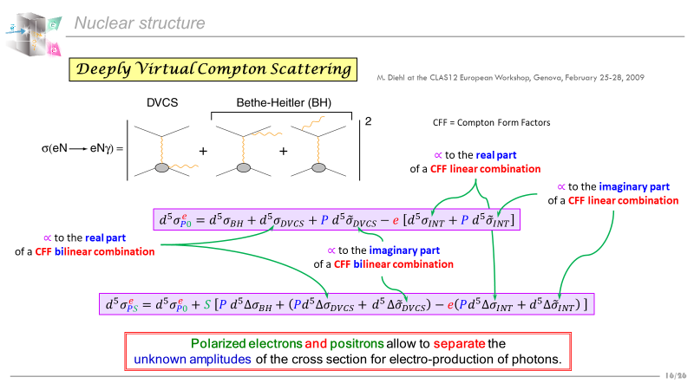
Notes:
The DVCS is when a virtual photon is generated by inelastic lepton scattering. It interacts with a quark within the nucleon and then this quark reemits a real photon and gets back to the ground state.

Slide 14
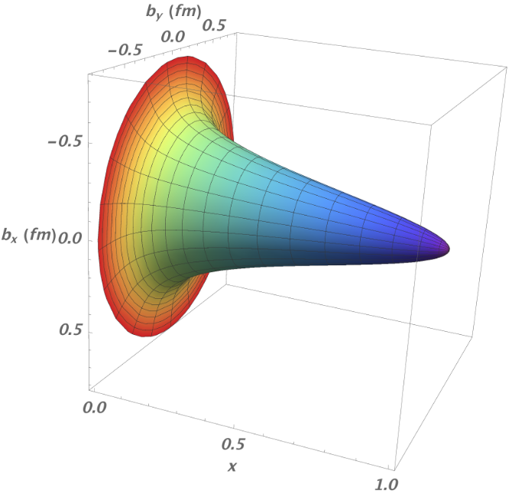
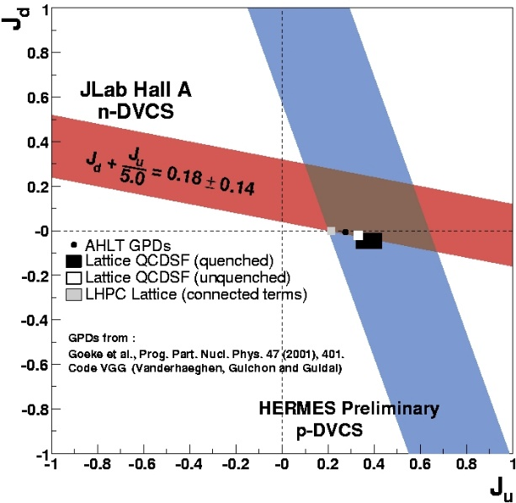
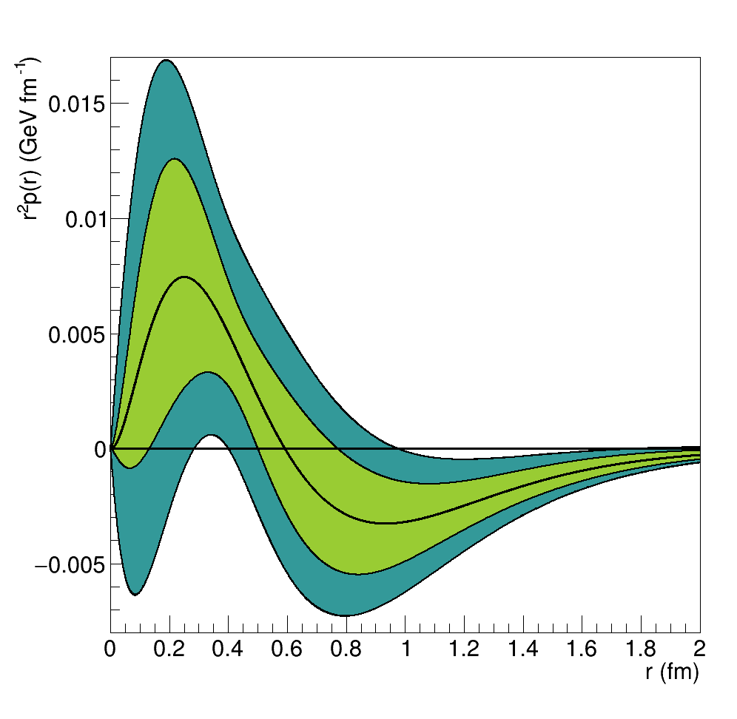
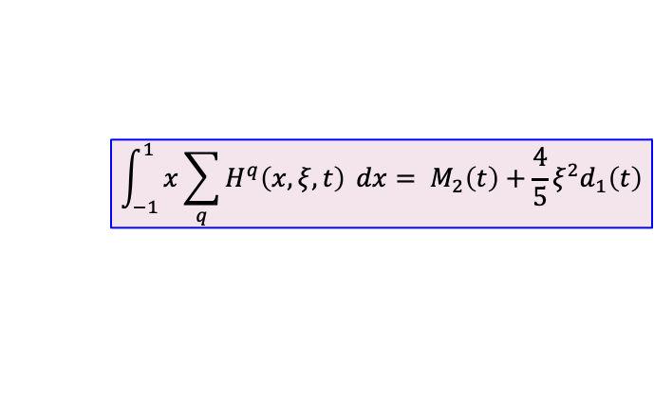
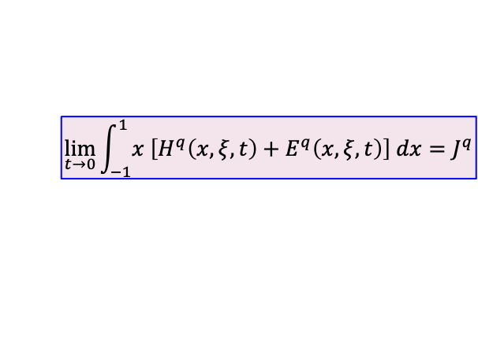
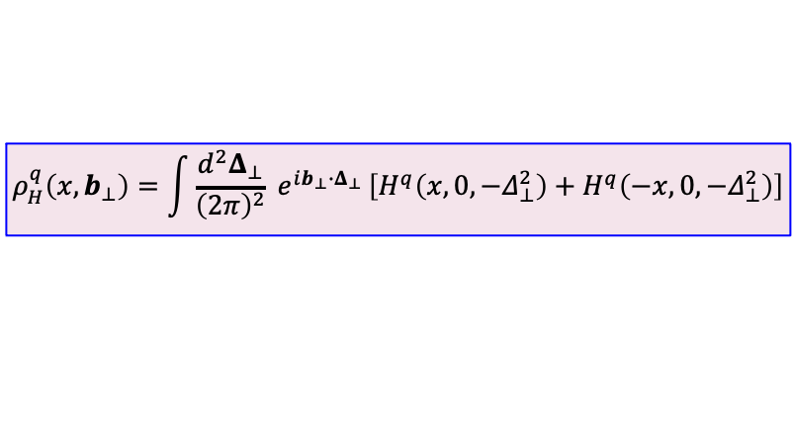
Nuclear structure
Generalized Parton Distributions
X. Ji, PRL 78 (1997) 610 M. Polyakov, PLB 555 (2003) 57
M.V. Polyakov, P. Schweitzer, IJMP A 33 (2018) 1830025
GPDs encode the correlations between partons and contain information about the internal dynamics of hadrons like the angular momentum or the distribution of the forces experienced by quarks and gluons.
$$ρ_{H}^{q}\left(x,b_{⊥}\right)=\int{\frac{d^{2}Δ_{⊥}}{{\left(2π\right)}^{2}}} e^{ib_{⊥}{∙Δ}_{⊥} }\left[H^{q}\left(x,0,−Δ_{⊥}^{2}\right)+H^{q}\left(−x,0,−Δ_{⊥}^{2}\right)\right]$$
d
$$\lim_{t→0}{\int_{−1}^{1}{x \left[H^{q}\left(x,ξ,t\right)+E^{q}\left(x,ξ,t\right)\right] dx}}=J^{q}$$
$$\int_{−1}^{1}{x\sum_{q}{H^{q}\left(x,ξ,t\right)} dx}= M_{2}\left(t\right)+\frac{4}{5}ξ^{2}d_{1}\left(t\right)$$
A.W. Thomas, PRL 101 (2008) 102003
Unpolarized e⁺ combined with unpolarized e⁻ access the real part of the Compton Form Factors.
Polarized e⁺ combined with polarized e⁻ access the imaginary part of the Compton Form Factors (CFFs) and probe higher twist effects.
u
M. Mazouz et. al. PRL 9 (2007) 242501
A. Airapetian et al. JHEP 06 (2008) 066 R. Dupré, M. Guidal, M. Vanderhaeghen, PRD 95 (2017) 011501 V. Burkert, L. Elouadrhiri, F.-X. Girod, Nat. 557 (2018) 396
Notes:
The study of the Generalized Parton Distributions (GPDs) captures the images of the transverse position distributions of fast-moving quarks.
The correlation of transverse spatial and longitudinal momentum information contained in the GPDs provides a new tool to evaluate the contribution of quark orbital angular momentum to the proton spin
Impact parameter vs momentum showing the valence quarks more central and sea quarks in periphery
Flavor separation of the u and d quarks, orbital angular momentum of q, highly model dependent
measurement of the pressure distribution experienced by the quarks in the proton. We find a strong repulsive pressure near the centre of the proton (up to 0.6 femtometres) and a binding pressure at greater distances.

Slide 15
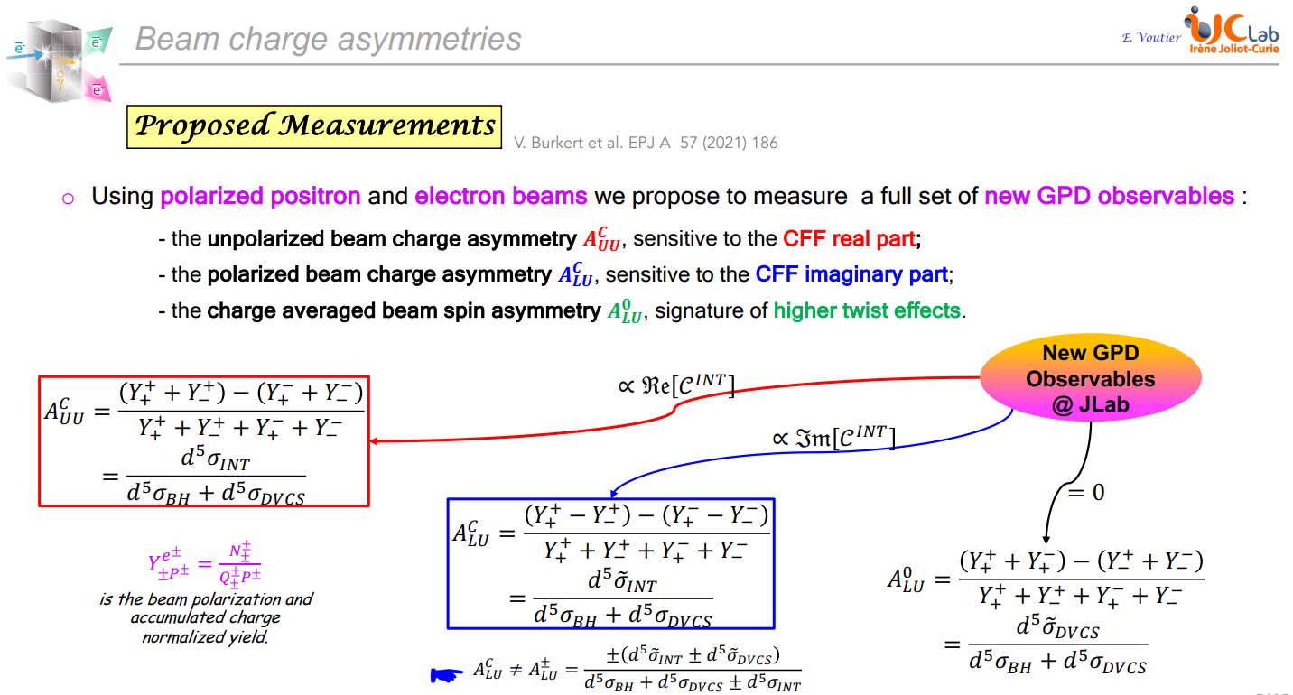

Slide 16
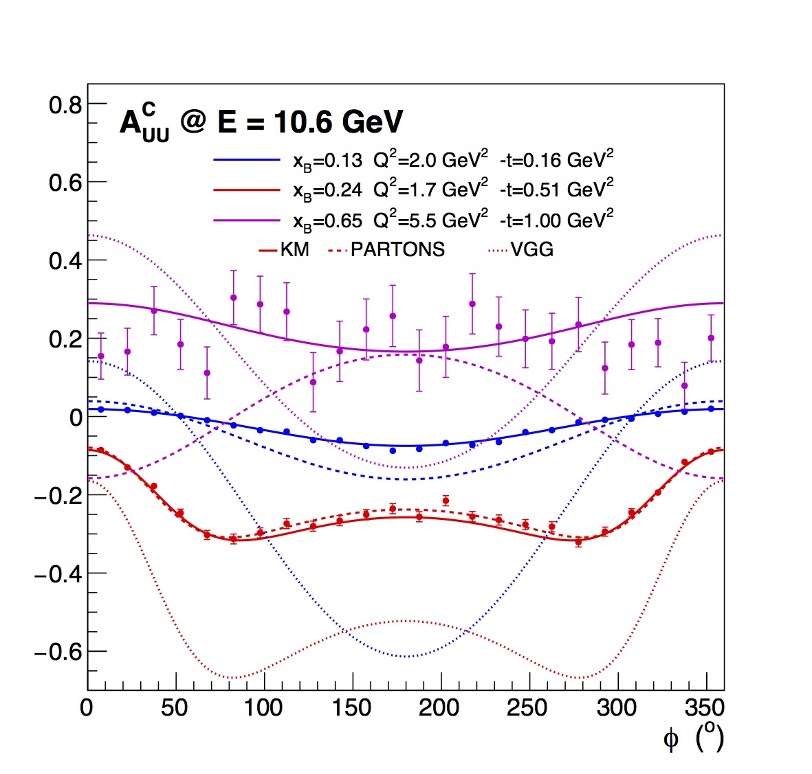
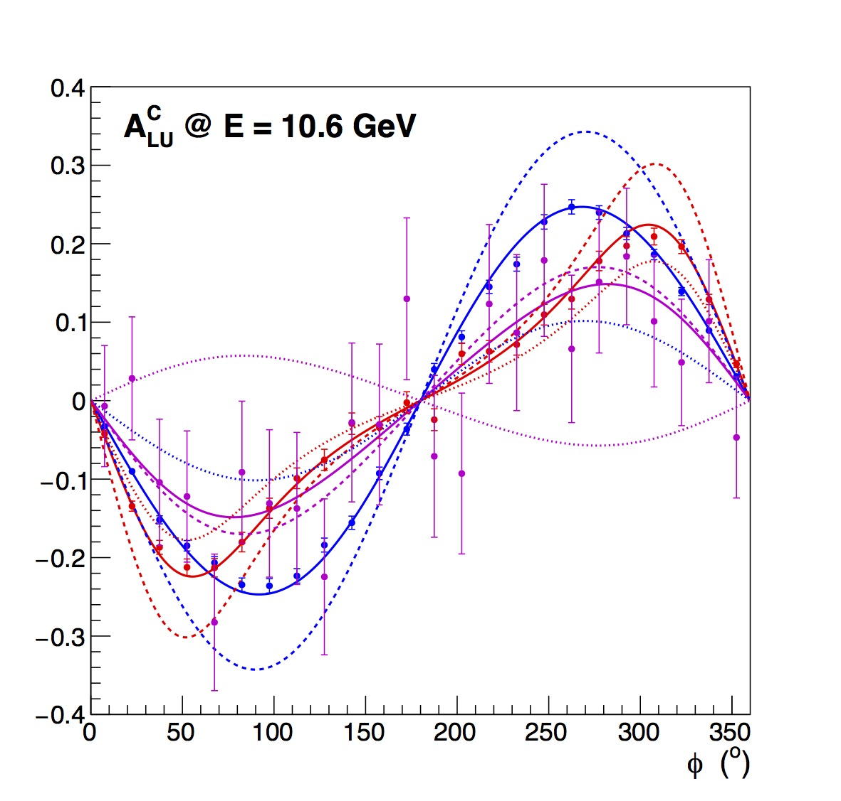


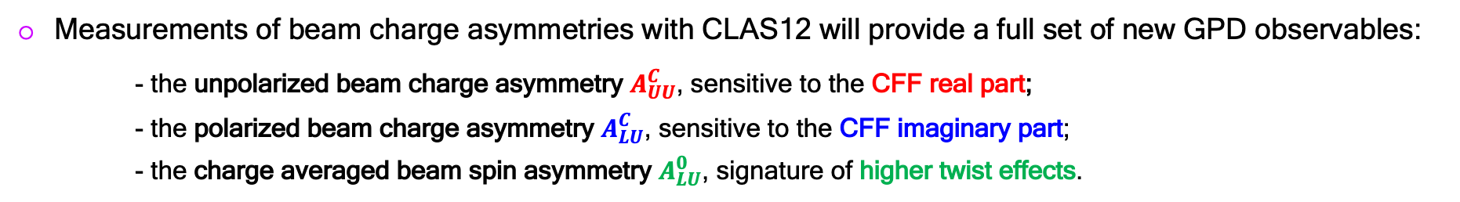
Nuclear structure
PR12+23-002
E. Voutier, V. Burkert, S. Niccolai, R. Paremuzyan et al.
V. Burkert et al. EPJ A 57 (2021) 186
Measurements of beam charge asymmetries with CLAS12 will provide a full set of new GPD observables:
- the unpolarized beam charge asymmetry $A_{UU}^{C}$, sensitive to the CFF real part;
- the polarized beam charge asymmetry $A_{LU}^{C}$, sensitive to the CFF imaginary part;
- the charge averaged beam spin asymmetry $A_{LU}^{0}$, signature of higher twist effects.
$$A_{UU}^{C}=\frac{d^{5}σ_{INT}}{{d^{5}σ}_{BH}+{d^{5}σ}_{DVCS}}$$
$$A_{LU}^{C}=\frac{d^{5}{\tilde{σ}}_{INT}}{{d^{5}σ}_{BH}+{d^{5} σ}_{DVCS}}$$
Projected data
18/26
Notes:
We propose to measure the unpolarized and polarized Beam Charge Asymmetries (BCAs) of the ⃗e±p → e ±pγ process on an unpolarized hydrogen target with CLAS12, using polarized positron and electron beams at 10.6 GeV. The azimuthal and tdependences of the unpolarized and polarized BCAs will be measured over a large (xB, Q2 ) phase space using a 2400-hour run with a luminosity of 0.66×1035 cm−2 ·s

Slide 17
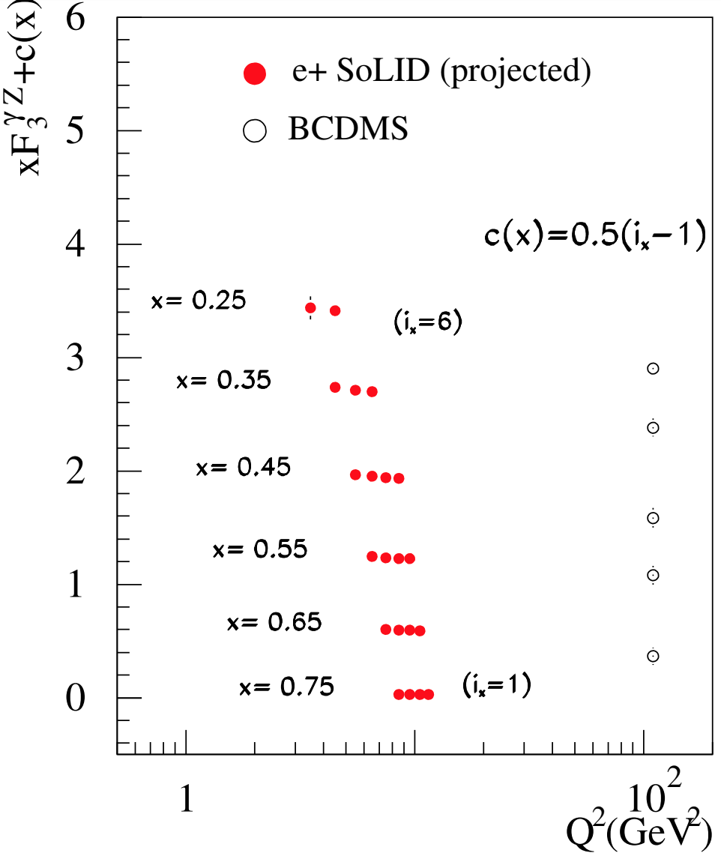
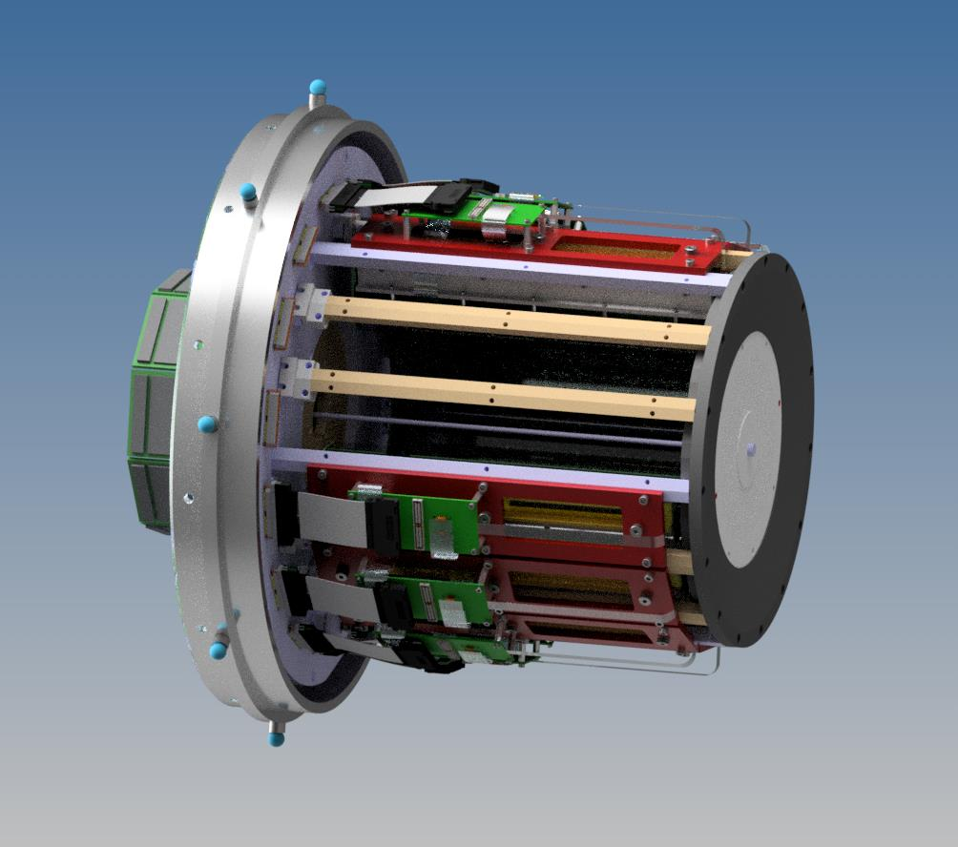
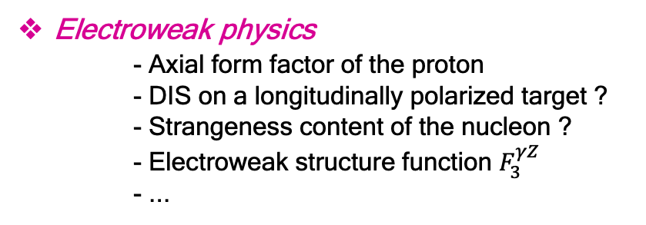
Nuclear structure
And Beyond...
S. Niccolai, P. Chatagnon, M. Hoballah, D. Marchand, C. Muñoz Camacho, E. Voutier, EPJ A 57 (2021) 226
S. Fucini, M. Hattawy, M. Rinaldi, S. Scopetta, EPJ A 57 (2021) 273
S. Zhao et al. EPJ A 57 (2021) 240
ALERT
Generalized parton distributions
- DVCS off the neutron
- Coherent DVCS off the nucleus
- Incoherent DVCS off the nucleus
- Double DVCS off the proton
- DVCS off polarized targets ?
- ...
Electroweak physics
- Axial form factor of the proton
- DIS on a longitudinally polarized target ?
- Strangeness content of the nucleon ?
- Electroweak structure function $F_{3}^{γZ}$
- ...
E. Aschenauer, T. Burton, T. Martin, H. Spiesberger, M. Stratman, PRD 88 (2013) 114025
W. Melnitchouk, J.F. Owens EPJ A 57 (2021) 311 X. Zheng et al. Jefferson Lab Proposal PR12-21-006 (2021)
D. Dutta et al. JLab Letter-of-Intent LOI12+23-002
SoLID^{μ}
This list is not exhaustive but only indicative of the current reflections.
20/26
Notes:
Already saw a signal for incoherent DVCS in clas12 EG6.
Incoherent DVCS is important as it allows for looking at things such as the EMC effect.
DVCS off polarized targets is challenging because of the practical difficulties in installing an polarized he3 target in clas.
Dvcs off the neutron will help in getting flavor separated GPDs.

Slide 18
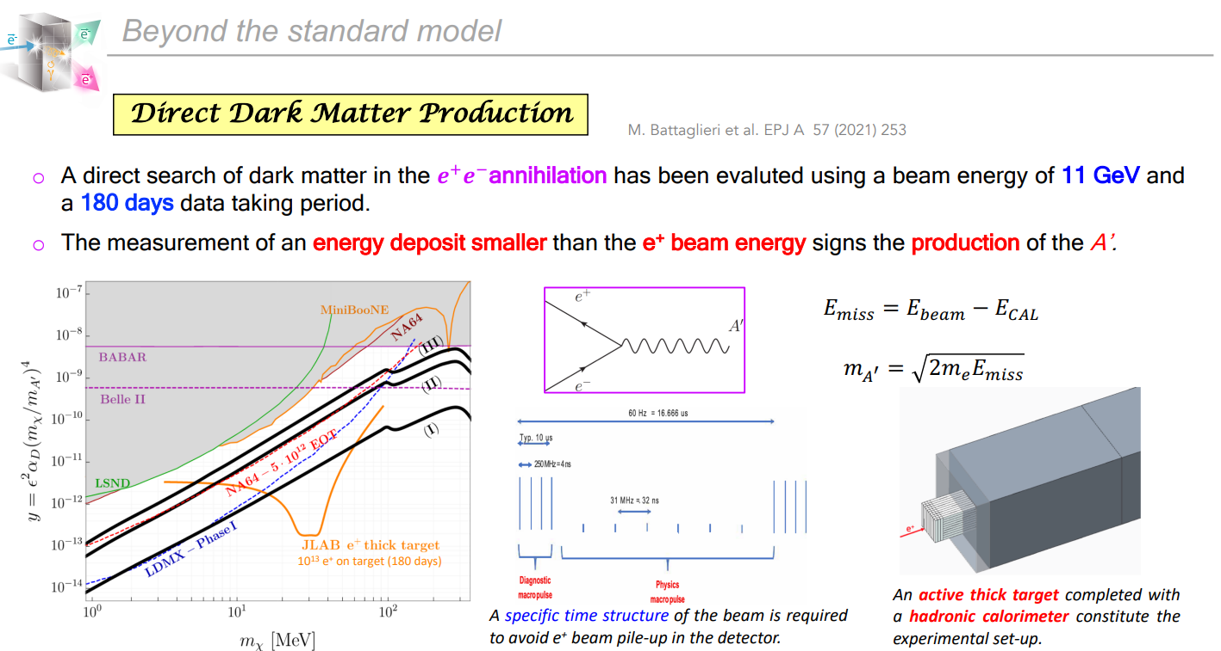
Beyond the standard model
Notes:
Direct implications with astrophysics. Some of the constraints on this come from neutrino experiments LSND, Mini BooNE,some others from colliders (BABAR,

Slide 19
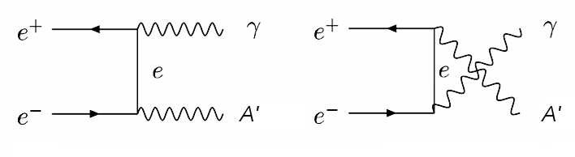
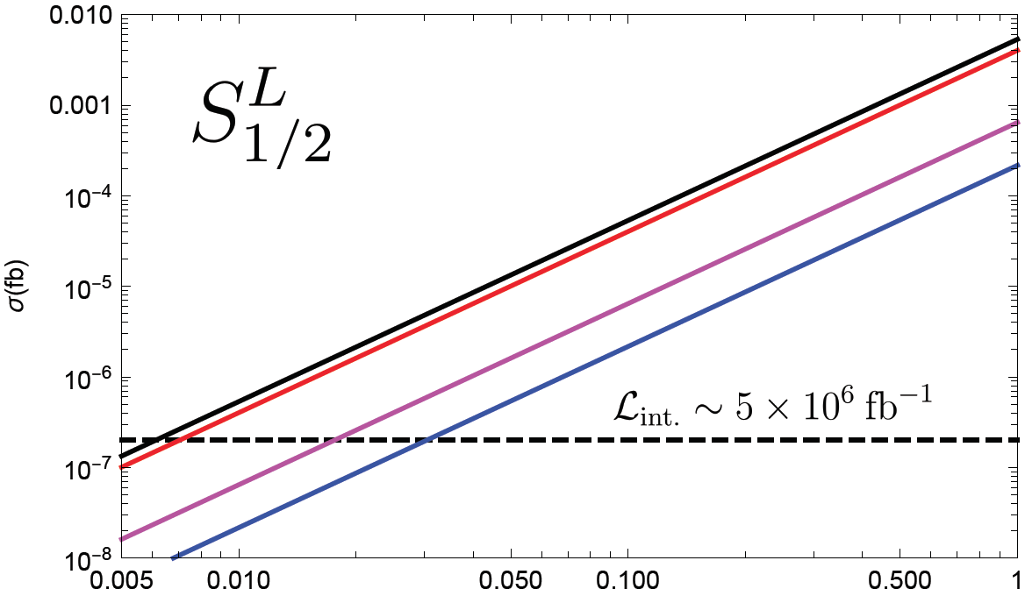
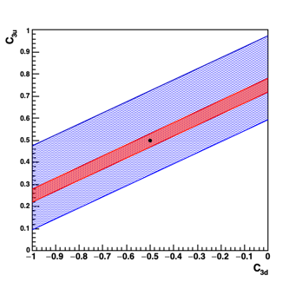
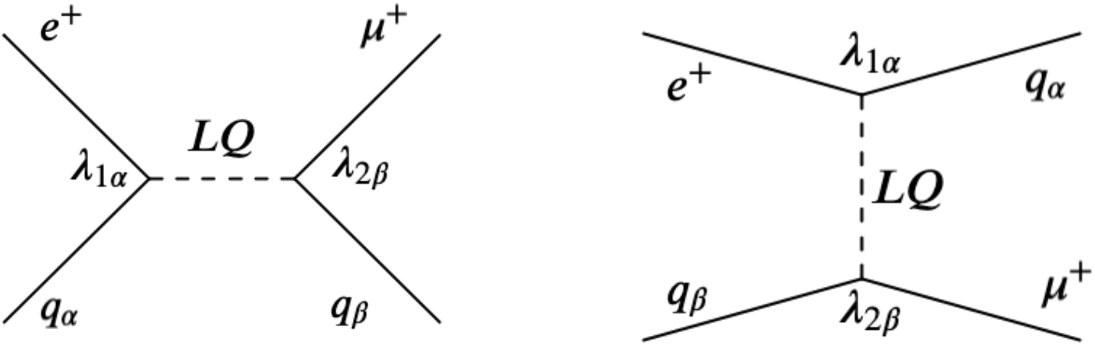

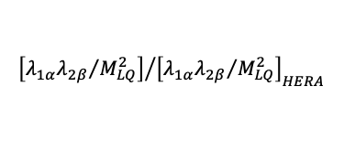
Beyond the standard model
And Beyond...
Testing standard model predictions
- Dark matter search
- Axial-axial neutral current coupling
- Charged lepton flavor violation ?
- ...
L ≥ 10³⁸cm⁻²⋅s⁻¹
$$e^{±}+N ⟶μ^{±}+X$$
μ±-CERN
e±-SoLID
projected
$${\left[{λ_{1α}λ_{2β}}/{M_{LQ}^{2}}\right]}/{{\left[{λ_{1α}λ_{2β}}/{M_{LQ}^{2}}\right]}_{HERA}}$$
X. Zheng, J. Erler, Q. Liu, H. Spiesberger, EPJ A 57 (2021) 173 Y. Furletova, S. Mantry, EPJ A 57 (2021) 315
B. Wojtsekhowski et al. Jefferson Lab Proposal PR12+23-005 D. Mack Jefferson Letter-of-Intent PR12+23-005
This list is not exhaustive but only indicative of the current proposals.
22/26
Notes:
Three different A production modes in fixed target lepton beam
experiments: (a) A -strahlung in e−
/e+-nucleon scattering; (b) A -
strahlung in e+e− annihilation; (c) resonant A production in e+e−
annihilation
e - + nucleus →e - + nucleus + A’ ( followed by A’→e +e - ) Bhabha scattering

Slide 20
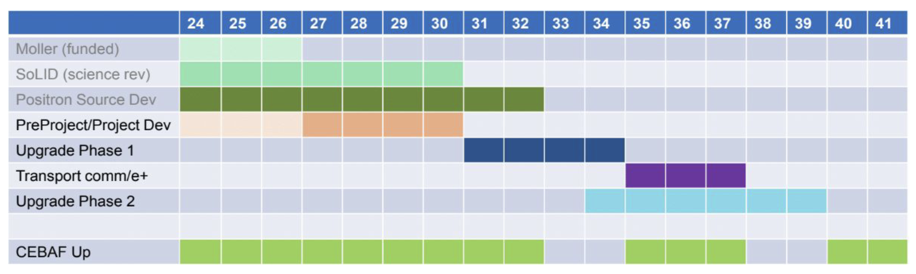
Proposed Timeline
Gantt chart to give a rough idea when these project could become a reality.
Phase 1 includes building the positron source and the tunnel & beamline connecting the source to main machine.
Phase 2 includes the new permanent magnets to allow 22 GeV within current CEBAF footprint.
NOTE: Plan was formulated so that these projects are ramping up as the EIC project cost is ramping down.
Patrizia Rossi, HADRON 2023

Slide 21
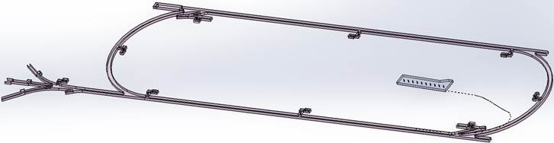
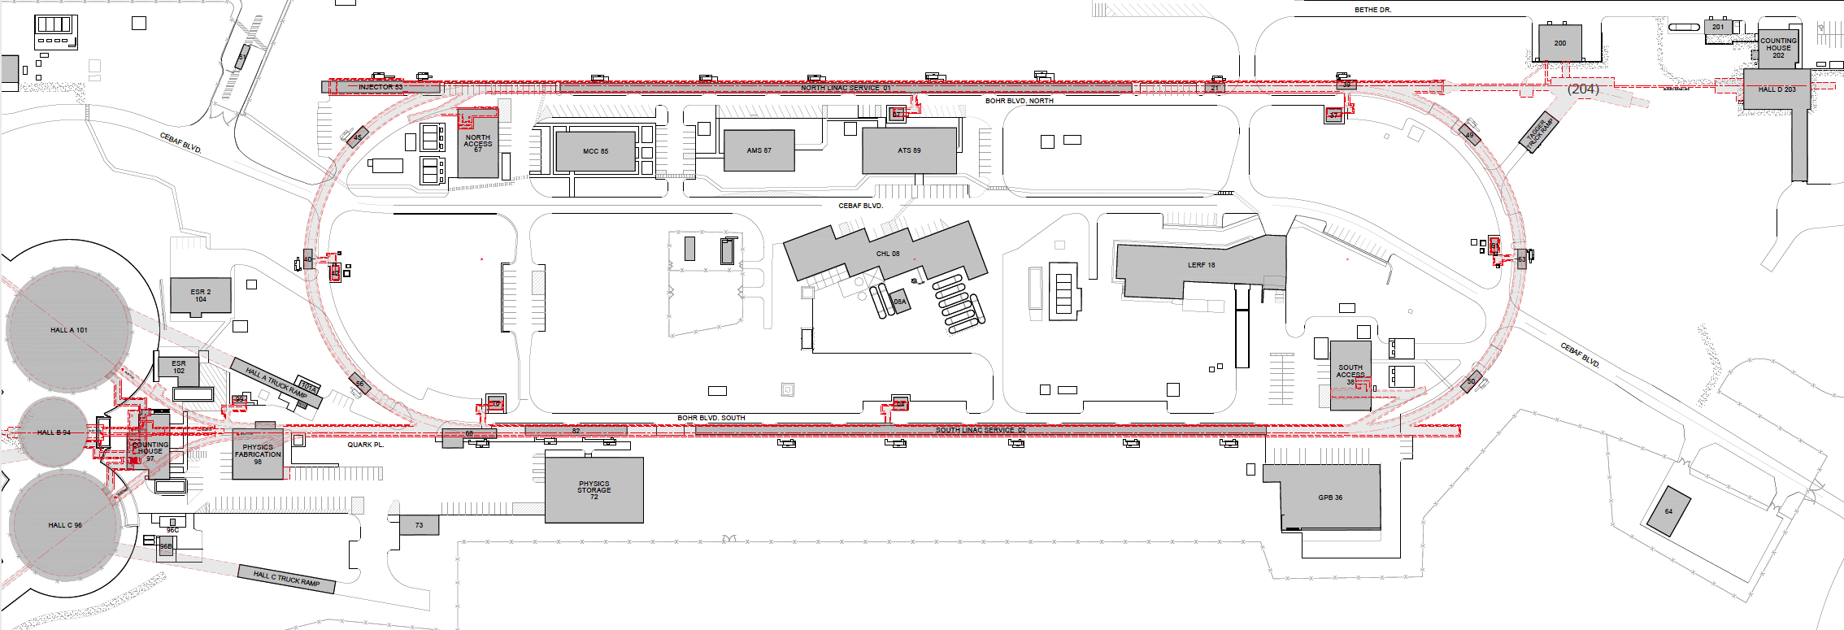

Turning the LERF into a Positron Injector Facility
123 MeV
At the last JLAAC we were exploring e+ production at 10, 100, 1000 MeV…
Today we are focused on producing 123 MeV e⁺ utilizing the Low Energy Research Facility
Inject e⁺ into North Linac to usual 12 GeV (w/ magnets reversed)
Build e⁺ injector at the LERF
Build new LERF to CEBAF tunnel
123 MeV
Build new transport line along South Linac and West Arc

Slide 22
Machine parameters, several new options
Machine parameter table now more comprehensive
Machine Parameter | CEBAF e- | Ce+BAF
 |  | e+ | Degraded e- | e-
Multiplicity | 4 | 1 or 2
Max. Energy (ABC/D) | 11/12 GeV | 11/12 GeV
Beam Repetition | 250/499 MHz | 250/499 MHz
Duty Factor | 100% cw | 100% cw
Unpolarized Intensity | 170 μA** | > 1 μA | >> 1 uA | 170 μA**
Polarized Intensity | 170 μA** | > 50 nA | >> 1uA | 170 μA**
Beam Polarization | > 85% | > 60% | >85% ? | >85%
** Total beam power at Jefferson Lab is limited to 1.1 MW with a max. of 0.9 MW to individual high power dumps.

Slide 23
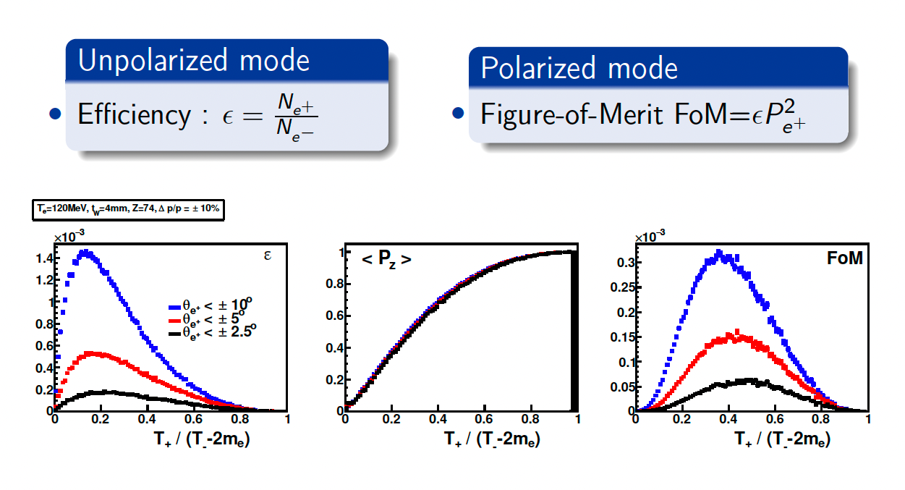
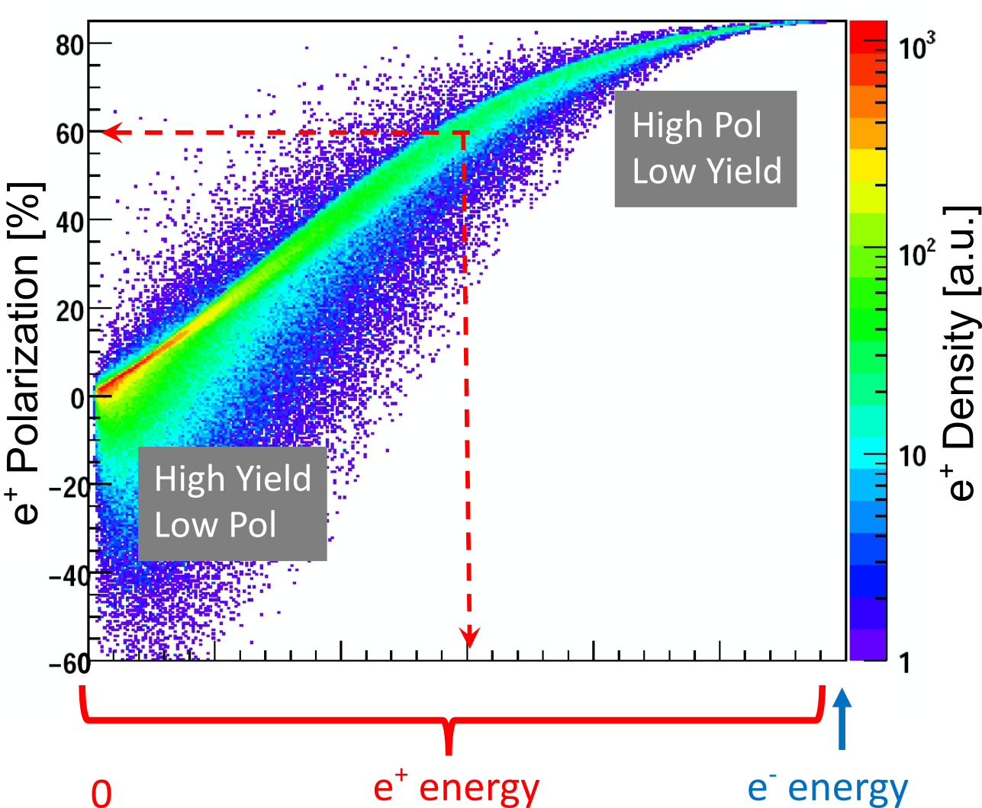
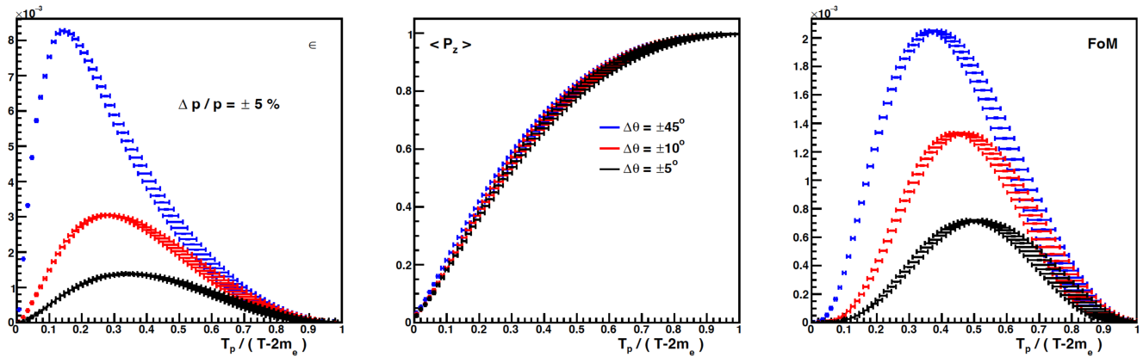
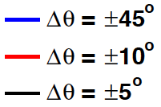
“Tunable” e⁺ source
e⁺ Polarization vs Energy
4 mm Tungsten Target
Efficiency
120 MeV e‒
FoM
e⁺
e‒
e⁺
e‒
Positron beamline has to be designed
for efficient capture and transport of e⁺ with different energies

Slide 24
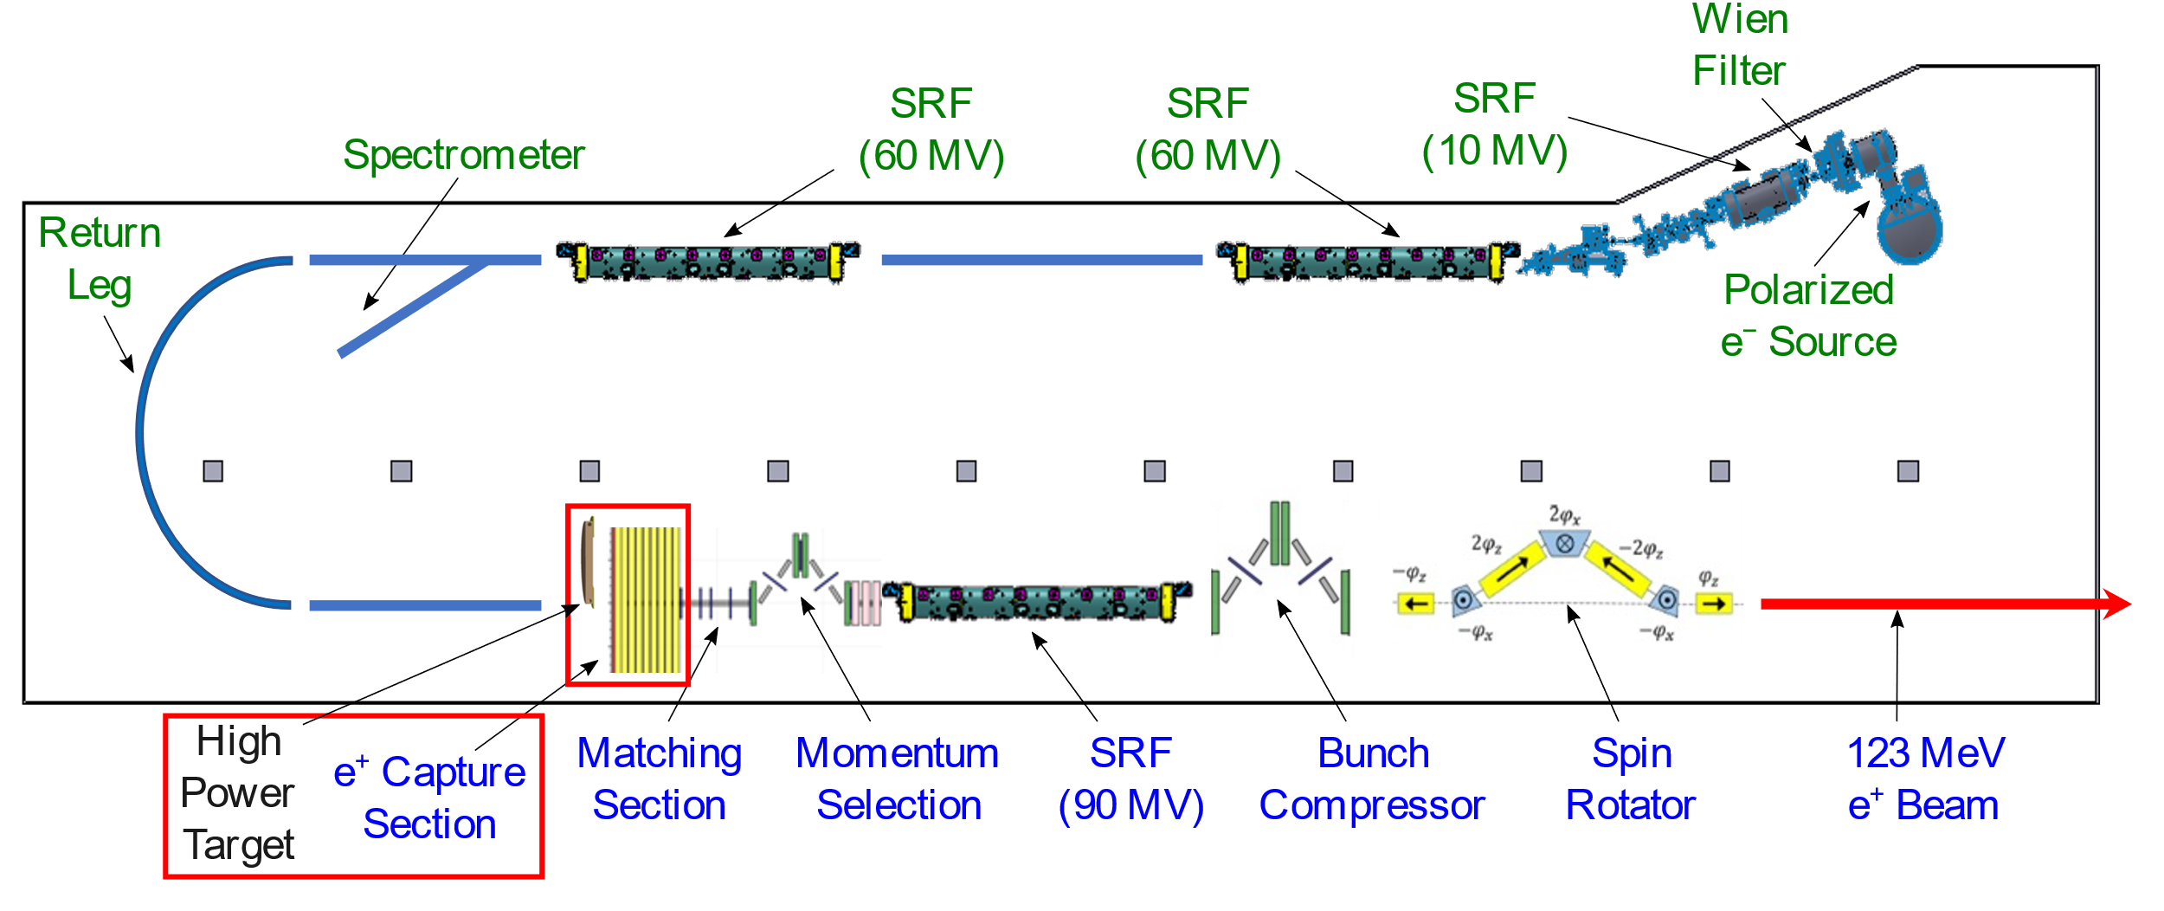
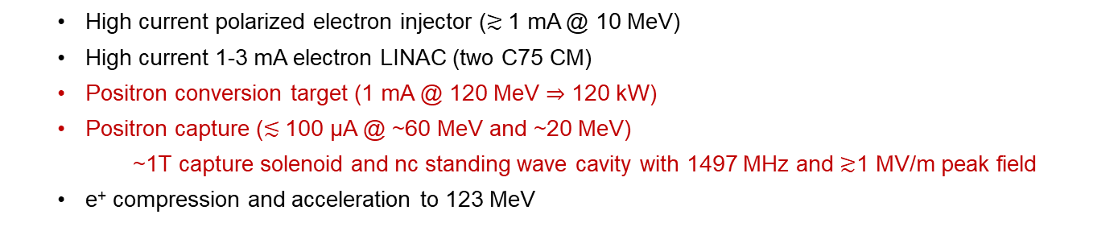
LERF Polarized Positron Injector Concept
  High current polarized electron injector ($≳$1 mA @ 10 MeV)
  High current 1-3 mA electron LINAC (two C75 CM)
  Positron conversion target (1 mA @ 120 MeV $⇒$ 120 kW)
  Positron capture ($≲$100 µA @ ~60 MeV and ~20 MeV)
    ~1T capture solenoid and nc standing wave cavity with 1497 MHz and $≳$1 MV/m peak field
  e⁺ compression and acceleration to 123 MeV

Slide 25
R&D activities for e- and e+ sources
>mA e- source & photocathodes
C. Hernandez-Garcia
Polarized e- injector
High power solid target
S. Covrig
e+ beam to CEBAF
High power liquid target
V. Kolstrum
e+ collection system
A. Ushakov
Transport large emittance e+ beams
A. Sy

Slide 26
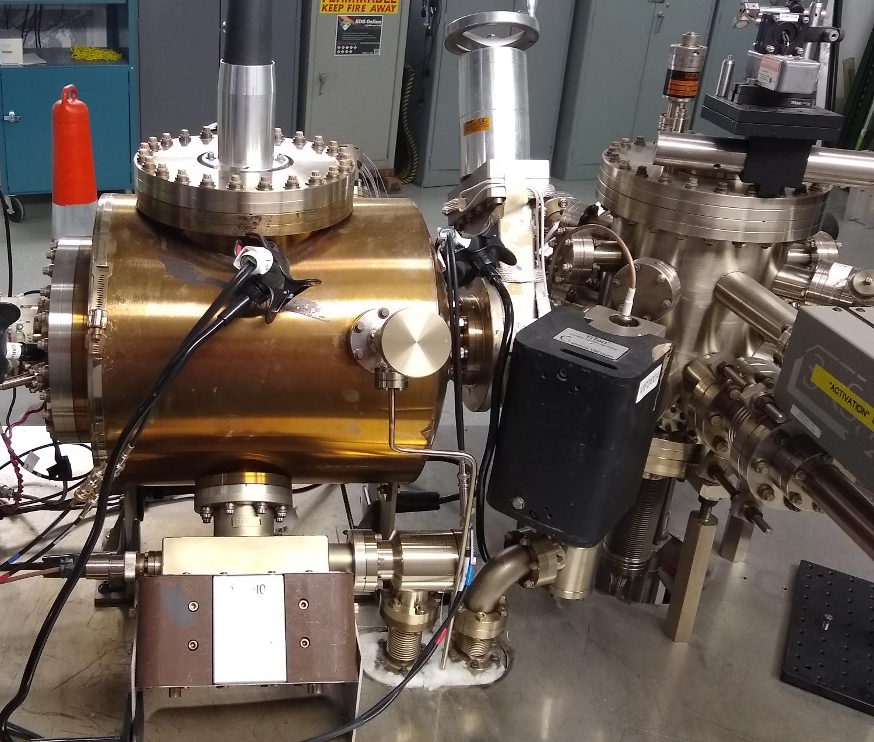
A high intensity polarized beam photogun for the Ce⁺BAF positron source
Towards 5X the beam current of the state-of-the-art CEBAF photogun
6 in
Carlos Hernandez-Garcia for the Ce⁺BAF team
CEBAF
130 keV
polarized
GTS
300 keV un-polarized
Prototype
500 kV
Positron Working Group Workshop ,Washington, DC, March 18-20, 2024

Slide 27
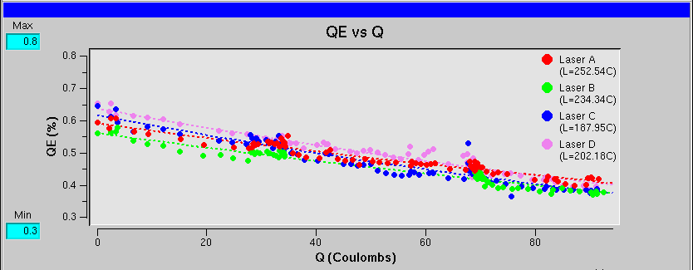
CEBAF polarized e- source @ 1 mA?
High polarization at 1 mA
[µA]
Gun2 Photocathode (Fall 2016 – Spring 2017)
QE = QE₀ e ^{-(Q/Lifetime)}
We have demonstrated polarization from the CEBAF PES remains steady up to 1 mA/499 MHz
The charge lifetime (at 0.2 mA) is about 200 C
This would provide only 2-3 days of positrons
Lifetime ~200 C (σ_{4D} ~ 1mm, I~200 μA)
Slide by J. Grames
Gun vacuum ~ 1x10⁻¹² Torr

Slide 28
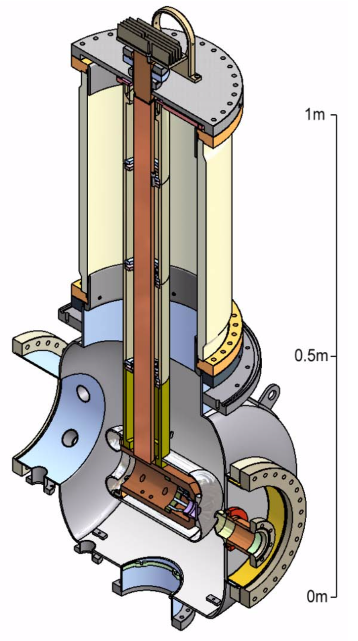
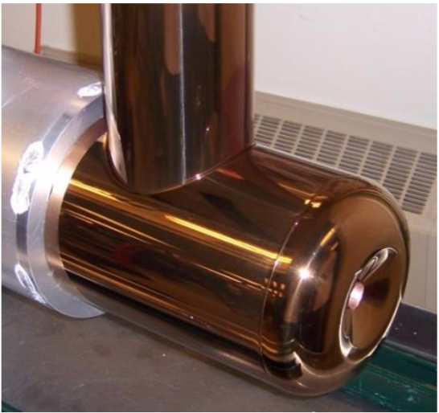
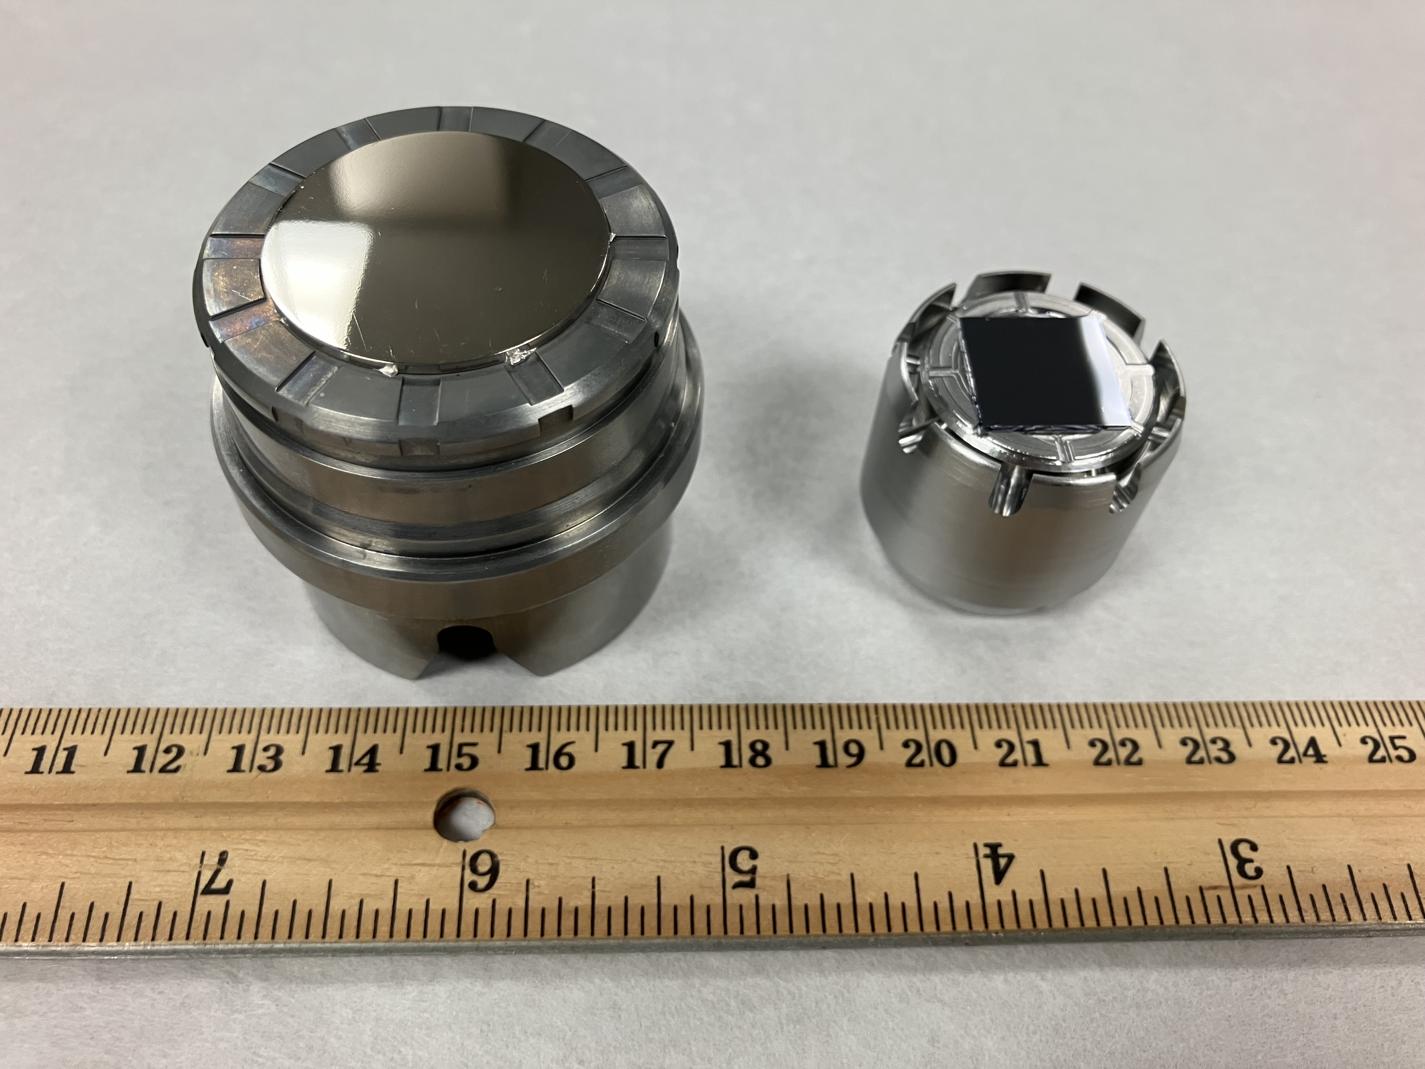

Larger size electrodes are needed for large size laser spot on photocathode
CEBAF photocathode puck
The Cornell photogun demonstrated up to 65 mA CW non-polarized beam from a ~ 4 mm diameter laser spot
Prototype photocathode puck
Cornell electrode
12 in
CEBAF electrode
6 in
B. Dunham et al., APPLIED PHYSICS LETTERS 102, 034105 (2013)

Slide 29




In 2023 we received a DOE HEP U.S.-Japan (FOA LAB 23-2858) grant to develop a 500 kV insulator fitting commercial HV cables
Electrostatic models in CST are being developed
The electrostatic potential simulations of the insulator will be used for designing a test electrode
Commercial HV cable rated to 400 kV
500 kV insulator prototype model

Slide 30





Concept and Challenges of High-Power Tungsten Target
Target Concept (Side View)
Heat by Beam
Temperature in Rot. Target
A. Ushakov et al, IPAC’23
Cycling Temperature
Some parameters of currently considered high-power e⁺ target:
~40 cm target diameter
2 Hz rot. frequency
8 mm radius of water channel
0.3 kg/s water mass flow (1.5 m/s)
Target Challenges:
High power deposited by beam → cool and rotate
Radiation damage → rotate
Material fatigue cause by cycling temperature → study material properties under realistic conditions
17 kW deposited by 1 mA @ 120 MeV
$σ_{x}=σ_{y}=$ 1.5 mm
A. Ushakov

Slide 31

Distribution of Power Deposed by 1 mA @ 120 MeV e‒ Beam (FLUKA)
 | Power [kW]
Target | 18.11
Compensation Solenoid | 0.74
Coil of Main Solenoid | 0.02
Iron of Main Solenoid | 0.06
W10Cu Absorber inside Main Solenoid | 18.88
TZM Absorber (99.4% Mo, 0.5% Ti, 0.1% Zr) | 58.66
W10Cu Absorber upstream Cavities | 12.50
Solenoid around Cavity | 0.12
Cu Cavities | 6.50
Total Absorbed Power | 115.56 (96.3%)
Beam Power at z = 275 cm, r < 3cm | 3.20
Steel
TZM
Cu Coil
Cu Coil
W10Cu
W10Cu
Cu Cavity*
Compensation
Solenoid
Target
Mechanical design and simulations of temperature,
thermal stress, radiation damage and
optimization of whole e⁺ capture system
have to be done / will be continued
 | Photons | Electrons | Positrons
Yield per primary e⁻ | 0.123 | 0.029 | 0.005
Mean Energy [MeV] | 12.7 | 49.6 | 35.7
Power [kW] | 1.57 | 1.44 | 0.19
Fraction in Total Beam Power | 49.1 | 44.9 | 6.0
* FLUKA model does not have E-field in cavity
A. Ushakov

Slide 32



Capture using a high field solenoid in a QWT configuration
Field Map (imported in FLUKA)
1.29 T Solenoid
Absorbers
Solenoids with and without Steel
(calculated by J. Benesch)
Target
e⁺
Highly
Polarized e⁺
15 cm thick good magnet steel with inner radius of 25 cm
allows significant reduction of current density and
reduces field in rotated target
A. Ushakov

Slide 33


GaInSn prototype test stand
A free surface GaInSn liquid metal test stand was constructed from 304 SS.
The GaInSn is pumped by a Liquiflo Model H7F Mag-Drive gear pump with speed controlled by a constant-torque VFD.
Example GaInSn jet with speed ∼ 8 m/s.
V. Kolstrum

Slide 34

Nozzle for GaInSn target investigated using OpenFOAM.
The red part shows a 3 mm × 10 mm jet. The nozzle extends from 0 to 0.015 m.
Nozzle velocity (blue), for an input velocity of 3 m/s. The output velocity is ∼12 m/s. The red curve is the kinematic pressure p/ρ.
V. Kolstrum

Slide 35
Transporting large e+ beam
Transverse emittance is many times that of CEBAF. Goal is to inject up to 40 mm.mrad (usual e- beam is 1mm.mrad) to the front of NL. This beam also has up to a percent of energy spread.
Dedicated transport lines with large bore quads and low dispersion optics were designed
LDRD (Amy Sy) aims at designing, installing and using a degraded e- beam in the existing CEBAF to confirm that one can transport 40mm.mrad.

Slide 36


Recent development: Using a DBA structure

Slide 37


Large bore quadrupoles
JLAB TN-06-029 (Benesch). Designed to accommodate the 60mm.mrad normalized emittance expected in 22 GeV hall lines
40 to 60 mm.mrad normalized is
what we expect in the LERF
to CEBAF transport.
104 mm ID. Can be made 35.56 cm or longer. More than enough field for our needs and
eliminate considerations of chromatic effects.
Will need custom power supplies
but it can be ganged together
in the LERF->SL line

Slide 38


Degrader girder location in CEBAF
Mott
DP can
DP can
booster
First full CM
Beamline valves
Fast valves
MHB0L02BH
MHE0L03V
58 inch section
Break at yellow markers
Amy Sy

Slide 39

Moving towards reality: engineering design
Target ladder
[G. Hays, S. Gregory]
Aperture
Aperture
Solenoid
Corrector
Corrector
Helicity coil

Slide 40

Reversing polarity in magnets, how fast can we go ?
Reversing polarity of 2100 CEBAF magnets (S. Philip Head DC Power group)
>1900 (correctors & quads) already bipolar operation
39 (recirculation/transport dipoles) will require engineered solution
  21 recirculation & dog-leg
  12 extraction units
  6 end-station transport/dump
Hall D is only permanent magnet – would have to be rotated
Magnetic Field Integrity (M. Tiefenback CEBAF magnet systems integrator)
Unipolar dipoles would need to be deliberately tested
  demonstrate field restores after polarity inversion
  quantify possible systematic effects
Soft iron steel are expected to perform well under polarity reversal
Two decades of operation suggest remnant fields <20 G tolerable
  Sudden power supply trips introduce uncontrolled flux
  Modifications to power supplies or field maps
Technote JLAB-TN-23-043

Slide 41
3-Year R&D overview – aggressively pursuing FOA’s

