Slide 1

Continuous Electron Beam Accelerator Facility Overview
Yves Roblin
Center for Advanced Studies of Accelerator

Slide 2
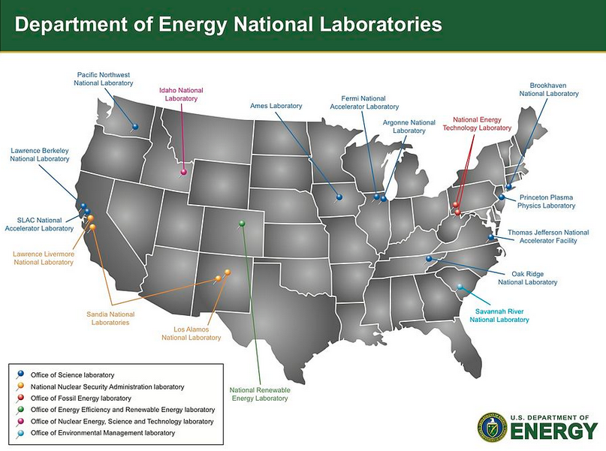
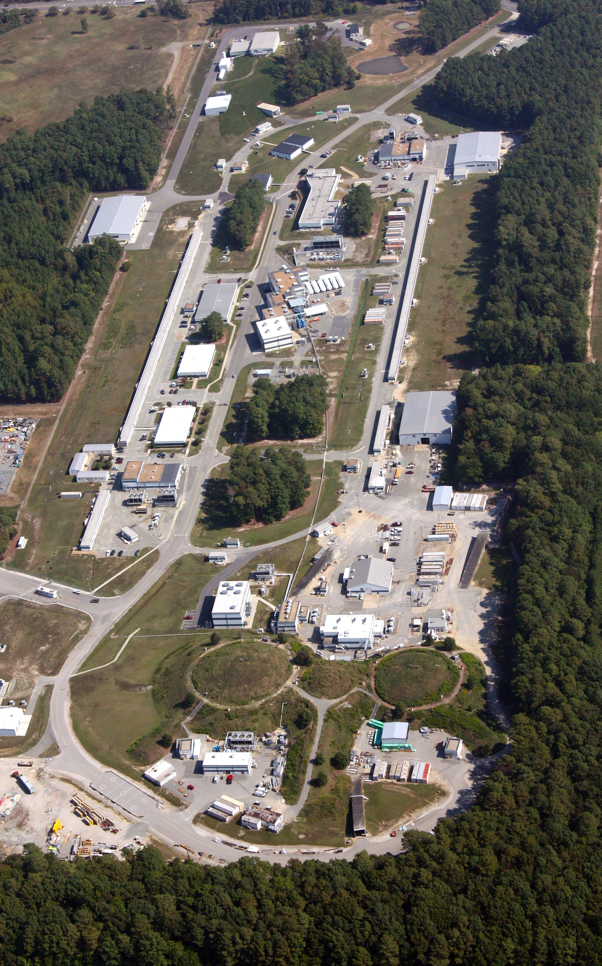
Jefferson Lab Overview
Core Competencies
  Nuclear Physics Research
  SRF Technology Leadership
  Polarized Electron Sources
  Cryogenics Research and Development
  Accelerator Physics and Diagnostics Development

Slide 3
Jefferson Lab Overview
Quick Facts
  180 M$ annual operating budget
  759 Full Time Employees
  >1600 Active Users
  Produces ~1/3 of US PhDs in Nuclear Physics
  169 acres and 80 buildings and trailers

Slide 4
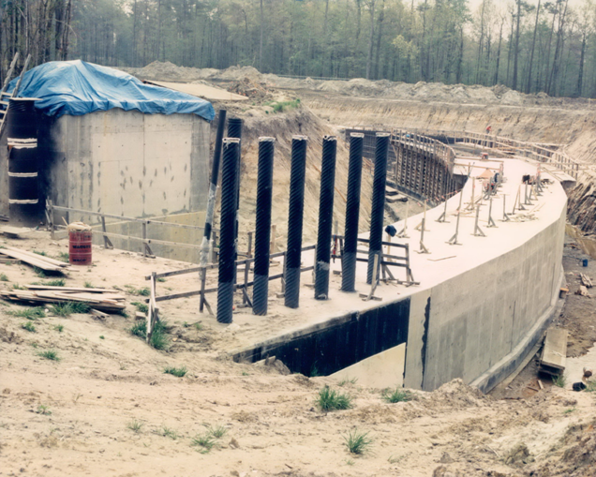
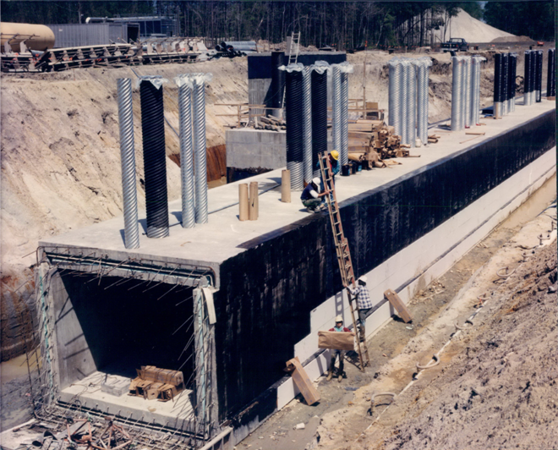
Cut and Cover Construction
CEBAF Tunnel ~30 feet underground
Sits on an ancient Sea Floor called the Yorktown Formation
Composed largely of over-consolidated sand, clay and sea shells
East Arc Tunnel
LINAC Tunnel

Slide 5
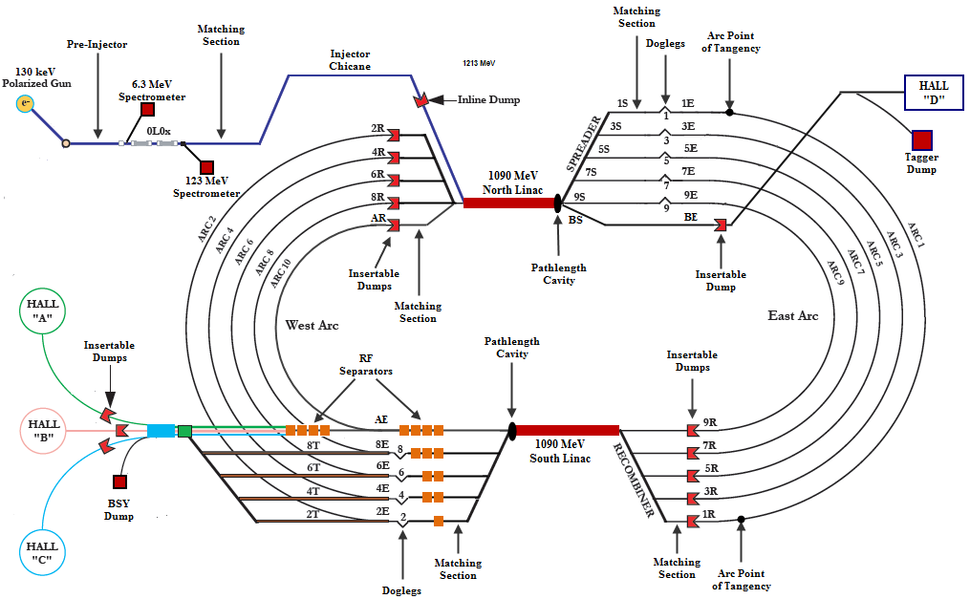
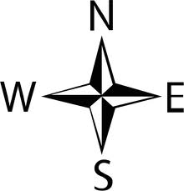

CEBAF Overview
12051MeV
2303 MeV
1213 MeV
4483 MeV
3393 MeV
6660 MeV
5573 MeV
8836 MeV
7747 MeV
11006 MeV
9922 MeV
11006 MeV

Slide 6
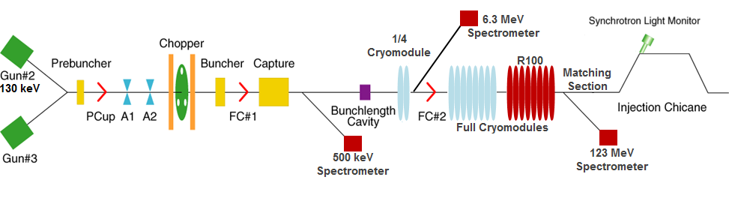
CEBAF Injector
~150 m
Source provides ~90% polarized electrons with variable bunch charge
Interleaved micro-bunch structure at 499 MHz or 249.5 MHz depending on physics program
Bunching cavities to control longitudinal size of beam
Faraday cups to measure beam current
Aperture A1 and A2 to collimate the beam and minimize transverse phase space extent
Chopper system to independently control beam intensity for each experiment
Capture RF system to transition to relativistic energy
18 SRF cavities accelerate beam to 123 MeV beam for injection into the North Linac
Spectrometers to measure energy of the electron beam

Slide 7
Why using a CW beam system ?
SRF technology allows for more efficient acceleration (higher gradients,not limited by resistive effects)
Better control of energy spread and stability. CEBAF is world leader in producing near chromatic beam (<2e-4 de/e at lower energy) perfect for hypernuclear experiments (tens of KeV resolution in the spectrometers)
Low bunch charge with high rep rate reduces pile up (one event per bunch or less), yet still enable measuring very small cross-sections
Narrow coincidence windows reduce accidentals.

Slide 8
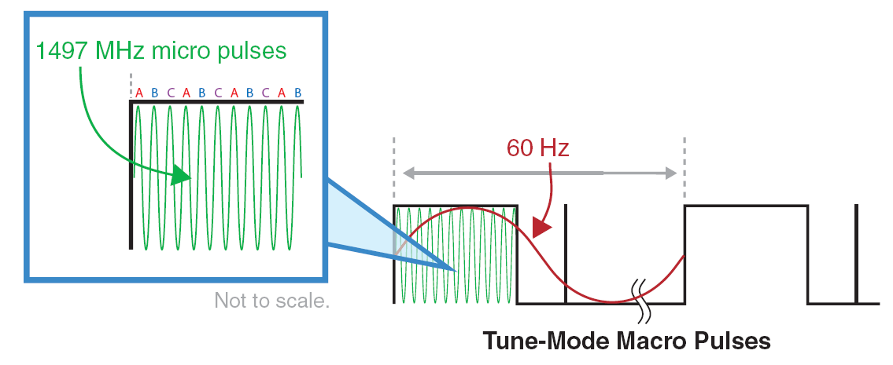
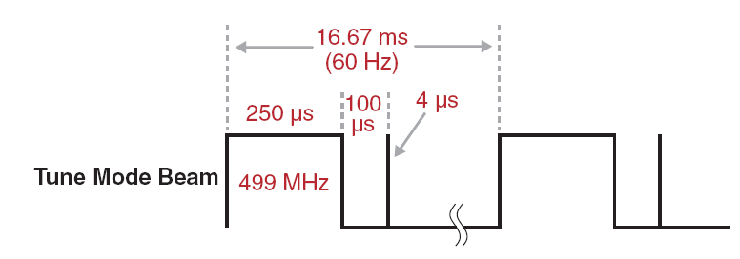
CEBAF Beam Structure
Accelerator tuning is always done using low average power beam.
The 250 μs pulse width at 60 Hz provides a 1.5% duty cycle.
Nominal pulse height is 4 μA.
Beam power is 720 W for a 12 GeV beam at this duty factor.
The 4 μs trailing pulse is for measuring linac BPM orbits and linac arrival time.
3 interleaved 499 MHz bunch trains injected into 1497 MHz Linacs
4-Hall operations uses 249.5 MHz bunch trains

Slide 9
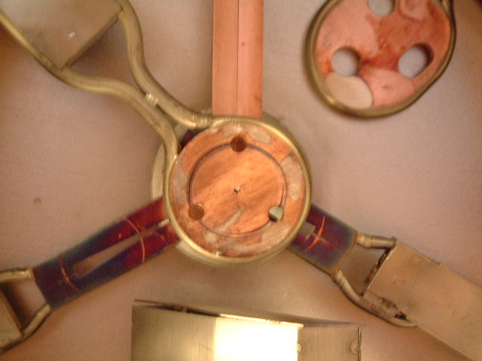
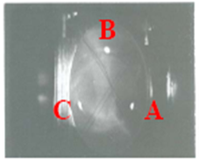

Chopping System
B
C
A/D
Beam
Beam
Beam
Beam
Beam
Beam
Beam
Beam
Beam
Beam
Beam
Beam
Beam
Beam
Beam
Beam
Beam
Beam
Beam
Beam
Beam
Beam
Beam
Chopper #1
RF Cavity (499 MHz)
Lens
Master Slit
Lens
Chopper #2
RF Cavity (499 MHz)

Slide 10
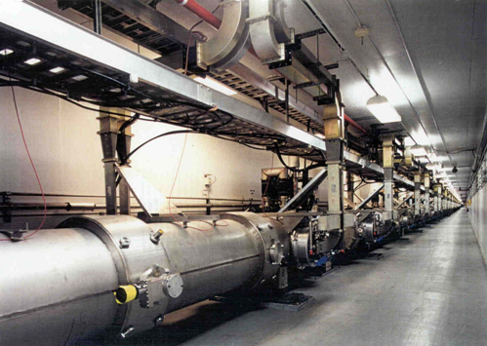
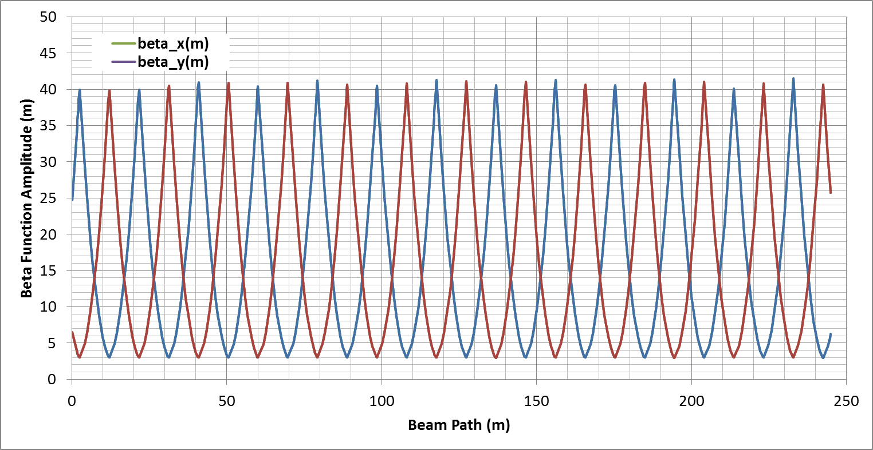
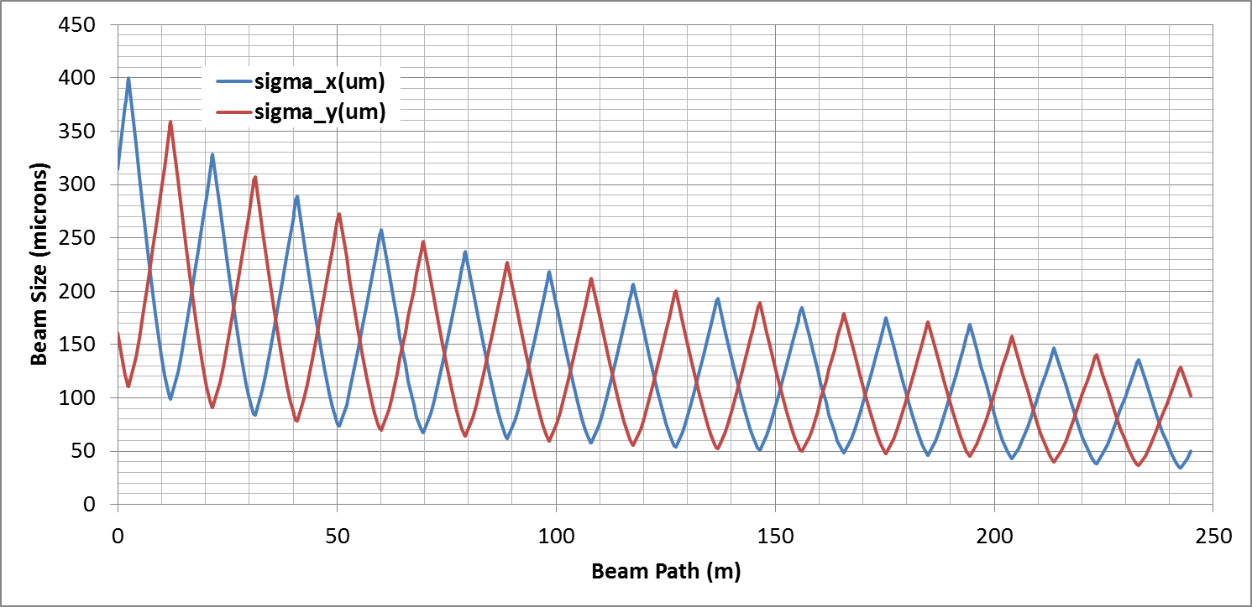
North and South Linacs
North and South Linac Optics:
  9.6 m FODO channel with cryomodules between quadrupoles.
  Beam injected with large spot size and damps as the beam is accelerated.
  Skew quads in lattice around C20 and C50 cryomodules to correct for skew moment in cavity fields.
  C100s have no skew moment.
  Designed to provide 1090 MeV for a 12 GeV CEBAF

Slide 11
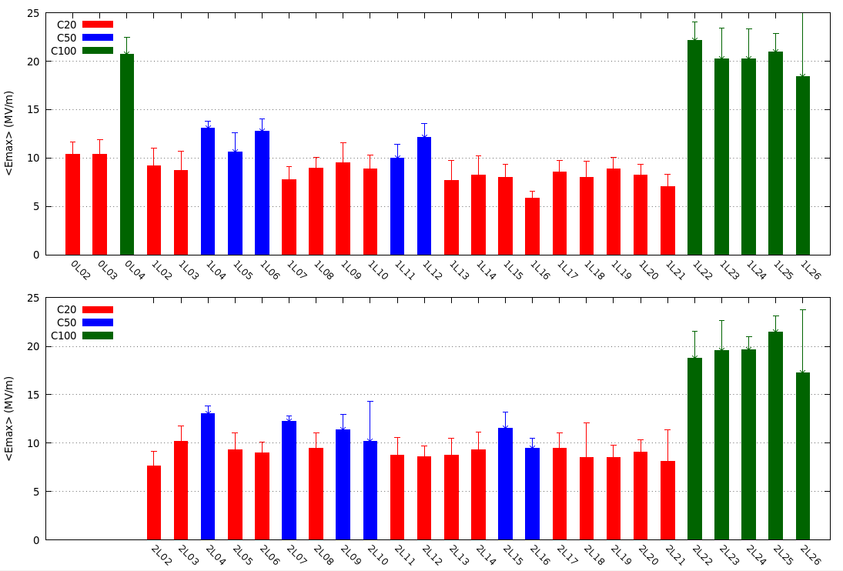
Average Cavity Gradient
There are 418 SRF cavities in CEBAF

Slide 12
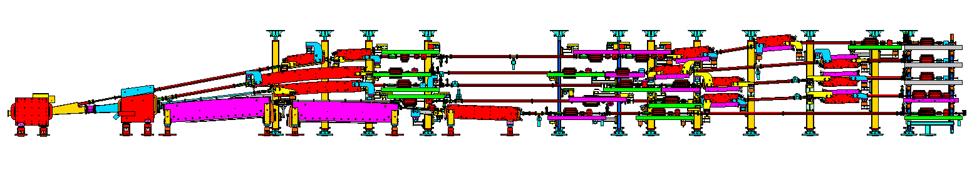
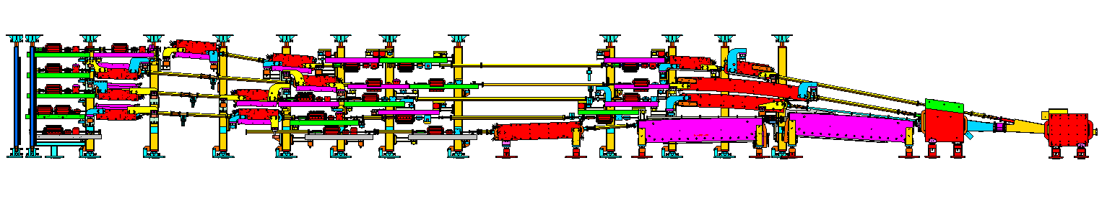
Spreaders and Recombiners
Spreader/Recombiner layout:
  Vertically achromatic system designed to accept broad range of multi-pass input parameters for recirculation transport.
  Final step heights in ½ meter increments above lowest pass.
  Quads in step control the vertical dispersion.
  Recombiner is mirror-symmetric to the Spreader.
West Spreader
West Recombiner

Slide 13
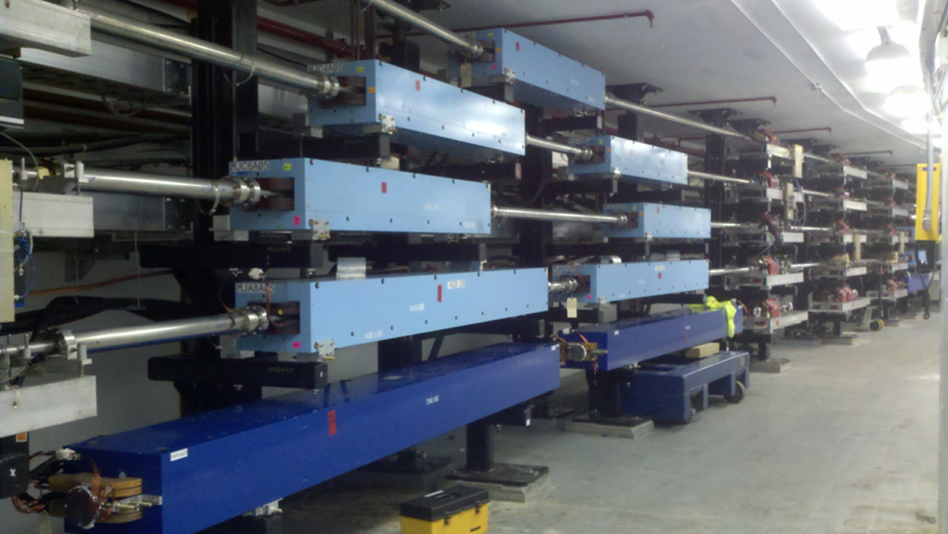
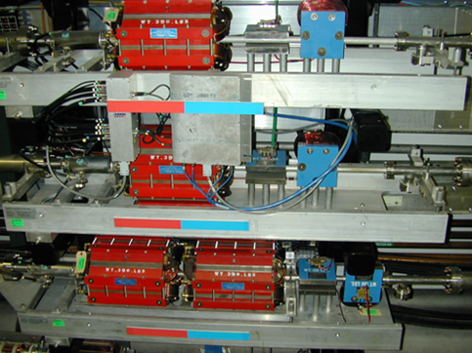
CEBAF Recirculation Arcs
Arc layout:
  Sixteen dipoles for Arc 1 and Arc 2 and thirty-two dipoles for Arc 3-10.
  The recirculating Pi bends are at a radius of 80 m.
  Each Arc has 32 quadrupole girders grouped in 4 families to control achromaticity, momentum compaction and the betatron tune.
  Beam Position Monitors at the entrance of quadrupoles.
  Horizontal and vertical correctors throughout to control the beam orbit.
West Arc Dipoles
Arc Quadrupole Girders

Slide 14
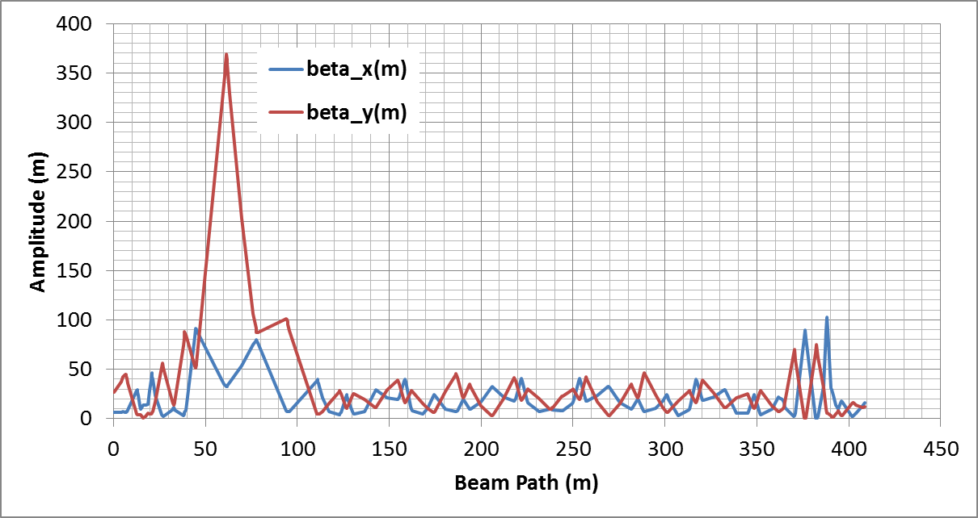
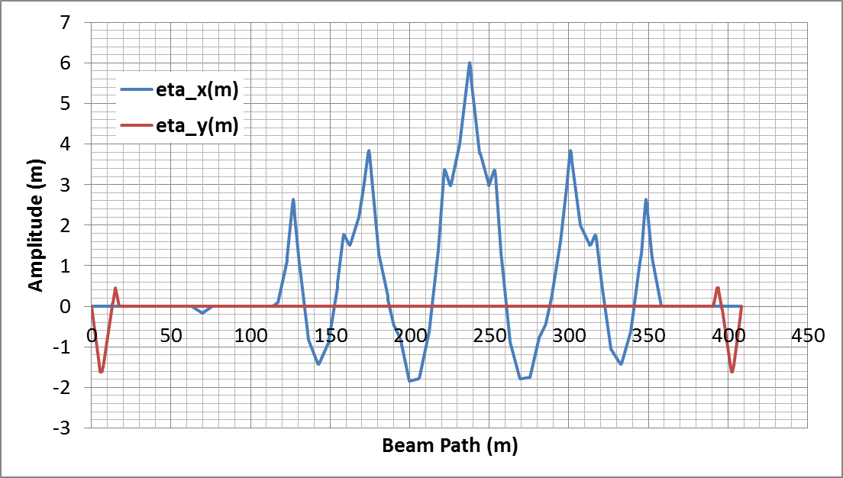
1st and 2nd Recirculation Arcs
Arc 1/2 Optics:
  Segment begins at start of the Spreader and ends at the exit of the Recombiner.
  Matching section in Spreader for matching the beam to the Arc.
  Matching section in Recombiner for matching to the Linac.
  Quads in vertical steps are used to null the vertical dispersion.
  Quads near peaks of dispersion function within the Arc are used to null the horizontal dispersion and control M₅₆.
  Enhanced horizontal dispersion in Arcs 1/2 provide better resolution for energy monitoring.
Vertical Dispersion Knobs
Horizontal
Dispersion Knobs
Vertical Dispersion Knobs
Matching Section
Matching Section

Slide 15
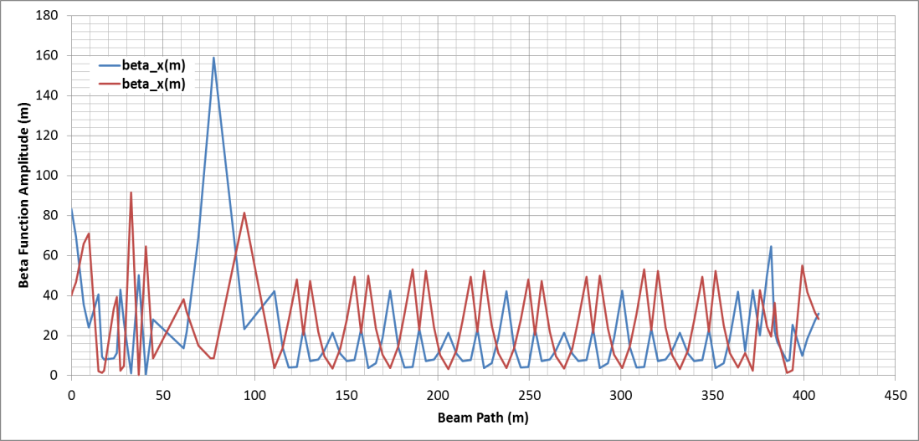
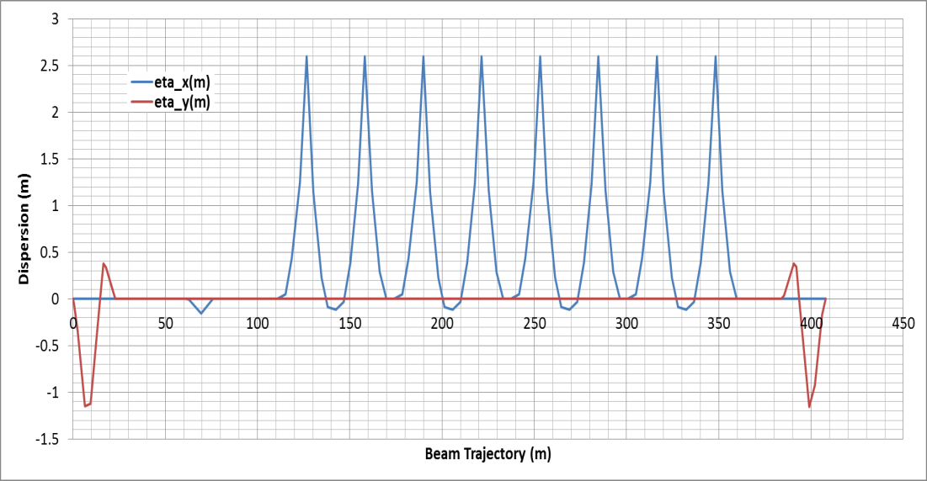
Higher Energy Arcs
Arc 3-10 Optics
  The design optics for the upper Arcs is represented below.
  Matching section in Spreader for matching the beam to the Arc.
  Matching section in Recombiner for matching to the Linac.
  Quads in vertical steps are used to null the vertical dispersion.
  Quads near peaks of dispersion function within the Arc are used to null the horizontal dispersion and control M₅₆.
  Amplitude of vertical dispersion peaks go down with pass count due to the smaller elevation change.
Insertable
Dump
Horizontal
Dispersion Knobs
Matching Section
Vertical Dispersion Knobs
Vertical Dispersion Knobs
Matching Section

Slide 16
Extraction Region
12051MeV
2303 MeV
1213 MeV
4483 MeV
3393 MeV
6660 MeV
5573 MeV
8836 MeV
7747 MeV
11006 MeV
9922 MeV
11006 MeV

Slide 17
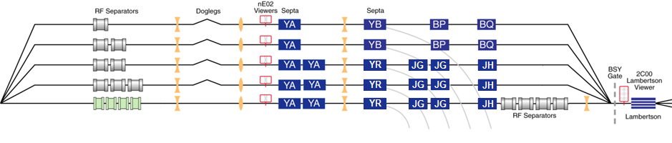
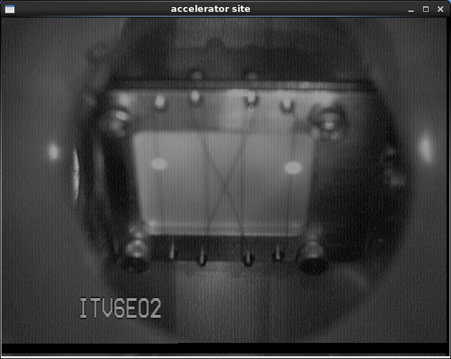
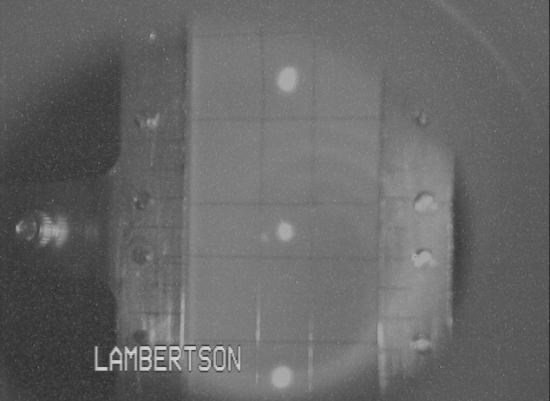
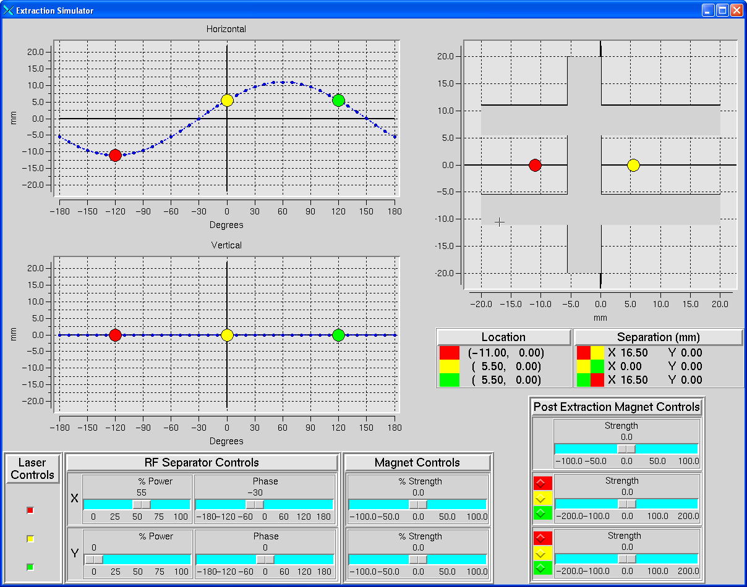
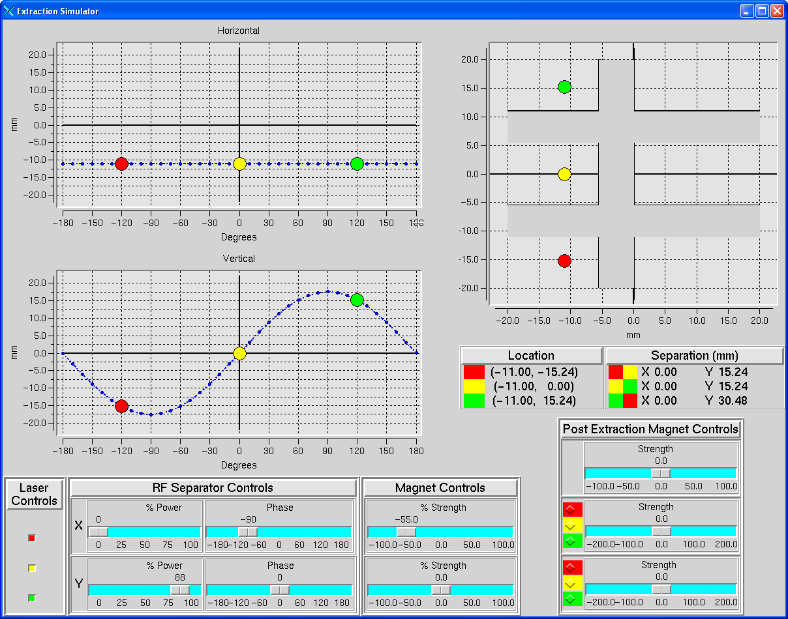
Extraction System
  Overall configuration:
    Horizontal extraction systems at 500 MHz for 1st through 4th pass
    Vertical extraction system at 500 MHz for 5th pass
    New horizontal extraction system at 750 MHz for 5th pass
Pass 1
Pass 2
Pass 3
Pass 4
Pass 5
Extraction Elevation View
West Arc Beamlines

Slide 18
RF Separation – 1st through 4th Pass
A
B
C
Turn on RF separator
Hall Lasers
Hall A: 500 MHz
Beam to Halls
B
B
B
B
B
B
B
B
B
B
Hall B: 500 MHz
B
B
B
B
B
B
B
B
B
Beam
B
B
B
B
Hall C: 500 MHz
B
B
B
B
B
B
B
B
B
B
B
B
B
B
B
B
B
B
B
B
B
B
B
B
B
B
C
B
C
A
B
C
A
B
C
A
B
C
A
C
A
B
C
A
B
C
A
B
B
C
C
A
A
B
B
C
A
B
C
A
B
C
A
B
C
C
C
C
A
B
C
A
B
C
C
C
C
C
C
A
C
A
C
A
C
A
A
C
C
A
C
A
C
A
A
A
A
C
A
C
A
C
A
A
C
C
A
A
C
A
A
A
C
A
C
A
C
A
A
C
A
C
C
A
C
A
C
A
C
A
C
C
A
C
A
C
A
C
A
C
A
C
C
A
C
A
C
A
C
A
C
A
C
A
C
A
C
C
C
A
C
B
C
A
B
C
C
A
C
A
C
A
A
C
C
A
C
A
C
A
A
A
C
C
Accelerator
Frequency
1500 MHz
C
C
Recirculated
Beams
Separator frequency is 1/3 of the fundamental frequency
RF Separator Cavity
500 MHz
Beams begin to separate
A
B
C
A
B
C
A
B
C
A
B
C
A
B
C
A
B
C
A
B
C
A
B
C

Slide 19
Halls A,B,C 5th Pass Vertical Separation
To Halls A,B,C
A
A
A
A
Beam
A
B
A
C
B
A
B
B
B
A
B
B
Accelerator
Frequency
1500 MHz
C
C
C
C
C
RF Separator Cavity
500 MHz

Slide 20
12 GeV Beam at CEBAF vs. Ce⁺BAF
Machine Parameter | Electrons | Positrons
Hall Multiplicity | 4 | 1 or more
Max. Energy (ABC/D) | 11/12 GeV | 11/12 GeV
Beam Repetition | 249.5/499 MHz | 249.5/499/1497 MHz
Duty Factor | 100% cw | 100% cw
Unpolarized Intensity | 170 μA** | > 1 μA
Polarized Intensity | 170 μA** | > 50 nA
Beam Polarization | > 85% | > 60%
** Total beam power at Jefferson Lab is limited to 1.1 MW with a max. of 0.9 MW to individual high power dumps.
Notes:
Slides 4 and 5 are basically what we told pac51 (and the users proposing to pac51) we were aiming for.
The key point is we are not going to get to very high currents. And polarization is even lower.
Hall B clearly rocks as they basically get polarized positions at their nominal current.
> Signs are ~ signs
One hall is easy. Multiple halls will be a challenge. Right now it is a three year program of single hall running.
1499 is one hall get best CW

Slide 21




The FFA@CEBAF Collaboration
R. M. Bodenstein, S.A. Bogacz, A.M. Coxe, K.E. Deitrick, B.R. Gamage, R. Kazimi, D. Khan, E.A. Nissen, K.E. Price, Y.R. Roblin, R. Ruber, T. Satogata, A. Seryi, Jefferson Lab
J.S. Berg, S.J. Brooks, D. Trbojevic, Brookhaven National Lab
V.S. Morozov, Oak Ridge National Lab
G.H. Hoffstaetter, Cornell University

Slide 22
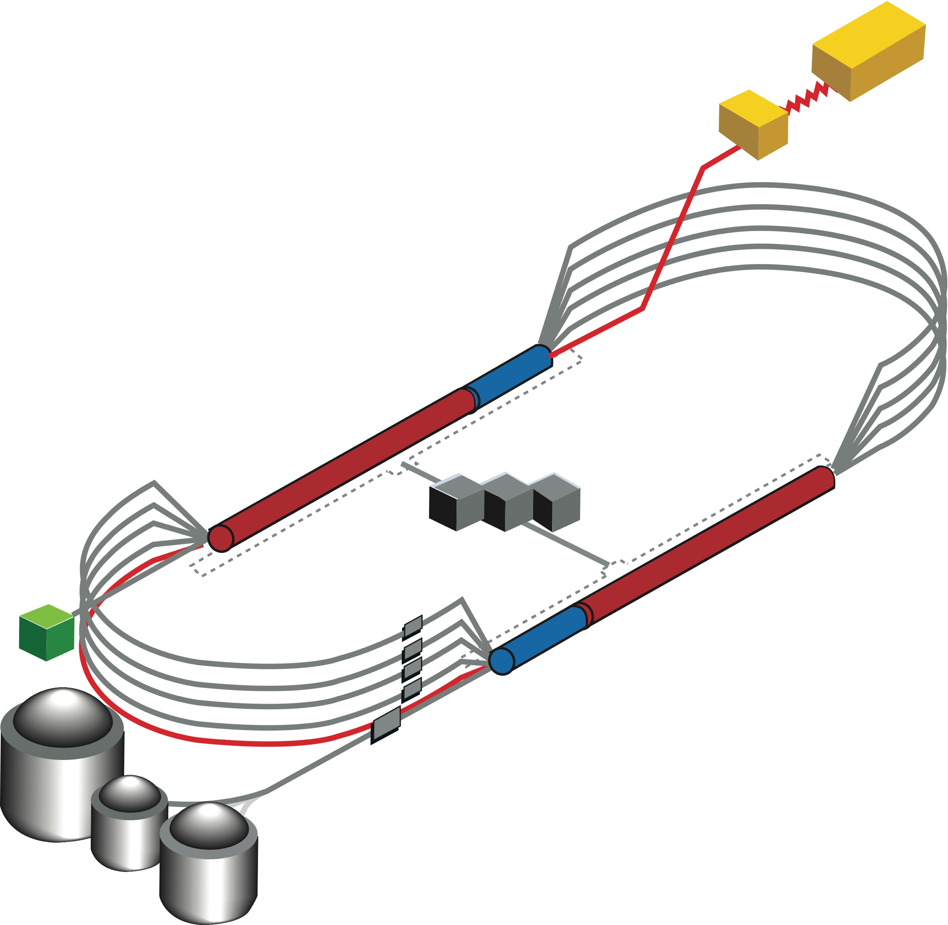

CEBAF FFA Upgrade – Baseline under Study
  While last energy upgrade was achieved by adding additional cavities, there is no more room for cavities in existing footprint (stay with 1.1 GeV per linac)
  So, increasing number of recirculation passes has been considered, keeping in mind very limited room in the arcs for additional passes
  Remove the highest recirculation pass (Arc 9 & A) and replace them with two compact FFA arcs including time-of-flight chicanes (TOF)
  New 650 MeV recirculating injector
  Recirculate 4 + 6.5 times to get to 22 GeV
TOF
650 MeV
TOF
Enabling Technology:
Novel permanent magnets, -like used for power and cost savings
Pass Arithmetic: 5 -1 + 6.5 = 10.5

Slide 23
Overview
Current baseline: 650 MeV inj + 4-pass CEBAF + 6.5-pass FFA
FFA Arc Architecture – -style
  Non-scaling FFA based on high-gradient permanent magnets
  Compact merger to control orbits, beta functions and dispersion at arc ends
Multi-pass linac optics
  650 MeV injector upgrade
  Strongly focusing triplet lattice periodic optics for lower passes
Modified CEBAF ‘switchyard’, Arcs 1-8 and TOF correction ‘splitters’
Synchrotron radiation impact on beam quality, mitigations
Summary, Outlook

Slide 24
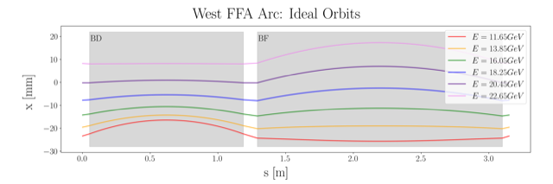
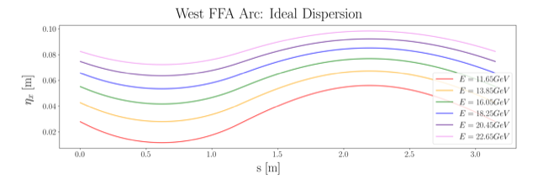
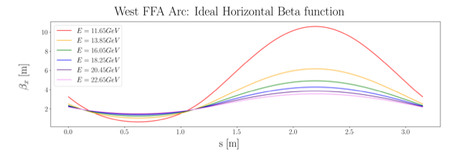
Non Scaling FFA Arc − Compact FODO Cell
orbits
Large momentum acceptance FFA cell, configured with combined function magnets capable of transporting six beams with energies spanning a factor of two
Arc composed of 75 cells, L_{cell} = 3.15 m
Closely spaced orbits for all six beams (~ 4 cm)
Low betas (~ a few m)
Extremally low dispersions (a few cm) - Virtue of combined function FFA magnets
dispersions
beta functions

Slide 25
Permanent Magnet Design
Very compact compared to conventional electro magnets
Allows for accommodating 6 additional passes in CEBAF tunnel
Provides power and cost savings
Concept successfully tested at
Open mid-plane geometry
Focusing Magnet BF
G_{F}= -41.13 T/m
L_{QF}= 1.67 m
B_{F}= -0.812 T
Defocusing Magnet BD
G_{D}= 43.44 T/m
L_{BD}= 1.24 m
B_{D}= -0.593 T
12 cm
12 cm
13 cm
13 cm

Slide 26
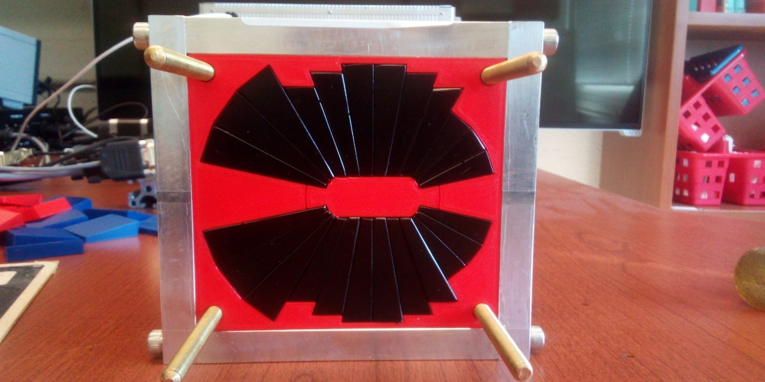
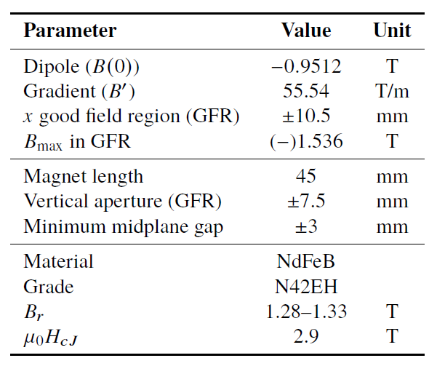

Prototype Magnet
Prototype open-midplane BF magnet successfully built and evaluated for mechanical integrity
>1.5 Tesla measured in good field region
Field accuracy of ${10}^{−3}$
Testing magnetic materials for radiation resilience at CEBAF - LDRD project started Oct. 1, 2023

Slide 27
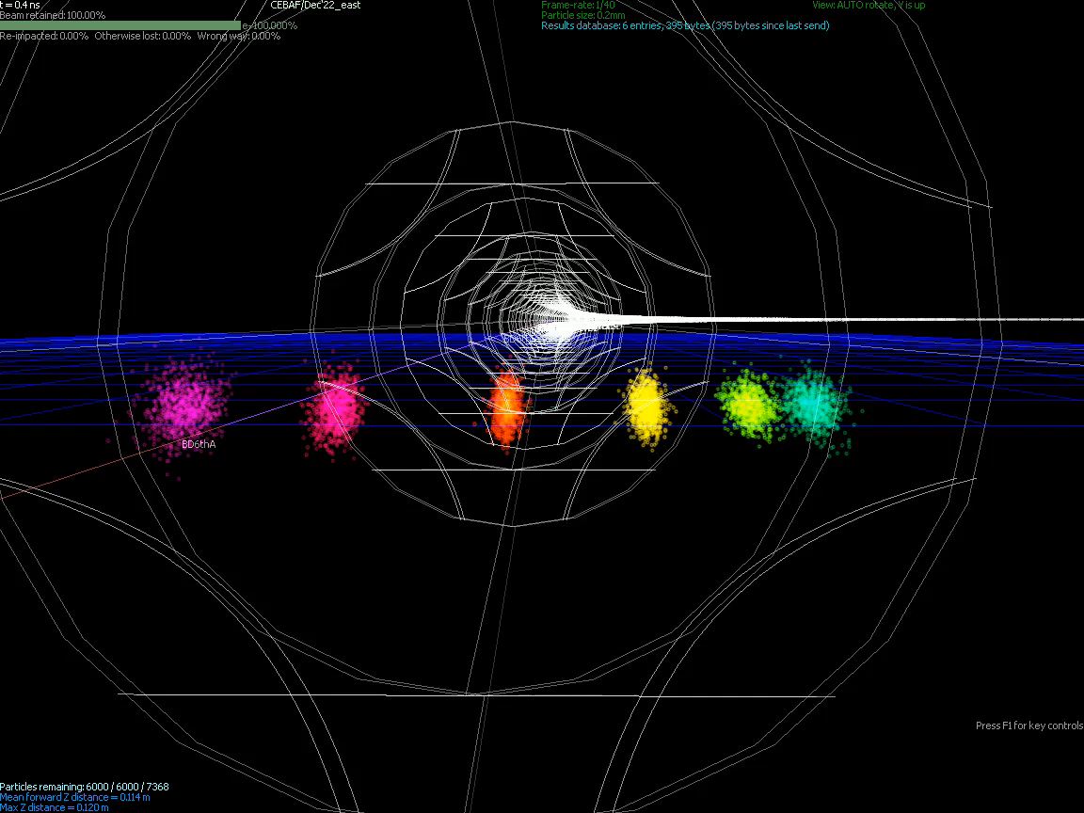
Stephen Brooks

Slide 28
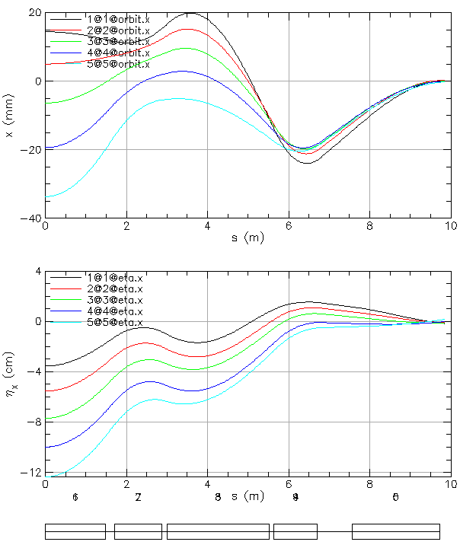
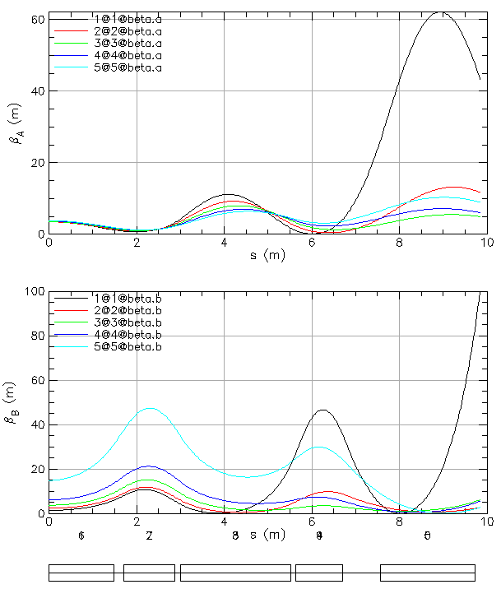
FFA Arc to Straight – Compact Merger
Breaking cell symmetry by altering (length, bend) of a few magnets to merge different energy orbits at arc ends.
Simultaneously, the dispersion and its derivative are suppressed at arc ends.
Furthermore, small beta functions (~5 m) need to be matched to higher-bets of the linacs (~90 m).
This simplifies switchyard and reduces its functionality to pathlength and momentum compaction adjustment.

Slide 29
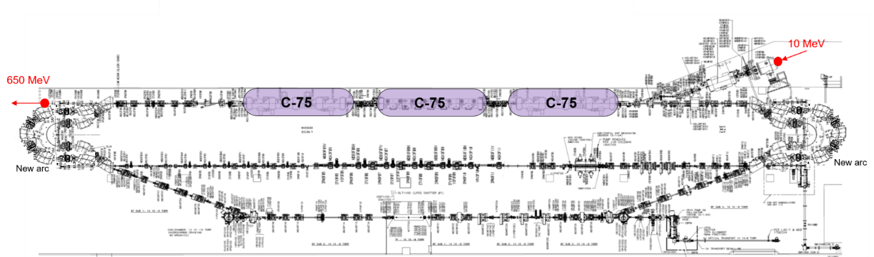
Injector Upgrade − 650 MeV Recirculating Injector
With the present 123 MeV injector, the difference in the first and final pass energies in the North Linac is too large (1:175) to effectively control the beam.
650 MeV recirculating injector (3-pass) based on LERF will allow a manageable difference in energies (1:33)

Slide 30
Recirculating Injector Based on LERF (3-pass)
10 MeV + 3 × 3 × 71 MeV = 650 MeV
10 MeV
436 MeV
C-75
C-75
C-75

Slide 31
Recirculating Injector Based on LERF (3-pass)
10 MeV + 3 × 3 × 71 MeV = 650 MeV
10 MeV + 3 × 3 × 71 MeV = 650 MeV
10 MeV
650 MeV
436 MeV
C-75
C-75
C-75
C-75
C-75
C-75
New arc
New arc

Slide 32
Multi-pass Linac Optics (11 passes, 1:33 Energy Ratio)
Present FODO linac offers periodic optics only for the lowest energy pass with large beta beating for higher passes (beta ~1000 m), which is not compatible with small betas (~5 m) in the FFA arcs.
Replacing FODO (alternating singlets) with alternating triplets – more uniform beam envelope
30
Triplet Cells, phase advance: 150⁰ per cell
pass 1
0.65 GeV
BETA_X&Y[m]
0
0
BETA_X
BETA_Y
DISP_X
DISP_Y
243.507
0
pass 4
60
7.25 GeV
BETA_X&Y[m]
0
0
BETA_X
BETA_Y
DISP_X
DISP_Y
243.507
0

Slide 33
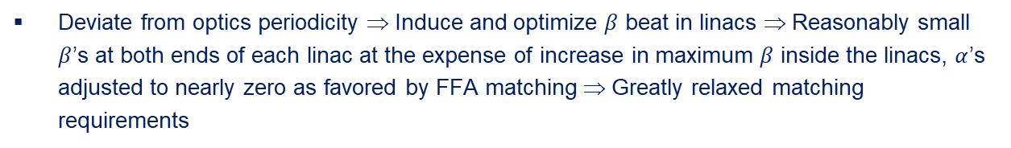
Transition to weakly focusing ‘Beta Beat’ Linac Optics for FFA Passes
Deviate from optics periodicity ⇒ Induce and optimize $β$ beat in linacs ⇒ Reasonably small $β$’s at both ends of each linac at the expense of increase in maximum $β$ inside the linacs, $α$’s adjusted to nearly zero as favored by FFA matching ⇒ Greatly relaxed matching requirements
180
5
pass 6
11.6 GeV
BETA_X&Y[m]
0
0
BETA_X
BETA_Y
DISP_X
DISP_Y
284.877
0
.
.
.
pass 10
240
5
20.5 GeV
BETA_X&Y[m]
0
0
BETA_X
BETA_Y
DISP_X
DISP_Y
284.877
0

Slide 34
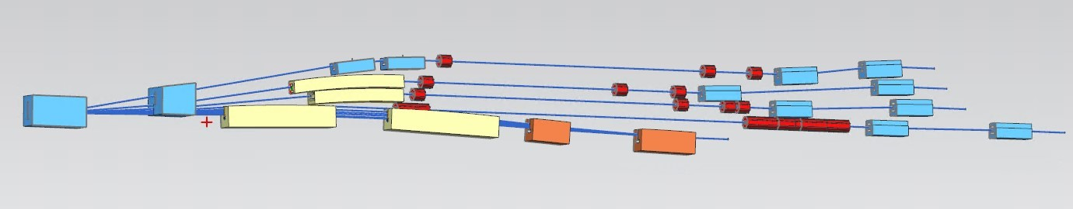
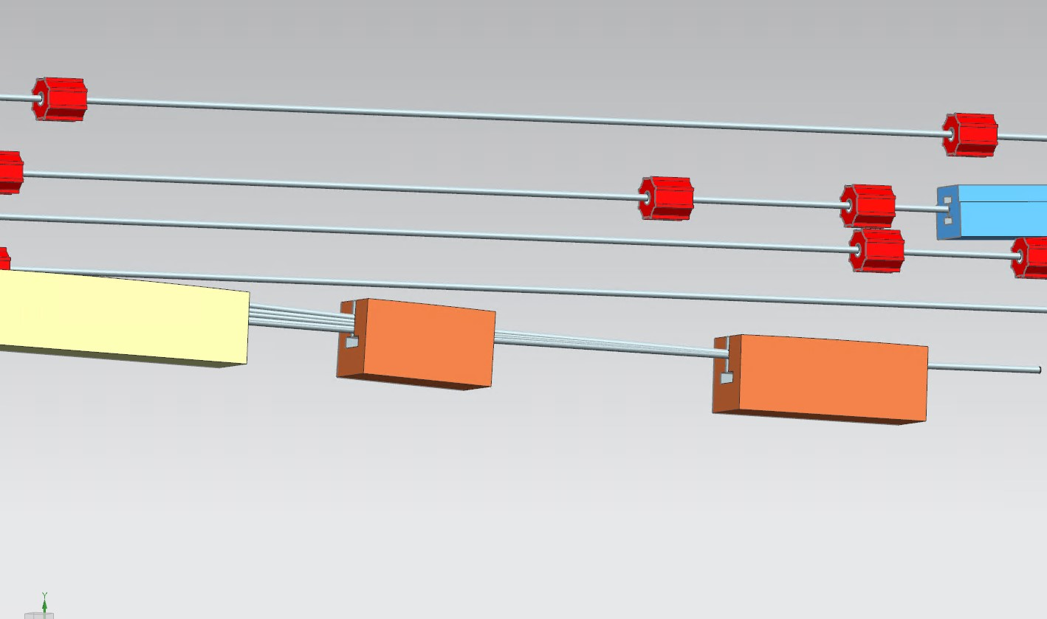
Modified Switchyard to Accommodate Six FFA Passes
pass 1
pass 2
pass 3
FFA passes 5-10
pass 4
FFA passes 5-10

Slide 35


Energy loss, Emittance dilution and Energy spread
  Doubling the energy, while staying within current CEBAF footprint, makes the synchrotron radiation effects of paramount importance.
  Quantum nature of a ‘recoil’ effect on electrons due to photon emission makes significant impact on both the transverse and longitudinal beam dynamics, leading to cumulative emittance growth (transverse and longitudinal).
Energy loss
Emittance dilution
Natural energy spread
Maximize $ρ$, minimize H
  Cumulative emittance dilution (transverse and longitudinal) at 22 GeV (4 CEBAF + 6 FFA passes)
Projected value from the Spr/Rec contribution

Slide 36


Summary
Present Baseline (1.1 GeV per linac):
  650 MeV Recirculating Injector (additional three C-75 cryomodules)
  Recirculate 4 passes with the current CEBAF
  Plus Additional 6 passes via a single FFA: 10 – 22 GeV
Non Scaling FFA Arc Architecture configured with compact FODO cells
  Beta and dispersion matching to the linacs through cell-by-cell variation (length, bend)
  Open mid-plane permanent magnet design: B-field ≤ 1 T, Gradient ≤ 50 T/m
Synchrotron Radiation impact on beam quality:
  Net transverse normalized emittance:
  Net natural energy spread: 1.5×10⁻³
  Net synchrotron radiated energy: 1 GeV
$$σ=\sqrt{β\frac{ε_{N}}{γ}}$$
$$ε_{N}=\text{80 }\text{mm} \text{mrad}$$
at 22 GeV, β = 20 m → σ = 175 microns
at 22 GeV → ΔE = 33 MeV

Slide 37
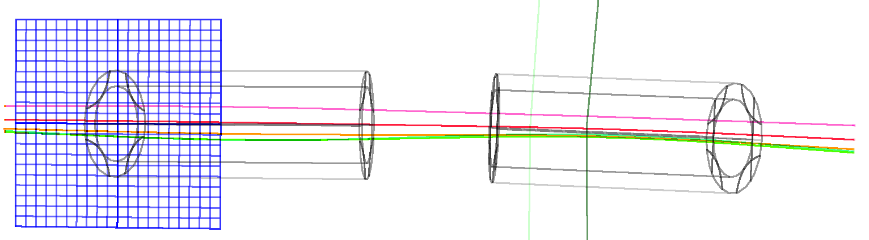

Thanks for your attention!
22 GeV CEBAF FFA Energy Upgrade

