Slide 1


Physics From Deep Virtual Exclusive Data
Charles Hyde

Slide 2
A few starting thoughts
Our analysis methods could probably be improved
Most experiments analyzed by binning data, and then fitting distributions
Possibilities to use Maximum Likelihood methods on un-binned data
  Very computationally intensive
  Opportunities for AI/ML?

Slide 3
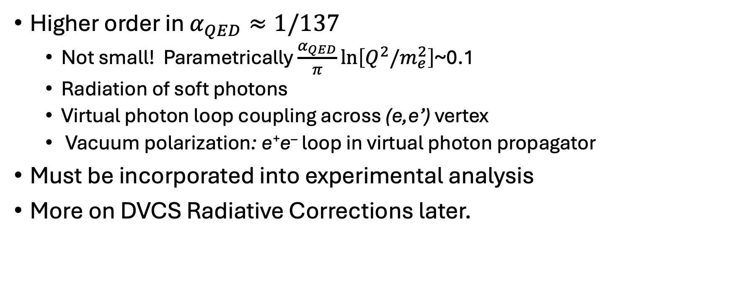
Radiative Corrections
Higher order in $α_{QED}≈1/137$
  Not small! Parametrically $\frac{α_{QED}}{π}ln⁡\left[Q^{2}/m_{e}^{2}\right]$~0.1
  Radiation of soft photons
  Virtual photon loop coupling across (e,e’) vertex
  Vacuum polarization: e⁺e– loop in virtual photon propagator
Must be incorporated into experimental analysis
More on DVCS Radiative Corrections later.

Slide 4
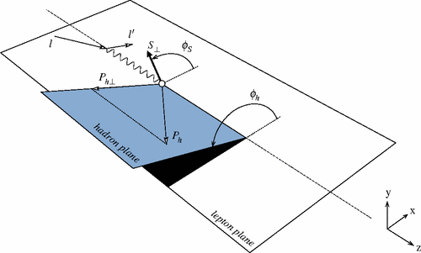
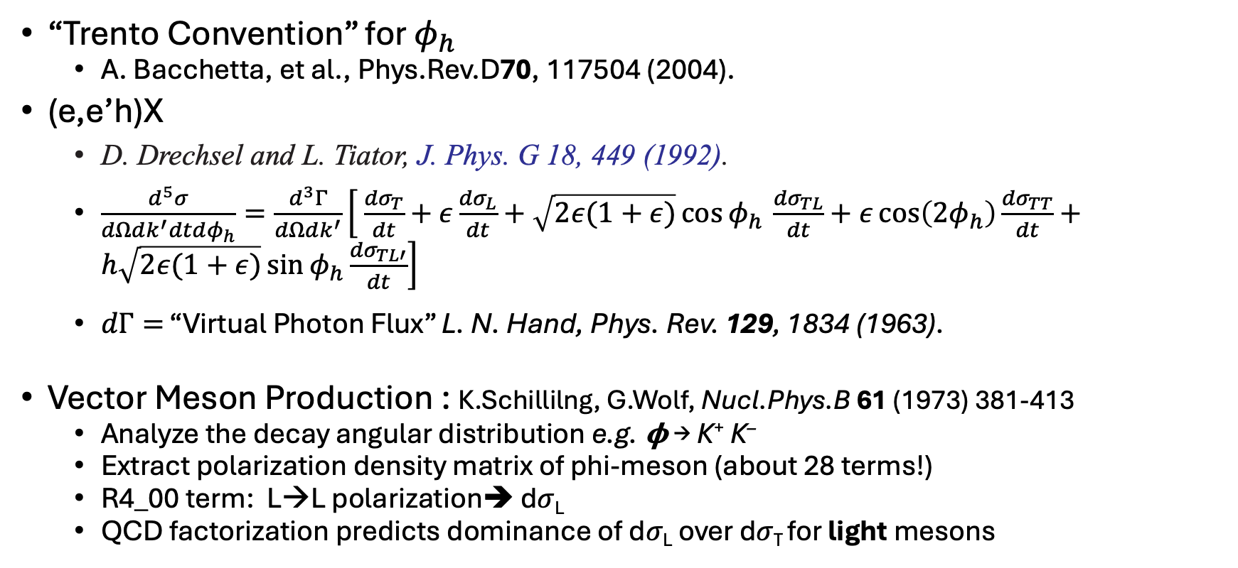
Electroproduction
“Trento Convention” for $φ_{h}$
  A. Bacchetta, et al., Phys.Rev.D70, 117504 (2004).
(e,e’h)X
  D. Drechsel and L. Tiator, J. Phys. G 18, 449 (1992).
  $\frac{d^{5}σ}{dΩdk^{′}dtdφ_{h}}=\frac{d^{3}Γ}{dΩdk^{′}}\left[ \frac{{dσ}_{T}}{dt}+ε\frac{{dσ}_{L}}{dt}+\sqrt{2ε(1+ε)}\cos{φ_{h }}\frac{{dσ}_{TL}}{dt}+ε\cos\left(2φ_{h}\right){\frac{{dσ}_{TT}}{dt}}+h\sqrt{2ε(1+ε)}\sin{φ_{h}}\frac{{dσ}_{TL′}}{dt}\right]$
  $dΓ=$ “Virtual Photon Flux” L. N. Hand, Phys. Rev. 129, 1834 (1963).
Vector Meson Production : K.Schillilng, G.Wolf, Nucl.Phys.B 61 (1973) 381-413
  Analyze the decay angular distribution e.g. 𝛟 → K⁺ K–
  Extract polarization density matrix of phi-meson (about 28 terms!)
  R4_00 term: L→L polarization➔ d𝜎_{L}
  QCD factorization predicts dominance of d𝜎_{L} over d𝜎_{T} for light mesons

Slide 5
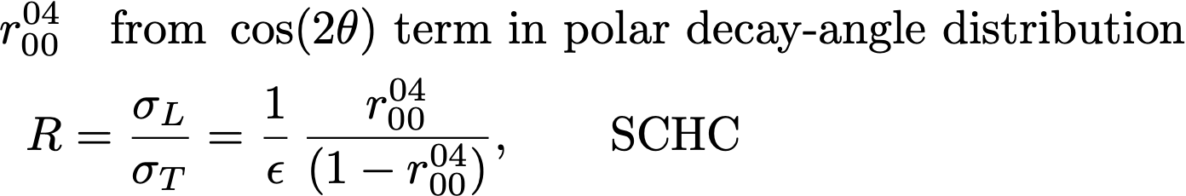
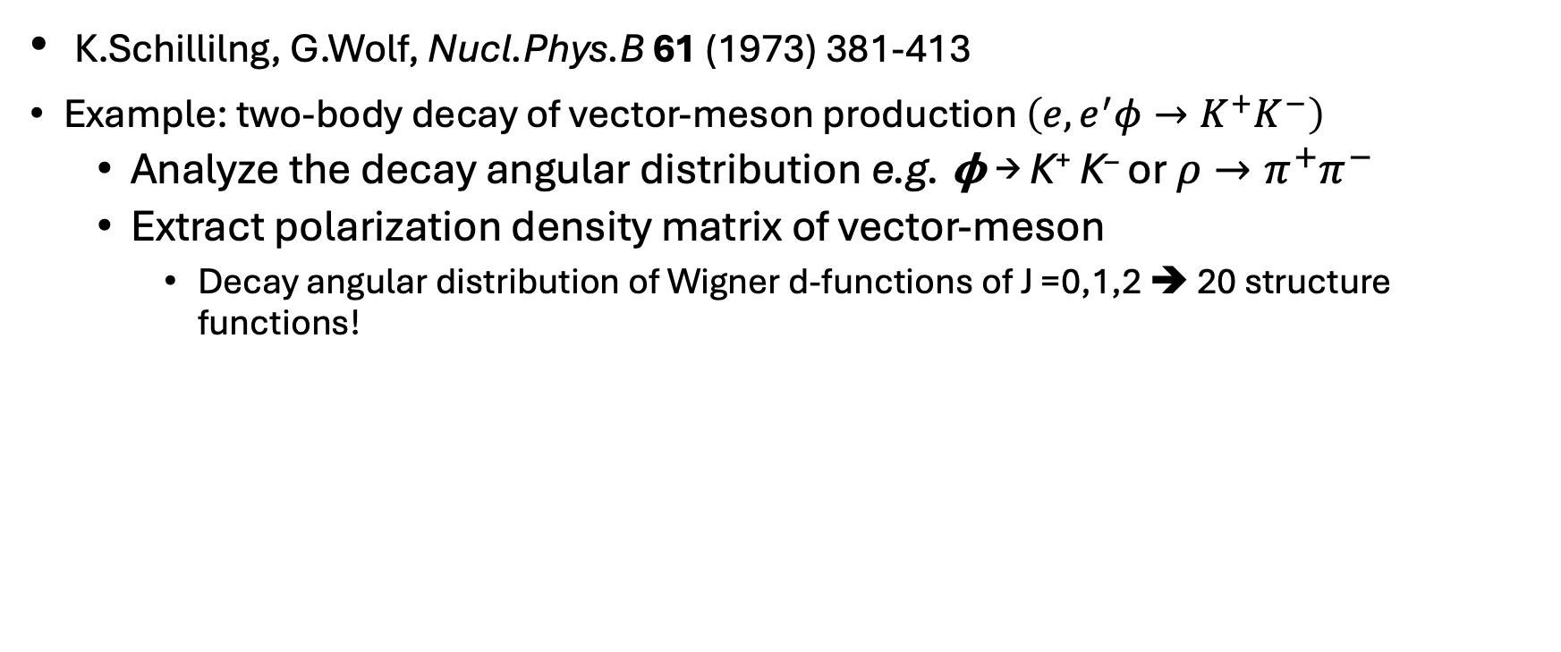
Vector Meson Electroproduction
K.Schillilng, G.Wolf, Nucl.Phys.B 61 (1973) 381-413
Example: two-body decay of vector-meson production $\left(e,e^{′}φ→K^{+}K^{−}\right)$
  Analyze the decay angular distribution e.g. 𝛟 → K⁺ K– or $ρ→π^{+}π^{−}$
  Extract polarization density matrix of vector-meson
    Decay angular distribution of Wigner d-functions of J =0,1,2 ➔ 20 structure functions!

Slide 6
Exclusive Vector Meson Production at HERA
Summary talk from Diffraction2004
A. Levy / Nuclear Physics B (Proc. Suppl.) 146 (2005) 92–101, arXiv:0501008
Ratio grows slower than Q²
  Factorization of 𝜎_{L} and 𝜎_{T} can be considered separately

Slide 7
Vector Meson production: t-dependence
G.Wolf https://arxiv.org/abs/0907.1217

Slide 8
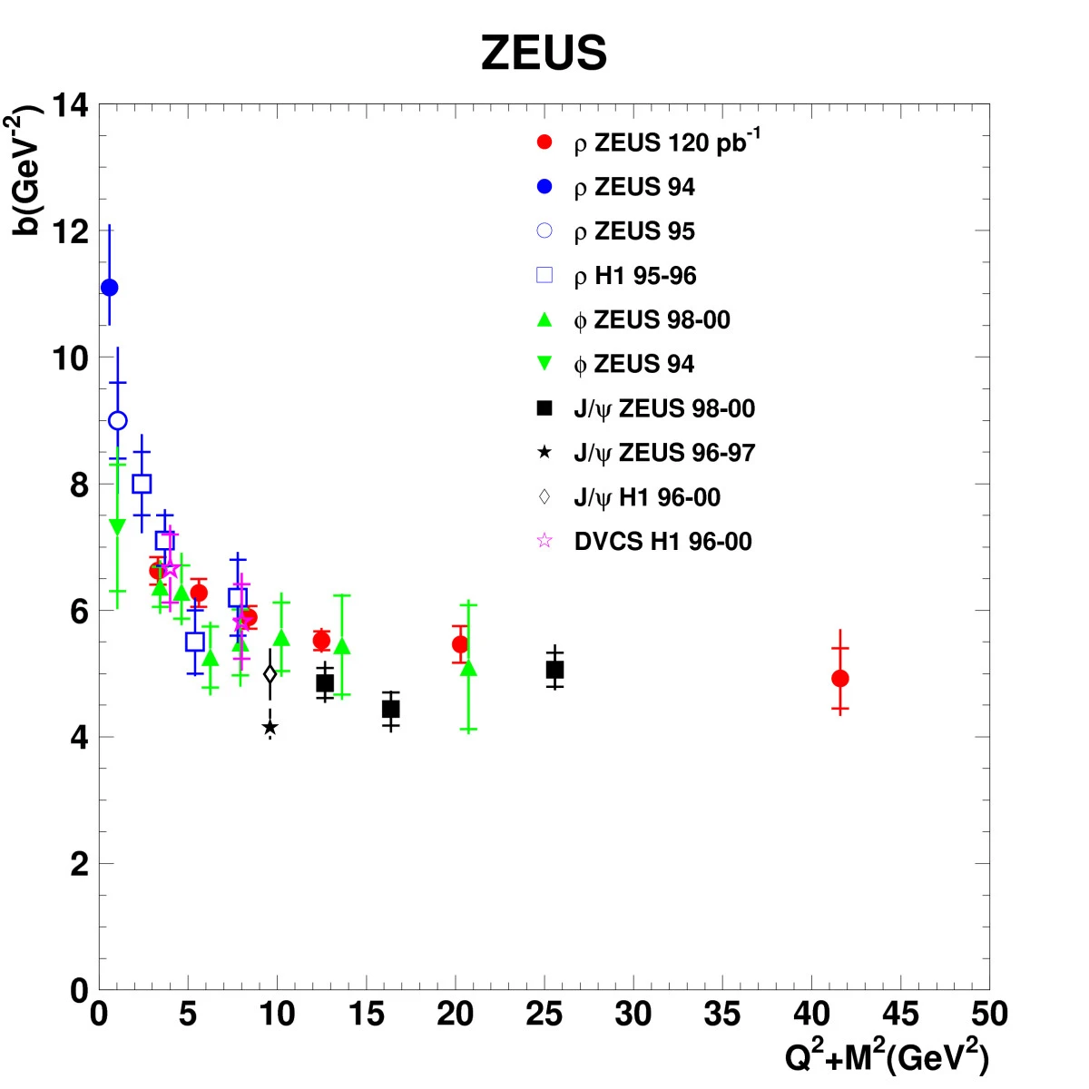
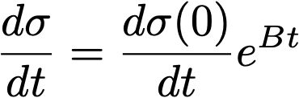

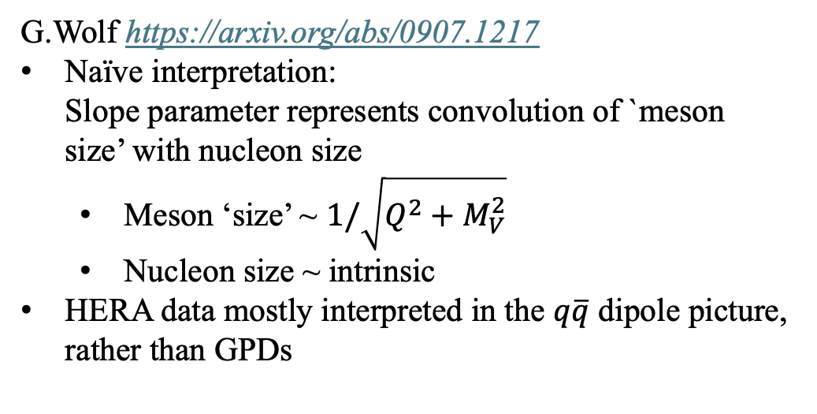
Exclusive Vector Meson Production at HERA
zDESY-07-118_11
G.Wolf https://arxiv.org/abs/0907.1217
Naïve interpretation:
Slope parameter represents convolution of `meson size’ with nucleon size
  Meson ‘size’ ~ $1/\sqrt{Q^{2}+M_{V}^{2}}$
  Nucleon size ~ intrinsic
HERA data mostly interpreted in the $q\overline{q}$ dipole picture, rather than GPDs

Slide 9
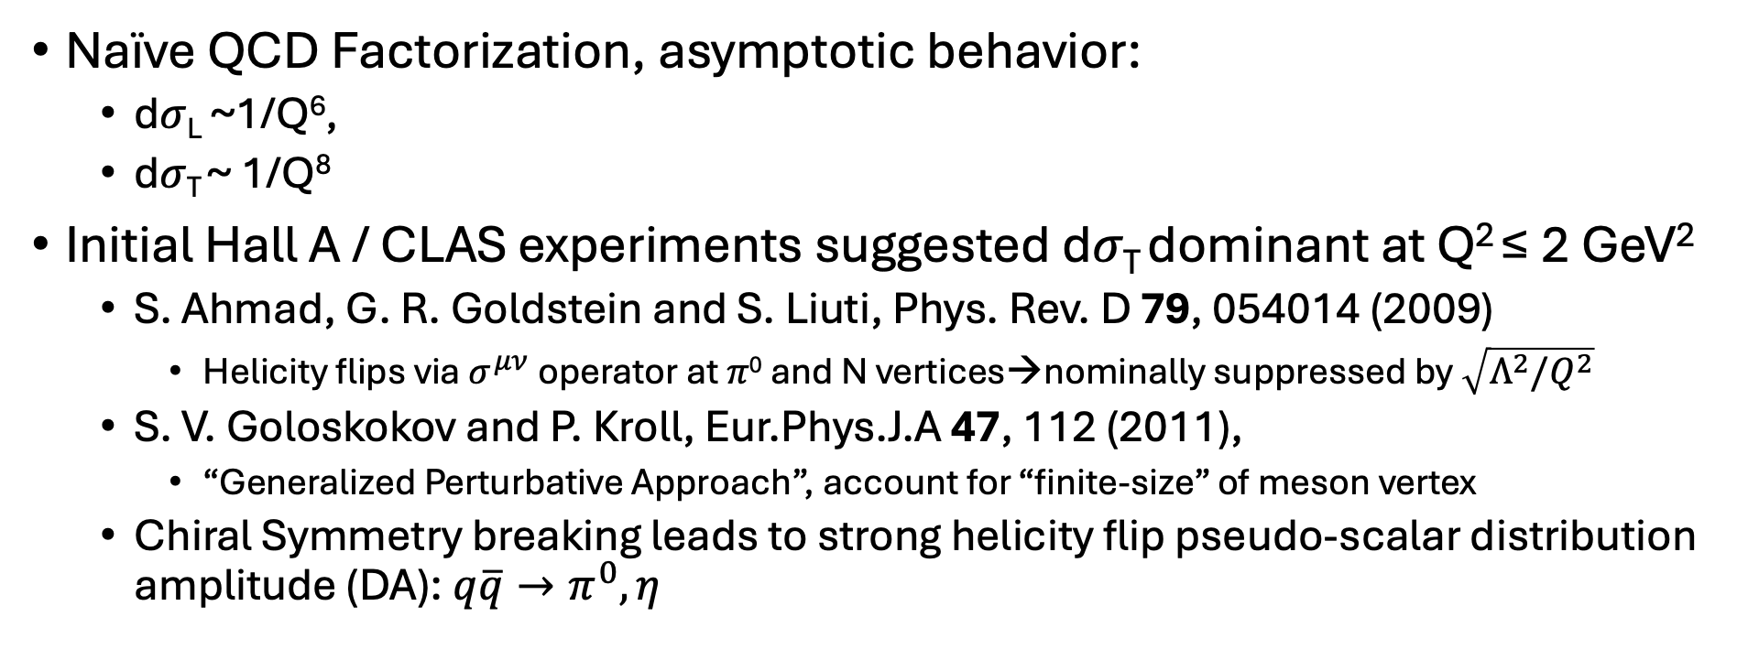
Deep Virtual 𝜋⁰ and 𝜂 Production
Naïve QCD Factorization, asymptotic behavior:
  d𝜎_{L} ~1/Q⁶,
  d𝜎_{T} ~ 1/Q⁸
Initial Hall A / CLAS experiments suggested d𝜎_{T} dominant at Q² ≤ 2 GeV²
  S. Ahmad, G. R. Goldstein and S. Liuti, Phys. Rev. D 79, 054014 (2009)
    Helicity flips via $σ^{μν}$operator at 𝜋⁰ and N vertices→nominally suppressed by $\sqrt{Λ^{2}/Q^{2}}$
  S. V. Goloskokov and P. Kroll, Eur.Phys.J.A 47, 112 (2011),
    “Generalized Perturbative Approach”, account for “finite-size” of meson vertex
  Chiral Symmetry breaking leads to strong helicity flip pseudo-scalar distribution amplitude (DA): $q\overline{q}→π^{0}, η$

Slide 10
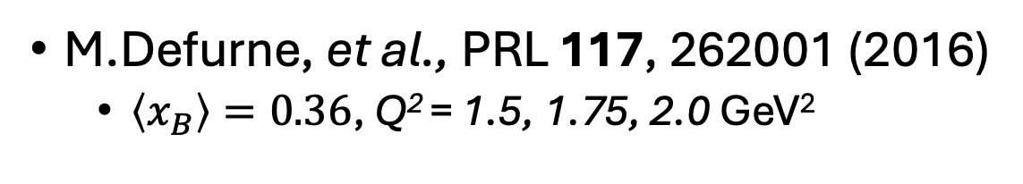
Hall-A Rosenbluth Separation:
H(e,e’𝜋⁰)p
d𝜎_{T}
d𝜎_{L}
VGG
M.Defurne, et al., PRL 117, 262001 (2016)
  $\left\langle x_{B}\right\rangle =0.36$, Q² = 1.5, 1.75, 2.0 GeV²
d𝜎_{TL}
Long Dashed:
Goldstein, Hernandez, Liuti, Phys. Rev. D 84, 034007 (2011).
Solid:
S. Goloskokov and P. Kroll, Eur. Phys. J. A 47, 112 (2011).
d𝜎_{TT}

Slide 11
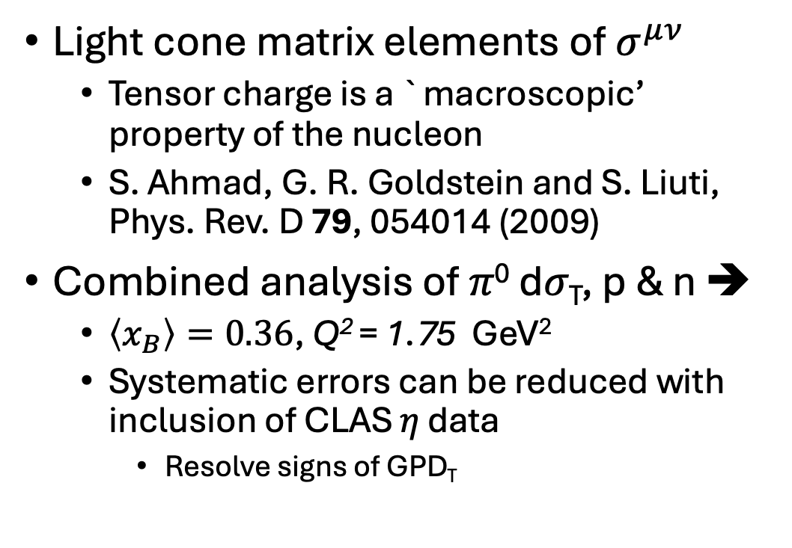
Transversity GPDs
M.Mazouz et al., [Hall A]
u
d
Light cone matrix elements of $σ^{μν}$
  Tensor charge is a `macroscopic’ property of the nucleon
  S. Ahmad, G. R. Goldstein and S. Liuti, Phys. Rev. D 79, 054014 (2009)
Combined analysis of 𝜋⁰ d𝜎_{T}, p & n ➔
  $\left\langle x_{B}\right\rangle =0.36$, Q² = 1.75 GeV²
  Systematic errors can be reduced with inclusion of CLAS 𝜂 data
    Resolve signs of GPD_{T}
u
d

Slide 12
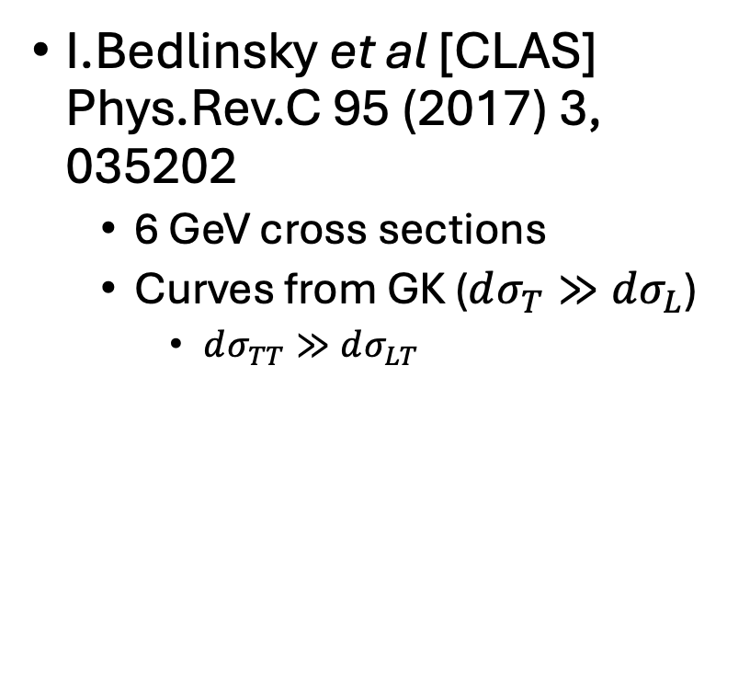
Deep Virtual 𝜂
I.Bedlinsky et al [CLAS] Phys.Rev.C 95 (2017) 3, 035202
  6 GeV cross sections
  Curves from GK ($dσ_{T}≫dσ_{L}$)
    $dσ_{TT}≫dσ_{LT}$

Slide 13
Comparison of
Deep 𝜋⁰ and 𝜂
I.Bedlinsky et al [CLAS] Phys.Rev.C 95 (2017) 3, 035202
Curves of Goloskokov & Kroll qualitatively accurate

Slide 14
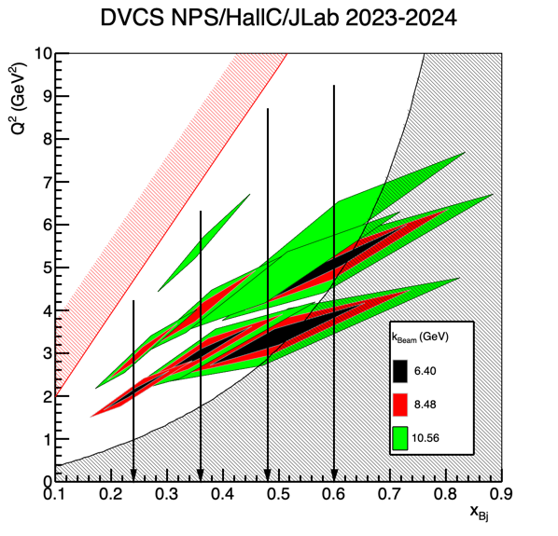
12 GeV: Hall A 𝜋⁰
Hall C data in analysis
Rosenbluth separations
H, D targets

Slide 15
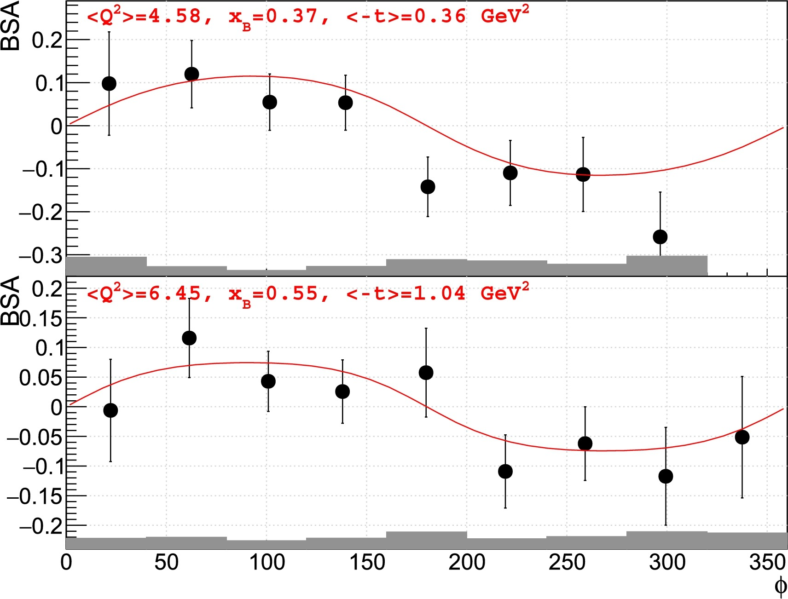
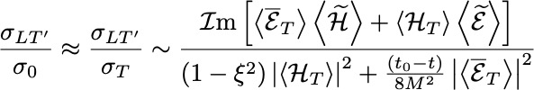
12 GeV: CLAS 𝜋⁰ BSA
In progress:
Full cross section
Eta-production
H, D targets…

Slide 16

Exclusive 𝜋⁰ : COMPASS
M. Alexeev et al. [COMPASS], Phys.Lett.B 805 (2020) 135454 arXiv:1093.12030
$\left\langle Q^{2}\right\rangle$ = 2.0 GeV²
$\left\langle x_{B}\right\rangle =0.093$

Slide 17
DVCS: What do we measure?
Cross sections and asymmetries
  Linked to CFFs, not GPDs
  Very complicated structure of cross section
  Need polarization observables to extract CFFs
Azimuthal distribution analyzes polarization of virtual photon
Longitudinal and transverse polarized targets
  Longitudinal is hard
  Transverse is extremely hard (except at EIC!)
    Only existing data are from HERMES

Slide 18
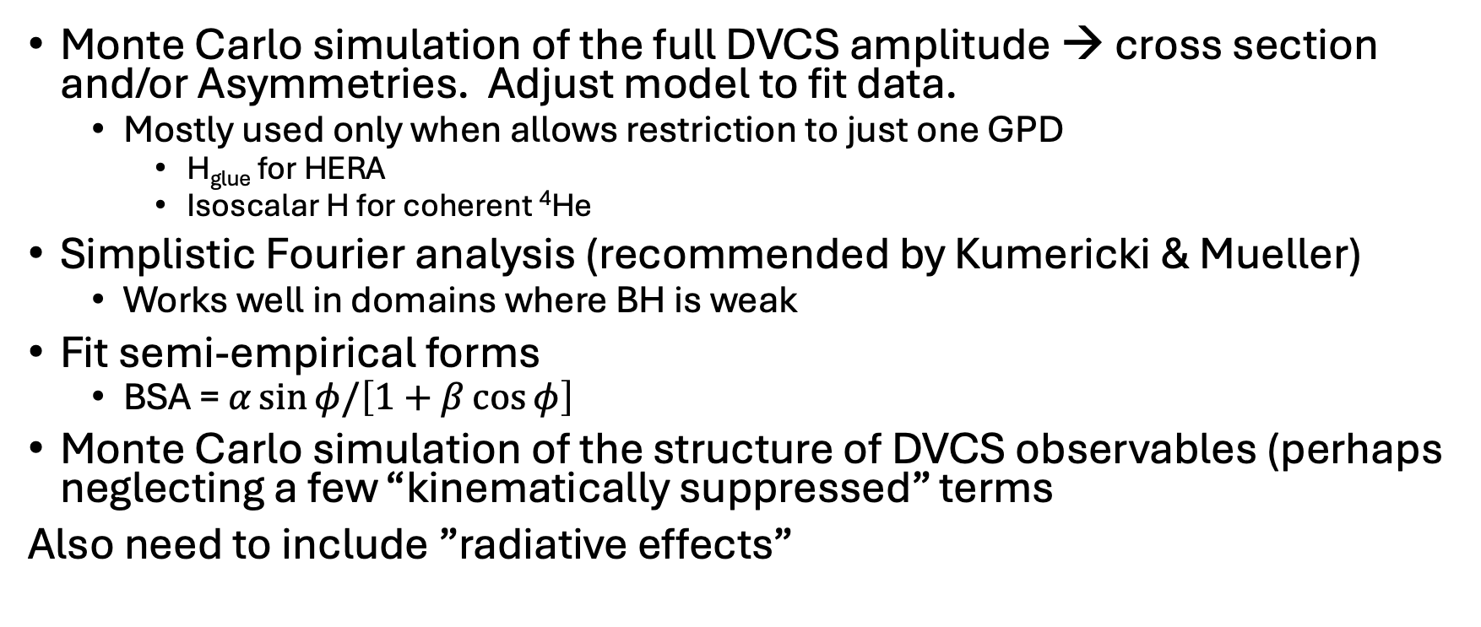
DVCS Analysis Techniques
Monte Carlo simulation of the full DVCS amplitude → cross section and/or Asymmetries. Adjust model to fit data.
  Mostly used only when allows restriction to just one GPD
    H_{glue} for HERA
    Isoscalar H for coherent ⁴He
Simplistic Fourier analysis (recommended by Kumericki & Mueller)
  Works well in domains where BH is weak
Fit semi-empirical forms
  BSA = $α\sin{φ/\left[1+β\cos{φ}\right]}$
Monte Carlo simulation of the structure of DVCS observables (perhaps neglecting a few “kinematically suppressed” terms
Also need to include ”radiative effects”

Slide 19
“BMK”
A.Belitsky, D.Mueller, PhysRev D 82, 074010 (2010)
Kinematic factors
Bilinear CFF terms
Linear CFF terms times elastic FF

Slide 20
Real & Imaginary part of [DVCS*BH] Interference
A careful examination of the kinematic pre-factors of the |BH|², Re[DVCS*BH] and |DVCS|² show they contain different powers of s=(k+P)^2.
Im[DVCS*BH] interference from spin-dependent cross sections d𝜎(+) – d𝜎(–), since BH is real
Two methods for separation of the Re[DVCS*BH] from |DVCS|^2
  Beam charge difference HERMES, HERA, COMPASS
  Beam energy-dependence “Generalized Rosenbluth Separation”:
    M.Defurne, et al [Hall A], Nature Commun. 8 (2017) 1, 1408
    2023-2024 Hall C “Neutral Particle Spectrometer (NPS)” data

Slide 21
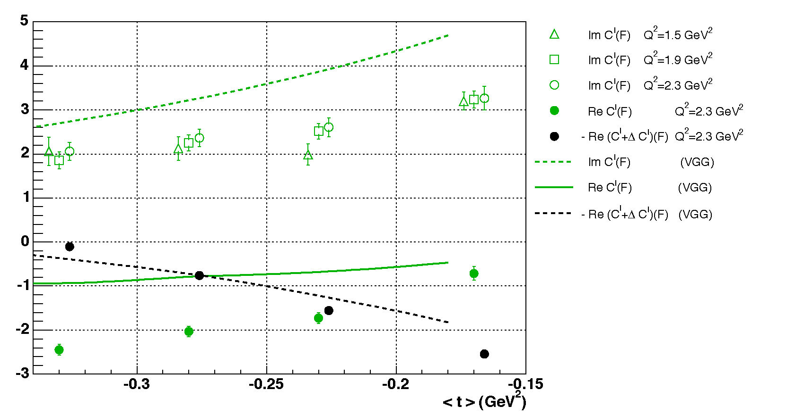
A first test of factorization at large x_{B}
Q²-independence of the imaginary part of the interference
  Dominance of Twist-2 (GPD)
  « VGG » model correct to 30%
C.Muñoz Camacho, et al. [Hall A], PRL 97:262002
Some ambiguities in how to extract Re[DVCS*BH]+|BH|²
ηC^{DVCS}+Re[C^{I}]
ηC^{DVCS}−Re[C^{I}+ΔC^{I}]
=

Slide 22
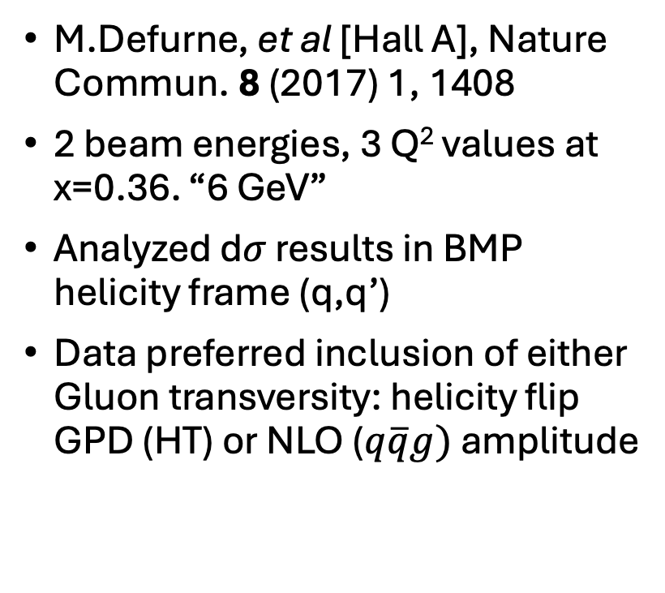
Separation of Re[DVCS*BH] and |DVCS|²
M.Defurne, et al [Hall A], Nature Commun. 8 (2017) 1, 1408
2 beam energies, 3 Q² values at x=0.36. “6 GeV”
Analyzed d𝜎 results in BMP helicity frame (q,q’)
Data preferred inclusion of either Gluon transversity: helicity flip GPD (HT) or NLO ($q\overline{q}g)$ amplitude

Slide 23
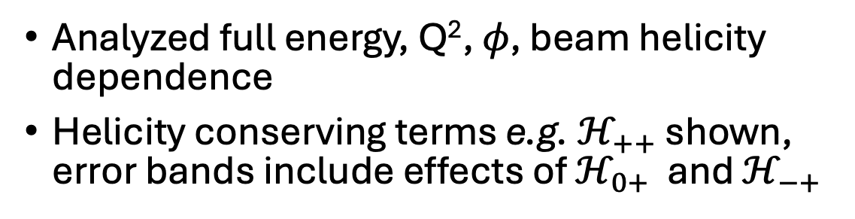
Hall A 12 GeV DVCS
Analyzed full energy, Q², 𝜙, beam helicity dependence
Helicity conserving terms e.g. $ℋ_{++}$ shown,
error bands include effects of $ℋ_{0+}$ and $ℋ_{−+}$

Slide 24
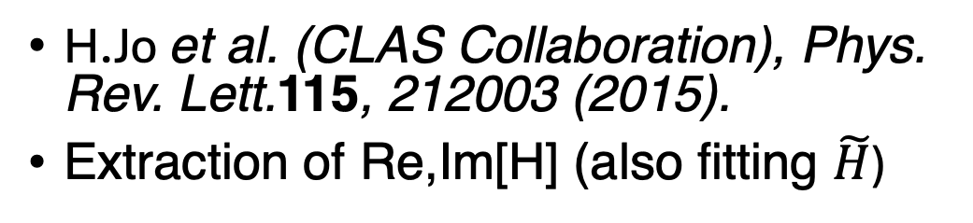
CLAS proton DVCS
H.Jo et al. (CLAS Collaboration), Phys. Rev. Lett.115, 212003 (2015).
Extraction of Re,Im[H] (also fitting $\tilde{H}$)

Slide 25
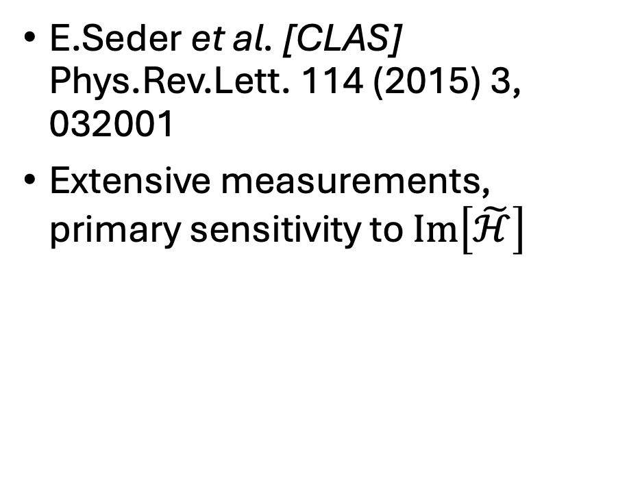
CLAS Longitudinally polarized NH₃ target
E.Seder et al. [CLAS] Phys.Rev.Lett. 114 (2015) 3, 032001
Extensive measurements, primary sensitivity to $Im\left[\tilde{ℋ}\right]$

Slide 26
CLAS Longitudinally polarized target
E.Seder et al. [CLAS] Phys.Rev.Lett. 114 (2015) 3, 032001
Amplitude of sin𝜙 term of target single-spin asymmetry

Slide 27
First CLAS12 proton DVCS results
G.Christiaens et al. [CLAS], Phys. Rev. Lett. 130 (2023) 211902

Slide 28
HERMES DIS2012

Slide 29
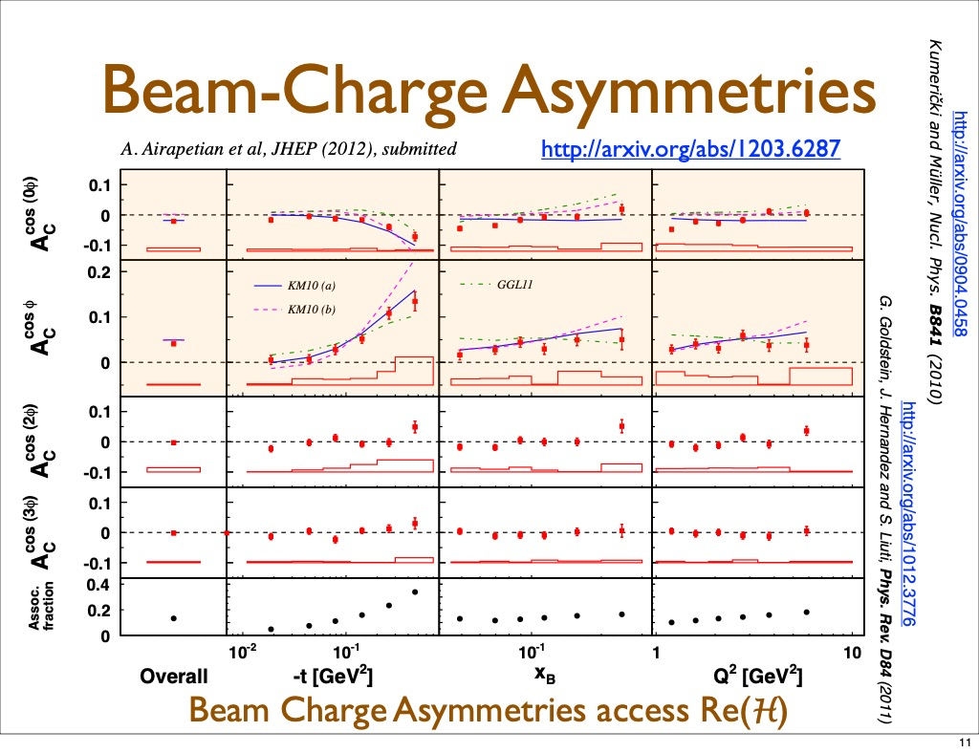

Slide 30
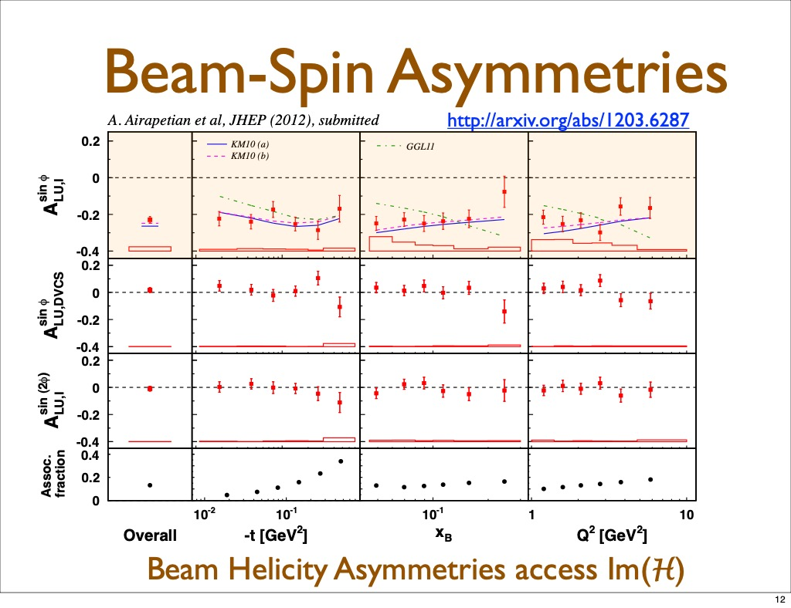

Slide 31
Neutron DVCS: An old, provocative Plot
M.Mazouz Phys.Rev.Lett. 99 (2007) 242501
Fit model of E GPD to one (𝜉,Q²) data point.
Integrate the model over x.
HERMES data was transversely polarized p

Slide 32
Neutron DVCS
M.Benali, et al. [Hall A], Nature Phys. 16 (2020) 2, 191
Combined D,H analysis
x_{B} = 0.36

Slide 33
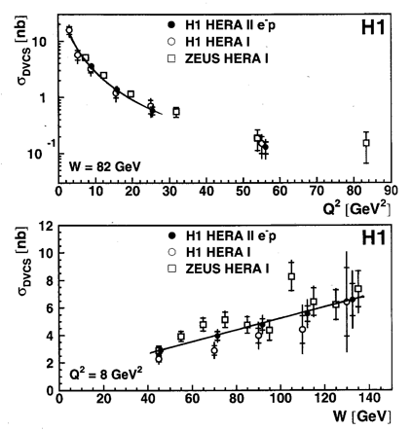
DVCS at HERA
Next three slides are from review by G. Wolf arXiv 0907.1217
This slide, GPD model of Freund

Slide 34
DVCS at HERA
t-dependence

Slide 35
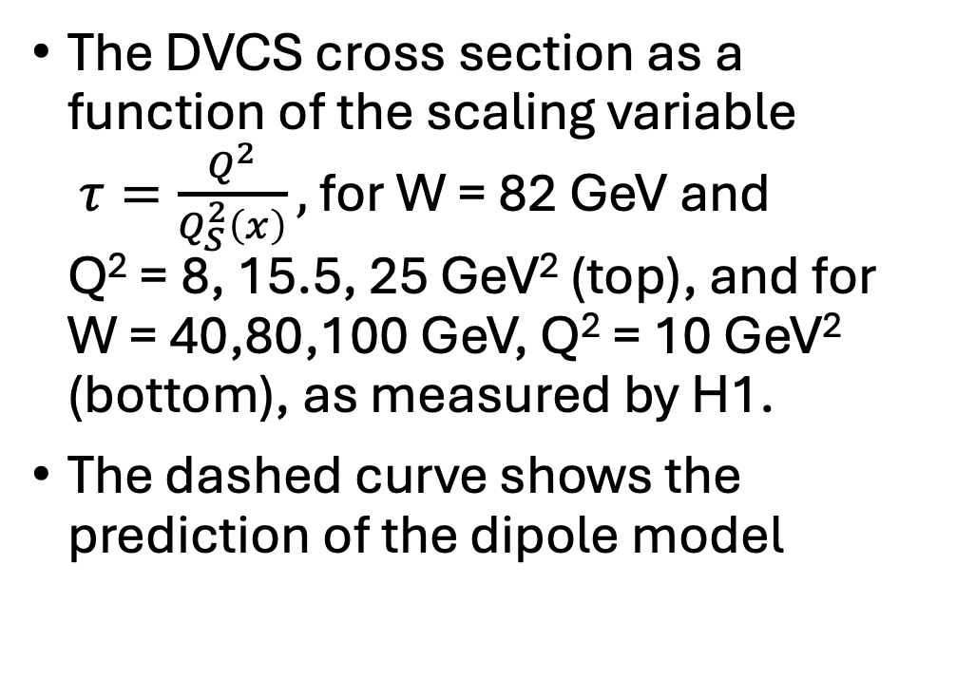
DVCS at HERA
The DVCS cross section as a function of the scaling variable
$τ=\frac{Q^{2}}{Q_{S}^{2}\left(x\right)},$for W = 82 GeV and
Q² = 8, 15.5, 25 GeV² (top), and for
W = 40,80,100 GeV, Q² = 10 GeV² (bottom), as measured by H1.
The dashed curve shows the prediction of the dipole model

Slide 36
Gluon Radius of Proton?
DVCS
Phys.Lett.B 793 (2019) 188-194 arXiv:1802.02739
COMPASS, HERA t-slope of H(x/2,x/2,t) at small-x
Smaller than charge radius
  0.84 fm
Evidence for low-x growth ~log(1/x)?
  Gribov diffusion
~50% of gluon momentum sum-rule is at x>0.1
How are these gluons distributed radially?

Slide 37
Model Fits: DVCS
R. Akhunzyanov et al. [COMPASS], Phys.Lett.B 793 (2019) 188-194 arXiv:1802.02739
COMPASS, HERA t-slope of H(x/2,x/2,t) at small-x
Kumericki Mueller (KM)
Goloskokov Kroll
What do these models do at high-x?

Slide 38
Conclusions
There is now a large data base of 1000s of DVCS measurements
  Cross sections
  Single and double spin asymmetries
Local and Global Fits enable separations of Compton Form Factors (CFFs), including flavor separations.
Global fits can also test assumptions of factorization, NLO contributions and Higher Twist (both kinematic & dynamic)
A great deal of Jlab 12 GeV data is on tape, in various stages of analysis and publication, and more data planned.

Slide 39
Epilogue
Radiative Corrections

Slide 40
Radiative Corrections to BH & DVCS
M. Vanderhaeghen, et al., Phys Rev C 62, 025501 (2000)
I.Akushevich and A. Ilyich, Phys Rev D 85, 053008 (2012)
A. Afanasev, I. Akushevich, et al, Phys Rev D 66 (2002) (EXCLURAD)
Figures that follow are from M.V. PRC 62

Slide 41
Virtual Radiative
Corrections
Vertex, Self-Energy, Vacuum-Polarization corrections to BH
Vertex, Vacuum-Polarization corrections to VCS
41

Slide 42
Virtual Radiative Corrections
Intrinsically different for BH & VCS
Vacuum-Polarization
BH: 1/[1+ Π(t)]
VCS: 1/[1+ Π(Q²)]
Self-Energy, Unique to BH

Slide 43
Real Radiative Corrections
BH
Factorize in soft limit
Include lineshape in MC simulation.
Simulation and data are cut-off dependent (e.g. M_{X}² limit)
VCS

Slide 44
Correction to measured cross section to obtain “Born” cross section does not factorize
Model dependent calculation.
  Hall A analysis uses P.Guichon code with old factorized GPD model
Final correction is relatively insensitive to specific DVCS kinematics in JLab range.
  ~10% effect

