Slide 1
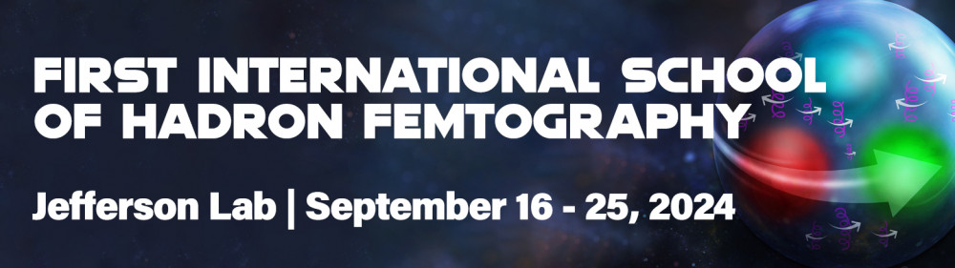


Experimental Aspects of Deep Virtual Exclusive Scattering
Charles Hyde
Francois-Xavier Girod

Slide 2
Outline of Lectures
Experimental Methods
Physics Analysis and Results
Deep Virtual Exclusive Scattering at the EIC
Prospects for DVCS with Positron Beams & ~20 GeV CEBAF

Slide 3
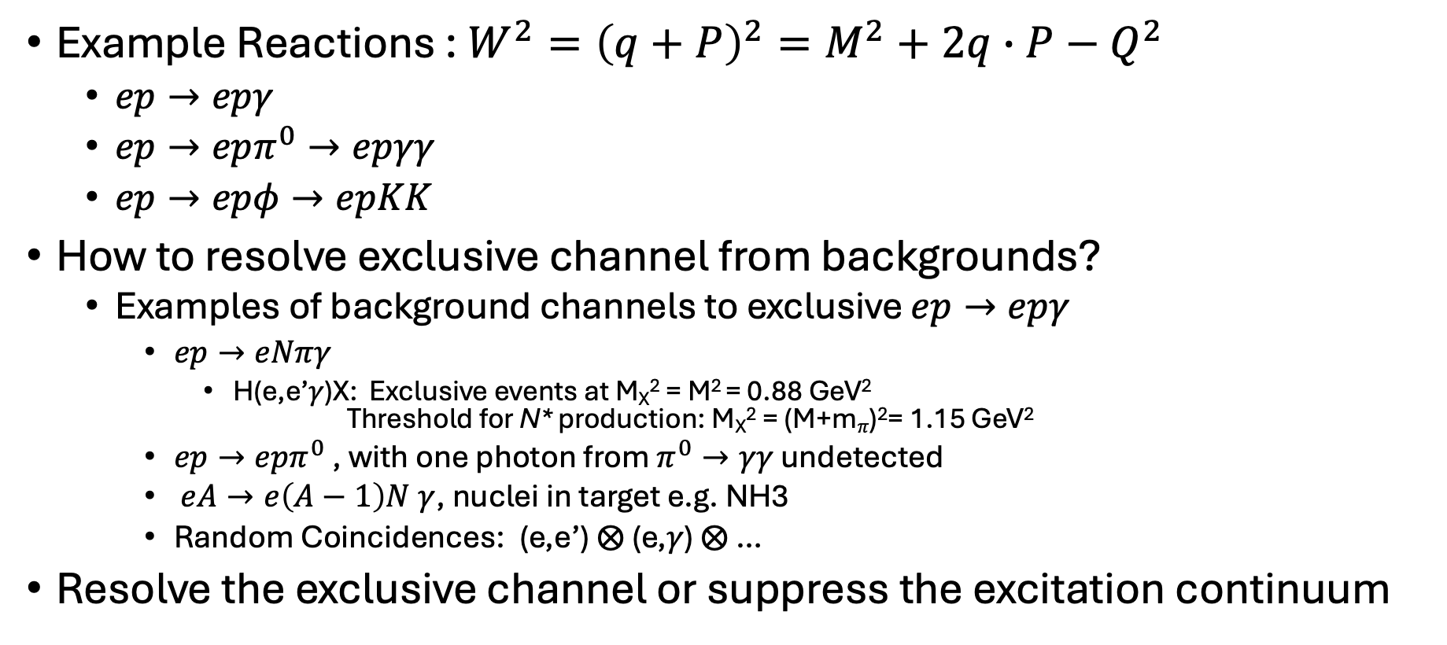
Exclusive reactions
Example Reactions : $W^{2}={\left(q+P\right)}^{2}=M^{2}+2q∙P−Q^{2}$
  $ep→epγ$
  $ep→epπ^{0}→epγγ$
  $ep→epφ→epKK$
How to resolve exclusive channel from backgrounds?
  Examples of background channels to exclusive $ep→epγ$
    $ep→eNπγ$
      H(e,e’𝛾)X: Exclusive events at M_{X}² = M² = 0.88 GeV²
      Threshold for N* production: M_{X}² = (M+m_{𝜋})²= 1.15 GeV²
    $ep→epπ^{0}$ , with one photon from $π^{0}→γγ$ undetected
    $eA→e\left(A−1\right)N γ$, nuclei in target e.g. NH3
    Random Coincidences: (e,e’) ⨂ (e,𝛾) ⨂ …
Resolve the exclusive channel or suppress the excitation continuum

Slide 4
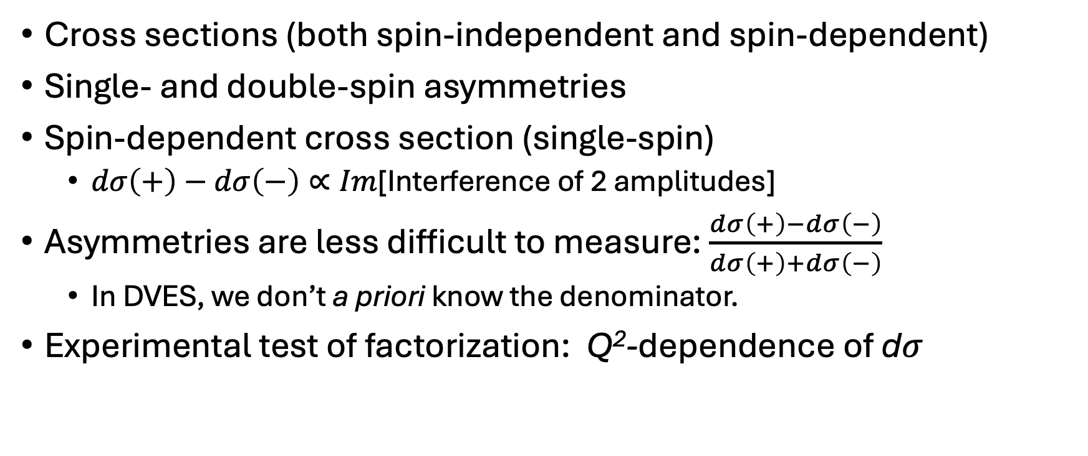
What do we measure?
Cross sections (both spin-independent and spin-dependent)
Single- and double-spin asymmetries
Spin-dependent cross section (single-spin)
  $dσ\left(+\right)−dσ\left(−\right)∝Im$[Interference of 2 amplitudes]
Asymmetries are less difficult to measure: $\frac{dσ\left(+\right)−dσ\left(−\right)}{dσ\left(+\right)+dσ\left(−\right)}$
  In DVES, we don’t a priori know the denominator.
Experimental test of factorization: Q²-dependence of d𝜎

Slide 5
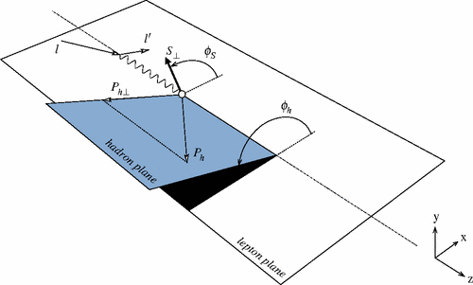
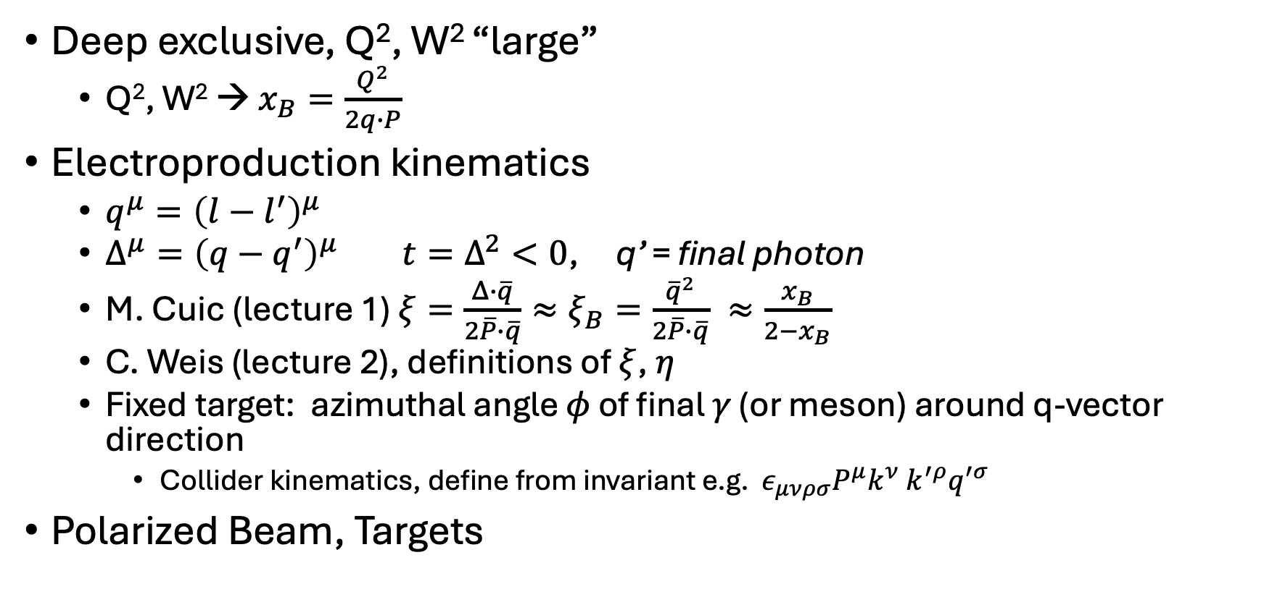
Exclusive Kinematics
“Trento” convention
Deep exclusive, Q², W² “large”
  Q², W² → $x_{B}=\frac{Q^{2}}{2q∙P}$
Electroproduction kinematics
  $q^{μ}={\left(l−l^{′}\right)}^{μ}$
  $Δ^{μ}={\left(q−q^{′}\right)}^{μ} t=Δ^{2}<0$, q’ = final photon
  M. Cuic (lecture 1) $ξ=\frac{Δ∙\overline{q}}{2\overline{P}∙\overline{q}}≈ξ_{B}=\frac{{\overline{q}}^{2}}{2\overline{P}∙\overline{q}} ≈\frac{x_{B}}{2−x_{B}}$
  C. Weis (lecture 2), definitions of $ξ$, $η$
  Fixed target: azimuthal angle 𝜙 of final 𝛾 (or meson) around q-vector direction
    Collider kinematics, define from invariant e.g. $ε_{μνρσ}P^{μ}k^{ν}$ $k^{′ρ}q^{′σ}$
Polarized Beam, Targets

Slide 6
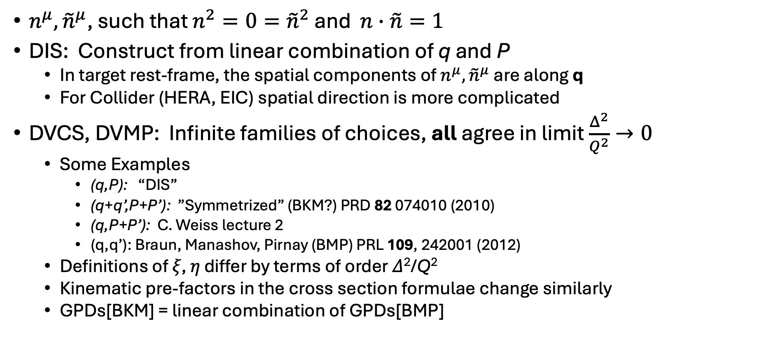
Choice of light-cone vectors:
$n^{μ},{\tilde{n}}^{μ}$, such that $n^{2}=0={\tilde{n}}^{2}$ and $n∙\tilde{n}=1$
DIS: Construct from linear combination of q and P
  In target rest-frame, the spatial components of $n^{μ},{\tilde{n}}^{μ}$ are along q
  For Collider (HERA, EIC) spatial direction is more complicated
DVCS, DVMP: Infinite families of choices, all agree in limit $\frac{Δ^{2}}{Q^{2}}→0$
  Some Examples
    (q,P): “DIS”
    (q+q’,P+P’): ”Symmetrized” (BKM?) PRD 82 074010 (2010)
    (q,P+P’): C. Weiss lecture 2
    (q,q’): Braun, Manashov, Pirnay (BMP) PRL 109, 242001 (2012)
  Definitions of 𝜉, 𝜂 differ by terms of order 𝛥²/Q²
  Kinematic pre-factors in the cross section formulae change similarly
  GPDs[BKM] = linear combination of GPDs[BMP]

Slide 7
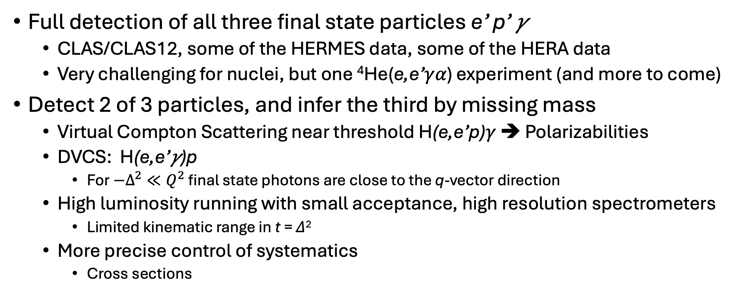
Experimental techniques
Full detection of all three final state particles e’ p’ 𝛾
  CLAS/CLAS12, some of the HERMES data, some of the HERA data
  Very challenging for nuclei, but one ⁴He(e,e’𝛾𝛼) experiment (and more to come)
Detect 2 of 3 particles, and infer the third by missing mass
  Virtual Compton Scattering near threshold H(e,e’p)𝛾 ➔ Polarizabilities
  DVCS: H(e,e’𝛾)p
    For $−Δ^{2}≪Q^{2}$ final state photons are close to the q-vector direction
  High luminosity running with small acceptance, high resolution spectrometers
    Limited kinematic range in t = 𝛥²
  More precise control of systematics
    Cross sections

Slide 8
CLAS/CLAS12 DVCS Pubs
Beam Spin Asymmetries
  G. Christiaens et al. [CLAS], Phys. Rev. Lett. 130 (2023) 211902
  P. Chatagnon et al. [CLAS], Phys. Rev. Lett. 127 (2021) no.26, 262501 (TVCS)
  A.Hobart et al. [CLAS], [arXiv:2406.15539] (nDVCS)
  G. Gavalian et al. [CLAS], Phys.Rev.C 80 (2009) 035206
F. X. Girod et al. (CLAS Collaboration), Phys. Rev. Lett.100, 162002 (2008).
S. Stepanyan, et al. (CLAS Collaboration), Phys. Rev. Lett. 87, 182002 (2001).
Cross Sections
H. S. Jo et al. (CLAS Collaboration), Phys. Rev. Lett.115, 212003 (2015).
Longitudinal Polarized Target
E. Seder et al. (CLAS Collaboration), Phys. Rev. Lett.114, 032001 (2015).
S. Chen et al. (CLAS Collaboration), Phys. Rev. Lett. 97, 072002 (2006).
‘12 GeV’ data coming soon!

Slide 9
Hall A DVCS Pubs (Hall C coming soon-ish)
Proton DVCS
C.Muñoz Camacho et al, Phys.Rev.Lett.97,262002(2006).
M.Defurne et al., Phys.Rev.C 92,055202(2015).
M.Defurne et al., Nature Communications 8,1408 (2017).
Neutron DVCS (deuteron target)
M.Mazouz et al, Phys.Rev.Lett. 99 (2007) 242501
M.Benali et al., Nature Physics16,191(2021).
Proton DVCS with 11 GeV electron beam
F.Georges et al., Phys.Rev.Lett.128, 252002(2022).
(e,e’𝜋⁰)
E. Fuchey et al., Phys.Rev.C 83 (2011) 025201,
M.Defurne et al., Phys.Rev.Lett. 117 (2016) 26, 262001
M.Mazouz et al, Phys Rev. Lett 118 (2017) 22, 222002
M. Dlamini et al., Phys.Rev.Lett. 127 (2021) 15, 152301

Slide 10
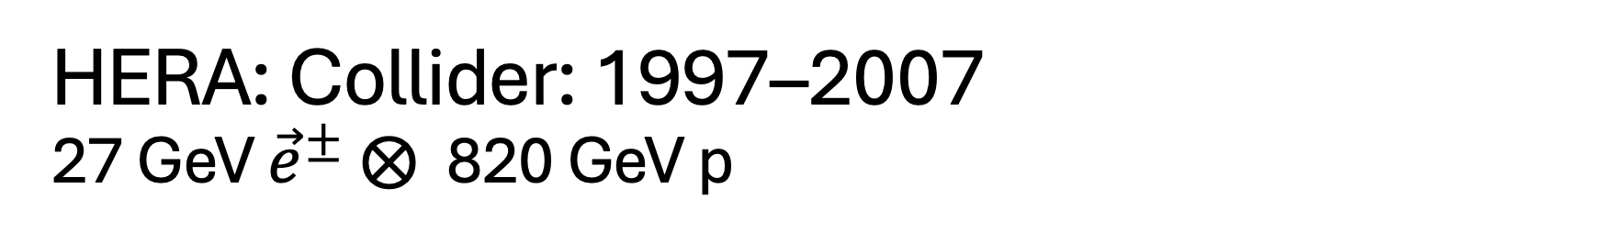
HERA: Collider: 1997–2007
27 GeV ${\vec{e}}^{±}$ ⨂ 820 GeV p
ZEUS DVCS Publications
S. Chekanov et al., JHEP 05 (2009) 108
S. Chekanov et al., Phys. Lett. B 573 (2003) 46-62
H1 DVCS Publications
F.D. Aaron et al., Phys.Lett.B 681 (2009) 391-399
F.D. Aaron et al., Phys.Lett.B 659 (2008) 796-806
A. Aktas et al., Eur.Phys.J.C 44 (2005) 1-11
A. Adlof et al., Phys.Lett.B 517 (2001) 47-58

Slide 11
COMPASS
100-200 GeV muons incident on fixed target
R. Akhunzyanov et al. [COMPASS] Phys.Lett.B 793 (2019) 188-194, Phys.Lett.B 800 (2020) 135129 (erratum)
  e-Print: 1802.02739 [hep-ex]
Inspirehep.net: search “collaboration compass and title exclusive”
14 journal publications
30 conference papers

Slide 12
HERMES: Fixed (gas-jet) target in HERA electron ring
A. Airapetian et al., JHEP 07 (2012) 032. “Beam-Charge Asym.”
A. Airapetian et al., JHEP 10 (2012) 042. “Kinematically Complete”
A. Airapetian et al., Nucl.Phys.B 842 (2011) 265-298. , “Longitudinally polarized D”
A. Airapetian et al., Phys.Rev.C 81 (2010) 035202. “Nuclear Targets”
A. Airapetian et al., Nucl.Phys.B 829 (2010) 1-27, “Deuterium”
A. Airapetian et al., JHEP 11 (2009) 083.
A. Airapetian et al., Phys. Lett. B 704 (2011) 15-23. “., “Transversely Polarized H”
A. Airapetian et al., JHEP 06 (2010) 019.
A. Airapetian et al., JHEP 06 (2008) 066.
A. Airapetian et al., Eur. Phys. J. C 62 (2009) 659-694.
A. Airapetian et al., Phys. Lett. B 679 (2009) 100-105.
A. Airapetian et al., Phys.Rev.Lett. 87 (2001) 182001

Slide 13
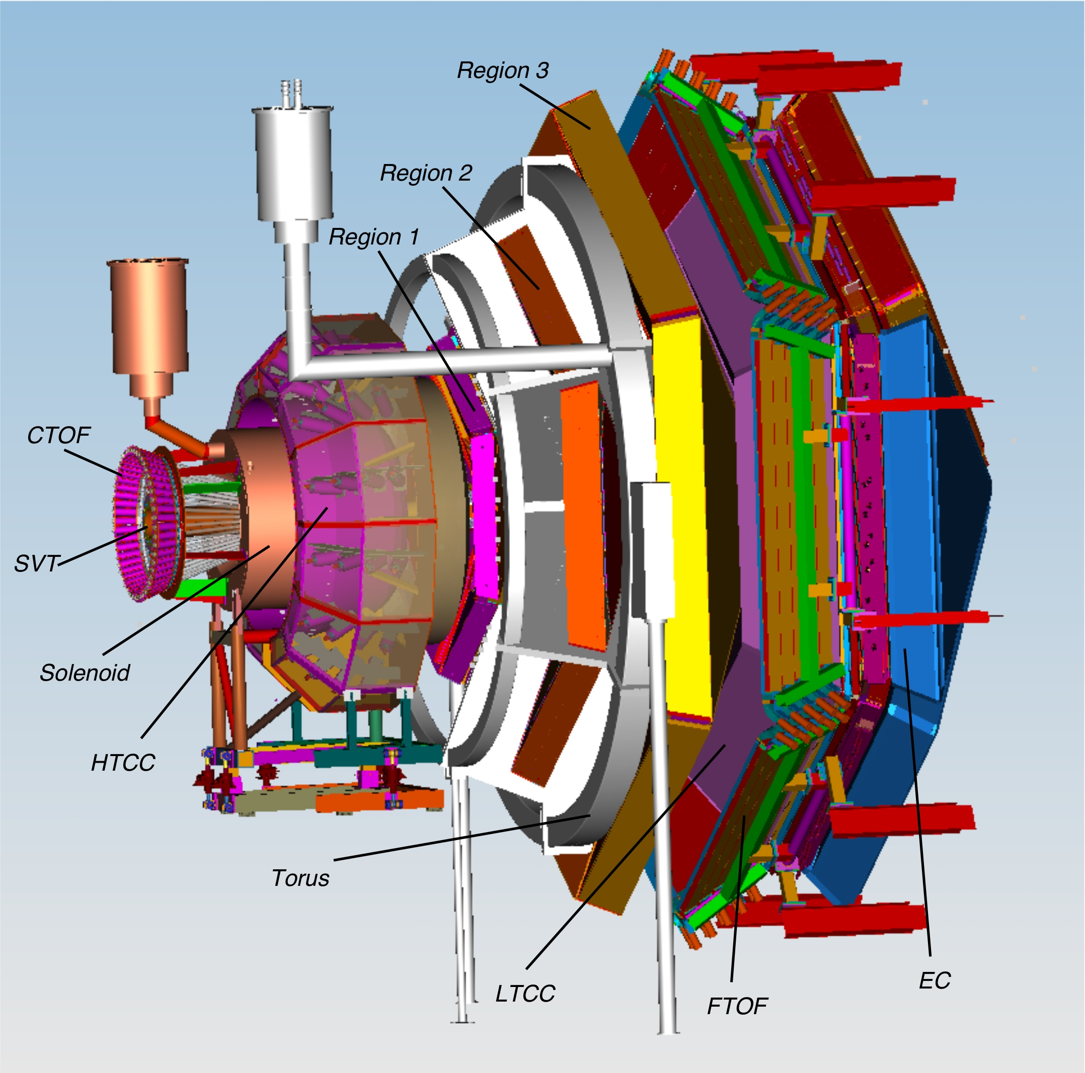
CLAS12
Detector
Central Detector
  Tracking, TOF
Forward Detector
  Tracking, PID, EMCal
Forward Tagger:PbWO₄
https://www.jlab.org/physics/hall-b/clas12

Slide 14
CLAS12: H(e,e’𝛾p) Single Event display
G.Christiaens et al., Phys. Rev. Lett. 130 (2023) 211902
G.Christiaens, PhD Thesis, U.Glasgow Scotland, Feb. 2021: https://theses.gla.ac.uk/82288/
Notes:
Electron and photon forward, proton large angle>45deg

Slide 15
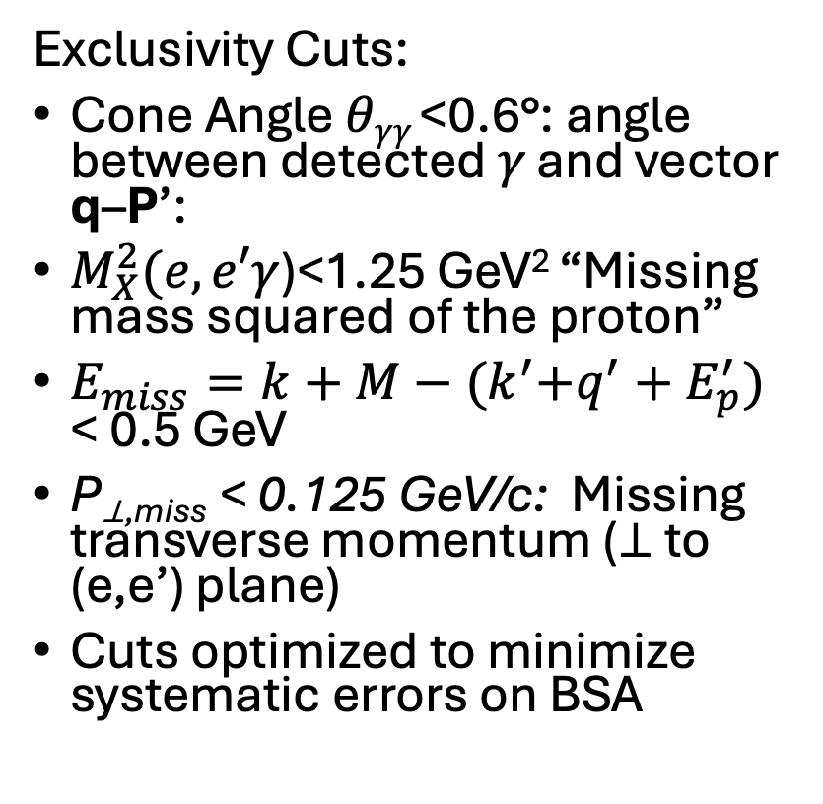
Example of CLAS/CLAS12 Exclusivity Analysis: H(e,e’𝛾p)
Exclusivity Cuts:
Cone Angle 𝜃_{𝛾𝛾} <0.6°: angle between detected 𝛾 and vector q–P’:
$M_{X}^{2}(e,e′γ$)<1.25 GeV² “Missing mass squared of the proton”
$E_{miss}=k+M−{(k}^{′}+q^{′}+E_{p}^{′})$ < 0.5 GeV
P_{⊥,miss} < 0.125 GeV/c: Missing transverse momentum (⊥ to (e,e’) plane)
Cuts optimized to minimize systematic errors on BSA
G.Christiaens et al. [CLAS], Phys. Rev. Lett. 130 (2023) 211902

Slide 16
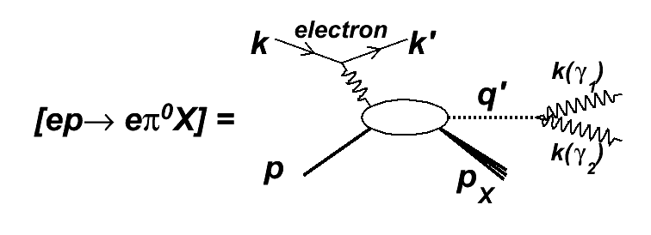
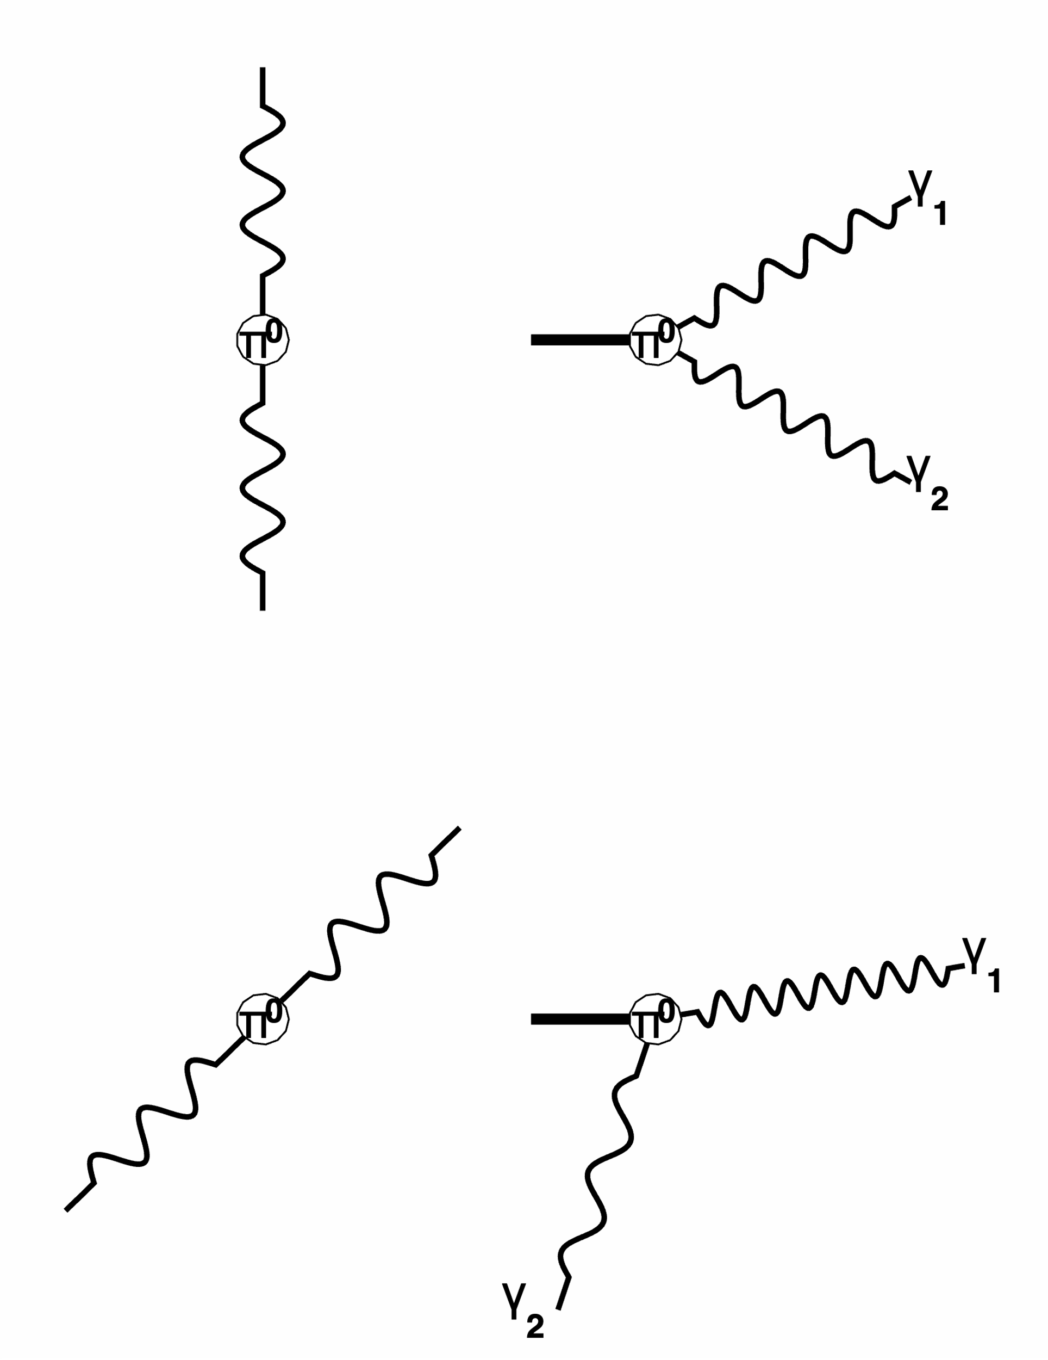
𝜋⁰ background in DVCS
𝜋⁰ Rest
Frame
Detector
Frame
M_{X}²(e,e’𝛾₁) ≈ W²/2
M_{X}²(e,e’𝛾₁) ≈ M²

Slide 17
The (irreducible) 𝜋⁰ background problem
H(e,e’p𝛾) has an irreducible background of H(e,e’p𝛾)𝛾 from 𝜋⁰ → 𝛾𝛾
(and 𝜂 → 𝛾𝛾 ) production
  𝜋⁰ → 𝛾𝛾 is isotropic in pion rest-frame, boosted forward in lab frame
  X=p+𝛾 missing mass distribution in H(e,e’𝛾)p𝛾 is uniform in M_{X}² from M_{p}² to W²
  Asymmetric decays (relative
Statistical Solution
  Measure (e,e’𝛾) and (e,e’𝛾𝛾) events
  For each 𝛾𝛾 =𝜋⁰ event, simulate [e.g. N_{sim} = 5000] isotropic 𝜋⁰ → 𝛾𝛾 in the (e,e’𝜋⁰) event kinematics
    Sort simulated events into sets of {0,1,2} - photons detected
    Weight every simulation single-𝛾 event by 1/N₂
    This produces an H(e,e’𝛾)p𝛾 event sample normalized to the experimental Luminosity⊗Acceptance
  Subtract the background simulation yield independently in every kinematic bin.

Slide 18
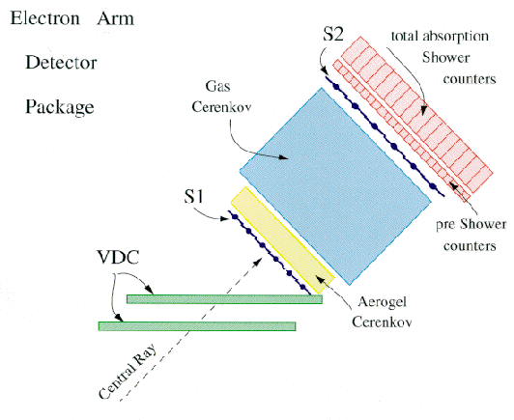
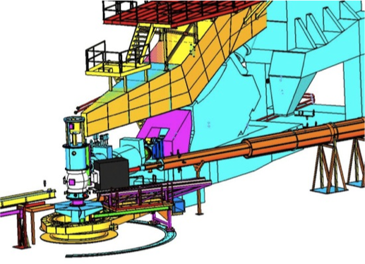
Hall A DVCS program
Liquid H and D targets
Detect scattered electron in “High Resolution Spectrometer”
Detect gamma in PbF₂ Calorimeter
  Radiation hard
  Pure Cherenkov signal➔very fast light pulse (~1ns)
  Tolerant to high rates from high luminosity (detector ~2m from target)
Scattered
e–
e– beam
PbF₂

Slide 19
Hall-A DVCS Kinematic Coverage
Not shown:
‘6-GeV’ beam energy scan at
x_{B} = 0.36
Defurne et al., NatComm 8,1408 (2017).

Slide 20
Hall A DVCS: 𝜋⁰ and accidental backgrounds and exclusivity result from ‘12GeV’ H(e,e’𝛾)X
4 nsec time-structure of beam
N*
F.Georges et al., Phys.Rev.Lett. 128 (2022) 25, 252002
See also NPS students for latest 2023-2024 Hall C results
with higher resolution PbWO₄ calorimeter!
Frédéric Georges, PhD U.Paris-Saclay, Oct 2018
https://theses.hal.science/tel-01925350/

Slide 21
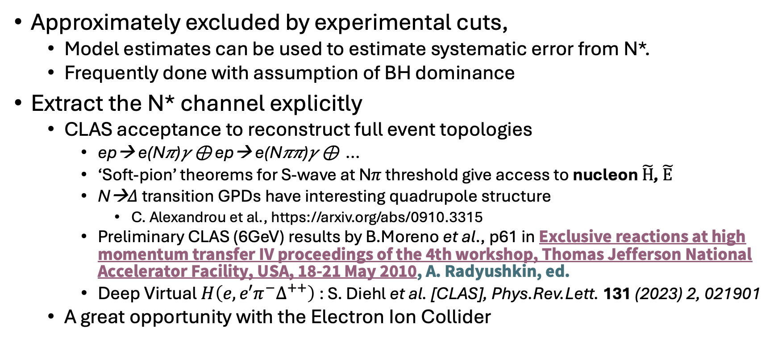
The N* problem: ep→ ep𝛾 ⊕ ep→ eN*𝛾 …
Approximately excluded by experimental cuts,
  Model estimates can be used to estimate systematic error from N*.
  Frequently done with assumption of BH dominance
Extract the N* channel explicitly
  CLAS acceptance to reconstruct full event topologies
    ep→ e(N𝜋)𝛾 ⊕ ep→ e(N𝜋𝜋)𝛾 ⊕ …
    ‘Soft-pion’ theorems for S-wave at N𝜋 threshold give access to nucleon $\tilde{H}$, $\tilde{E}$
    N→𝛥 transition GPDs have interesting quadrupole structure
      C. Alexandrou et al., https://arxiv.org/abs/0910.3315
    Preliminary CLAS (6GeV) results by B.Moreno et al., p61 in Exclusive reactions at high momentum transfer IV proceedings of the 4th workshop, Thomas Jefferson National Accelerator Facility, USA, 18-21 May 2010, A. Radyushkin, ed.
    Deep Virtual $H\left({e,e′π}^{−}∆^{++}\right)$: S. Diehl et al. [CLAS], Phys.Rev.Lett. 131 (2023) 2, 021901
  A great opportunity with the Electron Ion Collider

Slide 22
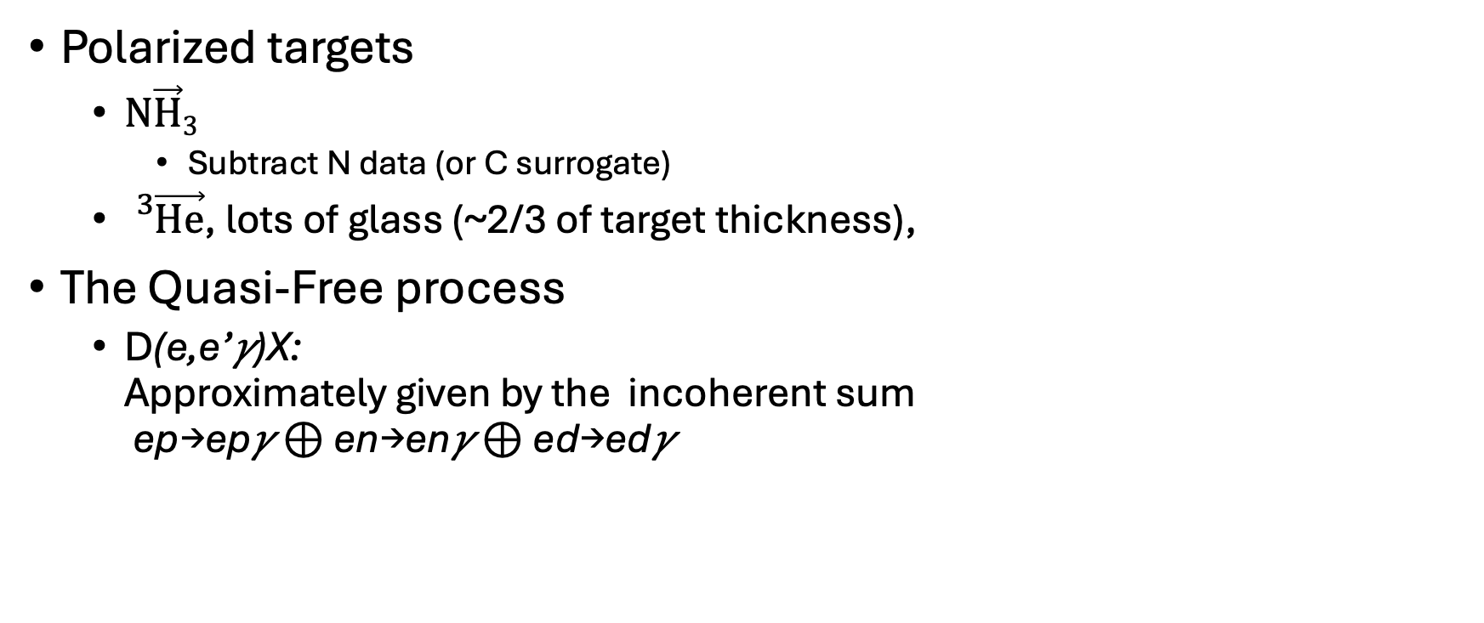
Nuclear Targets and Nuclear Background
Polarized targets
  $\text{N}\vec{\text{H}}3$
    Subtract N data (or C surrogate)
  ${}_{}^{3}{\vec{\text{He}}}$, lots of glass (~2/3 of target thickness),
The Quasi-Free process
  D(e,e’𝛾)X:
  Approximately given by the incoherent sum
  ep→ep𝛾 ⊕ en→en𝛾 ⊕ ed→ed𝛾

Slide 23
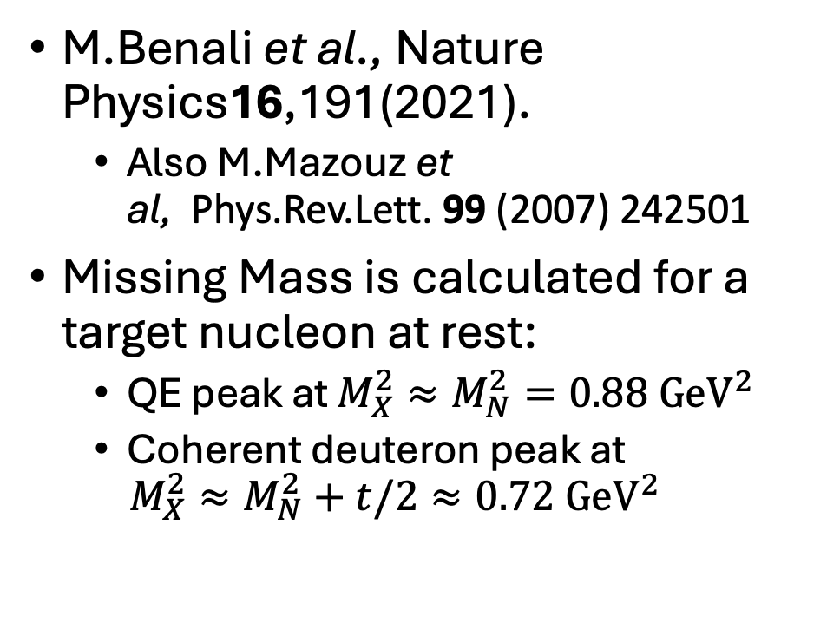

Neutron DVCS in Hall A
$$\left\langle t\right\rangle =−0.32 {\text{GeV}}^{2}$$
M.Benali et al., Nature Physics16,191(2021).
  Also M.Mazouz et al, Phys.Rev.Lett. 99 (2007) 242501
Missing Mass is calculated for a target nucleon at rest:
  QE peak at $M_{X}^{2}≈M_{N}^{2}=0.88 {\text{GeV}}^{2}$
  Coherent deuteron peak at
  $M_{X}^{2}≈M_{N}^{2}+t/2≈0.72 {\text{GeV}}^{2}$

Slide 24
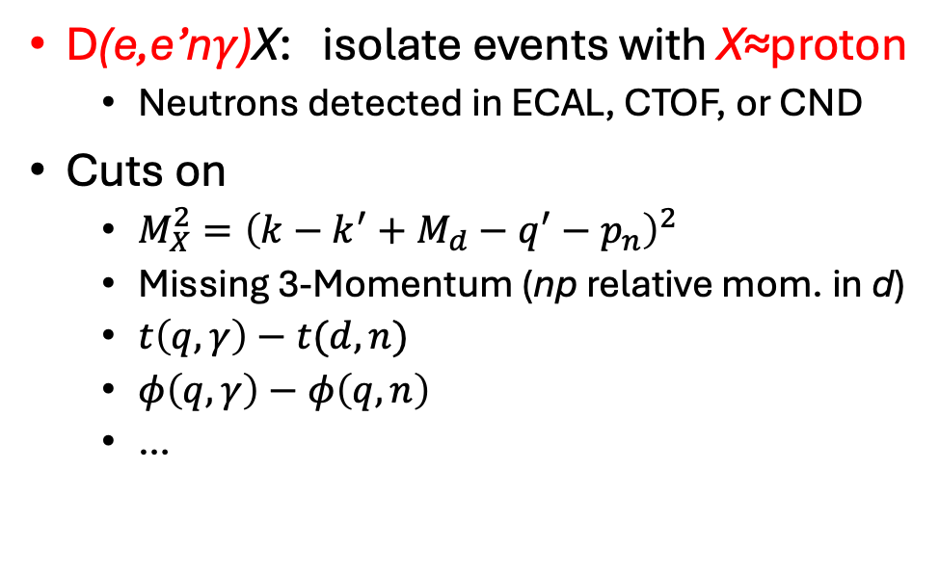
CLAS12 neutron
DVCS analysis
Data
nDVCS-MC
n𝜋→1𝛾
D(e,e’n𝛾)X: isolate events with X≈proton
  Neutrons detected in ECAL, CTOF, or CND
Cuts on
  $M_{X}^{2}={\left(k−k^{′}+M_{d}−q^{′}−p_{n}\right)}^{2}$
  Missing 3-Momentum (np relative mom. in d)
  $t\left(q,γ\right)−t(d,n)$
  $φ\left(q,γ\right)−φ\left(q,n\right)$
  …
A.Hobart et al., https://arxiv.org/abs/2406.15539

Slide 25
Other Fixed-Target exp’s:
COMPASS, HERMES
COMPASS:
  100-200 GeV muons incident on polarized and un-polarized targets
  SPS protons impinge on a production target → High energy pions
    Pions decay to muons (polarized by V–A weak decay)→ Momentum selection
HERMES
  27 GeV stored e+ or e- beams on gas jet target (no walls).

Slide 26
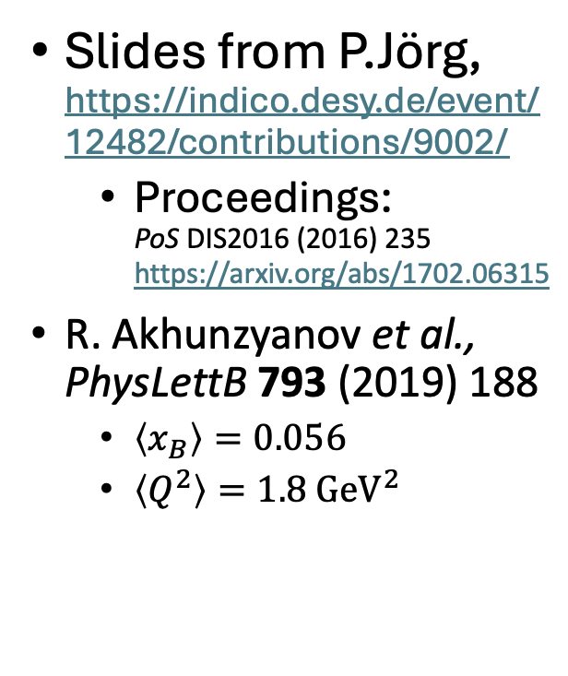
DIS2016
Slides from P.Jörg,
https://indico.desy.de/event/12482/contributions/9002/
  Proceedings:
  PoS DIS2016 (2016) 235
  https://arxiv.org/abs/1702.06315
R. Akhunzyanov et al., PhysLettB 793 (2019) 188
  $\left\langle x_{B}\right\rangle =0.056$
  $\left\langle Q^{2}\right\rangle =1.8 {\text{GeV}}^{2}$
2.5 m
LH₂
Proton telescope

Slide 27
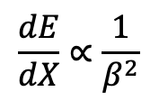
COMPASS
Exclusivity by recoil proton detection
stopping
$$\frac{dE}{dX}∝\frac{1}{β^{2}}$$

Slide 28
COMPASS Exclusivity
Absence of background outside cuts indicative of `diffraction’ → suppression of excitation of target in final state
M_{X}² distributions not shown.

Slide 29
HERMES
27.5 GeV e±
Gas-jet target into accelerator vacuum of HERA storage ring of 27.5 GeV
DIS2012
M. Murray et al, https://indico.cern.ch/event/153252/contributions/1396842/

Slide 30
HERMES, DIS2012: H(e,e’𝛾)X
Beam Charge asymmetries
Beam Spin asymmetries
Transverse target single-spin asymmetries
Transverse target double-spin asymmetries
Long target single-spin asymmetries
Long. target double-spin asymmetries

Slide 31
HERMES
Recoil Tracker upgrade
Kinematically complete (e,e’p𝛾) measurements
Data on transversely polarized target

Slide 32
HERA DVCS: H1 & ZEUS
DIS: QCD Evolution of parton distributions
  ~20% of all events are diffractive: No evidence of beam proton breakup in final state
  Both collaborations worked hard to add detectors in ~100m proton downstream space to better understand diffraction
  Strong motivation for design of EIC with forward detectors fully integrated into accelerator lattice
Most H1, ZEUS DVCS results are without forward detection of the proton
  “Exclusivity by event topology”

Slide 33
Kinematic Reach: Fixed Targets & HERA
Gluons expected to dominate in HERA kinematics
x H(x,x,t)

Slide 34


DIS2010
p
$$e’$$
L.Favart, https://indico.cern.ch/event/86184/contributions/2108312/
DVCS event is practically empty!
Inelastic events modelled
$$γ$$

Slide 35
Next Lecture
How do we extract physics from cross sections and spin asymmetries?
Summary of what we have learned.

