Slide 1

Center for Nuclear Femtography (CNF)
Overview and activities
Acting Director: Latifa Elouadrhiri
Associate Director: David Richards
Jefferson Lab Newport News, Va.
September 16, 2024

Slide 2
Mission
The Center of Nuclear Femtography (CNF) stands as a leading center of interdisciplinary pursuit, focusing on the emerging science of Nuclear Femtography:
  Mapping of the spatial distribution and motion of the quarks and gluons within the nucleus at the sub-femtoscale.
  Taking a leadership role in advancing the understanding of the gravitational structure inherent to the complex realm of hadrons, a new avenue of profound research within the field of nuclear and particle physics.
The realization of this science requires a multidisciplinary approach, encompassing experimental and theoretical nuclear physics, applied mathematics, and computational science. This includes machine learning, visualization, and first-principles QCD calculations at the frontier of exascale computing

Slide 3
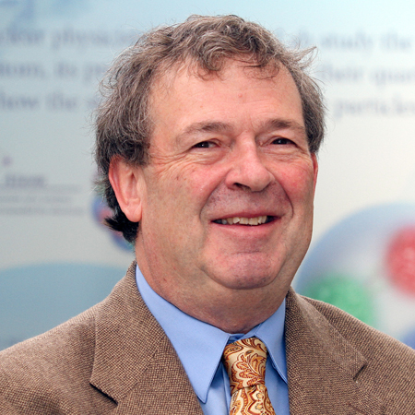
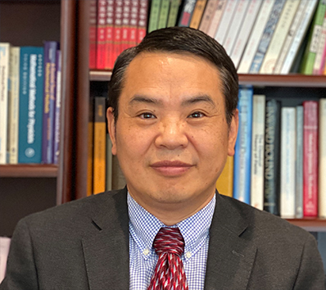

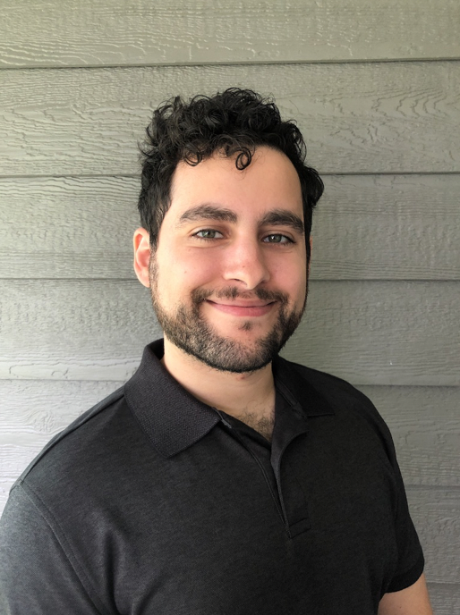

Organization
Acting Director:
Latifa Elouadrhiri
Associate Director: David Richards
Senior Advisor:
Xiangdong Ji
Post-doc
Fatma Pinar Aslan
Post-doc
Gabriel Santiago
CNF- Graduate students Fellows: five for 2023 – 2024 and expecting six for 2024 -2025
Fellows: from associated institutions
Steering Committee: Representative from each of the Virginia’s university and JLab
Admin support: - Bernice Whitehead (JLab, Theory Division)
- Carolyn Wilson (SURA)

Slide 4
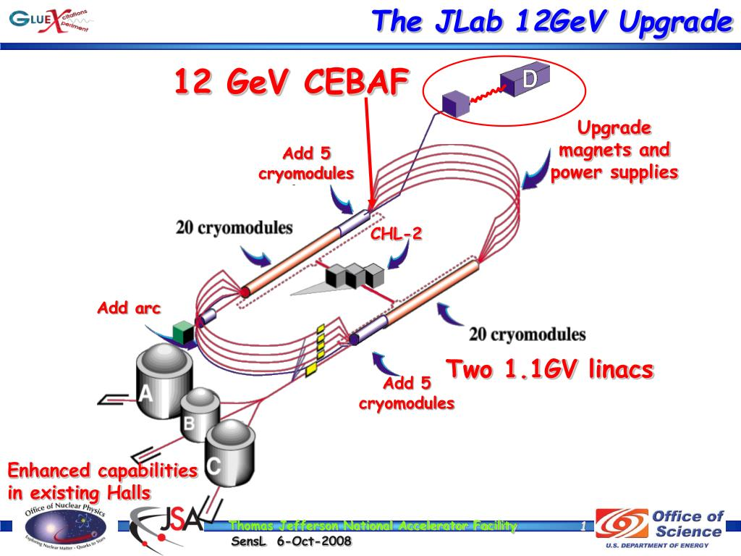
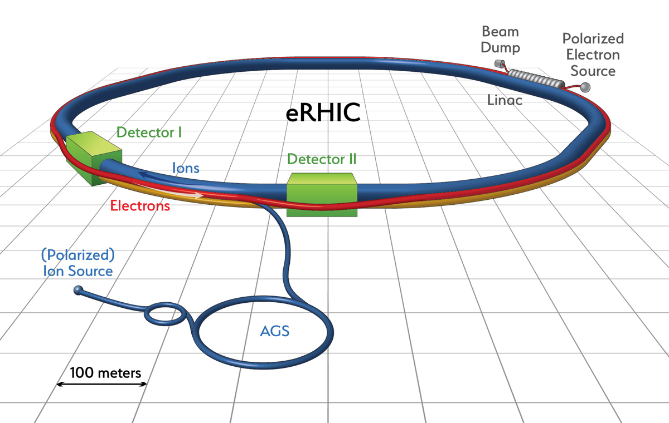
History
Over the last twenty years, significant progress has been made in developing a theoretical framework for describing the internal structure of protons and neutrons.
Breakthroughs in understanding the mechanisms of fundamental quarks and gluons, constituting the matter around us, have resulted from these developments.
Advancements in particle-accelerator and experimental detection technologies, as well as leadership-class computing capabilities, have played a crucial role.
Artificial Intelligence methods such as Machine Learning and Deep Learning have also contributed to the progress in nuclear femtography.
Nuclear Femtography lies at the heart of the 12 GeV program of Jefferson Lab and is integral to its future upgrades.
It is a key component of the science program for the future Electron-Ion Collider (EIC).
The Center for Nuclear Femtography (CNF) was established in 2019 by the Commonwealth of Virginia through SURA to become a world-leading center dedicated to understanding the three-dimensional internal structure of nucleons and nuclei.

Slide 5
CLAS12 in Hall B
Nuclear Inst. and Methods in Physics Research, A 959 (2020) 163419 + 17 articles on all subsystems.

Slide 6
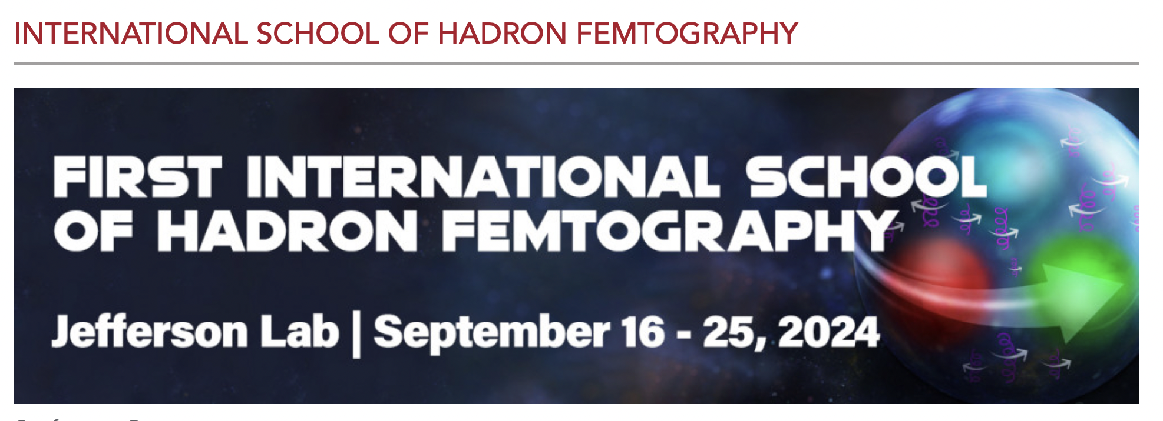
Significance of this Inaugural School
Timely theoretical advancements in understanding the internal structure of hadrons.
Accessing the mechanical structure of hadrons for the first time.
Key experiments with the 12 GeV upgrade of Jefferson Lab, and the upcoming Electron-Ion Collider (EIC) will propel progress further.
School's Overarching Goal
Provide comprehensive training on experimental, computational, and theoretical developments in hadron femtography.
Showcase how different components combine to reveal the intricate 3D structure and mechanical properties of hadrons.
Curriculum Details (see C. Weiss presentation)

Slide 7
Welcome!

