Slide 1
LD2409 – DIDACT Project Financials
Effort trailed planned rate through March
Operations contention for labor from other projects (ENP, LQCD)
One Staff member was temporarily on a part time schedule.
Effort Changes Starting in April:
Dedicating more Data Science time to ML model development effort. (Additional Postdoc assignment)
New technician time for hardware work
Increased MLOps framework development time
Contributors
Bryan Hess (PI), Malachi Schram (Co-PI)
Ops: Mark Jones (primarily), Laura Hild, Wesley Moore, Stephanie Siebor (new)
Data Science: Diana McSpadden, Ahmed Mohammed, Zhenyu Dai (new)

Slide 2
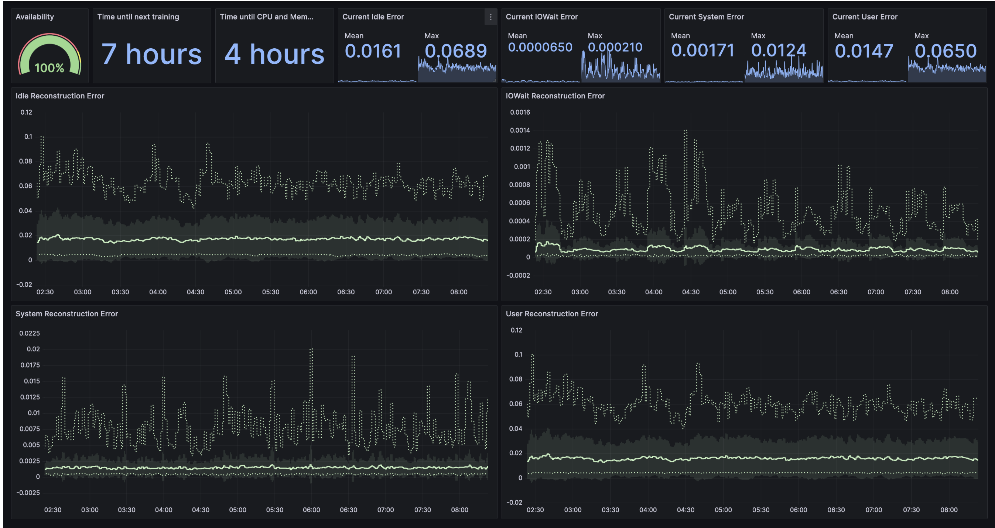
LD2409 – DIDACT Project Progress
Good Progress on ML Operations
Submission to IEEE Special Issue on MLOps: Enabling MLOps for Continual Learning in Computing Clusters
Challenges to modeling
Packaging Production Code
Testbed’s evolving nature
coarse sampling rate
Milestones and Progress – Half 1
✅ Summary and detail dashboards in Grafana
✅ Continuous learning process with daily updates
⚠️ Human in the loop to vet out-of-distribution events
⚠️ Study the performance of Variational AutoEncoder and Graph Neural Network (GNN) models
✅ Measure and characterize key timing characteristics to understand continuous learning cadence
Management Changes for Q3, Q4
Staffing increase for model development
MLOps work to complete workflow automation
Refactor software to fit existing architecture for pluggable changes
Increase effort to provide diverse NP jobs. This has been more challenging than expected.

Slide 3
Backup

Slide 4
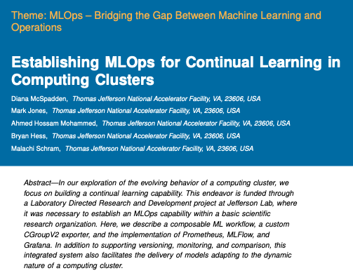
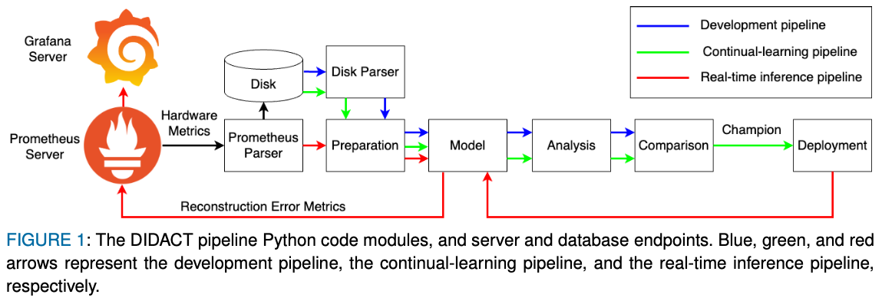
MLOps Update
The manuscript "Establishing MLOps for Continual Learning in Computing Clusters" is under review for an IEEE Software MLOps special issue.
Code for daily continual learning with competition between models has been manually tested on farm.
CPU and memory features
one model with a GNN layer and one without the GNN layer.
Both saved to the MLFlow model repository
Daily champion model is used for real-time reconstruction error results.
Continual Integration/Continual Deployment
Approved git pull request results in a Container rebuild
Container can be run on dt100
Containers built on a timer on the dt100, with built containers stored on Code Gitlab instance

Slide 5
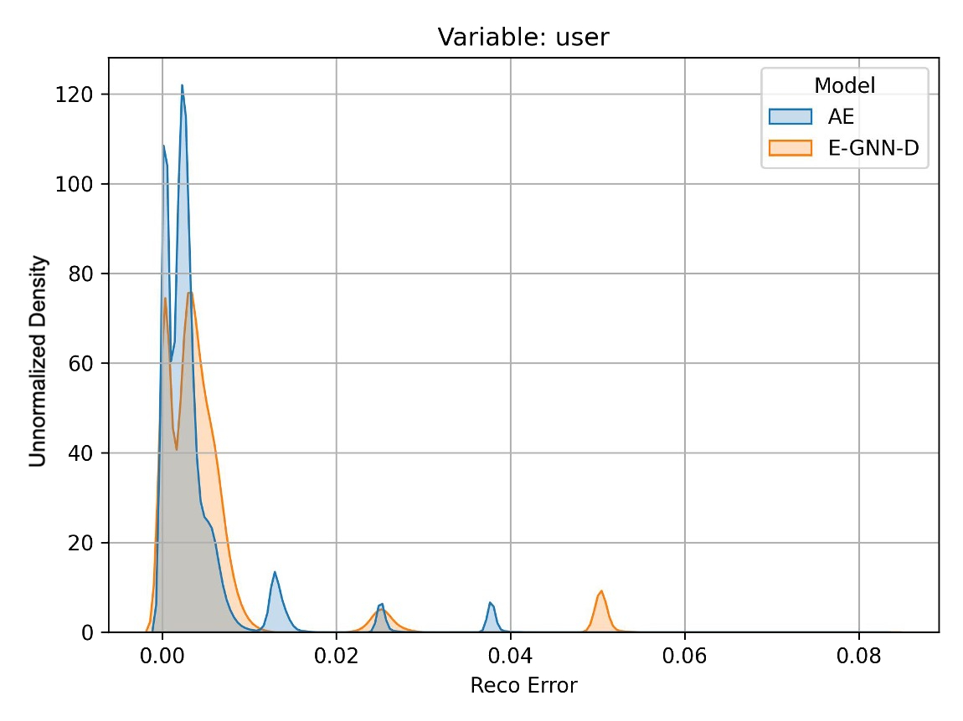
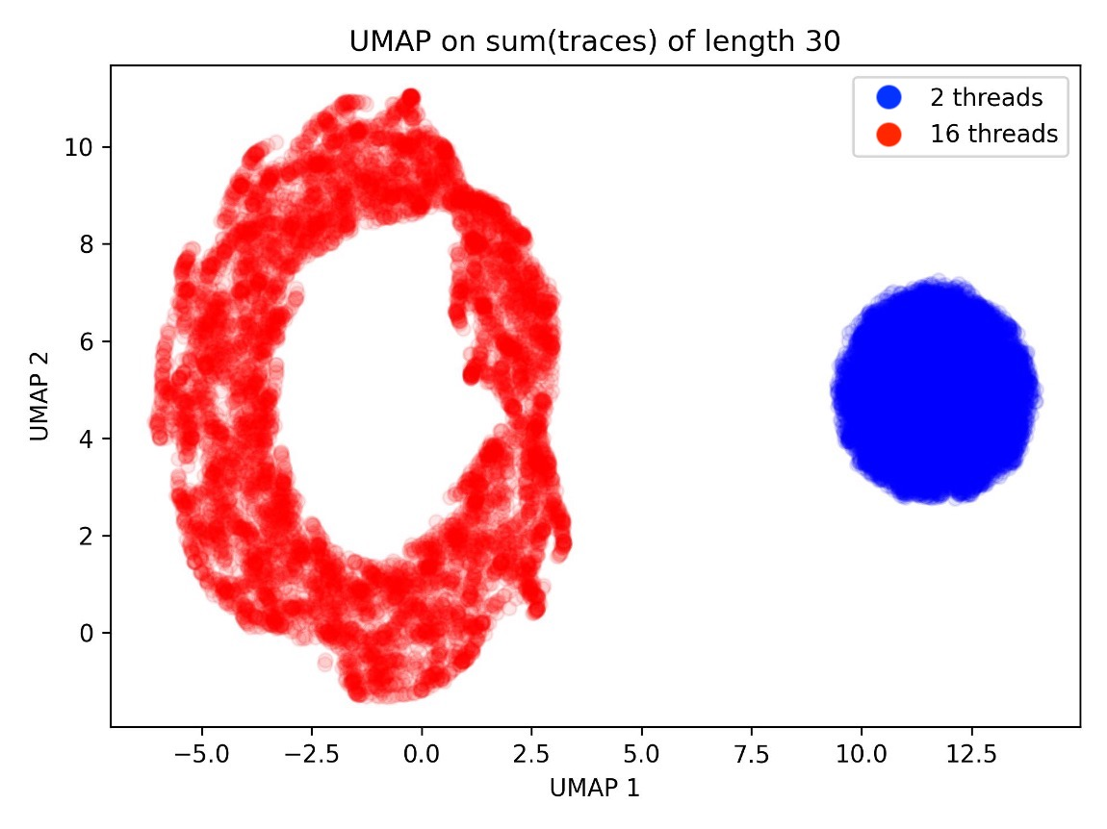
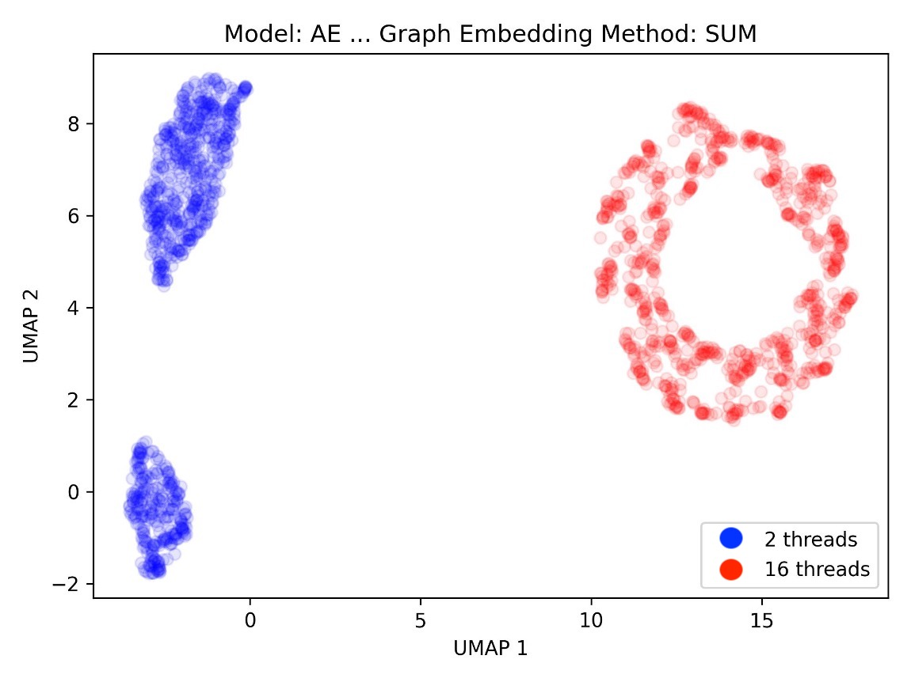
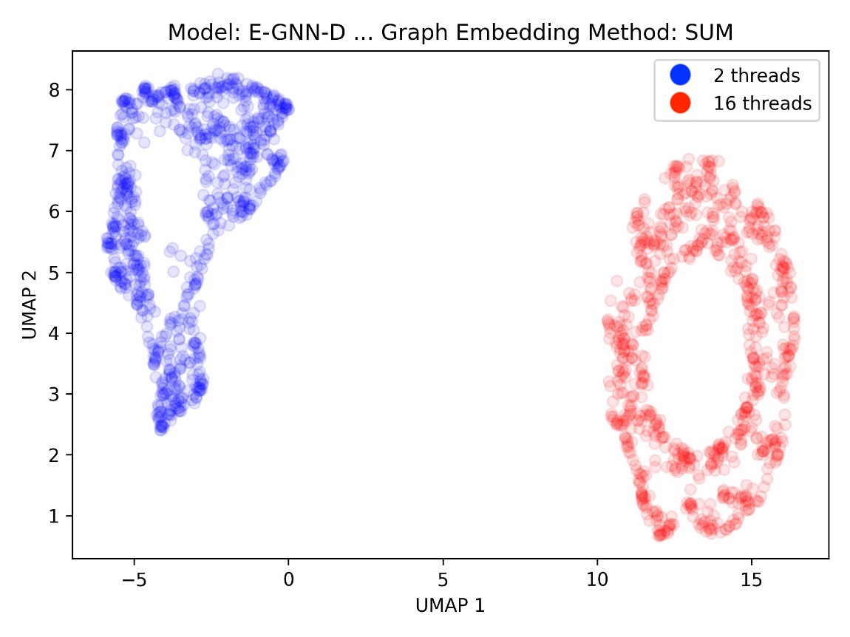
AutoEncoder (AE baseline architecture) VS GNN-assisted AE
The model is used for two different tasks:
The first task captures the salient features of the data using an AE.
The second task clusters the job types based on the salient features using techniques such as UMAP.
The baseline architecture is complete, and we will explore the performance of these models when we increasing the data volume and model parameters.
Based on the results, we see a clear separation between to current job types. However, it is unclear that one of the models does significantly better than the other in this case
We will study the performance of these models when we include additional job types and complexity
Additional research directions: VAE (Variational AE): Although vanilla AE does a very good job in producing representative embeddings, VAE can serve as a useful tool to quantify the uncertainty in data.

Slide 6
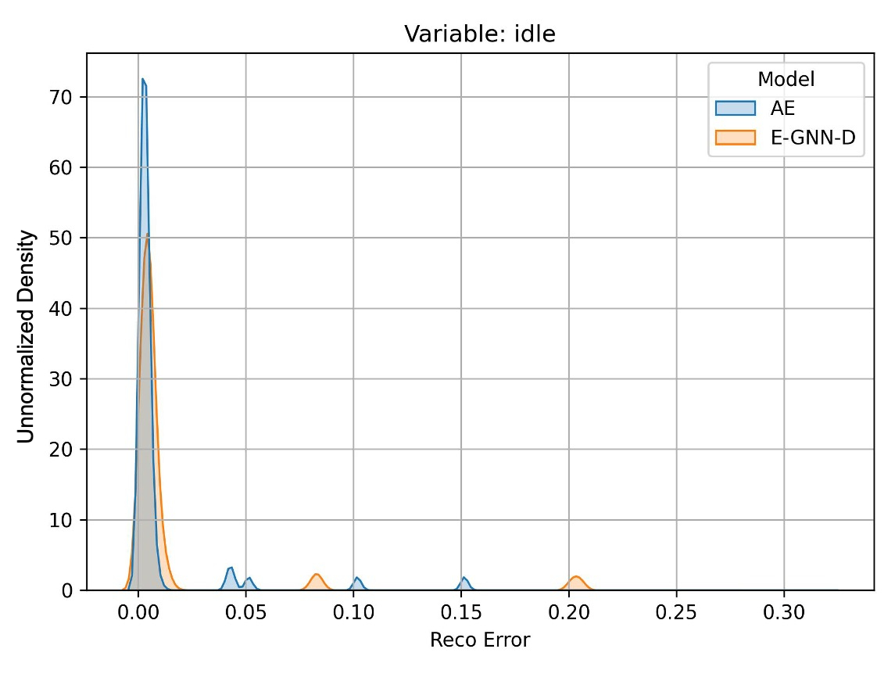
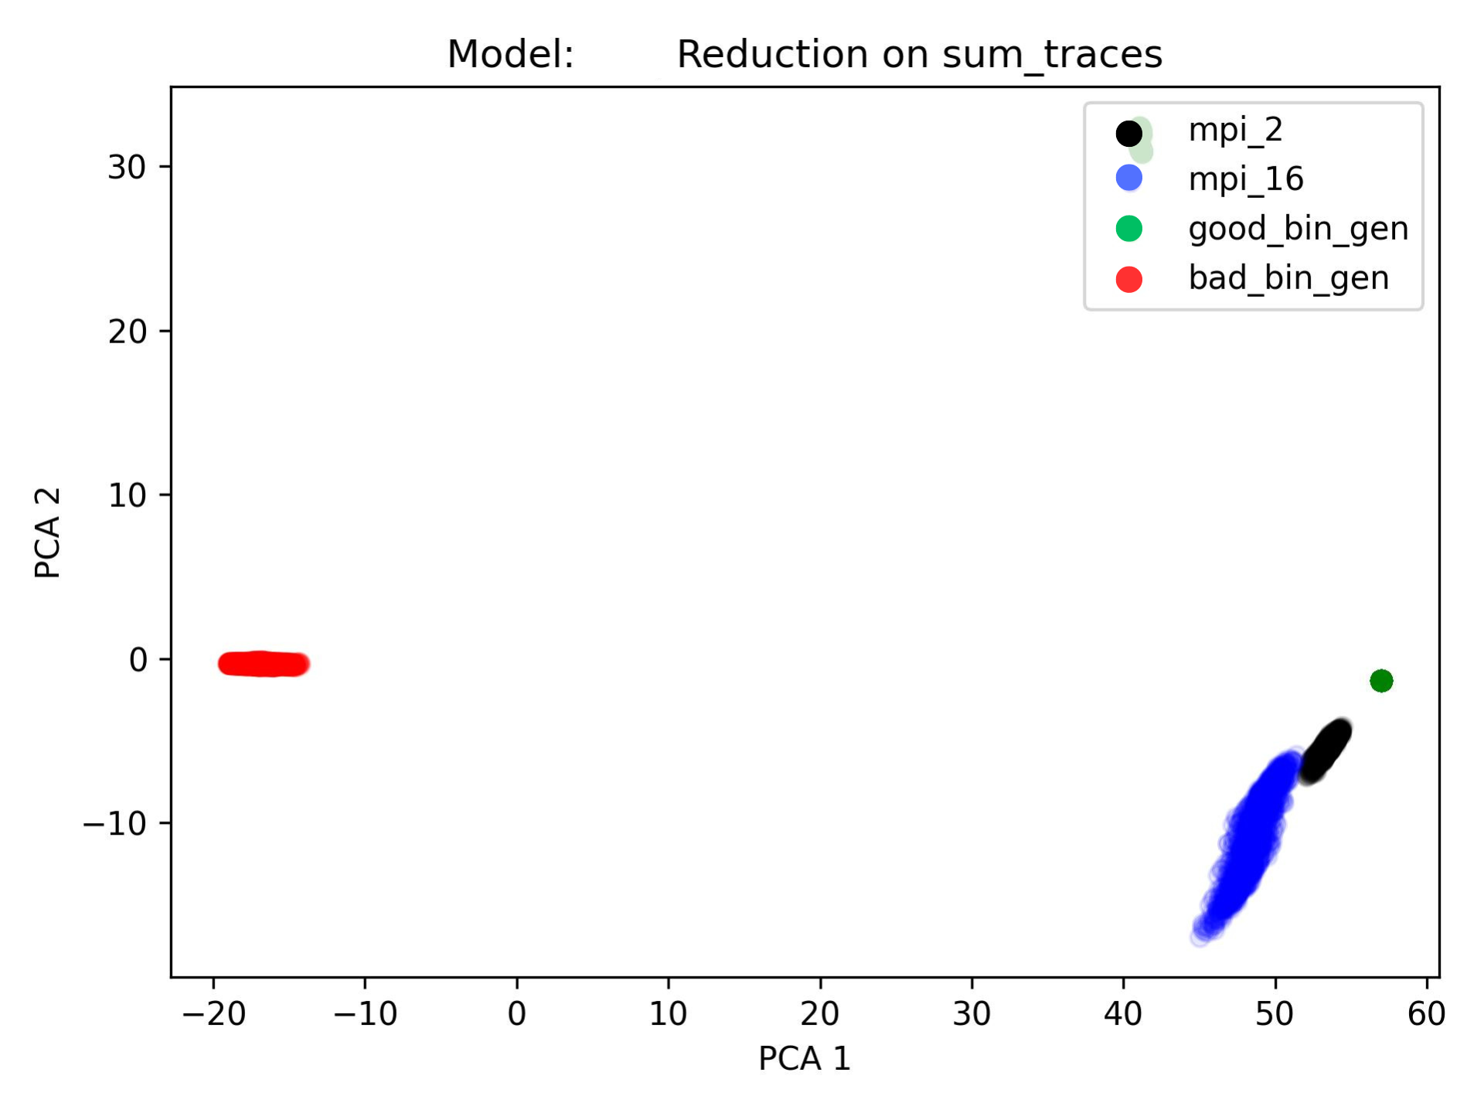
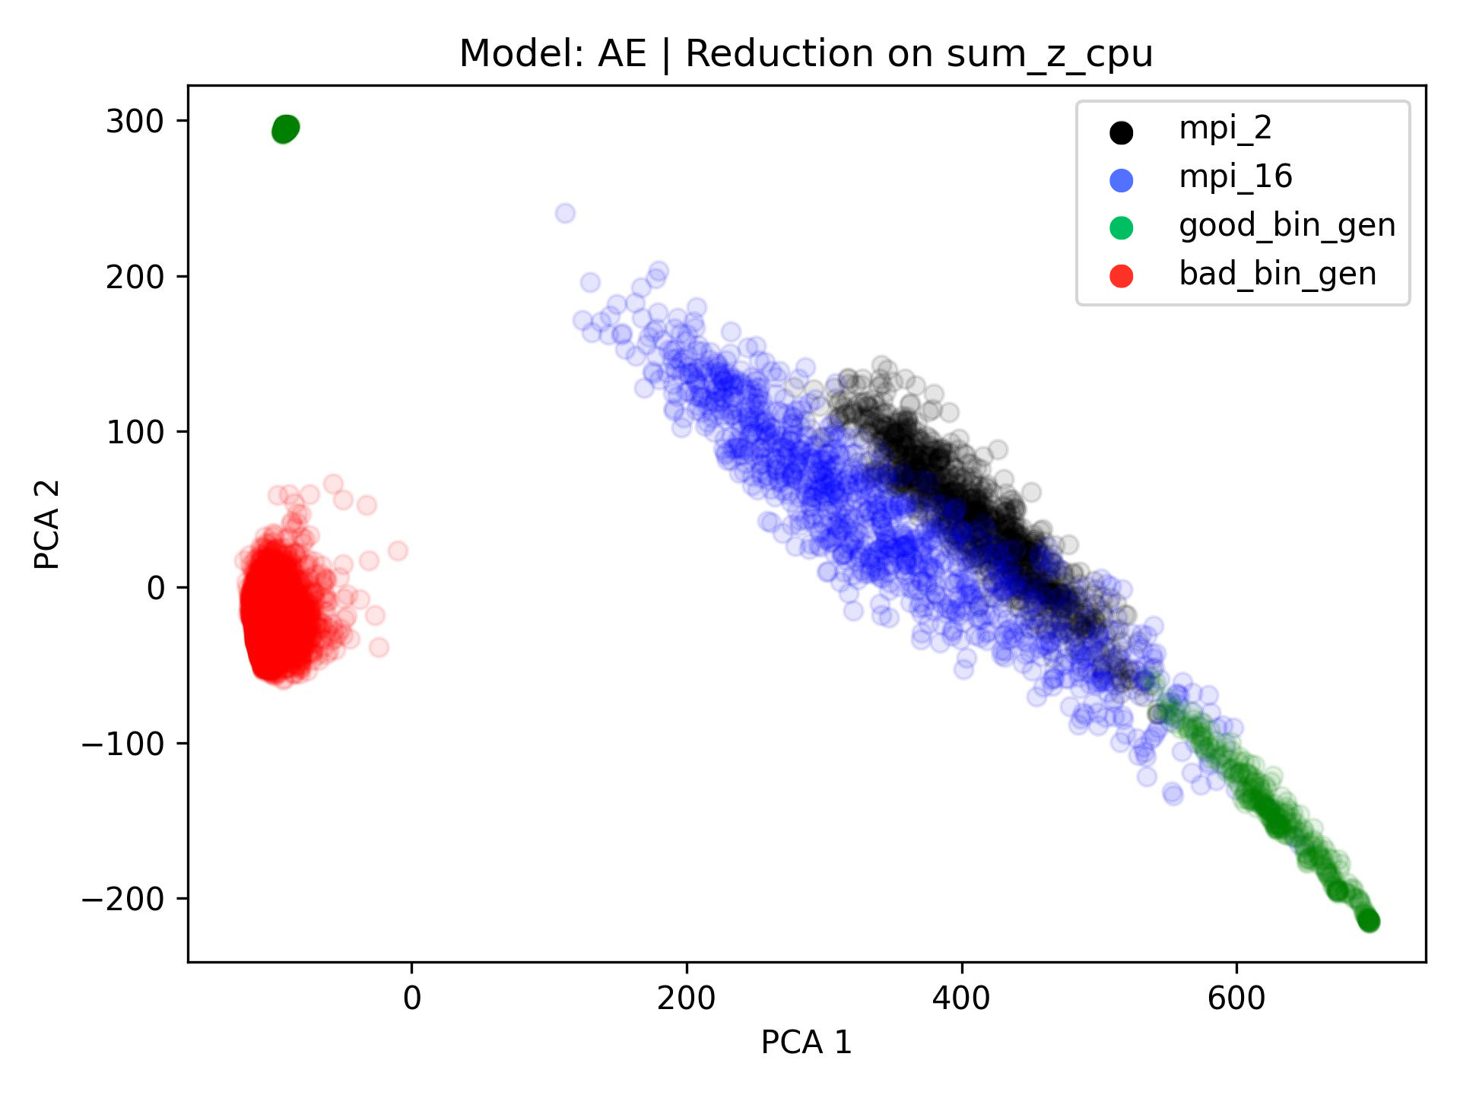
AutoEncoder (AE baseline architecture) VS GNN-assisted AE
We are working on stages of the models:
Capturing the salient features within the traces. This is quantified through the reconstruction error. Top figures compare the AE vs the GNN-assisted AE in terms of the reconstruction error of the "idle" and "user" traces of the CPU.
Understanding the separation between the jobs (PCA/UMAP). A representative model would be able to reflect the jobs that are separated in the original space (bottom left figure) into a separated embedded latent space (bottom right figure).
Based on the results, it is unclear that one of the models does significantly better than the other in this case
Pursued research direction: Although vanilla AE does a very good job in producing representative embeddings, VAE (variational AE) can serve as a useful tool to quantify the uncertainty in data (i.e., UQ analysis).

Slide 7
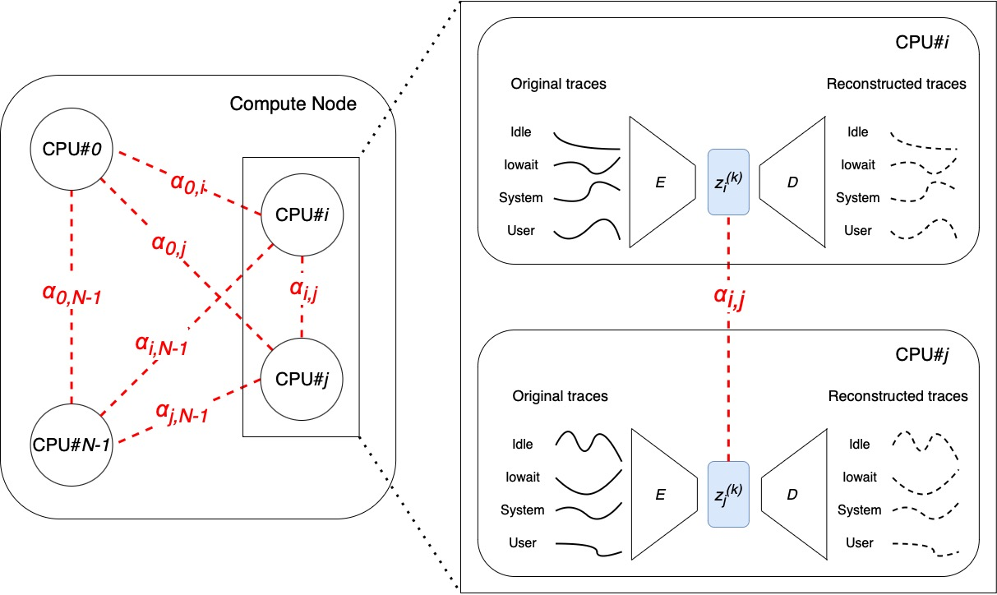
CPU Encoder-GNN-Decoder
Encoder E: Input traces of CPU#i ➔ compressed embedding z_{i}⁽⁰⁾.
Decoder D: Tries to reconstruct original traces from z_{i}. Due to compression loss, perfect reconstruction is impossible.
Hence, E learns the best compressed representation of the input while D learns the best reconstruction function.
We can optionally introduce a GNN module between E and D such that each CPU becomes aware of its neighbors activity by sharing the latent embedding z:
$z_{i}^{(1)}= z_{i}^{(0)}+f\left(z_{i}^{(0)} + \sum_{j=0}^{N−1}{α_{i,j} z_{j}^{(0)}}\right)$,
where f and $α$ are learnable functions.
Due to the additional information each CPU gets, it is believed that the reconstruction error would be less especially in multi-threaded jobs where different cores affect each other.

