Slide 1
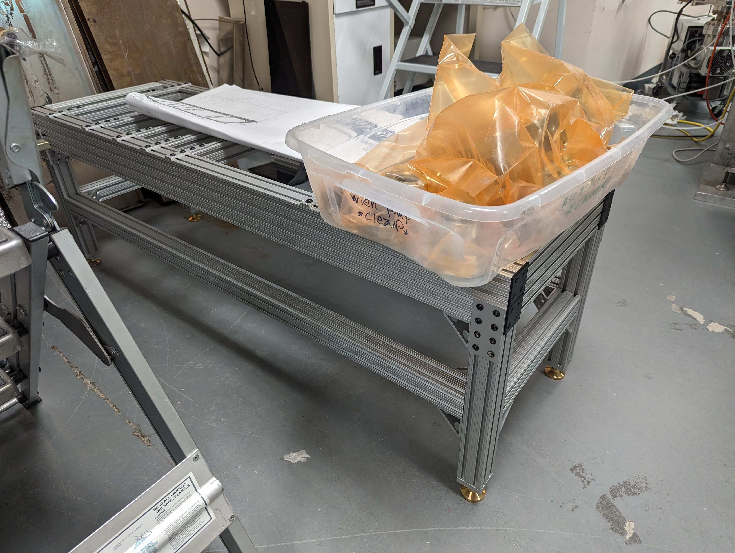
LD2408 Q2 progress and issues
Progress:
Coordination meeting with Accelerator Operations and support groups
Preliminary commissioning plan developed
Fabrication of components nearly complete
Reported on progress in invited talk at Positron Working Group Workshop in Washington, DC
Two publications to be presented at IPAC’24 in Nashville, TN
Issues:
Fabrication delay on aperture plugs; working with machine shop to alter design
Machine shop costs higher than anticipated
Ramp down labor to reserve funds for installation
Stand and cleaned components in TL1137

Slide 2
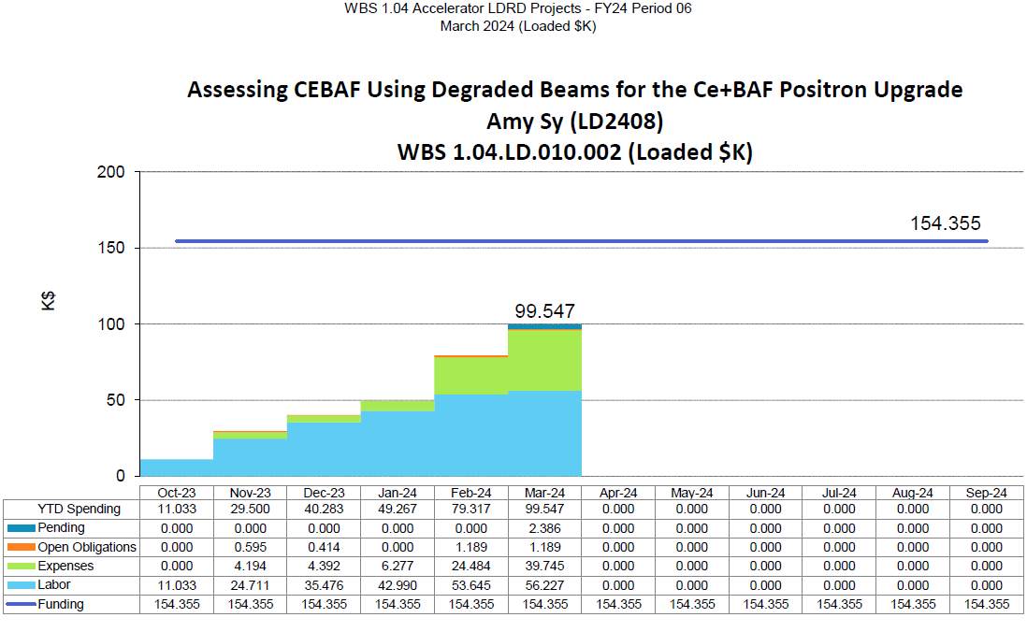
LD2408 Q2 spending profile

