Slide 1
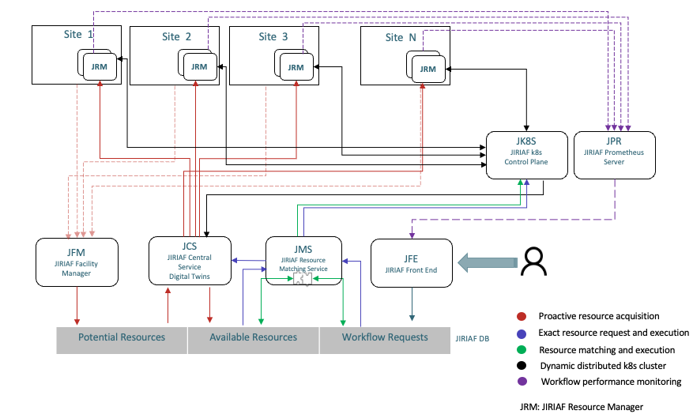
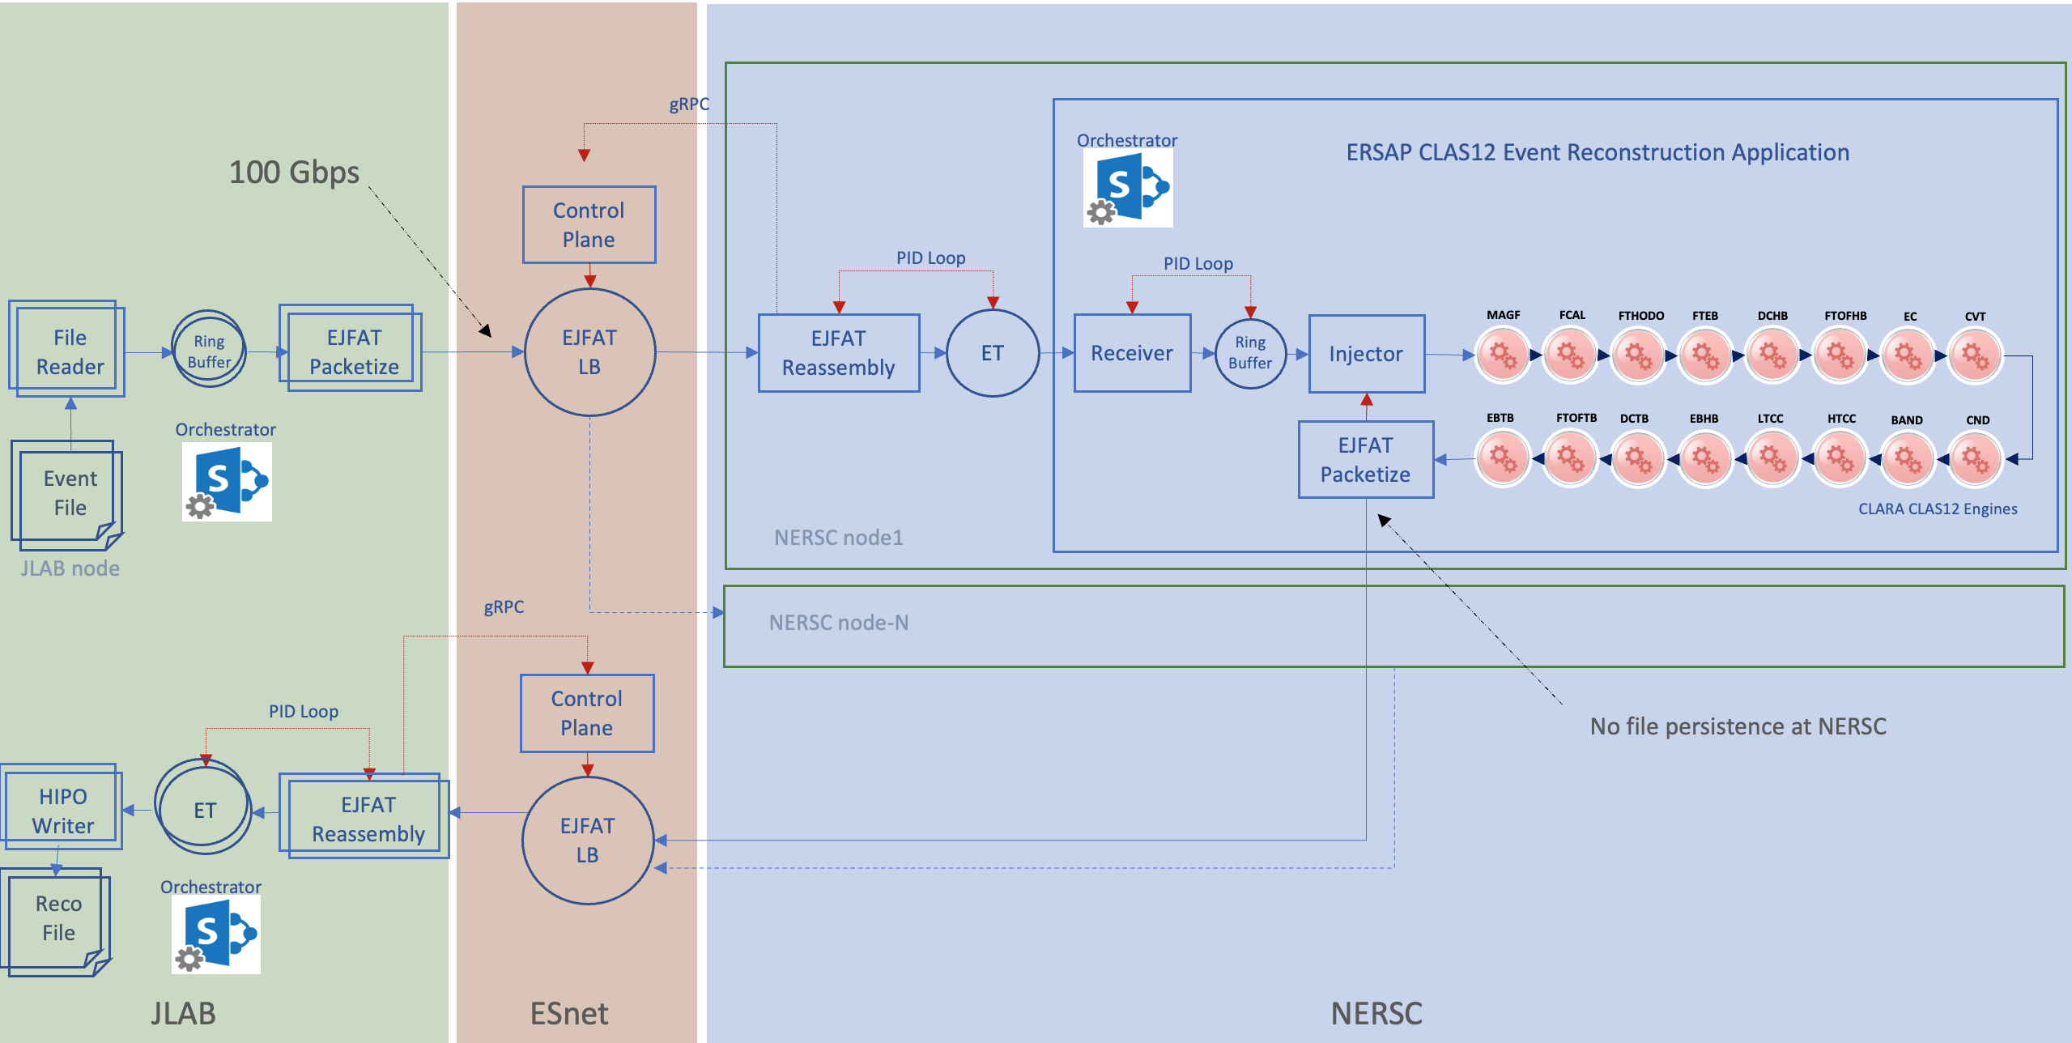
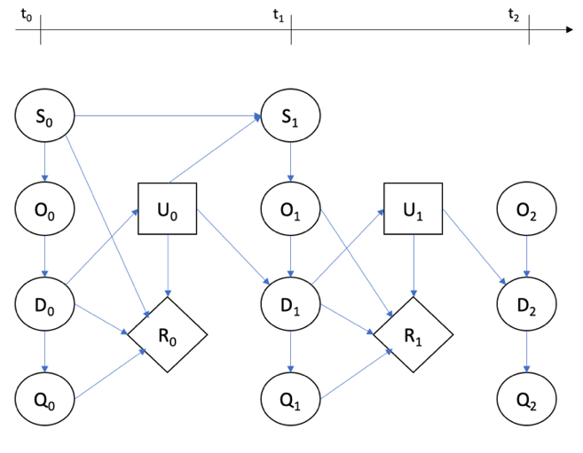
Present architecture and improvements
Q2 Achievements
The operational elastic and distributed computing cluster, utilizing resources from DOE computing facilities and coordinated by an adapted Kubernetes system, does not require any additional setup requirements from the provider's infrastructure.
The initial demonstration of remote data stream processing at a rate of 100 gigabits per second from JLAB to NERSC, marked a significant milestone.
Enhanced cooperation involving various Department of Energy (DOE) facilities.
Arrival rate (λ)
Agent
D_{t}
Service rate (μ)
Number of events in the system (Ls = ρ/(1-ρ))
The number of events in the queue (Lq = ρ²/(1-ρ))
Waiting time in the system (Ws = Ls/λ)
Waiting time in the queue (Wq = Ws - 1/μ = Lq/λ)
Q2 Milestones
Initial testing and refining of the bidirectional data-stream processing between JLAB and NERSC.
Execution of the initial phase of the migration plan, including setting up and testing the NSLS-II workflow at JLAB.
Implement the agent model and initial simulations for bottleneck prediction and resource optimization.
Development of the preliminary mathematical model of an actor, incorporating the identified parameters and dynamics.
Successful 100 Gbps data-stream processing at NERSC
Broadening the scope of possible deployments
Initial testing of workflow containers has been conducted at ORNL. We are currently awaiting the establishment of the L3VPN network connection between ESnet and ORNL.
Commenced meetings and engaged in discussions with the APS team.
A recent partnership has been established with ALS to leverage JIRIAF for the deployment and orchestration of ALS beam-line G2 curve reconstruction and analysis at NERSC.
JIRIAF
P (D₀…D_{t}, Q₀…Q_{t}, R₀…R_{t} | O₀…O_{t}, U₀…U_{t})
Digital agent state transition: F_{t} = P ( D_{t} | D_{t-1}, U_{t-1} )
Quantity of interest: F^{QoI}_{t} = P ( Q_{t} | D_{t} )
Reward function: F^{Reward}_{t} = P ( R_{t} | D_{t}, Q_{t}, U_{t}, O_{t} )
Assimilation (inverse probability or likelihood): F^{Assim}_{t} = P( O_{t} | D_{t} )
Control action: F^{Control}_{t} = P ( U_{t} | D_{t}, Q_{t} )
Publications
1st paper is accepted for publication in the EPJ
2nd technical paper: ACAT conference proceedings (in progress).
Submitting an abstract to CHEP24

Slide 2
Research Leadership Team
Name | Personnel | Committed time [%]
Vardan Gyurjyan | PI | 25
Christopher Larrieu | Co-I | 13
Jeng-Yuan Tsai | Postdoc | 100
Patrick Meagher | Student | 50

