Slide 1
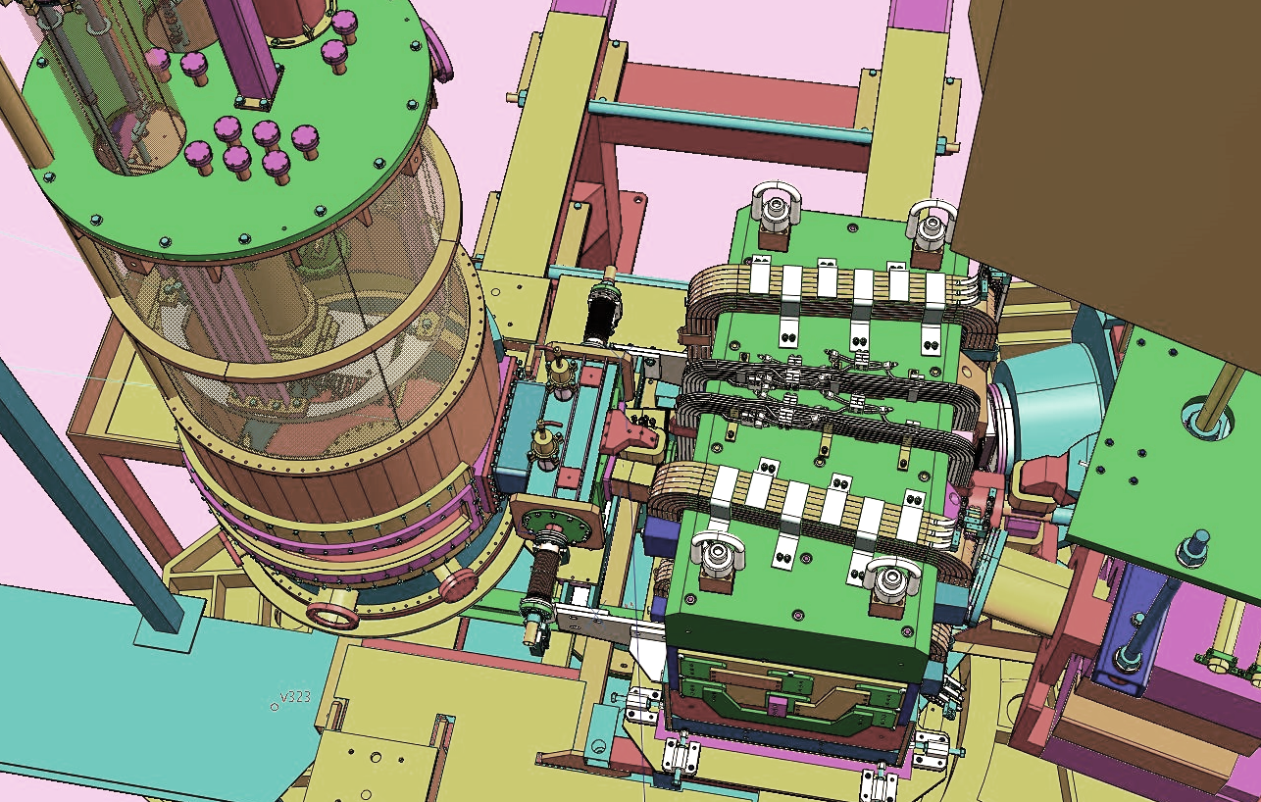
Dark-Photon (A’) Search with APEX
PR-10-009, E12-10-009
Spokespeople: R. Essig, P. Schuster, N. Toro, B. Wojtsekhowski
Presenter: Seth Hall Texas A&M University

Slide 2
Outline
Background: Dark Matter & the A’
APEX experimental Setup
Analysis
Challenges, methods, results
Next Steps
New Optics Approach

Slide 3
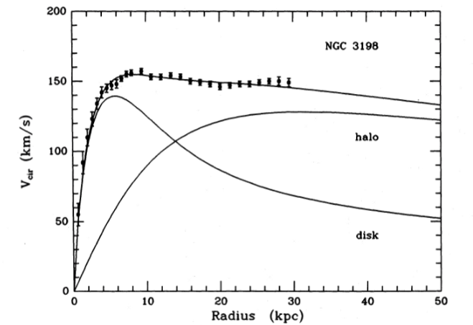
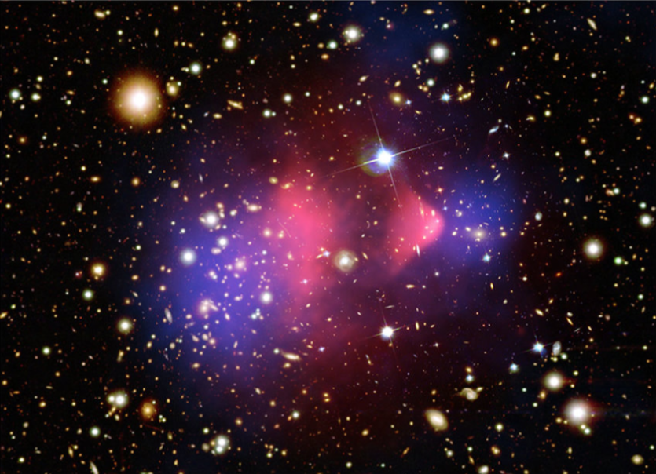
Background: Dark Matter & the A’
Astronomical evidence suggests presence of invisible (i.e. dark) matter
Invisible mass
Visible mass
Galaxy Rotation curves
Direct observation in cluster collisions

Slide 4
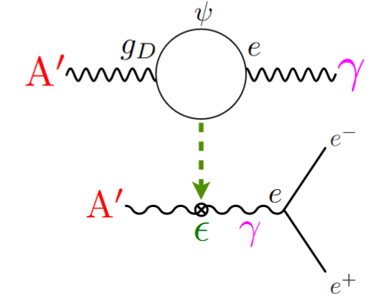
Background: Dark Matter & the A’
A new vector boson (A’, a dark photon) could be a ‘portal’ from SM to dark sector particles.
$$ℒ ={ ℒ}_{SM} + ε_{Υ }F^{Υ, μν}F_{μν}^{′} + ⋯$$
Standard-model Lagrangian
Dark-photon Field-Strength Tensor
SM Electromagnetic
Field-Strength Tensor
Coupling between $γ$and A’
Kinetic mixing of A’ with $γ$and A’
Notes:
SM Lagrangian: JWThesis.

Slide 5
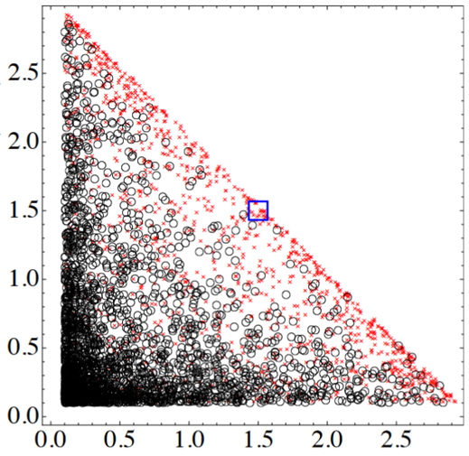
Background: Search for The A’
Scattering $e^{−}$ from fixed target gives rise to dark bremsstrahlung
A’ Signal
Background
S/B is optimal at equal $e^{+}$ $e^{−}$ angles (momenta)
$e^{+}e^{−}$ angle resolution is critical for $m_{A′}$ resolution!
$$×$$
$p_{e^{−}}$ ($GeV$)
°
APEX momentum acceptance $(±4\%)$
$$e^{−}$$
$$\sim {\left(\frac{m_{A′}}{E}\right)}^{3/2}$$
$p_{e^{+}}$ ($GeV$)
$$Θ_{±}\sim \frac{m_{A′}}{E}$$
[J.D.Bjorken et.al., “The A’ Experiment (APEX)”]
$$A′$$
$$e^{−}$$
$$e^{+}$$
$$\sim {\left(\frac{m_{A′}}{E}\right)}^{1/2}$$
$$\frac{dN_{A′}}{dt}∝\frac{Z^{2}ε^{2}}{m_{A′}^{2}}$$
$E=$beam energy
$W$ target ($Z=74$)
$$e^{−}$$
Notes:
Parameter-space taken from Vardan’s 2018 APEX update

Slide 6
A’ Invariant Mass Resolution
$$e^{−}$$
Objective: minimize ${\left(\frac{σ_{m}}{m}\right)}^{2}:$
$$\hat{y}$$
$${\overset{⃑}{ρ}}_{−}$$
$$φ_{+}$$
$$\hat{x}$$
$${\left(\frac{σ_{m}}{m}\right)}^{2}={\left(\frac{σ_{p}}{p}\right)}^{2}+0.5{\left(\frac{σ_{Θ_{±}}}{Θ_{±}}\right)}^{2}$$
$$z$$
$${\overset{⃑}{ρ}}_{+}$$
$$θ_{+}$$
$$e^{+}$$
$$Θ_{±}$$
$$Θ_{±}≈\frac{\left\|{\overset{⃑}{ρ}}_{+}−{\overset{⃑}{ρ}}_{−}\right\|}{z}$$
$$\sim 2×{10}^{−4}$$
$$σ_{HRS}^{2}+σ_{MS}^{2}$$
$σ_{HRS}$ - HRS angular resolution
Previously reported for APEX (mrad)
[J.Williamson, PhD Thesis]:
$$\frac{σ_{Θ_{±}}}{Θ_{±}} \sim \left(\frac{0.5 mrad}{175 mrad}\right)$$
 | LHRS | RHRS
$$σ_{θ}$$ | 1.74 | 1.94
$$σ_{φ}$$ | 0.56 | 0.59
$$\left|θ\right|<2.6$$
$σ_{MS}$ - Multiple-Scattering contribution
Notes:
Parameter-space taken from Vardan’s 2018 APEX update

Slide 7
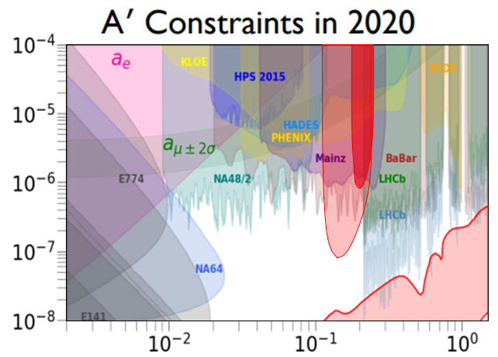
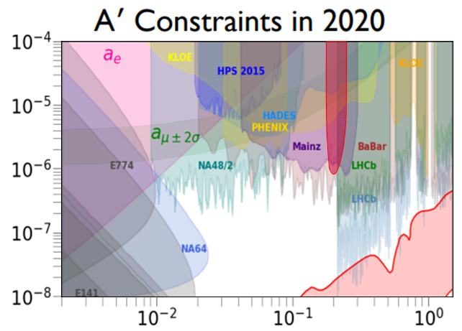
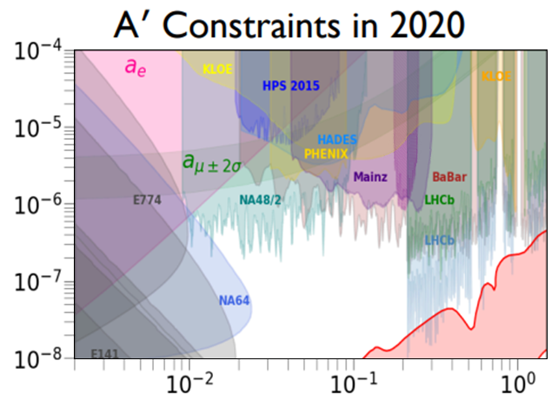
A’ Parameter-Space
Goals of APEX: Search the A’ parameter space:
2010 Test Run:
0.77 M$e^{+}e^{−}$ pairs
2019 Full Run:
$\sim$175 M $e^{+}e^{−}$ pairs
(before PID,
z-vertex cut)
$$ε^{2}=\frac{α^{′}}{α}$$
$m_{A^{′}} (GeV/c^{2}$)
[Tim Nelson, “HPS Update”. PAC52 Review, 2024]
Notes:
Parameter-space taken from Vardan’s 2018 APEX update

Slide 8
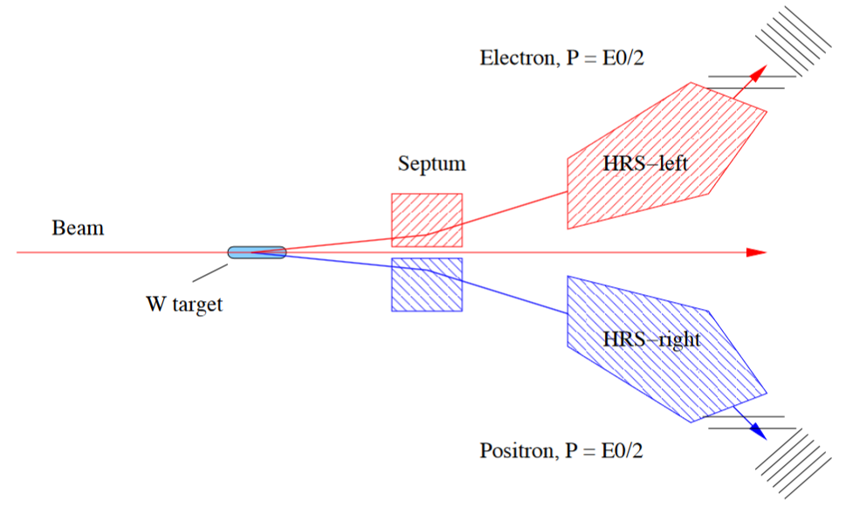
APEX Setup: HRS arms + Septum
Both High-Resolution Spectrometer (HRS) arms used in coincidence-mode
Beam:
15-50 μA
2.1 GeV
Notes:
Plots from APEX Test-run PRL

Slide 9
APEX Setup: HRS arms + Septum
Must use Septum to accommodate HRS min. angle!
Min HRS Angle$:12.5°$
$e^{−}$Angle$:5°$
Beam:
15-50 μA
2.1 GeV
Notes:
Plots from APEX Test-run PRL

Slide 10
APEX Setup: The Target
Target: $×$10 Tungsten Foils
$$e^{−}$$
Spacing: $55 mm$
$$10°$$
$$2 mm$$
Thickness:
$$10 μm (0.29\% X_{0})$$
$$e^{+}$$
Notes:
Plots from APEX Test-run PRL

Slide 11
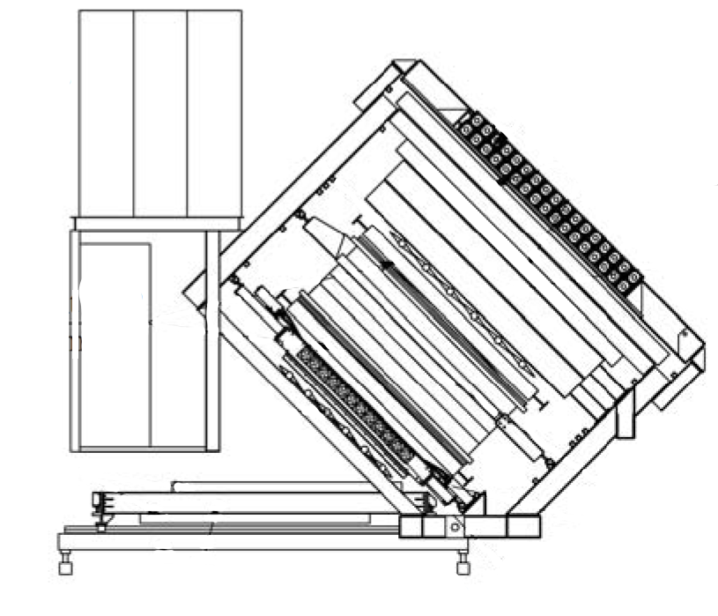
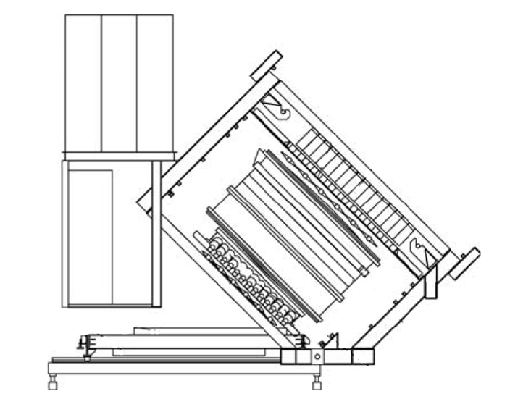
HRS Detector Package
Left HRS
Right HRS
DAQ Electronics
DAQ Electronics
Shower EMC Detectors
S2 Scintillator (x16 paddles)
Gas Cerenkov Counter (x10 channels)
Vertical Drift Chambers
4x drift-chambers for precise tracking $(σ\sim 85$μm/plane)
Notes:
Plots from APEX Test-run PRL

Slide 12
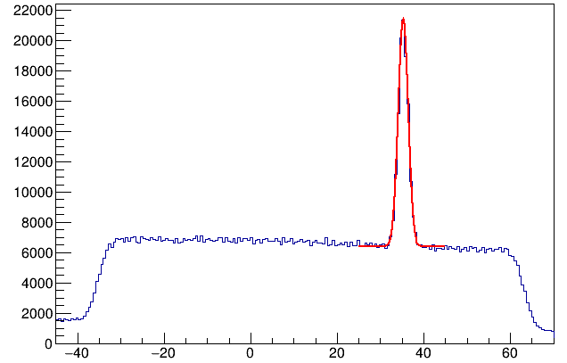
Coincidence Timing
1. Check all S2-hits of both arms. Select events by:
$T_{S2,R}$ - S2 paddle time, RHRS
$T_{S2,L}$ - S2 paddle time, LHRS
$$T_{S2,R}−T_{S2,L}$$
$$T_{0}=32.4 ns$$
Coinc-Event Cut:
$$\left|{(T}_{S2,R}−T_{S2,L}\right)−T_{0}|<1.5 ns$$
$\frac{Signal}{Background}=2.7$
$$σ_{T}=1.0 ns$$
Before PID, z-vertex cut
$$ns$$

Slide 13
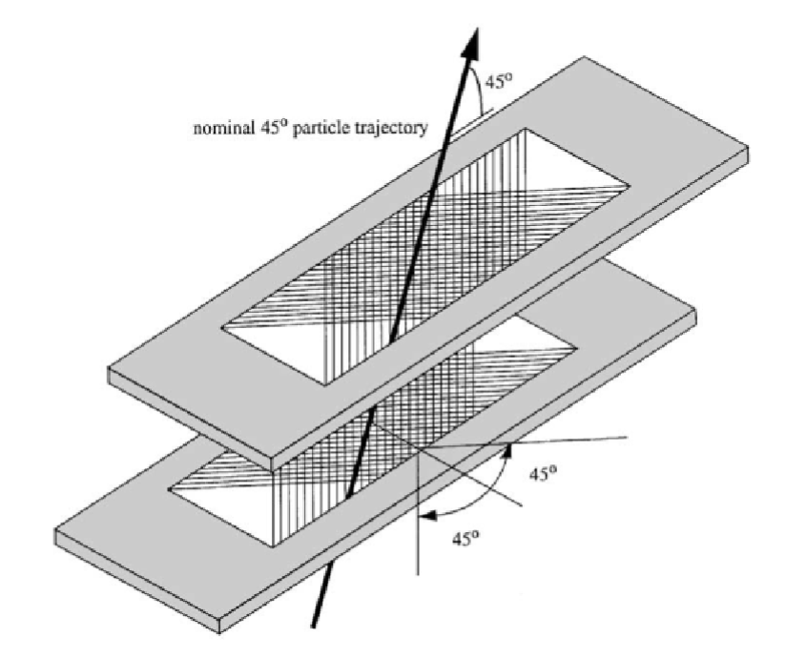
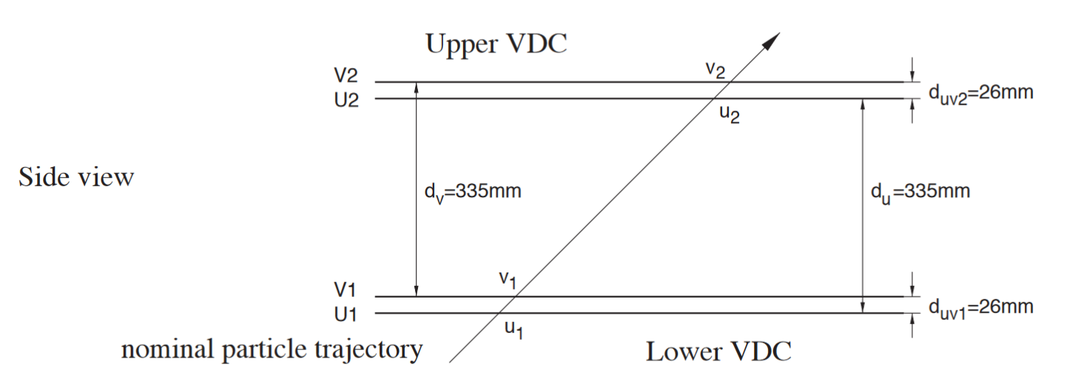
Detectors: Vertical Drift Chambers
One Vertical Drift Chamber (VDC) in each HRS
Two pairs of orthogonal drift-planes; named U1, V1, U2, V2.
Accuracy of $σ\sim 85 μm$ / plane
368 sense-wires / plane, spacing = $4.24 mm$
Notes:
All these taken from ‘Basic Instrumentation of Hall-A’

Slide 14
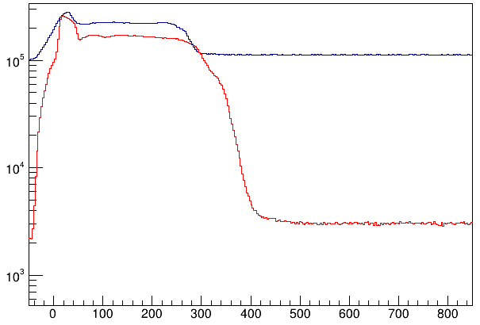
Detectors: Vertical Drift Chambers
Challenges:
High accidental rate of LHRS makes finding good tracks difficult!
LHRS
RHRS
$$VDC TDC time (ns)$$
Notes:
All these taken from ‘Basic Instrumentation of Hall-A’

Slide 15
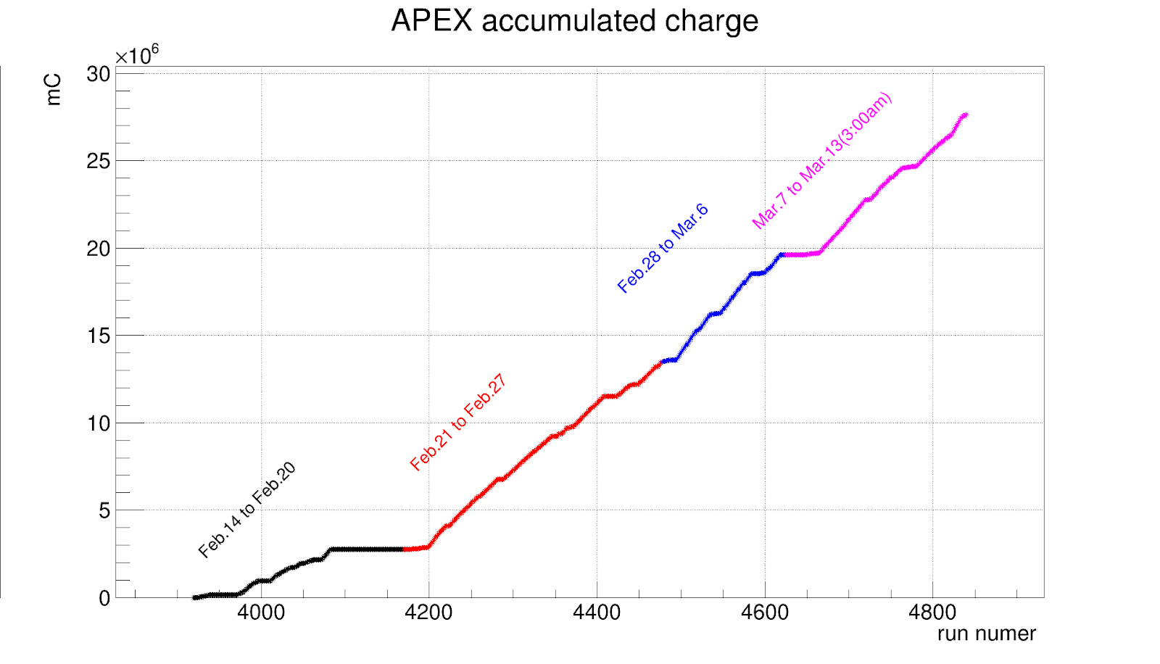
Detectors: Vertical Drift Chambers
Challenges:
High-voltage was too low for Left-HRS VDC!
(Not total accumulated charge)
Pre-fix
Post-fix
Notes:
All these taken from ‘Basic Instrumentation of Hall-A’

Slide 16
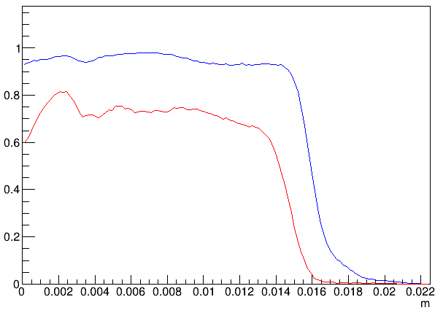
Detectors: Vertical Drift Chambers
Challenges:
Lower High-Voltage for Left-Arm VDCs (lower track-reconstruction efficiency)
$$4.24 mm$$
$$e^{−}$$
$$13 mm$$
Track-efficiency VS drift-distance
Pre-fix
Post-fix
$$x_{drift}$$
How often are TDC hits ‘missing’?
$$x_{drift}$$

Slide 17
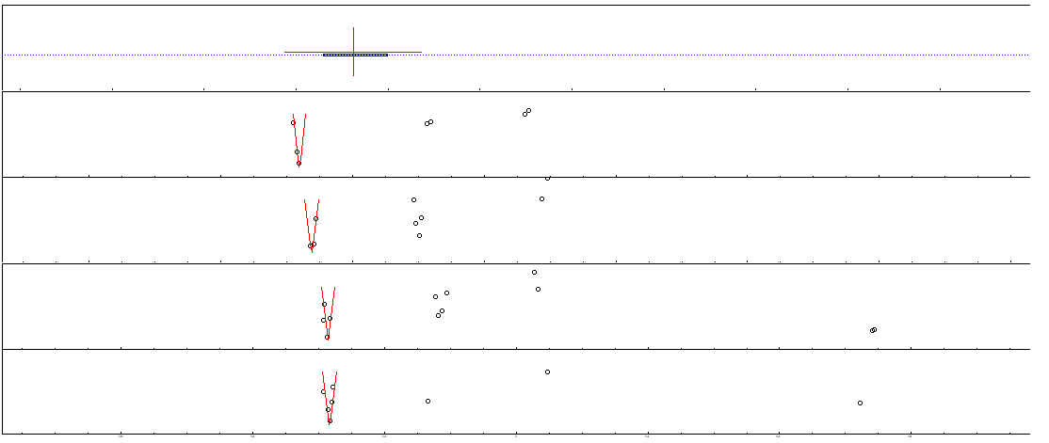
VDC Occupancy
Single-event Picture:
S2 hit
Track intercept with S2-plane
Track time
S2
$$50 ns$$
paddle #
VDC: V2
$$450 ns$$
wire #
U2
$$450 ns$$
wire #
V1
$$450 ns$$
wire #
U1
$$450 ns$$
wire #
Accepted track
Rejected Track

Slide 18
Track Reconstruction
2. The passage of $e^{−}$ through the drift-planes creates TDC hits
Coinc S2 hit: the timing of this S2-hit matches the other arm
$$T_{S2,R}−T_{S2,L}$$
S2
Non-Coinc S2 hit: this hit can be rejected
$$T_{S2}^{(0)}$$
$$T_{S2}^{(1)}$$
$$T_{S2}^{(1)}$$
$$T_{S2}^{(0)}$$
U2 & V2
U1 & V1

Slide 19
Track Reconstruction
2. The passage of $e^{−}$ through the drift-planes creates TDC hits
Coinc S2 hit: the timing of this S2-hit matches the other arm
S2
Once S2 hit is selected, it can be used to only look at parts of VDC where matching track could be
$$T_{S2}^{(0)}$$
U2 & V2
U1 & V1

Slide 20
Track Reconstruction
Particle passage through drift-planes create TDC hits
600
TDC time (ns)
$$T_{S2 }^{(1)}$$
$$T_{S2 }^{(0)}$$
$$e^{−}$$
0
Wire #
$$x_{drift}$$
$$t_{drift}$$
drift distance
drift
time

Slide 21
Track Reconstruction
Steps of track reconstruction:
Groups: $≥2$ hits, gap $≤3$ wires.
Clusters: grid-search for clusters with $≥2$ hits. (use S2 time as guess)
600
TDC time (ns)
$$T_{S2}$$
Use time of chosen S2-hit
0
Wire #
Groups with no clusters are discarded

Slide 22
Track Reconstruction
Steps of track reconstruction:
Groups: $≥2$ hits, gap $≤3$ wires.
Clusters: grid-search for clusters with $≥2$ hits. (use S2 time as guess)
Pairs: pair clusters in each plane.
S2
Clusters
U2 & V2
Pairs
U1 & V1
Groups with no clusters discarded

Slide 23
Track Reconstruction
Steps of track reconstruction:
Groups: $≥2$ hits, gap $≤3$ wires.
Clusters: grid-search for clusters with $≥2$ hits. (use S2 time as guess)
Pairs: pair clusters in each plane.
‘Raw’ Tracks: build tracks using pair-combinations.
Track intercept with S2
$$\hat{z}$$
S2
‘Raw’ Tracks
$$\hat{x}$$
False track! Must be rejected…
U2 & V2
U1 & V1

Slide 24
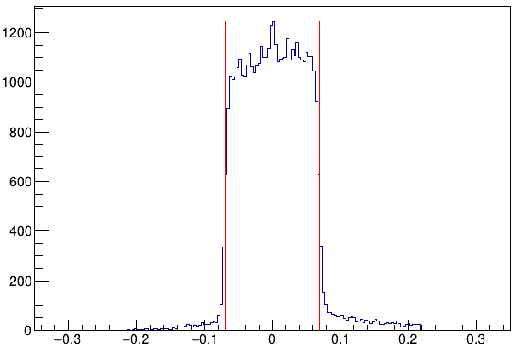
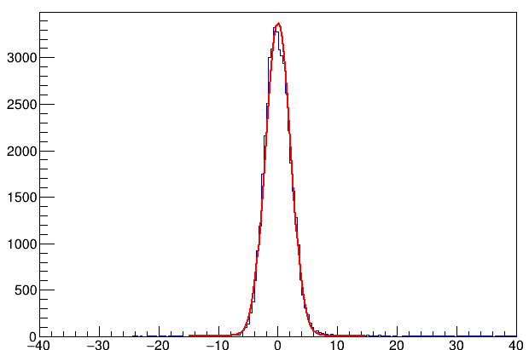
Track Reconstruction
Using S2 hits, accidental tracks can be rejected
Use Track intercept with S2
Use Track time at S2
$$e^{−}$$
$$\hat{z}$$
$$x_{track}$$
$$x_{paddle}$$
$$\hat{x}$$
(center of paddle)
$$σ=2.10 ns$$
(for post-fix
runs)
$$W_{S2}$$
(paddle width)
Paddle center
$x_{track} −$ $x_{paddle}$(m)
$t_{track}−$ $T_{S2}$ (ns)

Slide 25
Track Reconstruction
Steps of track reconstruction:
Groups: $≥2$ hits, gap $≤3$ wires.
Clusters: grid-search for clusters with $≥2$ hits. (use S2 time as guess)
Pairs: pair clusters in each plane.
‘Raw’ Tracks: build tracks using pair-combinations.
‘Refined’ Tracks: final track positions determined..
S2
Track rejected,
does not match with S2-hit
U2 & V2
U1 & V1

Slide 26
Tracking: Refining Tracks
Must find precise intercepts for ‘raw’ tracks
Initial guess
TDC time
Real trajectory

Slide 27
Tracking: Refining Tracks
To refine track, minimize error:
$$ε^{2}={Σ_{i}\left(t\left(x_{i}\right)+T_{0}−t_{i}\right)}^{2}$$
$t_{i}$ (model)
Timing offset of track (using S2)
$t_{i}$ (real)
$$x_{i}$$
$$t\left(x_{i}\right)$$
TDC time
$$ε_{i}$$
$$t_{i}$$

Slide 28
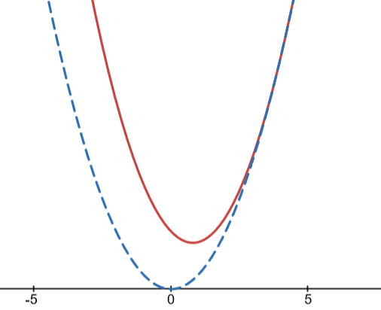
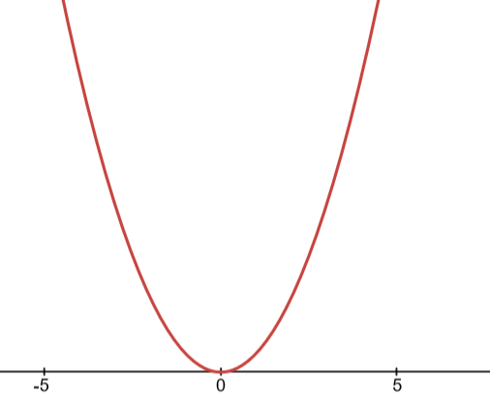
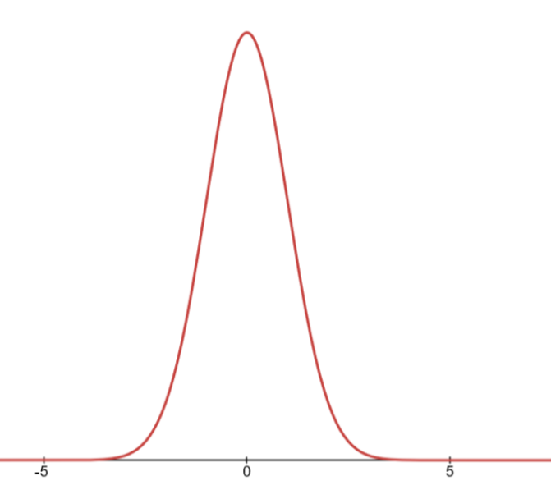
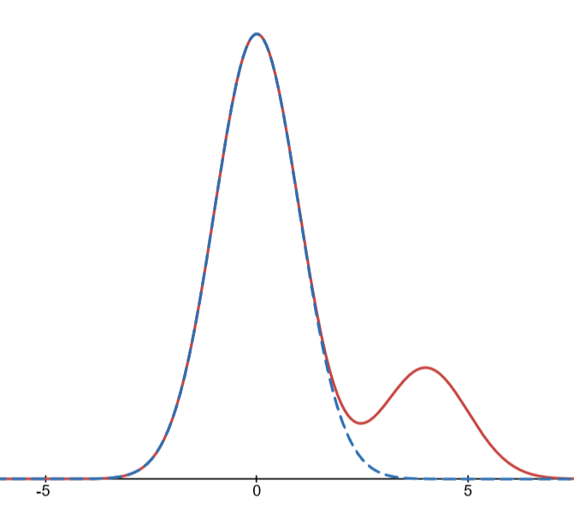
Tracking: Newtown’s Method
Different optimization methods:
Least squares:
$${min⁡(χ}^{2}); { χ}^{2}≡Σ_{i}{( τ_{i}−f\left(x_{i}\right) )}^{2}$$
Pros: Quick, analytical (for lin. Systems)
Cons: Susceptible to outliers
Max-Gauss:
$$max\left(η\right); η≡Σ_{i}exp\left[−\frac{1}{2σ^{2}}{\left( τ_{i}−f\left(x_{i}\right) \right)}^{2}\right]$$
Pros: Resistant to outliers
Cons: Non-analytical, sensitive to first-guess
peak
noise
peak

Slide 29
Tracking: Newtown’s Method
To find best track ($max\left(η\right)$), Solve $∇η\left(x\right)=0$
Where $x∈ ℝ^{5}; x=\{x_{0}⋯x_{1},T_{0}\}$
Track time-offset
4 VDC-plane intercepts
In other words, find the root: $F\left(x\right)=0$
Nonlinear equation in 5 dimensions!

Slide 30
Tracking: Newtown’s Method
To find best track ($max\left(η\right)$), Solve $∇η\left(x\right)=0$
Where $x∈ ℝ^{5}; x=\{x_{0}⋯x_{1},T_{0}\}$
Q: How can we solve a nonlinear system in 5 variables?
A: Newton’s Method!
Current guess
Next guess
$x_{1}=$ $x_{0}− {J\left(x_{0}\right)}^{−1}F(x_{0})$
Converges very quickly, provided suitable initial guess!
Jacobian matrix Defined as:
$$J{(x)}_{ij} = \frac{∂}{∂x_{j}}F{(x)}_{i}$$

Slide 31
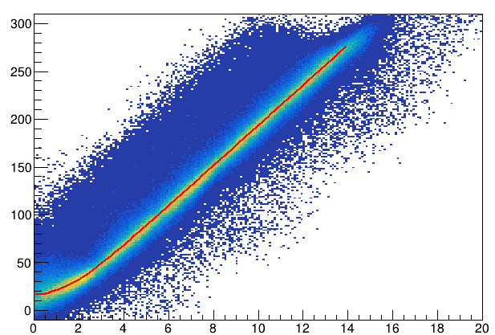
Time / Distance Drift-Model
5 – parameter drift model:
Quadratic region
Linear
region
$t_{0}$ zero-val. Of t
$x_{lin}$ x-val where model goes from quadratic to linear
$t_{lin}$ t-val where model goes from quadratic to linear
$m$ slope of lin. region
$b$ controls shape of quadratic region
Drift-Time (ns)
$$m\left(\frac{dt}{dx}\right)$$
$$b$$
$$t_{lin}$$
$$t_{0}$$
Drift-Dist (mm)
$$x_{lin}$$

Slide 32
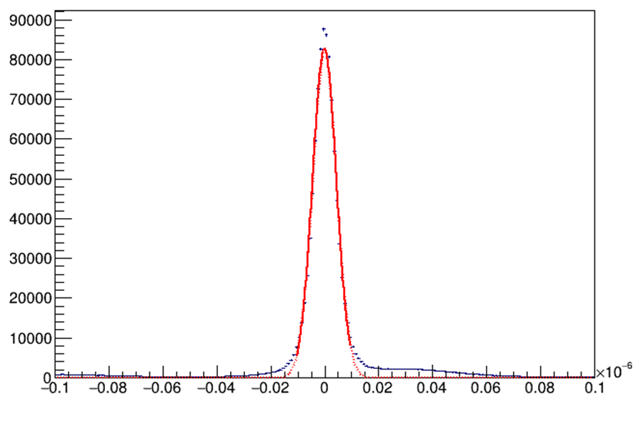
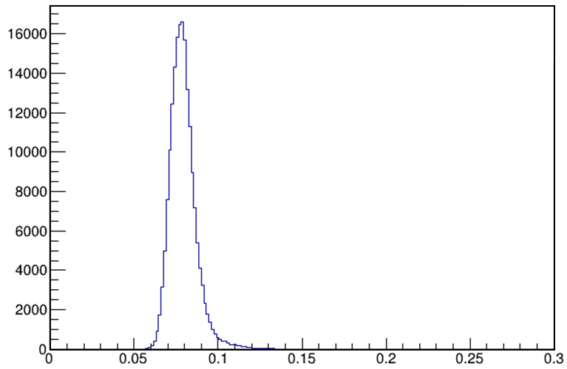
Evaluating Accuracy of Tracks
Error of track-intercepts can be estimated:
$$σ_{track}^{2}=σ_{time}^{2}+σ_{model}^{2}$$
Sys. Error of TDC
Per-Plane Track Error from TDC ($σ_{TDC}$)
$$σ_{Time}=4.42 ns$$
$$\left\langle x\right\rangle =80 μm$$
$$RMS=8.6 μm$$
s
mm
$σ_{time}=$ $80 μm$

Slide 33
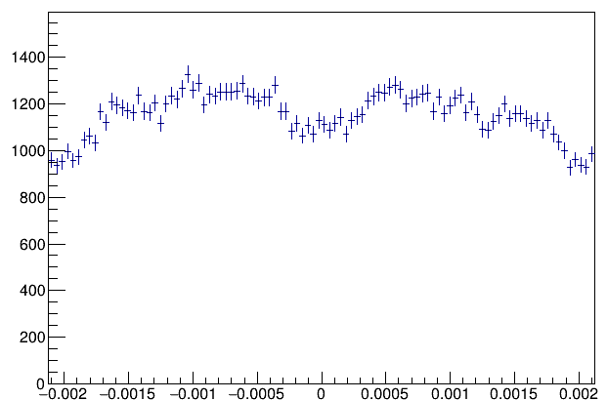
Evaluating Accuracy of Tracks
Error of track-intercepts can be estimated:
$$σ_{track}^{2}=σ_{time}^{2}+σ_{model}^{2}$$
If time-to-distance model is imperfect, there can be periodic error of plane-intercept!
$$2.1 mm$$
$$e^{−}$$
$$σ_{model}=38.8 μm$$
$$x_{Track}$$
$$x_{Wire}$$
$x_{Track}−x_{Wire}$ (m)

Slide 34
Evaluating Accuracy of Tracks
Error of track-intercepts can be estimated:
$$σ_{track}^{2}=σ_{time}^{2}+σ_{model}^{2}$$
$$σ_{track}=\sqrt{{\left(80 μm\right)}^{2}+{\left(39 μm\right)}^{2}}=89 μm$$
Pre-fix
$$σ_{track}=\sqrt{{\left(80 μm\right)}^{2}+{\left(12 μm\right)}^{2}}=81 μm$$
Post-fix

Slide 35
Analysis: Results
$$\frac{n.Evts. with ≥1 good track}{n.Evts. with S2 coincidence}$$

Slide 36
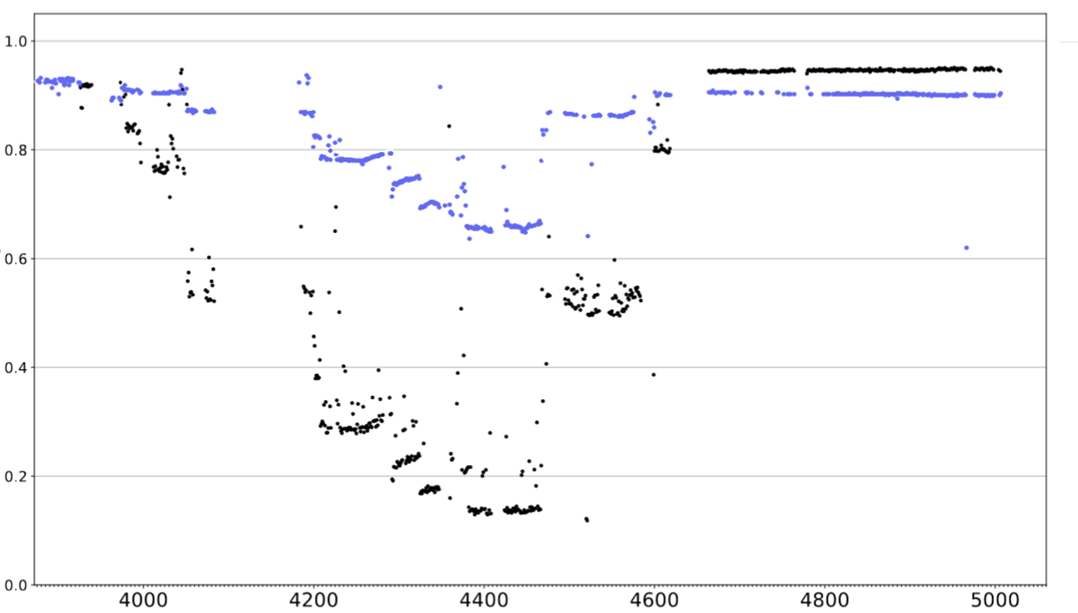
Analysis: Results
$$\frac{n.Evts. with ≥1 good track}{n.Evts. with S2 coincidence}$$
Pre-Optimization
Post-Optimization
Run Number

Slide 37
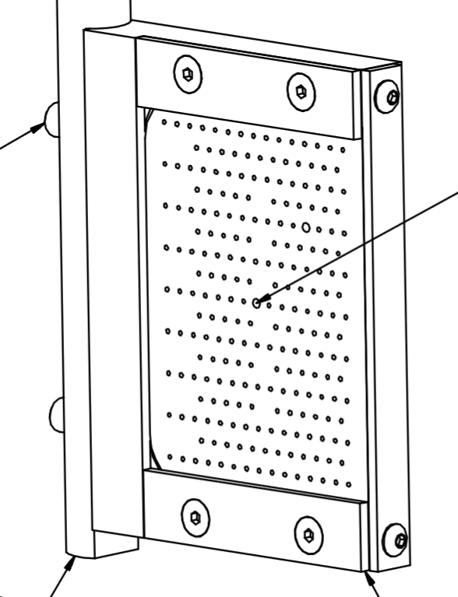
Next Steps: Optics for APEX
Detectors
${\overset{⃑}{x}}_{fp}$
Targets:
Vertical / Horizontal Tungsten Wires
Carbon Foils
Vertical Wire ($∅ 100μm$)
Standard HRS magnets (QQDQ)
Septum
${\overset{⃑}{x}}_{tg}$
Goal: construct map
${f:\overset{⃑}{x}}_{fp}→{\overset{⃑}{x}}_{tg}$
Sieve
$$e^{−}$$
Notes:
All these taken from ‘Basic Instrumentation of Hall-A’

Slide 38
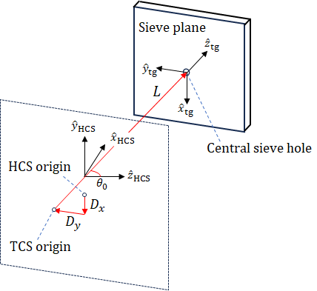
Next Steps: Optics for APEX
$$θ≡\frac{dx}{dz}$$
$$φ≡\frac{dy}{dz}$$
$$δ≡\frac{p−p_{0}}{p_{0}}$$
(Ideal) HRS optics approach:
Note:
${\left[\begin{matrix}δ \\ θ \\ \begin{aligned}y \\ φ\end{aligned}\end{matrix}\right]}_{tg}=\left[\begin{matrix}\left\langle δ | x\right\rangle & \left\langle δ | θ\right\rangle & 0 & 0 \\ \left\langle θ | x\right\rangle & \left\langle θ | θ\right\rangle & 0 & 0 \\ 0 & 0 & \left\langle y | y\right\rangle & \left\langle y | φ\right\rangle \\ 0 & 0 & \left\langle φ | y\right\rangle & \left\langle φ | φ\right\rangle \end{matrix}\right]$ ${\left[\begin{matrix}x \\ θ \\ \begin{aligned}y \\ φ\end{aligned}\end{matrix}\right]}_{fp}$
Assumptions:
Perfect HRS alignment
Independence of $x−y$ coords. (Untrue with Septum, $x−y$ Symmetry Broken!)
Notes:
All these taken from ‘Basic Instrumentation of Hall-A’

Slide 39
Next Steps: Optics for APEX
$$θ≡\frac{dx}{dz}$$
$$φ≡\frac{dy}{dz}$$
$$δ≡\frac{p−p_{0}}{p_{0}}$$
Optics with Septum:
Note:
For each coordinate, high-order poly:
$$δ ={\sum_{jkl}{D_{jkl}}θ}_{fp}^{j} y_{fp}^{k} φ_{fp}^{l}$$
3rd-rank tensor, which is itself poly. In $x_{fp}:$
$$D_{jkl}\left(x_{fp}\right)=\sum_{i}{a_{D,i}{ x}_{fp}^{i}}$$
Typically 3rd-5th order in $x_{fp}$
Notes:
All these taken from ‘Basic Instrumentation of Hall-A’

Slide 40
Next Steps: New Optics Approach
Consider: in Lab frame, each track has 5 DoF, i.e. ${\overset{⃑}{x}}_{tg}∈ℝ^{5}$,
VDC-tracks have 4 DoF, i.e. ${\overset{⃑}{x}}_{tg}∈ℝ^{4}$
Detectors
${\overset{⃑}{x}}_{fp}$
Last W-foil
$$2 mm$$
First W-foil
Standard HRS magnets (QQDQ)
$${\overset{⃑}{p}}_{tg}$$
$${\overset{⃑}{r}}_{react}$$
Septum
$${\overset{⃑}{x}}_{tg}={\left[\begin{matrix}x \\ y \\ θ \\ φ \\ δ\end{matrix}\right]}_{tg}$$
If $z_{react}$is known, we can use BPMs to find $x_{tg}$, but this is impossible with large spacing of w-foils!
$$495 mm$$
$$e^{−}$$

Slide 41
Next Steps: New Optics Approach
When mapping $ℝ^{4}$ $→$ $ℝ^{5}$ information must be discarded
New Approach: Map From ${\overset{⃑}{x}}_{tg}→{\overset{⃑}{x}}_{fp}$
Detectors
${\overset{⃑}{x}}_{fp}$
Projection of all possible target positions onto target
Standard HRS magnets (QQDQ)
$${\overset{⃑}{p}}_{tg}$$
$${\overset{⃑}{r}}_{react}$$
Septum
A spectrum of possible trajectories at target!
Use BPM-positions to choose best-fit track
$$e^{−}$$

Slide 42
Summary
New tracking code is able to increase statistics by a factor ~2.
Full replay of all production runs completed in April 2024, will be re-done (with minor updates) in August 2024.
New Optics Approach will be evaluated for accuracy & its ability to filter background events

Slide 43
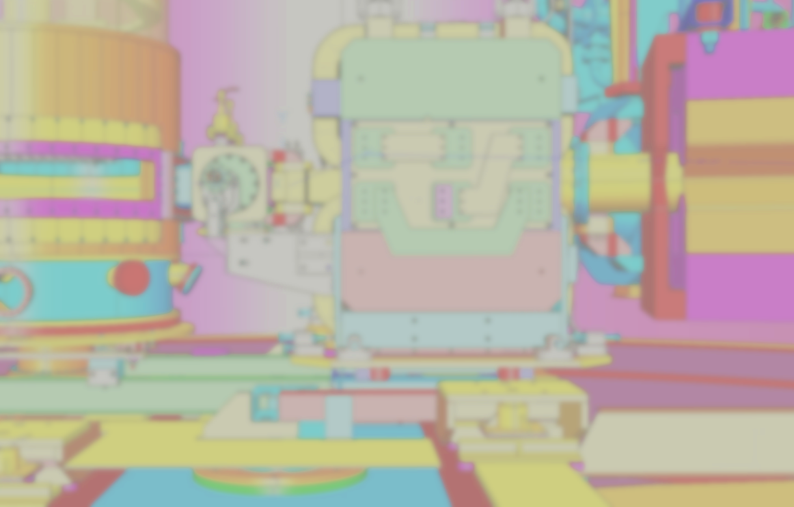
Backup Slides

Slide 44
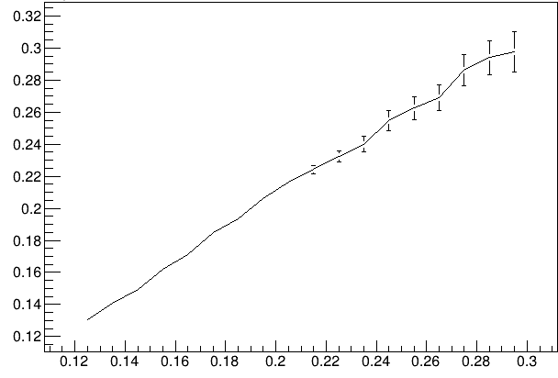
Backup Slides
Error prediction per-plane: ($σ_{track}^{2}$)
Per-Plane Track Error from TDC ($σ_{TDC}$)
Track Error Prediction
$$\left\langle x\right\rangle =80 μm$$
$$RMS=8.6 μm$$
$$σ_{Monte−Carlo } (mm)$$
mm
$σ_{predict.}$mm

Slide 45
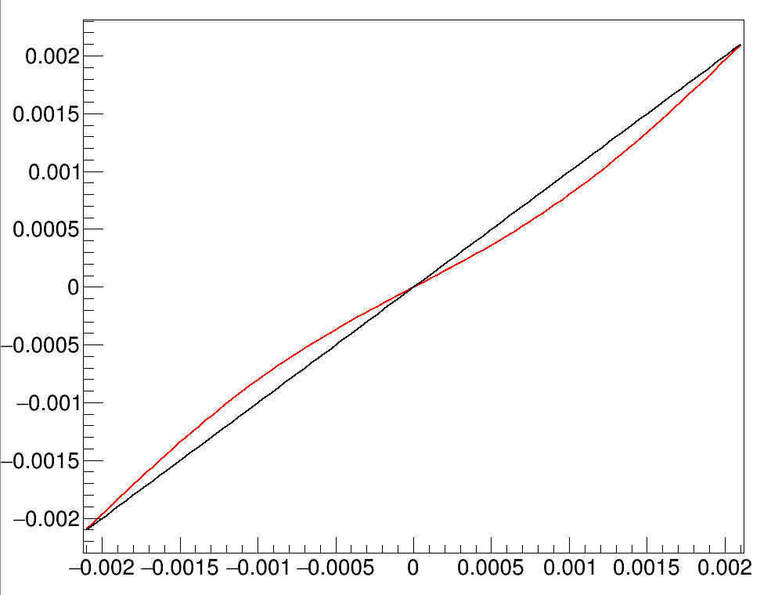
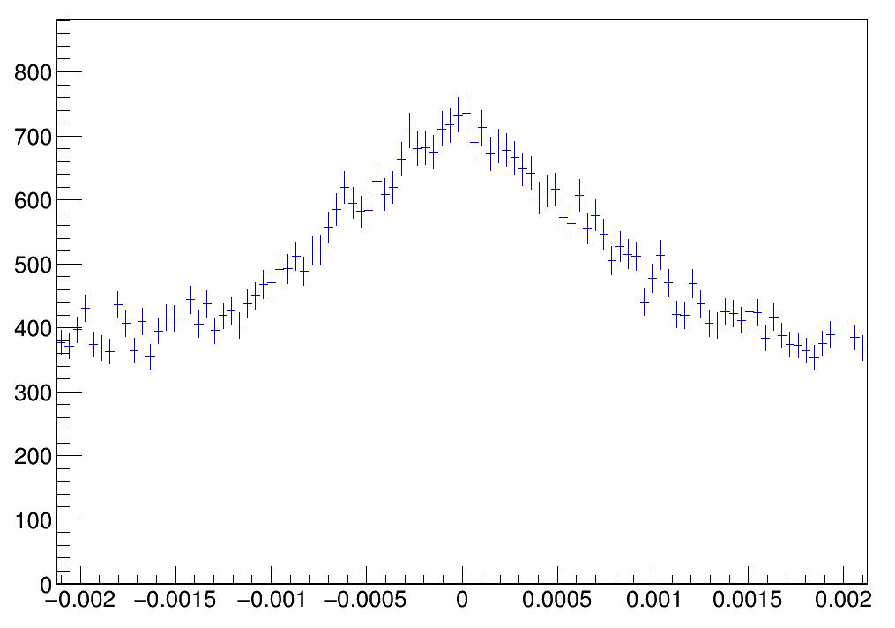
Backup Slides
Error prediction per-plane: ($σ_{model}^{2}$)
Use ‘toy’ perturbation function:
$$x^{′}=x+a sin(x)$$
50k Monte-Carlo events
$x′$(m)
$x$(m)
$x′$(m)

Slide 46
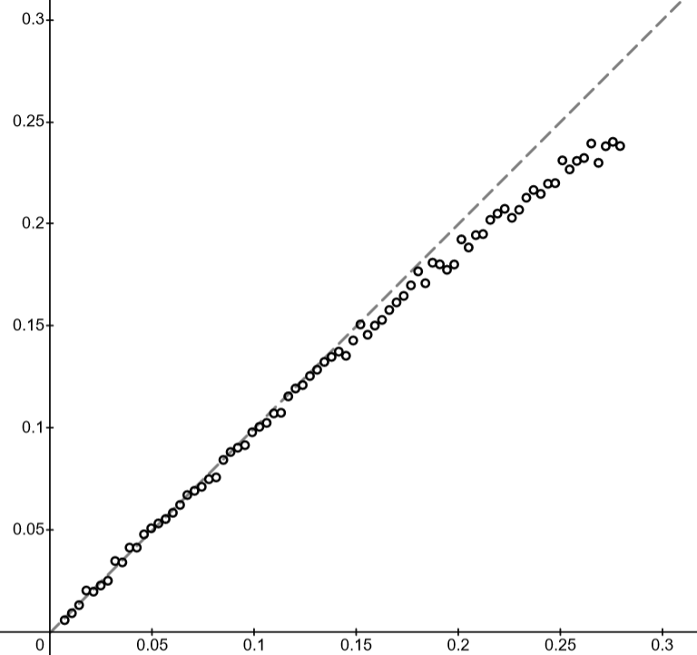
Backup Slides
Error prediction per-plane: ($σ_{model}^{2}$)
Accuracy:
200k MC stats per point
(same which was used in real-track testing)
$$RMS[ a\sin\left(x\right) ]=a\sqrt{2}$$
RMS, from histogram (mm)
$x′$(m)
RMS, actual (mm)

