Slide 1
Concept of a Positron Source at Ce⁺BAF
Concept of Ce⁺BAF injector
Simulation of e⁺ capture and acceleration
Calculated e⁺ polarization
Andriy Ushakov (Jefferson Lab)
on behalf of the Ce⁺BAF Working Group
Work supported by the U.S. Department of Energy Office of Nuclear Physics under contract DE-AC05-06OR23177 and Office of High Energy Physics US-Japan Science & Technology Cooperative Program

Slide 2
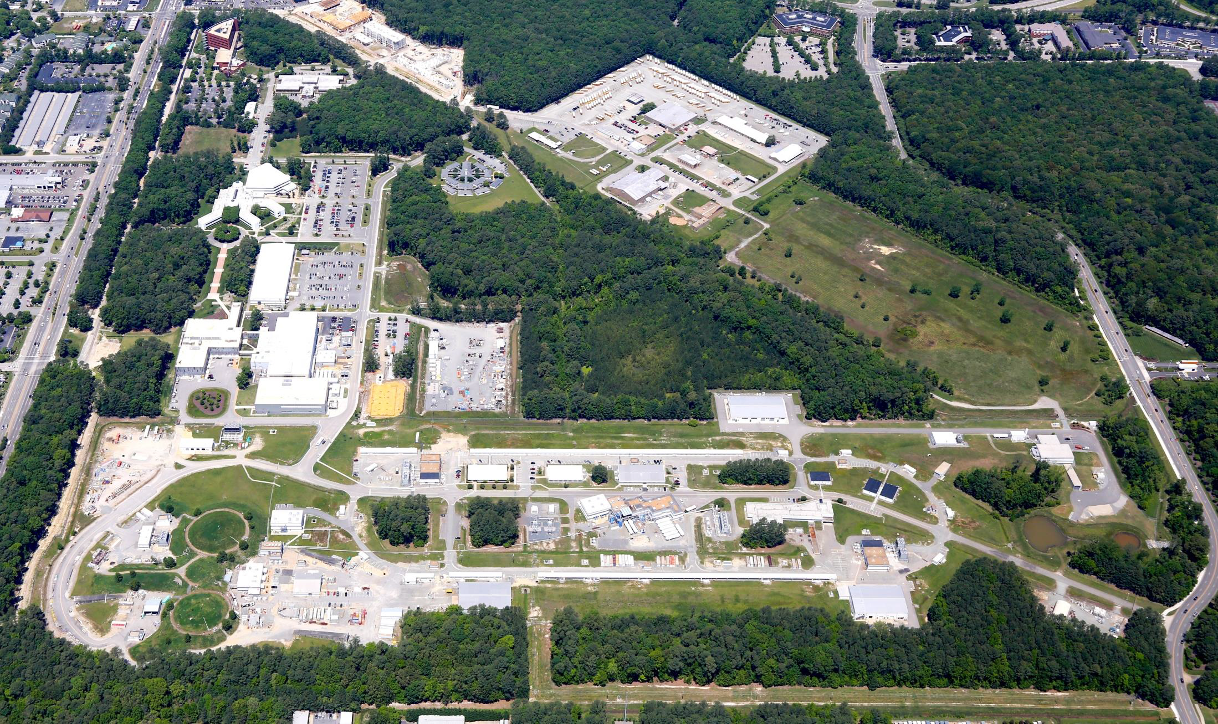
12 GeV Ce⁺BAF : Polarized Electron or Polarized Positron Beams
Machine Parameter | Electrons | Positrons
Hall Multiplicity | 4 | 1 or 2
Energy (ABC/D) | 11/12 GeV | 11/12 GeV
Beam Repetition | 249.5/499 MHz | 249.5/499 MHz
Duty Factor | 100% cw | 100% cw
Unpolarized Intensity | 170 µA | > 1 µA
Polarized Intensity | 170 µA | > 50 nA
Beam Polarization | > 85% | > 60%
Fast/Slow Helicity Reversal | 1920 Hz/Yes | 1920 Hz/Yes
2024 Summer Hall A/C Collaboration Meeting

Slide 3
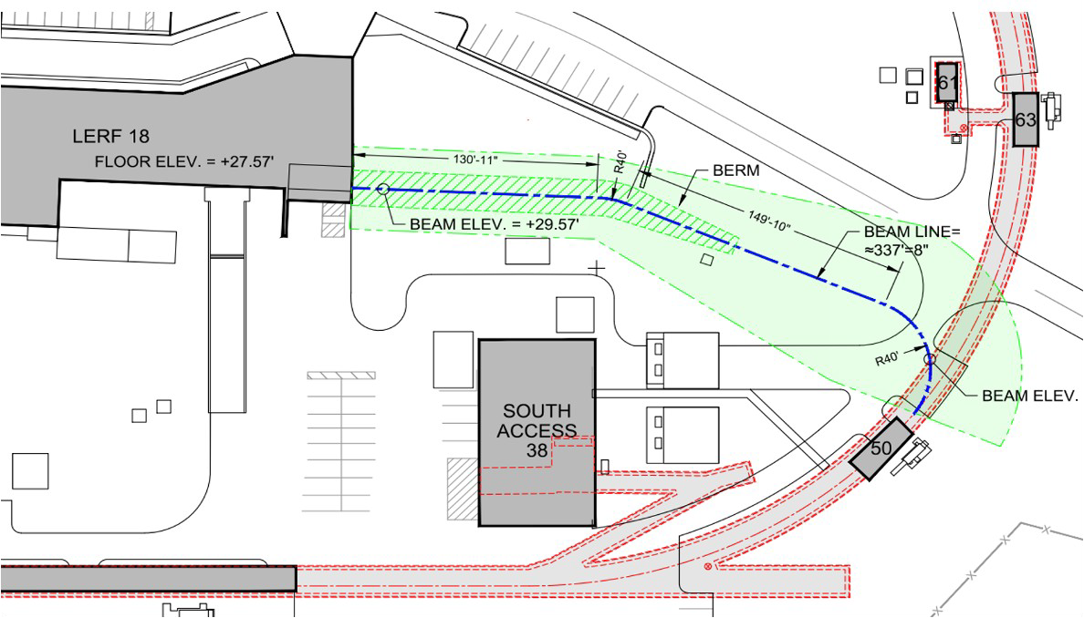
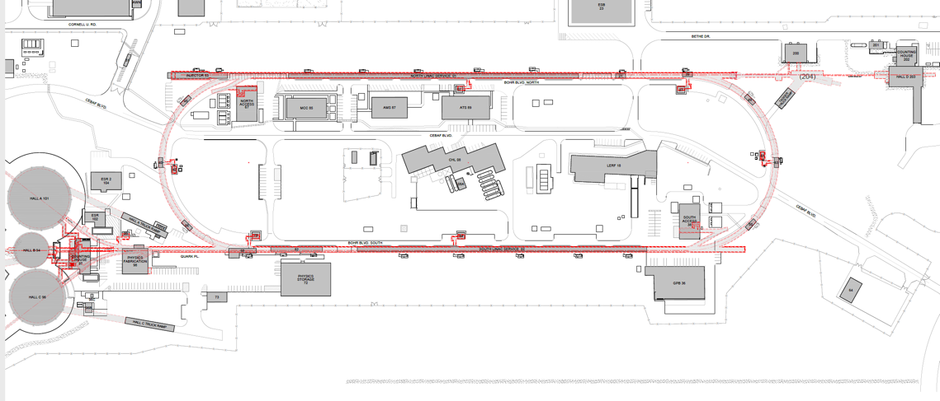
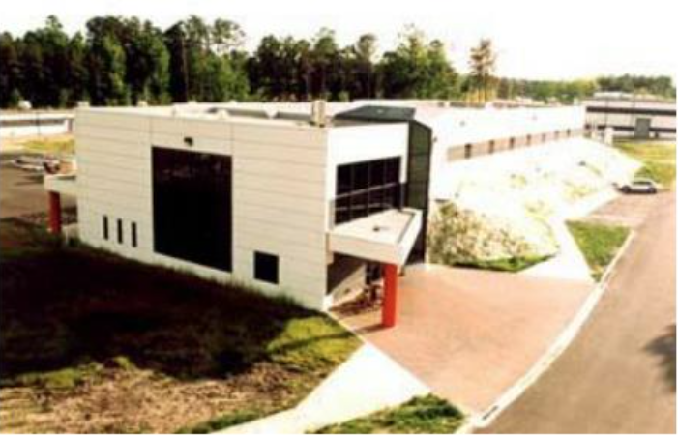
Turning the LERF into a Positron Injector Facility
New Beamline to CEBAF Tunnel
CEBAF Polarized Electron Injector
123 MeV e⁺ Beam Injected to NL
New e⁺ Injector at LERF
Strategic decision was taken to imagine using former FEL facility, starting with an R&D test bed
123 MeV e⁺
LERF
New Transport Line along SL and West Arc
LERF – Low Energy Recirculation Facility
J. Grames et al., IPAC’23, MOPL152
2024 Summer Hall A/C Collaboration Meeting

Slide 4
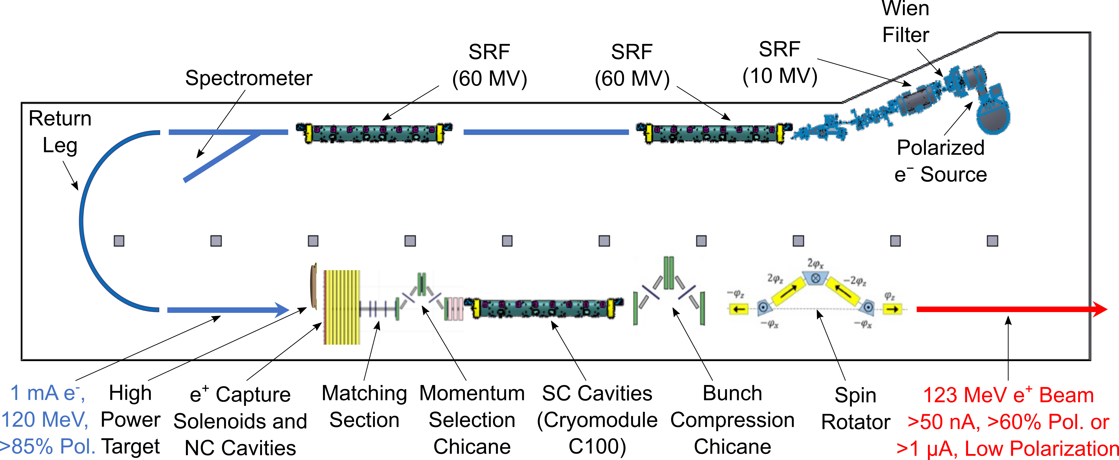
LERF Polarized Positron Injector Concept
Conceptual Development
Improve design of positron injector
Develop pCDR
Address Critical Risk Areas
mA polarized e⁻ source
High power target
CW capture cavity
2024 Summer Hall A/C Collaboration Meeting

Slide 5
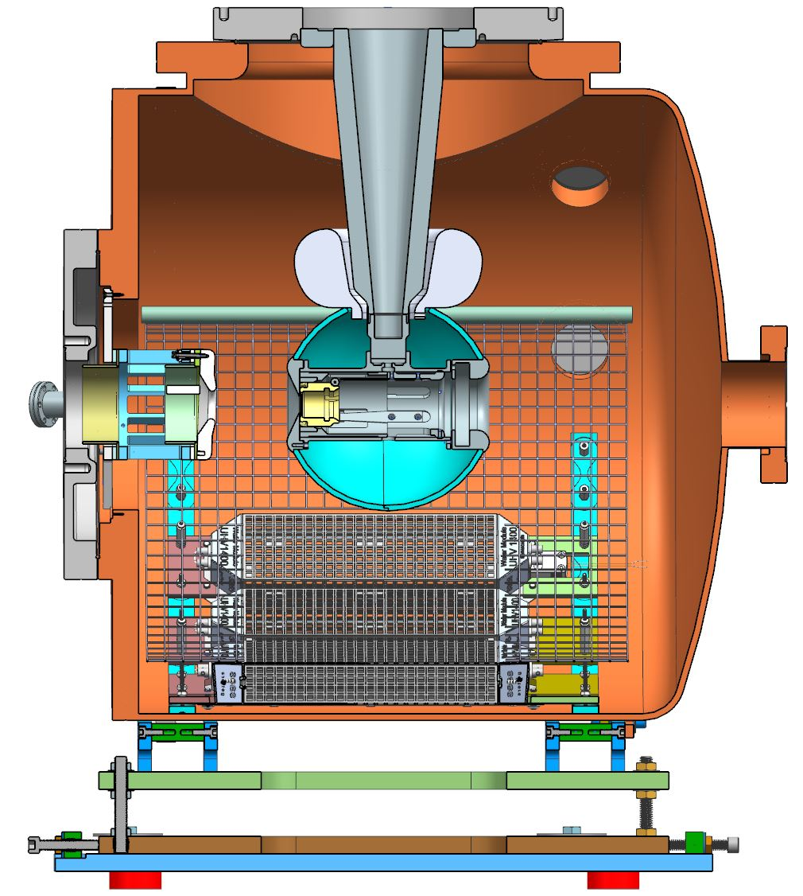
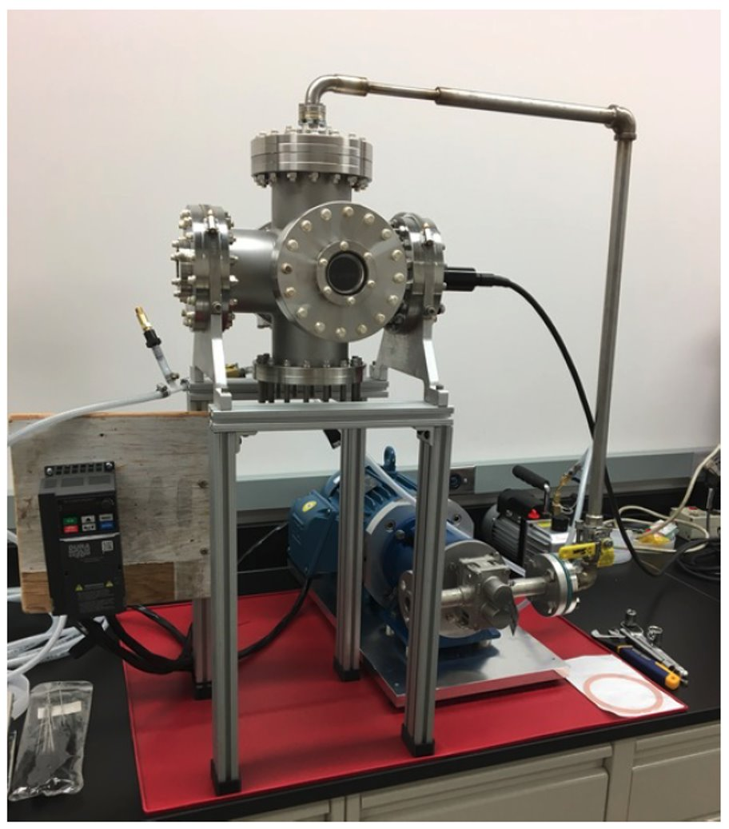
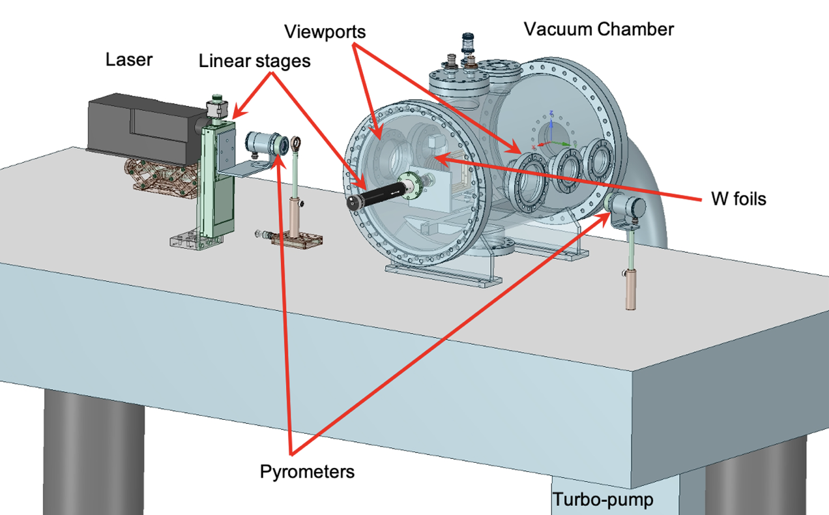
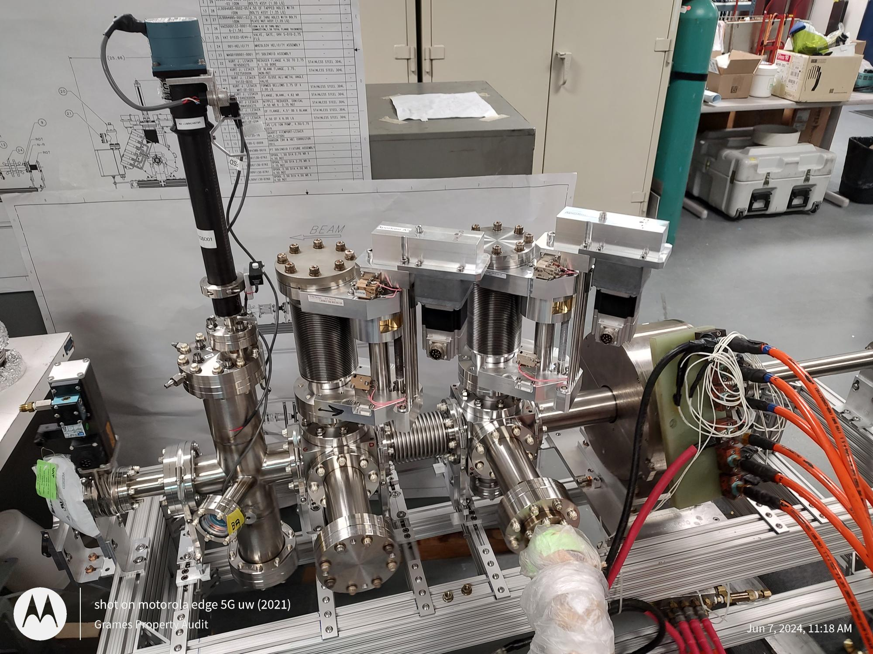
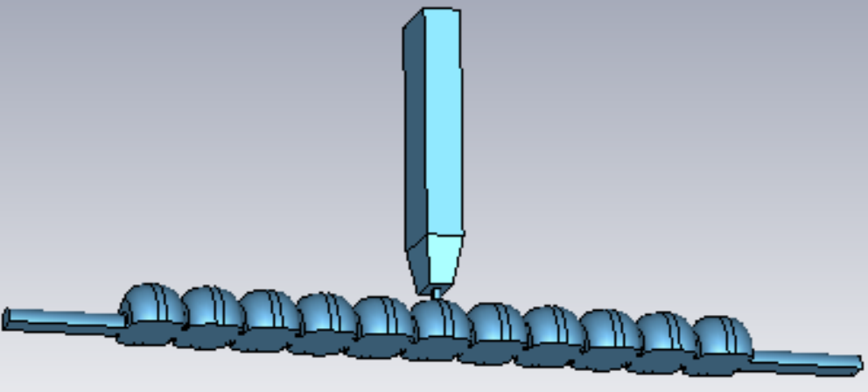
Ce⁺BAF Positron Activities
JLab LDRD Proposal
demonstrate mA e⁻ source
DOE SBIR Phase2
test GaInSn jet target
DOE NP Proposal
test prototype W target
JLab LDRD measure CEBAF acceptance
DOE HEP Proposal
prototype capture cavity
Silviu Covrig Dusa “CFD simulations of high power positron converter targets”, LCWS, Jul 10, 2024, talk
Shaoheng Wang “Capture cavities for the CW polarized positron source Ce⁺BAF”, LCWS, Jul 10, 2024, talk
2024 Summer Hall A/C Collaboration Meeting

Slide 6
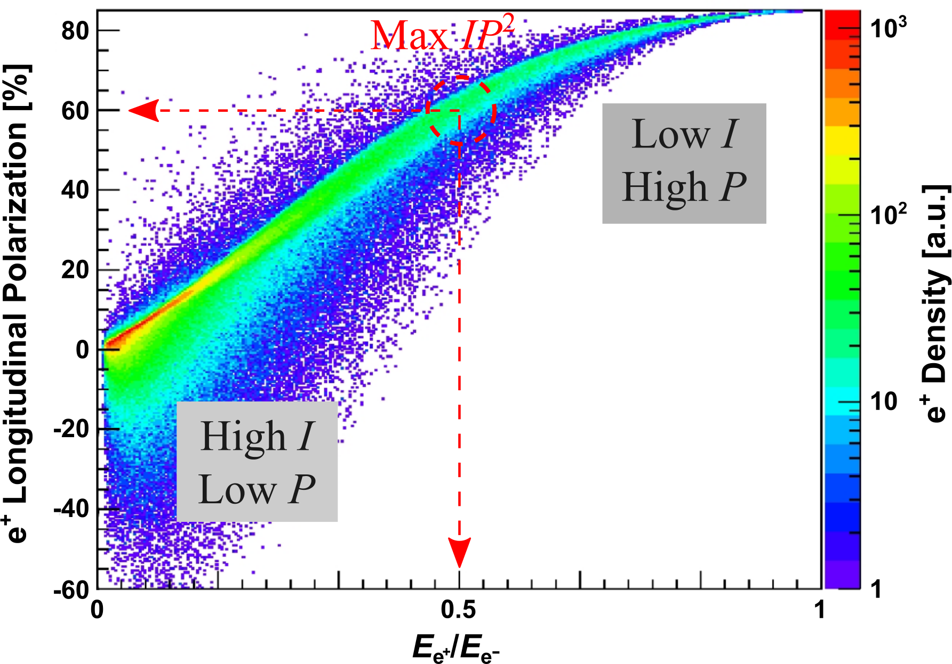
Selection of e⁺ Energy at Target Exit and Thickness of Tungsten Target
e⁺ Polarization vs Energy at Target Exit
For max Figure-of-Merit ($FoM=IP^{2}$, where $I$ is e⁺ current and $P$ is e⁺ polarization):
Optimal e⁺ energy at target exit is about half of e‒ drive beam energy.
e⁺ polarization at half of e‒ energy is ~60%.
4 mm is an optimal thickness of W target for 120 MeV e⁻ beam
S. Habet et al., “Characterization and optimization of polarized and unpolarized positron production”, Tech. Rep. JLAB-ACC-23-3794, Feb. 2023. doi:10.48550/arXiv.2401.04484
2024 Summer Hall A/C Collaboration Meeting

Slide 7
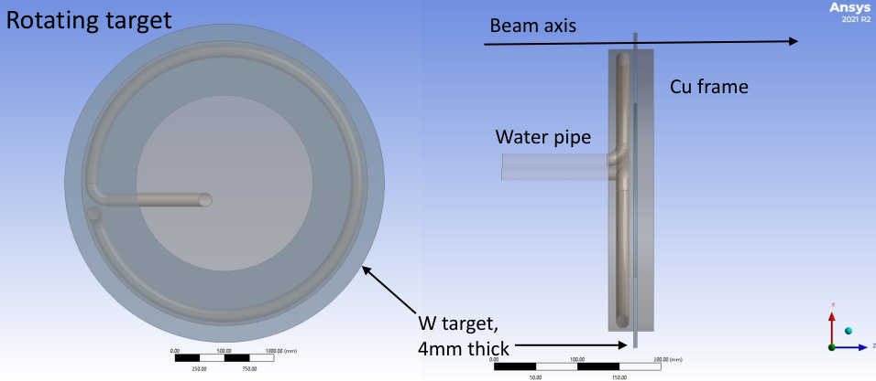
Concept of JLab Positron Target (Silviu Covrig Dusa)
Focused on assessing with CFD solid high-Z targets, mostly W, for e⁺ production at CEBAF:
A rotating target (<10 Hz, >30 cm diameter) could take 20 kW beam power with T_{max} < 1000 K
Max Tungsten Temperature vs Time
Max Cu Frame Temperature vs Time
e⁻ beam has a Gaussian profile with σ$\sim$ 1 $÷$3 mm
The beam hits the W target on a circle with radius 18 cm
The W target rotates at 2 Hz and the water flow is 0.3 kg/s, water pressure loss is 1.5 psi
Full time-dependent CFD simulations implemented
No studies on target material lifetime
Started looking at the target engineering, radiological issues, shielding
Max Cooling Water Temperature vs Time
2024 Summer Hall A/C Collaboration Meeting

Slide 8
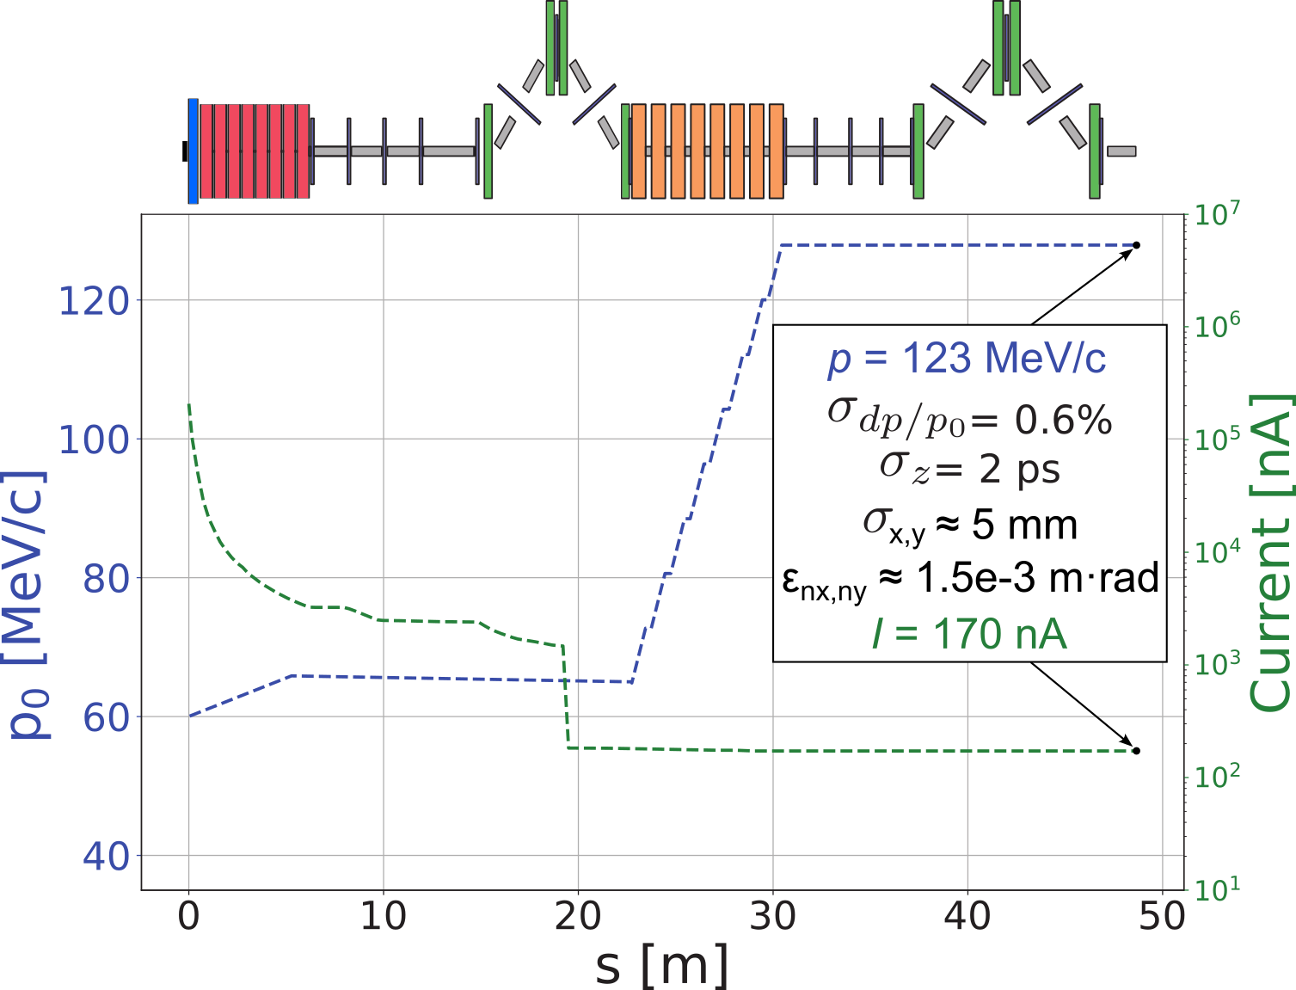
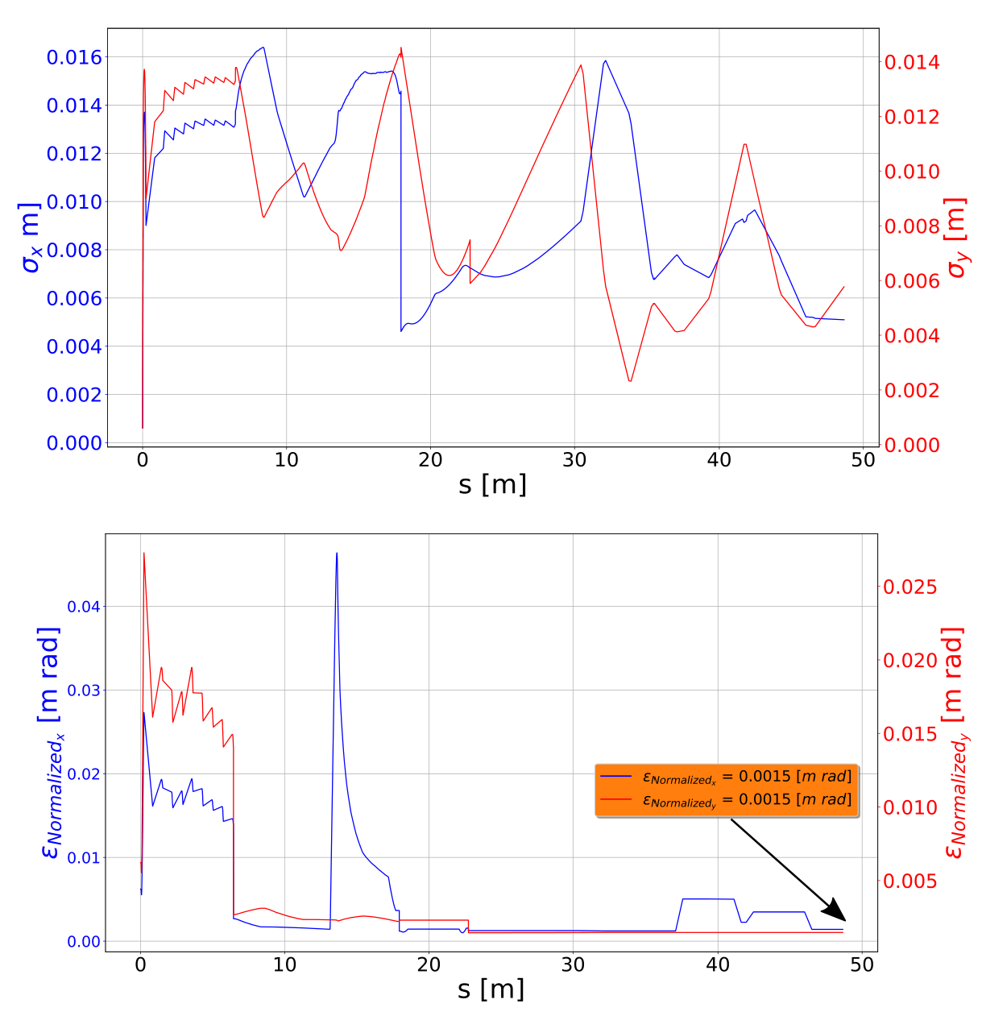
Simplified Model of Beam Line and e⁺ Beam Parameters in Polarized Mode
e⁺ Current and Energy along Beam Line
(S. Habet, PhD Thesis, Dec. 2023)
e⁺ Bunch Size and Emittance along Beam Line
(S. Habet, PhD Thesis, Dec. 2023)
Quarter-Wave Transformer (QWT) – 2 solenoids
Polarized mode, 60 MeV @ target: B₁ = 2.5 T, L₁ = 25 cm, B₂ = 0.05 T, L₂ = 6 m
Unpolarized mode, 19 MeV @ target: B₁ = 1.3 T, L₁ = 25 cm, B₂ = 0.05 T, L₂ = 6 m
2024 Summer Hall A/C Collaboration Meeting

Slide 9
Modeling Positron Injector in FLUKA and General Particle Tracer (GPT)
EM Fields
3D magnetic fields of solenoids - OPERA, CST
NC SW Cavity - Advanced Computational Electromagnetics Code Suite (ACE3P)
SC Cavities - CST
FLUKA
Simulations of all particle in target, capture solenoid and NC cavity
GPT
Positron production in 4 mm thick tungsten target by 1 mA @ 120 MeV e⁻ was calculated in Geant4 and imported to GPT at target exit
Positrons are tracked up to end of C100 cryomodule
A. Ushakov et al., LCWS2024, talk
2024 Summer Hall A/C Collaboration Meeting

Slide 10
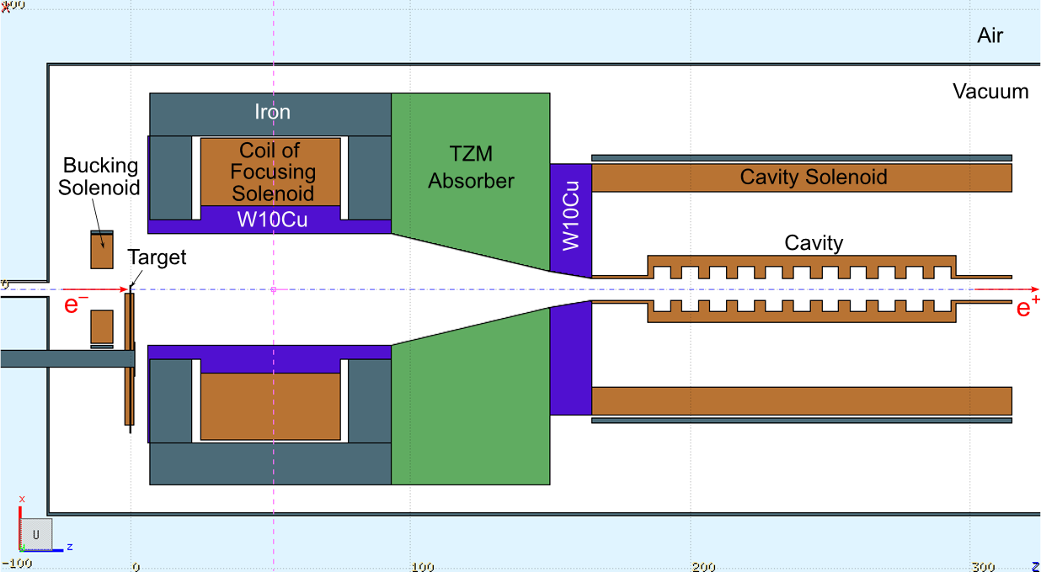
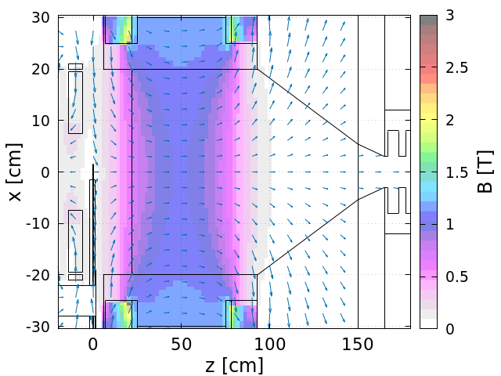
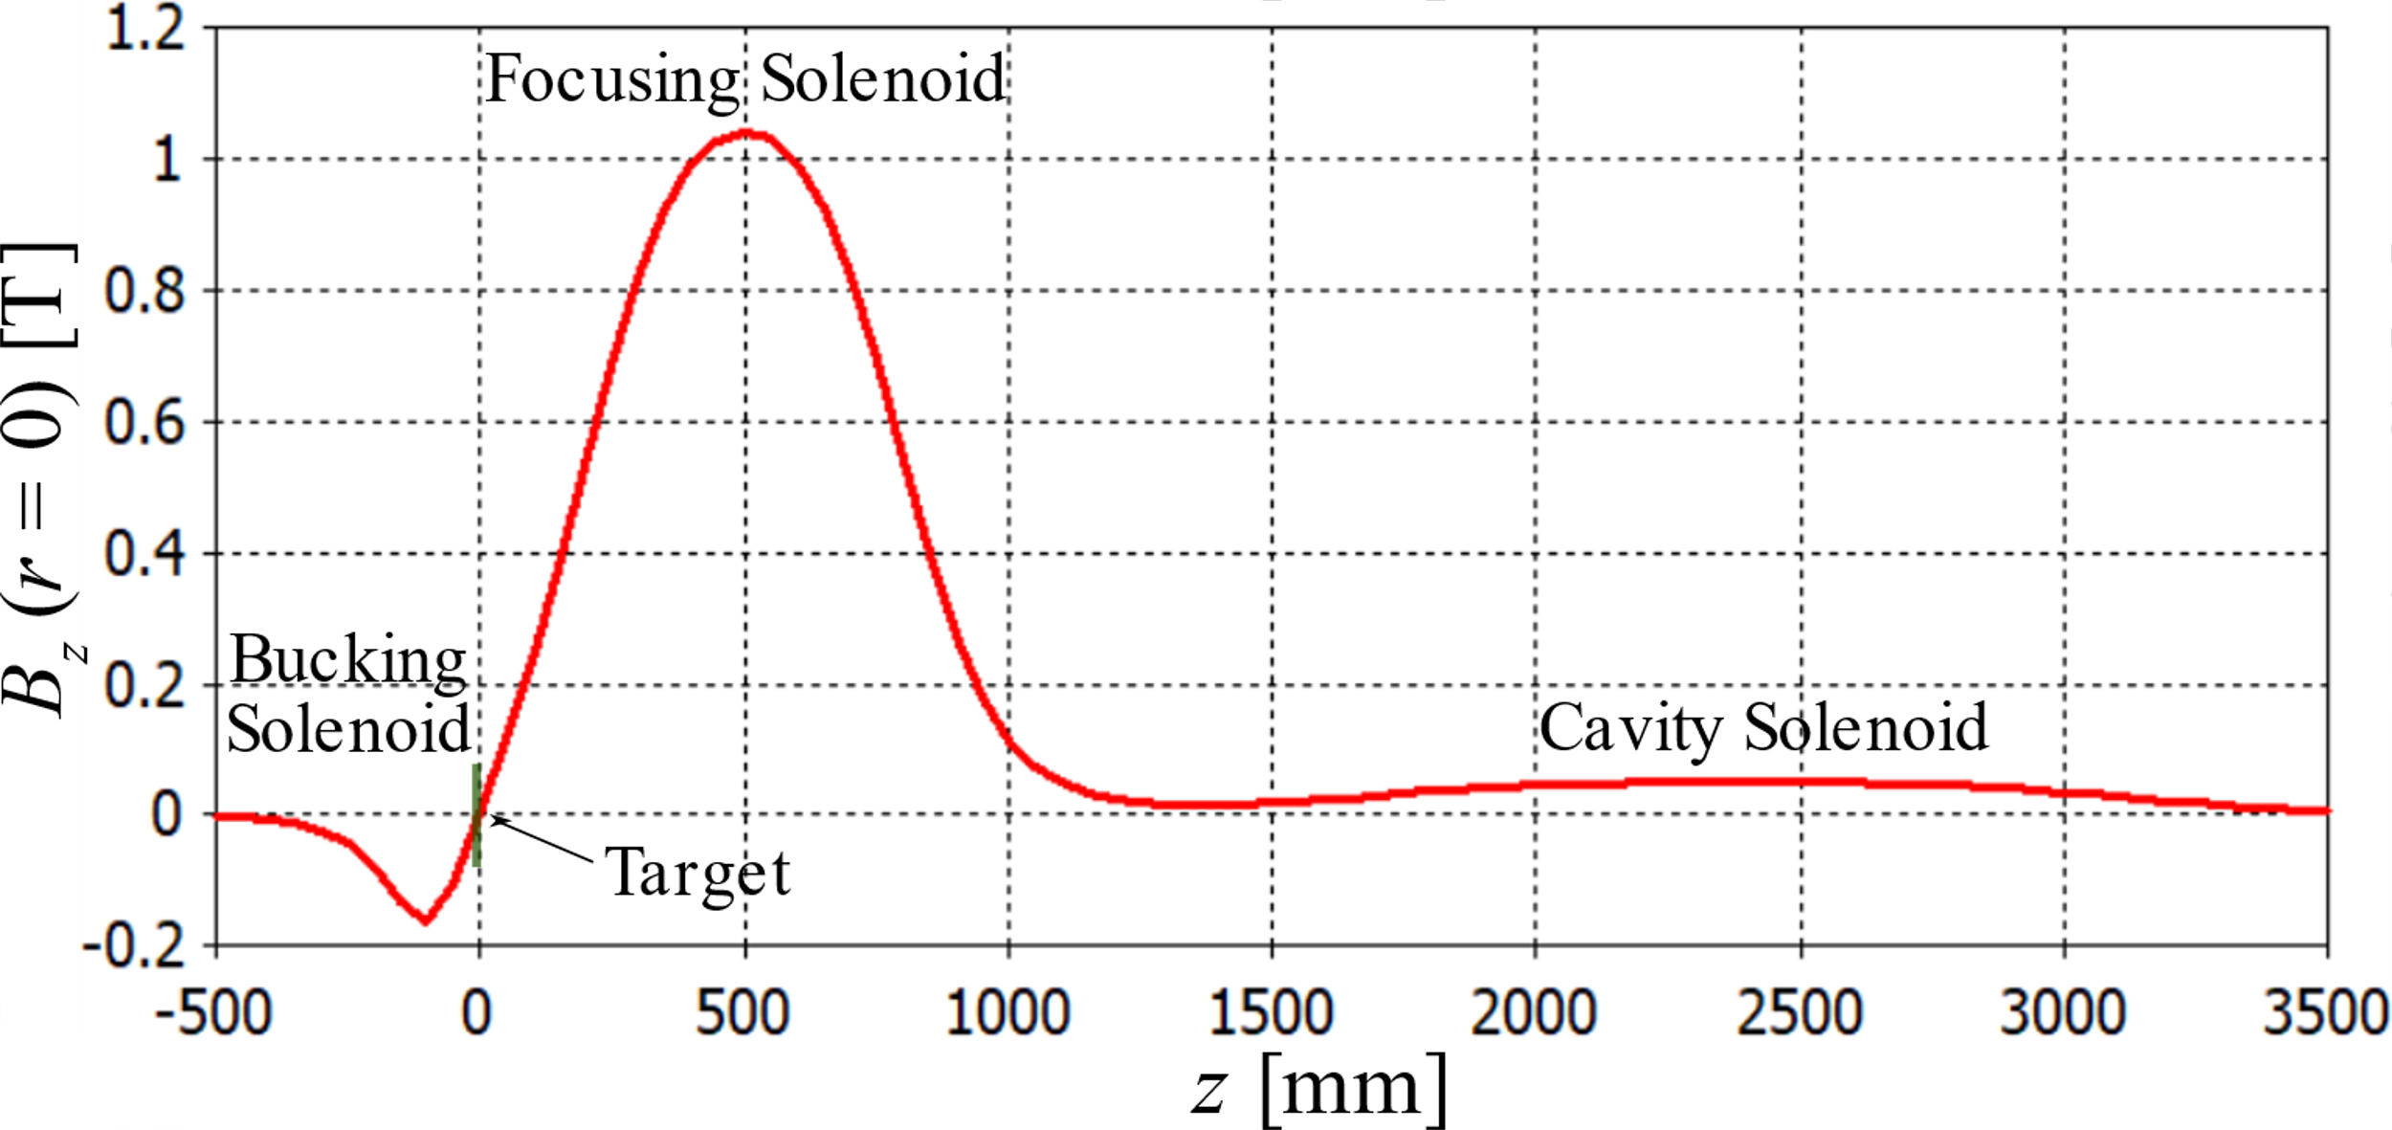
Model with Compensation Solenoid and Cavities
Geometry (FLUKA)
Bucking Solenoid
Main Solenoid
Absorbers
Target
e⁺
Cavity
Same 14 mm square Cu conductor (15 mm square including insulator)
with 11 mm hole
for both main and bucking solenoids
j ≈ 446 A/cm²
B_{max}(r = 0) = 1.03 T
Water flow:
~500 cc/sec, 18 bar
Conductor of bucking sol.:
L = 8 cm
R_{in} = 7.5 cm
R_{out} = 19.5 cm
Conductor of main sol.:
L = 50 cm
R_{in} = 30 cm
R_{out} = 54 cm
2024 Summer Hall A/C Collaboration Meeting

Slide 11
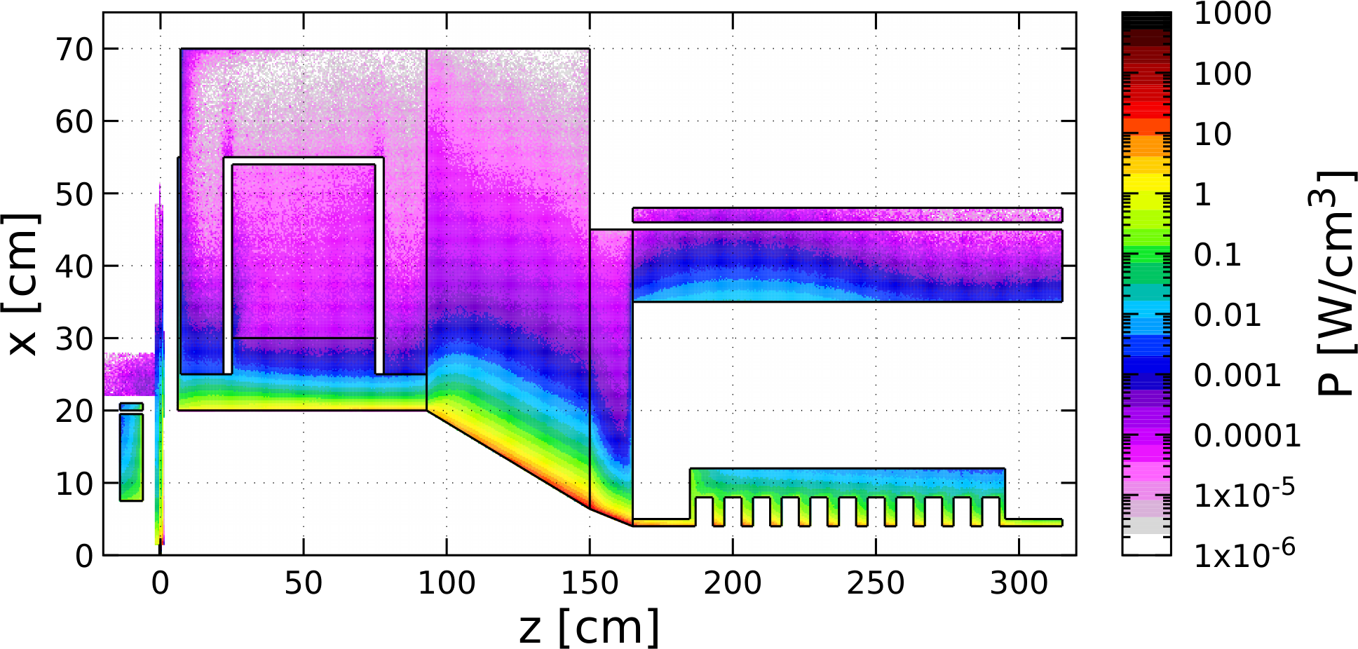
Distribution of Power Deposited by 1 mA @ 120 MeV e‒ Beam (FLUKA)
 | Power [kW]
Target | 18.32
Compensation Solenoid | 0.74
Coil of Main Solenoid | 0.02
Iron of Main Solenoid | 0.07
W10Cu Absorber inside Main Solenoid | 18.68
TZM Absorber (99.4% Mo, 0.5% Ti, 0.1% Zr) | 54.96
W10Cu Absorber upstream Cavities | 12.61
Solenoid around Cavity | 0.62
Cu Cavities | 6.50
Total Absorbed Power | 115.12 (96%)
Power of γ, e‒, e⁺ at z = 315 cm | 4.29
Steel
TZM
Cu Coil
Cu Coil
W10Cu
W10Cu
Cu Cavity*
Compensation
Solenoid
Target
A. Ushakov et al., IPAC’24, MOPC54
Mechanical design and simulations of temperature, thermal stress, radiation damage and optimization of whole e⁺ capture system have to be done / will be continued
 | Photons | Electrons | Positrons
Yield [N/$e_{pr}^{−}$] | 0.152 | 0.040 | 0.008
Mean Energy [MeV] | 13.06 | 50.54 | 33.78
Power [kW] | 1.99 | 2.03 | 0.27
Fraction in Total Beam Power | 46.4 | 47.3 | 6.3
* FLUKA model does not have E-field in cavity
2024 Summer Hall A/C Collaboration Meeting

Slide 12
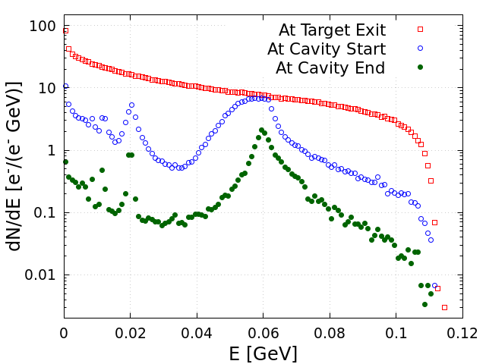
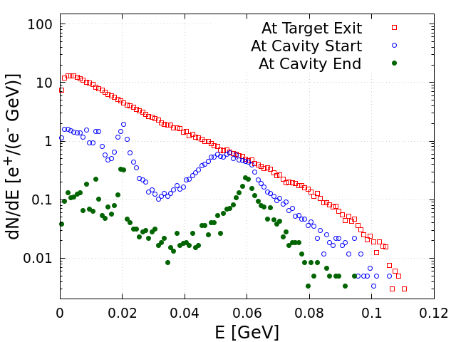
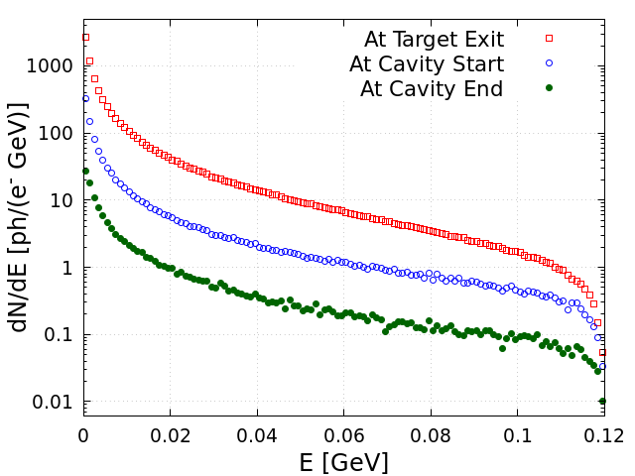
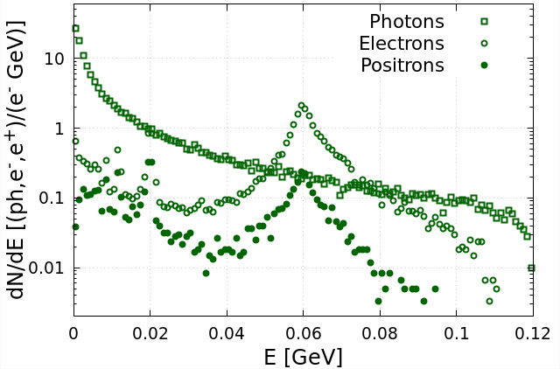
Energy Distributions of e‒, e⁺ and γ at Different Z-Positions (FLUKA)
Electrons
Positrons
Photons
At Cavity End
will be removed by forward dump
will be deflected by dipole and dumped
${ e}^{+}$Yield at Cavity End:
All energies:
Y_{e+} = 5.5·10^{‒3} $e^{+}/e_{pr}^{−}⟶$ 5.5 µA
60 MeV ± 5%:
Y_{60MeV e+} = 1.0·10^{‒3} $e^{+}/e_{pr}^{−}$ $⟶$ 1.0 µA
2024 Summer Hall A/C Collaboration Meeting

Slide 13
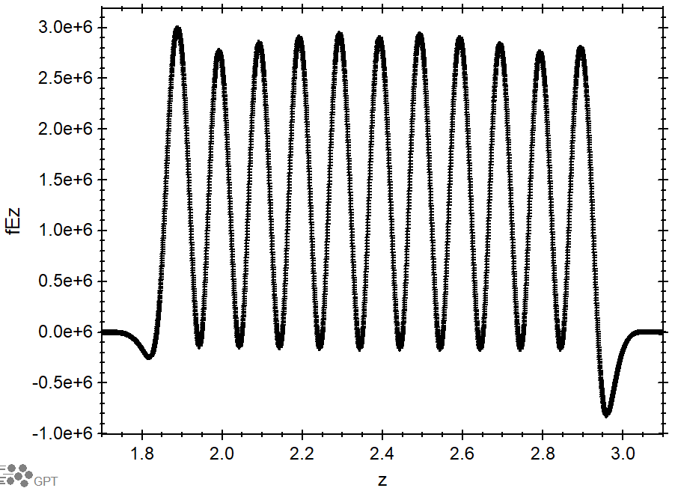
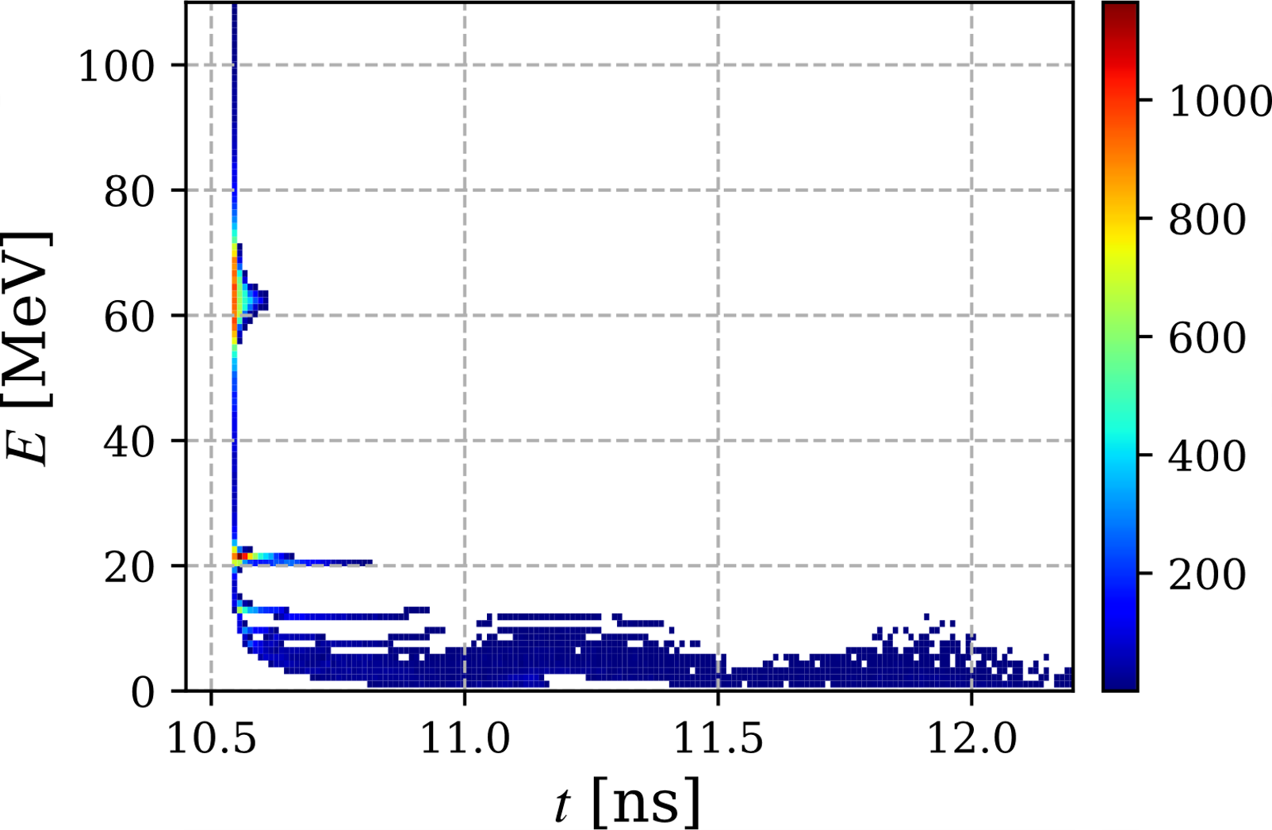
Standing Wave Capture Cavity (Shaoheng Wang)
Work on development of CW capture cavity has been started
Cavity with a large iris radius:
11 cells standing wave normal conducting cavity
Frequency = 1496.982 MHz
E_{max} $=$ 3 MV/m
Aperture radius = 4 cm
Time-Energy Phase Space at Cavity Exit (GPT)
E = 62.5 MeV
|ΔE|/E = 2%
I = 609 nA
σ_{z} = 4.5 mm
ε_{n} = 11.4 mm·rad
2024 Summer Hall A/C Collaboration Meeting

Slide 14
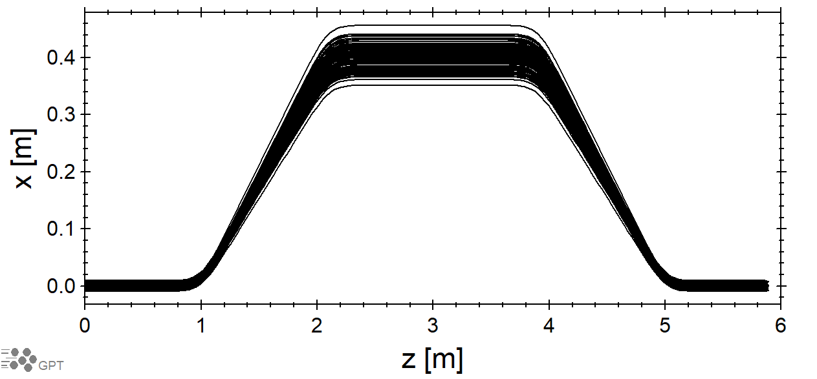
Energy Selection Chicane and SRF Cryomodule C100
Dipoles
Field = 0.34 T
Bending angle = 20°
Angle of entrance/exit pole face = 10°
Gap = 9 cm
First coefficient of fringe fields Enge function (2/Gap) = 22 m⁻¹
e⁺ Energy = 62.34 MeV (γ = 122)
Bending radius = 61.16 cm
Absorber/Collimators
Δx_{absorber} = 25 cm, length = 1 m
Δx_{col1} = 2.2 cm, length = 10 cm
r_{col2} = 2.0 cm, length = 10 cm
SRF Cryomodule (C100) at the end of chicane
8 cavities, 7 cells, 1497 MHz
Total accelerator length of 8 m
Field adjusted to accelerate e⁺ to 123 MeV
Trajectories of e⁺ with γ = 122 and σ_{γ} = 6
2024 Summer Hall A/C Collaboration Meeting

Slide 15
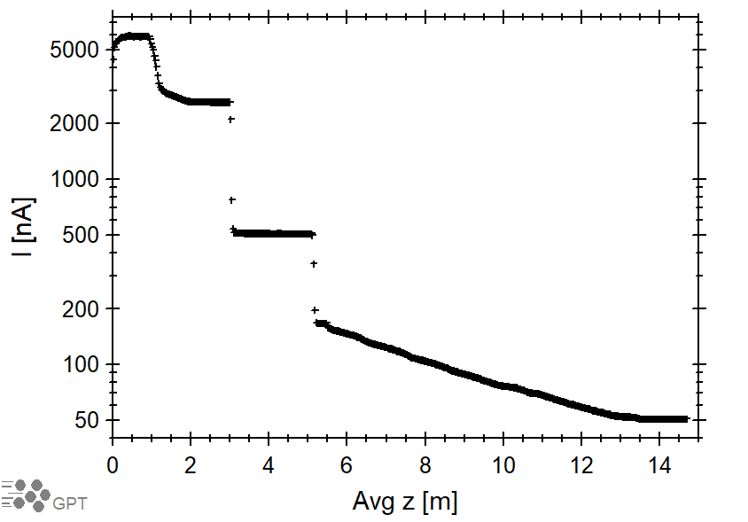
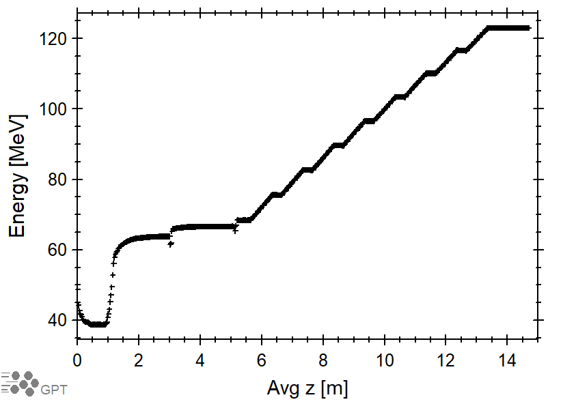
e⁺ Current and Energy vs Z in Chicane and Cryomodule (Preliminary Results)
Positron Current vs Z
Positron Average Energy vs Z
Avg z = 0 is at exit of NC capture cavity
2024 Summer Hall A/C Collaboration Meeting

Slide 16
Time-Energy Phase Space after Collimator #1 and before/after Cryomodule
After Collimator #1
At Entrance of C100
At Exit of C100
I = 516.7 nA
I = 166.6 nA
I = 50.8 nA
ΔE/E = 6.4%
ΔE/E = 2.6%
ΔE/E = 1.0%
σ_{t} = 21.4 ps
σ_{t} = 17.75 ps
σ_{t} = 17.9 ps
ε_{nx} = 1.4 mm·rad
ε_{ny} = 1.8 mm·rad
2024 Summer Hall A/C Collaboration Meeting

Slide 17
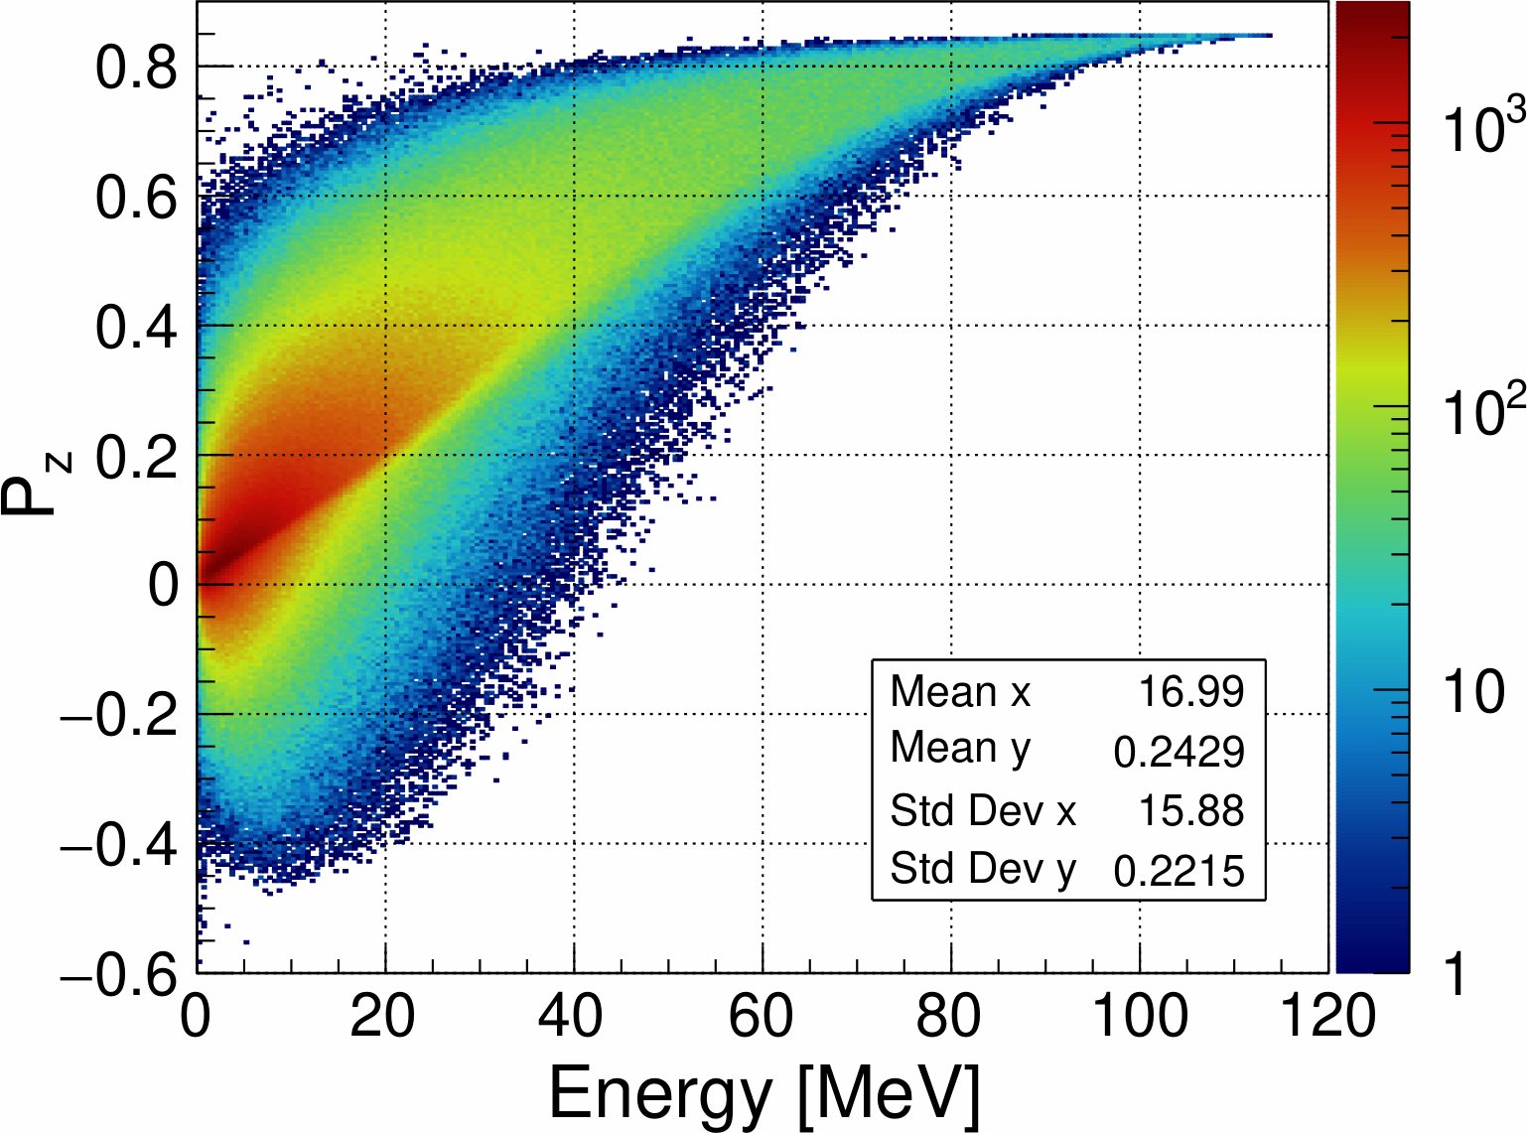
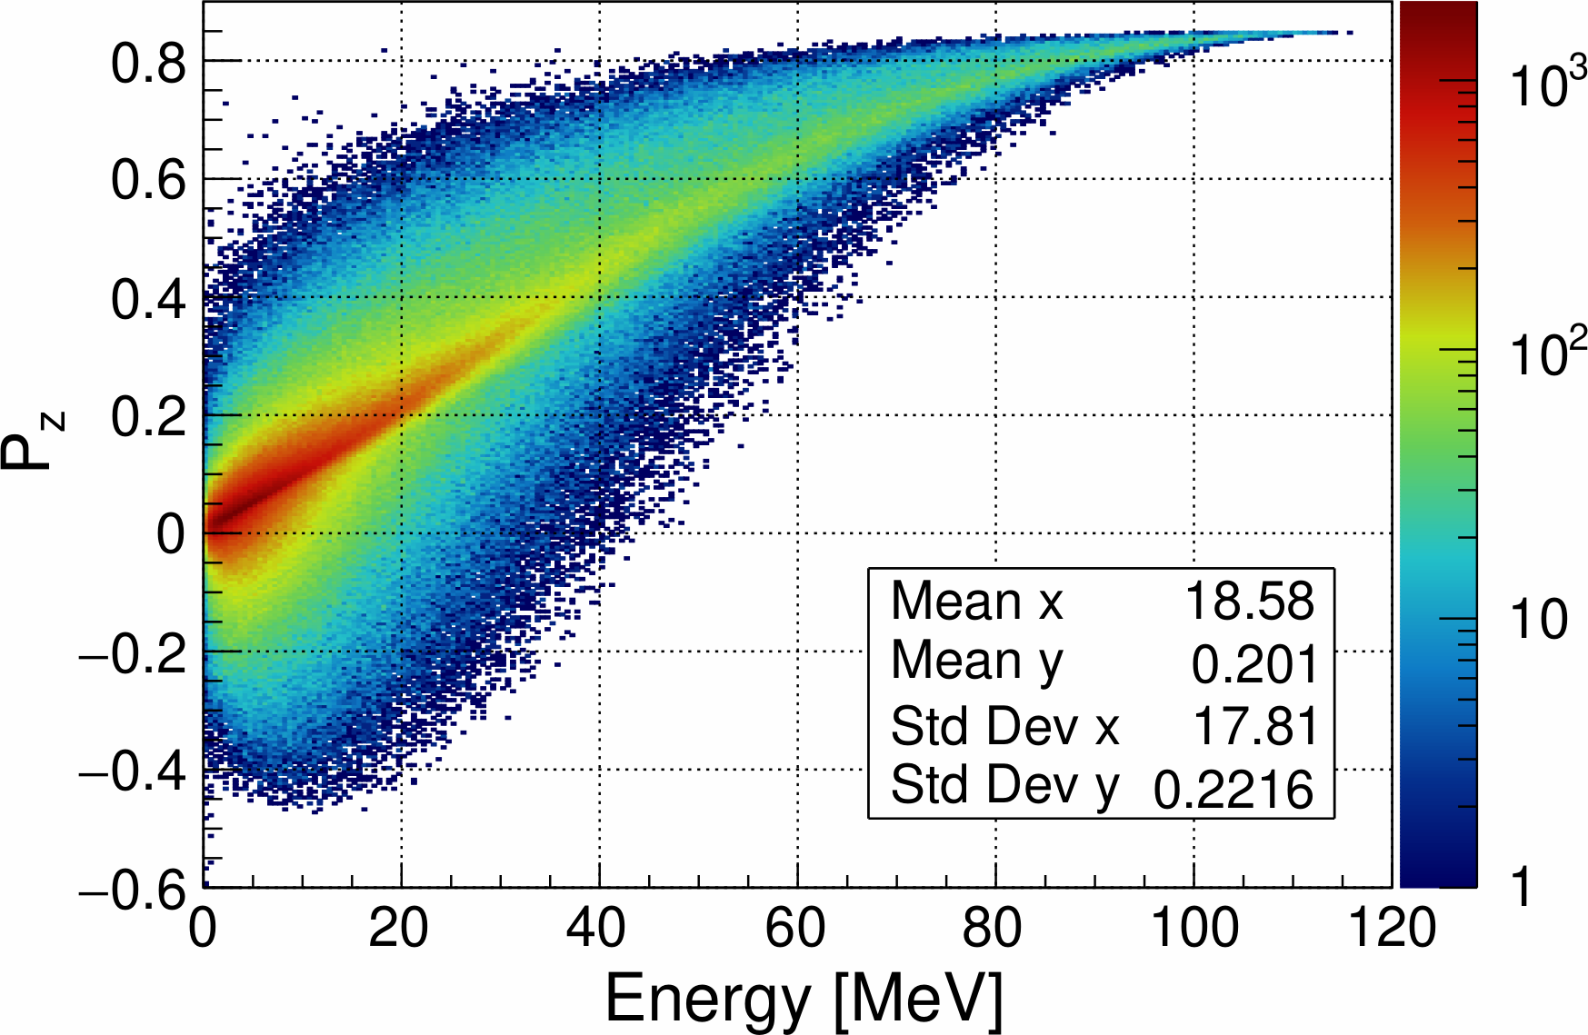
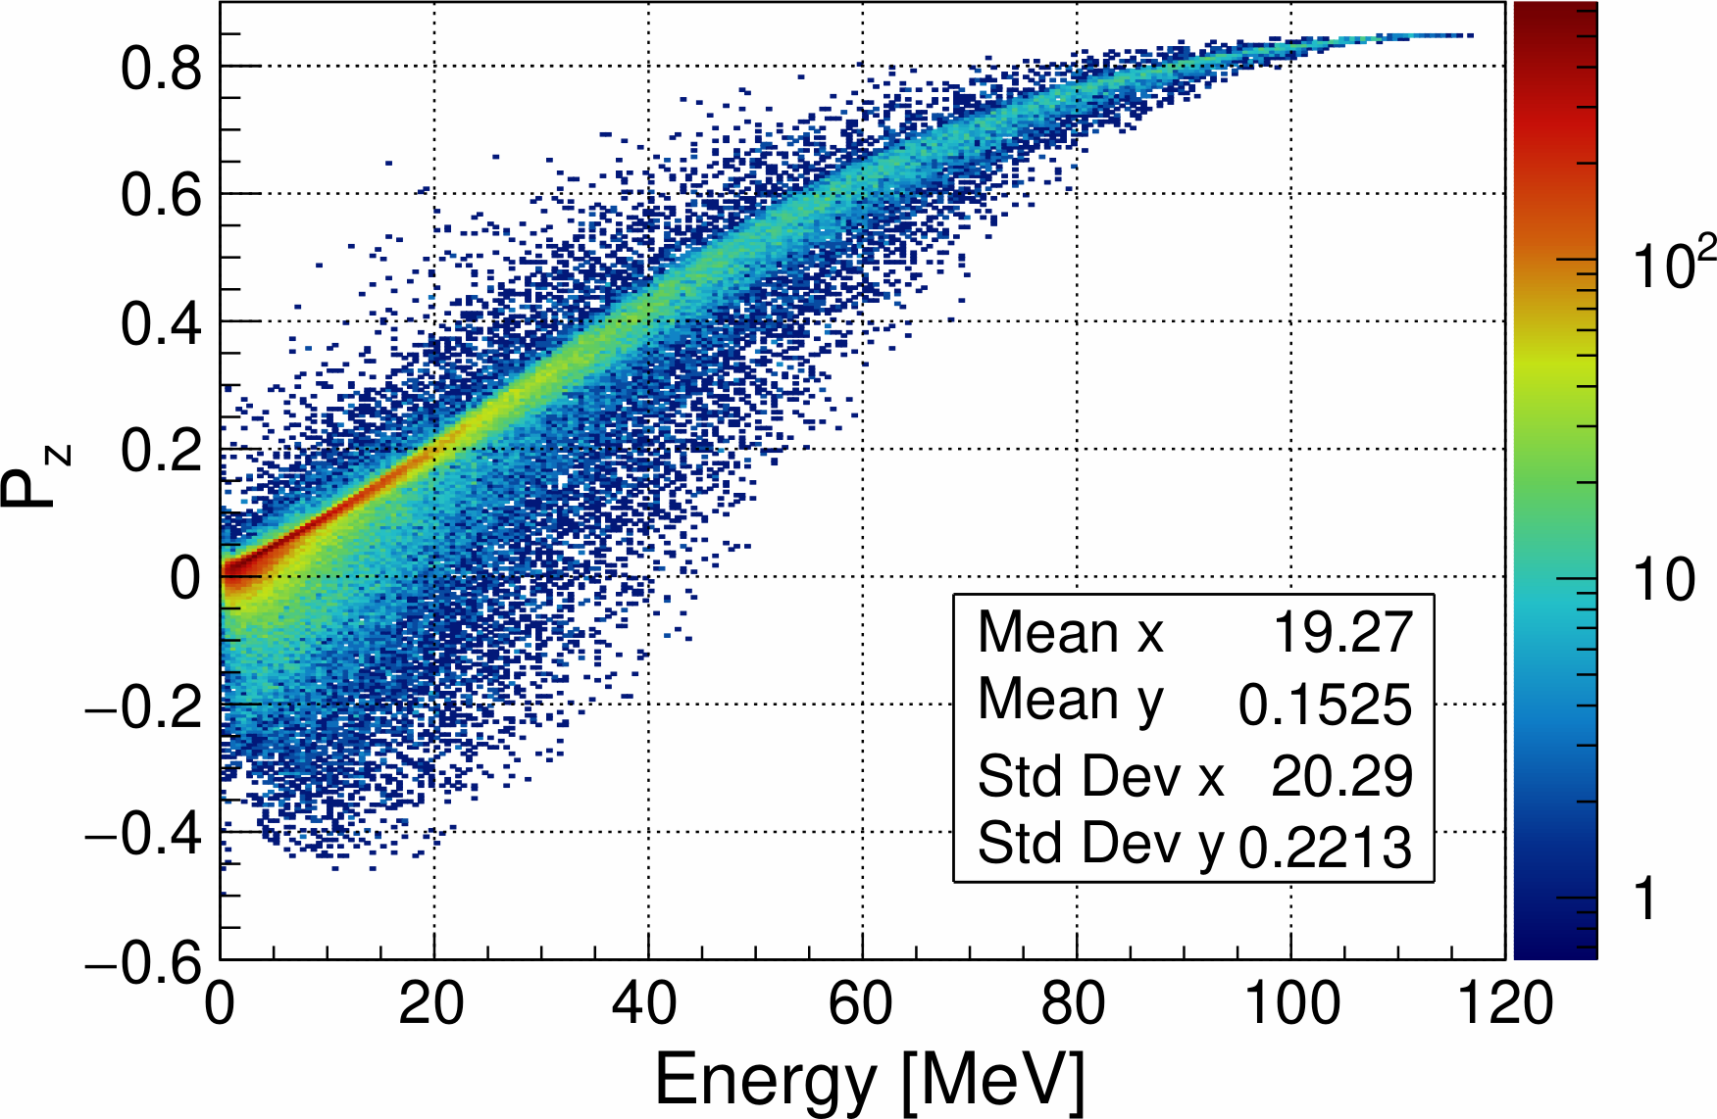
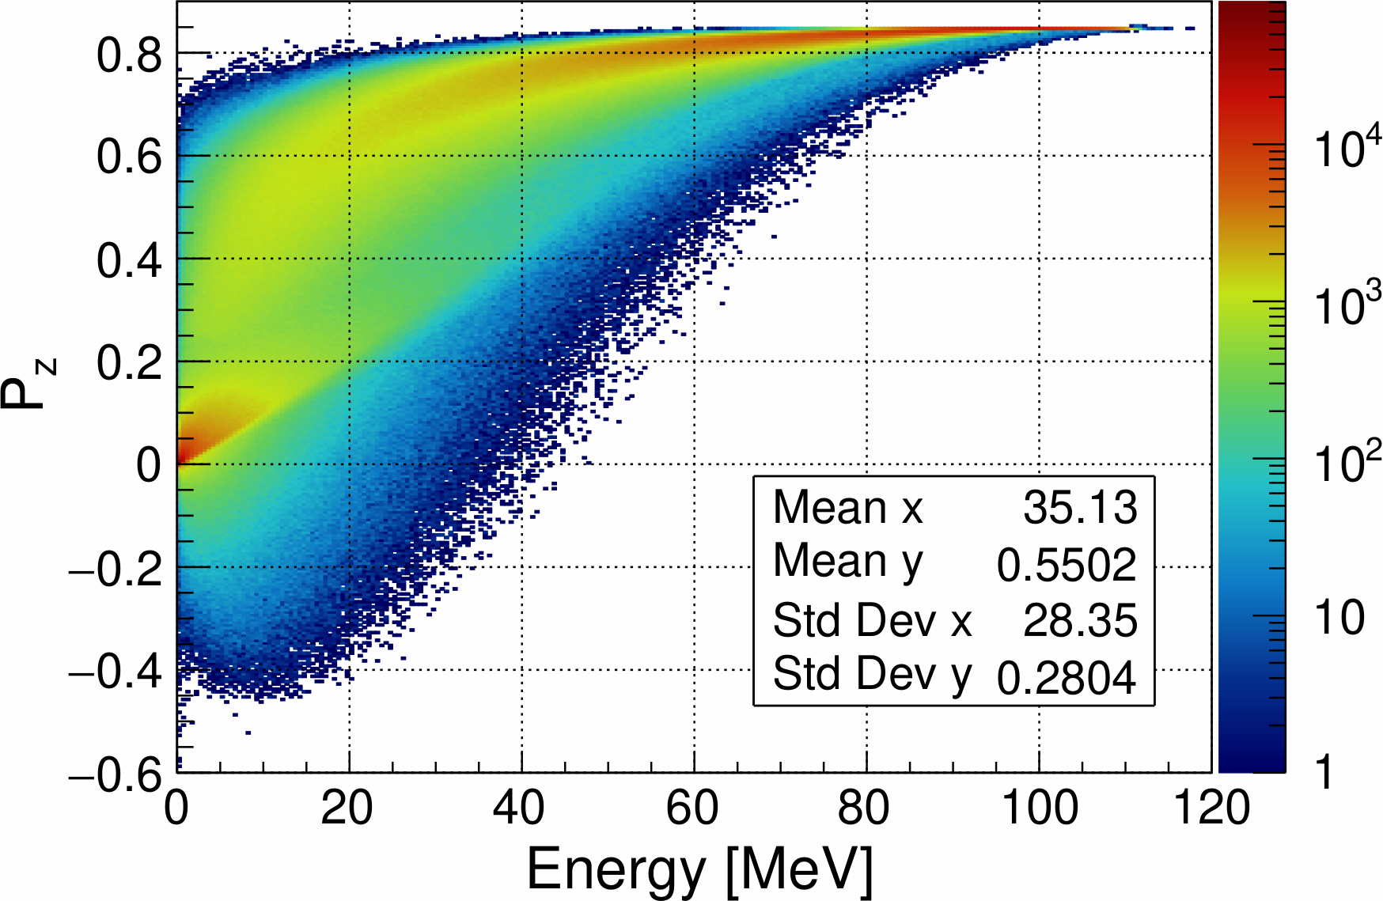
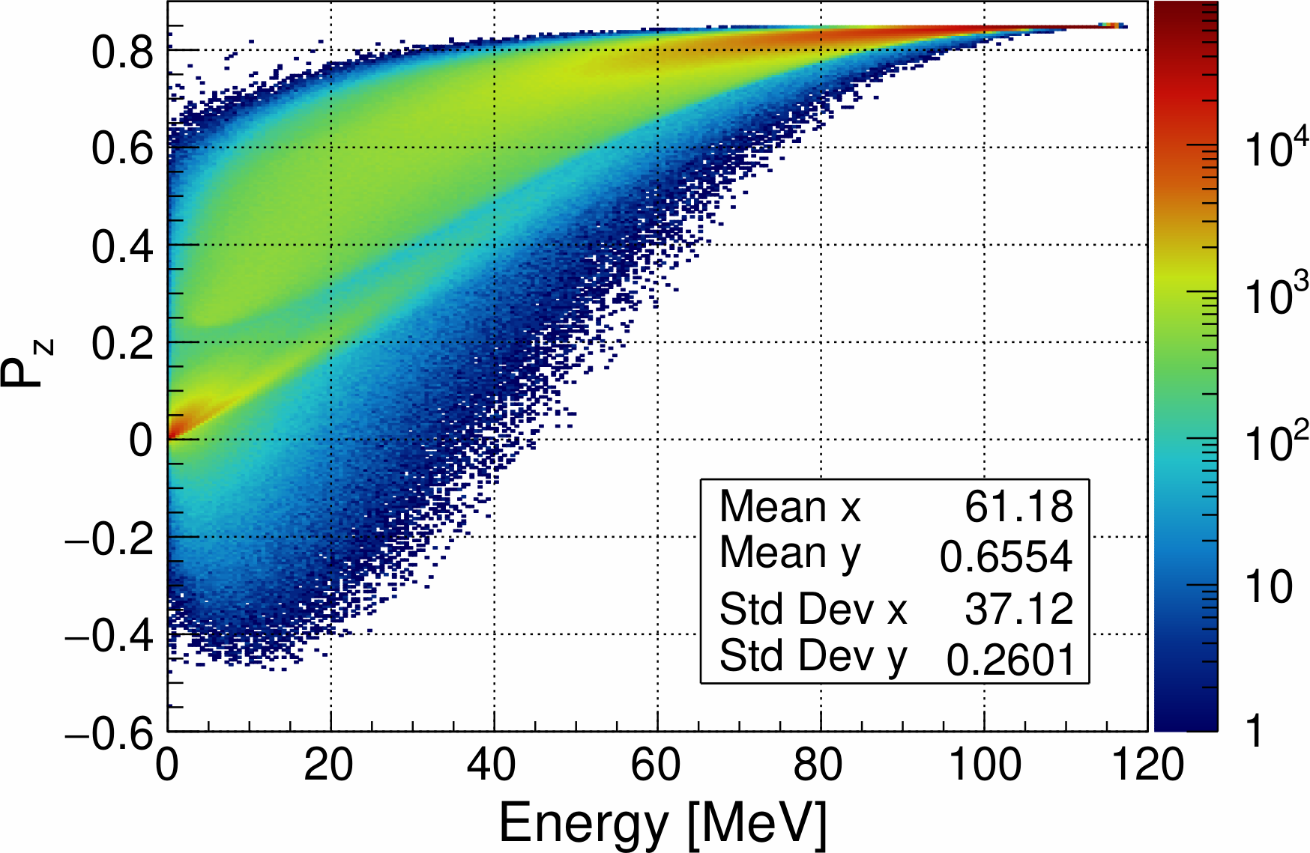
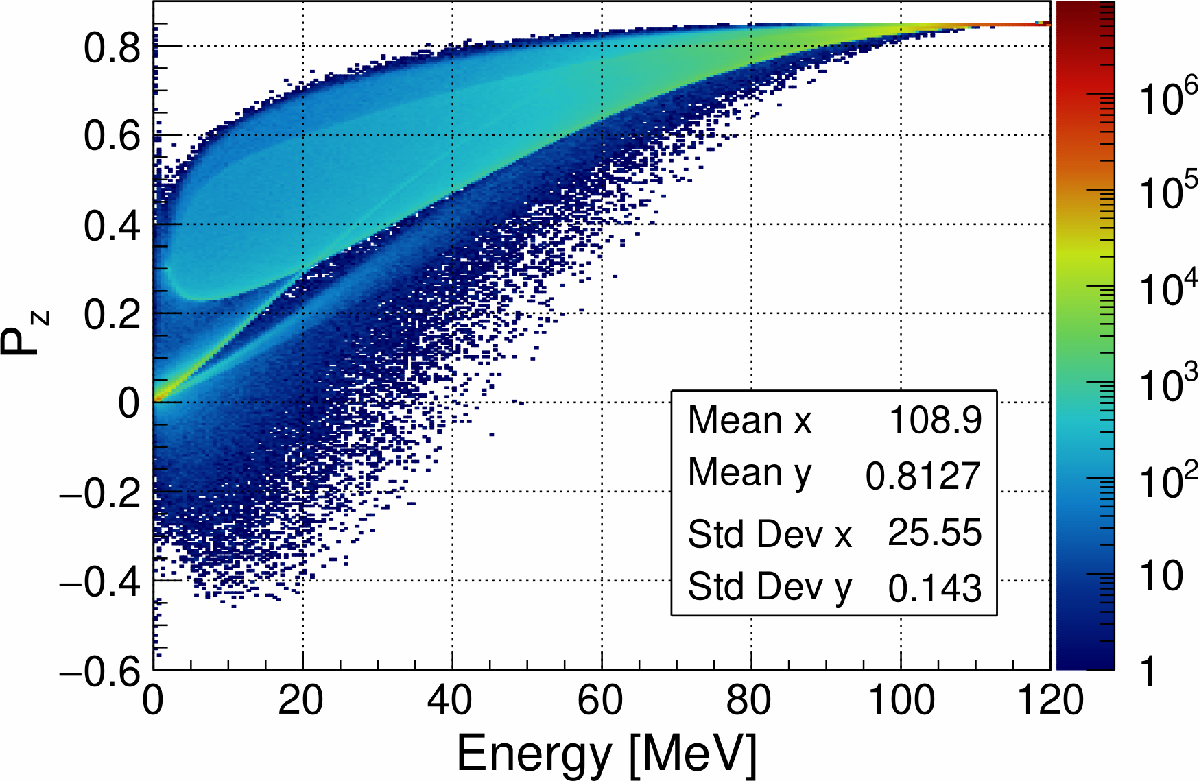
Polarization of e⁻ and e⁺ at Target Exit for 0.25, 2 and 4 mm W (Geant4-11.2)
4 mm W
2 mm W
0.25 mm W
Positrons
Positrons
Positrons
4 mm W
0.25 mm W
Electrons
2 mm W
Electrons
Electrons
2024 Summer Hall A/C Collaboration Meeting

Slide 18
e⁺ Polarization at Exit of 4 mm W Target and NC Capture Cavity
At Target Exit
At Entrance of Capture Cavity
At Exit of Capture Cavity
Average longitudinal e⁺ polarization (P_{z}) at target exit is 24.3%
2024 Summer Hall A/C Collaboration Meeting

Slide 19
e⁺ Polarization after Collimator in Middle of Chicane and at SRF C100
After Collimator #1
At Entrance of C100
At Exit of C100
Average longitudinal e⁺ polarization (P_{z}) downstream collimator at the middle of chicane exit is ~70%
2024 Summer Hall A/C Collaboration Meeting

Slide 20
Summary
We are working on improving the design of the Ce⁺BAF injector concept and critical risk areas:
mA polarized e⁻ source
High power target
CW capture cavity
Current projects:
Proposal for mA e⁻ source with >85% polarization
Test prototype tungsten target and liquid metal target (Xelera)
Develop normal conducting CW capture cavity
Measure CEBAF acceptance
Improved simulation model by using realistic geometries and fields of e⁺ injector components:
Initial concept of capture solenoids (main and bucking) has been developed
Development of capture solenoids and cavity, energy selection and bunch compression chicane will be continued taking into account measured CEBAF acceptance
Continue development of rotating tungsten target and simulations of e⁺ capture/acceleration for alternative target designs (liquid metal target)
2024 Summer Hall A/C Collaboration Meeting

Slide 21
Acknowledgments
We would like to acknowledge members of the Ce⁺BAF Working Group, the Jefferson Lab Positron Working Group, the DOE industry partner Xelera, members of the DOE US-Japan HEP Collaboration, and collaborators at Universities and National Labs which contribute to the positron R&D effort.
T. Abe, J. Benesch, A. Bogacz, L. Cardman, J. Conway, S. Covrig, P. Degtiarenko, Y. Enomoto,
S. Gessner, P. Ghoshal, S. Gopinath, J. Grames, J. Gubeli, S. Habet, C. Hernandez-Garcia, D. Higinbotham,
A. Hofler, R. Kazimi, M. Kostin, F. Lin, V. Kostroun, V. Lizarraga-Rubio, K. Mahler, Y. Morikawa, S. Nagaitsev,
E. Nanni, M. Poelker, N. Raut, B. Rimmer, Y. Roblin, A. Seryi, K. Smolenski, M. Spata, R. Suleiman,
A. Sy, D. Turner, C. Valerio-Lizarraga, E. Voutier, M. Yamamoto, S. Zhang
2024 Summer Hall A/C Collaboration Meeting

Slide 22
Backup Slides
2024 Summer Hall A/C Collaboration Meeting

Slide 23
Program Advisory Committee Positron Experiments
NUMBER | TITLE | CONTACT PERSON | HALL | DAYS REQUESTED | DAYS AWARDED | SCIENTIFIC RATING | PAC DECISION
PR12+23-002 | Beam Charge Asymmetries for Deeply Virtual Compton Scattering on the Proton at CLAS12 | Eric Voutier | B | 100 | 100 | A- | C1
PR12+23-003 | Measurement of Deep Inelastic Scattering from Nuclei with Electron and Positron Beams to Constrain the Impact of Coulomb Corrections in DIS | Dave Gaskell | C | 9.3 | 9.3 | A- | C1
PR12+24-005 | A Dark Photon Search with a JLab positron beam | Bogdan Wojtsekhowski | B | 55 | 55 | A- | C1
PR12+23-006 | Deeply Virtual Compton Scattering using a positron beam in Hall C | Carlos Munoz Camacho | C | 137 | 137 | A- | C1
PR12+23-008 | A Direct Measurement of Hard Two-Photon Exchange with Electrons and Positrons at CLAS12 | Axel Schmidt | B | 55 | 55 | A | C1
PR12+23-012 | A measurement of two-photon exchange in unpolarized elastic positron–proton and electron–proton scattering | Michael Nycz | C | 56 | 56 | A- | C1
C1 = Conditionally Approved w/Technical Review by the Lab
Approved 210 days Hall B & 202 days in Hall C for 357 total PAC days
(PAC day = two calendar day)
2024 Summer Hall A/C Collaboration Meeting

Slide 24
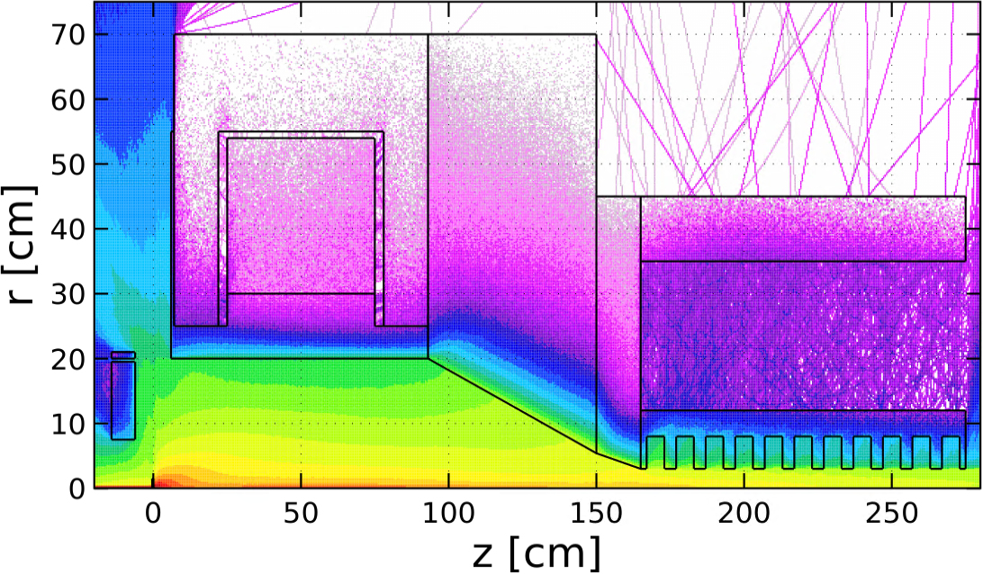
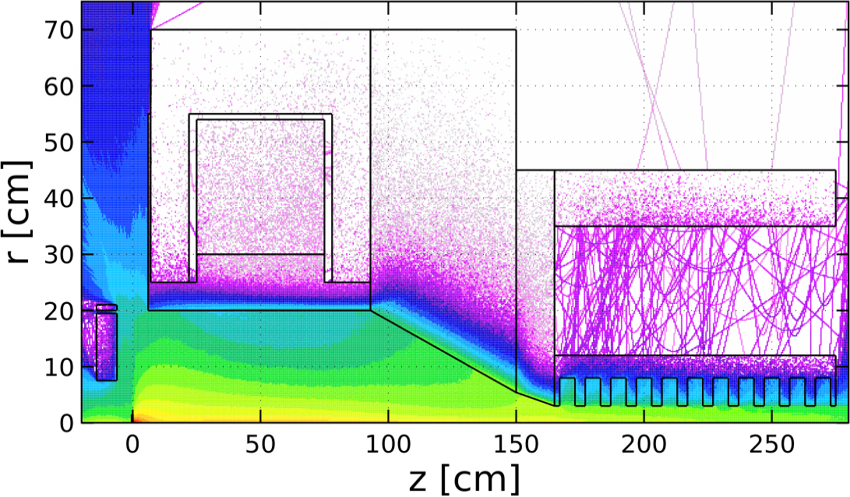
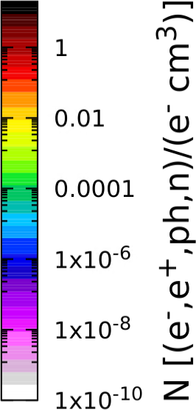
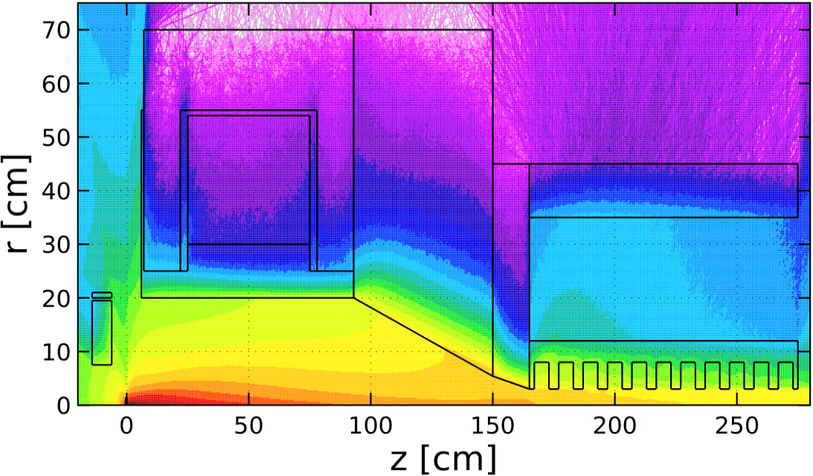
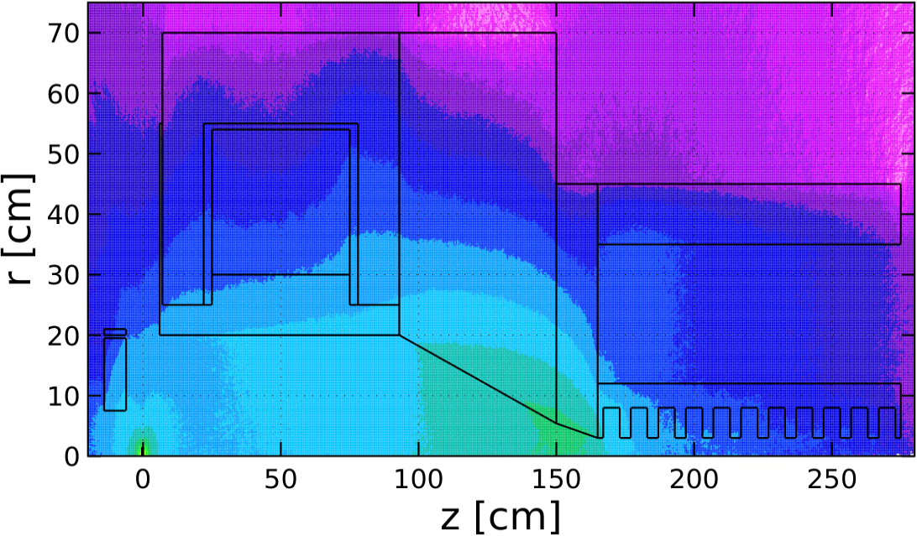
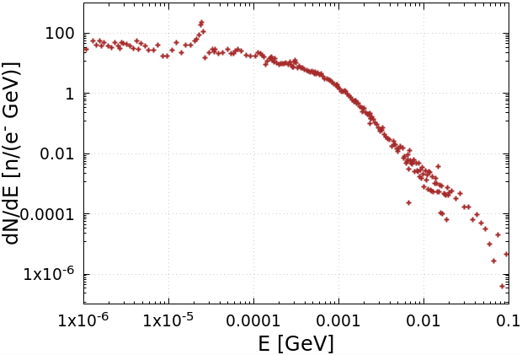
Spatial Distributions of e‒, e⁺, γ and n. Neutron Energy and Yield (FLUKA)
Electrons
Positrons
We have begun working with the Radiation Control Department on radiation shielding
Photons
Neutrons
Energy Spectrum of Neutrons
Neutron Yield:
$Y_{n}=9.2∙{10}^{−3}$ ${n/e}_{pr}^{−}$
$(5.7∙{10}^{13}$ $n/s)$
2024 Summer Hall A/C Collaboration Meeting

Slide 25
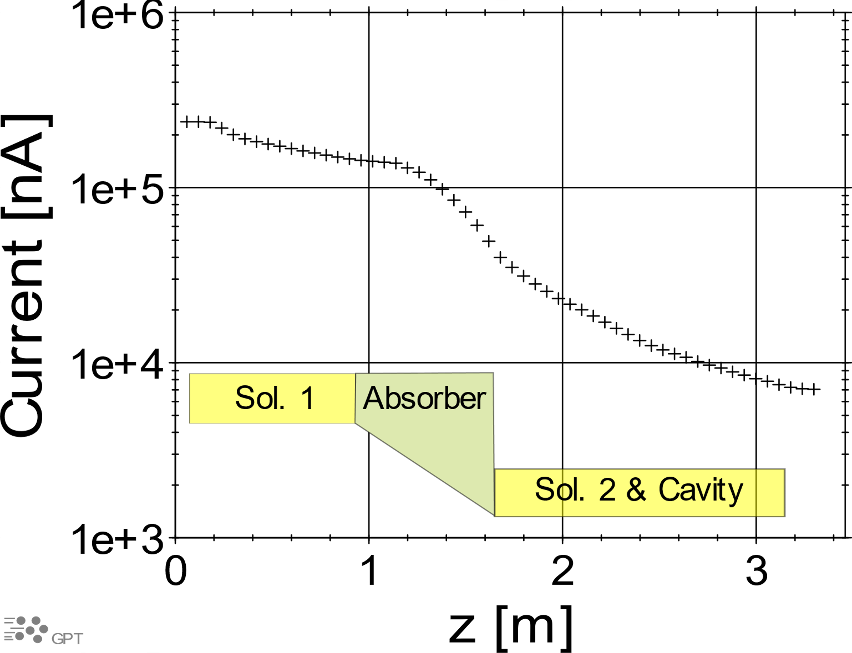
e⁺ Beam Current vs Z at Capture 1.03 T Solenoid and NC Capture Cavity
e⁺ Current And Energy along Beam Line
(S. Habet, PhD Thesis, Dec. 2023)
e⁺ Current vs Z at Capture Solenoid
and 1st Cavity
Current at the End of Capture Cavity:
Elegant (Sami): $I_{e^{+}}$= 3 µA
GPT (Andriy): $I_{e^{+}}$= 7 µA
2024 Summer Hall A/C Collaboration Meeting

Slide 26
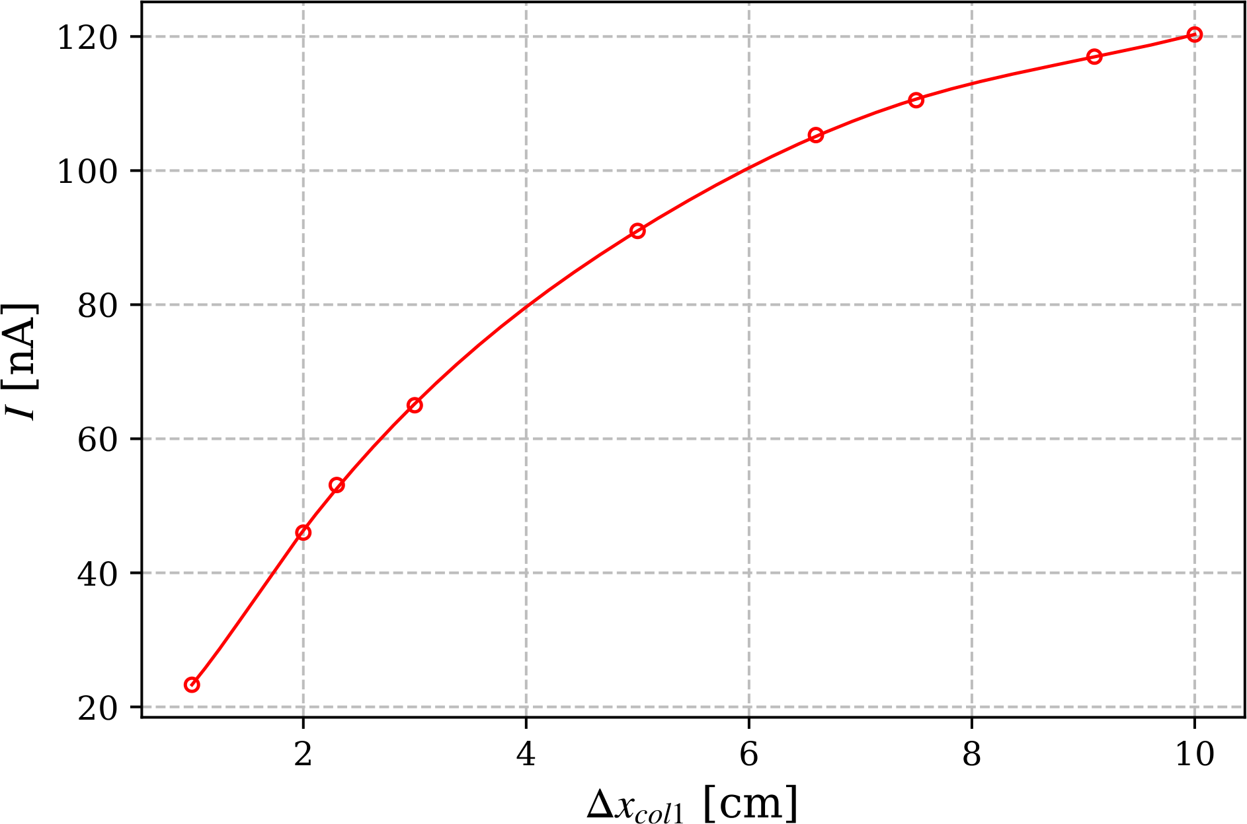
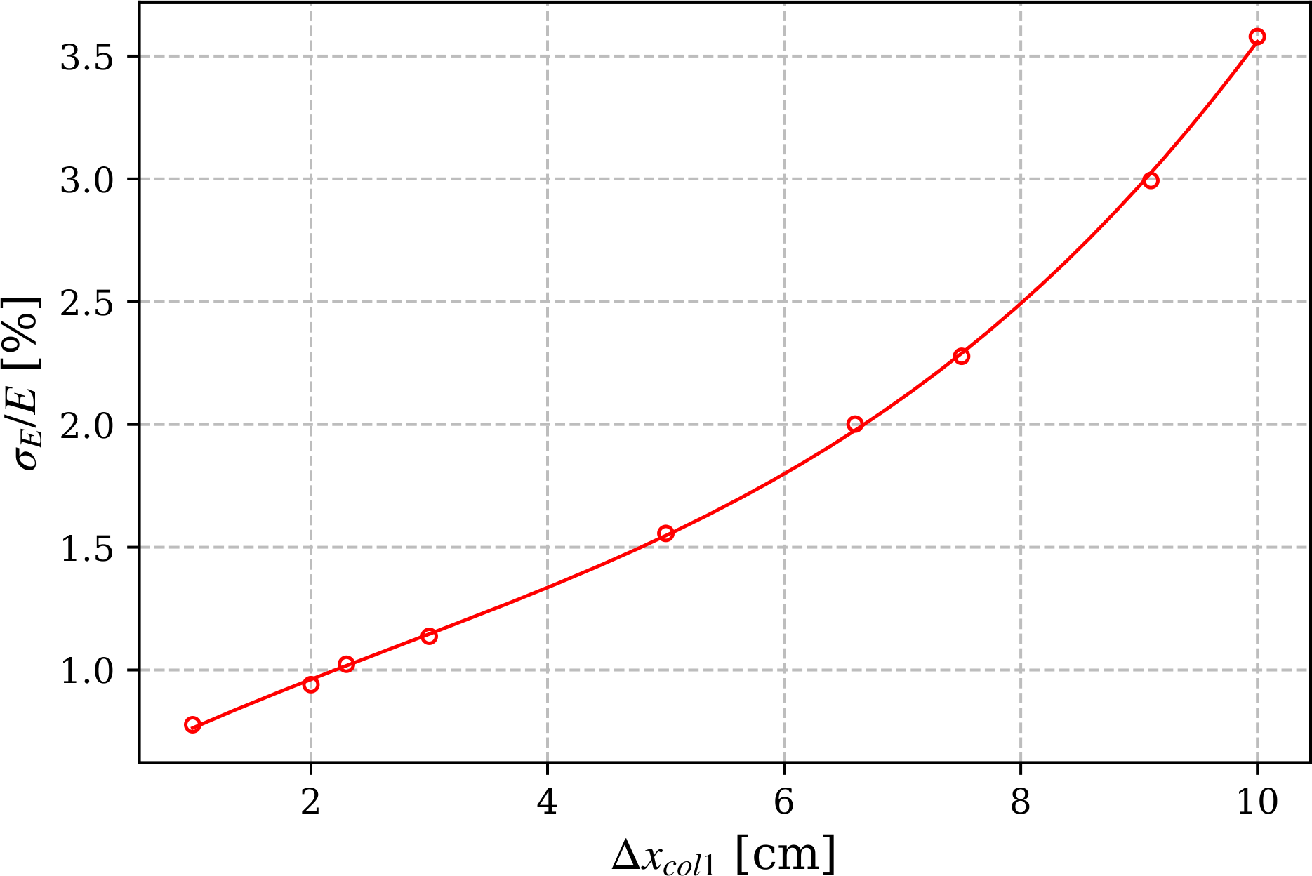
e⁺ Current and Energy Spread at Exit of C100 vs Aperture Size of Collimator #1
e⁺ Current vs Aperture Size (Δx) of Collimator #1
Energy Spread vs Aperture Size (Δx) of Collimator #1
I (Δx_{col1} = 2.2 cm) = 50.8 nA
σ_{E}/E (Δx_{col1} = 2.2 cm) = 1%
2024 Summer Hall A/C Collaboration Meeting

Slide 27
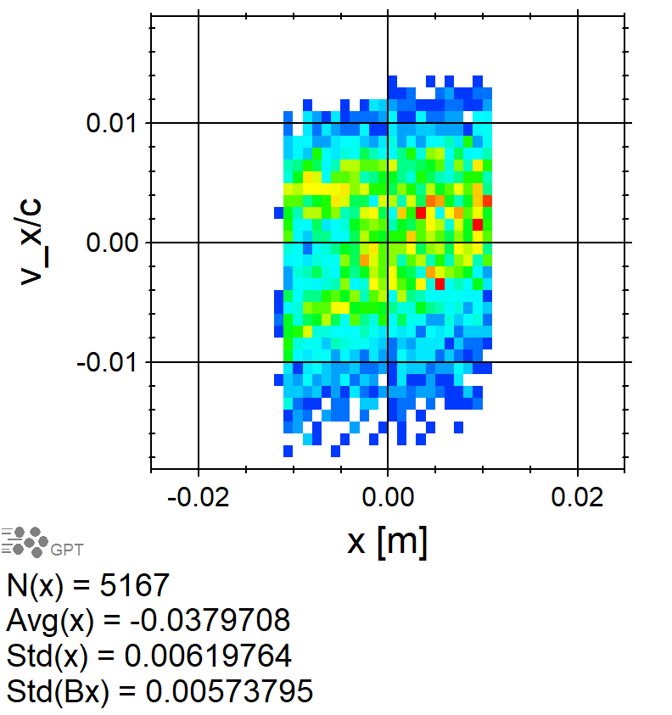
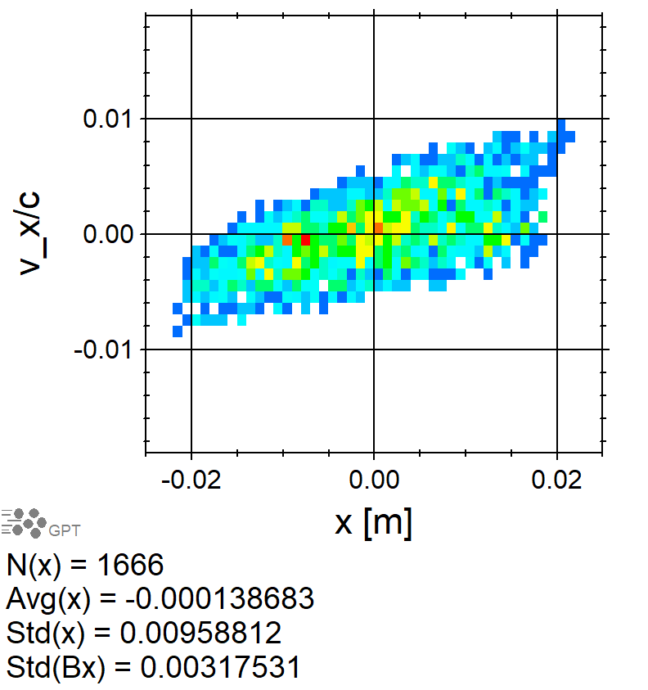
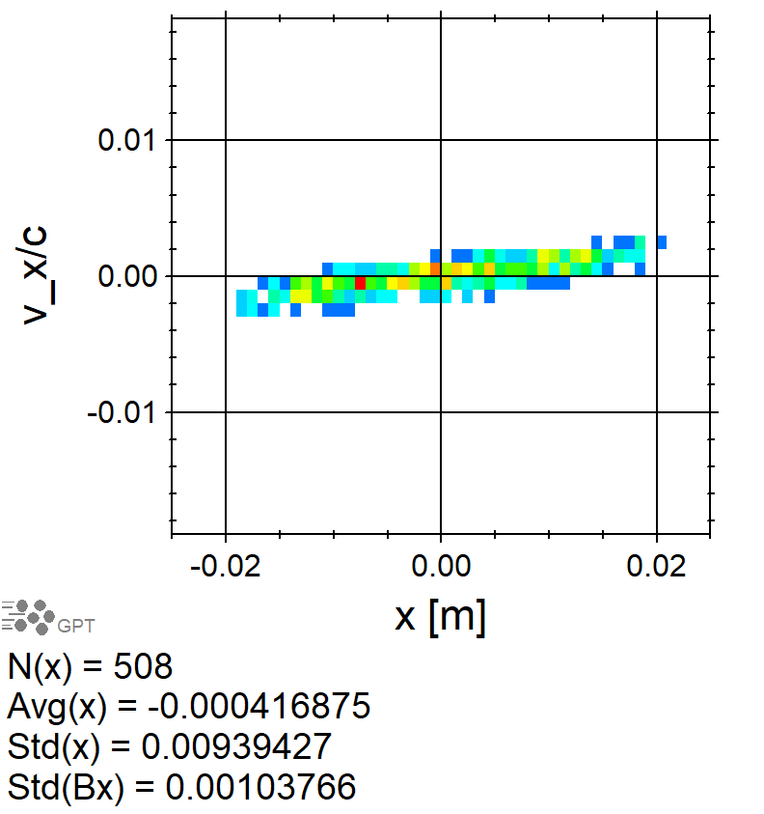
XX’ Phase Space after Collimator #1 and before/after Cryomodule
After Collimator #1
At Entrance of C100
At Exit of C100
ε_{nx} = 1.4 mm·rad
ε_{ny} = 1.8 mm·rad
2024 Summer Hall A/C Collaboration Meeting

Slide 28
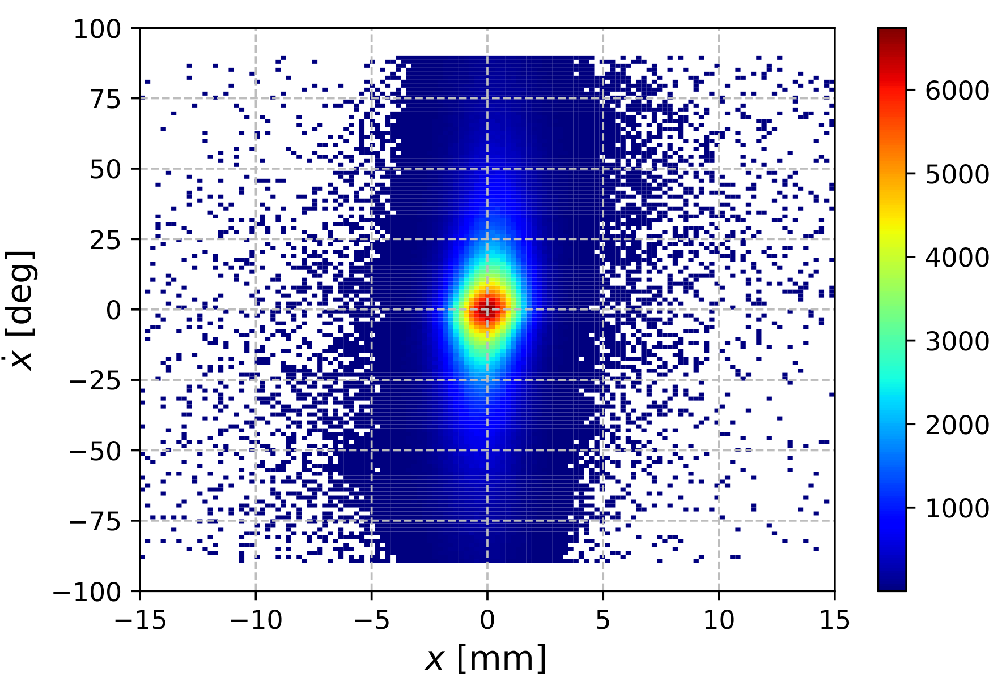
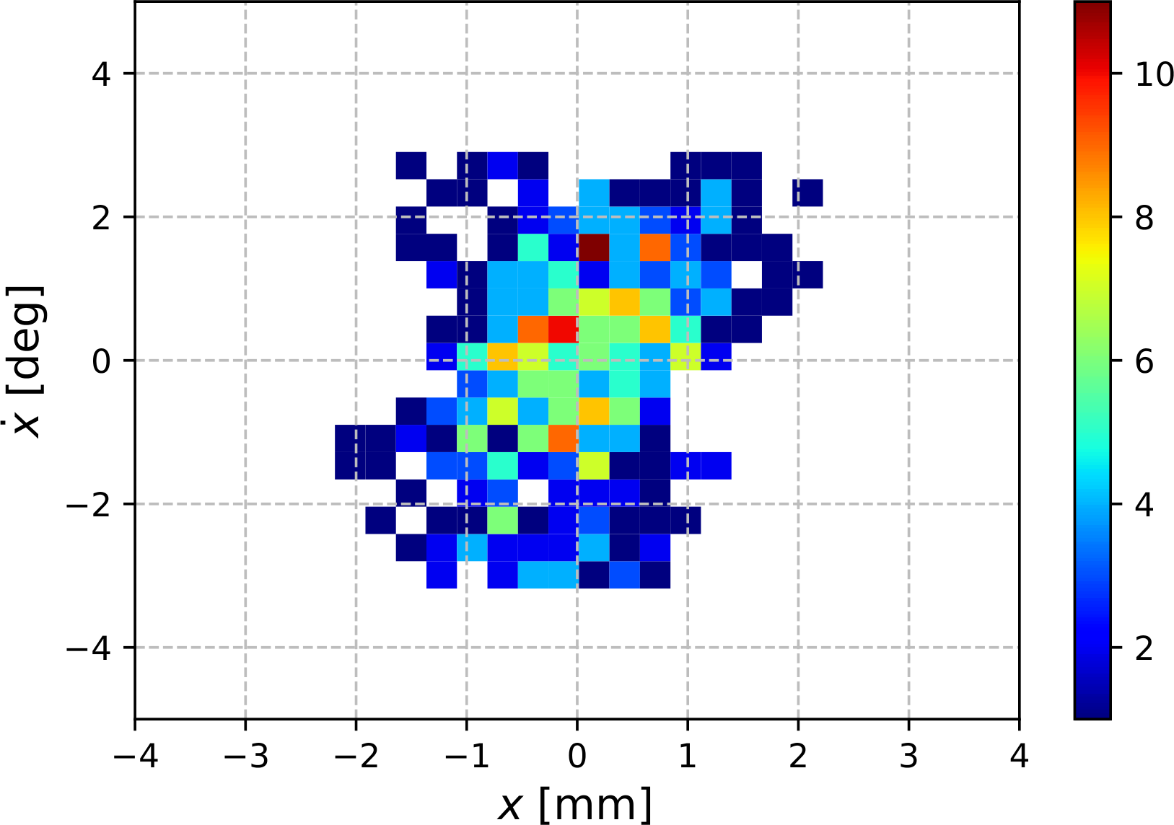
XX’ Phase Space of All e⁺ at Target Exit and Target e⁺ “Alive” at C100 Exit
All Positrons at Target Exit
Target e⁺ “Alive” at C100 Exit
$σ_{x}$ = 1.2 mm
$σ_{\dot{x}}$ = 27.8 deg
$ε_{nx}$ = 14.7 mm·rad
$σ_{x}$ = 0.7 mm, |$x$| < 2.2 mm
$σ_{\dot{x}}$ = 1.4 deg, |$\dot{x}$| < 3.2 deg
$ε_{nx}$ = 1.4 mm·rad
2024 Summer Hall A/C Collaboration Meeting

Slide 29
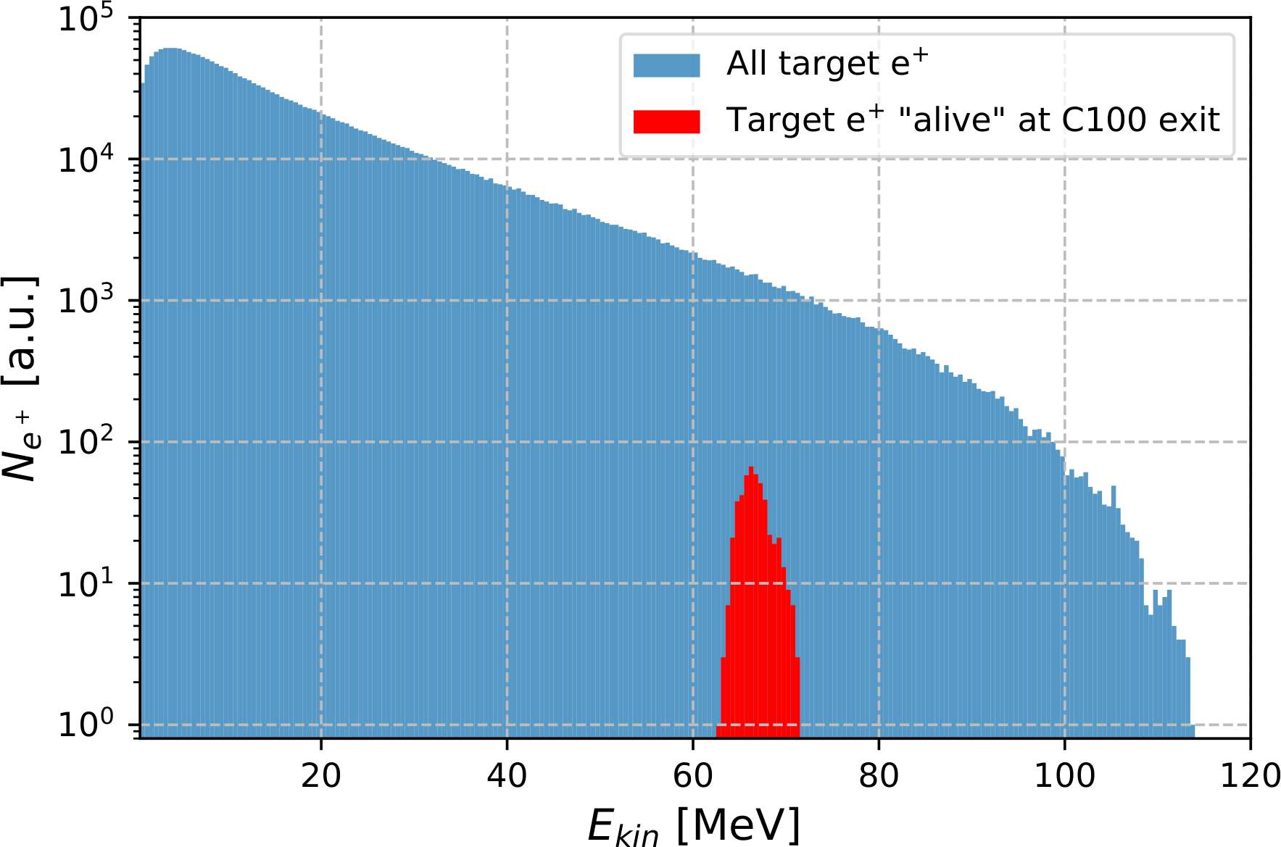
Energy Spectrum of All e⁺ at Target Exit and Target e⁺ “Alive” at C100 Exit
All positrons at target exit
$\left\langle E_{kin}\right\rangle$ = 17.0 MeV
$σ_{E_{kin}}$ = 15.9 MeV
Target e⁺ “Alive” at C100 Exit
$\left\langle E_{kin}\right\rangle$ = 66.7 MeV
$σ_{E_{kin}}$ = 1.6 MeV
2024 Summer Hall A/C Collaboration Meeting

