Slide 1
Introduction to the Jefferson Lab Data Science Department and its Capabilities
2024 Summer Hall A/C Collaboration Meeting
Steven Goldenberg, Daniel Lersch, & Malachi Schram
Tuesday, July 16th, 2024

Slide 2
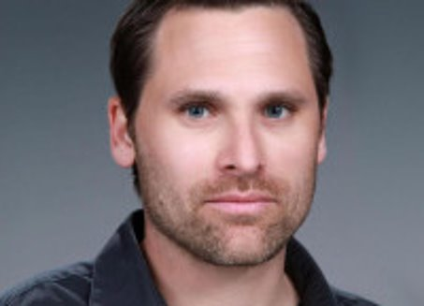
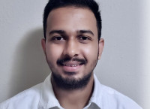
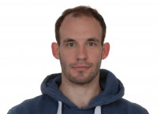
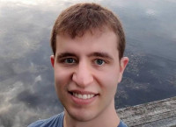
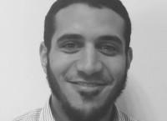
The Team
Malachi Schram
Department Head
8 Researchers: 5 Staff + 2 Postdocs
4 Researchers from ODU / JLab joint institute
And we keep growing
Kishansingh Rajput
Staff
Diana McSpadden
Staff
Armen Kasparian
Staff
Daniel Lersch
Staff
Steven Goldenberg
Postdoc
Ahmed Mohammed
Postdoc
2024 Summer Hall A/C Collaboration Meeting

Slide 3
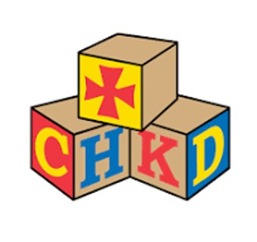
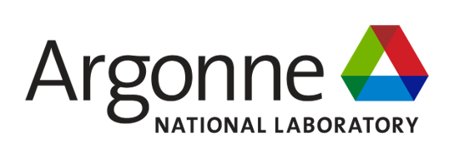
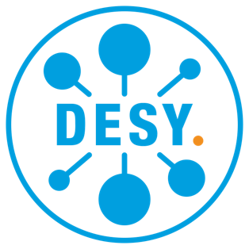
Building Collaborations
2024 Summer Hall A/C Collaboration Meeting

Slide 4
The Jefferson Lab Data Science Pillars
Nuclear Physics (NP), High Energy Physics (HEP), Advanced Scientific Computing Research (ASCR), Basic Energy Sciences (BES)
Health & Climate
Applications
AI based optimization & Controls
Robustness and Uncertainty Quantification
Generative AI
Scalable AI
Methods & Algorithms
JLab Data Science Composable Workflow
JLab ML & Data Hub
Infrastructure
2024 Summer Hall A/C Collaboration Meeting

Slide 5
The Jefferson Lab Data Science Pillars
Nuclear Physics (NP), High Energy Physics (HEP), Advanced Scientific Computing Research (ASCR), Basic Energy Sciences (BES)
Health & Climate
Applications
Today's Focus
AI based optimization & Controls
Robustness and Uncertainty Quantification
Generative AI
Scalable AI
Methods & Algorithms
JLab Data Science Composable Workflow
JLab ML & Data Hub
Infrastructure
2024 Summer Hall A/C Collaboration Meeting

Slide 6
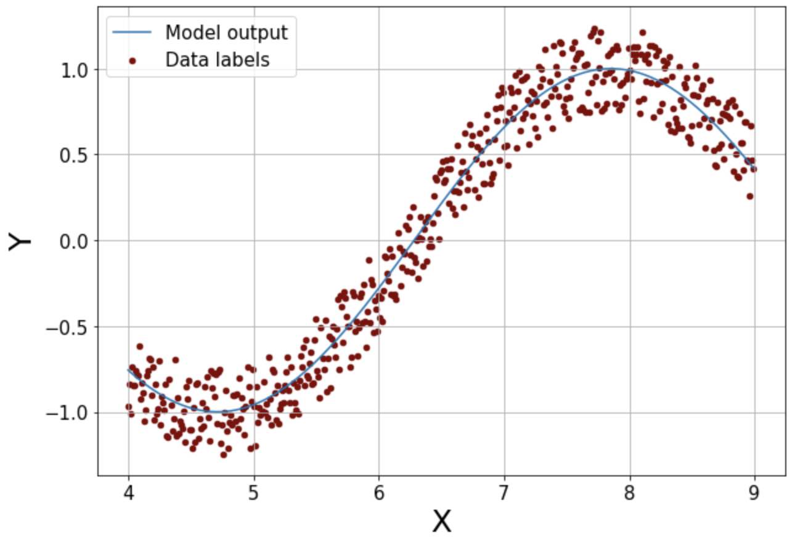
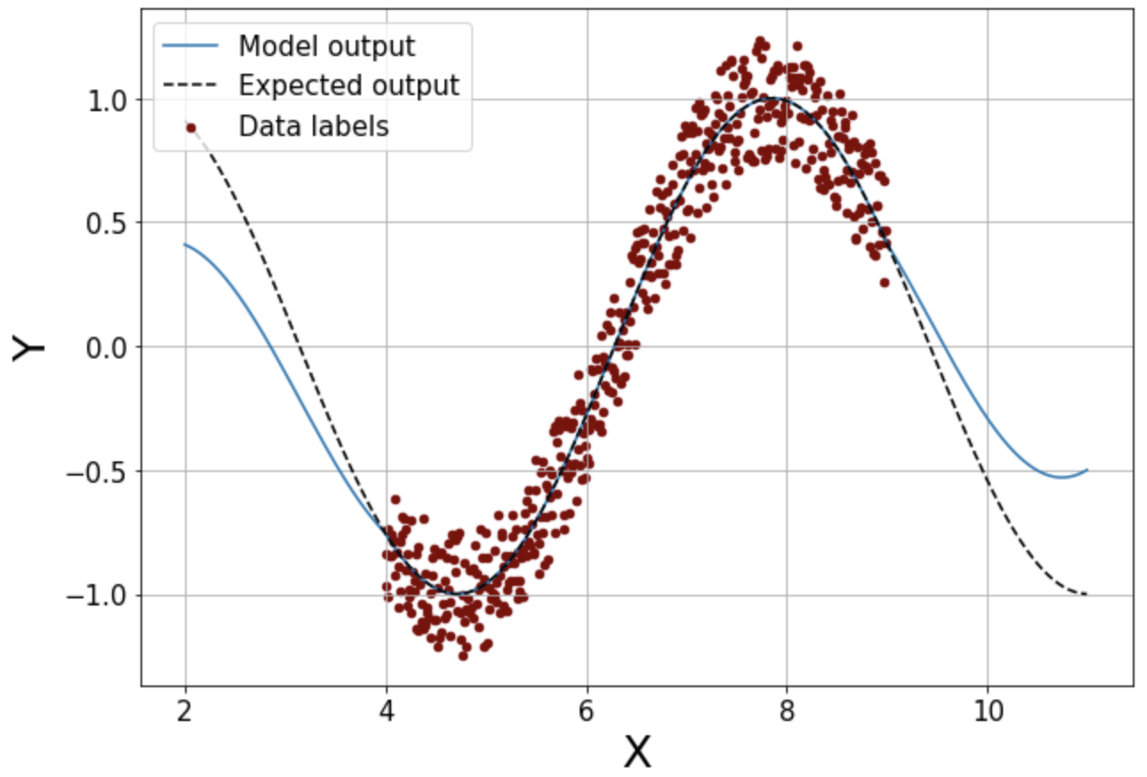
Uncertainty Quantification
Deep Learning (DL) models are deterministic transformation functions from an input to the output
DL models are very powerful and expressive
It is important to know the confidence associated with each prediction from a DL model for decision making
DL model
Input(s)
Output(s)
Aleatoric
Uncertainty Types: Aleatoric vs Epistemic uncertainties
Aleatoric → Data uncertainties
Epistemic → Out of training distribution uncertainty (OOD)
Epistemic

Slide 7
Uncertainty Quantification
A single model, without specific modifications, has no uncertainty!
What is often quoted: mean squared error, confusion matrix,.. ROC-Curve, …
Deduced from data with known truth (or something close to it)
No applicable to single prediction
Example: Mean Squared Error
==> Gives an idea how good / bad the model performs on the entire data set
2024 Summer Hall A/C Collaboration Meeting

Slide 8
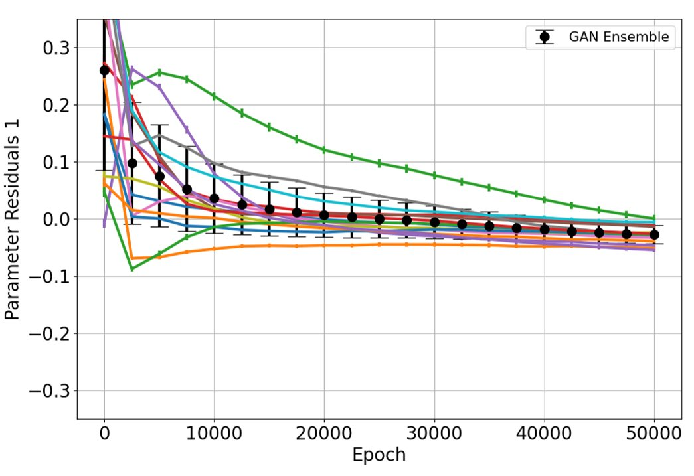
Uncertainty Quantification
A single model, without specific modifications, has no uncertainty!
What is often quoted: mean squared error, confusion matrix,.. ROC-Curve, …
Deduced from data with known truth (or something close to it)
No applicable to single prediction
Common Techniques (just 2 out of many techniques)
1.) Ensemble: M models, independently trained on same data, but different initialization for internal parameters
2024 Summer Hall A/C Collaboration Meeting

Slide 9
Uncertainty Quantification
A single model, without specific modifications, has no uncertainty!
What is often quoted: mean squared error, confusion matrix,.. ROC-Curve, …
Deduced from data with known truth (or something close to it)
No applicable to single prediction
Common Techniques (just 2 out of many techniques)
2.) Deep Gaussian Process Approximation (DGPA): Approximate kernel k(x,y) to reduce computational cost. Model directly predicts uncertainty.
Allows to formulate uncertainties
Input Feature Vector
DGPA
$$μ$$
$$σ$$
2024 Summer Hall A/C Collaboration Meeting

Slide 10
Generative AI in a Nutshell
Anomaly
Detection
Data
Generation
Training
Difficulty
Image Quality &
Diversity
Generative Adversarial
Network (GAN)
Variational Autoencoder
(VAE)
Diffusion Model
CLAS Collaboration Meeting March 2024

Slide 11
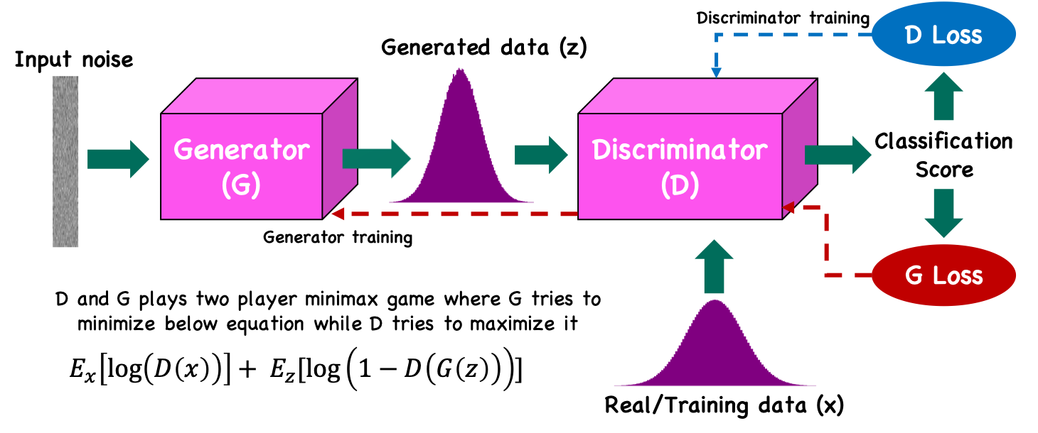
Generative Adverserial Networks (GANs)
Successfully utilized in multiple projects
Always used in combination with diagnostic tools (e.g. gradient monitor, loss landscape,…)
2024 Summer Hall A/C Collaboration Meeting

Slide 12
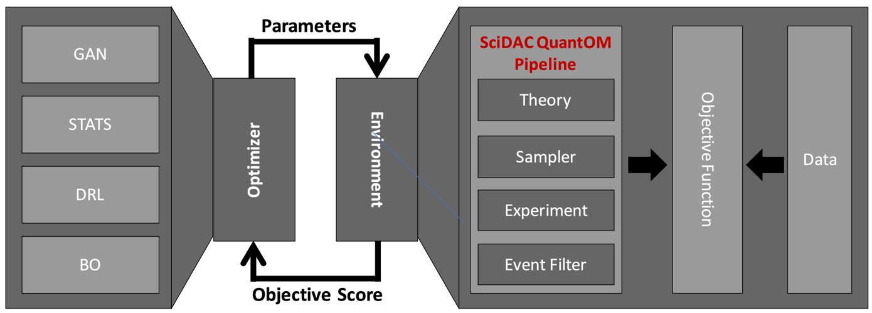
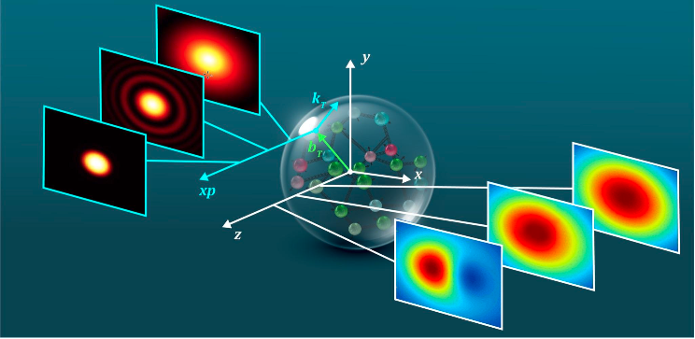
The Generative Inverse Problem Solver: GIPS
Developed within the SciDAC QuantOM project
Event-level toolkit for deep inelastic scattering data
3D imaging of the proton
CLAS Collaboration Meeting March 2024

Slide 13
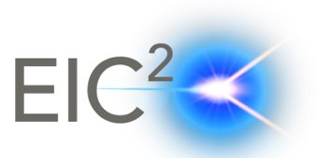
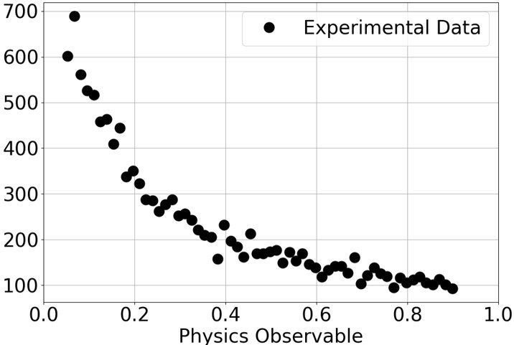
The Generative Inverse Problem Solver: GIPS
CLAS Collaboration Meeting March 2024

Slide 14
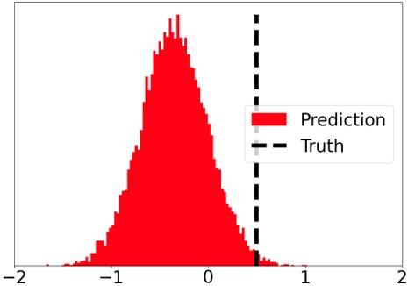
The Generative Inverse Problem Solver: GIPS
Iteration 0
Parameters p
Can not directly compare
CLAS Collaboration Meeting March 2024

Slide 15
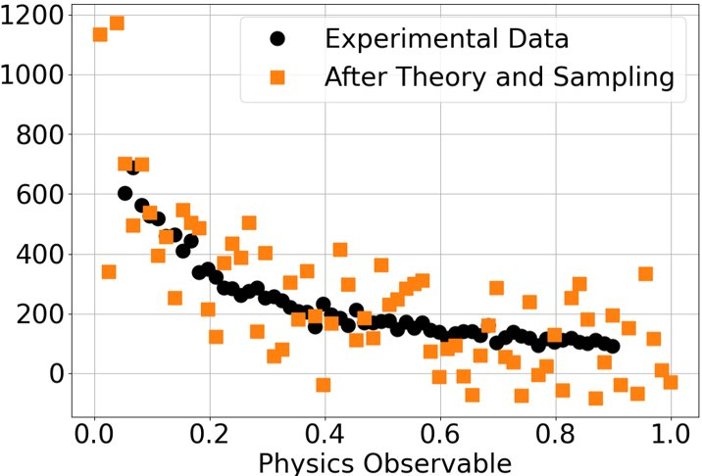
The Generative Inverse Problem Solver: GIPS
Iteration 0
Convert parameters to parton density functions (PDFs)
Include higher order and radiate corrections
Sample events from PDFs (e.g. via MCMC)
Parameters p
CLAS Collaboration Meeting March 2024

Slide 16
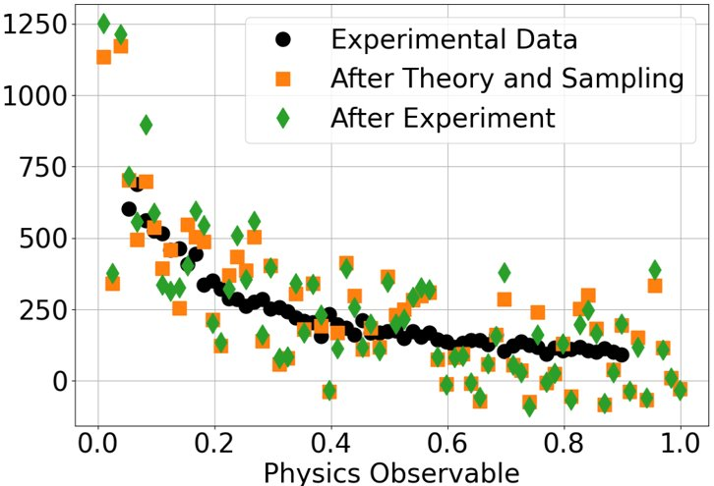
The Generative Inverse Problem Solver: GIPS
Iteration 0
Apply experimental effects (e.g. resolution, acceptance)
Handle background contributions
Use surrogate for detector
Parameters p
CLAS Collaboration Meeting March 2024

Slide 17
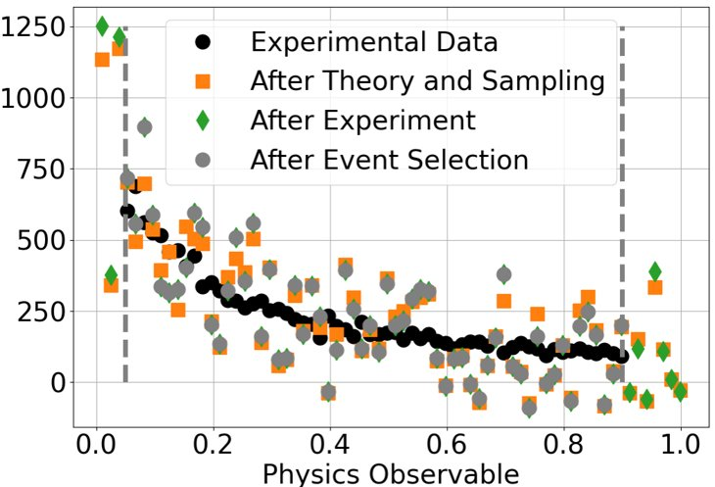
The Generative Inverse Problem Solver: GIPS
Iteration 0
Exclude un-physical data points
Match experimental and synthetic data
Parameters p
CLAS Collaboration Meeting March 2024

Slide 18
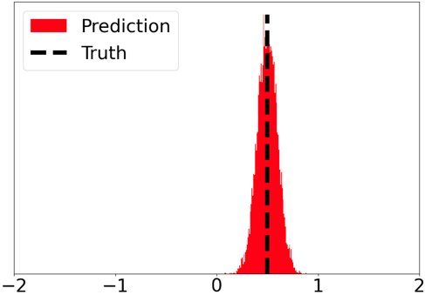
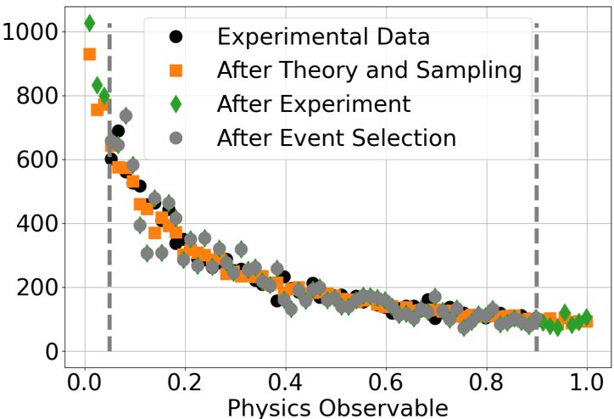
The Generative Inverse Problem Solver: GIPS
Iteration 100
Run workflow iteratively
Use objective score to update optimizer
Parameters p
CLAS Collaboration Meeting March 2024

Slide 19
What is a Workflow and why should I use one?
Workflow: Chain of independent modules
Common denominator for every analysis
Replace / swap out modules, depending on analysis
Key features
Work on modules independently --> Support collaborative efforts
Each module comes with a unit-test --> Easy debugging
Reproducibility and efficiency --> Everything runs from a configuration file
Profit from multiple ML / DL frameworks
2024 Summer Hall A/C Collaboration Meeting

Slide 20
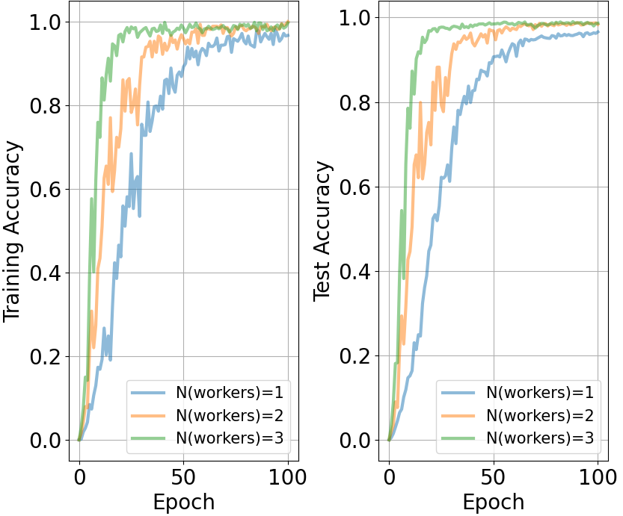
What is Scaling and do I need it?
Data Format | Model Complexity (Number of trainable Parameters)
Digits | ~1k - 100k
Images & Videos | ~100k - 10000k
Text & Language | >> 10000k
Depending on the model complexity, a single GPU is not suitable for training (Unless you are fine waiting months for your publication results)
To speed up training time: Run your analysis across multiple GPUs
Scaling: Total training time / Model performance vs. Number of GPUs
Example on the left: MNIST Classifier trained on JLab GPUs, training times nearly identical for all runs
2024 Summer Hall A/C Collaboration Meeting

Slide 21
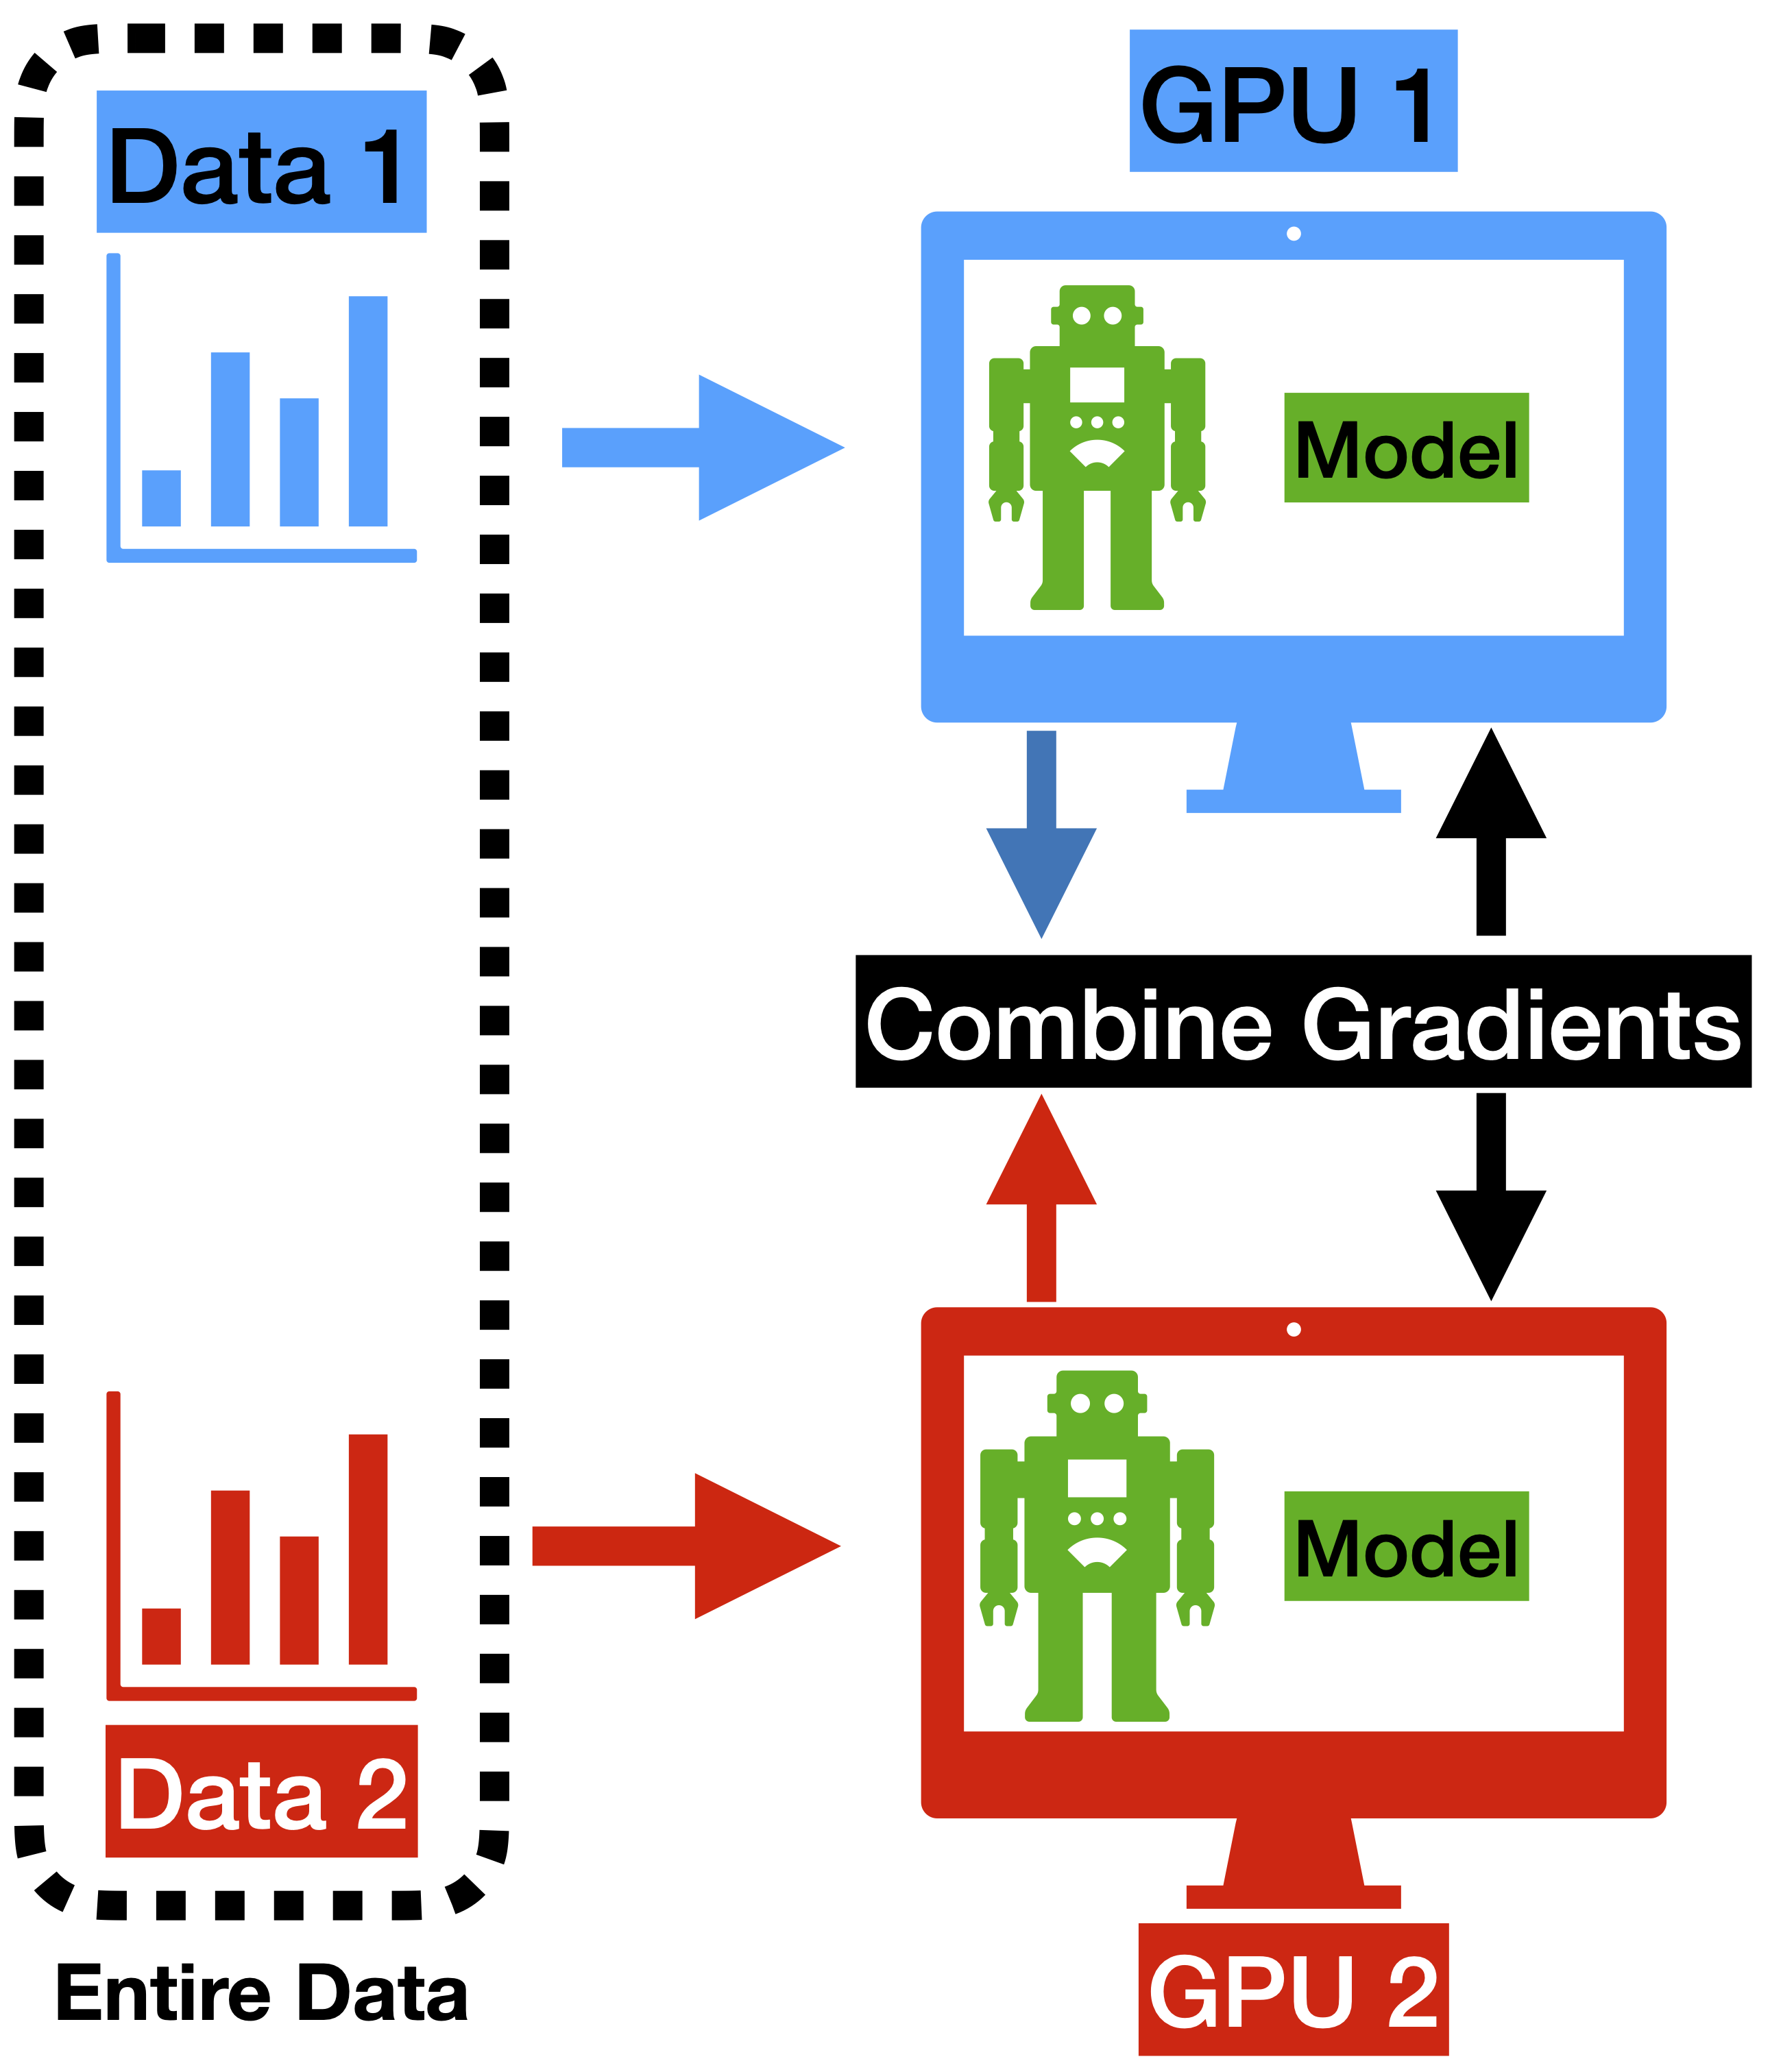
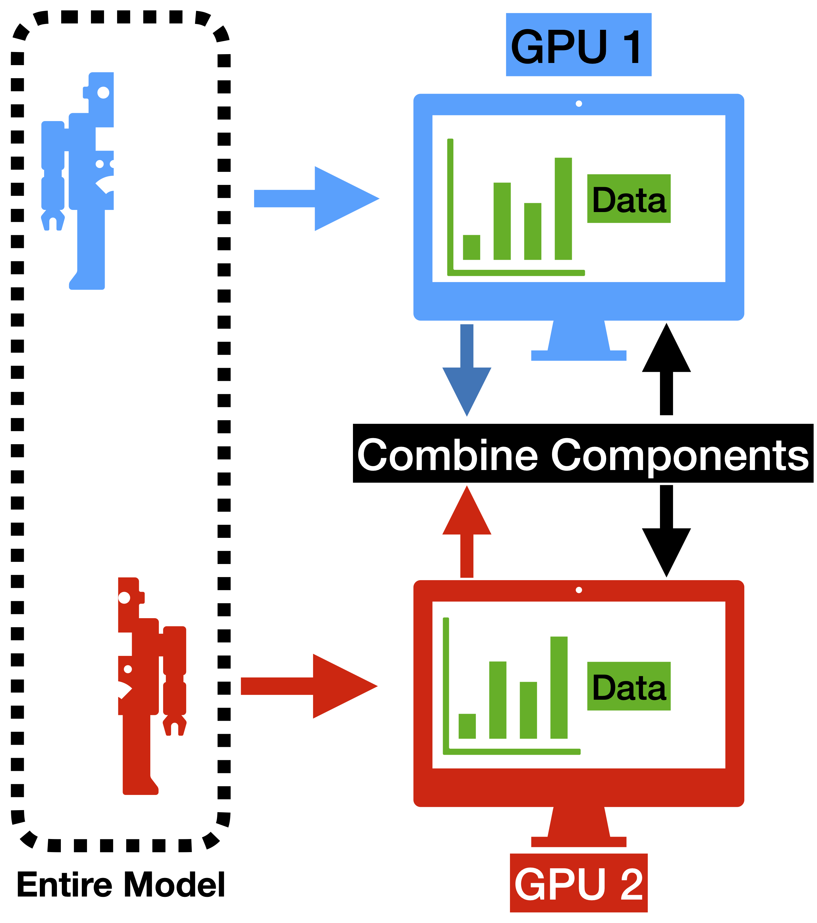
Basic Distributed Training Strategies
Training Method | Explanation
Data Parallel | Shard data across GPUs, each GPU sees full model --> Distribute gradients
Model Parallel | Shard model across GPUs, each GPU sees fraction of the model and full data
Pipeline Parallel | Combine the above two
Data Parallel + Shard model | Mainly data parallel, but each GPU operates only on subsection of model (implementation NOT the same as pipeline parallel)
2024 Summer Hall A/C Collaboration Meeting

Slide 22
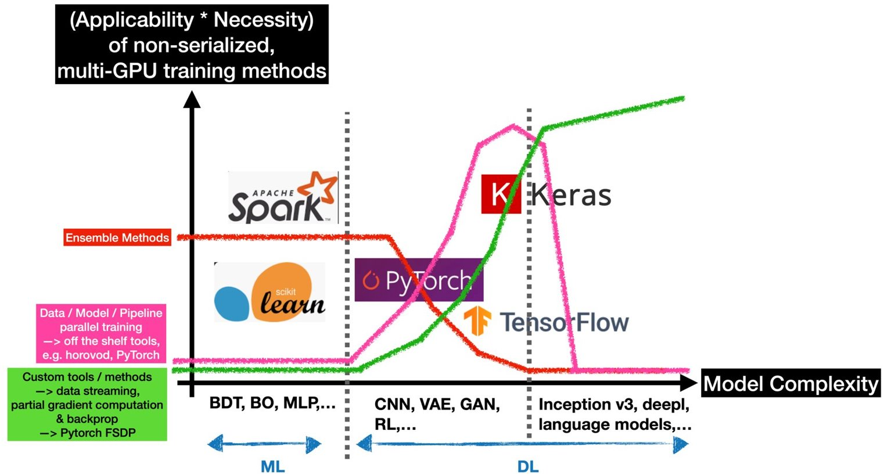
Distributed Training of Machine and Deep Learning Models
Applicability: Can I do it?
Necessity: Do I have to do it?
Plot below is inspired by NeurIPS 2023 conference
2024 Summer Hall A/C Collaboration Meeting

Slide 23
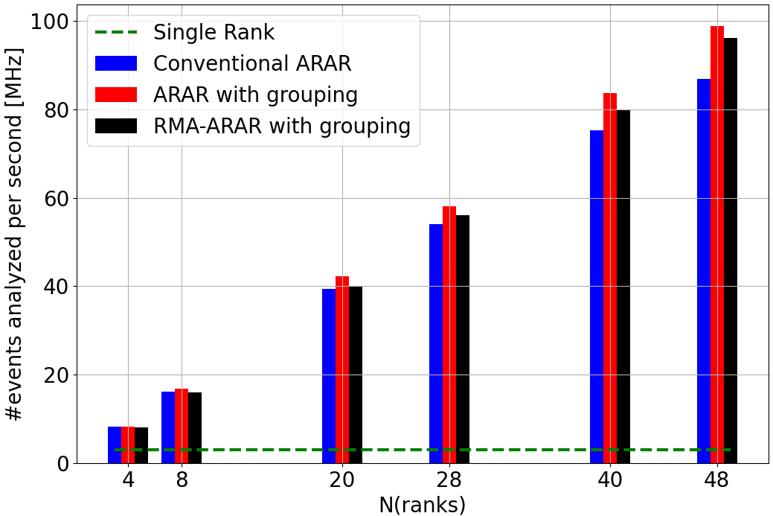
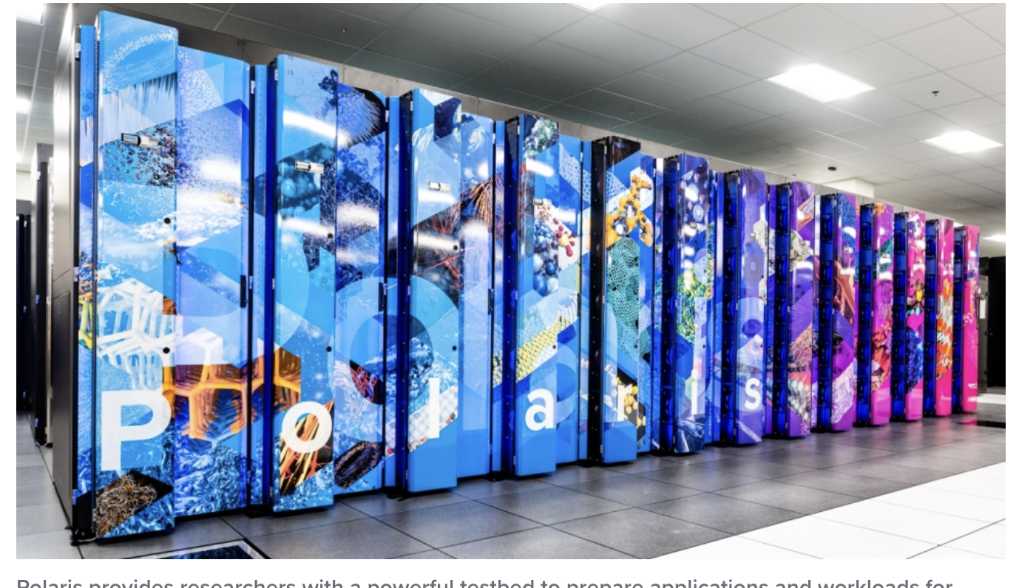
Scaling an entire Workflow
Run QuantOM workflow on Polaris machine @ Argonne
Utilize multiple GPUs to enhance analyzing power
Test different methods for scaling the workflow
Publication of current results in progress
2024 Summer Hall A/C Collaboration Meeting

Slide 24
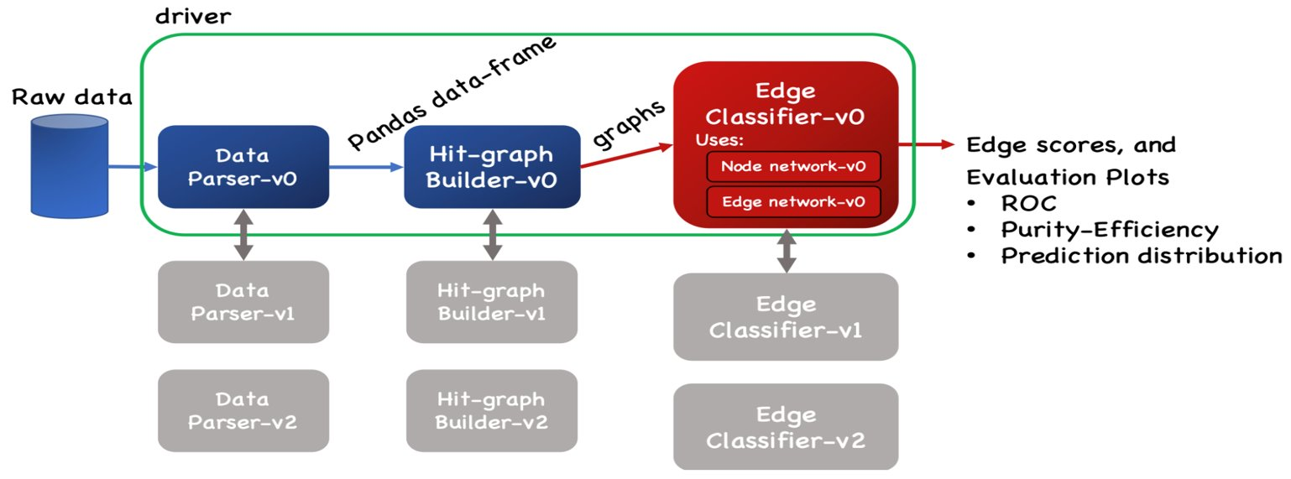
Charged Particle Tracking in Hall D
GNN
Model
Raw Data (Hits)
Hitgraph
Graph Neural Network (GNN) process raw detector hits
Observe ~10 speed up compared to conventional method
Deploy model of FPGAs
2024 Summer Hall A/C Collaboration Meeting

Slide 25
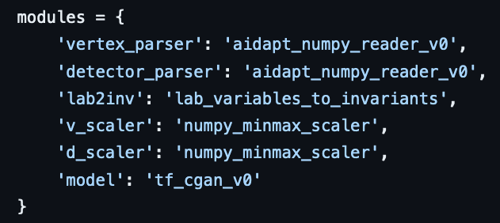
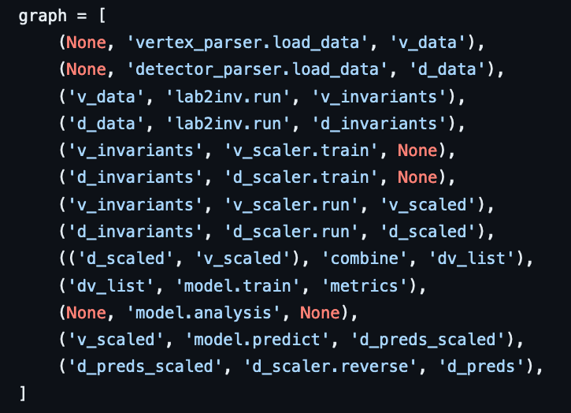
Data Science Workflow Goals
Create a modifiable graph-based workflow driver
Should be easy to write and replicable

Slide 26
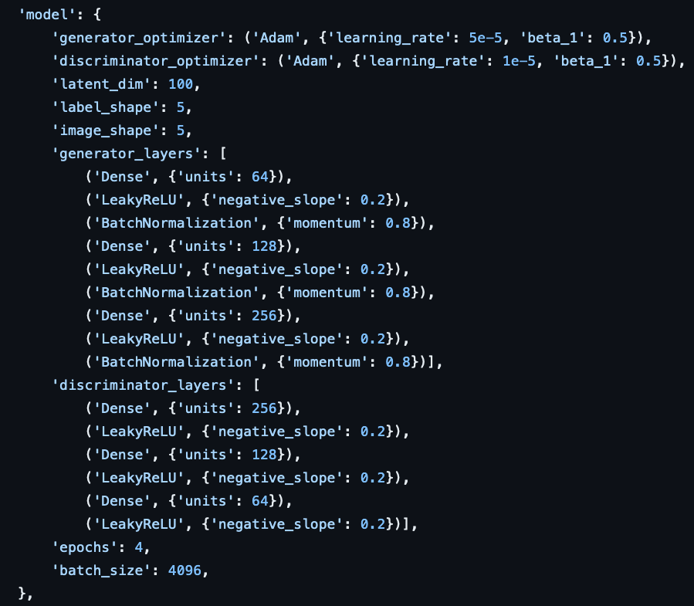
Modifying Module Behavior
Modules controlled through a configuration file/interface
CLI tools to be developed

Slide 27
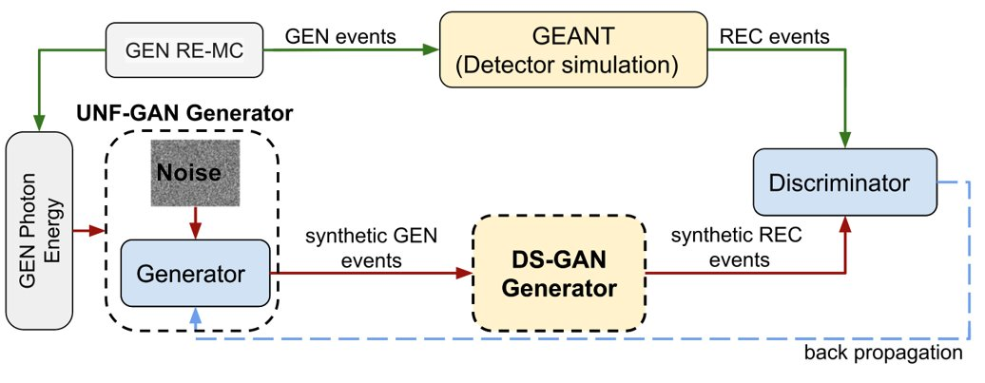
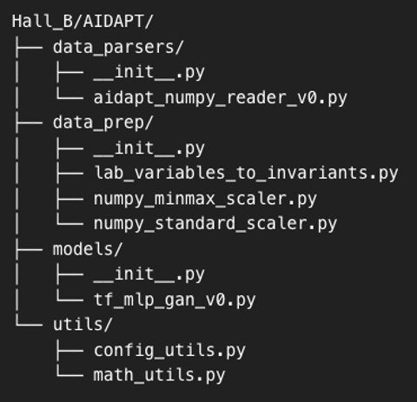
Generative Modeling Analysis in Hall B
Plot taken from: Clas12 collab., Phys. Rev. D, 108, 094030 (2023)
R & D already done by Y. Alanzi et al.
Our contribution(s):
Implement existing code into generic, composable workflow
Add uncertainty quantification for GAN(s)
Provide scaling capability
2024 Summer Hall A/C Collaboration Meeting

Slide 28
Let's Collaborate!
Jefferson Labs Research Mission
Experimental Halls
Data Science Department
Algorithmic Tools & Methods (e.g. uncertainty quantification, hyper parameter tuning,continuois learning...)
Infrastructure for running scalable and robust workflows
Experience and knowledge outside Nuclear Physics
Expert knowledge (e.g. detectors, data formats, analyses,…)
Interesting uses-cases (e.g. event-level fitting, tracking,…)
Existing ML & DL tools
If you have questions, concerns, suggestions, please contact me or Daniel: sgolden@jlab.org or dlersch@jlab.org
2024 Summer Hall A/C Collaboration Meeting

