Slide 1
SIDIS with Charged Pions in Hall C
Dave Gaskell
Hall A/C Summer Meeting
July 15-16, 2022
Hall C 6 and 12 GeV SIDIS Experiments
Flavor dependence of charged pion fragmentation
φ and P_{T} dependence of multiplicities
CSV in nucleon PDFs

Slide 2
JLab SIDIS Program
JLab has an extensive program of measurements in semi-inclusive DIS (SIDIS)
1D nucleon structure
deconvolution of polarized PDFs
→ constraints on unpolarized sea
3D nucleon structure
Transverse degrees of freedom allow us to explore k_{T} dependence of quarks – access to orbital angular momentum
Transversity distribution
→ Transverse Momentum Distributions (TMDs)
quarks
nucleon
Experiments include measurements using longitudinal and transversely polarized targets, single (electron) spin asymmetries, hadron

Slide 3
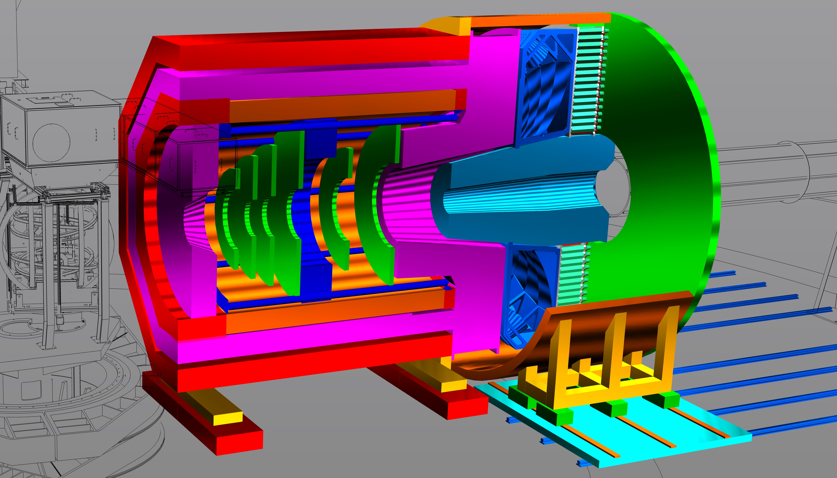
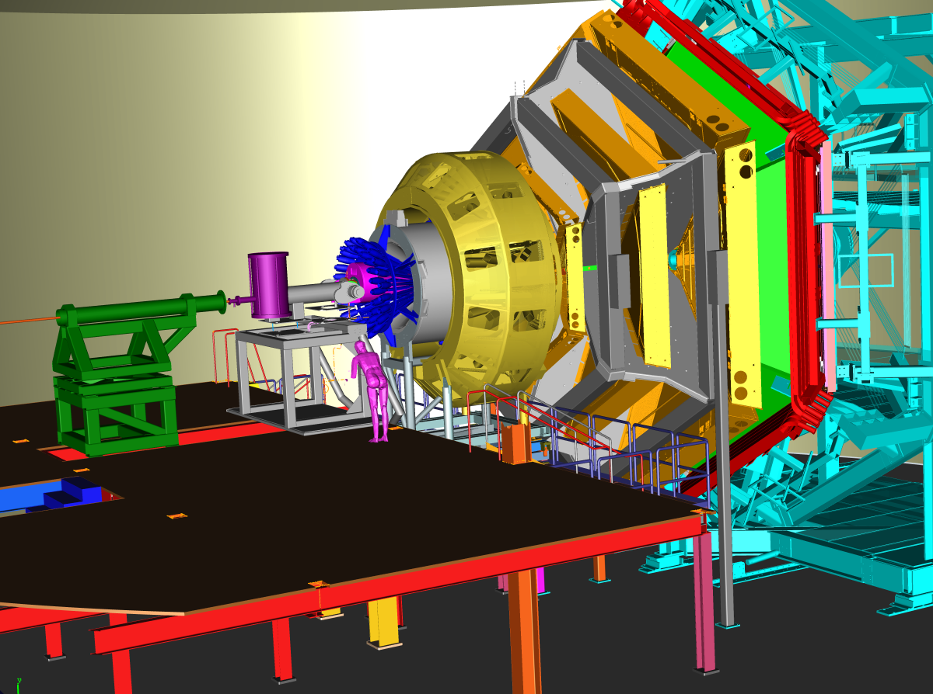
SIDIS with Large Acceptance
SoLID
CLAS12
SIDIS has several observables that depend on measuring the azimuthal dependance
Also need large P_{T} acceptance, multidimensional binning crucial
Well suited to large acceptance devices like CLAS12 and SoLID

Slide 4
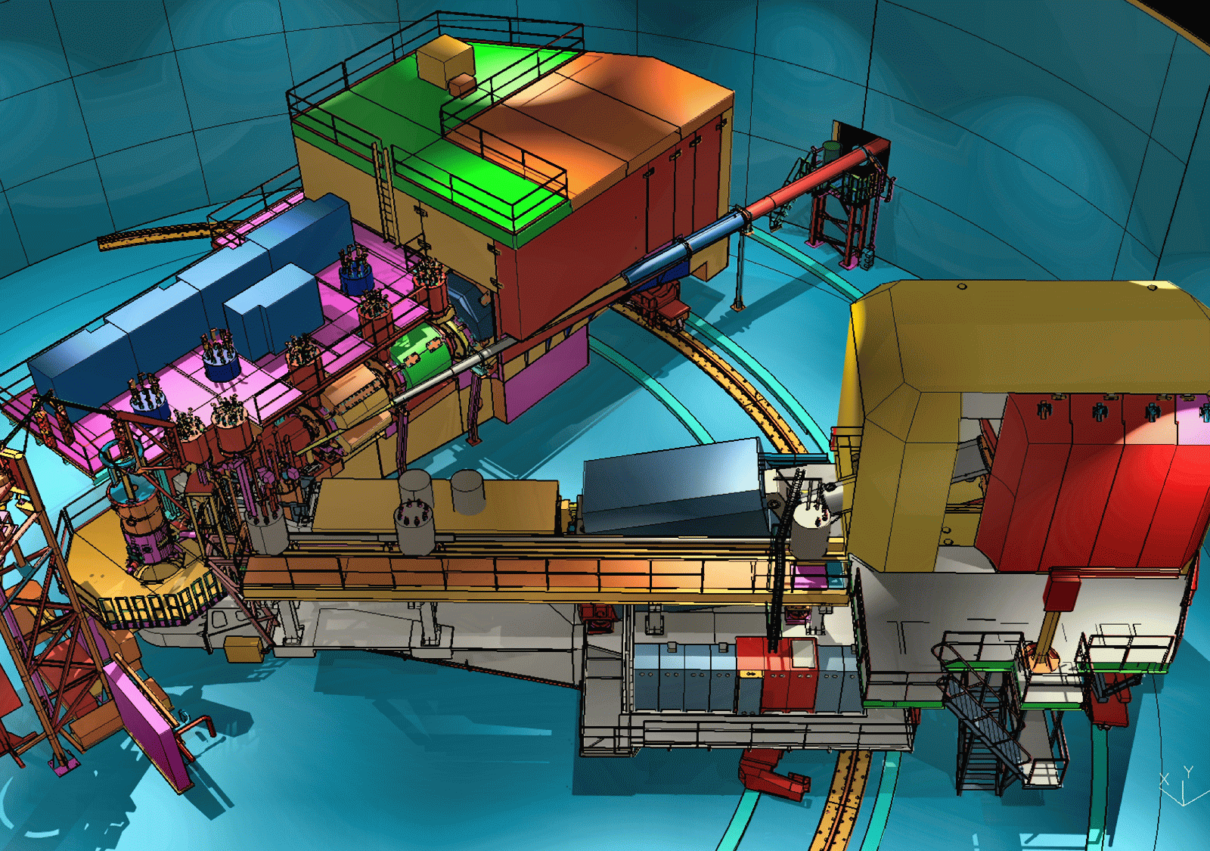
Role of Hall C in JLab SIDIS Program
Hall C uses magnetic focusing spectrometers with moderate acceptance
Optimal Hall C SIDIS program:
→ Targeted measurements in specific regions of phase space (i.e., low-rate processes)
→ Absolute cross sections, L-T separations, ratios
Complementary to large acceptance devices that can access large phase space all at once
SHMS
HMS
Excellent control of point-to-point systematic uncertainties required for precise L-T separations
Ideally suited for focusing spectrometers
One of the drivers for SHMS design
Identical acceptance for positive and negative polarity
→ Precision measurement of charged meson ratios

Slide 5
Hall C SIDIS Experiments
E00-108: “Duality in Meson Electroproduction”
→ 6 GeV, first Hall C SIDIS measurement
E12-09-017: “Transverse Momentum Dependence of Semi-Inclusive Pion Production”
Scans in z and P_{T}, x-dependence at fixed Q²
E12-09-002: “Charge Symmetry Violating Quark Distributions via Precise Measurement of π+/π− Ratios in SIDIS”
→ Scans in z at each x/Q² (parallel kinematics)
→ Deuterium at every setting, hydrogen at select settings
11 GeV phase space
6 GeV phase space
E00-108 (6 GeV)
E12-09-017
Hall C SIDIS experiments will provide information on the fundamental reaction mechanism/cross section
Consistency with simple factorization assumptions?
Charge symmetry of FF?
E12-09-002

Slide 6
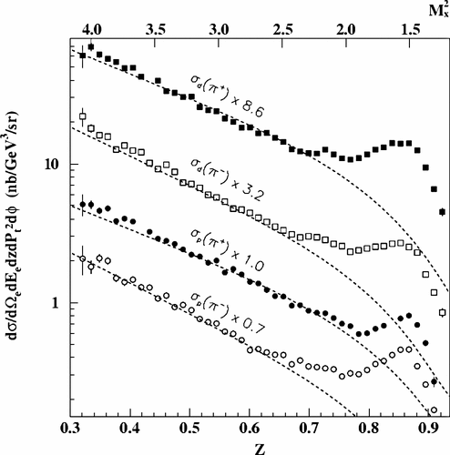
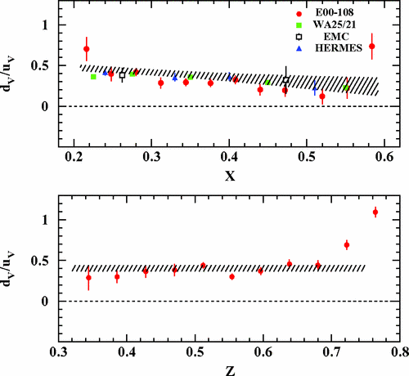
Hall C SIDIS Results from 6 GeV
E00-008: SIDIS π+/π- cross sections and ratios
Surprisingly consistent with expectations from higher energy experiments
T. Navasardyan et al. PRL 98, 022001
R. Asaturyan et al. Phys. Rev. C 85, 015202

Slide 7
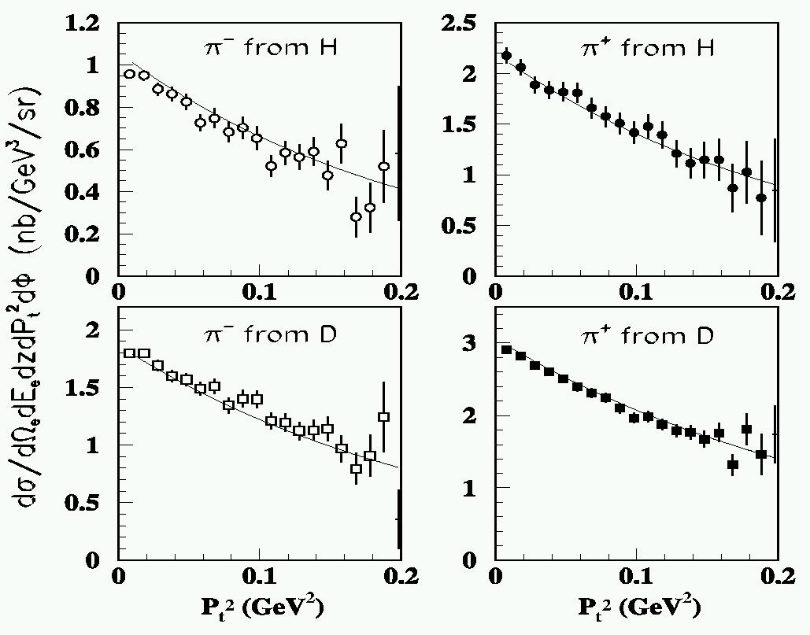
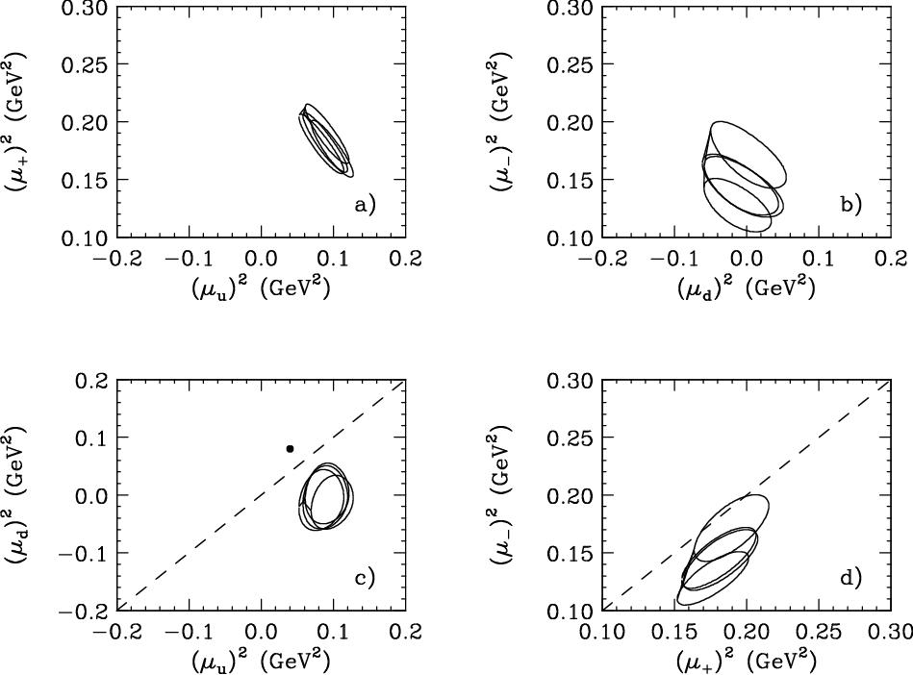
Hall C SIDIS Results from 6 GeV
PL B665 (2008) 20
Hall C experiment E00-108 (6 GeV):
→ Measured P_{T} dependent cross sections in semi-inclusive pion production
Measured both π+ and π-
Proton and deuteron (neutron) targets
Combination allows (in principle) disentanglement of quark and fragmentation widths
Example
Simple model, with several assumptions:
factorization valid
fragmentation functions do not depend on quark flavor
transverse momentum widths of quark and fragmentation functions are Gaussian and can be added in quadrature
more …
<p_{t}²> (favored)
Example
<k_{t}²> (up)

Slide 8
SIDIS Cross sections and Fragmentation Functions
Naïve quark model:
P_{T}-integrated fragmentation function
P_{T}=0.6 GeV
Assuming charge and isospin symmetry:
P_{T}=0.4 GeV
For finite P_{T} acceptance, cannot ignore P_{T} dependence of fragmentation functions
P_{T}=0.2 GeV (not visible)
Cross section also includes contributions from longitudinal photons, φ dependent terms
x=0.3 Q²=3 GeV²

Slide 9
Tests of Naïve Factorization
R1 (sum ratio)
Note: integration over (finite) P_{T} acceptance
R2 (difference ratio)
PRELIMINARY
Assumes no difference in P_{T} distribution for π⁺ or π⁻, and same for p and d targets
E12-09-017 and E12-09-002 combined analysis

Slide 10
Tests of Naïve Factorization
Closed symbols: no ρ subtraction
Open symbols: with ρ subtraction
R1 (sum ratio)
R2 (difference ratio)
Models with isospin symmetry
FF from MAPS
PRELIMINARY
FF from DSS
Ratios agree with naïve expectation at larger W
x and W anti-correlated, which is right degree of freedom?
JLab 6 GeV results at x=0.31 at lower W=2.4 GeV agree well with larger W results
MAPS = A. Bacchetta et al, J.400 of High Eng. Phys. 10, 127 (2022), DSS= D. deFlorian, et al, PRD75, 114010 (2007), PRD 91, 014035395 (2015)

Slide 11
CSV/ISV in Fragmentation Functions
Relax assumption of charge/isospin symmetry:
Favored
Un-favored
Can use π⁺/π⁻ multiplicities from p/d to determine 4 remaining fragmentation functions

Slide 12
Multiplicities and FF
Multiplicities
Extracted (effective) fragmentation functions
PRELIMINARY
φ-averaged multiplicities evaluated at P_{T}=0.1 GeV
Empirical fit
JAM
DSS
JAM = Moffat et al PRD 104, 016015 (2021)

Slide 13
Favored and Unfavored FF Asymmetries
W=2.2→3.2
x=0.59←0.3
Explore CSV in FF via favored and unfavored FF asymmetries:
PRELIMINARY
DSS fits
Global fit from Peng and Ma
Results most consistent with CS/IS expectation at highest W (lowest x)
Hem Bhatt thesis, draft paper in circulation

Slide 14
φ and P_{T} dependence of Multiplicities
Previous analysis averaged over φ, bin-centered to single value of P_{T}
φ and P_{T} dependence of FF functions also of interest
→ cos(φ) dependence related to Cahn effect → twist-3
→ P_{T} dependence can be related to intrinsic quark k_{T}
PRELIMINARY
φ and P_{T} dependence can be extracted by fit to multiplicities of the form:
Assumes Gaussian P_{T} dependence
Figure courtesy Peter Bosted
x=0.3, Q²=3 GeV²

Slide 15
φ and P_{T} dependence of Multiplicities
Results of 4-parameter for P_{T}<0.25 GeV
Solid curves for z²M₀ and μ² from MAPS global fit
Curve for A parameter from Cahn prediction, assuming <k_{T}>=0.3 GeV
P_{T} dependence very similar for all 4 cases
Relevant for CSV/ISV tests in previous results
cos(φ) dependence very different from Cahn effect expectation
This term involves L-T interference – perhaps suggest larger than expected longitudinal contribution?
cos(2φ) term appears non-zero and positive for p/d π⁻
PRELIMINARY
μ²=1/b
Larger x and Q² provides improved constraints for global fits
Figure courtesy Peter Bosted

Slide 16
Extended P_{T} Dependence
155 < φ <205 degrees
HMS+SHMS does not have complete φ coverage at large P_{T}
Can look at P_{T} dependence for a “slice” in φ
Z=0.35
PRELIMINARY
Z=0.45
4 parameter fit for P_{T}<0.25 GeV
Z=0.55
Z=0.65
3 parameter fit for all P_{T}
4 parameter fit for all P_{T}
Paper draft in progress
Figure courtesy Peter Bosted

Slide 17
Charge Symmetry Violation in Quark PDFs
Ratio of π⁺/π⁻ cross sections from isoscalar target sensitive to CSV quark distributions
B(x,z) from PDFs
Δ(z)=D⁻(z)/D⁺(z)
δd=d^{p}-u^{n} and δu=u^{p}-d^{n}
where
Assumes factorization in SIDIS process, no (or small) ISV/CSV in fragmentation
E12-09-002 measured SIDIS charged pion ratios from deuterium for Q²=4, 4.5, 5 GeV²
→ Range of x at each Q², range of z for each (x, Q²)

Slide 18
Charge Symmetry Violation in Quark PDFs
R^{d}_{meas} vs. z
PRELIMINARY
Q²=4 GeV²
Q²=4.5 GeV²
Q²=5 GeV²
Δ(z) from fit to Hall C data
→ Impact from global FF fits was also explored
Quark CSV results from E12-09-002
CSV term extracted from fit of the form:
Shuo Jia thesis, paper draft in progress

Slide 19
Hall C (near) Future: Measurement of R_{SIDIS}
E12-06-104: Measurement of the Ratio R=σ_{L}/σ_{T} in Semi-Inclusive Deep-Inelastic Scattering
Almost no existing data on R=σ_{L}/σ_{T} in SIDIS (p and n)
Limited data from Cornell
[Bebek et al, PRL 34, 759 (1975), PRL 37, 1525 (1976), PRD 15, 3085 (1977)]
R = σ_{L}/σ_{T} in SIDIS (ep → e’π^{+/-}X)
E12-06-104 is will make precise measurements of R_{SIDIS} in
e+p → e’+π^{+/-}+X , e+D → e’+π^{+/-}+X
L-T separation requires excellent understanding of acceptance, control of point-to-point systematic errors
→ Ideally suited to Hall C equipment at 12 GeV
Scans in z at Q² = 2.0 (x = 0.2) and 4.0 GeV² (x = 0.4) → behavior of σ_{L}/σ_{T} for large z.
Cover Q² = 1.5 – 5.0 GeV², → both H and D at Q² = 2 GeV²
p_{T} up to ~ 1 GeV.
Expected to run in 2025

Slide 20
Nuclear Dependence of R in SIDIS
SLAC E140: Nuclear Dependence of R in DIS
PR12-24-001: Nuclear Dependence of R in SIDIS
(projected precision)
Goal: Directly measure the nuclear dependence of R=σ_{L}/σ_{T} in semi-inclusive DIS
No existing measurements of nuclear dependence of R in SIDIS
Potential impact on SIDIS results (dilution factor for polarized targets)
Potential impact on measurements of hadron-attenuation
Exploratory measurement to determine if more comprehensive program merited
Experiment: Measure cross sections and ratios for H, D, C, Cu targets at 3 beam energies
→ Allows LT separation
E12-06-104 (R in SIDIS on H and D) in Hall C experiment scheduled for CY2025.
E12-24-001 with E12-06-104 at select kinematics adding nuclear targets (¹²C and ⁶⁴Cu).
Will measure R_{A}-R_{H} for
2-3 values of x (x=0.2 to 0.5)
Range of z for x=0.2
Range of P_{T} at one value of x

Slide 21
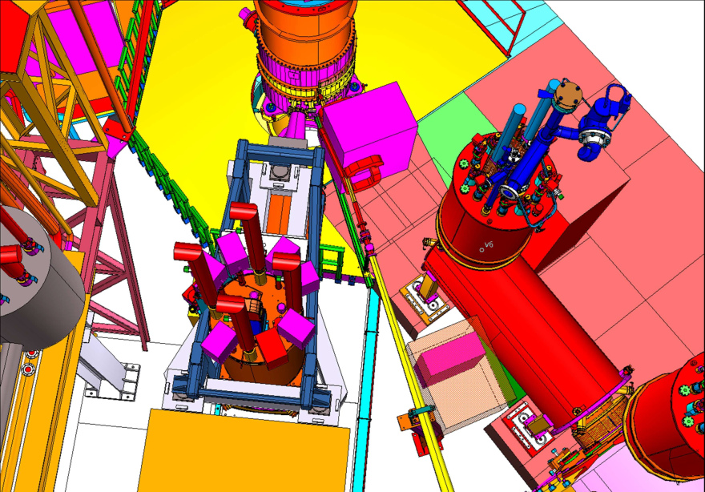
π⁰ SIDIS with Neutral Particle Spectrometer (NPS)
π⁰ avoids complications from vector meson decay, smaller radiative tails from exclusive pion production
→ NPS provides complete φ coverage for larger region of P_{T}
Calorimeter + sweeper magnet adds capability to detect neutral particles: γ and π⁰
First NPS run just completed → large amount of SIDIS π⁰ (and exclusive π⁰ and DVCS) data to analyze

Slide 22
Hall C SIDIS Experiments - Updated
11 GeV phase space
E00-108: Meson Duality
E12-09-017: PT-SIDIS
E12-09-002: CSV-SIDIS
E12-06-104/E12-24-001: R-SIDIS, Nuclear R-SIDIS
E12-13-007/E12-23-014: π⁰ SIDIS, π⁰ R-SIDIS
+
6 GeV phase space

Slide 23
Summary
Hall C plays an important (complementary) role in JLab SIDIS program
  Strengths include precision cross sections, ratios (target and charge), LT separations
Analysis from E12-09-017 (PT-SIDIS) and E12-09-002 (CSV-SIDIS) nearing completion
  First draft paper from combination of both experiments circulating
  2 more drafts in progress
R-SIDIS experiment planned to run in calendar 2025
  Measurements with nuclear targets will be included
NPS has added capability for π⁰ SIDIS measurements

Slide 24
EXTRA

Slide 25
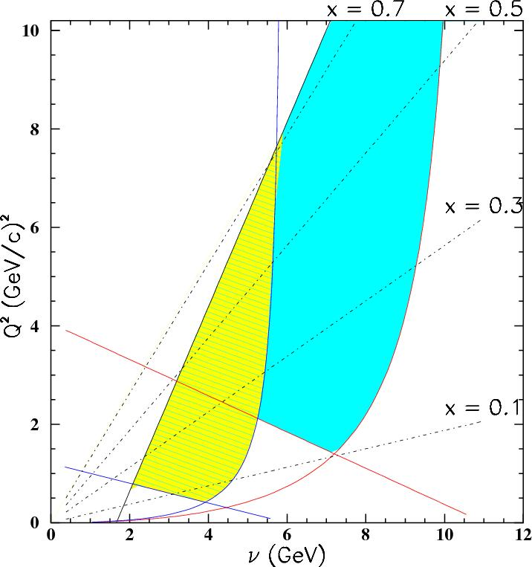
12 GeV Hall C SIDIS Program – HMS+SHMS+NPS
Accurate cross sections for validation of SIDIS factorization framework and for L/T separations
E12-13-007
Neutral pions:
Scan in (x,z,P_{T})
Overlap with
E12-09-017 &
E12-09-002
6 GeV phase space
Charged pions:
E12-06-104
L/T scan in (z,P_{T})
No scan in Q² at fixed x: R_{DIS}(Q²) known
Parasitic with E12-13-010
E12-09-017
Scan in (x,z,P_{T})
E00-108 (6 GeV)
+ scan in Q²
at fixed x
E12-09-002
+ scans in z
Courtesy R. Ent

Slide 26
SHMS and HMS in Experimental Hall C
Spectrometer properties
HMS: Electron arm
Nominal capabilities:
dΩ ~ 6 msr, P₀= 0.5 – 7 GeV/c
θ₀=10.5 to 80 degrees
e ID via calorimeter and gas Cherenkov
SHMS: Pion arm
Nominal capabilities:
dΩ ~ 4 msr, P₀= 1 – 11 GeV/c
θ₀=5.5 to 40 degrees
π:K:p separation via heavy gas Cherenkov and aerogel detectors
SHMS
HMS

Slide 28
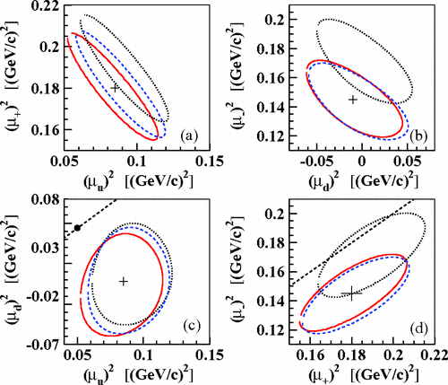
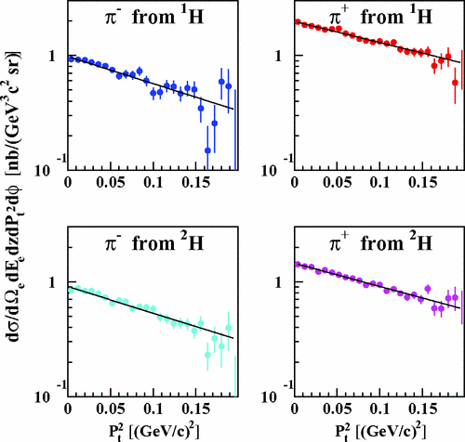
Hall C SIDIS Results from 6 GeV
Used P_{T} dependence of unpolarized cross sections to place constraints on up/down quark, favored/unfavored FF widths
R. Asaturyan et al. Phys. Rev. C 85, 015202
quark avg. k_{T}
Frag. Function widths

Slide 29
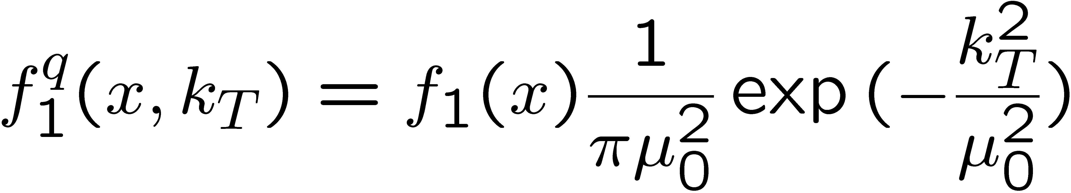
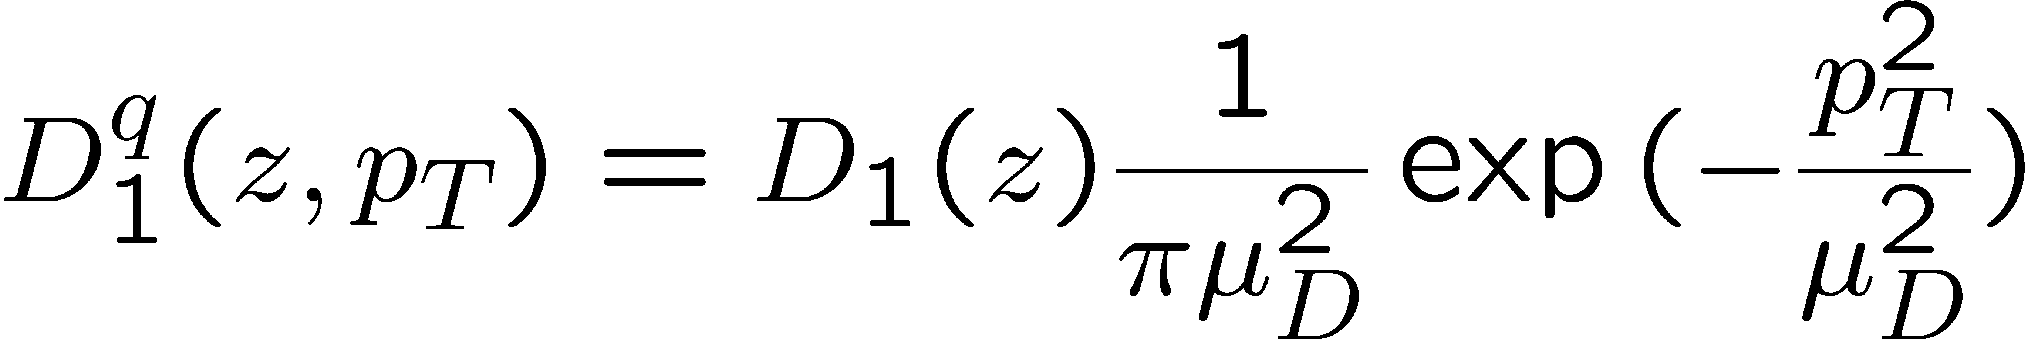
Transverse Momentum Dependence of SIDIS
Unpolarized k_{T}-dependent SIDIS: in framework of Anselmino et al [hep-ph/0608048], described in terms of convolution of quark distributions f and (one or more) fragmentation functions D, each with own characteristic (Gaussian) width
μ₀ describes transverse momentum of quarks
μ_{D} describes p_{T} dependence of Frag. Func.
(assuming μ_{0,u} = μ_{0,d})
Possibility to constrain k_{T} dependence of up and down quarks separately by combination of π⁺ and π⁻ final states, proton and deuteron targets

Slide 30
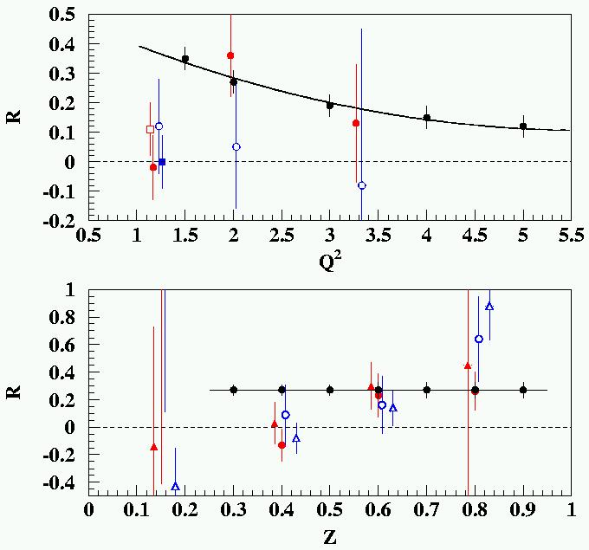
R = σ_{L}/σ_{T} in SIDIS (ep → e’πX)
R_{DIS}
Conclusion: “data both consistent with R = 0 and R =“ R_{DIS}”
Cornell data of 70’s
R_{DIS} (Q² = 2 GeV²)
Some hint of large R at large z in Cornell data?

