Slide 1


eRHIC
A QCD Microscope to study the glue that binds us all
E.C. Aschenauer
arXiv: 1212.1701
arXiv:1409.1633

Slide 2


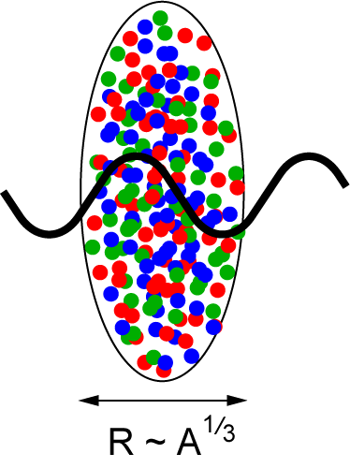

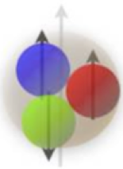
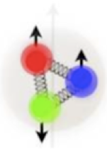
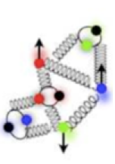
What do we know
What we DON’T know
HERA’s discovery:
Gluon density dominates at x<0.1
nucleons and nuclei for x < 0.1 multi body system
which correlations constitute the dynamics of
the system
How does quark and gluon dynamics generate the proton spin?
It is more than the number 1/2 !
It is the interplay between the intrinsic
properties and interactions of quarks and gluons
How do hadrons emerge from a created quark
or gluon?
Neutralization of color - hadronization
2+1D Structure of nucleons and nuclei
How does the glue bind quarks and itself into
nucleons and nuclei?
Rapid rise in gluons described naturally by
linear pQCD evolution equations
This rise cannot continue forever –
→ non-linear pQCD evolution equations
provide a natural way to tame this growth
and lead to a saturation of gluons,
characterized by the saturation scale Q²_{s}(x)
QCD: Dynamical balance between radiation and
recombination
A new regime of QCD matter
→ Color Glass Condensate (CGC)
Hints from HERA, RHIC and LHC
Color Confinement
Asymptotic freedom
Q² GeV²
Probing
momentum
200 MeV (1 fm)
2 GeV (1/10) fm)
eA: Probe interacts
coherently with all nucleons
Au: ~200 times smaller effective x !
Notes:
Counter-intuitively the best way is through an EM process: DIS
y = inelasticity = fraction of the incoming electron energy carried by photon in the rest frame of the nucleon
The structure function F2 is sensitive to the sum of quark and anti-quark momentum distribution in the nucleon.
The apparent scaling of the data with Q2 at large x in early DIS data from SLAC was termed “Bjorken scaling” and motivated the parton model.
In the parton model, FL = 0, while in QCD, it is directly proportional to the gluon structure function, FL(x,Q2) ~ aS xG(x,Q2), at low x.
DGLAP: fixed x -> evolution along Q2
sigma (gamma N) = sig_T + sig_L
sig_L ~ FL
sig_tot ~ F2/Q^2
\frac{d^2 \sigma^{ep \rightarrow eX}}{dx dQ^2} = \frac{4 \pi \alpha^2_{e.m.}}{xQ^4} \left[ \left(1-y+\frac{y^2}{2} \right ) F_2(x,Q^2) - \frac{y^2}{2} F_L(x,Q^2) \right]

Slide 3
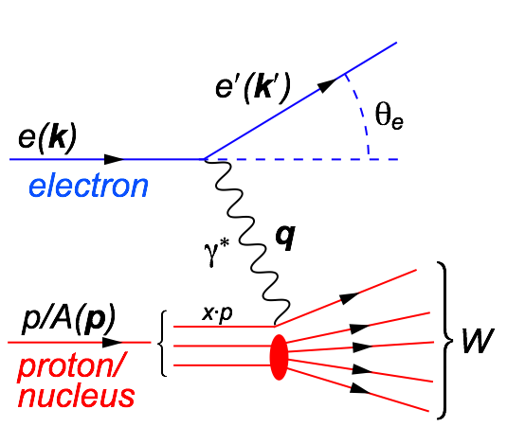
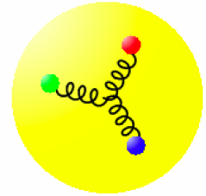
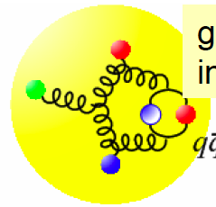
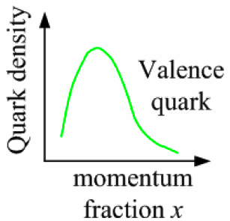
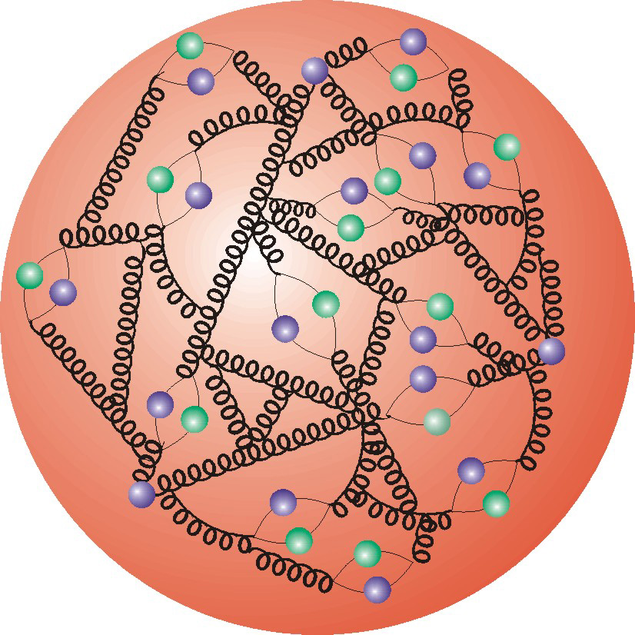
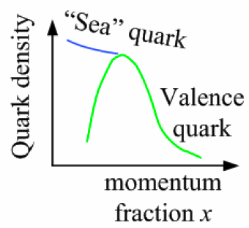
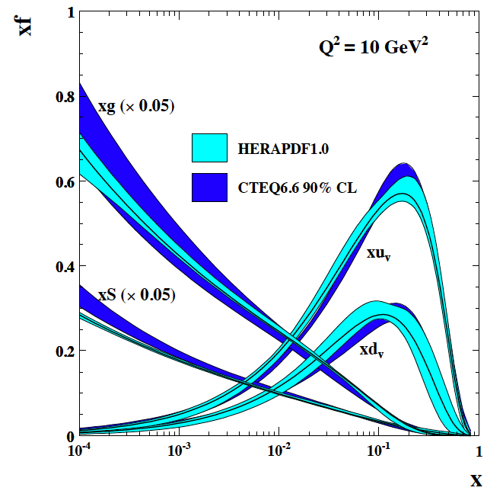
Deep Inelastic Scattering
Kinematics:
Measure of resolution power
Measure of inelasticity
Measure of momentum fraction of struck quark
center-of-mass energy of electron-hadron system
Gluon splits
into quarks
Quark splits
into gluon
splits
into quarks …
DIS:
As a probe, electron beams
provide unmatched precision of
the electromagnetic interaction
Direct, model independent,
determination of kinematics of
physics processes
10⁻¹⁶m
10⁻¹⁹m
higher √s
increases resolution

Slide 4
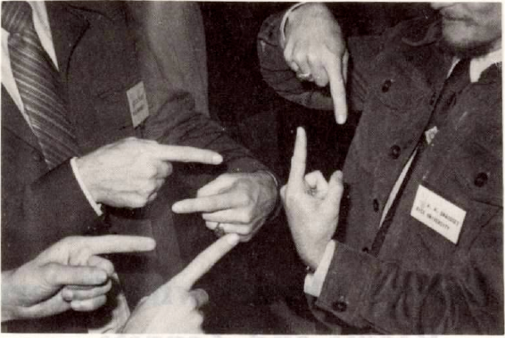
What can polarized beams tell us

Slide 5
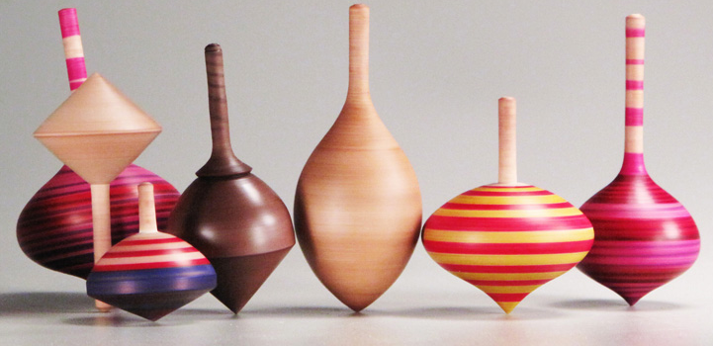
SPIN: Fundamental quantum Number
Remember:
x-distribution of PDF provides insight to intrinsic properties
vs. dynamic QCD effects
To separate interaction dependent phenomena from intrinsic properties
UNIVERSALITY
different complementary probes are needed
SPIN is one of the fundamental properties of matter
all elementary particles, but the Higgs carry spin
Studying Spin revealed many surprises in physics
→ proton anomalous magnetic moment → substructure
cannot be explained by a static picture
of the proton
Proton Spin:
It is more than the number ½ ! It is the interplay between
the intrinsic properties and interactions of quarks and gluons
If we do not understand the proton spin in QCD,
we do not fully understand QCD !
need a polarized collider to have full access
to the proton dynamics

Slide 6

What composes the Spin of the Proton
L_{g}
Σ_{q}Δq
Σ_{q}L_{q}
??
ΔG
The Holy Grail
The Spin Sum Rule
total
quark
spin
“Helicity sum rule”
gluon
spin
angular
momentum
Can quarks and gluons explain all the spin?
→ what is the role of gluons?
→ what is the role of sea quarks?
How much orbital angular momentum is needed?

Slide 7
present vs eRHIC kinematic coverage
RHIC pp data
constraining Δg(x)
in approx. 0.05 < x <0.2
data plotted at x_{T}=2p_{T}/√S
likewise for Q²
eRHIC extends x coverage
by up to 2 decades
(at Q²=1 GeV²)
lowest x so far 4.6 x10⁻³ COMPASS

Slide 8
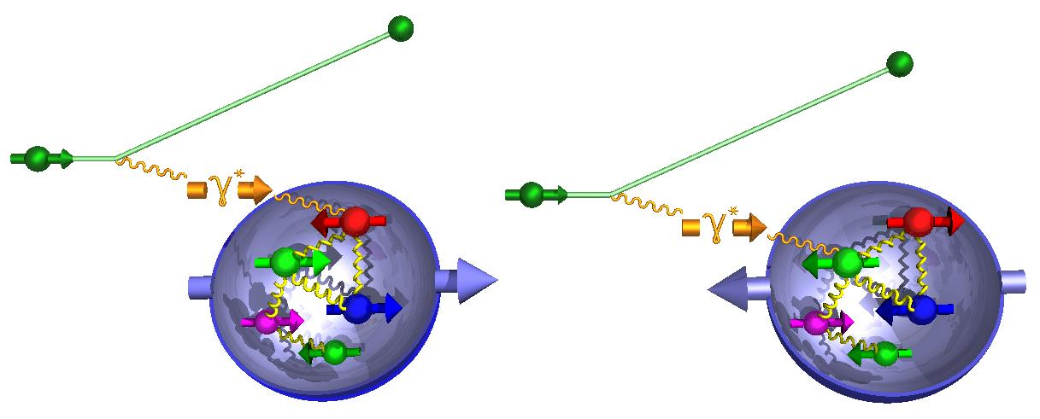
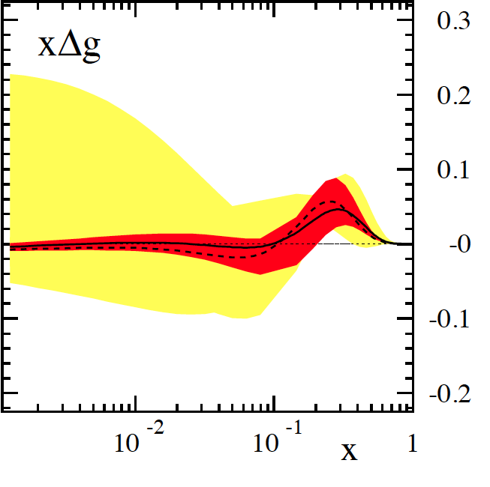
g₁^{p}: the way to find the Spin
Measure cross section for lepton spin and and proton spin aligned vs. anti-aligned
g₁ = difference of cross sections
hep-ph:1206.6014 (M.Stratmann, R. Sassot, ECA)
-
cross section:
dramatic reduction
of uncertainties:
pQCD scaling violations
world data
till eRHIC
now
eRHIC
unseen precision and x-Q² coverage

Slide 9

eRHIC: Spin puzzle solved
15 x 100 GeV (10 fb⁻¹ xmin = 2.04 10⁻⁴)
eRHIC
15 x 100 + 15 x 250 GeV (10 fb⁻¹ xmin = 8.15 10⁻⁵)
15 x 100 + 15 x 250 + 20 x 250 GeV (10 fb⁻¹ xmin = 5.14 10⁻⁵)
After eRHIC:
spin puzzle will be solved
1/2 -
Gluon
-
Quarks
=
orbital angular
momentum
Current knowledge: uses strong theoretical constraints
eRHIC projections do not ⇒ test of assumptions

Slide 10
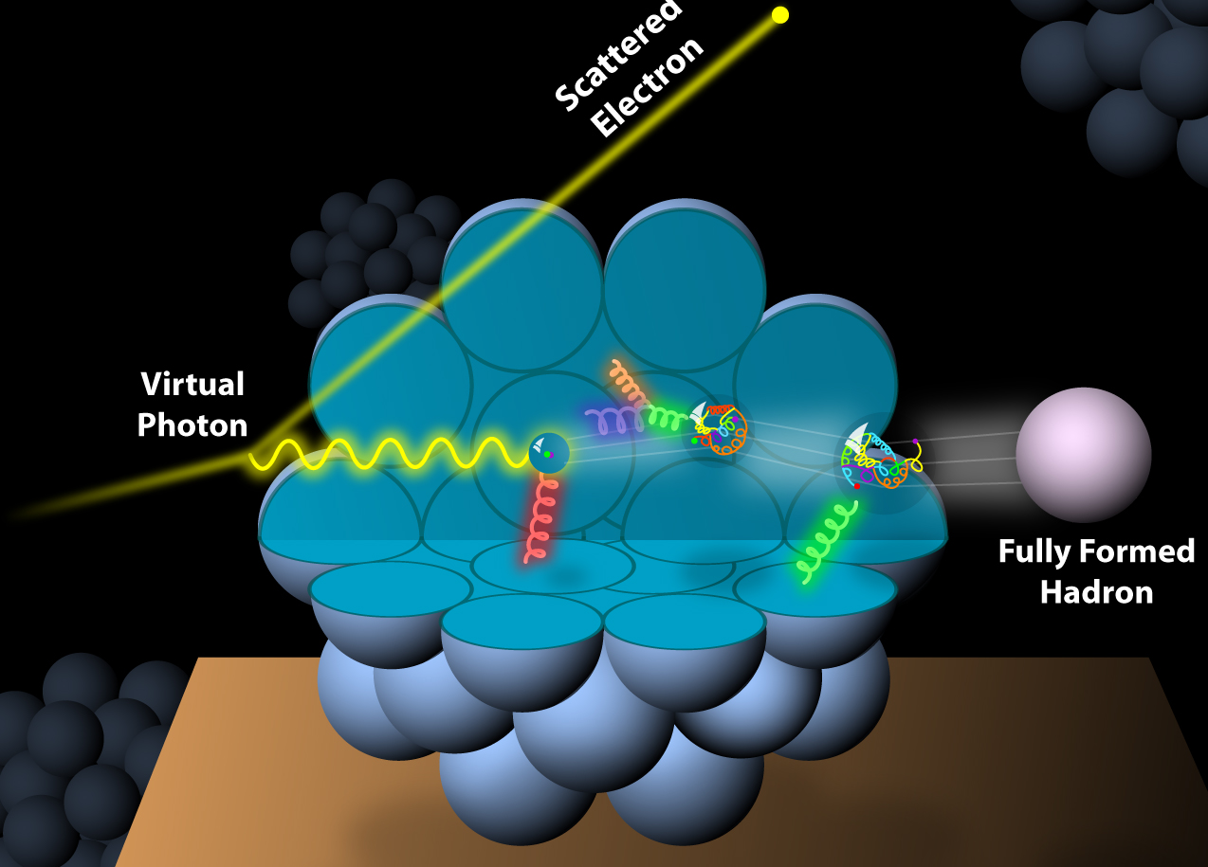
And What about nuclei
Incoming
Electron Beam

Slide 11
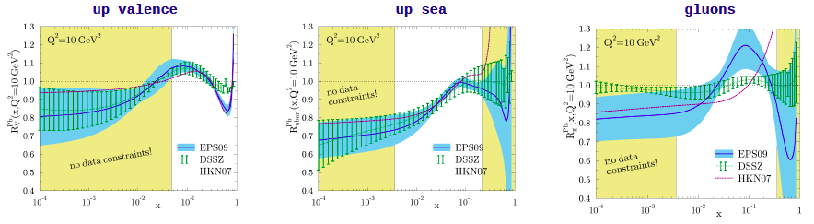
What Do We Know About xG in Nuclei?
99% of all h± have p_{t} < 2 GeV/c
“Bulk Matter” → x < 0.01
Other than in p:
g(x,Q²) for nuclei little is known
R_{g}^{A}=g(x,Q²)_{A} / g(x,Q²)_{p}
Current situation:
H. Paukkunen, DIS-2014

Slide 12
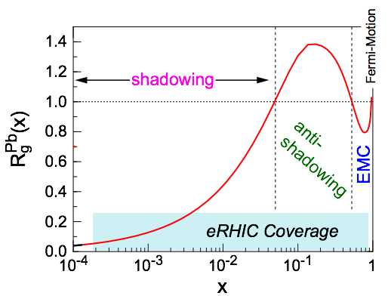
eRHIC: Nuclear Structure Functions
Inclusive DIS on eA:
quark+anti-quark
momentum distributions
gluon momentum distribution
F2 and FL are benchmark measurements:
Theory/models have to be able to describe the structure
functions and their evolution.
Leading twist pQCD models parameterize the observed suppression of the structure function with decreasing x using nuclear parton distribution functions (nPDFs)
Aim at extending our knowledge on structure functions into the realm where gluon saturation effects emerge
Notes:
\frac{d^2 \sigma^{eA\rightarrow eX}}{dx dQ^2} = \frac{4 \pi \alpha^2}{x Q^4} \left[ \left(1-y+\frac{y^2}{2}\right) {\color{blue}F_2(x, Q^2)} - \frac{y^2}{2} {\color{red}F_L(x, Q^2)}\right]

Slide 13
Measuring FL with the EIC
quark+anti-quark
momentum distributions
gluon momentum distribution
Remember DGLAP predicts only evolution in Q²
the distribution in x and the A dependence need to be fitted
Saturation models predict evolution in x and the A dependence
Notes:
\begin{eqnarray*}\sigma_r = \left( \frac{d^2 \sigma}{dx dQ^2}\right)\ \frac{x Q^4}{2 \pi \alpha^2 [1 + (1-y)^2]}
&=& F_2(x, Q^2) - \frac{y^2}{\color{red}{1+(1-y)^2}} F_L(x, Q^2) \\
{} &=& F_2(x, Q^2) - \frac{y^2}{{\color{red}Y^+}} \ F_L(x, Q^2) \\\end{eqnarray*}

Slide 14
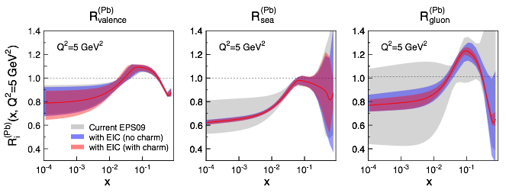
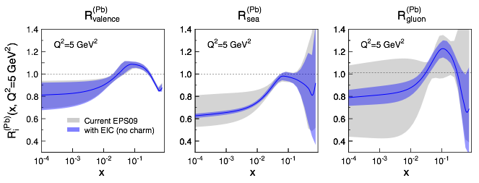
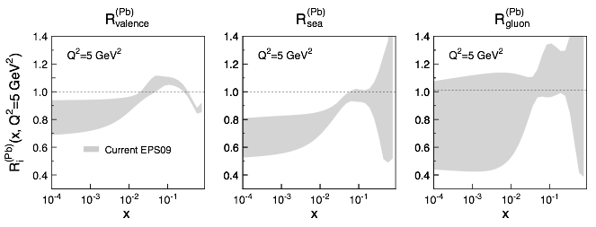
eRHIC: Impact on Knowledge on nPDFs
Ratio of PDF(Pb)/PDF(p)
  Without EIC, large uncertainties for sea quarks and gluons
  Adding in EIC, pseudo-data significantly reduces the uncertainties, particularly at small-x
  Fitting the charm pseudo-data has a dramatic effect at high-x
  Something pA at RHIC & LHC will not be able to address

Slide 15
Gluon splitting and recombination
Gluon density dominates at x<0.1
Rapid rise in gluons described naturally by linear pQCD evolution equations
This rise cannot increase forever - limits on the cross-section
  → non-linear pQCD evolution equations provide a natural way to tame this growth and lead to a saturation of gluons, characterized by the saturation scale Q²_{s}(x)
Notes:
Counter-intuitively the best way is through an EM process: DIS
y = inelasticity = fraction of the incoming electron energy carried by photon in the rest frame of the nucleon
The structure function F2 is sensitive to the sum of quark and anti-quark momentum distribution in the nucleon.
The apparent scaling of the data with Q2 at large x in early DIS data from SLAC was termed “Bjorken scaling” and motivated the parton model.
In the parton model, FL = 0, while in QCD, it is directly proportional to the gluon structure function, FL(x,Q2) ~ aS xG(x,Q2), at low x.
DGLAP: fixed x -> evolution along Q2
sigma (gamma N) = sig_T + sig_L
sig_L ~ FL
sig_tot ~ F2/Q^2
\frac{d^2 \sigma^{ep \rightarrow eX}}{dx dQ^2} = \frac{4 \pi \alpha^2_{e.m.}}{xQ^4} \left[ \left(1-y+\frac{y^2}{2} \right ) F_2(x,Q^2) - \frac{y^2}{2} F_L(x,Q^2) \right]

Slide 16
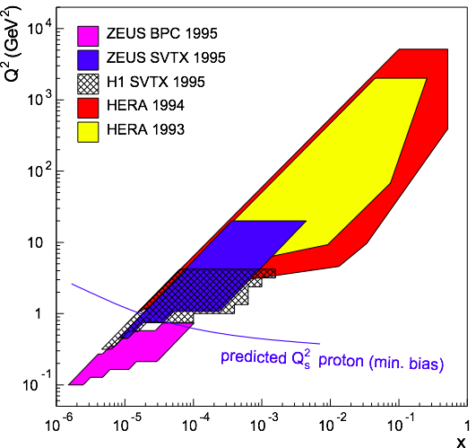
eRHIC: Reaching the Saturation Region
eRHIC (eA):
HERA (ep):
Despite high energy range:
F2, Gp(x, Q²) outside the saturation regime
Need also Q² lever arm!
Only way in ep is to increase √s
Would require an ep collider at
√s ~ 1-2 TeV → LHeC
L ~ (2m_{N} x)⁻¹ > 2 R_{A} ~ A^{1/3}
Probe interacts
coherently with all nucleons
Gold: 197 times smaller effective x !

Slide 17
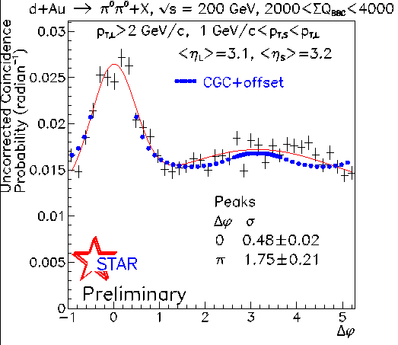
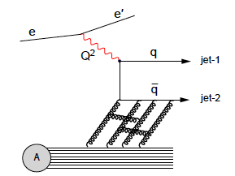
Di-hadron Correlations in ep and eA
“Simple” measurement giving access to multi-parton correlations
→ saturation
Same observable as in dA @ RHIC
p_{T}^{trig}
p_{T}^{assoc}
π
Zheng et al., PRD89 (2014) 074037
beam-view
Advantage of eA over p(d)A:
eA experimentally much cleaner
    no “spectator” background to subtract
    Access to the exact kinematics of the
    DIS process (x,Q²)
    only process sensitive to WW gluon
    distribution G¹(x,k_{T},Q²)
Fully based on:
Dominguez et al. PRD83, 105005 (2011),
PRL 106, 022301 (2011)

Slide 18

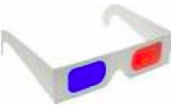
Quantum tomography of the nucleons & Nuclei
Join the real
3D experience !!
TMDs
GPDs
2D+1 picture in momentum space 2D+1 picture in coordinate space
Spin as vehicle to do tomography of the nucleon
What is the dynamic structure of the proton and nuclei
2D+1 picture in momentum and coordinate space
Visualize color interactions in QCD
collective phenomena and correlations in fragmentation
New physics aspects due to confined motion

Slide 19
Transverse momentum dependent distributions (TMD)

Slide 20
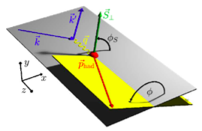




transverse momentum dependent PDFs & FFs
observable: azimuthal modulations
of 6-fold differential SIDIS cross section
theoretically interesting multi-scale problem: Q², p_{T}
TMD framework/factorization applicable for Q² >> p_{T}
so far if at all only valence quark TMDs
extracted from fixed target data
very different evolution then collinear PDFs
pertubative & non-pertubative contributions
slew of different TMDs can be defined
example: Sivers function
correlation of nucleon’s transverse spin
with the kT of an unpolarized quark
modulation
unpolarised TMD
Sivers function
important link to physics of
gluon saturation at small x
measures spin-orbit correlations
link to parton orbital motion (through models)
reveals non-trivial aspects of QCD color gauge
invariance
Similar for gluons

Slide 21
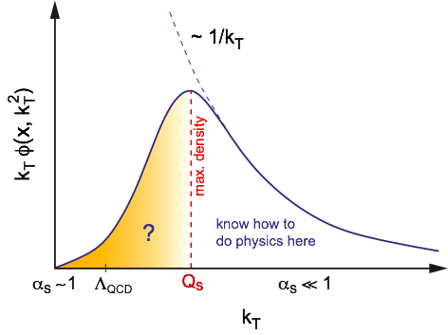
More insights to the proton: TMDs
eRHIC vs. world coverage
eRHIC:
large x,Q²,p_{T} and z coverage
only place to measure data
to pin down TMD evolution
only place to
test theoretical concepts of
TMD to collinear TWIST-3
three-parton correlation functions
TMD
Q>>Q_{T}>=Λ_{QCD}
Q>>p_{T}
Collinear
Twist-3
Q,Q_{T}>>Λ_{QCD}
p_{T}~Q
Λ_{QCD}
<<
Q_{T}/P_{T}
Q
Q_{T}/P_{T}
<<
shows emerges of a scale Qs
where gluon density saturates
unintegrated gluon density g(x,Q2,k_{T}) important
for physics at small x
→ CGC
→ many applications at LHC
Important: eRHIC ideal machine to understand
transition form low to high k_{T}
What are the best observables ?

Slide 22
TMDs @ EIC
Sivers fct. before and after
Sivers asymmetry for π+:
√s=140 GeV / 45 GeV / 15 GeV
can be viewed as parton flow
inside nucleus
Other quarks look similar
What about the gluon ?

Slide 23
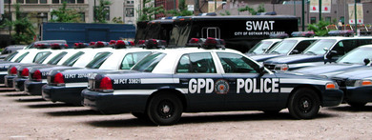
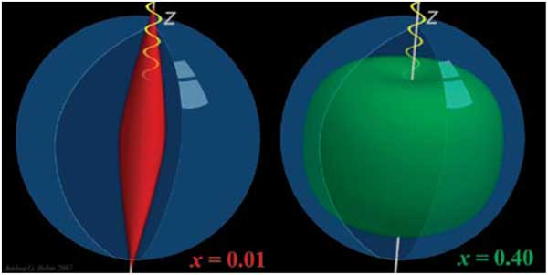
Generalized Parton Distributions (GPDs)
or

Slide 24



Beyond form factors and PDFs
Generalized Parton Distributions
X. Ji, D. Mueller, A. Radyushkin (1994-1997)
Proton form factors, transverse charge & current densities
Structure functions,
quark longitudinal
momentum & helicity
distributions
Correlated quark momentum
and helicity distributions in
transverse space - GPDs
the way to 3d imaging of the proton and the orbital angular momentum L_{q} & L_{g}
Constrained through exclusive reactions

Slide 25


DVCS at eRHIC
e’
γ
e
γ_{L}*
(Q²)
DVCS: Golden channel
theoretically clean
wide range of observables
(σ, A_{UT}, A_{LU}, A_{UL}, A_{C})
to disentangle different GPDs
x+ξ
x-ξ
~
~
p
H, H, E, E (x,ξ,t)
p’
t
D. Mueller, K. Kumericki
S. Fazio, and ECA
arXiv:1304.0077
DVCS data at end of HERA
Fourier
Transform
large t
small t

Slide 26
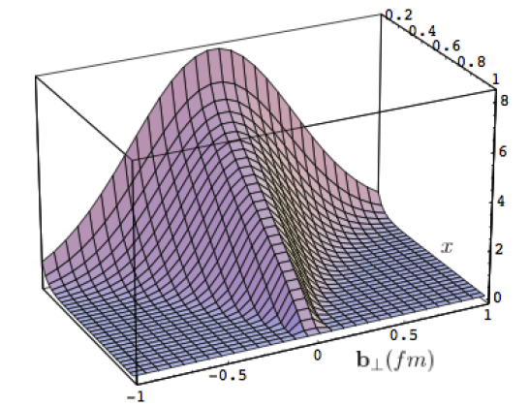
What can we learn
Model of a quark GPD
x
b_{T} (fm)
b_{T} decreasing as a function of x
eRHIC
Valence (high x) quarks at the center → small b_{T}
Sea (small x) quarks at the perifery → high b_{T}
GLUONS ???

Slide 27
GPD H^{g}: J/ψ
To improve imaging on gluons
add J/ψ observables
cross section
A_{UT}
…..
Fourier
Transform

Slide 28
eRHIC: Diffractive Events in eA
Diffractive physics will be a major component of the eA program at an EIC
High sensitivity to gluon density: σ~[g(x,Q²)]² due to color-neutral exchange
Only known process where spatial gluon distributions of nuclei can be extracted
2 Types: Coherent (A stays intact) & Incoherent (A breaks up)
Experimental challenging to identify
  Rapidity gap ⇒ hermetic detector
  Breakup needs to be detected ⇒ n and γ in Zero Degree Calorimeter, spectator tagging (Roman Pots), IR design!
Notes:
HERA: σdiff/σtot ~ 15%

Slide 29
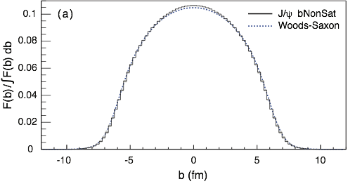
eRHIC: Spatial Gluon Distribution from dσ/dt
1950-60: Measurement of charge (proton) distribution in nuclei
Ongoing: Measurement of neutron distribution in nuclei
EIC ⇒ Gluon distribution in nuclei
Diffractive vector meson production:
e + Au → e′ + Au′ + J/ψ, φ, ρ
Method:
Fourier Transform
Diffractive vector meson production:
e + Au → e′ + Au′ + J/ψ, φ, ρ
Momentum transfer t = |pAu-pAu′|² conjugate to bT
PRC 87 (2013) 024913
Converges to input F(b) rapidly: |t| < 0.1 almost enough
Recover accurately any input distribution used in model used to generate pseudo-data (here Wood-Saxon)
  Systematic measurement requires ∫Ldt >> 1 fb⁻¹/A
  dσ/dt: diffractive pattern known from wave optics
  φ sensitive to saturation effects, smaller J/ψ shows no effect
  J/ψ perfectly suited to extract source distribution
Notes:
spin-dependent gluon distribution

Slide 30

Requirements to realize the Program
Requirements from Physics:
High Luminosity ~ 10³³ cm⁻²s⁻¹ and higher
Flexible center of mass energy → gluon dominated matter
highly polarised electron and proton/light nuclei beams → study spin
Wide range of nuclear beams (D to Au, Pb, U) → high gluon densities
a wide acceptance detector with good PID (e/h and π, K, p)
wide acceptance for protons from elastic reactions and
neutrons from nuclear breakup

Slide 31


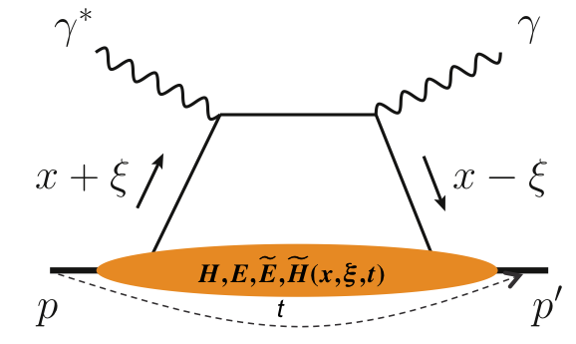
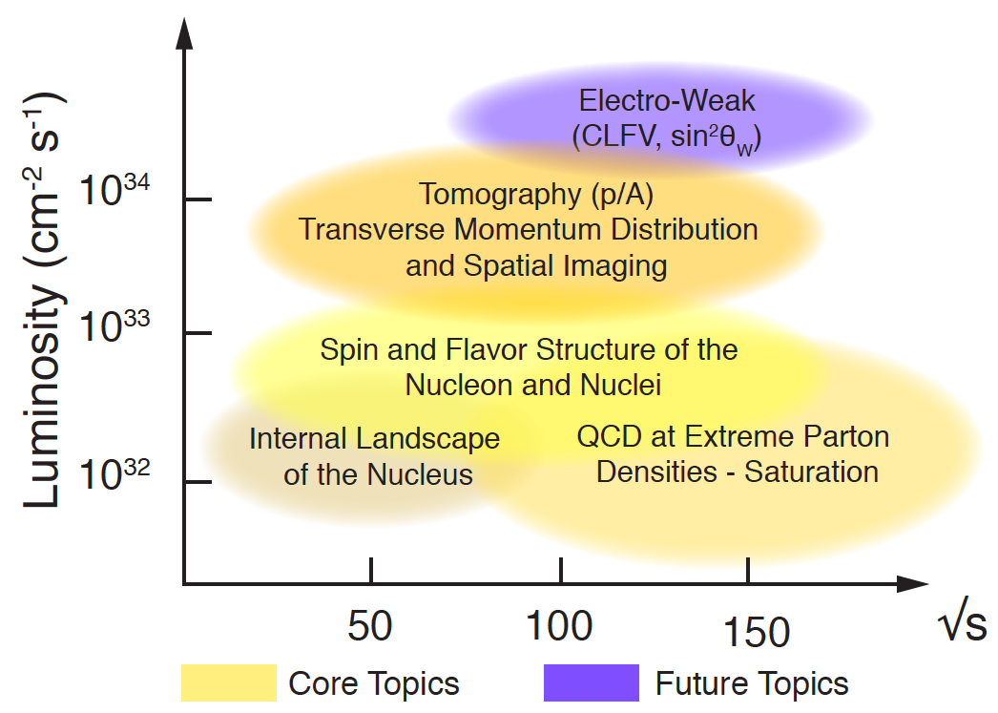
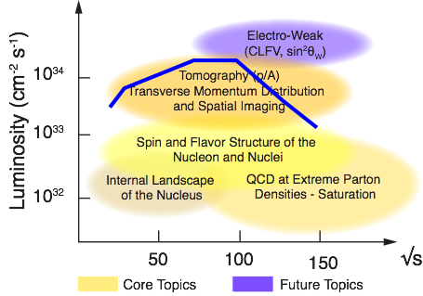
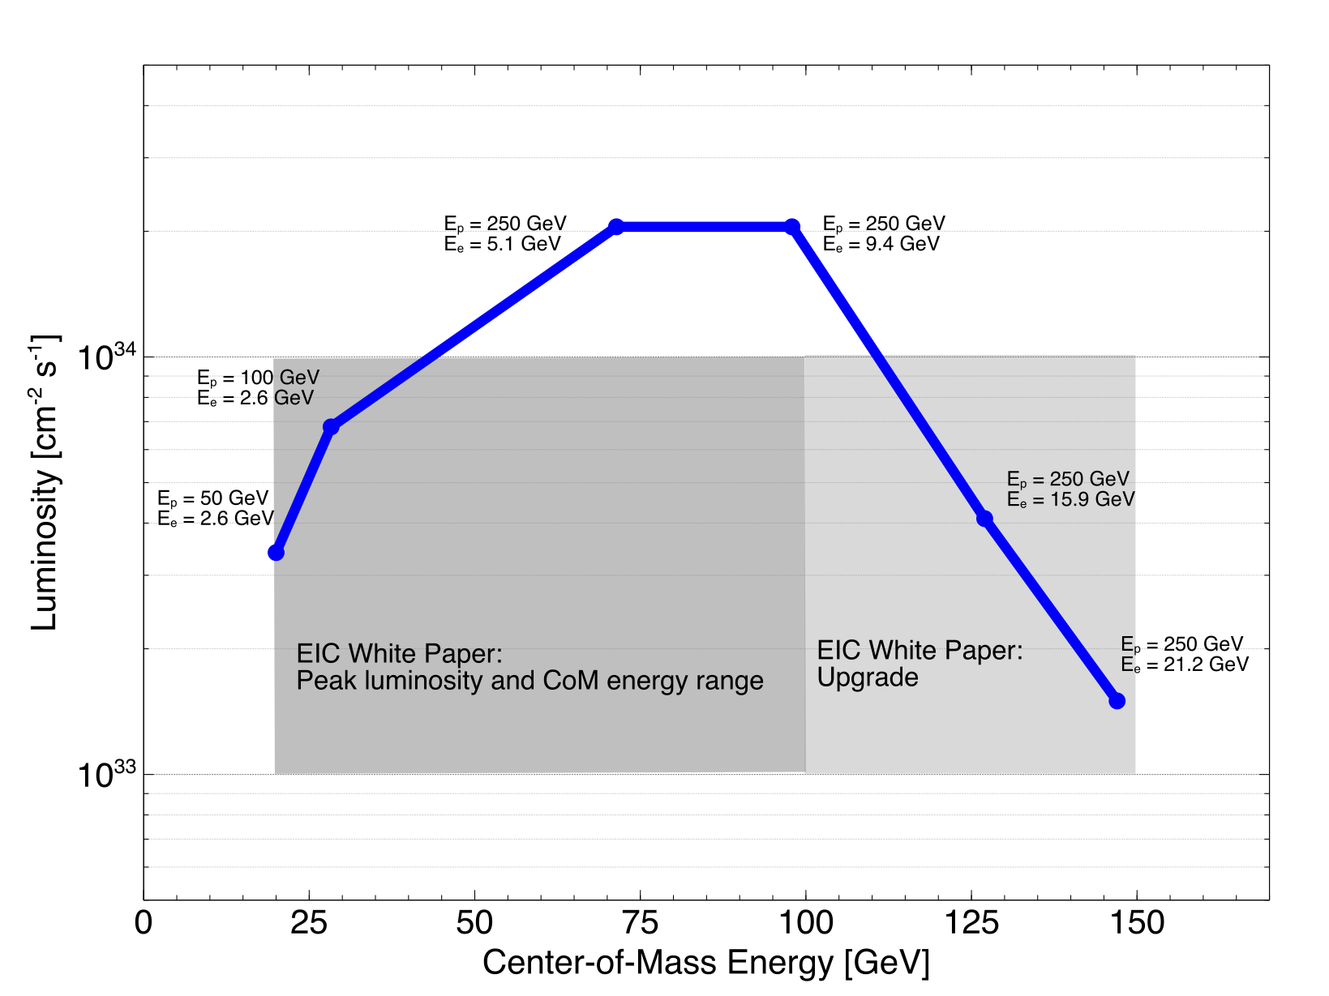
What is needed to realize EIC program
experimental program to address these questions:
prerequisites
inclusive and semi-inclusive DIS
all need √s_{ep} > 50 GeV
to access x < 10⁻³ where
sea quarks and gluons dominate
longitudinal motion of spinning quarks and gluons
machine & detector requirements
azimuthal asymmetries in DIS
L ≃ 10 fb⁻¹
adds their transverse momentum dependence
L ≃ 10 - 100 fb⁻¹
exclusive processes
multi-dimensional binning
→ x, Q², z, p_{T} (or t), Θ
to reach pT > 1 GeV
to reach |t| > 1 GeV²
adds their transverse position
+

Slide 32
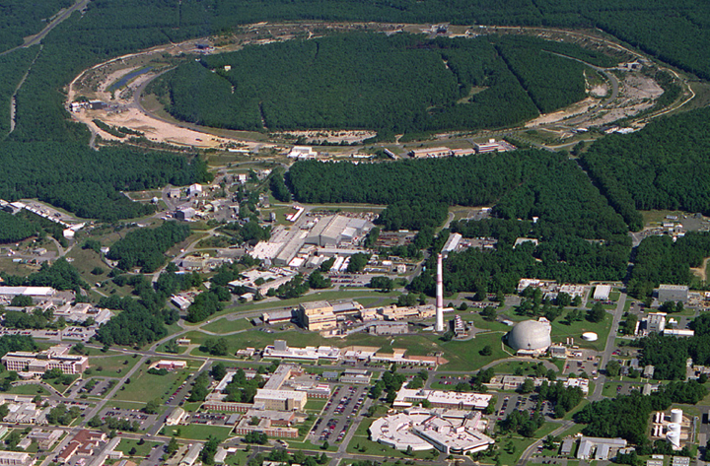

From RHIC to eRHIC
Jet/C-Polarimeters
eRHIC
CeC
RHIC
PHENIX
eRHIC Detector
RF
STAR
eRHIC Detector
LINAC
NSRL
EBIS
Booster
AGS
RHIC
Existing = $2B
Electron accelerator
to be build
p
70% Polarized protons
25-250 GeV
polarized leptons
15 & 21.2 GeV
and lower
E_{e} >1.6 GeV
Polarized light ions He³ 17-166 GeV/u
e⁻
Light ions (d,Si,Cu)
Heavy ions (Au,Pb,U)
10-100 GeV/u
goal: 80% e⁻ polarization

Slide 33

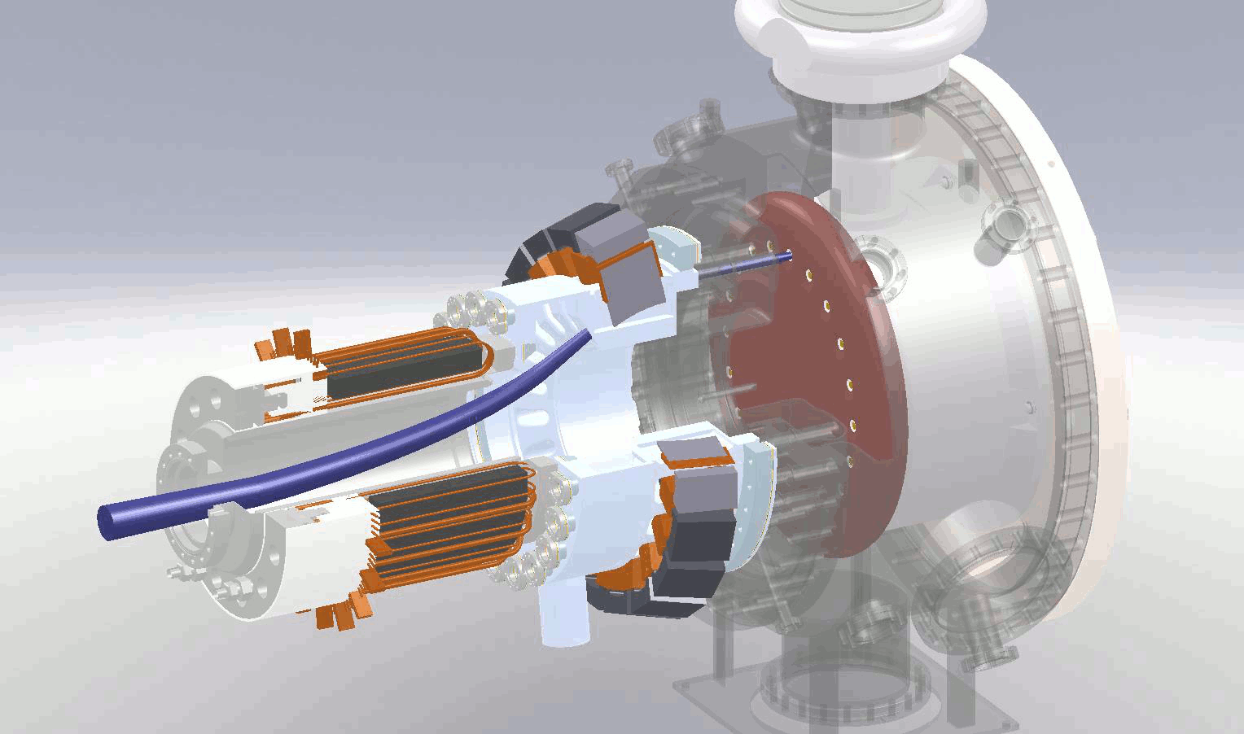
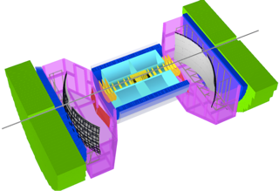
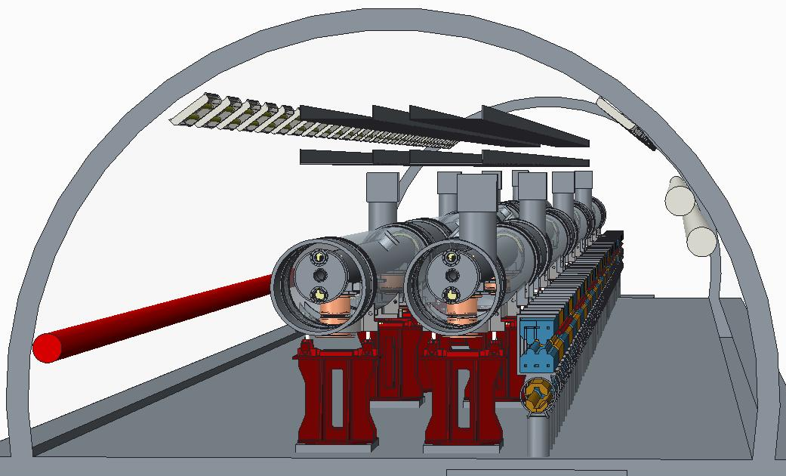
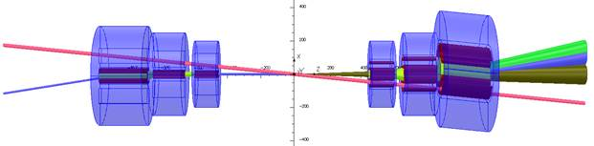
eRHIC Design
eRHIC:
energy recovery linac + fixed-field alternating-gradient ring design
record luminosity (10³³/cm⁻²s⁻¹) 100 – 1000 x HERA
eRHIC
When completed, eRHIC will be the most advanced and energy efficient accelerator in the world

Slide 34
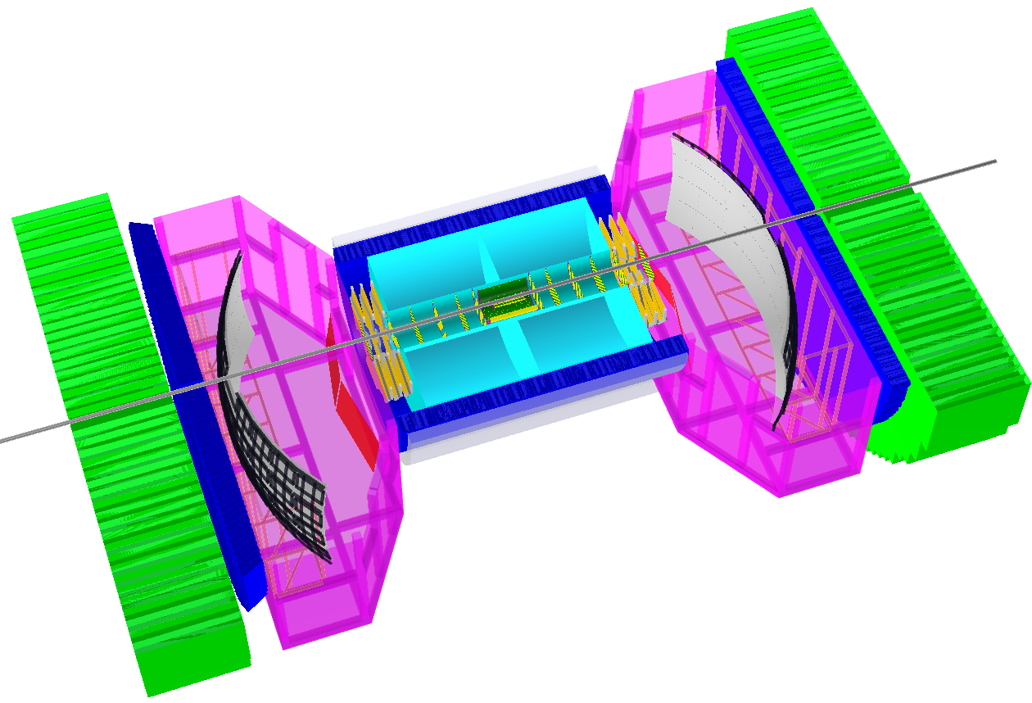
BeAST: The eRHIC Model Detector
Detector fully model in Geant
Hcal μ-vertex
Ecal GEM
RICH TPC
To
Roman Pots
&
Zero Degree
Calorimeter
Mainly based on detector ready to built technologies
or
as proposed in EIC-Detector R&D:
https://wiki.bnl.gov/conferences/index.php/EIC_R%25D
R&D: required for cost reduction with improved performance
low Q²
tagger
and
luminosity
detector
−η
+η
lepton beam
hadron beam
Unique particle detector design:
combines the features of a standard particle detector with
detectors identifying particle type over the entire acceptance
very stringent requirements on material thickness of different
tracking detectors to be able to do high precision event kinematic
reconstruction

Slide 35


Take Away Message
Why eRHIC now?
“all stars align”:
theory developments will allow to obtain
the answers to the big questions
discussed
  Solve the proton spin puzzle
  How visible matter emerges from
  quarks or gluons?
  Discover a new state of matter (CGC)
  Do gluons saturate?
accelerator technologies allow for a high
energy, high brightness polarized ep/eA
collider
detector technologies allow for a collider
detector with high resolution, wide
acceptance and particle identification
Additional material:
https://wiki.bnl.gov/eic/index.php/Publications_and_presentations#Publications
Current
knowledge about
Gluons in p /A
eRHIC science program will profoundly impact
our understanding of the inner structure
of the world around us
uniquely tied to a future high energy, high luminosity,
polarized ep / eA collider
never been measured before & never without
with eRHIC

Slide 36
BACKUP

Slide 37
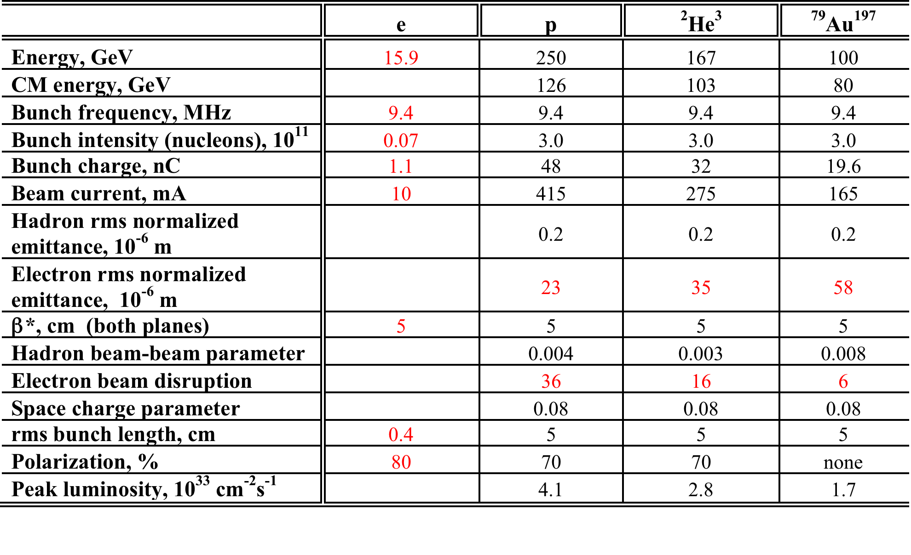
eRHIC R&D highlights and Luminosity
Challenge | Increase/reduction beyond the state of the art
Polarized electron gun | 10 x increase
Coherent Electron Cooling Beam-Beam effects in linac-ring collider | New concept new type of collider
Multi-pass SRF ERL with FFAG arcs | 5 x increase in current 30 x increase in energy
Crab crossing | New for hadron colliders
Dynamic aperture with β*=5 cm | 5x reduction
Polarized 3He production

Slide 38
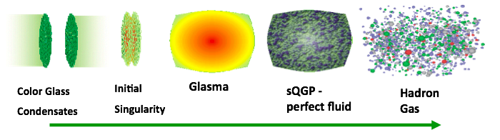

The eA Physics program
time
The Initial Conditions
Hard Processes
(pQCD)
FF/coal.
CGC
JIMWLK/BK
I
Hadron
Transport
Hydro (EoS)
Our understanding of some fundamental
properties of the Glasma, sQGP and
Hadron Gas depend strongly on our
knowledge of the initial state!
Advantage over p(d)A:
  eA experimentally much cleaner
      no “spectator” background to subtract
    Access to the parton kinematics through scattered lepton (x, Q²)
    initial and final state effects can be disentangled cleanly
3 conundrums of the initial state:
What is the spatial transverse distributions
of nucleons and gluons?
2. How much does the spatial distribution
fluctuate? Lumpiness, hot-spots etc.
3. How saturated is the initial state of the
nucleus?
→ unambiguously see saturation

Slide 39


What is Needed to Realize this Program
Inclusive Reactions in ep/eA:
Physics: Structure Fcts.: g₁, F₂, F_{L}
scattered lepton → kinematics of event (x,Q²)
identify scattered lepton → excellent electron id
Momentum/energy and angular resolution of e’ critical
Semi-inclusive Reactions in ep/eA:
Physics: spin of the proton, FF, TMDs → flavor tagging through hadron type
→ Kaon asymmetries, cross sections → strangness PDFs
π±,K±,p± separation over a wide range |η|<3
→ covers entire kinematic region in p_{t} & z
→ Excellent particle ID
  → excellent p resolution at forward rapidities
TMDs: full Φ-coverage around γ*, wide p_{t} coverage
Excellent vertex resolution → Charm, Bottom separation
Exclusive Reactions in ep/eA:
Physics: GPDs, parton imaging in b_{T} through DVCS, excl. VM/PS prod.
Exclusivity → large rapidity coverage → rapidity gap events
↘ reconstruction of all particles in event
high resolution, wide coverage in t → b_{t} → Roman pots
eA: → acceptance for neutrons in Zero Degree Calorimeter
  veto nucleus breakup
  determine impact parameter of collision

Slide 40
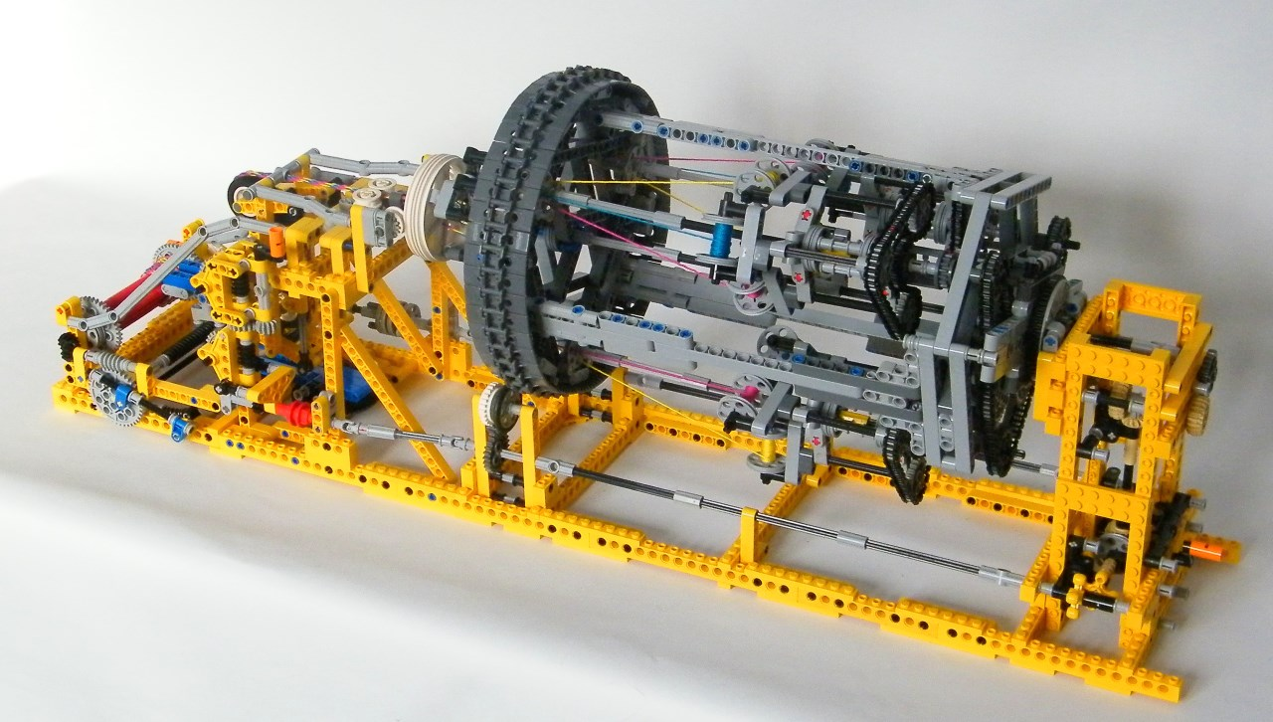
BeAST:
A Model Detector Realization Study

Slide 41
The Model Detector
Detector fully model in Geant
Hcal μ-vertex
Ecal GEM
RICH TPC
To
Roman Pots
&
Zero Degree
Calorimeter
Mainly based on detector ready to built technologies
or
as proposed in EIC-Detector R&D:
https://wiki.bnl.gov/conferences/index.php/EIC_R%25D
only minimal R&D required → cost reduction with improved performance
low Q²
tagger
and
luminosity
detector
−η
+η
lepton beam
hadron beam
Hadron PID:
-1<η<1: proximity focusing LiF (Aerogel)-RICH (CLEO) + TPC: dE/dx
1<|η|<3: Dual-radiator RICH (Aerogel + C₄F₁₀) (modeled: LHC-b RICH-I)
Lepton-ID:
-3 <η< 3: e/p
1<|η|<3: in addition Hcal response & γ suppression via tracking
|η|>3: ECal+Hcal response & γ suppression via tracking
-4<η<4: Tracking (TPC+GEM+MAPS) MAPS: CMOS Monolithic Active Pixel Sensors

Slide 42
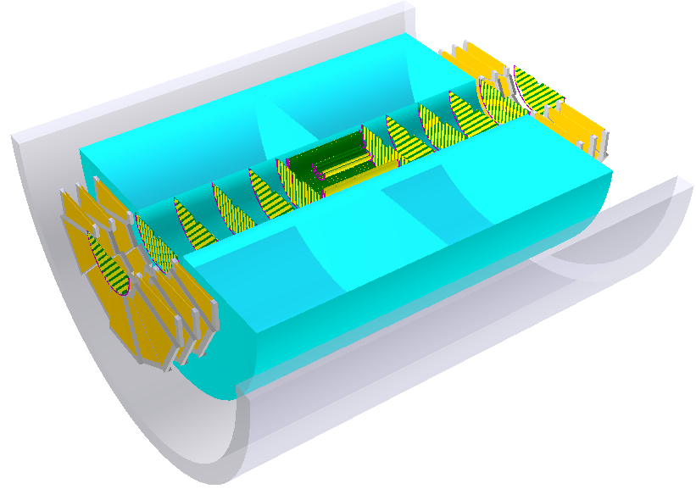
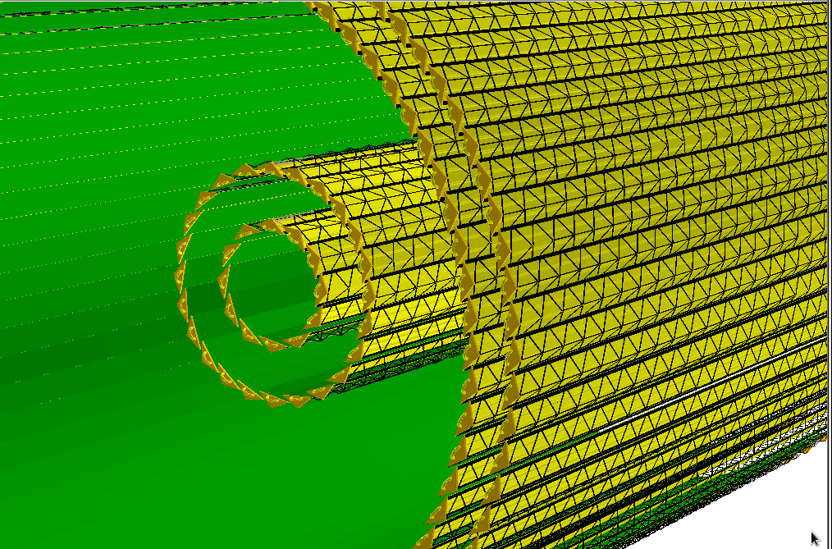
The Model detector: Tracking
Tracking:
-1 < η < 1: TPC + MAPS μ-vertex
1 < |η| < 3: TPC + GEM
3 < |η| < 5: MAPS μ-vertex
MAPS
barrel
μ-vertex
MAPS
fwd μ-vertex
fwd. GEM
bwd. GEM
TPC
MAPS
bwd μ-vertex
Requirements on the tracking detector
performance, depend strongly on the
magnetic field configuration
3 T solenoid
effective field length 2m; 1.2m radius

Slide 43
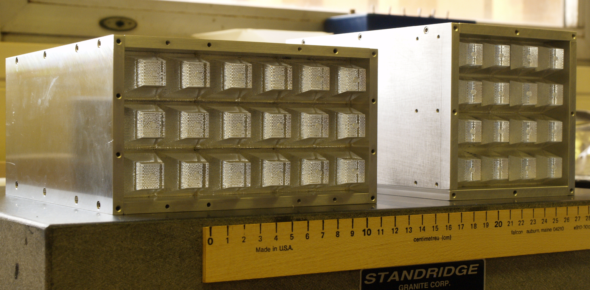
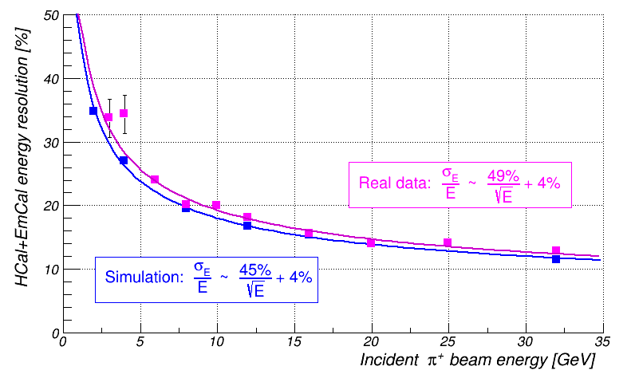
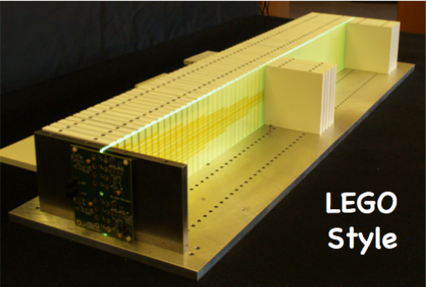
The model Detector Calorimeter System
C(entral)EMC, F(orward)EMC and B(ack)EMC:
tungsten powder scintillating fiber sampling calorimeters
sampling fraction for e/m showers ~2.6%
tower and fiber geometry modeled precisely
Alternative B(ack)EMC:
PWO-II, layout a la CMS & PANDA
digitization based on PANDA R&D
→ needed if tracking performance is worse
and/or lower magnetic field
CEMC
B/FEMC
HCal
F(orward)HCal and B(ack)HCal:
compensated sampling calorimeter Pb/Sc a la ZEUS
64 stacks (10cmx10cm) → 4 interaction length

Slide 44
Resolution in Kinematics variables
electron method: 15 GeV x 250 GeV
Hadron PID: forward RICH
y
x
Q²
p-resolution critical for RICH performance
no photon detector resolution
y=0.95
y=0.01
Electron PID: E/p
high > 60% important to
unfold measured quantities to Born level

Slide 45
Possible Schedule To Realize eRHIC

Slide 46
What will we learn about 2d+1 structure of the proton
GPD H and E as function of t, x and Q²
GPD H and E 1d+1
arXiv:1304.0077
A global fit over all pseudo data was done, based on the GPDs-based model:
[K. Kumerički, D Müller, K. Passek-Kumerički 2007]
Known values q(x), g(x) are assumed for H^{q}, H^{g} (at ξ=0, t=0 forward limits E^{q}, E^{g} are unknown)
Excellent reconstruction of H^{sea}, H^{sea} and good reconstruction of H^{g} (from dσ/dt)
GPD H and E 2d+1 structure for sea-quarks and gluons

Slide 47
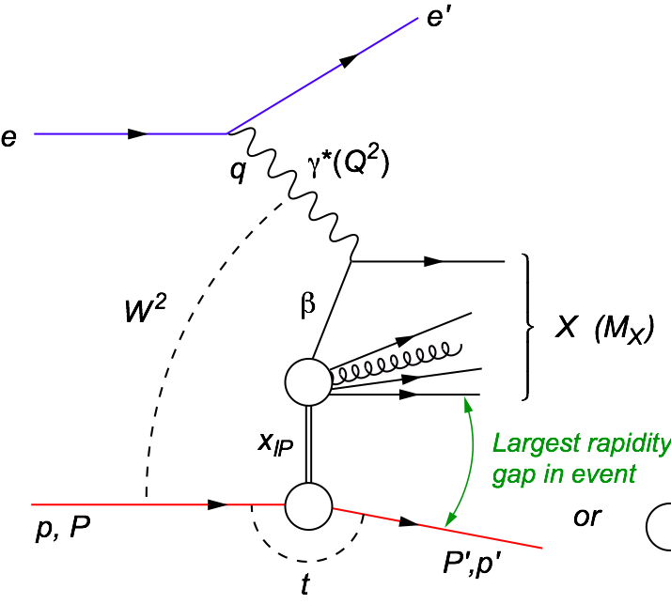


Imaging in eA: Diffraction
Hard diffraction at small x
Why is diffraction so important
Sensitive to spatial gluon distribution
(t ←→ b_{T})
  Hot topic:
    Lumpiness?
    Just Wood-Saxon+nucleon g(b_{T})
      coherent part probes “shape of black disc”
      incoherent part (large t)
      sensitive to “lumpiness” of the source
      (fluctuations, hot spots, ...)
VM: Sensitive to gluon momentum distributions
  σ ~ g(x,Q²)²
t = Δ²/(1-x) ≈ Δ² (for small x)
possible Source distribution with b_{T}^{g} = 2 GeV⁻²

