Slide 1
Towards a Direct Measurement of the Quark Orbital Angular Momentum Distribution
Simonetta Liuti
University of Virginia
6th GHP Workshop
Baltimore, April 8-10th, 2015
In collaboration with: Aurore Courtoy, Michael Engelhardt, Abha Rajan

Slide 2
The spin crisis in a cartoon
Jaffe Manohar
Ji
L_{q}≠L_{q}
J_{g}≠L_{g} + ΔG
Notes:
There are other components that we identify perhaps with OAM

Slide 3
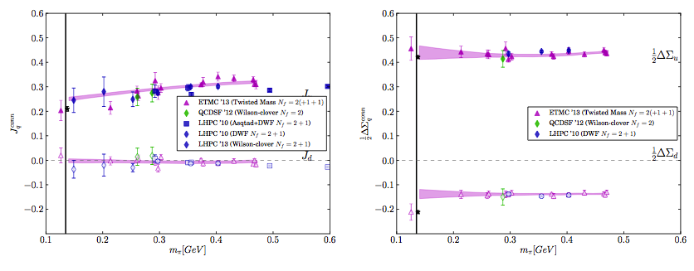
Lattice QCD
J_{q}
ΔΣ_{q}
S. Syritsyn, PoS Lattice 2013
L_{q} L_{q} are also derived

Slide 4
Model dependent extractions of J_{u} and J_{d}
O. Gonzalez Hernandez et al.,
Phys. Rev. C88, 065206; arXiv:1206.1876

Slide 5
Angular Momentum Sum Rules
Express the various components, ΔΣ, ΔG, L_{q}, J_{q,} J_{g,} L_{q,} L_{g} in terms of non-local light-cone operators of twist 2 and twist 3.
Jaffe Manohar: in LC gauge rewrite AM using Dirac eqn. to isolate spin terms
ΔΣ
L_{q}
ΔG
L_{g}
Ji:
ΔΣ
L_{q}
J_{g}

Slide 6
The two sum rules give equivalently valid representations:
Different mechanisms for generating OAM in the proton can coexist
The ones that will make physical sense are the ones that can be measured
OAM represents the correlation between the position and momentum of the quarks and gluons
Hatta (2011)
Lorce, Pasquini (2011)
GTMD
OAM Wigner Distribution
Hatta (2011)
Burkardt(2013)
Wilson-line gauge link, “n” defines the path along which we evaluate the vector potential

Slide 7
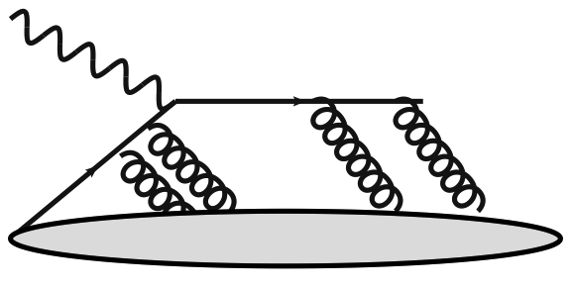
Burkardt’s torque (2013)
Evaluate gauge links (Hatta Yoshida, 2012; Burkardt, 2013)
L_{q} ➔ “staple” gauge link,
L_{q} ➔ “straight” gauge link
z⁻,z_{T}
∞,z_{T}
0,0
∞,0
z⁻,z_{T}
∞,z_{T}
0,0
∞,0
The difference of the two gives a torque,
➔ “Chromodynamic torque”*
Jaffe Manohar
Ji
*a Qiu-Sterman term type term analogous to f_{1T}^{perp}

Slide 8

Polyakov’s relation (2000)
Polyakov et al. (2000), Hatta, Yoshida (2012): Define twist three GPDs
Derive Wandzura Wilczeck relation using OPE tw 2 and tw 3 operators.
Take off-forward matrix elements
Similarly to the forward case,
genuine twist three
In the hypothesis that the genuine twist three integrates to 0, Ji’s OAM distribution is
identified with a twist 3 GPD

Slide 9
Generalized Wandzura Wilczek relation

Slide 10
k_{T} substructure
Burkardt, Hatta (2011)
F₁₄ (Meissner, Metz, Schlegel, 2009)
Both Jaffe Manohar and Ji OAM are identified with a k_{T} moment of a twist 2 GTMD
Courtoy et al. (2014)
F₂₇, F₂₈ (Meissner, Metz, Schlegel, 2009)
Ji’s OAM is identified with the integral of twist 3 GTMDs

Slide 11
Spin correlations
F₁₄
G₂

Slide 12
There exists a connection between F₁₄ and G₂ that uncovers different types of quark-gluon interactions behind the Jaffe Manohar and Ji mechanisms for generating OAM
(A. Courtoy, M. Engelhardt, S. L., A. Rajan, 2015)
a unique probe of quark-gluon interactions
Using directly the unintegrated quark-quark correlator defining GTMDs,
Insert the Equations of Motion,

Slide 13
Q-g-q correlator
For longitudinal polarization and Integrating over k_{T}
A sum rule relating Ji and JM OAM

Slide 14
Compare with gauge-links derivation
We are investigating further this connection

Slide 15

≠F₁₄!
u quark
GPDs calculated in Reggeized diquark model
GGL PRD (2010),
O. Gonzalez et al, PRC(2013)

Slide 16
Preliminary results in reggeized diquark model (With Abha Rajan)
X(H+E)
Q²=2 GeV²
G₂
F₁₄
-H tilde
u quark
J_{q} | ΔΣ_{q} | L_{q} | Int -xG₂ | Int F₁₄
0.24 | 0.46 | -0.22 | -0.025 | -0.045

Slide 17
Effect of evolution
GPDs calculated in Reggeized diquark model
GGL PRD (2010), O. Gonzalez et al, PRC (2013)

Slide 18
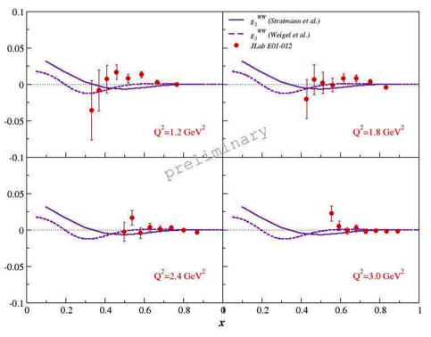
g₂^{n} Hall A

Slide 19
A few observations
The new expression relates a GTMD (F₁₄) with a twist 3 GPD (G₂), intrinsic k_{T} enters even if integrated over ➔ it establishes a connection between transverse spatial and momentum dependences
Similar to the Sivers effect but here the function vanishes for a straight link, only staple links are probed
A unique setup to study/test transverse momentum dependence and related effects, factorization issues, renormalization issues…
A unique handle on quark-gluon interactions through the explicit appearance of the quark-gluon-quark correlator in the sum rule
The role of partonic k_{T} and off-shellness, k² is manifest.
Similarities with g₂

Slide 20
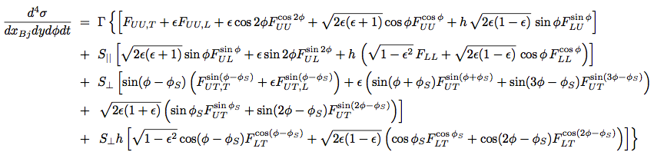


Observability: Cross section and asymmetries

Slide 21
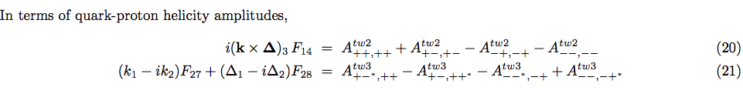
We identified the quark-proton helicity amplitudes combinations
G₂

Slide 22

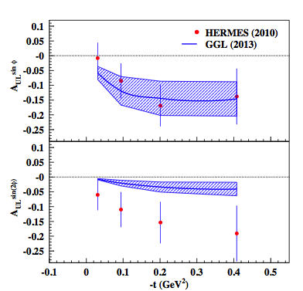
Direct measurement of OAM via G₂: DVCS on a longitudinally polarized target
WW, small ξ
Hall B analysis in progress!
Avakian, Pisano

Slide 23
UL correlation
Direct measurement of (k_{T} moment of) F₁₄
p
F₁₄ is Parity even: its matrix element transforms like:
it can therefore in principle represent OAM!
S
x
Most of the criticism in Kanazawa et al. (2014) is unfounded, it raised a
controversy on an issue that is uncontroversial!
However, because F₁₄ transforms opposite to helicity, we did raise an issue about its observability in terms of helicity amplitudes!!
4/8/15
23

Slide 24
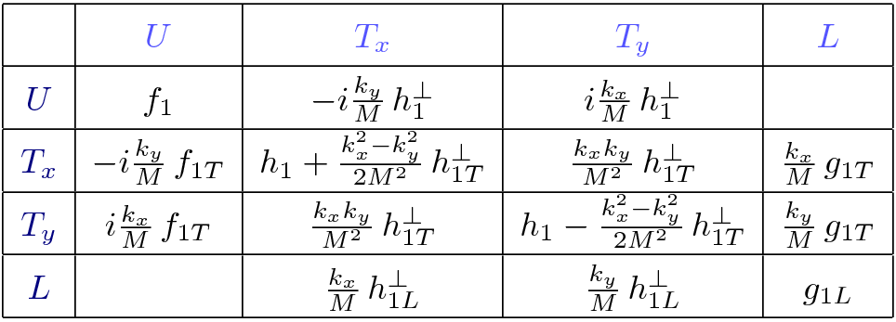
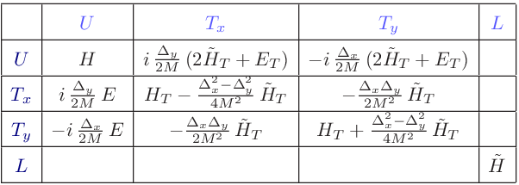
Parity predicts a lack of a UL correlation at twist 2
TMDs
GPDs
The amps will cancel unless they are imaginary:
A_{+ +, + +} = A*_{- -,-} ₋ ; A_{+ - , + -} = A*_{- +,} ₋ ₊
But this cannot be when the scattering happens in one single hadronic plane. In this case there can be no relative phase between helicity amps (this is what we referred to as Parity Odd, not F₁₄ itself!).
Different from GPD E where the amplitude’s phase is a consequence of helicity flip and off-forward spinor rotation
The phase in F₁₄ is obtained by introducing two scattering planes

Slide 25
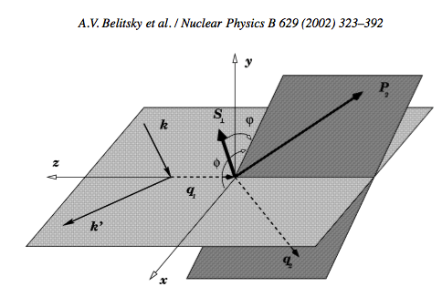
  Off forward SIDIS
To measure F₁₄ one has to be in a frame where the reaction cannot be viewed as a two-body quark-proton scattering
In the CoM the amplitudes are imaginary ➔UL connection goes to 0
The way to accomplish this is to define two planes
virtual photon coming at you
φ_{k}
φ_{Δ}
φ_{Δ}

Slide 26

… “off-forward SIDIS” allows us to introduce additional degrees of freedom:
π₁
π₂
k,λ
k’,λ’
H,E
p,Λ
p’,Λ’
⬇

Slide 27
Conclusions and Outlook
With observables in hand we can now state that OAM acquires different meanings depending on the way we probe it
The difference between JM and Ji sheds light on the working of the quark-gluon correlations (twist analysis)
Unique connection between (G)TMDs and GPDs, allows us to study in detail the role of quark-gluon correlations, and of transverse momentum or off-shellness
OAM was obtained so far by subtraction (also in lattice) We suggest an independent measurement of OAM
Many more interesting new connections: with transverse spin (Sivers effect, transverse spin) and axial vector sector (g₂)
Test renormalization issues, evolution etc…
Notes:
However, in the definition of these distributions, care must be applied to ensure manifest gauge invariance. In general, this can be accomplished by connecting any non- local correlation function with a Wilson-line gauge link. Specifying a Wilson-line gauge link requires selecting a path along which the vector potential is evaluated. The choice of path raises the immediate issue of how the quantities defined using Wigner distributions (TMDs, OAM, . . .) depend on that choice.

Slide 28
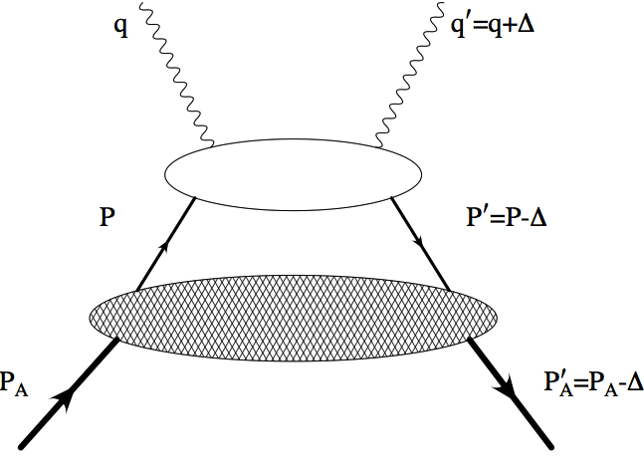



ADVERTISEMENT: Sum Rules in Deuteron
z=p_{N}⁺/P⁺_{D}
λ_{q}
Nucleon DVCS
λ_{N}
Deuteron
λ
Nucleon
Deuteron
F₁+F₂= G_{M}
G_{M}

Slide 29
Back Up

Slide 30
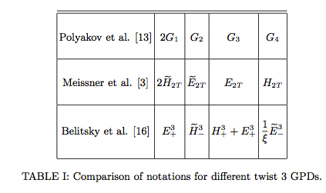
Twist 3 decomposition of hadronic tensor in various notations
Courtoy et al, PLB (2014)arXiv:1310.5157

Slide 31
The QCD Energy Momentum Tensor
T⁰⁰ | T⁰¹ | T⁰² | T⁰³
T¹⁰ | T¹¹ | T¹² | T¹³
T²⁰ | T²¹ | T²² | T²³
T³⁰ | T³¹ | T³² | T³³
Momentum density
Energy density
Shear stress
Momentum density
Pressure
Angular Momentum density

Slide 32
Sum Rule: Part I
First define the angular momentum components
then parametrize the EMT in terms of form factors A, B, C
Finally, connect the EMT matrix element with AM components
Jaffe Manohar (1990)
Ji (1997)
Notes:
Before moving on recall some definitions

Slide 33
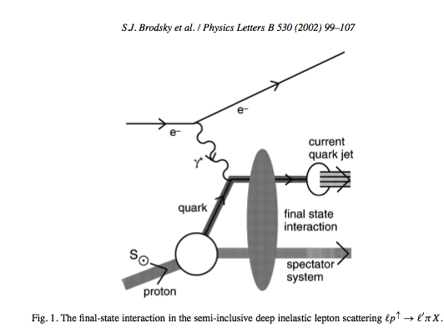
Ah ha!
This is the same argument that allows us to observe the T-odd TMDs by understanding the role of the gauge links

Slide 34
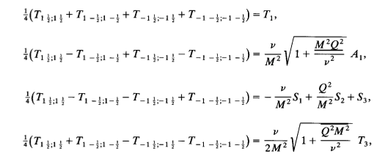
F₁₄ appears in the unintegrated structure functions for deep inelastic scattering with electroweak currents
F₁
A₁
G₁
F₃
W±,Z
X.Ji, NPB402 (1993)
p

Slide 35


g₁
F₁₄
parity odd
F₁₄
g₁
F₁₄ is the parity odd contribution to g₁ and the parity even contribution to A₁!

Slide 36
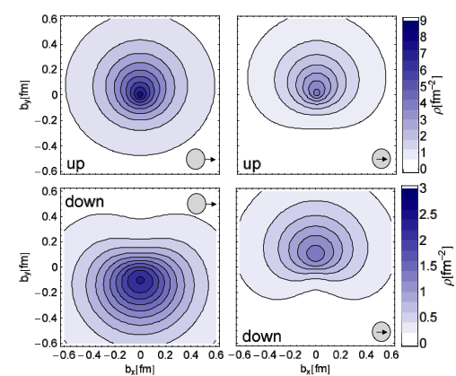
Analogous situation as for E wrt. transverse spin (M. Burkardt)
E
k_{T}
The net b corresponds to net k_{T} in the opposite direction (attractive color force due to FSI)

