Slide 1




Dilepton & Quarkonium Measurements in STAR
Frank Geurts
Rice University

Slide 2
Outline
Motivation
Recent dilepton results
  dielectron measurement at top RHIC energies
  dielectron measurements in Beam Energy Scan
Recent quarkonium results
  J/ψ and Υ measurements in various collision systems
Summary

Slide 3
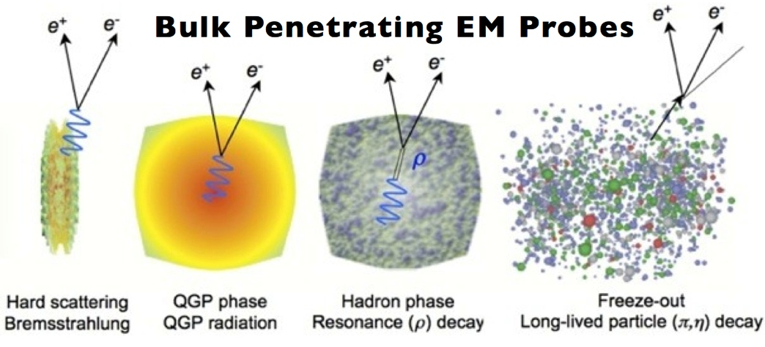
Dilepton Physics
Dileptons are excellent penetrating probes
  very low cross-section with QCD medium
  created throughout evolution of system
Rapp & Wambach, Adv.Nucl.Phys. 25 (2000) 1
High Mass Range (HMR)
    M_{ee} > 3 GeV/c²
  primordial emission, Drell-Yan
  J/ψ and ϒ suppression
Intermediate Mass Range (IMR)
    1.1 < M_{ee}< 3 GeV/c²
  QGP thermal radiation
  heavy-flavor modification
Low Mass Range (LMR)
    M_{ee}< 1.1 GeV/c²
  in-medium modification of vector mesons
  system lifetime measurement

Slide 4
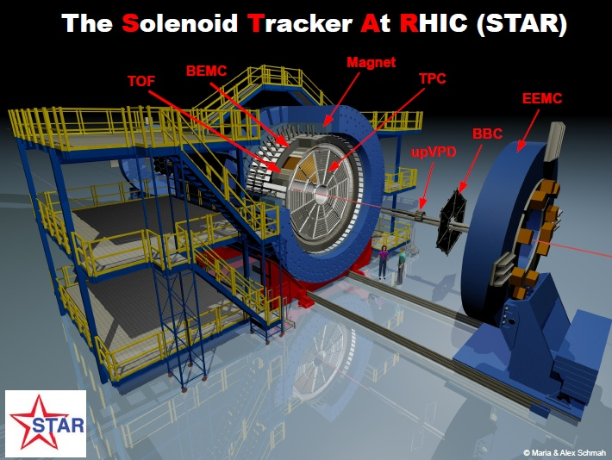
The STAR Experiment
Large and uniform acceptance at mid-rapidity
  |η|< 1 and 0< φ< 2π
Excellent particle identification
Fast data acquisition
Recent upgrades targeted at heavy-flavor measurements
  improve tracking (Heavy Flavor Tracker)
  improve muon PID (Muon Telescope Det.)
STAR detectors in these analyses
  Time Projection Chamber
  Time-of-Flight detector
  Barrel EM Calorimeter
  Vertex Position Detector
dE/dx
1/β
E/p

Slide 5
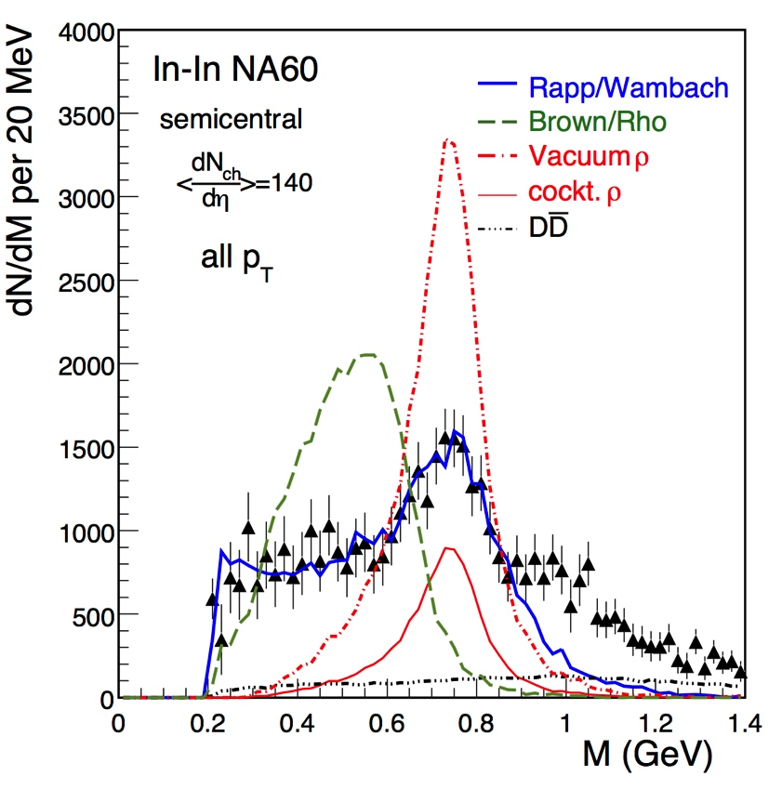
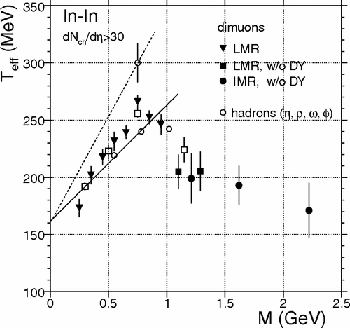
LMR/IMR: What did we learn from SPS?
PRL 96 (2006) 162302
PRL 100 (2008) 022302
EPJ C61 (2009) 711
Precise dimuon mass spectrum
favors ρ broadening through interactions with hadronic medium
Inverse slope parameter from m_{T} distributions
IMR: no indication of mass dependence
indicative of thermal radiation from partonic medium, T=205 ± 12 MeV

Slide 6
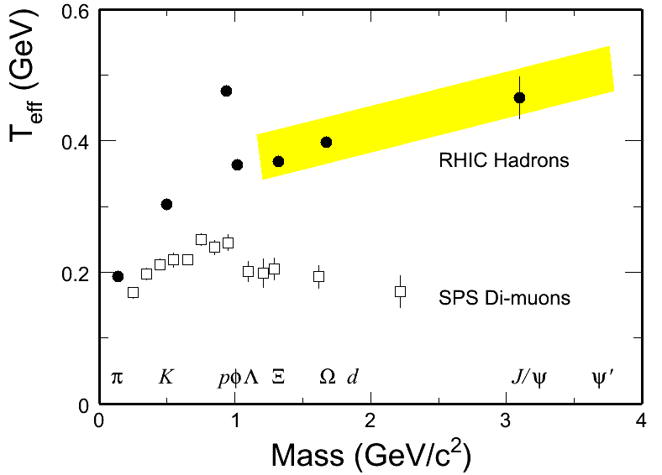
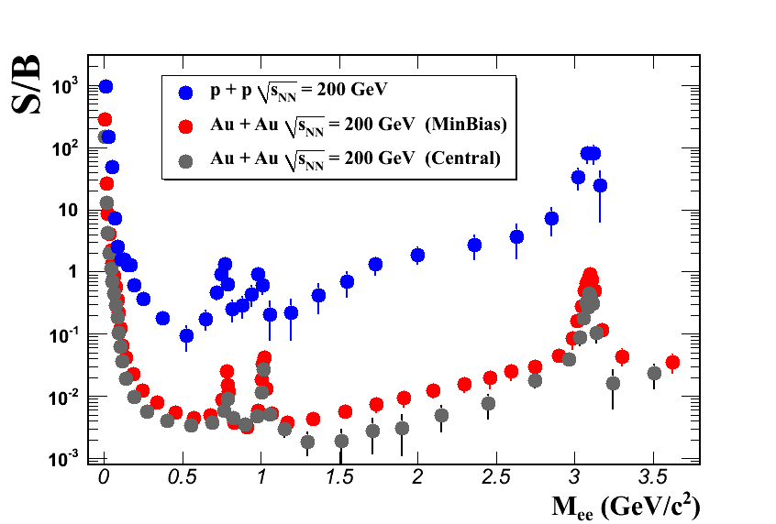
What to expect at RHIC?
Opportunities:
expect significant increase of partonic source contribution
Beam Energy Scan provides unique opportunities to
  systematically study in-medium ρ broadening
  on-set of QGP thermal radiation
Challenges:
increased particle multiplicities at higher √s_{NN} lead to significant increase in combinatorial backgrounds
STAR at 200 GeV for M_{ee}~ 0.5GeV/c²
  p+p: S/B ~1/10
  Au+Au: S/B ~1/250

Slide 7
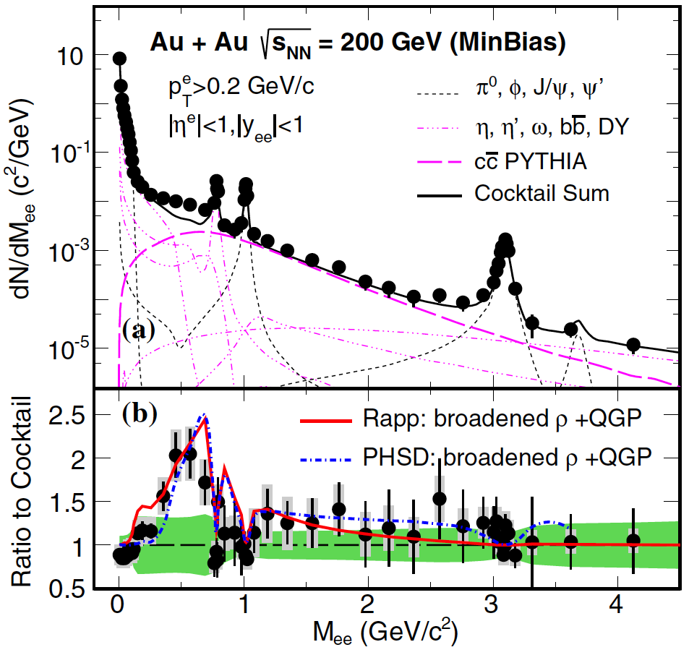
Production in Au+Au at 200 GeV
STAR Au+Au @ √s_{NN}=200GeV
PRL 113 (2014) 022301
Low Mass Range:
enhancement
  when compared to cocktail (w/o ρ)
  Model calculations with in-medium broadened ρ spectrum function describe LMR excess
Intermediate Mass Range:
  within errors consistent with cocktail
  dominated by correlated charm contributions
  thermal QGP radiation
  modification of charm?
difficult to disentangle
Run-14/16 with new upgrades will address this
  R. Rapp, Phys.Rev. C 63 (2001) 054907
O. Linnyk et al., Phys. Rev. C 85 024910 (2012)

Slide 8
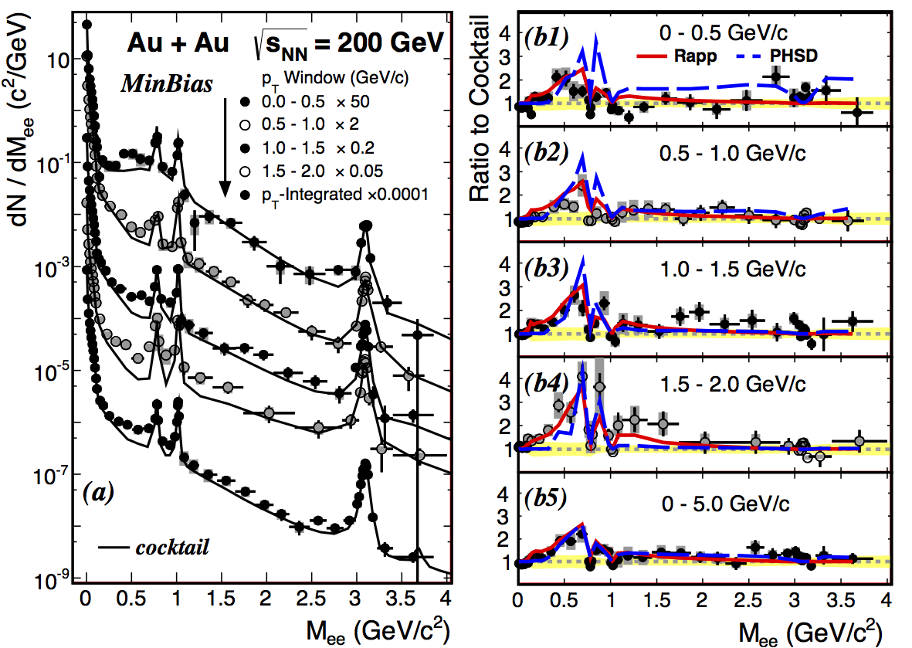
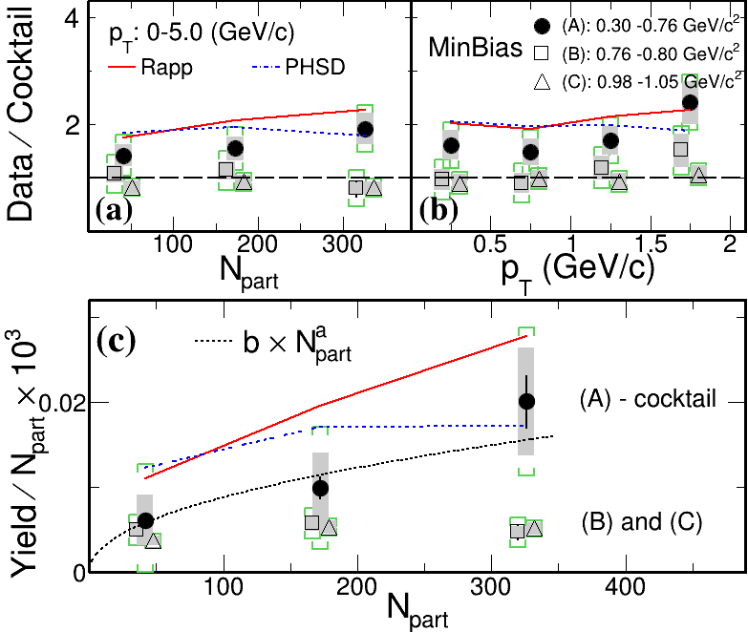
Centrality and p_{T} Dependence
arXiv:1504:01317 (subm. to PRC)
Combined statistics of Run 10 and 11
    submitted to PRC (PRL: run-10 only)
Data/cocktail: no strong dependence on centrality or p_{T}
Model calculations continue to give a reasonable description
arXiv:1504:01317

Slide 9
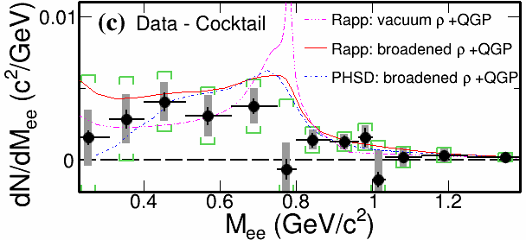
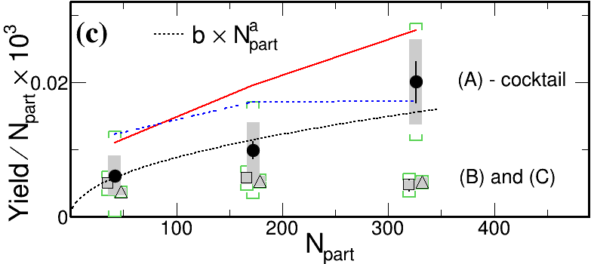
Low-Mass Excess: Rapp & PHSD
arXiv:1504:01317 (subm. to PRC)
Both models describe NA60 & STAR
agreement w/in uncertainties
vacuum ρ disfavored
low-mass dielectron yield increase ~(N_{part}) ^{α} with α=1.44±0.10
Ralf Rapp (priv. comm.)
  R. Rapp, Phys.Rev. C 63 (2001) 054907
  R. Rapp & J. Wambach, EPJ A 6 (1999) 415
Complete evolution (QGP+HG)
PHSD (Linnyk, priv.comm.)
O. Linnyk et al., Phys. Rev. C 85 024910 (2012)
Collisional broadening & radiation from QGP
(PRL 113 022301)
A: ρ-like 0.30 - 0.76 GeV/c²
B: ω-like 0.76 - 0.80 GeV/c²
C: φ-like 0.98 - 1.05 GeV/c²
a = 0.44 ± 0.10

Slide 10
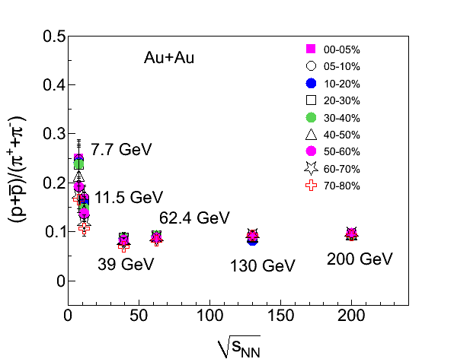
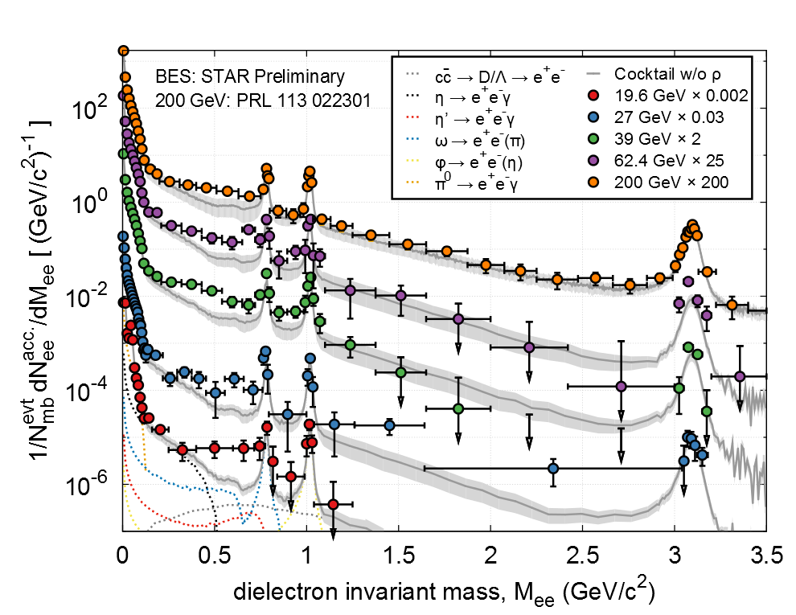
Dielectron Production at lower √s_{NN}
Observed low-mass enhancement at top RHIC energy
  in-medium modification effects?
  indication of chiral symmetry restoration?
Explore low-mass range down to SPS energies
  change initial conditions, net-baryon density
  ~constant total-baryon density
  possible enhancement, consistent model description?
arXiv:1409.5675
Beam Energy Scan Dielectrons:
  2010 – 2011 Au+Au at
62.4, 39,
27, and 19.6 GeV

Slide 11
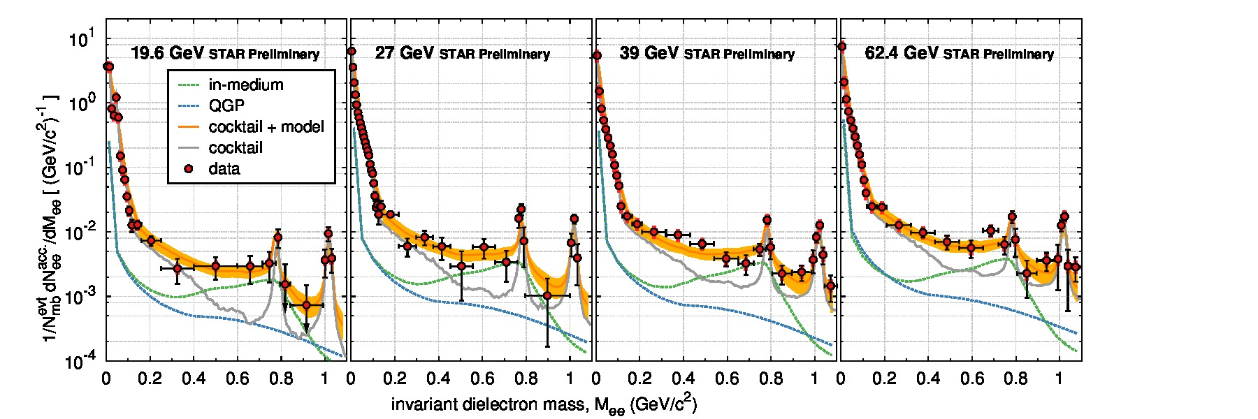
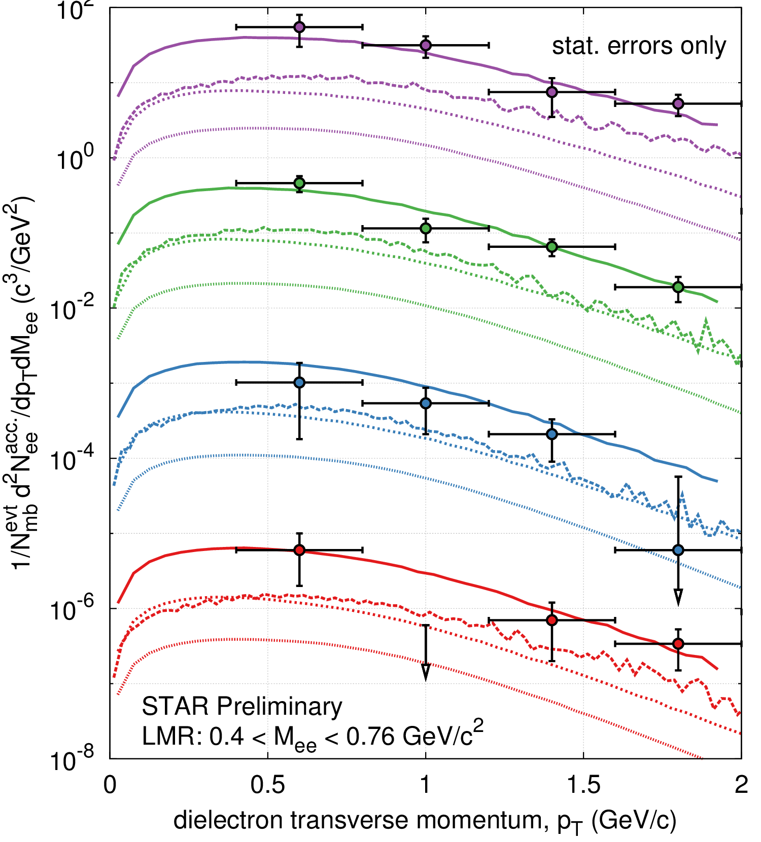
Compare to Theory: In-Medium ρ
Butterworth, TPD’14
Sustained low-mass excess radiation
  top RHIC down to SPS energies
Robust theoretical description
  black dotted curve: cocktail + in-medium ρ (Rapp)
Consistent with in-medium ρ broadening
  expected to depend on total baryon density
Hohler & Rapp: “Is ρ-meson melting compatible with chiral restoration? ” PLB 731 (2014) 103
arXiv:1409.5675
Notes:
For 19.6GeV – model calculations: Tinit=224MeV tau0=0.33fm/c

Slide 12
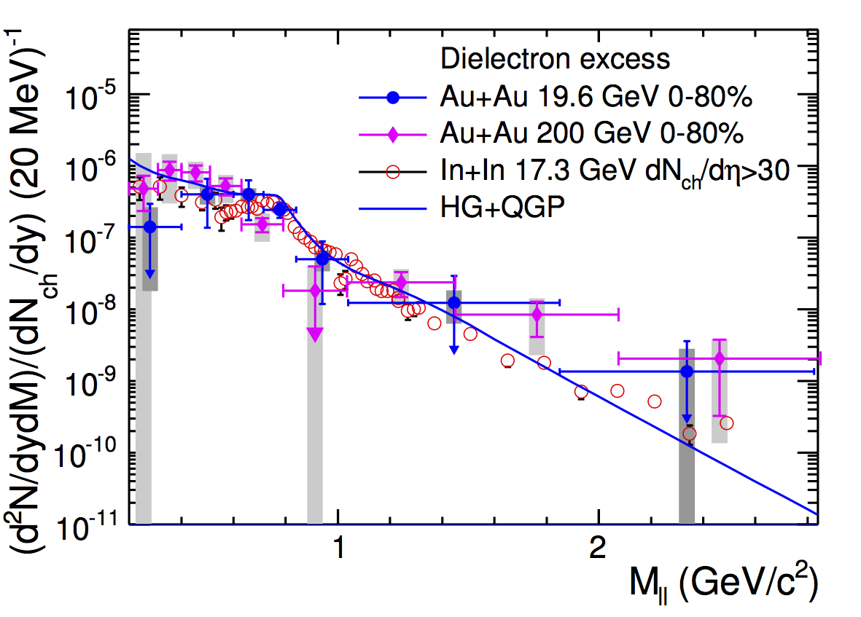
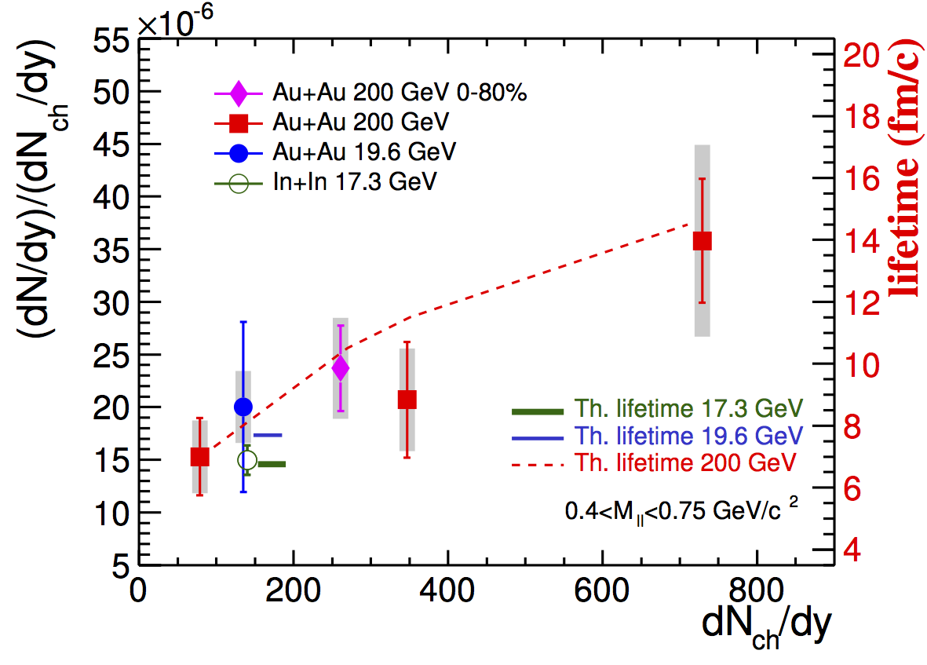
Excess Yields and Medium Lifetimes
STAR arXiv:1501.05341
subm. to PLB
Acceptance corrected STAR excess spectra for 200GeV and 19.6GeV
  normalized to (dN_{ch}/dy)_{y=0}
  compared to NA60 dimuon excess (17.3GeV)
Integrated LMR excess yields
  17.3GeV (NA60) and 19.6GeV consistent
  200GeV yields larger than in 19.6GeV
  centrality dependence in 200GeV
Lifetime of the emitting medium in 200GeV longer
  in central compared to peripheral
  when compared to 17.3GeV
17.3 GeV | 6.8 ± 1.0 fm/c
19.6 GeV | 7.7 ± 1.5 fm/c
200GeV | 10.5 ± 2.1 fm/c

Slide 13
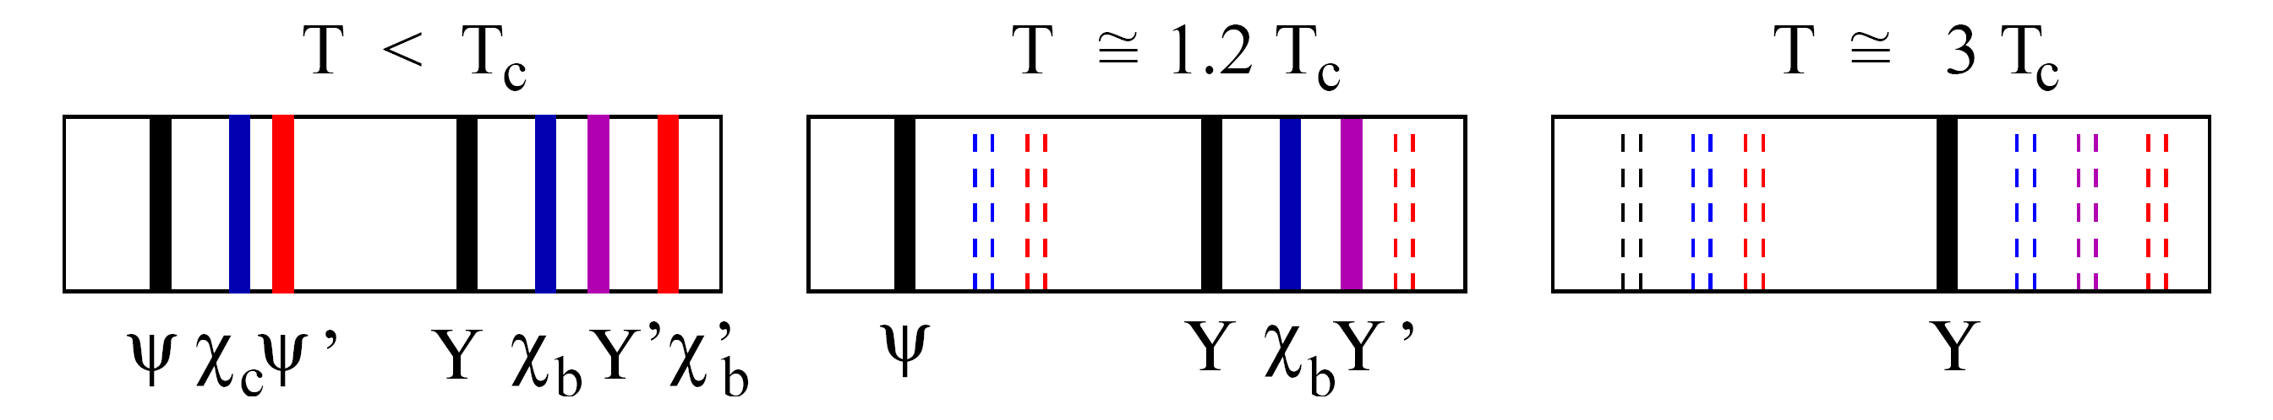

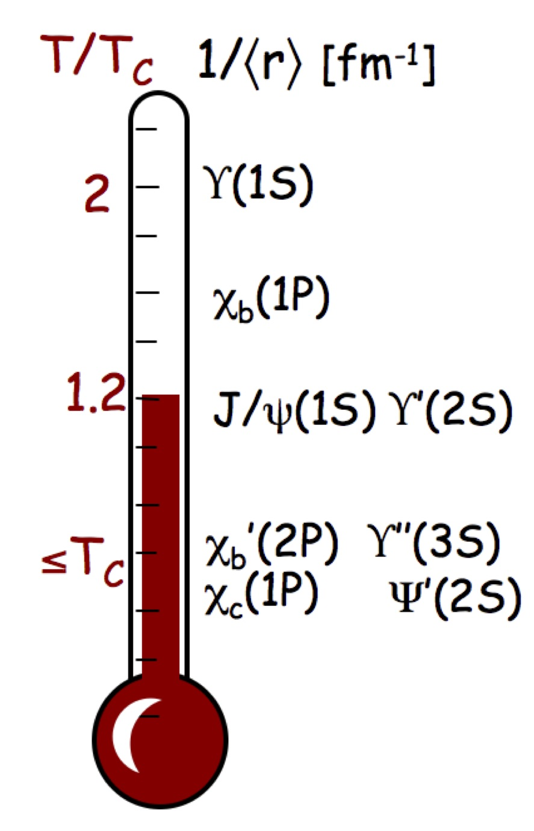
Quarkonia in Strongly Interacting QGP
Sensitive to color Debye screening of quark potential
  expect to dissociate in sQGP
Suppression of different states determined by T_{medium} and E_{bind}
  sequential melting of different states
QGP thermometer
A more complicated picture …
Significant feed-down contributions
  non-prompt J/ψ :: up to 25% (at 12GeV/c) from B-mesons
  prompt J/ψ :: 40% from ψ’ and χ_{c}
Cold Nuclear Matter effects
  initial-state energy loss
  co-mover absorption
  nuclear shadowing (modified PDFs)
Hot Nuclear Matter effects
  regeneration from coalescence of charm and bottom pairs
H. Satz, Nucl. Phys. A (783):249-260(2007)
Mocsy, EPJ C61 (2009) 705

Slide 14
STAR Quarkonia Measurements
J/ψ measurements
  high p_{T} :: much less affected by CNM and regeneration
  different colliding systems
    d+Au :: cold nuclear matter effects
    Au+Au and U+U :: hot nuclear matter effects, different energy densities
  beam energy scan
    change relative production contributions
Υ measurements
  negligible recombination effect
    RHIC: σ_{cc}(~800μb) >> σ_{bb}(~1-2μb)
  less co-mover absorption predicted
    Υ(1S) tightly bound, thus large kinematic threshold
    expect σ^{Υ}_{abs} ~0.2mb < σ^{J/ψ}_{abs}
      Lin & Ko, PLB 503 (2001) 104
  low production rate

Slide 15
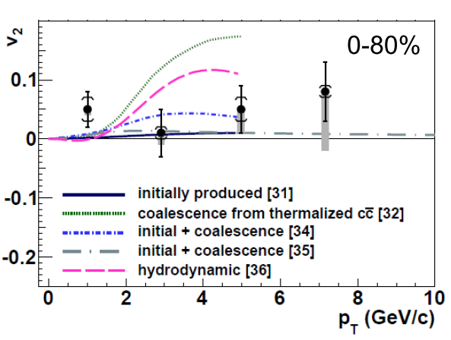
J/ψ Flow in Au+Au at 200 GeV
PRL 111 (2013) 052301
elliptic flow v₂ is consistent with 0 for p_{T} > 2GeV/c
  disfavors model with J/ψ production via thermalized charm coalescence
STAR Au+Au
√s_{NN}=200 GeV
PRC 90 (2014) 024906
[31] Yan, Zhuang,Xu, PRL97 (2006) 232301
[32] Greco, Ko, Rapp, PLB595 (2004) 202
[34] Zhao, Rapp, PLB 655 (2007) 126
[35] Liu,Xu,Zhuang, NPA834 (2010) 317c
[36] Heinz, Chen (2012)
J/ψ spectra softer than TBW predictions from lighter hadrons
  small radial flow?
  regeneration at low p_{T}?

Slide 16
J/ψ Spectra in Au+Au at 200 GeV
J/ψ spectra softer than TBW predictions from lighter hadrons
  small radial flow?
  regeneration at low p_{T}?
viscous hydrodynamics
  fails at low p_{T}
  decouples at 120 – 160 MeV
comparison with Liu et al.
    J/ψ suppression from color screening
    statistical regeneration
  initial production dominates in peripheral collisions
  in central collisions: regeneration more significant at low p_{T}
Need coalescence of charm quarks
PRC 90 (2014) 024906
Y. Liu et al., Phys. Lett. B 678, 72 (2009)
U. W. Heinz and C. Shen (2011), priv. comm.

Slide 17
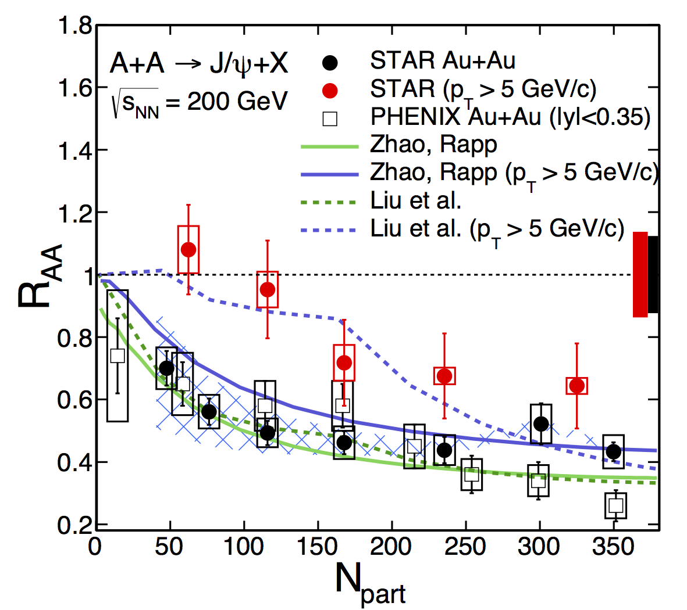
J/ψ R_{AA} in Au+Au at 200 GeV
nuclear modification factor:
suppression increases with centrality
high p_{T} R_{AA} systematically higher
J/ψ at high p_{T} almost not affected by CNM effects and recombination
high-p_{T} J/ψ suppressed in central collisions
  may indicate QGP effects
Comparison with models
low p_{T}: good description by models
high p_{T}: underprediction of R_{AA} by Zhao et al
Liu et al: direct J/ψ production with color screening and recombination
Zhao et al: similar plus J/ψ formation time effect and B-meson feed-down

Slide 18
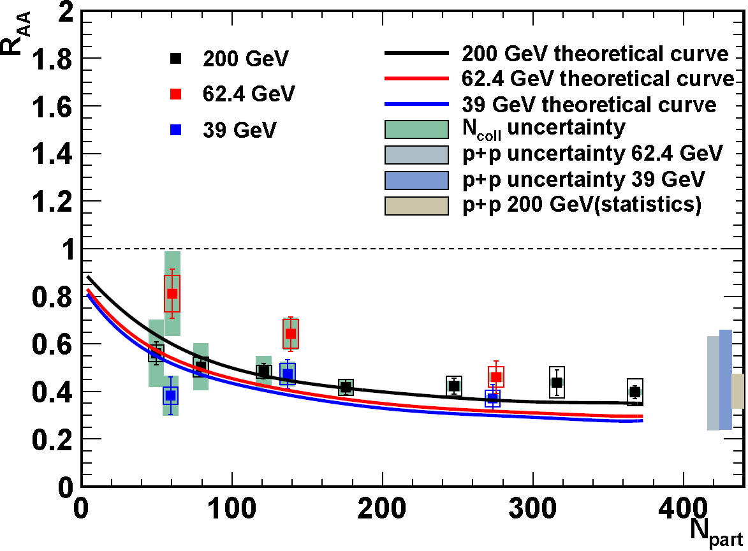
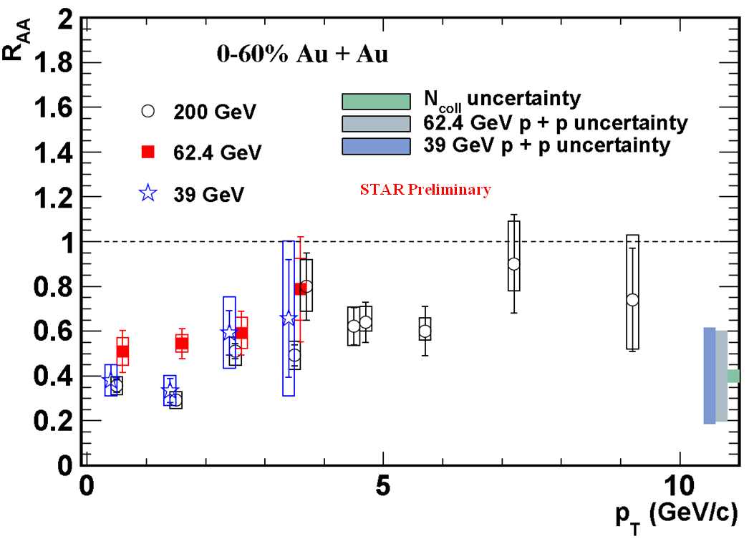
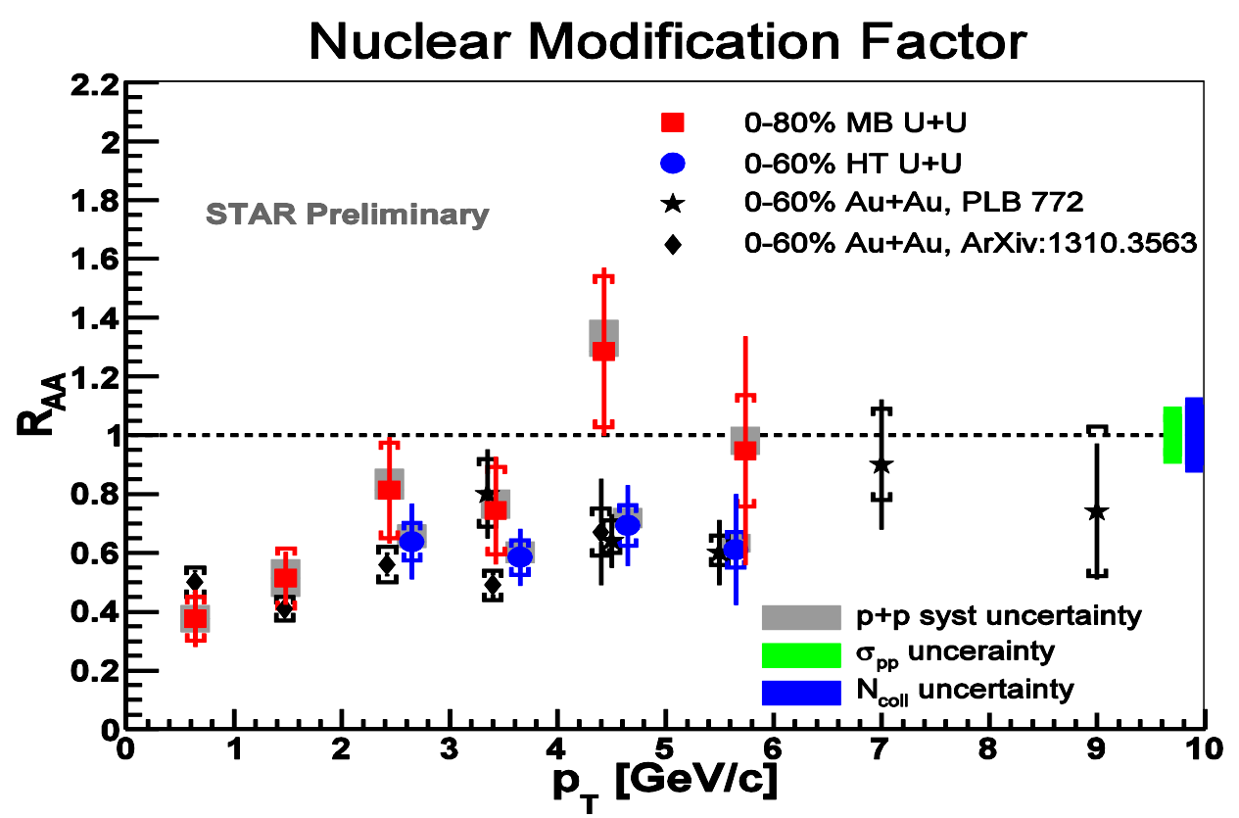
Energy Dependence of J/ψ R_{AA}
No strong energy dependence of J/ψ R_{AA} within uncertainties
  Similar p_{T} trend in suppression for all energies
  large uncertainty from CEM-based p+p reference for 39 and 62.4GeV data
Expect higher energy densities in U+U collisions at similar centralities
J/ψ R_{AA} in U+U at 193GeV
  p+p reference at 200GeV
  similar trend in p_{T} compared to Au+Au
STAR Preliminary

Slide 19
Υ in d+Au at 200GeV :: CNM Effects
R. Vogt Phys. Rep. 462125 (2008)
Arleo et al. EPJ C73 (2013) 2427
Models include:
  gluon nPDF (anti)shadowing
  initial parton energy loss
Agreement with models
  for p+p, and backward/forward d+Au
  except at midrapidity d+Au
  for |y_{Υ}|<0.5
  R_{dAu} = 0.48 ± 0.14 (stat) ± 0.07 (pp-stat)
  ± 0.02 (syst) ± 0.06 (pp-syst)
  indication of suppression at mid-rapidity beyond model predictions
  (e.g. sensitive to co-mover absorption?)
Phys. Lett. B735 (2014) 127

Slide 20
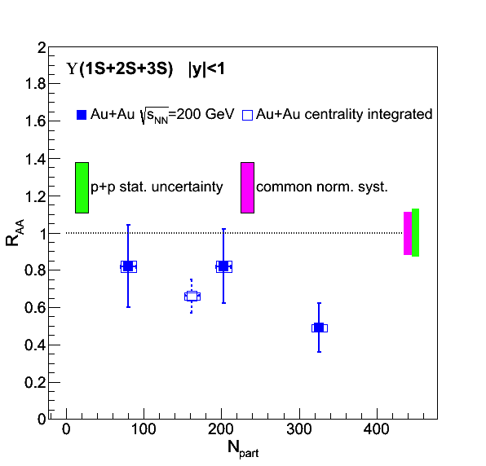
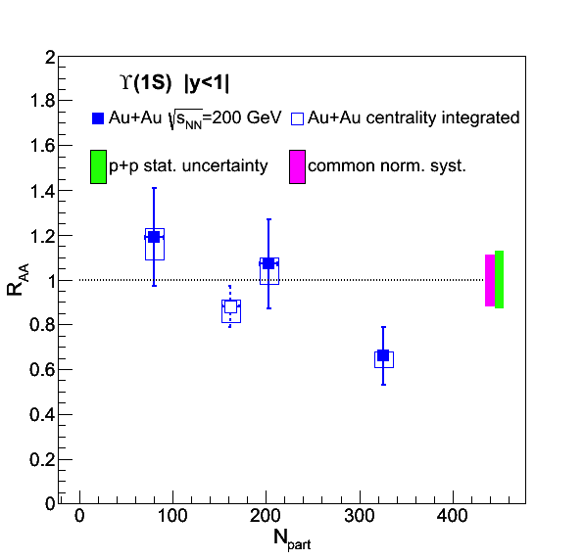
Suppression of Υ in Au+Au
peripheral Υ: consistent with no suppression
central Υ: significant suppression
central Υ(1S): significant suppression

Slide 21
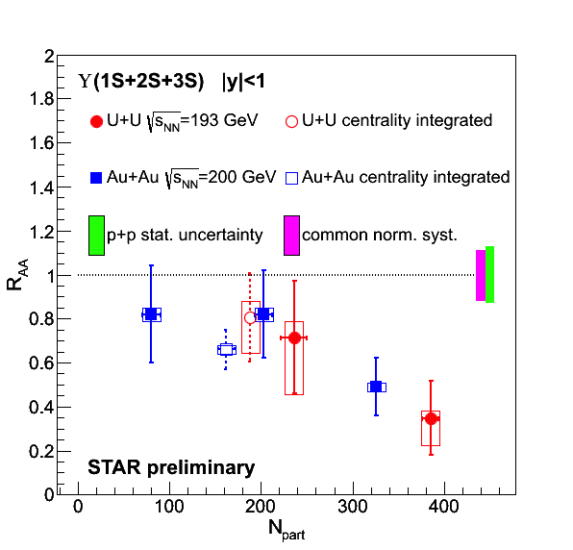
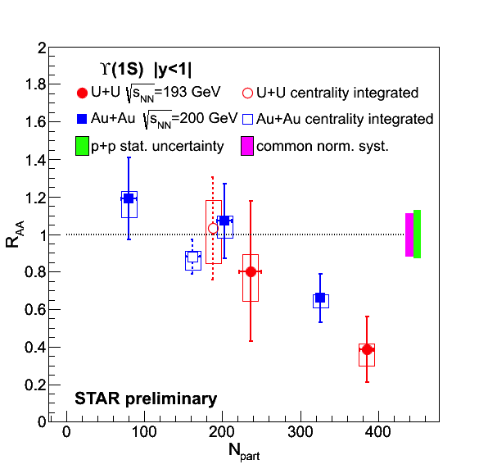
Υ R_{AA} :: Au+Au vs. U+U
peripheral Υ: consistent with no suppression
central Υ: significant suppression
central Υ(1S): significant suppression
new U+U data confirms and extends Au+Au trend

Slide 22
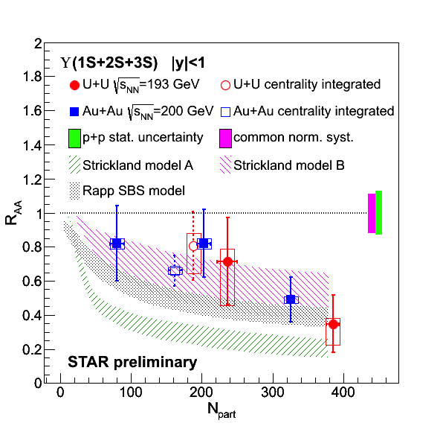
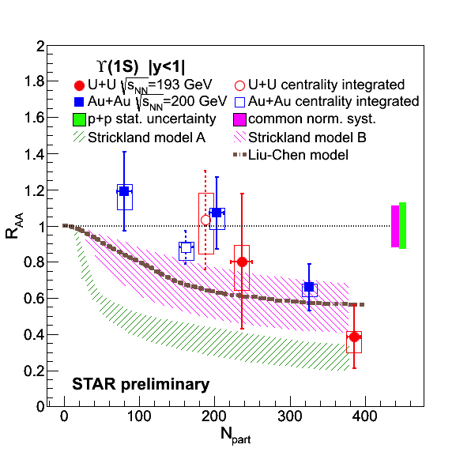
Υ R_{AA} :: data vs. models
Strickland, Bazov
  no CNM
  model A disfavored: potential based on heavy quark free energy
  model B: potential based on heavy quark internal energy
Liu et al.
  potential model, no CNM effects
  only excited states disssociate
Rapp et al.
  CNM effects included
  strong binding scenario
NPA 879 (2012) 25
PLB 697 (2011) 32
EPJ A48 (2012) 72

Slide 23
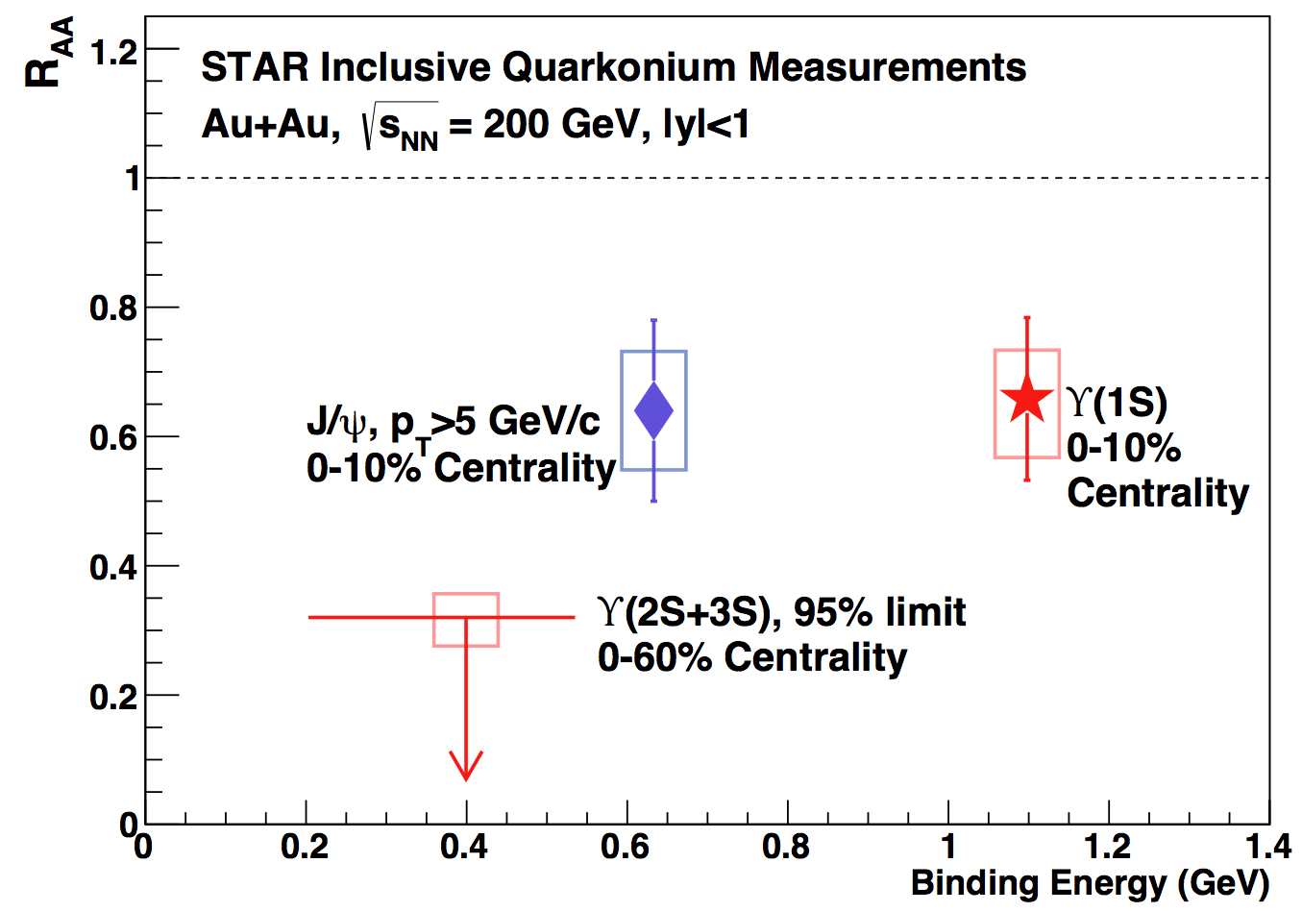
Suppression of Υ states in Au+Au
Phys.Lett. B735 (2014) 127
Central collisions:
  indication of complete Υ(2S+3S) suppression
  suppression of Υ(1S) similar to high-p_{T} J/ψ
Υ suppression pattern supports sequential melting

Slide 24
Summary & Outlook
LMR dielectron excess in Au+Au@200GeV consistent with in-medium broadening of ρ meson
  systematic BES measurements agree with this picture down to 19.7GeV
LMR excess yields scale with lifetime of the emitting system
  search for anomalous increases, suggestive of a critical point in the QCD phase diagram
Quarkonium collectivity: J/ψ no strong v₂ or radial flow
  thermalized charm coalescence not dominant in production
Quarkonium hot medium effects: significant suppression of high-pT J/ψ
  similar to Υ(1S) suppression in Au+Au
  Υ(2S+3S) suppression stronger than Υ(1S)
Quarkonium CNM effects: Υ suppression in d+Au not yet understood
Outlook:
Two important STAR upgrades: Heavy Flavor Tracker and Muon Detector
RHIC luminosity has seen a dramatic improvement
Both have been in effect since 2014
  first part of a large p+p (2015) and Au+Au@200GeV data set (2014+2016)
  later this month p+A
BES phase-2 (2019/2020): improve LMR statistics, increase baryon-density

Slide 25
BACKUP

Slide 26
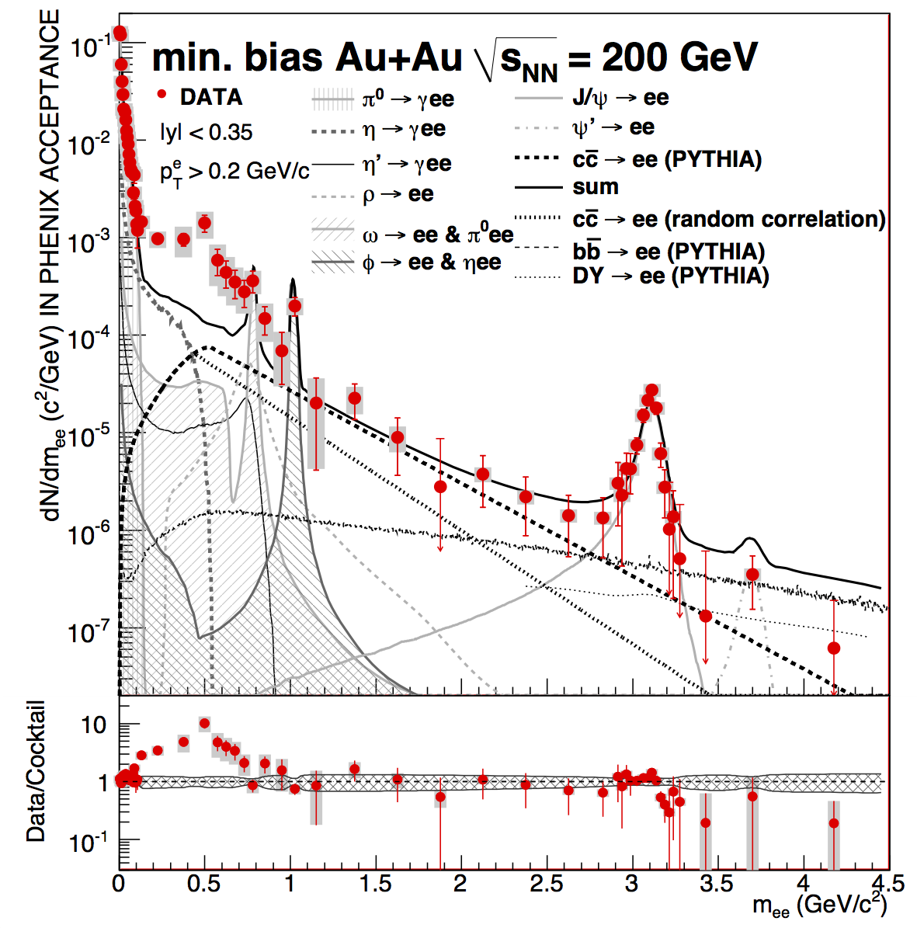
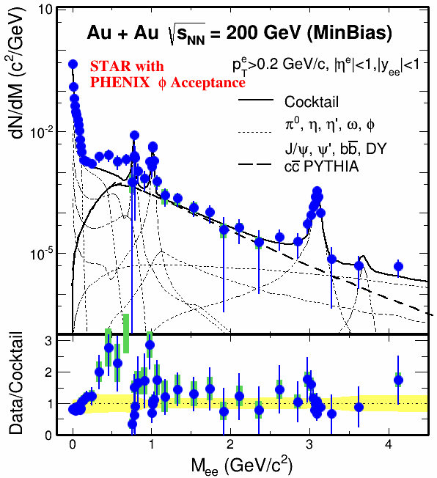
RHIC: PHENIX vs. STAR
STAR in PHENIX acceptance
PHENIX – PRC 81 (2010) 034911
Large quantitative differences in the low-mass , low-p_{T} region remain unresolved
STAR combined Run 10 and 11 data sets
Work in progress: PHENIX HBD analysis Run-10 data, waiting on top centrality

Slide 27
A Phenomenological Approach
Experiment: Strong evidence ρ meson “melts”
Input
  vector SF (ρ meson) from phenomenological model, verified against experimental data
  T dependence of the condensate: from LQCD
QCD sum rules
  constrain vector/axial-vector SFs individually
Weinberg sum rules
  difference between vector & axial-vector SFs
Output …
Hohler at TPD’14:
But, still need microscopic calculations of a₁(1260). (Massive Yang-Mills)
Work in progress …
Hohler, Rapp – PLB 731 (2014) 103

Slide 28
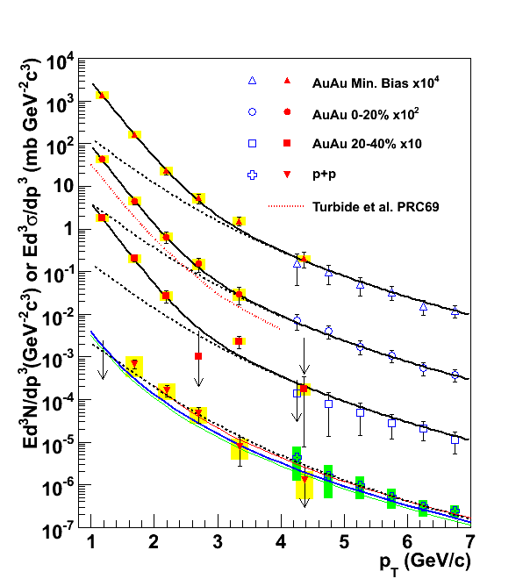
Direct photon measurements
Two methods:
  real photons: measure inclusive spectrum and subtract sources such as from hadron decays
    e.g WA98
    establish mostly upper limits
  virtual photons: measure dileptons and use relation between virtual photon and direct photon
    PHENIX, based on a method proposed by UA1
Virtual photons:
  any process that radiates γ will also radiate γ*
  for M << p_{T} such a γ* is “almost real”
  extrapolate γ*➝e⁺e⁻ to M=0 will give the direct-γ yields
WA98, PRL 85 (2000) 3595
    PHENIX, PRL 104 (2010) 132301

Slide 29
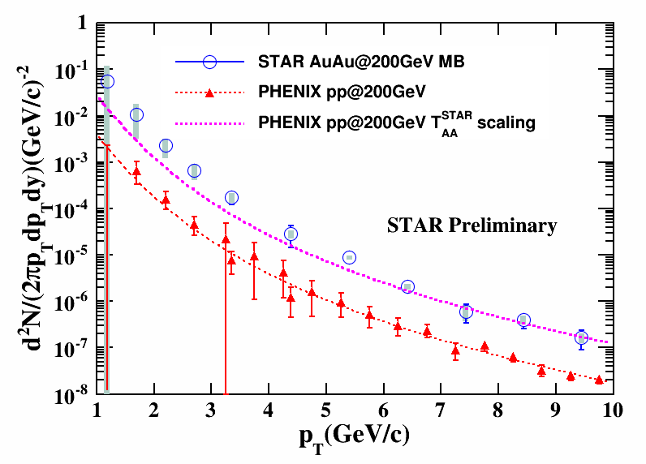
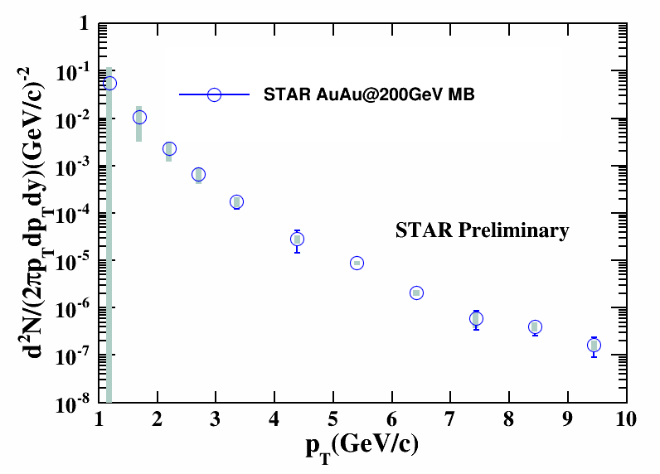
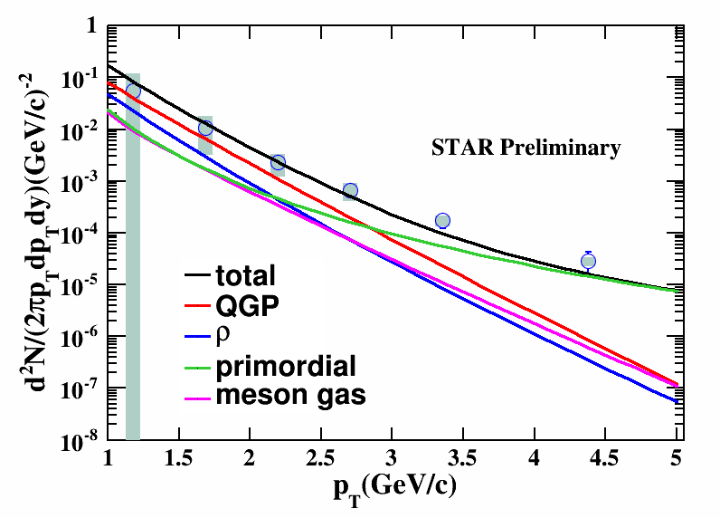
Direct Virtual Photon Invariant Yield
B. Huang, TPD’14
arXiv:1408.2371
Large uncertainty for p_{T} < 2 GeV/c due to lack of η measurements
Comparison with PHENIX
  high p_{T} – consistent with T_{AA}-scaled fit to p+p data
  for 1-5 GeV/_{c} observe excess when compared to this p+p reference
Theory calculations consistent within uncertainty
  includes contributions from QGP, ρ, meson gas, and primordial production
Notes:
0-20%: initial temperature about 445MeV at 0.17fm/c, fireball life time 15fm/c.
[Van Hees, Gale, and Rapp, Phys. Rev. C 84, 054906]

Slide 30
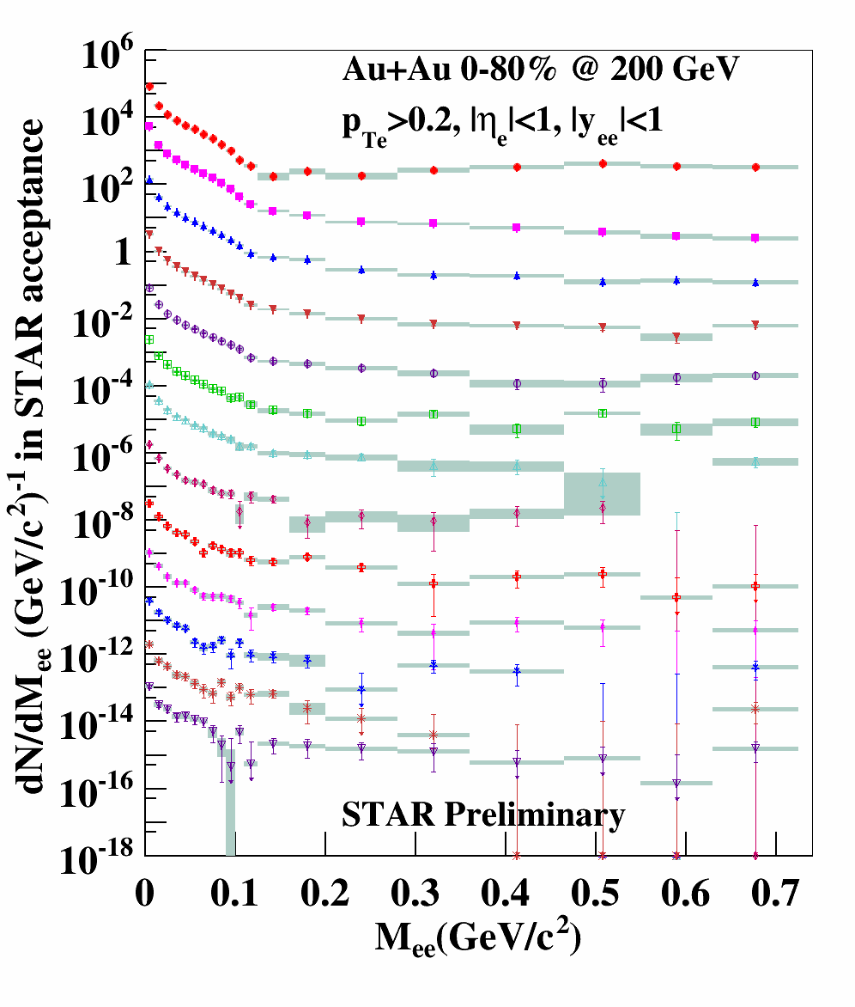
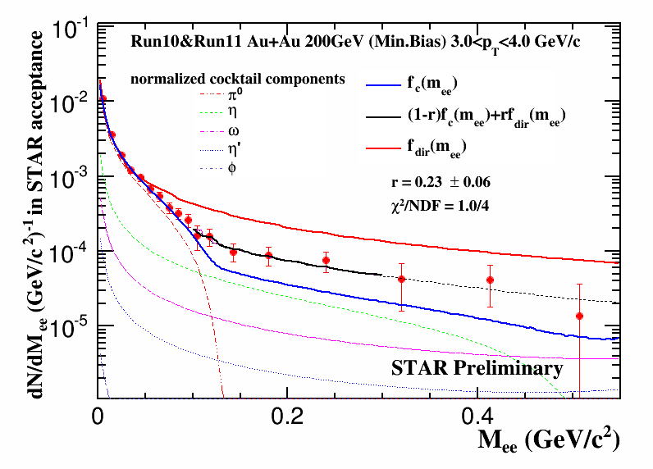
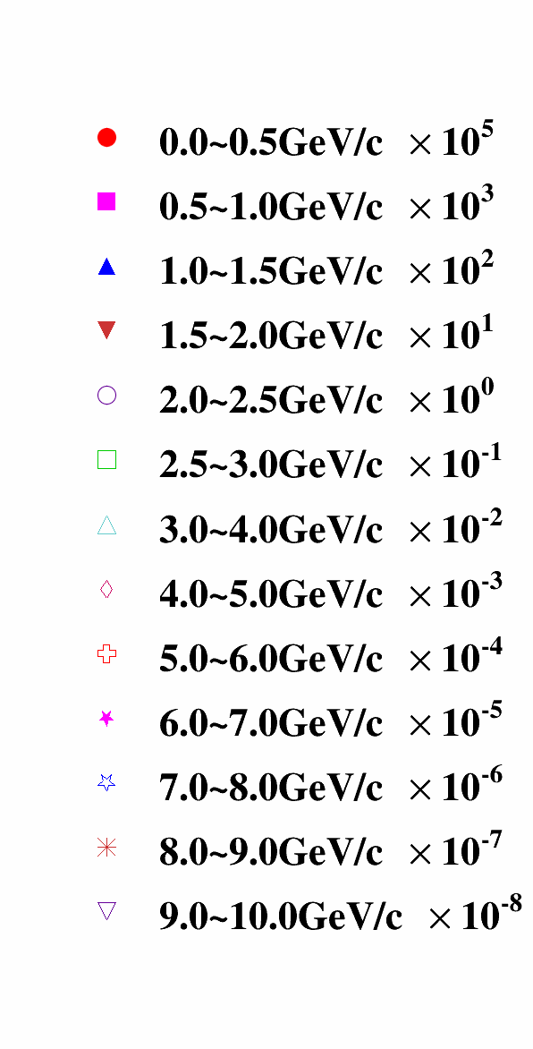
Recent Measurements from STAR
Using similar method as PHENIX
      PRC 81 (1020) 034911
apply 2-component fit
C. Yang – QM’14
p_{T}<5 GeV/c – Run10+11 (MinBias)
5<p_{T}<10GeV/c – Run11 (EMC trig)

Slide 31
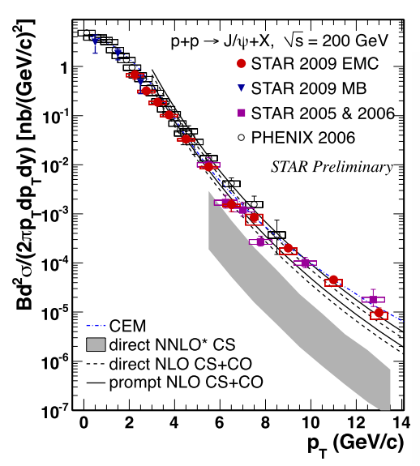
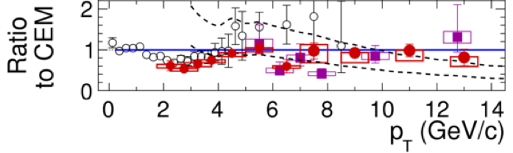
J/ψ Spectra in p+p at 200GeV
pT range in p+p extended to 14GeV/c
  Good agreement with PHENIX
Model Comparison
  prompt NLO CS+CO describes data pT>4GeV/c
  direct NNLO*CS misses high-pT

Slide 32
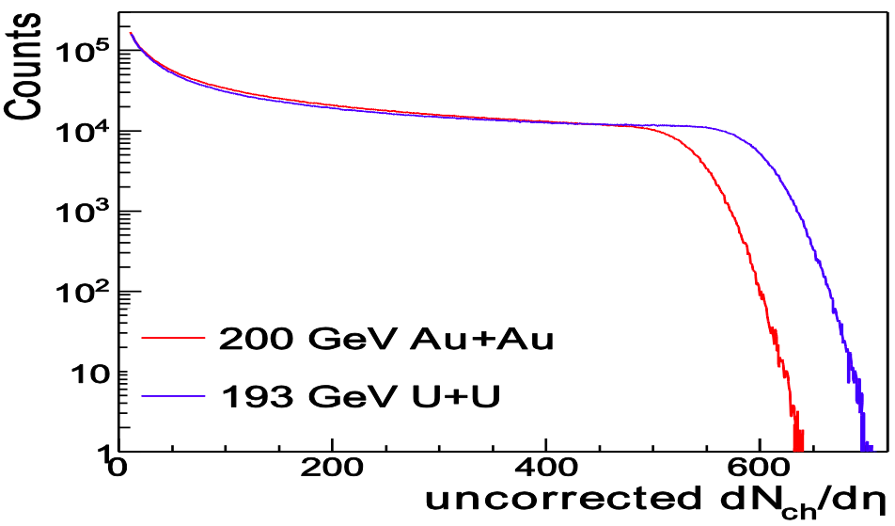
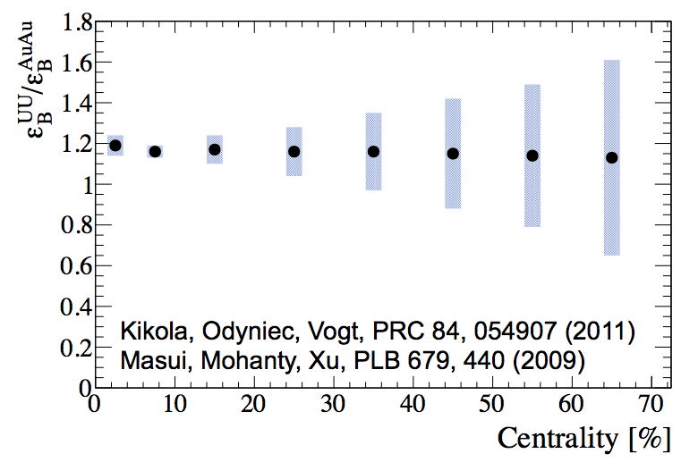
U+U: higher energy densities
RHIC Run-12: √s_{NN}=193 GeV U+U data
Reach higher N_{part} than in Au+Au
Provide higher energy density at same centralities
STAR preliminary

