Slide 1
Exploring the Transition Region of QCD with the Proton’s g₂ Structure Function
-
PR12-24-002
Jefferson Lab PAC 52
7/8/2024
David Ruth, Jian-Ping Chen, Nathaly Santiesteban, Karl Slifer

Slide 2
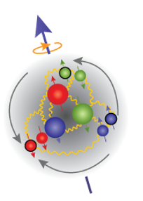
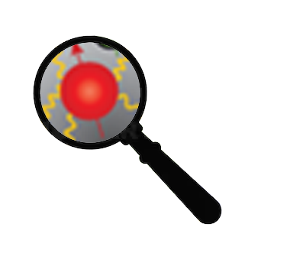
QCD
?
Low
Q²
High
Partons Combine to Form Nucleon
Confinement
Effective Theories: χPT
Can’t use Twist Approx.
Quark/Gluon Correlations
Lattice QCD
Higher Twists
Individual Partons
Asymptotic Freedom
Perturbative QCD
Leading Twist

Slide 3
How to study QCD and higher twist in the transition region?
In unpolarized systems, F₁ and F₂ structure functions describe the quark-gluon distribution of a hadron:
In a spin-½ polarized system, two additional structure functions describe the spin distribution of the hadron:
Nucleon Spin Structure
Quark-Gluon Correlations

Slide 4
g₂ Structure Function enables direct tests of QCD and higher twist
Higher Twist:
Benchmarking (Lattice) QCD:
Small
$$g_{2}\left(x,Q^{2}\right)=g_{2}^{WW}\left(x,Q^{2}\right)−\int_{x}^{1}{\frac{∂}{∂y}\left[\frac{m_{q}}{M}h_{T}\left(y,Q^{2}\right)+ζ\left(y,Q^{2}\right)\right]\frac{dy}{y}}$$
Twist-3
Function of g₁
Weighted integrals (moments) of the spin structure functions can be directly calculated by effective theories:
These polarizabilities describe the nucleon’s ensemble response to an external field
B-Field
$$\overline{d_{2}}= \int_{0}^{x_{th}}{x^{2}[{2g}_{1}\left(x,Q^{2}\right)+{3g}_{2}\left(x,Q^{2}\right)]dx}$$
Proton
Proton

Slide 5
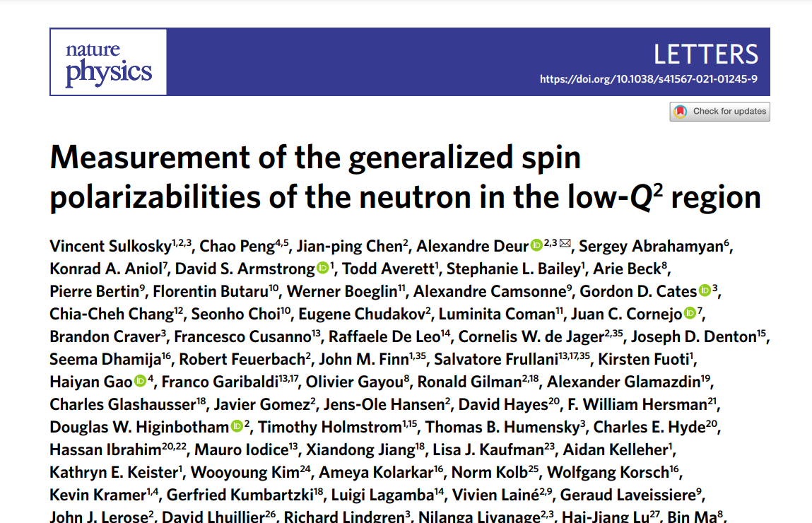
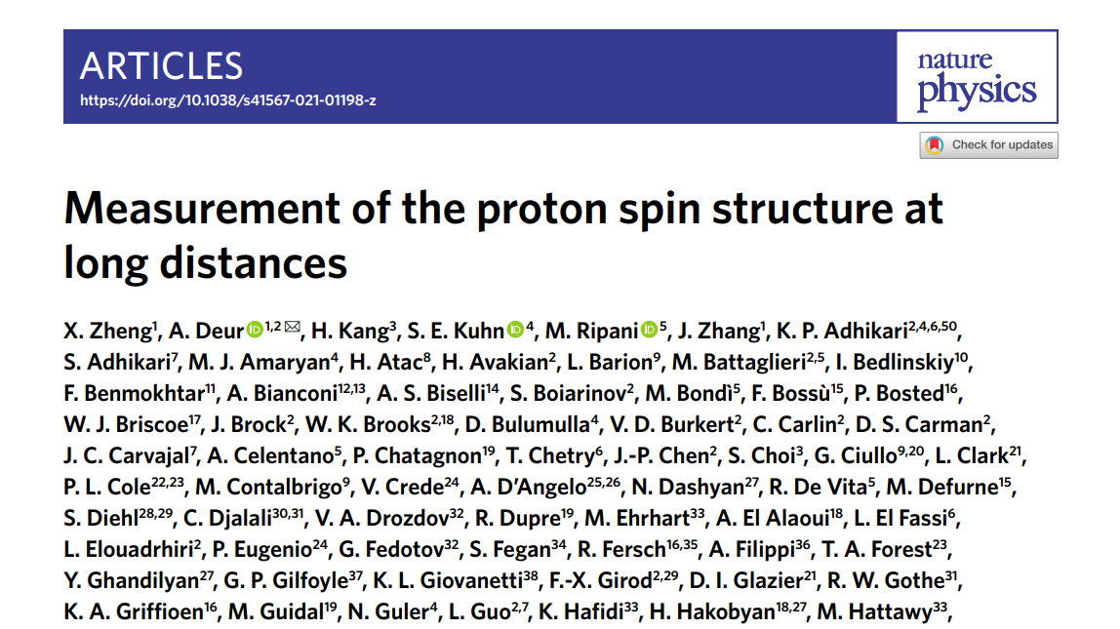
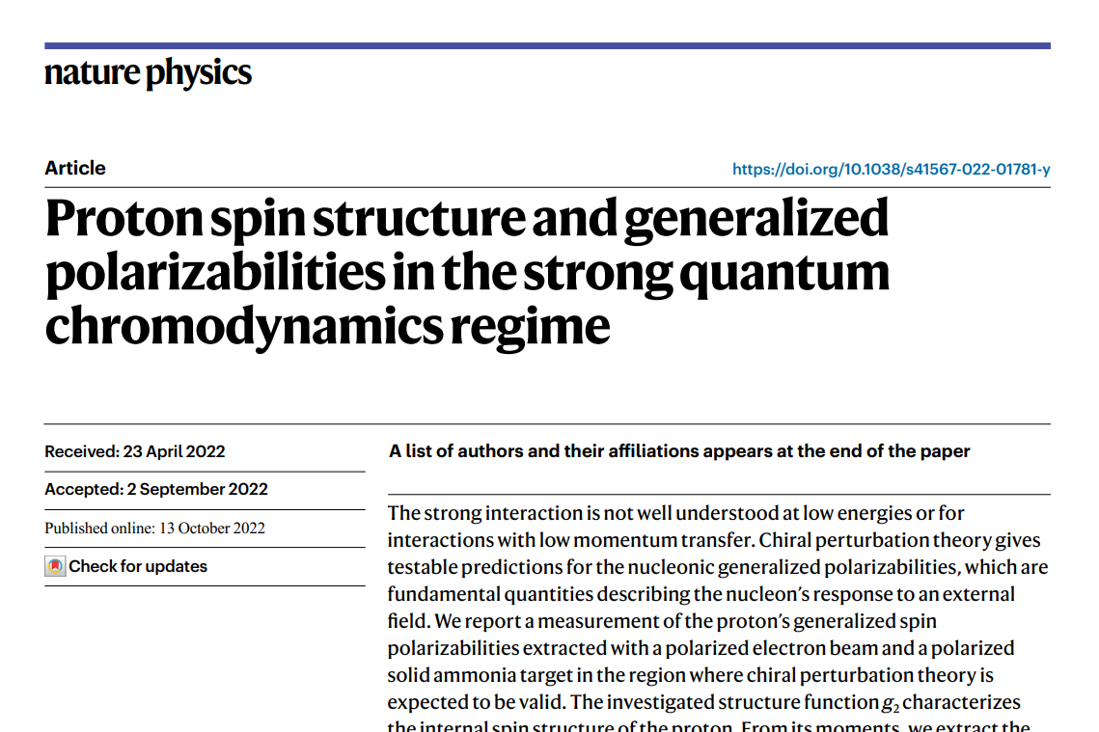
Recent Successful JLab Program
JLab has led a highly successful program to measure the spin structure functions (SSF) for both nucleons over a broad kinematic range
Three different experiments published recent SSF results in Nature Physics
2007 JLab Review: DOE Milestone to “measure g₁ and g₂ over an enlarged range of x and Q²”

Slide 6
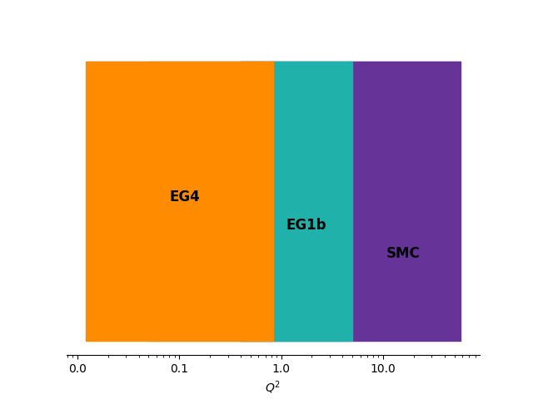
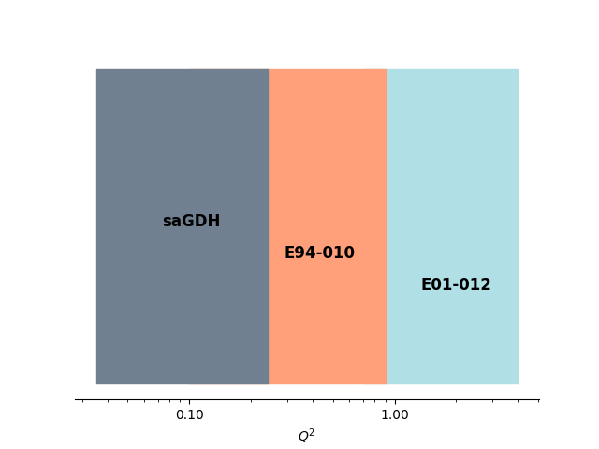
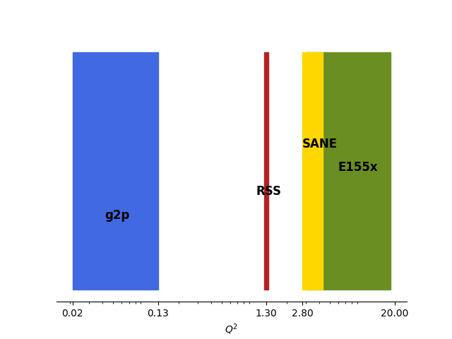
Existing Coverage
Proton
Neutron
g₁
g₂

Slide 7
“Low Hanging Fruit”
Much higher rates than the higher Q² experiments
No need for a septum magnet as was used in the low Q² g2p experiment in Hall A
Smaller out-of-plane angle than the low Q² data
Ripe with scientific motivation:
Necessary Benchmark for Lattice QCD
Unique Sensitivity to Twist-3 Effects
Significant contribution to Theoretical Hydrogen Hyperfine Splitting Uncertainty
Study sum rules and transition from perturbative QCD to effective theories
g₂
This
Proposal

Slide 8
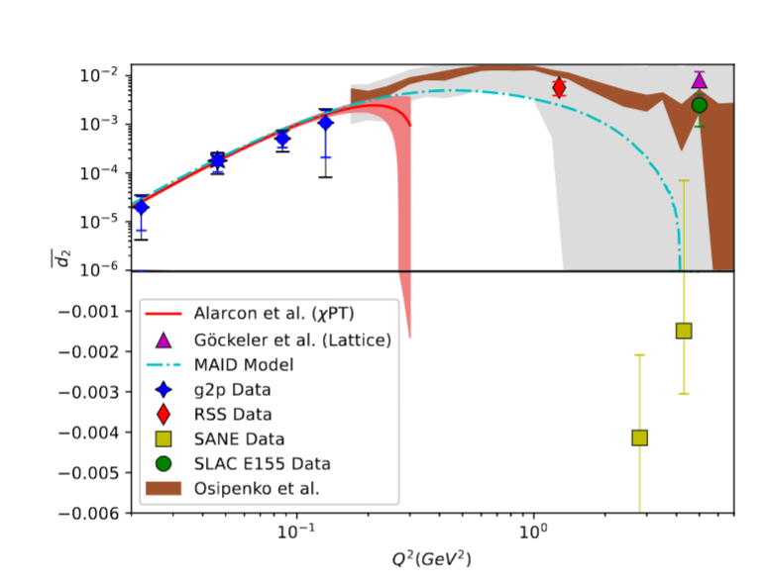
“Color Polarizability” $\overline{d_{2}}$
$$\overline{d_{2}}= \int_{0}^{x_{th}}{x^{2}[{2g}_{1}\left(x,Q^{2}\right)+{3g}_{2}\left(x,Q^{2}\right)]dx}$$
At high Q², identified as a color polarizability or “color Lorentz force”
Interesting negative result from SANE motivates further study at high Q²
Maxima and zero crossing of d₂ are in the unmeasured region
Upcoming lattice predictions in this region need an experimental benchmark!

Slide 9
Hyperfine Contribution
Running Integral from $\int_{Q_{min}^{2}}^{∞}{dQ^{2}}$
$$Δ_{2}=−24M_{p}^{2}\int_{0}^{∞}{\frac{dQ^{2}}{Q^{4}}}\int_{0}^{x_{th}}{\tilde{β_{2}}\left(x , Q^{2}\right)g_{2}\left(x , Q^{2}\right)dx}$$
The leading error in theoretical calculations of the hydrogen HFS comes from these spin-structure function dependent integrals!
The subject of an ongoing tension between theory and experiment
The transition region accounts for ~30% of the integral!
Running Integral
$Q_{min}^{2}$ (GeV²)

Slide 10
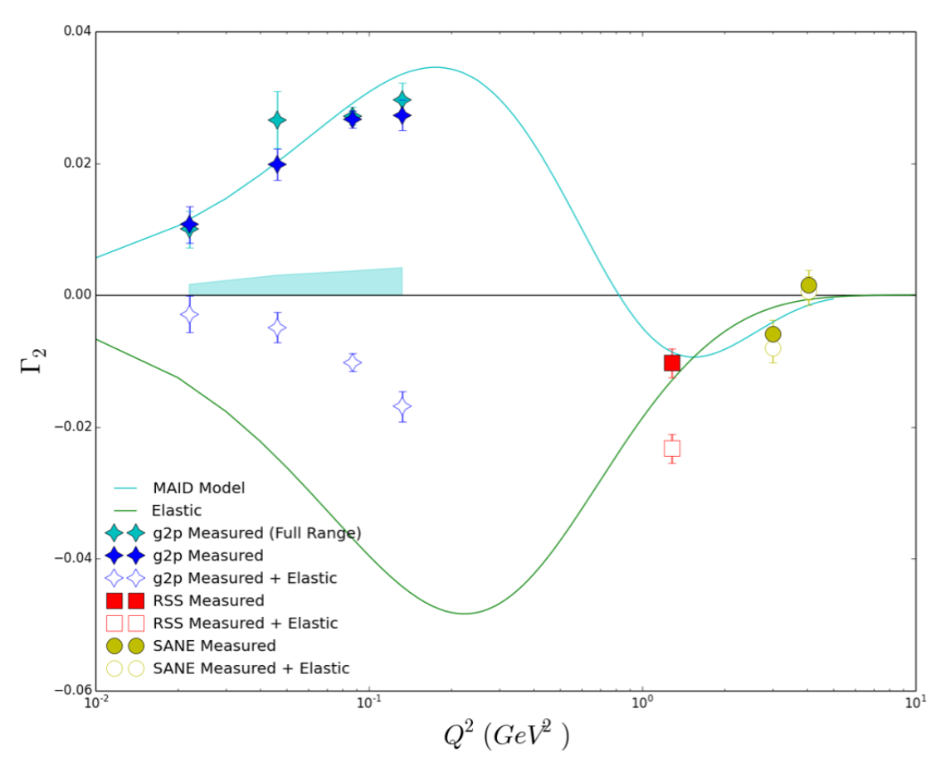
Γ₂ Moment & Burkhardt-Cottingham (BC) Sum rule
$Γ_{2}= \int_{0}^{x_{th}}{g_{2}\left(x,Q^{2}\right)dx}$ = 0
Resonance part of moment crosses zero in transition region
More transition data needed to understand low-x contribution as leading twist starts to fail

Slide 11
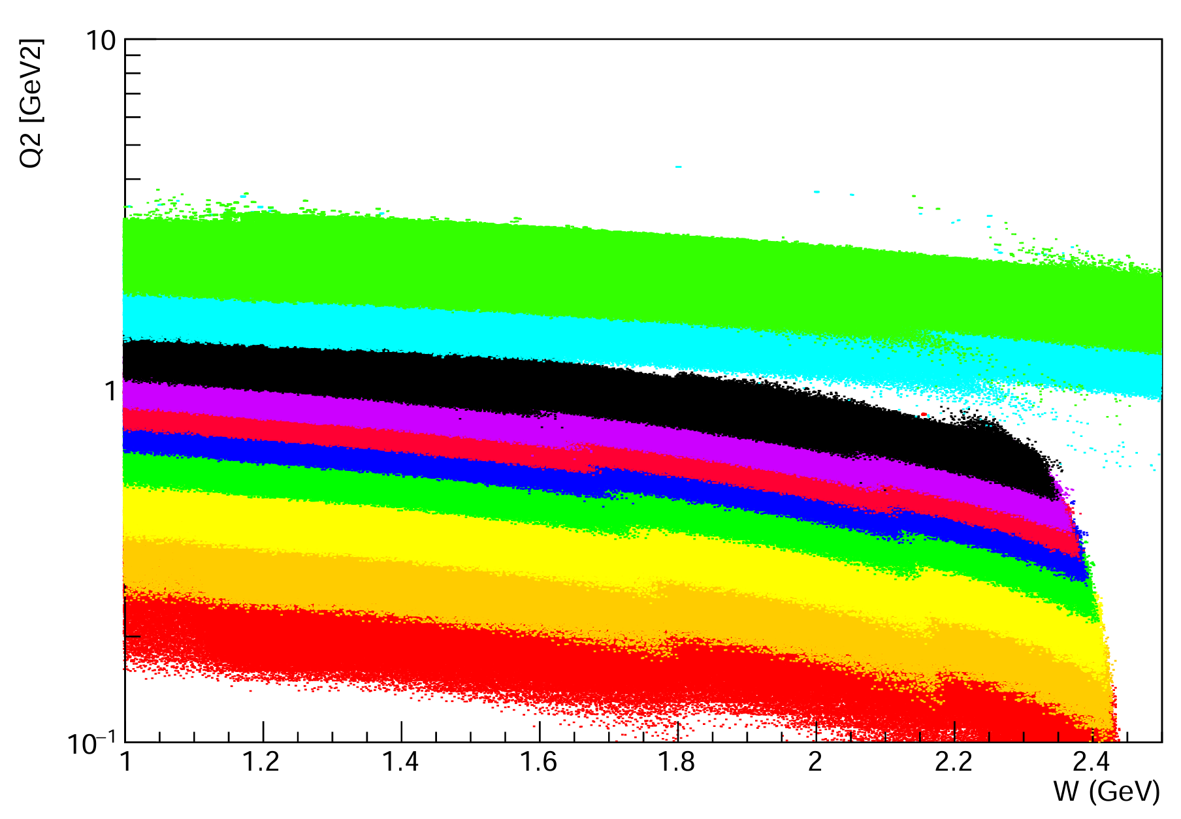
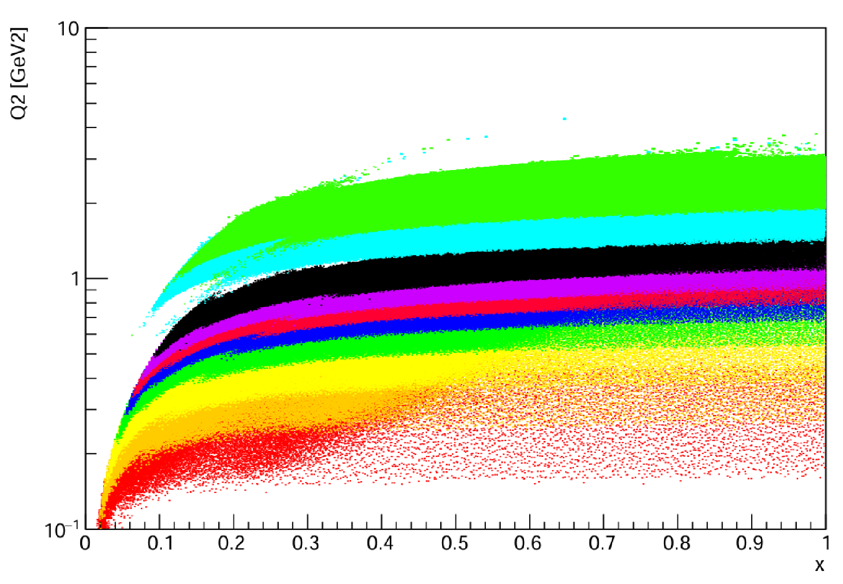
Proposed Experiment
Measure proton g₂ in the resonance region for a full order of magnitude in Q² range from 0.2 GeV² - 2.2 GeV²
Use a transversely polarized NH₃ target and the SHMS spectrometer in Hall C
Low current (85 nA) beam at 4.4 and 8.8 GeV beam energies
Collect the first transition region measurement of the proton’s g₂, and extract its moments and higher twist effects

Slide 12
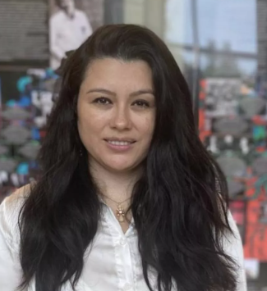
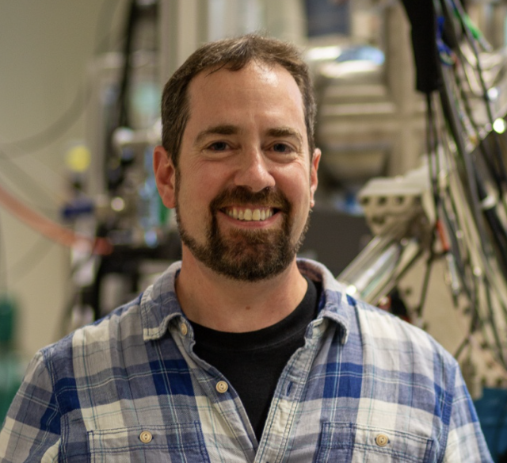
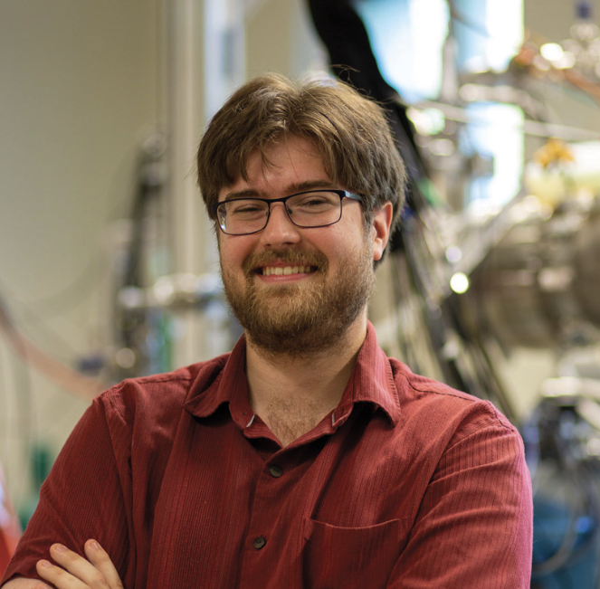
Collaboration
Jian-Ping Chen
Nathaly Santiesteban
Karl Slifer
David Ruth
Polarized Target
Experts
g2p Analysis
SANE Analysis
RSS Analysis
W. Armstrong
J. Maxwell
Z.E. Meziani
M. Jones
K. Slifer, A. Arora, M. Farooq, N. Santiesteban, H. Chinchay, Z. Wolters, O. Olokunboyo, A. Zec, E. Long, J.P. Chen, D. Ruth, C. Keith, J. Maxwell. D. Meekins, J. Brock, D. Keller, I. Fernando, S. Covrig Dusa
D. Ruth
J.P. Chen
K. Slifer
K. Slifer
M. Jones
O. Rondon
Notes:
.

Slide 13
Experimental Setup
SHMS
Moller
Polarimeter
Fast Raster
Slow
Raster
Slow
Raster
Chicane
1
Chicane
2
BPMs/Harps
5T Transverse
Target
BCMs
Dump
Standard equipment package, plus:
Installation of the target group’s 5T polarized target
Commissioning of Dr. Jay Benesch’s new chicane magnet design
Configuration of the beamline to operate at low current (85 nA)
Installation of the slow raster
Installation of the smaller exit beampipe for small angle SHMS measurements

Slide 14
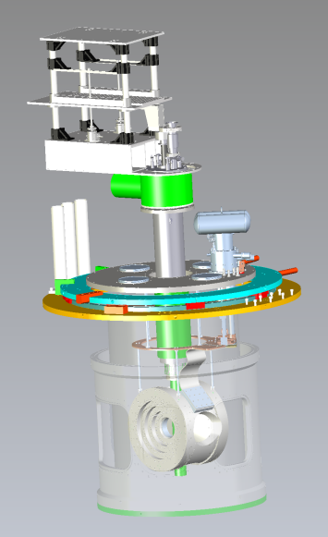
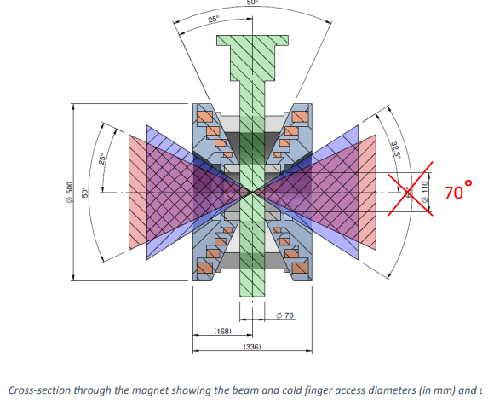
Polarized Target
Target group has new polarized target magnet capable of improving performance from the g2p run
Helmholtz-configuration magnet is optimized for running with transverse field and acceptance appropriate for the desired kinematics (± 25°)
Run will require a polarized NH₃ (Ammonia) target
Several polarized target experiments already approved in Hall C – possibility for cooperation on scheduling

Slide 15
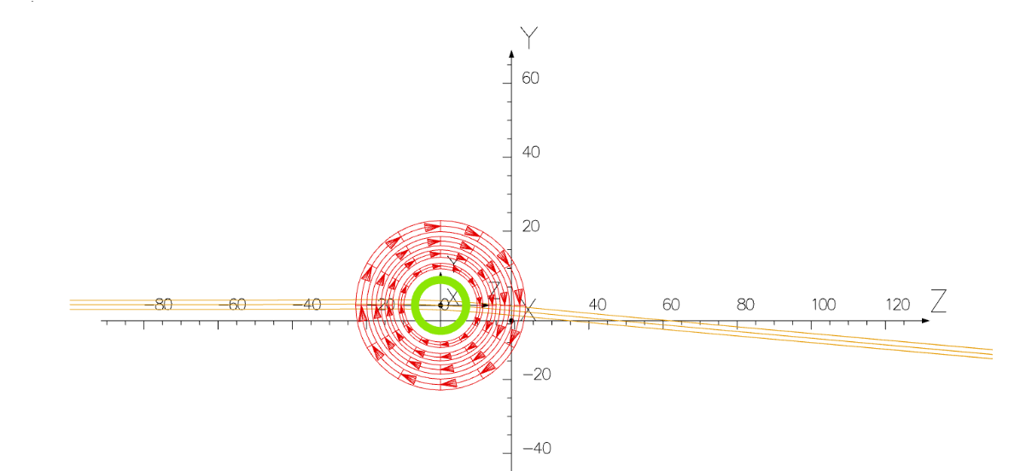
Chicane Magnet
Beam Direction
The transverse target field necessitates a pre-bending of the beam to locate the beam at the center of the target and within the area of the hall dump
Dr. Jay Benesch has worked on a new design which would replace two of the existing 1m dipoles and satisfy the needs of this proposal
New installation will need to be commissioned, and is needed for SoLID and any other experiment with transverse polarized target

Slide 16
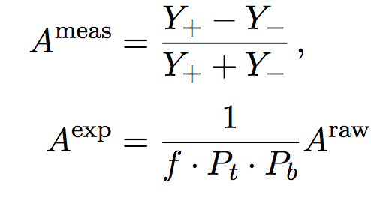
g₂ Extraction Method
Measure Asymmetry and Cross Section:
Form Polarized XS Difference:
Extract g₂
$$A_{⊥}^{Raw}=\frac{σ^{↑⇒}−σ^{↓⇒}}{σ^{↑⇒}+σ^{↓⇒}}$$
$$\frac{d2σ}{dΩdE′}=\frac{(ps)N}{N_{in}ρ(LT)ε_{det}}\frac{f}{ΔΩΔE′ΔZ}$$
Spin-Dependent Effects
$${∆σ}_{⊥} =2A_{⊥}^{exp}σ_{0}$$
Unpolarized
Scattering
Input from
Hall B Data
$$g_{2}\left(x,Q^{2}\right)= \frac{K_{1}y}{2}\left[Δσ_{⊥}\left(K_{2}+\tan{\frac{θ}{2}}\right)\right]+ \frac{g_{1}\left(x,Q^{2}\right)y}{2}$$

Slide 17
Beam Time Required
Source | Time (PAC Days)
Q² = 0.22 GeV² | 0.1
Q² = 0.33 GeV² | 0.2
Q² = 0.46 GeV² | 0.3
Q² = 0.62 GeV² | 0.8
Q² = 0.77 GeV² | 1.1
Q² = 0.89 GeV² | 1.8
Q² = 1.03 GeV² | 2.3
Q² = 1.25 GeV² | 4.6
Q² = 1.84 GeV² | 0.9
Q² = 2.2 GeV² | 0.9
Total Physics Days | 13
Overhead Days | 13
Only
26 Days
To measure 10 Q² settings of g₂ with high precision…
covering a full order of magnitude of the transition region!

Slide 18
Projected Systematics
Source | %
Acceptance | 4-6
Packing Fraction | 3
Charge Determination | 1
Tracking Efficiency | 1
PID Efficiencies | < 1
Software Cut Efficiency | < 1
Energy | 0.5
Deadtime | < 1
XS Total | 5-7
Target Polarization | 5
Beam Polarization | 3
Radiative Corrections | 3
Parallel Contribution | 2
Const Q² Adjustment | < 1
S.F. Total | 8.5-9.8
Dominating systematics are target polarization and acceptance

Slide 19
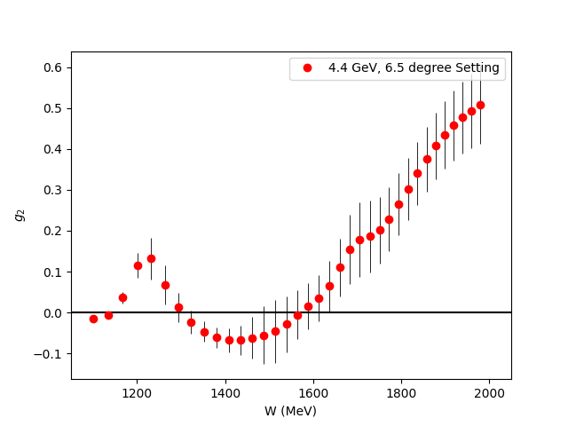
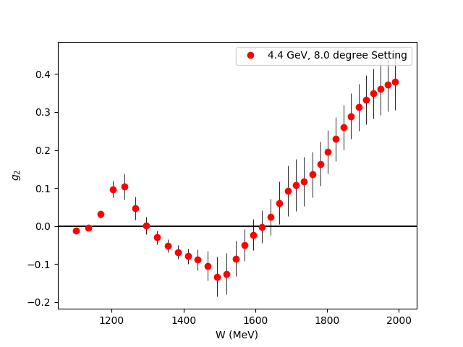
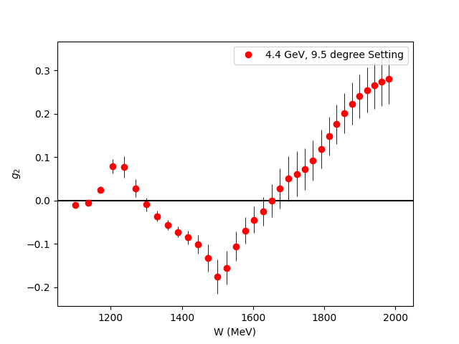
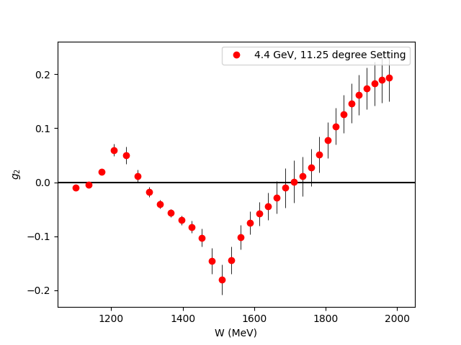
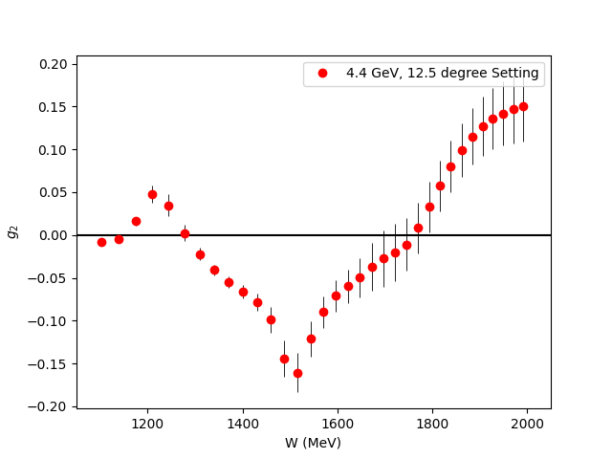
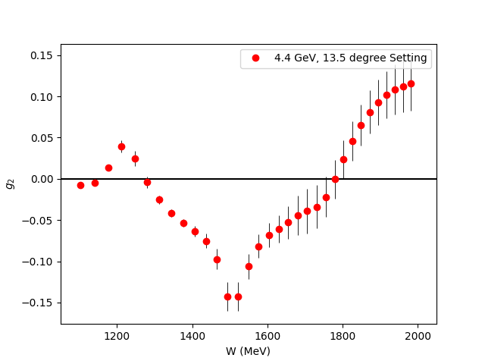
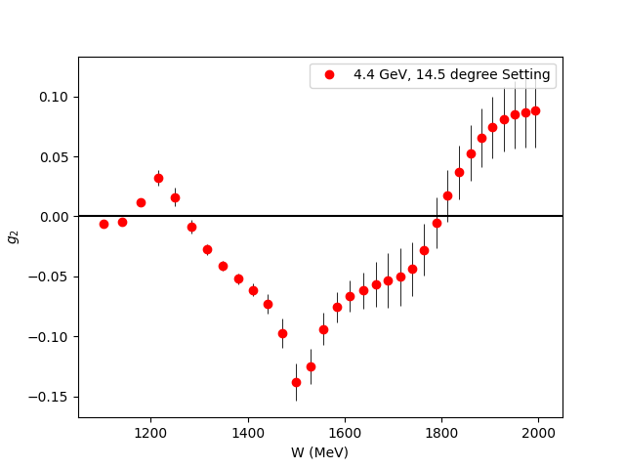
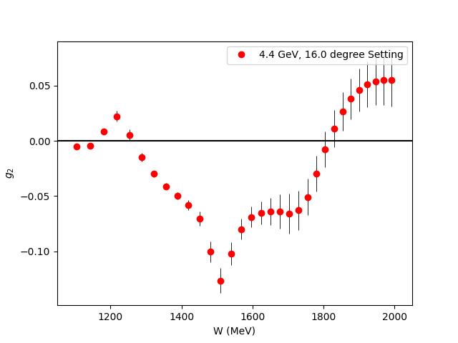
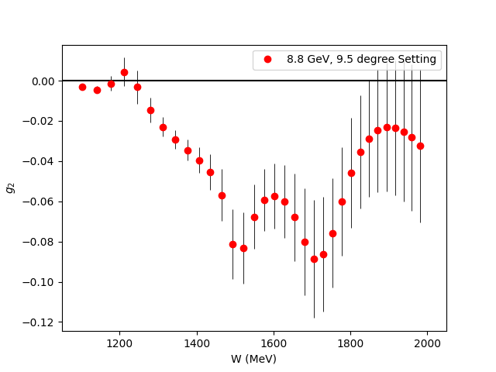
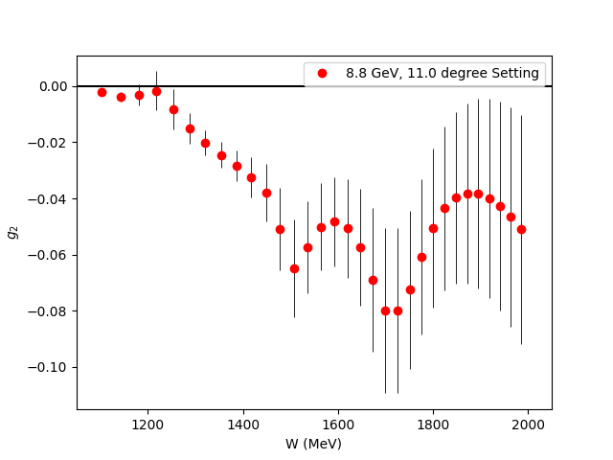
Projected g₂ Uncertainties
Fills the last major Q² spectrum gap for the nucleon spin structure functions
Covers almost the entire transition region

Slide 20
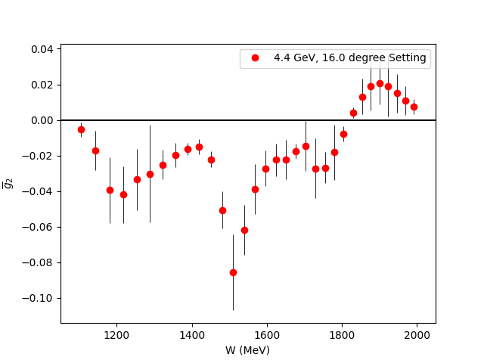
$\overline{g_{2}}$ (Twist 3 Extraction)
Small
$$g_{2}\left(x,Q^{2}\right)=g_{2}^{WW}\left(x,Q^{2}\right)−\int_{x}^{1}{\frac{∂}{∂y}\left[\frac{m_{q}}{M}h_{T}\left(y,Q^{2}\right)+ζ\left(y,Q^{2}\right)\right]\frac{dy}{y}}$$
$\overline{g_{2}}$ (Twist-3)
Utilize CLAS Hall B Results
for g₁ in same regime
Direct extraction of Twist 3 effects
in the regime they contribute most significantly

Slide 21
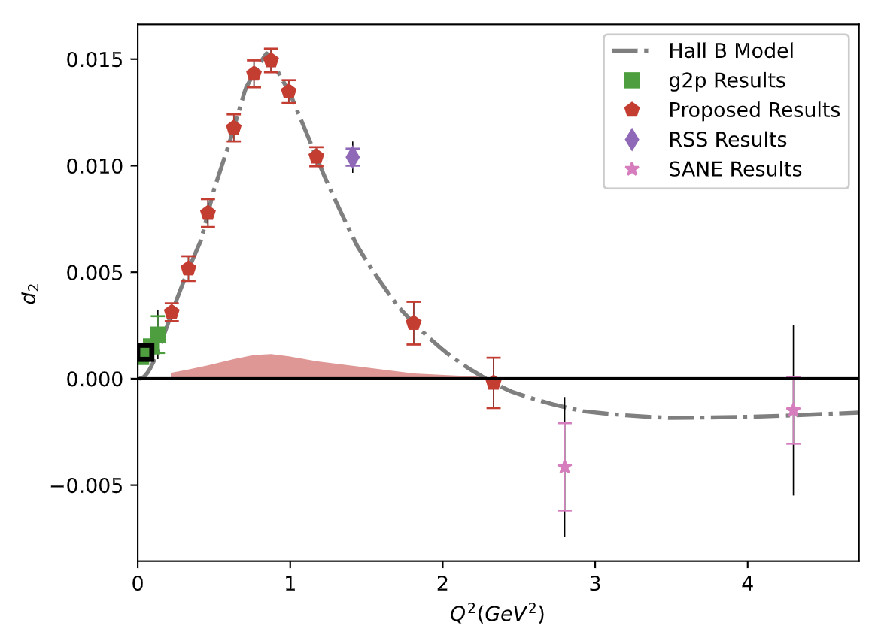
Projected $\overline{d_{2}}$ Uncertainties
Can benchmark Lattice QCD in the regime where Perturbative QCD starts failing
New Lattice calculations expected in next few years!
Results should discover maximum and zero crossing of this unique polarizability!

Slide 22
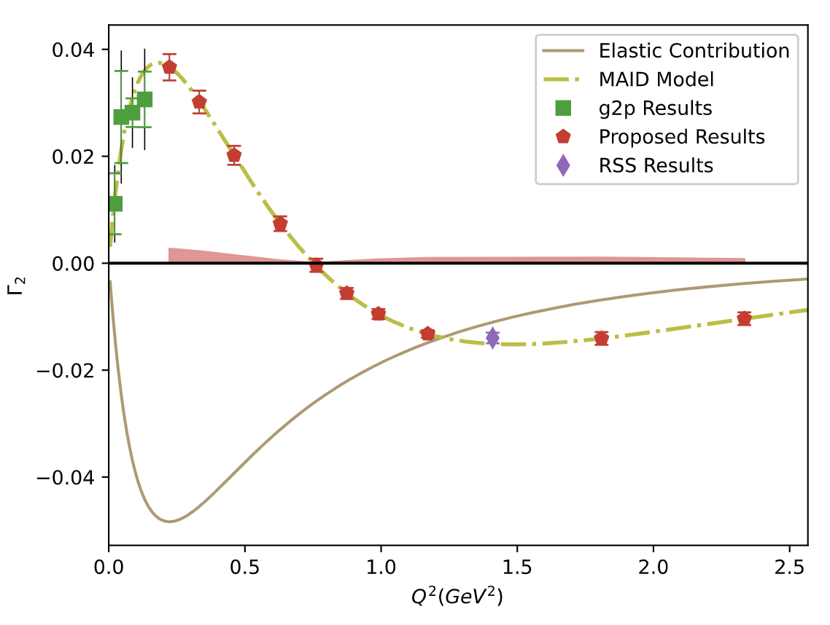
Projected $Γ_{2}$ Uncertainties
Having data in the regime where twist-2 assumption fails helps us better understand the small-x regime
If B.C. Sum Rule is followed, then we directly measure how the low-x part transitions from $g_{2}^{WW}$into a more complex form!

Slide 23
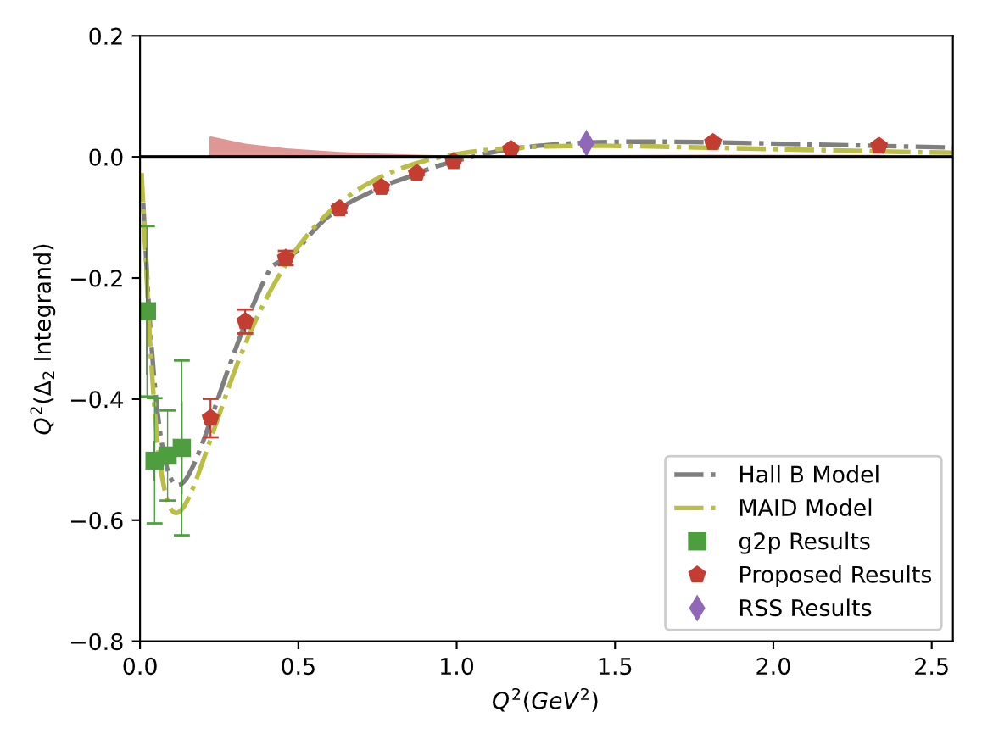
Projected $Δ_{2}$ Uncertainties
Transition region accounts for 30% of $Δ_{2}$
These results can cut the error in this region to $1/6$ of the current error
$Δ_{pol}={c(Δ}_{1}+Δ_{2})$ accounts for 81% of the current two-photon Hyperfine Splitting uncertainty
Opportunity to study or maybe eliminate a long-standing tension between theory and experiment for $Δ_{pol}$!

Slide 24
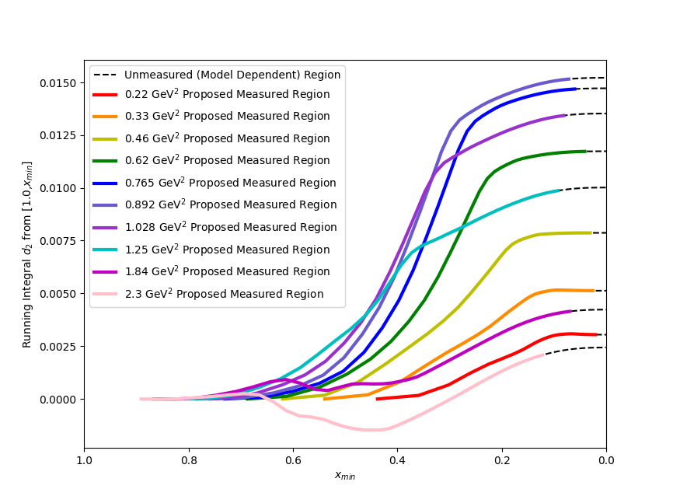
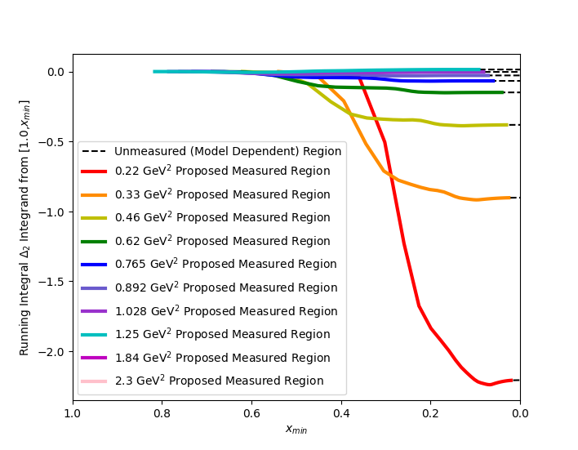
Running Integrals from $\int_{x_{min}}^{x_{th}}{dx}$
$Δ_{2}$
Running Integral
Running Integral
$\overline{d_{2}}$
x_{min}
x_{min}
Integrals are saturated in the measured region (flat slope)
Therefore, the low-x regime is irrelevant to these integrals

Slide 25
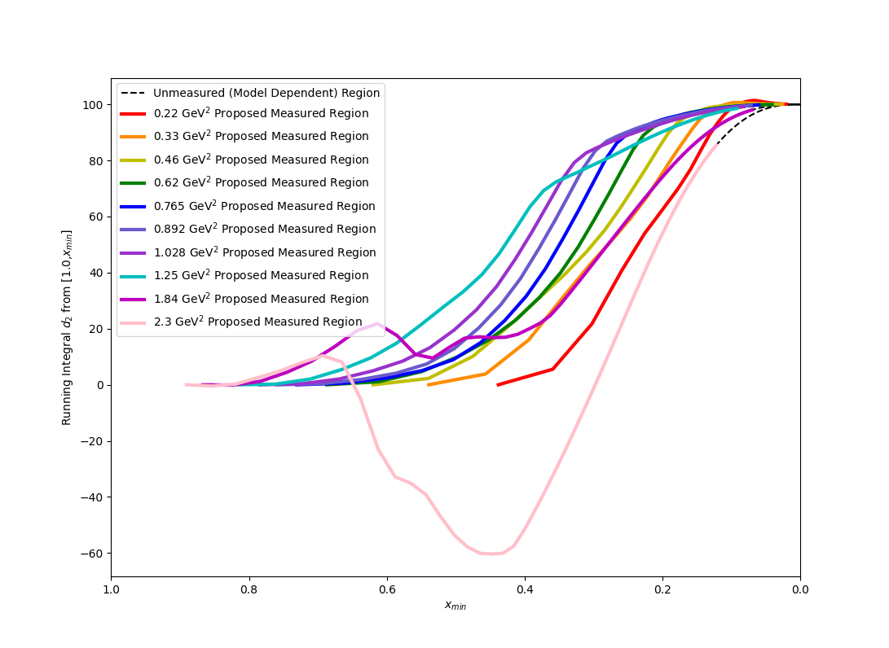
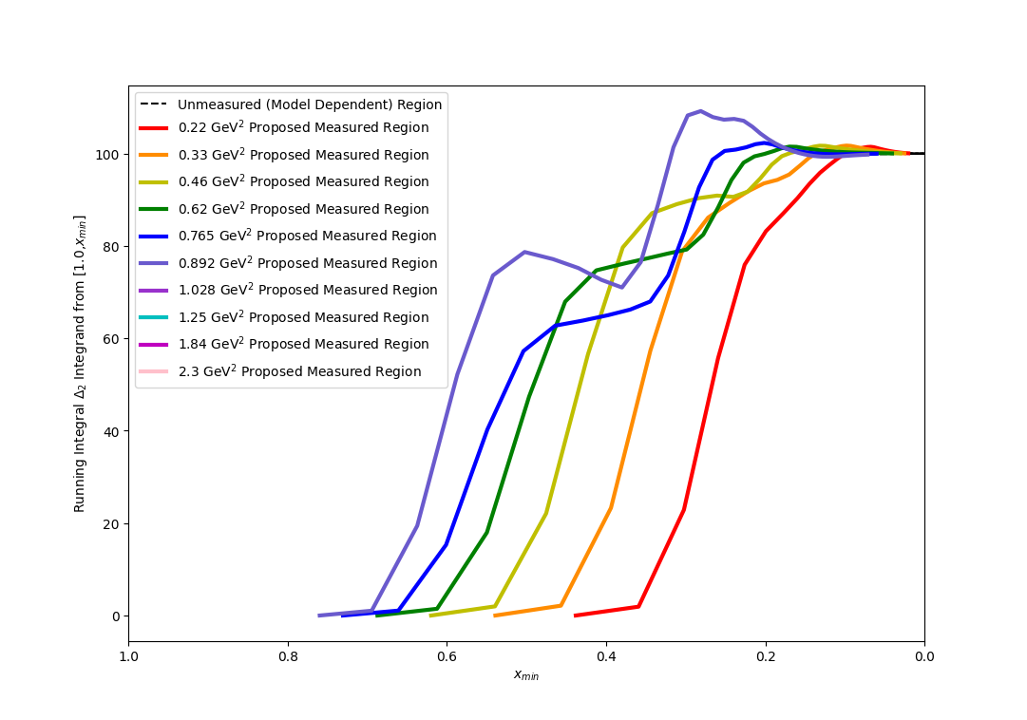
Running Integrals as % Total Value ($\int_{x_{min}}^{x_{th}}{dx}$)
Running Integral (% Total)
Running Integral (% Total)
$\overline{d_{2}}$
$Δ_{2}$
x_{min}
x_{min}
Integrals are saturated in the measured region (flat slope)
Therefore, the low-x regime is irrelevant to these integrals

Slide 26
What do the theorists have to say…?
“A clear case of ‘low-hanging fruit’ with a wealth of opportunities to address long-standing open questions.”
“The measurement will be very important for future efforts to understand the proton’s structure and the transition between parton and hadron descriptions of QCD dynamics”
– PR12-23-007 Theory Report
“[g₂] measurements over a range of Q2 are needed for a comprehensive understanding of the transition from perturbative to nonperturbative QCD”
“Scientifically sound, with a clear rationale and a well-designed experimental plan”
– PR12-24-002 Theory Report

Slide 27
Summary
In 26 PAC Days, we will measure and publish fundamental observable g₂ across an order of magnitude range of the transition region Q² = 0.22 – 2.2 GeV² and:
Study Twist-3 with $\overline{g_{2}}$
Reduce error on the leading uncertainty in Hydrogen Hyperfine Splitting and study a long-standing tension
Fill the last major gap in the nucleon spin structure function Q² spectrum
Benchmark Lattice QCD with $\overline{d_{2}}$
Enable a better understanding of the B.C. Sum Rule in the nonperturbative regime

Slide 28
Backup Slides

Slide 29
Rates Table
E₀ (GeV) | Scattering Angle (deg) | P₀ (GeV) | Target Q² (GeV²) | Proton Rate (Hz) | Rate (kHz) | Time (h)
4.4 | 6.5 | 3.607 | 0.22 | 77 | 40.0 | 1
 |  | 2.661 |  | 65 | 25.1 | 1
 |  | 1.963 |  | 69 | 18.9 | 1
 | 8 | 3.607 | 0.33 | 41 | 21.4 | 1.3
 |  | 2.661 |  | 28 | 11.5 | 1.9
 |  | 1.963 |  | 30 | 8.3 | 1.8
 | 9.5 | 3.607 | 0.46 | 18 | 9.1 | 2.3
 |  | 2.661 |  | 14 | 5.9 | 3.0
 |  | 1.963 |  | 15 | 4.3 | 2.8
 | 11.2 | 3.607 | 0.62 | 7 | 3.7 | 6.0
 |  | 2.661 |  | 6 | 3.0 | 6.5
 |  | 1.963 |  | 7 | 2.2 | 5.9
 | 12.5 | 3.607 | 0.765 | 4 | 2.0 | 9.1
 |  | 2.661 |  | 4 | 1.9 | 8.5
 |  | 1.963 |  | 4 | 1.5 | 7.6
 | 13.5 | 3.607 | 0.892 | 2 | 1.3 | 16.5
 |  | 2.661 |  | 3 | 1.3 | 13.7
 |  | 1.963 |  | 3 | 1.1 | 12.1
 | 14.5 | 3.607 | 1.028 | 1 | 0.8 | 23.2
 |  | 2.661 |  | 2 | 1.0 | 17.4
 |  | 1.963 |  | 2 | 0.8 | 14.9
 | 16 | 3.607 | 1.250 | 0 | 0.4 | 50.8
 |  | 2.661 |  | 1 | 0.6 | 32.7
 |  | 1.963 |  | 1 | 0.5 | 26.6
8.8 | 9.5 | 7.213 | 1.8 | 0 | 1.3 | 12.9
 |  | 5.321 |  | 0 | 1.6 | 9.3
 | 11 | 7.213 | 2.3 | 0 | 0.5 | 14.3
 |  | 5.321 |  | 0 | 0.8 | 8.2
Total PAC Days:
13.0

Slide 30
Overhead
Overhead | Number | Time Per (hr) | (hr)
Target Anneal | 26 | 2.0 | 52.0
Beamline Survey | 10 | 8.0 | 80.0
Target Swap | 2 | 4.0 | 8.0
Target T.E. | 6 | 2.25 | 13.5
Target Field Ramp | 10 | 1.0 | 10.0
Carbon, Dummy, Empty runs | 28 | 0.5 | 14.0
Pass Change | 2 | 4.0 | 8.0
Momentum Change | 28 | 0.5 | 14.0
Moller Measurement | 10(+1 shift) | 4.0(+8.0) | 48.0
Pair-Symmetric Background | 2 | 4.0 | 8.0
Optics Calibration | 2 | 16.0 | 32.0
BCM Calibration | 2 | 4.0 | 8.0
Total: 13.0 Overhead Days

Slide 31
Burkhardt-Cottingham Sum Rule
$Γ_{2}= \int_{0}^{x_{th}}{g_{2}\left(x,Q^{2}\right)dx}$ = 0
“Superconvergence” Sum Rule for an amplitude whose imaginary part is g₂
Assuming convergent dispersion relations for g₂(𝜈) and 𝜈g₂(𝜈), arises naturally from subtraction of VVCS amplitudes:
$Im S_{2}\left(ν,Q^{2}\right)= \frac{2π}{ν^{2}M}g_{2}(x,Q^{2})$
$S_{2}\left(ν,Q^{2}\right)=\frac{2}{π}\int_{ν_{th}}^{∞}{\frac{ν Im S_{2}}{ν^{′2}−ν^{2}}dν^{′}}$
$νS_{2}\left(ν,Q^{2}\right)=\frac{2}{π}\int_{ν_{th}}^{∞}{\frac{ν^{′}Im S_{2}}{ν^{′2}−ν^{2}}dν^{′}}$
B.C. Integral converges to 0 in both QED and Perturbative QCD, and follows from Wandzura-Wilczek relation (Altarelli et al [1994], R. L. Jaffe [1990 Review])

Slide 32
Reliability of the Chicane
Chicane is a new installation, not a refurbishment of the old chicane
Design is fundamentally similar to numerous similar projects by the JLab staff, nothing untested or uncertain about it
Dr. Benesch is the longest serving member of the TAC and has designed resistive and superconducting magnets since 1976
Design is “Proof of Principle” only in sense that mm scale refinements still need to be made
Staff scientists are very confident that chicane will be carefully built and tested and will work well, but will need some time to commission

Slide 33
Target Mass Corrections
Target Mass Corrections irrelevant for a purely experimental quantity like g₂
But are needed to compare moments to theory
Use Nachtmann Moments instead of Cornwall-Norton:
$${2M}_{2}^{(3)}=Nachtmann Moment of \overline{d_{2}}$$

Slide 34
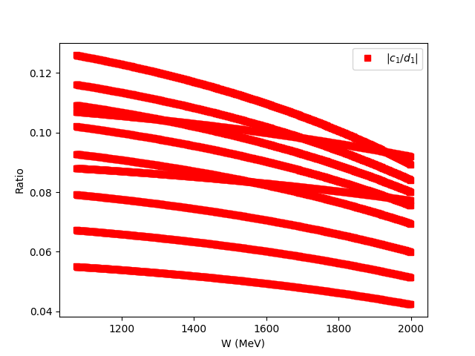
Sensitivity to ${Δσ}_{∥}$
$$g_{2}\left(x,Q^{2}\right)= \frac{K_{1}y}{2}\left[Δσ_{⊥}\left(K_{2}+\tan{\frac{θ}{2}}\right)\right]+ \frac{g_{1}\left(x,Q^{2}\right)y}{2}$$
88-96% of g₂
From this proposal
4-12% of g₂
From Hall B Data
which has its own
(small) systematics

Slide 35
Multiple Scattering
TAC Question if Multiple Scattering in the target could expand the beam spot enough to hit the exit beampipe (6 mm clearance)
Using g2p values for x/X₀, and the proposal beam energies for p (z = charge number = 1 for electrons) we obtain:
The beam will take 12.684 m to expand by 6mm, being well out of the small diameter pipe (3.3 m length)
Less than 0.0008% of the beam will interact with the pipe, so this background is negligible

Slide 36
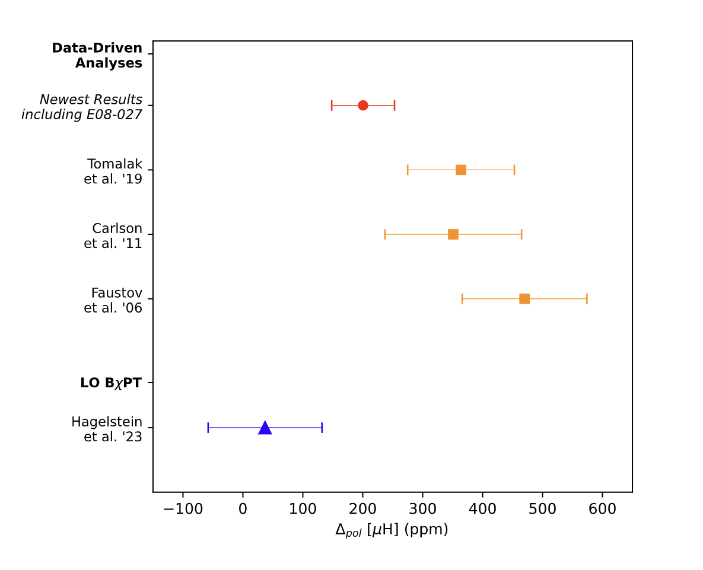
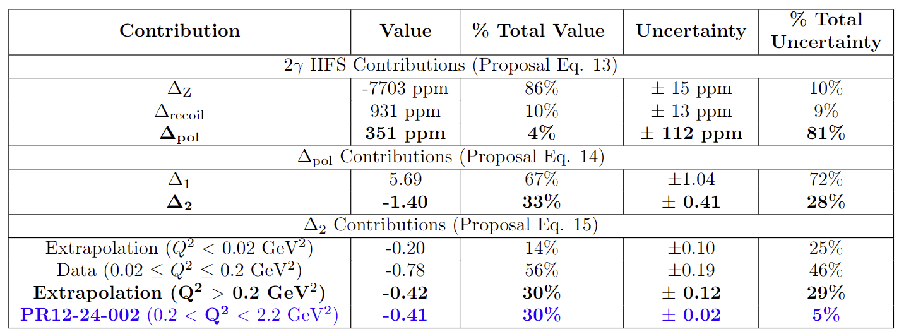
Hyperfine Details
g2p (E08-027) Data helped to reduce tension significantly by being more negative than expected…
Will transition region data do the same and eliminate the tension? We need to know

