Slide 1
JLab Positron and Energy Upgrade
12 GeV e+ and 22 GeV e-
Joe Grames and Alex Bogacz
Program Advisory Committee (PAC52)
Jefferson Lab
indico.jlab.org/event/838/
July 8-12, 2024

Slide 2
Ce⁺BAF baseline: 123 MeV polarized e-/e+ injector + 12 GeV CEBAF (e-/e+)
Polarized Electron Source
  Diffracted-Bragg Reflector polarized GaAs/GaAsP photocathodes
  Compact high power 120 kW SRF linac
Positron Source
  High power (20 kW) target
  Normal conducting magnet and capture region for tunable intensity/polarization
  SRF linac and bunch compressor
Modified CEBAF for bi-polar operation, low-disperson optics, low-current diagnostics
Developing a pre-conceptual design for a new e-/e+ injector at the LERF with a new CEBAF transport tunnel to reach the top energy of 12 GeV
Enabling Technology:
High-current spin-polarized electron source + compact & tunable high power PEPPo target

Slide 3

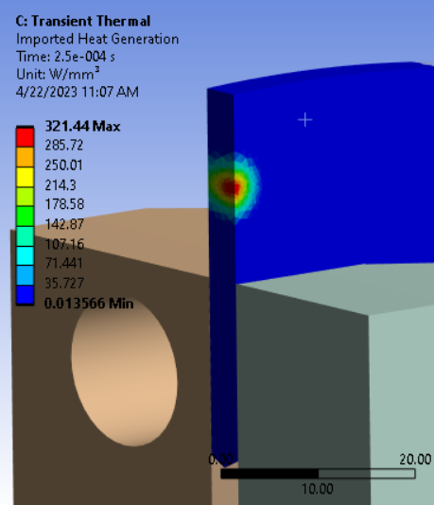
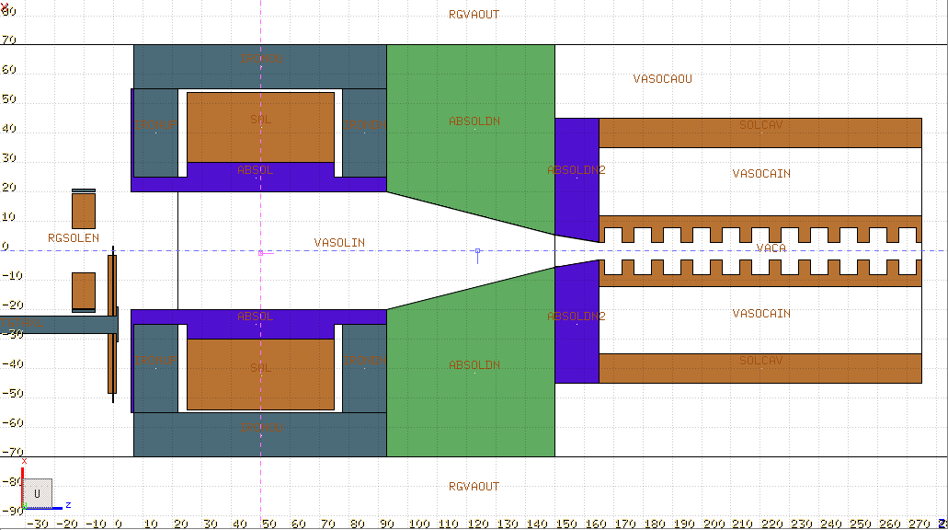
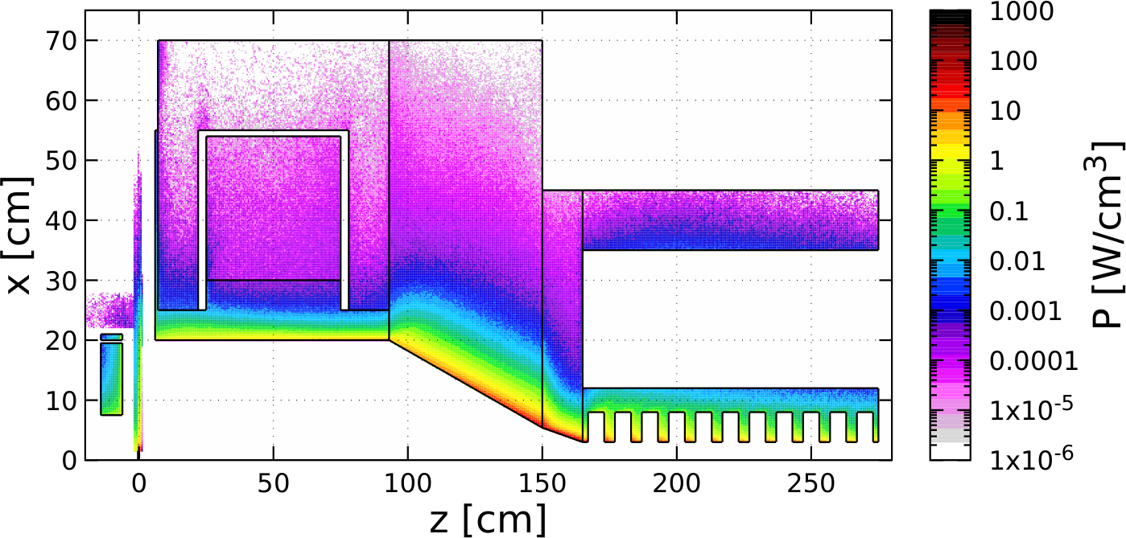
LERF Polarized Positron Injector Concept
Two challenging injectors have to be built
>1 mA polarized e- injector >150 MeV
>100 kW target & cw-collection beam line

Slide 4
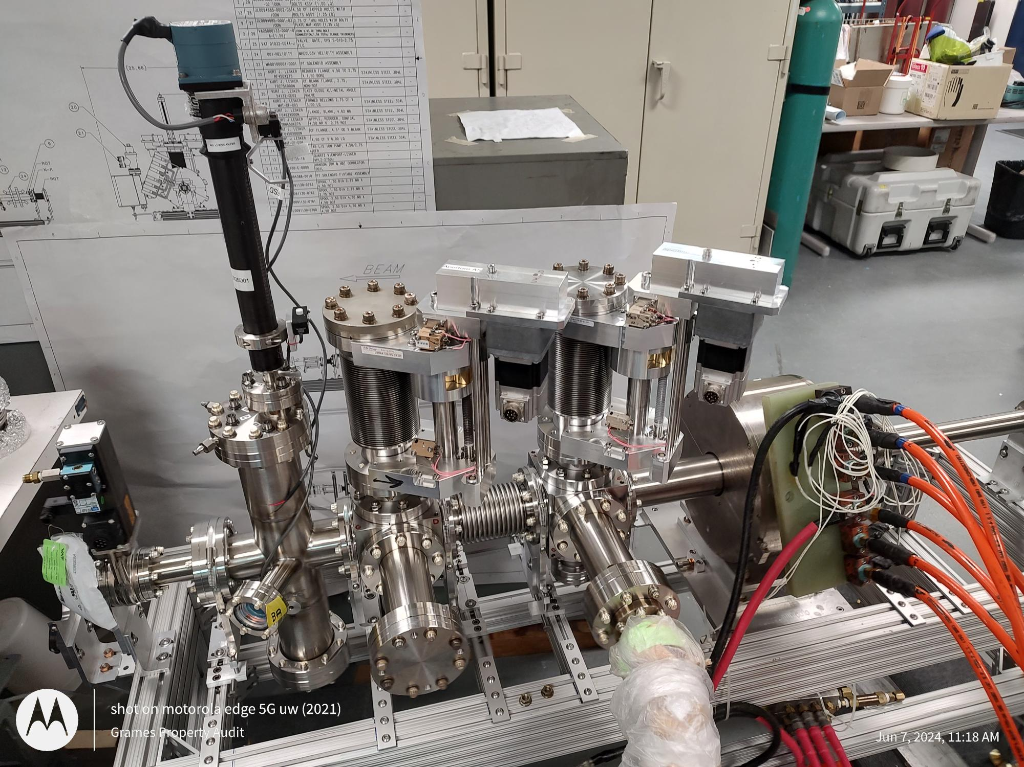
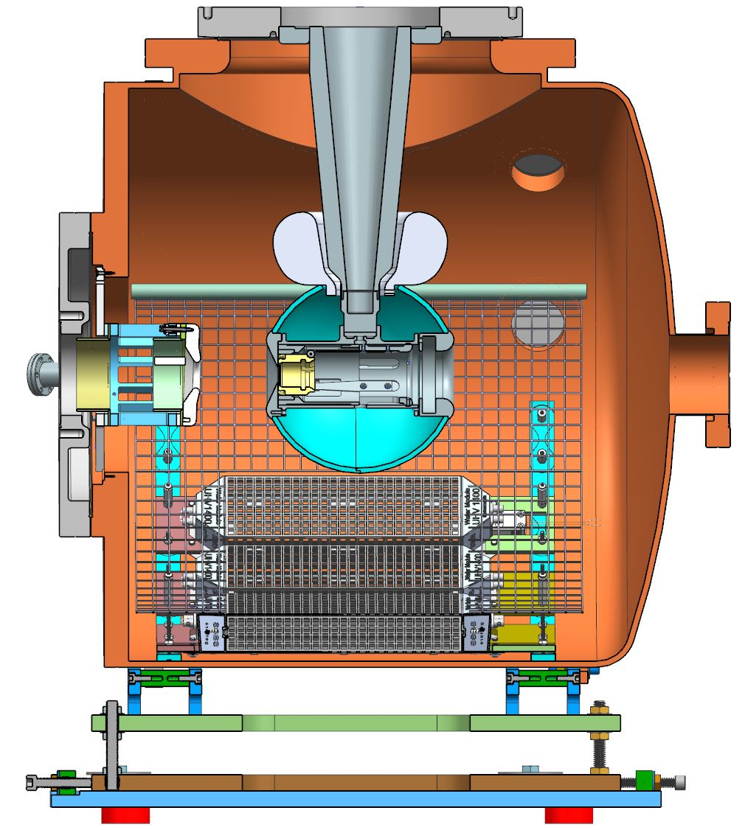
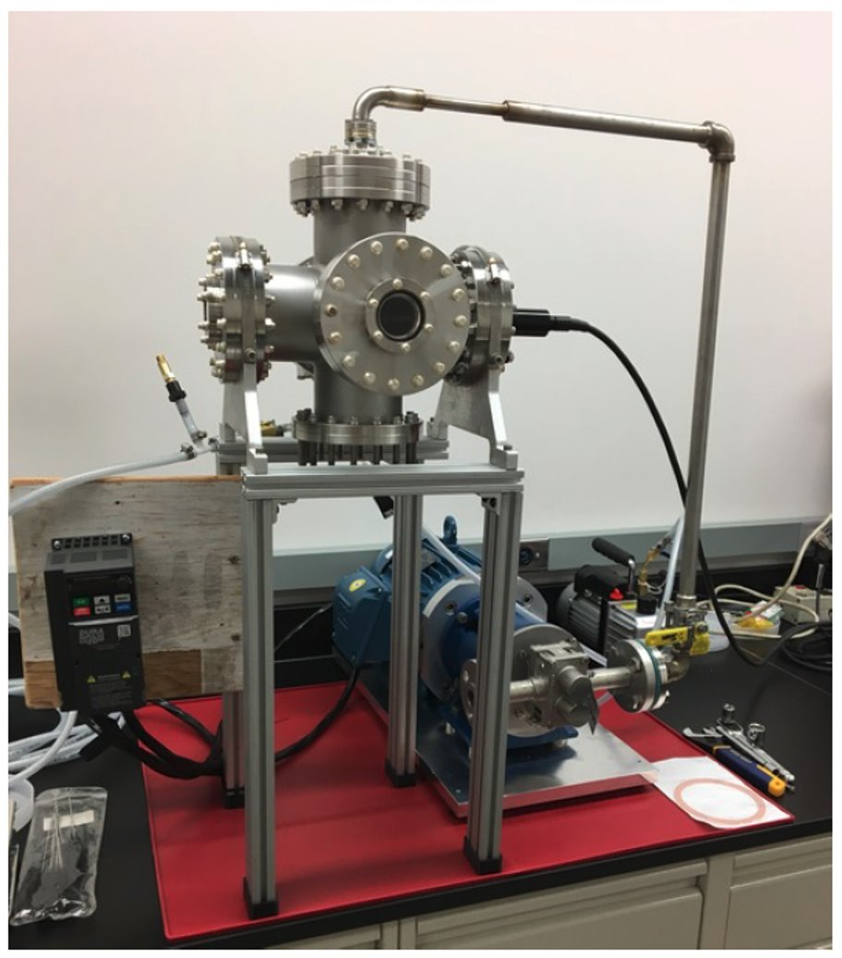
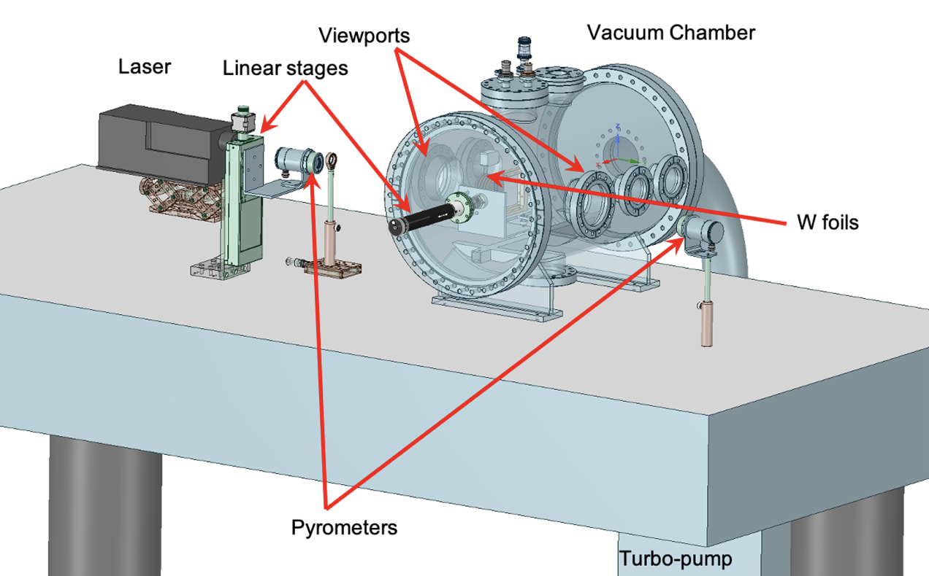
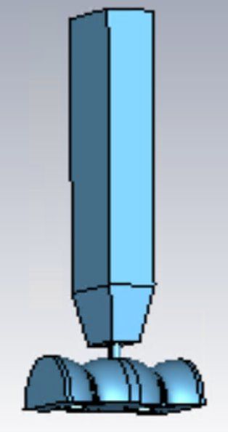

3 Year e⁺ R&D Plan – Proposals
Conceptual Development
  improve design
  develop pCDR
Address Critical Risk Areas
  mA polarized e- source
  high power target
  cw capture cavity
Concept to provide users e- or e+ on demand
JLab LDRD to
Measure CEBAF acceptance
JLab LDRD Proposal
to demonstrate mA e- source
DOE SBIR Phase2
Test GaInSn Jet Target
DOE NP Proposal
to test prototype W Target
DOE HEP Proposal
to prototype capture cavity

Slide 5
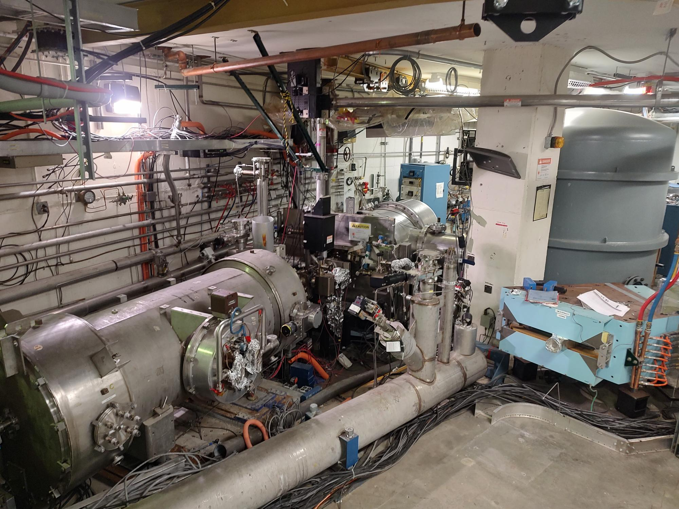
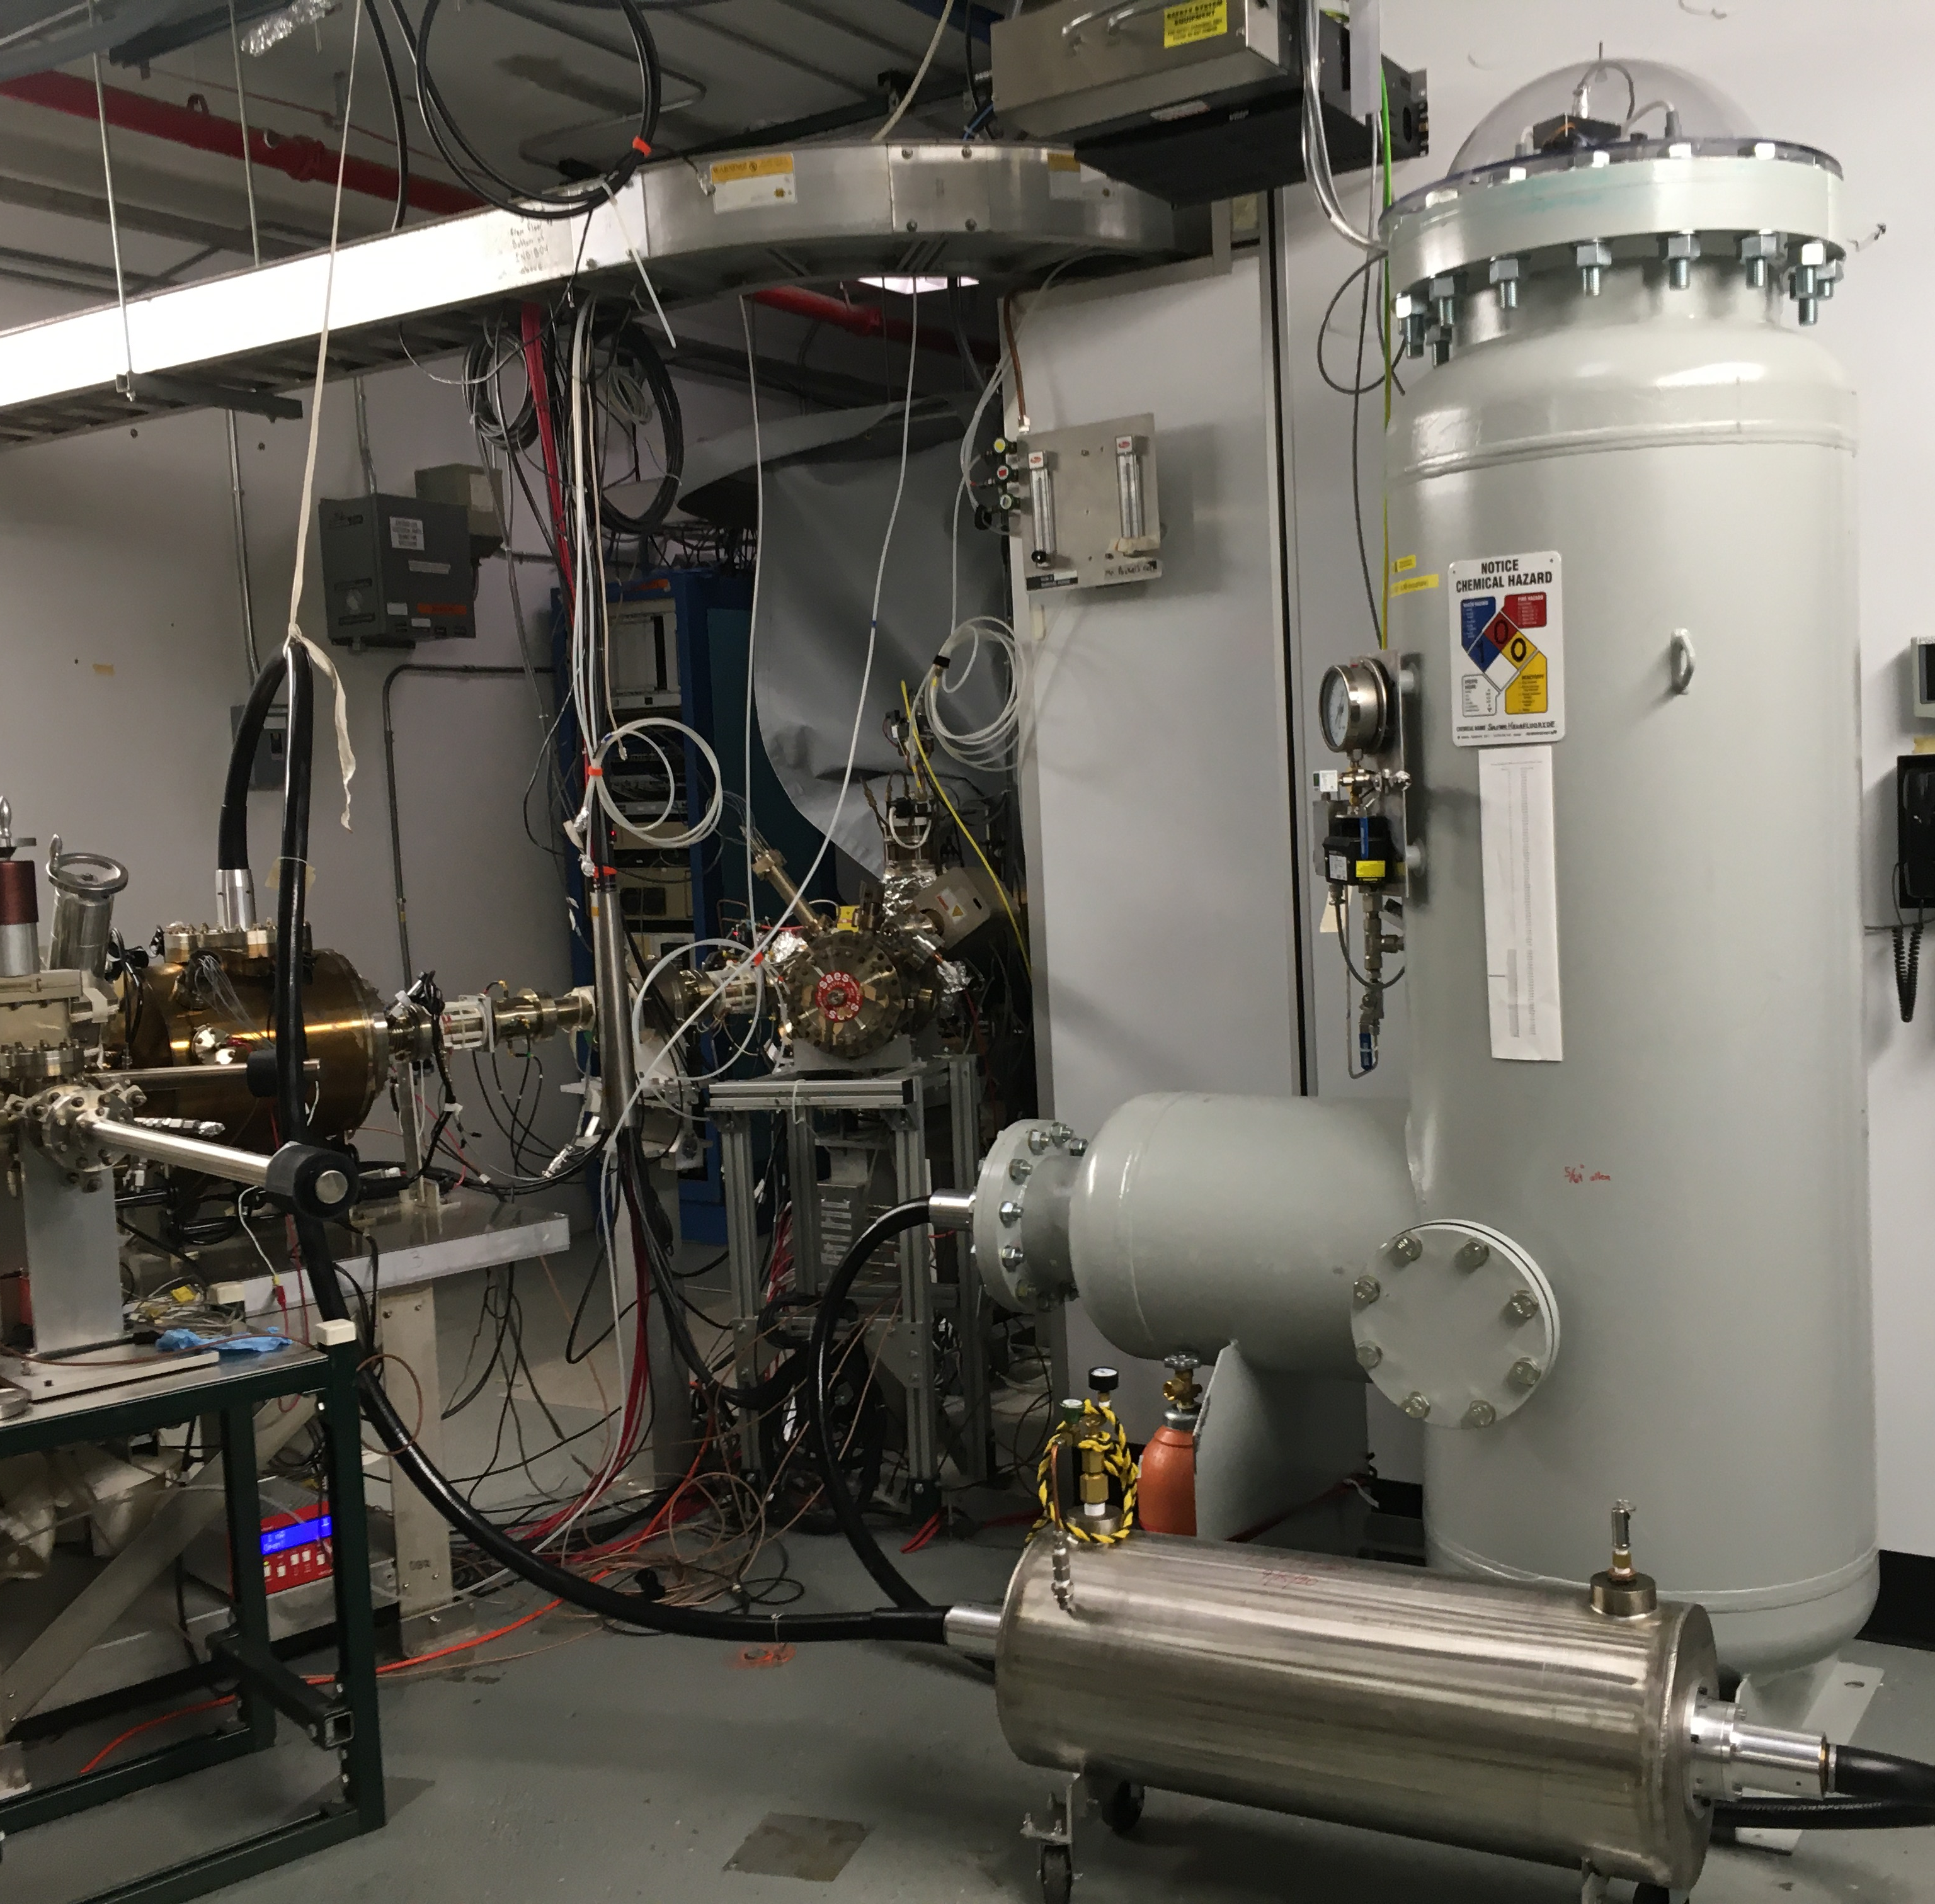
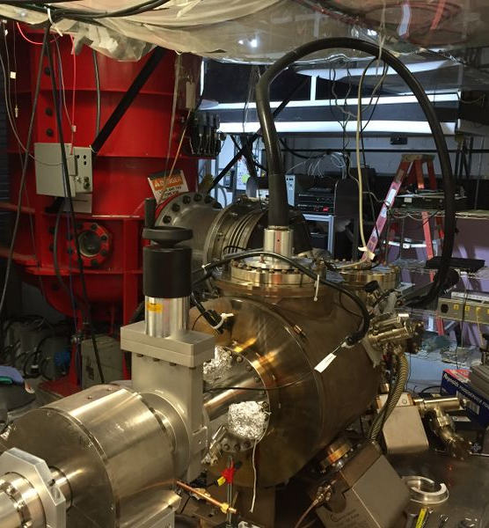
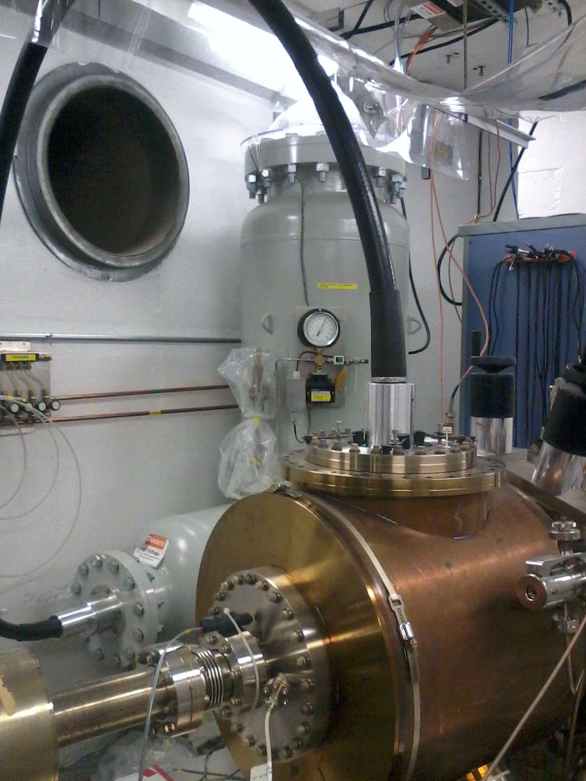
3 Year e⁺ R&D Plan – 100 kW Testbed @ LERF
CEBAF : Nuclear Physics
Existing FEL 100 kW e- photoinjector
UITF : MeV Test Facility
GTS : Advanced Gun Test Facility
450 kV power supply
500 kV power supply
HV cable
HV cable
HV cable
Y1 – Restore 10 mA HVPS & photogun
Y2 – Refurbish 10 MeV cryomodule
Y3 – Test e⁻ sources & e⁺ targets
photogun
350 kV power supply
photogun
photogun

Slide 6
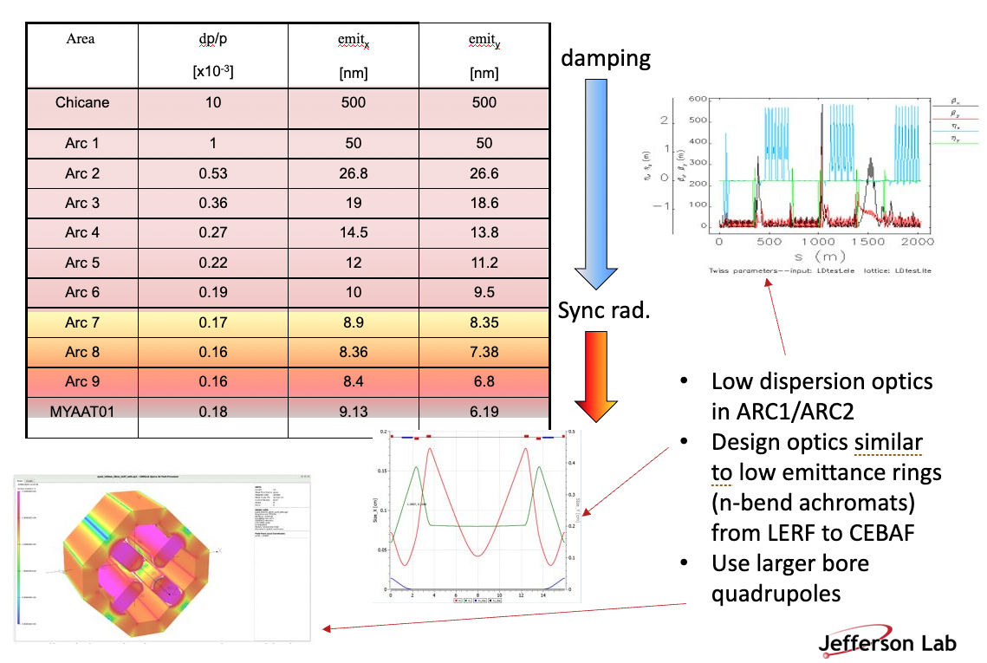
Accelerating e⁺ to 12 GeV
Managing larger 6d phase phase
  Designing low-emittance transport and injection line from LERF to CEBAF
  Low dispersion successfully tested, employ in Arc1 and Arc2
Generating e+ distributions for Users
  Developing S2E lattice in BMAD to track beam and polarization from LERF to halls
  Simulating e+ distributions at more working points (trade off between intensity and polarization)

Slide 7







Acknowledgments
The Ce⁺BAF Working Group, the Jefferson Lab Positron Working Group and laboratory management have been supportive for progression of activity.
J. Benesch, A. Bogacz, L. Cardman, J. Conway, S. Covrig, P. Degtiarenko,
P. Ghoshal, S. Gopinath, J. Gubeli, S. Habet, C. Hernandez-Garcia, D. Higinbotham,
A. Hofler, R. Kazimi, M. Kostin, F. Lin, V. Kostrum, V. Lizarraga-Rubio, S. Nagaitsev,
M. Poelker, N. Raut, B. Rimmer, Y. Roblin, A. Seryi, K. Smolenski, M. Spata, R. Suleiman,
A. Sy, D. Turner, A. Ushakov, C. Valerio-Lizarraga, E. Voutier, S. Zhang

Slide 8
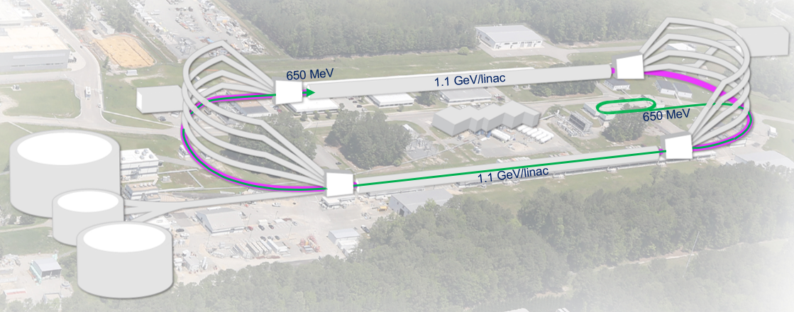

22 GeV CEBAF baseline: 650 MeV inj + 4-pass CEBAF + 6-pass FFA*
FFA Arc Architecture
  Non-scaling FFA based on high-gradient permanent magnets
  Compact merger to control orbits, beta functions and dispersion at arc ends
Multi-pass linac optics
  650 MeV injector upgrade
  Strongly focusing triplet lattice periodic optics for lower passes
Modified CEBAF ‘switchyard’ and TOF correction ‘Splitters’
Developing a pre-conceptual design for additional FFA* racetrack in the existing CEBAF tunnel to reach the top energy of about 22 GeV
*FFA (Fixed Field Alternating-Gradient)
Enabling Technology:
Novel permanent magnets, -style used for power and cost savings

Slide 9
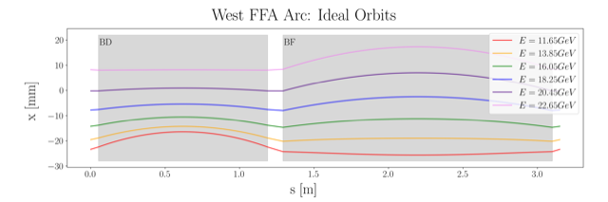
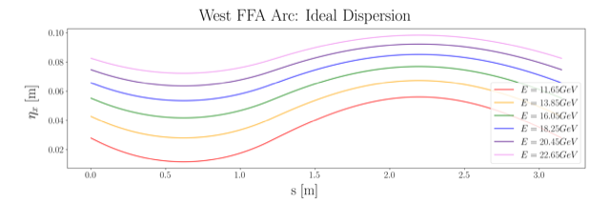
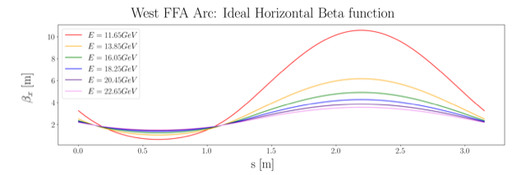
Non Scaling FFA Arc − Compact FODO Cell
orbits
Large momentum acceptance FFA cell, configured with combined function magnets capable of transporting six beams with energies spanning a factor of two
Arc composed of 75 cells, L_{cell} = 3.15 m
Closely spaced orbits for all six beams (~ 4 cm)
Low betas (~ a few m)
Extremally low dispersions (a few cm) - Virtue of combined function FFA magnets
dispersions
beta functions

Slide 10
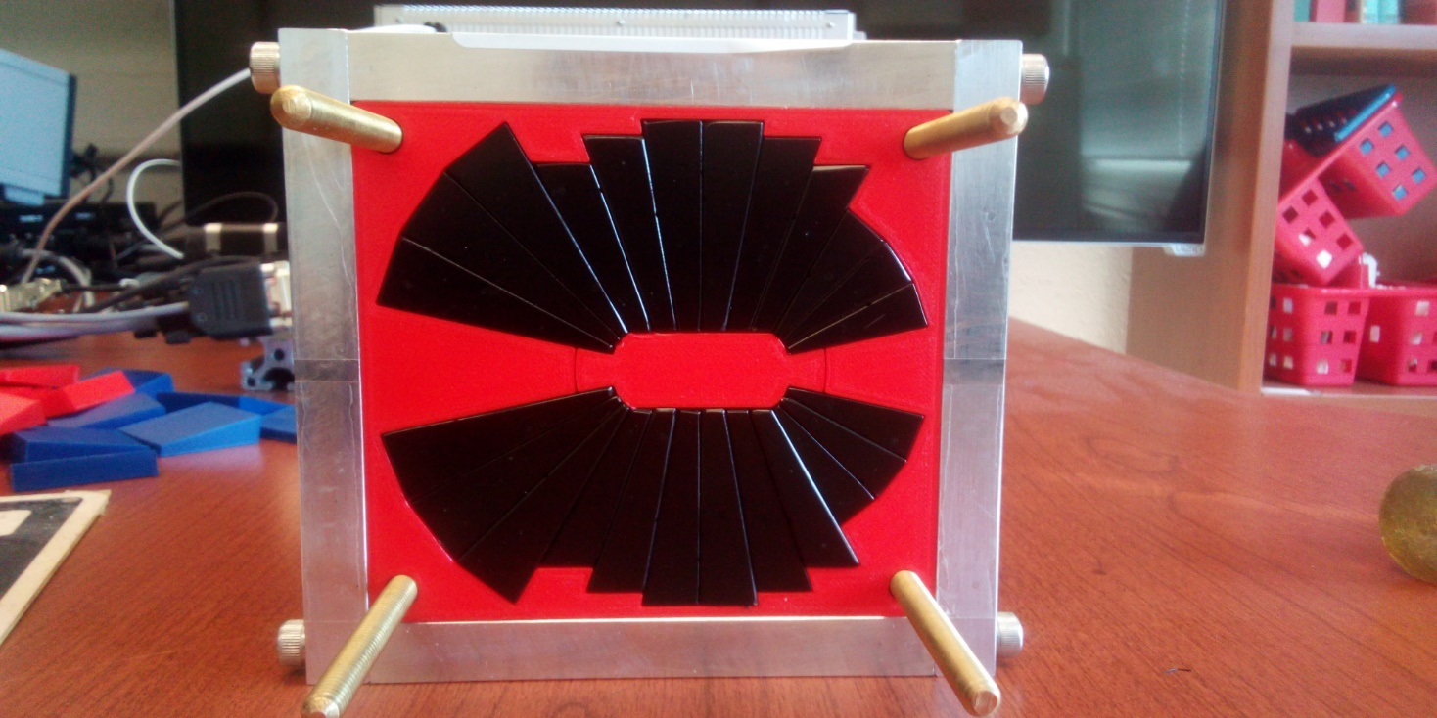
Permanent Magnet Design
Very compact compared to electro-magnets
Accommodates 6 additional passes in CEBAF tunnel
Provides power and cost savings
Concept successfully tested at
Open mid-plane geometry
Focusing Magnet BF
G_{F}= -41.13 T/m
L_{QF}= 1.67 m
B_{F}= -0.812 T
Defocusing Magnet BD
G_{D}= 43.44 T/m
L_{BD}= 1.24 m
B_{D}= -0.593 T
12 cm
12 cm
13 cm
13 cm

Slide 11
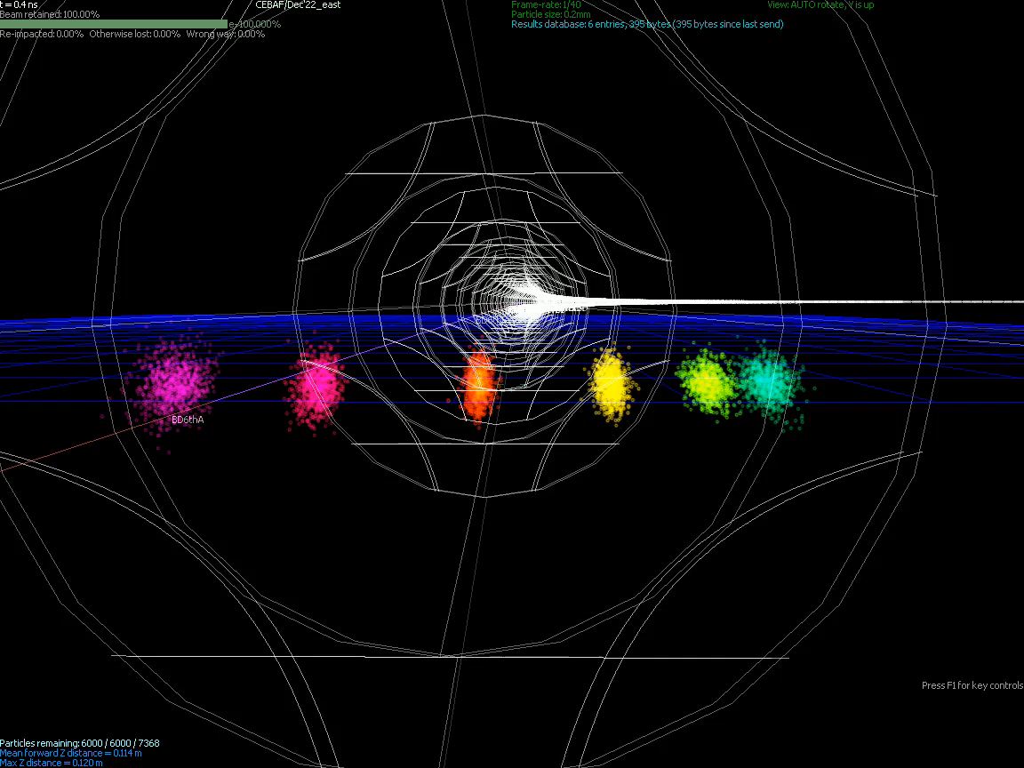
Animation of Recirculating Beams in FFA

Slide 12
22 GeV – Near Term Strategy
Accelerator design focus for the next few years should be:
  Developing a pre-conceptual design for FFA racetrack to reach 22 GeV
  Complete design of FFA arcs and transitions to linacs
  Design extraction system for all FFA passes to Halls A, B, C, D
  Study SR emittance and polarization effects
  Design 650 MeV recirculating injector
Technical design focus for the next few years should be:
  Testing resilience of permanent magnets in CEBAF beam environment
  Testing performance of an FFA FODO cell with multi GeV beams at CEBAF
  Designing and prototyping beam separation components (splitter, septa, RF cavities)

