Slide 1

Hall-B Status Report
Status of Hall-B Group
Status of Hall-B and Operations
Status of Hall-B Publications
Patrick Achenbach
8 July 2024

Slide 2
Status of Hall B Group

Slide 3
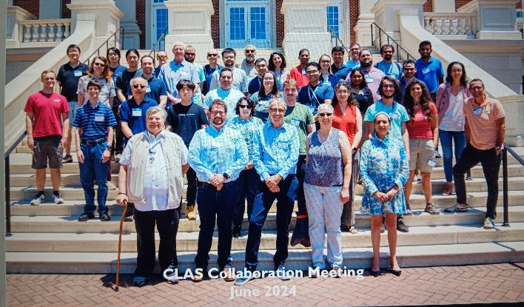
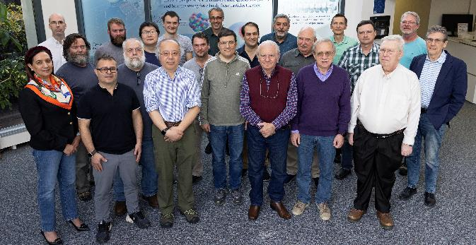
Overview
CLAS12
ℓH2 & ℓD2 cryo-target
Long. polarized NH₃/ND₃ target
Solid nuclear targets
HyCal setup upstream
HPS setup in alcove
CLAS Collaboration (44 institutions, 198 members)
HPS Collaboration; PRad-II/X17/π⁰TFF Groups
[V.D. Burkert et al., Nucl. Inst. and Meth. A 959, 163419 (2020)]
Hall B Group
22 Staff Scientists, 2 Postdocs, joint appointments
6 Technical & 3 Engineering/Designer staff

Slide 4




In and Out of Hall-B Group
In:
Hall-B Postdoc Richard Tyson started in Nov 2023
  J/ψ near threshold photoproduction of the proton and neutron
  Development of AI/ML level-3 trigger for CLAS12, also organizing a CLAS AI/ML Group
Hall-B Staff Scientist Raffaella De Vita started in Nov 2023
  Development of offline CLAS12 software and automated calibrations
  CLAS12 experiments with higher-than-design luminosity
LDRD & Hall-B Postdoc Sara Liyanaarachchi started in May 2024
  Develop a new high-rate micropattern gaseous detector for high-luminosity experiments
  PhD from Hampton U (supervisor Michael Kohl), years of experience with GEM detectors
Spin-Polarized Fusion & Hall-B Systems Engineer Phillip Dobrenz started in May 2024
  Design and commission cryogenic equipment and contribute to Hall B target systems
Out:
Hall-B Postdoc Pierre Chatagnon accepted an offer for a permanent position at CEA in Saclay

Slide 5
Status of Hall-B and Operations

Slide 6
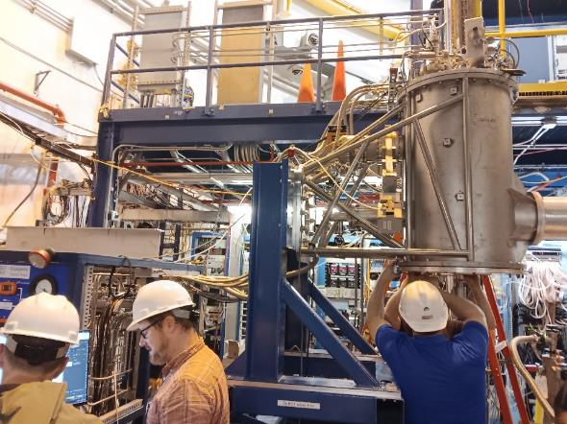
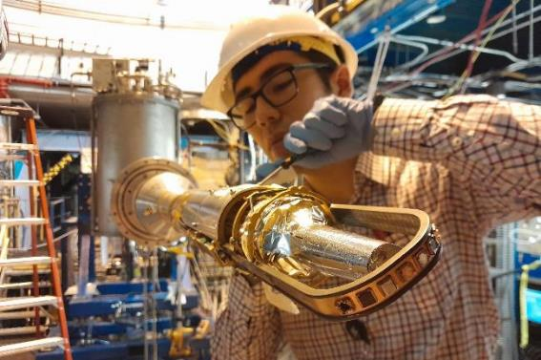
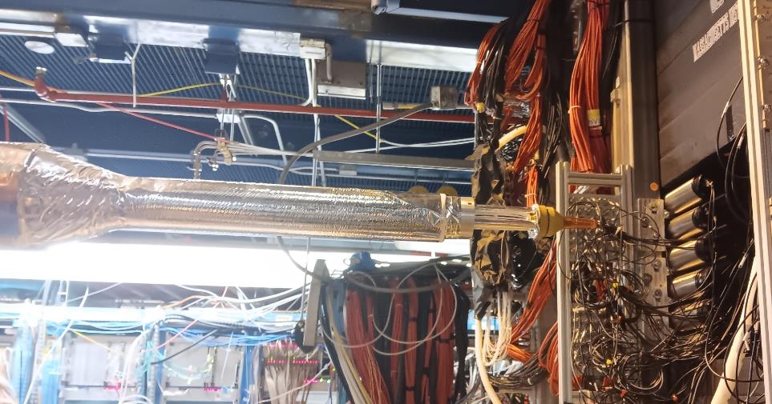
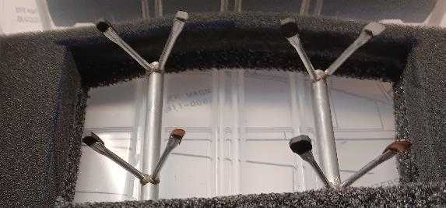
New Cryo-Target Operation in Hall B
Installed & commissioned in Sept 2023
ℓH₂ & ℓD₂ operation until May 2024
Combined with RG-D/E solid targets
RG-E:
ℓD₂
foils
RG-D:
flag assemblies
All target system performed excellent with fast changes and stable & robust operation

Slide 7
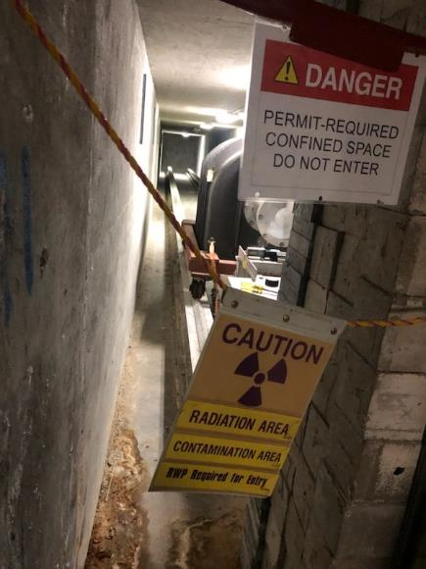
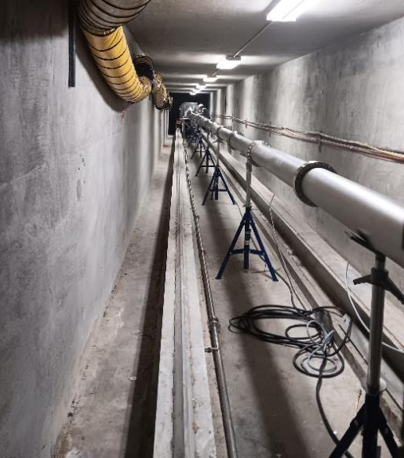
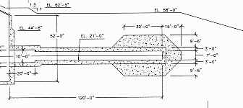
Beam-Dump Power Upgrade Completed
Faraday cup was moved downstream during SAD 2023
Replacement of ion pump during winter break 2023-24
New dump position has better radiation shielding
Faraday cup with beam blocker approved for 17 kW
corresponding to beam currents of ~ 1.6 µA at 10.6 GeV

Slide 8
Timeline Since SAD 2023
SAD or scheduled Run Group |  |  |  |  |  | Scheduled Calendar Days | Remaining PAC Days Before Run | Scheduled PAC Days | Actual PAC Days from ABUs | Remaining PAC Days After Run
 | Setup / Status | Target | Beam Energy | Start Date | End Date
RG-D |  | liq. D2 & nuclear | 11 | 2023-10-01 | 2023-12-15 | 75 | 30 | 38 | 40 | 0
RG-K |  | liq. H2 | 6,4 | 2023-12-15 | 2023-12-18 | 3 | 88 | 2 | 2 | 86
 | winter break | change |  | 2023-12-18 | 2024-01-10 | 23
RG-K |  | liq. H2 | 6,4 | 2024-01-11 | 2024-02-12 | 32 | 86 | 16 | 19 | 67
RG-K |  | liq. H2 | 8,4 | 2024-02-12 | 2024-03-11 | 28 | 67 | 14 | 16 | 51
 |  | change |  | 2024-03-11 | 2024-03-15 | 4 |  | 2
RG-E |  | liq. D2 & nuclear | 11 | 2024-03-15 | 2024-05-20 | 66 | 60 | 33 | 27 | 33
SAD 2024 |  |  |  | 2024-05-20 |  |  | sum: | 104 | 104
December 15, 2023: RG-D experiments completed and will not come back to the floor of Hall B
March 11, 2024: RG-K finished 37 PAC days of data-taking with ℓH₂ and lower-pass beams; reached highest momentum resolutions in CLAS12, necessary for baryon spectroscopy
May 19, 2024: RG-E ended data-taking for 27 of 33 PAC days that were scheduled suffering from
major downtimes of 50 + 270 hours due to two vacuum events / beam strikes in the accelerator
In 4½ weeks FY22 + 30 weeks FY23: 50% (+/- 20%) efficiency for PAC days wrt. calendar days

Slide 9
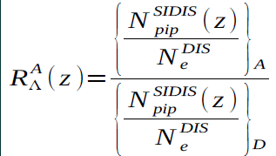
Status of Hadrons and Cold Nuclear Matter
Proposal | Physics | Exp. Contact | Rating | PAC | Jeop. | Group Days | Equipment | Energy | Group Contact | Target | Complete
E12-06-106 | Color transparency in exclusive vector meson production | L. El Fassi | B+ | 30 | 48 | 30 | CLAS12 | 11 | RG-D L. El Fassi | Nuclear & liquid D₂ | 40 d 100%
E12-06-106A | Nuclear TMDs | R. Dupre |  | 48
E12-06-117 | Quark propagation and hadron formation | W. Brooks | A- | 30 | 48 | 60 | CLAS12 | 11 | RG-E H. Hakobyan | Nuclear & liquid D₂ | 27 d 45%
E12-06-117A | Dihadron measurements in electron-nucleus scattering | M. Arratia |  | 48
RG-D used 3 different solid targets separatly from ℓD₂
RG-E used 5 different solid targets simultaneously with ℓD₂
RG-D:
RG-E:
ρ-meson
Together, a large fraction of data-taking for the Hadrons and Cold Nuclear Matter program in Hall B was completed within a year
PRELIMINARY
PRELIMINARY
[Matthew Maynes, APS April Meeting 2024]

Slide 10
Near-Term Schedule 2024-25
SAD or scheduled Run Group |  |  |  |  |  | Scheduled Calendar Days | Remaining PAC Days Before Run | Scheduled PAC Days = Cal. Days/2 | Actual PAC Days from ABUs | Remaining PAC Days After Run
 | Setup / Status | Target | Beam Energy | Start Date | End Date
RG-L | ALERT | high pressure gas | 11 | 2025-02-10 | 2025-05-31 | 110 | 55 | 55 |  | 0
RG-T | ALERT | high pressure gas | 6.6 | 2025-05-31 | 2025-07-04 | 34 | 17 | 17 |  | 0
SAD 2025 |  |  |  | 2025-07-04 |  |  | sum: | 72
Begin of main ALERT run tentatively scheduled for February 2024
Followed by low-pass run with ALERT that was awarded 17 PAC days by last year’s PAC51
With only 24 weeks of physics operation, no other runs scheduled
By next SAD, ALERT program will be completed assuming canonical 50% efficiency

Slide 11
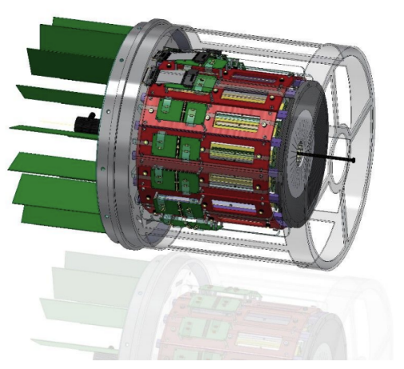
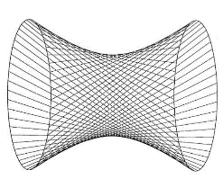
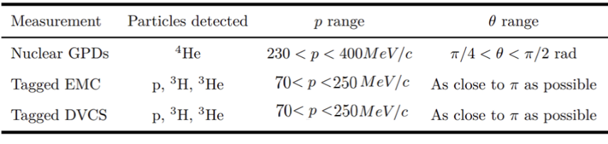
ALERT Experiments and Detectors
Proposal | Physics | Exp. Contact | Rating | PAC | Group Days | Equipment | Energy | Group Contact | Target
E12-17-012 | Partonic structure of light nuclei | Z. Meziani | A- | 45 | 55 | CLAS12; ALERT | 11 | L R. Dupre | High pressure gaseous H, D, ⁴He
E12-17-012A | Tagged EMC measurements on light nuclei | R. Dupre |  | 45
E12-17-012B | Spectator-tagged DVCS on light nuclei | W. Armstrong |  | 45
E12-17-012C | Other physics opportunities with ALERT | M. Defurne |  | 45
E12-23-013 | Measuring short-range correlations with ALERT | F. Hauenstein | A | 51 | 17
E12-23-013 | Measuring short-range correlations with ALERT | Hauenstein | A |  | 17 |  | 6.6 | T
A Low Energy Recoil Tracker (ALERT):
Hyperbolic drift chamber
Time-of-Flight array
Target straw for H₂, D₂, and ⁴He
ALERT is effectively replacing the CVT detector similarly to the BONuS12 experiment

Slide 12
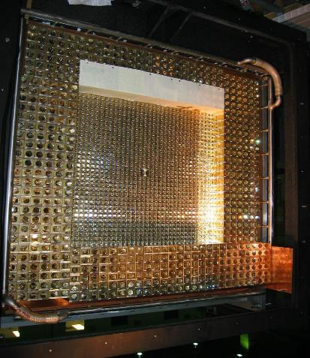
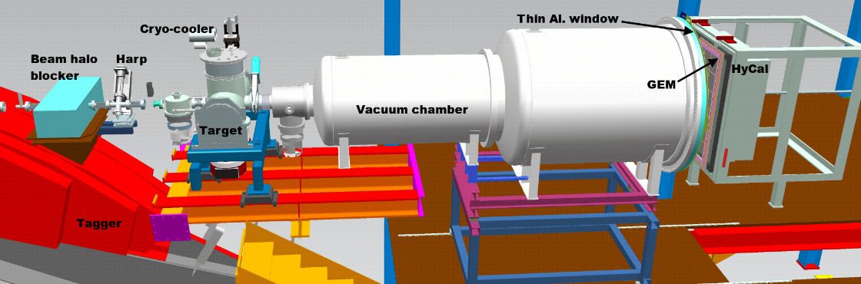
Conditional Schedule 2025-26
SAD or scheduled Run Group |  |  |  |  |  | Scheduled Calendar Days | Remaining PAC Days Before Run | Scheduled PAC Days | Actual PAC Days from ABUs | Remaining PAC Days After Run
 | Setup / Status | Target | Beam Energy | Start Date | End Date
Assuming ~ 100 PAC days in this period and successful Experiment Readiness Review in 2024
RG-O | PRad-II | gas jet | 0.7; 2.1; 3.5 | 2025-26 |  | 80 | 40 | 40 |  | 0
 | reconfigure | change |  |  |  | 7 |  | 4
RG-Q | X17 search | Ta foil | 2.2; 3.3 | 2025-26 |  | 120 | 60 | 60 |  | 0
SAD 2026 |  |  |  |  |  |  | sum: | 104
PRad-II and X17 will run with inner HyCal, new readout electronics, and new GEM trackers

Slide 13
Conditional Schedule 2026-27
SAD or scheduled Run Group |  |  |  |  |  | Scheduled Calendar Days | Remaining PAC Days Before Run | Scheduled PAC Days | Actual PAC Days from ABUs | Remaining PAC Days After Run
 | Setup / Status | Target | Beam Energy | Start Date | End Date
Assuming ~ 100 PAC days in this period and successful Experiment Readiness Review in 2025
RG-C |  | long. pol. NH3/ND3 | 11 | 2026-27 |  | 80 | 40 | 40 |  | 0
RG-G |  | long. pol. 7LiD | 11 | 2026-27 |  | 110 | 55 | 55 |  | 0
SAD 2027 |  |  |  |  |  |  | sum: | 95
RG-C will have to return for 40 days to complete its approved 120 PAC day program
Consecutive execution of RG-C and RG-G would minimize substantial overhead
RG-G no longer requests a double target but will alternate between NH₃ and ⁷LiD;
no modifications to the polarized target will be necessary
Well aligned with the Spin-Polarized Fusion Project: irradiation using 8 MeV beam from injector and a variable temperature cryostat; commissioning expected 2024-25

Slide 14
Status of Publications Since Sept 2023
No proceedings, no papers under review, no pre-prints …

Slide 15
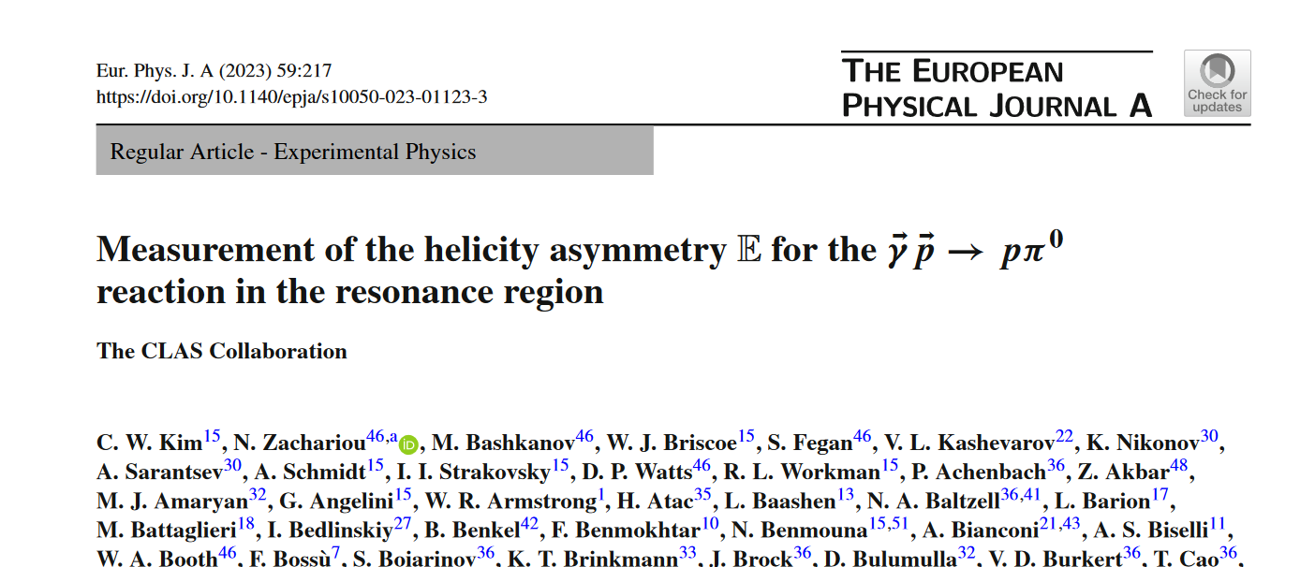
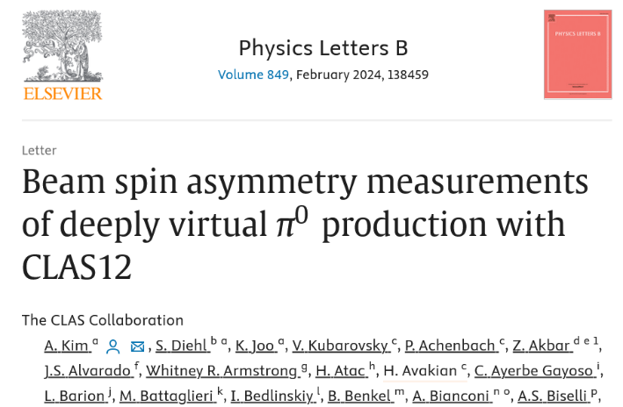
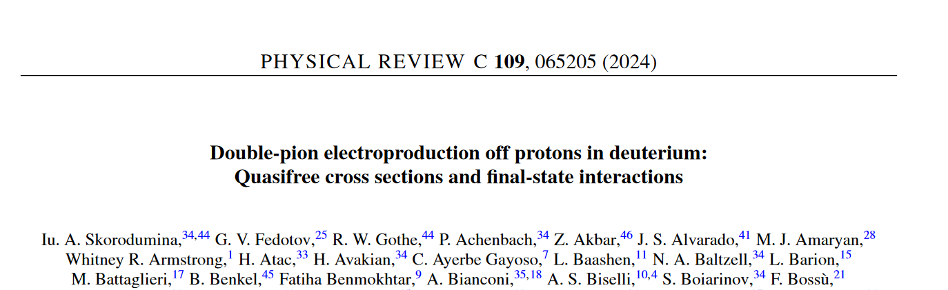
CLAS Collaboration Publications
CLAS12 Analysis
CLAS Analysis
4 more CLAS Collaboration papers submitted

Slide 16
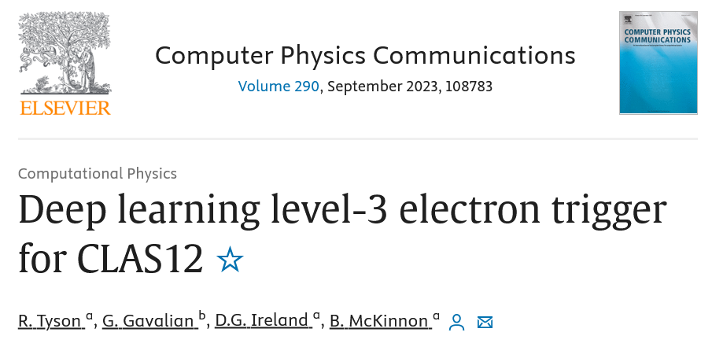
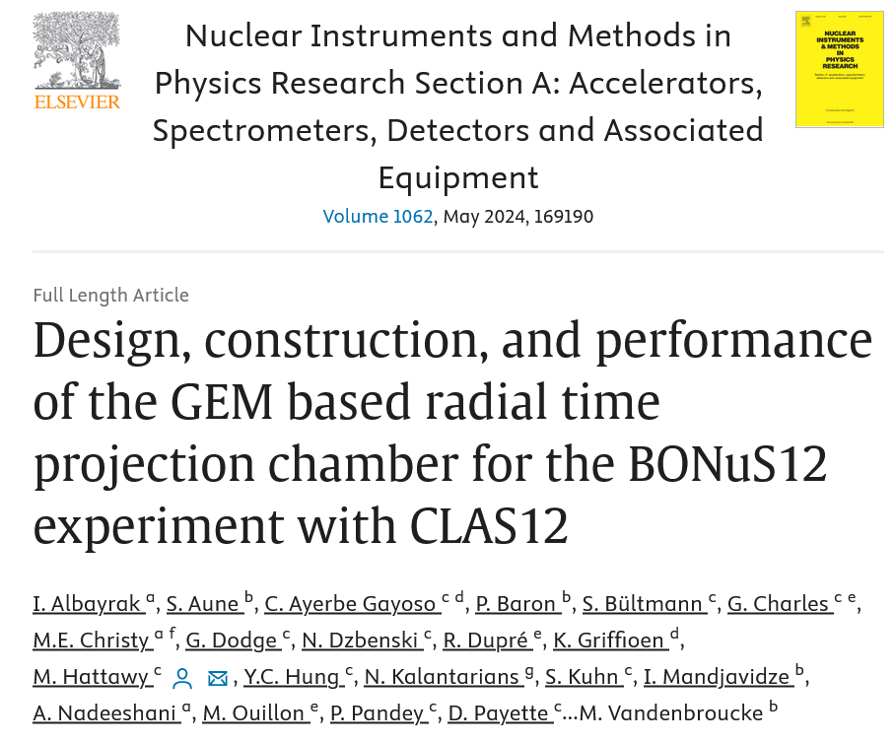
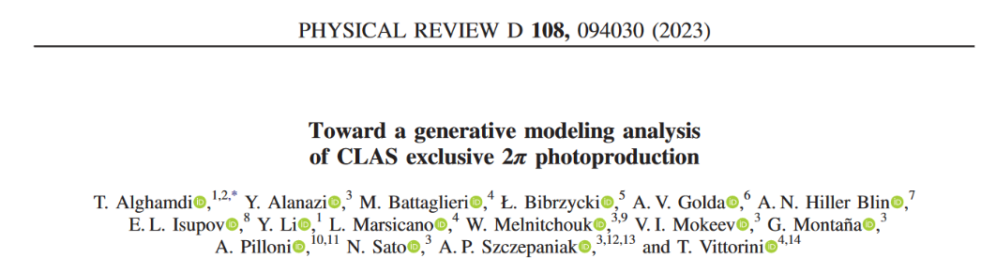
Technical Publications
AI/ML
Detectors

Slide 17
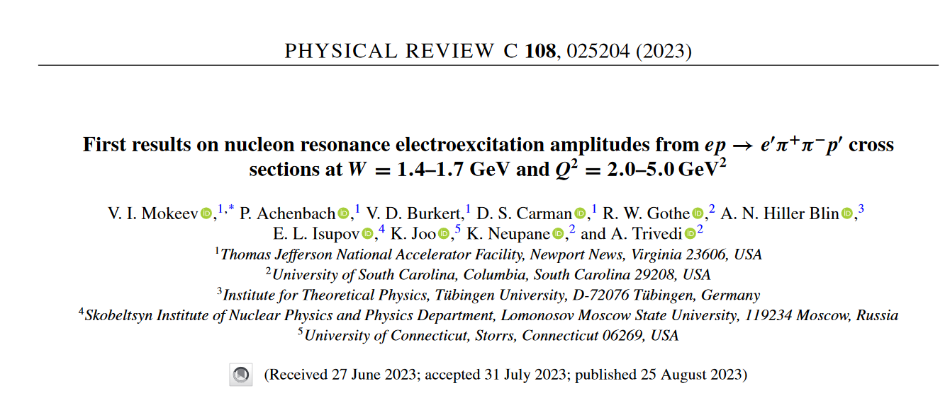
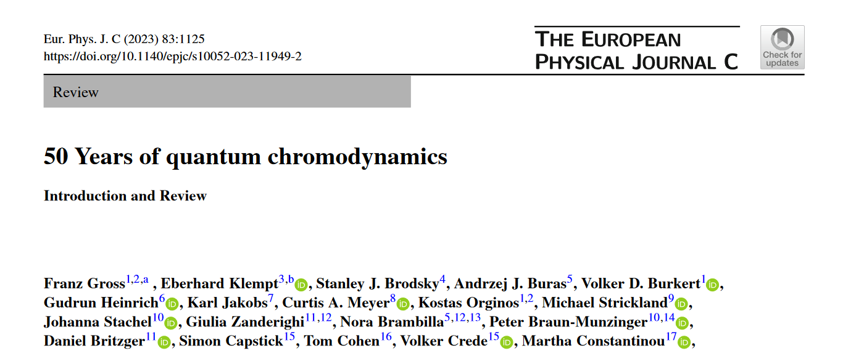
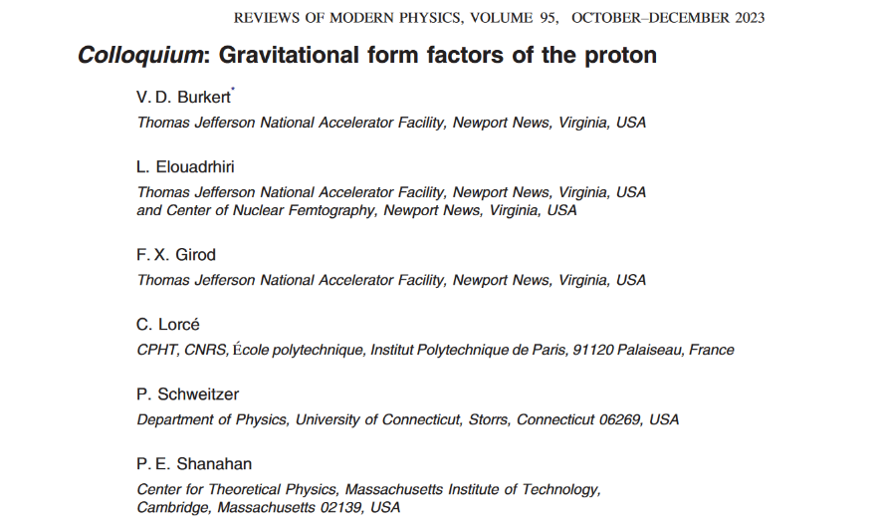
Other Publications
High-level analysis
Reviews

Slide 18
Thank You For Your Attention

