Slide 1
Accelerator Update
by
Douglas Higinbotham

Slide 2
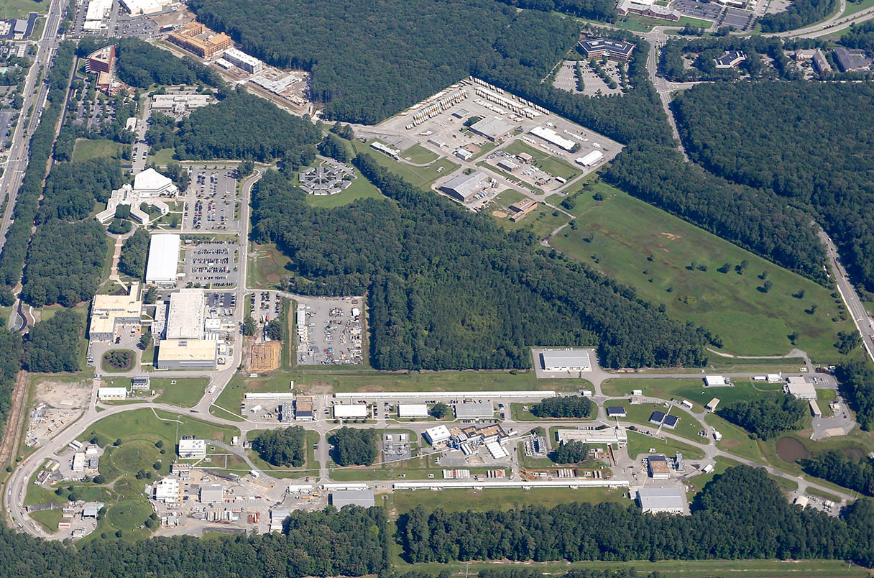
CEBAF: Race track design to send polarized electrons at different energies and different currents to multiple halls simulationsly with up to 1.1 Megawatt of power.

Slide 3
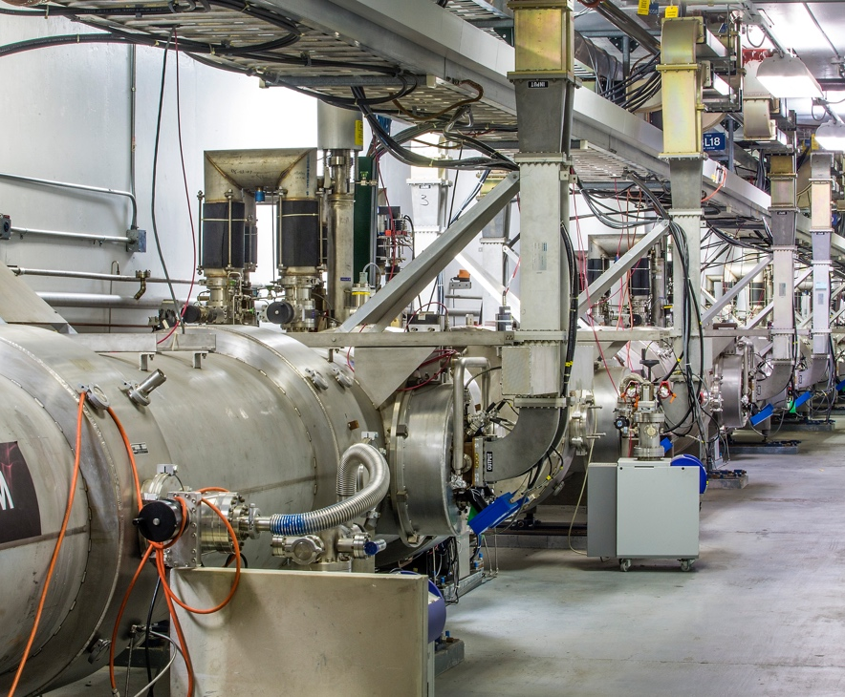
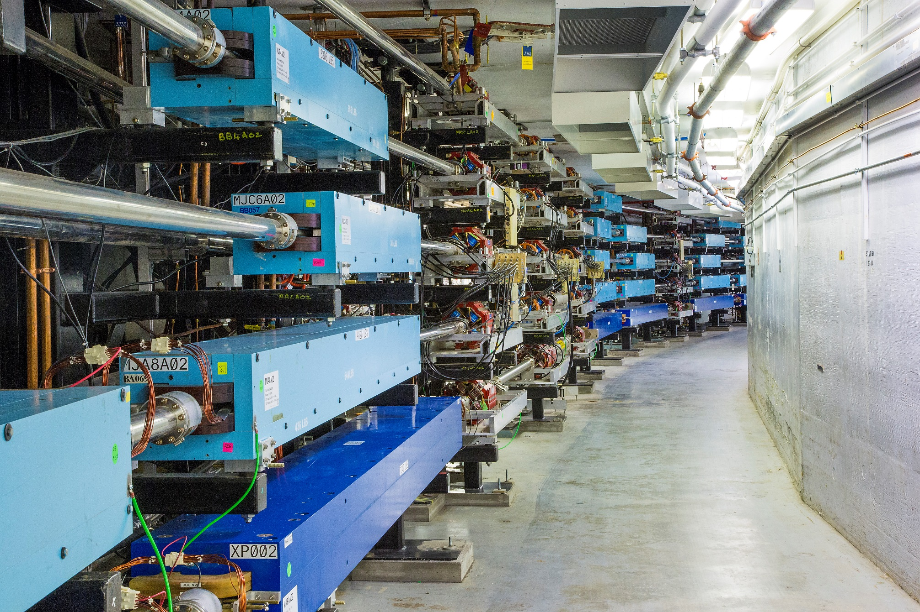

Slide 4
CEBAF Accomplishments During Last Run Period
Hall A
39 PAC Days Completed with major reconfirmation from pol. ³He to cryo-target during run
Completed Polarized ³He GEN Experiment (E12-09-016)
Completed GEN Recoil Polarization Experiment (E12-17-004)
Completed K_{LL} Experiment (E12-20-008)
Unfortunately due to beam dump problems the short, A_{LL} experiment (E12-20-008) was canceled.
Hall B
104 PAC Days Completed
Completed Run Group D (E12-06-106 and A)
Partially Completed Run Groups K (E12-16-010, A, and B) and E (E12-06-117)
Hall C
116 PAC Days Completed
Partially Completed Neutral Particle Spectrometer (NPS) Run Group (E12-13-010, E12-13-007, E12-22-006, E12-23-014)
Hall D
4 opportunistic calendar days
Installation of new calorimeter during most of the run period
Opportunistically extracted beam to Hall D for short beam test in March ‘24
Test went very smoothly, checking out beamline and detector performance
TOTAL OF 259 PAC DAYS RUN, 5 Experiments Completed and 8 Experiments Partially Completed
HUGE THANK YOU TO LEADERSHIP FOR RUNNING 30 WEEKS INSTEAD of 27 WEEKS

Slide 5
Upcoming Schedule
CEBAF has now run at an energy of 1047 MeV/linac for two run periods; with lower trips this year as we had a lot more gradient: ~10.5 GeV max to Hall’s A,B,C and ~11.6 GeV to D
Many discussions about how far to push CEBAF for the next run.
Goal to push up to an energy that is within Moller’s required energy ( 10.6 to 11 GeV).
Hall D is now requesting (this PAC) linear polarization; so we have considered that too.
This has pushed us to picked 1060 MeV/linac plus the ~100 MeV from the injector
10.7 GeV to Halls A, B, C
11.8 GeV to Hall D
Next slide will show the schedule we made a couple of months ago BUT two items are causing it to be redone
Budget with ~25 weeks of physics running expected in FY25
Lock-out Tag-out Pause
And of course, the priorities and new experiments approved PAC52 will also influence the long term schedule.

Slide 6
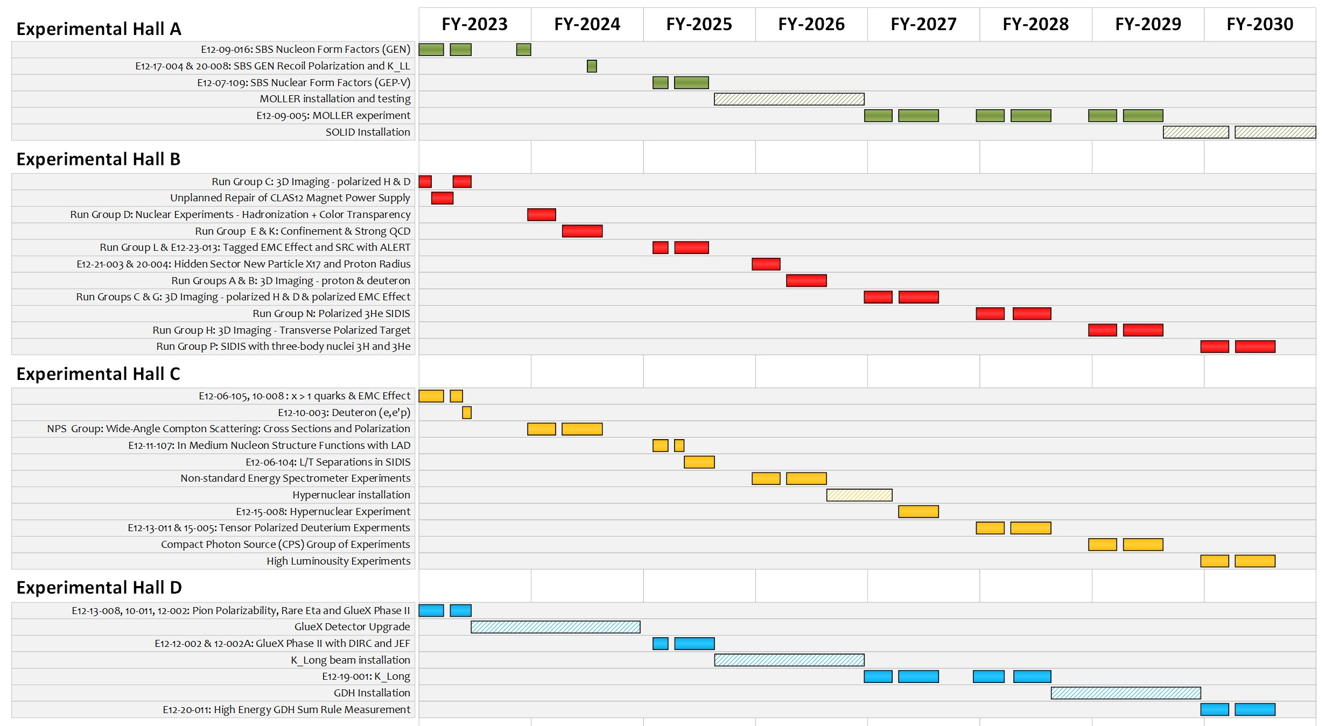
Long Term Schedule ( recently made, though already out of date )

Slide 7
Detailed Break-Down Of One Week of CEBAF Operations
Category | Restore Days (hours/week) | Research Days (hours/week)
Scheduled Maintenance | 40 | 12
Scheduled Beam Studies | 64 | 12
Planned Average Tune Time | 64 | 8
Hall Down When Beam Available (BANU) * | - | 16
Trips ** | - | 8
Down Time Events *** | - | 24
Planned Configuration Changes **** | - | 4
Actual Beam Used By Exp. Hall (ABU) | - | 84
Total Hours Per Week | 168 | 168
136 Research hours
* The number one source of lost time in the accelerator is down time events. These are any equipment problem that stops beam from accelerator to the halls. Depending on when an event happens, the planned weekly maintenance can be done in parallel, also, when possible, beam studies are done during this time.
** Currently trips cause ~1 hour per shift and in the past, prior to recent CPP improvement, we even need to limit current to the high power halls to keep the trip rate reasonable. *** Though some events, such as a cryo-event, can bring all the halls down together, typically individual downs are due to DAQ or detector problems. **** Planned changes, such as a pass change, will stop beam to all the halls while the accelerator configuration is changed.

