Slide 1
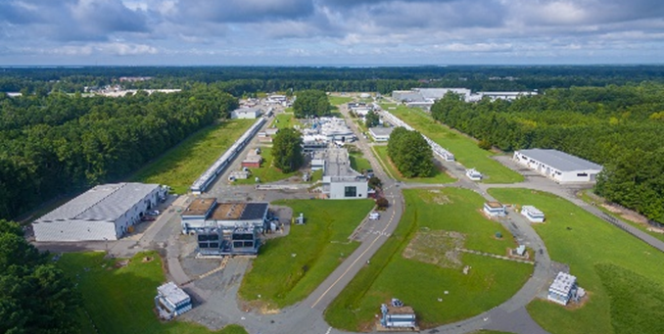
PAC51 Charge and Agenda
Cynthia Keppel
PAC52
July 8, 2024

Slide 2
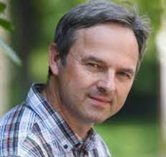
Welcome PAC members!!
MANY, MANY, MANY THANKS!!!! Serving on the PAC is critical and greatly appreciated work. Your expert input is absolutely essential to the success of the Jefferson Lab program.
Committee Member Changes for PAC52 - Barbara Erasmus and Matthias Grosse Perdekamp have rotated off. - New Incoming Chair (one year overlap, Markus Diehl still Chair) Pasquale DiNezza (INFN) – welcome! - Welcome also to Krešimir Kumerički (University of Zagreb) and Cynthia Hadjidakis (Université Paris-Saclay/CNRS).

Slide 3
Jefferson Lab Science in the Long Range Plan
Recommendation 1: "Continuing effective operation of the national user facilities ATLAS, CEBAF, and FRIB..”
Jefferson Lab science features prominently in both the QCD and fundamental symmetries discussions
Recommendation 3: “We recommend…..the EIC as the highest priority for facility construction.”
Recommendation 4: “Strategic opportunities exist to realize a range of projects that lay the foundation for the discovery science of tomorrow. These projects include……the Solenoidal Large Intensity Device (SoLID) at Jefferson Lab…”
Recommendation 4: “Future advances in nuclear physics rely upon a vibrant program of detector and accelerator R&D……influence fields such as medicine”
MicroPattern Gaseous Detection Center (proposed), BioMedical Research and Innovation Center (launched 2022)
Positron and 22 GeV CEBAF upgrades also mentioned positively in text

Slide 4
Approved PAC Days by Physics Topic
Background….
PHYSICS TOPIC | Hall A | Hall B | Hall C | Hall D | Total
The Hadron Spectra as probes of QCD ( GlueX and heavy baryon and meson spectroscopy) |  | 219 | 11 | 420 | 650
The transverse structure of the hadrons ( Elastic and transition Form Factors ) | 52 | 40 | 168 |  | 260
The longitudinal structure of the hadrons ( Unpolarized & polarized parton distribution functions ) | 38 | 190 | 152 | 33 | 413
The 3D structure of the hadrons ( Generalized Parton Distributions and Transverse Momentum Distributions ) | 319 | 812 | 345 |  | 1476
Hadrons and cold nuclear matter ( Medium modifications, quark hadronization, short-range correlations, hypernuclear spectroscopy, few-body experiments ) | 95 | 292 | 237 |  | 624
Tests of the Standard Model and Fundamental Symmetries | 513 | 307 |  |  | 820
Total | 1016 | 1860 | 913 | 453 | 4242
Reference: https://misportal.jlab.org/ul/ul_office/ExperimentDB/rptApprovedExperimentsByHallAndTopicDays.cfm

Slide 5
Number of Approved Experiments by Physics Topic
PHYSICS TOPIC | Hall A | Hall B | Hall C | Hall D | Total
The Hadron Spectra as probes of QCD ( GlueX and heavy baryon and meson spectroscopy) |  | 6 | 1 | 4 | 11
The transverse structure of the hadrons ( Elastic and transition Form Factors ) | 7 | 6 | 7 | 1 | 21
The longitudinal structure of the hadrons ( Unpolarized & polarized parton distribution functions ) | 5 | 5 | 8 | 1 | 19
The 3D structure of the hadrons ( Generalized Parton Distributions and Transverse Momentum Distributions ) | 10 | 14 | 10 |  | 34
Hadrons and cold nuclear matter ( Medium modifications, quark hadronization, short-range correlations, hypernuclear spectroscopy, few-body experiments ) | 10 | 12 | 11 | 2 | 35
Tests of the Standard Model and Fundamental Symmetries | 3 | 3 |  | 1 | 7
Total | 35 | 46 | 37 | 9 | 127
Reference: https://misportal.jlab.org/ul/ul_office/ExperimentDB/rptApprovedExperimentsByHallAndTopic.cfm

Slide 6
Status of Approved Experiments
 | Full Completed | Partially Completed | Approved (Not Yet Run) | Total Approved Number of Experiments
Hall A | 13 | 1 | 21 | 35
Hall B | 8 | 18 | 20 | 46
Hall C | 12 | 7 | 18 | 37
Hall D | 5 | 1 | 3 | 9
Total | 38 | 27 | 62 | 127
Many of the longer experiments prefer to split into distinct run periods where a fraction of the data is collected and analyzed prior to the final full run (i.e. partially completed).
To ensure the relevancy of experiments which haven’t run within a five year window of time, the Jefferson Lab Program Advisory Committee is asked to review experiments in a jeopardy process to ensure the experiments are still world class and can reject, defer, approve or adjust the letter grade of the experiment as deemed appropriate.

Slide 7
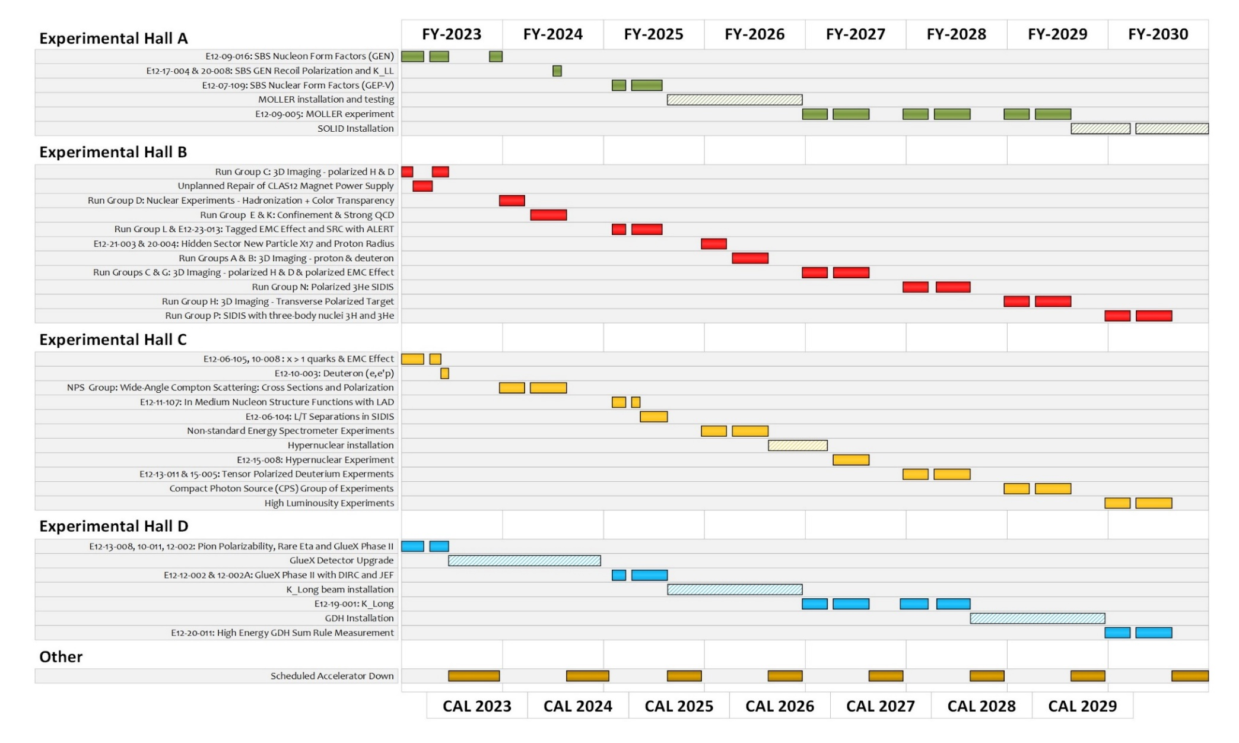
Extended Experimental Schedule – has assumptions!
SoLID install could start ~mid-FY29
We’re in a safety pause – expect to restart January 2025
Not static!...
Need to design, build install for upcoming experiments
Need to remove, decommission completed experiments
May move into upgrade era
7

Slide 8
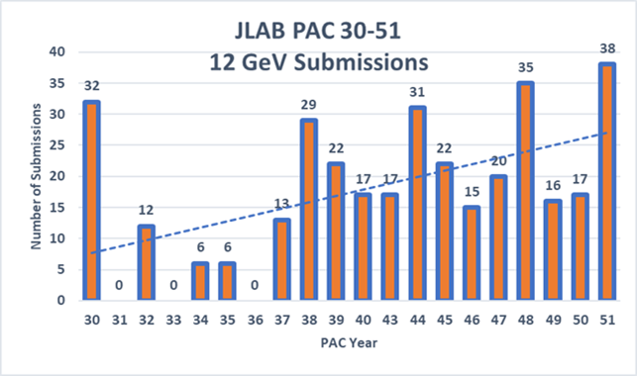
Exciting times!
PAC 52
Record numbers of PAC submissions
Positrons, user increase, new questions to unravel

Slide 9
PAC52
Charge:
Review new proposals, previously conditionally approved proposals, jeopardy proposals, and letters of intent for experiments that will utilize CEBAF and provide advice on their scientific merit, technical feasibility and resource requirements.
Identify proposals that represent high quality physics within the range of scientific importance represented by the previously approved proposals and recommend for approval.
Also provide a recommendation for scientific rating for experiments newly recommended for approval, and on continued approval and scientific rating for worthy jeopardy proposals
Identify other proposals with physics that have the potential for falling into this category pending clarification of scientific and/or technical issues and recommend for conditional approval. Provide comments on technical and scientific issues that should be addressed by the proponents prior to review at a future PAC.

Slide 10
Conditional Approval
Two types:
C1 – Approval (with grade and time allocation) pending technical review, no need to return to PAC
C2 – Approval pending further review by future PAC

Slide 11
Jeopardy
Policy
Finalized after discussion with UGBOD in September 2016
Rationale
Use normal yearly PAC in ~4 year cycle to address all presently approved proposals that have not been scheduled. Estimate ~5-10 proposals per meeting
Started in 2019, now steady state - proposals that have been approved for 4 years or more but are not scheduled will be considered in Jeopardy.
Changed to “not completed” instead of “not scheduled”
Does not speak to projected long term schedule
New beam time or significant resource requests must be submitted as full proposals
Major changes to configurations should come back as new proposals

Slide 12
Jeopardy issues
Is there any new information that would affect the scientific importance or impact of the Experiment since it was originally proposed?
2) If the Experiment has already received a portion of its allocated beam time and/or is on the presently published near term NPES schedule, the spokespersons should provide an analysis of the existing data set, the projected result for any additional time on the published schedule, and the projected result for the complete data set including all remaining unscheduled time. The goal is to show the physics impact of the respective data sets.
3) What is the status of the collaboration in terms of institutes, committed staff, and prospective students?
4) Should the remaining beam time allocation and experiment grade be reconsidered?

Slide 13
Proposals with Parallel/GROUP Running
Parallel running procedure (in equal time, conditions)
Intent is to encourage new proposals of “run groups”
– Only a brief summary needed for additions to existing run group
- These run in parallel with previously approved or conditionally approved proposals, so they are considered already approved (or conditional) and are presented by approved collaboration or Hall leadership
– The PAC will provide a written comment for each of these in the report.
- Summary is different from collaboration endorsement – should speak only to impact on approved experiment/group, science remains with PAC

Slide 14
Reminder about letters of intent
Letters of Intent will be given the same “rights” to their scientific ideas as are currently afforded to deferred experiments, i.e.:
LOI has established a claim to a physics measurement that lasts for the next two successive PAC meetings.

Slide 15
Policy on Equipment Availability
Categories for resource availability:
– Stage I: resources need to be identified/obtained
– Stage II: resources are essentially available
This will be considered a Laboratory issue
(not for PAC) – addressed by Experimental Readiness Review process

Slide 16
PAC Report
Draft report text must be complete before closeout on Friday. We will review all the draft text Friday afternoon before the closeout.
Pamela Cole will assemble the draft text into a report for a final round of edits by email during 2 weeks following the PAC meeting.

Slide 17
Role of User Chair and Chair elect on PAC
Monitor communications between PAC and spokespersons – identify issues.
Monitor PAC meeting proceedings for conflicts of interest.
Monitor PAC meeting proceedings to identify issues of fairness and ethical behavior.
Participate in all scientific discussions to provide additional expertise (except where there is a conflict of interest).
Should not vote on grading.

Slide 18
Communication with PAC
Communication with PAC members should be limited to:
Submission of proposal before the deadline
Presentation/discussion at PAC meeting, must be in-person (not remote connection)
Responses from spokespersons and/or contact person to inquiries from PAC for further information or clarification

Slide 19
SOme last noteS
We had a proposal withdrawn at the last minute this time – I believe a new situation
Decided to inform, but keep it with the PAC
Comments may be useful to the collaboration
Does not need to go into PAC report other than noting withdrawn
The agenda is available on indico here:
https://indico.jlab.org/event/838/
Groups of open session talks ”sandwiched” between Executive Summary discussions
Open sessions end Thursday lunch
Close-out (draft report complete) Friday at 2:30 pm
Reception tonight
Celebration for Stuart tomorrow evening starting at 4:30 at Traditions Brewery – we can coordinate rides together (it’s close, but not a walk), let Pam or any of us know if you need directions

Slide 20
Thank you!
We’re still new, bear with us!
Questions?
Please feel free/encouraged to discuss any suggestions informally with Doug and I. We will also meet with Markus and Pasquale after this meeting.

