Slide 1
PAC 52…Welcome and perspectives
David J. Dean
Deputy Director for Science
Presented To:
PAC 52 meeting
July 8, 2024

Slide 2

Outline
Framing CEBAF science and recent results
A brief word about the contract competition
Introduction of Kimberly Sawyer (Lab Director, effective August 3)

Slide 3
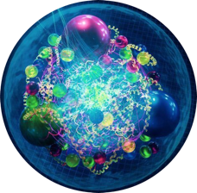
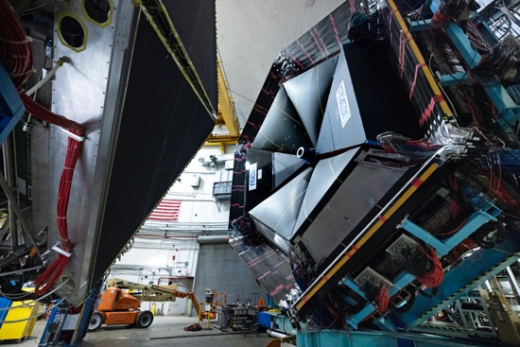
Experiments (data) Coupled with Theory Reveal Emergence
Quarks and gluons are ‘confined’ → experiments ‘see’ hadrons and infer an underlying quark and gluon structure and their dynamics
Experiments measure outgoing particles (hadrons and leptons)
Theory
Data
Computation
e
e’
Hadrons
True across the sciences: “Quantifying emergence and modeling emergent dynamics in a data-driven manner for complex dynamical systems is challenging due to the lack of direct observations at the micro-level.” Yang, et al., arXiv:2308.09952 (2023)
Hall B detector
The combination of experimental data, theory, and computing create a new approach to science

Slide 4
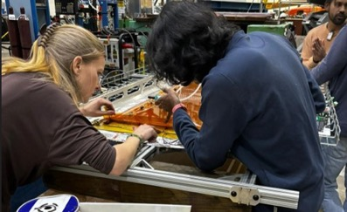
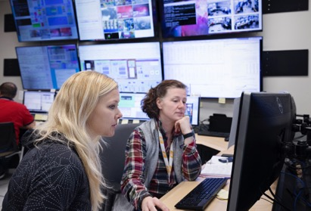
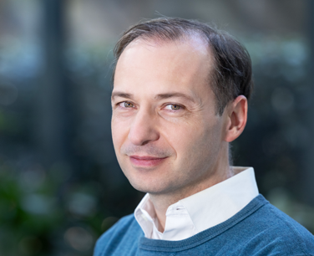
Sustain Global Leadership in Nuclear Physics R&D
Vision
Strategy
CEBAF delivers a vibrant research program, operating more than 30 weeks per year, supporting ~1,900 users annually
Priority areas
Ensure that TJNAF maintains a role as the premier cold QCD laboratory in the world through a world-class experimental program and theoretical leadership in hadron structure and spectroscopy
Realize CEBAF reliability at 12 GeV and develop concepts for future upgrades
Recent achievements
Physics:
  Explore Exotic Hybrid Mesons
  Precision nuclear femtography of quarks and gluons
  Precision tests of the Standard Model
Continue the CEBAF Performance Plan implementation to ensure high-intensity high-reliability 12 GeV operations.
Pursue a cost-effective approach to building the SoLID detector
Develop pathways to CEBAF upgrades (positrons and 22 GeV)
Over the last 5 years: 300 publications including 49 PRLs and 15 Nature articles
107 doctoral theses awarded based on experiments from JLab
23 (inter)national awards: 2 DOE Early Career; 3 APS Fellows; Altarelli Prize; DOE SC Distinguished Scientist Fellow.
MOLLER BSM experiment achieves CD-2/3
MOLLER
Hall A GEMs
Hall A/C Staff scientist, Holly Szumila-Vance, working with graduate students and postdocs from the University of Virginia on the GEMs used in the Hall A Super BigBite experiments.
American Physical Society Fellow: Alexandre Deur

Slide 5
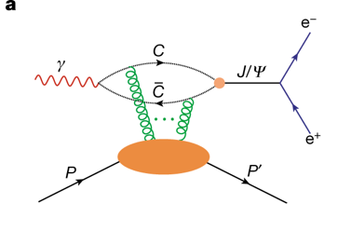
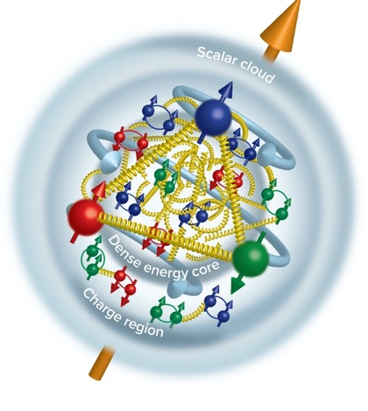
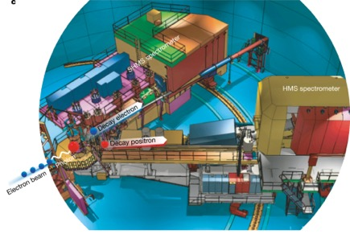
CEBAF Experiment Locates Gluon Mass in the Proton
Near threshold J/psi photoproduction experiment
Inner Gluon radius: 0.52 +/- 0.03 fm
Charge radius: ~0.84-0.88 fm
Scalar gluon rad: 1.069+/-0.056 fm
Measured in Hall C
“Determining the gluonic gravitational form factors of the proton," Duran et al, Nature 615, 813 (2023)

Slide 6
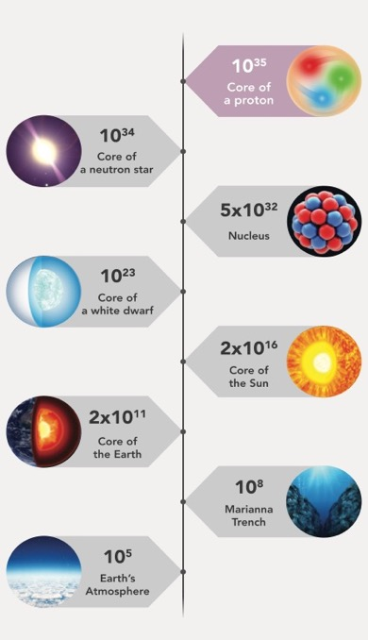
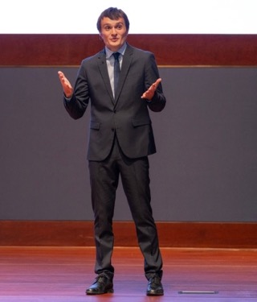

Mechanical Structure of the Proton: Pressure and Sheer Forces
Pressure Distribution
Inside the Proton
Peak pressure in objects on earth, the sun, and the universe
Tangential stress force inside the proton changes direction near r ~ 0.45 fm
Peak : 38,000 N (4 metric tons)
V.Burkert, L. Elouadrhiri, F.X. Girod, Nature 557 (2018) 7705, 396
Pierre Chatagnon
JLab – Post-doc
Burkert, V.D., et al., Colloquium: Gravitational form factors of the proton. Reviews of Modern Physics 95, 041002 (2023)
This breakthrough has paved the way for a completely groundbreaking approach to unraveling the intricate structure of the proton.

Slide 7
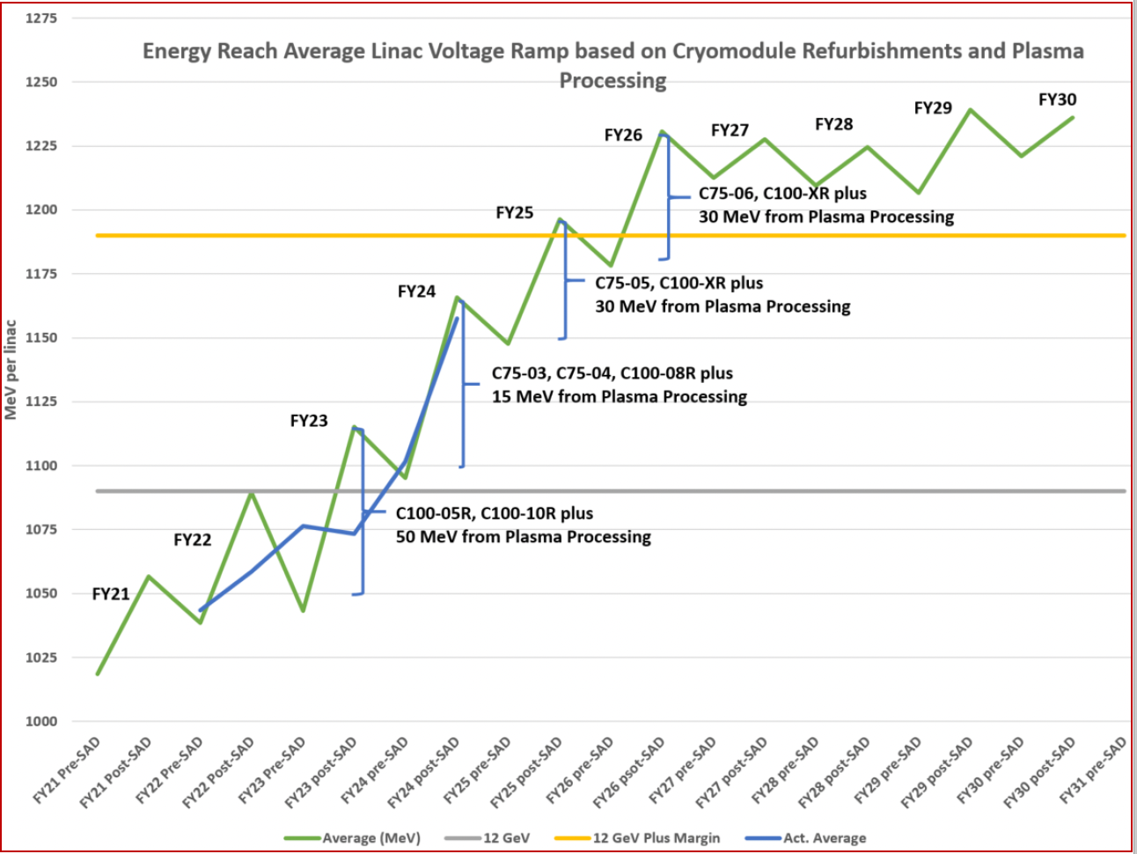
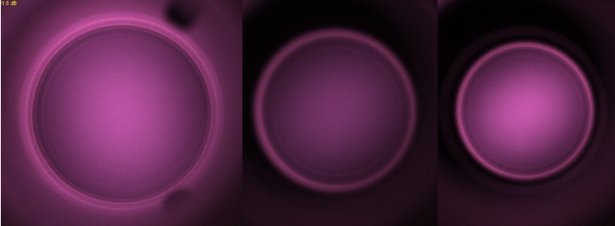
Energy Reach and Reliability in CEBAF Operations
Lower run E
Continuous improvement efforts (CPP) are enabling both better performance and energy reach required by experiments

Slide 8
Notional CEBAF and EIC Efforts on One Chart
Accelerator team has worked up an early schedule and cost estimate
  Schedule assumptions based on a notional timing of when funds might be available (near EIC ramp down based on EIC V3 profile)
  For completeness, Moller and SoLID (part of 12 GeV program) are shown; positron source dev shown
EIC Project is shown
Activities | Fiscal Year
 | 24 | 25 | 26 | 27 | 28 | 29 | 30 | 31 | 32 | 33 | 34 | 35 | 36 | 37 | 38 | 39 | 40 | 41 | 42
Moller (MIE, 413.3B, CD-2/3)
SoLID (LRP, Rec 4)
Positron Source (R&D)
CEBAF Upgrade preCDR/preplan
Positron Project (potential)
Transport e+
22 GeV Development (R&D)
22 GeV Project (potential)
EIC Project (V4.2, CD-1, CD-3A)
CEBAF Up

Slide 9
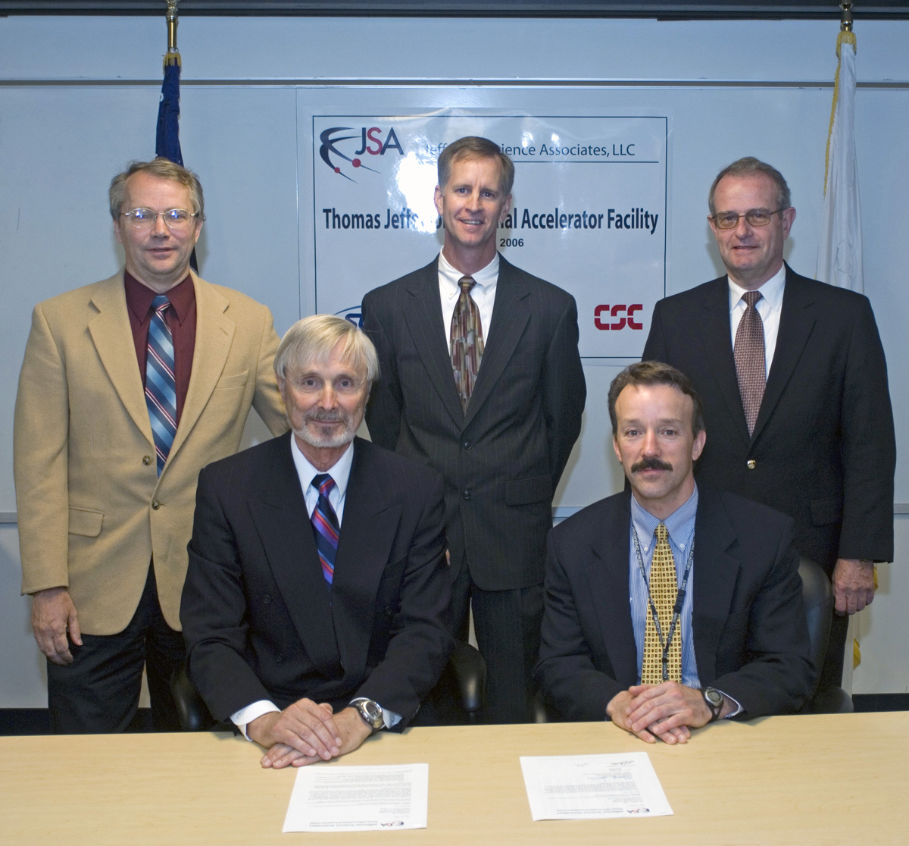
Management and Operations (M&O) Contract Competition
Jefferson Lab is a Government Owned-Contractor Operated (GOCO) Federally Funded Research and Development Center (FFRDC)
Jefferson Lab has been managed by:
  Southeastern Universities Research Association: 1984-2005
  Jefferson Science Associates: 2006-present
Most DOE National Labs’ M&O contracts are re-competed every ~20 years
Department of Energy announced intent to compete the M&O Contract for Jefferson Lab with a new contract in place on June 1, 2025
Contract signing ceremony on May 31, 2006
Request for Proposals issued on July 3, 2024 – due date 30 September 2024
SURA will respond with a proposal
The next M&O contractor is expected to transition lab staff to the new employer so staff should not fear that their employment is in jeopardy; programs continue as today (there will be a PAC 53-75-100!!!!)

Slide 10

Introducing Kimberly (Kim) Sawyer
Stuart Henderson has provided the laboratory with a solid trajectory upon which to build. We will celebrate his accomplishments later and this week.
Kim Sawyer will become Jefferson Lab’s fifth Director on 3 August 2024.
Previously
  Deputy Director and Chief Operations Officer at Argonne National Lab
  Deputy Director for Lab Operations and COO at Sandia Labs
  VP for Technical Operations at Lockheed Martin
Brings a wealth of experience to the position as we navigate this transitional period.

Slide 11
Discussion
Questions?

