Slide 1
DOE Annual Laboratory Plan 2024 Development
David J. Dean
Deputy Director for Science
Presented To:
JSA Board
February 20, 2024

Slide 2

Outline
Highlights
Discussion

Slide 3
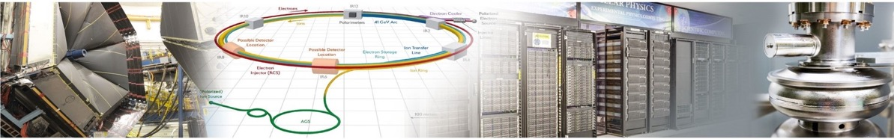

Expanding Jlab’s Science and Technology Mission
Physics at CEBAF
Collider R&D
Computational & Data Science
Applied Research & Technology
Vibrant physics research program at CEBAF with optimal 34 weeks/yr supporting ~1,900 annual users
MOLLER Project
BSM Physics – BDX
High precision pictures of the quarks and gluons inside hadrons
Developing CEBAF upgrade paths including positrons and energy doubling
Partnering with BNL in the management, design, and construction of the Electron-Ion Collider Project
Leadership in the design and construction of SRF accelerator capability for the Office of Science
Leadership in energy recovery, polarized e- beams, emerging expertise in polarized e+ and FFA
Among the leaders in Lattice QCD
Pioneers in multi-facility streaming data and fast data transfer and analysis
Vision for world-leading first-of-its-kind Data specific scientific computing facility: High Performance Data Facility
R&D in accelerator, detectors and applications in nuclear imaging and medicine
Compact accelerator technology for industrial applications
Industrial partnerships on lithographic technology
Advanced detector development (MPGD)
S&T thrusts are synergistic and mutually supportive
Build on our core capabilities to pursue a diverse scientific portfolio

Slide 4
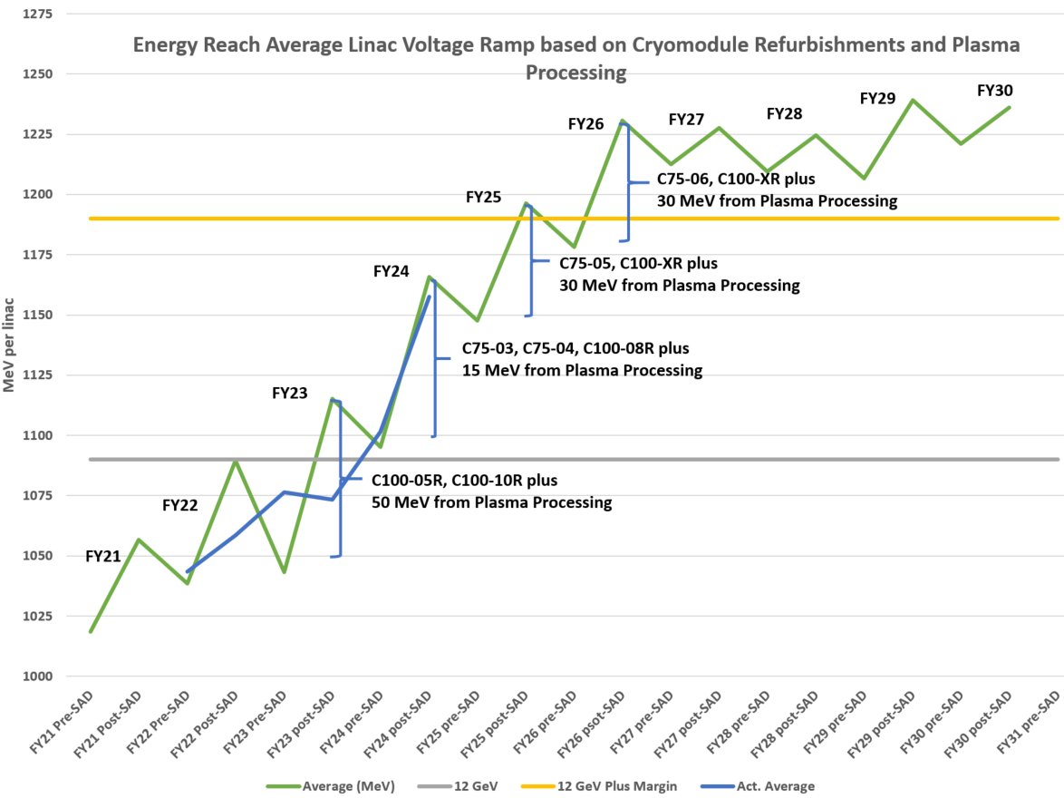
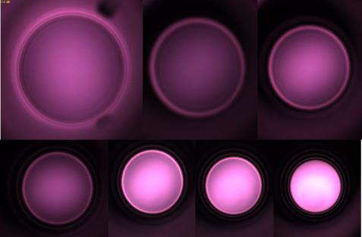
JLab Highlights
Successful partnership with BNL in management, design, construction of EIC Project; successful CD-3a review
In home-stretch for baselining MOLLER
Developed long-term CEBAF Upgrade strategy to enable new scientific opportunities
Completed re-organization of Accelerator and Engineering Divisions to better align resources and accountability for CEBAF Operations
Established an Engineering Council to guide a lab-wide systems engineering framework for JLab
12 GeV scientific era is going strong
  High-profile results emerging from 12 GeV program
  On track for > 30 weeks operation in FY24
  Performance improvements from CEBAF Performance Plan
Multi-Lab Partnerships: SNS PPU nearly complete; LCLS-II HE in full production
Significant developments in Safety
Major developments to diversify Jefferson Lab’s scientific mission

Slide 5
Core Capabilities Underpin Impactful S&T
187
Patents granted
2444
Journal articles
published
Nuclear Physics
Research
Advanced
Computer Science,
Visualization, &
Data
755
PhDs granted
(236 in progress)
915
employees
Two National User
Facilities:
CEBAF & HPDF
Accelerator
Science &
Technology
$206M
FY23
expenditures
1,905
research
guests
annually
Mechanical
Engineering &
Design
$200M
modernization
investment
Systems
Engineering

Slide 6
JLab Nuclear Physics Future Aligned with the FY23 LRP
Nuclear Physics future
  Run the 12 GeV program (1st Recommendation in FY23 LRP)
  Execute SoLID
  (4th recommendation)
  Contribute to EIC
  (3rd recommendation)
  Plan for e+ and 22 GeV
  (in the text)
  Build an EIC research program
  Exploit opportunities
  (Dark Matter; neutrino nucleus;…)
I: The highest priority of the nuclear science community is to capitalize on the extraordinary opportunities for scientific discovery made possible by the substantial and sustained investments of the United States. We must draw on the talents of all in the nation to achieve this goal.
III: We recommend the expeditious completion of the EIC as the highest priority for facility construction.
IV: We recommend capitalizing on the unique ways in which nuclear physics can advance discovery science and applications for society by investing in additional projects and new strategic opportunities.
Upgrades to CEBAF mentioned in document text.

Slide 7
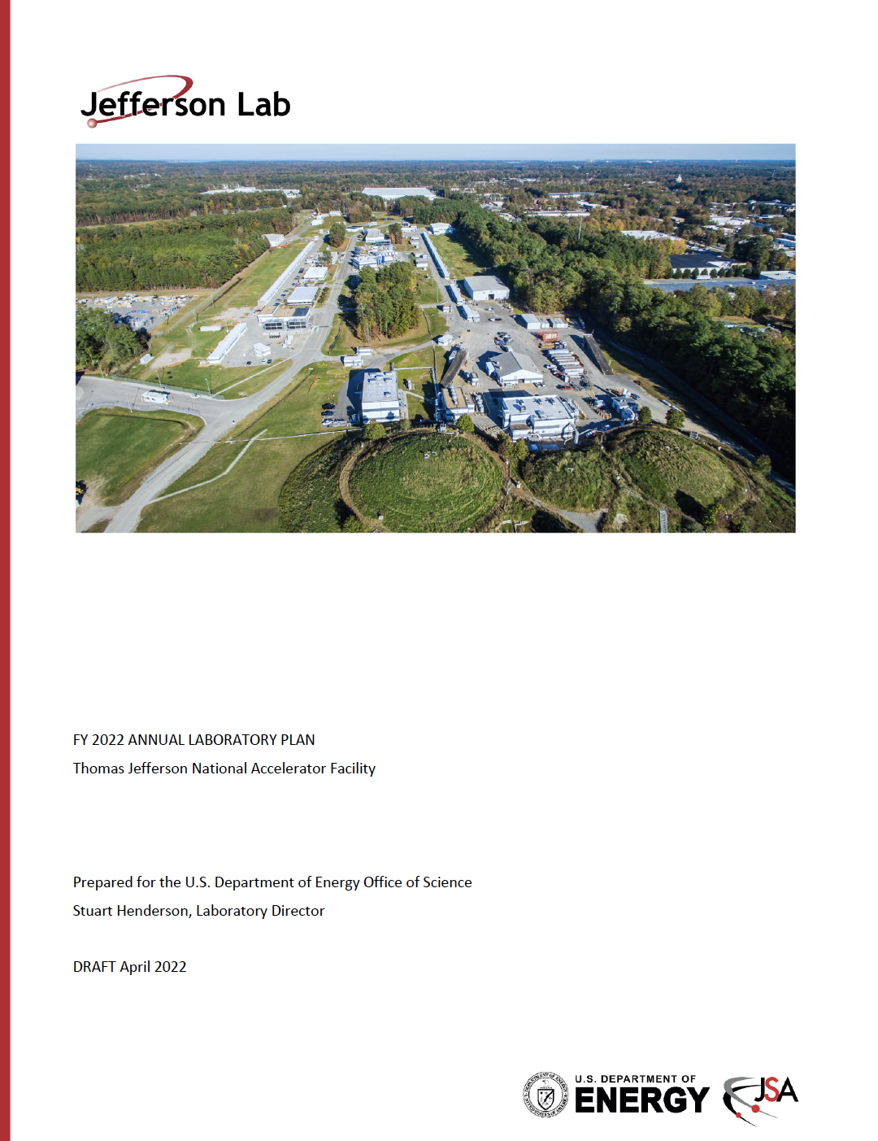
Annual Laboratory Plan presents a 10-year strategy
A strategic planning activity
  Define an exciting, yet realistic, long-range vision for the future of the lab and the S&T conducted on behalf of the Department.
Provides the starting point for a discussion between the DOE leadership and the lab about future directions, strengths and weaknesses, immediate and long-range challenges, and resource needs.
Spans 10 years and reflects DOE’s view of the future of the laboratory
Includes some elements of reporting requirements
It looks like this is going toward an ‘every-other-year’ process for the written plan, and yearly for associated data call.

Slide 8
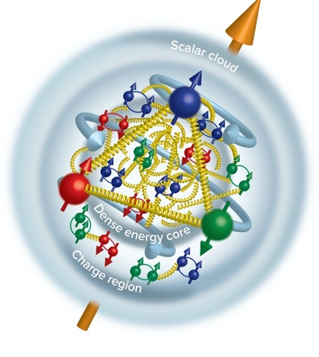
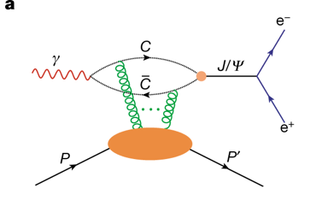
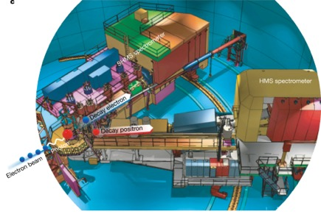
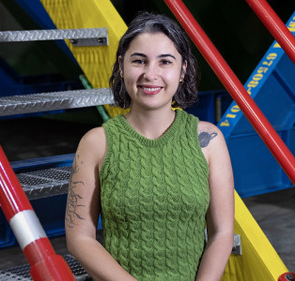
CEBAF Experiment Finds Gluon Mass in the Proton
Near threshold J/psi photoproduction experiment
Inner Gluon radius: 0.52 +/- 0.03 fm
Charge radius: ~0.84-0.88 fm
Scalar gluon rad: 1.069+/-0.056 fm
“Determining the gluonic gravitational form factors of the proton," Duran et al, Nature 615, 813 (2023)
Burcu Duran, first author on Nature article highlight - now a postdoc with one of JLab’s Bridge faculty members
Measured in Hall C

Slide 9
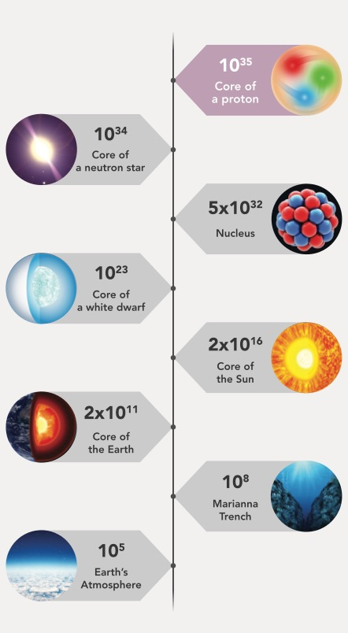
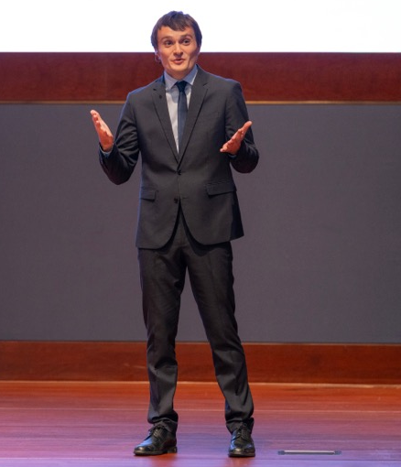

‘Stress-Energy Tensor’ and the proton – LRP 2023 Highlight
Peak pressure in objects on earth, the sun, and the universe
Tangential stress force inside the proton changes direction near r ~ 0.45 fm
Peak : 38,000 N (4 metric tons)
Pressure Distribution
Inside the Proton
V.Burkert, L. Elouadrhiri, F.X. Girod, Nature 557 (2018) 7705, 396
Pierre Chatagnon
JLab – Post-doc
Burkert, V.D., et al., Colloquium: Gravitational form factors of the proton. Reviews of Modern Physics 95, 041002 (2023)
This breakthrough has paved the way for a completely groundbreaking approach to unraveling the intricate structure of the proton.

Slide 10
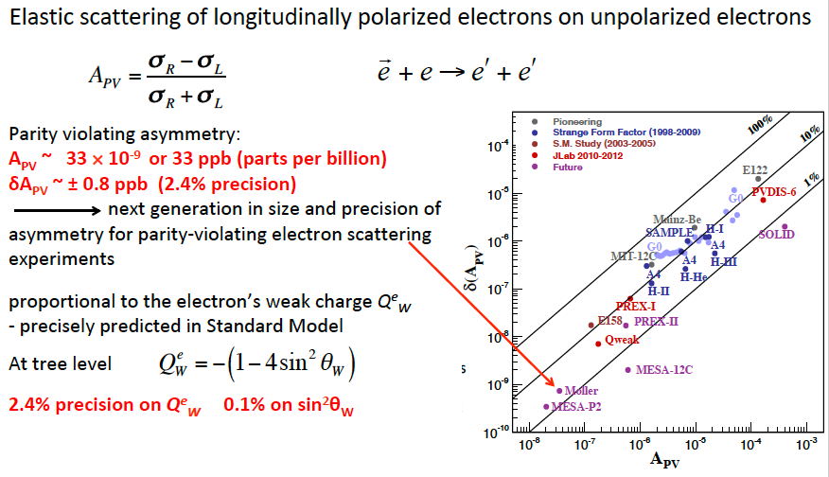
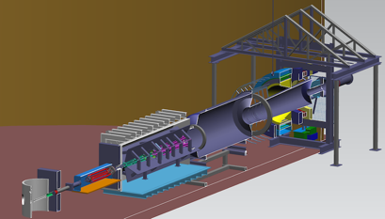
Moller: Probing the Standard Model to 27 TeV
MOLLER will probe energy regions for Beyond Standard Model Physics to ~27 TeV in this Q-weak sector
LHC energies: 13 TeV
Excellent technical work being accomplished.
OPA Review recommended proceeding to CD-2/3 following several plan updates.

Slide 11
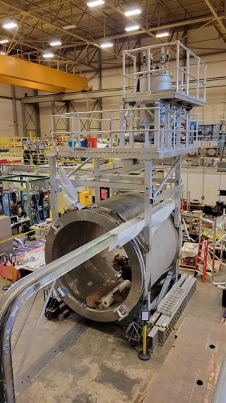
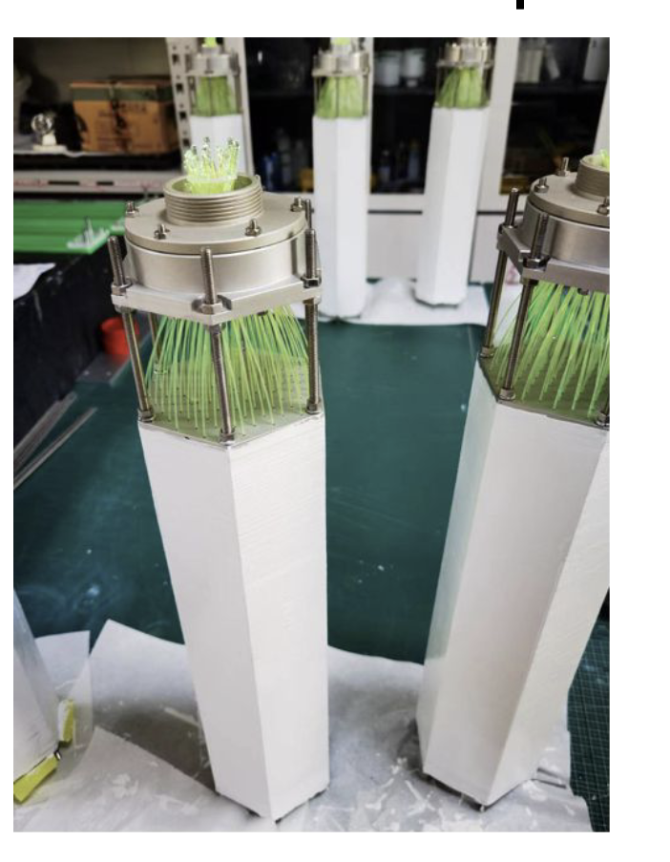
SoLID: Fully enables CEBAF 12 GeV at Intensity Frontier
The SoLID science program was endorsed by the 2023 NSAC Long Range Plan (Recommendation #4) as one of the projects "that lay the foundation for the discovery science of tomorrow". SoLID is mentioned positively over 25 times in the Plan.
Nucleon spin, proton mass, BSM experiments require precision measurements of small cross sections and asymmetries, combined with multiple particle detection
There is a critical need for a high luminosity 10³⁷-10³⁹ cm⁻²s⁻¹ and large acceptance working in tandem – takes full advantage of Jefferson Lab capabilities
SoLID Whitepaper Published in: J.Phys.G 50 (2023)
Highlights of SoLID scientific programs and instrumentation
Risk-reducing R&D continues!
SoLID cost updated FY2023 (TPC = ~$92M)
Experimental operations and CE, with some sacrifice, could support ~$24M dependencies
Electromagnetic Calorimeter Prototype for the SoLID Project at Jefferson Lab
TIPP, SPRINGER NATURE (2018)
Magnet testing

Slide 12
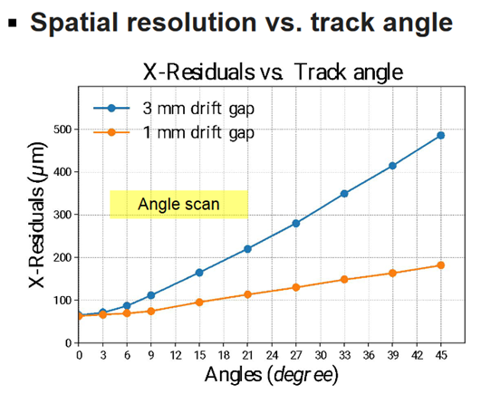
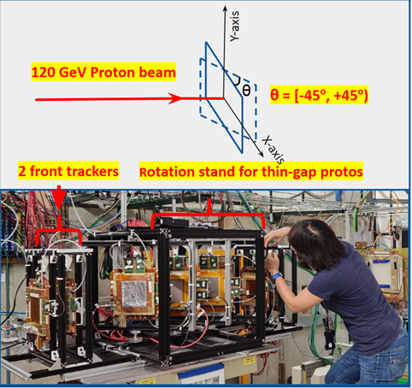
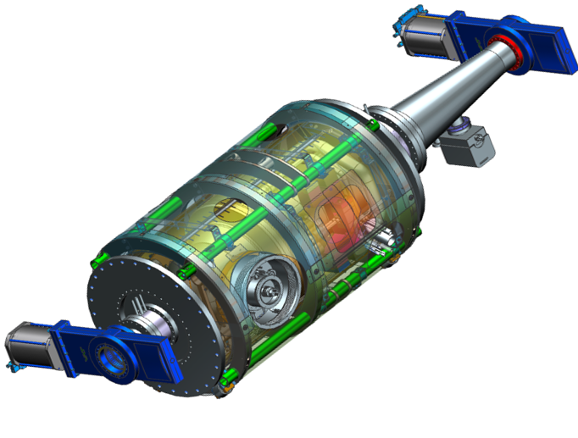
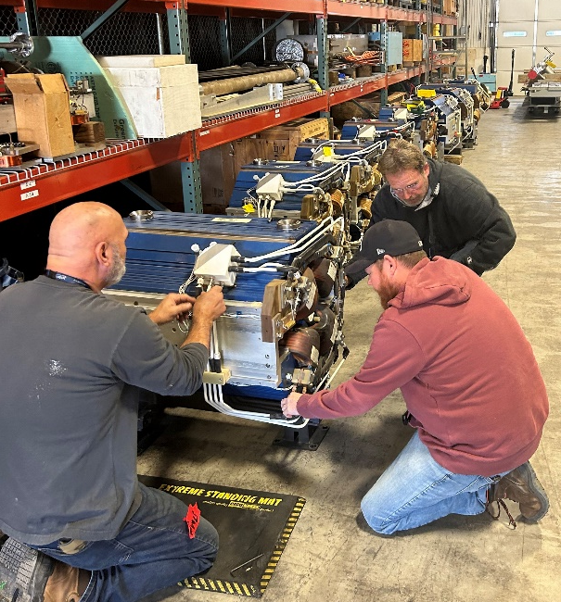
EIC Project and Generic R&D Highlights at JLab
JLab leads the EIC detector and international community efforts to success
  Completed FDR for detector solenoid
JLab leveraging expertise in cryomodule design and construction to support EIC SRF efforts
  Final design review for the first article 591 MHz single cell recently completed
  Development of prototype elliptical and crab cavities underway
400+ quadrupole magnets from APS being refurbished at JLab Magnet Measurement Facility for use in EIC
JLab cryogenics staff managing significant satellite cryoplant procurement effort.
Thank you: EIC Generic Detector R&D ($2M) funded for a second year.
A few highlighted proposals funded in 2023:
  Generic Glass Scintillators for EIC Calorimetry R&D
  Z tagging mini-DIRC
  Photonics-Based Readout and Power Delivery by Light for Large-Area MAP Sensors
  A Fast Timing MAPS Detector for the EIC

Slide 13
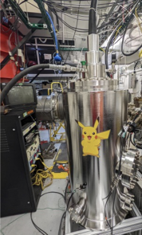
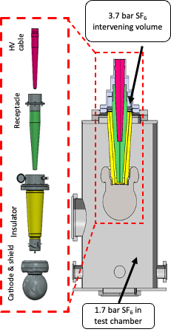
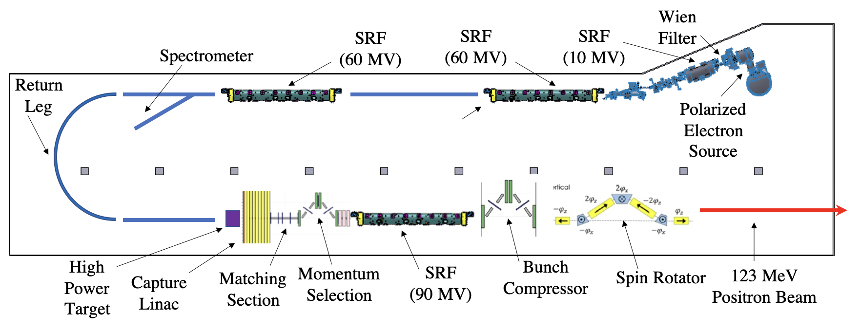
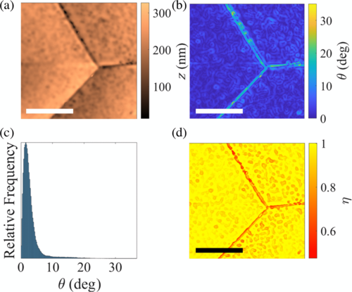
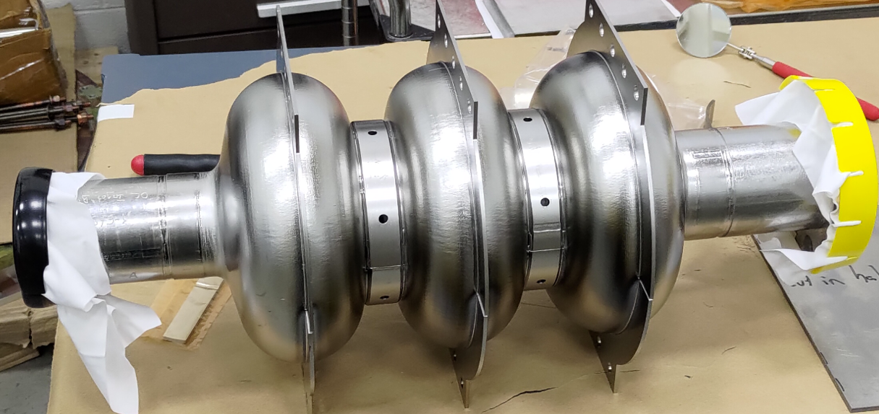
Accelerator S&T Advances Enable Future Capability
Developing design and layout of polarized positron production in support of CEBAF upgrade preparations
Continue FFA 22 GeV design efforts including LDRD on assessing permanent magnet material performance in real tunnel environment
Achieved 500 kV in a novel SF6 high voltage connector – key for mA beam for e+ production
Demonstrated longer lifetime photocathode with "robust" chemistry
Achieved new fundamental understanding on impact of SRF surface topology to attainable accelerating gradient in cavities. A major milestone toward next generation high-Q₀/High-Gradient SRF cavities.
First multi-cell Nb cavity
with conduction-cooling
Nb ring made with
in-house EBW machine. On schedule to coat its inner surface with Nb3Sn using in-house vapor diffusion furnace.
Measured Atomic Force Microscopy topography and calculated superheating field suppression factor
E. Lechner et al, Phys. Rev. Accel. Beams 26, 103101 (2023)

Slide 14
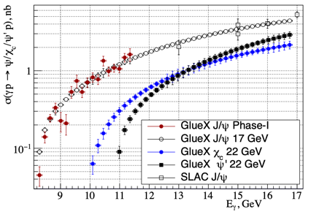

Scientific Vignettes for the 22 GeV Upgrade
How does QCD generate hadrons?
Are there pure exotic states?
Can we harness threshold charmonium production to probe proton/gluon properties?
In the context of the CSM approach, Q² evolution of the γ_{v}pN* electrocouplings could offer an insight into hadron mass generation and the emergence of the N* structure from QCD
Simulations indicate JLab22 is the only foreseeable facility to extend these measurements up to 30 GeV² and down to α_{s}/π=0.15 where non-and perturbative QCD coexist.
Direct (photon) probe of the
$Z_{c}→J/ψπ$ coupling without rescattering effects provides unique complementary data to constrain interpretation of $e^{+}e^{−}$ and B decays data.
Exclusive charmonium production near threshold probes gluon/mass properties of proton (mass radius, gravitational form factors, D-term, anomalous contribution to proton mass), however
  assuming factorization
  assuming two-gluon exchange

Slide 15
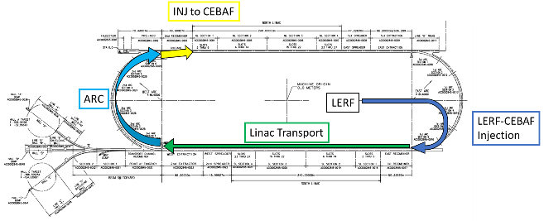
Technically Feasible, Cost Effective, and Innovative Path to 22 GeV
Capitalizing on recent science insights and US-led accelerator science and technology innovations, develop a staged program at the luminosity frontier
Positrons (e+) in the LERF (former FEL) with transport to CEBAF (validation of the scattering formalism)
Injection energy Upgrade for 650 MeV Electron (e-) in LERF [see Afanasev et al., EPJ A 57, 188 (2021)]
Replace arcs on each side with new FFA permanent magnet arcs to upgrade to 22 GeV
The science and technology of the e+ and energy upgrade are discussed in the 2023 Long Range Plan

Slide 16
High Level CEBAF Schedule (FY24 – FY42)
Accelerator team has worked up an early schedule and cost estimate
  Schedule assumptions based on a notional timing of when funds might be available (near EIC ramp down based on EIC V3 profile)
  For completeness, Moller and SoLID (part of 12 GeV program) are shown; positron source dev shown
Activities | Fiscal Year
 | 24 | 25 | 26 | 27 | 28 | 29 | 30 | 31 | 32 | 33 | 34 | 35 | 36 | 37 | 38 | 39 | 40 | 41 | 42
Moller (413.3B)
SoLID (LRP)
Positron Source Dev
Pre-Proj Dev
Upgrade Phase 1
Transport comm/e+
Upgrade Phase 2
CEBAF Up
FY24 $$
Phase 1: tie LERF to CEBAF & injector for e+ $104M ($80M – $157M)
Phase 2: High Energy Upgrade (includes FFAs) $251M ($194M – $377M)
Total cost (Class 4 estimate) $355M ($273M – $532M)
Pre-R&D (FY26 – FY28) $3.0M/year (+$0.5M/year in LDRD)

Slide 17
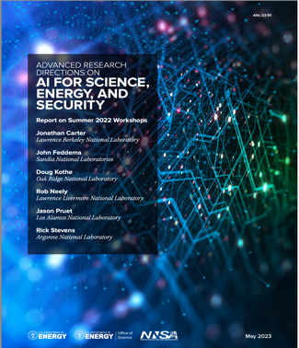
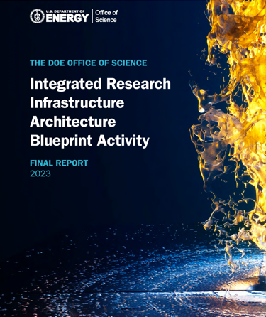
AI + IRI + HPDF – We are aligned with ASCR’s view of the future
Cross Cutting AI Themes
Advanced materials properties, interfaces and inverse design
Software engineering and programming
Robotics for autonomous discovery
Prediction and control of complex engineered systems
Surrogates for high-performance computing
Foundation, Assured AI for scientific Knowledge
Time Sensitive Patterns
Data Integration Intensive Patterns
Long-Term Campaign Patterns
Types of Data ‘Patterns’ to be supported by HPDF

Slide 18
Budget: FY24 and FY25 (and beyond)
FY24 was just passed; FY25 President’s Budget just released
 | FY23 | FY24 | FY25 (PB)
NP Top Line | $805M | $804M | $833M
ME Operations | $149.8M | $141.9M | $147.2M
EIC (Const) | $50M | $95M | $110M
HPDF (ASCR) | $2M | $8M | $16M
ME Ops:
FY24 ~ 27 weeks (likely stretch the SAD)
FY25 – (PB Budget Language: 89% Optimal Funding)

Slide 19
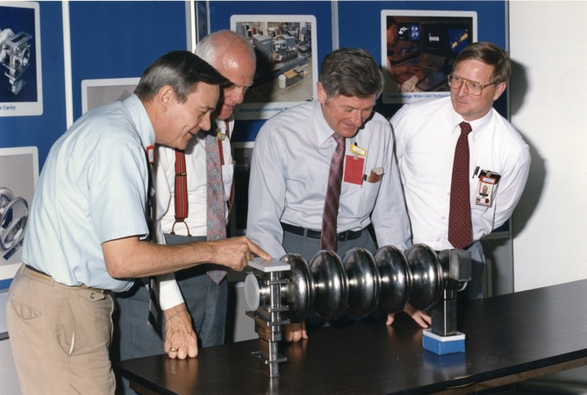
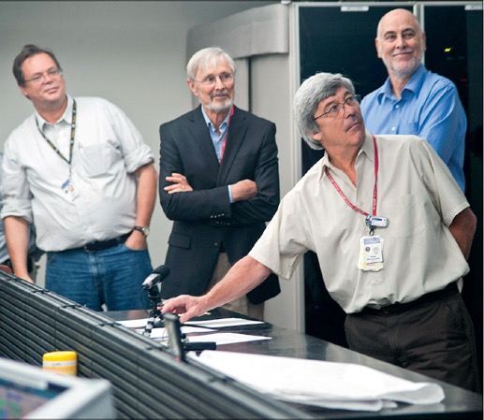
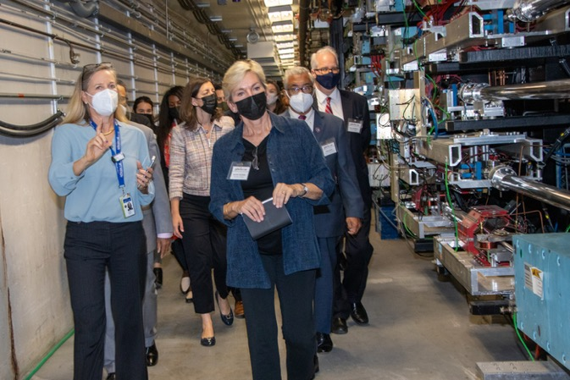
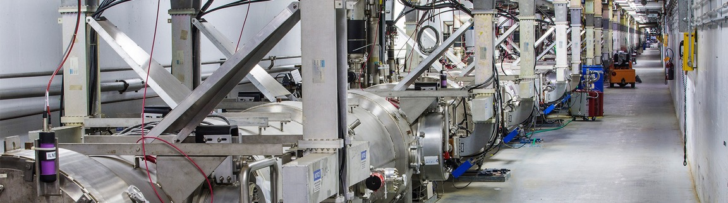
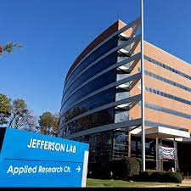

JLab’s Past Will Lead to an Exciting Future
What we do today will enable a vibrant future into the 2040s and beyond

