Slide 1
The High Performance Data Facility: HPDF
Graham Heyes
HPDF Technical Director
March 12th, 2024

Slide 2
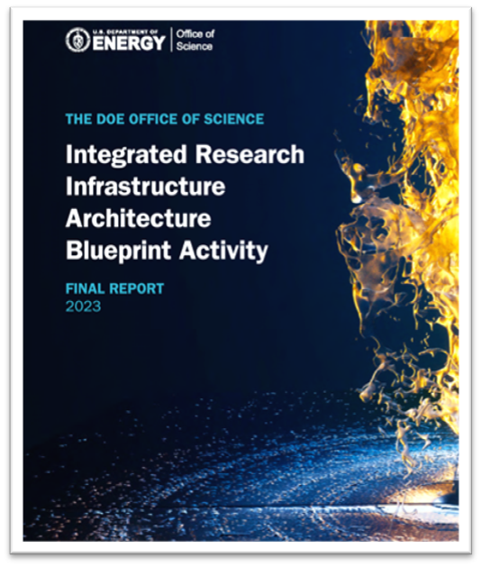
HPDF - Meeting the Greatest Needs
The DOE envisions a revolutionary ecosystem – the Integrated Research Infrastructure – to deliver seamless and secure interoperability across National Laboratory facilities
The 2023 IRI Architecture Blueprint Activity identified three broad science patterns that demand research infrastructure interoperability:
Time-sensitive patterns
Data-integration-intensive patterns
Long-term campaign patterns
IRI will be a program within the Office of Science, executive, leadership and steering committees are being set up now.
HPDF is the fifth facility funded by the Advanced Scientific Computing Research program (ASCR) as a cornerstone of the IRI to meet the needs of data driven research
HPDF will enable analysis, preservation, and accessibility of the experimental data produced by SC facilities across ALL programs
Report published in 2023, available on OSTI
https://doi.org/10.2172/1984466

Slide 3
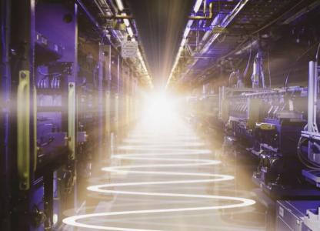
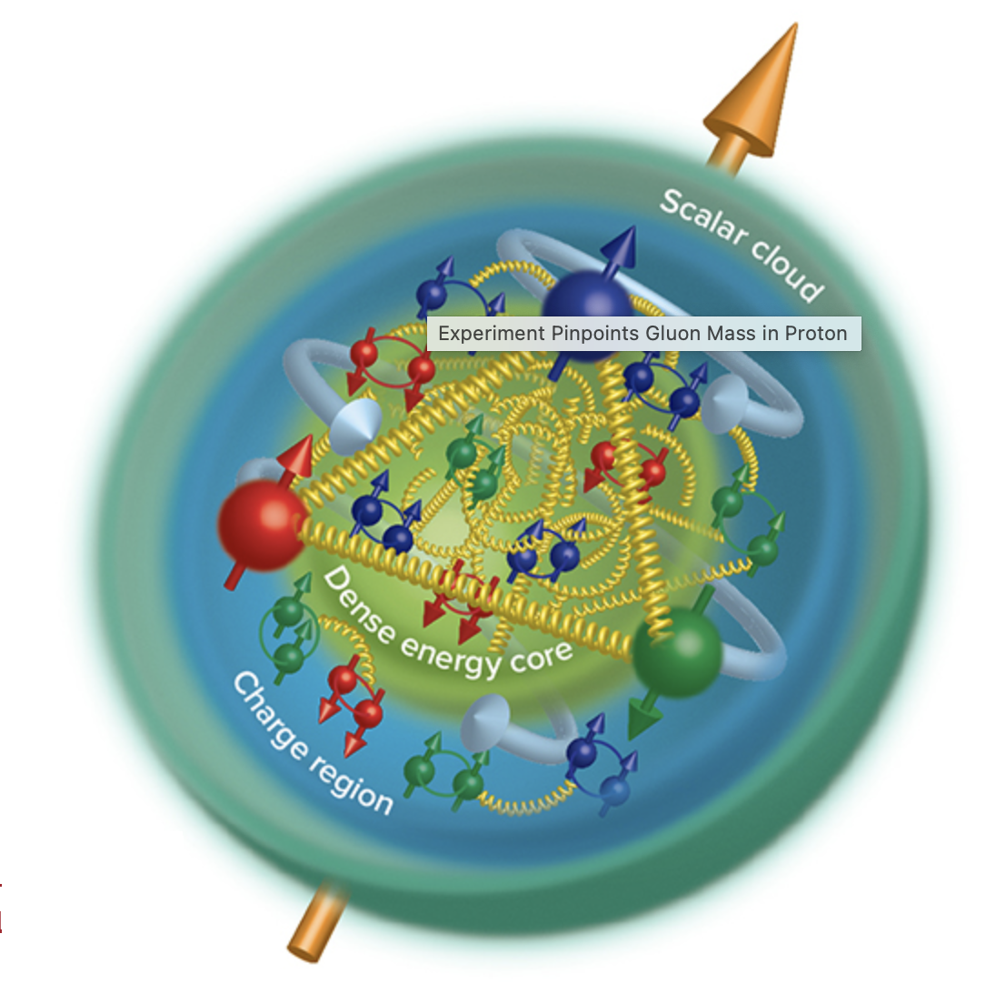
Three Deeper Dives: LCLS, ESGF, EIC
LCLS-HE (BES)
ESGF (BER)
EIC (NP)
Linac Coherent Light Source at SLAC, X-ray laser
Science: Visualizing a broad range of excited-state molecular dynamics
Data needs
Access and management
Caching and orchestration
Storage of large data sets
Support for a wide range of storage and processing requirements
Experimental data is used in conjunction with Exascale simulations enabled by ECP
Earth System Grid Federation
Science: Facilitate advancements in Earth System Science
Data needs
Access and management
Caching and orchestration
Storage of large data sets
Data integration and interoperability
E3SC – Exascale Earth System Model project, links to ECP
Electron Ion Collider Facility at BNL, a joint project with JLab – distributed computing
Science: Understanding the structure of protons and neutrons
Data needs:
Access and management
Caching and orchestration
Realtime processing
Long term archive
LQCD theory calculations enabled by ECP
ECP enabled Exascale Simulations necessary for scientific discoveries

Slide 4
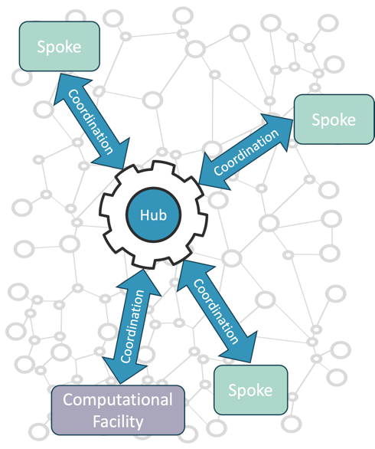
HPDF: A Distributed Facility
Concept: HPDF is a distributed facility with a hub and spoke architecture.
Hub. Data-centric infrastructure with high availability and performance, as well as geographically and operationally resilient active-active failover.
Spokes. Distributed data-centric infrastructure to enhance HPDF access and support for science users and integrate distributed computing or storage resources.
Integration and services. Orchestration hardware, software, and services for data movement, storage and retrieval, and science workflow automation. These will use a mesh data fabric with data flows orchestrated by the hub.
HPDF data fabric

Slide 5
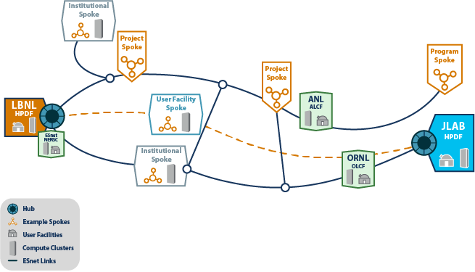
HPDF in the ASCR Ecosystem
Working with IRI, and other ASCR facilities ensures a secure, high-performance mesh data fabric that enables data and workloads to flow freely
Built on ESNet 6
Informing ESNet 7 design
The HPDF distributed infrastructure will be designed to maximize planned availability and resilience
Partnering with spoke sites will provide seamless data life cycle services to scientific users worldwide
Pilot activities and partnerships will help refine the design as hub software and hardware technology evolve and foster workforce development

Slide 6
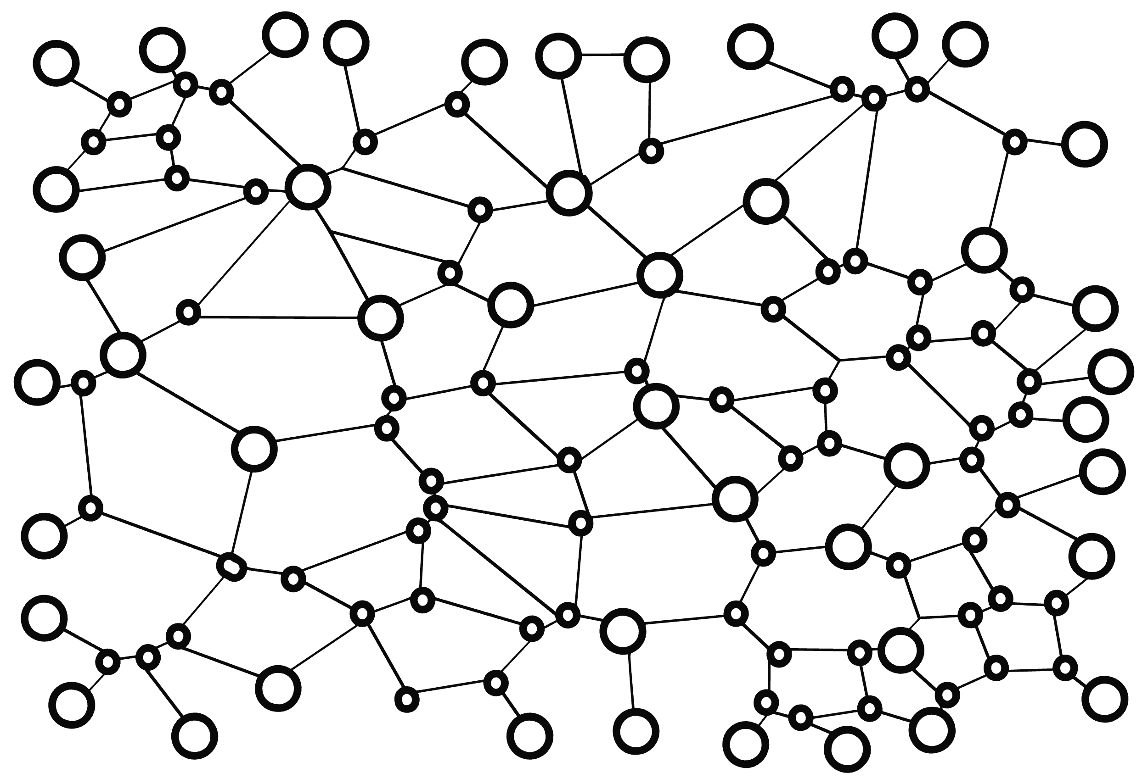
What is a Spoke?
Spokes are component parts of HPDF that integrate a science “organizational unit”
Collaboration
Facility or institute
Instrument
Resource
A spoke has two components
Things
Spoke infrastructure – how it links to the rest of HPDF
Contributed resources – things the organization contributes to HPDF (storage, compute)
Contributing resources – things HPDF contributes to the organization (services, storage, compute)
People
Support staff – HPDF funded or trained
Software developers – HPDF and organization
Science researchers and subject matter experts – people like you
??
Coordination
??
Coordination
Hub
HPDF data fabric
Coordination
Coordination
??
??

Slide 7
HPDF Will Address SC Priority IRI Science Patterns
Drivers | IRI Patterns | Exemplars
Supporting data curation, repositories, and archives |  | BER: ESS-DIVE, NMDC HEP: DESI
Supporting data processing and analysis pipelines |  | BES: Light Sources, NCEM NP: EIC HEP: DUNE
Data federation, sharing, and collaboration |  | BES: Materials Project BER: ESGF, KBase, NSF: OSG NP: GLUEX
Real-time streaming and processing |  | BES: Light Sources FES: DIII-D, PPPL/KSTAR HEP: Direct Dark Matter Searches NP: EIC, FRIB
Time-Sensitive
Data Integration-intensive
Long-Term Campaign

Slide 8
HPDF Will Set the Standard for Data Life Cycle Management
Data science requires curated and annotated data that adheres to FAIR principles, and data reuse will be a metric for HPDF. Office of Scientific and Technical Information services will complement HPDF to provide full life cycle coverage.
Refine
User Facilities
Science Gateways
Raw & Derived Data
Publish
Share
Hub
Release
Acquire and Prepare
Fulfill FAIR principles for scientific data
Ingest experimental and observational and reprocessed data using standard APIs
ESnet
Preserve
Tiered Storage
Transfer
Analyze
Long-term data curation and archival
Move and manage data and dynamic data streams
Clean and Process
Compute
Scalable scientific and AI/ML workflows

Slide 9
Key Facets of Data Requirements
Management – A dynamic and scalable data management infrastructure integrated with the DOE computing ecosystem
Capture – Dynamically allocatable data storage and edge computing at the point of generation
Staging – Dynamic placement of data in proximity to appropriate computing for reduction, analysis, and processing
Archiving – Extreme-scale distributed archiving and cataloging of data with FAIR principles
Processing – Resources for workflow and automation for processing and analyses of data at scale
Policy of data and providing collaborative environments around data are also critical

Slide 10
Design Overview

Slide 11
Technical Design Core Capabilities
Hub Computing and Data Infrastructure
Distributed Spoke Infrastructure
Data-centric Orchestration of Hardware, Software, and Services
High uptime
Experiment-friendly availability
Data-driven agility
Support for new technologies
Data storage, management, and interoperability
Data preservation
User support
Scientific application tailoring
Hardware resources that mirror, supplement, or complement hub resources
Low-latency or high-bandwidth coupling of HPDF services to edge compute
High availability
High-performance mesh data transport fabric
Secure data paths
Monitoring
Orchestration

Slide 12
High-Level HPDF Technical Concept
Spoke
Interface
Mesh Data
Fabric Built on ESnet6
Hub
System Services
Data Services
User-facing APIs
Interface to local resources
Data caching
Data management
Scheduling and orchestration
Monitoring
Auth. and user management
User- and operator-facing APIs
Federated data management
Data catalog
Distributed storage interface
SLA-based data transport
Intelligent data distribution
Data caching
Storage
Compute
Data caching
Archive/cold storage
High-performance/hot data storage
SLA-based heterogenous computation
Configured to maximize availability
Dynamic cluster resources
Design methodology, qualification, and approach:
Pilot and phased delivery, enable early development, fine tune design
Use of proven technologies to ensure a reliable, robust platform
Hardware distributed and replicated at both sites to improve reliability and geographic diversity
Modular heterogeneous approach to support a broad range of analysis
Approach to delivery and modularity allows composition adjustment during the design phase

Slide 13
The HPDF Hub: Unique Hardware Capabilities
The hub computing infrastructure must combine high availability with flexibility while supporting time-critical and real-time workflows
To achieve this, our design is based on the concept of “standard units,” hardware elements following well defined architectures targeting specific use cases
Batch jobs, AI/ML intensive workflows, streaming real-time data, dynamic reconfiguration
CPU/GPU flavors to run existing optimized code
The hub will incorporate several standard units in a mix that meets the science needs but can evolve over time
This is not a one-size-fits-all approach, but allows tailoring to need and lowers the barrier to HPDF use
We will implement composable storage configured to minimize the need for users to modify existing code
Hub Compute
CPU Standard Unit
GPU/AI/ML SU
Real-time SU
Future novel HW SU

Slide 14
HPDF Architecture Stack
Common APIs and data services to facilitate portability
Distributed orchestration and execution layers
Data transport, caching, communication, and monitoring built on ESnet6 capabilities
Dynamic virtualized compute and storage ensuring portability between sites
Cross-cutting components for security and monitoring
Developed in partnership with IRI
Data Services
User Software Tools
Site-specific Stacks
Both sites will have similar storage & compute resources, at differing scales, that complement existing ASCR HPC facilities and target data-driven use cases
Databases
Storage Interfaces
APIs
Orchestration Framework
Security
Monitoring & Telemetry
Distributed Execution & Resource Management
Mesh data fabric (Building on ESnet6)
Compute
Storage
Compute
Storage
Compute
Storage
Hub
Future Spokes

Slide 15
Scalable Data Management Infrastructure Mapped to IRI Patterns
Data replication & tiering
FAIR data support, curate data with metadata
Streaming data core & edge services co-dev with ESnet
Robust and reliable distributed data management layer
Data analysis tools/services: user feedback, vendor/OSS engagement
Data Capture & Storage
Data Life Cycle Services
Techniques for data filtering, data scheduling, parallel stream processing
Replication
APIs for Schedulers
Publication QA/QC pipeline, search tools, AI/ML dataset tagging
Long-term storing, archiving, access, and discovery through web interface, DOIs, and APIs
Data Management & Staging
Data Repository & Archiving
APIs to services across entire data lifecycle
Access through web-based APIs and Python/C++
Interface to SF-API
Connect data to clusters/ clouds/HPC
Integrated AI platform with uniform APIs
Re-use and reproduce previous results
Programmable APIs
Data Analysis & AI
Time-Sensitive
Data Integration-intensive
Long-Term Campaign

Slide 16
HPDF Governance and Execution

Slide 17
Summary

Slide 18
HPDF Over the Next 10 Years
Pilot Deployment
Spokes 1
Spokes 2
HPDF w/ Initial Spokes
HPDF Era:
Address: Urgency drives early spokes
Train: Expand data workforce
Establish: Data infrastructure component of IRI and ASCR Ecosystem
Engage: Deep conversations with users
Innovate: Usher in new era and new ideas
Spokes 1 and 2 Era
Address: Extensive data needs
Train: Data workforce at spokes
Establish: Seamless user experience through IRI
Engage: National and international partners
Innovate: Storage and data technologies

Slide 19
Continuous Innovation Cycle is Critical to HPDF
IRI & ASCR Facilities
Track/Engagement with Vendors and Community
Integration
Deployment & Operations
Assess and Develop Requirements
Development and NRE
Vendors
Research & development
(ASCR, etc.)
Data science is driving innovations in software and hardware for storage, data cataloging, and accessibility.
HPDF will drive storage technologies with science use cases and vendor partnerships
Open-source community

Slide 20
What does this mean for you?
The addition of HPDF makes JLab a multi-purpose lab and a member of the ASCR family
In my view nothing but positive outcomes for nuclear physics
Some clearly visible some harder to see
Being the hub of HPDF requires:
High network bandwidth – we just upgraded to dual 100 Gbit/s more to come – priority bump
Power resilience – adding substations and utility feeds – possible more power options for CEBAF
High availability – lessons learned will be applied to all lab computing (already seeing improvements)
The HPDF project brings:
Influx of people with new ideas, experiences, and skills
R&D projects that benefit both HPDF and NP – like EJFAT, applied AI/ML, advanced computing technologies
Things that are core to HPDF’s mission but were secondary to the NP mission, like FAIR data
Heightened visibility across a broader science community
Positive changes in policies and procedures as the lab transitions to a multi-funding source model
The opportunity to be more than one-deep in many support areas
Overall, it’s an exciting journey to be starting out on!

Slide 21
Q&A

