Slide 1
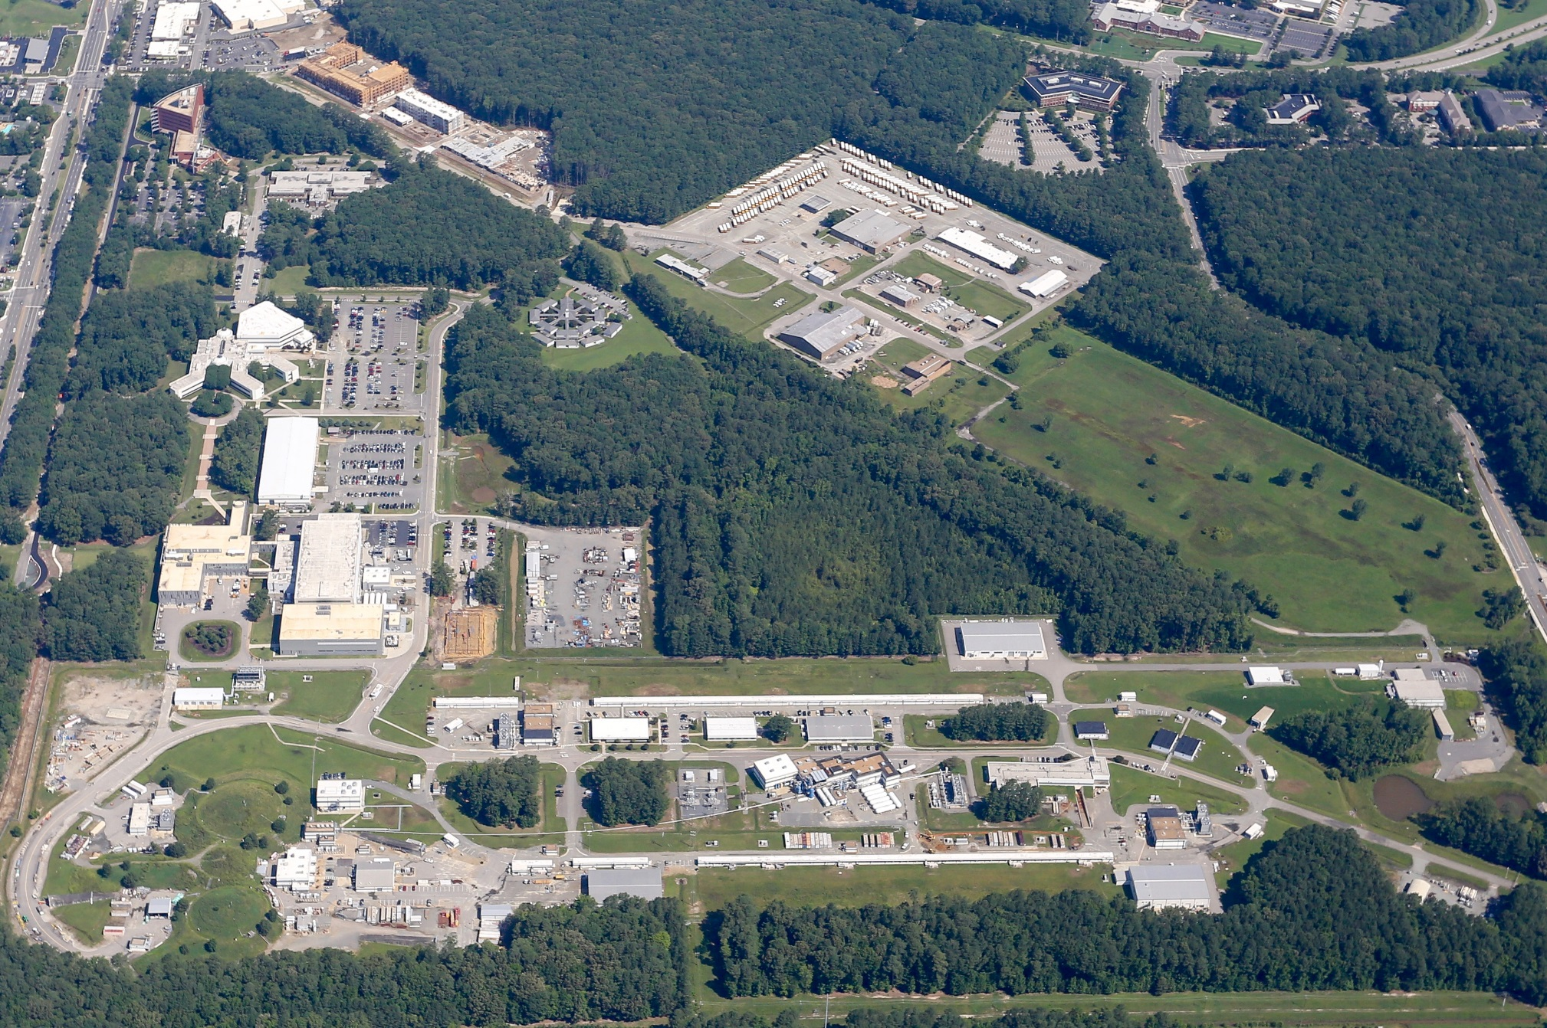
Jefferson Lab’s 12GeV Experimental Schedule & Future Directions
by
Douglas Higinbotham

Slide 2
Nuclear Physics Experiment Scheduling Committee https://www.jlab.org/physics/experiments/NPEScommittee
Deputy Director for Research | David Dean | deandj@jlab.org
Physics Division AD | Thia Keppel | keppel@jlab.org
Physics Division Deputy AD | Patrizia Rossi | rossi@jlab.org
Physics Operations Director (chair) | Douglas Higinbotham | doug@jlab.org
Halls A & C Leader | Mark Jones | jones@jlab.org
Hall B Leader | Patrick Achenbach | patricka@jlab.org
Hall D Leader | Eugene Chudakov | gen@jlab.org
Accelerator Division Deputy AD | Mike Spata | spata@jlab.org
Director of Accelerator Operations | Eduard Pozdeyev | pozdeyev@jlab.org
Center for Injector Studies Leader | Joe Grames | grames@jlab.org
Input is taken from MANY other groups!

Slide 3
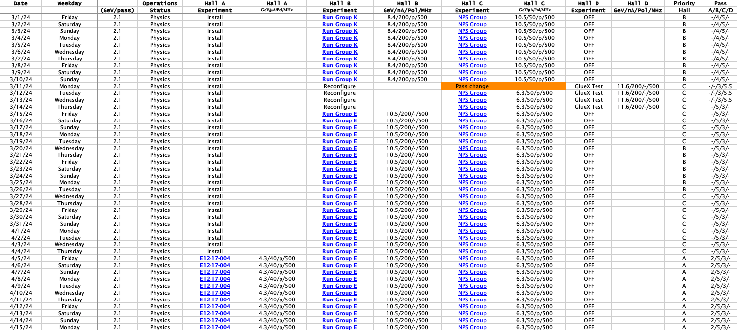

Slide 4
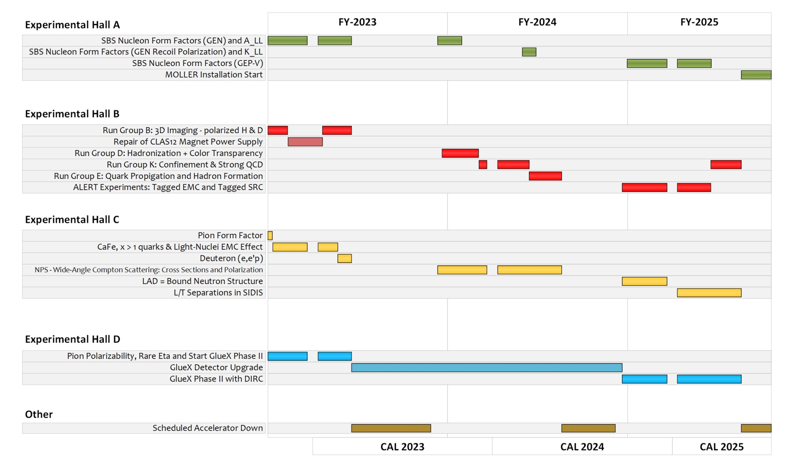
Near Term Jefferson Lab Experimental Schedule

Slide 5
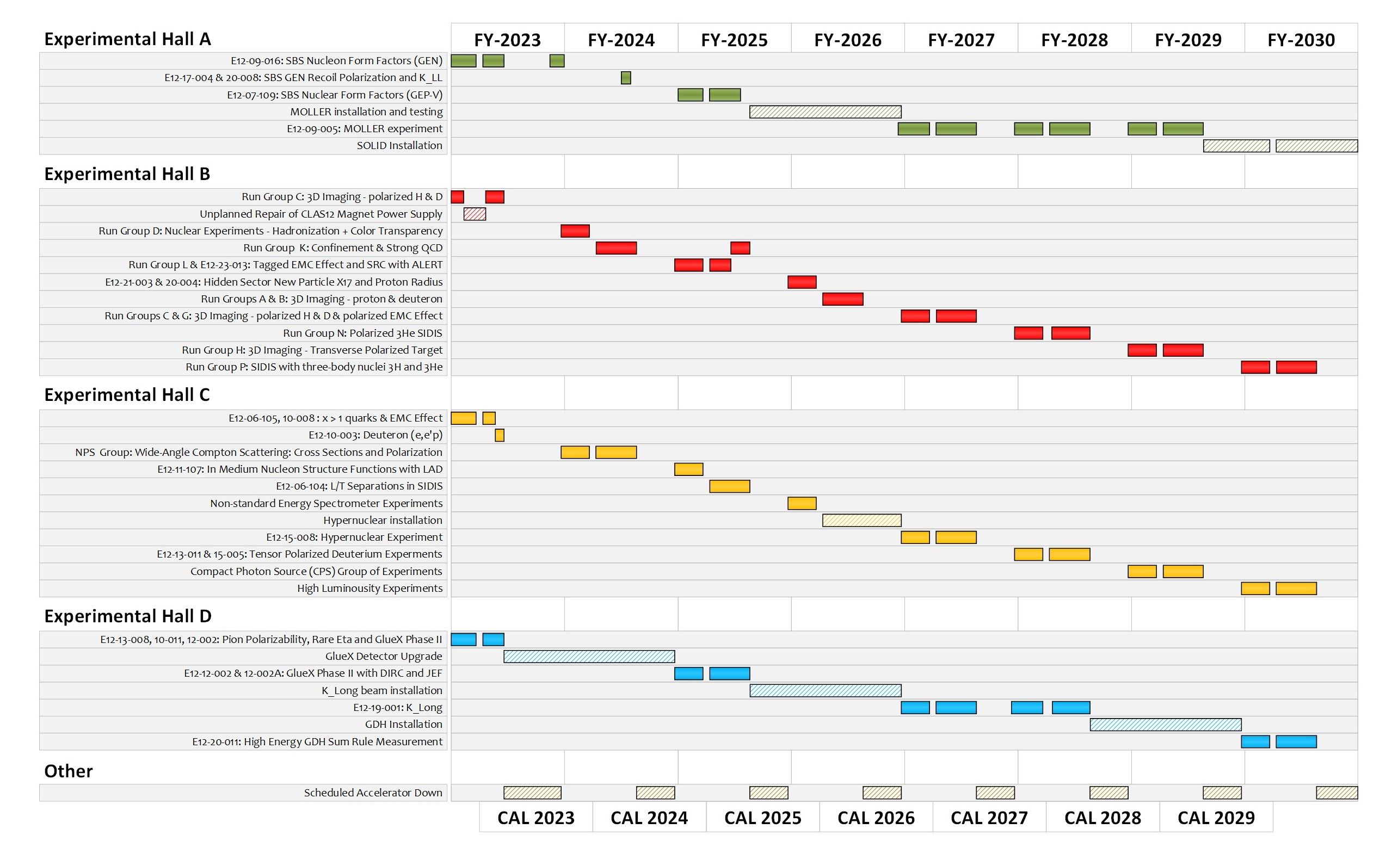
Extended Experimental Schedule

Slide 6


Polarized Electrons for Polarized Positrons (PEPPo)
https://doi.org/10.1103/PhysRevLett.116.214801
Photo of the PEPPo setup in the injector area of CEABF.

Slide 7
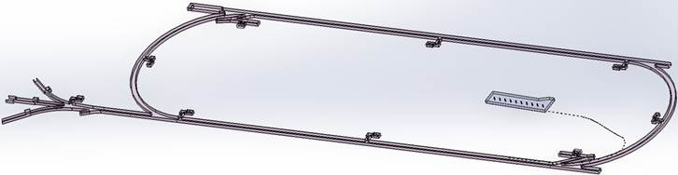

Low Energy Recirculator Facility (LEFRF) As The New Injector Facility for CEBAF
123 MeV e+
(650 MeV e-)
Inject e⁺ into North Linac to usual 12 GeV (w/ magnets reversed)
Build e⁺ injector at the LERF
Build new LERF to CEBAF tunnel
123 MeV e+
(650 MeV e-)
Build new transport line along South Linac and West Arc

Slide 8
12 GeV CEBAF vs. Ce⁺BAF
Machine Parameter | Electrons | Positrons
Hall Multiplicity | 4 | 1 or more
Max. Energy (ABC/D) | 11/12 GeV | 11/12 GeV
Beam Repetition | 249.5/499 MHz | 249.5/499/1497 MHz
Duty Factor | 100% cw | 100% cw
Unpolarized Intensity | 170 μA** | > 1 μA
Polarized Intensity | 170 μA** | > 50 nA
Beam Polarization | > 85% | > 60%
** Total beam power at Jefferson Lab is limited to 1.1 MW with a max. of 0.9 MW to individual high power dumps.

Slide 9
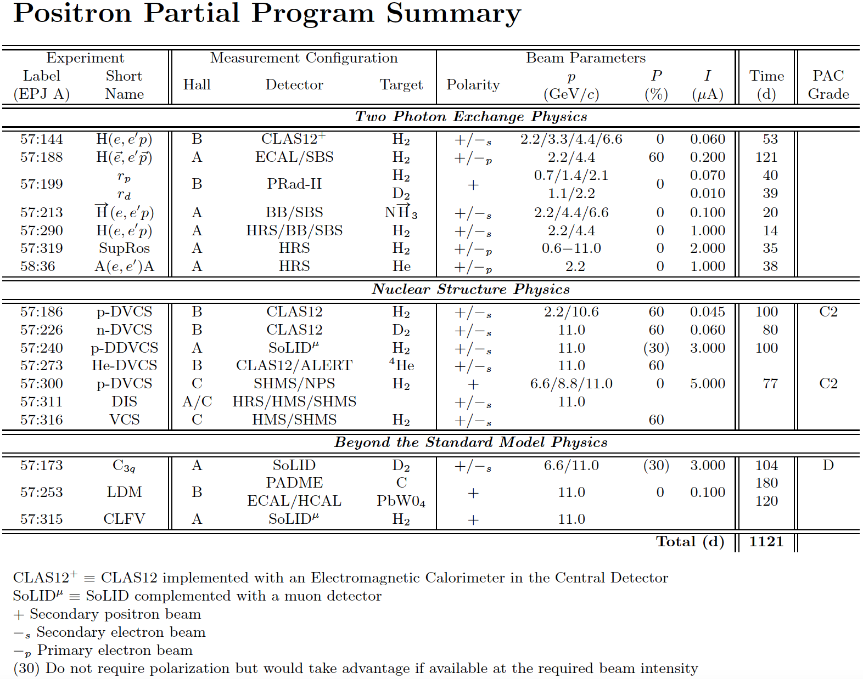
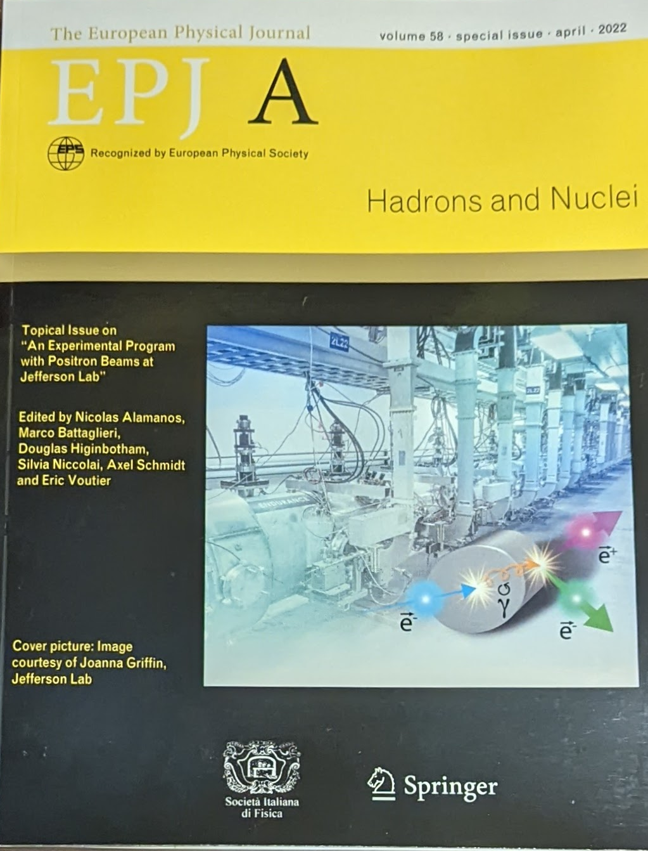
Positron Program White Paper Published 2022
https://doi.org/10.1140/epja/s10050-022-00699-6

Slide 10
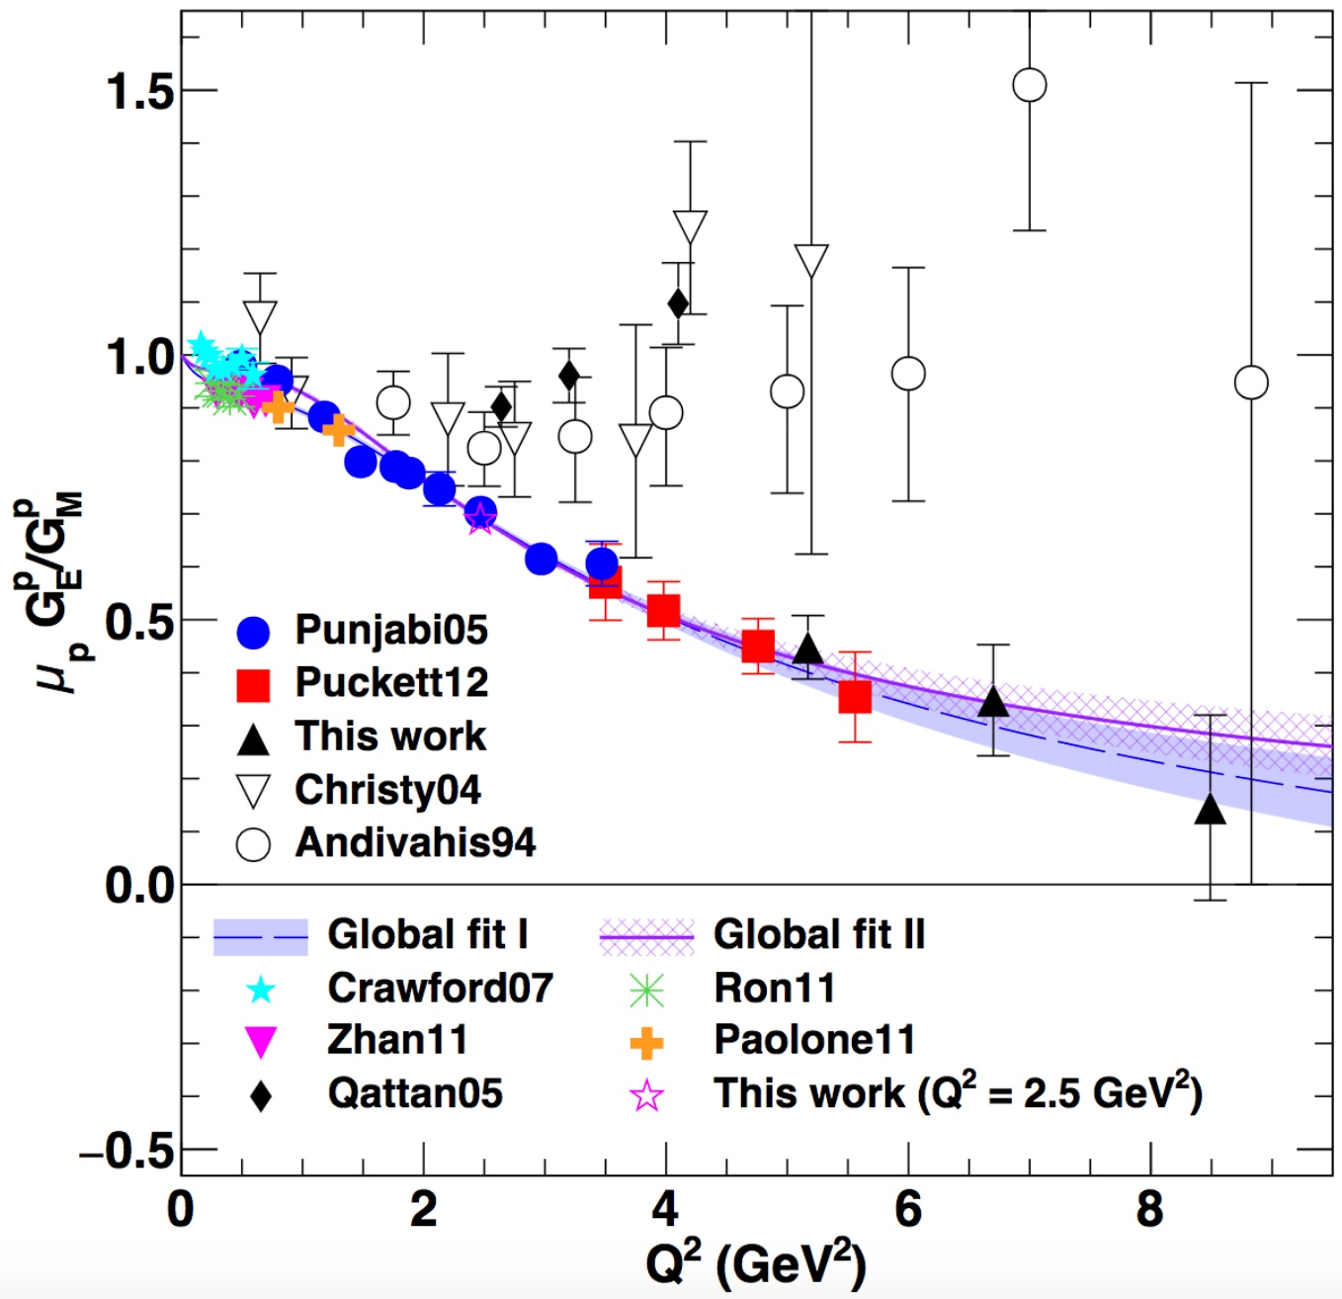
One Detailed Example: Understanding Two Photo Exchange
P.A.M. Guichon, M. Vanderhaeghen, PRL 91 (2003) 142303 P.G. Blunden, W. Melnitchouk, J.A. Tjon, PRL 91 (2003) 142304
Measurements of polarization transfer observables in electron elastic scattering off protons likely showing the breaking-down of the1γ exchange approximation of the electromagnetic interaction.
A.J.R. Puckett et al. PRC 96 (2017) 055203
Two-photon exchange (TPE) is likely the cause of the form factor discrepancy at high Q².
Q² (GeV²)
e⁺ @ JLab has a the unique opportunity to bring a definitive answer about TPE.

Slide 11
Program Advisory Committee Positron Results (July 2023)
NUMBER | TITLE | CONTACT PERSON | HALL | DAYS REQUESTED | DAYS AWARDED | SCIENTIFIC RATING | PAC DECISION
PR12+23-002 | Beam Charge Asymmetries for Deeply Virtual Compton Scattering on the Proton at CLAS12 | Eric Voutier | B | 100 | 100 | A- | C1
PR12+23-003 | Measurement of Deep Inelastic Scattering from Nuclei with Electron and Positron Beams to Constrain the Impact of Coulomb Corrections in DIS | Dave Gaskell | C | 9.3 | 9.3 | A- | C1
PR12+23-005 | A Dark Photon Search with a JLab positron beam | Bogdan Wojtsekhowski | B | 60 |  |  | Deferred
PR12+23-006 | Deeply Virtual Compton Scattering using a positron beam in Hall C | Carlos Munoz Camacho | C | 137 | 137 | A- | C1
PR12+23-008 | A Direct Measurement of Hard Two-Photon Exchange with Electrons and Positrons at CLAS12 | Axel Schmidt | B | 55 | 55 | A | C1
PR12+23-012 | A measurement of two-photon exchange in unpolarized elastic positron–proton and electron–proton scattering | Michael Nycz | C | 56 | 56 | A- | C1
C1 = Conditionally Approved w/Technical Review by the Lab
Approved 155 days Hall B & 202 days in Hall C for 357 total PAC days!
Three years of running at 34 weeks per year. ( PAC day = two calendar day)
11

Slide 12
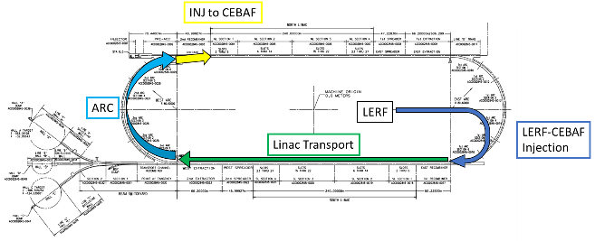
A CEBAF Energy upgrade is technically feasible
Capitalizing on recent science insights and US-led accelerator science and technology innovations, develop a staged program at the luminosity frontier
Injection energy Upgrade for 650 MeV Electron (e-) in LERF
Replace arcs on each side with new Fixed Field Alternating-gradient (FFA) magnets arcs to upgrade to 22 GeV
It will be possible to send the beam to Hall D though likely half pass lower energy then A,B,C instead of the half pass higher energy as 12GeV Jefferson Lab.

Slide 13
Permanent Magnet Design – Open Mid-plane Geometry
10 cm
10 cm
10 cm
10 cm
Focusing Magnet
Defocusing Magnet

Slide 14
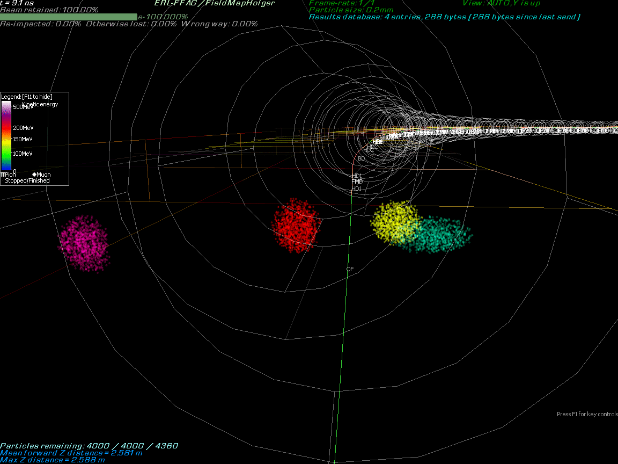
Multi-Bunch Dynamics in Fixed Field Alternating-gradient (FFA) Arc

Slide 15
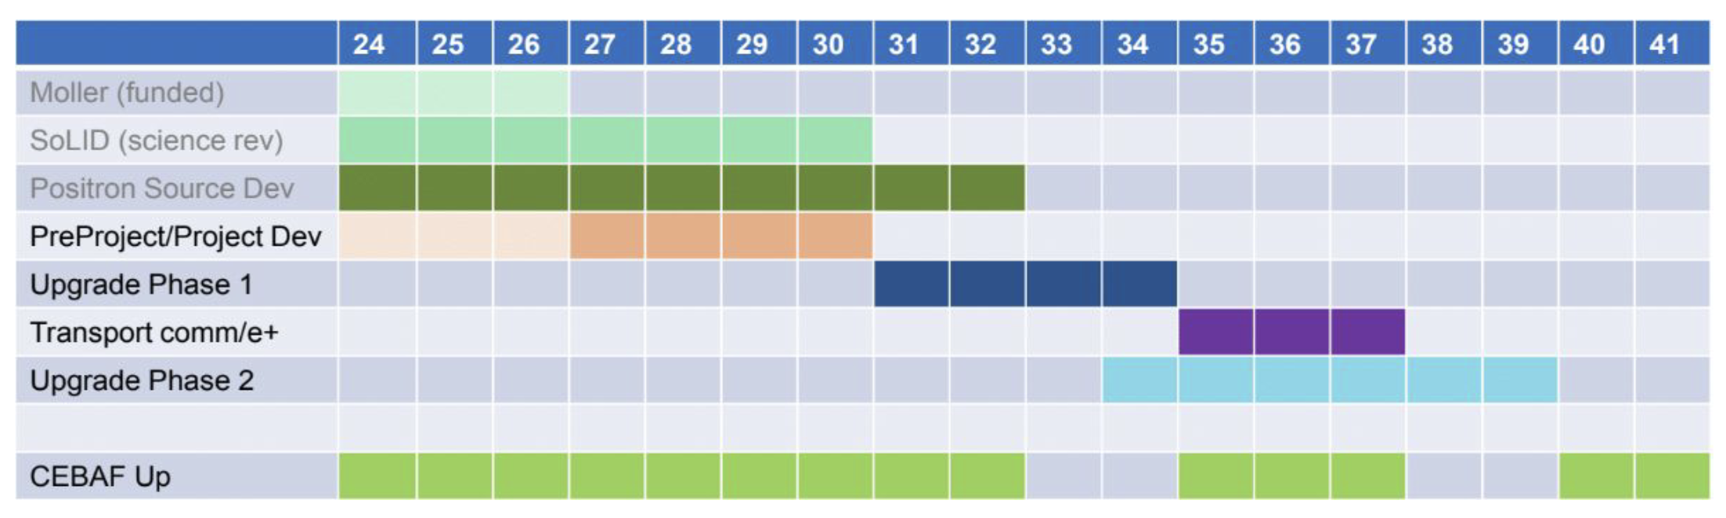
EXTREMELY ROUGH Timeline CEBAF’s Future
( though 2040 maybe seem very far away, this is actually a very aggressive schedule )
Phase 1 includes building a positron source and the tunnel & beamline connecting the source to main machine.
Phase 2 includes the new permanent magnets to allow 22 GeV within current CEBAF footprint.
NOTE: Plan was formulated so that these projects are ramping up as the EIC project cost is ramping down.

Slide 16
Useful Links
Scheduling Memo
  https://www.jlab.org/physics/experiments/schedule
  Note the text on priority halls completely changed to be a simpler first among equals
  Feedback on the posted schedule is welcome
Approved Experiment Lists
  https://www.jlab.org/physics/experiments
PLEASE let me know when you see incorrect information.

Slide 17
Summary
Jefferson Lab’s 12GeV physics program is strong, with excellent new ideas still coming, and will continue into the next decade.
Positron source will be developed in the JLab LERF/FEL building and connected to CEBAF. Five physics experiments already approved.
Beyond positrons, accelerator division is looking to use fixed field magnets to be able to economically update CEBAF to 22 GeV beams.

