Slide 1
TListSpectrum: toolset for spectroscopic analysis
Heather I. Garland
Postdoctoral Research Assistant
Notes:
Image: Abstract Data Visualization – Stock Photo

Slide 2


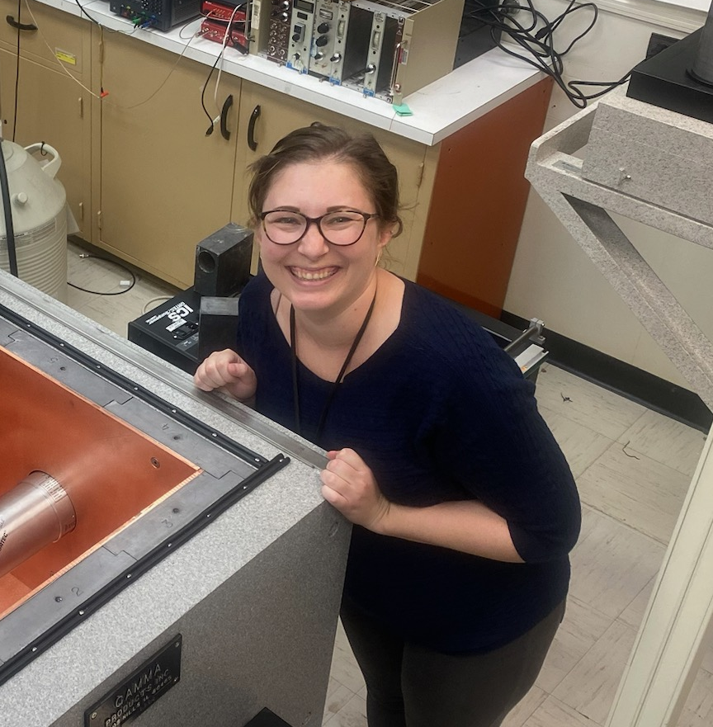



Outline
Bruce Pierson, PNNL
Brian Archambault, PNNL
The data analytics need
TListSpectrum as a new ROOT package
How TListSpectrum addresses the data analytics need
Current and future capabilities of TListSpectrum
Erin Good, PNNL
Heather Garland, PNNL
Soren Cheng, PSU/PNNL
Scott Garner, FSU/PNNL

Slide 3
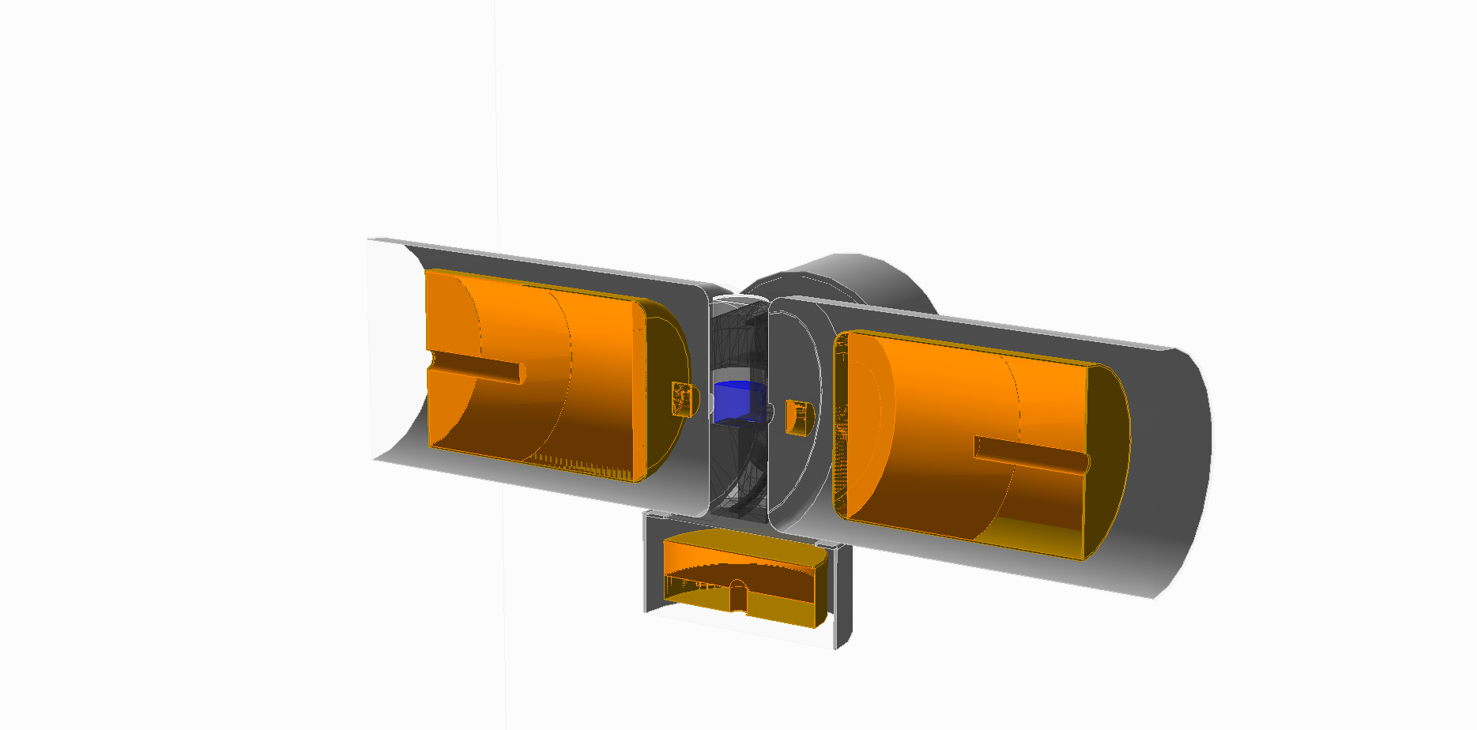
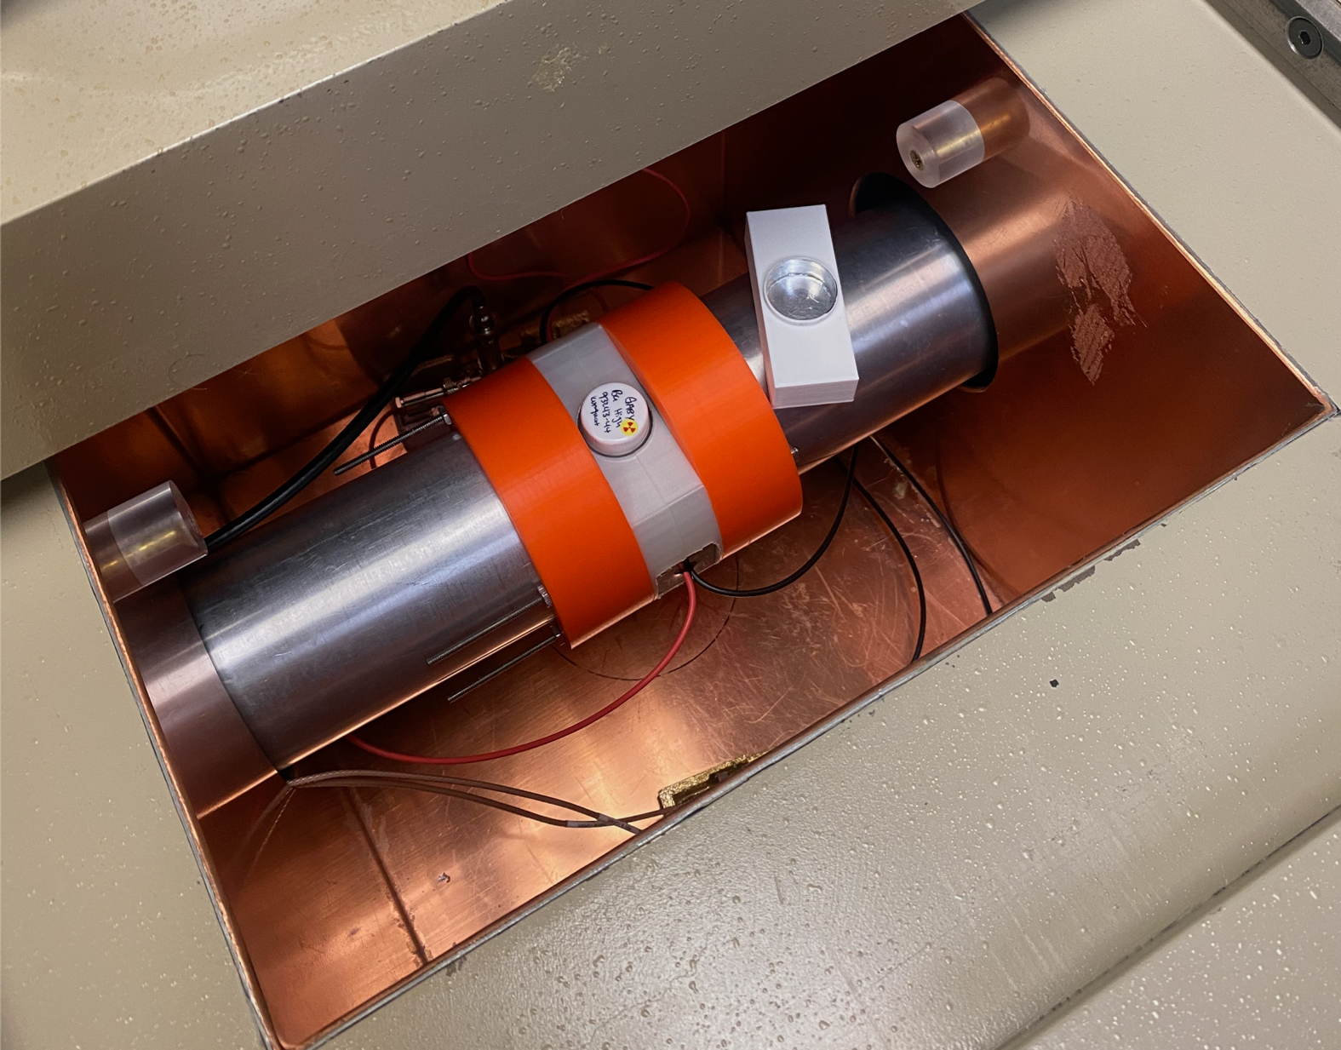

GABRIEL Detector
(Gamma Alpha Beta Radio-Isotope EvaLuator)
PNNL Detectors
GeGI
(GeGI Gamma-ray Imaging spectrometer)
SXGABRIEL
(Super X-Ray Gamma Alpha Beta
Radio-Isotope EvaLuator)
𝛾W
𝛾S
XS
XN
𝛾N
𝛾β
Notes:
Liquid scintillation
Pulse-shape discrimination
ɣ-ɣ coincidence counting

Slide 4
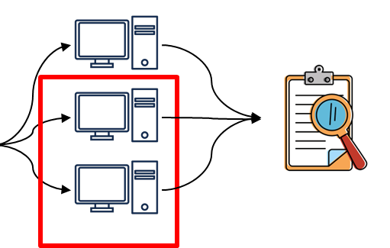
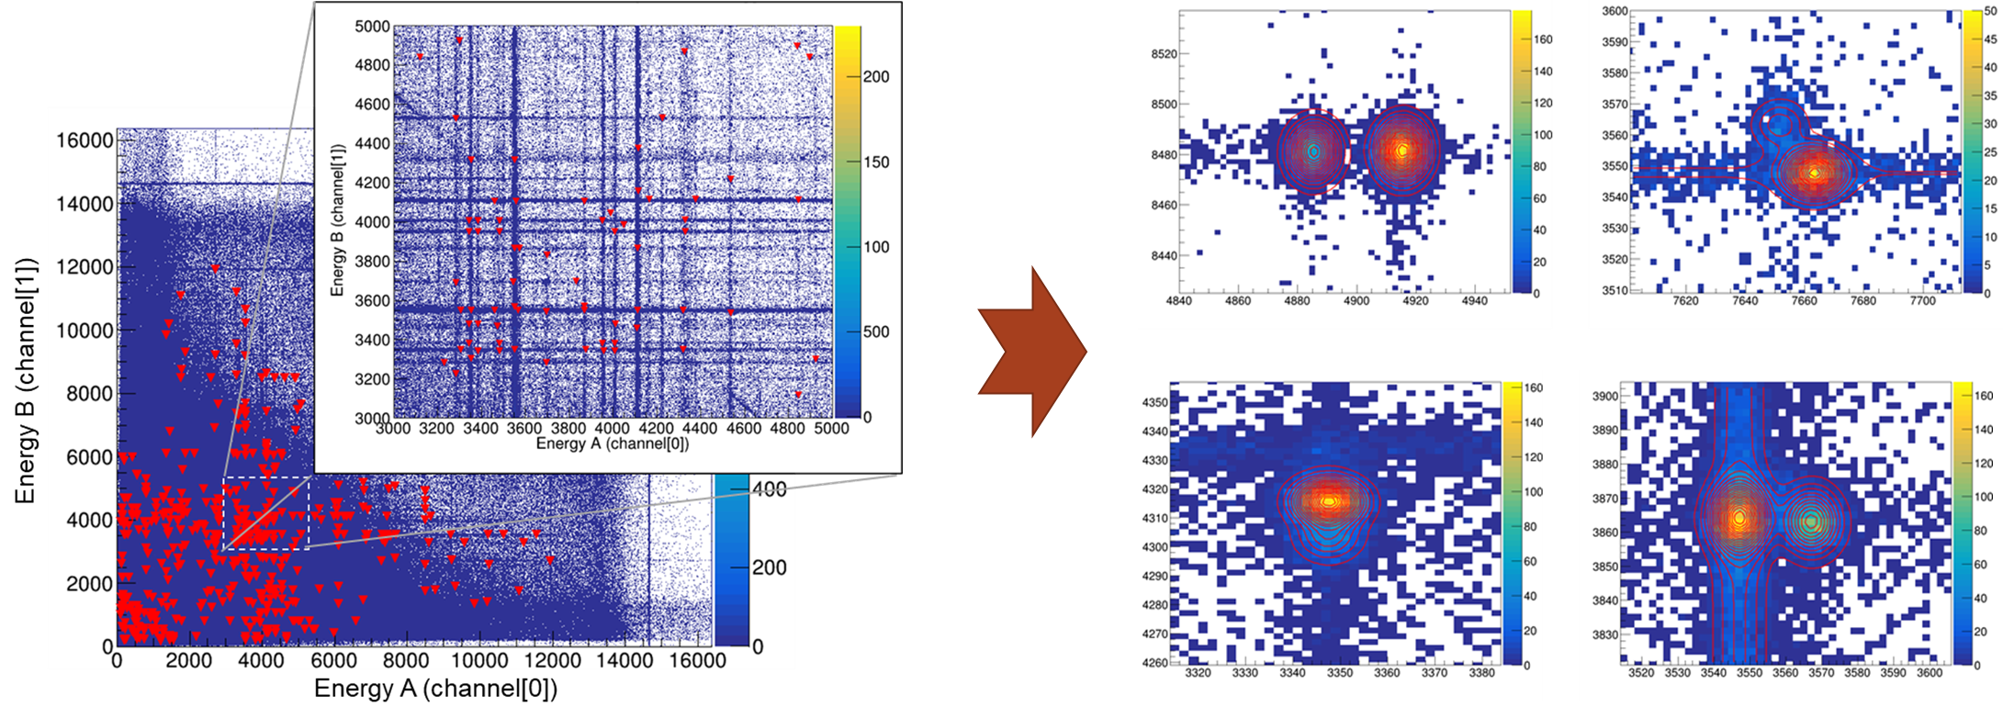
Data Analytics Need
List mode (Time, Energy, Pulse Shape Discrimination) data sets
  Can be ~100 GBs, nearly x1000 more than traditional screening datasets
  Require more computational onus and researcher expertise

Slide 5
Data Analytics Need
List mode (Time, Energy, PSD) data sets
  Can be ~100 GBs, nearly x1000 more than traditional screening datasets
  Require more computational onus and researcher expertise
Software for rapid, reliable, and accurate analysis of coincident data doesn’t exist as a commercially available source
  Researchers/graduate students writing unique data parsers and offline analysis suites per piece of equipment – sometimes per experiment, inhibits scientific advancement

Slide 6
Data Analytics Need
List mode (Time, Energy, PSD) data sets
  Can be ~100 GBs, nearly x1000 more than traditional screening datasets
  Require more computational onus and researcher expertise
Software for rapid, reliable, and accurate analysis of coincident data doesn’t exist as a commercially available source
  Researchers/graduate students writing unique data parsers and offline analysis suites per piece of equipment – sometimes per experiment, inhibits scientific advancement
TListSpectrum plans to develop a universal software analysis toolset that will leverage high performance computing resources to expedite analyses

Slide 7
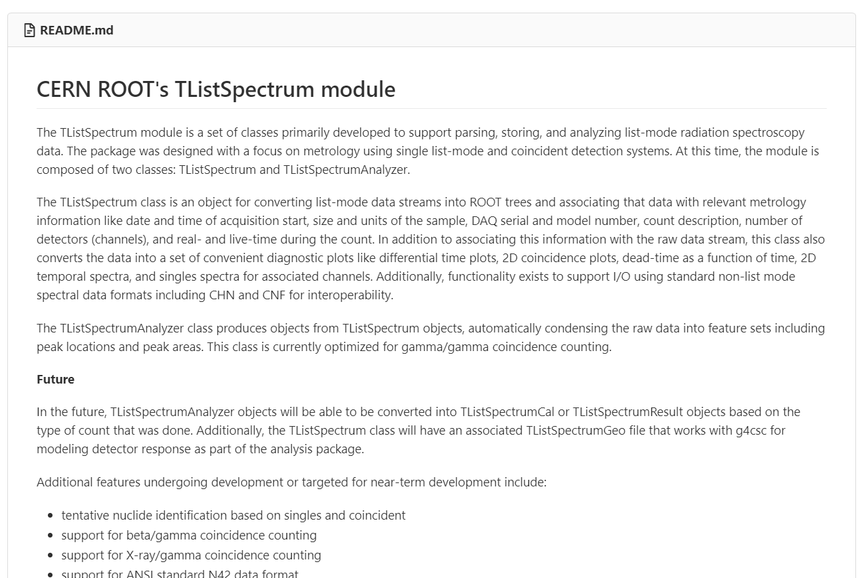
ROOT TListSpectrum
Leverages:
  ROOT – a widely used software package from CERN
  PNNL’s prior development of a tool-set for analysis of datasets from advanced radiometric detection systems
Enables parsing, storing, and analyzing of list-mode spectroscopic data

Slide 8
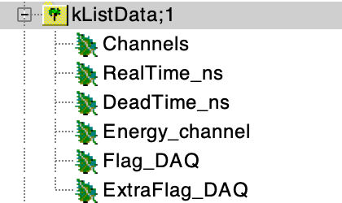
How ROOT TListSpectrum addresses the data analytics need
TListSpectrum TTree Format:
Standard flexible TTree format allows for interchangeable analysis codes with only minor updates per system/experiment
Analysis toolkit suite readily available for integrated use

Slide 9
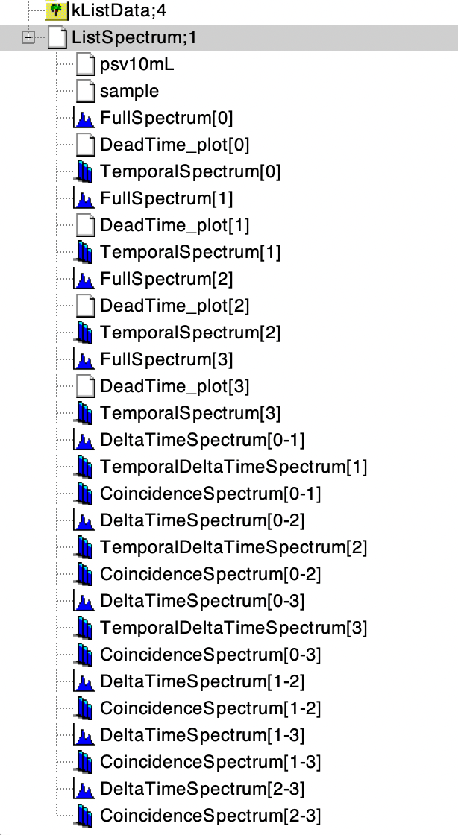
How TListSpectrum addresses the data analytics need
Speed.
Completely analyzes 24 hours worth of data in 4 hours
  20 GB of data can be parsed in 30-60 minutes
  Analyzed in 1.5-2 hours through post process
  Dependent on the computer – this was done on a 52 core machine
Spectra is output after post process sequence – near immediate results
Only need to ”view” the data you need – not all data like when processing with event splitting
  Aka can view the 𝛾-𝛾 data without running over the β data if you so choose

Slide 10
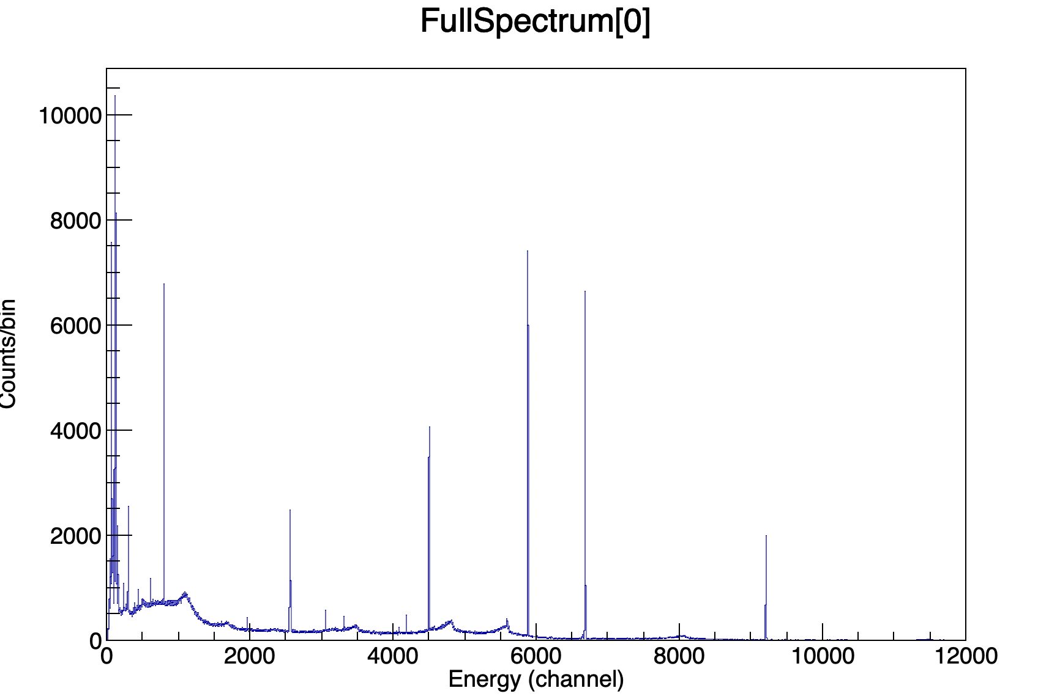
How TListSpectrum addresses the data analytics need

Slide 11
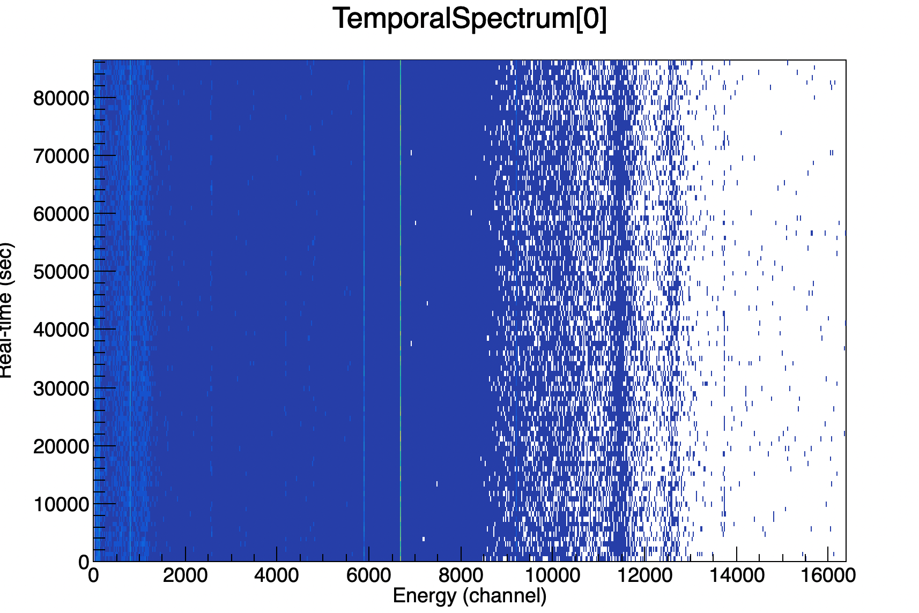
How TListSpectrum addresses the data analytics need
Real Time (sec)

Slide 12
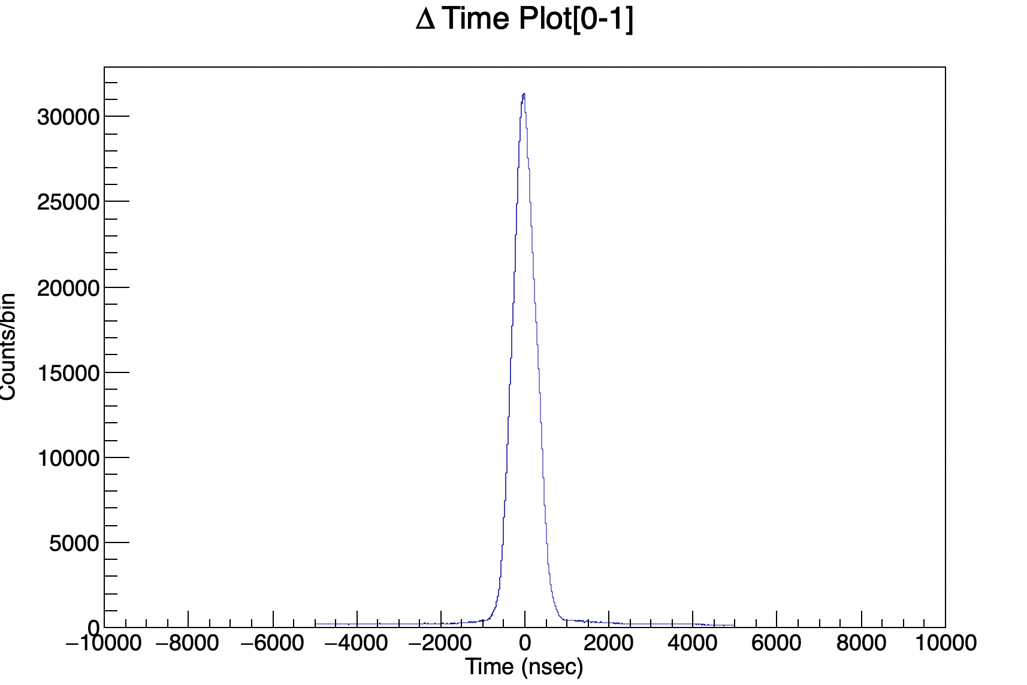
How TListSpectrum addresses the data analytics need

Slide 13
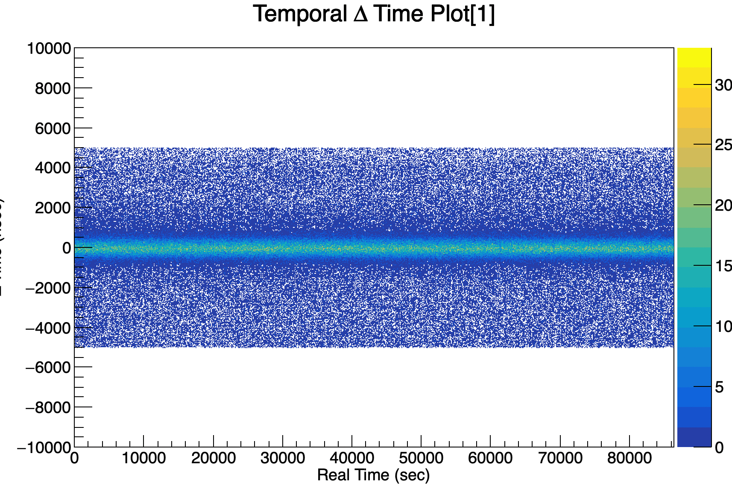
How TListSpectrum addresses the data analytics need
ΔTime (nsec)

Slide 14
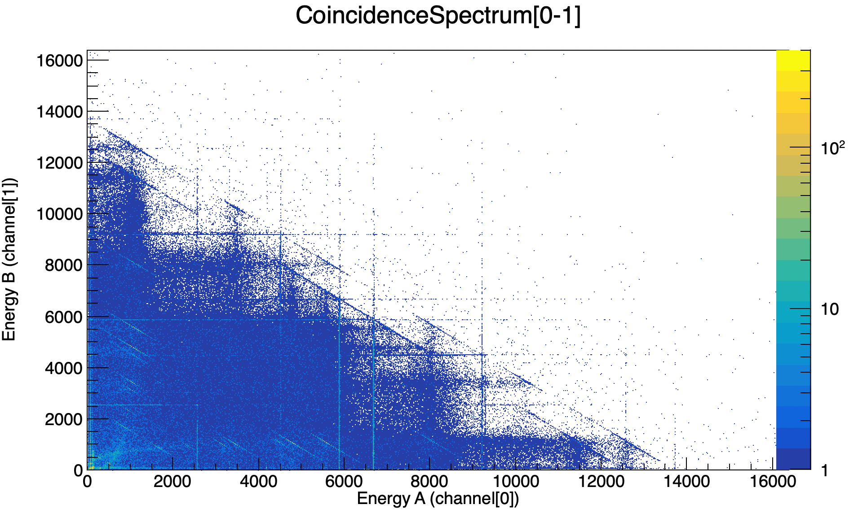
How TListSpectrum addresses the data analytics need

Slide 15
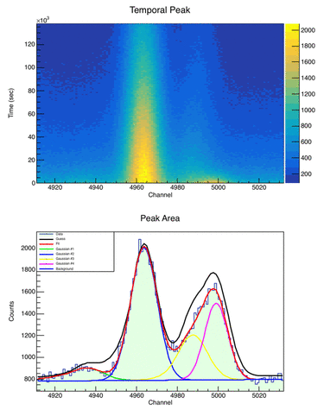
ROOT TListSpectrum: Current Capabilities
Enables parsing, storing, and analyzing of list-mode spectroscopic data
  Singles & Coincidence
  Automated temporal slicing
Supports multi-particle higher order coincident combinations
  γ- γ, β-γ-γ, β-γ-X-ray, α-γ-γ, etc..
Automated analysis of γ-γ/X-ray coincident data
  AI/ML techniques used to track and fit features of radionuclides

Slide 16
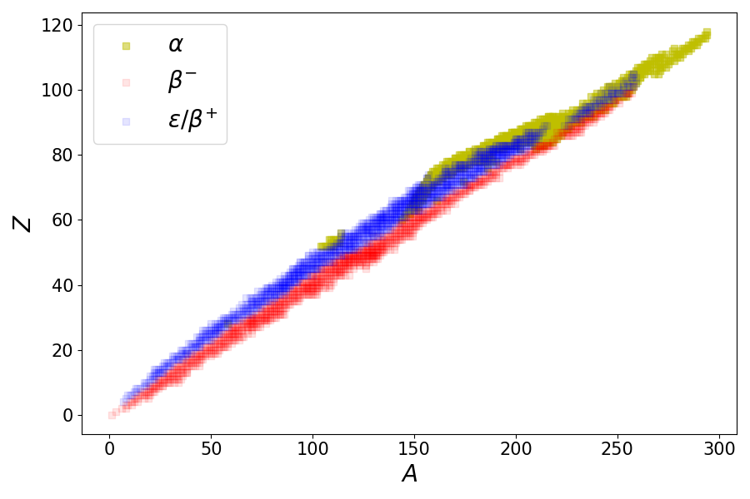
ROOT TListSpectrum: Future Capabilities
pace-ENSDF
Integration of coincident feature library for automated identification of features into existing tool-sets
  Coverage spanning ~2720 radioisotopes
  Filterable by half-life, energy, and associated decay pathway
    β⁻ ,β⁺, ec, and α decay
Initiated development of a Geant4 database to provide cascade summing and angular correlations required for accurate quantification
  Coverage spanning 34 key radioisotopes (~5000 𝛾-𝛾 signatures) and growing
  Gabriel 2 (𝛾-𝛾) and SXG1 (𝛾-𝛾, 𝛾-x, 𝛾-β)
  Leveraging PNNL HPC resources (>120,000+ cpu-hrs)
A.M. Hurst, B.D. Pierson, B.C. Archambault, L.A. Bernstein, S.M. Tannous, “A decay datababase of coincident 𝛾-𝛾 and 𝛾-X-ray branching ratios for in-field spectroscopy applications”, Eur. Phys. J. (Web of Conf.) 284, 18002 (2023); https://doi.org/10.1051/epjconf/202328418002
https://pypi.org/project/paceENSDF/

Slide 17
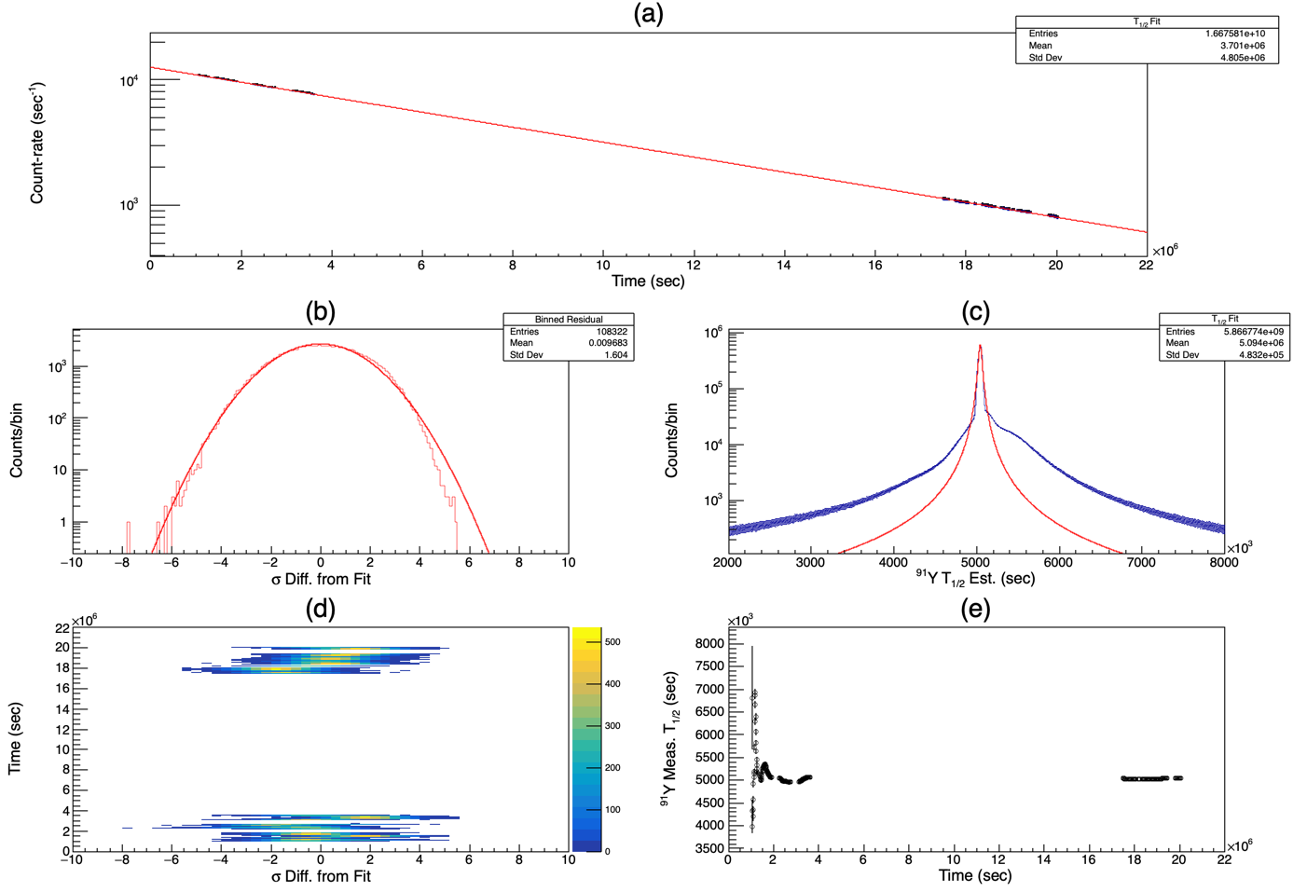
Example Analysis from ROOT TListSpectrum
Erin Good, Bruce Pierson
Y-91
Acquisition of list-mode data-sets enables temporal slicing of beta/gamma signatures that can be used as an additional verification of nuclide identification
Extended measurement (~ 6mo.) of a purified Y-91 sample was done with G2 as a benchmark against other detectors
Goal: Evaluate Half-life by beta and gamma counting
  Life-time fit
  Statistical reliability tests
  Half-life fit over time
Notes:
Others: Cd 115m, Mo 99, Tb 161, Nd 147

Slide 18
Publications where analysis was performed with TListSpectrum
Lani, C, “Measurement of Independent Fission Yields Using Cyclic Neutron Activation Analysis and a Fast Fission Spectrum at the Penn State Breazeale Reactor.” Thesis, 2024. Submitted
S. M. Collins et al., “Determination of the 161Tb half-life,” Applied Radiation and Isotopes, vol. 182, p. 110140, Apr. 2022, doi: 10.1016/j.apradiso.2022.110140.
M. Kuatbek, B. D. Pierson, S. M. Lyons, M. Flaska, and A. M. Johnsen, “Characterization of the Fast-Neutron Irradiator and the Fast-Flux Tube Irradiation Fixtures at the Pennsylvania State Breazeale Reactor,” Nuclear Engineering and Design, vol. 413, p. 112505, Nov. 2023, doi: 10.1016/j.nucengdes.2023.112505.
B. D. Pierson et al., “Alpha/beta-gated gamma–gamma spectroscopy of mixed fission products for trace analysis,” J Radioanal Nucl Chem, Nov. 2022, doi: 10.1007/s10967-022-08606-5.
B. D. Pierson, L. R. Greenwood, M. Flaska, and S. A. Pozzi, “Fission Product Yields from 232Th, 238U, and 235U Using 14 MeV Neutrons,” Nuclear Data Sheets, vol. 139, pp. 171–189, Jan. 2017, doi: 10.1016/j.nds.2017.01.004.

Slide 19
Summary
The data analytics need
TListSpectrum as a new ROOT package
How TListSpectrum addresses the data analytics need
Current and future capabilities of TListSpectrum
Example of TListSpectrum analysis and papers published that used TListSpectrum
This work was supported by the Office of Defense Nuclear Nonproliferation Research and Development within the U.S. Department of Energy’s National Nuclear Security Administration and Pacific Northwest National Laboratory, which is operated by Battelle Memorial Institute for the U.S. Department of Energy under contract DE-AC05-76RLO1830.

Slide 21
Summary
The data analytics need
TListSpectrum as a new ROOT package
How TListSpectrum addresses the data analytics need
Current and future capabilities of TListSpectrum
Example of TListSpectrum analysis and papers published that used TListSpectrum
This work was supported by the Office of Defense Nuclear Nonproliferation Research and Development within the U.S. Department of Energy’s National Nuclear Security Administration and Pacific Northwest National Laboratory, which is operated by Battelle Memorial Institute for the U.S. Department of Energy under contract DE-AC05-76RLO1830.

