Slide 1

Integrated Research Infrastructure (IRI) Overview
Software Infrastructure
For Advanced
Nuclear Physics
Computing
June 21, 2024
Carol Hawk
ESnet Program Manager, Facilities Division
Advanced Scientific Computing Research (ASCR)

Slide 2
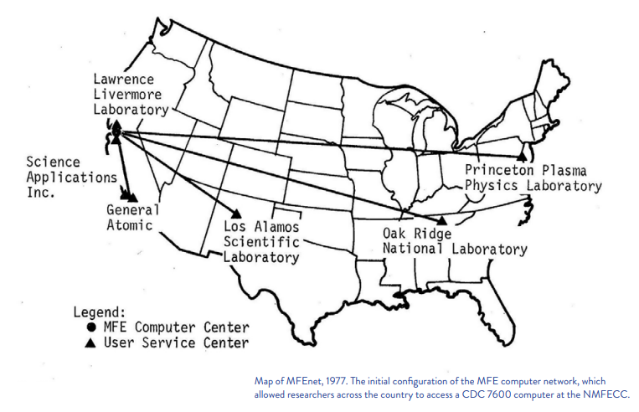
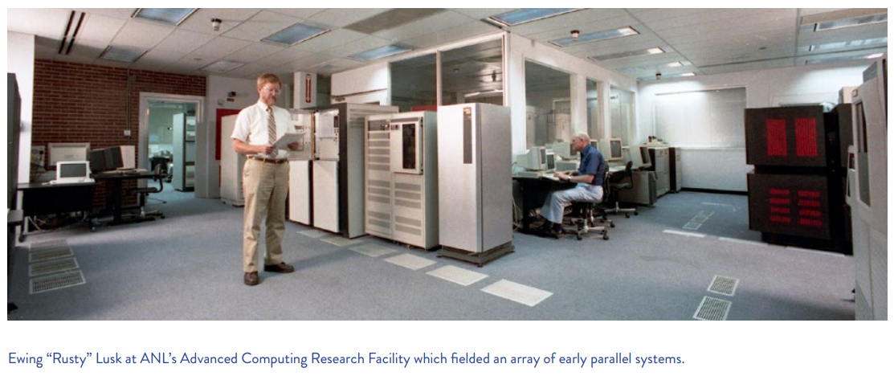
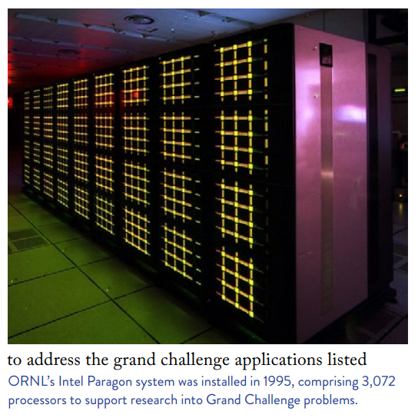
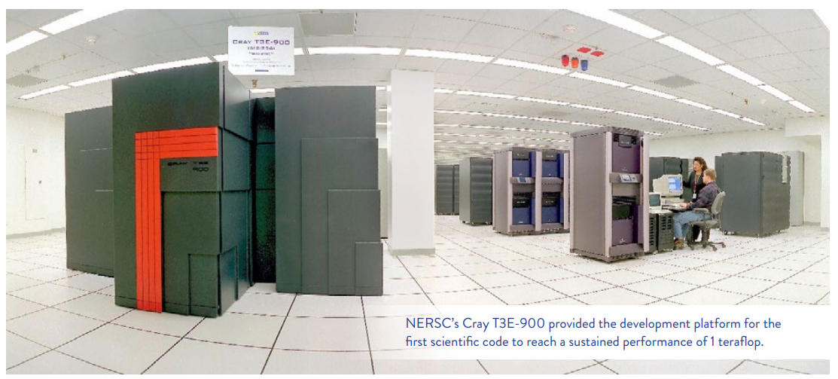
ASCR Facilities: History
ASCR@40: Highlights and Impacts of ASCR’s Programs

Slide 3
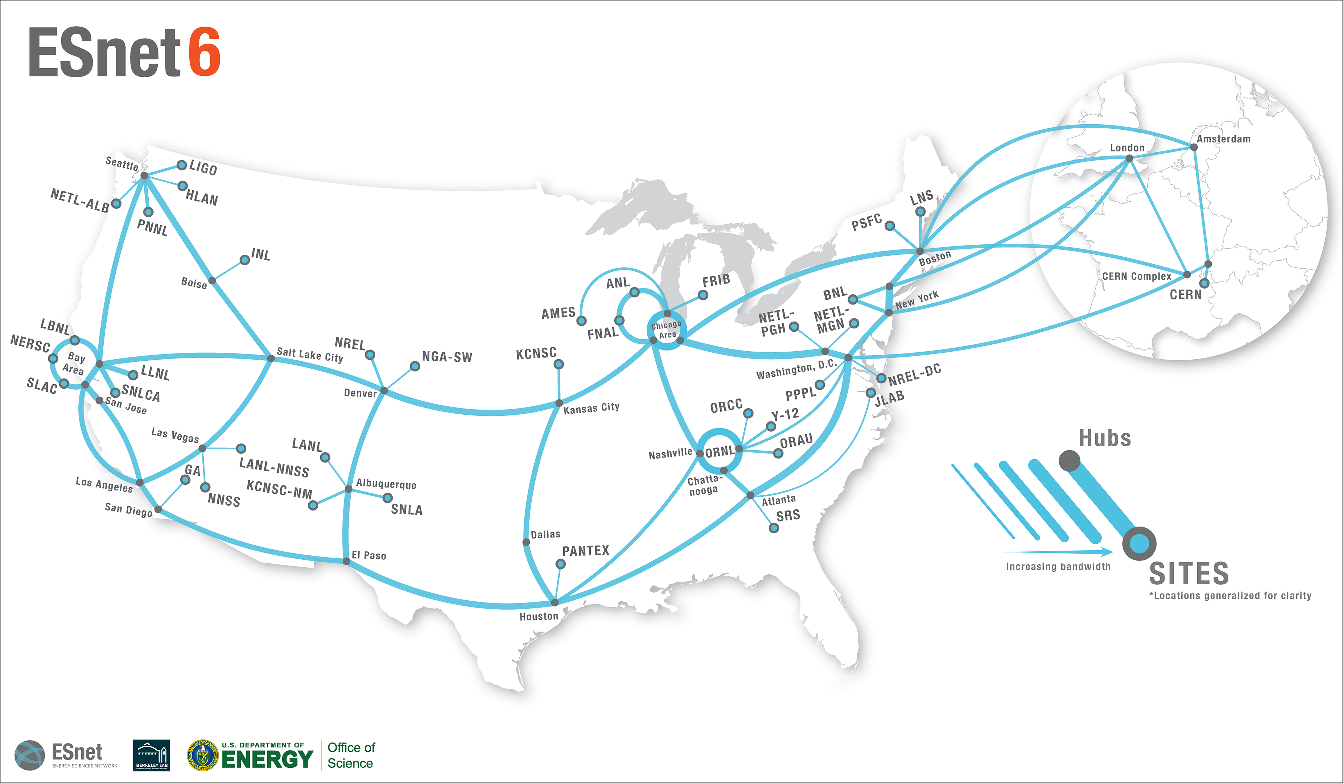
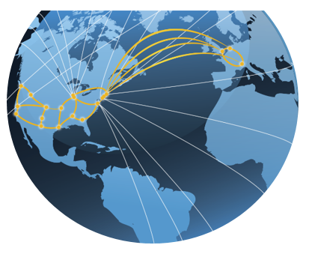



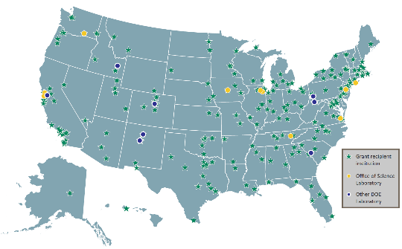
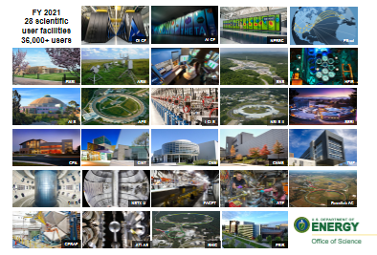

ASCR Look Ahead: Foster the DOE Integrated Research Infrastructure (IRI)
Provide researchers with seamless interoperability of DOE’s unique infrastructure & capabilities
Advanced Networking
Laboratory
Compute Assets
Sensors
at the edge
Advanced Computing
Researchers
Testbeds
Experimental and Observational
User Facilities
Data Management
Cloud Computing
Software
New modes of integrated science
Rapid data analysis and steering of experiments
Novel workflows using multiple user facilities
AI-enabled insight from
integrating vast data sources
Notes:
• The IRI vision is about integrating our user facilities together to be more than the sum of the parts, providing researchers with transformational acceleration of their research process, raising productivity.
• The National Virtual Biotechnology Laboratory is perhaps the most obvious recent example of IRI, but there are many. The NVBL sought to meld HPC with materials characterization facilities – there were successes, but melding the experiments, the data, and the computing was very challenging and required manual effort at every link in the chain.
• In FY 2022 we brought over 150 experts across DOE together to identify the key IRI challenges and opportunities. Today, several of the largest labs, including ORNL, are attempting to integrate the user facilities on campus with the HPC. The community recognized that we should avoid duplication and tackle common issues together.
• Consistent with the omnibus report language, in FY 2023 we aim to launch a new IRI program that will start with projects that bridge our experimental user facilities to advanced computing resources.

Slide 4

Timeline of IRI Program Development
FY 2021 President’s Budget Request includes Integrated Computation and Data Infrastructure Initiative
FY 2024 PBR advances IRI and the
High Performance Data Facility
HPDF Hub
Selection
ASCR IRI Task Force launch
SC IRI Blueprint Activity launch
ASCR IRI Task Force report
IRI Blueprint Activity results
IRI Program Development
Jan 2020
Jan 2021
Jan 2022
Jan 2023
Jan 2024
Vision
Strategy
Implement
4

Slide 5

IRI Blueprint Activity Key Results
We now possess a reference framework to inform a coordinated, SC-wide strategy for IRI.
The key organizing elements of the IRI Framework are Science Patterns and Practice Areas:
IRI Science Patterns that represent integrated science use cases across DOE science domains and
IRI Practice Areas that will support the realization of a DOE-integrated IRI ecosystem.

Slide 6
The IRI Framework: Science Patterns
IRI Science Patterns are broad classes of integrated research workflows with common driving features. Each Science Pattern represents a spectrum of DOE science domains and will benefit from a strategic and coordinated approach to design and solution. A given workflow case may span several Science Patterns.
Time-sensitive pattern has urgency, requiring real-time or end-to-end performance with high reliability, e.g., for timely decision-making, experiment steering, and virtual proximity.
Data integration-intensive pattern requires combining and analyzing data from multiple sources, e.g., sites, experiments, and/or computational runs.
Long-term campaign pattern requires sustained access to resources over a long period to accomplish a well-defined objective.

Slide 7
IRI/ESnet Requirements Reviews Meta-analysis
The percentage of ESnet Requirements Review (RR) case studies that reflect a particular IRI pattern for each SC Program.

Slide 8
IRI/ESnet Requirements Reviews Meta-analysis
The number of ESnet Requirements Reviews (RR) case studies that reflect a particular IRI pattern or combination of patterns, for each SC Program.

Slide 9
Questions?

Slide 10
IRI program startup status – March 2024
IRI Executive Authority
SC DDSP
IRI Management Council
Program ADs/ODs/DDs
ALCF, ESnet, HPDF, NERSC, OLCF are providing the initial leadership:
Executive Committee is the ASCR Facility Directors
Leadership Group: Representatives from each ASCR Facility
The fully constituted Management Council will include senior personnel from partner SC user facilities and other DOE personnel.
Technical Subcommittees will also foster shorter term work groups and workstreams with opportunities for broader participation.
Executive Committee
Steering Committee
Chair: ASCR Facilities Division Director
[Comprised of senior staff from
BES, BER, FES, HEP, NP, IP]
Leadership Group
Technical Subcommittees
Outreach/Engagement
Subcommittee
Outreach/Engagement activities
The Management Council is responsible for bringing projects and activities into formal coordination.
This slide shows the initial set of activities described in the Prospectus document, which will expand over time as resources grow.
Foundational Infrastructure:
major projects with IRI scope
HPDF project
NERSC-10 project
OLCF-6 project
ALCF-4 project
ESnet6 services development
Technical Subcommittees
Data Movement
Interfaces
Scheduling
Software Deployment and Portability
Identity and Access Management
Pathfinder Projects
IRI Pathfinding Testbed
IRI HPC Allocation

