Slide 1
Composable Optimization and Control Toolkits for Scientific Applications
Kishansingh Rajput
On behalf of Data Science Dept. JLab

Slide 2
Outline
Composable Workflows
A Generic Workflow for application of ML in NP
  Example: Tracking with Graph Neural Networks
Scalable and Composable Workflow for QuantOm
Scientific Optimization and Control Toolkit – Link to github
  Example(s): Beam Loss minimization
  FEL intensity Tuning
Conclusion

Slide 3
Jefferson Lab Data Science Dept.
Nuclear Physics (NP), High Energy Physics (HEP), Advanced Scientific Computing Research (ASCR), Basic Energy Sciences (BES)
Health & Climate (ACES – ODU/JLab)
Applications
AI based optimization & Controls
Explainability and Robustness
Generative AI
Scalable AI
Methods & Algorithms
JLab Data Science Composable Workflow
JLab ML & Data Hub
Infrastructure

Slide 4

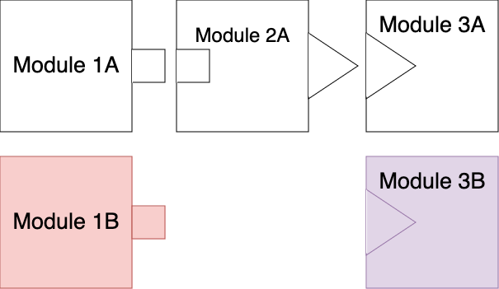
Composable Workflows
Modularity
Reusability
Flexibility
Scalability
Interoperability
Spaghetti code slow down development
No/Minimal code reusability
Redundant codes are prone to bugs
Challenging to debug
Many more challenges…
Faster development cycles
Reduced risk of introducing bugs or breaking changes
Easier maintenance and updates
Improved scalability and flexibility

Slide 5
Applications of ML in NP
Data Parser
Data Preparation
ML Models
Analysis
Data Formats
Read the data
Return in pre-defined format
Accepts data from parser
Prepare data for ML models training/evaluation
Data Generators
Various types of ML models
Supervised/Unsupervised models
Self contained model class
includes loss functions and training
Post training analysis on results
Classification vs Regression
UQ analysis
Configured based on the ML model type

Slide 6
Charge Particle Tracking with GNN
CSV Parser
GlueX Graph Constructor
ML Model (GNN)
Analysis
Replace
CLAS Graph Constructor
Graph Neural Network (GNN) based track finding
GNN
Model
TDIS Graph Constructor
Raw Hits
Hitgraphs

Slide 7
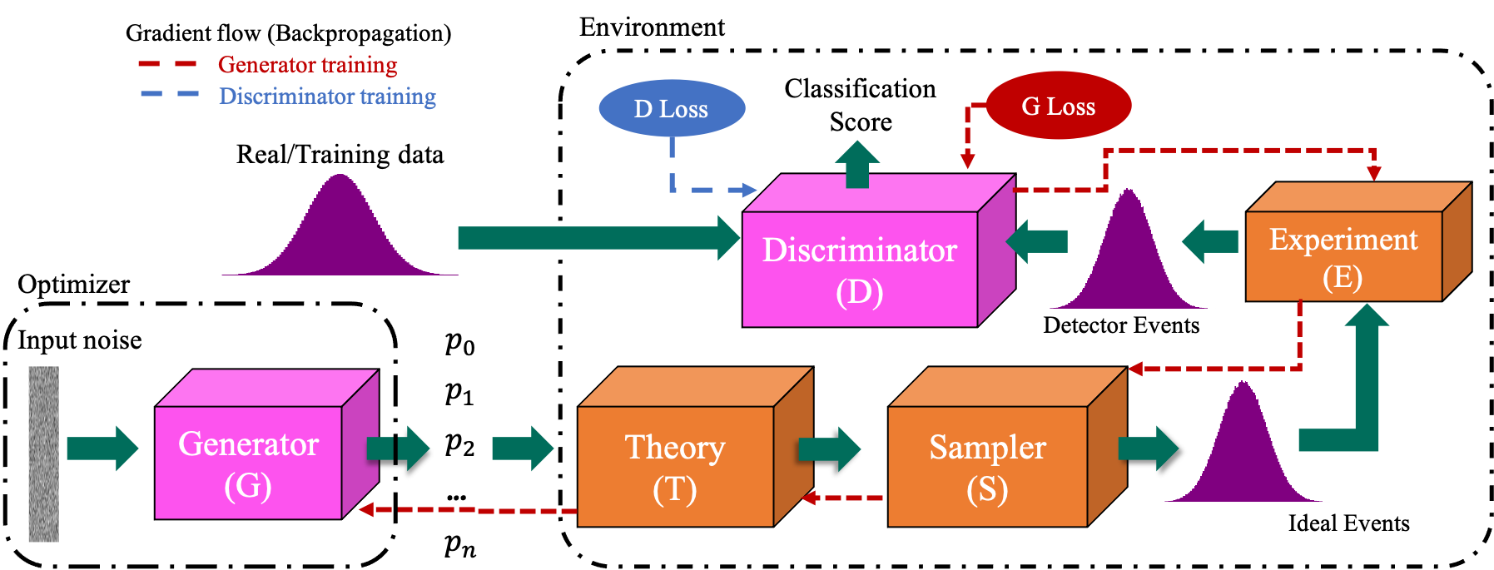
QuantOm
Optimize QCF Parameter generation
Many pieces/modules from different domain teams
Differentiability for back-propagation
Auto-differentiation provided by ML libraries (TF, Torch)
Generator
Theory
Sampler
Experiment
Event Filter
Discriminator
Data
MLP Gen
GPD
MCMC
FastSim
Analysis v1
Disc MLP
Hall C

Slide 8
QuantOm
A python based composable workflow
Available Optimizers
Optimization Step
SciDAC Pipeline
Objective Function
Data
GAN
Optimizer
Environment
Theory
STATS
Sampler
DRL
Experiment
BO
Event Filter
Loss/Reward

Slide 9
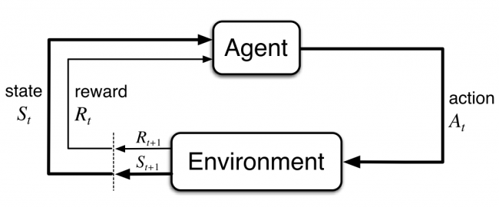
Scientific Optimization and Control
For optimization and Control problems
A workflow can be divided in two parts
  Environment – The control or optimization environment; the problem to be solved
  Agent – the algorithm responsible for optimization
Actor Neural Network
Example: Minimize beam loss using reinforcement learning based control
Critic Neural Network
Training batch(s, a, r, s’, d)
Agent
State (s)
Action (a)
Virtual Accelerator
Buffer
(s, a, r, s’, d)

Slide 10
Python Registry
Agents
Neural Networks
Buffers
Follows OpenAI Gymnasium Standards
DDPG-v0
MLP
ER
Environment
- Number of state variables
- Number of action variables
- Optimization problem; Reward (Loss) function
DDPG-v1
CNN
PER-v0
TD3
LSTM
PER-v1
Python registry allows to register python classes within a directory and assign unique ids
A default initialization can be provided (optional)
Allows to build objects from registered modules without changing code (imports)

Slide 11
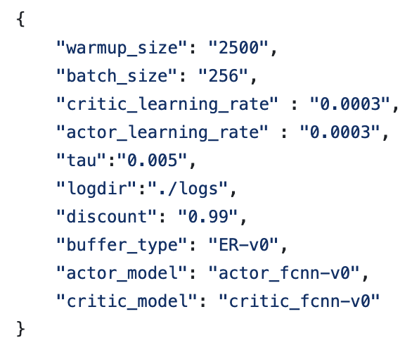
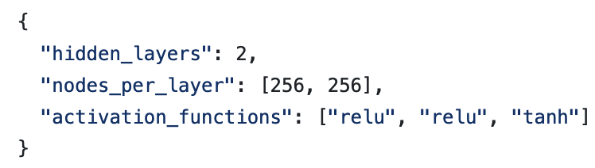
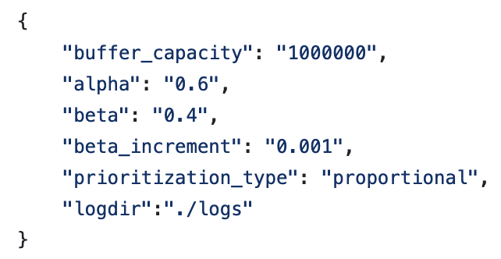
Configurability
json configurations for TD3 initialization
Example neural network config
Env object is built first as it’s independent of anything else
Agent reads number of states and action variables from env to initialize the inputs and output shapes of NNs
Example PER config
Buffer objects read the shapes of states, action etc. to initialize its size
Registered ids

Slide 12
Example SciOptControl Workflow
Environment
- Number of state variables
- Number of action variables
- Optimization problem; Reward (Loss) function
Driver/Workflow
- Read Env id from CLI or configuration file
- Build Environment (from registered envs)
- Read Agent id from CLI or configuration file
- Build Agent from registered agents; pass env details, and other configurations for initialization
- Enable communication between the env and agent for training and inference
Actor (MLP)
Critic
(MLP)
Target Actor (MLP)
Target Critic
(MLP)
Buffer PER-v1
DDPG-v0

Slide 13
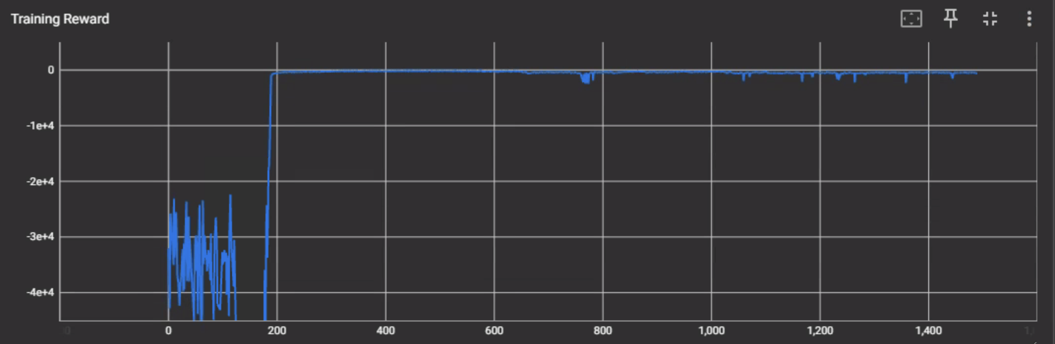
Results: Beam Loss Minimization
Goal: Minimize 8 beam position monitor readings
State (18): MEBT Orbit Correctors (10), BPMs (8)
Action (10): MEBT Orbit Correctors (10)
Reward = -1*mean(BPM^2)
Env: Virtual Accelerator (pyOrbit3)
Optimizer: TD3 algorithm with MLP NN
Training: Offline
Evaluation: Online (Scheduled in July)

Slide 14
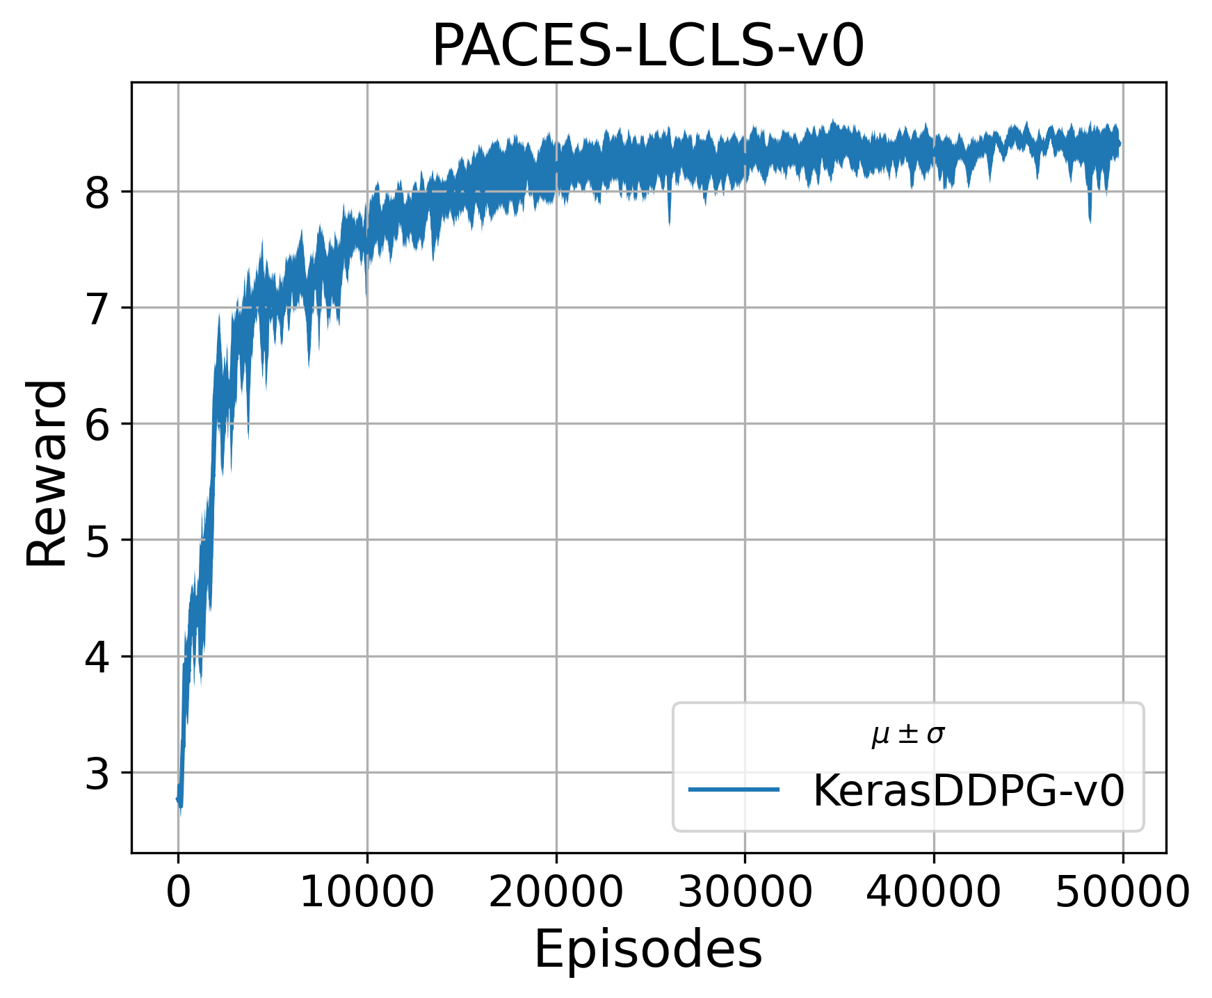
Results: Free Electron Laser Intensity Tuning
Env: Cheetah Beam Simulation (DESY, Germany)
Optimizer: DDPG3 algorithm with MLP NN
(Jefferson Lab)
Training: Offline
Evaluation: To be scheduled
Goal: Tune the Intensity of Free Electron Laser beam at LCLS, SLAC
State (15): intensity, and 14 magnet settings
Action (14): delta change to magnet settings
Reward = Normalized Intensity [0-1] per step

Slide 15
Conclusion
Spaghetti code is not sustainable; Long term stewardship requires composable code development
Near term: Composable code development practices allow
  Faster development of scalable and flexible codes with lower risk of bugs
Jefferson Lab Data Science Department is actively incorporating composability in ML research and deployment workflows
Composable workflows are developed for
  ML in NP applications (Generic Data Science Workflow)
  QuantOm Collaboration (Scalable Generative ML with Stochastic Elements)
  Scientific Optimization and Control Toolkit – github (Reinforcement Learning algorithms, other algorithms such as Bayesian Optimization coming soon…)

