Slide 1
Exp – JLab/FRIB
Sean Liddick
SANPC Workshop
June 2024

Slide 2
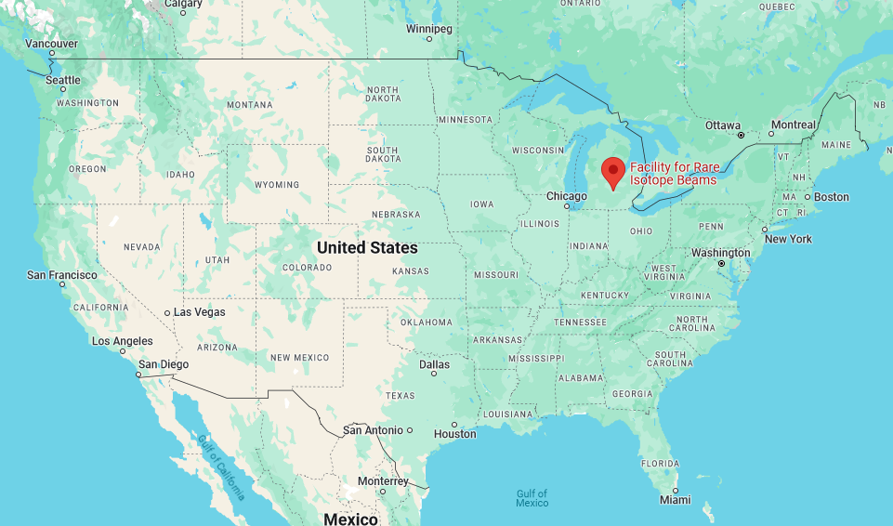
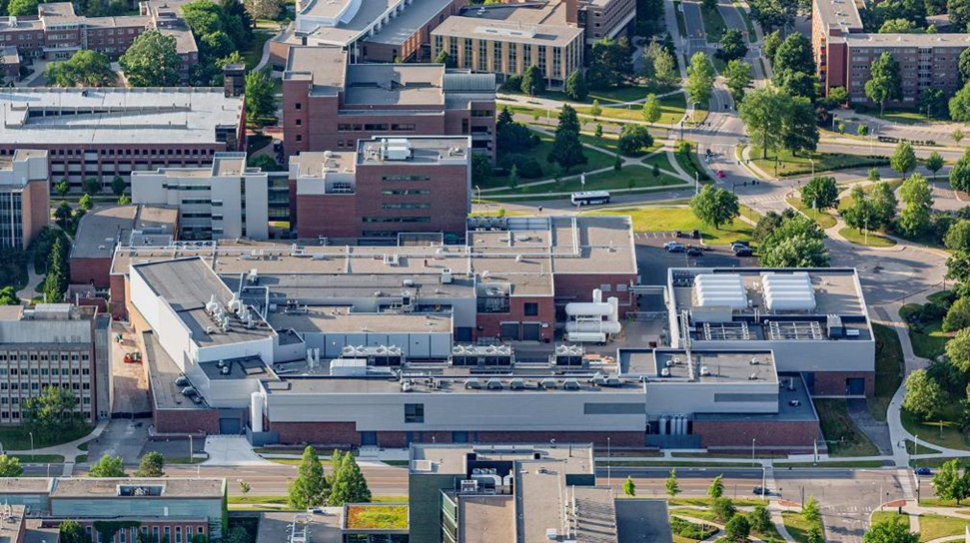
The Facility for Rare Isotope Beams (FRIB) Located on the campus of Michigan State University
FRIB is a scientific user facility funded by the US Department of Energy Office of Science (DOE-SC), Michigan State University (MSU), and the State of Michigan
  Open to researchers from around the world
  User Organization: 1800 members (125 colleges and universities, 13 national labs, 53 countries)
  Experimental program began in May, 2022
Key feature of FRIB: high-power LINAC, 400 kW at 200 MeV/u for ²³⁸U
  Beams from oxygen to uranium
FRIB also provides stopped and low-energy re-accelerated beams (< 12 MeV/u)
Access to atomic nuclei across the nuclear chart at a range of energies

Slide 3

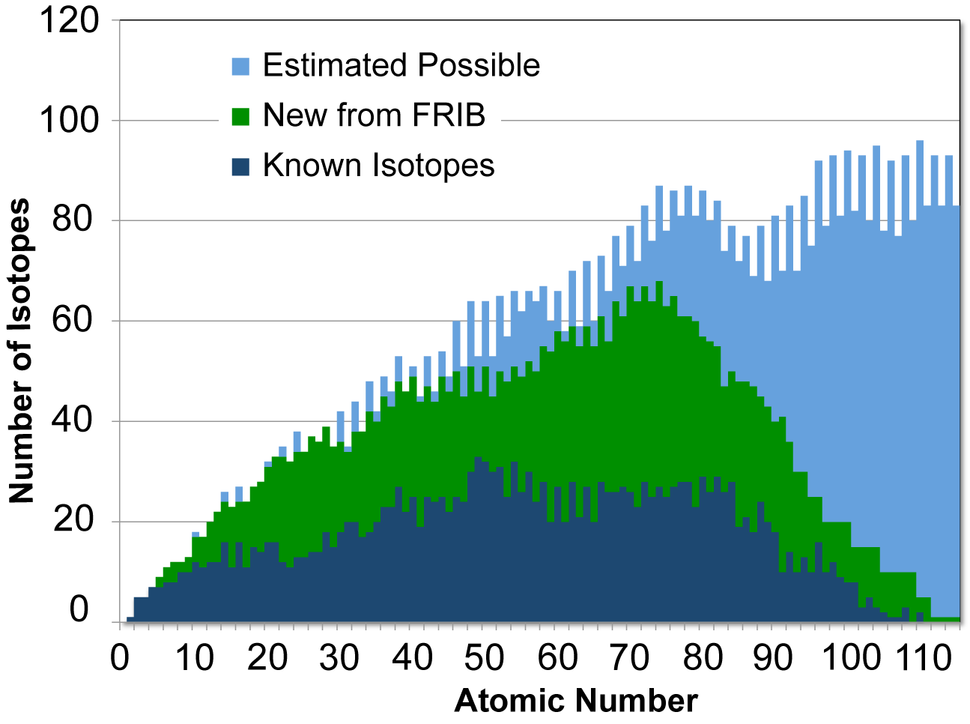



FRIB Addresses Multiple Questions in Nuclear Science Long Range Plan Through Access to Designed Nuclei
Nuclear structure
  How does subatomic matter arrange itself and how does it evolve?
  What combinations of neutrons and protons form bound atomic nuclei?
Nuclear astrophysics
  How are the chemical elements created?
  What is the nature of matter at extreme temperatures and densities?
Fundamental symmetries
  Why is there more matter than antimatter?
  Are neutrinos their own antiparticles?
Societal applications and benefits
  Medicine, energy, material sciences, environment, workforce development, etc.

Slide 4
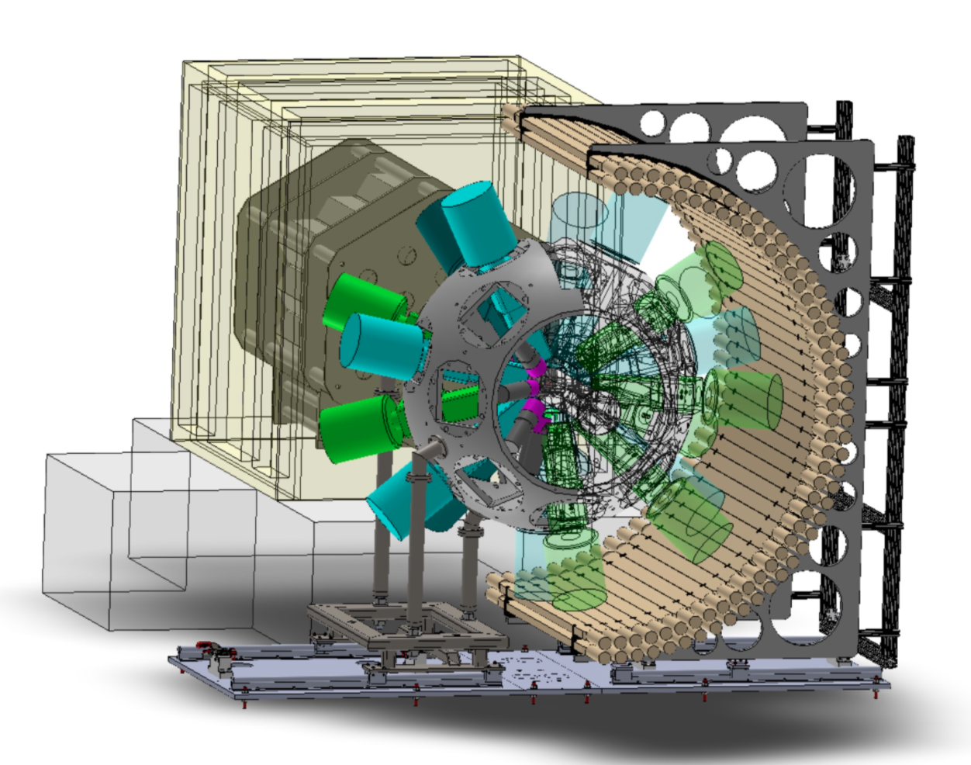
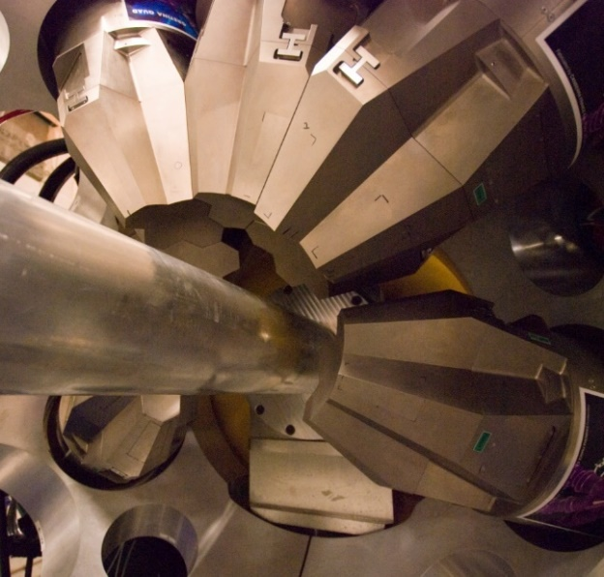
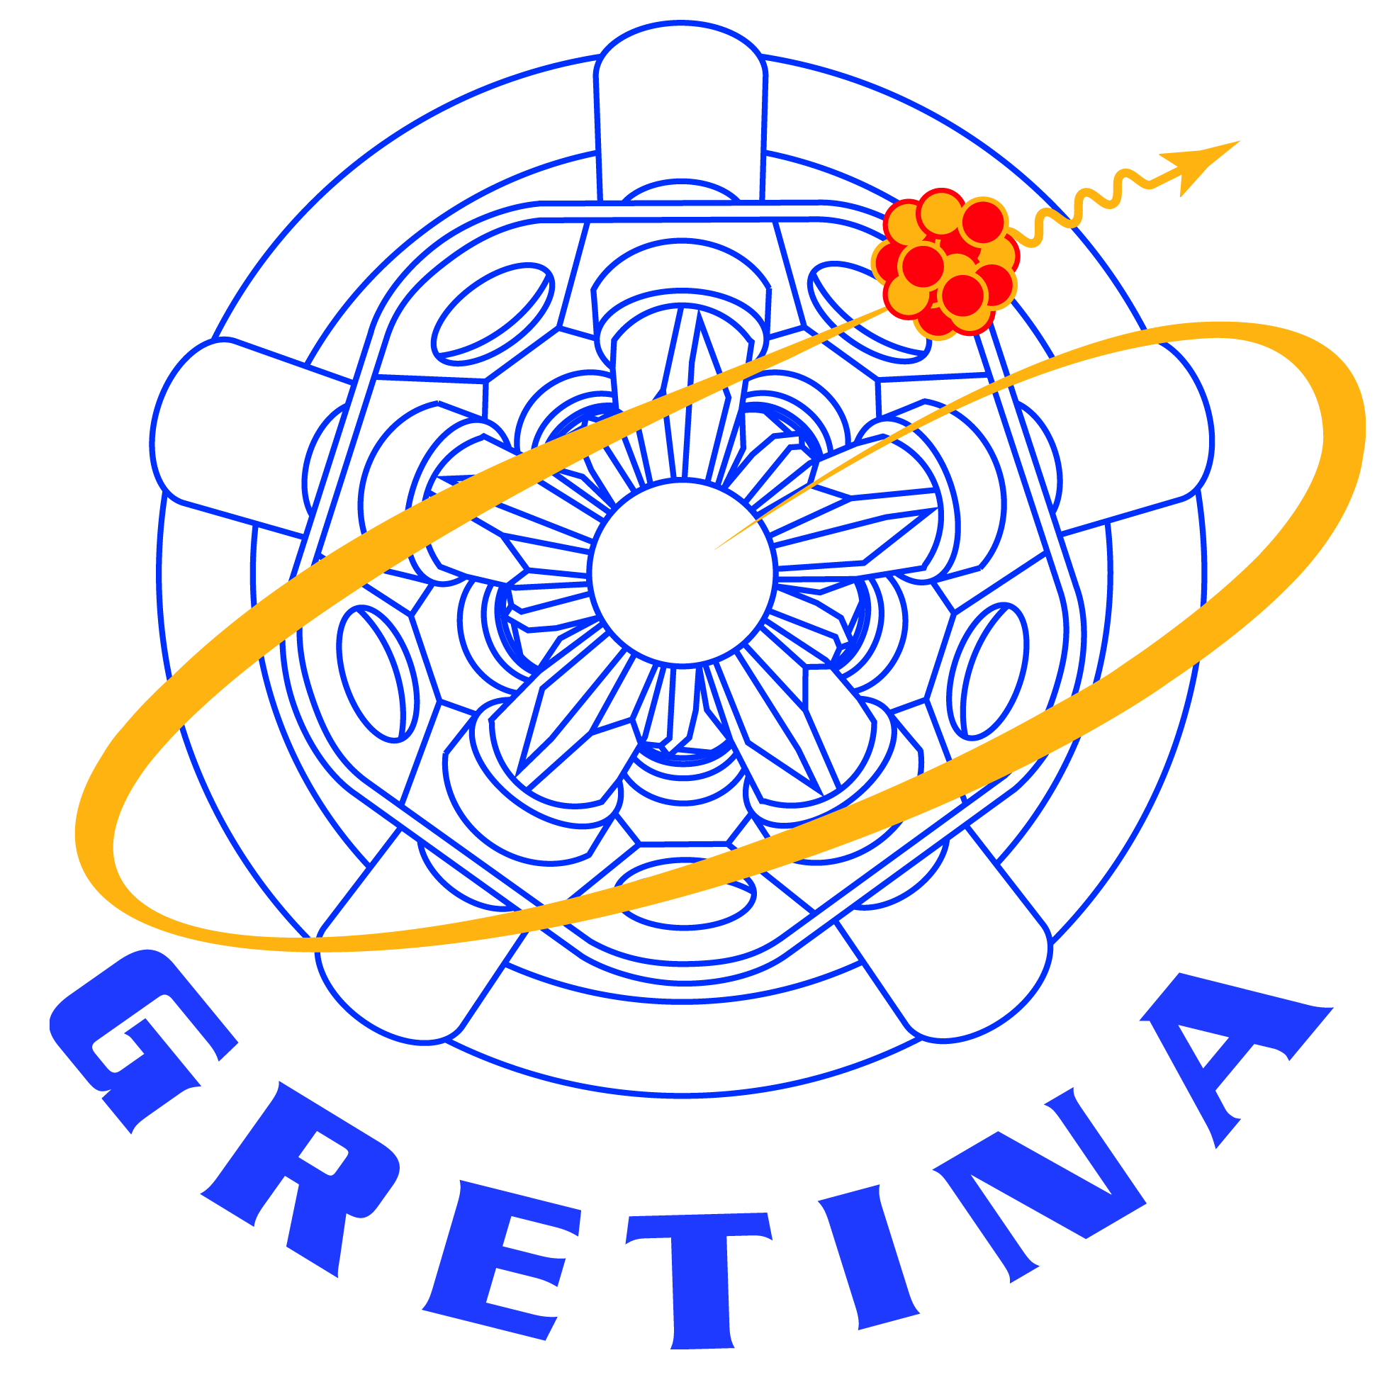
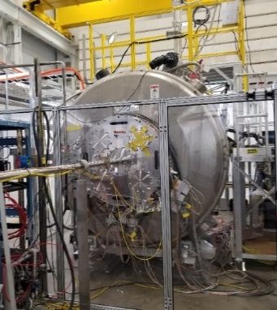
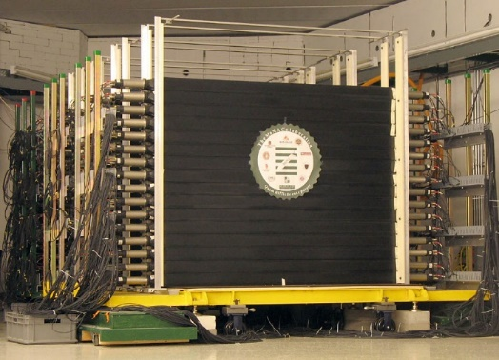
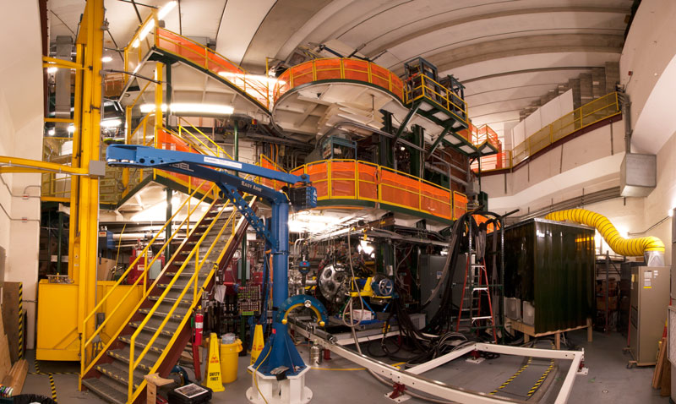
Needs of Experimental Groups Depends Greatly on Experimental Collaboration
Users organized as part of independent FRIB Users Organization (FRIBUO)
  Chartered organization with an elected executive committee
  1,800 members (125 U.S. colleges and universities, 13 national laboratories, 53 countries) as of 31 January 2024
  21 working groups on instruments
Strong interest from user community wanting to use FRIB beams
  Users establishing programs for FRIB science
  Two PACs run to date
  >20,000 hrs of beam-on-target requested
Mix of facility-supported experimental equipment and collaboration supported experimental equipment.
GRETA
> 2025
GRETINA
S800
SOLARIS
MONA-LISA

Slide 5
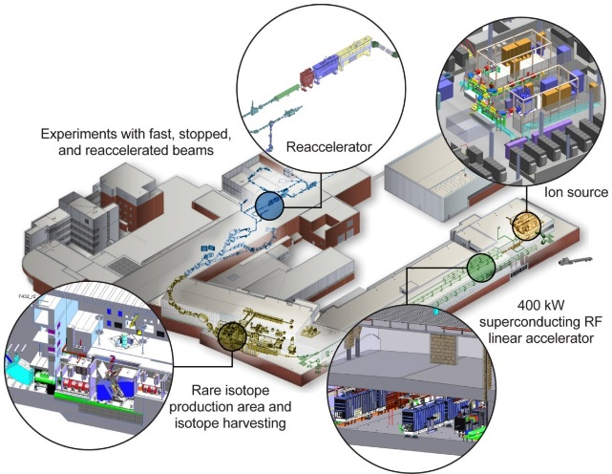
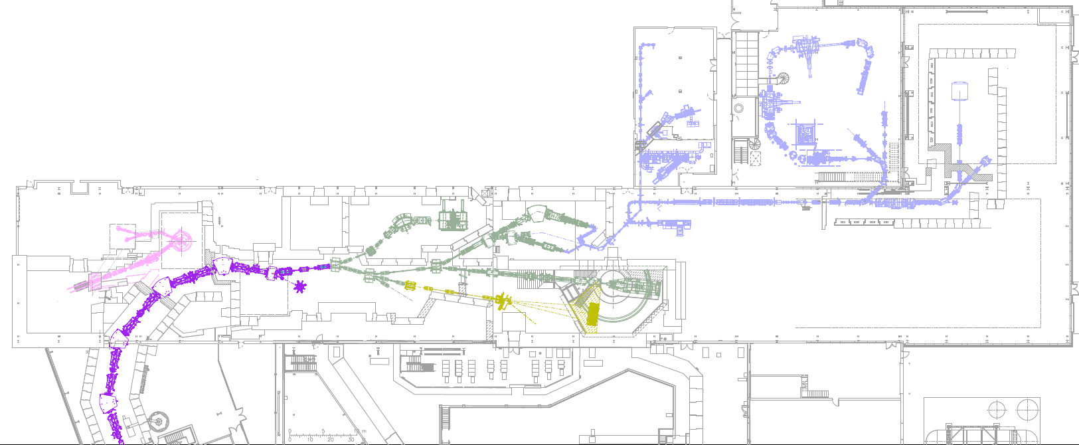
Typical Experimental Program Involves Frequent Changes of Facility-Delivered Isotopes and Experimental Equipment
Three energy regimes for beam delivery
  Fast (~200 Gev/u)
  Stopped (thermal)
  Reaccelerated (~3-12 MeV/u)
Experiments Request Approximately
  One week beam time
  Data sizes range widely 2GB – 70 TB (avg. 4 TB)
  New isotopes for each experiment
Few permanent experimental installations
  Setup time on order of weeks
  Take down times on order of weeks
Stopped
Beams
SECAR
SOLARIS
BECOLA
Cyclotron Stopper
Gas Stopper
LEBIT
ReA3
ReA6
Reaccelerated Beams
Reaccelerated Beams
Most collaborations do not have dedicated software developers
FDSi
S800
Gretina
Fast
Beams
MoNA
EOS
Fragment Separator

Slide 6
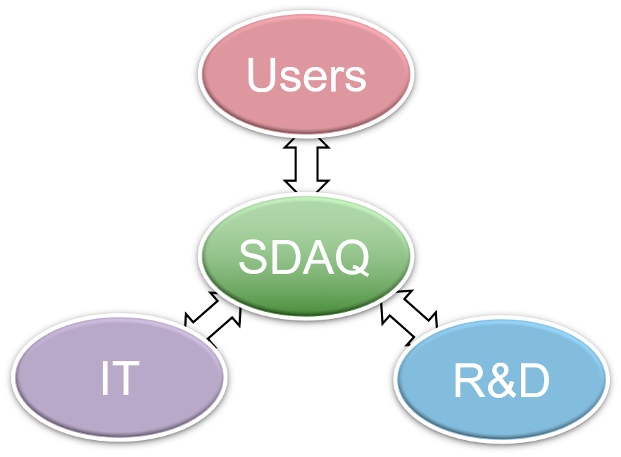
Facility Provides Support to Experimental Groups to Enable Data Taking and Online/Nearline Analysis Capabilities
Scientific Software Group
  Four full time employees
    Placed in Experimental Systems Division of FRIB
    Provide FRIB Users and Scientists reliable 24/7 support in hardware, software, computing, storage and network for the success of the scientific experimental program
Responsibilities:
  Interface and collaborate with Users to address their needs and maximize the likelihood of success
  Collaborate with Business IT to provide IT services (network, storage, computing) for the experimental program
  Researching and developing on data acquisition, computing, storage and network to find new solutions to keep up with the User requests and needs
Experimenters can request improvements to software systems
  Developments impacting multiple groups are prioritized
  Limited ability to perform R&D
    Desire to leverage R&D across multiple national and international facilities

Slide 7
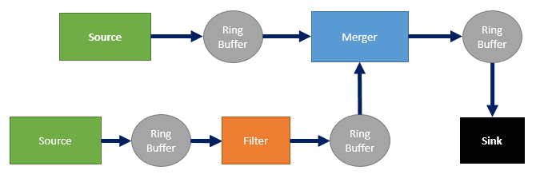
Facility Provides Software Framework to Experimental Groups to Enable Data Taking and On/Near-line Analysis Capabilities
Software suite (C++, Tcl, Python) that provides a flexible and extensible framework for handling the data flow produced by nuclear physics experiments
Support for a wide variety of electronics: VME, CAMAC, CAEN and XIA digitizers, GET, …
Manage the data stream by breaking it into smaller pieces
Event-building based on timestamps
Flexible trigger configuration
ReadoutGUI
ReadoutGUI is the “conductor” of the system
  Pipeline management, data recording, consolidation of data to output, …
Outputs data
Input/output (i.e. data integrity, format conversion...)
Multiple input/ single output
Reads data
Diagnostic sink
Diagnostic sink

Slide 8
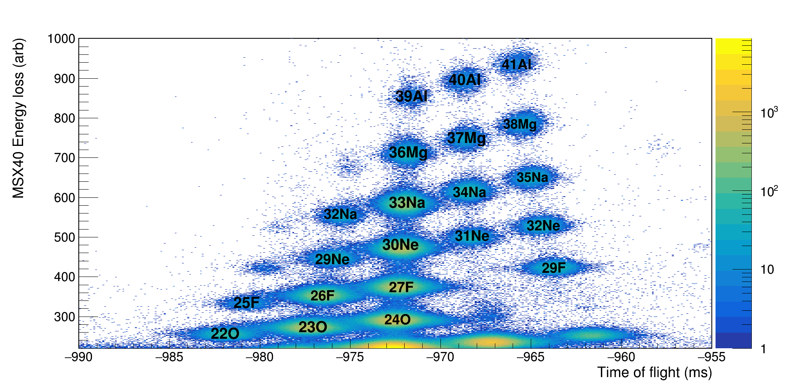
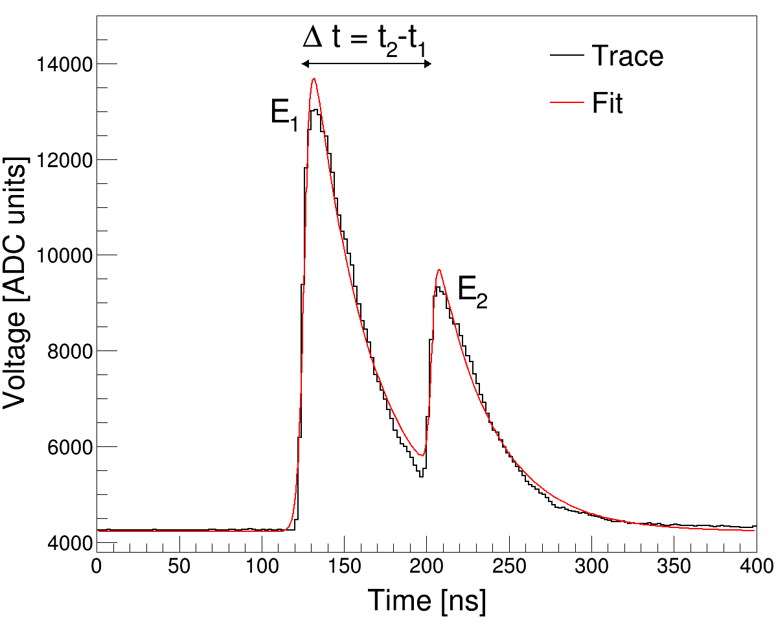
Case Study: Adoption of DOE IRI Model To Increase Science Productivity
Science to be Addressed
  Exploration of low-energy nuclear structure in mass 30 nuclei
Multiple detector subsystems running simultaneously
Previous data analysis model
  Experiment collaboration adopted use of facility-supported resources
  Analysis pipeline was not automated.
  System was not designed for high-throughput complex data analysis.
  Analysis was limited to local facility
New science opportunities present in waveform acquisition and analysis
  Required dedicated staff with non-nuclear expertise to implement

Slide 9
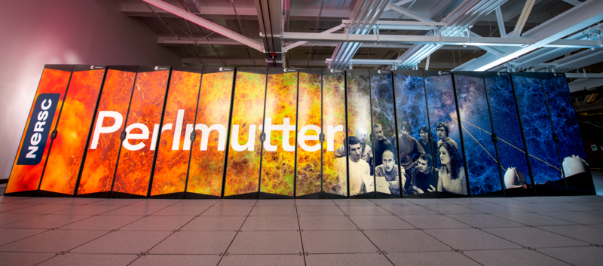
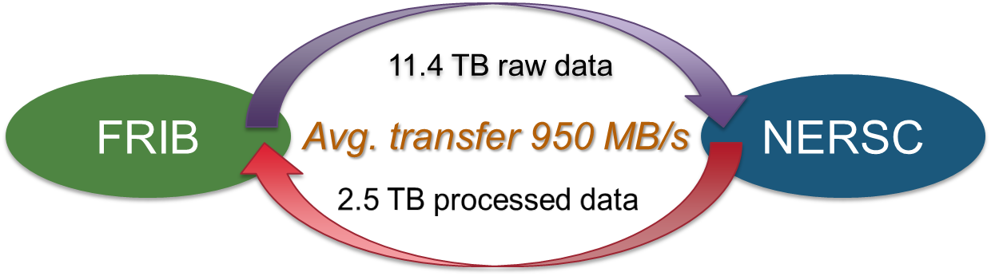
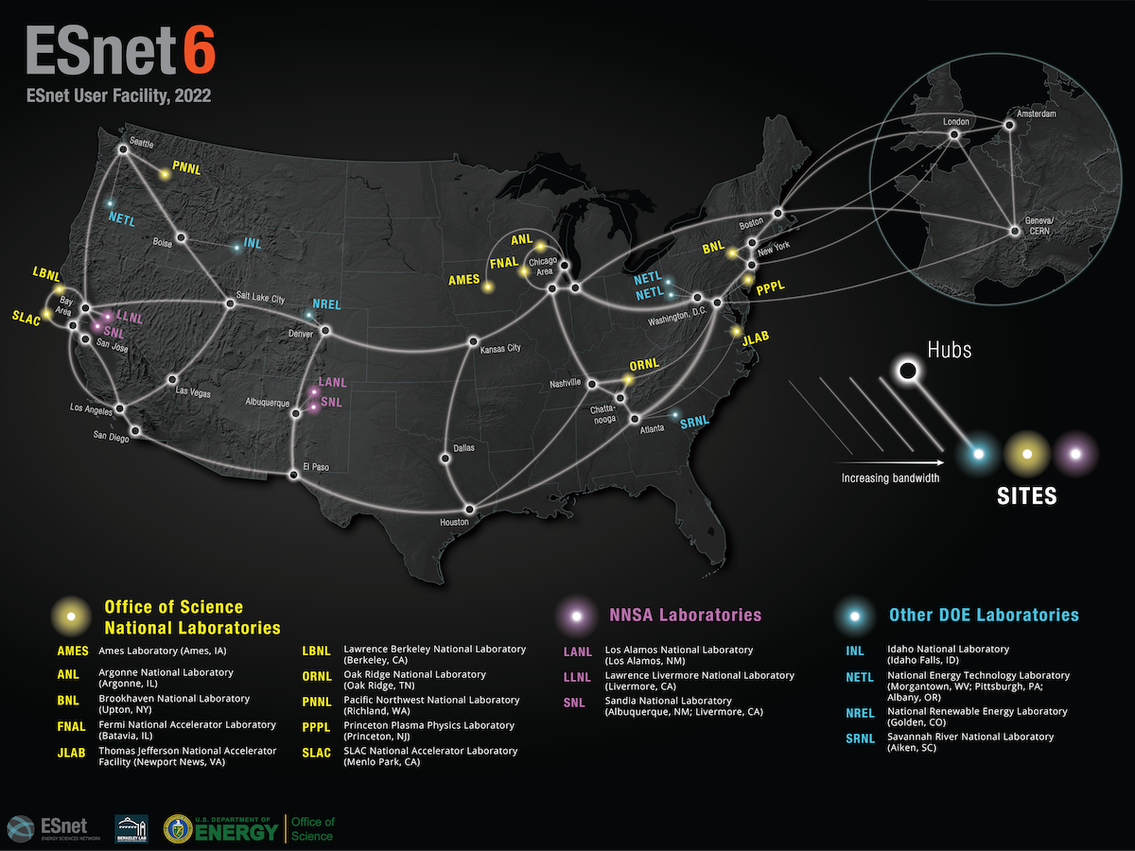
Case Study: Adoption of DOE IRI Model To Increase Science Productivity
What was required
  Implement “Science DMZ” at FRIB
  Implement process level pipeline parallelism into readout structure
  Develop in-line software triggers and event editing
  Access to DOE supercomputers
    NERSC for computation
    ESnet for data transmission
    Globus Flows for overall automated data orchestration
Effort required fractions of FTE over many years
  Project initiated in 2019
Completed first test case in early 2024
  Success deployed system to acquire data at FRIB, send to NERSC, process and extract results
  Near real-time performance required by experiment satisfied

Slide 10
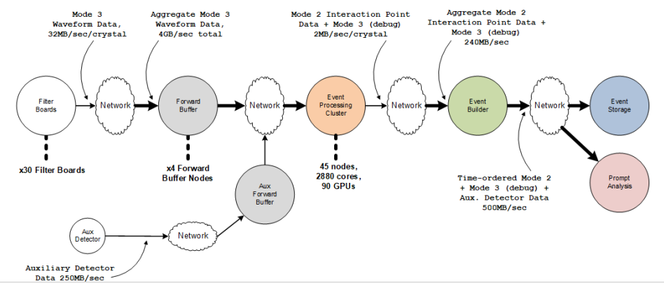
Case Study: GRETA
GRETA is a 4π tracking detector which can reconstruct the energy and 3d-position of gamma-ray interactions
Experiments are of relatively short duration (1-5 days)
  often will have multiple beam and target combinations
  Constant changes to complex experimental setups and device configurations
  Need to debug / optimize without resorting to offline analysis
Require a streaming data acquisition system - inline processing with seconds of latency
Eventual move toward streaming data readout. Test developments ongoing between GRETA and Esnet.
Detector moves between facilities
GRETA
> 2024

Slide 11
Case Study: Integration of ML Techniques
The adoption of ML algorithms can speed up the analysis by several order of magnitude
  Ability to train data at the beginning of an experiment
  Inference can then follow in real time
Data analysis models (old vs new)
  Old
    Estimating parameters using Levenberg-Marquardt curve fitting
    Principal Component Analysis (PCA) + binary classifier
  New
    Auto-encoders with an additional parameter estimation branch that combines PCA and parameter estimation
  Advantages:
    Less computational expensive (no Jacobian estimation)
    End-to-end model for high data throughput
    Increased in performance and speed
In the analysis pipeline this can be turned on or off according to the needs (or adapted for the available computational resources)
 | LMFit | ML
Avg. mean sq. error | 0.0012 | 0.0004
Inference run-time | 4,000s | 5s
Training run-time | 0s | 3,600s
Classification accuracy | 92.3% | 99.8%
Comparison test:
~70k events (single and double peak traces)
Apple M1 Pro (16G RAM) with python3

Slide 12
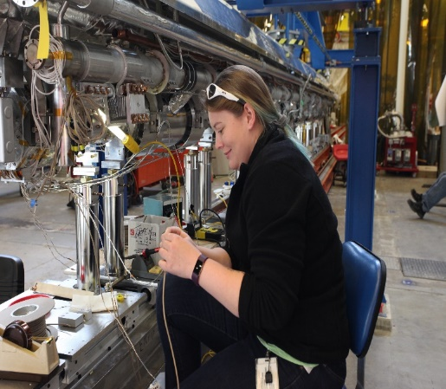
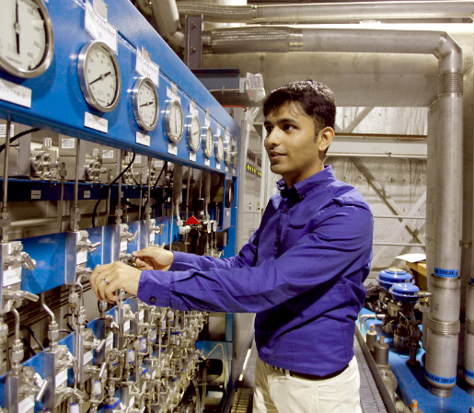
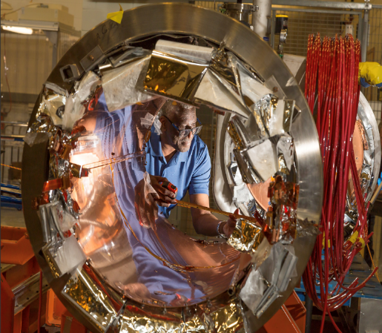
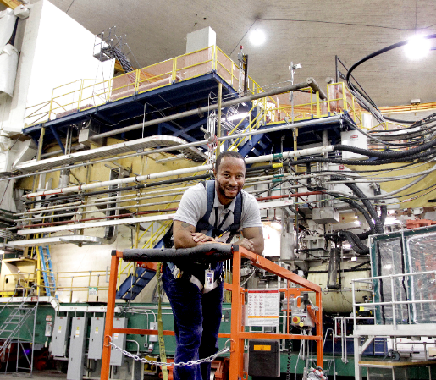
Thomas Jefferson National Accelerator Facility
Jefferson Lab is one of the Department of Energy’s 17 National Laboratories.
Created in the 1980s to build and operate the Continuous Electron Beam Accelerator Facility (CEBAF), a world-unique scientific user facility used by more than 1,900 scientists from around the world. Our mission is to explore the fundamental science of protons, neutrons and atomic nuclei using CEBAF, theory and supercomputing.
LCLS-II Cryomodule
Assembly
Central Helium Liquefier
SRF Institute
Cryomodule Building
Hall A
Slides courtesy David Lawrence
Notes:
This introduces JLab

Slide 13
Jefferson Lab By The Numbers
187
Patents granted
2444
Journal articles
published
Nuclear Physics
Research
Advanced
Computer Science,
Visualization, &
Data
755
PhDs granted
(236 in progress)
938
employees
Two National User
Facilities:
CEBAF & HPDF
Accelerator
Science &
Technology
$206M
FY23
expenditures
1,905
research
guests
annually
Mechanical
Engineering &
Design
$200M
modernization
investment
Systems
Engineering
Notes:
The graphic on this slide taken from David Dean’s talk at the June 2024 Jlab User’s Group Meeting.
https://indico.jlab.org/event/856/

Slide 14
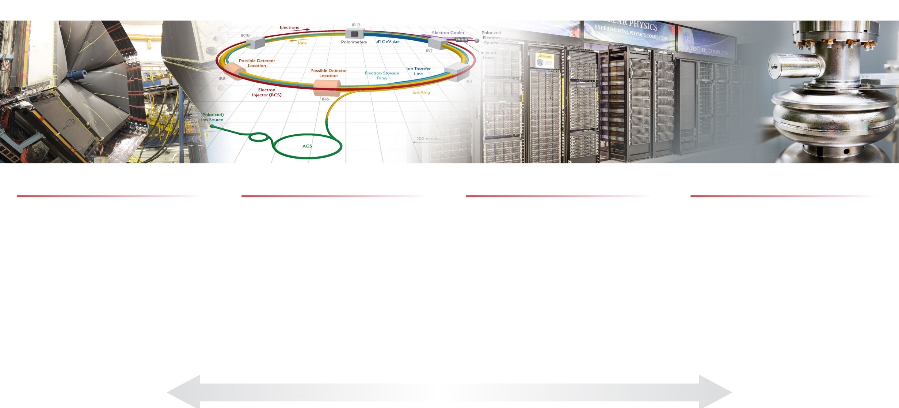
Jefferson Lab’s Science and Technology Vision
Nuclear Physics at CEBAF
Electron-Ion Collider
Computational Science &
Technology
Accelerator Science & Technology
Vibrant nuclear physics research program at CEBAF supporting ~1,900 annual users
MOLLER Project
Future opportunities complementary to EIC
Theory and computation supporting NP goals
Partnering with BNL in the management, design, and construction of the Electron-Ion Collider Project
Leadership in EIC scientific program
Leadership of the Generic EIC–related Detector R&D Program
Design, construction, operation of first-of-its-kind data-intensive computing facility: High Performance Data Facility
Building out data science, domain science capabilities in support of HPDF and to take advantage of HPDF
Accelerator component production for DOE construction projects partnering across the National Lab complex.
Develop CEBAF upgrade concepts
R&D in accelerator, detectors and applications in nuclear imaging and medicine
S&T thrusts are synergistic and mutually supportive
Notes:
The graphic on this slide taken from David Dean’s talk at the June 2024 Jlab User’s Group Meeting.
https://indico.jlab.org/event/856/

Slide 15
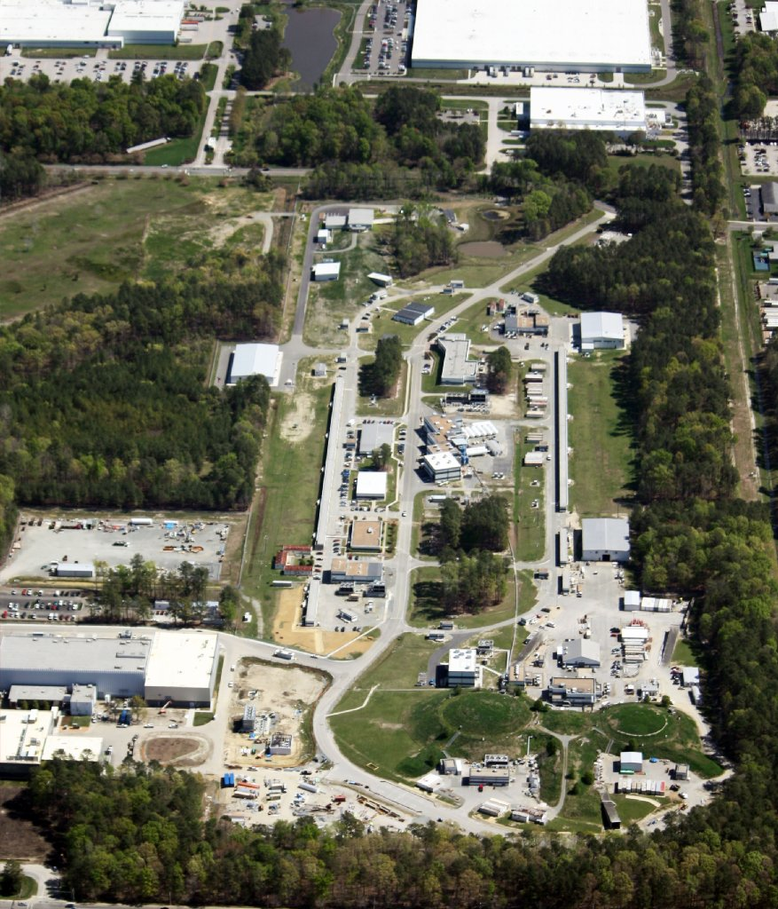
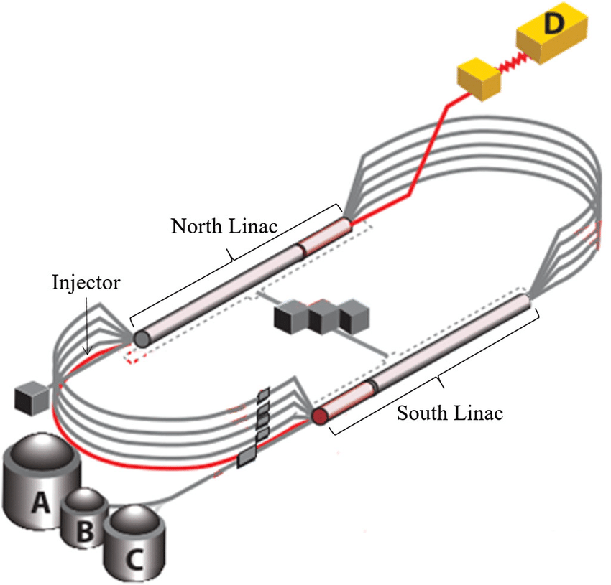
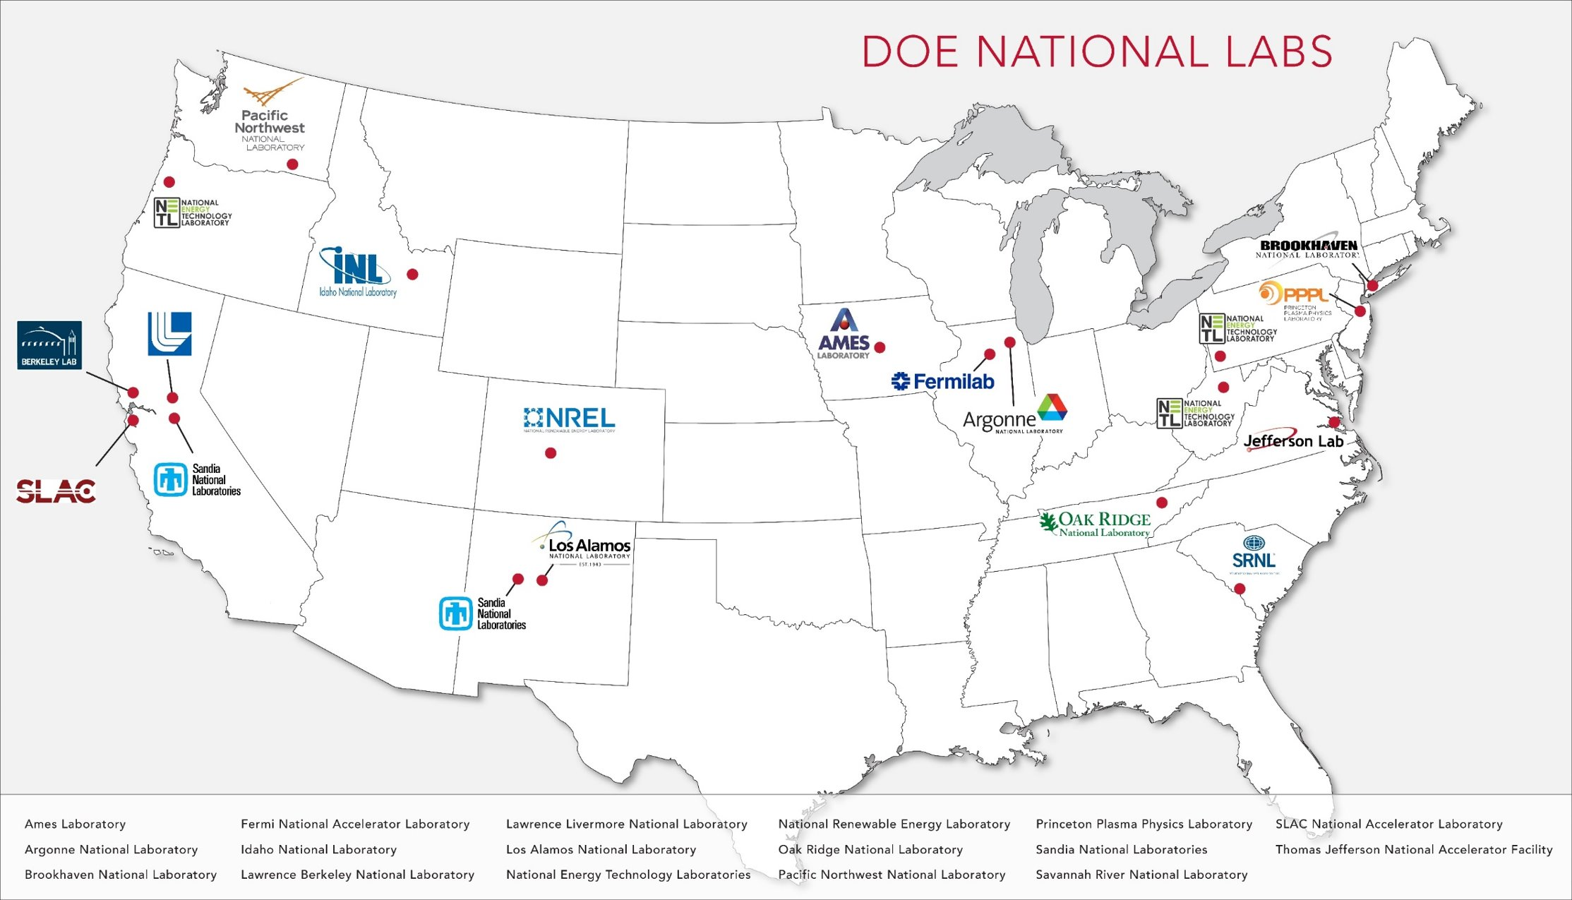
Jefferson Lab Electron Accelerator Facility - CEBAF
Jefferson Lab is located in Newport News, Virginia
D
A
B
C
JLab
CEBAF:
Continuous Electron Beam Accelerator Facility
Aerial Photo of CEBAF
Notes:
The location should already be well-known to everyone attending since they will be at JLab. The pictures give a view of the accelerator in both diagram and photo form for those who are unfamiliar with it.
Note that FRIB is not shown on the DOE National Labs map. I did not see one that shows it. I assume because it is a DOE facility at MSU. By contrast, CEBAF is a DOE facility at the JLab DOE national lab,

Slide 16
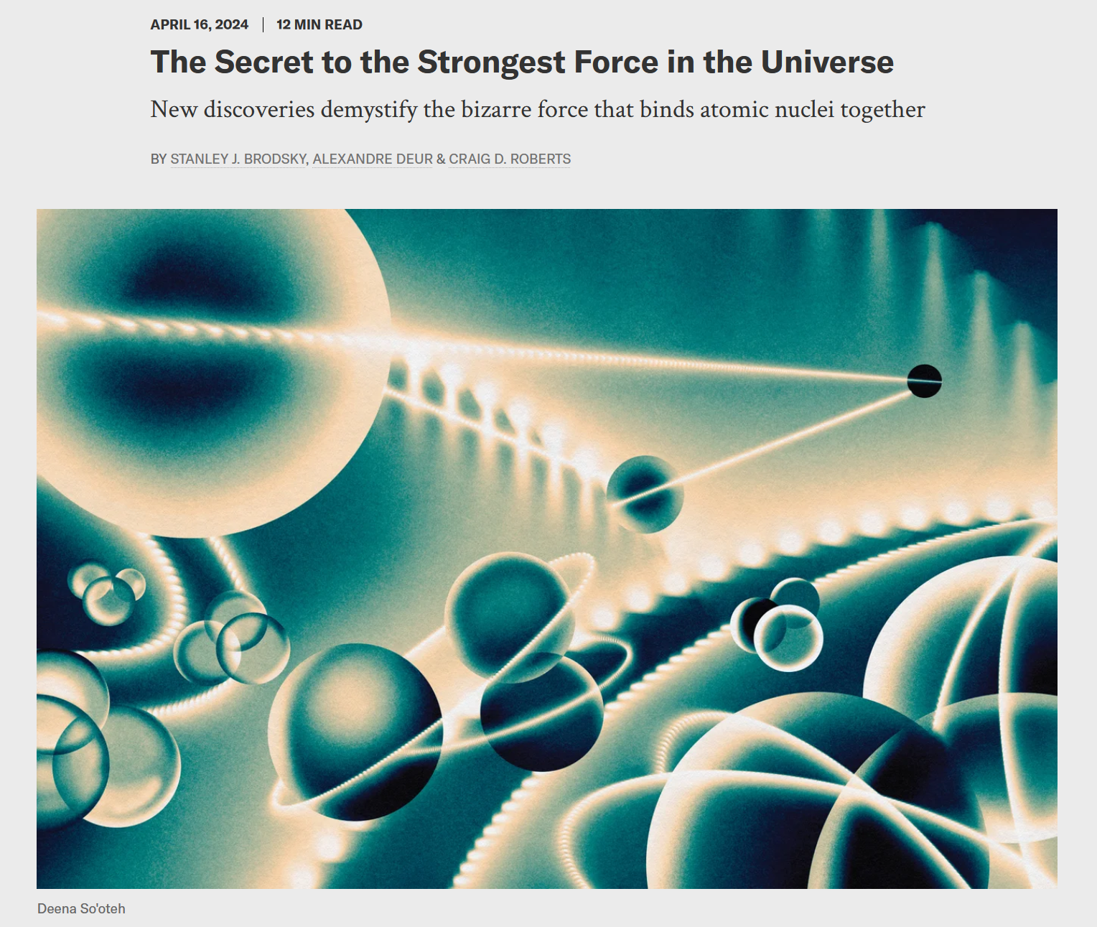
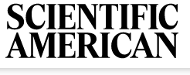
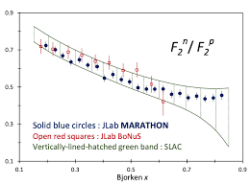
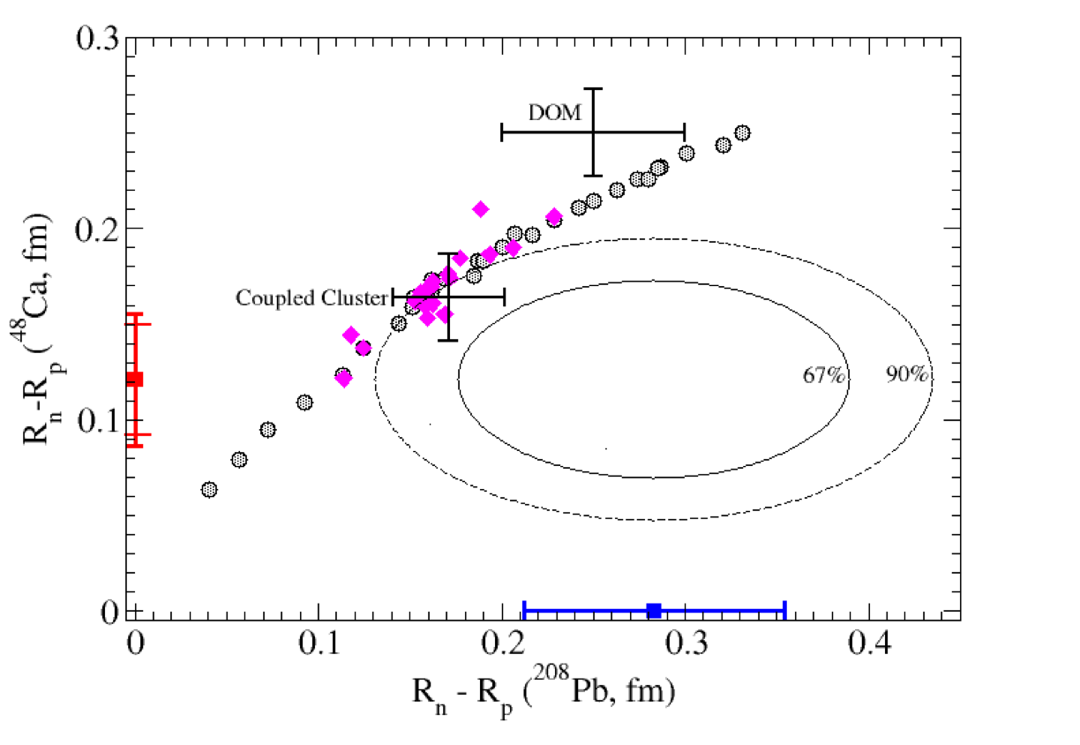
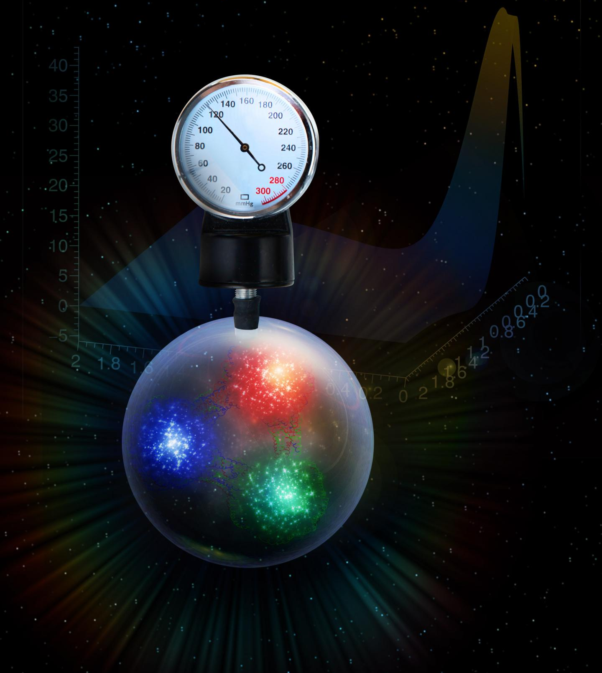
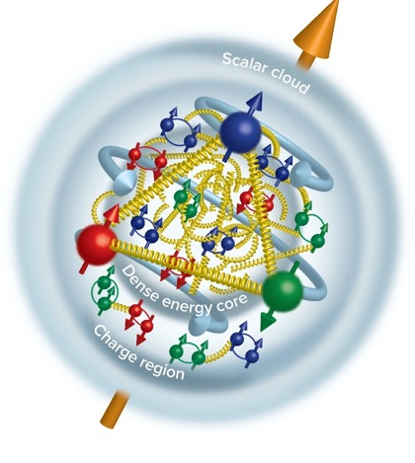
Recent Scientific Results From Jefferson Lab
MARATHON used mirror nuclei to assess neutron valence structure
Proton Radius: Nature 575, 147 (2019)
Neutron radii measured by parity violating electron scattering – implications for neutron stars
Phys. Rev. Lett. 128, 13, 132003 (2022)
“Determining the gluonic gravitational form factors of the proton," Duran et al, Nature 615, 813 (2023)
Tangential stress force inside the proton changes direction near r ~ 0.45 fm
Peak: 38,000 N (4 metric tons)
PREX-II PRL 126, 172502 (2021)
CREX Phys. Rev. Lett. 129, 4, 042501 (2022)
Burkert, V.D., et al., Gravitational form factors of the proton. Reviews of Modern Physics 95, 041002 (2023)
16
Notes:
The content of this slide taken from Stuart Henderson’s talk at the June 2024 Jlab User’s Group Meeting.
https://indico.jlab.org/event/856/

Slide 17
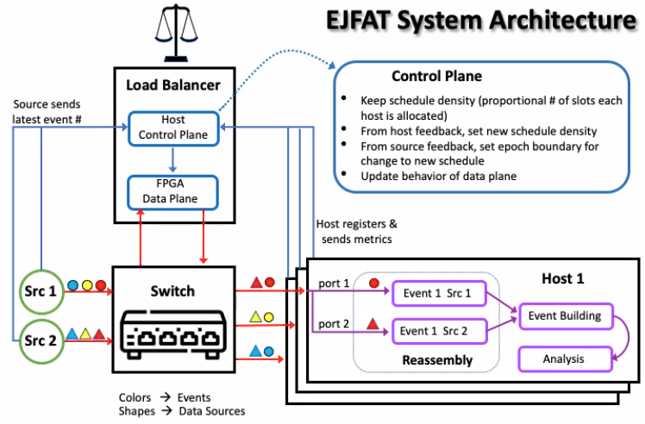
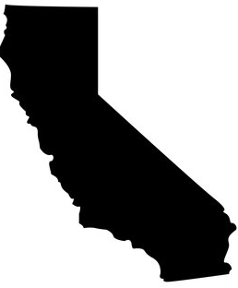
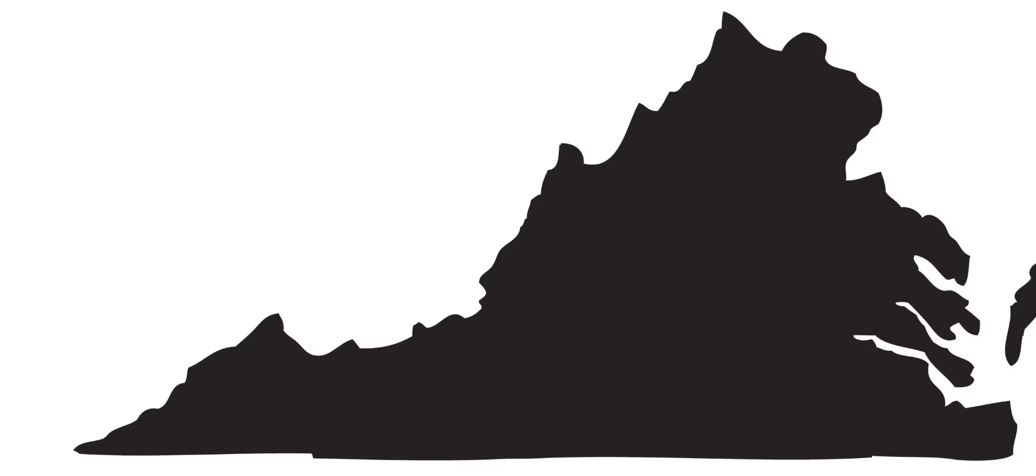
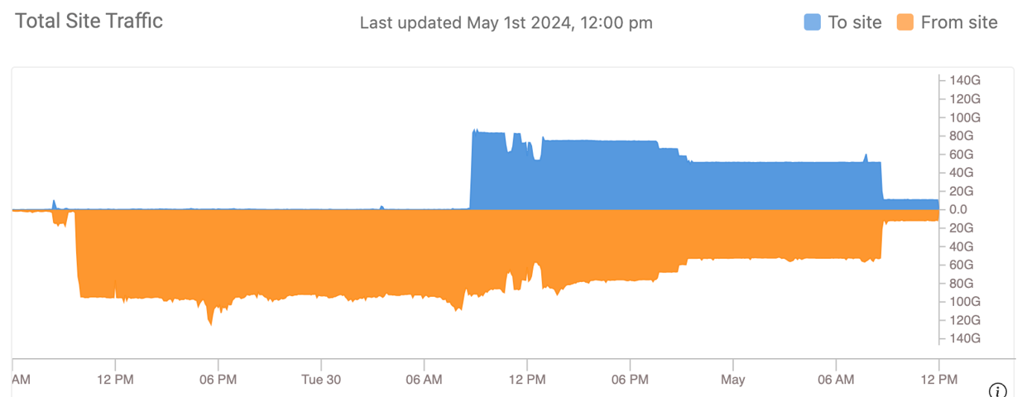
EJFAT: ESNet/JLab FPGA-based Accelerated Transport
Smart packet routing in-network to destinations in HTC allocated resource.
Designed to load balance work to the destination compute farm endpoints with low latency
and full line rate bandwidth (e.g. 100 Gbps) with feedback from the destination compute farm.
CLAS12 Data
(archival)
Virginia (Jlab)
California (NERSC)
80Gbps returning to JLab
100Gbps from Jlab to NERSC
Notes:
This slide describes the EJFAT system.
The diagram on the left is an overview of the architecture. Notice the colored shapes in the bottom part. The colors represent different time slices. The shapes represent different data streams (it is easiest to think of the shapes as representing different subdetectors.) The various sources have their clocks synchronized so to get a snapshot of the full detector, one needs to send all time frames of the same color to the same node on the compute farm.
Another important feature to note here is that the stream sources (i.e. subdetectors) do not actually know the final destination of their stream. They basically send to an address that can be thought of as “The EJFAT network for experiment X”. The Load Balancer is aware of what nodes are currently allocated for experiment X at the destination compute farm and redirects packets there.
The graphics in the bottom half of the right side show results of a test where some archival data from the CLAS12 detector was streamed to NERSC where some minimal processing was done on Perlmutter. The point where the blue part starts indicates when we modified the test to send all of the data back to Jlab just to demonstrate bi-directional high bandwidth capability.

Slide 18
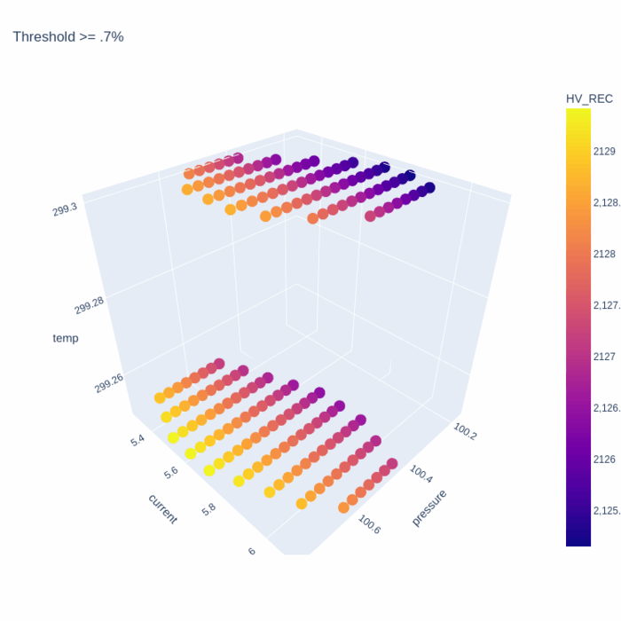
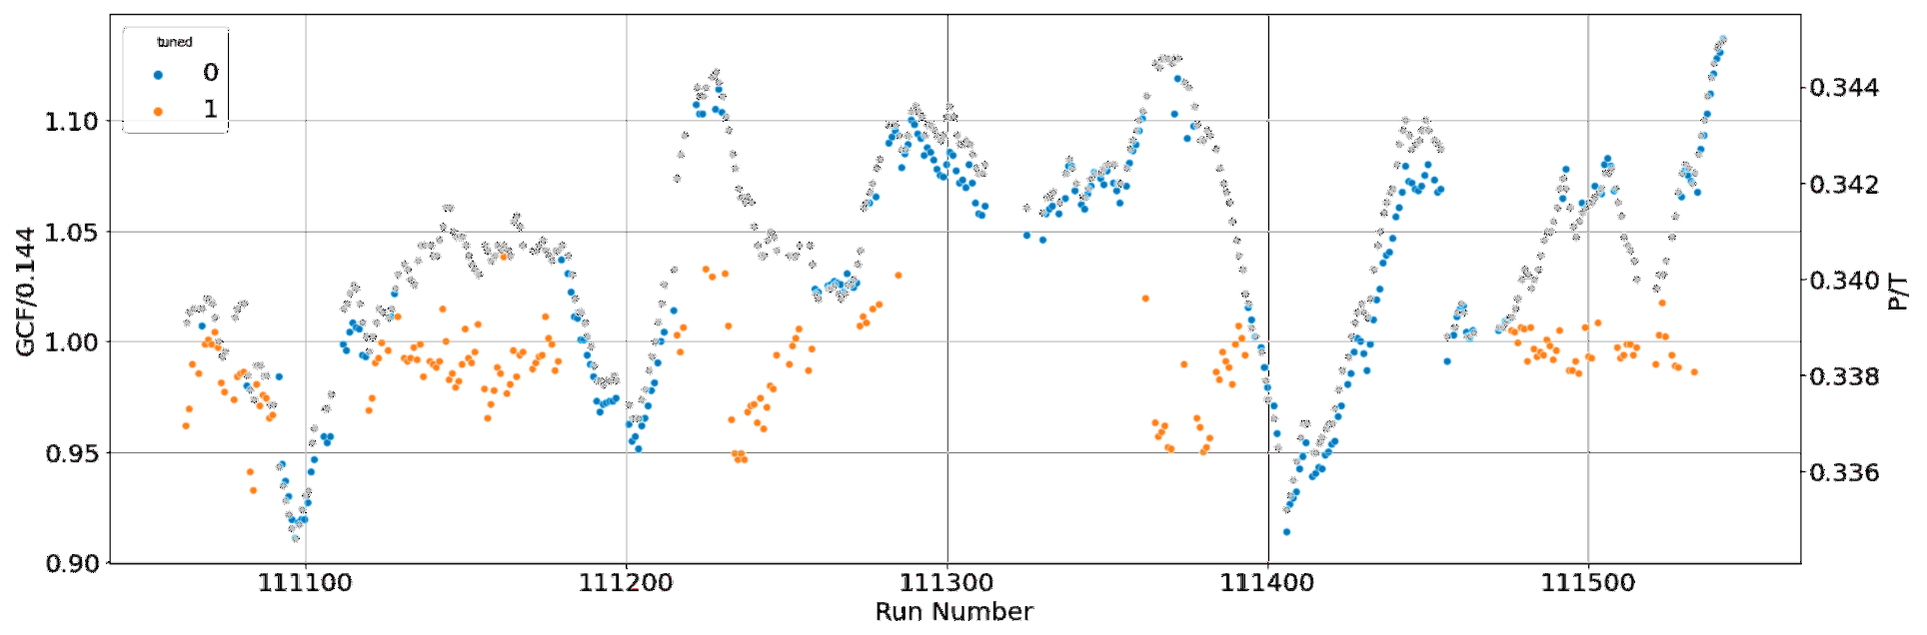
AIEC - AI for Experimental Controls
Developed system that uses AI/ML to determine control settings that are automatically applied during production data taking to stabilize gains of drift chambers.
DOE NP LAB-20-2261
PI: David Lawrence
Co-PIs: Thomas Britton, Naomi Jarvis
AI trained on existing calibrations derived from data. Predicts calibrations from environmental values known prior to data taking.
Atmospheric pressure
AI
Gain
Calibration Factors
CDC HV
CDC gain
Flux
Temperature
Deployment 3 – PrimEx-η June-Dec 2022
final policy: when outside the volume of confidence revert to observation mode in order to gather more training data
GCF/Ideal GCF (0.144)
Notes:
This project uses AI to control the HV on the GlueX Central Drift Chambers. A couple of interesting notes:
We trained the AI model to predict the calibration constants that would eventually be derived from the data after it was taken with environmental values known just before the data was taken. We did this using the calibrations derived from the first few years of GlueX running. This allows us to adjust the HV just before we take data so that the data comes out very close to being completely calibrated already
A lot of the work consisted of uncertainty quantification, guardrails for production operation, and generally deciding on policy and implementing it in a way that the collaboration was comfortable with.
The plot on the lower left shows the normalized Gain Correction Factor (calibration constant). Orange points are when the AI was controlling the HV and blue points are when it was not. The grey points are the atmospheric pressure to chamber gas temperature ratio plotted vs the right hand axis. The green box shows the +/-5% goal of the project.
The animated plot on the bottom left is the boundary of the uncertainty. The animation is just a way of showing the surface for various thresholds of uncertainty. The model is a Gaussian Process Regression model that provides its own estimate of the uncertainty of the prediction.

Slide 19
Summary
Nuclear science programs require dedicated knowledge from computer science and data science
  Minimize time between acquiring data and publishing science
  Inform experimental conditions to make optimal use of limited beam time
Not always practical for a single experimental collaboration to retain computer/data science expertise (not necessarily a constant full FTE of need depending on experimental group).
  However, a pooled resource of individuals across an entire program would greatly benefit entire facilities
Need viable career path for involved computer science/data science individuals
Focus on development of frameworks that could be shared broadly amongst fields
  e.g. EJFAT
Requires buy-in from science collaboration from the very beginning to ease adoption by rest of scientific community once development is completed
Administrative agreements between institutions are required.
  API standardizations
  Policy agreements among labs
  …

