Slide 1
Infrastructure for Nuclear Nonproliferation Data Science Research
Paul Adamson, PhD
Senior Program Manager for Data Science
20 June 2024

Slide 2
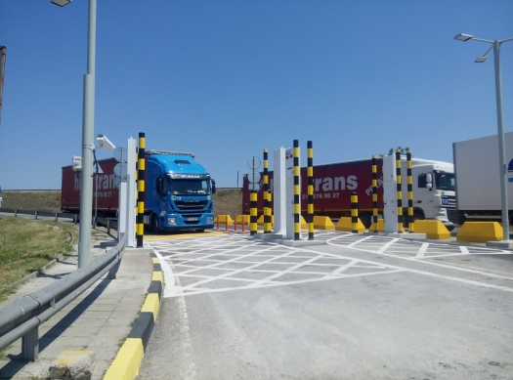
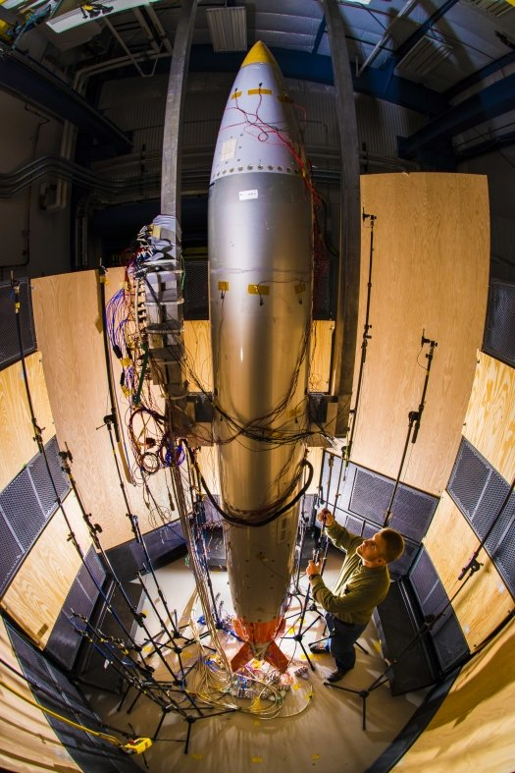
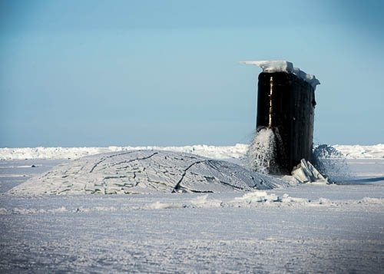
National Nuclear Security Administration Mission
Nonproliferation
Maintaining the Stockpile
Powering the Navy

Slide 3
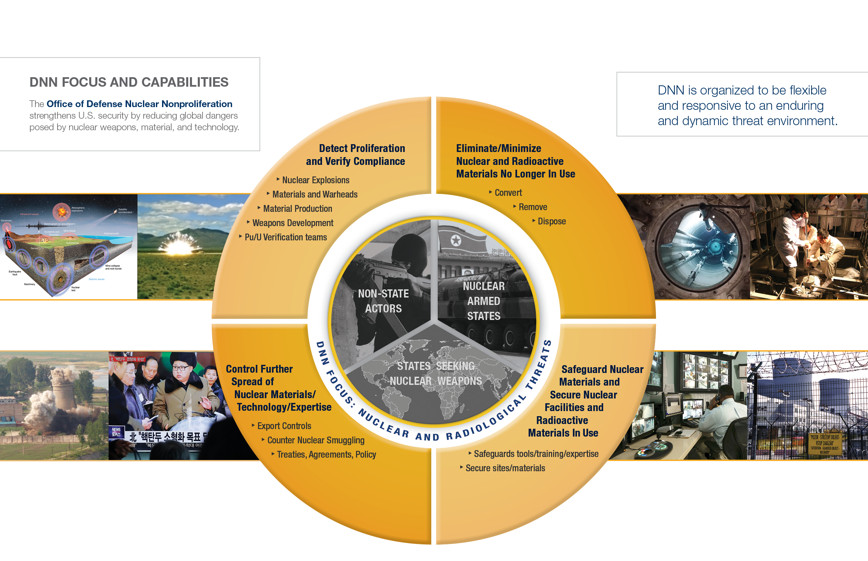
Defense Nuclear Nonproliferation
Notes:
DNN, works globally to prevent state and non-state actors from developing nuclear weapons or acquiring weapons-usable nuclear or radiological materials, equipment, technology, and expertise.
NNSA’s focus and capabilities are designed to be aligned with the President’s nuclear posture review: to Prevent, Counter and Respond to nuclear threats. DNN is organized to be adaptable and responsive to an enduring and dynamic threat environment. We focus on three main threats: those posed by non-state actors (e.g. ISIS), those posed by states seeking nuclear weapons (e.g. Iran), and, those posed by nuclear armed states (e.g. North Korea).
We have four primary areas of work to address these threats:
Eliminating or minimizing the amount of nuclear and radiological material in the world through conversion, removal, disposition and alternative technologies to ensure they do not fall into the wrong hands.
Safeguarding and securing those sites and/or materials that we are not able to minimize or eliminate to ensure they do not fall into the wrong hands.
Controlling the further spread of nuclear materials, technology and expertise to prevent its misuse for non-peaceful purposes, and
Detecting or verifying the nuclear programs and activities of others in the world including: nuclear explosions, materials and warheads, material production, and more.

Slide 4
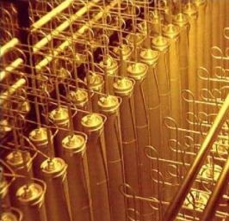
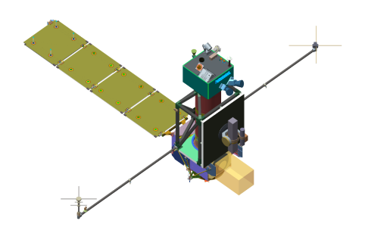
DNN R&D At a Glance
Our
Purpose
DNN R&D is the leading USG organization for the development of advanced technology in support of the USG’s nuclear nonproliferation and nuclear security goals
Applications in cooperative and non-cooperative environments that address horizontal and vertical proliferation
Our
Environment
Our
Mission
Develop technical capability resident at the DOE National Labs, to be leveraged by mission partners for specific applications
Notes:
DNN R&D is the leading USG organization for the development of advanced technology in support of the USG’s nuclear nonproliferation and nuclear security goals.
Our program represents 80% of the Nation’s investment in this area. \
Most of our funding goes directly to the DOE National Labs – we have 16 lab, site, and plant partners – but we also fund universities (obviously) as well as industry through small business grants.
We support activities in cooperative environments under bilateral or multilateral agreements like the NPT and CTBT with technologies for things such as safeguards, arms control, or radiological source replacement. In unilateral environments, we support the DoD or the Intelligence Community with technologies for things like search and interdiction, remote sensing, or nuclear forensics.
Our mission is to develop capabilities. These are capabilities resident in our National Labs, and by capabilities, I mean enabling infrastructure, S&T activities, and subject matter expertise.

Slide 5
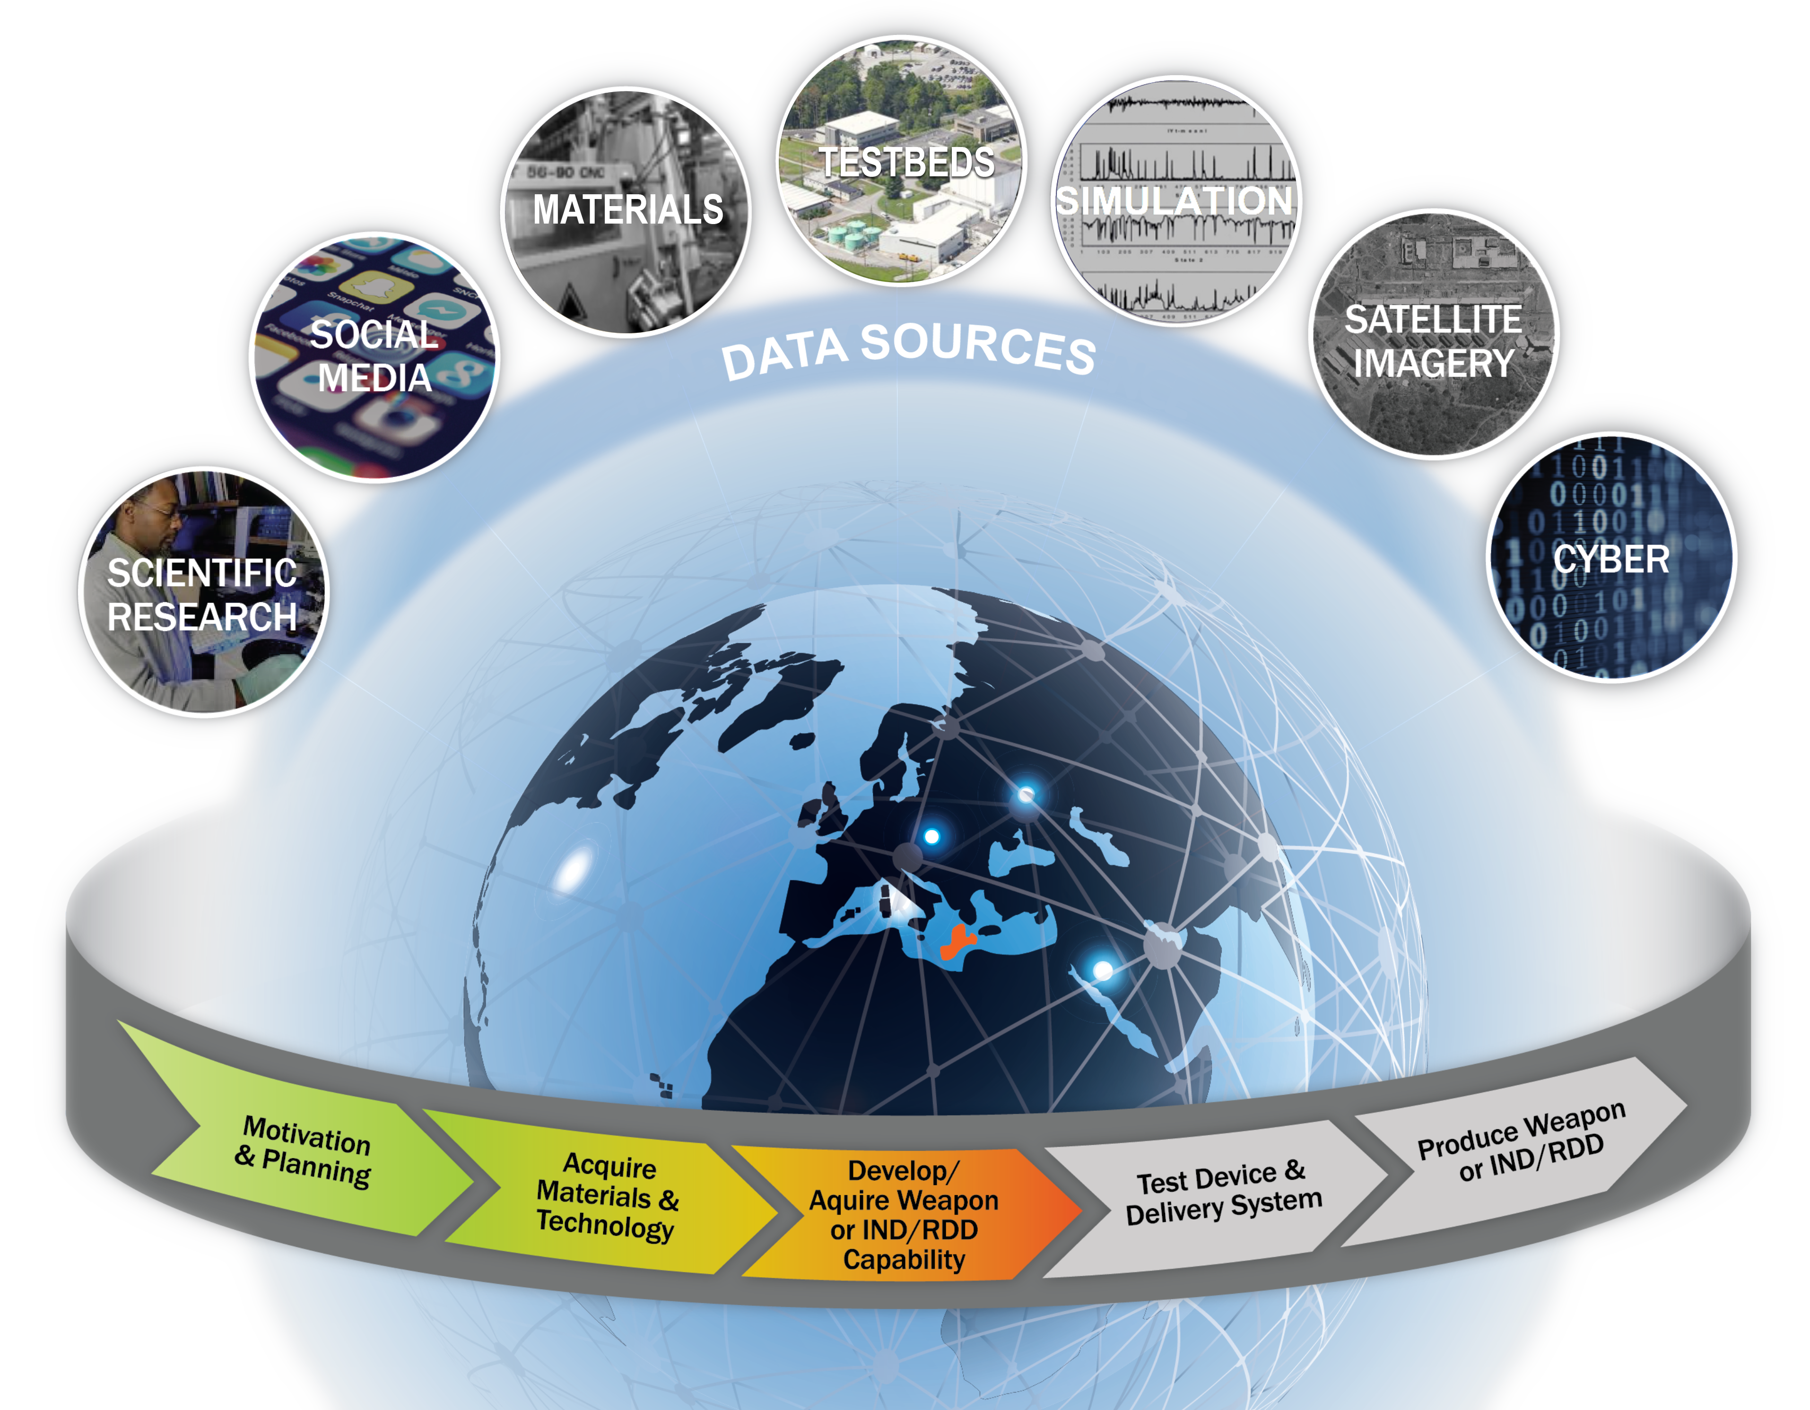
Data Science
Develop and transition enabling capabilities in “data science,” including data analysis and artificial intelligence, advancing U.S. capabilities to
detect, locate, and characterize foreign nuclear weapon development activities and
support nuclear security.
Develop and sustain data stewardship capabilities across the office.

Slide 6
Commercial and open source AI does not directly address national security applications
Trustworthy
Effective
Explainable
Traceable
Robust
Secure
Universal
Accurate
Reliable
Generalizable
Insightful
Deployable
Affordable
Available
Modular
Adaptable
Interoperable
Domain-aware
Opportunities:
Decision making under uncertainty
Accelerating discovery
Challenges:
Modeling complex systems (and systems of systems)
Sparse and noisy data
Rare events
Drive investment in science, technology, and engineering:
Extending foundation models, knowledge graphs, and AI agents to nonproliferation-relevant data modalities
Developing benchmarks and tools for test & evaluation
Building trust through human-AI teaming
AI Attributes
Notes:
While we leverage advances in industry, academia, and open source communities, there is a lot of fundamental research and development required for trustworthy, effective, and deployable methods and systems for high consequence applications in nuclear nonproliferation and nuclear security.
These investments include extending AI technologies like foundation models, knowledge graphs, and agents to non-proliferation relevant data modalities, developing benchmarks and tools for T&E, and maturing trustworthy methods though human-AI teaming.

Slide 7





Multimodal foundation model R&D
Multimodal foundation models are enabling many advances in AI
  Trained on large data sets
  Can be adapted to a wide range of downstream tasks (e.g., via fine-tuning)
Developing a multimodal foundation model in a month capability
  Train on multiple modalities or types of data (e.g., text, image, seismic)
  Rapidly build, test, and validate at large scale
  Leverage industry and open source models
    NukeLM: https://github.com/pnnl/NUKELM
    SciTune: Approval for release in progress, https://arxiv.org/abs/2307.01139
  Benchmark for downstream tasks => buy down risk and reduce cost
Notes:
Previous DNN R&D projects have been early pathfinders – successfully demonstrated how machine learning and data analytics can enhance DNN’s mission.
Over the last few years, we’ve ramped up two multi-lab ventures, one to adapt foundation model technologies to data modalities of interest, and the other to explore analytic discovery through large-scale knowledge graphs over the same data types.
Brief slide

Slide 8
Multimodal Foundation Model
Research Thrusts
Foundation Models
Test and Evaluation
Human-AI Teaming
Model Scaling
Nonproliferation Benchmarks
Transparency
Multimodality
Fine-Tuning & Continual Learning
Usability
Portability
Model Prompting
Security & Privacy
Data & Compute
Trustworthy AI Ecosystem
Robustness
Notes:
Our foundation model venture is organized around three research thrusts.
Brief slide

Slide 9
Multimodal Foundation Model
Research Thrusts
Human-AI Teaming
Build trust with SMEs through developing novel techniques to explain and interpret multimodal foundation model behavior
Transparency
Usability
Security & Privacy
Robustness
Ensure models are robust to distribution (domain, task) shifts in multimodal setting
Notes:
I’ll step through each research thrust and highlight a couple components especially relevant to common challenges in science and nuclear security domains.

Slide 10
Multimodal Foundation Model
Research Thrusts
Test and Evaluation
Create benchmarks, test harness software, and metrics to perform reproducible evaluation and trade-off analysis.
Nonproliferation Benchmarks
Fine-Tuning & Continual Learning
Model Prompting
Release unclassified models, FAIR and AI-ready datasets and benchmarks, so they can be easily found, accessed, deployed, and reused
Trustworthy AI Ecosystem

Slide 11
Multimodal Foundation Model
Research Thrusts
Foundation Models
Model Scaling
Create novel neural architectures and pretraining objectives to operate with heterogeneous data streams
Multimodality
Portability
Establish and maintain shared data and compute resources using the best practices for data processing and model pretraining
Data & Compute

Slide 12
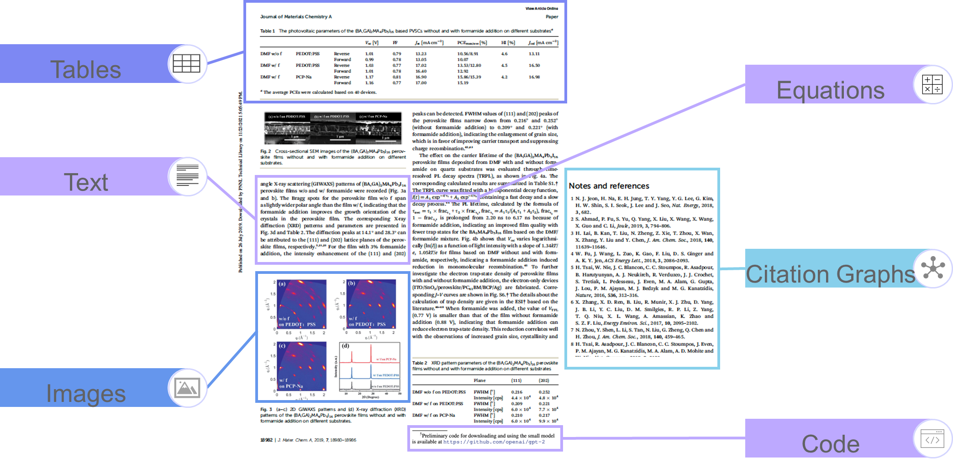
Multimodal scientific literature data
Notes:
An obvious place to start looking for multimodal scientific data is the scientific literature, and we have been exploring this space for many years, developing machine learning and natural language processing approaches to scrape PDFs and the like and build deep neural nets and graphs to help answer a whole host of questions.

Slide 13
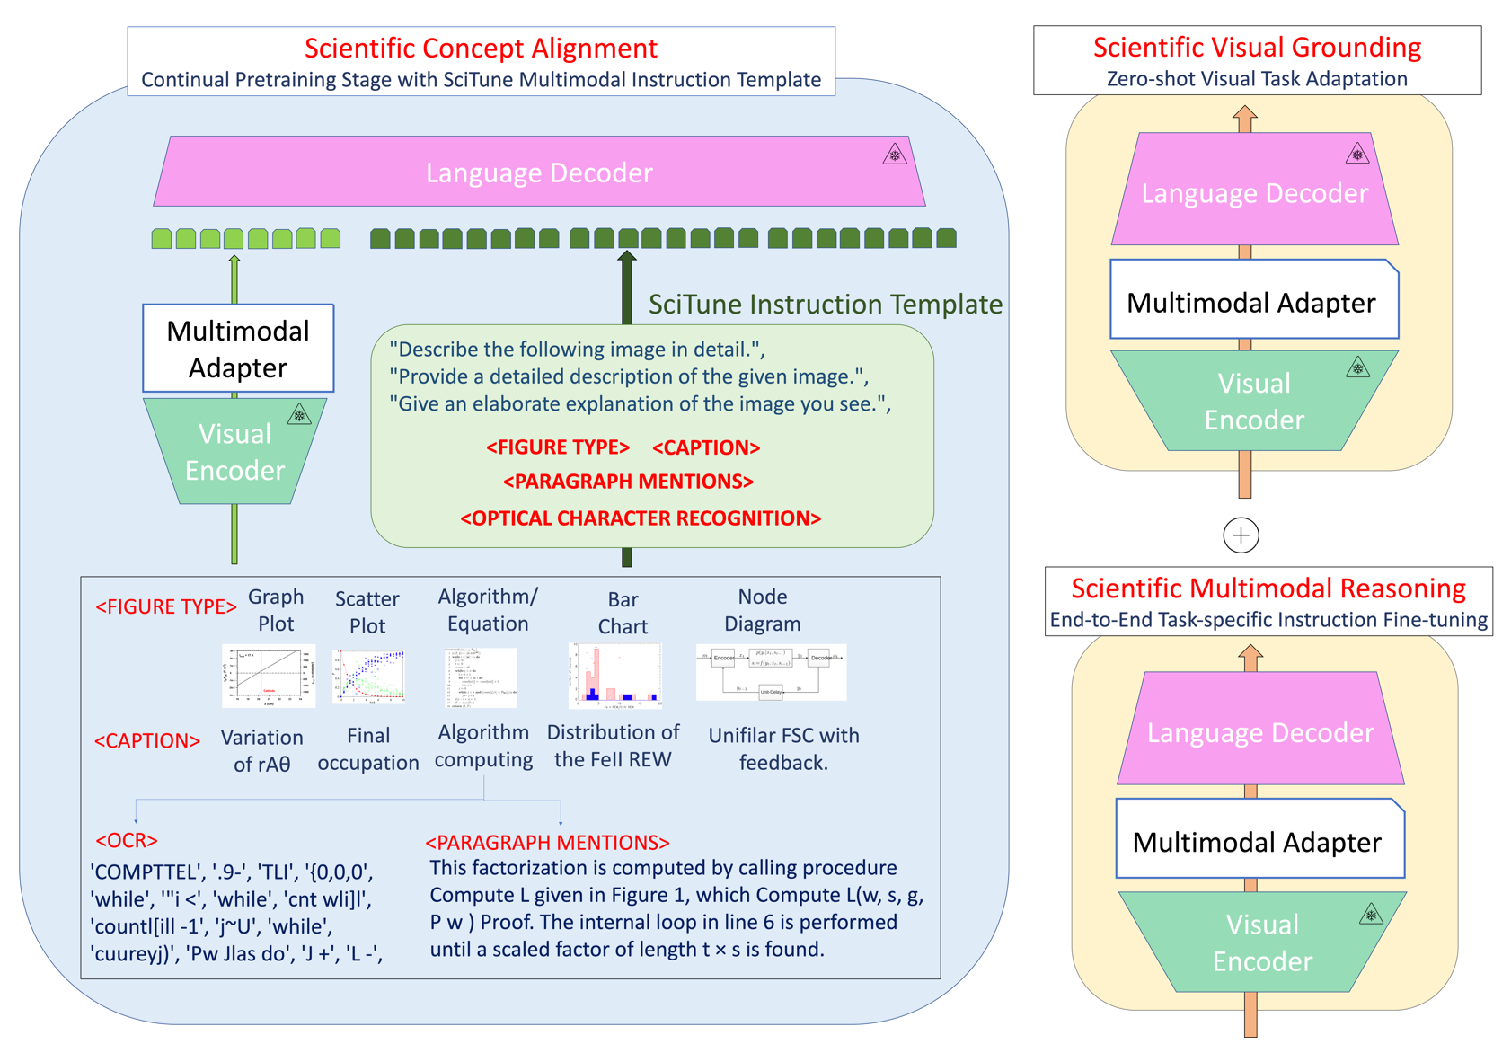
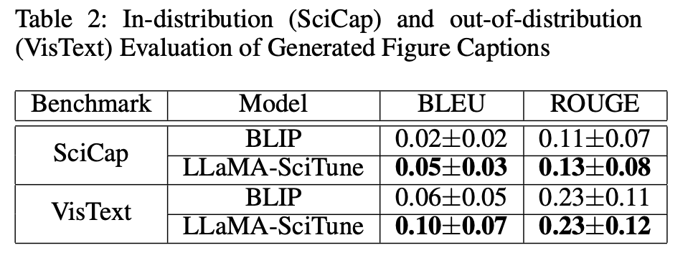
SciTune
Multistage Concept and Task Alignment
Horawalavithana, Sameera, et al. "SCITUNE: Aligning Large Language Models with Scientific Multimodal Instructions." arXiv preprint arXiv:2307.01139 (2023).
SciTune outperforms other state-of-the-art models in generated figure types and captions in multimodal benchmarks.
Notes:
One result of this research is the SciTune tuning framework to improve the ability of LLMs to follow scientific multimodal instructions. To test our methodology, we used a human-generated scientific instruction tuning dataset and trained a large multimodal model starting from LLaMa, the best-performing open source model. In comparison to the models that are fine-tuned with machine generated data only, LLaMA-SciTune surpasses human performance on average and in many sub-categories of ScienceQA, a standard scientific reasoning benchmark.

Slide 14

Analytic Discovery
Research Thrusts
Deep Knowledge Construct
AI-Informed Reasoning
Data Discovery
How and where to look
Integrate and structure multimodal data
Generalizable, commonsense reasoning
Analytic Discovery System Framework
Acquisition Analytics
Computational Fuel Cycle
Structured Knowledge
Targeted Collect
Decision Analytics
Notes:
We are also leveraging advances in knowledge graphs, multi-modal foundation models (initially large language models), and other AI technologies such as agents to develop a broad area search capability to discover, detect, and locate nuclear proliferation activities.
Our Analytic Discovery research is organized in three R&D thrusts, Data Discovery, Deep Knowledge Constructs, and AI-Informed Reasoning. Through these research thrusts, we will develop components (shown in the ovals) of an overall Analytic Discovery System Framework.
Through Data Discovery, we will develop methods to help us discovery where to look for proliferation relevant signals in growing volumes of varied quality data. The Acquisition analytics capability generates leads, while the targeted collect capability helps the system detect and locate data to feed agents for building structured knowledge (for example knowledge graphs).
The computational fuel cycle (CFC) component holds all of the nuclear fuel cycle knowledge, including signatures, signals, indicators, and processes associated with proliferation activities. The CFC guides data discovery within the acquisition analytics component, provides the organization structure of the structured knowledge component, and gives patterns for decision analytics.

Slide 15
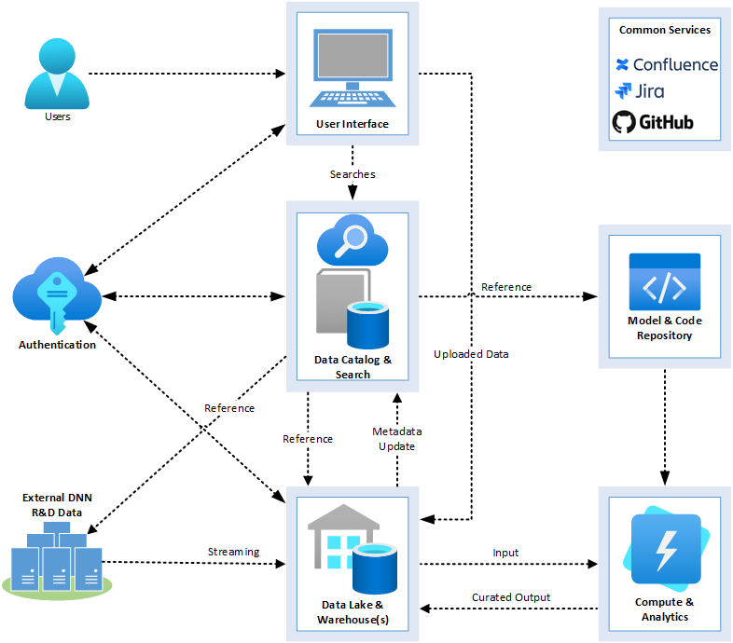

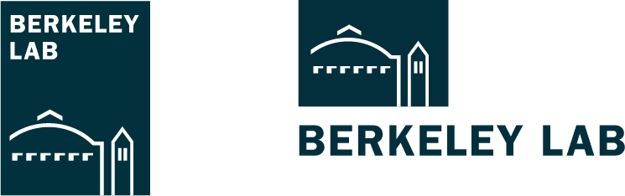
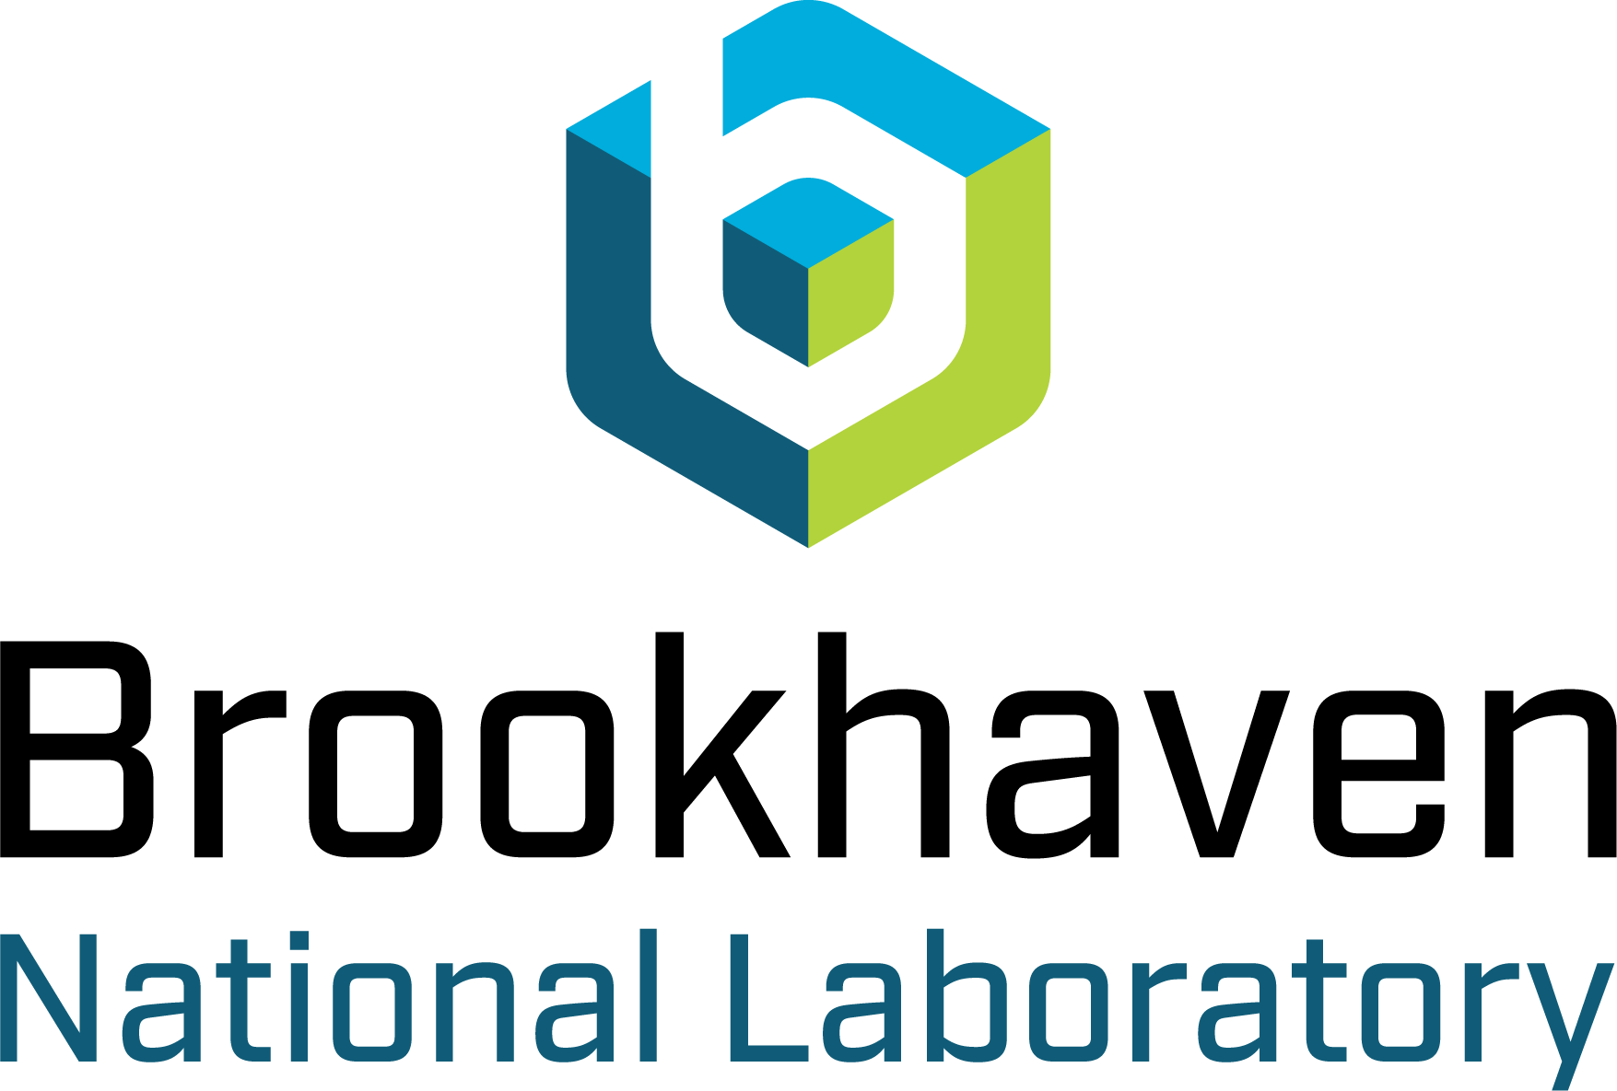



Data-Centric Research Collaboration Architecture
Authentication: Central Login
Common Services: System Dev
Catalog: Index of Data
Lake: Unstructured Data
Warehouse: Structured Data
Search: Centralized Queries
Model & Code Repo: Collaborative Dev
Compute: Shared Resources
Analytics: Hosted Visualization, etc
Notes:
Here is a view of the data management architecture that is currently under development in DNN R&D. This will provide us with an end-to-end system for managing R&D data and enabling collaborative nonproliferation research. The system will operate at multiple classification levels.

