Slide 1
SciDAC institutes
july 20, 2024
Todd munson
Senior Computational Scientist

Slide 2
Scidac Institutes

Slide 3

A brief history of Scidac
Program | Time Frame | Description | Result
SciDAC-1 | 2001 – 2006 | Created scientific software infrastructure for parallel computing; Funded collaborations in DOE science domains | Science at the Terascale
SciDAC-2 | 2006 – 2011 | Added DOE science domains; Enhanced university involvement; Outreach to broader scientific community; Added Data & Visualization | Science to the Petascale
SciDAC-3 | 2011 – 2016 | Improved collaborations among the Institutes and between ASCR-SC programs; Enhanced architecture- and applications-awareness within each Institute; Added Uncertainty Quantification | Science on multi-core and emerging hybrid architectures;
SciDAC-4 | 2017 – 2021 | Outreach to broader scientific community; First connection to Applied Energy; Built-in flexibility; Added Machine Learning | Science on pre-Exascale architectures
SciDAC-5 | 2020 – 2025 | Institutes recompeted and refocused on introducing new AI and ML algorithms and tools; Partnerships recompeted to continue to address DOE science priorities | Science at the Exascale
Thanks to Ceren Susut-Bennett
Notes:
SciDAC is a DOE program “created to bring together many of the nation's top researchers to develop new computational methods for tackling some of the most challenging scientific problems.”
SciDAC stands for scientific discovery through advanced computing and is meant as a bridge to connect the computer scientists and applied mathematicians in the office of advanced scientific computing research to the applied offices in basic energy sciences, biological and environmental research, fusion energy sciences, high energy physics, nuclear physics, nuclear engineering, and a pilot with the office of electricity.
HPC systems have bifurcated from those with accelerators and those without. Multi-core with Knights landing. To today where all of the power is in the GPU accelerators from NVIDEA, AMD, and Intel. The Department of Energy has various programs for supporting these machines. The program I will talk about today is the SciDAC Program.
SciDAC-3: Titan (AMD/Nvidea), Mira (BG/Q), Theta (Intel/KNL), Cori (Intel Xeon/KNL)
SciDAC-4: Summit (IBM/Nvidea), Perlmutter (AMD/Nvidea)
SciDAC-5: Frontier (AMD), Aurora (Intel)

Slide 4
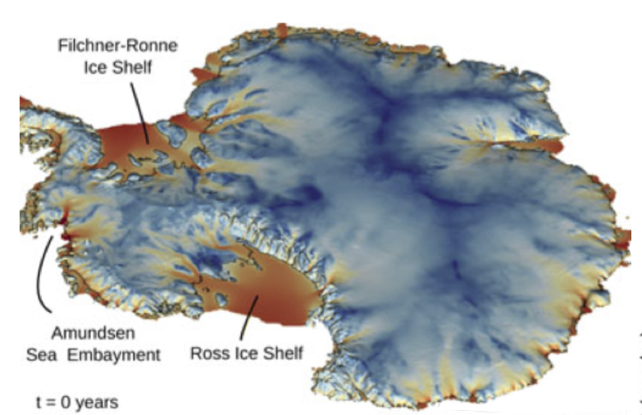
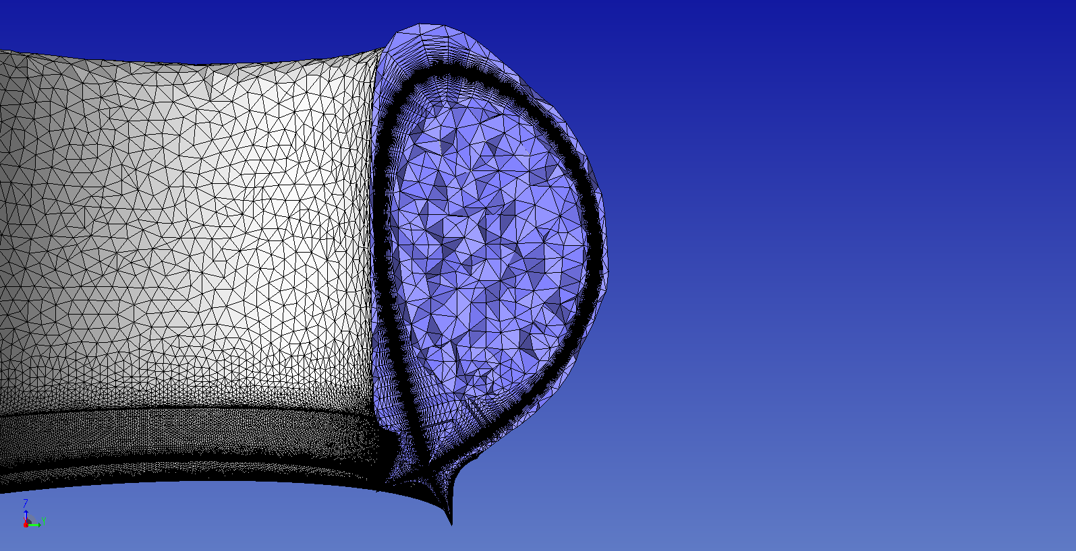






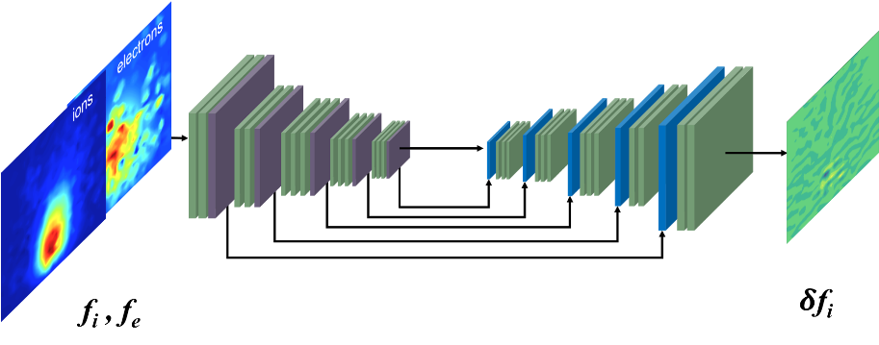
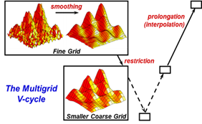




The SciDAC FASTMath Institute
Provide leading edge applied and computational mathematics to remove the barriers facing computational scientists
Structured
Mesh Spatial
Discretization
Technical Approach
Develop robust math techniques and numerical algorithms for DOE science problems
Deliver highly performant software with strong software engineering to run efficiently and scalably on DOE supercomputers
Work closely with domain scientists to leverage our math and ML expertise and deploy our software in large-scale scientific codes
Build and support the broader computational math and computational science communities across DOE
Data Analytics
Unstructured
Mesh Spatial
Discretization
Cross-cutting activities, such as scientific AI/ML, link the areas
Uncertainty
Quantification
Time
Integration
Numerical
Optimization
Solution of Linear/Nonlinear Systems
Solution of
Eigenvalue
Problems
Director: Esmond G. Ng (LBNL)
Deputy: Todd Munson (ANL)

Slide 5
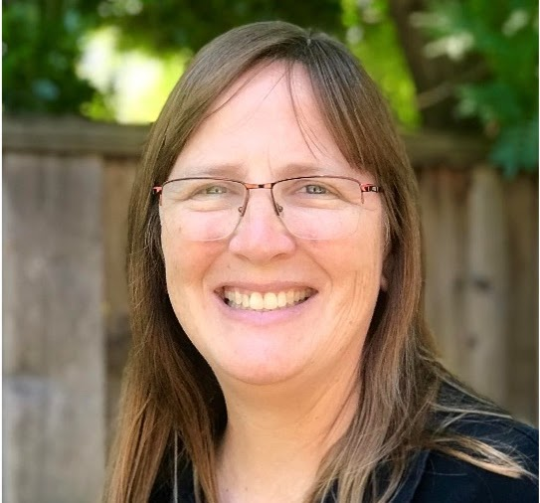
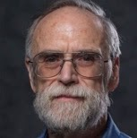
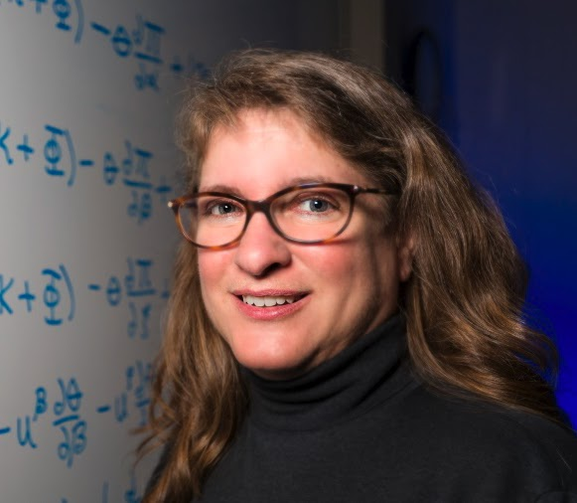
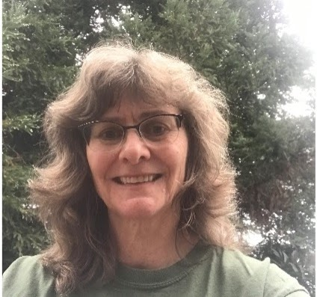
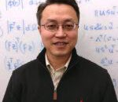
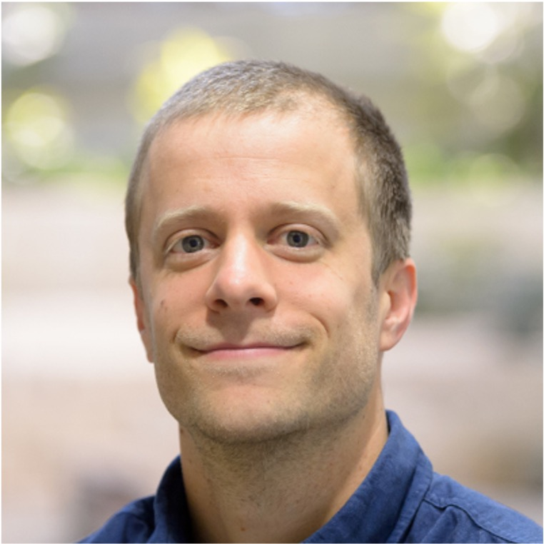
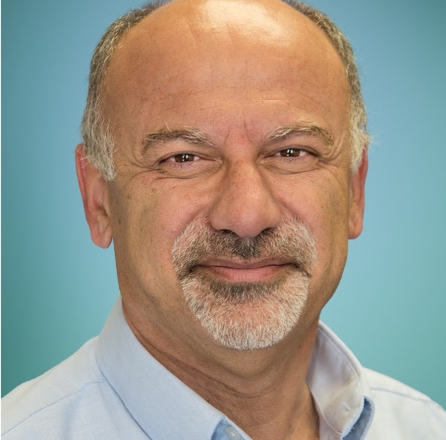
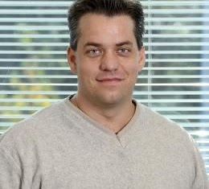
Fastmath area leads
Discretization
Ann Almgren
asalmgren@lbl.gov
Structured Mesh Spatial Discretization
Mark Shephard
shephard@rpi.edu
Unstructured Mesh Spatial Discretization
Carol Woodward
woodward6@llnl.gov
Time Integration
Solution of algebraic
systems
Ulrike Yang
yang11@llnl.gov
Solution of Linear/Nonlinear Systems
Chao Yang
cyang@lbl.gov
Solution of Eigenvalue Problems
Outer loop
Jeff Larson
jmlarson@anl.gov
Numerical Optimization
Habib Najm
hnnajm@sandia.gov
Uncertainty Quantification
Rick Archibald
archibaldrk@ornl.gov
Data Analytics

Slide 6











The SciDAC RAPIDS Institute
Enabling scientific breakthroughs using DOE supercomputers by assisting SciDAC and DOE scientists and engineers to solve computer science, data, and artificial intelligence (AI) challenges
Four thrust areas covering key needs
Emphasis on enabling AI/ML use by science teams and leveraging within RAPIDS tools
Software stewardship activities targeting widely used software packages
Application, Institute, Facility, and Community Engagement
Application enhancement, RAPIDS/FASTMath collaboration, tutorials
Data
Understanding
Ensemble analysis
Feature detection
Production vis.
In situ analysis
Platform
Readiness
Heterogeneous programming
Performance modeling and analysis
Autotuning
Correctness
Scientific Data
Management
Storage systems and I/O
Knowledge management
Workflow automation
Artificial
Intelligence
Representation learning
Surrogate modeling
Automation
Director: Robert Ross (ANL)
Deputy: Leonid Oliker (LBNL)
Integration of AI within RAPIDS technologies
Software Stewardship
Notes:
The RAPIDS team has decades of experience in helping scientists overcome computational and data-related challenges.

Slide 7

Software stewardship in rapids and fastmath
Objectives
Advance and steward a selected set of production software products providing key capabilities to DOE science teams
Help bring new software products to a production state
Foster the integration of software tools to help achieve DOE mission objectives.
Name | Summary
Data
ADIOS | ADIOS provides a simple, flexible way for scientists to describe the data in their code that may need to be written, read, or processed.
DIY | Block-parallel library for writing scalable parallel algorithms
HDF5 | Parallel I/O library for high performance access to self-describing HDF5 datasets
Paraview/Catalyst | ParaView is a tool for post hoc visualization at scale. Catalyst is the associated in situ library.
PnetCDF | Parallel I/O library for high performance access to self-describing netCDF datasets
VisIt/Ascent | VisIt is an open source, interactive, scalable, visualization, animation and analysis tool. Ascent is a lightweight in situ library leveraging VTK-m for GPU support.
VTK-m | VTK-m is a performance portable visualization library leveraged by production tools e.g., ParaView and VisIt.
zfp | Open-source library for compressed floating-point and integer arrays that support high throughput read and write random access.
Applied Math
AMReX | Framework for massively parallel, block-structured adaptive mesh refinement applications
Ginkgo | High-performance linear algebra library for manycore systems, with a focus on solution of sparse linear systems
MAGMA | Collection of next-generation linear algebra libraries for heterogeneous computing
hypre | Linear solvers library with emphasis on multigrid for structured and unstructured problems
Kokkos Kernels | On-node, portable, sparse/dense linear algebra library based on Kokkos programming model.
MFEM | Light-weight, scalable building blocks for implemeting finite element algorithms
PETSc | Suite of data structures, linear solvers, preconditioners, non-linear solvers for distributed memory scientific simulations
STRUMPACK | Solvers for dense rank-structured or sparse linear systems with support for variety of rank-structured formats
SUNDIALS | Nonlinear solvers and time integration library
SuperLU | Sparse direct solver library providing a robust solution approach for hard to solve sparse linear systems.
Trilinos | Framework with linear solvers, preconditioners, non-linear solvers, partitioning tools, and discretization libraries to support science simulations
libCEED | libCEED provides fast algebra for element-based discretizations, designed for performance portability, run-time flexibility, and clean embedding
AI/ML
DeepHyper | Scalable neural architecture and hyperparameter optimization for deep neural networks on leadership-class machines
Tools
ERT (Roofline) | Automates generation of roofline model for architecture-specific performance analysis and optimization
TAU | Portable profiling and tracing toolkit for performance analysis of parallel programs written in Fortran, C, C++, UPC, Java, Python.
Technical Approach
Identify priority software products via stakeholder input
Fund product-specific activities that improve the software in terms of impact, quality, and/or sustainability
Identify and support promising potential products for “incubation”
Actively collaborate with our peer SSOs to train software teams on best practice, to integrate into the broader software ecosystem, to gain access to CI/CD resources, and to build connections between teams
Promote equity and inclusion as an intrinsic element to advancing scientific excellence
FY24 Institute supported software stewardship recipients
Notes:
A robust software ecosystem is a critical enabler of DOE science, helping adapt to the evolution of the underlying hardware technology ecosystem and evolving DOE mission needs.

Slide 8
PETSc/TAO Deep Dive

Slide 9
PETSc/TAO Contributors to this section
Mark Adams (Lawrence Berkeley National Laboratory)
Satish Balay (Argonne National Laboratory)
Jed Brown (University of Colorado Boulder)
Jacob Faibussowitsch (Argonne National Laboratory)
Mathew Knepley (University at Buffalo)
Scott Kruger (Tech-X)
Richard Tran Mills (Argonne National Laboratory)
Todd Munson (Argonne National Laboratory)
Barry Smith (Flatiron Institute)
Stefano Zampini (KAUST)
Hong Zhang (Illinois Institute of Technology)
Junchao Zhang (Argonne National Laboratory)

Slide 10


Overview of petsc/tao
Provides efficient, scalable, customizable, application focused linear and nonlinear solvers, integrators, and numerical optimization algorithms for large-scale scientific applications with a strong emphasis on interoperability with complementary software.
Some community features:
Open source with large developer community
Many users that become developers
Longevity – first release in 1995
Flexibility, portability and efficiency
Support for exascale architectures
  CUDA backend with CUDA-12 support
  HIP backend with rocBLAS/rocSparse
  Kokkos backend
Many examples and tutorials
Notes:
At a high level, we have made quite a bit of progress over the last year
Many of our activities are related to accelerator support that we will spend some time on for next
We support all of the GPU accelerators and have new prototype backend support for Kokkos. We have made progress on the early access hardware
We provide examples and benchmarks for various configurations
We use these examples and benchmarks in our efforts to optimize the communications and improve solver performance
These improvements are integrated into the math community software development kit
There is ongoing work on tulip, iris, and yarrow.

Slide 11
Accelerator strategy for flexibility and Performance
GPU
CPU
C, C++, Fortran
Compiler Directives
OpenMP, OpenACC
Cuda PM
CUDA, HIP
C++ data-parallel PM
Kokkos, SYCL, RAJA
Application code
Using PETSc/TAO API
Front-end PETSc/TAO Vector and Matrix arrays
are shared with user programming language/model
PETSc/TAO computation kernels
CPU: Use compiler options and vendor libraries
for performance
GPU: Chosen for either speed of development or
highest performance; use vendor libraries
Back-end PETSc/TAO Vector and Matrix
implementations
C Code
BLAS/LAPACK MKL
OpenCL
OpenCL: ViennaCL
Cuda PM
CUDA: cuBLAS, cuSparse
HIP: rocBLAS, rocSparse
C++ data-parallel PM
Kokkos: Kokkos Kernels
SYCL: OneAPI
GPU
Notes:
Our overall strategy for performance portability and accelerator support is based on flexibility and separation of concerns.
Support the tools that the application developers are using
While obtaining performance in the numerical libraries and kernels
We do this by wrapping the data pointers inside of PETSc matrix and vector objects and provide access via those objects. The separation of concerns allows us to focus our effort on the kernels, such as vector, matrix-vector, matrix-matrix, and other fused computational kernels, while the developer can focus on their application.
This can introduce challenges when the application and library meet, for example with oversubscription of streams, but these can be managed.
We provide multiple backends and support AMD, Intel, and NVIDIA as needed by the applications on the platforms.

Slide 12
Support is flexible for applications and architectures
Application
PETSc/TAO
Notes:
To illustrate our approach, let’s walk through an example as you transition from basic to advanced usage of CUDA.
In the simplest case, we have an application using PETSc.

Slide 13
Support is flexible for applications and architectures
Application
PETSc/TAO
cuBLAS
cuSparse
uses
CUDA
optional
Notes:
Then we can switch the matrix and vector types to use a CUDA backend by changing the types and enabling the CUDA backend in the configuration that brings in the cuBLAS and cuSparse libraries.
This has been possible for a while in PETSc with MATAIJCUSPARSE and MATDENSECUDA, for example.

Slide 14
Support is flexible for applications and architectures
Application
PETSc/TAO
cuBLAS
cuSparse
uses
CUDA
optional
Notes:
Then we can add direct calls to CUDA from the application.

Slide 15
Support is flexible for applications and architectures
Application
PETSc/TAO
cuBLAS
cuSparse
Kokkos
uses
CUDA
optional
Notes:
Then we can add a Kokkos portability layer with a CUDA backend. At this point, parts of PETSc/TAO and the application can use Kokkos, while still having access to CUDA directly.
Our Kokkos integration in PETSc is basic at this time. We have routines like DMDAVecGetKokkosOffsetView(da,v,&kv) to return ready-to-use Kokkos views from PETSc vectors to the user. We currently do not accept input Kokkos data structures. If users want, they can create PETSc objects with raw pointers from Kokkos Views.

Slide 16
Support is flexible for applications and architectures
Application
PETSc/TAO
Kokkos Kernels
cuBLAS
cuSparse
Kokkos
uses
CUDA
optional
Notes:
Finally, we add a Kokkos Kernels layer with a CUDA backend to use some of the kernels provided. We still have full PETSc support for CUDA, but we can transition to a full Kokkos Kernels backend. Currently, there is basic support for Kokkos Kernels.

Slide 17
Support is flexible for applications and architectures
Application
PETSc/TAO
Kokkos Kernels
rocBLAS, rocSparse
Kokkos
uses
HIP
optional
Notes:
The support is similar for AMD with the rocBLAS, rocSparse, and HIP

Slide 18
challenges
Full utilization
Multi-precision
Data channel
Instruction channel
GPU cores
GPU
Memory
NIC
Data transfer control
CPU to GPU
Kernel control
NVSHEM NIC control
MPI control
Stream queue
CPU
Memory
Kernel launch
Code management
Memory types
Precisions
Streams
CPU to GPU status
CPU core
Full utilization
Notes:
Use library to hide all of these challenges.
There are many number of challenges in supporting these models and getting the most performance. This diagram shows some of the complexities.
Some of the key challenges are
Keep both the CPUs and GPUs busy. The mismatch between the number of CPU cores and number of GPUs brings the ‘oversubscription’ problem and its incurred overhead
Memory management can be challenging in terms of placement and there must be a system to ensure that the appropriate version of a function is called for the given memory type
CPU-GPU communications can limit the application’s overall performance and communication across nodes can be inefficient, as GPU-aware MPI implementations cannot currently pipeline MPI calls and kernel launches
Portability for application codes
Applications and libraries have multiple choices of languages (Fortran, C/C++, Python, Julia etc) and programming models (CUDA/HIP, SYCL,OpenCL, OpenMP, Kokkos). User apps, different libraries may all have different choice, for their own considerations. Even adopting a portability-layer such as Kokkos, a library still has to deal with interface with dependency libraries/apps not written in Kokkos. It is challenging to write a portable library code like PETSc that uses many (evolving) third party libraries.
Algorithms for high-throughput systems
Efficient use of GPU requires new innovative algorithms exploiting the massive parallelisms and high-bandwidth available on GPU.
Utilizing all CPU and GPU compute power
Keep CPU and GPU busy. For GPU, one needs to avoid synchronizing device (or stream) since that would drain the pipeline. Current this is inevitable due to MPI. For CPUs, one would want to use all CPU cores. But the mismatch between number of CPU cores and number of GPUs brings the ‘oversubscription’ problem and its incurred overhead.
Managing the kernel queue
Due to kernel launch cost, one may want to fuse kernels, but it is anti-modularization. CUDA graph might help in this situation.
Network communication
GPU-aware MPI implementations cannot pipeline MPI calls and kernel launches
Over and under-subscription
Over-subscription: when multiple CPU processes use the same GPU simultaneously
Under-subscription: when a large computation has short phases that are best computed on fewer GPUs and CPUs, e.g., coarse level in multigrid
CPU-GPU communication time
CPU-GPU communications can limit the application’s overall performance
Multiple memory types
When multiple types of memory are used, especially by different libraries, there must be a system to ensure that the appropriate version of a function is called for the given memory type.
Use of multiple (CUDA ) streams from libraries
If different libraries use different streams, there must be a mechanism to pass the stream info for synchronizations
Multi-precision on the GPU
How to take advantage of the “lower-precision higher performance” feature on GPUs

Slide 19
Challenges and responses
Portability for application codes
  Separate numerical code for algorithmic implementation
  Provide glue to connect to front end
  Emphasis on Kokkos + Kokkos Kernels
Algorithms for high-throughput systems
  Matrix assembly on device (CUDA and Kokkos)
Utilizing all CPU and GPU compute power
  Outer loop fusion to reduce latencies
  Move more computation to the GPU
  Binding vectors and matrices to CPU
  Async APIs (in progress)
Managing the kernel queue
  NVSHMEM to eliminate MPI device synchronizations
Network communication
  Efficient communication using GPU-aware MPI
  NVSHMEM to further improve communications
Oversubscription
  Manage using an internal MPI communicator
CPU-GPU communication time
  Pinned (non-pageable) host memory to reduce CPU-GPU communication
  Finer memory access routines to avoid unnecessary data movement
Multiple memory types
  Track the memory type during allocation
Use of multiple streams from libraries
  Store stream info at object and solver level
  PetscDeviceContext
Multi-precision on the GPU
  Track requested precision and convert on the fly
Notes:
COO matrix assembly for CUDA device
MatSetValues() matrix assembly with CUDA and Kokkos
CPU bound vectors and matrices, so that even these objects are of GPU type, they are executed on CPU. That is used on MG coarse level, as CPU is more efficient there.
Async APIs to avoid unneeded synchronizations with GPU
PetscDeviceContext (which is in petsc/main), is supposed to handle the fork-join parallelism so that we can fork multiple streams which execute currently.

Slide 20
Status of gpu support
AMD
  rocBLAS + rocSparse + HIP – good support
  Kokkos + Kokkos Kernels – good support
Intel
  Kokkos + Kokkos Kernels – good support
  Eventual HIP + SYCL
NVIDIA
  cuBLAS + cuSparse + CUDA-12 – advanced support
  Kokkos + Kokkos Kernels – good support
Bare metal builds and smoke tests on AMD, Intel, and NVIDIA hardware
Notes:
An overview of the status of the backends
CUDA/Kokkos backends work on Summit
OneAPI/SYCL backend works on Intel integrated GPUs
HIP + SYCL is an ECP HI project that is being developed and we will leverage

Slide 21
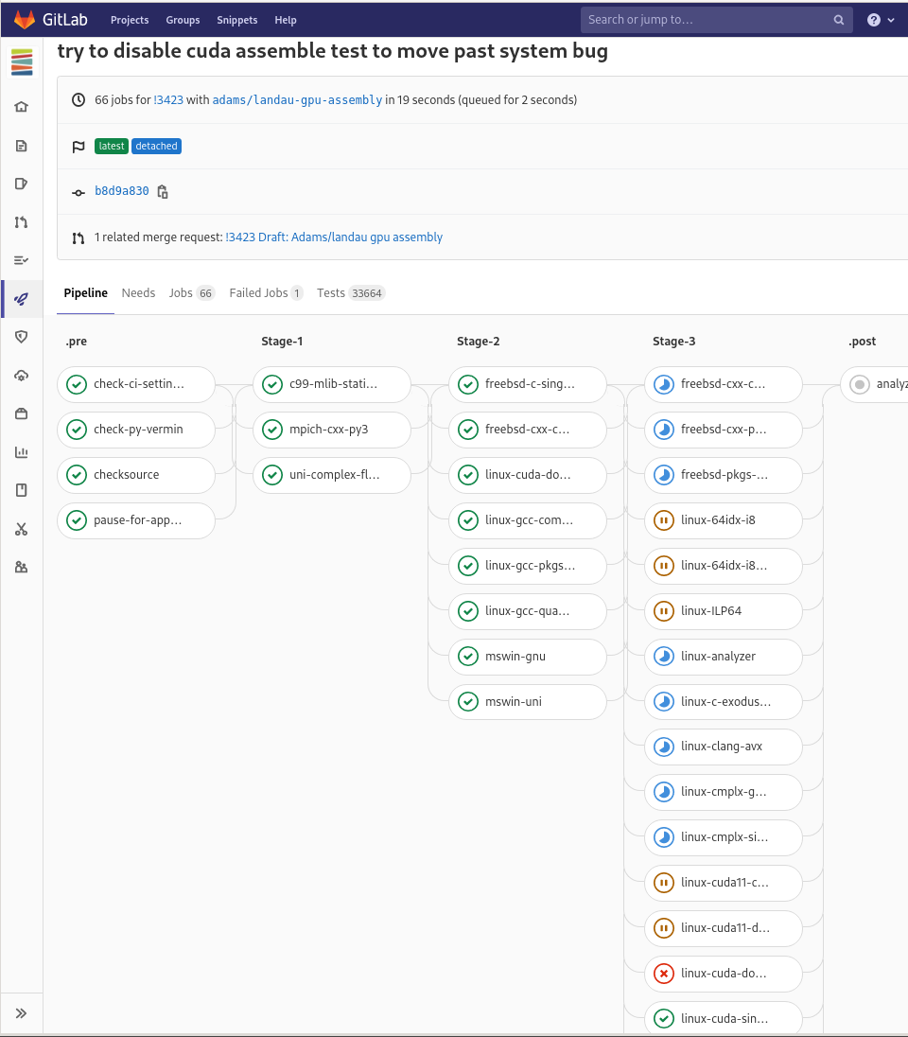
Building and testing
Bare metal builds and smoke tests on AMD, Intel,
and NVIDIA hardware
Managing complexity of architectures and
dependencies is challenging
  Have architecture-specific Spack recipes
Testing all possible configurations is impossible
  Provide examples of application and back end configurations
  Select common configurations for applications and back ends
  Utilize hardware farm for testing on many architectures
Notes:
The complexity needs to be managed in the build system to allow application users to test different options. This is challenging.
Some backends currently have workarounds in order to get the bare metal builds to compile and run. We are working on updating the configuration and build system to cleanly support these builds.
At the same time, we are working on architecture-specific spack and spack test recipes to be used with the ECP testing effort.
Testing all possible configuration is impossible, but we test quite a bit using our hardware farm
Image shows (partially) an active test pipeline on the hardware farm - consisting of 66 jobs [some success, some in progress, some fail]
Every (code) change to gets tested this way via the merge request process.
Most jobs
configure and build petsc [and dependent packages - as needed for that job]
run the full test suite
These tests across all the jobs add up to 33k count - as per the screenshot
Examples of GPU jobs in the screenshot: linux-cuda****
[not visible in this screenshot are: linux-hip****, linux-sycl*** (no syscl code to test yet - so the job tests sycl checks in configure..)]

Slide 22
Keys to software success
High-quality software
Documentation, examples, and tutorials
Vibrant user and developer communities
Users that become developers
Flexibility to meet user needs
Trusted, tested, and performant on multiple platforms
Long-term funding and support

Slide 23
Some Barriers to software success
Sociological
  Not invented here syndrome
Lack of standards
  Many implementations with different APIs
  Beneficial for resilience / redundancy
Funding mechanisms
  Focus on new research and development
  Encourage competition and not cooperation
Rewards for papers not reusable software

Slide 24
Open discussion

