Slide 1




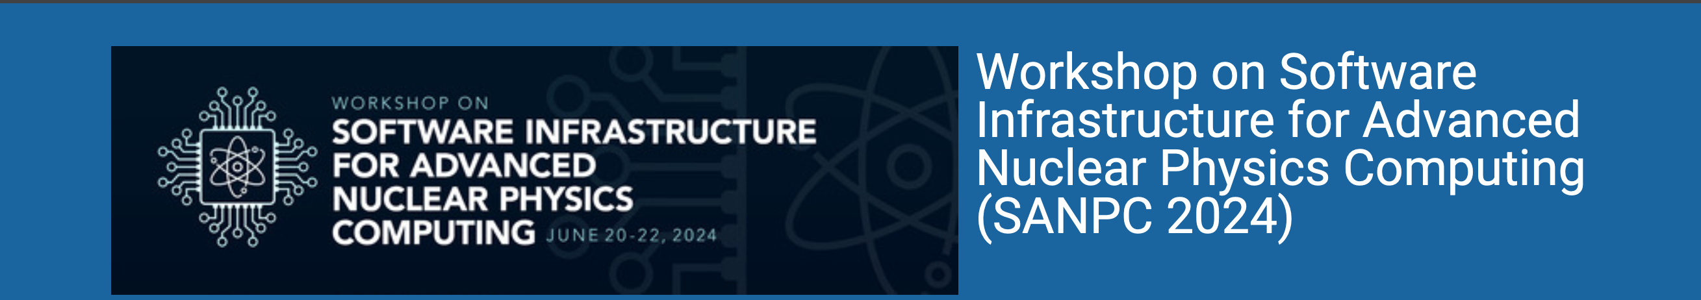
JETSCAPE
Majumder
Wayne State University

Slide 2
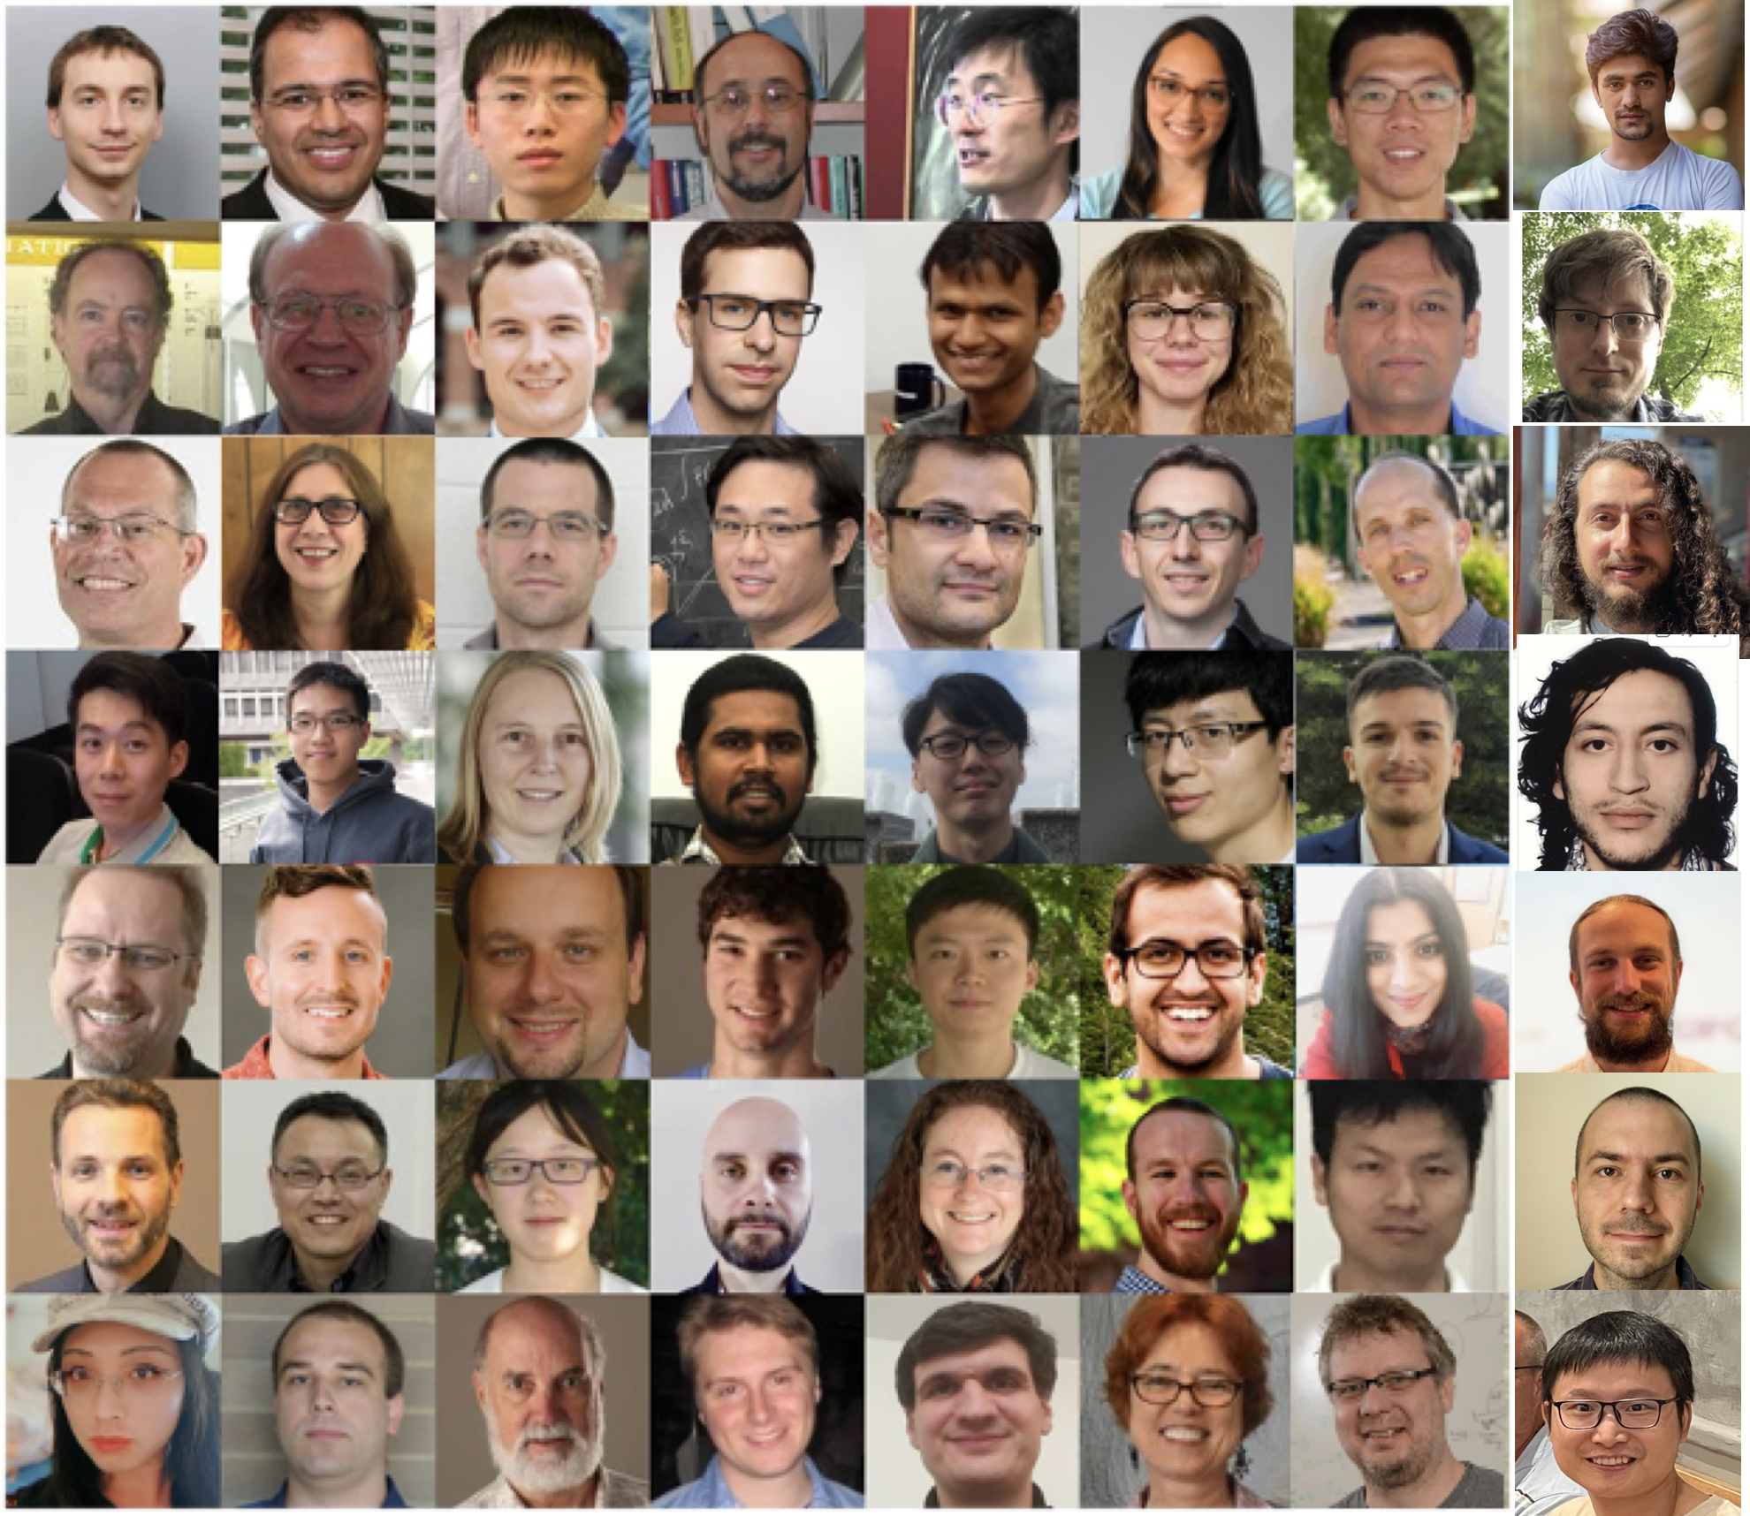
What is JETSCAPE?
Jet-Energy-loss-Tomography-with-a-Statistically-and-Computationally-Advanced-Program-Envelope
A collaboration of Nuclear (domain) scientists (Theory+Experiment), computer scientists and data/statistical scientists
About 50-60 people: faculty, postdocs, students, research staff.
Funded by NSF and DOE grants.
Base grants mostly DOE
Collaborative grant by NSF ($8M over 8 years) [SSI-CSSI]
No PI salary on Collaborative grant
Most students + postdocs on 50-50 arrangement

Slide 3
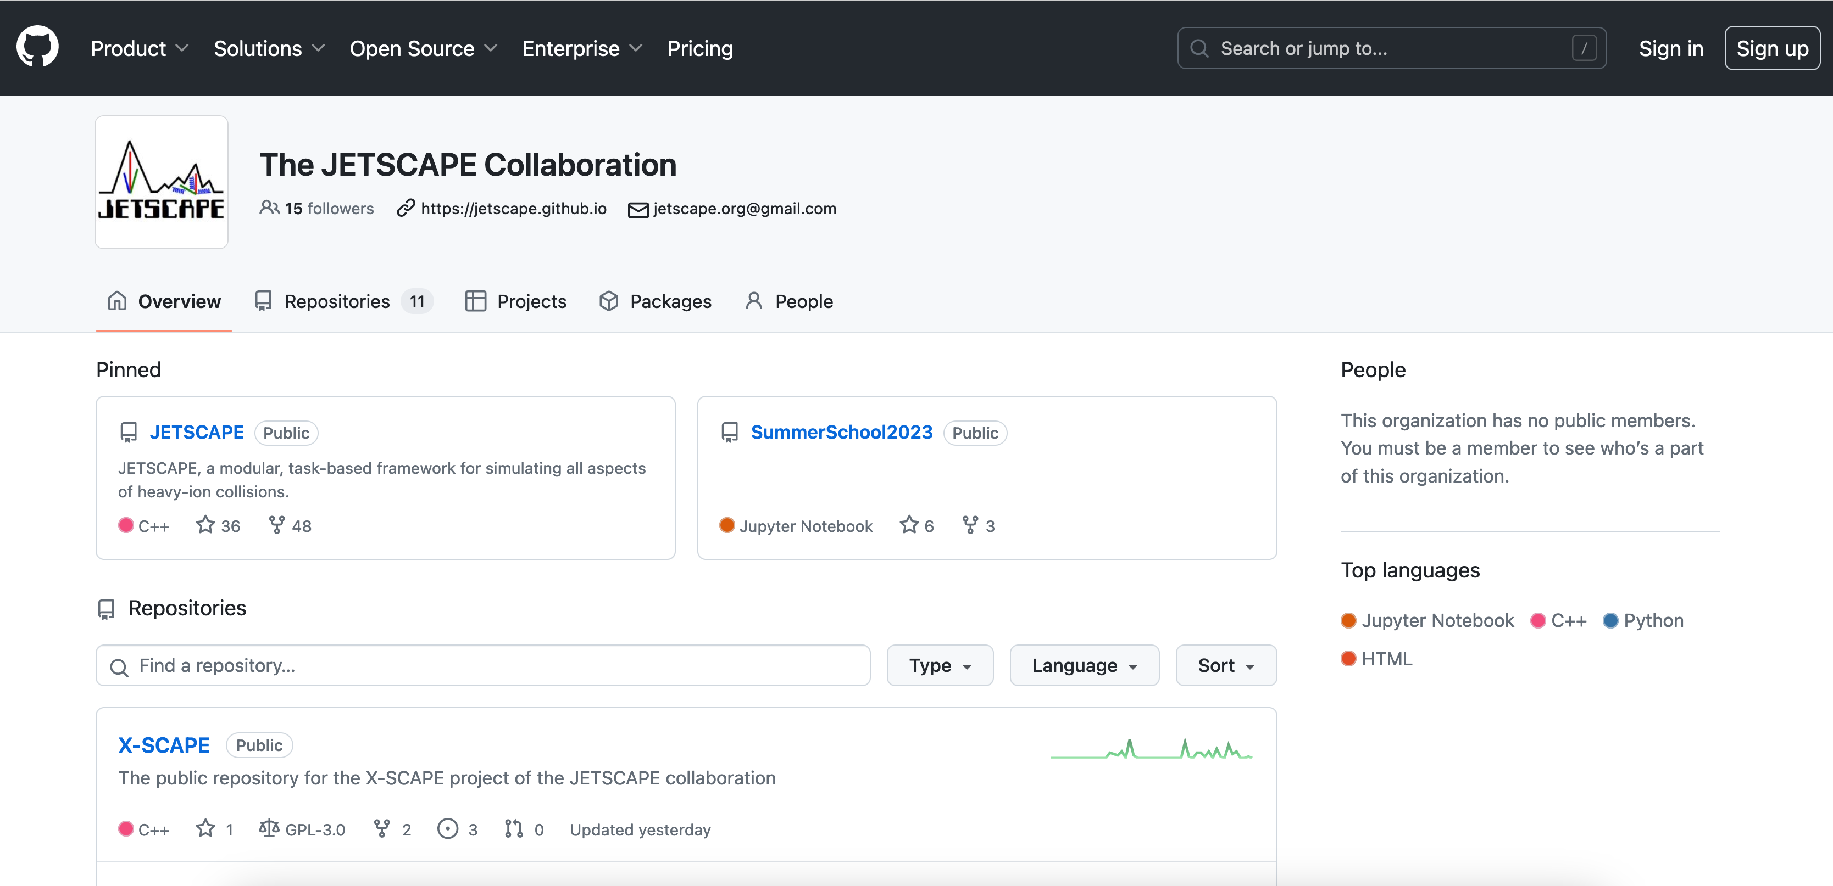
All code in C++ on Github
https://github.com/JETSCAPE https://hub.docker.com/u/jetscape

Slide 4
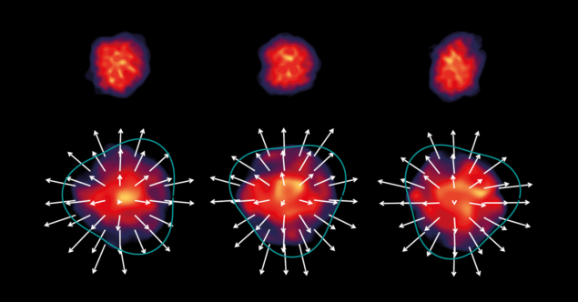
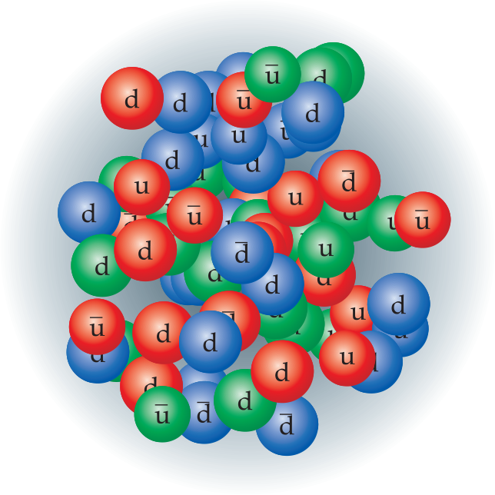
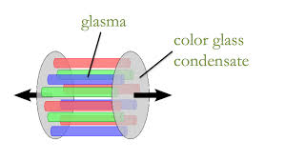
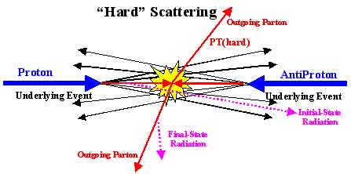
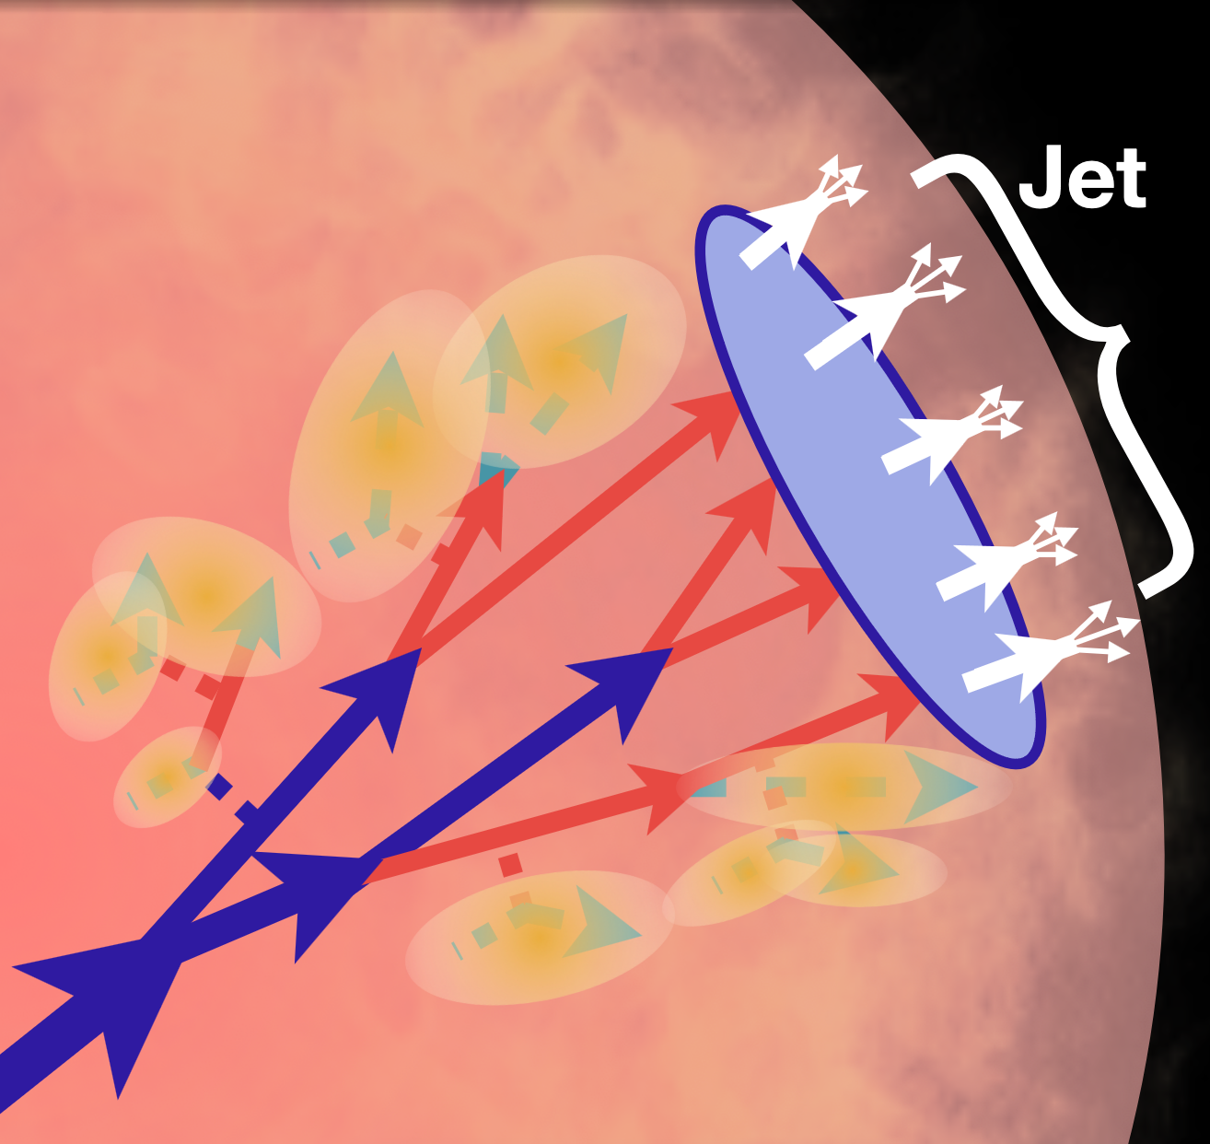
Nuclear collisions: a multi-scale approach
parameters
parameters
parameters
parameters
parameters
parameters
parameters
parameters
parameters
parameters

Slide 5
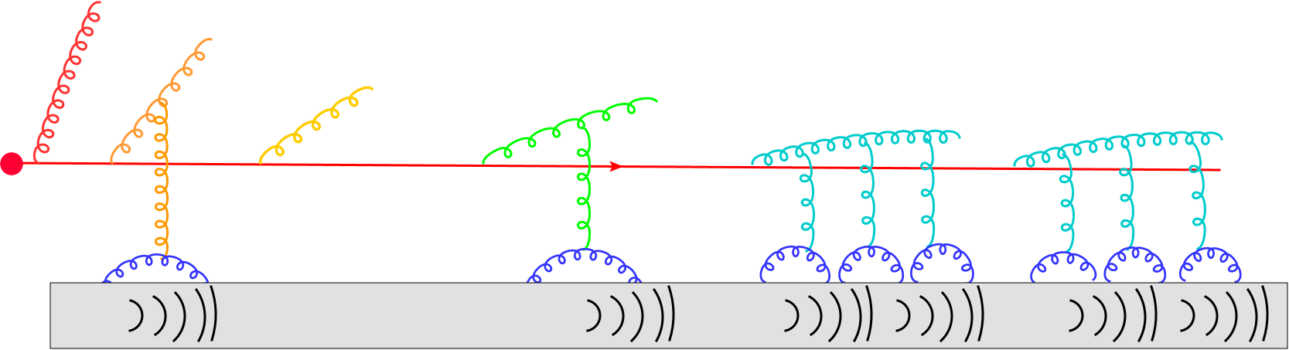
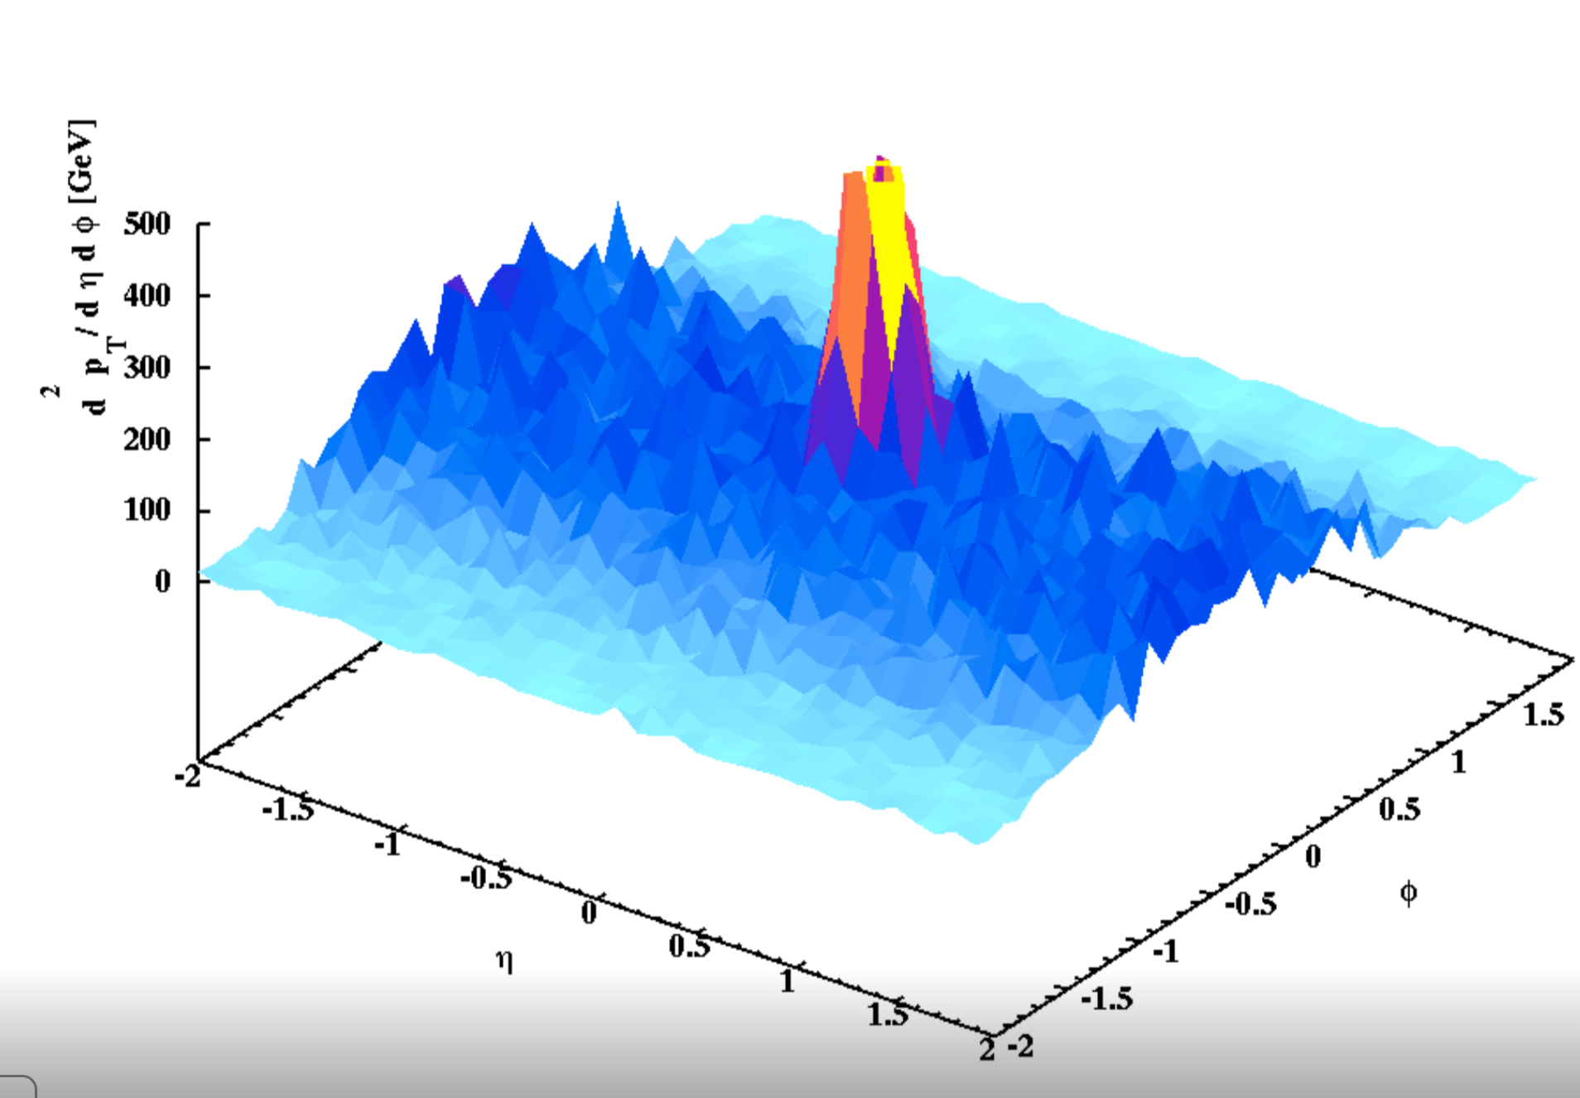
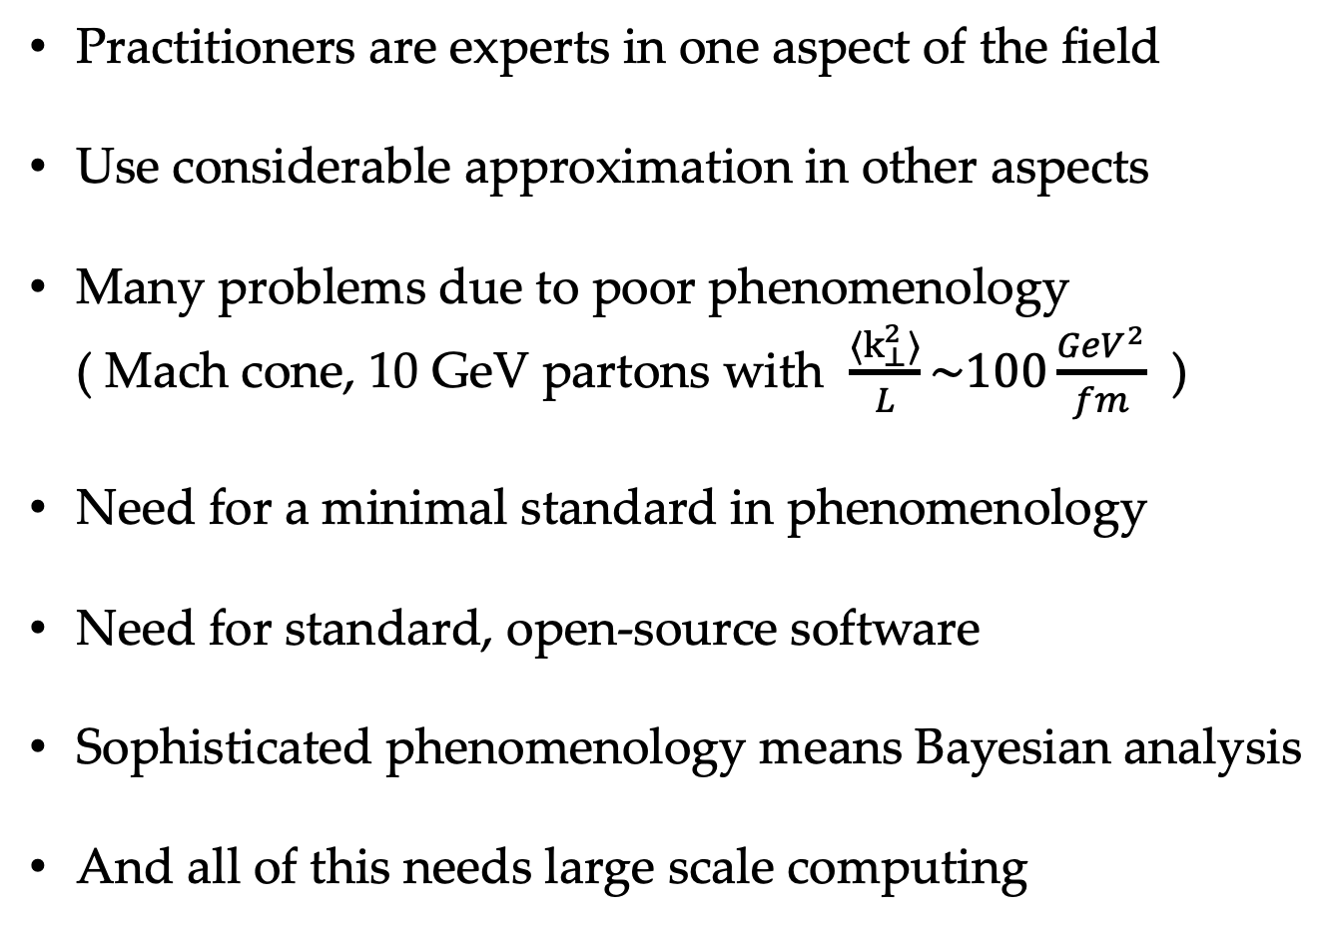
The need for extensive simulation framework with a Bayesian driver
Practitioners are experts in one aspect of the field
Use considerable approximation in other aspects
Many problems due to poor phenomenology
( Mach cone, 10 GeV partons with $\frac{{⟨k}_{⊥}^{2}⟩}{L}\sim 100\frac{GeV^{2}}{fm}$ )
Need for a minimal standard in phenomenology
Need for standard, open-source software
Sophisticated phenomenology means Bayesian analysis
And all of this needs large scale computing
Phys.Rev.C 96 (2017) 2, 024909

Slide 6
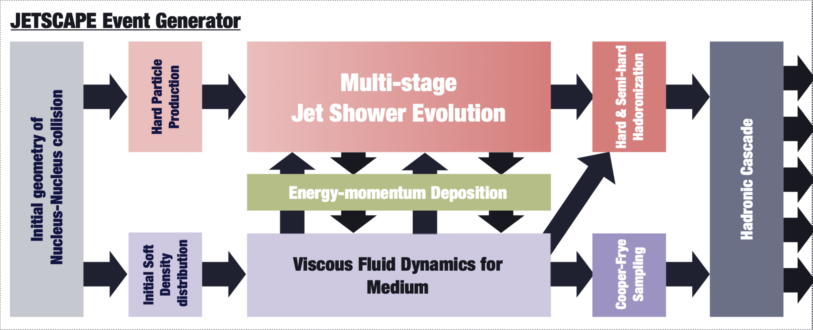
JETSCAPE: a p-p and A-A generator
Framework controls order of modules and information flow
Modules are user defined, replaceable, divisible
Can be run in pure bulk, pure hard, or interactive modes
Bayesian Analysis
Bayesian Analysis
Artwork by Y. Tachibana
e-Print: 1903.07706 [nucl-th]

Slide 7

The JETSCAPE event generator in soft mode:
One can simply turn off the hard sector if one chooses, from the top level.
Focusing only on the bulk portion of the event generator
Diagram by Y. Tachibana

Slide 8
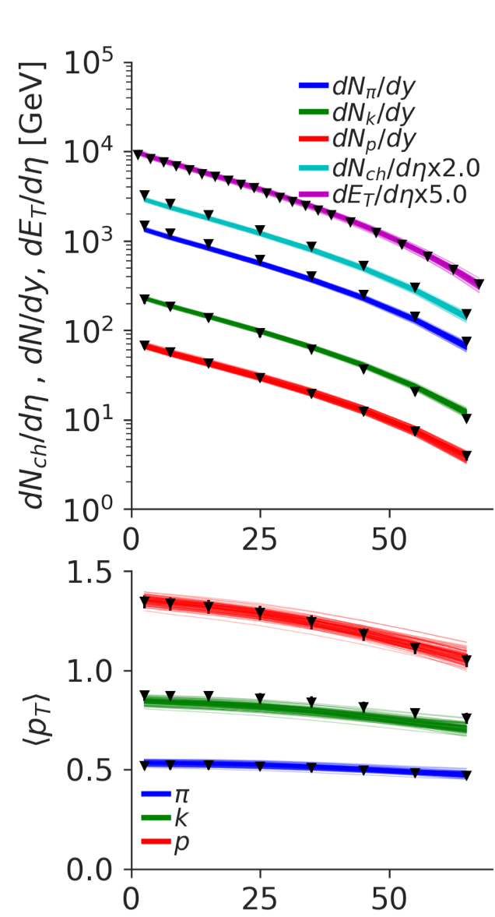
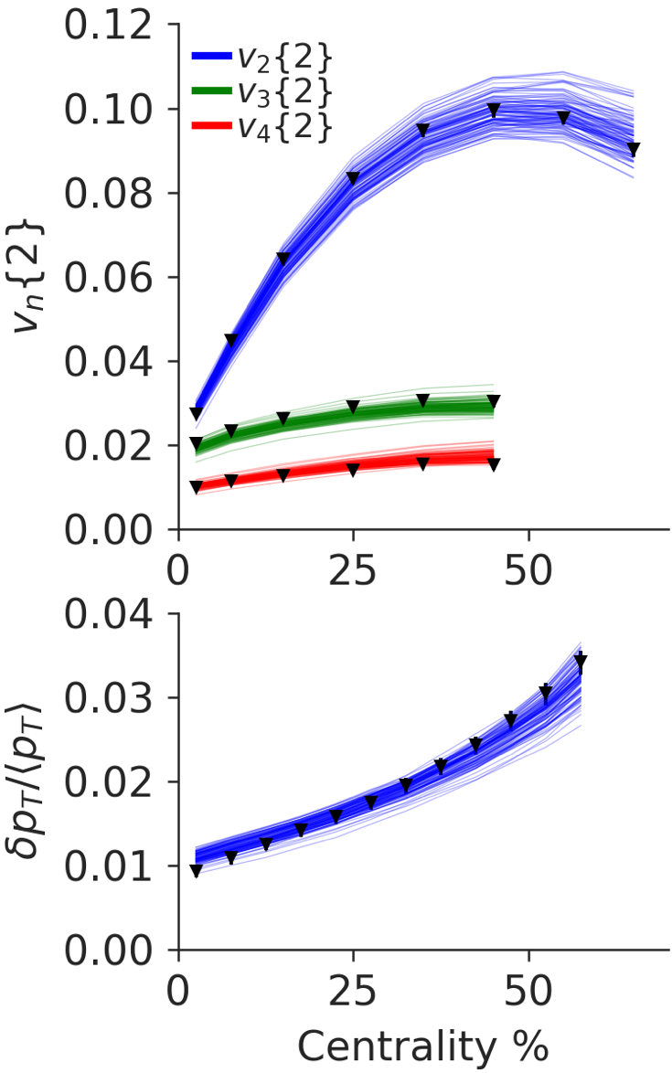
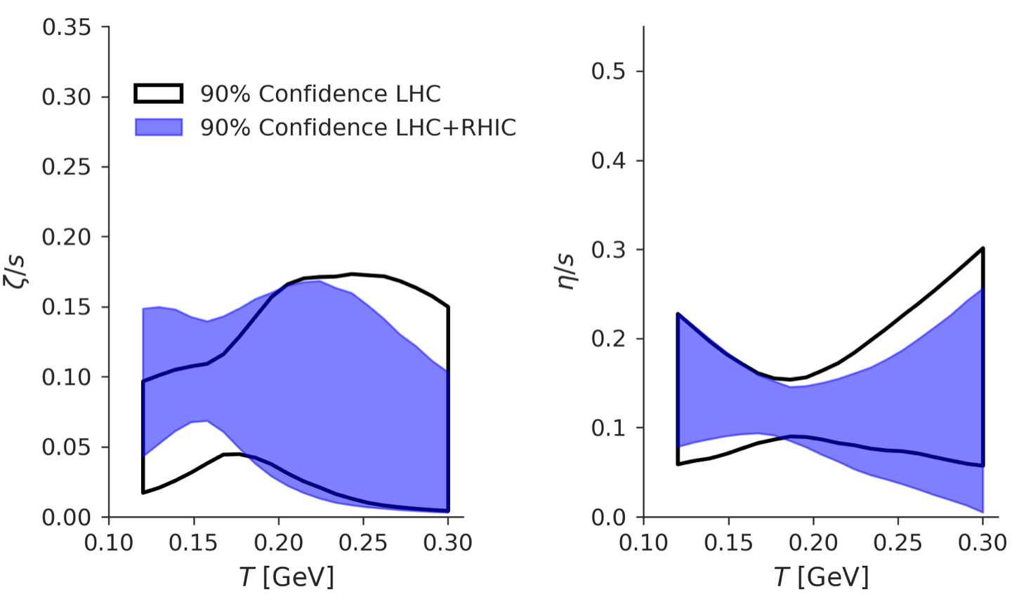

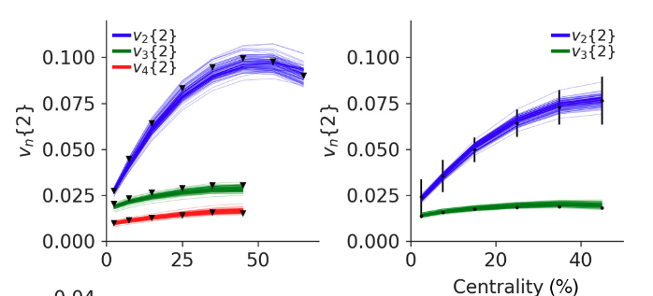


Low viscosity matter produced at RHIC & LHC
$$η∝\frac{1}{σ}$$
D. Everett et al., Phys. Rev. C 103 (2021) 5, 054904,
Phys.Rev.Lett. 126 (2021) 24, 242301
30+ Million Core hours
Generates 20TB of data (2+1D hydro)
Hosted on OSIRIS, access via Globus.
$$\frac{dN}{dp_{T}dφ}=\frac{dN}{dp_{T}}\left(1+2v_{2}cos(2φ)+…\right)$$

Slide 9
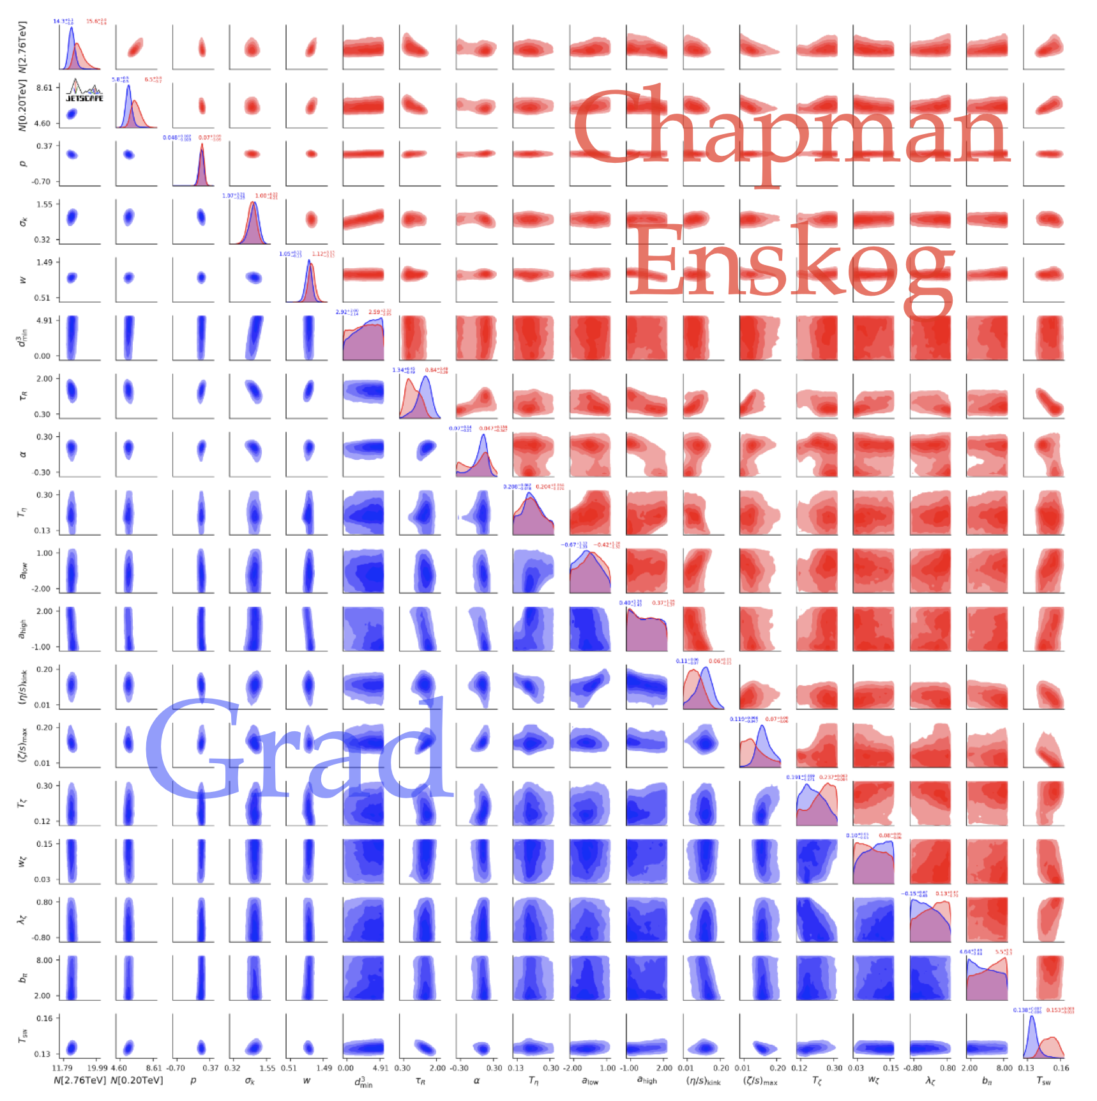
Soft Calibration independent of hard sector
The entire calibration uses 17 parameters,
Jets are ignored and have no influence on hydro.
Assumption is the energy in the hydro far exceeds the jets.
Currently finishing a 3+1D calibration (~100 M core hours)

Slide 10
Hard production and energy loss modules
Adding in the hard sector
Removing the feedback from hard to soft.
Can do hand tune/ or separate Bayesian Calibration of hard sector

Slide 11
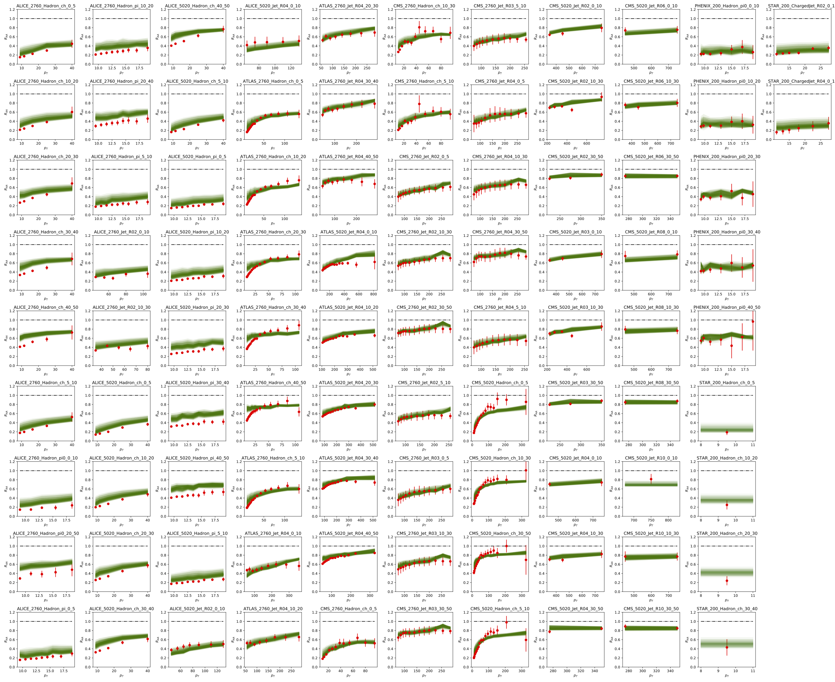
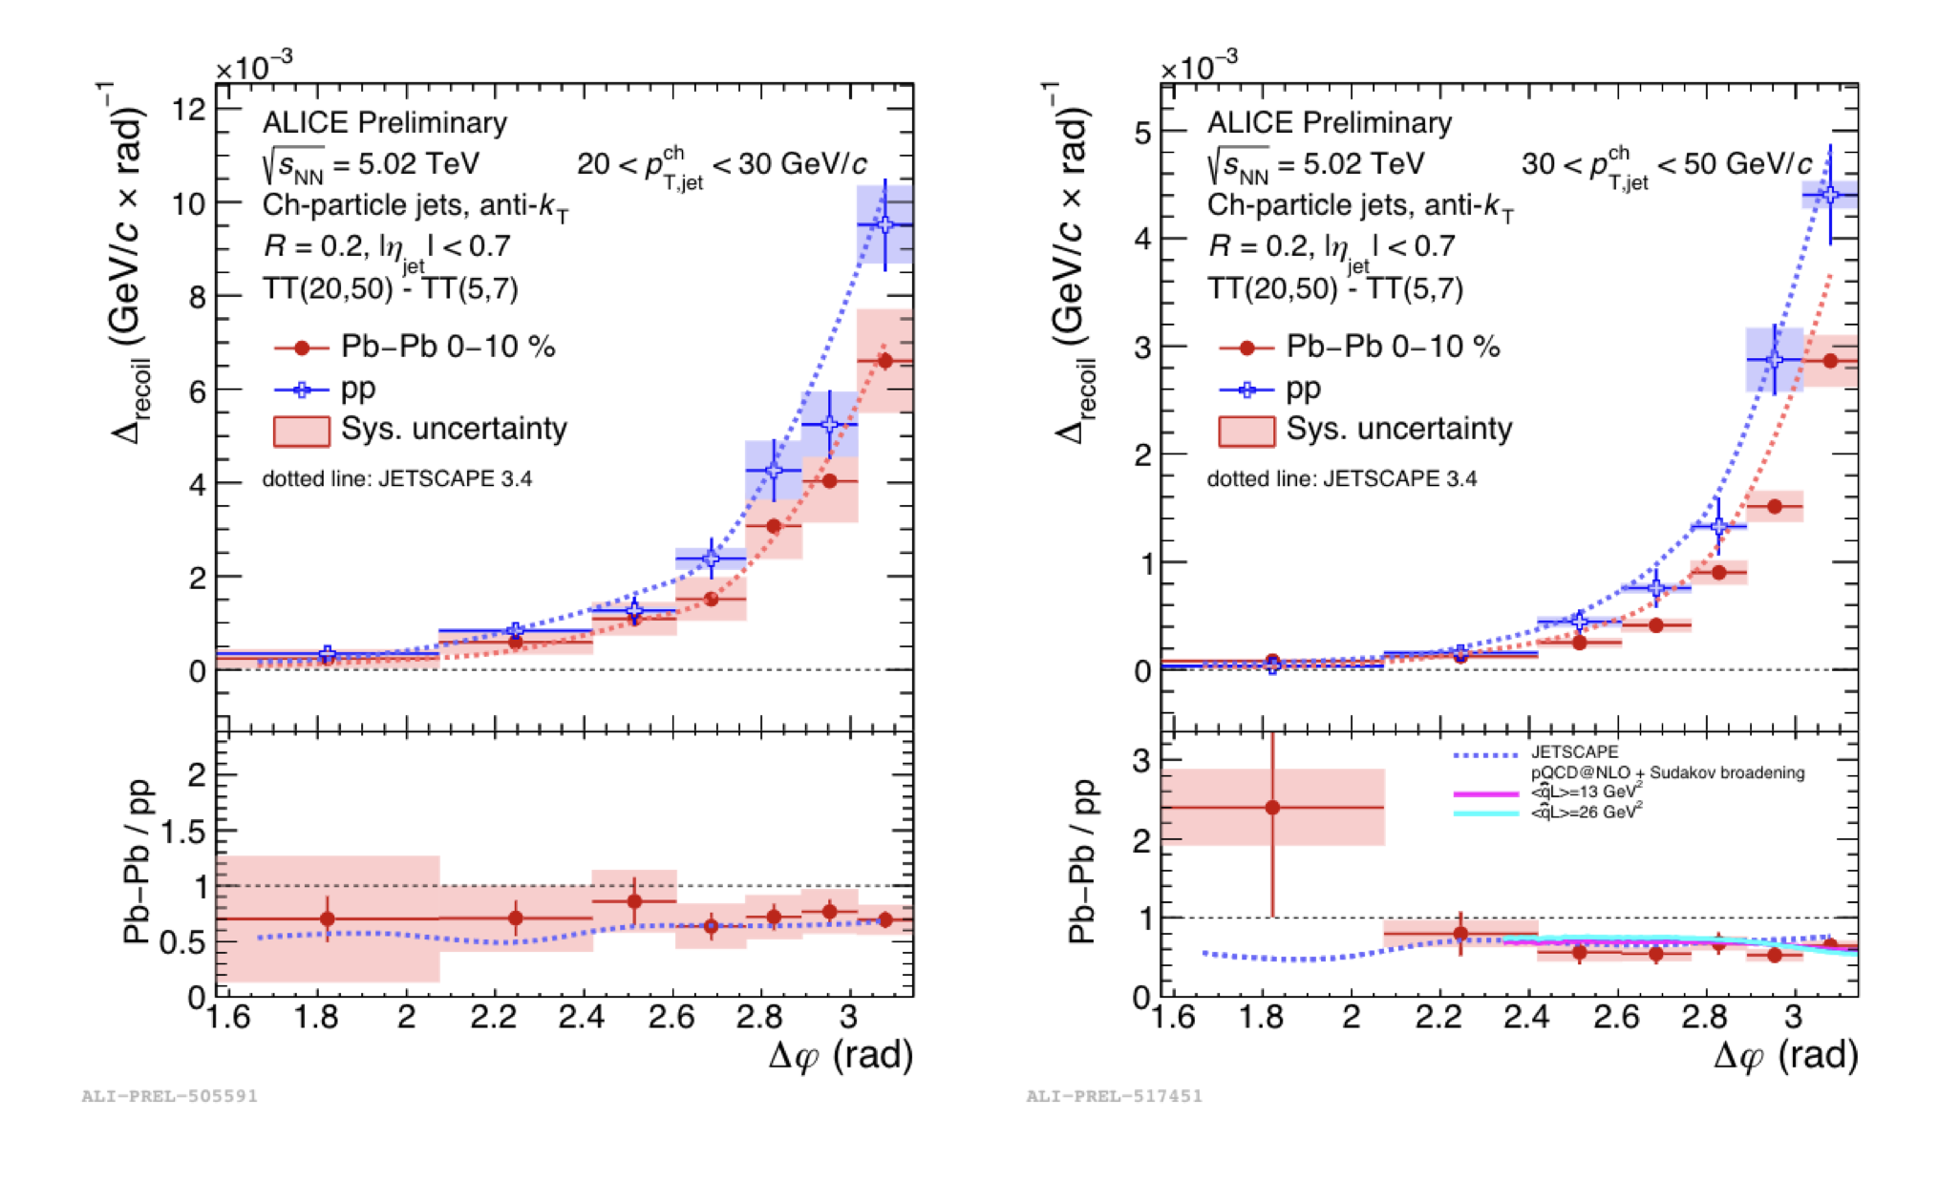
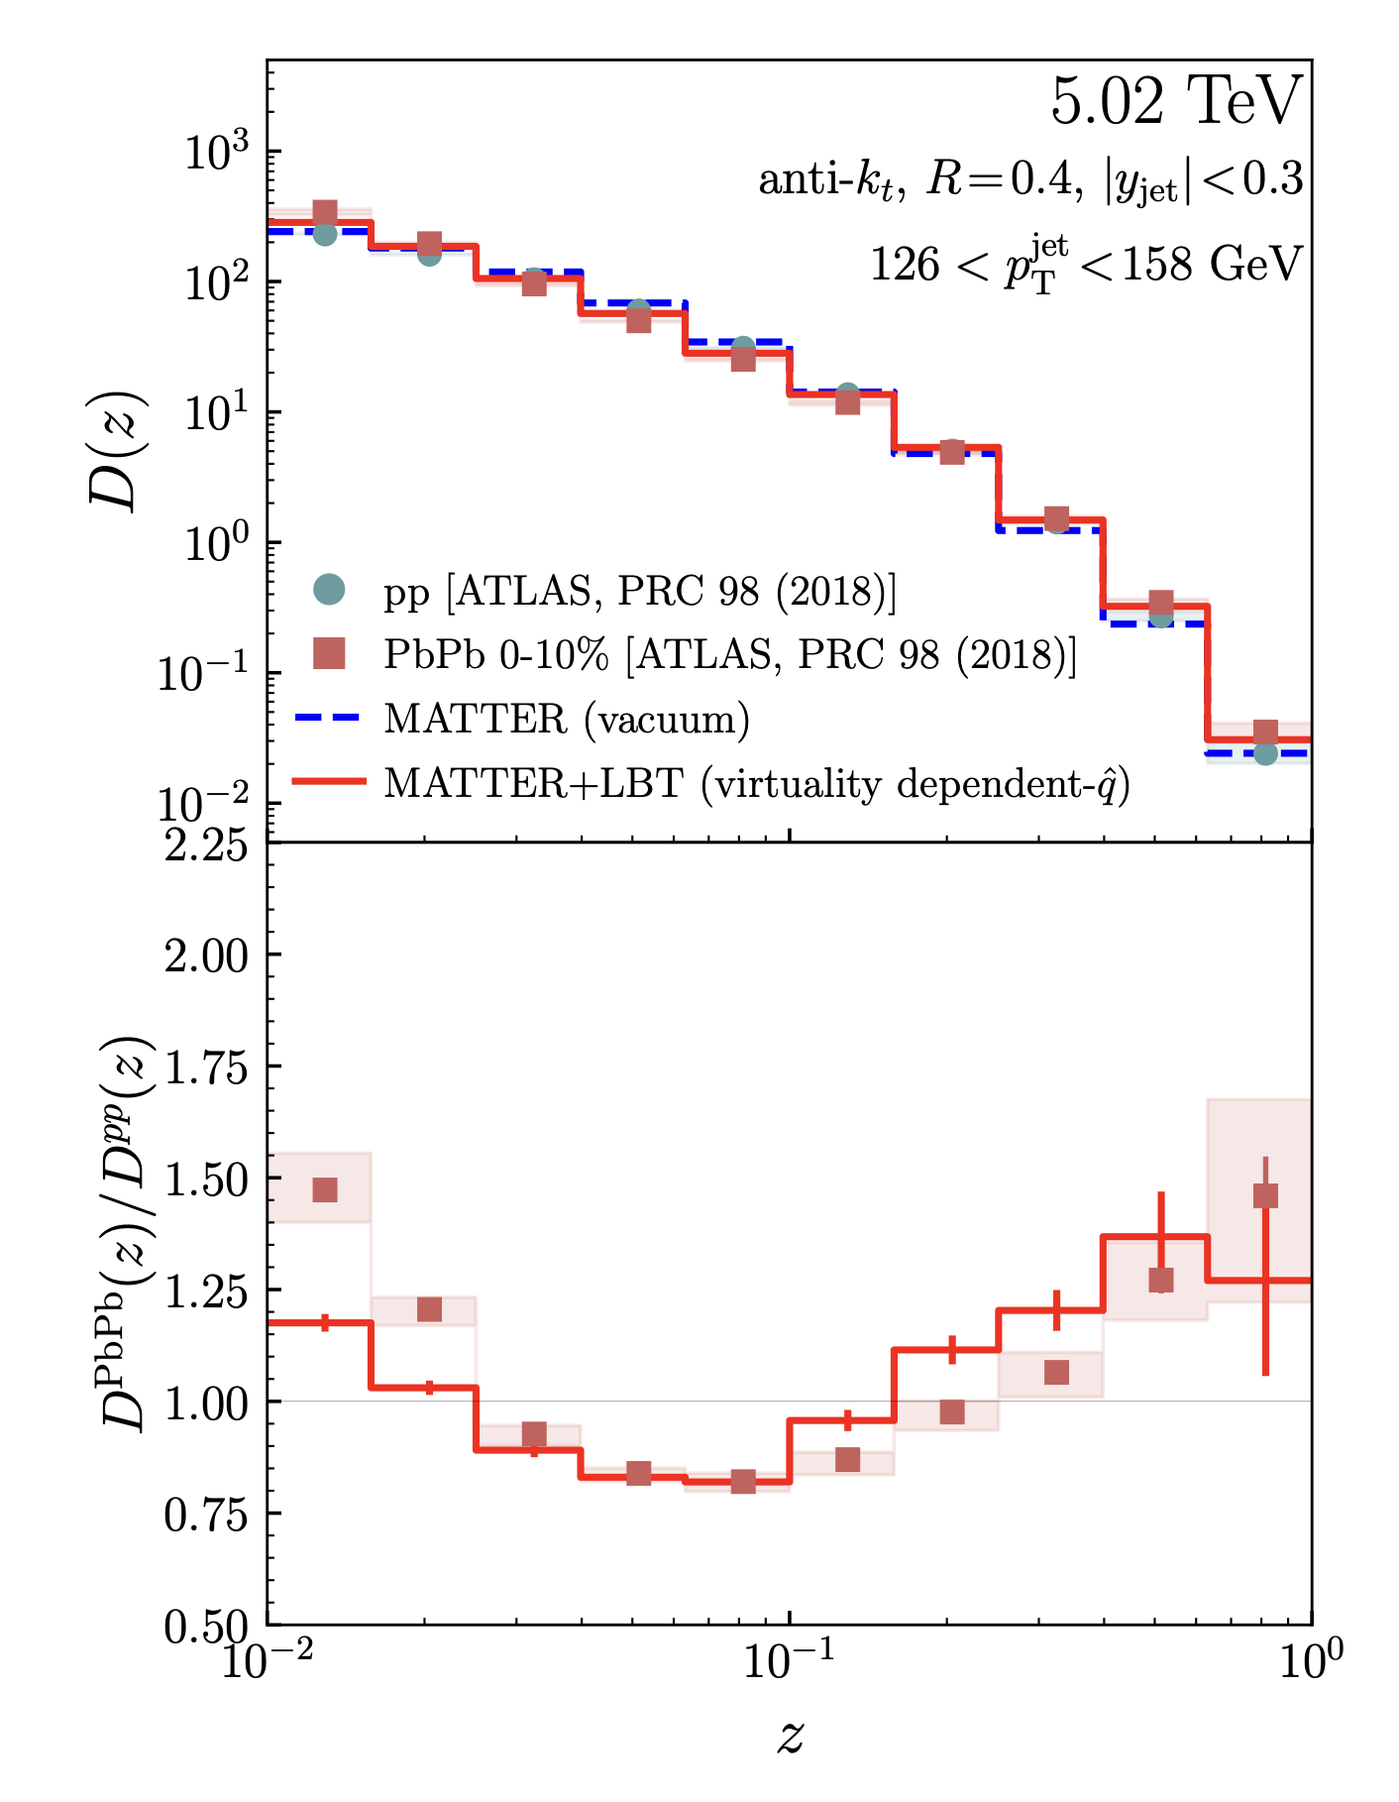
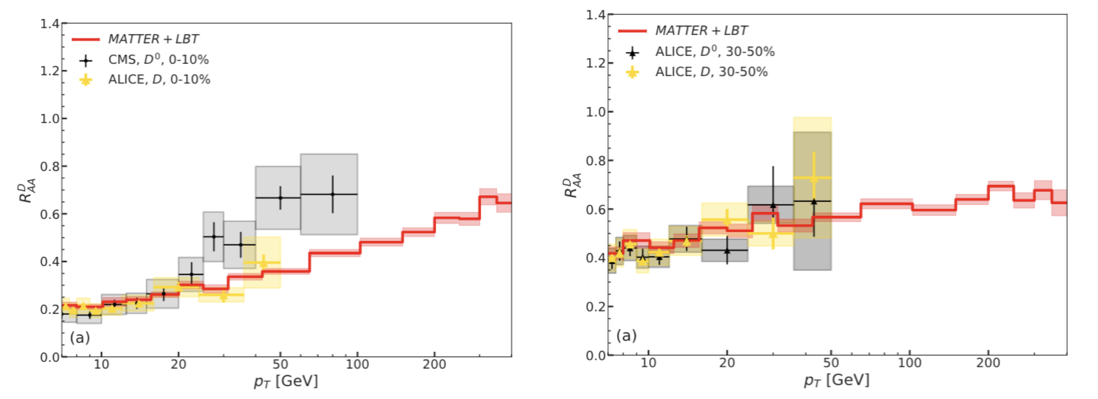
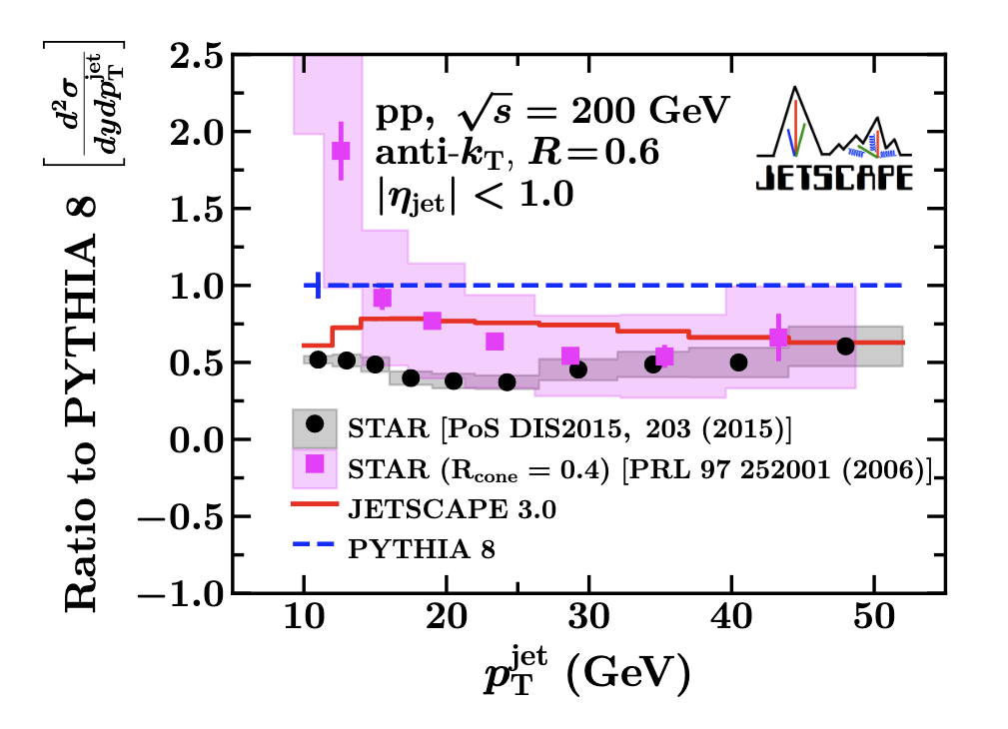
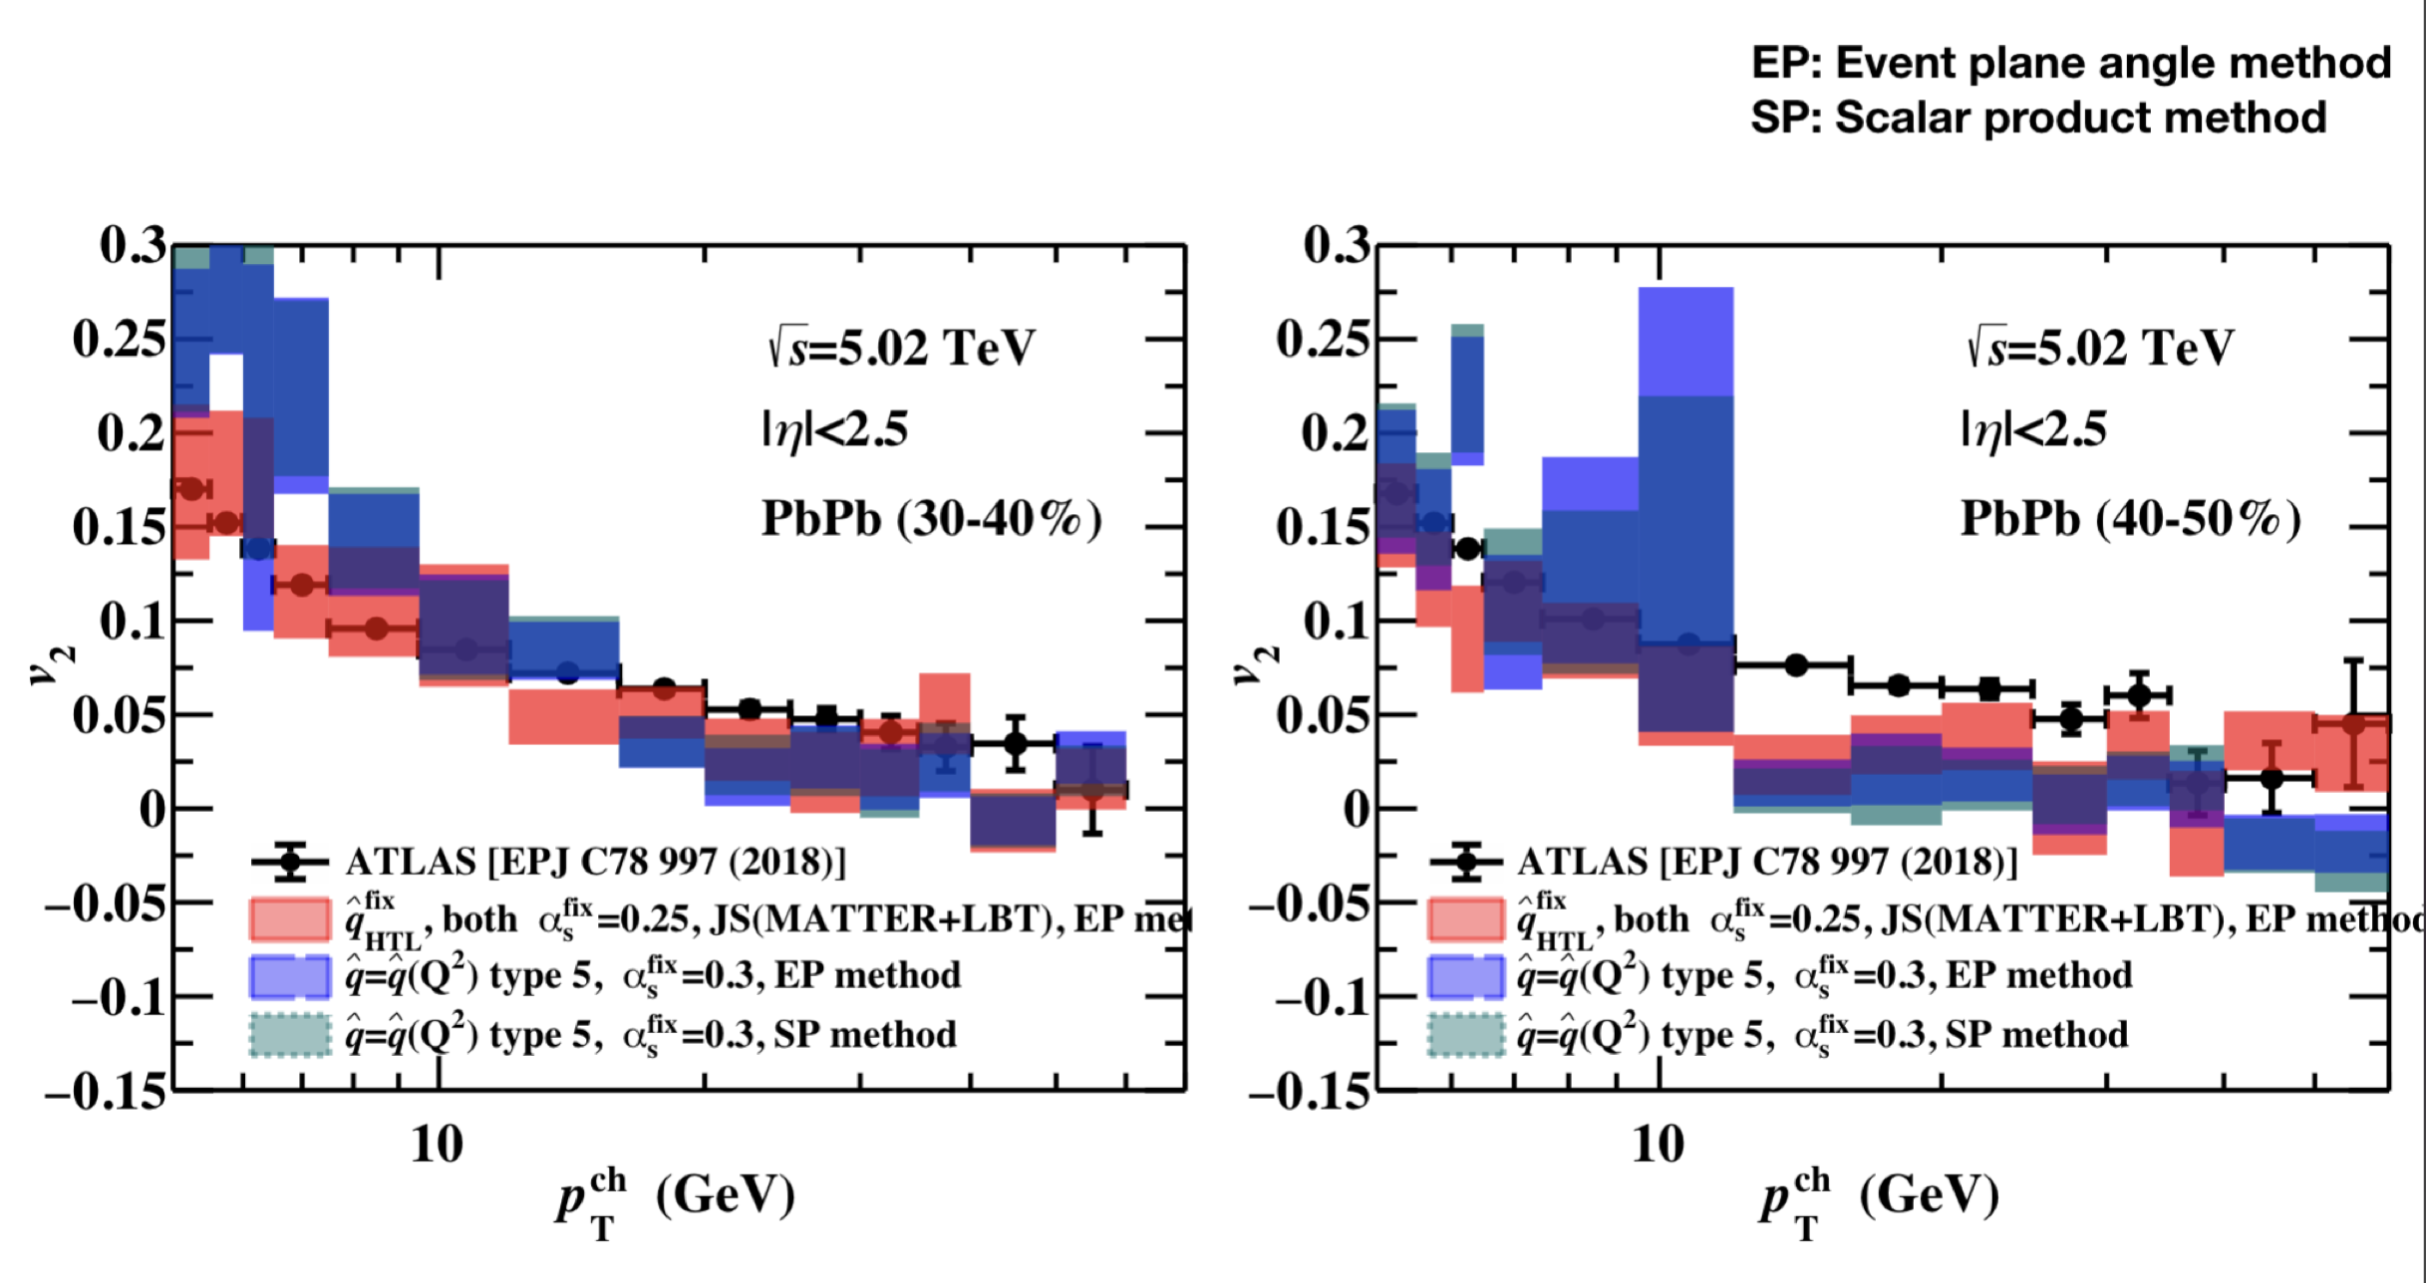
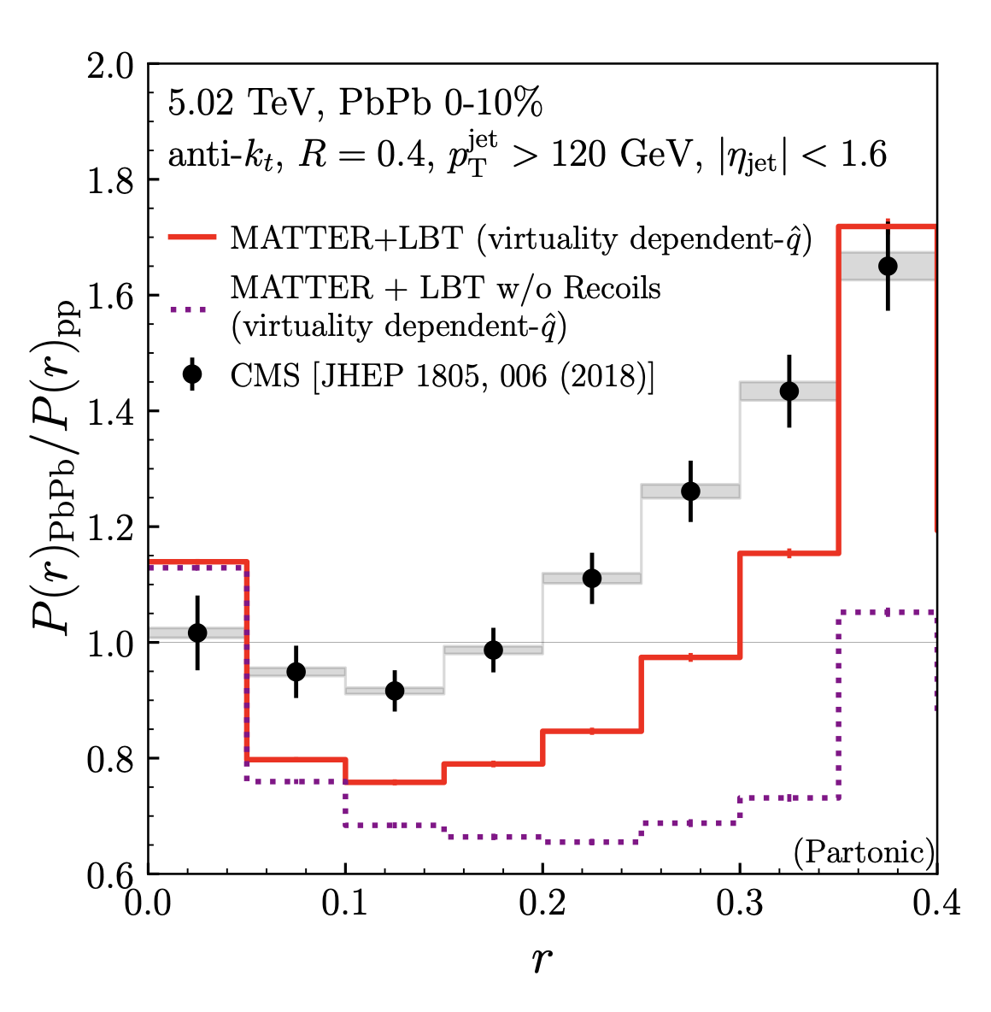
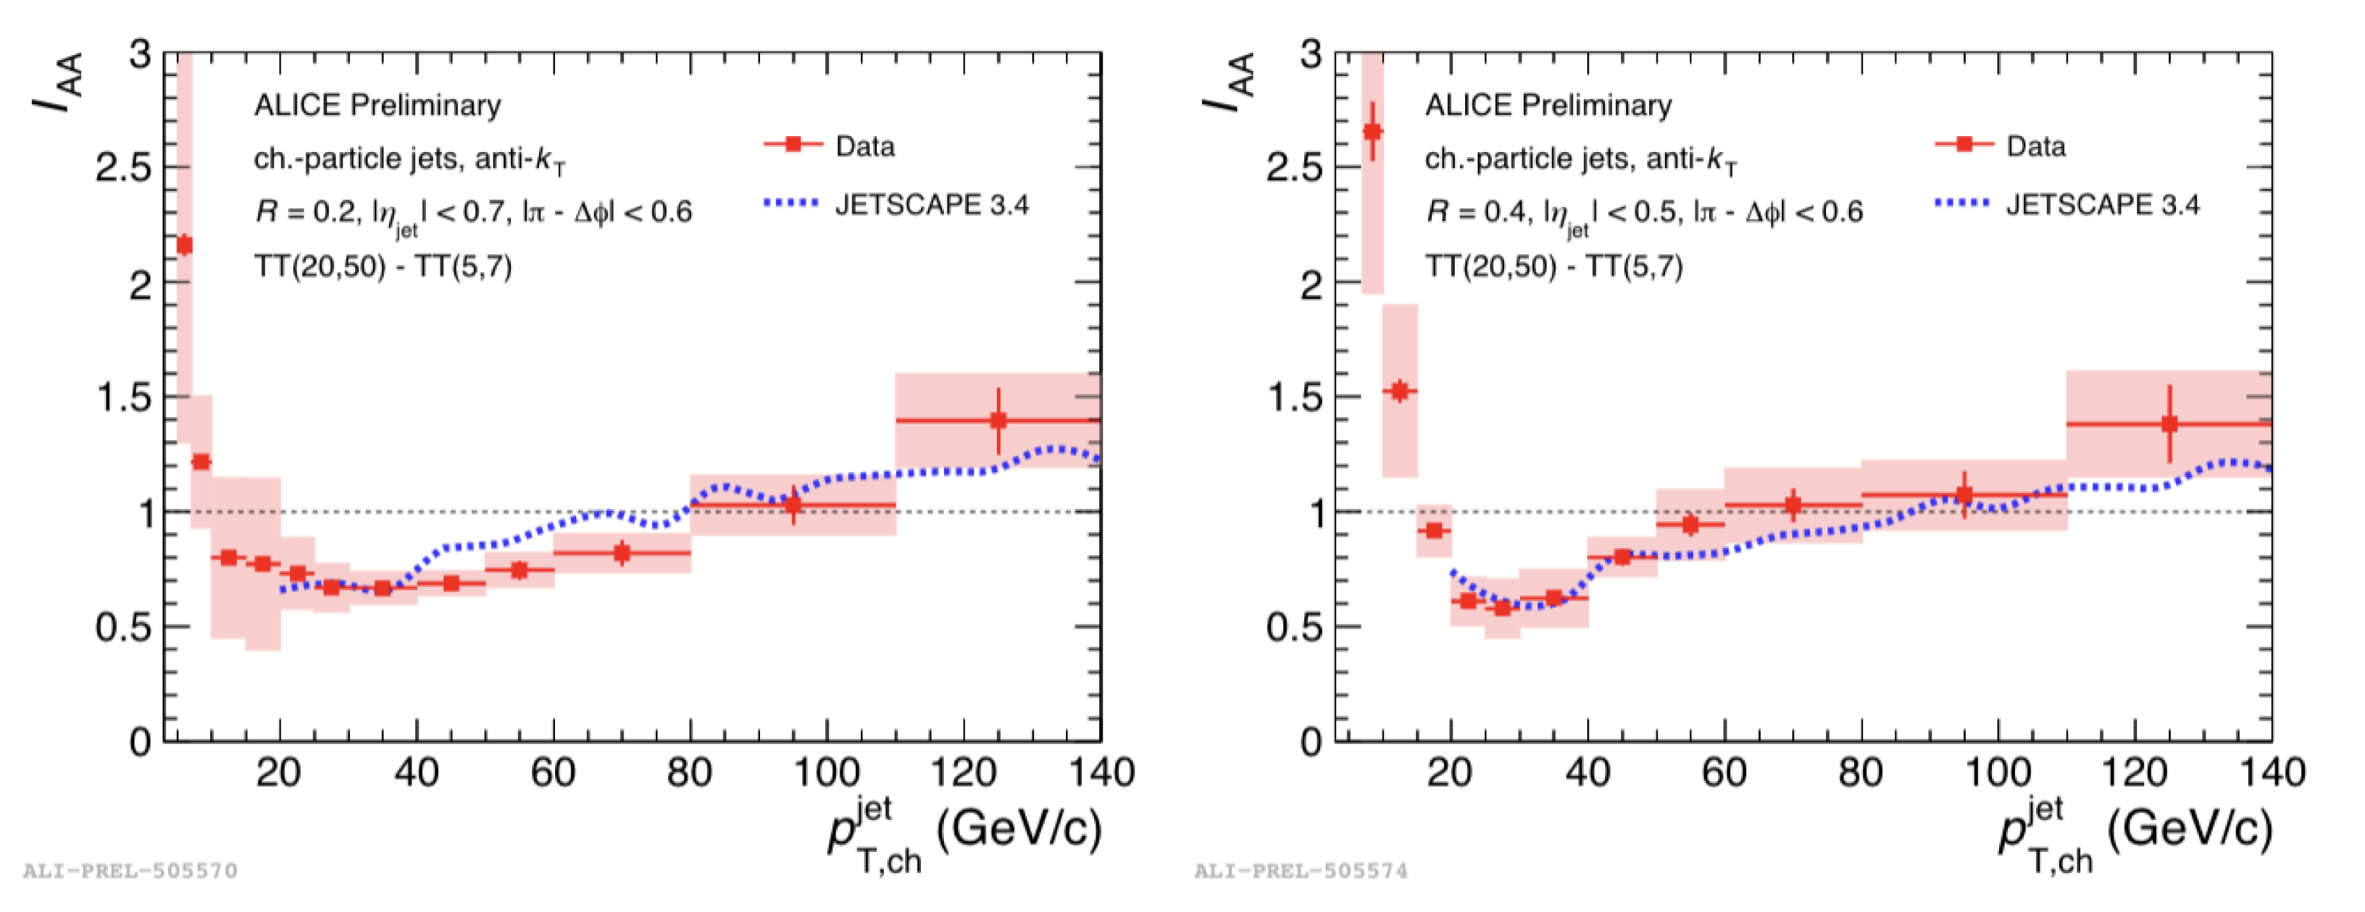
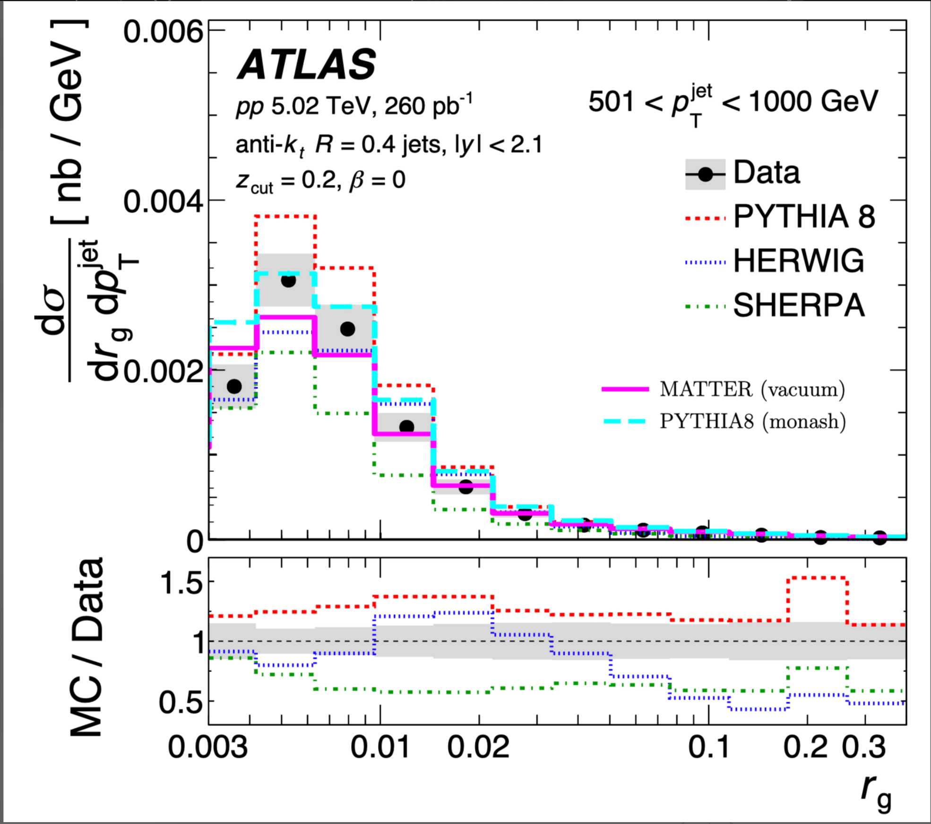
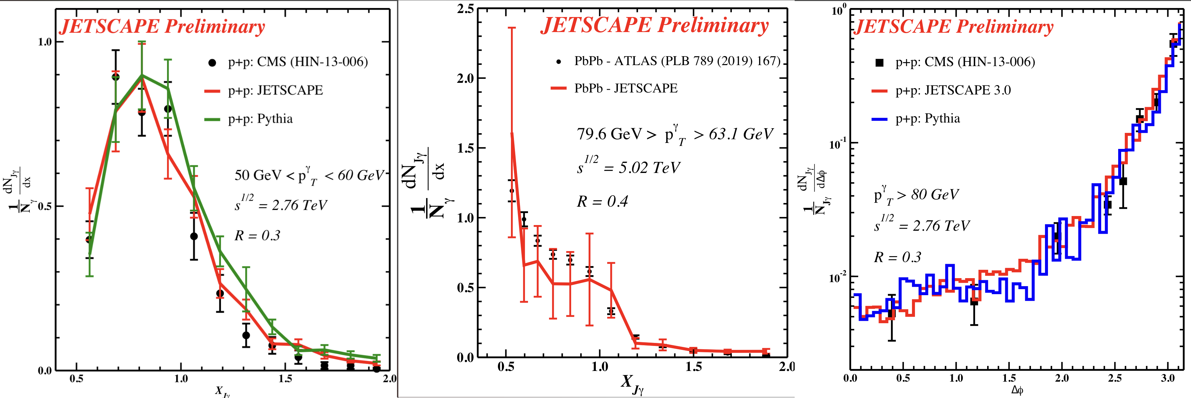
JETSCAPE results (hard sector)
Big picture or base model (141 different data sets) gets within 1-2$σ$ of all data
Bayesian
Posterior
Hand
Tune
Phys.Rev.C 104 (2021) 2, 024905 10 M Core hours
Phys.Rev.C 107 (2023) 3, 034911

Slide 12
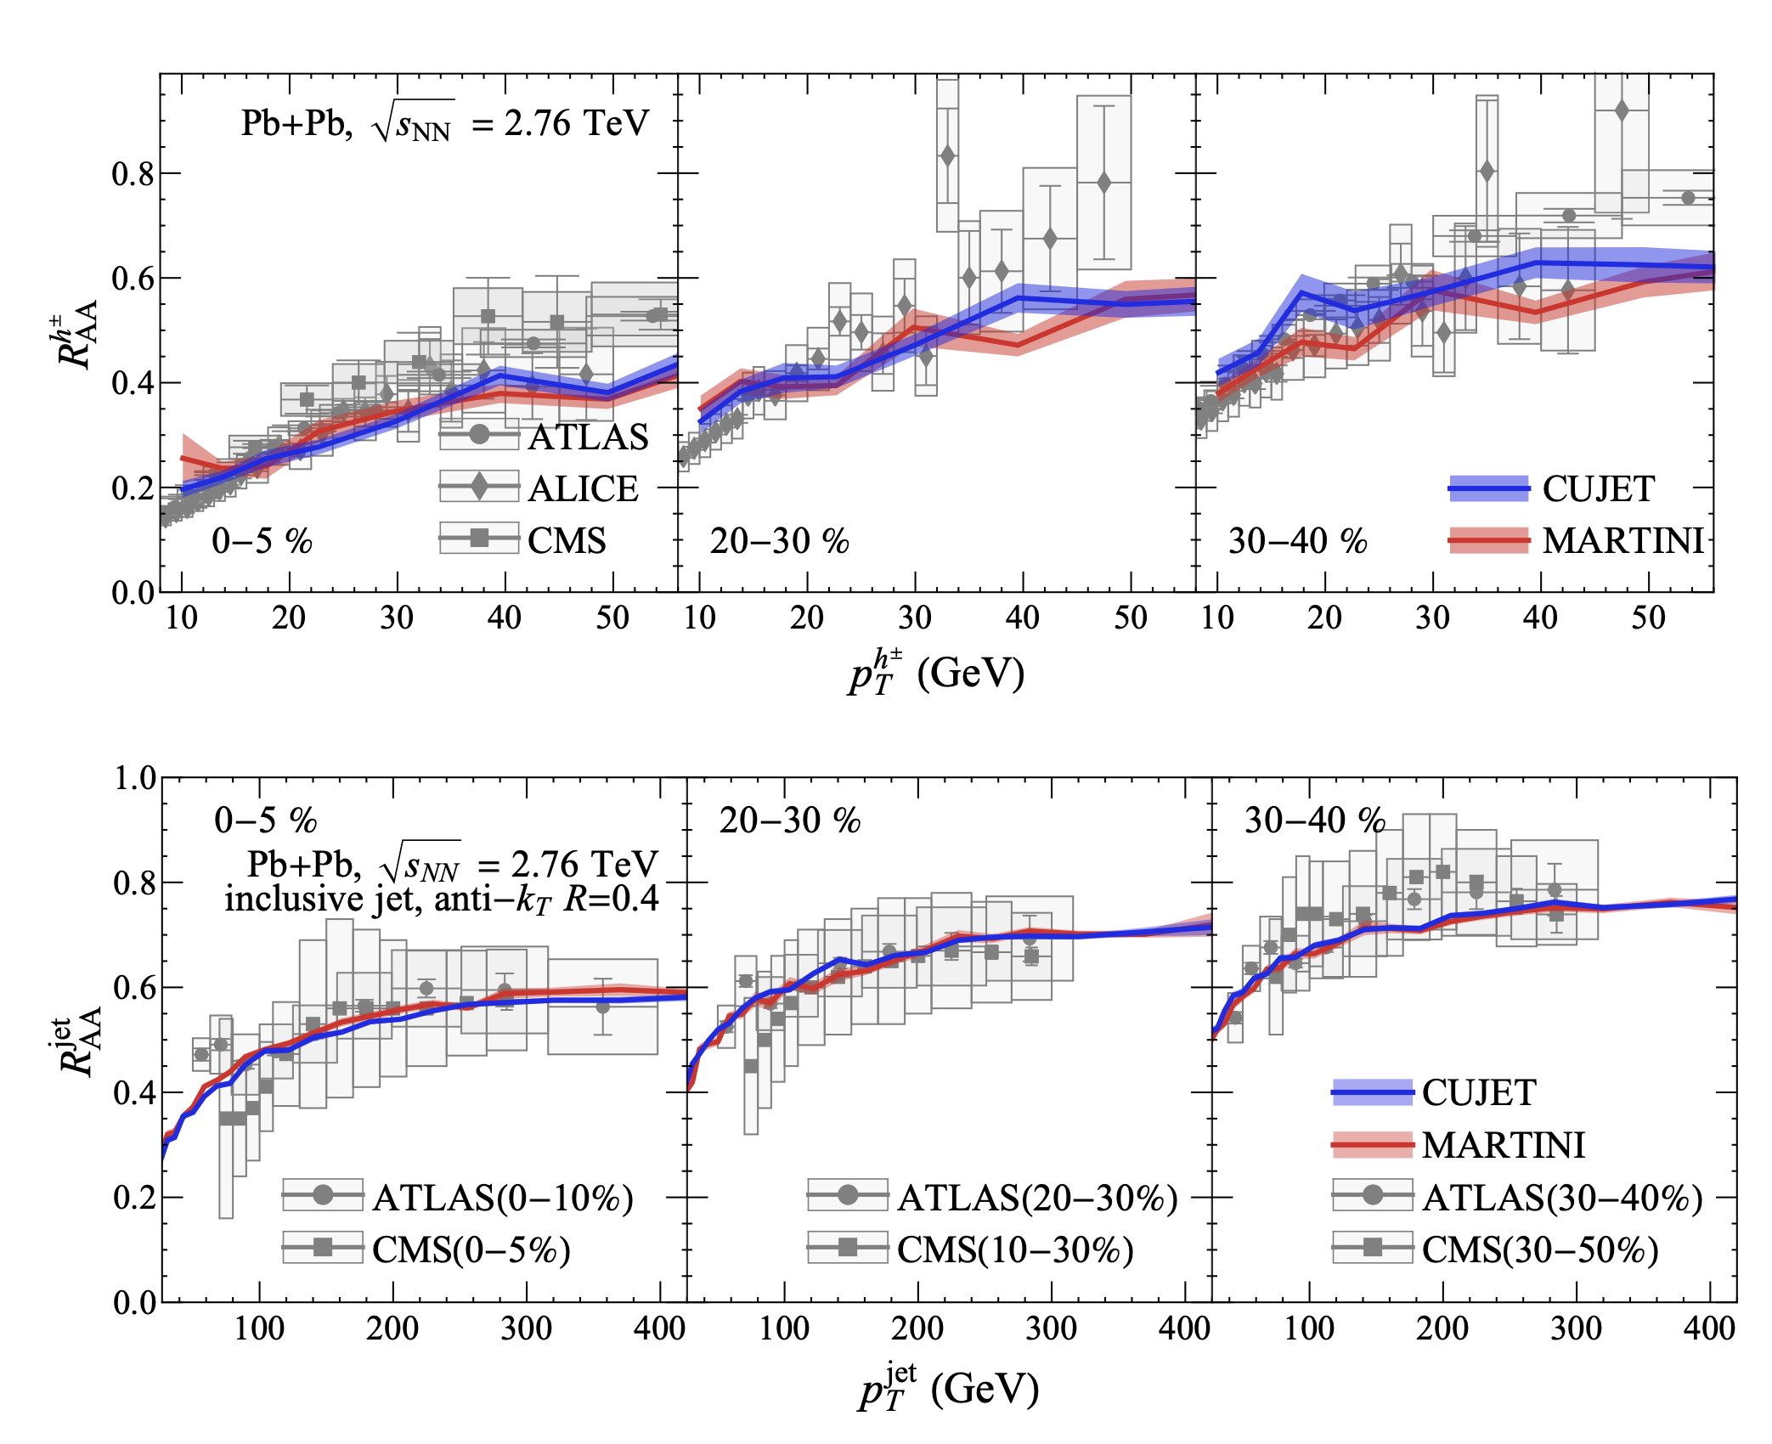
Not all problems are high-end/high-performance
The CUJET and MARTINI model were derived using different approximations
But always used in different environments/media
Using JETSCAPE, evaluated in an identical environment
For RHIC to LHC, not very different (intrinsically)
comparison by R. Modarresi-Yazdi & S. Shi

Slide 13
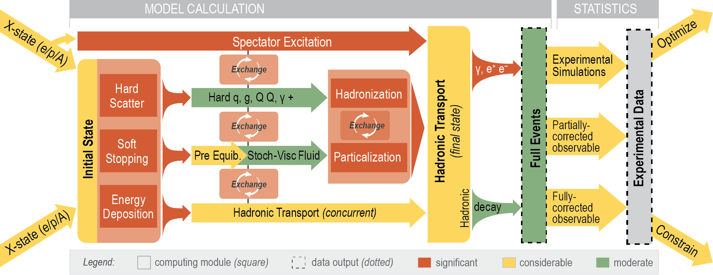
X-SCAPE framework: next generation
A new framework that allows the user to order operations
Can be run with an arbitrary number of modules.
Needed for high mult. p-p, p-A, low Energy A-A, and e-A
Artwork by R. Soltz

Slide 14
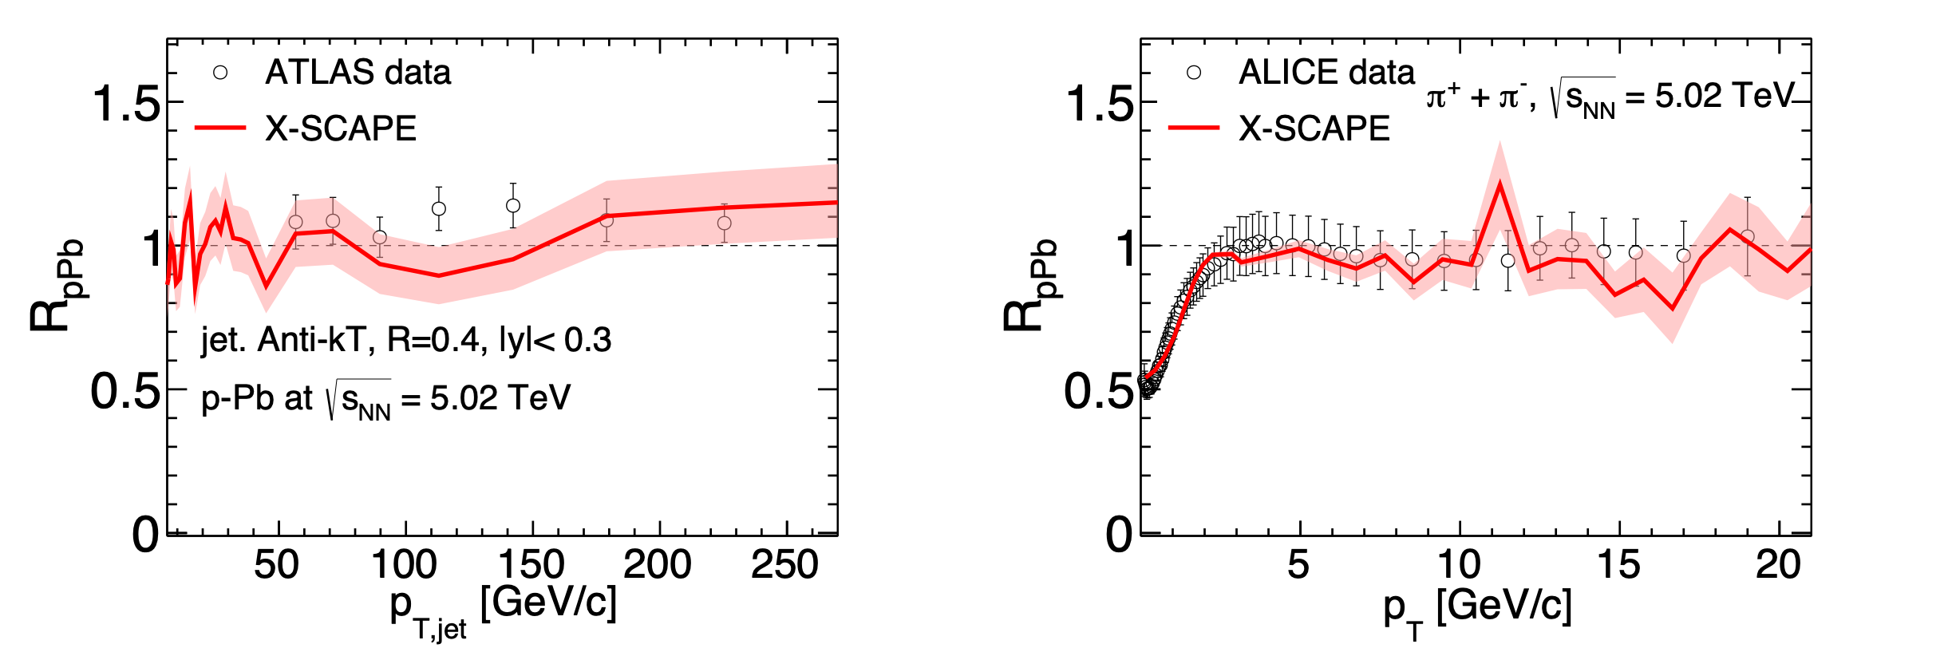
A new p-p and p-A simulator for all multiplicity
A snippet of new results for small systems in p-p and p-A.
Framework being extended to A-A at Lowest RHIC energies
Next, we will move to jets in e-p and e-A collisions (for EIC)

Slide 15
Quo Vadis: Software Infrastructure for
High Energy Nuclear Physics
A single framework for partonic physics based real time simulations
  A-A (low RHIC to top LHC)
  p-p (RHIC to top LHC, low to highest multiplicity)
  p-A (RHIC to top LHC, low to highest multiplicity)
  e-A (jets, TMD, CGC) ... also e-p
A single Bayesian (or ML based) calibration of all systems simultaneously
A uniform standard of writing, sharing, and maintaining a code base.
A bare minimum: does not preclude any fundamental discovery, this will help

Slide 16
How long will it take?
It should run through the combined EIC & LHC era.
To incorporate and test with all available data
Development of other ML/AI approaches
How will it work (and has it worked) ?
The 50-50 model has worked (at least for JETSCAPE)!
50% base + 50% collaborative funding for students and postdocs
C.S. and statistical science have 50-100% funding.
Several students moved on to postdoc positions
Several postdocs moved on to faculty positions
Seems to be the right mix for success of students and postdocs
Right mix for the science (at least for our science)

Slide 17
Long term support
Combination of base and collaborative funding
Needs a specific funding instrument.
Theorists develop physics on base funding.
Incorporate within the framework for large scale simulations.
Experimentalists decide on data set for model calibration.
Apply Bayesian analysis, find out how good your model really is.
Reduce time between hypothesis and accept/abandon decision.
Experimentalists use calibrated model to compare with new data
Revise data set for calibration…
5-year renewable grants ~$1-1.5M per year seems to be the right level.

Slide 18
Thank you for your attention

Slide 19
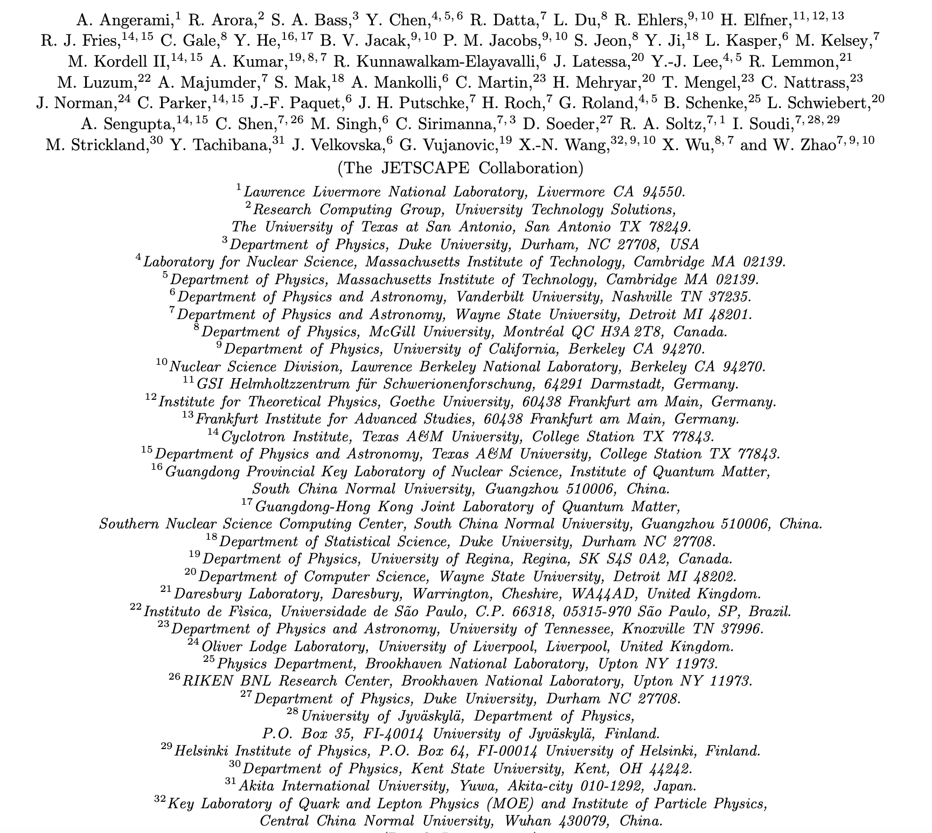

Slide 20
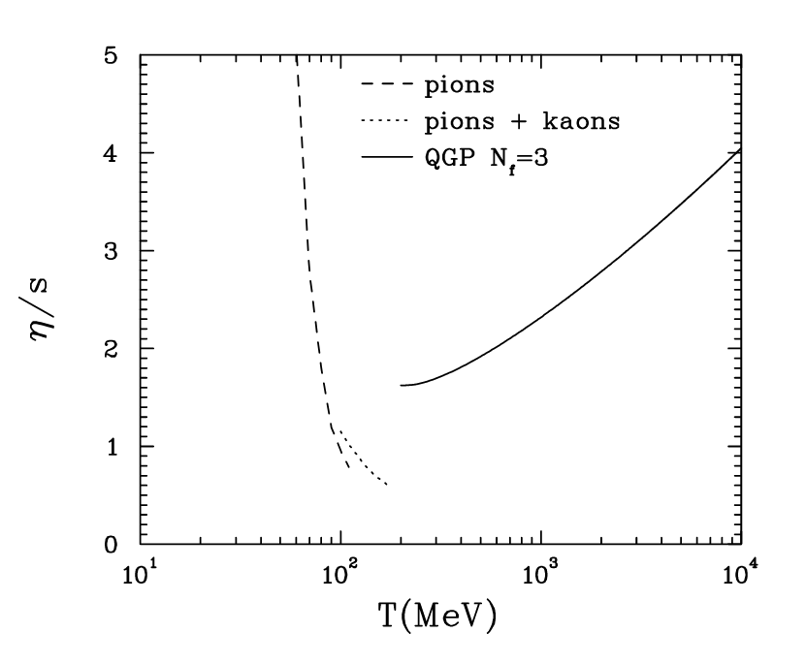
Low viscosity matter produced at RHIC & LHC
$$η∝\frac{1}{σ}$$
HTL pQCD: Csernai, Kapusta, McLerran
PRL 97 2006 1523030
$$\frac{dN}{dp_{T}dφ}=\frac{dN}{dp_{T}}\left(1+2v_{2}cos(2φ)+…\right)$$
D. Everett et al., Phys. Rev. C 103 (2021) 5, 054904

Slide 21
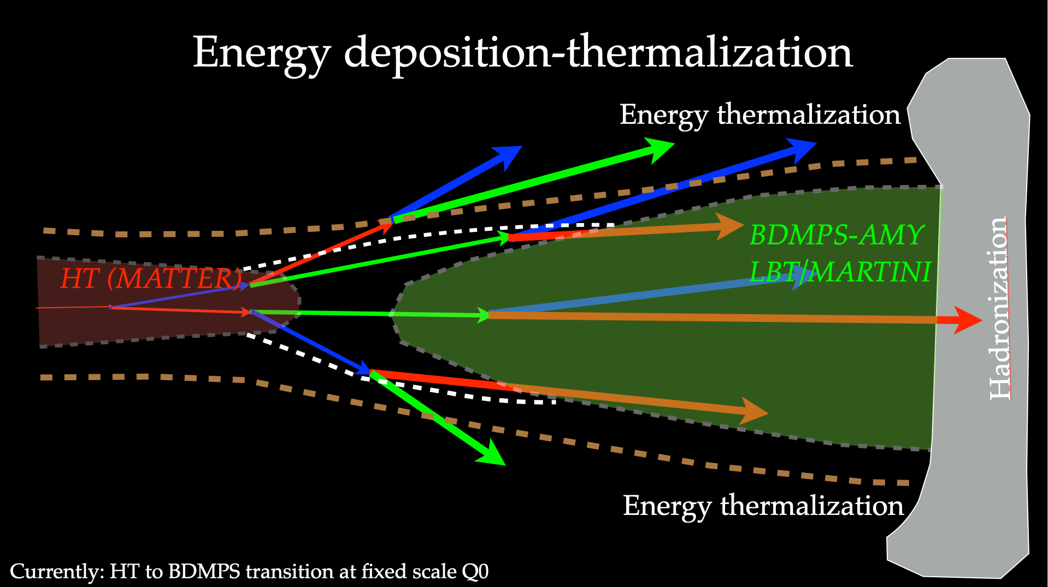
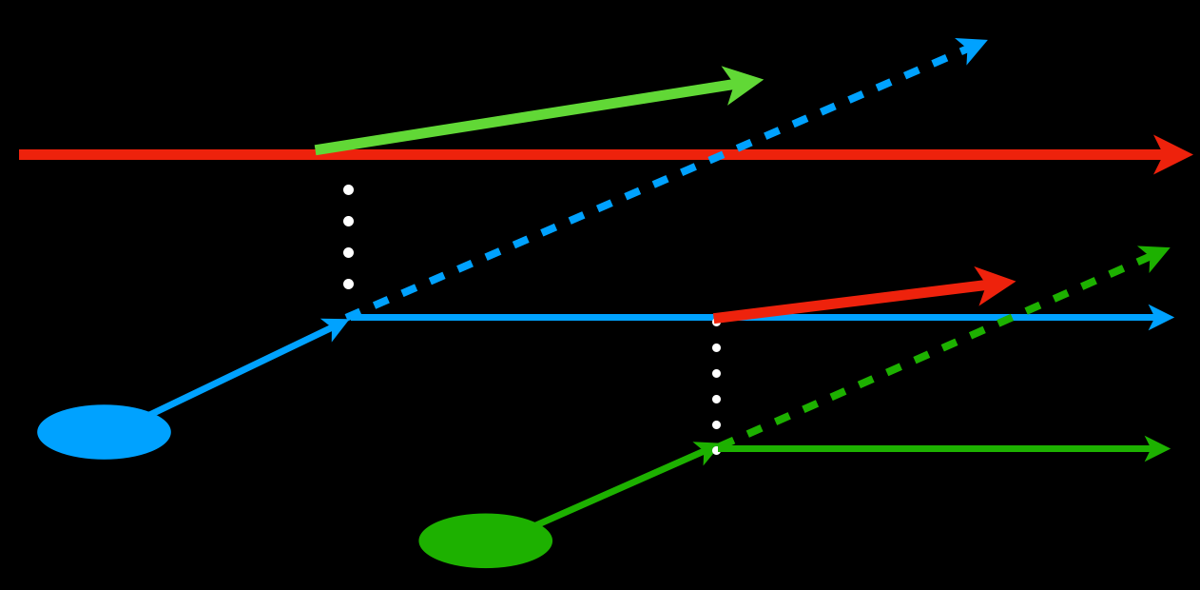
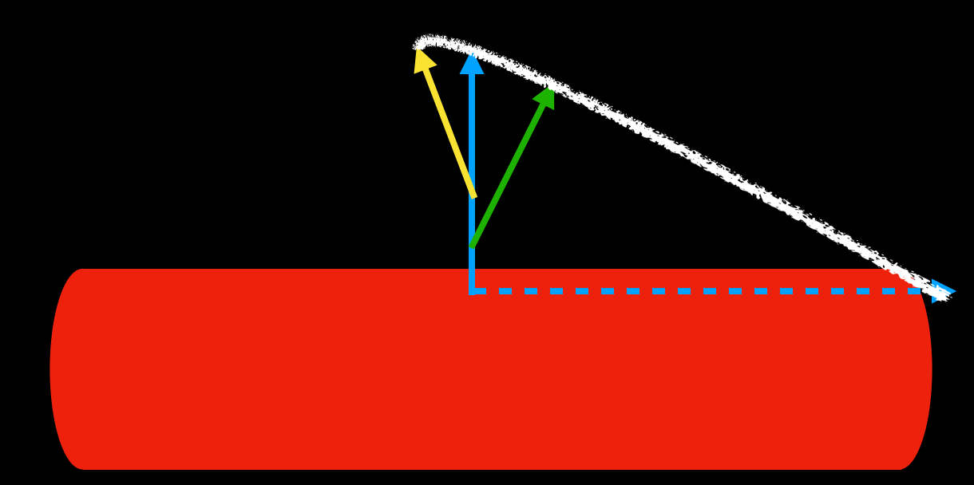
Basic physics picture in one slide

Slide 22
Single calibration: hard and soft calibrated together
One event generator for p-p, low to high multiplicity
A-A from BES to top LHC energies
Also include p-A
3 -D hydro
Simultaneous calibration that includes hard and soft sectors

