Slide 1
SPIN TRANSPORT in Ce+BAF
Y. Roblin Jefferson LAB

Slide 2
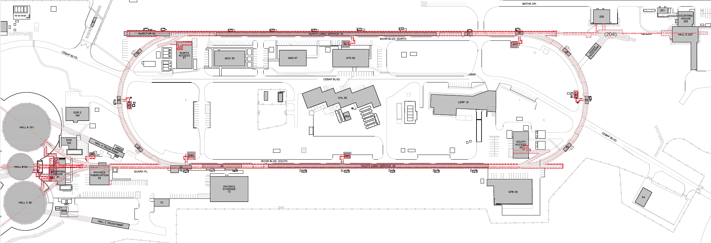
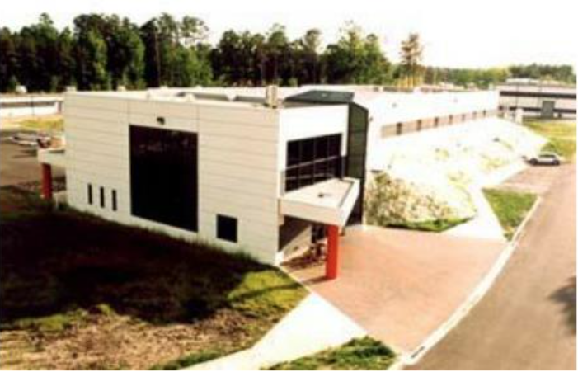
Turning the LERF into a Positron Injector Facility
123 MeV
At the last JLAAC we were exploring e+ production at 10, 100, 1000 MeV…
Today we are focused on producing 123 MeV e⁺ utilizing the Low Energy Research Facility
Inject e⁺ into North Linac to usual 12 GeV (w/ magnets reversed)
Build e⁺ injector at the LERF
Build new LERF to CEBAF tunnel
123 MeV
Build new transport line along South Linac and West Arc

Slide 3
Layout under study

Slide 4
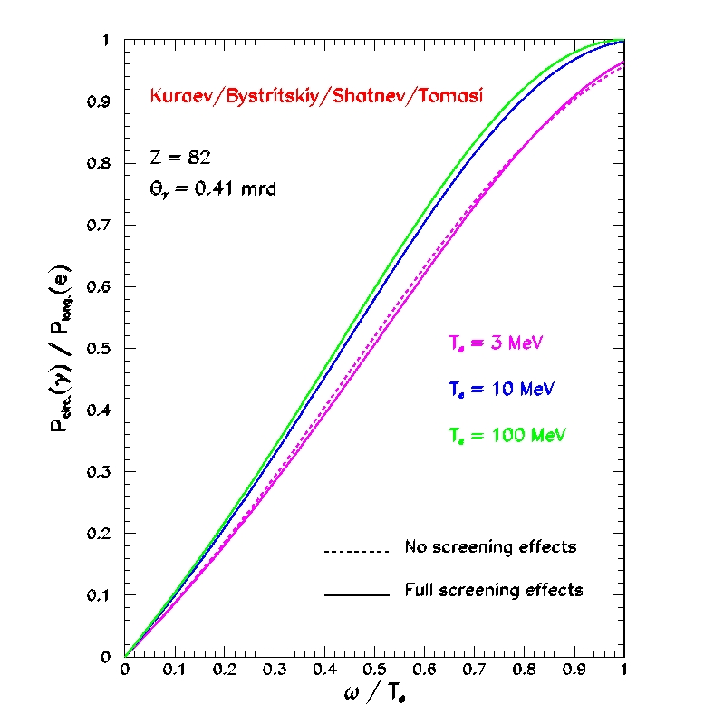
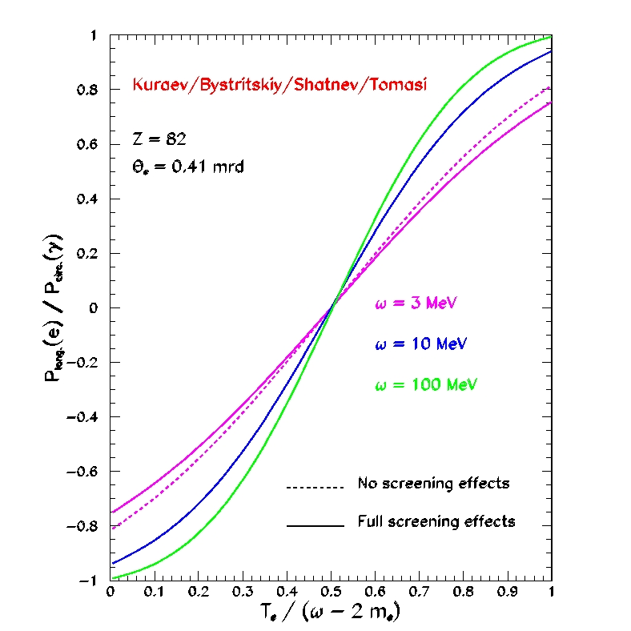
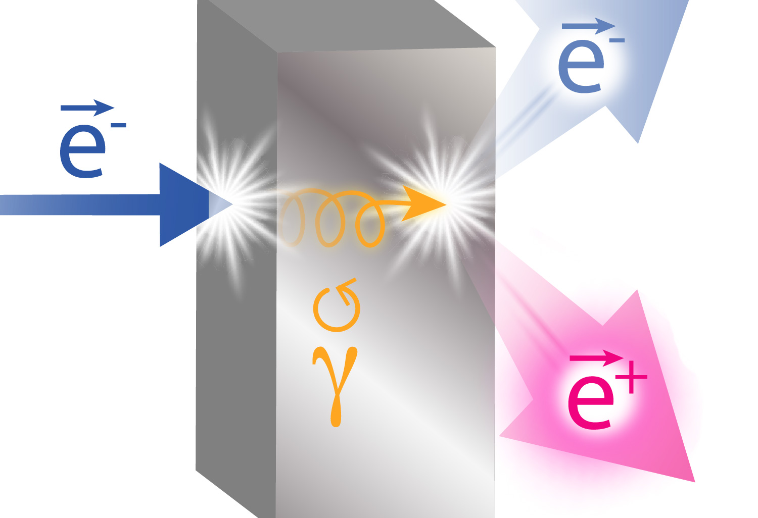
Exploit electron spin polarization to produce polarized positrons
When a longitudinally polarized e⁻ beam strikes matter, e⁺ produced in the shower carrying >50% of the e⁻ beam energy are significantly longitudinally spin polarized…
Polarized Bremsstrahlung
Polarized Pair Creation
P_{circ}(γ) / P_{z} (e⁻)
P_{z} (e⁺) / P_{circ} (γ)
…so why not take advantage of this?
E_{γ} / T_{e-}
T_{e+} / (E_{γ} – 2m_{e+})
E.A. Kuraev, Y.M. Bystritskiy, M. Shatnev, E.Tomasi-Gustafsson, PRC 81 (2010) 055208

Slide 5
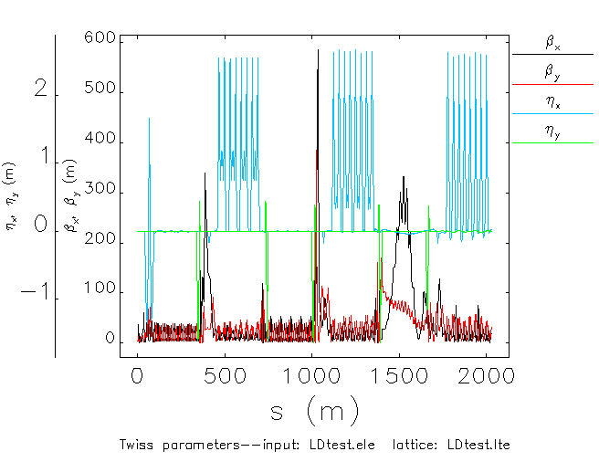
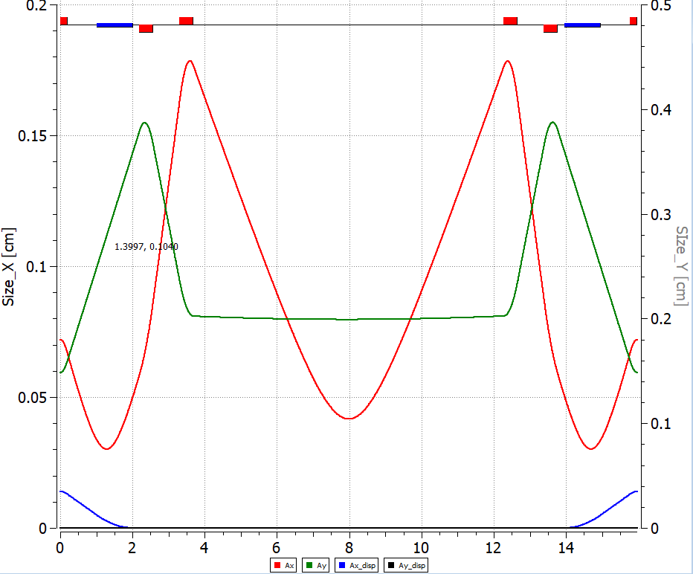
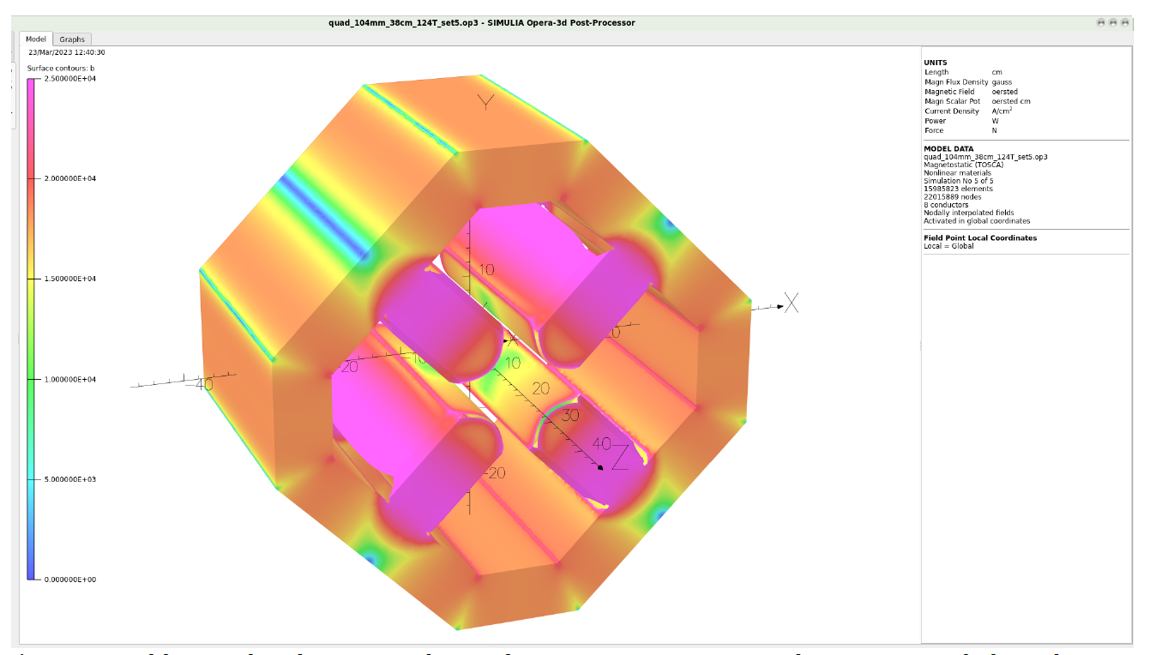
Transporting large e+ beams
Area | dp/p [x10⁻³] | emit_{x} [nm] | emit_{y} [nm]
Chicane | 10 | 500 | 500
Arc 1 | 1 | 50 | 50
Arc 2 | 0.53 | 26.8 | 26.6
Arc 3 | 0.36 | 19 | 18.6
Arc 4 | 0.27 | 14.5 | 13.8
Arc 5 | 0.22 | 12 | 11.2
Arc 6 | 0.19 | 10 | 9.5
Arc 7 | 0.17 | 8.9 | 8.35
Arc 8 | 0.16 | 8.36 | 7.38
Arc 9 | 0.16 | 8.4 | 6.8
MYAAT01 | 0.18 | 9.13 | 6.19
damping
Sync rad.
Low dispersion optics in ARC1/ARC2
Design optics similar to low emittance rings (n-bend achromats) from LERF to CEBAF
Use larger bore quadrupoles

Slide 6
Spin Transport Calculations
Using ELEGANT and post-processing calculations, we propagate the spin using the Thomas BMT equation:
We implemented this analytically taking into account synchrotron radiation (Sands formulas)
This allows us to quickly forecast possible configurations for scheduling purposes.
The final choice is checked via tracking to get a more accurate estimate.

Slide 7
How do we orient the spin?
OPTION 1: use a snake or a Universal spin rotator in the halls
A SIMPLE SOLENOID will not do, the required strength is too big.
OPTION 2: USE a universal spin rotator in the LERF proper, see Fanglei’s talk.
Note: We can not use a Wien filter anymore to orient e+ since they are created as a two-step process. We do use a Wien filter in LERF e+ injector to insure e- driver beam is at the proper orientation on the positron target.

Slide 8
Spin Transport Calculations (cont)
For Ce+BAF , we need to add the bending from the LERF to SL and west arc line for a total of $2π.$
The range that the spin rotator can compensate for can be compared with what one needs to reach in order to produce a longitudinal beam in Hall A, B or C.

Slide 9
MAXIMIZING POLARIZATION IN A SINGLE HALL
Longitudinal spin precession from exit of injector to Experimental target
+2π
Due to LERF->CEBAF transport
$$θ_{1}, θ_{2},θ_{h}$$
Amount of rotation on west, east arcs and experimental hall
Spin rotator adjusted to produce integer number of spin rotation

Slide 10
Range of spin rotation required
Hall | 1 | 2 | 3 | 4 | 5 | linac gain | P(Mev)
A | -71.97 | -63.83 | -34.708 | 20.424 | -69.3 | 1090 | 10980.4
 | -71.2 | -60.8 | -27.8 | 32.9 | -49.7 | 1089 | 10970.43
 | -70.5 | -57.8 | -20.8 | 45.4 | -30.1 | 1088 | 10960.47
 | -69.8 | -54.7 | -13.8 | 57.9 | -10.5 | 1087 | 10950.5
 | -69 | -51.7 | -6.9 | 70.4 | 9.1 | 1086 | 10940.6
 | -68.3 | -48.7 | 0.1 | 82.9 | 28.75 | 1085 | 10930.6
 | -67.6 | -45.6 | 7 | 95.4 | 48.36 | 1084 | 10920.7
Hall | 1 | 2 | 3 | 4 | 5 | linac gain | P(Mev)
B | -56 | -42.4 | -8 | 51.9 | -34.3 | 1090 | 10987.1
 | -55.43 | -39.7 | -1.54 | 63.67 | -15.52 | 1089 | 10977.1
 | -54.9 | -37 | 4.9 | 75.7 | 3.24 | 1088 | 10967.13
 | -54.3 | -34.3 | 11.3 | 87.3 | 22 | 1087 | 10957.14
 | -53.8 | -31.6 | 17.8 | 99.1 | 40.8 | 1086 | 10947.16
 | -53.2 | -29 | 24.2 | -69 | 59.5 | 1085 | 10937.2
 | -52.7 | -45.6 | 7 | 95.4 | 48.4 | 1084 | 10927.2
Hall | 1 | 2 | 3 | 4 | 5 | linac gain | P(Mev)
C | -40 | -20.92 | 18.73 | 83.29 | 0.73 | 1090 | 10980.4
 | -39.62 | -18.59 | 24.65 | 94.42 | 18.64 | 1089 | 10970.43
 | -39.2 | -16.3 | 30.6 | -74.45 | 36.55 | 1088 | 10960.47
 | -38.9 | -13.9 | 36.5 | 63.3 | 54.5 | 1087 | 10950.5
 | -38.5 | -11.6 | 42.4 | -52.2 | 72.4 | 1086 | 10940.6
 | -38.1 | -9.3 | 48.3 | -41 | -89.7 | 1085 | 10930.6
 | -37.8 | -26.3 | 30.7 | -57.3 | 78.3 | 1084 | 10920.7
Its possible to choose a linac gain yielding a correction that is “in-range”.
Optimization of experimental setups will have to take into account the reach of the spin rotator.

Slide 11
OPTIMIZING POLARIZATION IN TWO HALLS
Works the same way as it does for CEBAF.
Spin dance to verify setup, can we do that for e+?
Discrete energies allow for maximum polarization/
In two halls

Slide 12
EFFECT OF SYNCHROTRON RADIATION
Area | dp/p [x10⁻³] | emit_{x} [nm] | emit_{y} [nm]
Chicane | 10 | 500 | 500
Arc 1 | 1 | 50 | 50
Arc 2 | 0.53 | 26.8 | 26.6
Arc 3 | 0.36 | 19 | 18.6
Arc 4 | 0.27 | 14.5 | 13.8
Arc 5 | 0.22 | 12 | 11.2
Arc 6 | 0.19 | 10 | 9.5
Arc 7 | 0.17 | 8.9 | 8.35
Arc 8 | 0.16 | 8.36 | 7.38
Arc 9 | 0.16 | 8.4 | 6.8
MYAAT01 | 0.18 | 9.13 | 6.19
Spin precession varies with amount of synchrotron radiation.
Broadening of spin distribution will occur because of the increase in energy spread. It is not a depolarizing effect, but a dilution effect
Note that at higher passes, energy spread is similar to what it was for CEBAF.

Slide 13
Spin broadening with energy spread, estimate for 1st pass with zgoubi
Broadening of the spin component projection, resulting in dilution of average longitudinal polarization.
$${dp}/p={10}^{−3}$$
$${dp}/p={10}^{−4}$$
Spin component along beam before adjustment
Need to develop a full model for the entire machine to refine estimates.

Slide 14
Conclusion, future work
We have a concept to transport the polarized e+ from LERF to target
It is possible to accommodate up to two halls, provided one choose carefully the accelerating gradient such that the spin precession is correctable by the rotator
We are developing a full model for the Ce+BAF optics in order to refine the estimates and track all spin components (BMAD or zgoubi).
The spin distribution at the exit of the positron production target will be fully tracked through the accelerator.
Preliminary estimates are that the effect of synchrotron radiation results in a broadening of the polarization vector distributions rather than a dilution.

