Slide 1
We enjoyed hosting you here at Jefferson Lab & hope to see you again soon!
The terrific presentations, questions, and discussions prove that the workshop topics remain dynamic and stimulating areas of research and development!
Still a lot of work to do, but fresh young faces are taking charge!
In the next week or so you’ll receive
Online survey
Instructions for PSTP2024 proceedings
Have a safe trip home!!
Thanks
for coming!!

Slide 2
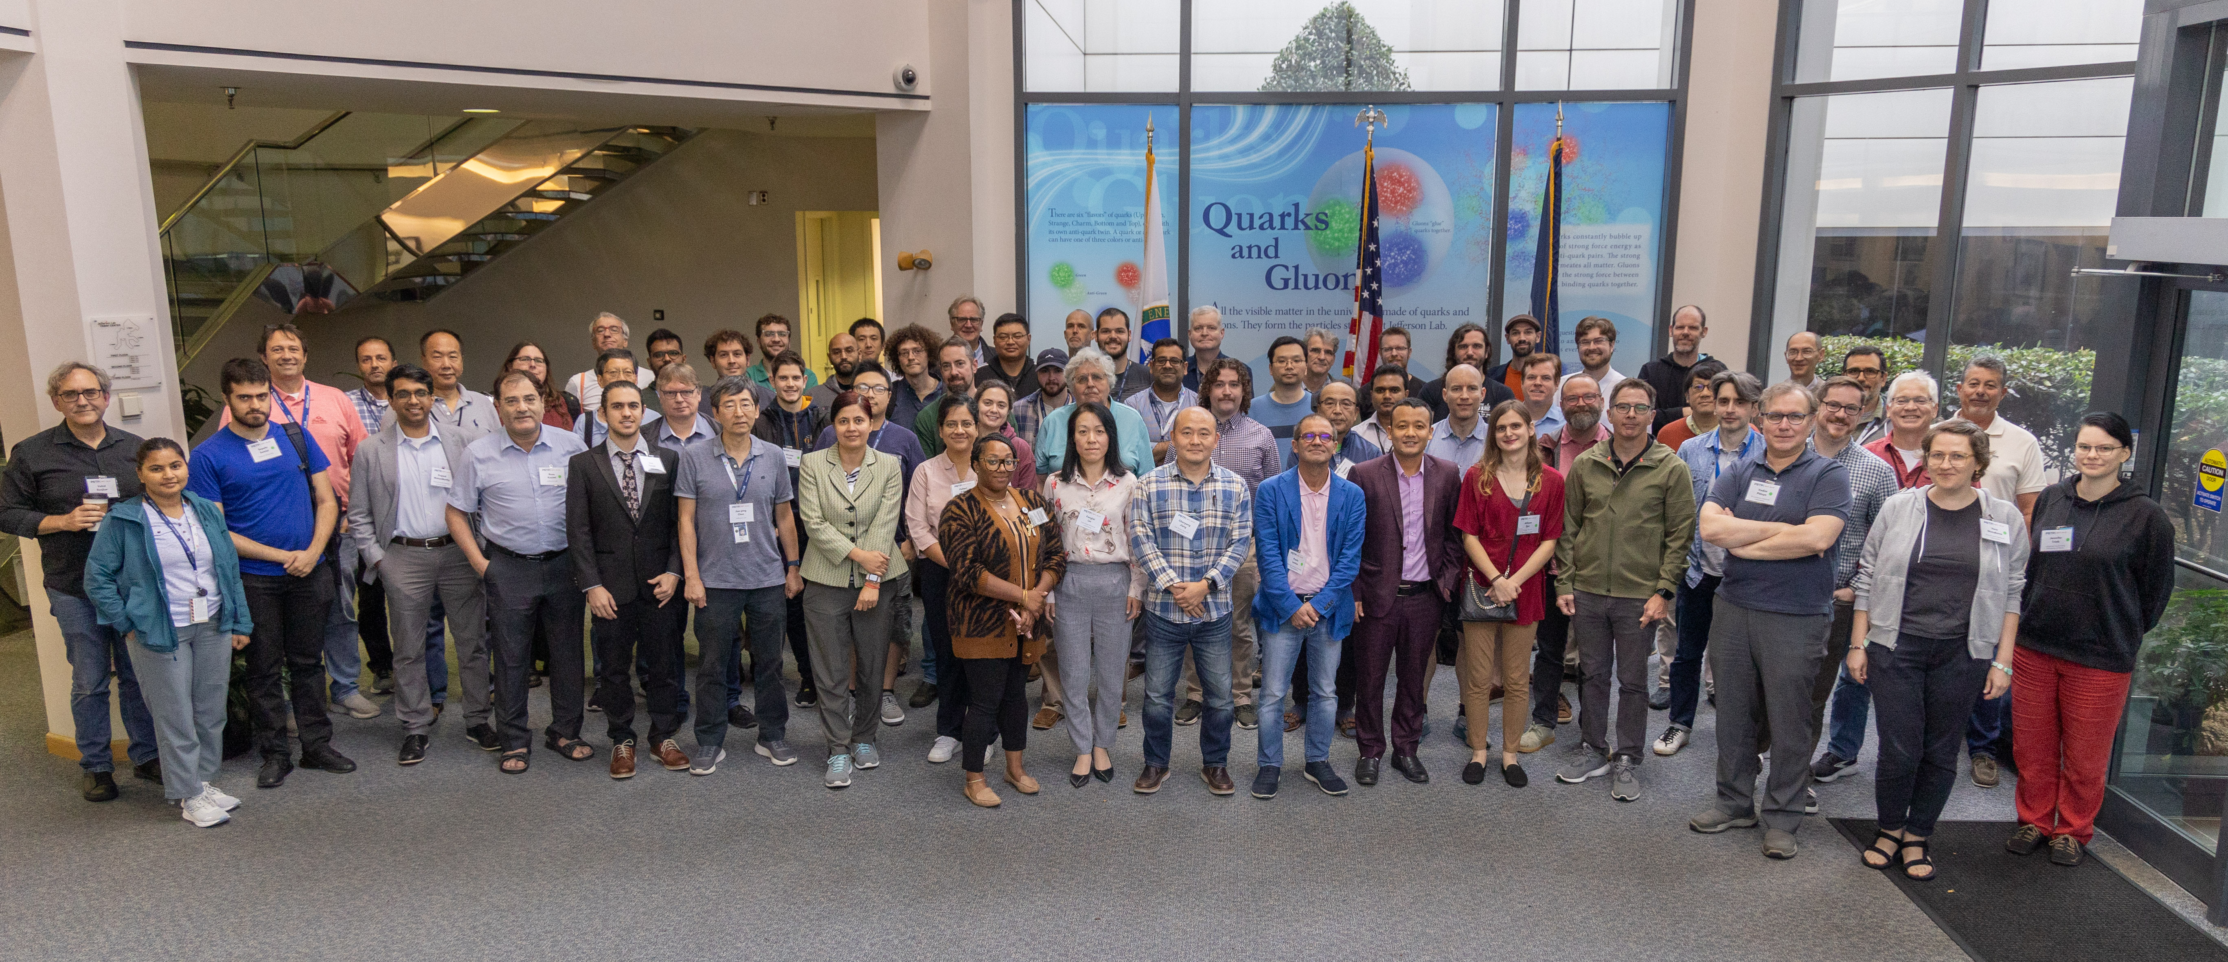

Slide 3
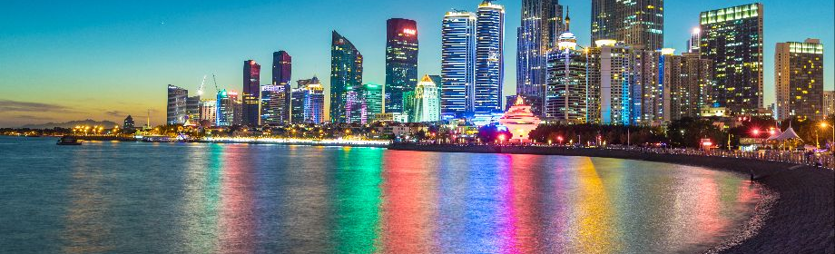
26th International Symposium on Spin Physics (SPIN 2025) September 21-26, 2025
Qingdao Haitian Hotel
Qingdao, Shandong Province, China
https://indico.ihep.ac.cn/event/22189/

