Slide 1
Jefferson Laboratory: a brief overview
David J. Dean
Deputy Director for Science
Presented To:
20th International Workshop on Polarized Sources, Targets, and Polarimetry
September 23, 2024

Slide 2
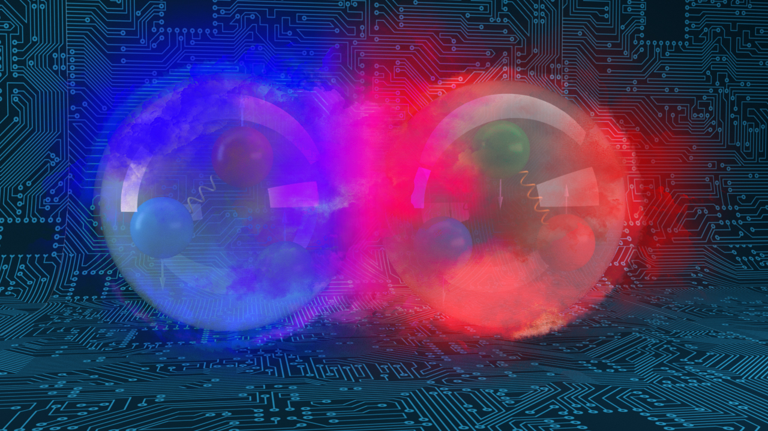
Outline…
Welcome to DOE and JLab
S&T strategy overview in 3 slides
A few general laboratory pointers

Slide 3
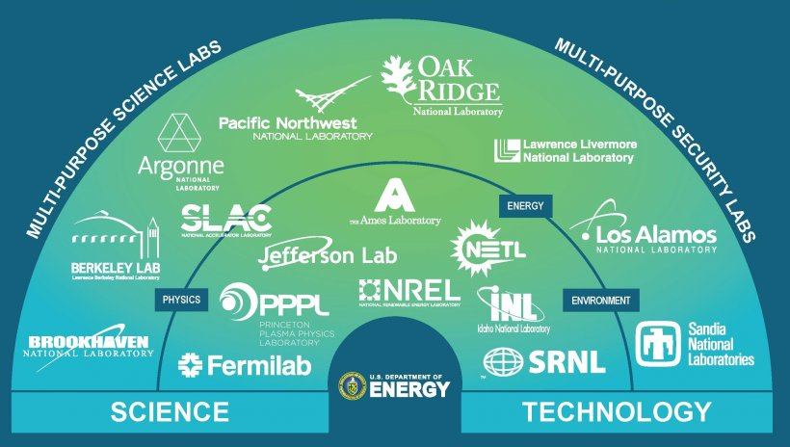
DOE’s 17 National Laboratories: S&T, RD&D

Slide 4
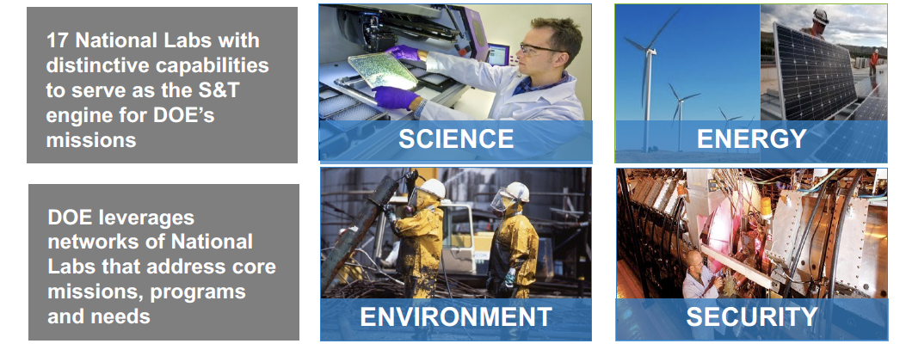
The U.S. Department of Energy (DOE) Mission Space
National Laboratories enable DOE missions

Slide 5
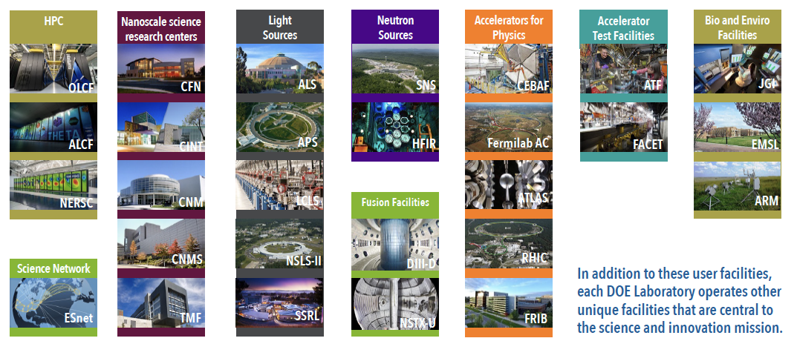
National User Facilities at the DOE National Laboratories
Unique facilities with unmatched expertise, providing access to 36,000+ scientific users from universities, national laboratories, and industry

Slide 6
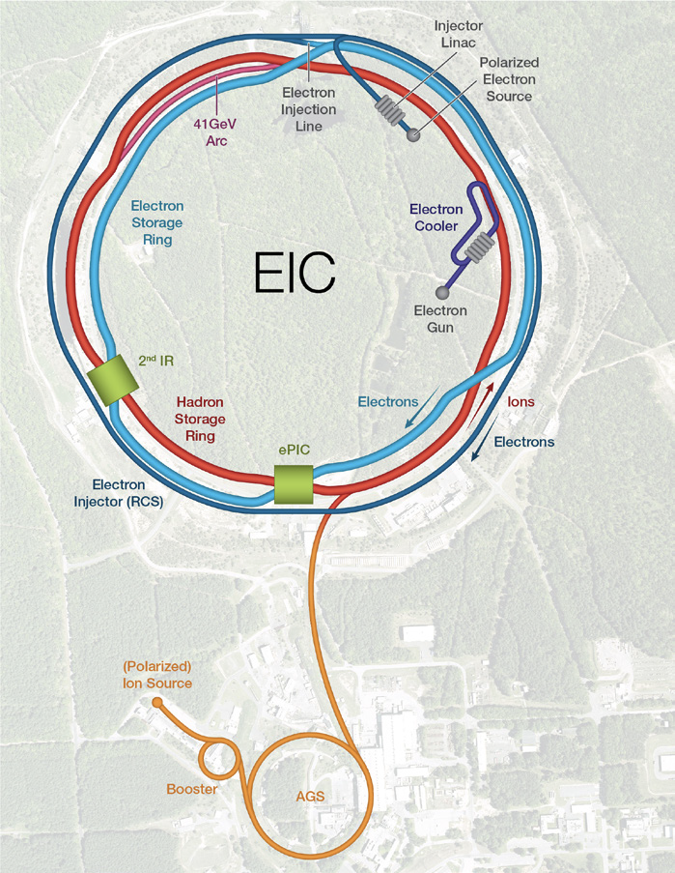
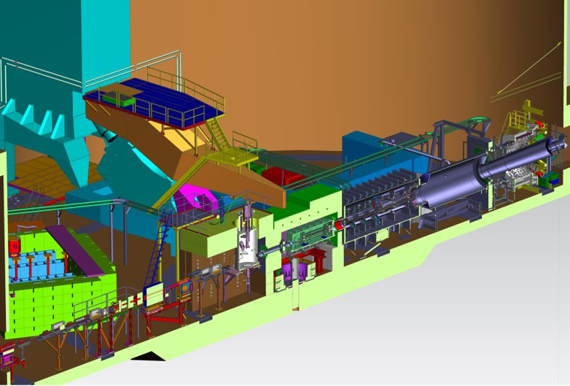
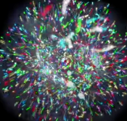
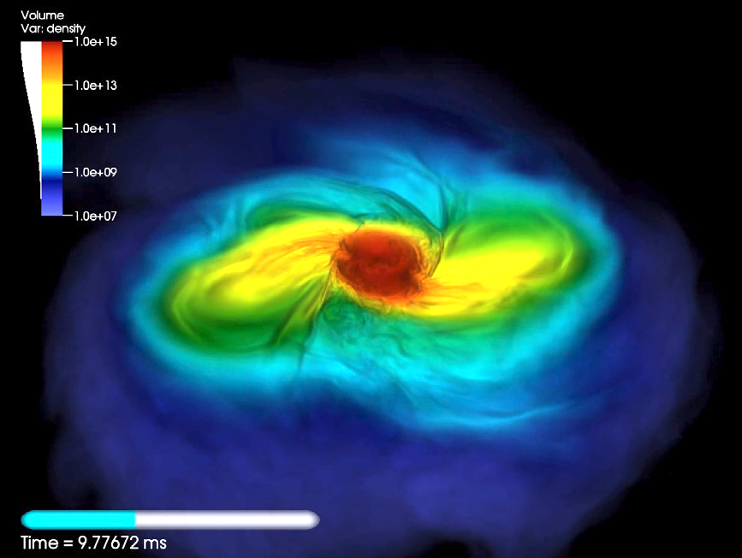
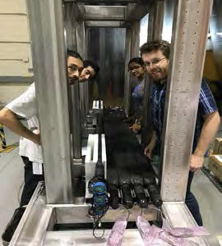
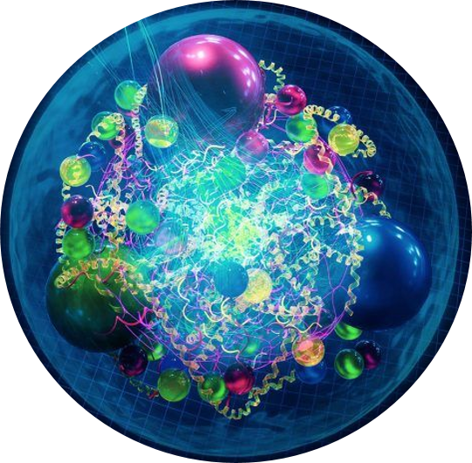
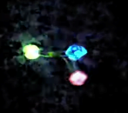
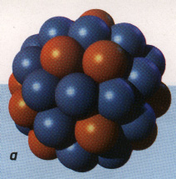
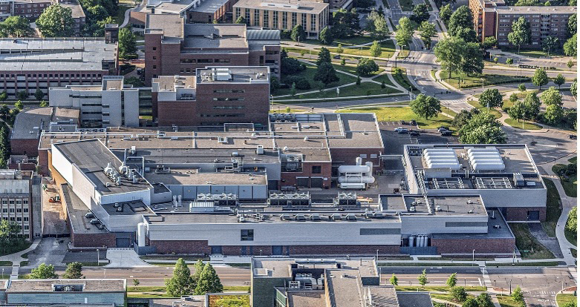
Nuclear Physics across the Universe
2023 LRP Science Questions
How do quarks and gluons make up protons, neutrons, and, ultimately, atomic nuclei?
How do the rich patterns observed in the structure and reactions of nuclei emerge from the interactions between neutrons and protons?
What are the nuclear processes that drive the birth, life, and death of stars?
How do we use atomic nuclei to uncover physics beyond the Standard Model?
Gluons
Fundamental Symmetries
Neutron Star Mergers
Quarks
Nuclear Physics & Astrophysics
10⁻¹⁰ –10⁻³ sec
The world of QCD
Notes:
<10⁻⁴³ seconds…Planck epoch
<10⁻³⁶ seconds…Grand Unification Epoch
<10⁻³² seconds…inflation epoch
10⁻¹² seconds…electroweak epoch
10-¹² – 10⁻⁶ seconds quark epoch (think QGP)
10⁻⁶ – 1 second the hadron epoch
1 second – neutrino decoupling
1 second – 10 seconds, lepton epoch…(lepton nonconservation…neutrinoless bb decay…)
10 seconds to 3 minutes – BBN
Recombination (electron capture on light nuclei) 370,000 years
150 million years later…first stars and galaxies form…
And they collide!!

Slide 7
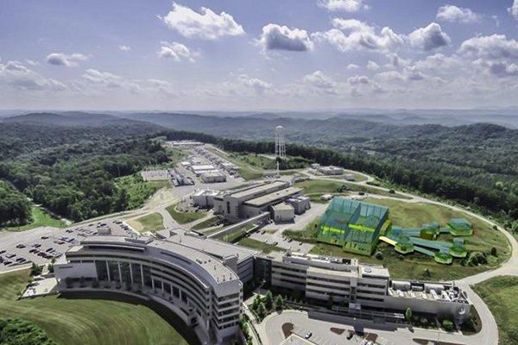
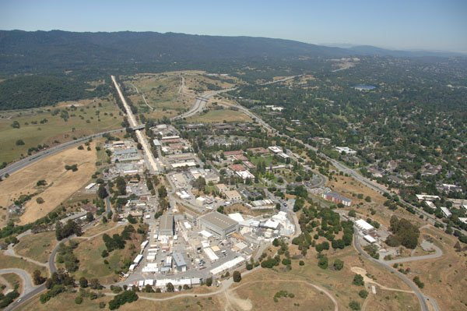
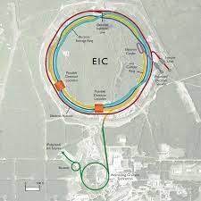
Advanced Detectors and accelerators make our quest possible
Theorists guide experiments & interpret results
SRF R&D makes accelerators better
e
H
SRF Capability enables research in chemistry, materials, medical research, isotope production
US-based MicroPattern Gaseous Detector Facility - A proposed User Resource

Slide 8
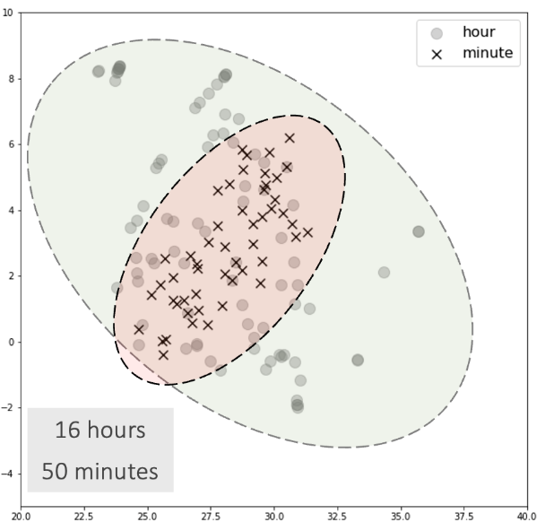
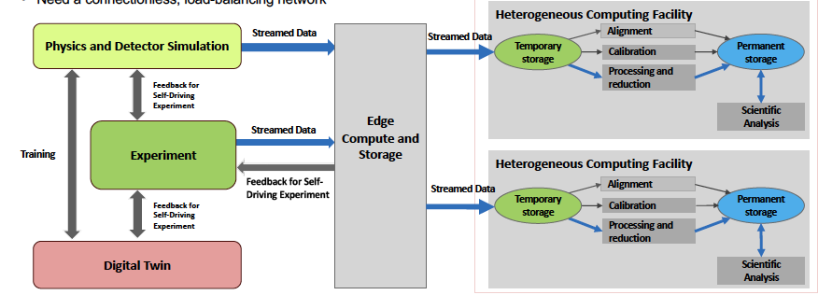
The data strategy extends from a new facility through R&D and application
Establish HPDF as the premier Data Science facility for SC and DOE
Generate foundational research and prototype computing systems to inform pathways for the integrated ecosystem.
Drive and enable AI/ML applications across the sciences. Grow in traditional computer science and applied math. Integrate facilities, workflows, algorithms, software and application tools.
Position HPDF as an integral component of a single, larger computational ecosystem that bolsters national S&T capabilities
Lead the NP engagements for IRI and an HPDF spoke. How: hold workshops, build on current research (EJfat, streaming grand challenge), and influence EIC computing model
JLDC
Application: AL/ML improve integrating into CEBAF Ops
HPDF hardware concepts

Slide 9
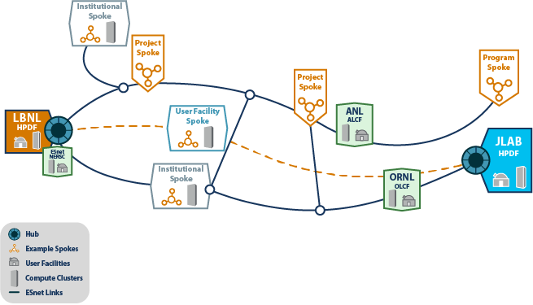
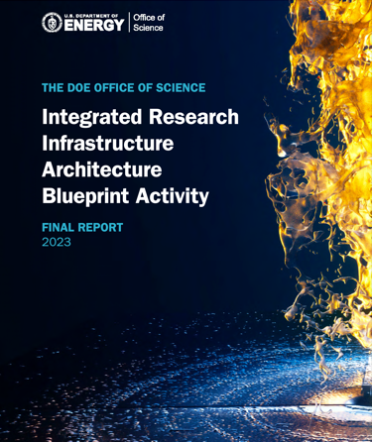
HPDF will be at the Heart of Data and Computation in the Office of Science
The HPDF (data intensive), other HPC facilities (compute intensive),
User Facilities…coupled through ESNet represent components of the ‘Integrated Research Infrastructure’ connects all SC user facilities

Slide 10
Core Capabilities Underpin Impactful S&T
187 Patents granted
2444 Journal articles published
Nuclear Physics Research
Advanced
Computer Science, Visualization, & Data
755 PhDs granted (236 in progress)
938 employees
Two National User Facilities: CEBAF & HPDF
Accelerator Science &
Technology
$206M FY23 expenditures
1,905 research guests annually
Mechanical Engineering & Design
$200M modernization investment
Systems
Engineering

Slide 11
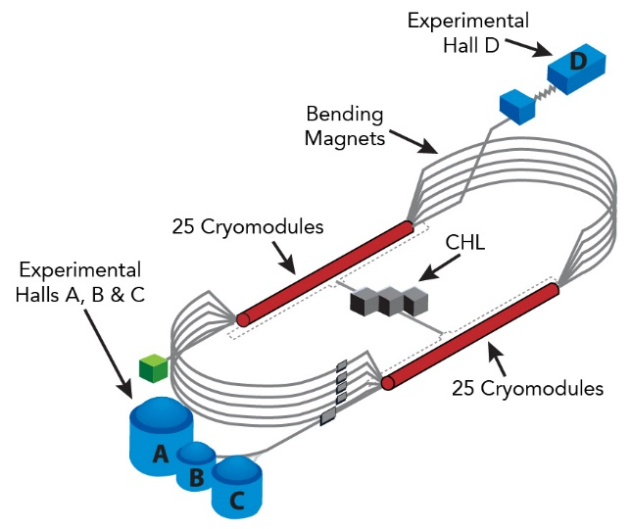
CEBAF: The Continuous Electron Beam Accelerator Facility
Accelerator
Two 1 GeV Superconducting Linacs
418 SRF cavities in 52 cryomodules with associated RF systems
7 km of beamline
> 2800 magnets
> 500k channels in accelerator control system
Independent beam delivery with tunable current from 100 uA to few nA
1 MW beam power capable
Experimental Halls
4 Halls, simultaneous operation
23 Superconducting magnets in operation
Two 1MW beam dumps
Up to 2.5 kW cryogenic targets
Well over 100k data channels
1 nm position difference of beams with different helicity
Cryogenics
CEBAF is one of the largest and most complex accelerator-based scientific facilities in the U.S. and the world
5 Cryogenic plants
Largest 2K cryoplant in the world; combined capacity of 9.4 kW@2K
115,000 liquid liters He

Slide 12
Discussion

