Slide 1
EIC Electron Storage Ring Polarization
Vadim Ptitsyn,
Brookhaven National Laboratory
EIC Project
PSTP’24
September 24, 2024

Slide 2
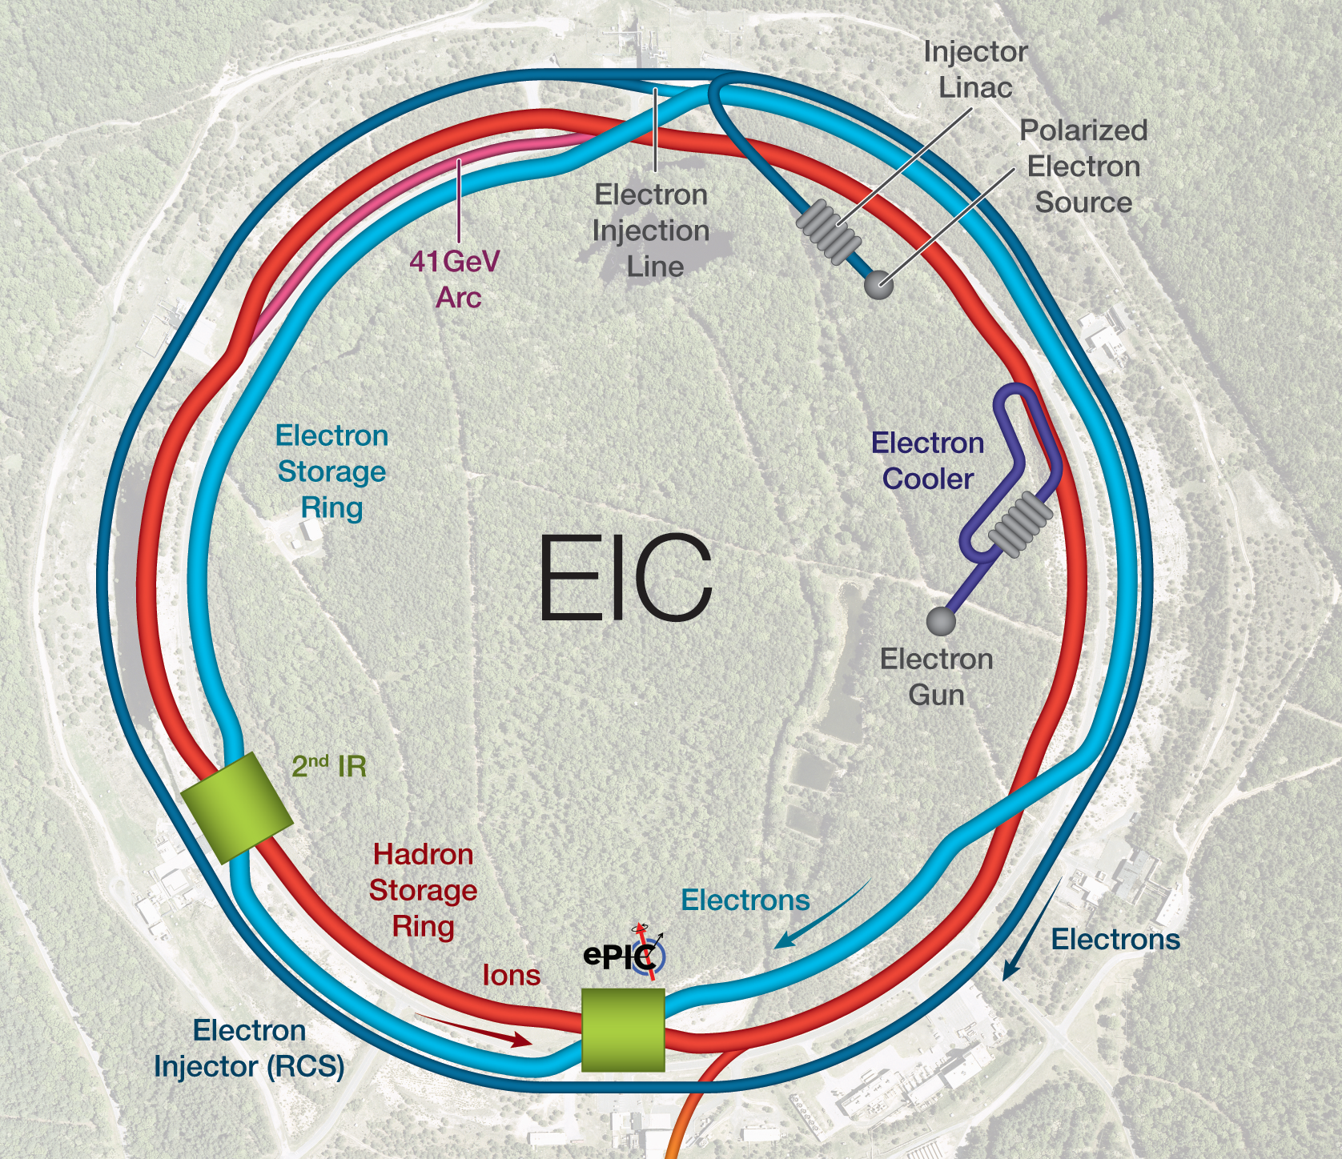
EIC Polarized Beam Requirements
Highly polarized beams of:
  Electrons
  (polarization goal: 70% average)
  Proton, ³He
  (polarization goal: 70%)
Note: Polarized deuterons under discussion.
Spin orientation at the collision point:
  Electrons: longitudinal
  Hadrons: longitudinal or vertical
Using bunches with opposite spin orientation on the same fill
protons
electrons

Slide 3
Self-Polarization and Depolarization Processes
In Electron Storage Ring two processes related with synchrotron radiation, define polarization behavior:
Self-polarization:
Slow build-up of electron spins against the guiding magnet field.
P_{ST} = 92.4%, τ_{pol} = |ρ|³ / γ⁵
ESR with rotators: P_{BKS} ~ 82-85%, τ_{pol} ~ 31 min at 18 GeV,
τ_{pol} ~ 10 h at 10 GeV
Stochastic depolarization:
Caused random nature of the photon emission.
Analogy: transverse emittance excitation.
τ_{dep} = |ρ|³ /(|d|² γ⁵) , where
Gianfelice-WendtGianfelice-Wendt
(taken at const x, x’, y, y’)
Combined, these two processes define P$∞$ and τ_{eq}

Slide 4
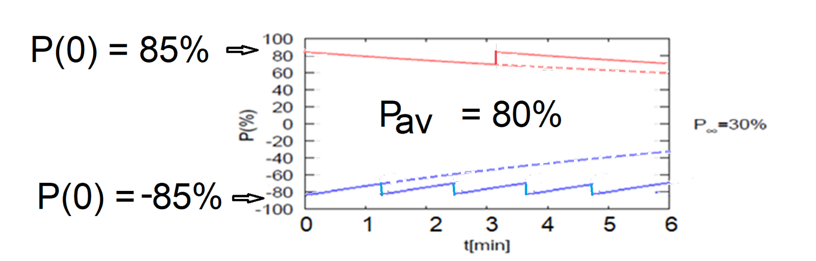
Maintaining High Average Electron Polarization
Frequent injection of bunches from RCS with high initial polarization of 85%. Maximum 1Hz injection rate.
Initial polarization is decaying decays towards P∞ value
As polarization decays the bunches are replaced
B P
B P
Refilled every 1.2 minutes
Refilled every 3.2 minutes
Re-injection
P_{av}=80%
P∞= 30%
P_{av}=80%
Re-injections

Slide 5
ESR Polarization Design
Goal:
Maximize τ_{eq} by minimizing stochastic depolarization. That is done by minimizing
spin dispersion function d around ring
(Spin Matching).
Sources of spin dispersion d:
  Spin rotators
  Machine errors (misalignments, magnet rolls)

Slide 6
Spin Matching and Vector d
Absolute value of vector d in the EIC ring
with spin rotators. Without spin matching.
Absolute value of vector d in the EIC ring
with spin rotators with perfect spin matching.
ASPIRRIN
After perfect spin matching the vector d is only present in the area between rotators.
Thus, stochastic depolarization is limited only to that area.

Slide 7
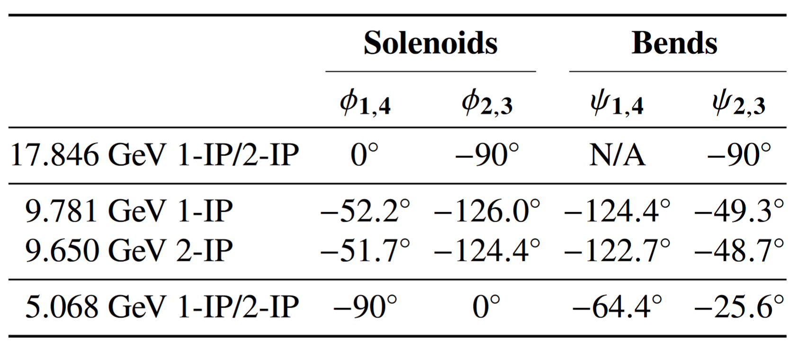
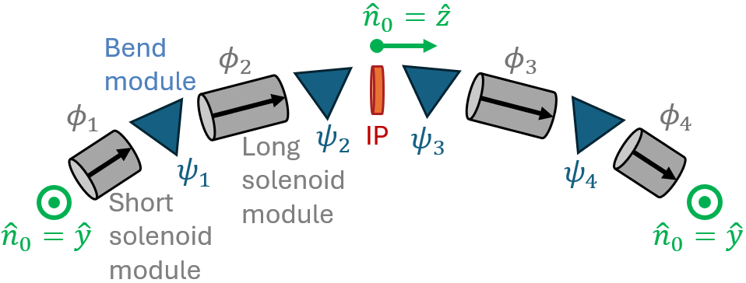
Electron Storage Ring Spin Rotators
Goal electron energy range: 5-18 GeV
A HERA-type rotator (based on sequence of vertical and horizontal bend) creates meter scale orbit excursion at lower energies.
The rotator design capable to operate in all energy range is based on the combination of solenoidal and horizontal bending magnets.
EIC spin rotator configuration
ψ₁= ν₀θ₁
ψ₂= ν₀θ₂
ϕ_{j} – spin rotation angle in solenoids
ψ_{i} – spin rotation angle in bends
ν₀= γa
θ_{1,2}− bending angles

Slide 8
Strong Spin Matching Conditions for Spin Rotators
In order to minimize stochastic depolarization the rotator insertion optics has to satisfy special set of spin matching conditions:
Betatron spin matching
Longitudinal spin matching
where:
F is either f_{I} or D
f_{I} is an eigenvector of
horizontal motion
entrance of first part
of solenoid
exit of second half
of solenoid

Slide 9
Spin Rotator Insertion
Quadrupole are set up for Strong betatron spin matching and betatron coupling compensation
For Strong betatron spin-matching and fully decoupled solenoidal insertion the horizontal and vertical transport matrices must have following forms:
In addition, another solution for the case of vertical spin at the solenoid entrance was found by V. Morozov.

Slide 10
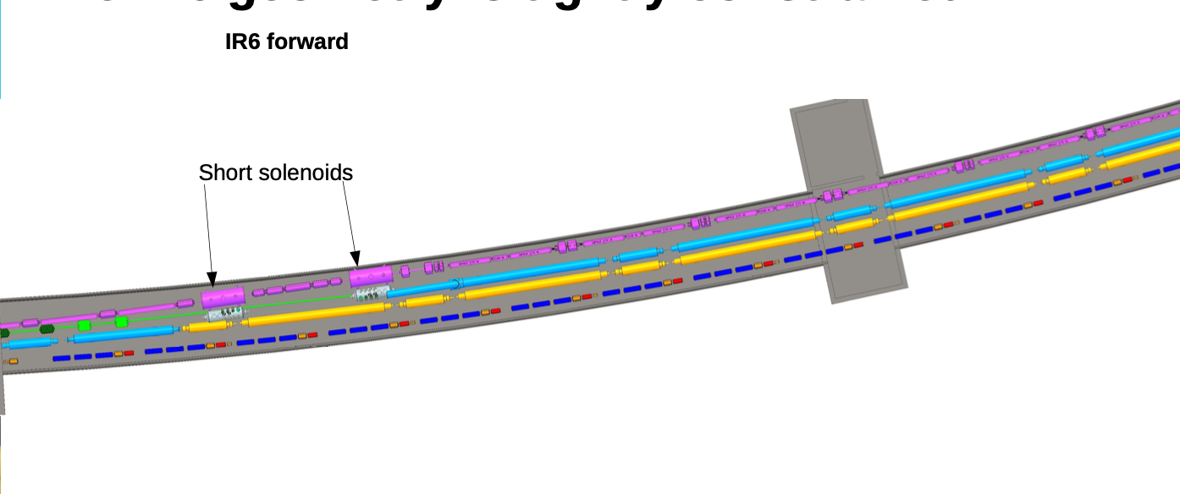
Spin Rotator Insertion in the Tunnel

Slide 11
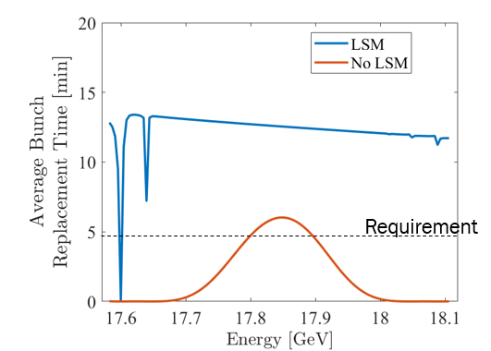
Longitudinal Spin Matching Issue
Unfortunately, the Strong Longitudinal Spin Matching requires very high
solenoidal field, 11 T.
And one can not increase the solenoid magnet length because of
the space limitations.
We still can get acceptable average polarization
in limited energy range.

Slide 12
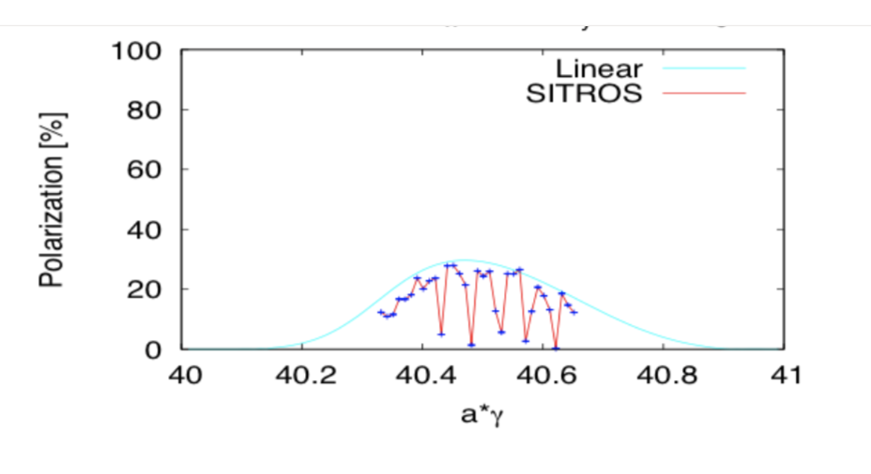
Polarization Simulation Studies
Used codes: SITROS+SITF (E. Gianfelice-Wendt, FNAL),
BMAD+PTC (M. Signorelli, Cornell U)
Perturbation theory (Y. Cai, SLAC)
Zgoubi (F. Meot, BNL)
SITROS simulations studies with machine errors done at 10 and 18 GeV established required degree of orbit and coupling control in the ESR.
E. Gianfelice-Wendt, SITROS/SITF
18 GeV
Asymptotic polarization [%]
Orbit corrected to rms: ~0.150 mm,
coupling corrected to below 0.005.
SITROS includes nonlinear sextupole
fields and quantum excitation
At 18 GeV with 2.4 min average refill time:
16% asymptotic polarization corresponds to ~70% average polarization

Slide 13
Challenges
Although 70% average polarization was demonstrated in simulations with one detector, the polarization performance was marginal.
For instance, the addition of second detector, accompanied by a set of spin rotators would increase depolarization.
The same would happen if one would like to modify vertical emittance or adjust the betatron coupling.
So, we were looking for further improvements in polarization and tools for operational polarization control and tuning.

Slide 14
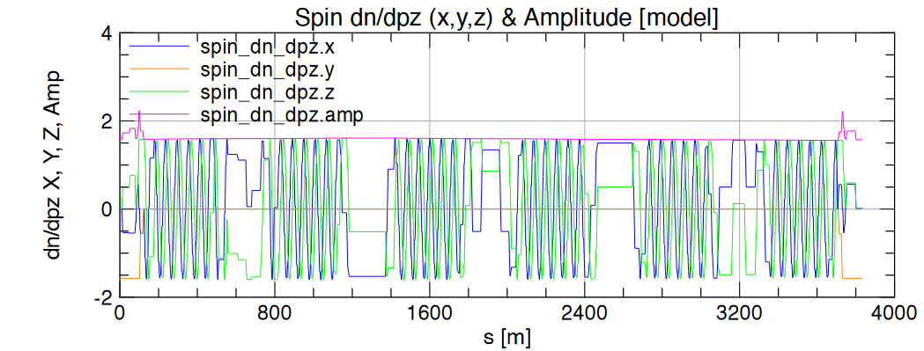
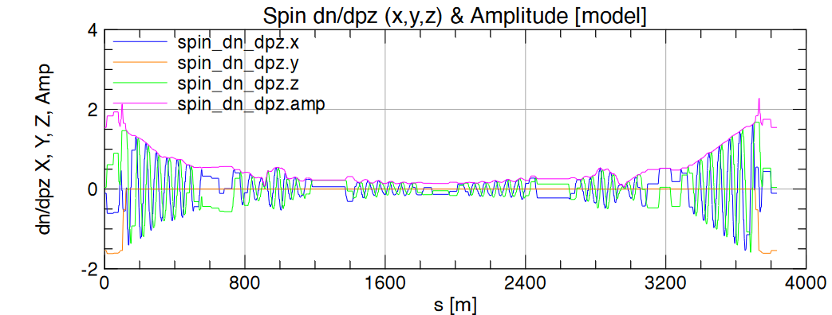
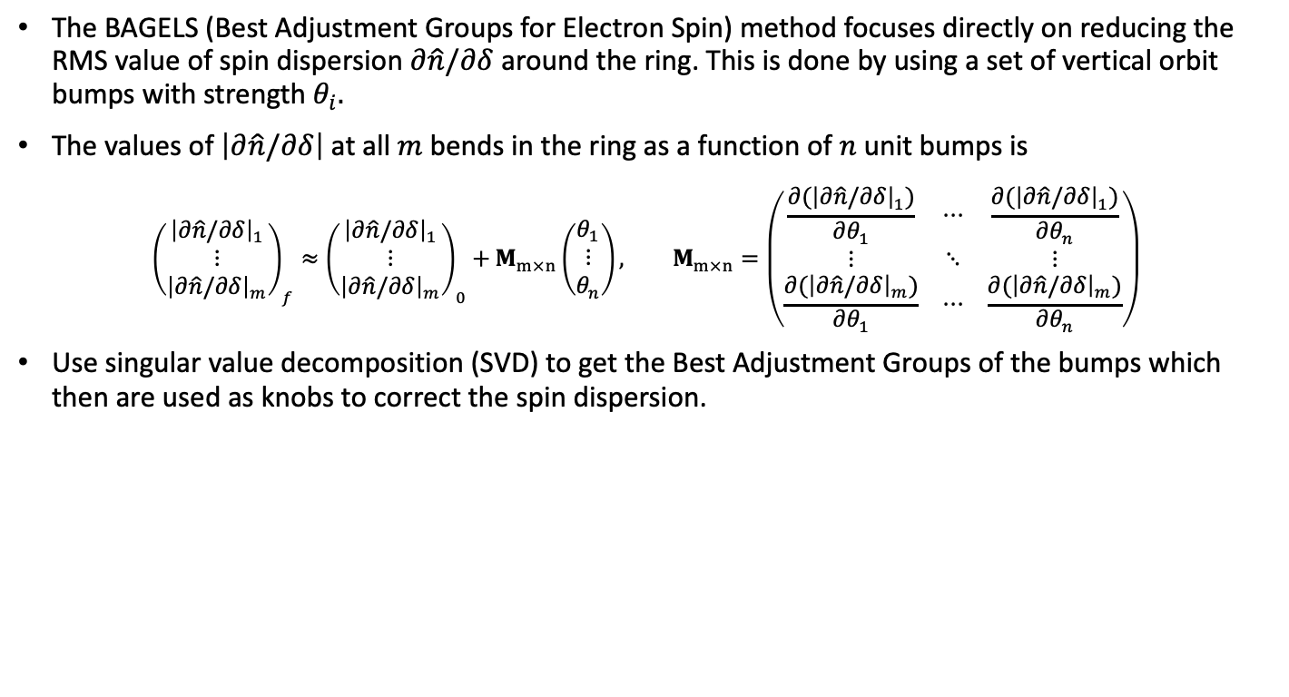
The BAGELS Method (M.Signorelli and G. Hoffstaetter)
The BAGELS (Best Adjustment Groups for Electron Spin) method focuses directly on reducing the RMS value of spin dispersion $∂\hat{n}/∂δ$ around the ring. This is done by using a set of vertical orbit bumps with strength $θ_{i}.$
The values of $\left|∂\hat{n}/∂δ\right|$ at all $m$ bends in the ring as a function of $n$ unit bumps is
$${\left(\begin{matrix}{\left|∂\hat{n}/∂δ\right|}_{1} \\ ⋮ \\ {\left|∂\hat{n}/∂δ\right|}_{m}\end{matrix}\right)}_{f}≈{\left(\begin{matrix}{\left|∂\hat{n}/∂δ\right|}_{1} \\ ⋮ \\ {\left|∂\hat{n}/∂δ\right|}_{m}\end{matrix}\right)}_{0}+M_{m×n}\left(\begin{matrix}θ_{1} \\ ⋮ \\ θ_{n}\end{matrix}\right), M_{m×n}=\left(\begin{matrix}\frac{∂({\left|∂\hat{n}/∂δ\right|}_{1})}{∂θ_{1}} & ⋯ & \frac{∂({\left|∂\hat{n}/∂δ\right|}_{1})}{∂θ_{n}} \\ ⋮ & ⋱ & ⋮ \\ \frac{∂({\left|∂\hat{n}/∂δ\right|}_{m})}{∂θ_{1}} & ⋯ & \frac{∂({\left|∂\hat{n}/∂δ\right|}_{m})}{∂θ_{n}}\end{matrix}\right)$$
Use singular value decomposition (SVD) to get the Best Adjustment Groups of the bumps which then are used as knobs to correct the spin dispersion.
Global spin matching!
Orbit bumps
Spin dispersion over the ring before and after applying BAGELS correction

Slide 15
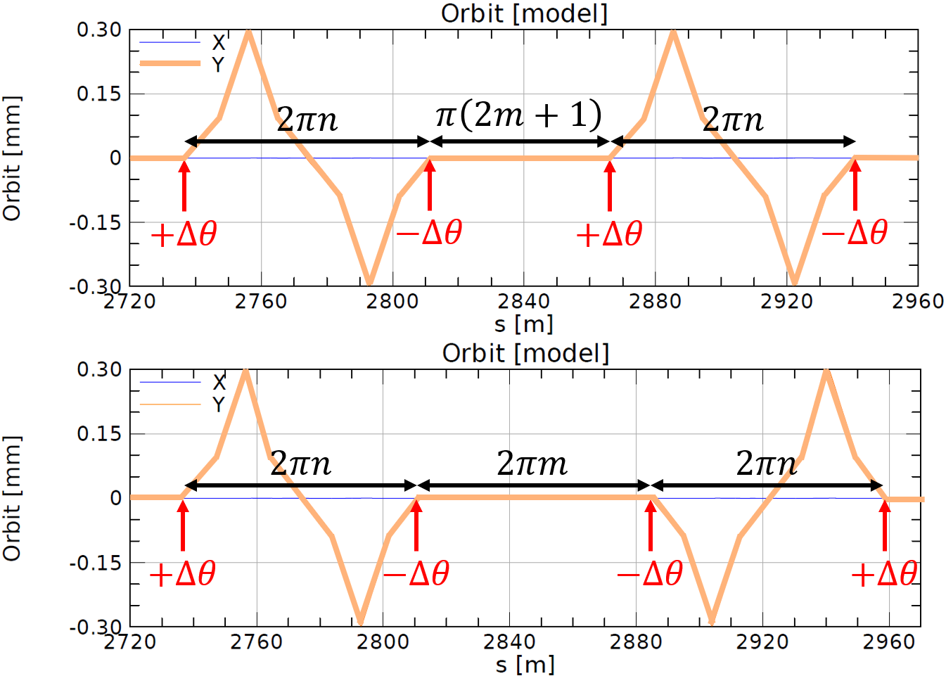
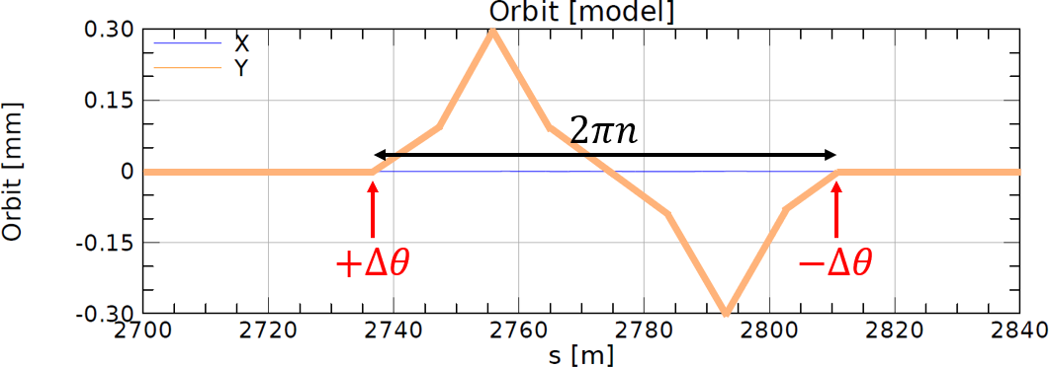
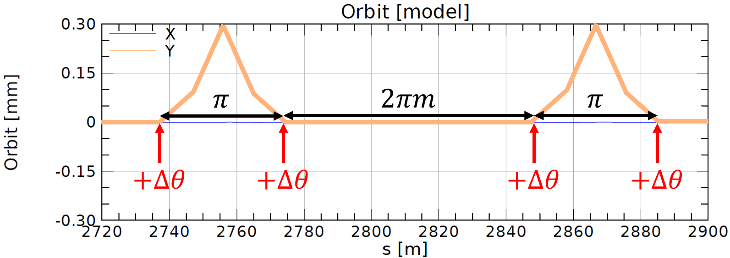
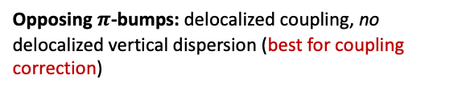


Orbit Bumps in the BAGELS Method
Examples of vertical orbit used bumps setup in the ESR arcs for the BAGELS.
Choice of “unit bump” guided by particular application/goal:
  Sextupoles included in FODO cells here
$2πn$-bump: no delocalized coupling, delocalized vertical dispersion (best for vertical emittance creation)
Opposing $2πn$-bumps: no delocalized coupling and no delocalized vertical dispersion (best for spin matching)
Opposing $π$-bumps: delocalized coupling, no delocalized vertical dispersion (best for coupling correction)
Besides polarization optimization, one can control vertical emittance and betatron coupling
without increasing depolarization!

Slide 16
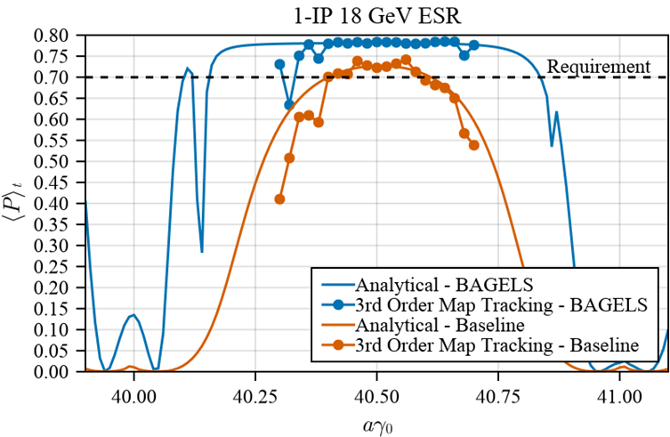
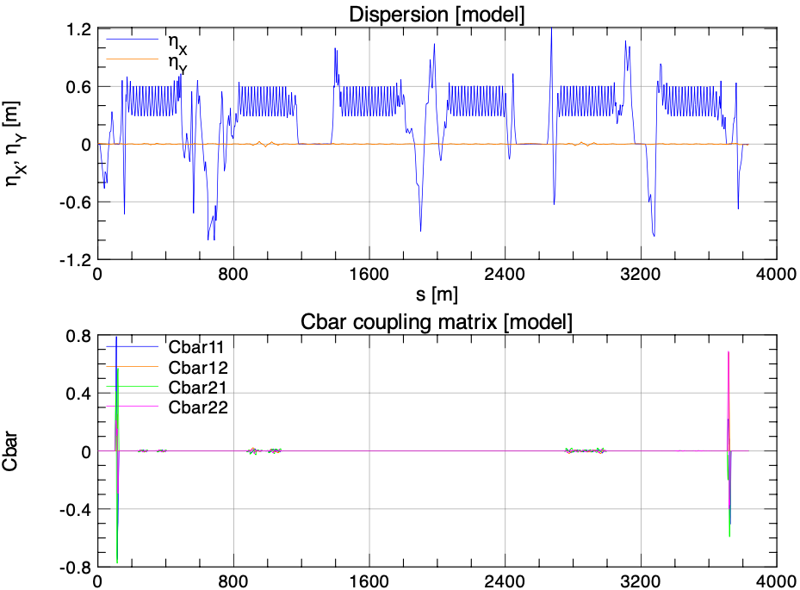
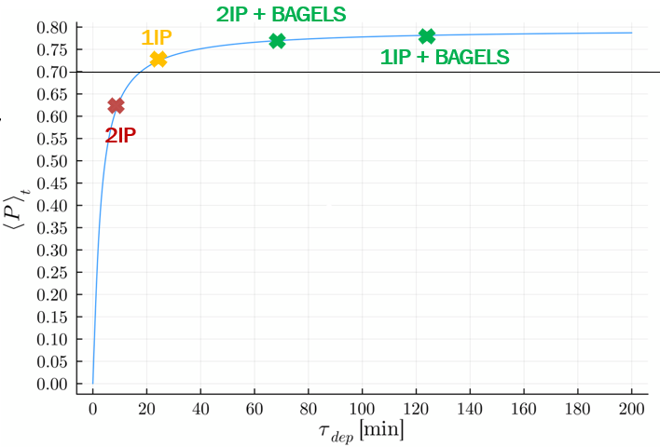
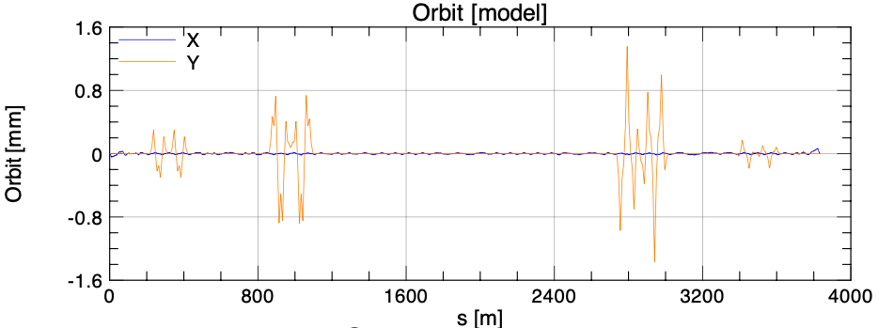
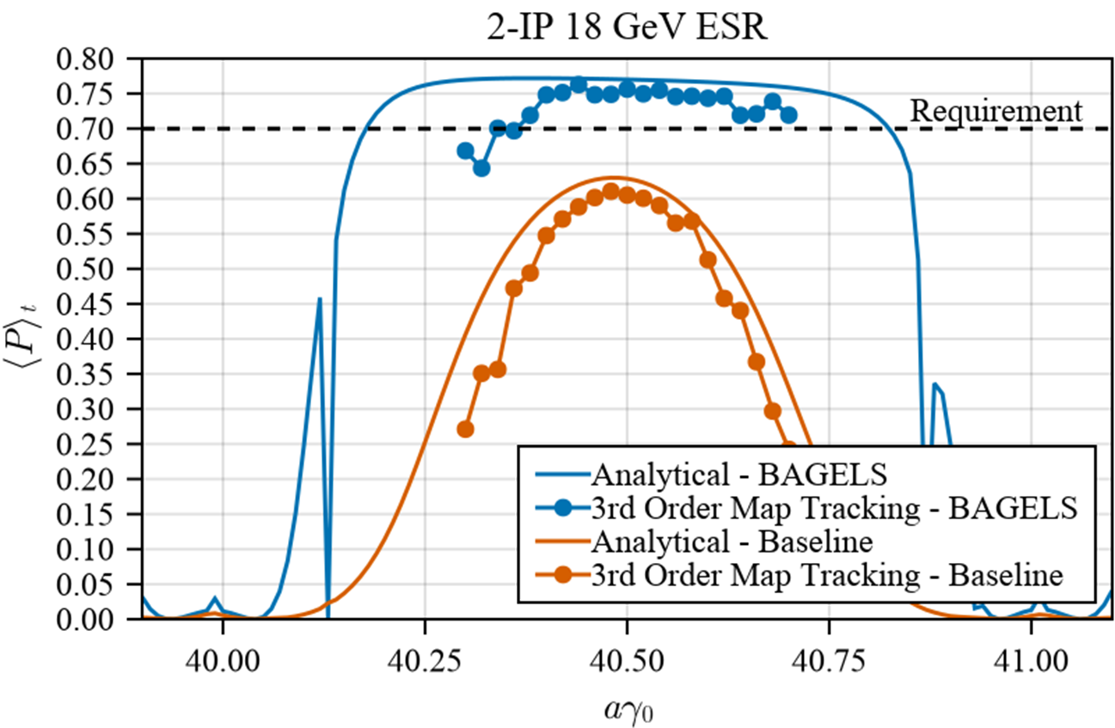
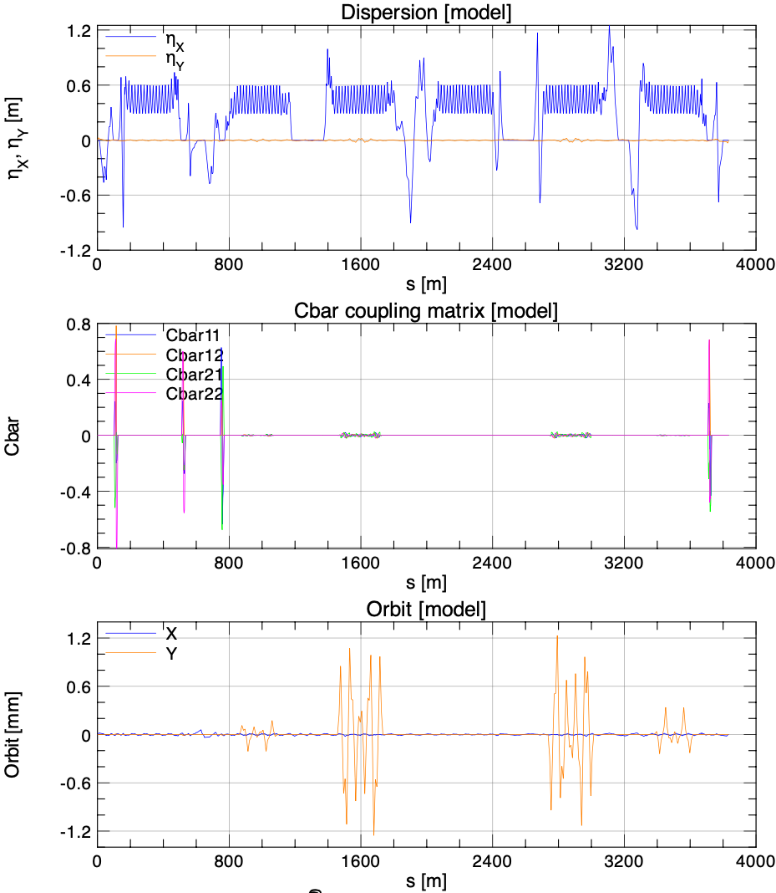

High Polarization at 18 GeV with BAGELS
Choice of unit bump: “Opposing $2πn$-bumps” for no delocalized coupling & no delocalized vertical dispersion
Turning only 4 knobs until polarization is maximal:
Courtesy of M. Signorelli
Max orbit excursion < 1.4 mm
Polarization requirements now exceeded for both 1- and 2-IP 18 GeV lattices

Slide 17
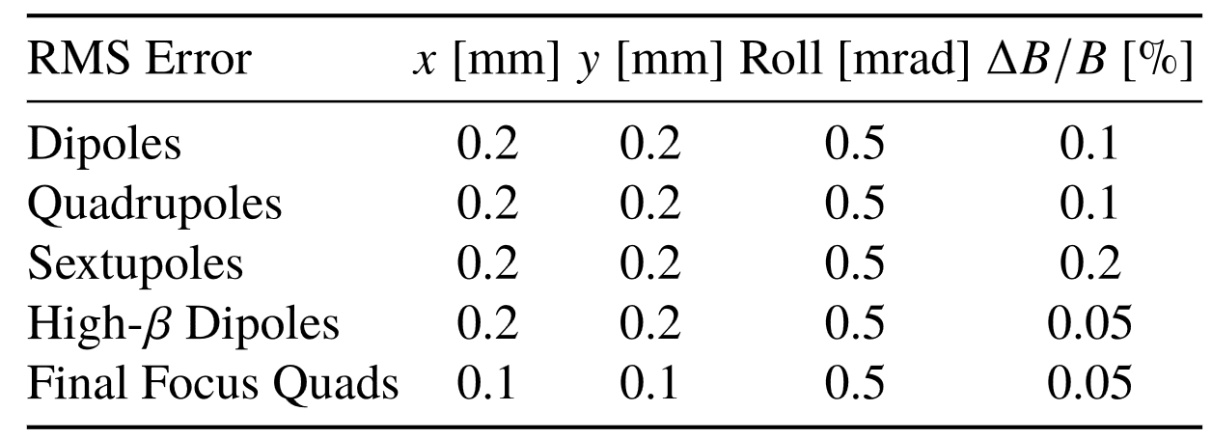
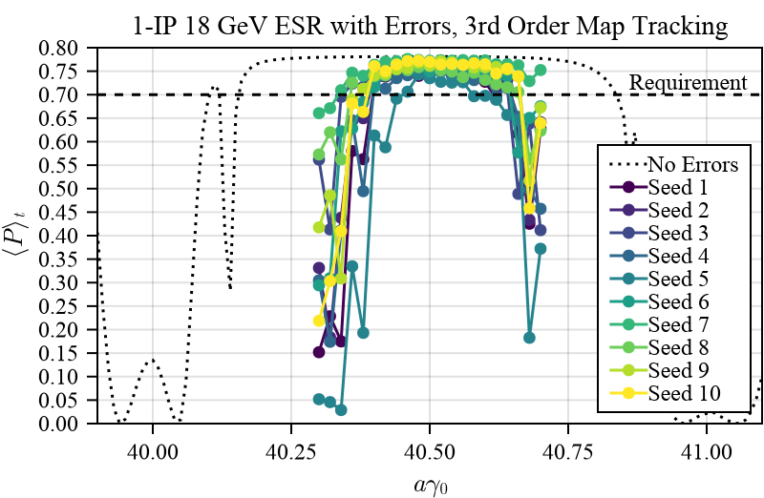
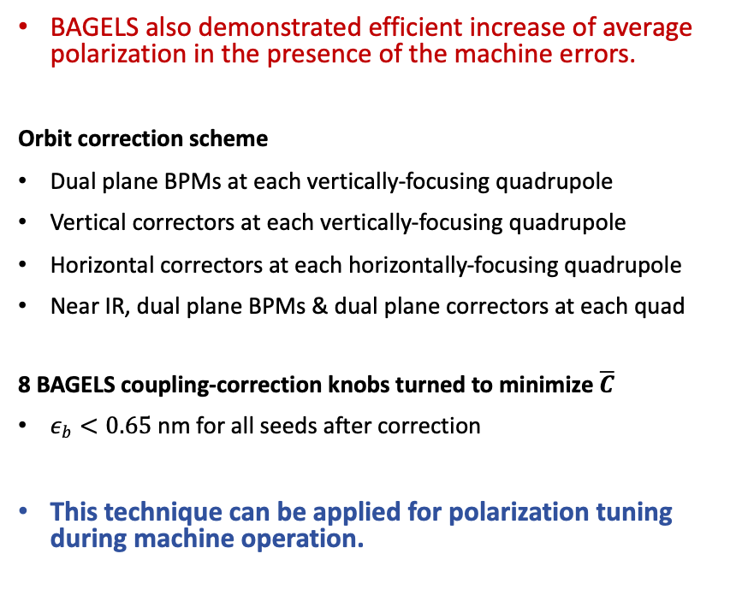
18 GeV Polarization Tuning with Random Errors
BAGELS also demonstrated efficient increase of average polarization in the presence of the machine errors.
Orbit correction scheme
Dual plane BPMs at each vertically-focusing quadrupole
Vertical correctors at each vertically-focusing quadrupole
Horizontal correctors at each horizontally-focusing quadrupole
Near IR, dual plane BPMs & dual plane correctors at each quad
8 BAGELS coupling-correction knobs turned to minimize $\overline{C}$
$ε_{b}<0.65$ nm for all seeds after correction
This technique can be applied for polarization tuning during machine operation.
Courtesy of M. Signorelli

Slide 18
Summary
EIC Electron Storage Ring polarization design is well advanced.
The set of spin rotators based on solenoidal magnets are used to create longitudinal polarization at the IP in all energy range, 5-18 GeV.
The optics of rotator insertions has been optimized for Strong spin matching.
Further spin matching is provided globally by using knobs based on vertical orbit bumps (BAGELS method).
BAGELS method allows to reach high average polarization, and tuning of the vertical emittance and betatron coupling without enhancing depolarization.
Current work is on:
  Study of beam-beam effect on the polarization
  Effect of detector solenoid on the polarization
  Effect of crab-cavities on the polarization

Slide 19
Acknowledgements
BNL: D.Marx, C. Montag, S.Tepikian J. Kewisch, F. Meot
Cornell U: M. Signorelli, G. Hoffstaetter
FNAL: E. Gianfelice-Wendt
ORNL: F. Lin, V. Morozov
SLAC: Y. Cai, Y. Nosochkov
DESY: D. P. Barber

Slide 20
Thank you
for your attention!

