Slide 1
Polarization transmission to high energy at the EIC’s HSR
Eiad Hamwi
PhD Candidate, Cornell ERL/EIC Group
PI: Georg Hoffstaetter de Torquat

Slide 2
Outline
Motivation
Mathematical Background
Scenario 1
Scenario 2
Summary and Conclusion

Slide 3
Motivation
Accelerating polarized hadron beams is quite challenging, since any depolarization is permanent.
Special function “Siberian snake” magnets are expensive and very large (12 meters long). It is important to optimize their use to avoid wasting space and losing polarization.

Slide 4
Spin Transport (TBMT equation)
Under the influence of a magnetic field, the 3D semiclassical spin angular momentum of a motionless particle with gyromagnetic ratio $\left(\frac{q}{2m}g\right)$ precesses in a simple way, known as Larmor precession:
$$\frac{d\vec{S}}{dt}=−\frac{q}{2m}g\vec{B}×\vec{S}$$
However, a curving spinor in the presence of an electromagnetic field will accumulate new effects due to Thomas precession. Combining these effects leads to the Thomas-Bargmann-Michel-Telegdi equation, which can be written as:
$$\frac{d\vec{S}}{dt}={\vec{Ω}}_{TBMT}×\vec{S}$$
$${\vec{Ω}}_{TBMT}=−\frac{q}{mγ}\left[\left(Gγ+1\right)\vec{B}−\frac{G\vec{p}⋅\vec{B}}{\left(γ+1\right)m^{2}c^{2}}\vec{p}−\frac{1}{mc^{2}}\left(G+\frac{1}{γ+1}\right)\vec{p}×\vec{E}\right]$$
Where $γ$ is the relativistic factor, and $G=\frac{g−2}{2}$, where $g$ is the dimensionless g-factor

Slide 5
Spin Transport (TBMT equation)
In the absence of electric fields, this equation can be rewritten in terms of transverse and longitudinal $\vec{B}$ fields:
$$\vec{Ω}=−\frac{q}{mγ}\left[\left(Gγ+1\right){\vec{B}}_{⊥}−\left(1+G\right){\vec{B}}_{∥}\right]$$
In the context of an ultrarelativistic circular accelerator without solenoidal (longitudinal) fields, we are left with one dominating term:
$$\vec{Ω}=−\frac{q}{mγ}\left(Gγ+1\right){\vec{B}}_{⊥}$$
Finally, in a stationary reference frame rotating in sync with the momentum $\vec{p}$ of the particle, we find the natural precession rate of the spin, commonly known as the closed-orbit spin tune $ν_{0}$:
$$\left|\vec{Ω}\right|=\frac{qG}{m}\left|{\vec{B}}_{⊥}\right|=Gγ [rev/turn]$$

Slide 6
Spin-Orbit Resonance
Conditions arise that can trigger resonant effects in a bunch’s spin precession.
Particularly, natural errors in magnet alignments and magnetic field strengths give rise to imperfection resonances if the expected c.o. spin tune $ν_{0}$ is integer, i.e. if the polarization vector is unchanged turn-by-turn.
$$ν_{0}=Gγ∈ℤ$$
This subjects the bunch polarization to the same perturbations every turn, leading to exponential decoherence of polarization.
Otherwise, natural vertical betatron oscillations subject particles in a bunch to horizontal transverse fields in a quasiperiodic manner, possibly leading to depolarization. These effects are known as intrinsic resonances since they arise from the strong focusing of alternating gradient accelerators, and occur if the c.o. spin tune $ν_{0}$ synchronizes with the vertical betatron tune $Q_{y}$:
$$ν_{0}±Q_{y}∈ℤ$$

Slide 7
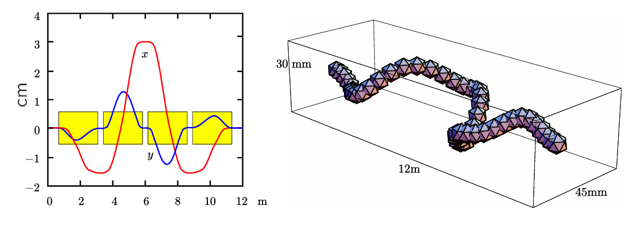
Avoiding Spin Resonances with Siberian Snakes
Siberian snakes are special-function magnets that were conceived in Novosibirsk in the late 1970s by Ya. S. Derbenev and A. M. Kondratenko. They are used to rotate the spin of particles with large $Gγ$-factors by 180° during acceleration.
The name "Siberian snake" was coined by E.D. Courant and refers to the helical shape of the beam path in the device.

Slide 8
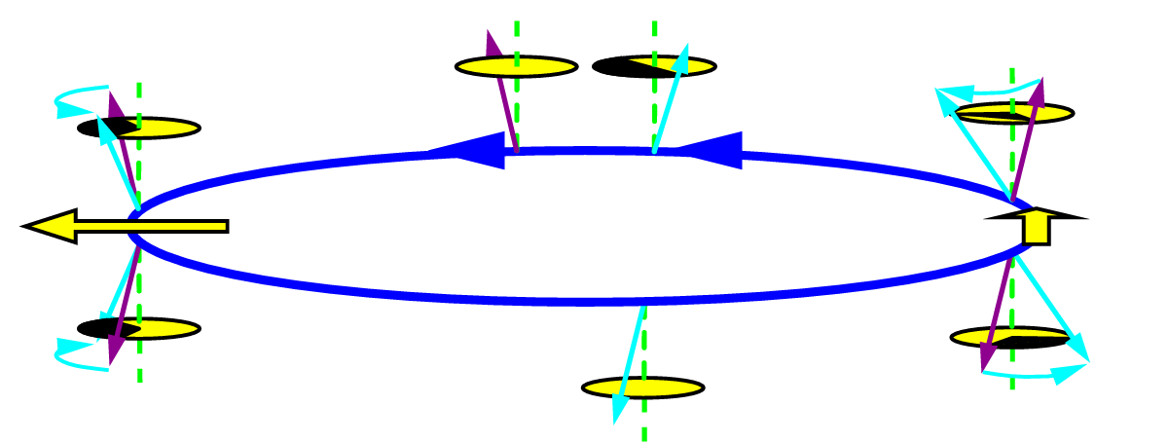
Avoiding Spin Resonances with Siberian Snakes
By rotating the spin around a horizontal axis, pairs of diametrically opposite snakes can be used to fix $ν_{0}=\frac{1}{2}$
The necessary conditions for this phenomenon are that the integrated vertical spin precession through dipoles $ΔΨ$ is zero, and the total vertical spin precession through snakes is exactly $180°$. Together, these conditions allow $ν_{0}=\frac{1}{2}$ independent of energy.
$$+Ψ$$
$$+Ψ$$
$$−Ψ$$
$$−Ψ$$

Slide 9
Invariant Spin Field
The proper use of Siberian snakes enables the beam to avoid all first-order spin resonances, both imperfection and intrinsic, due to fixing the closed orbit spin tune $ν_{0}$.
However, in stable beam dynamics there usually exists a generalized reference frame describing the spin precession of particles away from the closed orbit, known as the invariant frame field. In this coordinate system, the generalized precession frequency is termed the amplitude-dependent spin tune $ν$ and is in general different from the closed orbit spin tune:
$$ν≠ν_{0}=\frac{1}{2}$$
In this coordinate system, we find new, higher-order spin-orbit resonances arising from nonlinearities in the spin-orbit coupling integrals. Amongst these higher-order resonances are the well-known snake resonances, occurring for specific choices of vertical orbital tune that generate fundamental discontinuities in the invariant spin field.
$ν+jQ_{y}=k,$ $j,k∈ℤ$

Slide 10
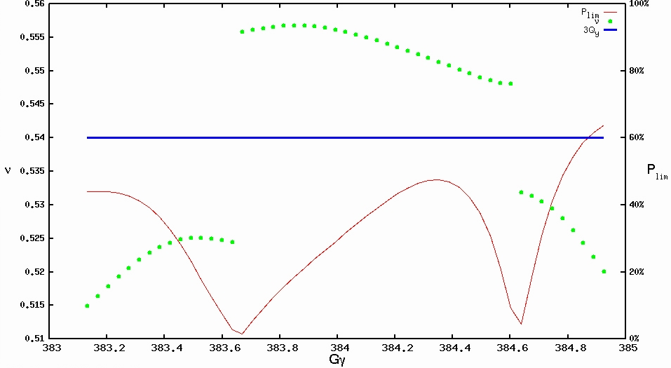
Higher-Order Spin Resonances
$ν+j_{x}Q_{x}+j_{y}Q_{y}+j_{z}Q_{z}=k,$ $\vec{j},k∈ℤ$
By choosing appropriately irrational tunes,
higher-order resonances can be avoided for
small amplitude particles.
Higher-order spin resonances are found in
the energy vicinity of major first-order spin
resonances due to their strong spin-orbital
perturbations.
The only way to confirm the presence of
higher-order resonances is via computationally
expensive, non-perturbative methods.
(Stroboscopic averaging, SODOM-2, etc.)
ADST
3rd order spin resonance
Equilibrium polarization

Slide 11
Spin-Orbit Coupling
a.k.a. first-order spin resonance strengths
In a linearized approximation of spin-orbit motion, the cumulative effect of non-vertical spin precession is referred to as spin-orbit coupling.
Frequently only includes the effect of quadrupoles but can include coupled motion and higher-order magnets.
$$Δ\left(s_{x}+is_{z}\right)∝\oint_{l_{0}}^{l_{0}+L}{\left[\vec{Ω}\left(s\right)⋅\left(\hat{x}+i\hat{z}\right)\right] e^{−iψ\left(s\right)} ds}$$
$$≈\left(Gγ+1\right) \oint_{l_{0}}^{l_{0}+L}{k\left(s\right) y\left(s\right) e^{−iψ\left(s\right)} ds}$$
$$≈\left(Gγ+1\right) \oint_{l_{0}}^{l_{0}+L}{k\left(s\right)\sqrt{β_{y}\left(s\right)} e^{±iφ_{y}\left(s\right)} e^{−iψ\left(s\right)} ds}$$
$ψ\left(s\right)=\int_{l_{0}}^{s}{Ω_{y}(s)}ds$

Slide 12
Snake Matching
Best way to mitigate higher-order resonances is by minimizing first-order spin resonance strengths (even though snakes kill them).
In other words, to minimize the spin-orbit coupling integrals at relevant depolarizing energies:
$$\frac{Gγ+1}{i\sqrt{2}} \oint_{l_{0}}^{l_{0}+L}{k(s)\sqrt{β_{y}(s)} e^{i\left(−ψ\left(s\right) ± φ_{y}\left(s\right)\right)} ds}$$
This can be done by any or both of:
Exploring the 5D space of allowed snake rotation axes $∝ψ_{i}$
Exploring the space of phase advances between snakes with fixed lattice tune $\oint{φ_{y} ds}=2πQ_{y}$

Slide 13
First Scenario
In this report I attempt to vary the phase advances between 3 snakes by adding power supply shunts to quadrupoles in the arcs adjacent to each IR in the 2-IR store lattice.
Power supply 1 is attached in series to all the quadrupoles between
YI6_QD10 ↔ YI7_QD10
Power supply 2 is attached in series to all the quadrupoles between
YO8_QF10 ↔ YI9_QF10
For each choice of phase advance, I ramp a single Helion particle polarized parallel to the invariant spin field from $Gγ=700$ rev/turn to $Gγ=800$ rev/turn to measure polarization transmission in the most depolarizing energy range.
PS-2
PS-1

Slide 14
The requisite extra power supply currents for phase advance control:
I₁ Arc 6-7 YI6_10 ↔ YI7_10
I₂ Arc 8-9 YO8_10 ↔ YI9_10
$I_{1}$ (A)
$I_{2}$ (A)
$φ_{2}$ (rad)
$φ_{2}$ (rad)
$φ_{1}$ (rad)
$φ_{1}$ (rad)
Working point

Slide 15
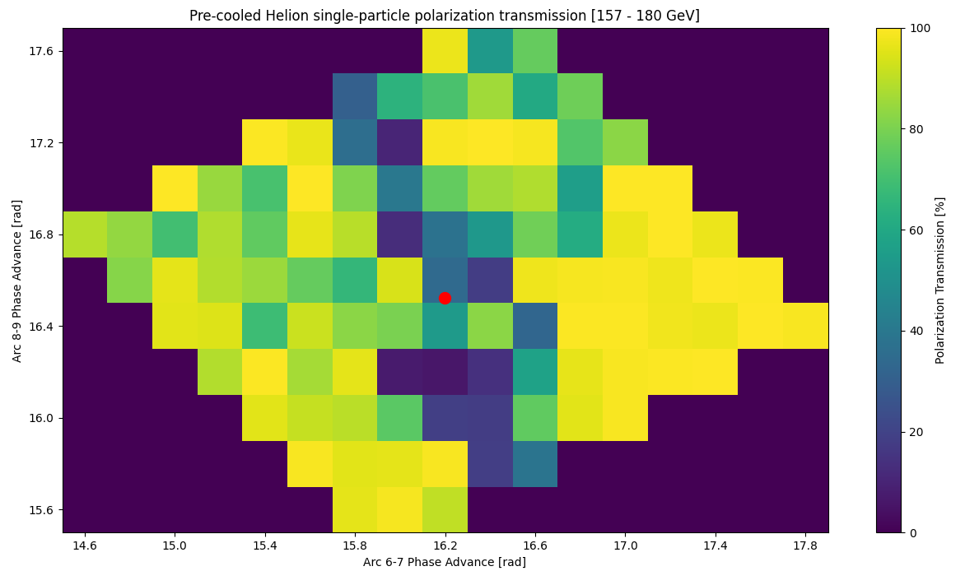
Normalized
emittances
$$ε_{x}=2.5 μm$$
$$ε_{y}=0.5 μm$$
Working point

Slide 16
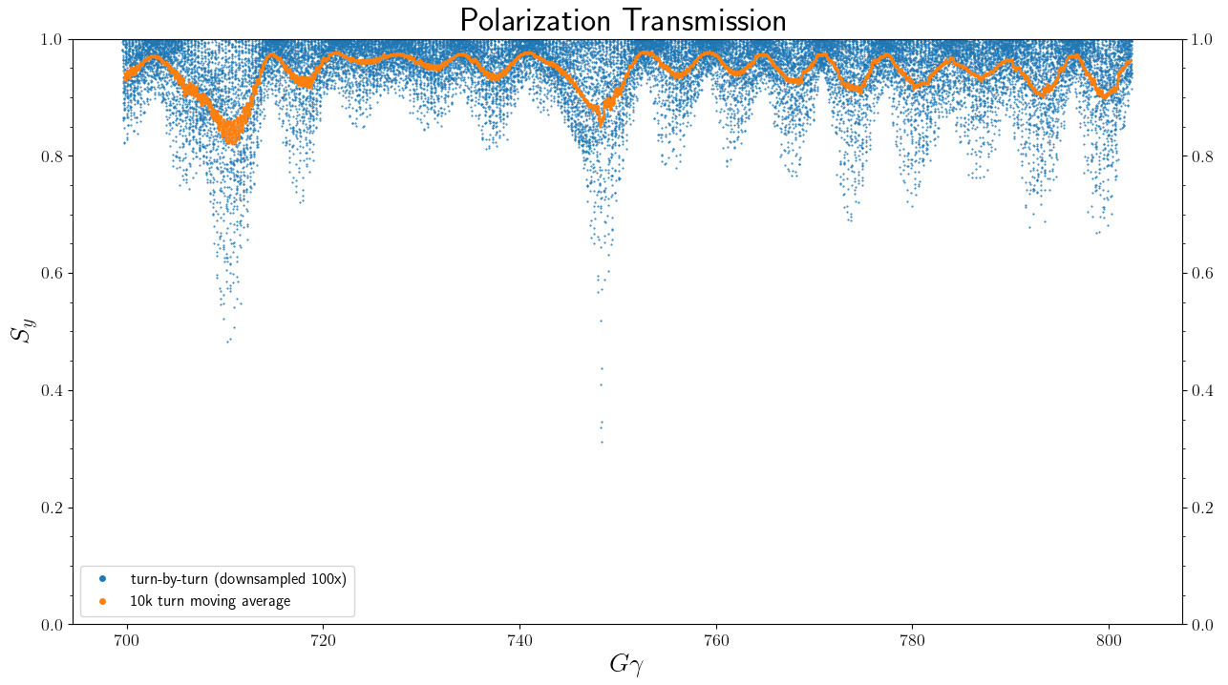
One example of a successful polarized ramp with ~98% transmission is (16.6, 16.6)

Slide 17
Second Scenario (1-IR Injection Lattice)
In the following case I vary the phase advances in all six arcs of the injection lattice by imposing artificial distributed “phase trombones” throughout the ring, using 4x4 transfer matrices.
The phase advances are varied to minimize the spin-orbit coupling in critical regions as previously suggested.
For each choice of phase advance, I ramp an ellipse of helium-3 ions polarized parallel to the invariant spin field from $Gγ=700$ rev/turn to $Gγ=800$ rev/turn to measure polarization transmission in the most depolarizing energy range.

Slide 18
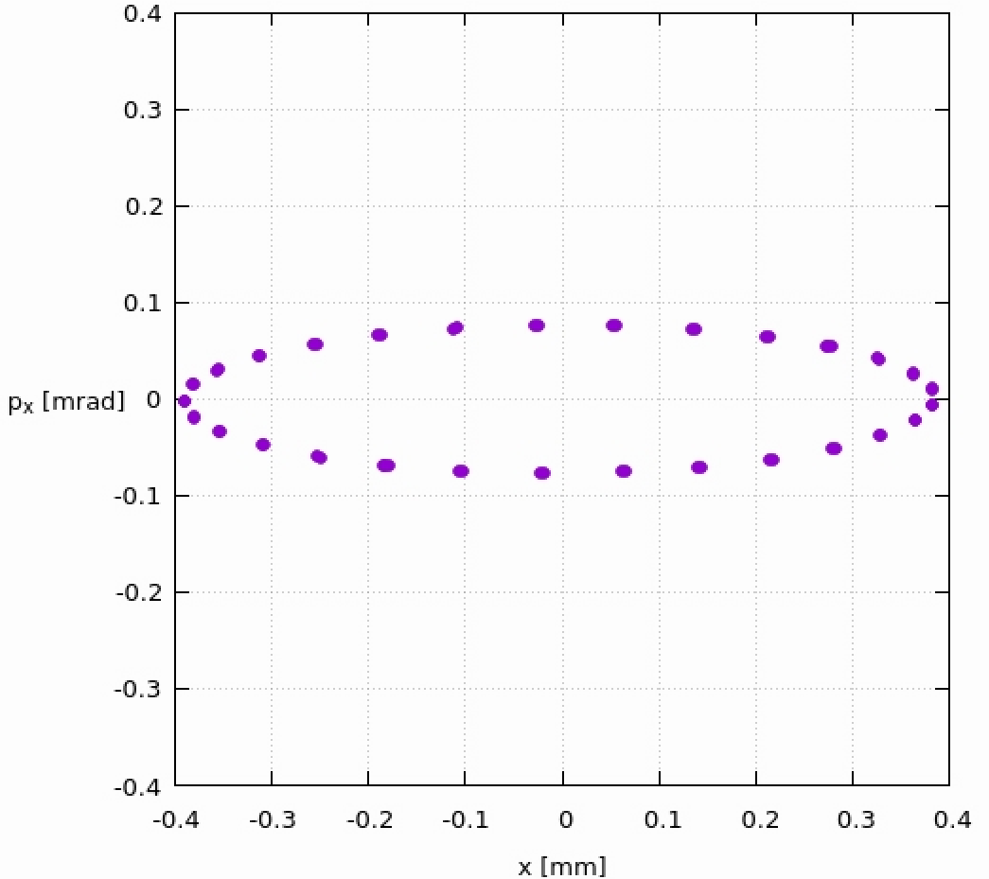
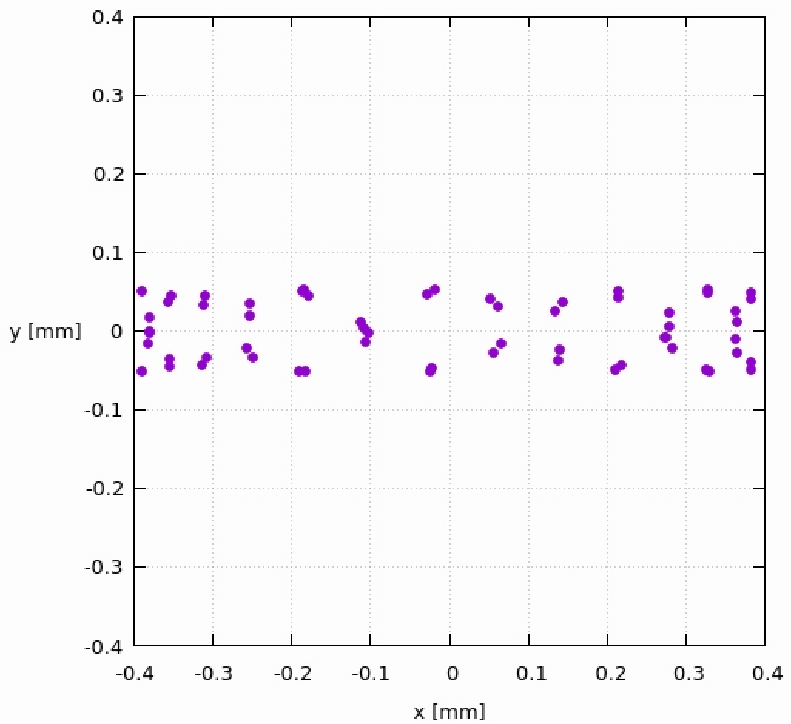
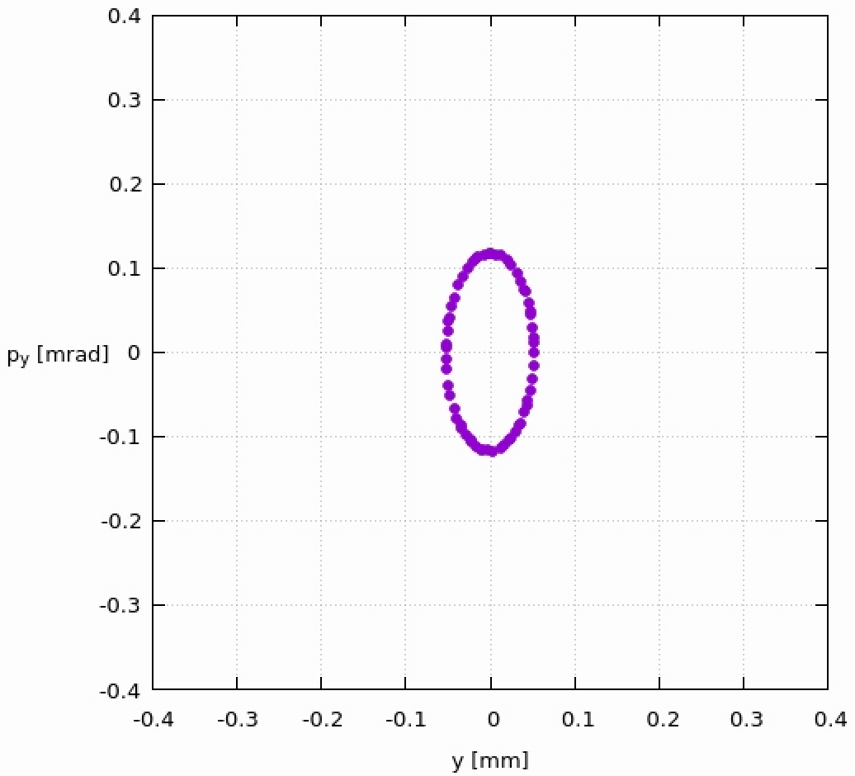
Pre-cooled bunch distribution
Normalized
emittances
$$ε_{x}=2.5 μm$$
$$ε_{y}=0.5 μm$$
Horizontal phase space
Bunch profile
Vertical phase space

Slide 19
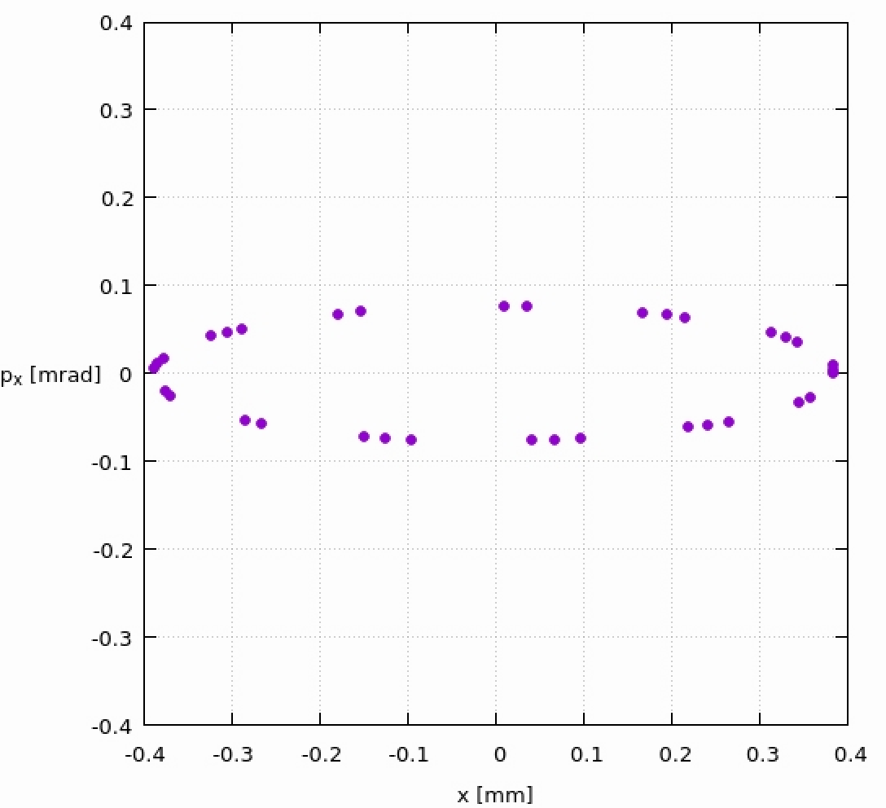
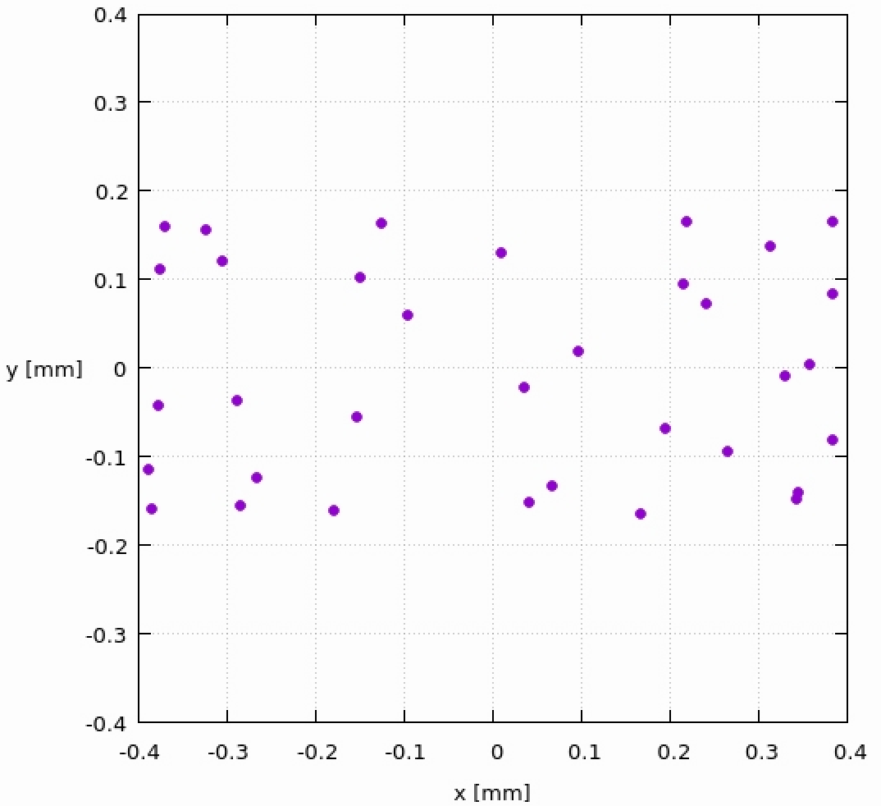
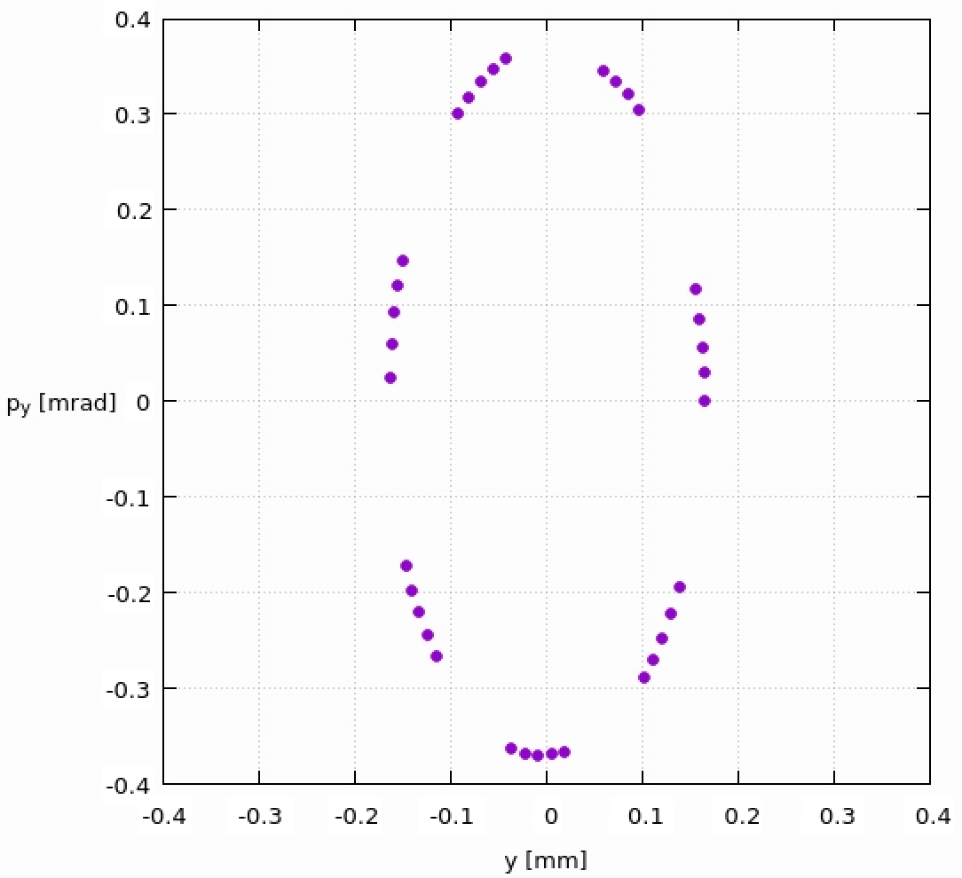
Regular bunch distribution
Normalized
emittances
$$ε_{x}=2.5 μm$$
$$ε_{y}=5.0 μm$$
Horizontal phase space
Bunch profile
Vertical phase space

Slide 20
99.8% transmission for pre-cooled helium-3 (Phase trombones unnecessary)
$$⟨S_{y}⟩$$
$$Gγ$$

Slide 21
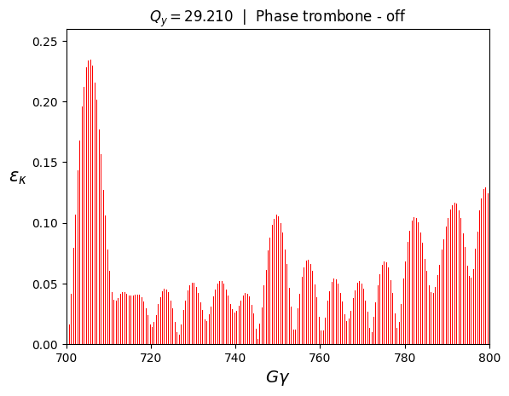
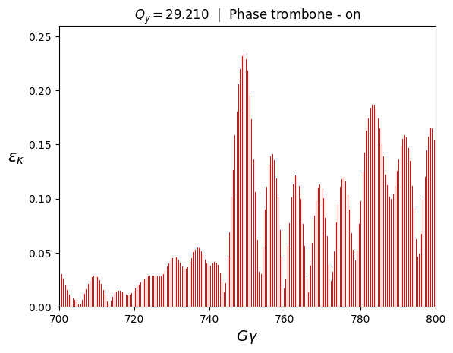
Uncooled helium-3 resonance spectra (no snakes)
Phase trombones are effective at damping first resonant region around $Gγ \sim 705$

Slide 22
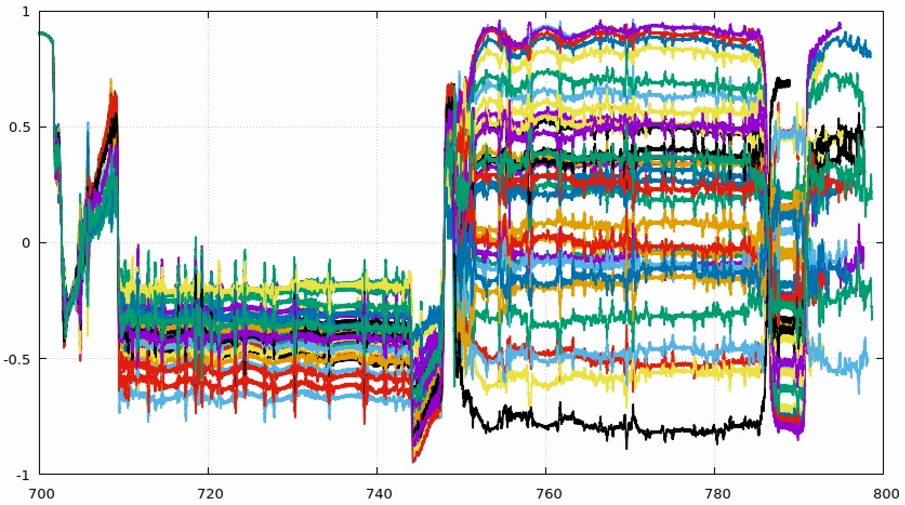
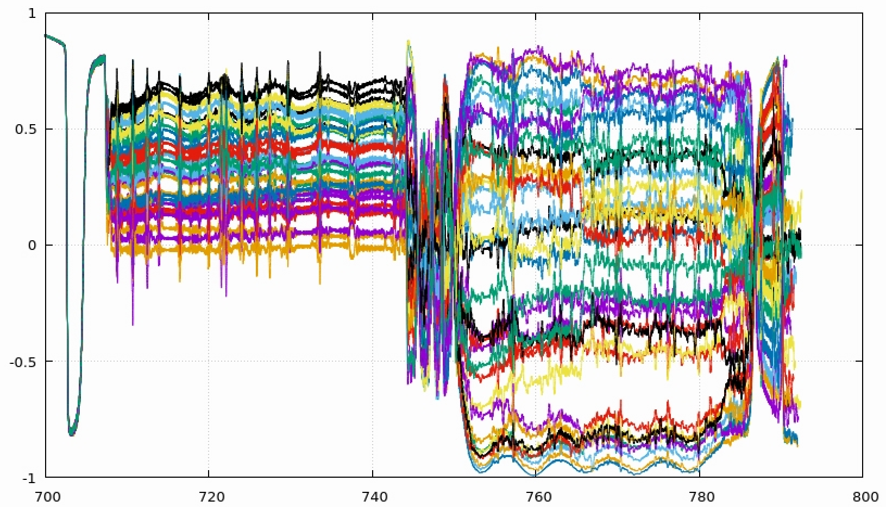
Tracking comparison for uncooled helium-3
Phase trombones - off
Phase trombones - on
$$\left\langle \vec{S}⋅\vec{n}\right\rangle =−0.45$$
$$\left\langle \vec{S}⋅\vec{n}\right\rangle =0.36$$
Significant depolarization with uncooled emittance was improved (at one resonance) using phase trombones.

Slide 23
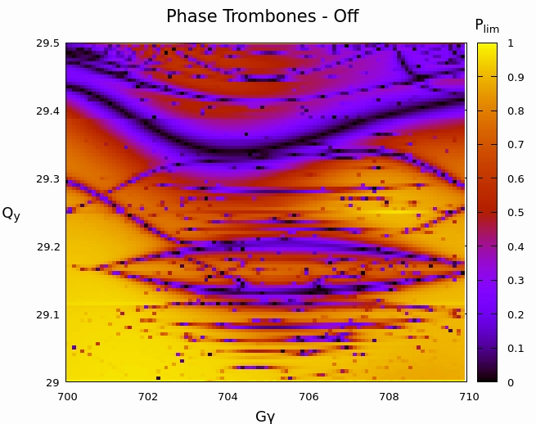
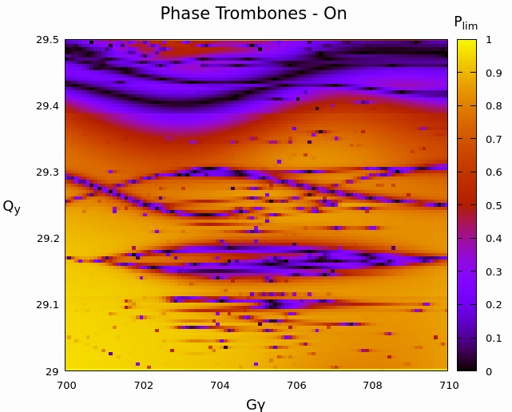
Tune-energy scan $\left(Gγ \sim 705\right)$

Slide 24
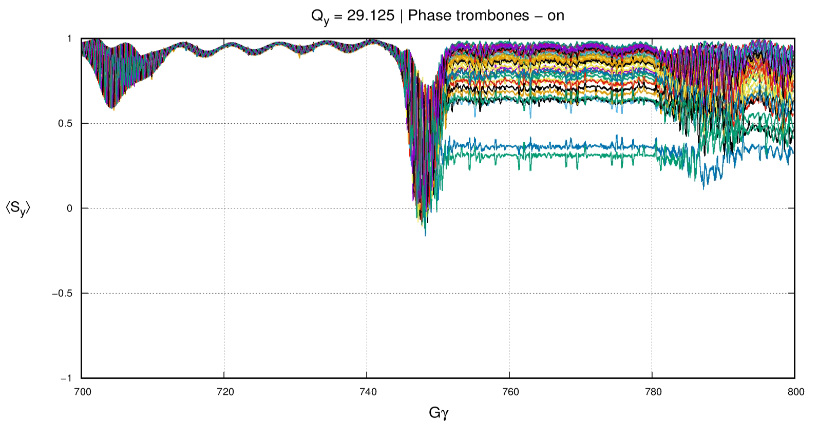
Tracking with new tune* $\left(Q_{y}=29.125\right)$
Adjusting the vertical tune as well as using phase trombones allows complete avoidance of higher-order resonances.
$$\left\langle \vec{S}⋅\vec{n}\right\rangle =0.992$$
*This is a 4th order snake resonance

Slide 25
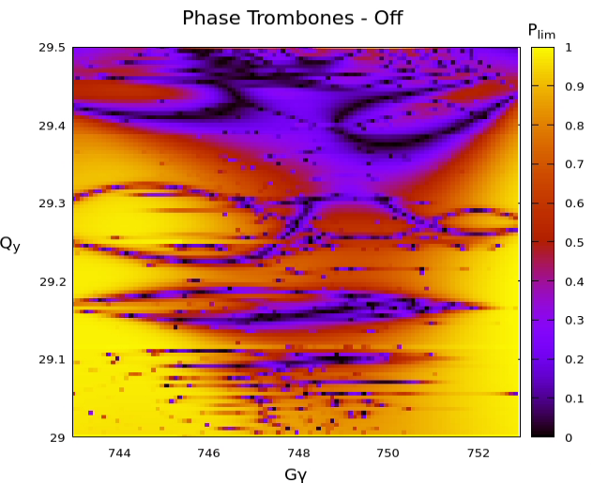
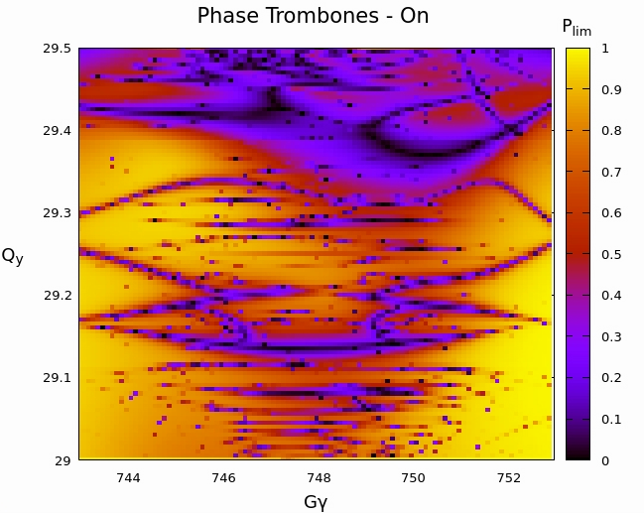
Tune-energy scan $\left(Gγ \sim 748\right)$

Slide 26
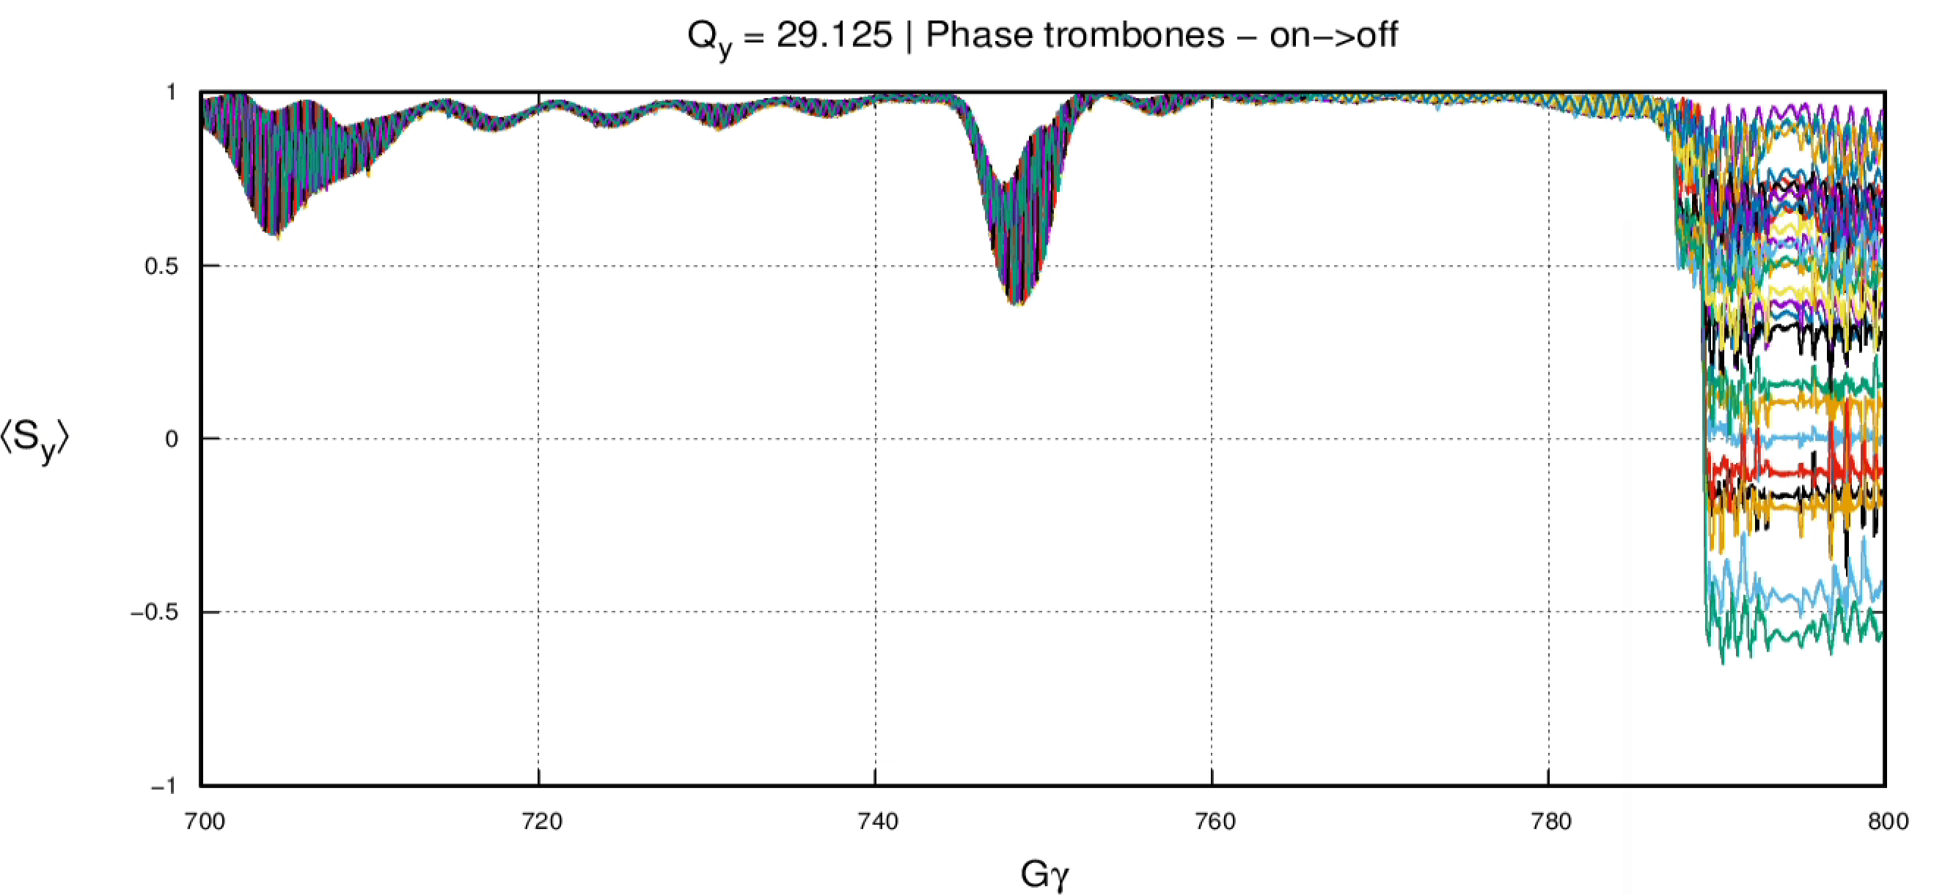
Tracking with changing phase advance
Turning off the phase trombones in the shaded region alleviates the second resonance

Slide 27
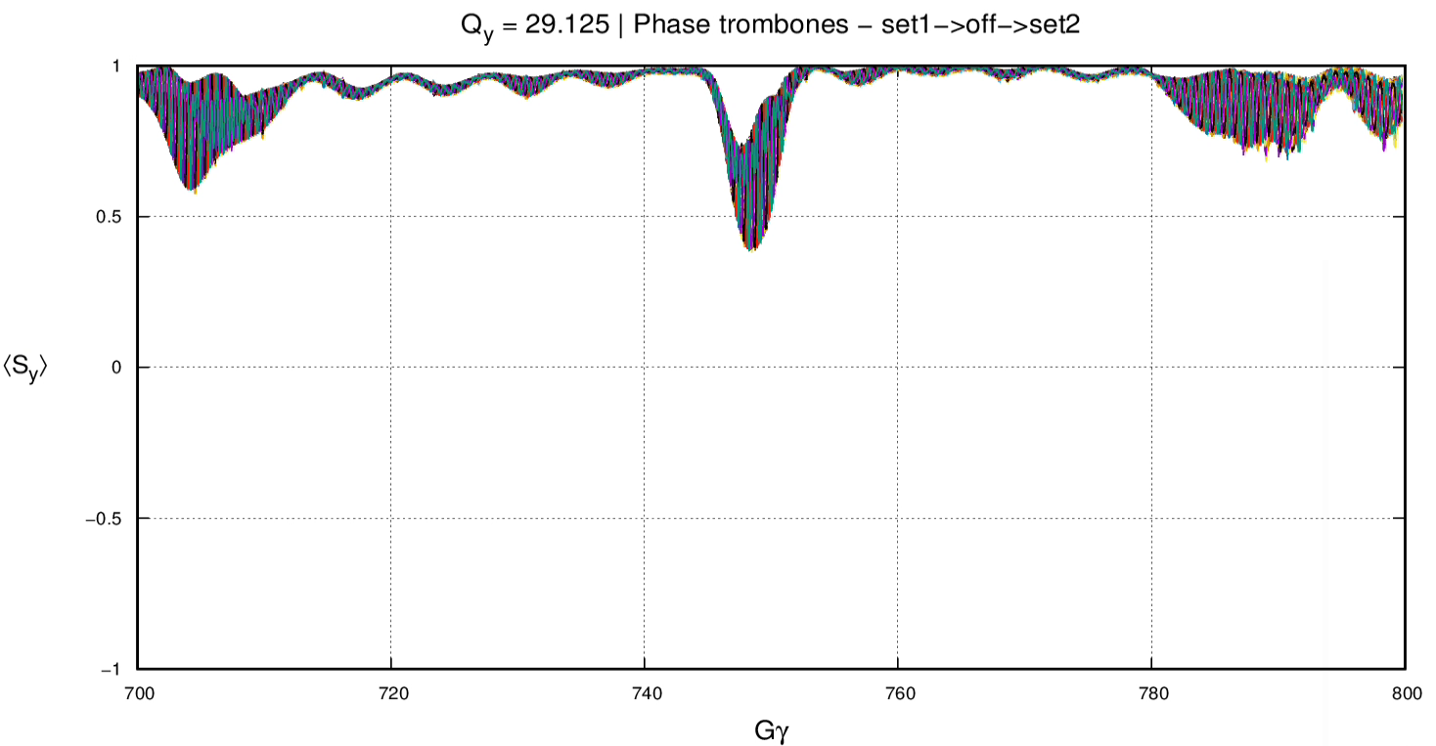
Tracking with two sets of phase advances
Using 3 sets of phase trombone settings alleviates all 3 resonance crossings.

Slide 28
$I_{1}$ (A)
Practical phase advances
Max $\ddot{I} \sim 0.3 A/s^{2}$
Max $\dot{I} \sim 22 A/s$
Referring to previous results, changing quadrupole currents by 100s of Amperes is not feasible during ramp.
The most feasible strategy is finding the best set of phase advances and tunes for all strongly depolarizing regions simultaneously.
We propose to do this by leveraging PTC’s normal form computation of the amplitude-dependent spin tune using Bmad’s automated multi-universe optimization.
$φ_{2}$ (rad)
$φ_{1}$ (rad)
$I_{2}$ (A)
$φ_{2}$ (rad)
$φ_{1}$ (rad)

Slide 29
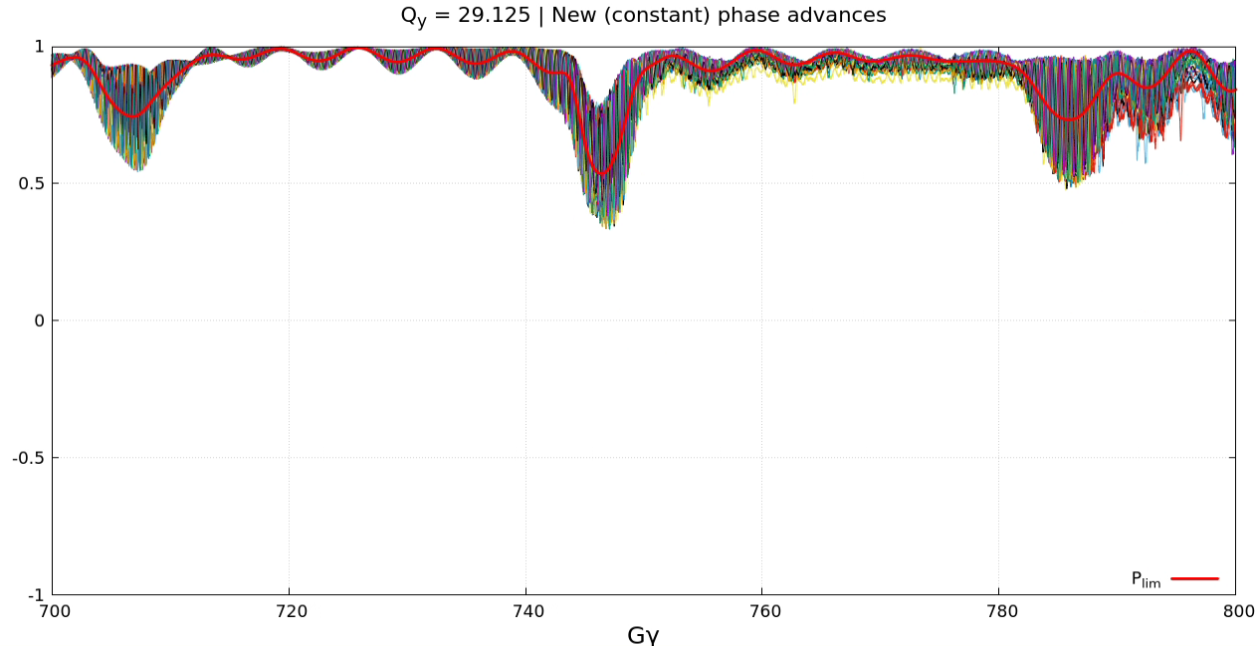
Tracking with constant phase advance
$$\left\langle \vec{S}⋅\vec{n}\right\rangle =0.964$$

Slide 30
Summary and Conclusion
Large parameter space is being explored for tuning 6 Siberian snakes in the HSR lattice.
Pre-cooled beams of polarized protons and polarized helium-3 are safe against spin resonances.
Polarization transmission of uncooled helium-3 beams benefit tremendously from vertical phase advance optimization.
Remaining snake axes degrees of freedom offer avenues for further enhancing polarization transmission robustness against errors.

Slide 31
Acknowledgements and References
I would like to thank Kiel Hock, Haixin Huang, and Vahid Ranjbar for helpful discussions about this topic.
This work has been supported by Brookhaven Science Associates, LLC under Contract No. DE-SC0012704 with the U.S. Department of Energy, and No. DE-SC0018008.
[1] Hoffstaetter, G. H. “High energy polarized proton beams: a modern view.” (Vol. 218). Springer Science & Business Media (2006).
[2] Yokoya, K. “An algorithm for calculating the spin tune in circular accelerators.” DESY–99–006 (1999). [3] Bai, Mei, et al. “Observations of Snake Resonance in RHIC.” in Proc. IPAC’05. IEEE (2005). [4] Hoffstaetter, G. H. “Optimal axes of Siberian snakes for polarized proton acceleration.” Phys Rev ST A&B 7, no. 12 (2004): 121001.

Slide 32
Thanks for Listening!
Questions?

