Slide 1
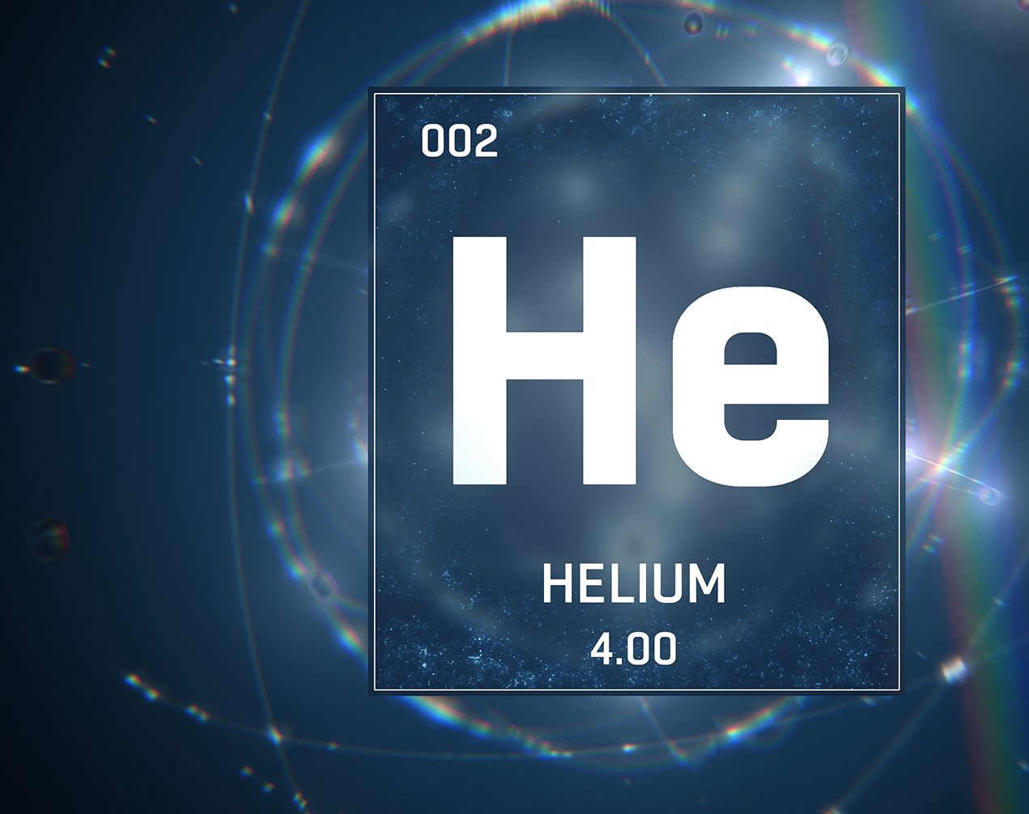
The New Helium Recapture System at Dynamic Nuclear Polarization Target group at UNH
Chhetra Lama
University of New Hampshire
1

Slide 2
Outline of the Presentation
Motivation and Introduction
Experimental Setup Idea/ Recovery Pathway
The Working Principle
Issues Seen and the troubleshooting
Conclusion

Slide 3
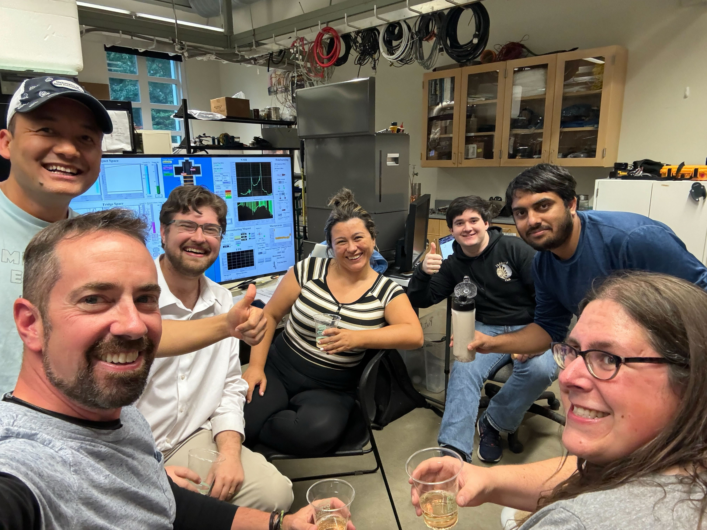
Motivation for Recapturing LHe
Finding ways to conserve LHe helps save funds and conserves a limited resource.
Our physics runs increases from 3runs/year to >15 runs/year
From Left to Rigrht: Chhetra, Karl, David, Nathaly, Eli, Farooq, Elena

Slide 4
What is Helium Recapture System?
Mother Dewar
Polarized target
Collection manifold
Gas Bag
Compressor
Gas Bank
Purifier
Liquefier
The system which recaptures the used Helium and processees supply for reuse in the next experiment.
In our first cooldown 91% recovery rate and the second 90.5%

Slide 5
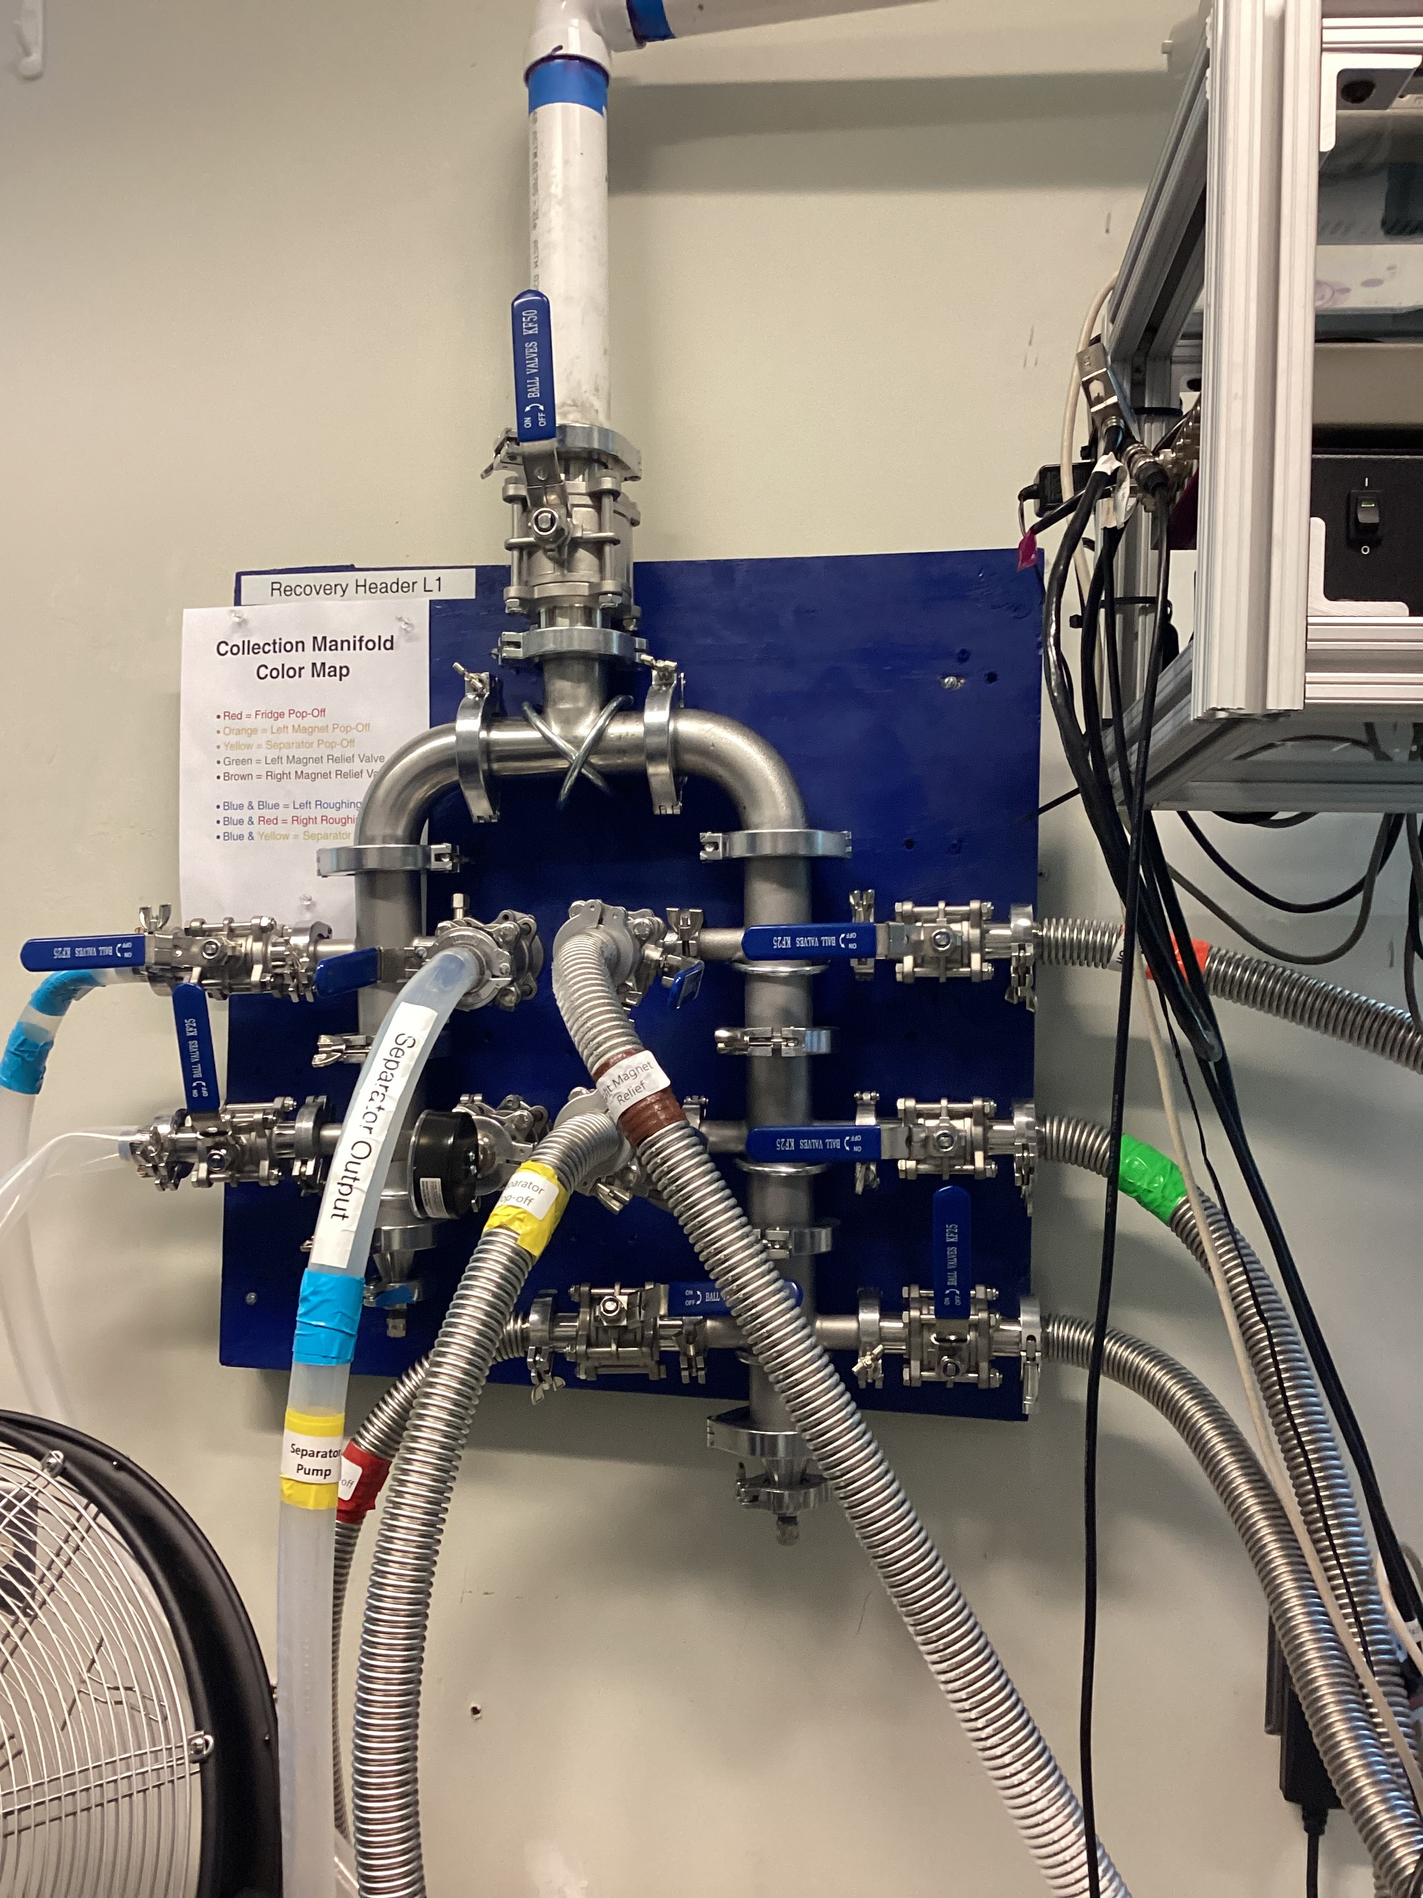
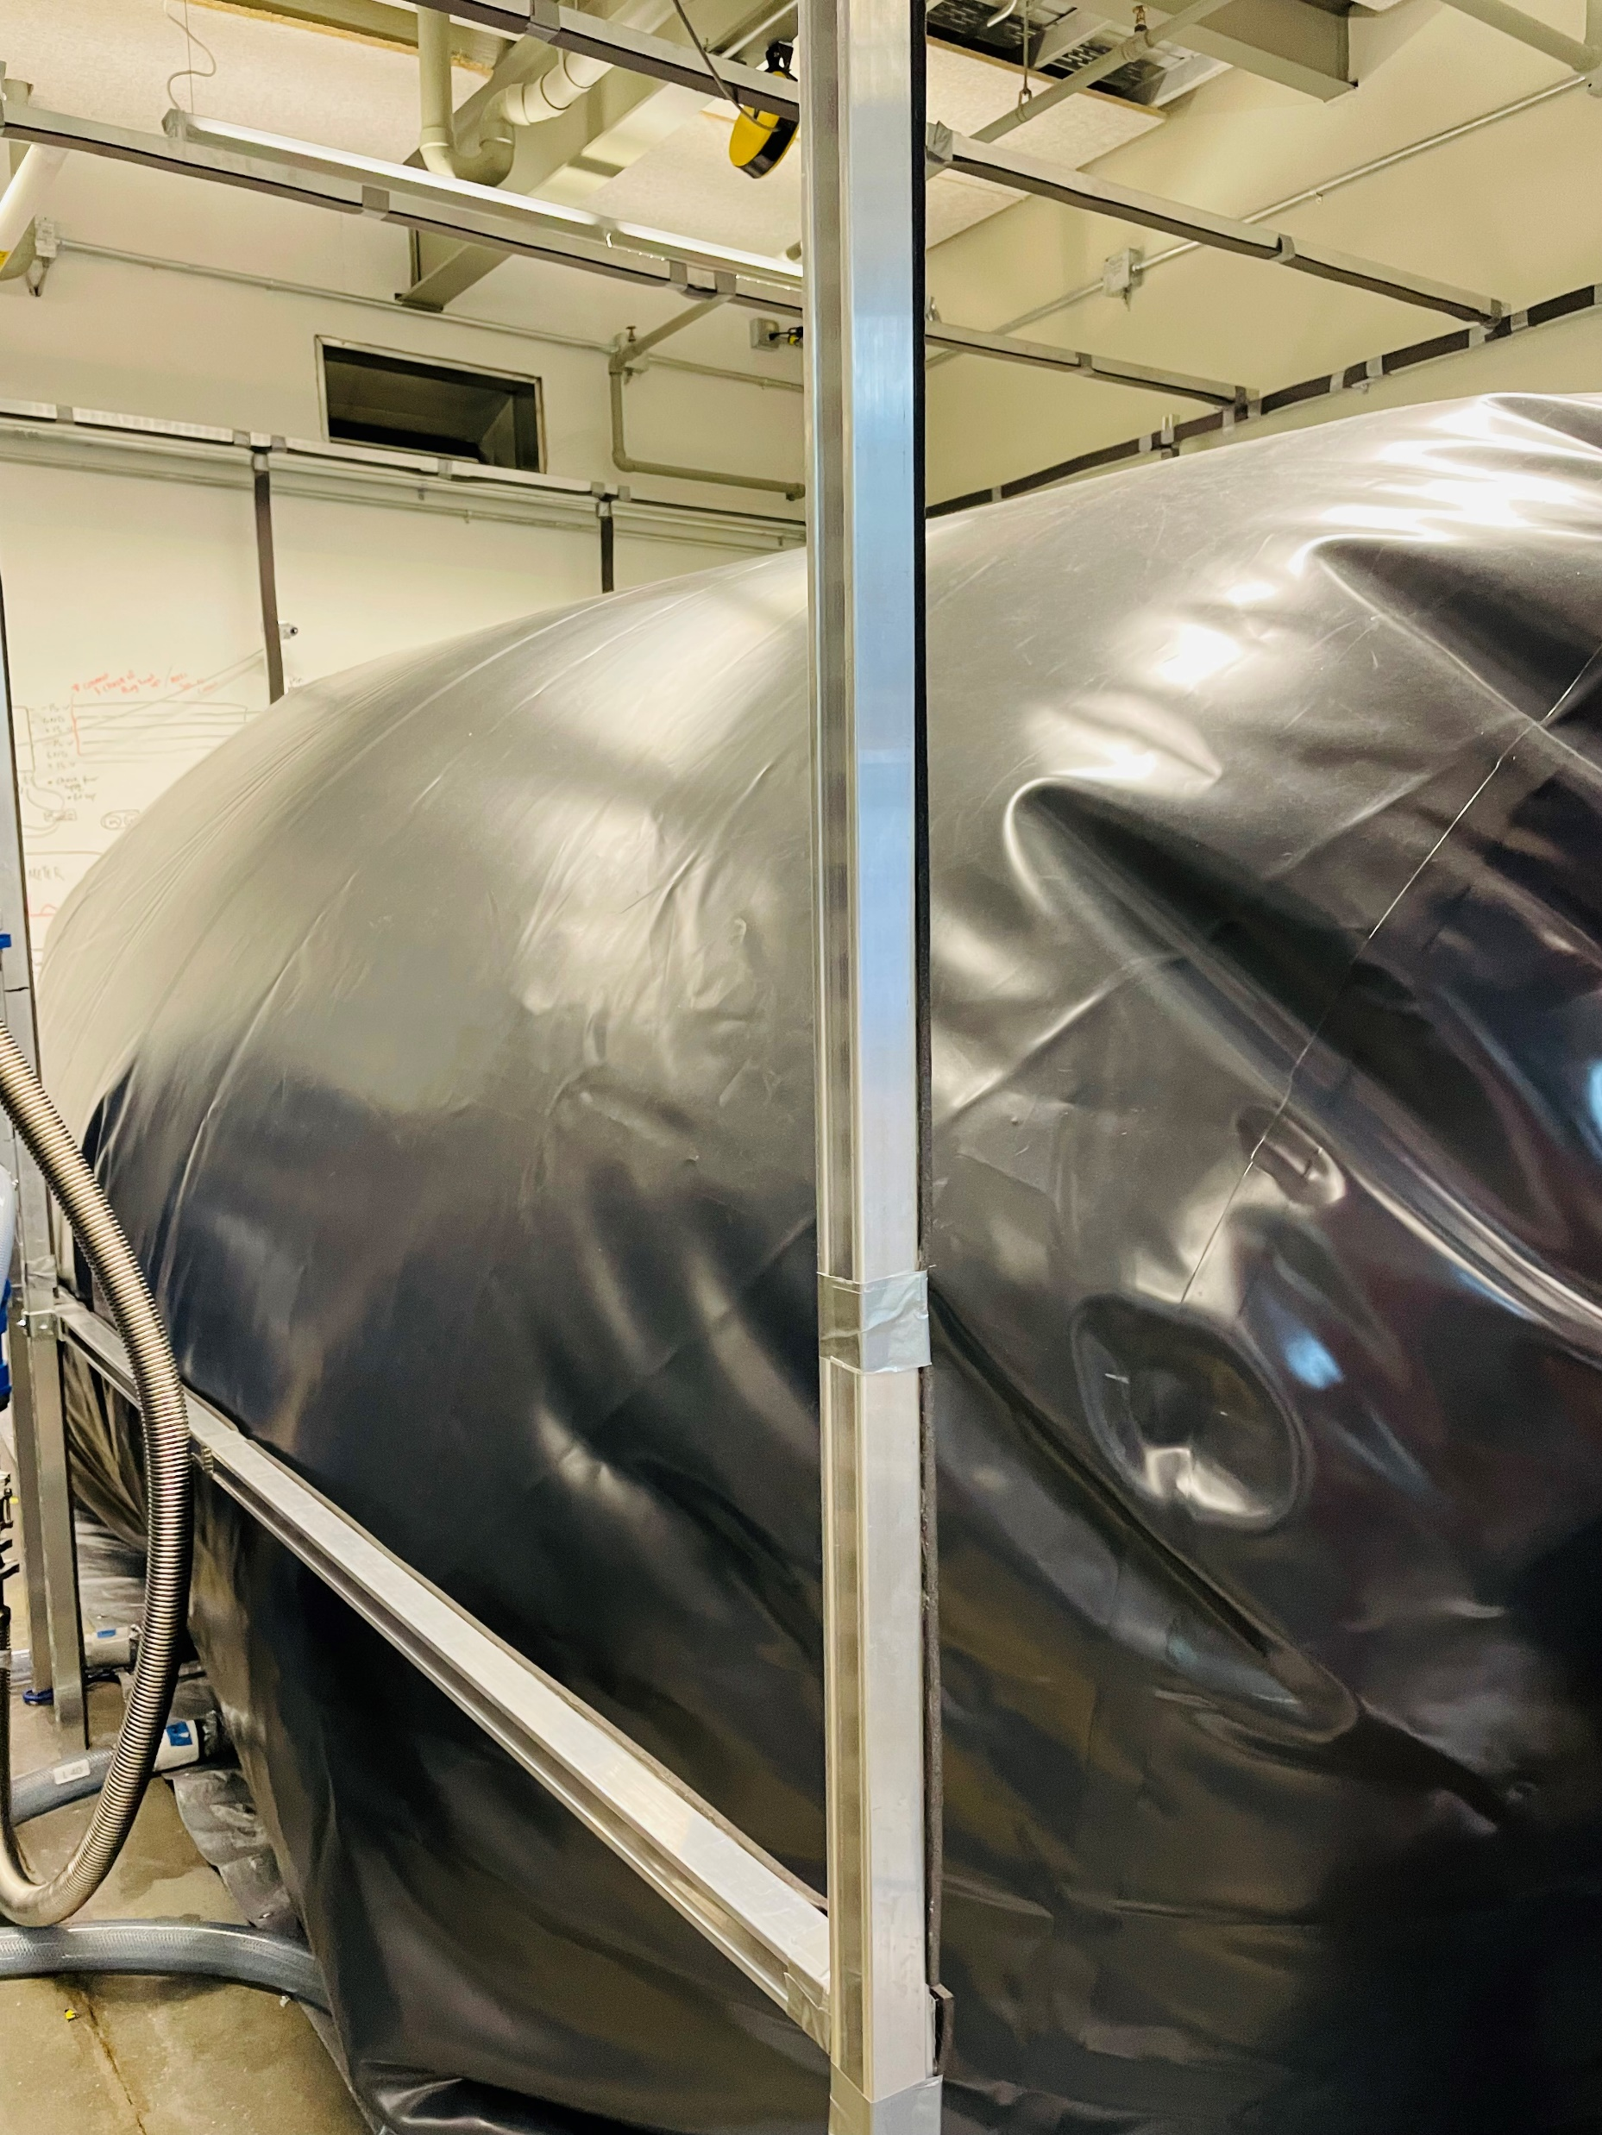
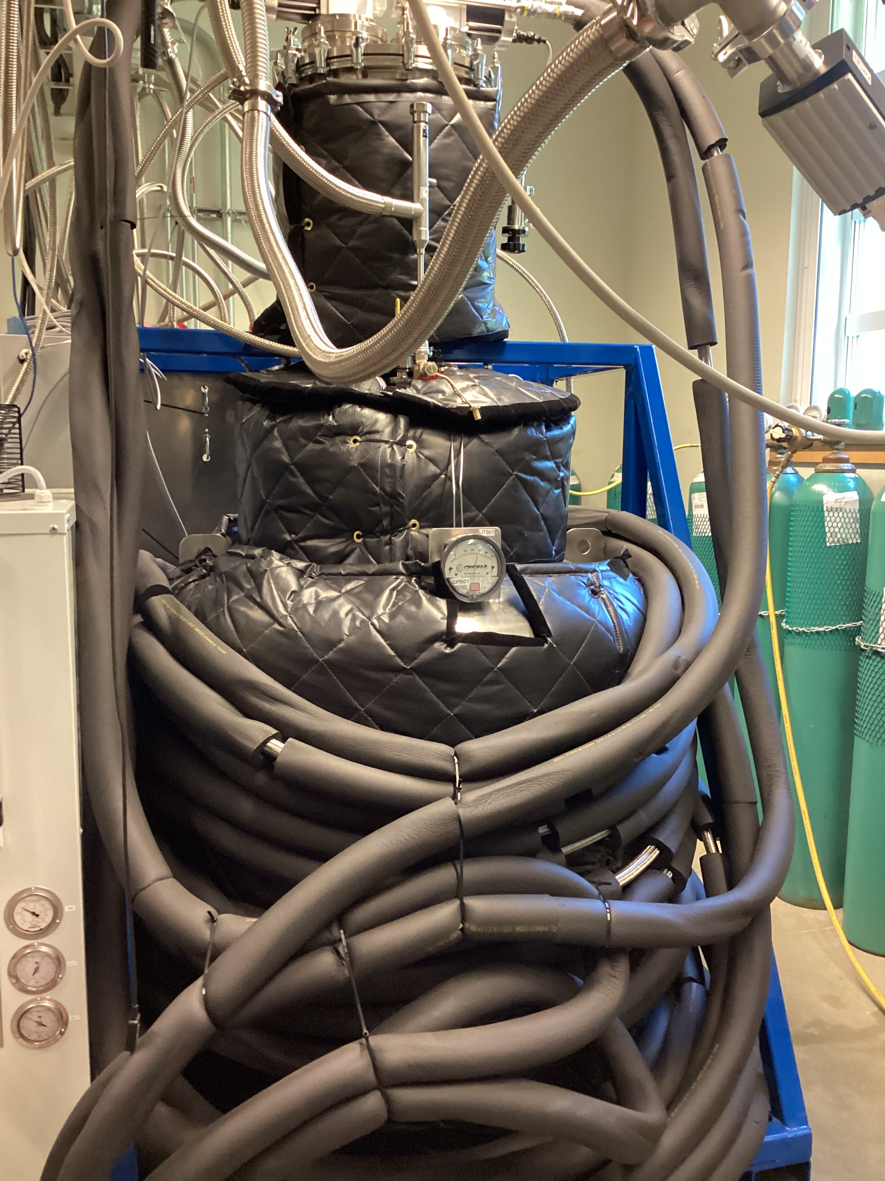
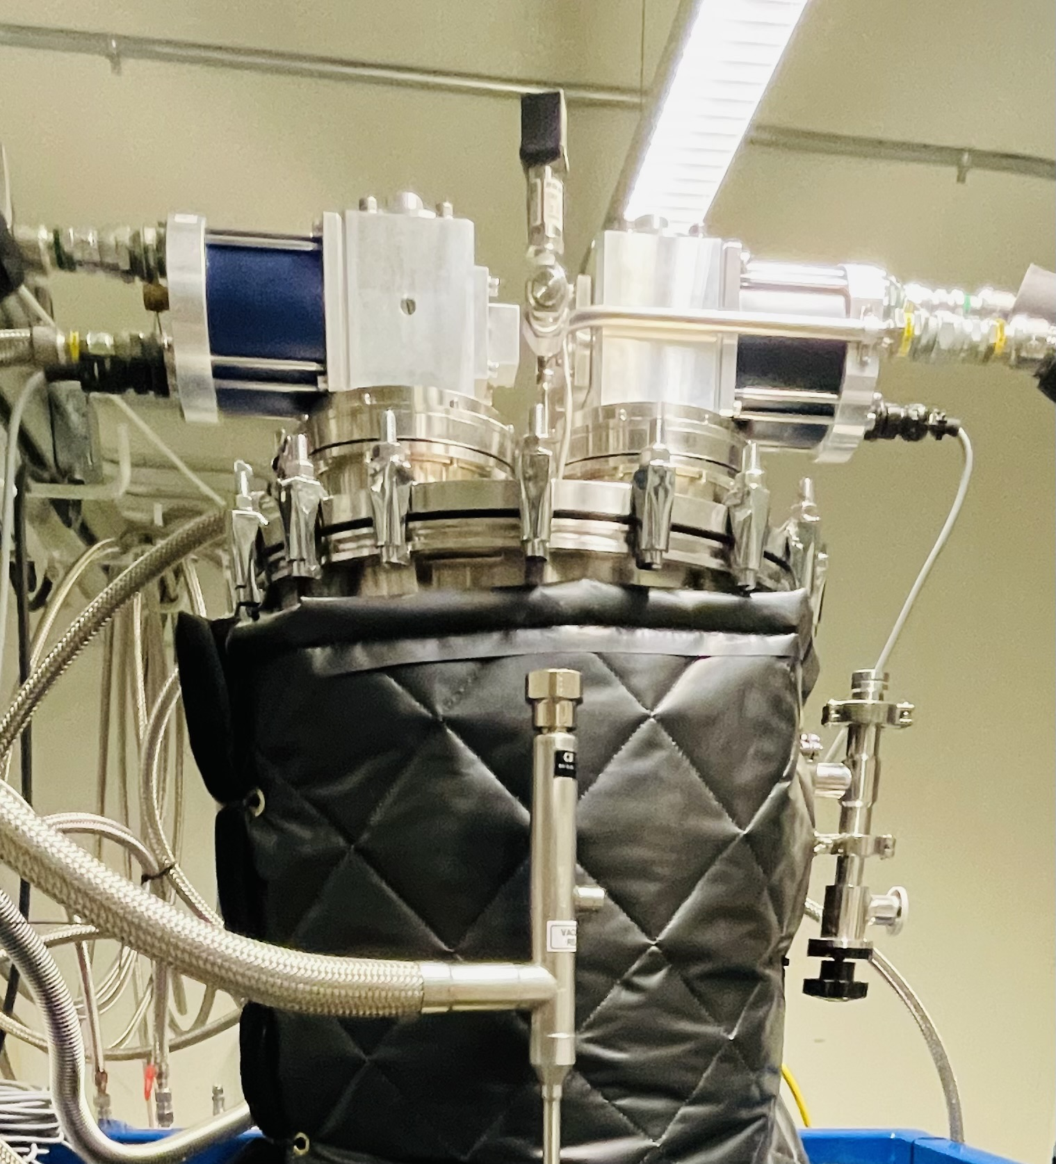
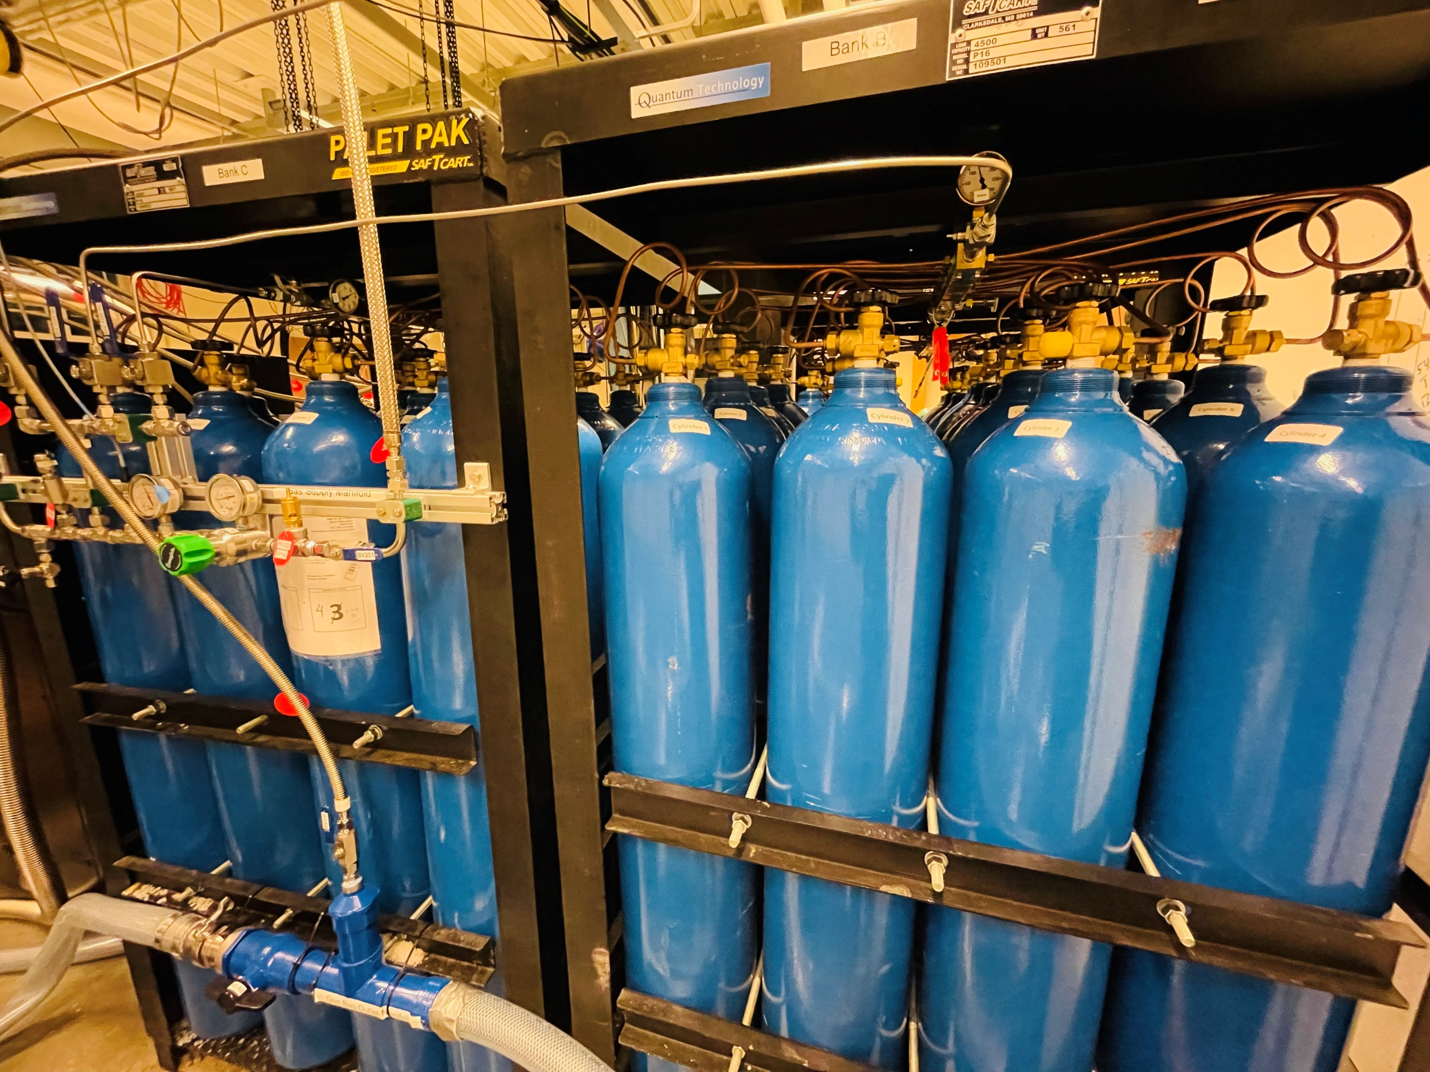
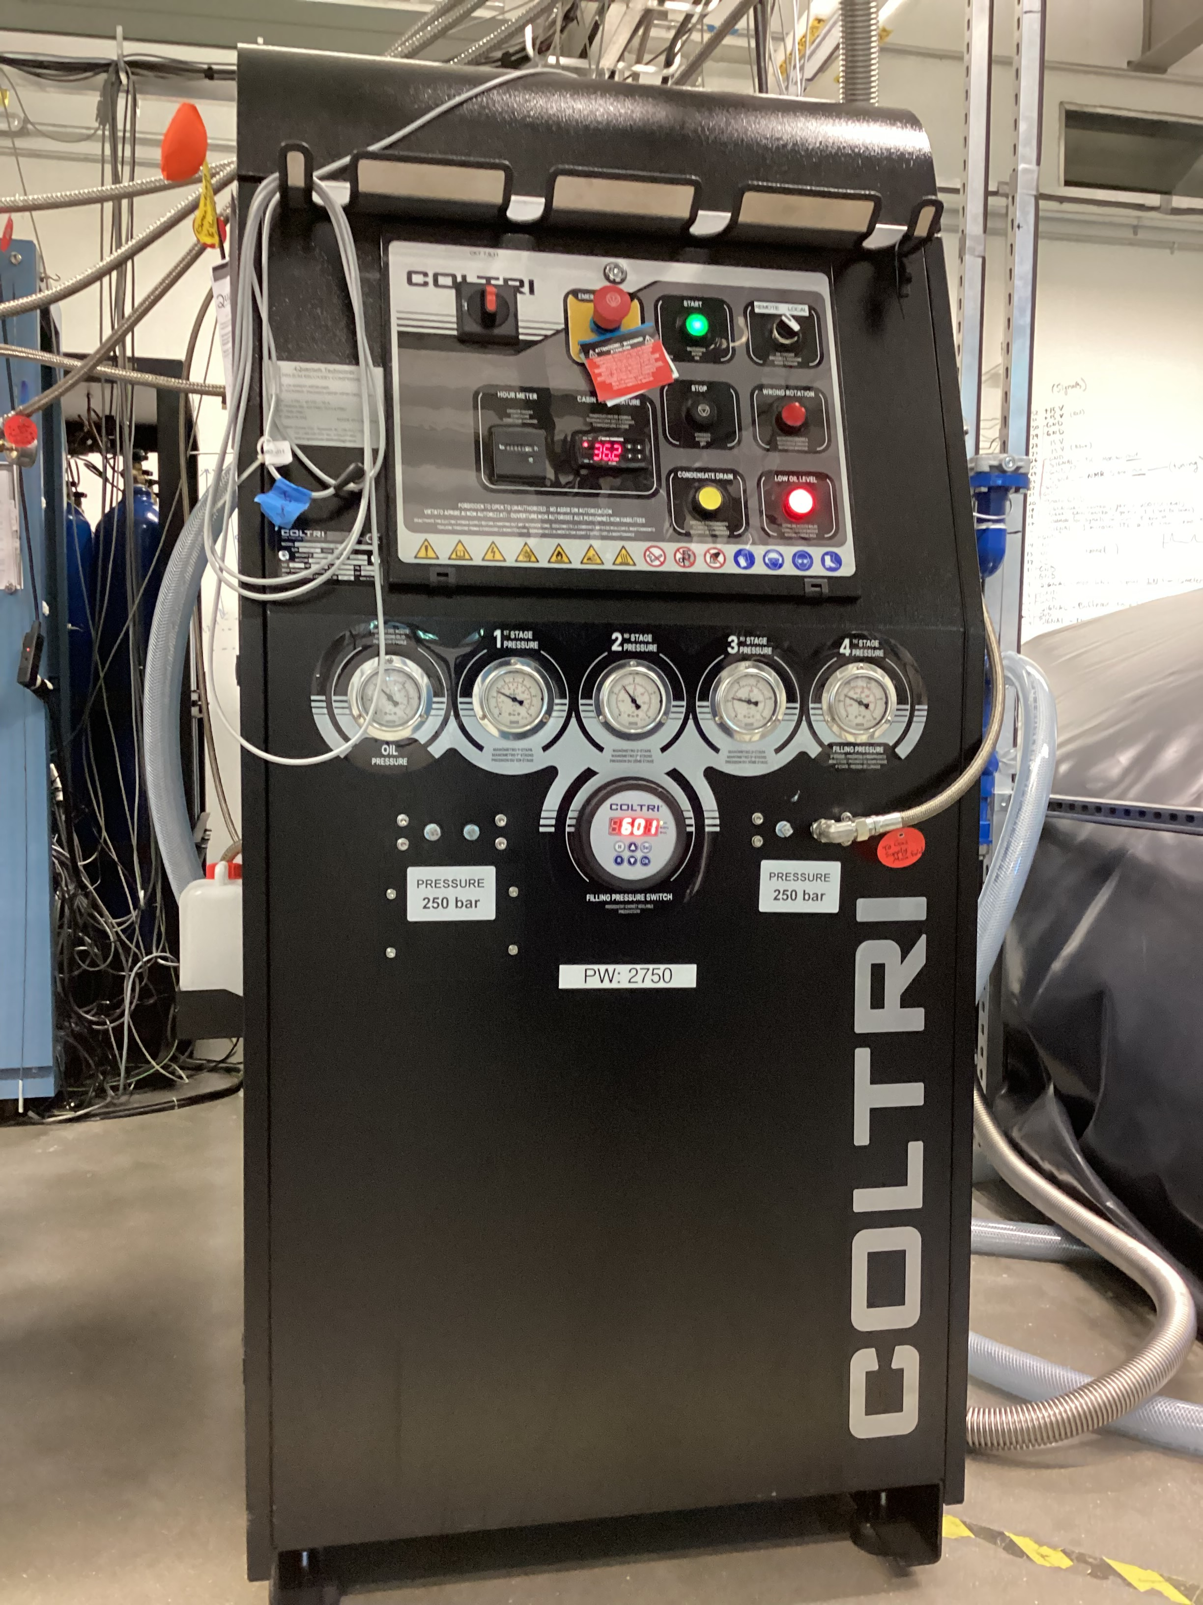
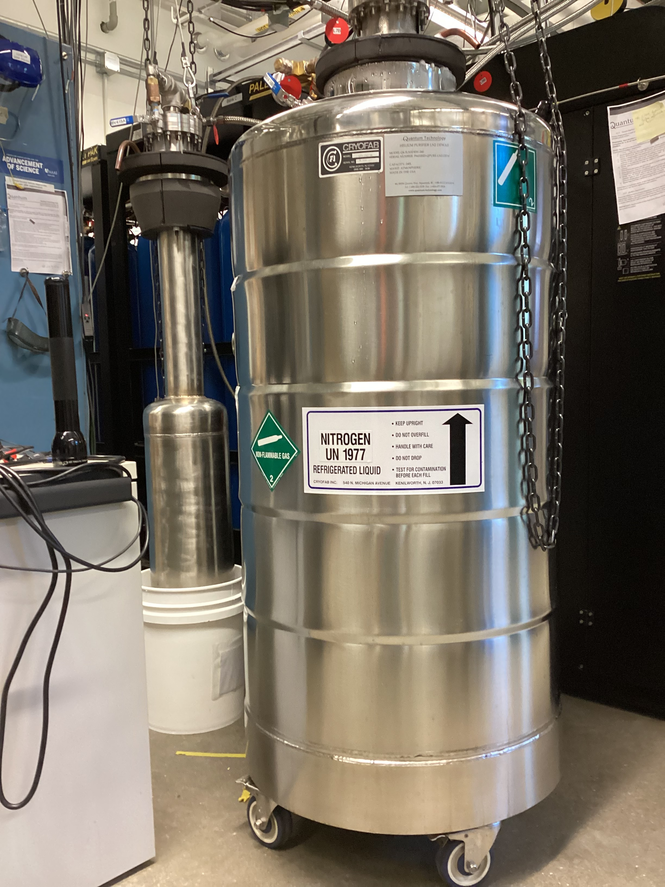
Experimental Setup or Recovery Pathway
Gas Bag
Mother Dewar
Polarized Target
Manifold
Gas Banks(48 cyl.)
gHe Compressor
Liquefier
Purifier

Slide 6
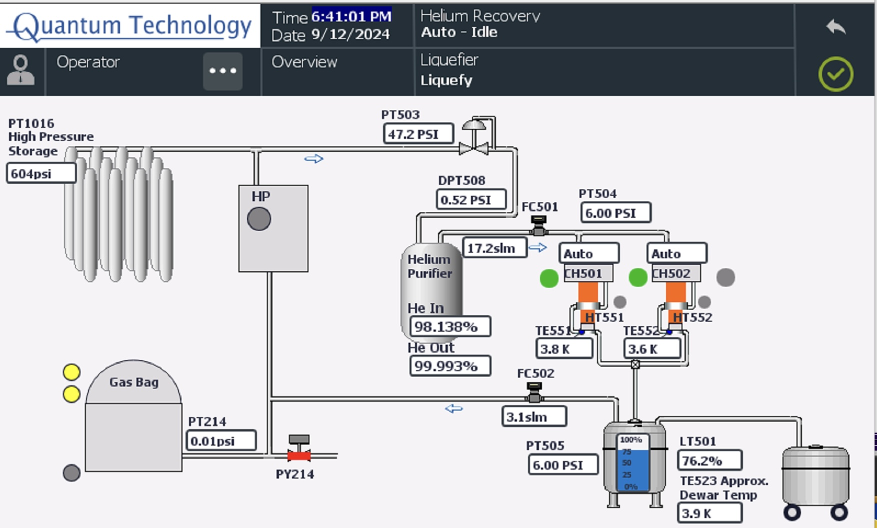
Working Principle
If System is working Properly,
Collection manifold collects gas and sends to gas bag
The HP compressor compresses to Bank of 48 cylinders (highest 2750psi)
Then purifier purifies to >99.995% and sends to liquefaction.
Mother Dewar will collect the Liquid Helium 500L.
96%
54%
24%

Slide 7
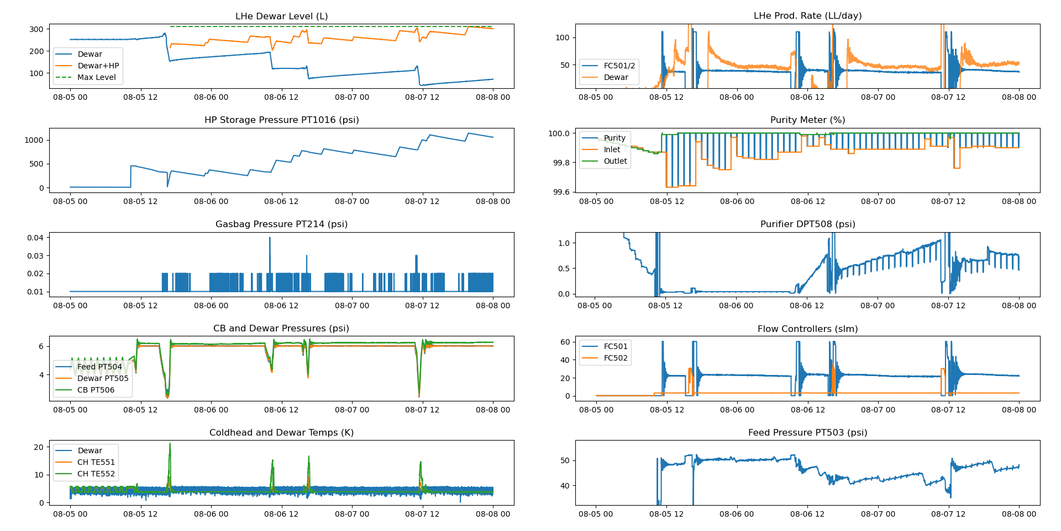
Smooth Working State

Slide 8
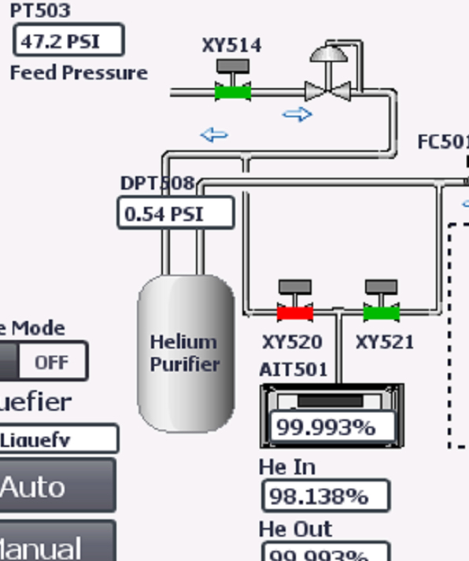
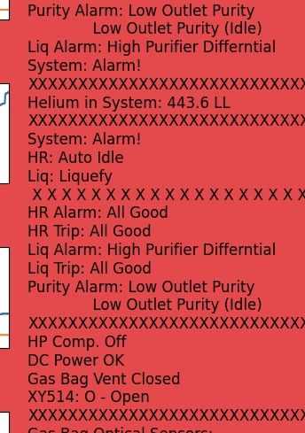
When Does it Fail?
The system breaks down when….
Inlet Purity drops to <95%
High DPT 508 >2psi.
Low Oil Level in the Compressor.

Slide 9
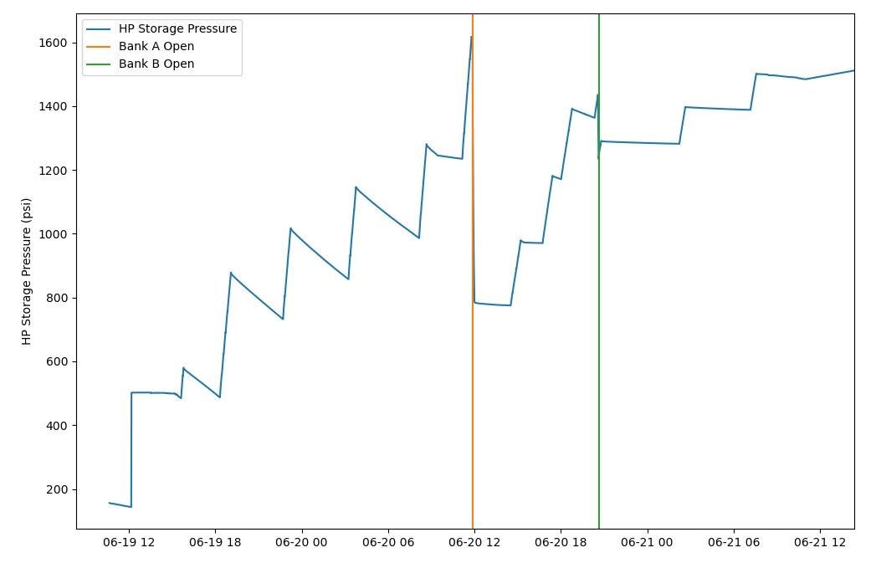
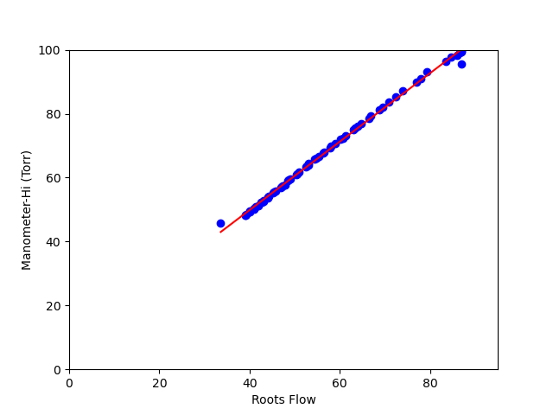
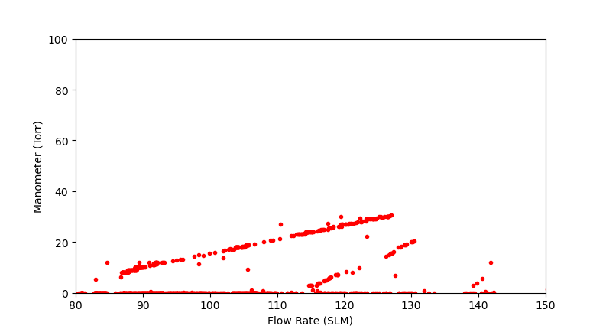
Lessons Learned During Commissioning
One Bank (16 cyld) was filled with atmospheric air.
The Ballast Valve was open.
The separator pump broke down and air was pulled inside the gas bag.
Pressure(psi)
Time
Presssure(torr)
Flow

Slide 10
Working Principle of Purifier
Inlet
The inlet gas enters the purifier which is submerged in a LN2 dewar. The 77K environment condenses out all impurities leaving only He as a gas.
Works properly DPT 508 < 2psi and inlet purity 95% >.
Hard for less than 95% inlet purity need something different
Outlet
Overfill
Max Level of LN2
Min Level of LN2
Underfill

Slide 11
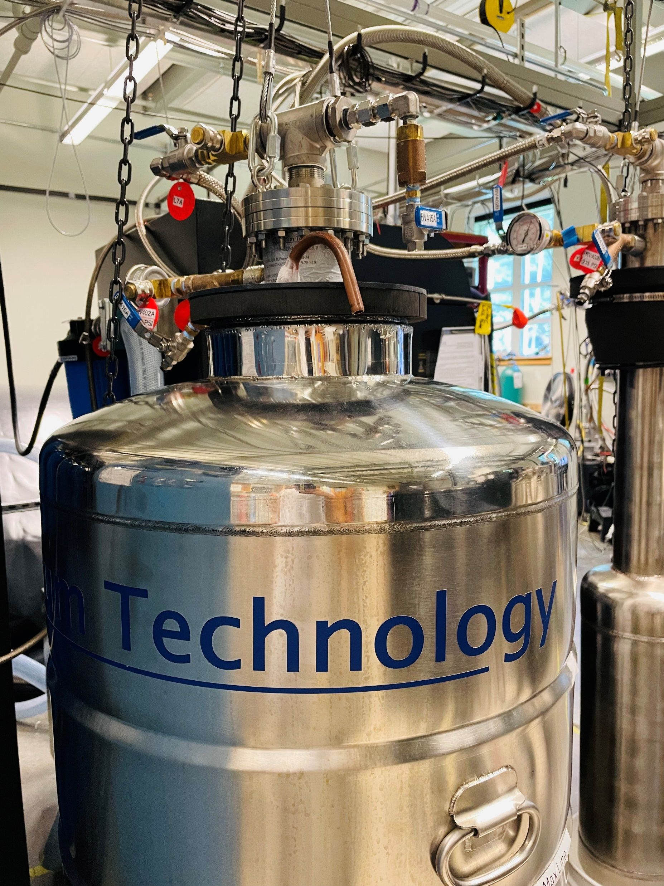
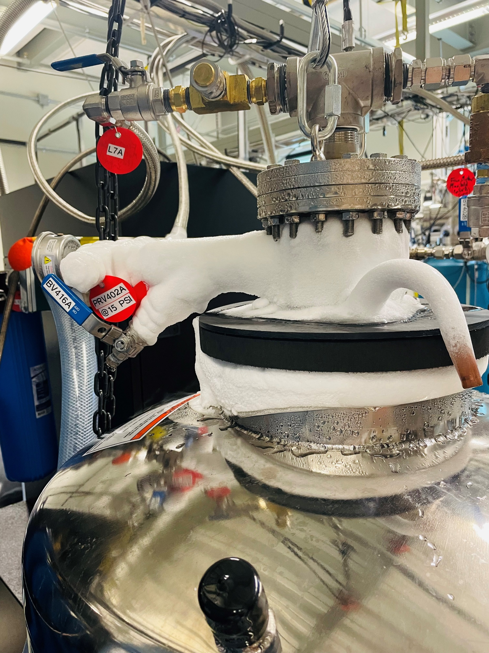
Trouble Shooting
Lots of impurities! (75% Purity)
Few impurities (99% Purity)

Slide 12
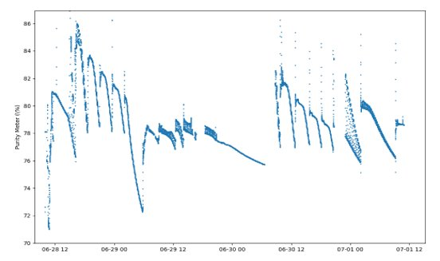
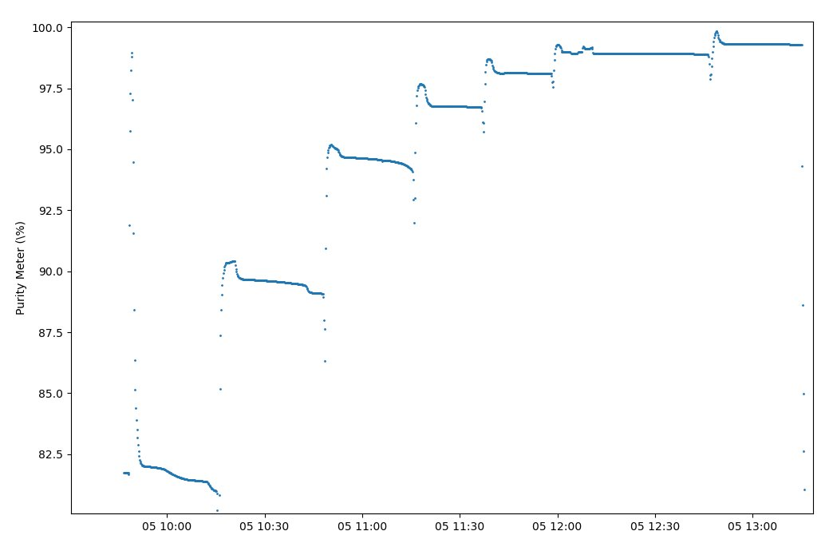
Trouble Shooting Purifier
Purity
86%
Our purifiers could not handle the ~75% purity helium in our system​
Spent ~2 weeks attempting to clean it. ​
Minor success w/ small # of cylinders, but loss rate of ~90%​
QT recommended a membrane filter before the cryo filters if we want to clean <90% purity helium
78%
16 cylinders
70%
100%
95%
Prof Long 2024/07/19 presentation
1 cylinder
82.5%

Slide 13
Recovery Rate and Production Number
Our recovery rate is around 91% first cooldown and 90.5% in the second cooldown if we do not take consideration of separator breakdown otherwise 87.16%
The production rate is around 40LL/day at the normal pressure 6psi as QT suggested.
The capacity to hold is Mother Dewar 500L can expand upto 800L.
1 week of Physics and 2-3 weeks of reliquefying.

Slide 14
The main take away
The system is working great.
Needs to avoid mixing impurities.
Ballast valve must be closed.
Always start with pump and purge of the system which will give us a clean system to use LHe.
Try to minimize the leaks.
We can do more Physics 15+ cooldown per year for what used to be at cost of one cooldown.

Slide 15
Q & A

Slide 16
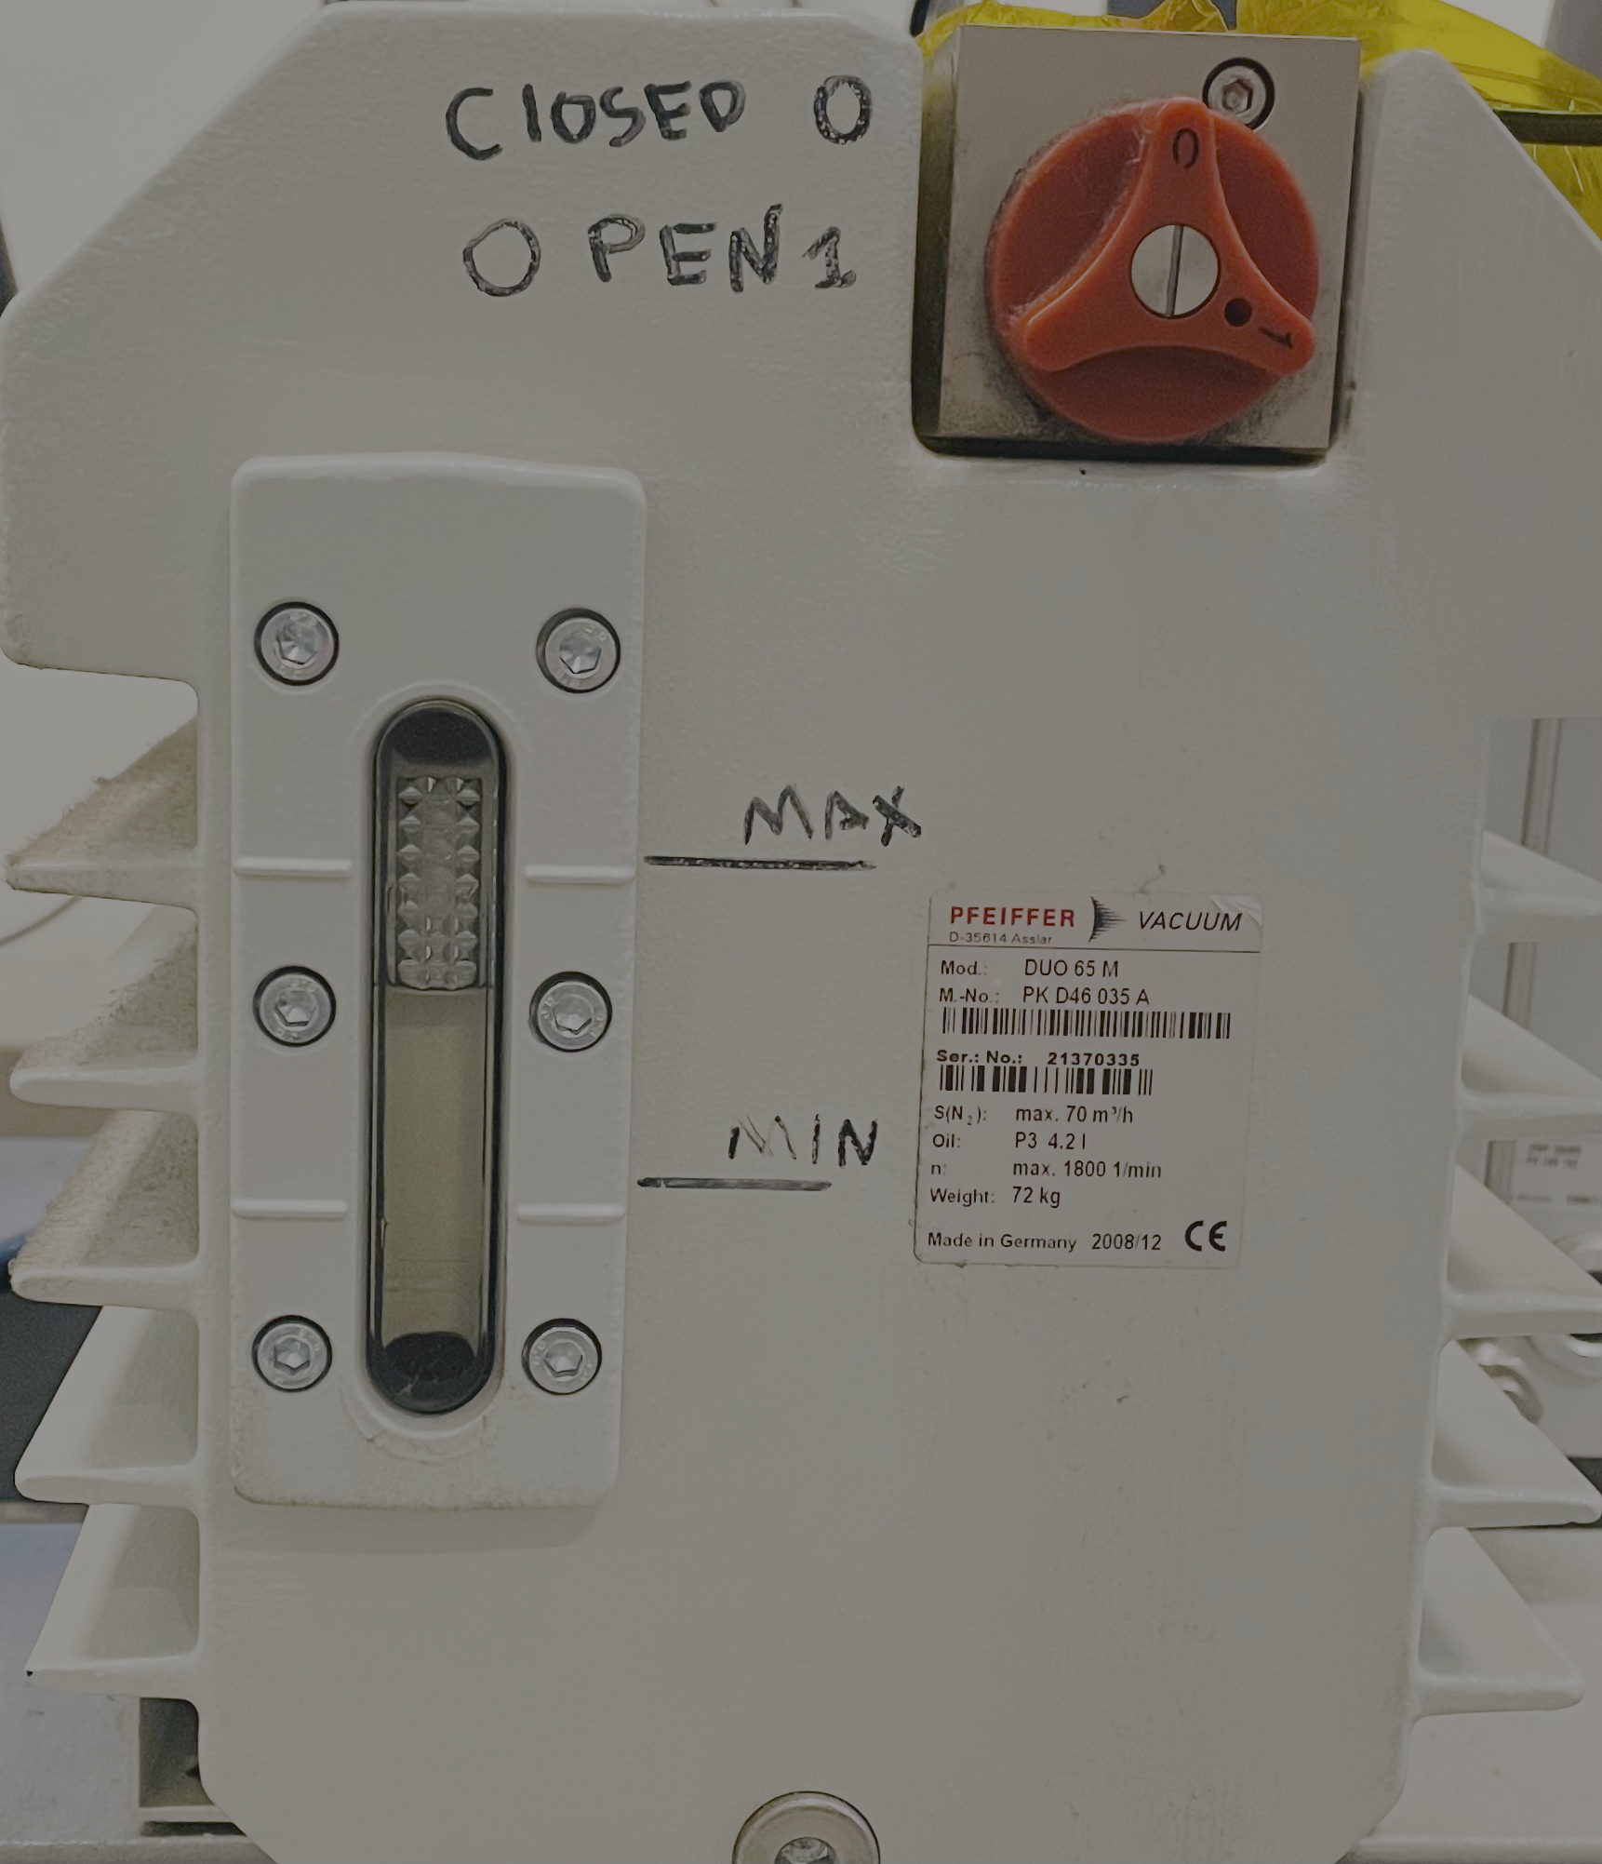
P. Rate$=\frac{\left(FC 501 −FC502\right). 1.1L l}{60. 24. day. 746 gas}$

