Slide 1
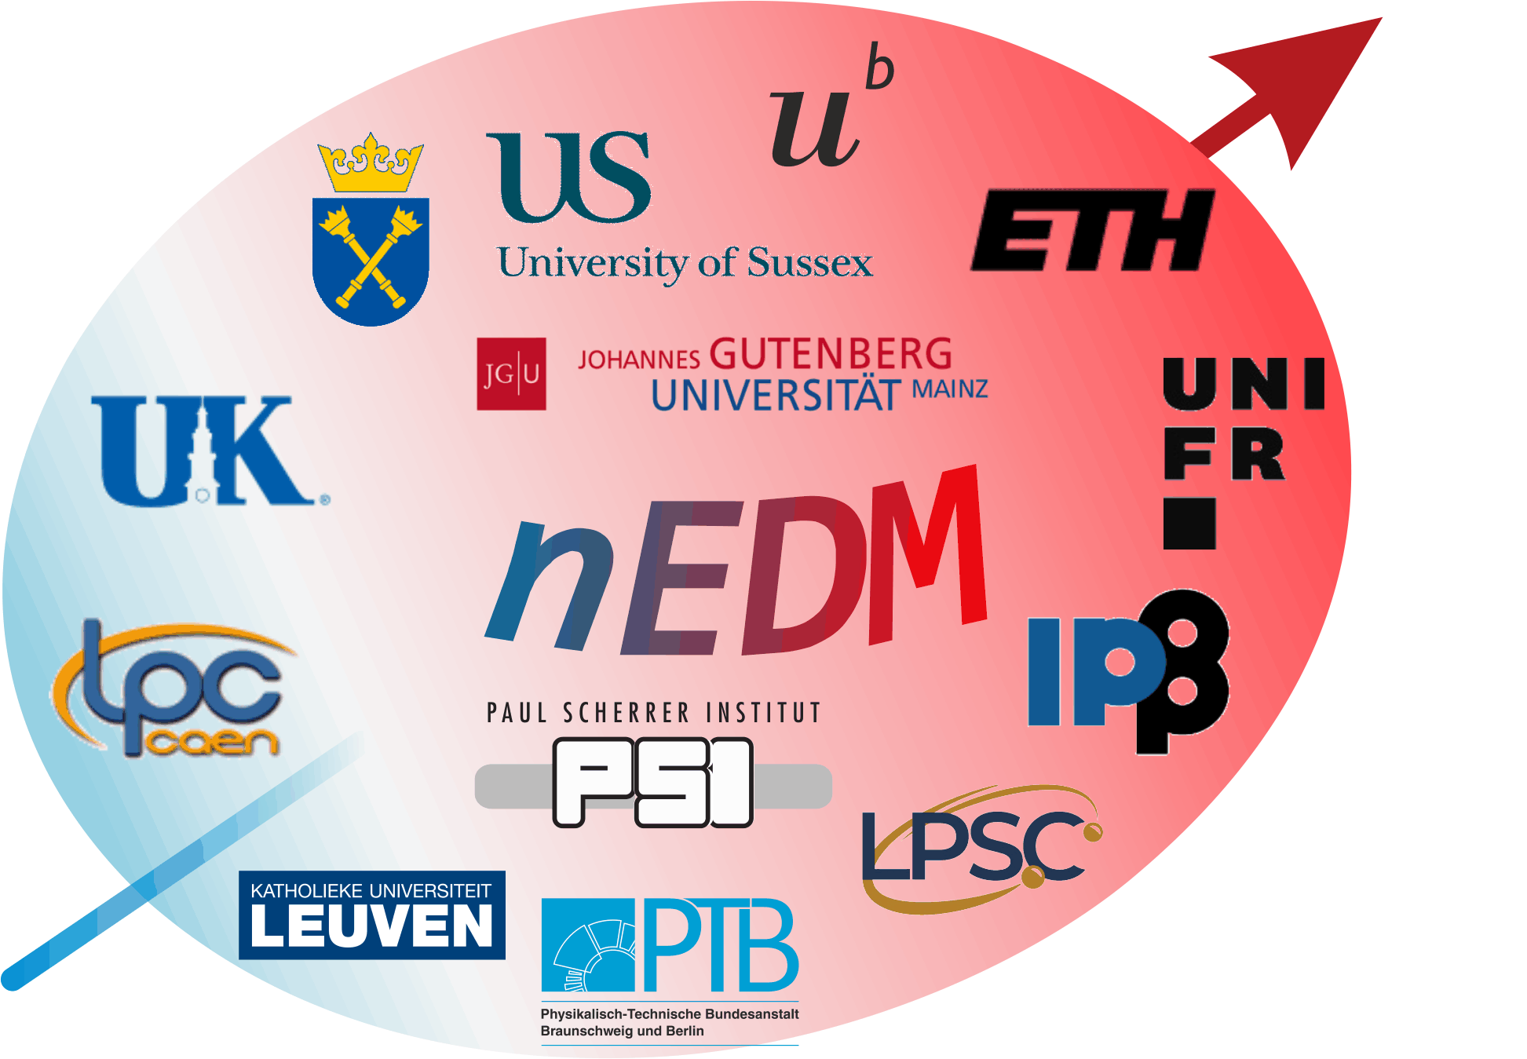

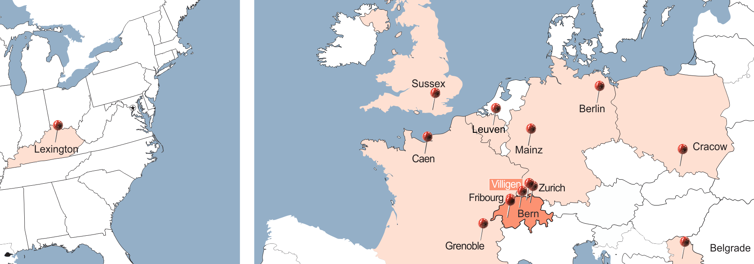
Spin Transport for the
PSI n2EDM Experiment
Christopher Crawford, U. Kentucky for the PSI nEDM Collab.
20th International Workshop on Polarized Sources, Targets, and Polarimetry, New port News, VA 2024-09-27

Slide 2
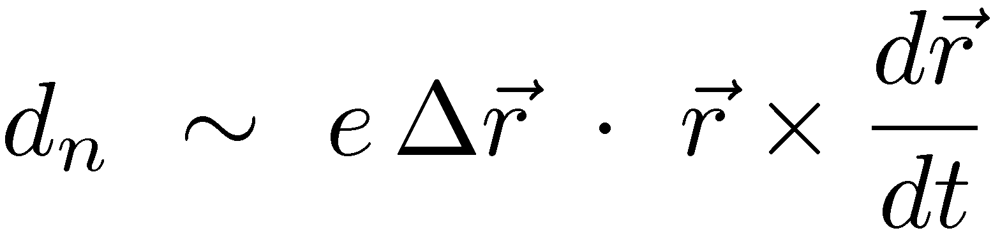
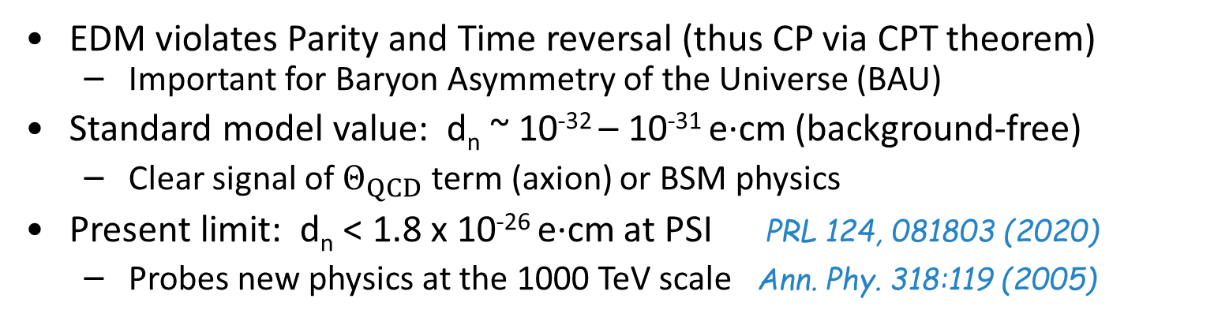
Electric Dipole Moment
+
+
+
-
-
-
P reversal
T reversal
EDM violates Parity and Time reversal (thus CP via CPT theorem)
  Important for Baryon Asymmetry of the Universe (BAU)
Standard model value: d_{n} ~ 10⁻³² – 10⁻³¹ e·cm (background-free)
  Clear signal of $Θ_{QCD}$ term (axion) or BSM physics
Present limit: d_{n} < 1.8 x 10⁻²⁶ e·cm at PSI PRL 124, 081803 (2020)
  Probes new physics at the 1000 TeV scale Ann. Phy. 318:119 (2005)

Slide 3
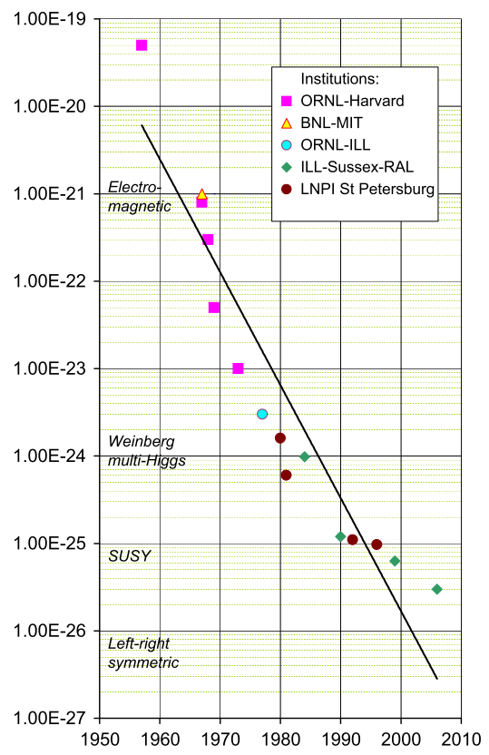
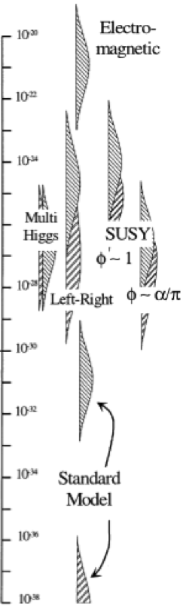

Evolution of constraints on the nEDM
NIM A 736, 184 (2014)
J.M. Pendlebury and E.A. Hinds, NIM A 440, 471 (2000)
Planned future experiments
with 10⁻²⁷ e cm sensitivity
  n2EDM (PSI)
  nEDM (LANL)
  PanEDM (ILL)
  TOUCAN (TRIUMF)
PSI:
nEDM
n2EDM
(projected)

Slide 4
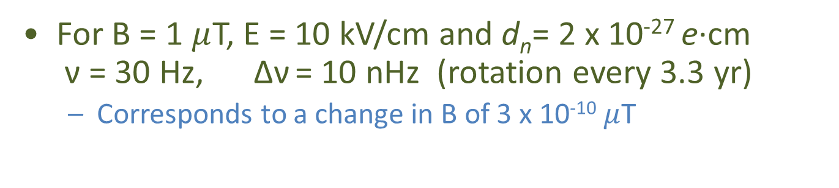
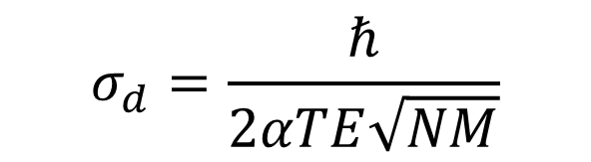

How to measure an EDM
E
B
$$hν=−2μ_{n}B±2d_{n}E$$
The EDM is extracted
from the E-field dependent
shift in the neutron spin
precession frequency.
GOAL:
d_{n}< 2 x 10⁻²⁷ e·cm
ν
$$σ_{d}=\frac{ℏ}{2αTE\sqrt{NM}}$$
For B = 1 $μ$T, E = 10 kV/cm and d_{n}= 2 x 10⁻²⁷ e·cm
ν = 30 Hz, Δν = 10 nHz (rotation every 3.3 yr)
  Corresponds to a change in B of 3 x 10⁻¹⁰ $μ$T

Slide 5
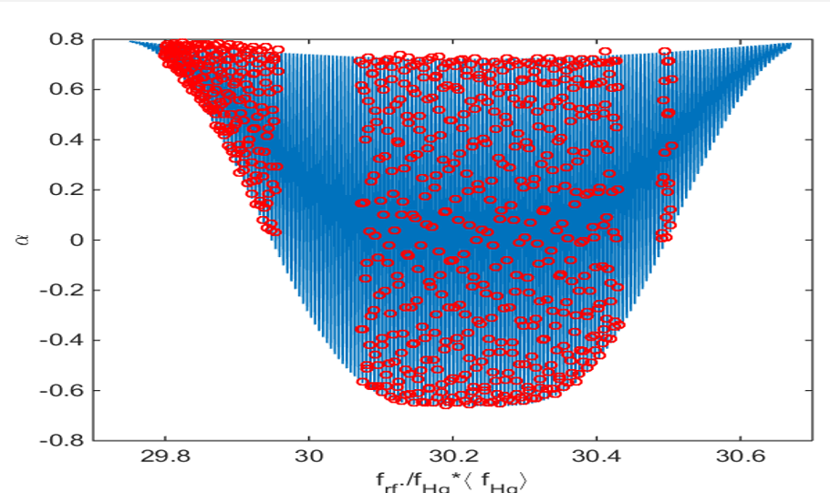
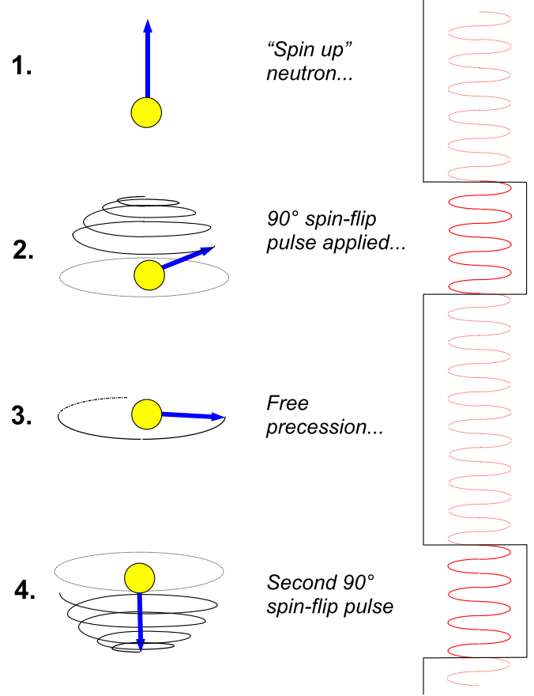
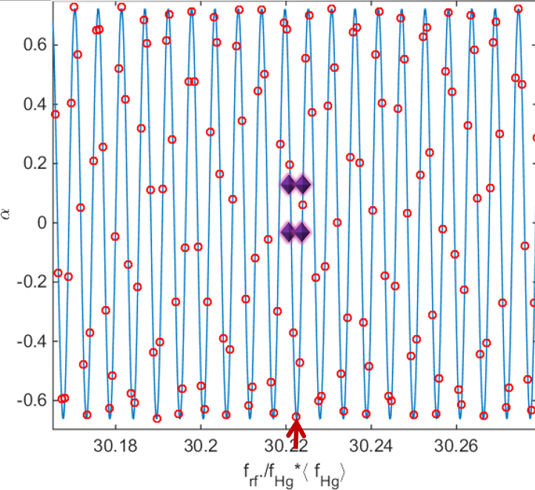
Ramsey cycle: Separated oscillatory fields
NIM A 736, 184 (2014)
PR 78, 695 (1950)

Slide 6

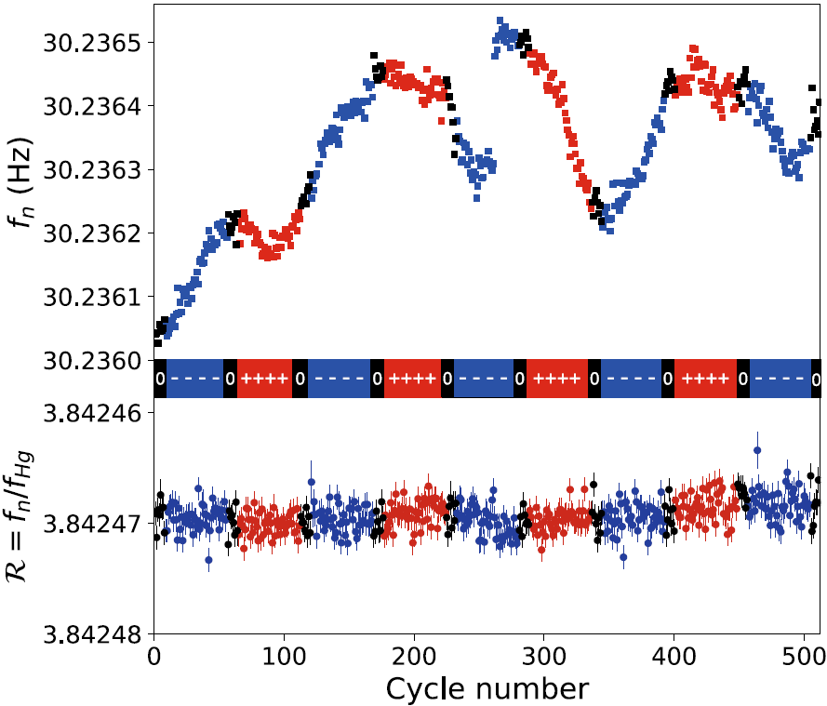
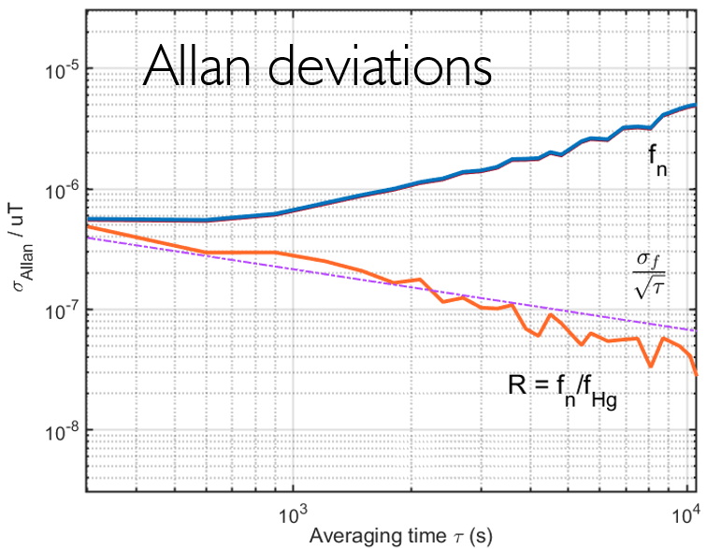
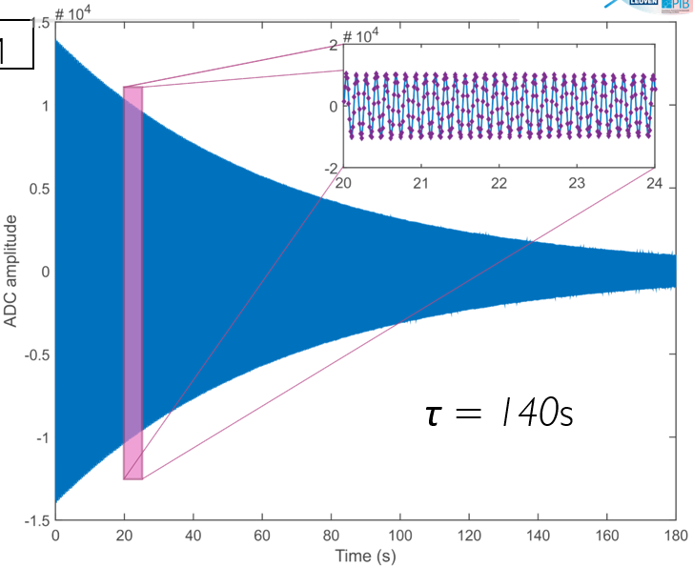
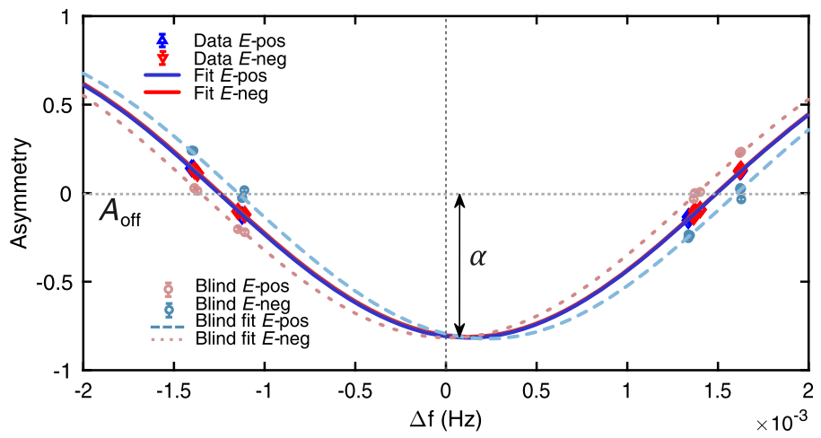
Extraction of nEDM – Hg comagnetometer
EPJC (2021) 81, 512 (2021)

Slide 7
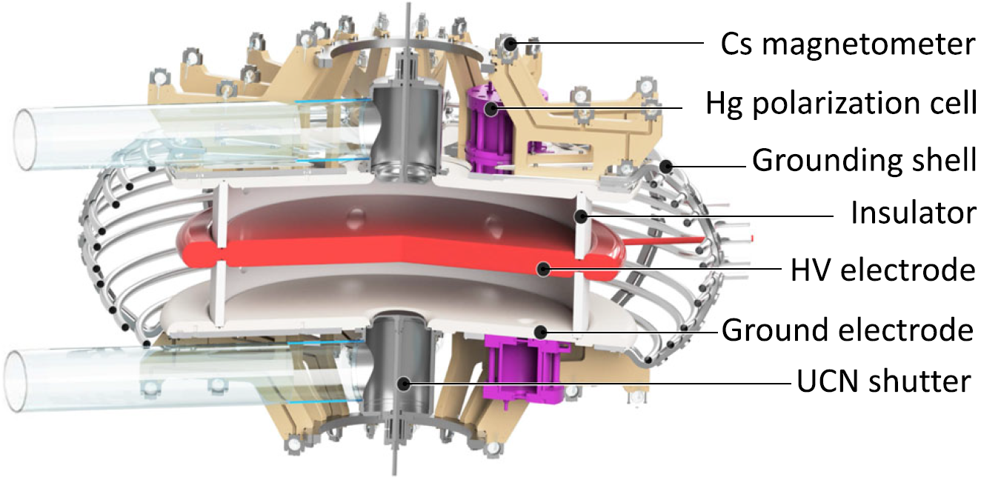
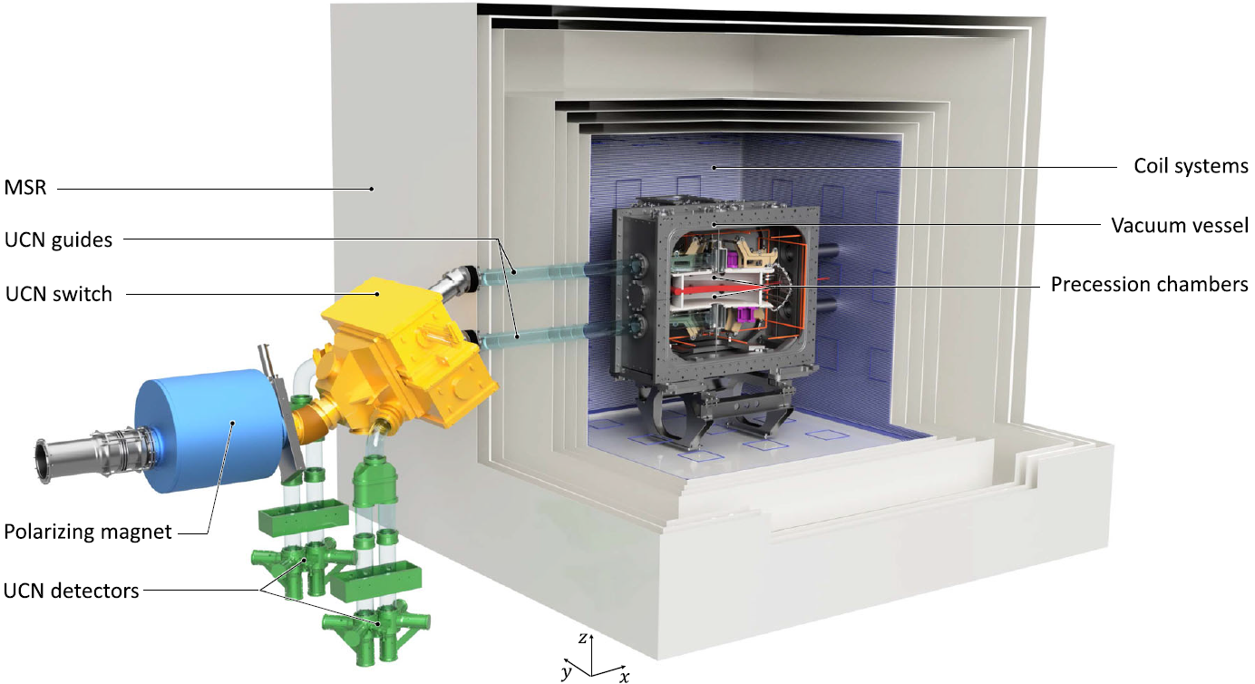
n2EDM experimental apparatus
Eur. Phys. J. C 81, 512 (2021)

Slide 8
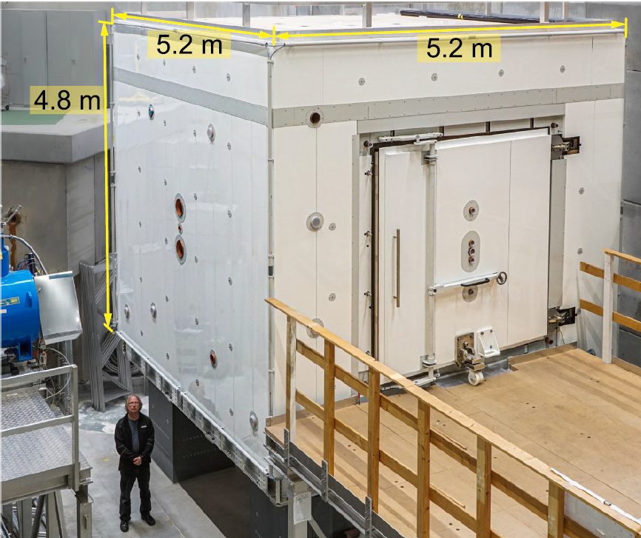
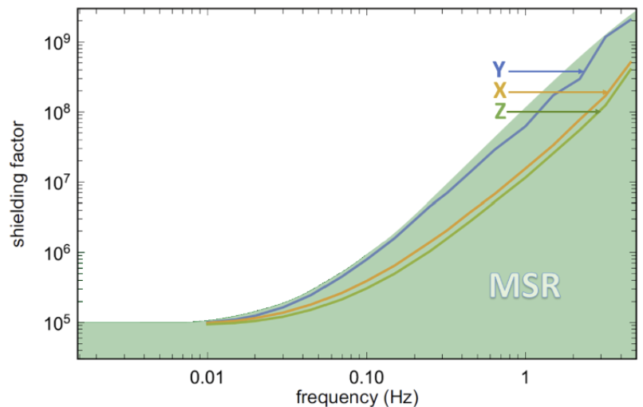
Magnetic Shield Room (MSR)
6 layers mu-metal + 1 layer Al RF shielding
Degaussing coils for equilibration
of each layer
Quasistatic shielding factor: 10⁵
Rev. Sci. Instrum 93, 095105 (2002)

Slide 9
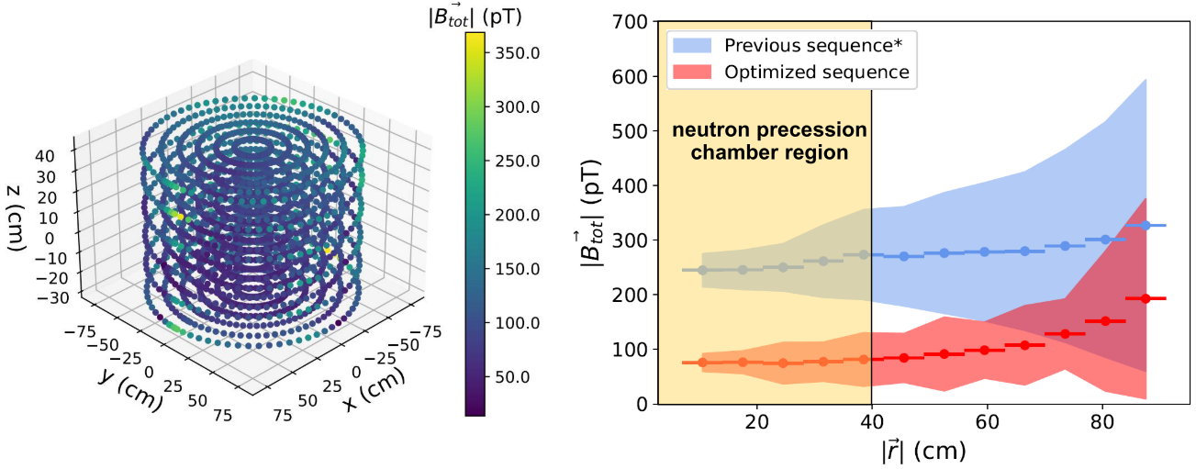

Equilibration of MSR
New degaussing sequence optimized for residual fields and time (12 hours $→$1.5 hours)
Eur. Phys. J. C 84, 18 (2024)
PhD Thomas Bouillaud 2023

Slide 10
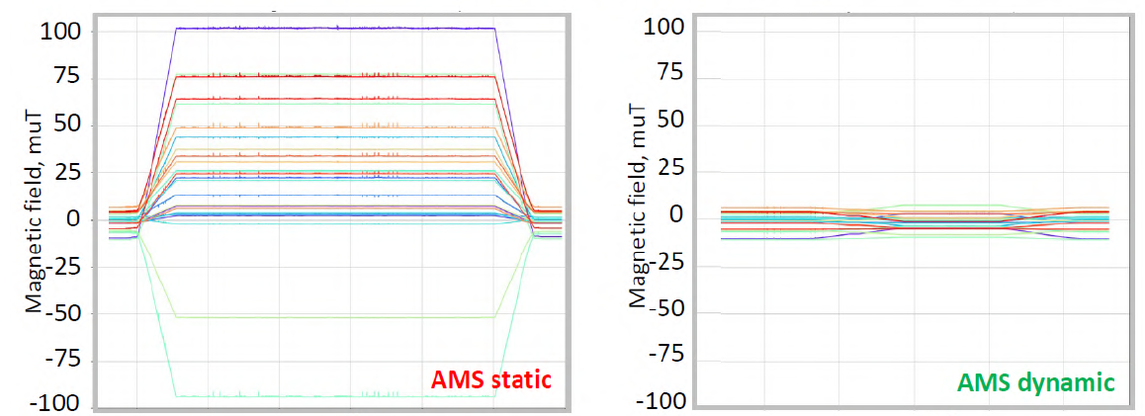
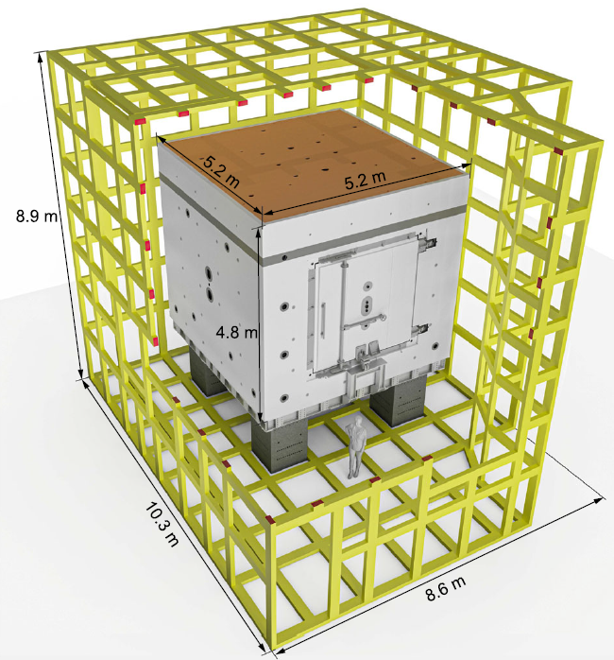
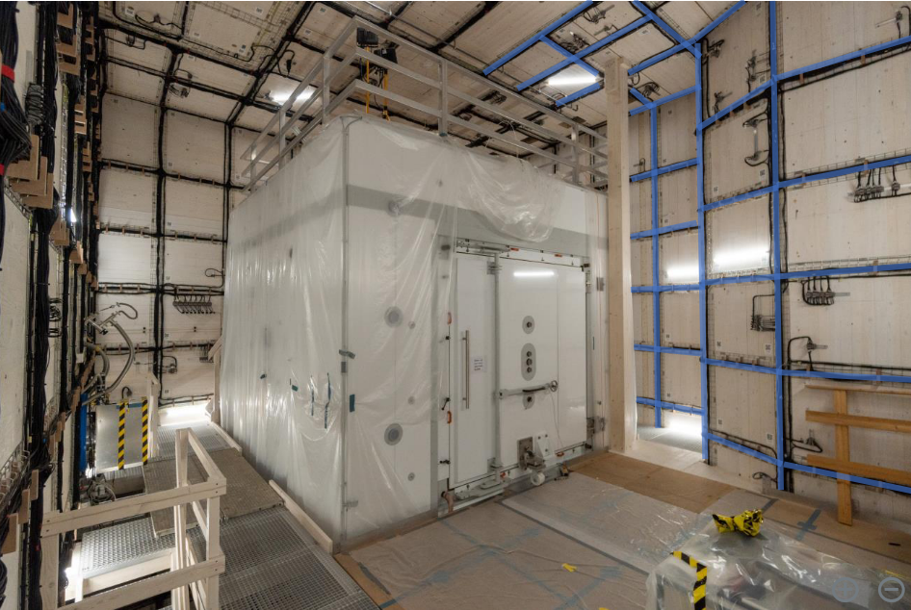
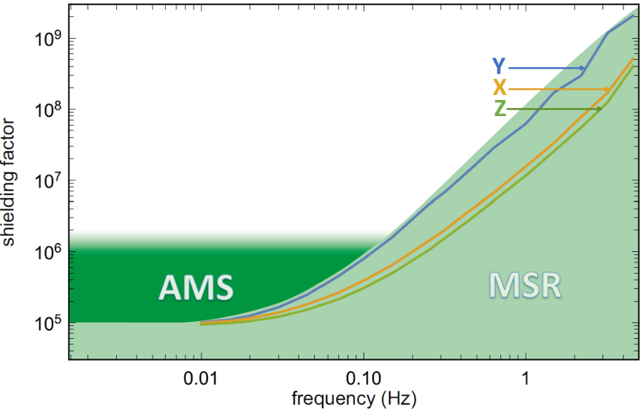

Active Magnetic Shield (AMS)
• Over 300 rectangular tiles with 55 km of wire
• 3 Homogenous coils range: +/- 50 𝜇T
• 8 Gradient Coils range: +/- 5 𝜇T/m
• 8 three-axis fluxgates for active control
$$B_{outside MSR} (μT)$$
AMS off
AMS on
Eur. Phys. J. C 83 11, 1061 (2023)

Slide 11
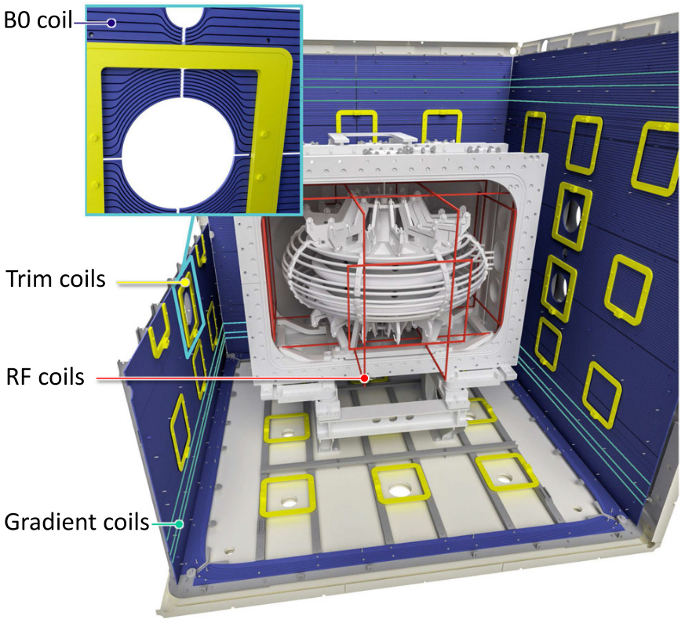
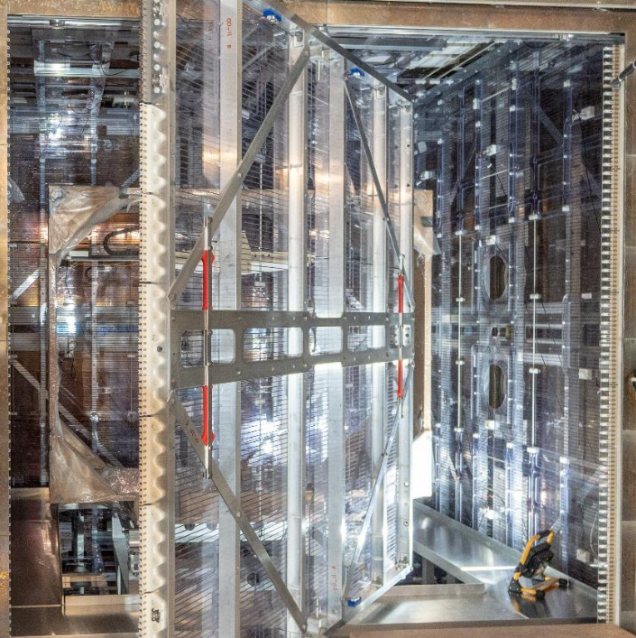
MSR Coil Package
(56 basis
functions)

Slide 12
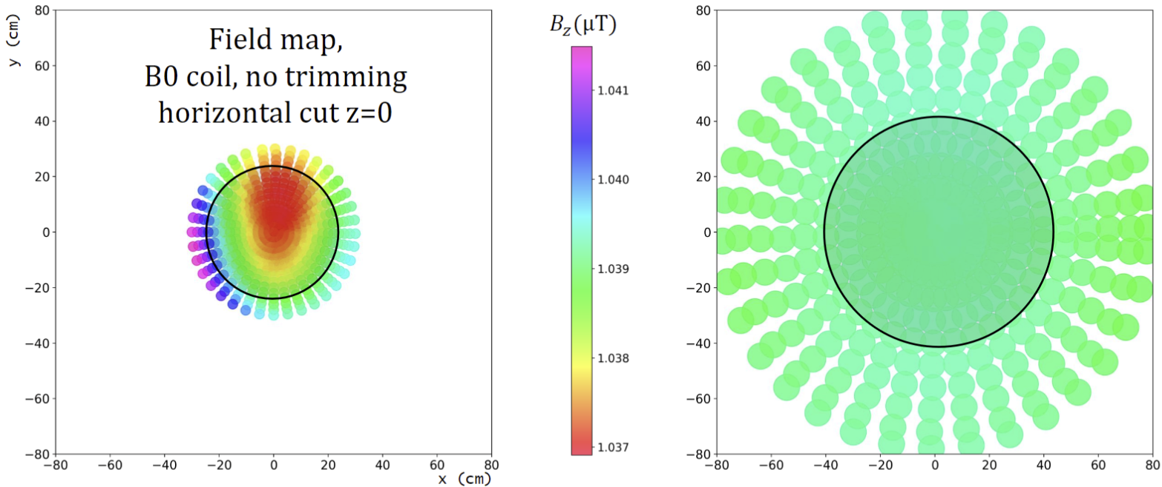
Improvement in B₀ uniformity

Slide 13
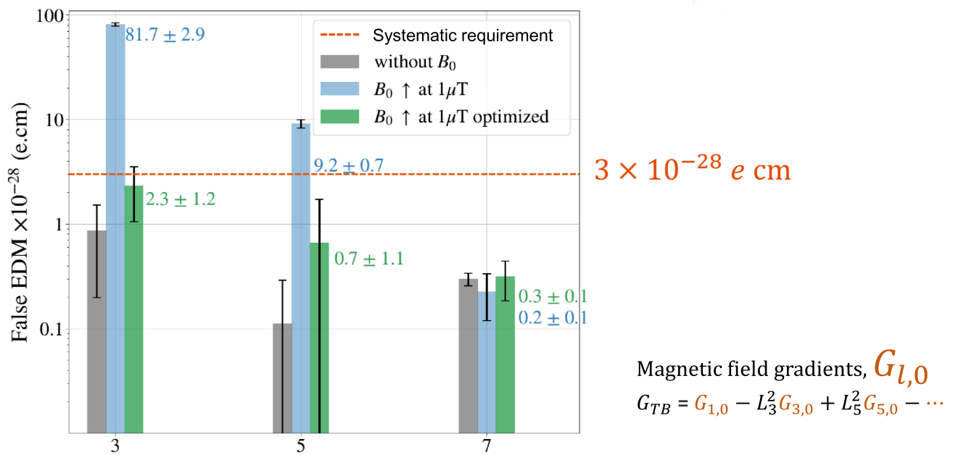
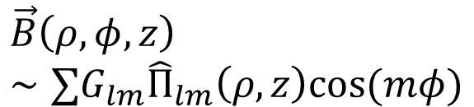
Gradient contributions to false nEDM
$$\vec{B}\left(ρ,φ,z\right) \\ ∼∑G_{lm}{\hat{Π}}_{lm}\left(ρ,z\right)cos(mφ)$$
PRELIMINARY
PhD Thomas Bouillaud 2023

Slide 14
Streamlined Approach to Magnetic Design
traditional design sequence
using the magnetic scalar potential
Is
it OK?
yes!
Transport
& geometry
requirements
Initial coil
design
Calculate Field
Construction
Adjust coil
no ☹ …
Transport
Requirements
Calculation of
Ideal Field
Calculation of
Coil Windings/
Optimizations
Validation
Geometric constraints
Construction

Slide 15
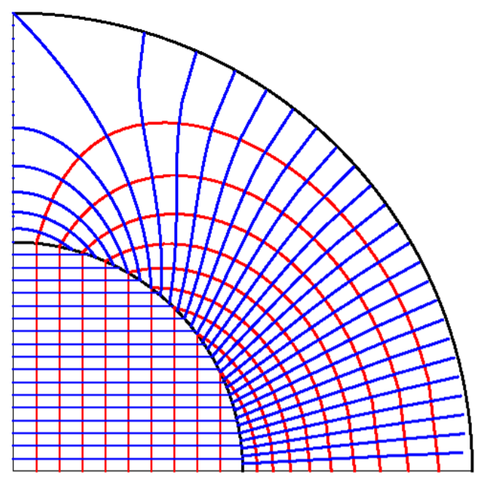



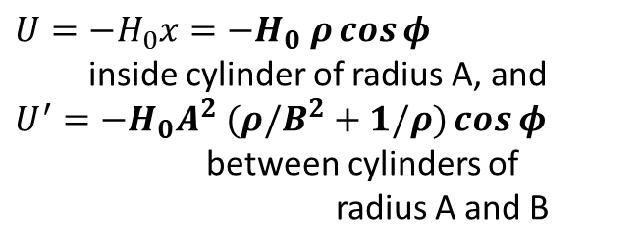
SPOTLIGHT – Magnetic Scalar Potential
FLUX FLOW
Field Equations
field
potential
Boundary Cond.
field
potential
Double Cosine Theta Coil
$U=−H_{0}x=−H_{0} ρ\cos{φ}$
inside cylinder of radius A, and
$U^{′}=−H_{0}A^{2} (ρ/B^{2}+1/ρ)\cos{φ}$
between cylinders of
radius A and B
Magnetic flux lines
Magnetic flow sheets
(scalar equipotential)
Surface Current
P. L. Walstrom, PRSTAB 15 (10) 2401 (2012)
P. L. Walstrom, Proc. EPAC 2002, Paris, France
CBC, arXiv:2012.00800; CBC, J. Straley, arXiv:2102.00149 [physics.class-ph]

Slide 16
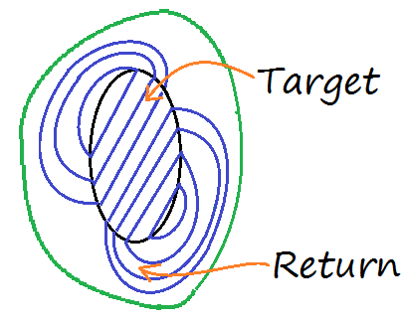
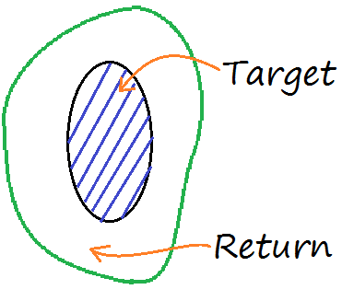
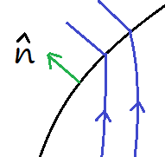





Fields and windings from the scalar potential
Choose desired
field in the
Target region
Confine flux
inside the
Return region
Separate regions
by Transition layer
Equipotential contours
indicate winding pattern
`
Rev. Sci. Inst. 92 124703 (2021)

Slide 17
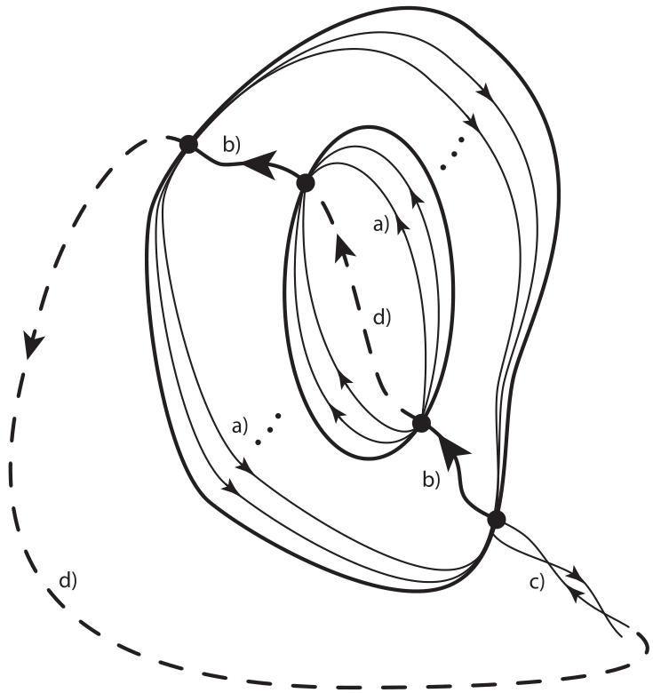
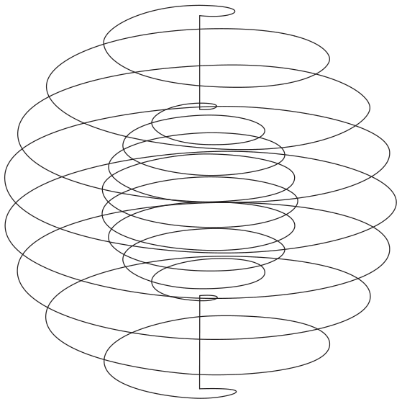




A better way to wind slices …
in general
discrete windings
+ straight wire
= helical winding
Rev. Sci. Inst. 92 124707 (2021)

Slide 18
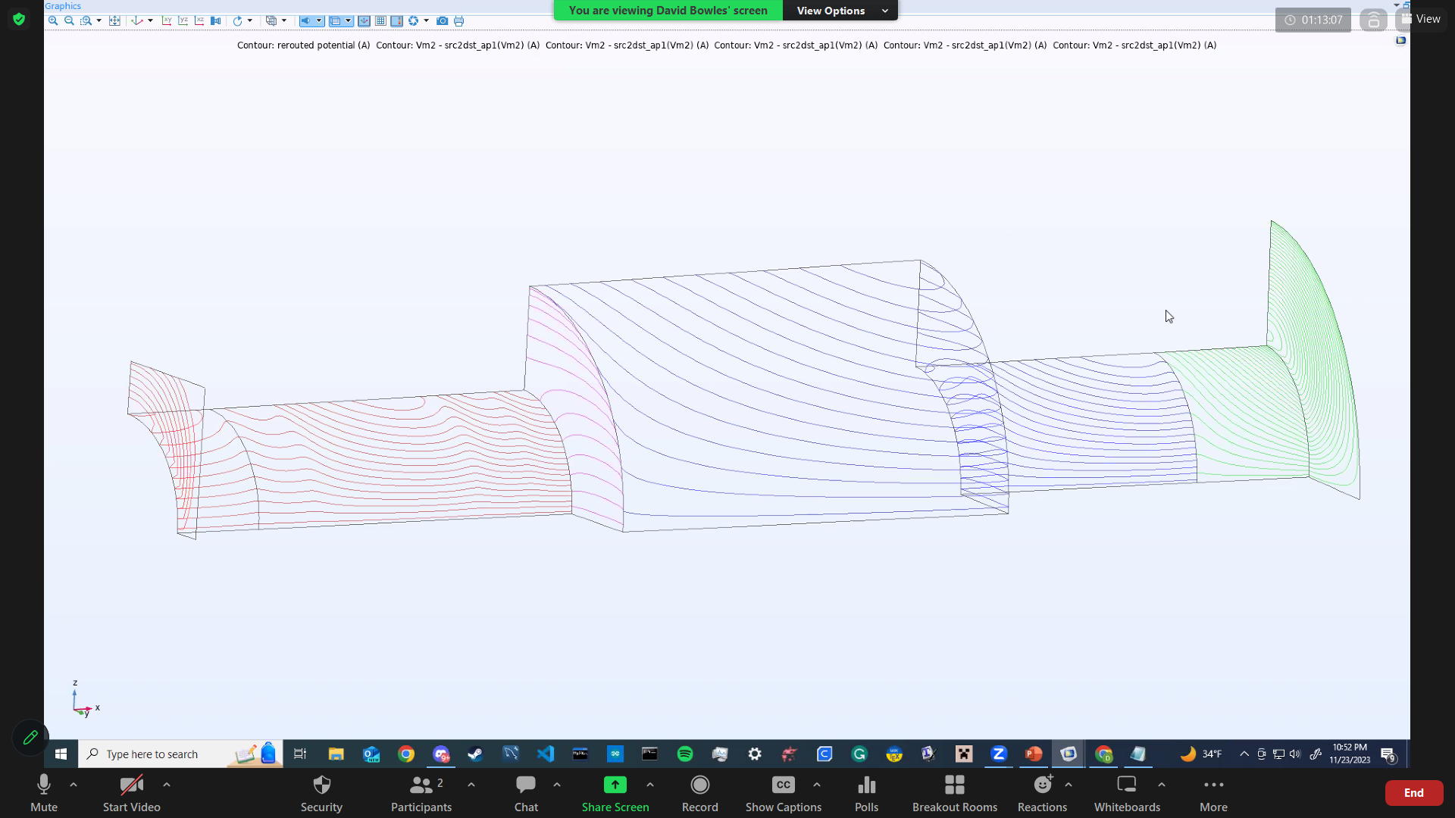
















UCN Spin Transport Coils

Slide 19
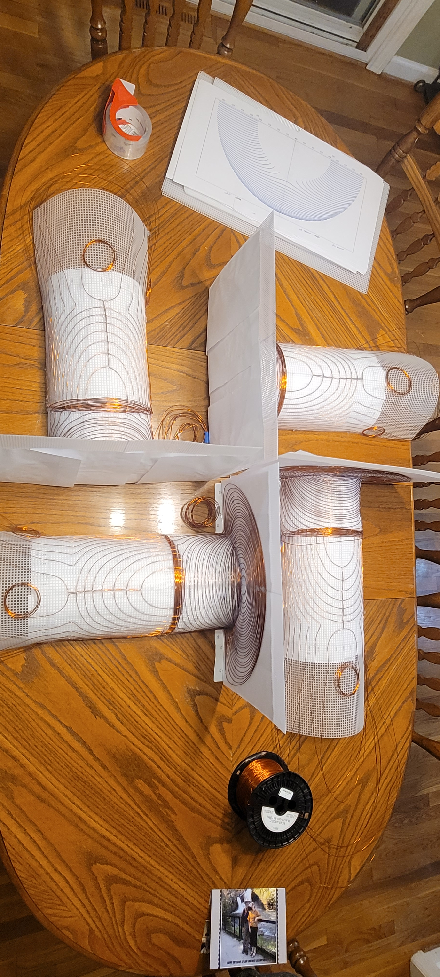
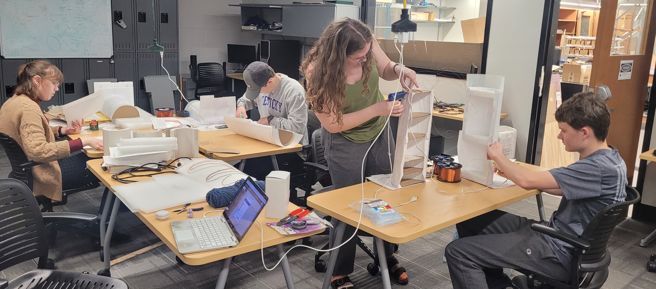
Fabrication of coils

Slide 20
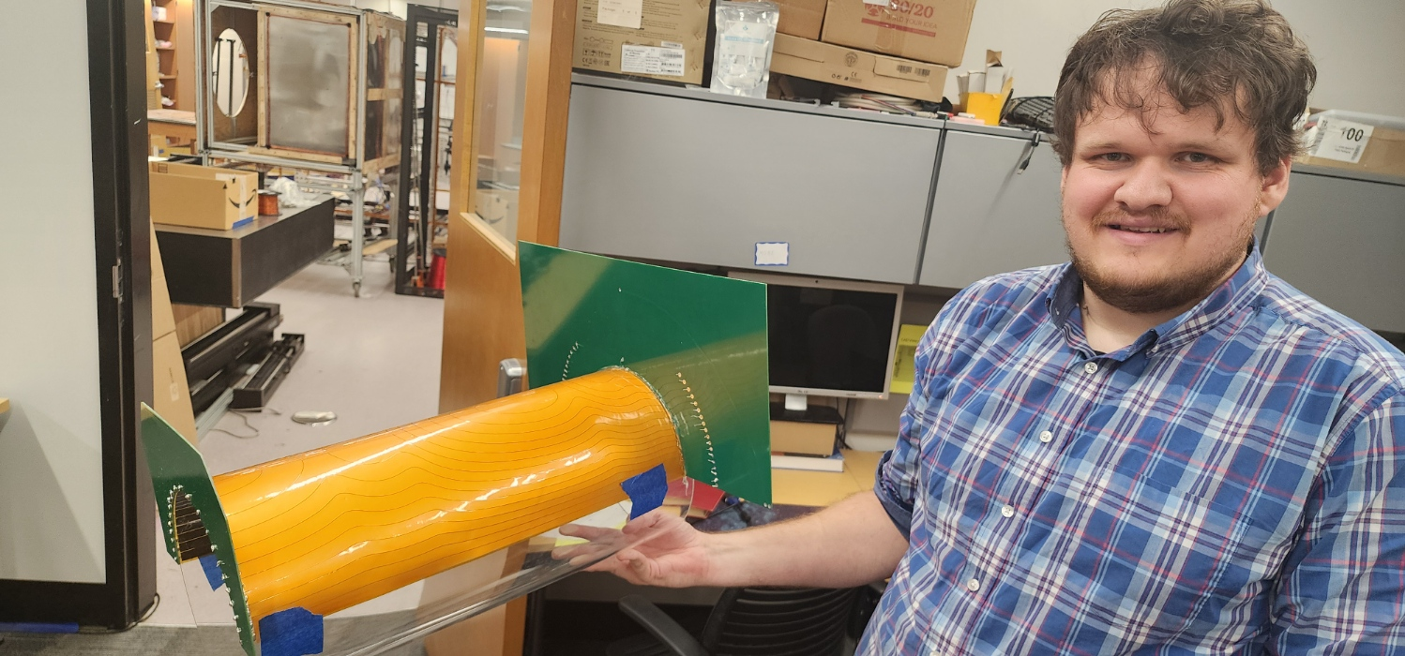
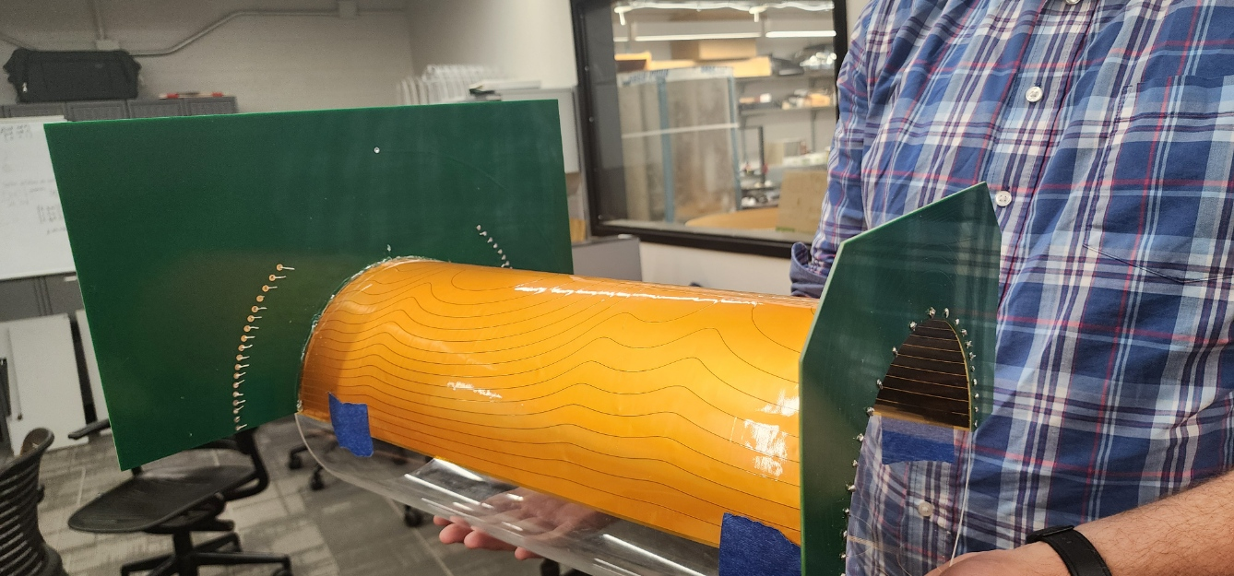
Fabrication of coils

Slide 21
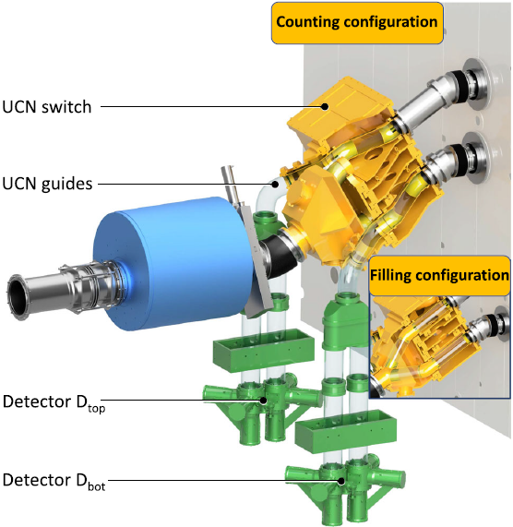
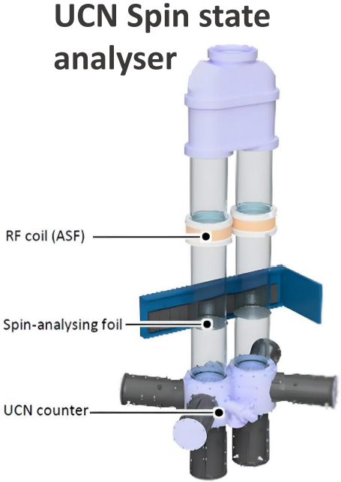
UCN Polarization/Analysis
³He n detection
CF₄ scintillator

Slide 22
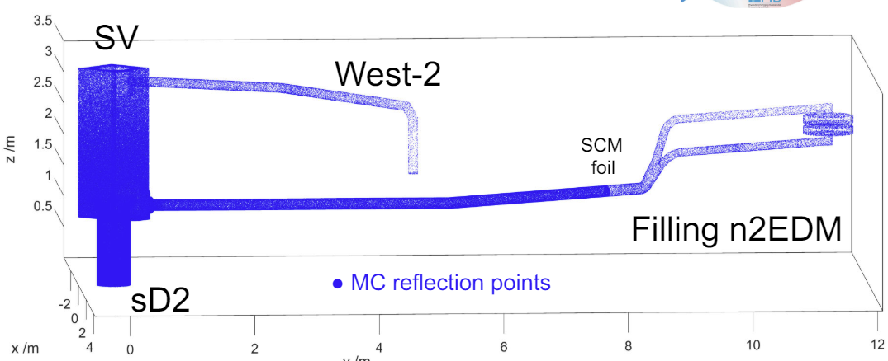
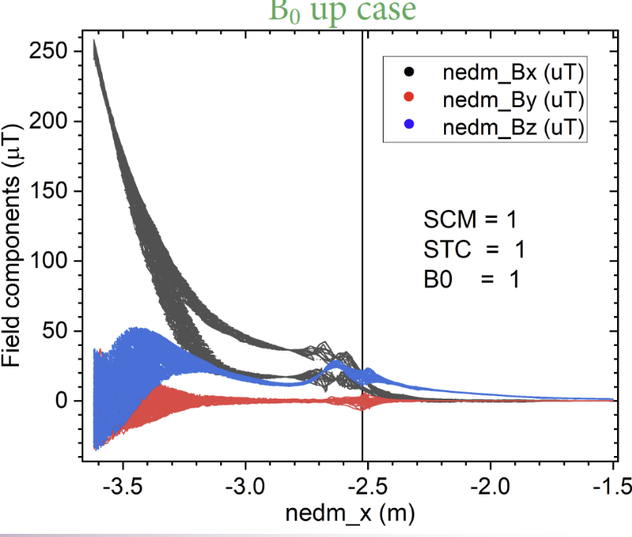
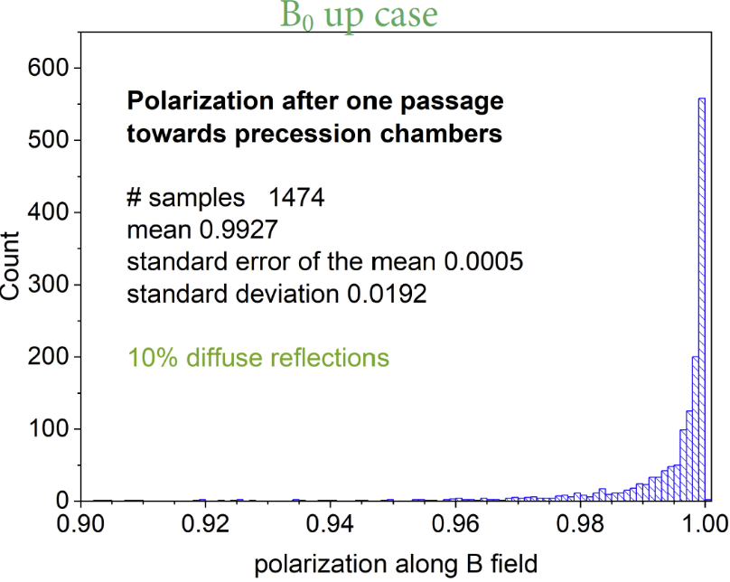
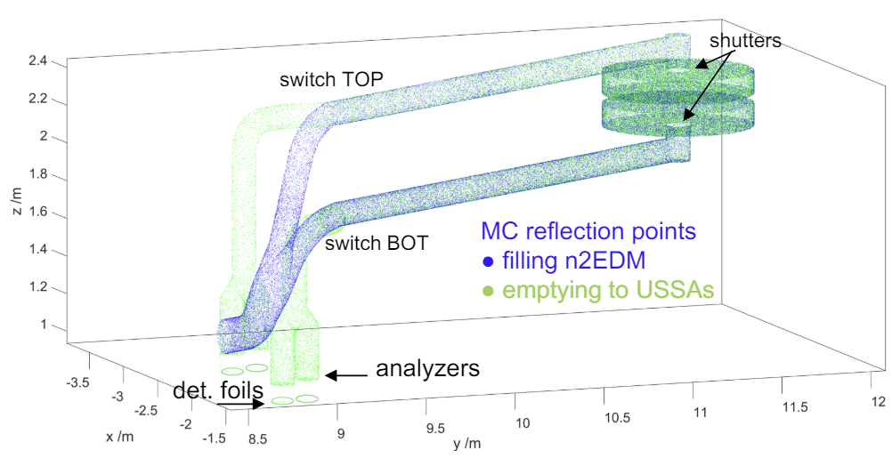
MCUCN Simulation
PRELIMINARY
Eur. Phys. J. C, 81, 512 (2021)

Slide 23
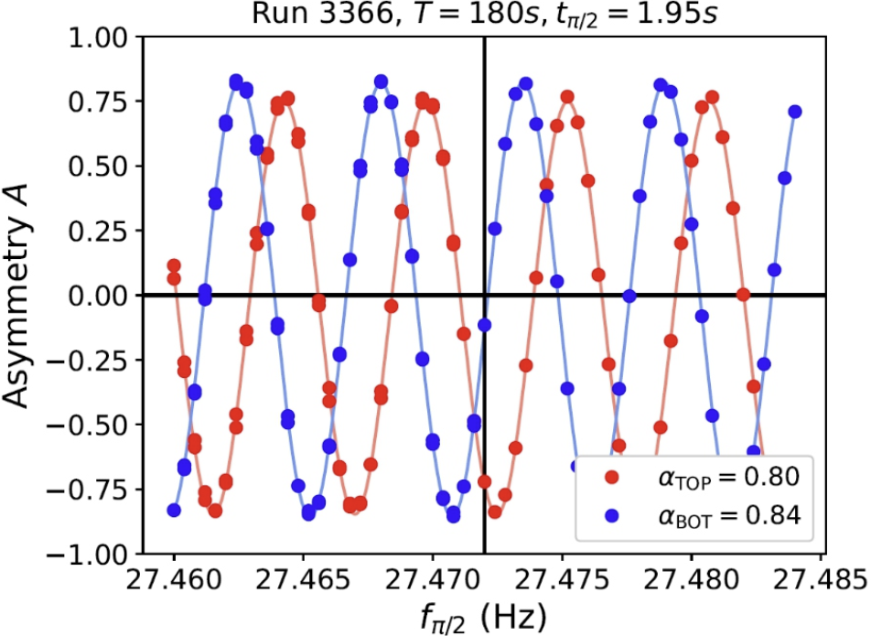
Ramsey curve, first commissioning in 2023
PRELIMINARY

Slide 24
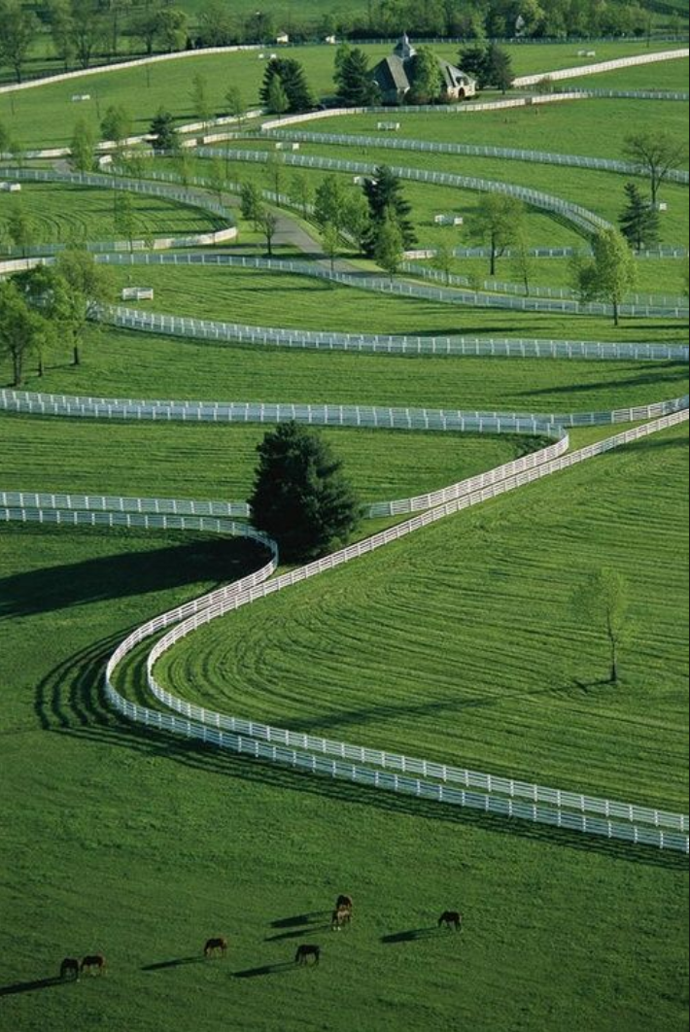

Thanks from Kentucky …
… land of fields and boundary conditions

Slide 25


PSI Ultra Cold Neutron source
UCN counts
per 300s
Proton
pulse
HIPA beam

Slide 26


Vacuum chamber and Precession cells

Slide 27




Cs Magnetometry
Total of 112 Cs cells on 28 plates
(gradients up to 𝑙 ≤ 7)
Placement accuracy: ±0.5 mm
Magnetometry accuracy: 5 pT
PhD Victoria Kletzl

