Slide 1
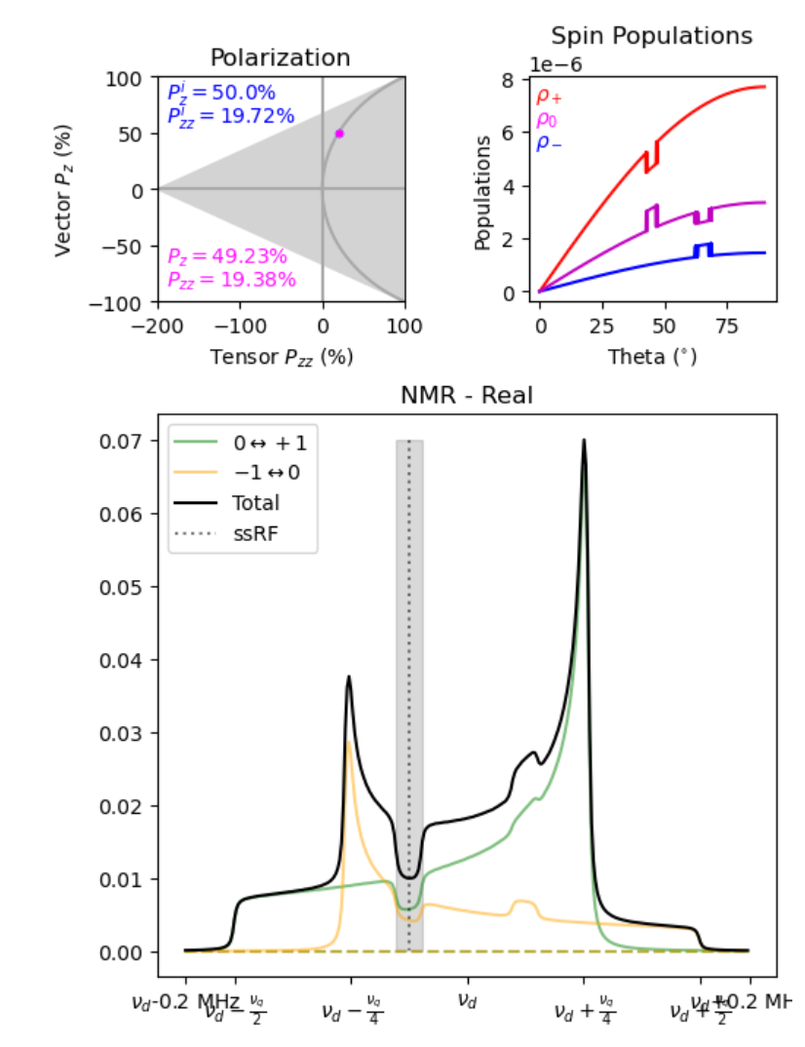
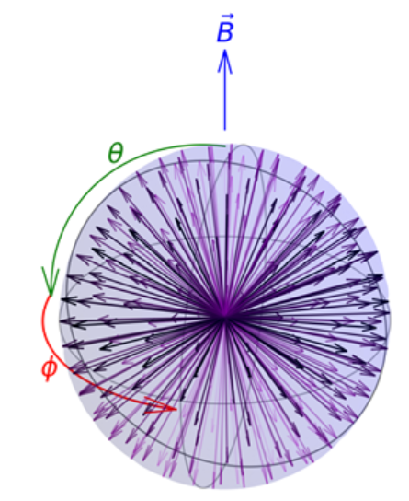
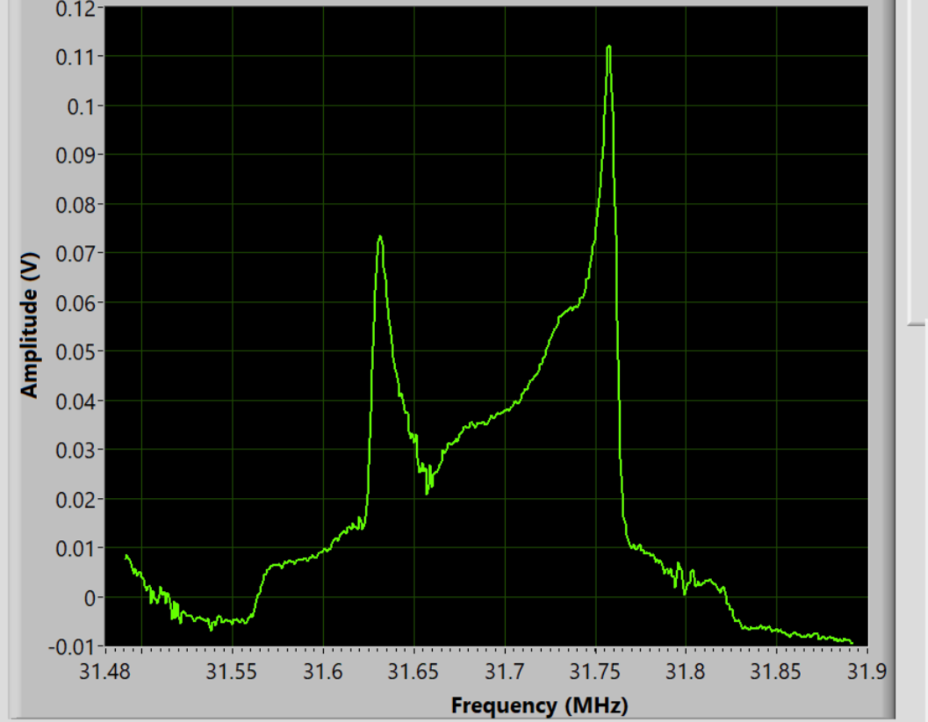
Computational NMR Model for Deuteron Vector & Tensor Polarization
Elena Long
PSTP
Sept. 24th, 2024

Slide 2
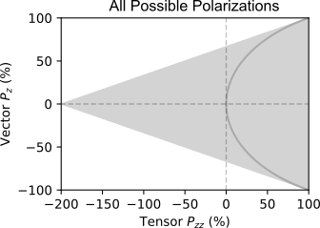
Tensor Polarization Basics
J Forest, et al, PRC 54 646 (1996)
Spin-1
System
$$𝒬^{equil}=2−\sqrt{4−3𝒫^{2}}$$
$=Gray Half−circle$
m = +1
m = 0
m = -1
( + )-2
Tensor $𝒬={(p}_{+}+p_{−})−2p_{0}=1−3p_{0}$

Slide 3
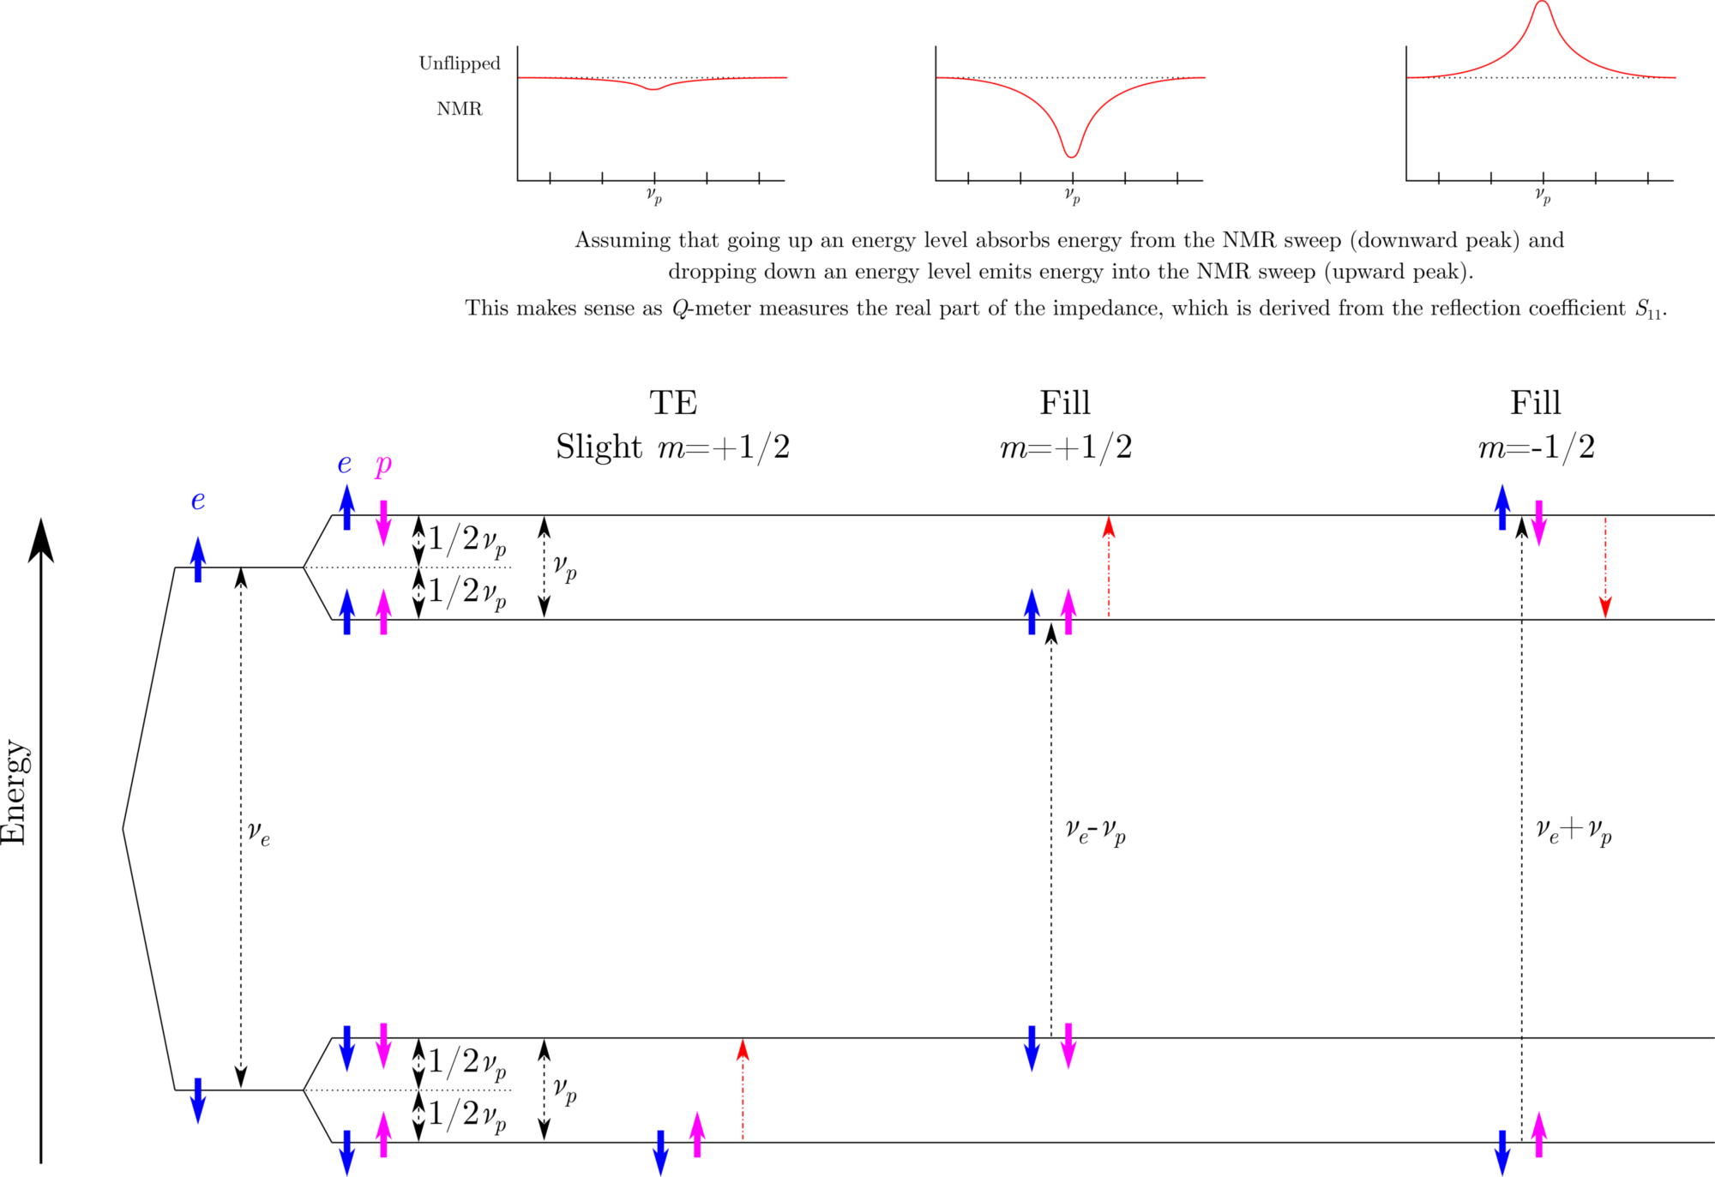
Building NMR
Proton

Slide 4
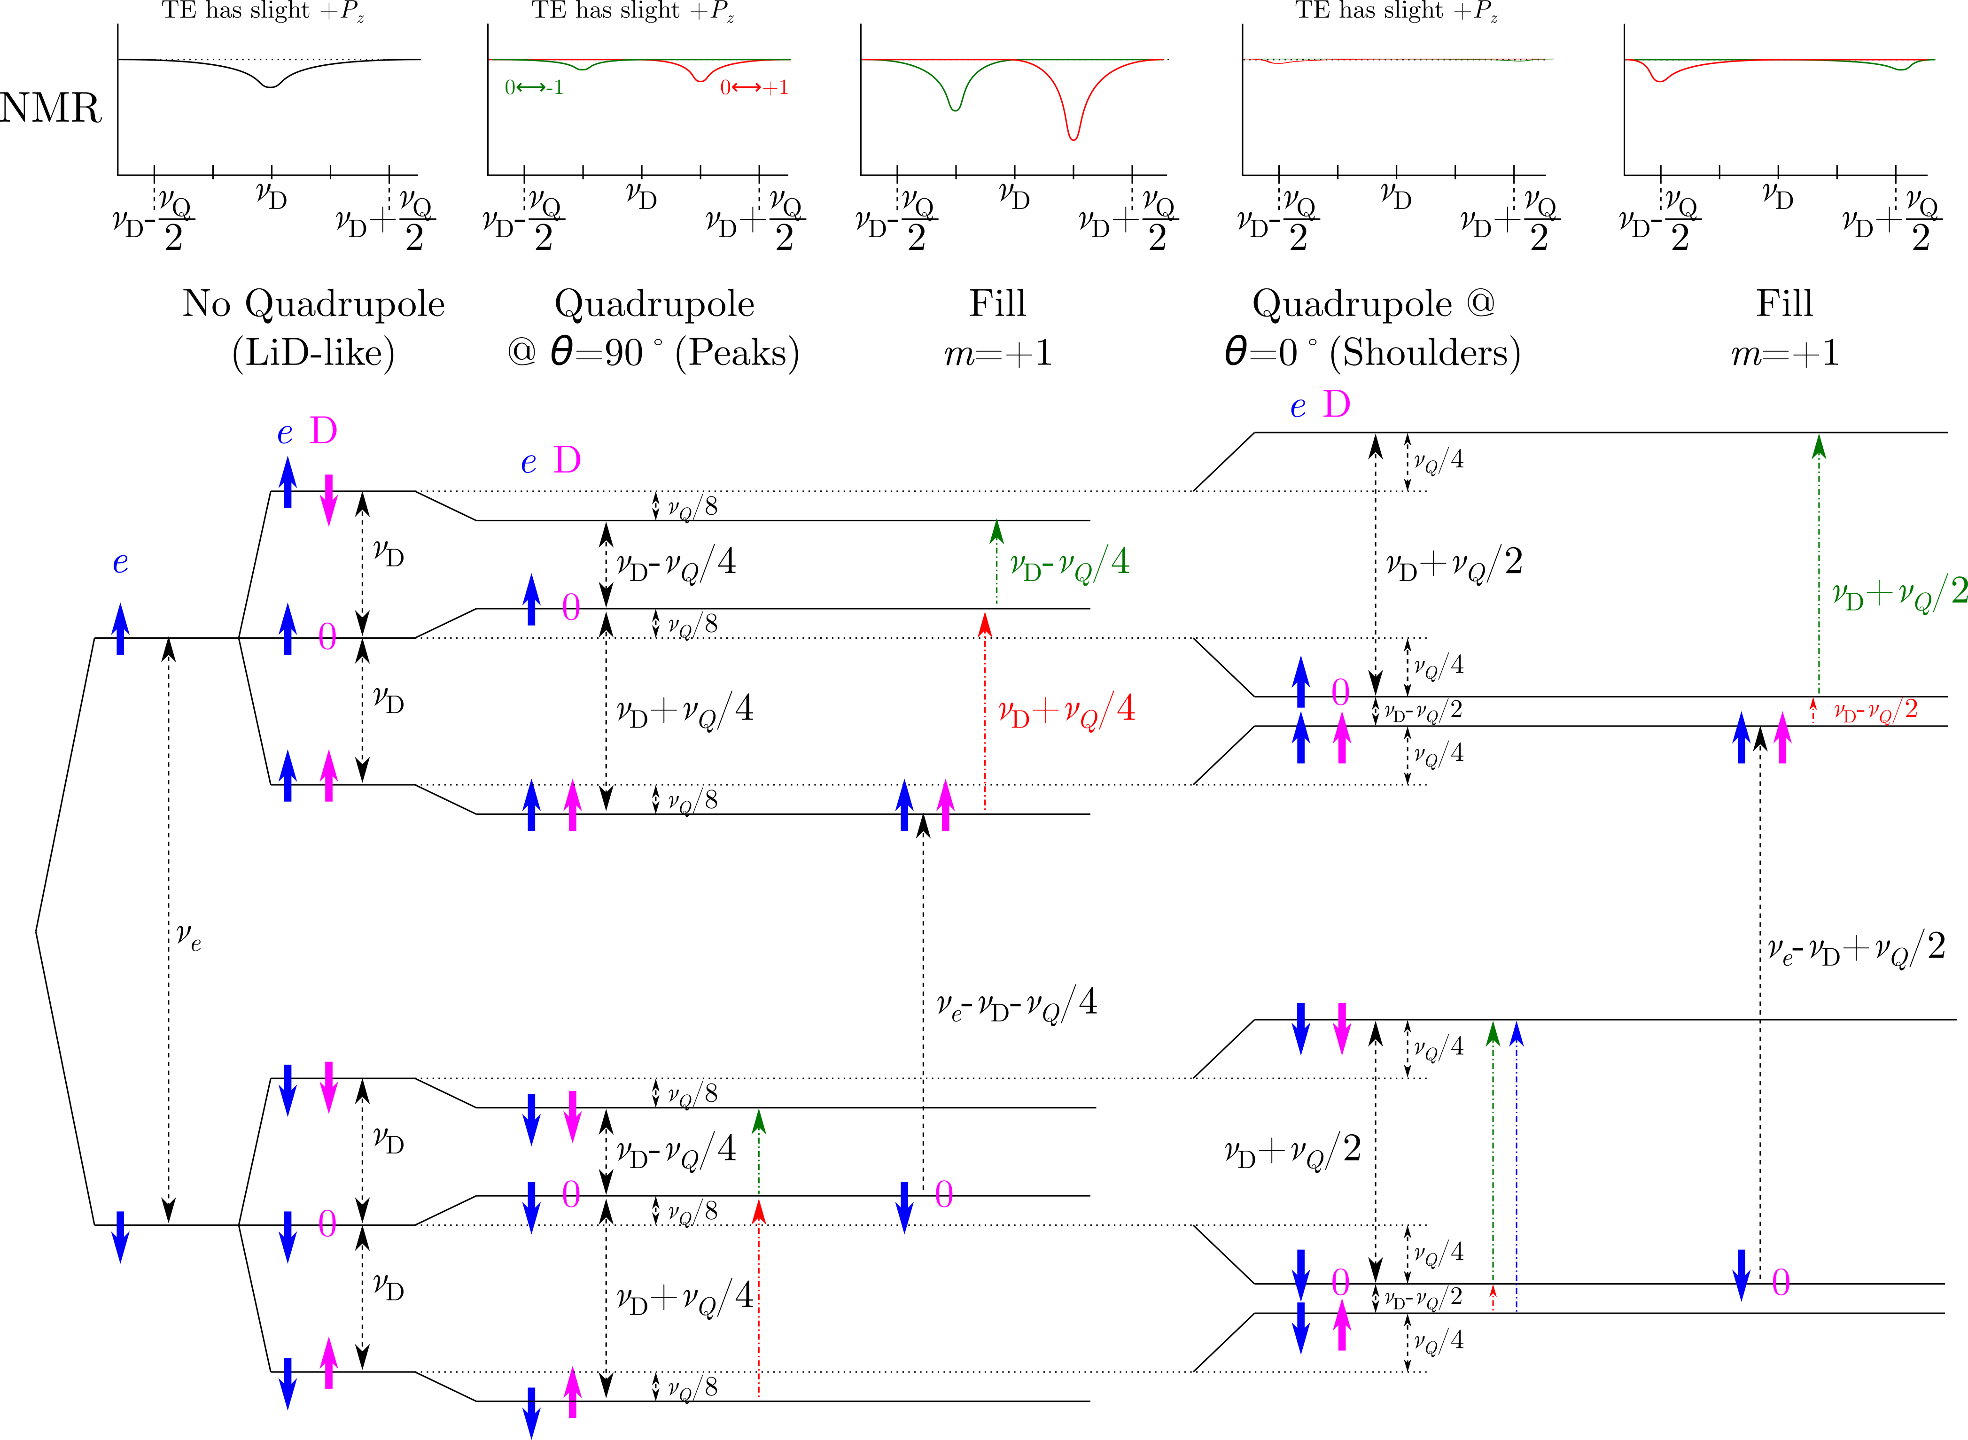
Building NMR
Deuteron
Courtesy C. Keith

Slide 5
Quick Note on Notation for Experts
This simulation based on M.H. Cohen, F. Reif, Solid State Phys. 5, 321 (1957)
Major difference with Abragam is definition of quadrupole freq.
Cohen & Reif
Abragam
Cohen & Reif
Abragam
$$ν_{q}=12ω_{q}$$
$$ω_{q}$$
$$ω_{q}$$
$$ω_{q}$$
$$ω_{q}$$
$$ω_{q}$$
$$ω_{q}$$
$$ν_{q}$$
$$ω_{q}$$
$$ω_{q}$$
$$ω_{q}$$
$$ω_{q}$$
$$ω_{q}$$
$$ω_{q}$$

Slide 6
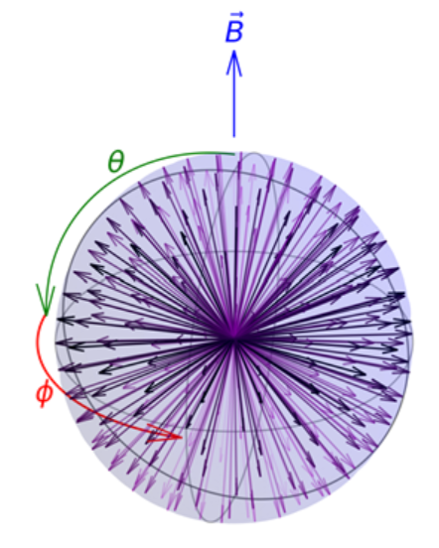
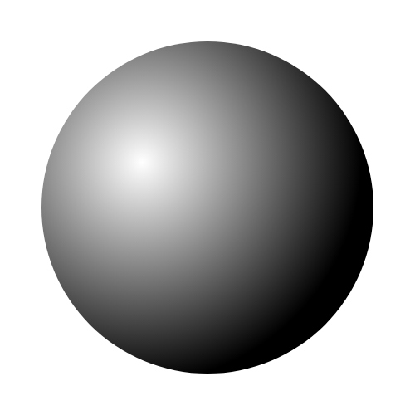
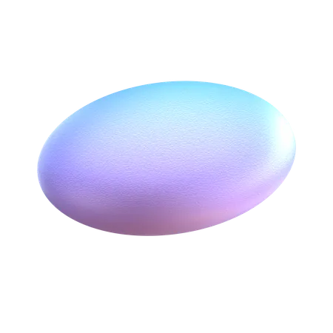
Energy Levels
Deuteron
Larmor Freq.
$φ$-Dependent
Asymmetry Parameter
Spin State
-1, 0, +1
Deuteron
Quadrupole Freq.
Example:
the ND₃ molecule
$$\vec{B}$$
Deuteron energy levels dependent on orientations of holding $\overset{⃑}{B}$ field & molecular $\overset{⃑}{E}$ field
These fields are described by the quadrupole angles $θ$ and $φ$
θ
N
$$\vec{E}$$
D
Courtesy C. Keith

Slide 7
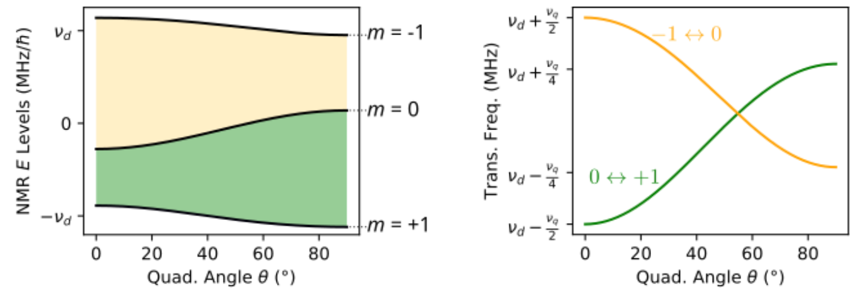
Energy Levels → NMR Frequencies

Slide 8
Initial Populations
Simulation doesn’t care how polarization was obtained, but uses $𝒫$ and $𝒬$ as inputs to determine population levels
$$ρ_{−1}=\frac{1}{2}\left(1−\frac{1−𝒬}{3}−𝒫\right)$$
$$ρ_{0}=\frac{1−𝒬}{3}$$
$$ρ_{+1}=\frac{1}{2}\left(1−\frac{1−𝒬}{3}+𝒫\right)$$
$$𝒫=ρ_{+1}−ρ_{−1}$$
$$𝒬=\left(ρ_{+1}+ρ_{−1}\right)−2ρ_{0}=1−3ρ_{0}$$
$$ρ_{+1}+ρ_{−1}+ρ_{0}=1$$

Slide 9
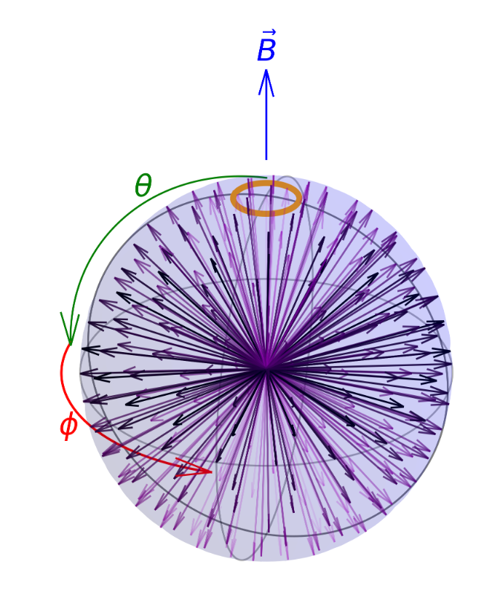
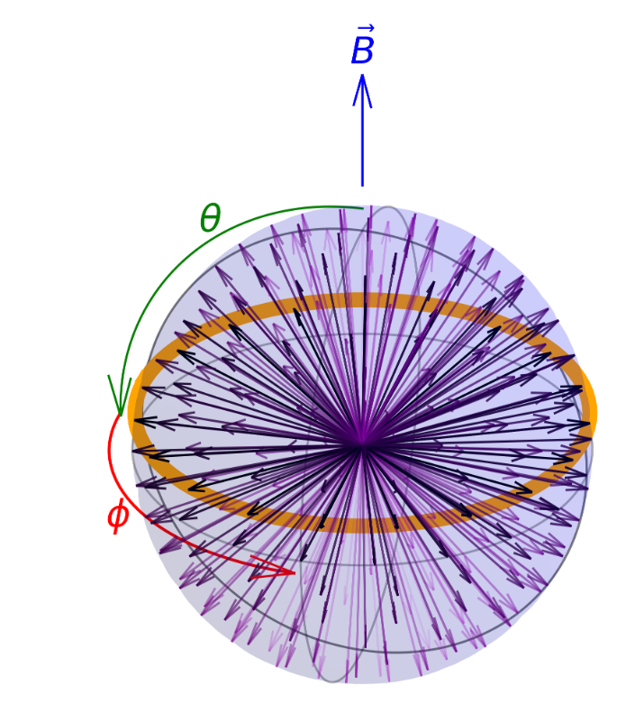
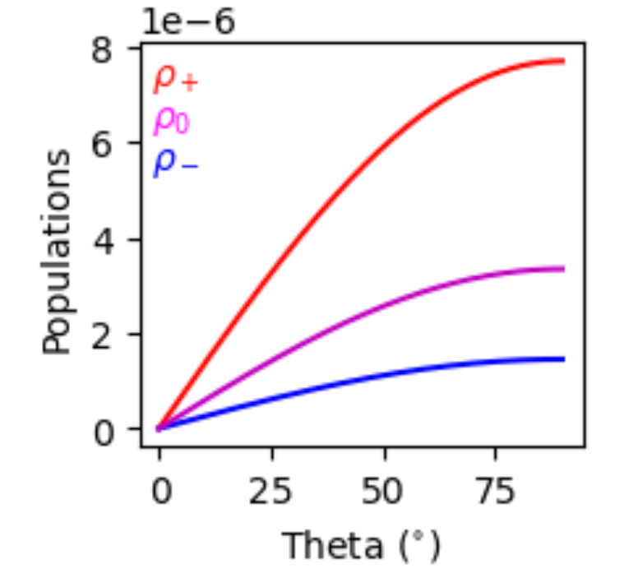
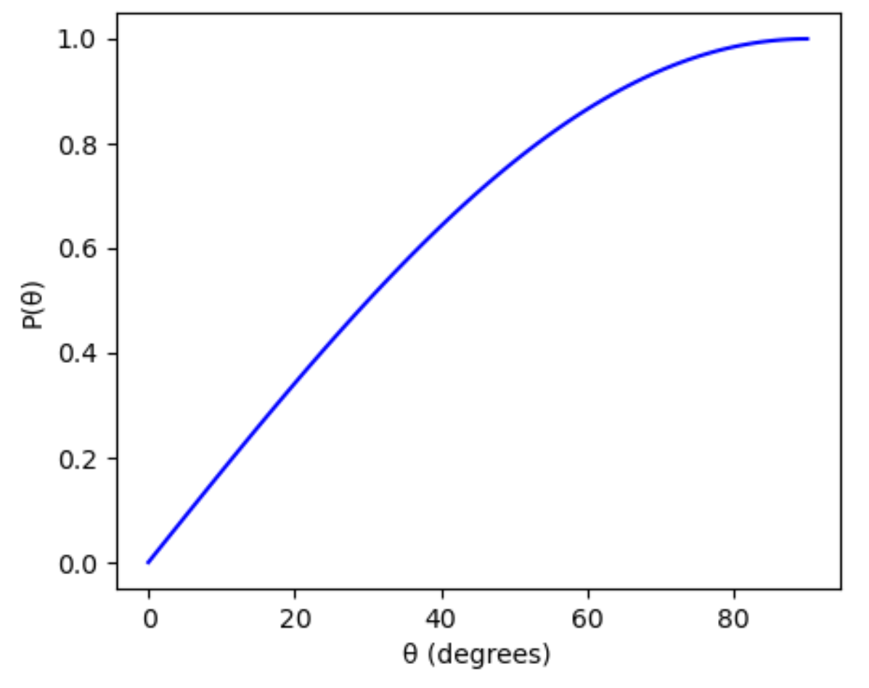
$θ$-Dependent Populations
Integrations over $φ$ causes a $θ$ dependence for # of nuclei with particular quadrupole angles
M. Eden, Conc. in Mag. Res. A 18, 24 (2003)
$$θ=10°$$
$$θ=80°$$
$$P\left(θ\right)=A\sin{θ}$$

Slide 10
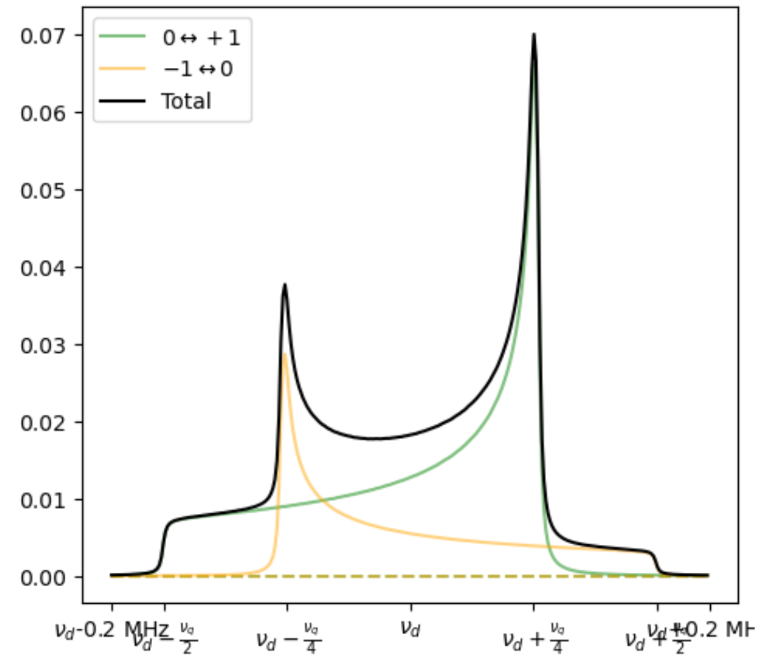
Counting Spin Flips
Simulation creates >300k individual spin flips to build frequency-dependent counts of spin flips
$$×Broadening$$
$$×$$
$$=$$

Slide 11
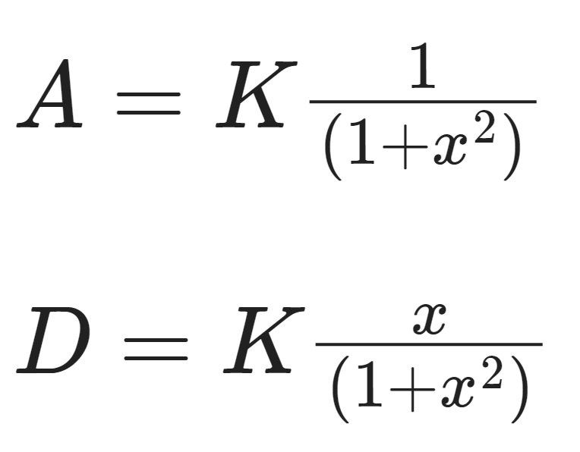
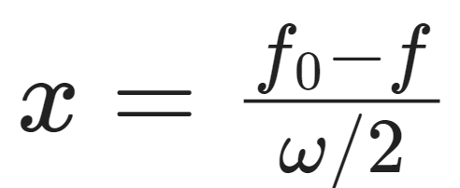
Broadening
Each bin of spin flip counts is broadened by a Lorentzian
Includes broadening of both absorptive (real) and dispersive (imaginary) to account for phase tuning
Broadening based on lessons learned with simple oscillator signal on various tunes using VNA
Used to model both real & imaginary NMR signals, as well as combinations of both

Slide 12
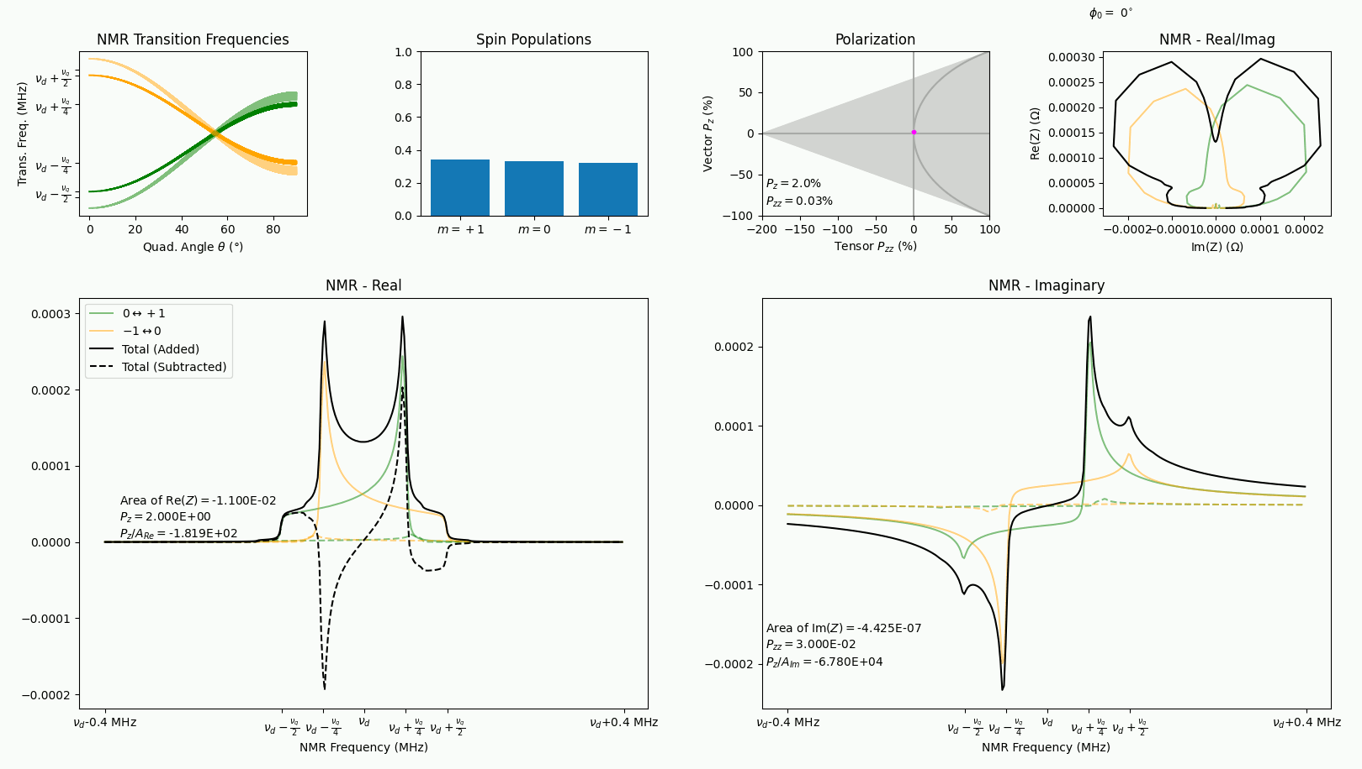
Real & Imaginary Deuteron NMR Signals
Preliminary
See M. McClellan’s Talk

Slide 13
Measuring Polarization
For vector polarization,
$𝒫=cc∙A_{NMR}=cc∙\left(I_{+}+I_{−}\right)$
For tensor polarization,
$𝒬=cc∙\left(I_{+}−I_{−}\right)$
Reducing $I_{−}$
Increases +$𝒬$
Line shape fits used to extract $I_{+}$ and $I_{−}$ area difference
D. Keller, et al., NIM A 981, 164504 (2020)
D. Keller, Eur. Phys. J. A 53, 155 (2017)

Slide 14
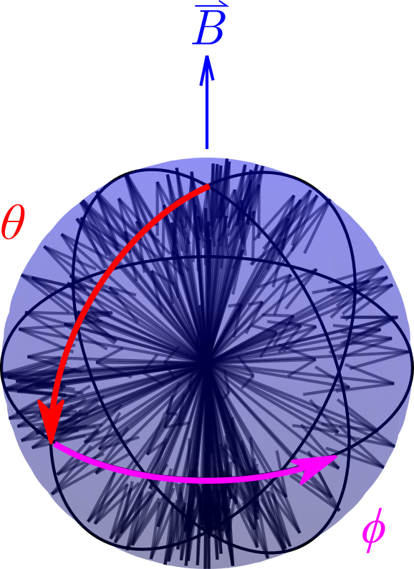
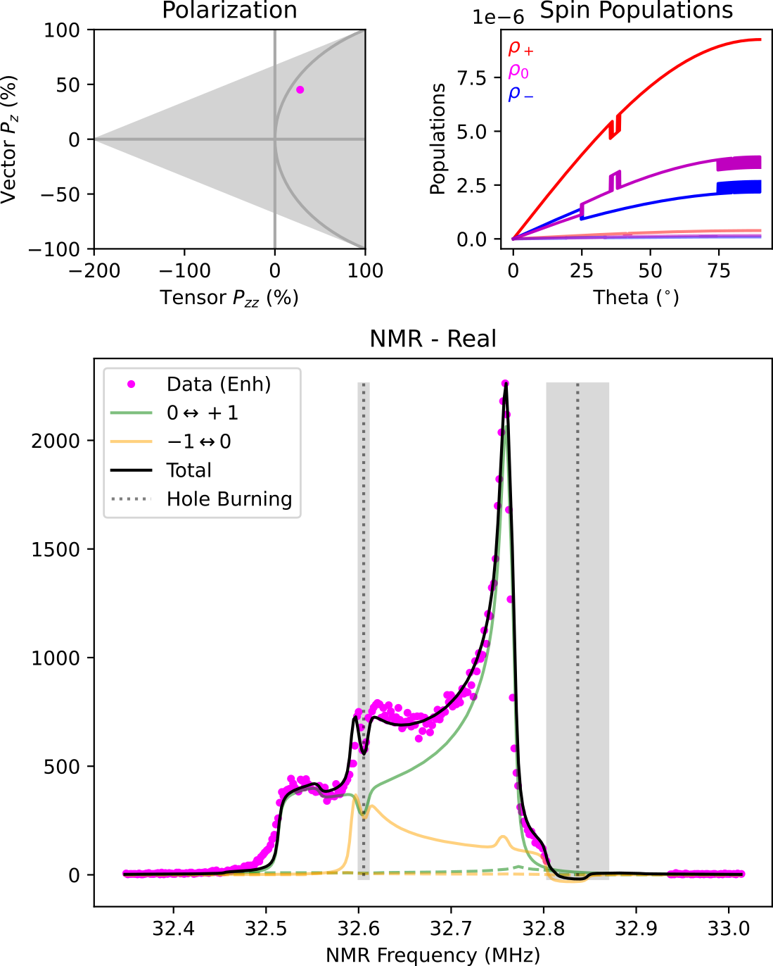
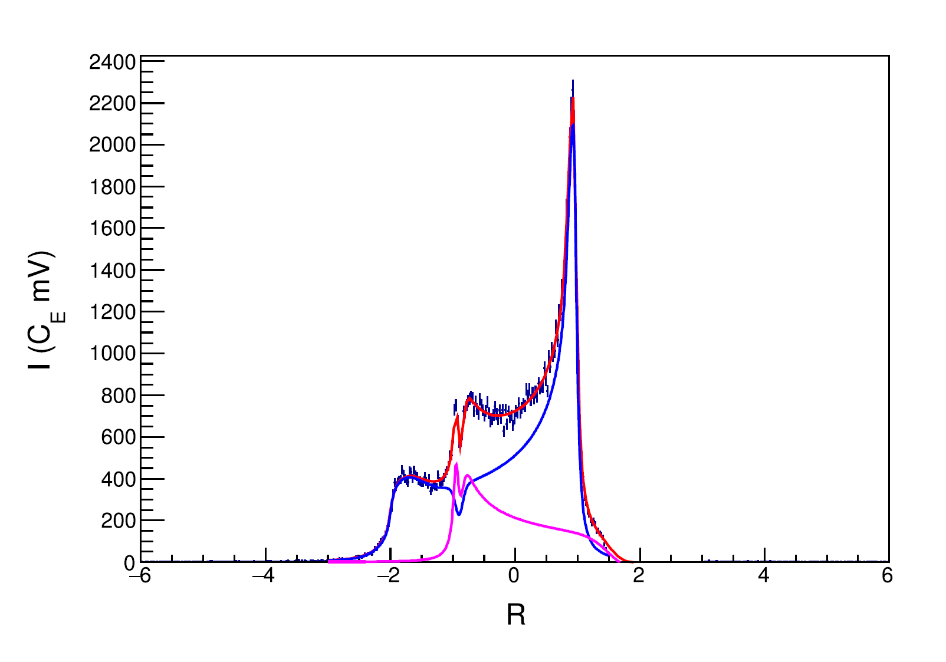
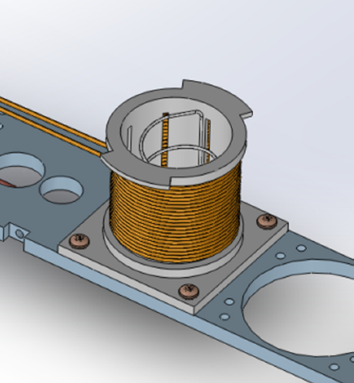
Selective Semi-Saturation of RF (ssRF)
^{[1]} D. Keller, et al., NIM A 981, 164504 (2020)
^{[2]} D. Keller, Eur. Phys. J. A 53, 155 (2017)
^{[3]} A. Abragam, Principles of Nuclear Magnetism (1961)
^{[4]} J. Clement, D. Keller, NIM A 1050, 168177 (2023)
Technique developed by D. Keller & UVA Polarized Target Lab^{[1,2]}
Additional RF coils drive spin-flips within NMR frequencies to minimize $I_{−}$ while having a minimal or enlargement factor on $I_{+}$
Area reduction of $I_{−}(θ)$ causes a ½ area increase of $I_{+}(θ)$
To measure $𝒬$, a line shape derived from Abragam was used that allows for manipulated spin states with different polarizations at different frequencies (and thus different values of $θ$) ^{[2,3]}
UVA achieved $𝒬=28.8\%$ using ssRF^{[1]} on peak and shoulder of $I_{−}$
UNH simulation in agreement with UVA measurement
$$±(3\cos{θ}−1)$$
$$𝒬=28.8\%±5.7\% {(rel)}^{[1]}$$
$$+\frac{1}{2}I(θ)$$
$$−I(θ)$$

Slide 15
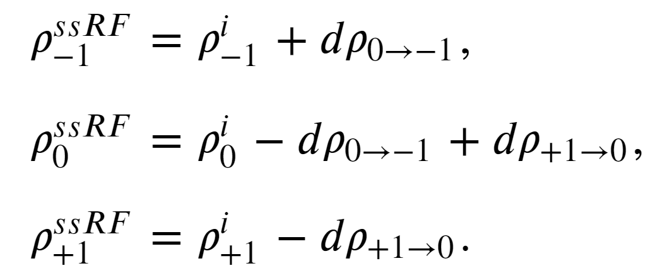
RF Manipulation: ssRF & AFP
RF-induced spin flips are parameterized by an ‘efficiency’ parameter $ℰ$ to induce additional frequency (and thus $θ$) dependent spin flips
This creates new bin-by-by vector & tensor polarizations

Slide 16
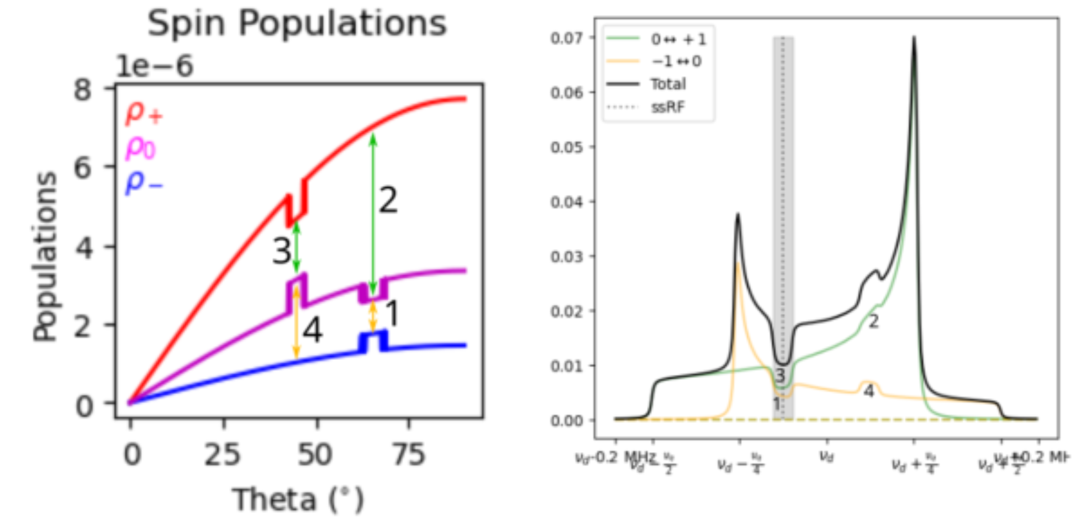
$0<ℰ≤0.5$: Simulates ssRF
Bin-dependent depolarizations from ssRF are modeled with $ℰ≤0.5$

Slide 17
$0.5<ℰ≤1.0$: Simulates AFP*
Bin-dependent population inversions from AFP are modeled with $0.5<ℰ≤1.0$

Slide 18
Q-Curve & Noise Simulated

Slide 19
Comparisons w/ Data (from last week)
See talks by
K. Slifer, S.N. Santiesteban, A. Zec,
M. McClellan, C. Lama, D. Ruth
Extremely Preliminary
Extremely Preliminary

Slide 20
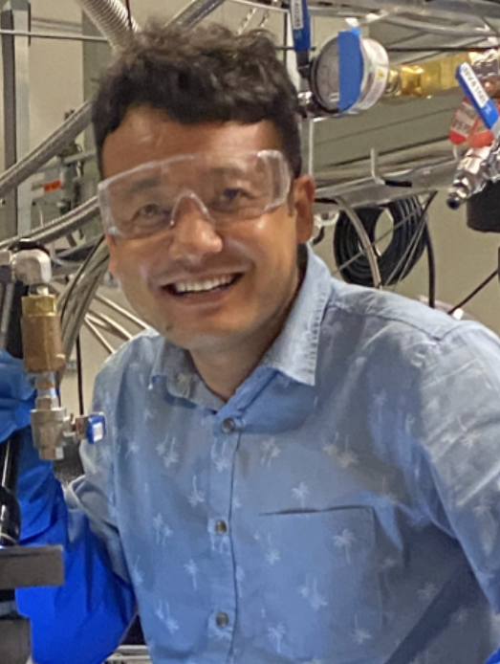
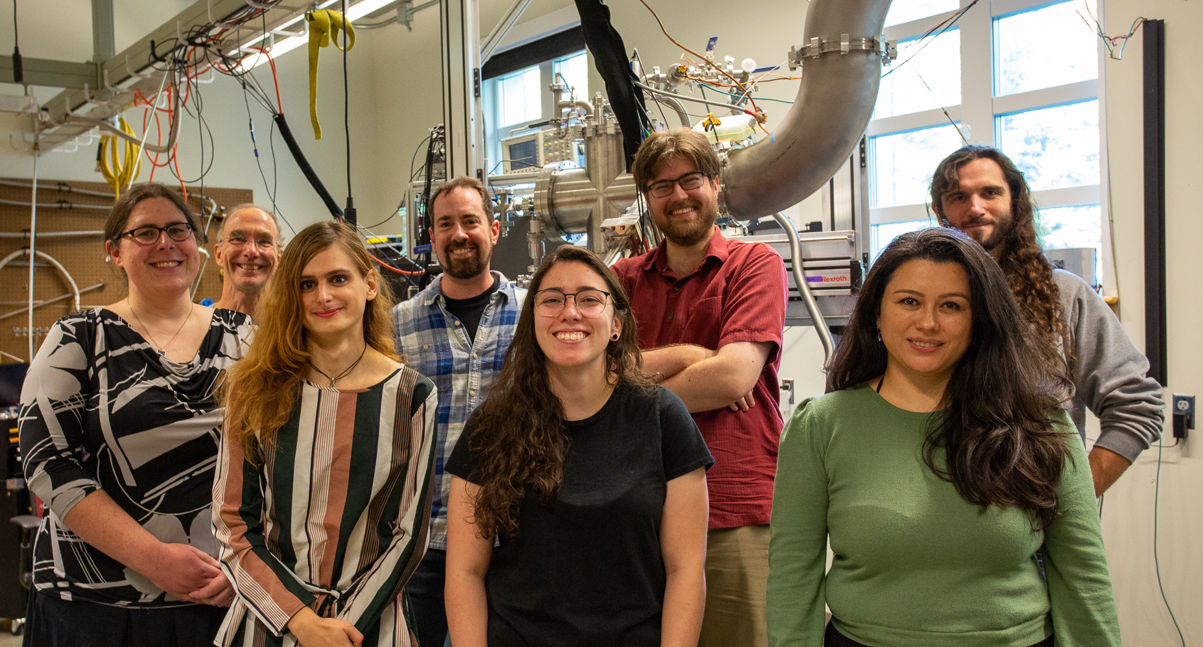
Thank you!
C. Lama PhD Student
A. Aurora PhD Student
D. Ruth Post Doc
M. McClellan PhD Student
K. Slifer PI
E. Long
PI
A. Zec
Post Doc
Z. Wolters PhD Student
N. Santiesteban PI
O. Olokunboyo PhD Student
H. Chinchay PhD Student
M. Farooq PhD Student

Slide 22
Backup Slides

Slide 23
Spin Temperature

Slide 24
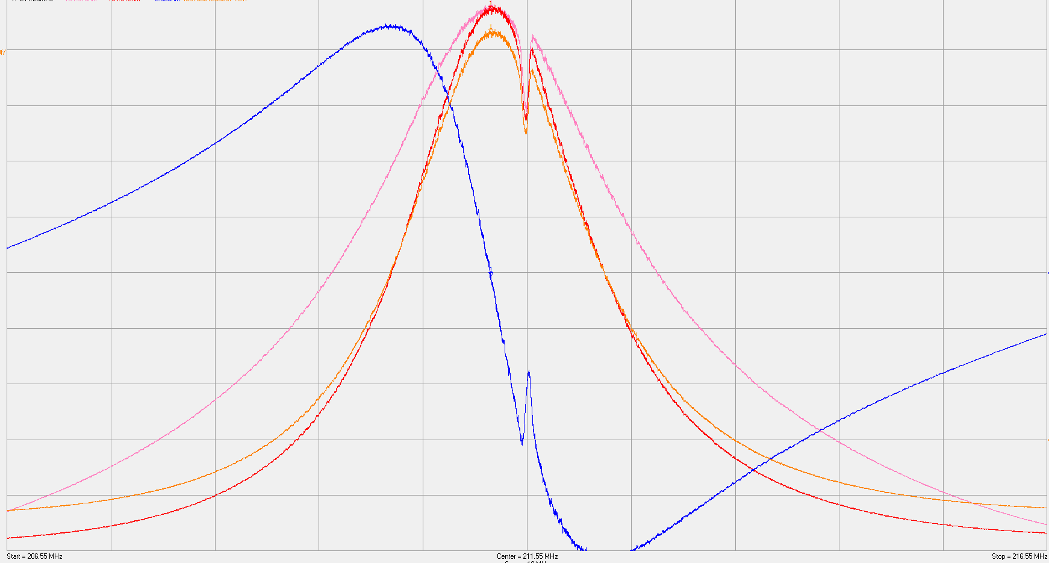
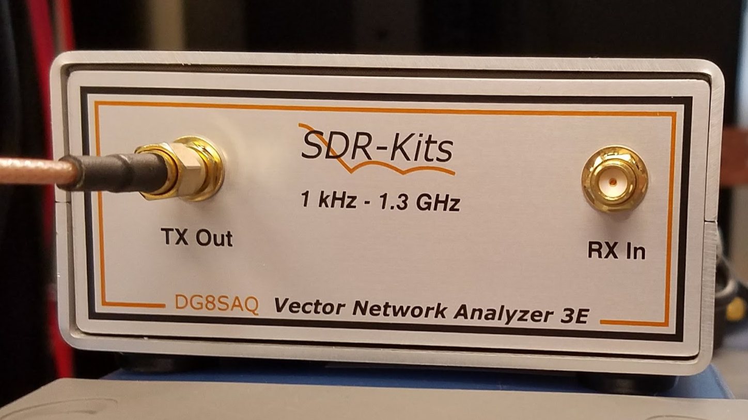
SDR-based VNA NMR
Using Eq (1), Eq (3), & Table I from Yu.F. Kisselev et al., NIM A 354, 249 (1995)
SDR = Software Defined Radio
Simultaneous measurement of all parts (Real & Imaginary) of NMR signal
DNP-Enhanced Proton Signal
$$Re(Z)$$
$$Im(Z)$$
$$|Z|$$
~$450

Slide 25
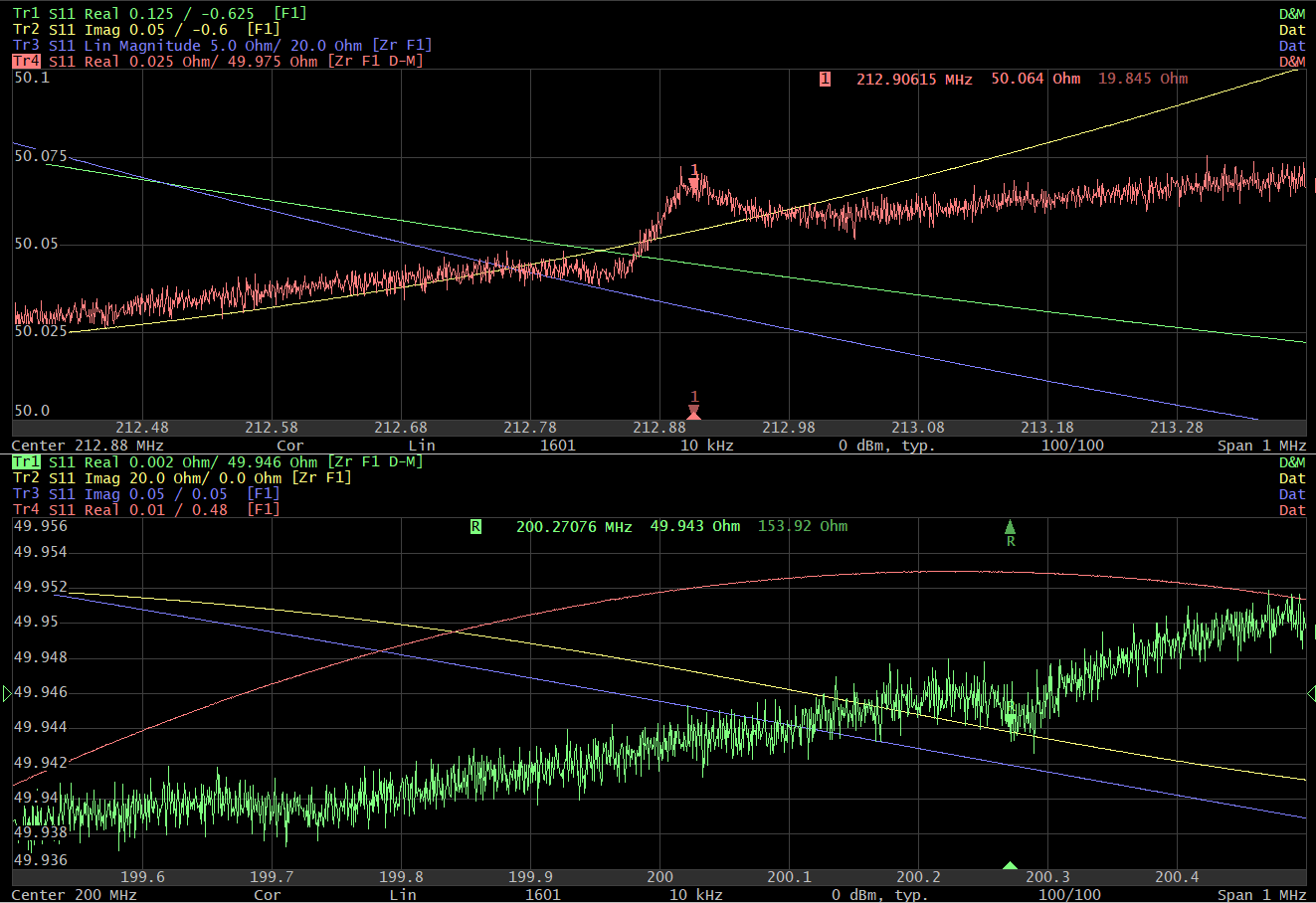
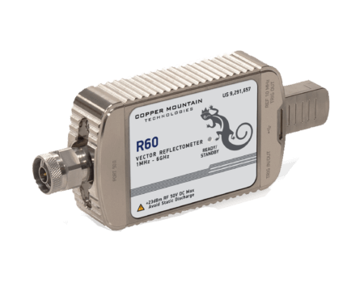
VNA NMR – Multiple Signals @ Same Time
Does not require soldering new tank circuits to use with different nuclei (ie, 5T proton @ 213 MHz and 5T deuteron @ 32 MHz)
Can measure multiple nuclei simultaneously
Proton
~$4k
¹⁹F
(from Kel-F Cup)

Slide 26
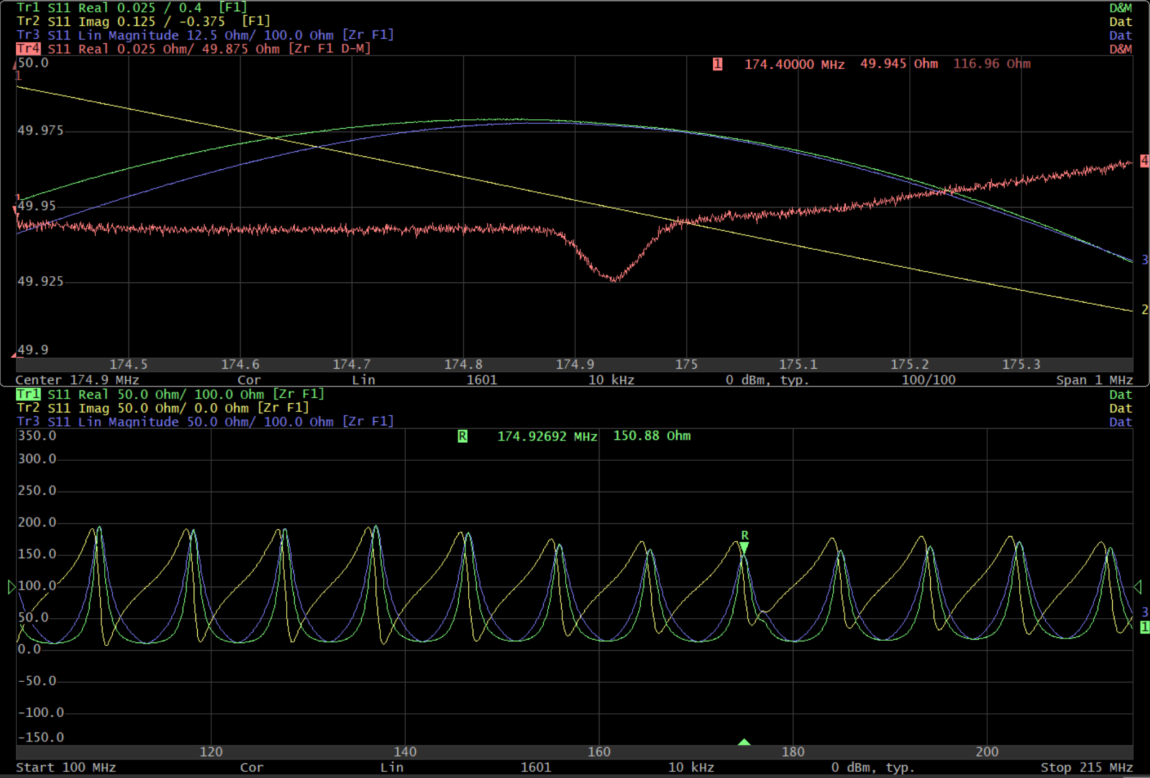
VNA NMR – Q-curve BG Studies
Can measure extremely wide frequency ranges (~up to 50 MHz span w/ NMR signal, 0.001-6 GHz span for Q-curve background studies)
Normally only +/- 400kHz measured
Combining Real & Imaginary information over a large frequency range may remove need for a baseline!
4T Proton
100 MHz to 215 MHz

Slide 27
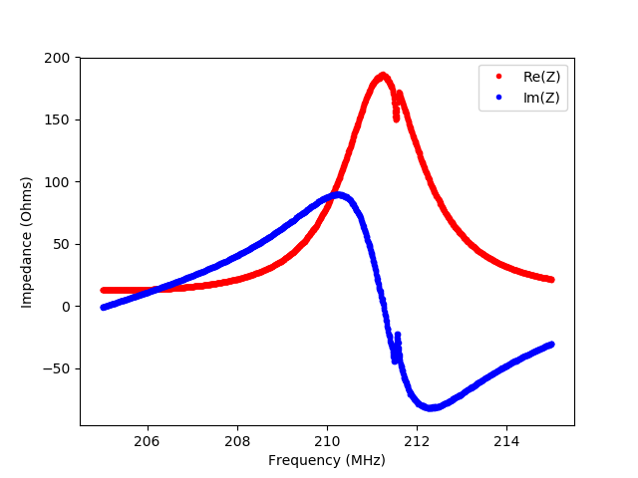
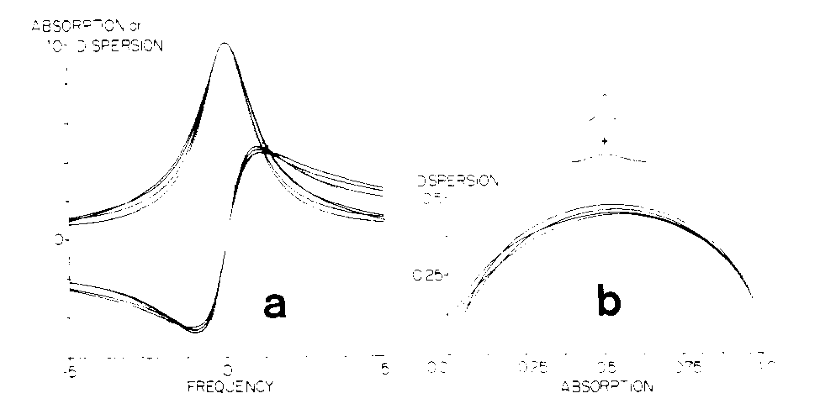
VNA NMR – Re & Im + Q-curve BG Studies
Absorption (Real) vs. Dispersion (Imaginary) creates circles for Lorentzian signals
Tuned NMR cables are Lorentzian with NMR signals on top
Enhanced proton signal on VNA
D.C. Roe, A.G. Marshall, Analytical Chemistry, 50, 756 (1978)
D.C. Roe, A.G. Marshall, Analytical Chemistry, 50, 764 (1978)

Slide 28
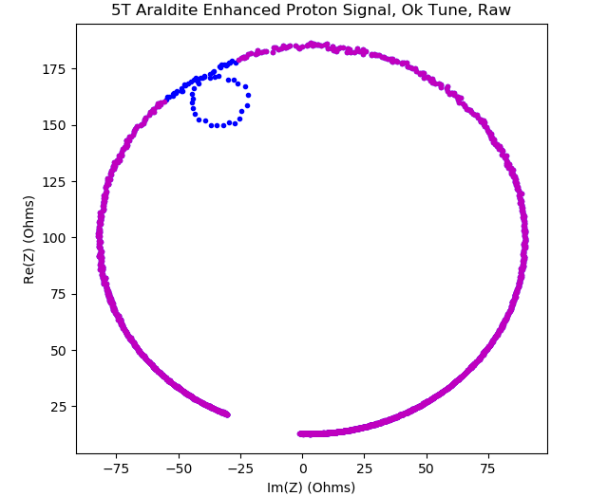
New BG Subtraction Method
Re(Z) vs. Im(Z) creates easy-to-fit circles!
Proton Signal
Signal on Top = Good Tune
Signal on Left/Right = Re(Z) signal hidden
(Looks like Im(Z) when near sides, goes away when equal to sides) Signal on Bottom ½ = ‘Flipped’ Proton Signal
‘Q-Curve’ Background

Slide 29
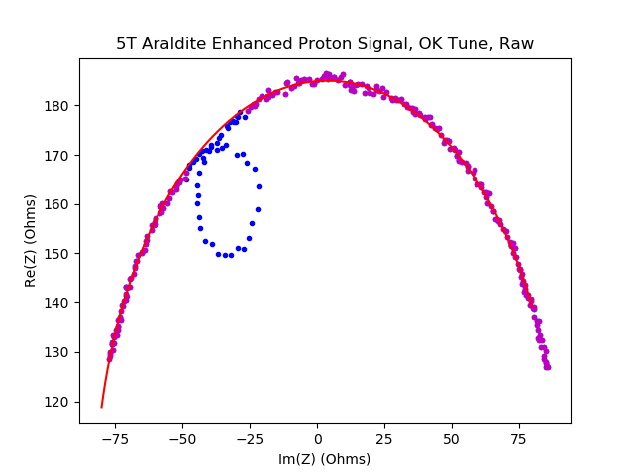
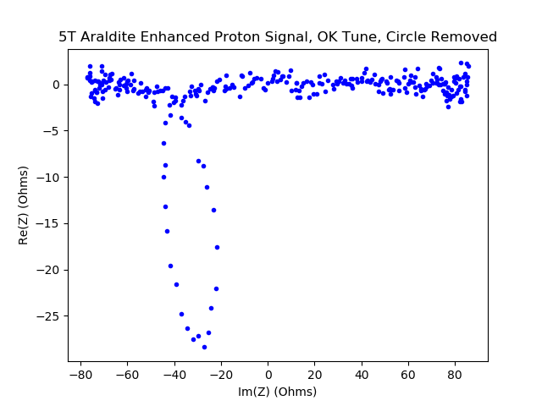
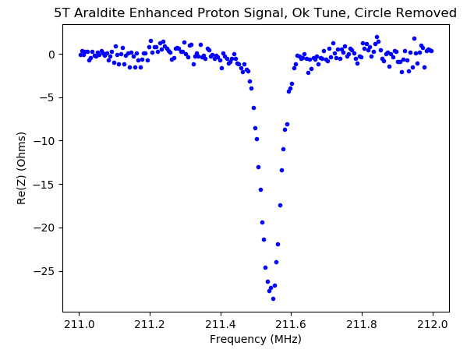
New BG Subtraction Method
Fit BG circle w/ radius & center offset
Plot remaining Re(Z) vs. Frequency
Subtract out BG circle

Slide 30
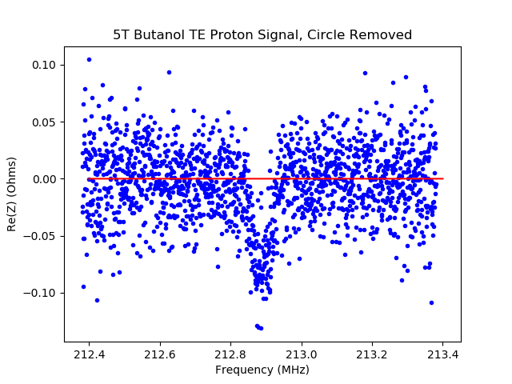
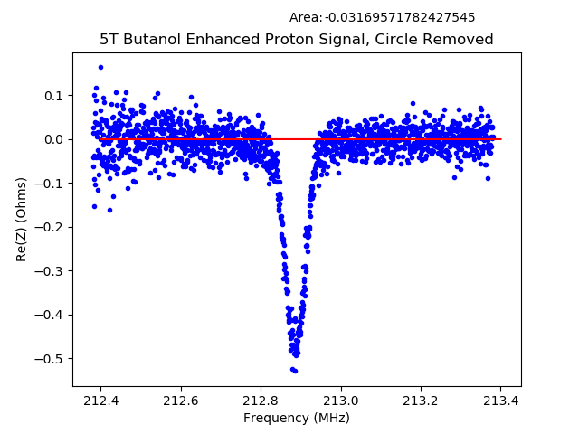
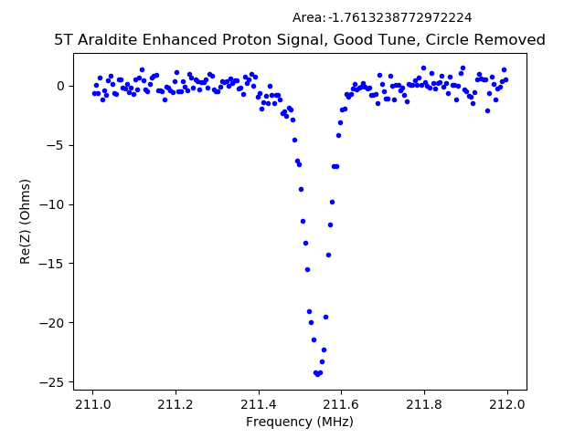
New BG Subtraction Method
Remaining background is extremely flat
Works from TE through enhanced

