Slide 1
RF techniques for enhancing tensor polarization in solid targets
David Ruth, Nathaly Santiesteban
PSTP 2024

Slide 2
Physics Motivation: Tensor Measurements Solid Targets = Spin-1 (ND₃)
l
l'
l
l'
l
l'
q
q
H
q
p
p_{miss}
DIS: Tensor structure functions QCD effects
SIDIS: Tensor structure functions Novel information about the interplay between QCD and nuclear structure.
Quasielastic Scattering: Understanding Nucleon-Nucleon repulsion
Current cases of active study in UNH
Strong collaboration: UNH, UVa, JLab, FIU, UCAM, U. Pavia, ORNL, Universidad Técnica Federico Santa María, among others.
Seeking more collaborators: The Tensor program is a large project.
More tensor physics could be possible (DVCS, real photons, etc)

Slide 3
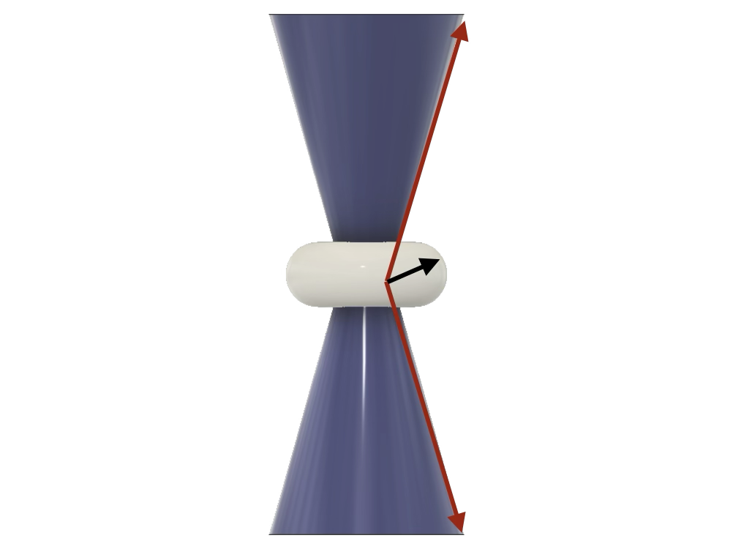
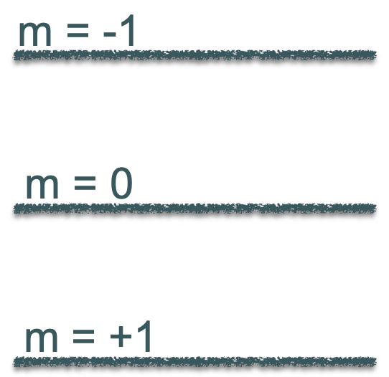
What do we need? Large tensor polarization Spin-1 Polarization
Spin-1 in a magnetic field
3 sub-levels (+1, 0, 1) due to Zeeman interaction.
Two energy transitions $I_{+}$(+1$↔$ 0) and $I_{−}$ (0 $↔$-1).
$$ν_{D}$$
$$\vec{B}$$
$$ν_{D}$$
$$ν_{D}= \frac{μ_{D}B}{h}$$
$ν_{D}=6.54$ MHz/T

Slide 4
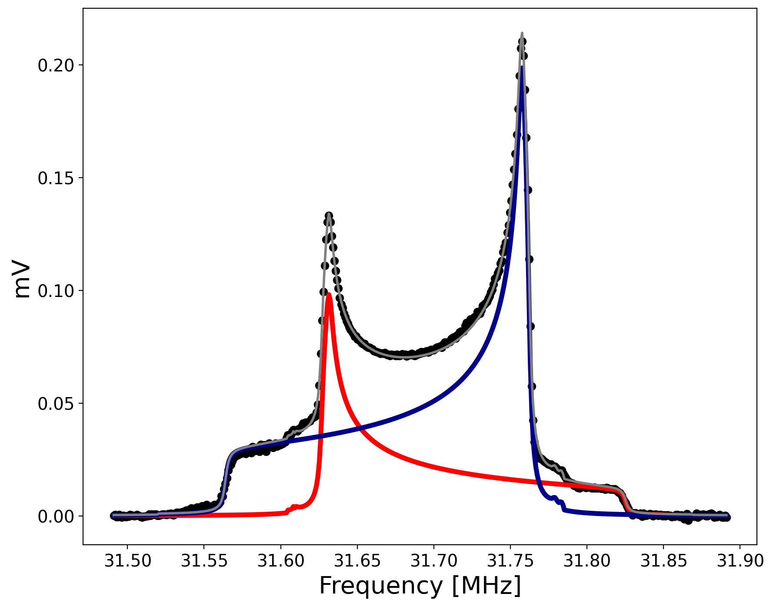
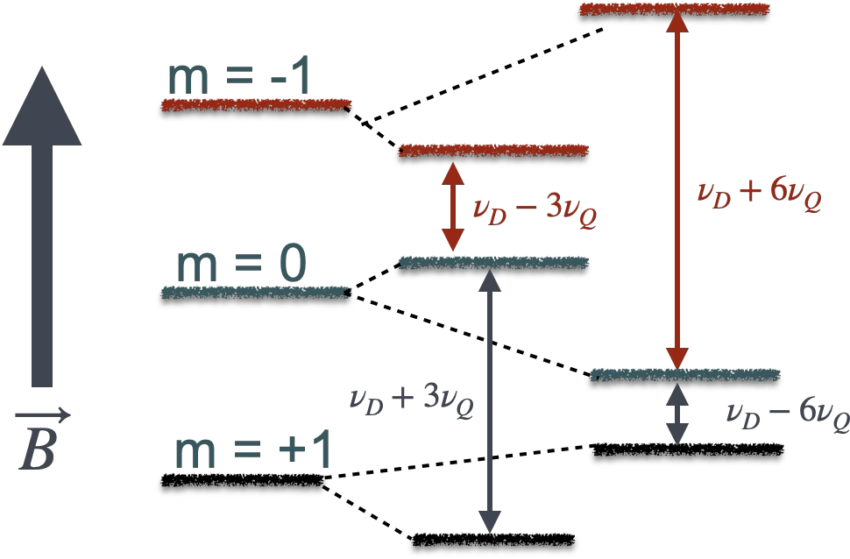
Spin-1 Polarization
$$E_{m }=−hν_{D}m+hν_{Q}(\cos^{2}θ −1)(3m^{2} −2)$$
$eQ$: Electric quadrupole interaction (shifts the energy levels)
$eq$: Electric field gradient
$θ$: angle between $eq$ and $eQ$
UNH Butanol data
P = 42-47% (Vector Polarization) Q = 13 - 17% (Tensor Polarization)
Preliminary
$$I_{+}$$
$$I_{−}$$

Slide 5
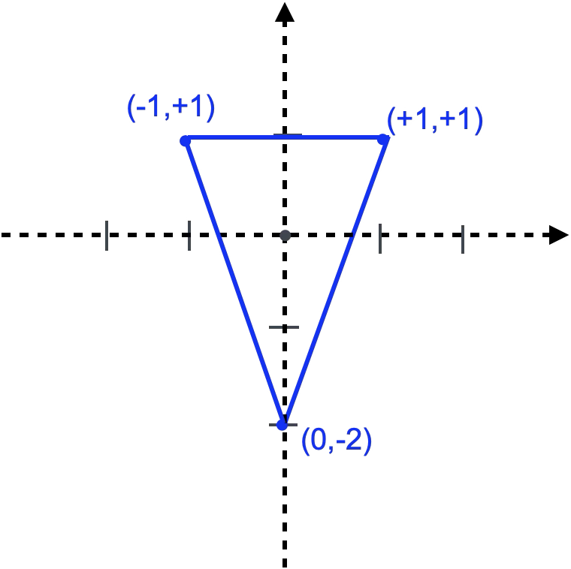
Enhancing Vector Polarization with DNP
At thermal equilibrium (B = 5 T and T = 1 K), the vector polarization is P ~0.1%
Dynamic Nuclear Polarization (DNP) enhances the vector polarization to up to 50% in deuterated butanol and deuterated ammonia. In short, paramagnetic centers in the material, either chemically doped or irradiated, induce spin transitions through the application of microwaves to the sample, which is already in a magnetic field at very low temperatures.
Vector Polarization: $P= N_{+}−$ $N_{−}$ $$−1<P< +1$$
Tensor Polarization: $Q= N_{+}+$ $N_{−}$ $−$ ${2N}_{0}$ $$−2<Q< +1$$
Normalization: $1= N_{+}+$ $N_{−}+ N_{0}$

Slide 6
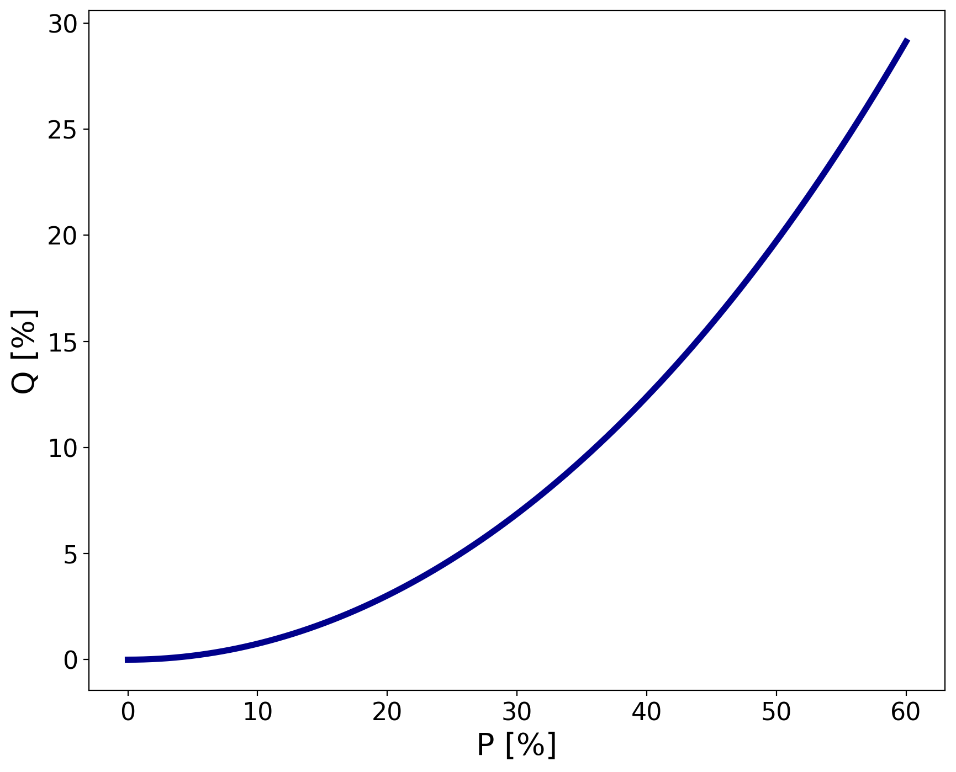
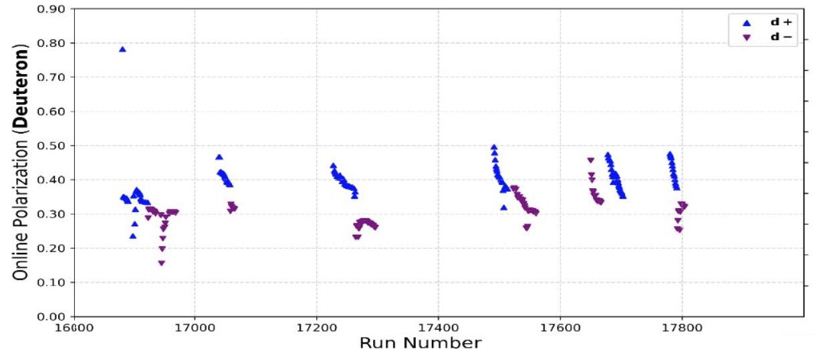
Can we perform an experiment with this technique?
Target material used in tensor polarized techniques: deuterated ammonia (ND₃)
After DNP, Vector and tensor polarizations are related as: $Q=2 − \sqrt{4 −3P^{2}}$
Tensor polarization with DNP is at best 15 – 20% and decays with dose (under electron beam).
Courtesy of Pushpa Pandey
Need additional techniques to enhance the tensor polarization

Slide 7
Enhancing tensor polarization: RF “hole burning”
$\vec{B}$: Holding field
$\vec{B_{1}}$: RF field perpendicular to the holding field.
$ν_{RF}$: RF frequency
$hν_{RF}$ energy levels will be in saturation.
The intensity of the NMR around $ν_{RF}$ will decrease.
If $P$ > 0:
burning a hole in the (0↔-1) transition decreases the m = 0 population, which increases $Q$.
burning the (1 ↔ 0) transition increases the m = 0 population , which decreases $Q$.
$$\vec{B}$$
$$\vec{B_{1}}$$
it is not possible to saturate one deuteron transition without also saturating the other, which dilutes the effect. The only exception to this is the pedestal regions of the NMR line (shoulders).

Slide 8
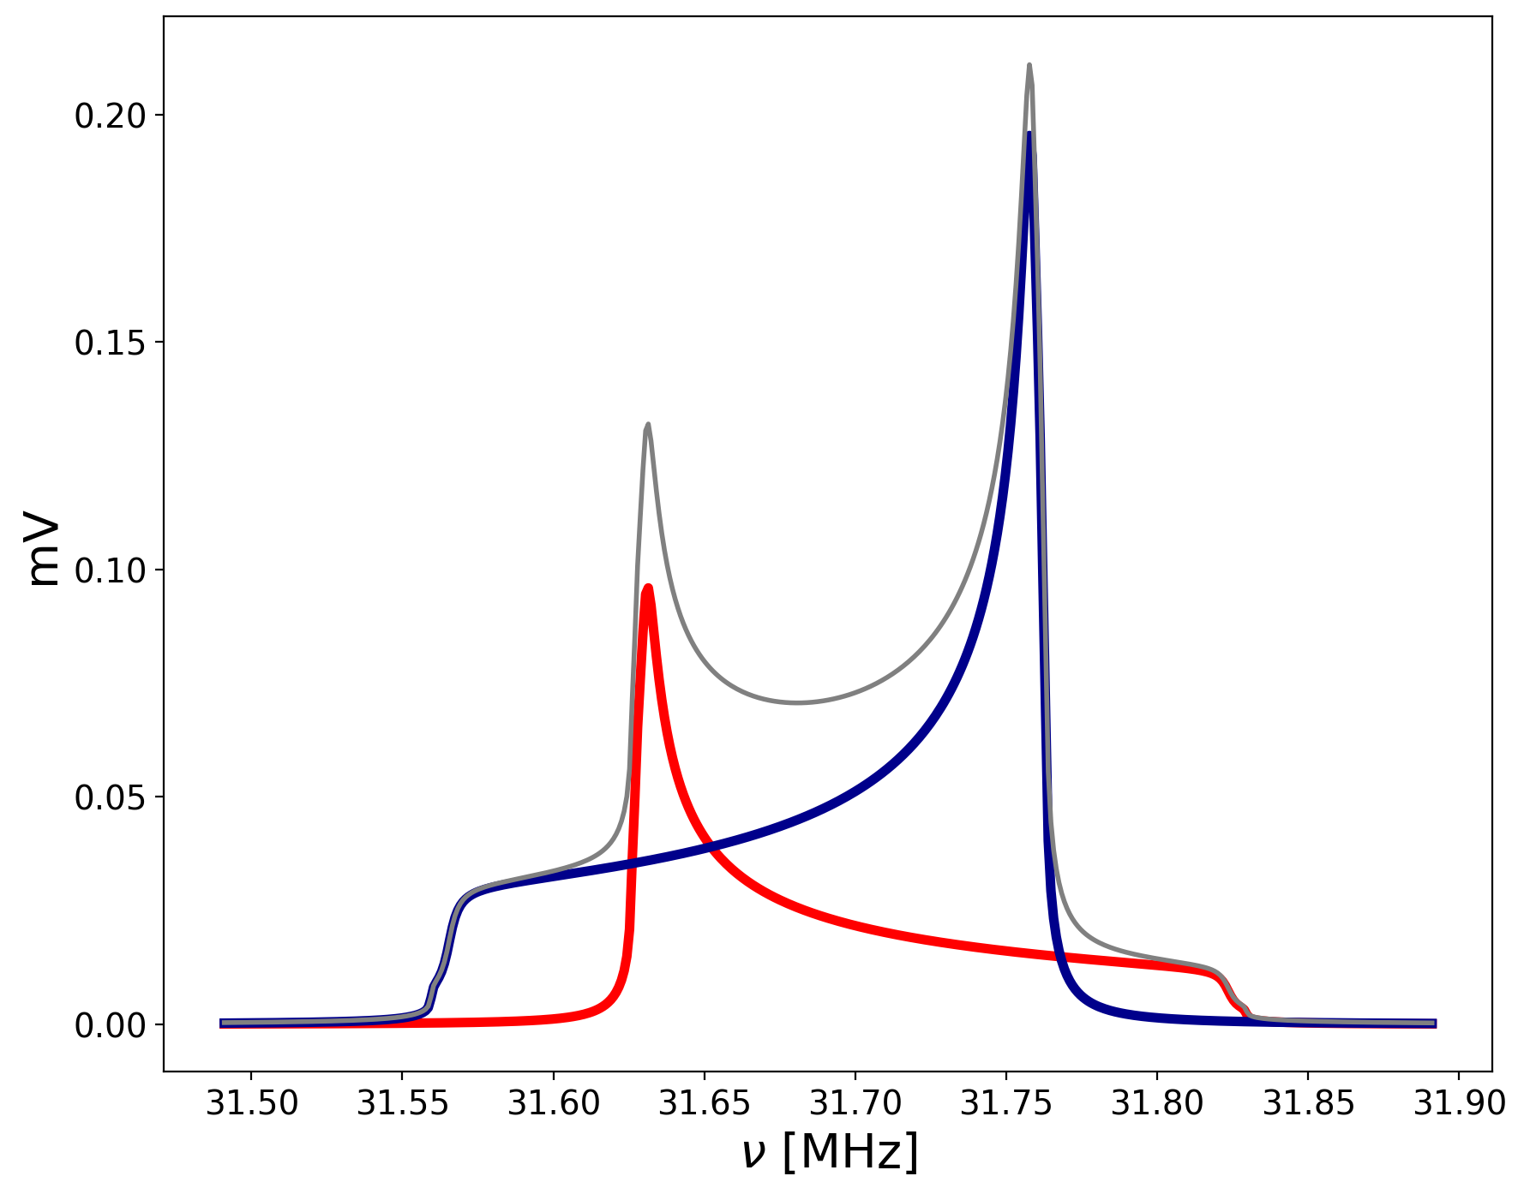
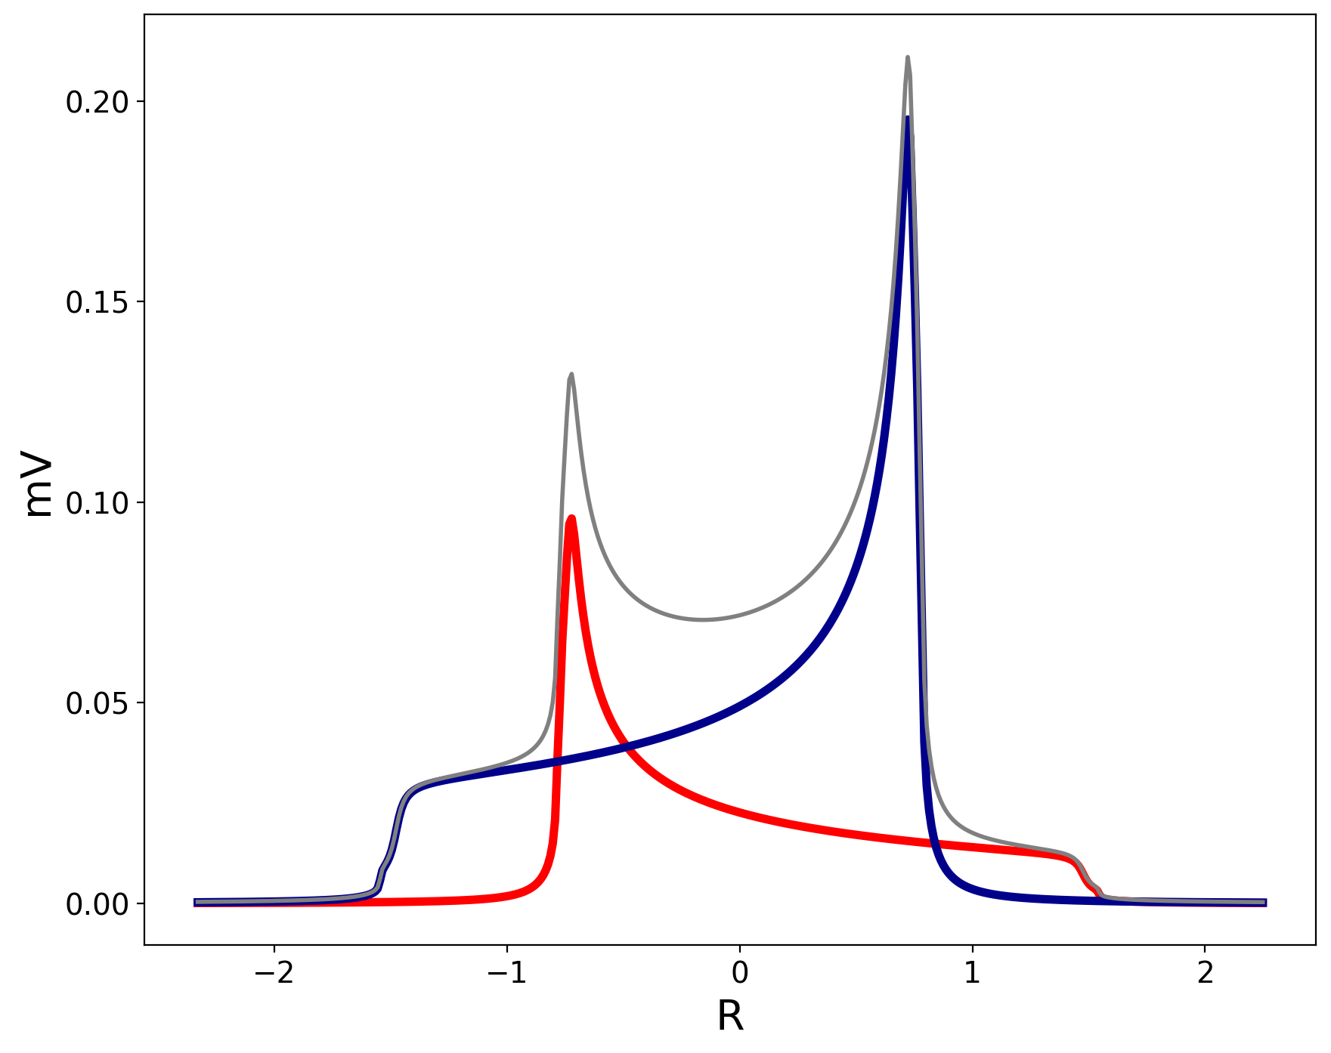
Assume we start from:
$P=0.45$ and $Q = 0.16$
$N_{+}=0.585$, $N_{−}=0.135,N_{0}=0.28$
$$R= \frac{ν − ν_{D}}{ν_{Q}}$$
$$I_{+}$$
$$I_{+}$$
$$I_{−}$$
$$I_{−}$$
In general:
$I_{+}∝[1−R]^{−\frac{1}{2}}$ where $−2 ≤R ≤1$
$I_{−}∝[1+R]^{−\frac{1}{2}}$ where $−1 ≤R ≤2$
Simulation
Note UNH data with Butanol has two bonds.
See M. McClellan talk
$N_{+} −N_{0}=C \int_{−2}^{1}{[1−R]^{−\frac{1}{2}}}$dR
$N_{0} −N_{−}=C \int_{−1}^{2}{[1+R]^{−\frac{1}{2}}}$dR

Slide 9
Assume we start from:
$P=0.45$ and $Q = 0.16$
$N_{+}=0.585$, $N_{−}=0.135,N_{0}=0.28$
$I_{−}$ pedestal (from $1≤R ≤−2)$: Almost no effect in $I_{+}$ The fraction of burned signal would be:
$f_{−}= \frac{\int_{1}^{2}{[1+R]^{−\frac{1}{2}}}\text{dR}}{\int_{−1}^{2}{[1+R]^{−\frac{1}{2}}}\text{dR}}$ =0.184
$${N′}_{0}=N_{0} − f_{−}\frac{N_{0} −N_{−}}{2}$$
$${N′}_{−}=N_{−}+ f_{−}\frac{N_{0} −N_{−}}{2}$$
$P′=0.42$ and $Q′ =0.20$
If we burn the pedestal:
$I_{+}$ pedestal (from $−2≤R ≤−1)$:
Almost no effect in 𝐼_ The fraction of burned signal would be:
$f_{+}= \frac{\int_{−2}^{−1}{[1−R]^{−\frac{1}{2}}}\text{dR}}{\int_{−2}^{1}{[1−R]^{−\frac{1}{2}}}\text{dR}}$ =0.184
$${N′}_{+}=N_{+} − f_{+}\frac{N_{+} −N_{0}}{2}$$
$${N′}_{0}=N_{0}+ f_{+}\frac{N_{+} −N_{0}}{2}$$
$P′=0.42$ and $Q′ =0.076$
$$I_{+}$$
$$I_{−}$$
Burning any of the two pedestals will decrease P
Burning the pedestal of $I_{−}$ has an increment of Q

Slide 10
Assume we start from:
$P=0.45$ and $Q = 0.16$
$N_{+}=0.585$, $N_{−}=0.135,N_{0}=0.28$
If we burn the peak:
It will have an effect in both $I_{+ }$ and $I_{−}$
To understand the effect:
Estimate the fractions of burned signal $f_{+ }$ and $f_{−}$
Estimate the new populations: ${N′}_{+ }, {N′}_{−}$ and ${N′}_{0}$
Estimate P’ and Q’
Typically, the vector polarization decreases and the tensor polarization increases up to 20 -22% depending on the initial polarization.
$$I_{+}$$
$$I_{−}$$

Slide 11
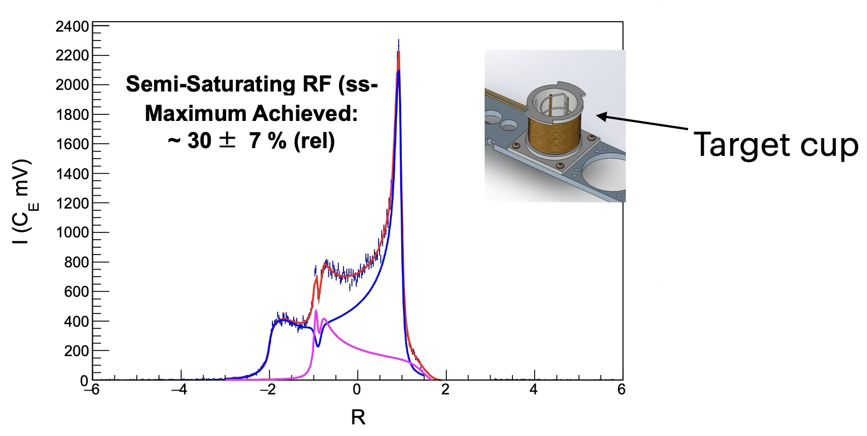
Other Techniques: semi-selective RF (ss-RF)
D. Keller Eur. Phys. J. A53 (2017)

Slide 12
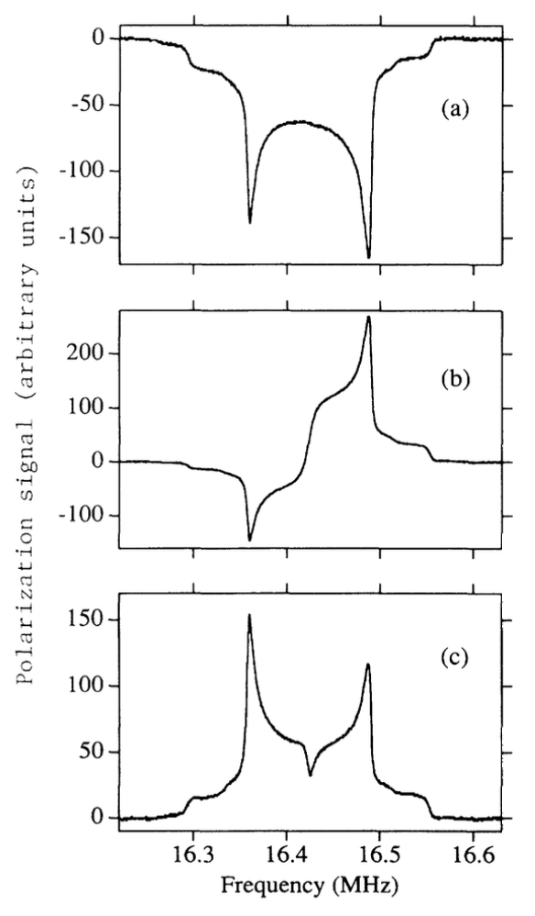
Adiabatic fast passage (AFP)
Initial State
Polarization direction of nuclear spins can be rapidly reversed
$B_{1}$ is swept one and a half through the resonance frequency of the nuclear spins
sweep rate should be faster than the longitudinal relaxation rate$T_{1}$, but slower than the transverse relaxation rate $T_{2}$.
Not yet tested in UNH.
After one sweep
after an
additional half-sweep from the low to the center frequency

Slide 13
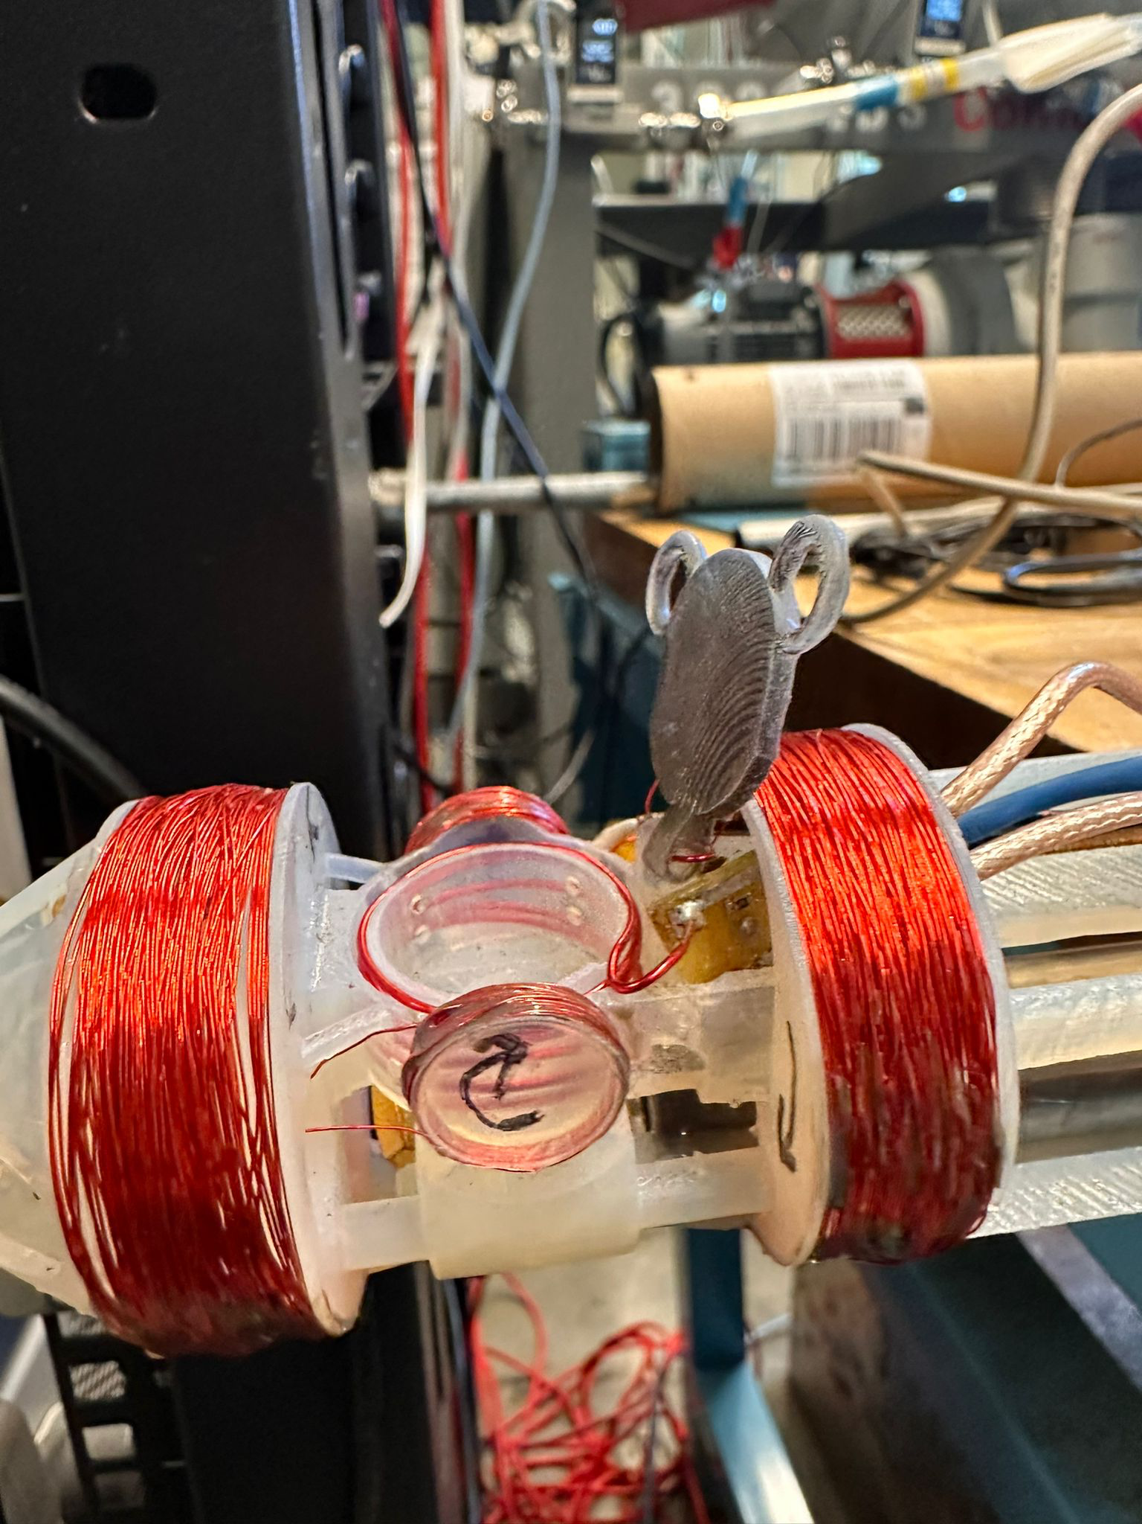
RF Configuration at UNH
Switch is only closed when actively doing RF. Otherwise is closed to protect the NMR board.
The cable loses -4 dBm.
The switch loses -1 dBm.
Current configuration
Next configuration
NMR coils
NMR coils inside the cup
See A. Zec talk
RF coils
Uniform RF around the target cup
Test AFP
EPR coils Currently not in use

Slide 14
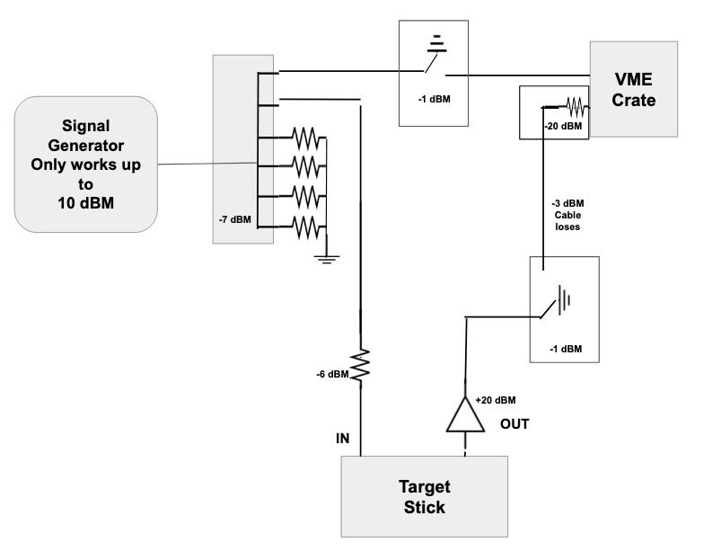
A few words about our NMR system
P. Mcgaughey, NIM Volume 995, 11 April 2021, 165045
NMR system is LANL developed Q-Meter equivalent
Shown are the losses or gains in the line due to the different components.
The VME and the signal generator can be very sensitive to the power of the RF.
Switches are opened when actively performing RF manipulation.
The DAQ process is still quite manual when switching between RF and NMR; it requires just a click.

Slide 15
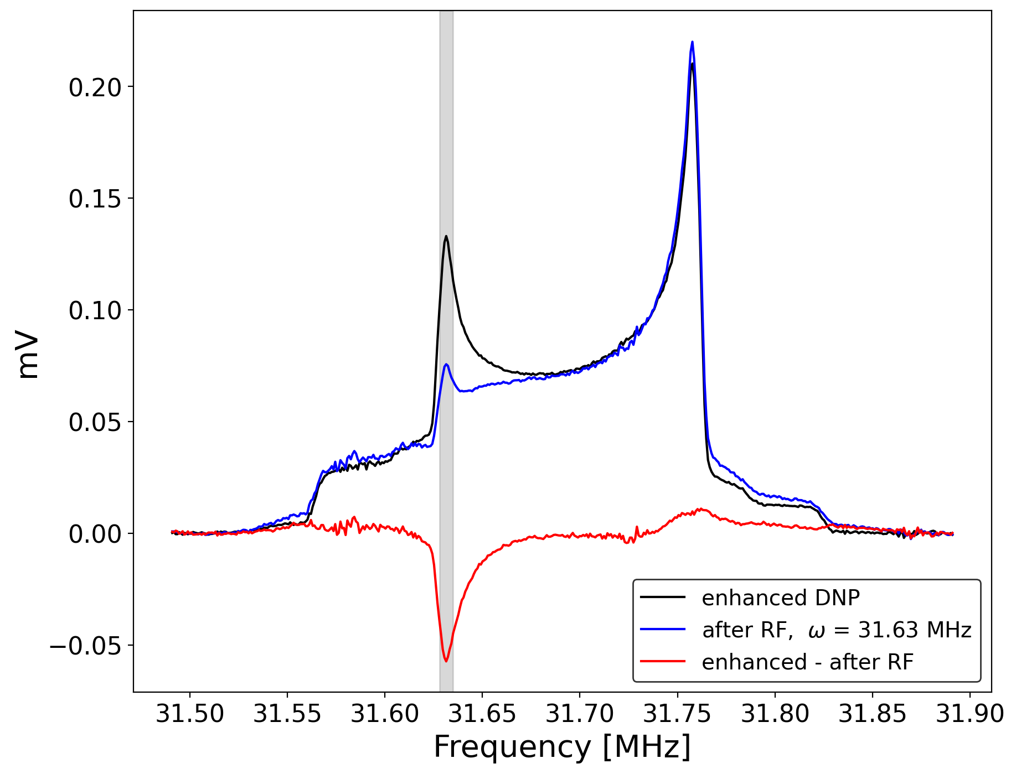
Most recent results
(less than a week ago)
Maintained high (> 40%) vector pol. while holeburning!
RF applied to a central frequency 31.63 MHz, on the peak
Power estimated on target 30 dBm
Red Area (enhanced – after RF)
$$A_{− }=0.55 A_{+}$$
Preliminary
Preliminary
$$A_{+}$$
$$A_{−}$$
$$ν_{RF}$$
What is the Tensor polarization? Analysis is ongoing
The plots show the lineshape of the NMR after subtracting the baseline and the wing fit, with no further manipulation.

Slide 16
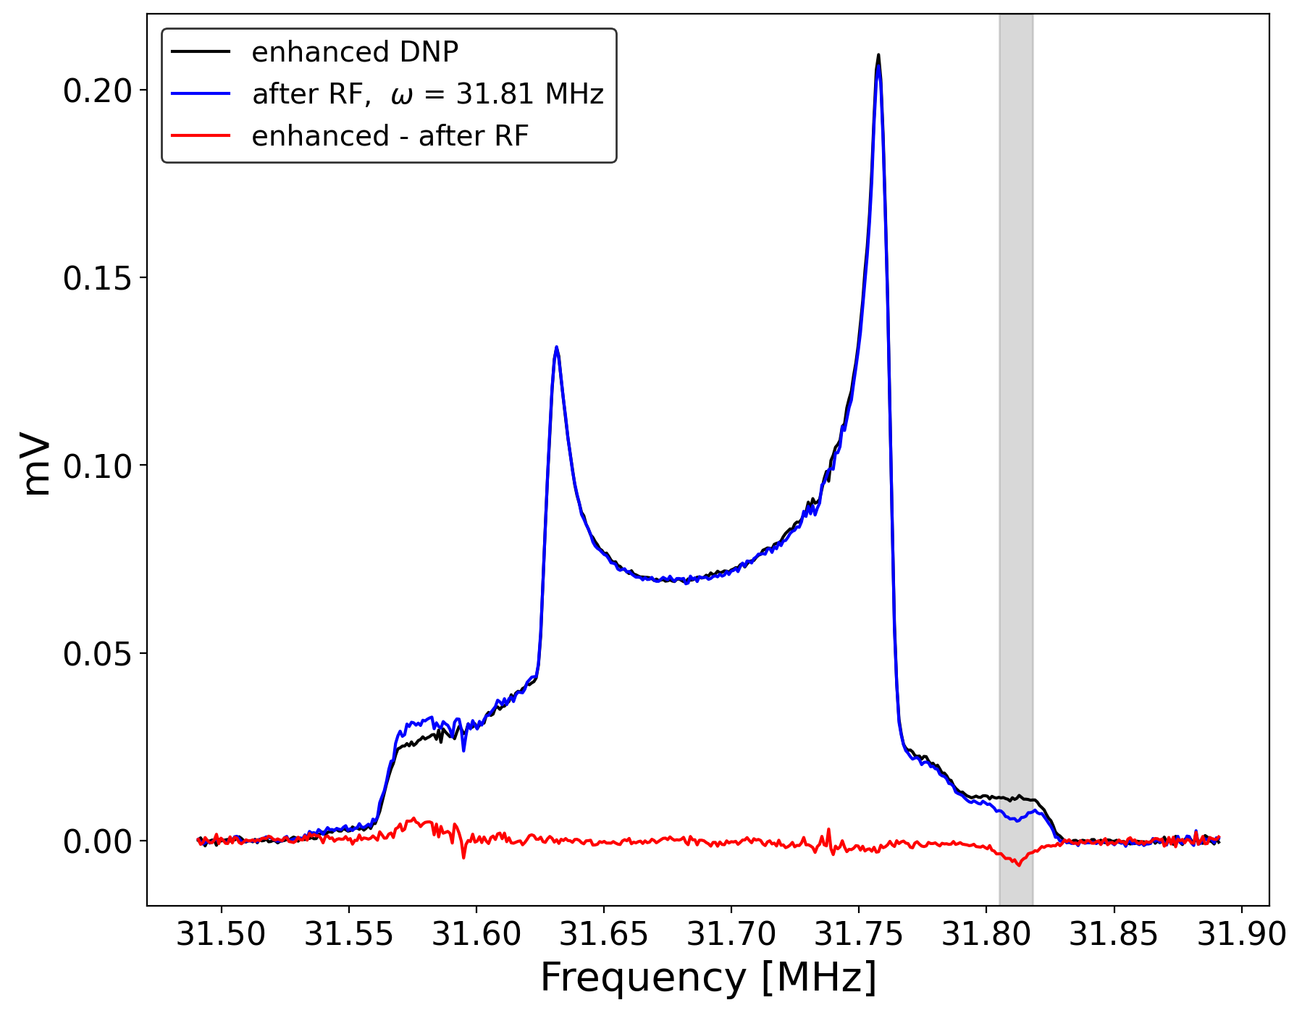
Most recent results
(less than a week ago)
$$ν_{RF}$$
Maintained high (> 40%) vector pol. while holeburning!
RF applied to a central frequency 31.81 MHz, on the shoulder
Power estimated on target 30 dBm
Red Area (enhanced – after RF)
$$A_{− }=0.6 A_{+}$$
Preliminary
Preliminary
$$A_{+}$$
$$A_{−}$$
What is the Tensor polarization? Analysis is ongoing
The plots show the lineshape of the NMR after subtracting the baseline and the wing fit, with no further manipulation.

Slide 17
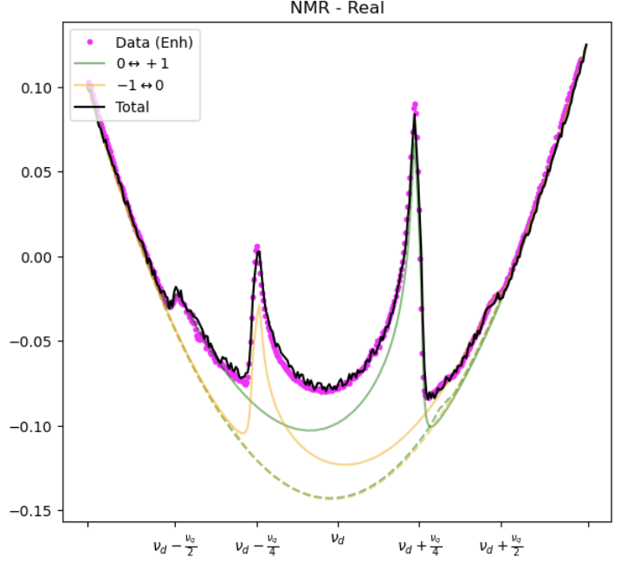
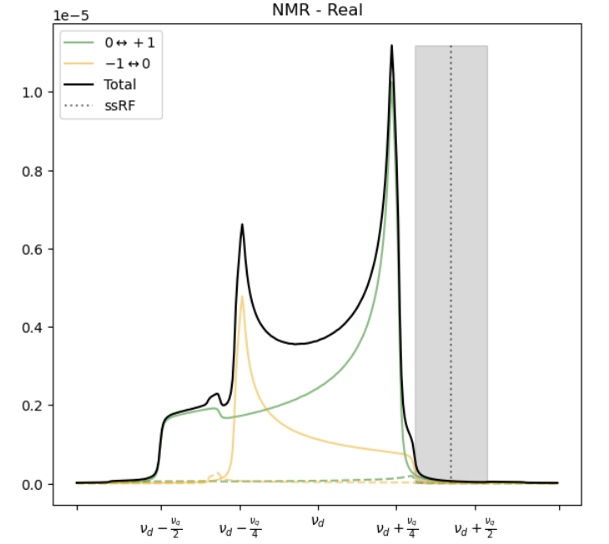
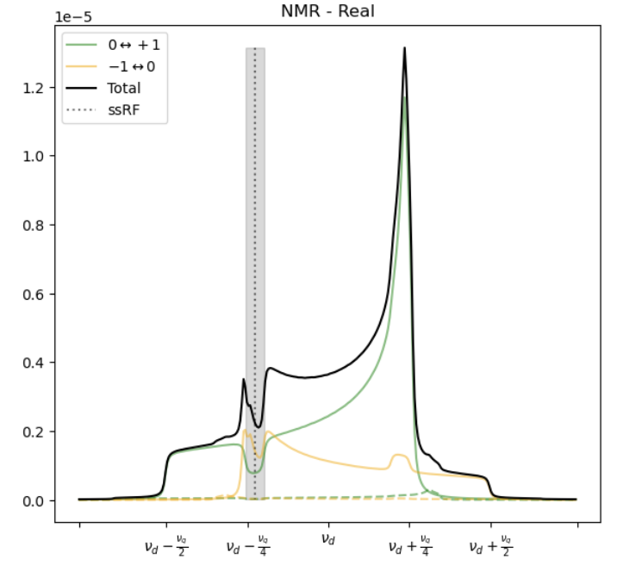
Simulation of Hole-Burned Signal
UNH Data vs.
Simulation
Simulation of deuteron spin-flips seems to replicate our data very well
Elena Long working to model hole burning effects with simulation
See E. Long talk
Shoulder Burn
Peak Burn

Slide 18
Next Steps
$$ν_{RF}$$
Preliminary
Preliminary
$$ν_{RF}$$
Continue the data analysis to determine the tensor and vector polarization of the collected data.
Utilize a more uniform coil configuration in the cup.
Develop a more automated DAQ controller to simultaneously RF the shoulder and the peak, while also enabling NMR checks.
AFP manipulation.

