Slide 1
Characterizing the AFP Spin Flipper for the Nab Experiment
Rebecca Godri
27 September 2024

Slide 2
Outline
Introduction to the SNS and the Nab experiment
Importance of polarimetry within the Nab experiment
Nab spin flipper
Design
Adiabaticity
Characterization effort
Devices
Results
Future work

Slide 3
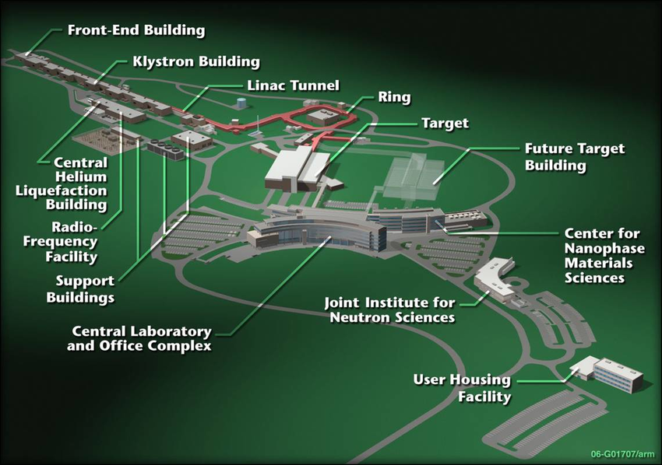
The Spallation Neutron Source
Uses a pulsed beam of negative hydrogen ions
Beam is accelerated and circulates around an accumulator ring approximately 1200 times; this forms the proton pulse
Proton pulse reaches steel target filled with liquid mercury every 60 Hz
Protons hit the nucleus of the mercury atom and release neutrons which are guided to various beamlines

Slide 4
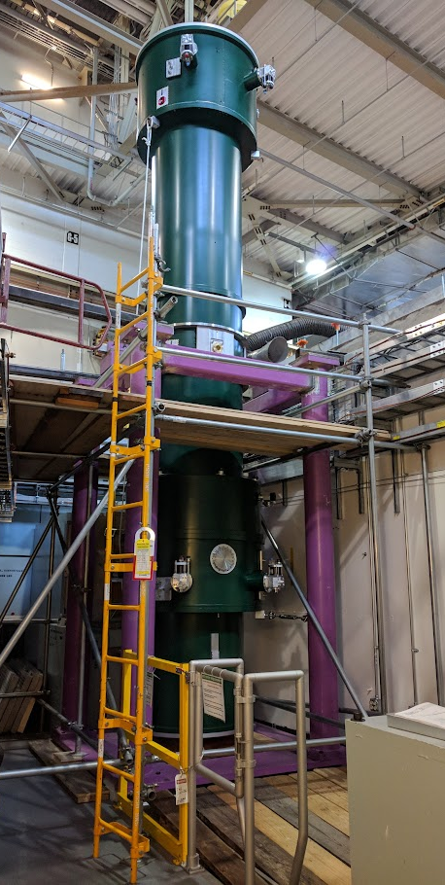

Slide 5
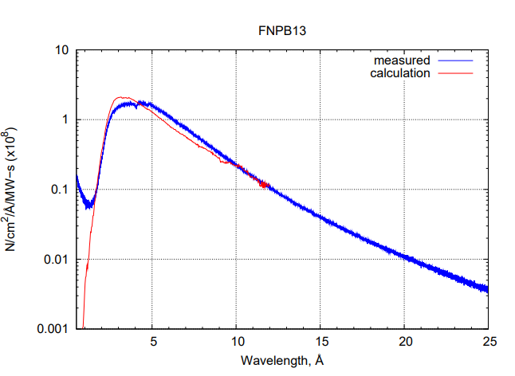

Slide 6
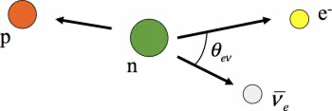
The Nab experiment
Neutron beta-decay experiment (Neutron “a” and “b”)
a: electron-neutrino correlation parameter
b: Fierz interference term
Goal: to make a precise determination of
a ($\frac{δa}{a}={10}^{−3}$) and b ($δb=3×{10}^{−3}$)

Slide 7
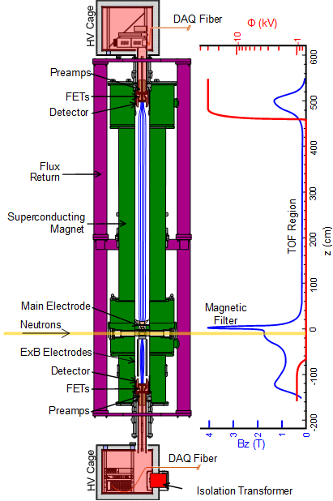
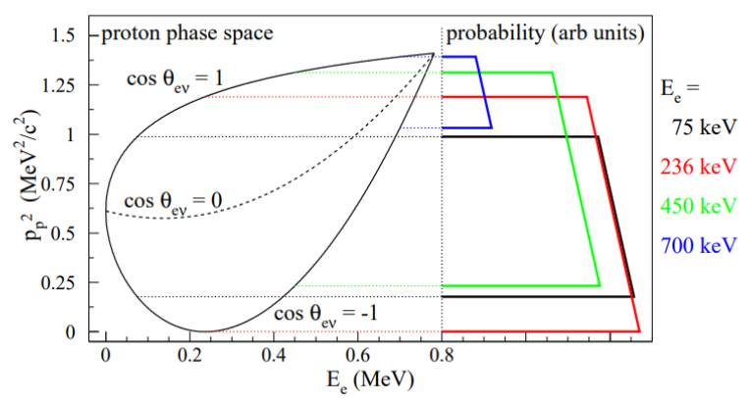
Experimental highlights
Proton momentum is determined from TOF in magnetic field
Plotting the proton phase space creates a teardrop shape

Slide 8
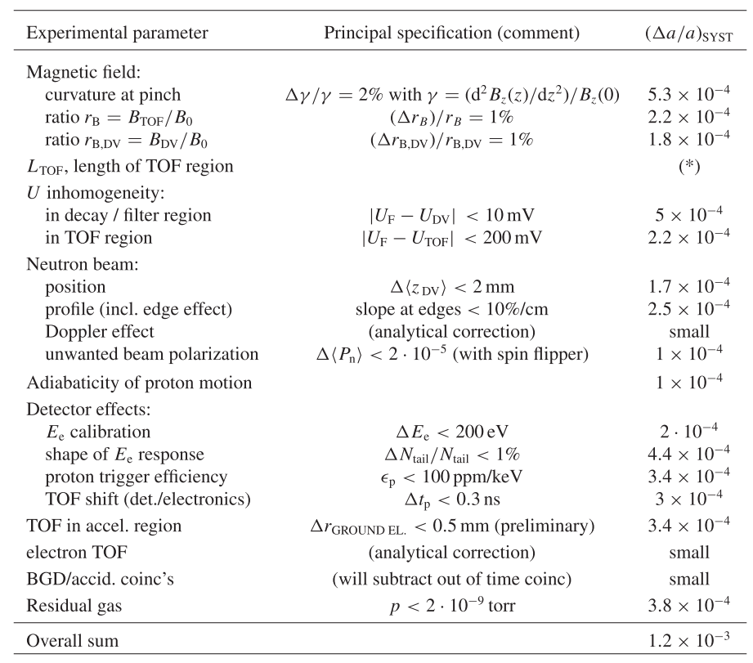

Slide 9
Effect of Beam Polarization within the Nab Experiment
If σ_{n}≤ 2 x 10⁻⁵
⇒
= ☺
If σ_{n}> 2 x 10⁻⁵
To meet our experiment goal:
Must measure beam polarization and if found to be non-zero, it must be periodically reversed during data taking

Slide 10
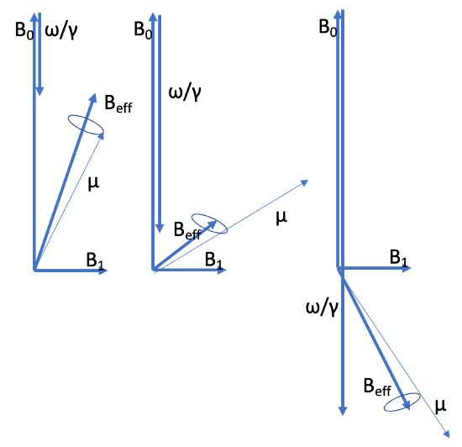
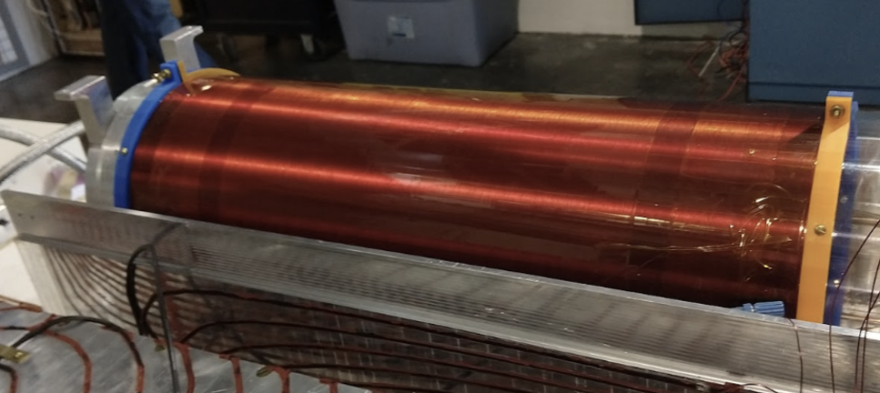
The Nab Spin Flipper
The Nab spin flipper is an Adiabatic Fast Passage (AFP) spin flipper
Neutrons align themselves with the gradient field and precess
Spin flip occurs when the Larmor frequency of the neutron is equal to the frequency of the oscillating field
13B is a polychromatic beam; we want all wavelengths to flip

Slide 11
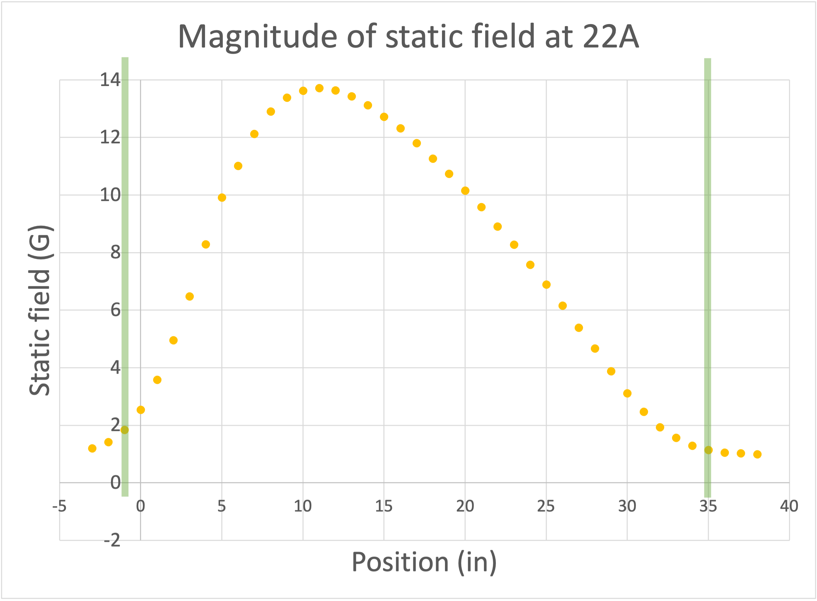
The Nab Spin Flipper
The Nab spin flipper is an Adiabatic Fast Passage (AFP) spin flipper
Neutrons align themselves with the gradient field and precess
Spin flip occurs when the Larmor frequency of the neutron is equal to the frequency of the oscillating field
13B is a polychromatic beam; we want all wavelengths to flip

Slide 12
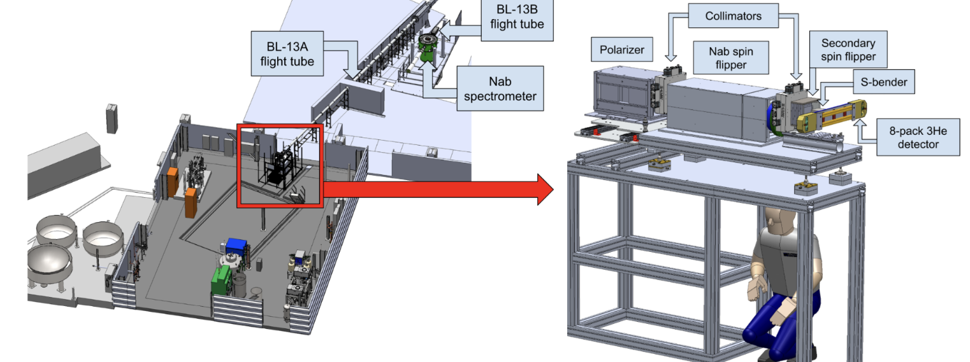
Characterizing the spin flipper at FNPB
Second characterization effort
Monochromatic beam (4.45 Å and 8.9 Å)

Slide 13
Task: perform a series of transmission measurements with different components on/off, solve for individual device efficiencies

Slide 14
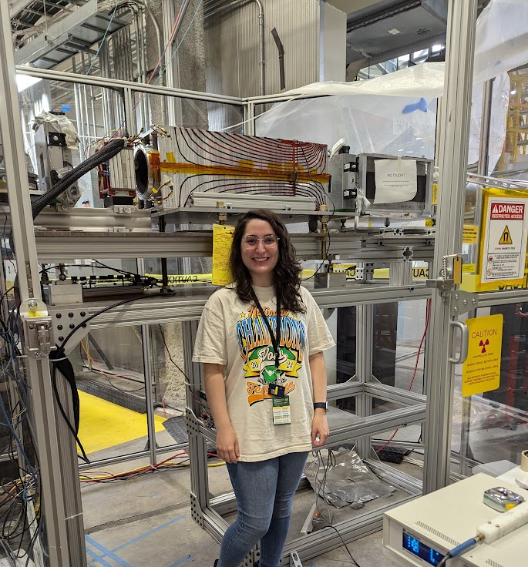
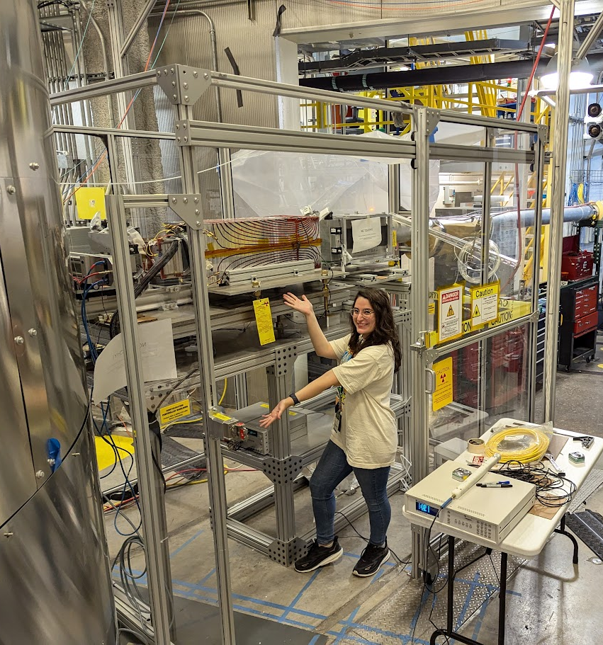

Slide 15
Devices used in characterization measurements
Neutron filtering devices
Collimators
Nab spin flipper
Mezei spin flipper
8-pack detector

Slide 16
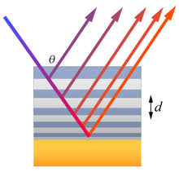
Neutron filtering devices
Supermirror polarizer
Alternating layers of ferromagnetic and nonmagnetic materials
Magnetic: large nuclear and magnetic scattering lengths
Non-magnetic: scattering length close to zero
These layers create a highly reflective polarizing mirror for one spin state
One spin state is reflected (absorbed) while the other is refracted (transmitted)
S-bender
Essentially two C-shaped supermirror polarizers
Serves as our analyzing device

Slide 17
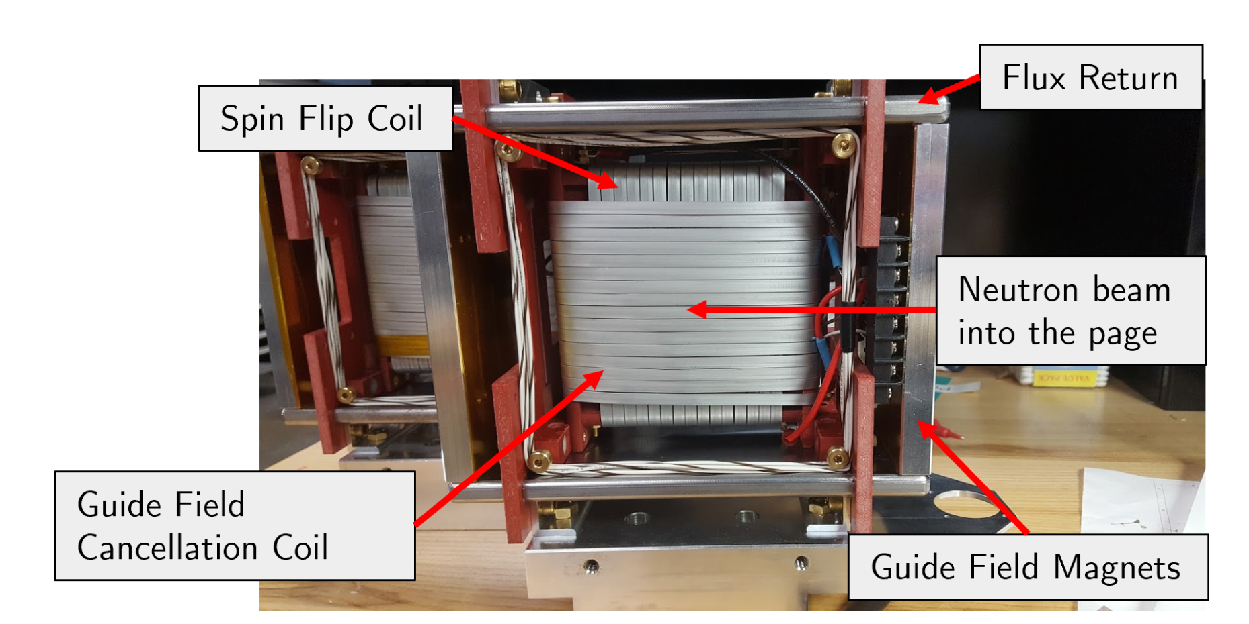
Mezei spin flipper
3 main components
Inner coil – spin flip coil which provides a perpendicular guide field
Outer frame – provides a continuous guide field
Outer coil – cancels the guide field so the neutron effectively precesses about the perpendicular guide field from the inner coil
Notes:
Explain why we have a second spin flipper

Slide 18
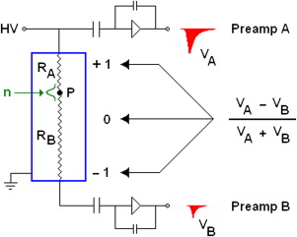
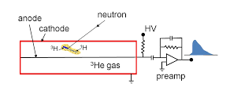
8-pack detector
Eight ³He filled tubes oriented horizontally
Neutrons capture on ³He
A neutron event is determined via resistive anode charge division
Preamplifiers convert signals into voltages to determine the neutron interaction location

Slide 19
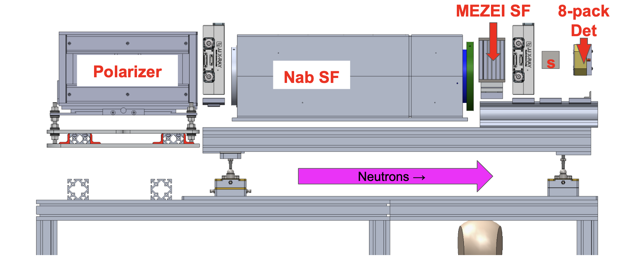
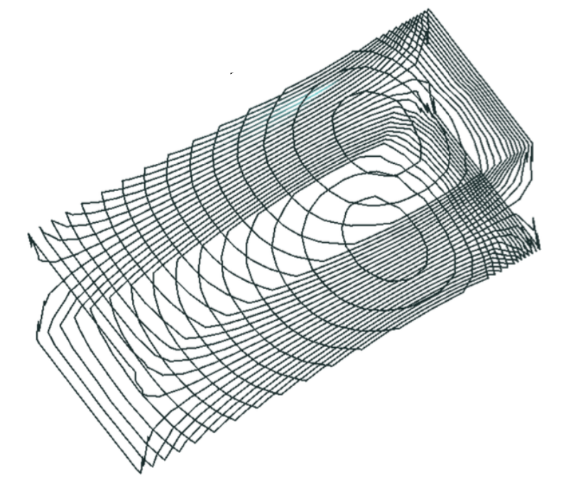
Four measurement sequence
N₀: no flips
N₁: Nab SF flips
N₂: Mezei SF flips
N₁₂: Both flippers flip
Two configurations (upstream and downstream)
Two wavelengths (4.45 Å and 8.9 Å)
High field
Low field

Slide 20
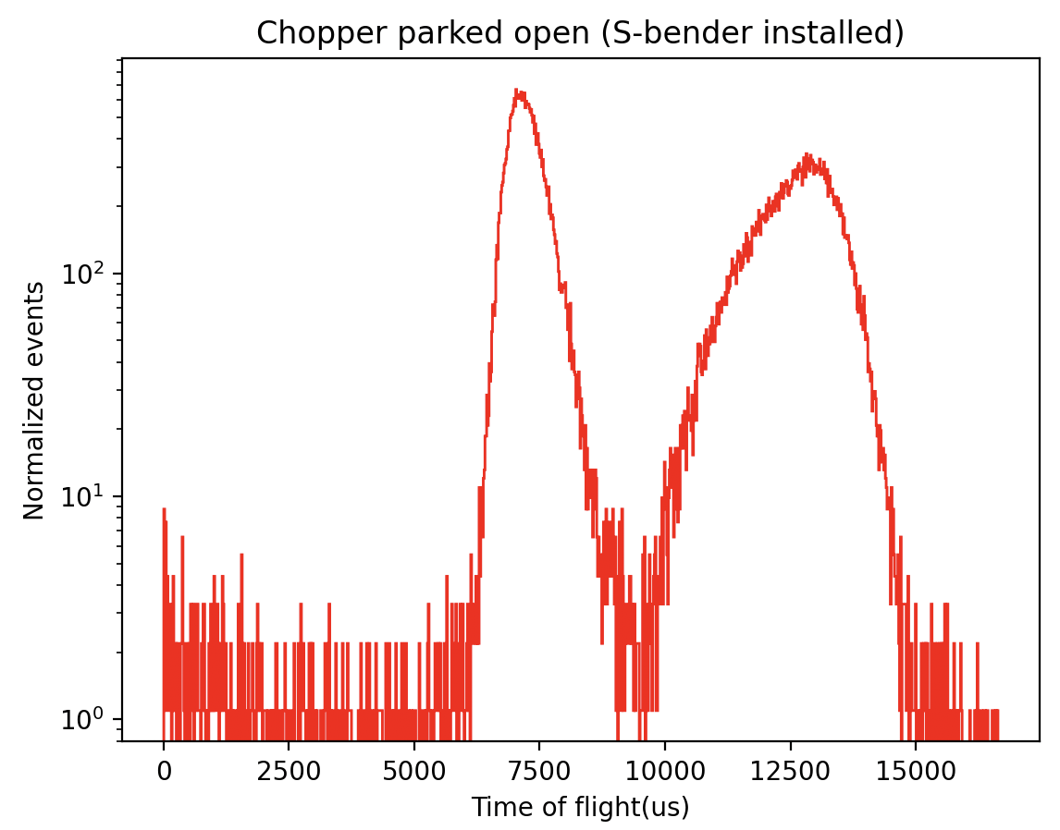
Choppers
Rotating disks with a pizza slice-shaped opening
TOF delay “chops” neutrons with an undesired wavelength
4.45 Å
8.9 Å
4.45 Å
8.9 Å
4.45 Å

Slide 21
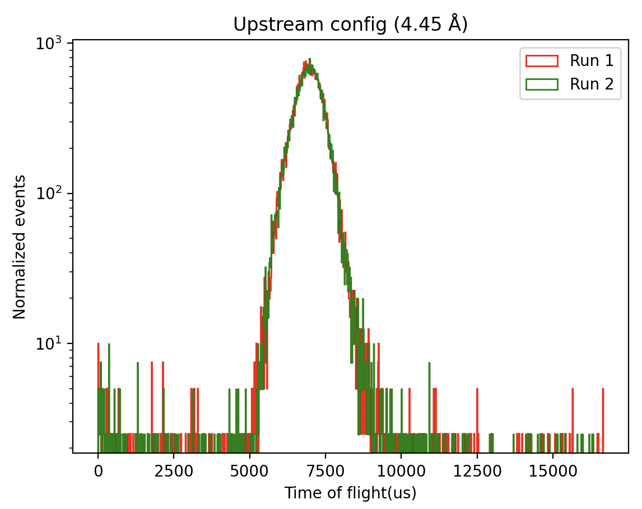
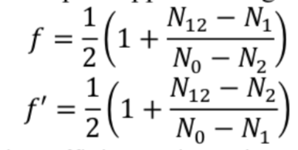
Upstream (4.45 Å)
Both off | Nab on | Mezei on | Both on | f (Nab) | f’ (Mezei) | Combined efficiency
53775.65 ±231.90 | 8186.298 ±90.48 | 4103.63 ±64.06 | 49750.14 ±223.05 | 0.918 ±0.0031 | 1.001 ±0.0037 | 0.857 ±0.0063
54988.64 ±234.50 | 8215.24 ±90.64 | 3906.08 ±62.50 | 50088.73 ±223.81 | 0.910 ±0.0031 | 0.994 ±0.0036 | 0.878 ±0.0064

Slide 22
Downstream (4.45 Å)
Both off | Nab on | Mezei on | Both on | f (Nab) | f’ (Mezei) | Combined efficiency
53038.38 ±230.30 | 27542.6 ±165.96 | 4386.81 ±66.23 | 25778.61 ±160.56 | 0.482 ±0.0024 | 0.9195 ±0.0058 | 0.995 ±0.0127
51661.98 ±227.29 | 29121.28 ±170.65 | 4534.72 ±67.34 | 26838.33 ±163.82 | 0.476 ±0.0025 | 0.995 ±0.0074 | 0.847 ±0.0118

Slide 23
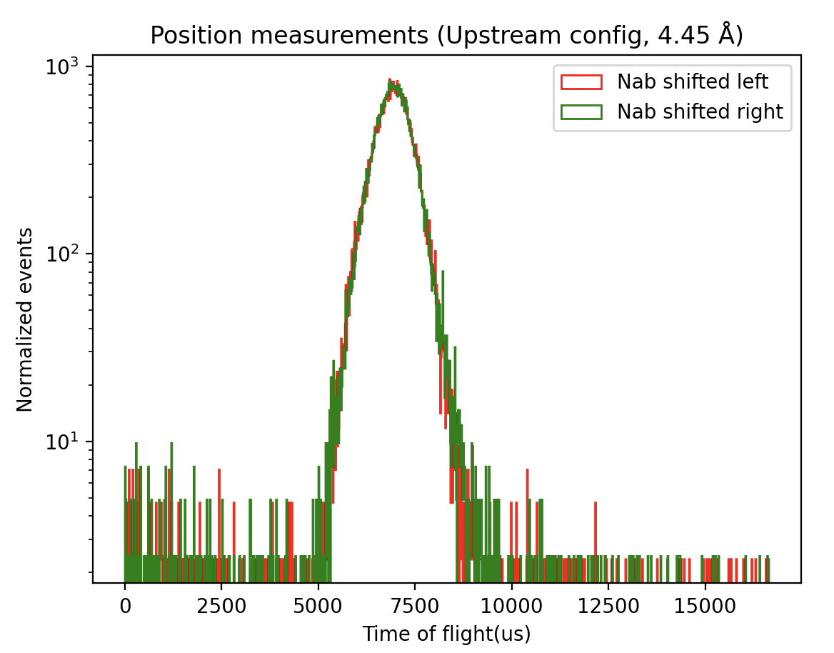
Investigating non-uniformity
 | Both off | Nab on | Mezei on | Both on | f (Nab) | f’ (Mezei) | Combined efficiency
Left | 57587.36 ±239.97 | 6109.36 ±78.16 | 4087.98 ±63.94 | 54059.16 ±232.51 | 0.948 ±0.0031 | 0.985 ±0.0034 | 0.892 ±0.0061
Right | 57885.96 ±240.595 | 7200.81 ±84.56 | 4306.53 ±65.62 | 54361.07 ±233.15 | 0.940 ±0.0031 | 0.994 ±0.0034 | 0.872 ±0.0060

Slide 24
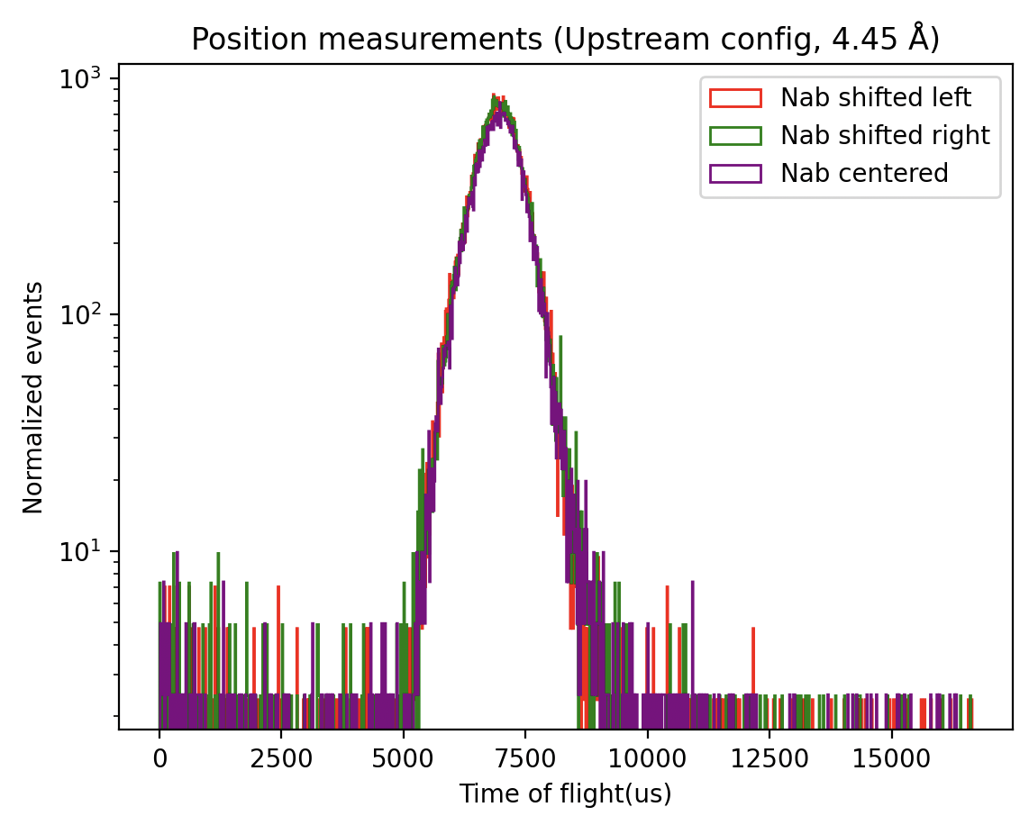
Investigating non-uniformity
 | Both off | Nab on | Mezei on | Both on | f (Nab) | f’ (Mezei) | Combined efficiency
Left | 57587.36 ±239.97 | 6109.36 ±78.16 | 4087.98 ±63.94 | 54059.16 ±232.51 | 0.948 ±0.0031 | 0.985 ±0.0034 | 0.892 ±0.0061
Right | 57885.96 ±240.595 | 7200.81 ±84.56 | 4306.53 ±65.62 | 54361.07 ±233.15 | 0.940 ±0.0031 | 0.994 ±0.0034 | 0.872 ±0.0060
Center | 54988.64±234.497 | 8215.24±90.64 | 3906.08±62.499 | 50088.73±223.81 | 0.9099 ±0.0031 | 0.994 ±0.0036 | 0.878 ±0.0064

Slide 25
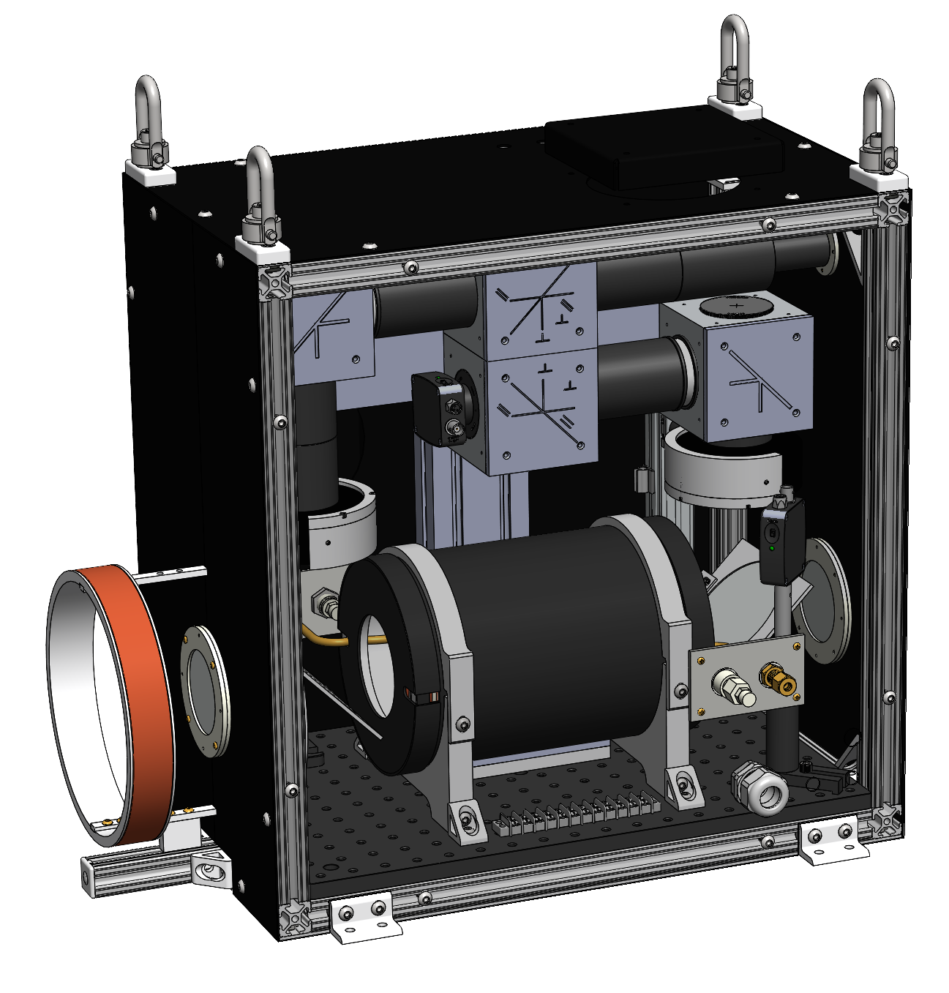
Future work
Further data analysis
Further characterization at HFIR (late 2024)
Characterization and implementation on BL-13B (2025)
Optimize S-bender parameters
Design and build an in-situ ³He analyzer system
Optimize new ³He tube characteristics for final monitor
P. Jiang (ORNL)
This material is based upon work supported by the U.S. Department of Energy, Office of Science, Office of Nuclear Physics Fundamental Symmetries program under Award Number DE-FG02-03ER41258

Slide 26
The Nab collaboration
Nab collaborating institutions:
University of South Carolina, Universität Karlsruhe (TH), Universidad Nacional Autónoma de México, Western Kentucky University
Main project funding:

Slide 27
Backup slides
:)

Slide 28
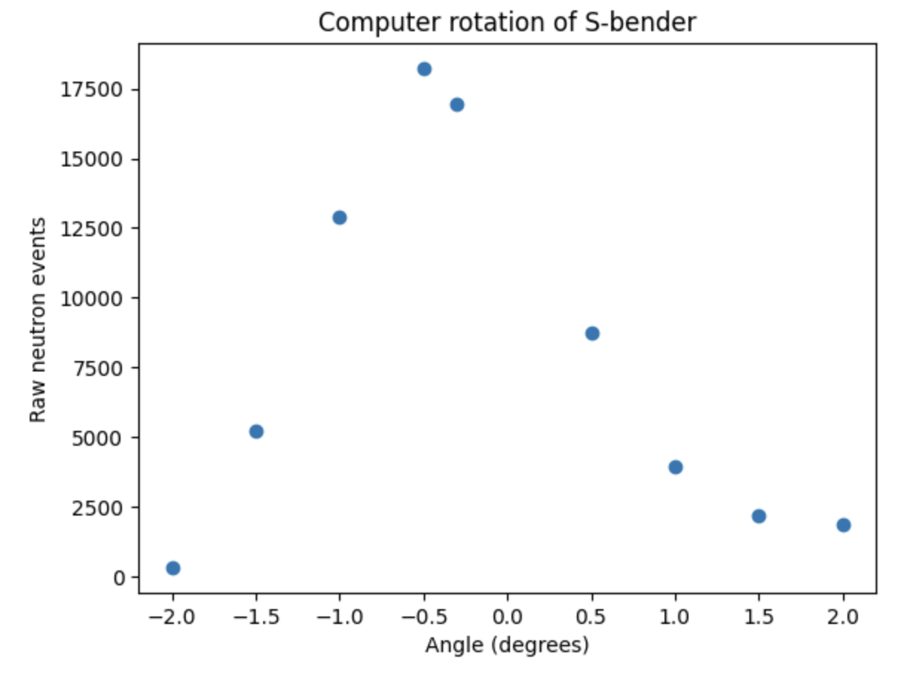
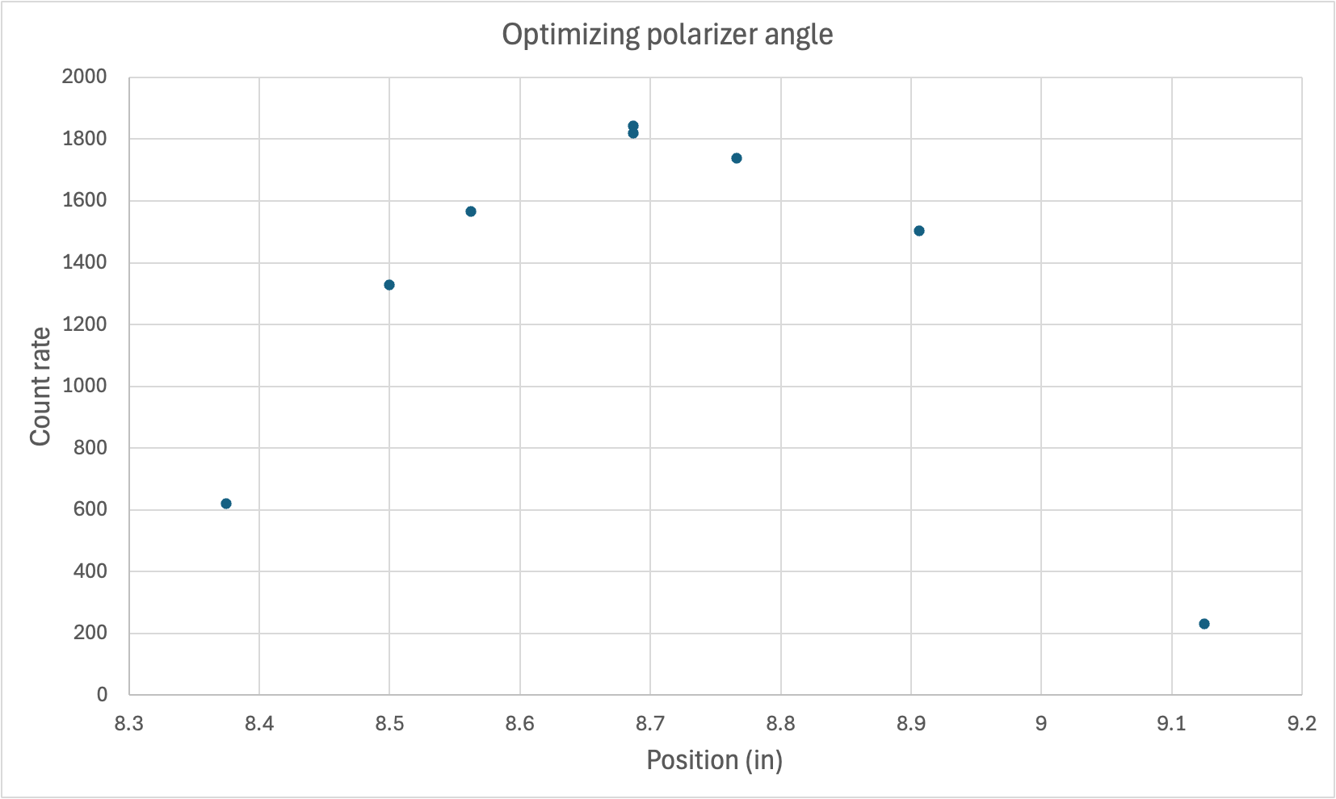
Tuning polarizing devices

Slide 29
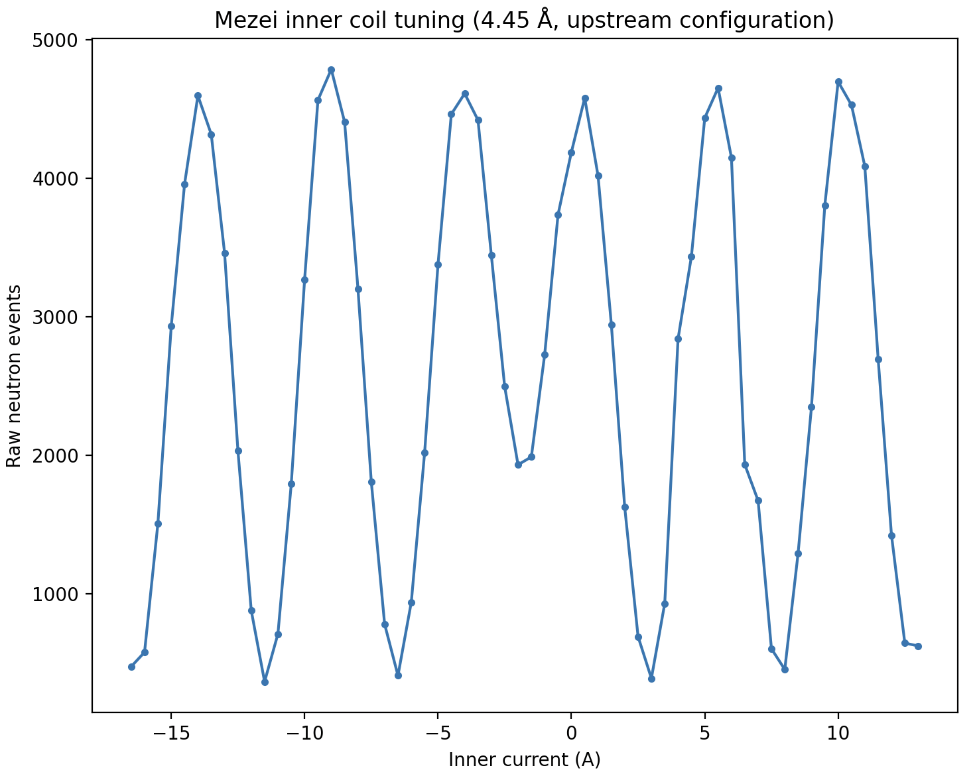
Mezei flipper settings
S-bender installed
Peaks indicate non-flip states
Valleys indicate flipped states

Slide 30
Upstream (8.9 Å)
 | Both off | Nab on | Mezei on | Both on | f_Nab | f_Mezei | Combined efficiency
8/23/24 Run 1 | 91274.74 ±302.12 | 21037.28 ±145.04 | 20076.65 ±141.69 | 87176.68 ±295.26 | 0.964 ±0.0032 | 0.978 ±0.0033 | 0.664 ±0.0044
8/23/24 Run 2 | 85888.46 ±293.07 | 21886.78 ±147.94 | 20500.76 ±143.18 | 86472.31 ±294.06 | 0.994 ±0.0035 | 1.02 ±0.0037 | 0.5997 ±0.0042
8/29/24 Run 1 | 79093.33 ±281.24 | 33256.55 ±182.36 | 19828.02 ±140.81 | 89460.47 ±299.099 | 0.974 ±0.0049 | 1.2596 ±0.0066 | 0.423 ±0.0037
8/29/24 Run 2 | 78125.93 ±279.51 | 31500.45 ±177.48 | 19742.69 ±140.51 | 90021.55 ±300.04 | 1.001 ±0.0040 | 1.254 ±0.0064 | 0.425 ±0.0037

Slide 31
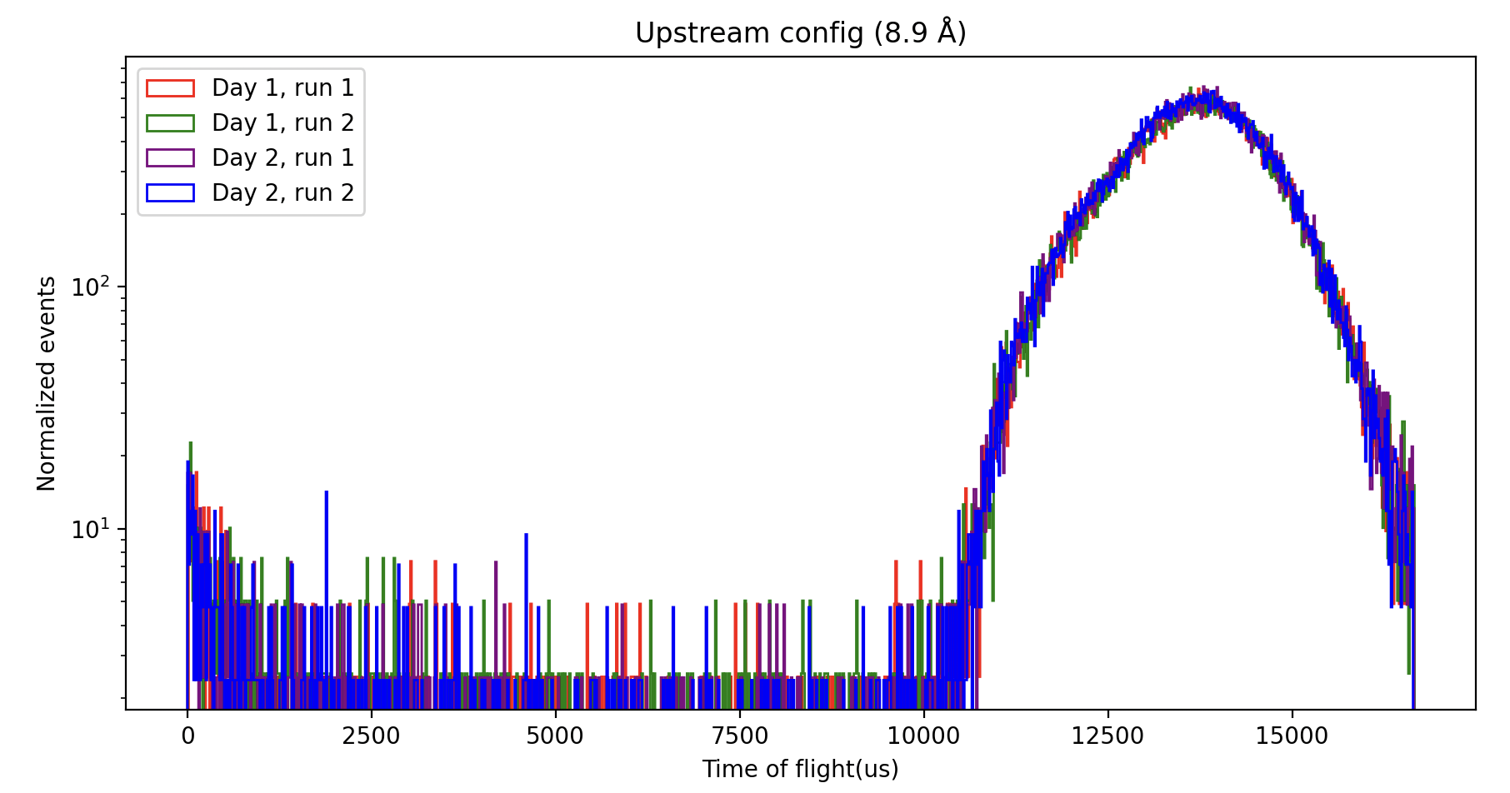
Upstream (8.9 Å)

Slide 32
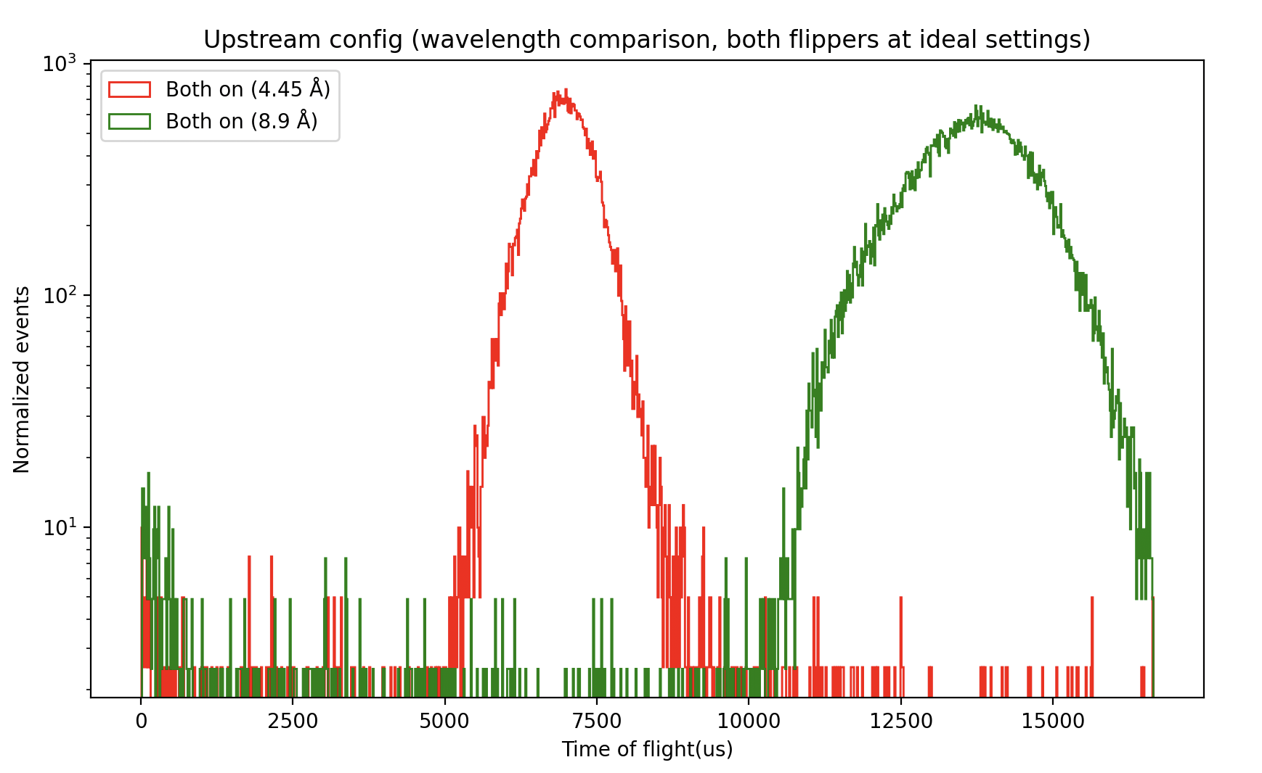
Upstream (4.45 Å and 8.9 Å)

Slide 33
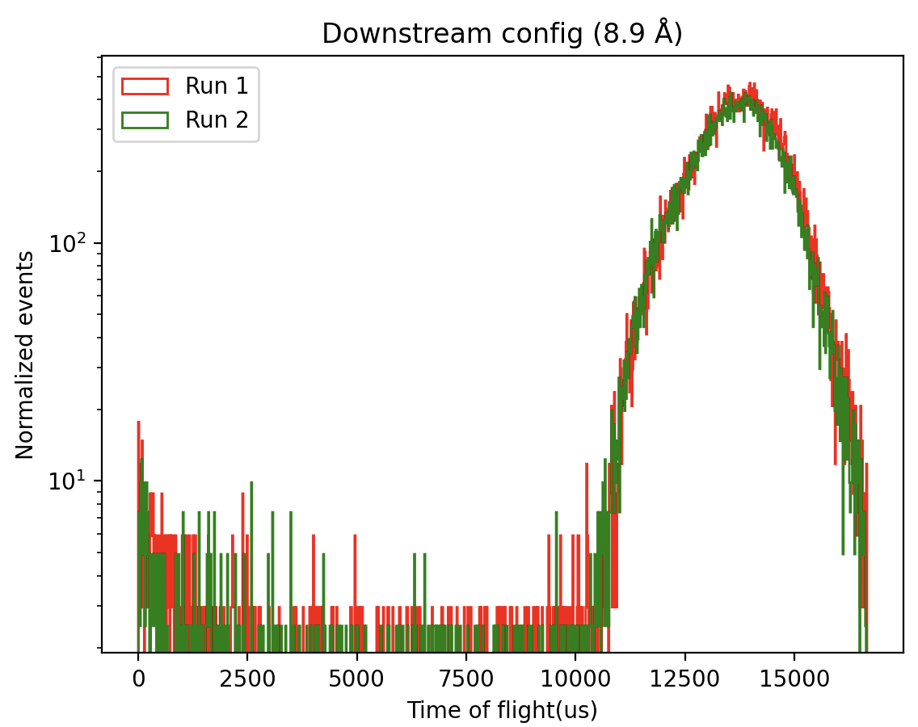
Downstream (8.9 Å)
Both off | Nab on | Mezei on | Both on | f (Nab) | f’ (Mezei) | Combined efficiency
78944.57 ±280.97 | 45366.17 ±212.99 | 19642.75 ±140.15 | 62986.3 ±250.97 | 0.649 ±0.0029 | 1.145 ±0.0080 | 0.488 ±0.0055
80225.0 ±283.24 | 46865.66 ±216.48 | 20147.7 ±141.94 | 58977.54 ±242.86 | 0.601 ±0.0028 | 1.082 ±0.0075 | 0.529 ±0.0061

Slide 34
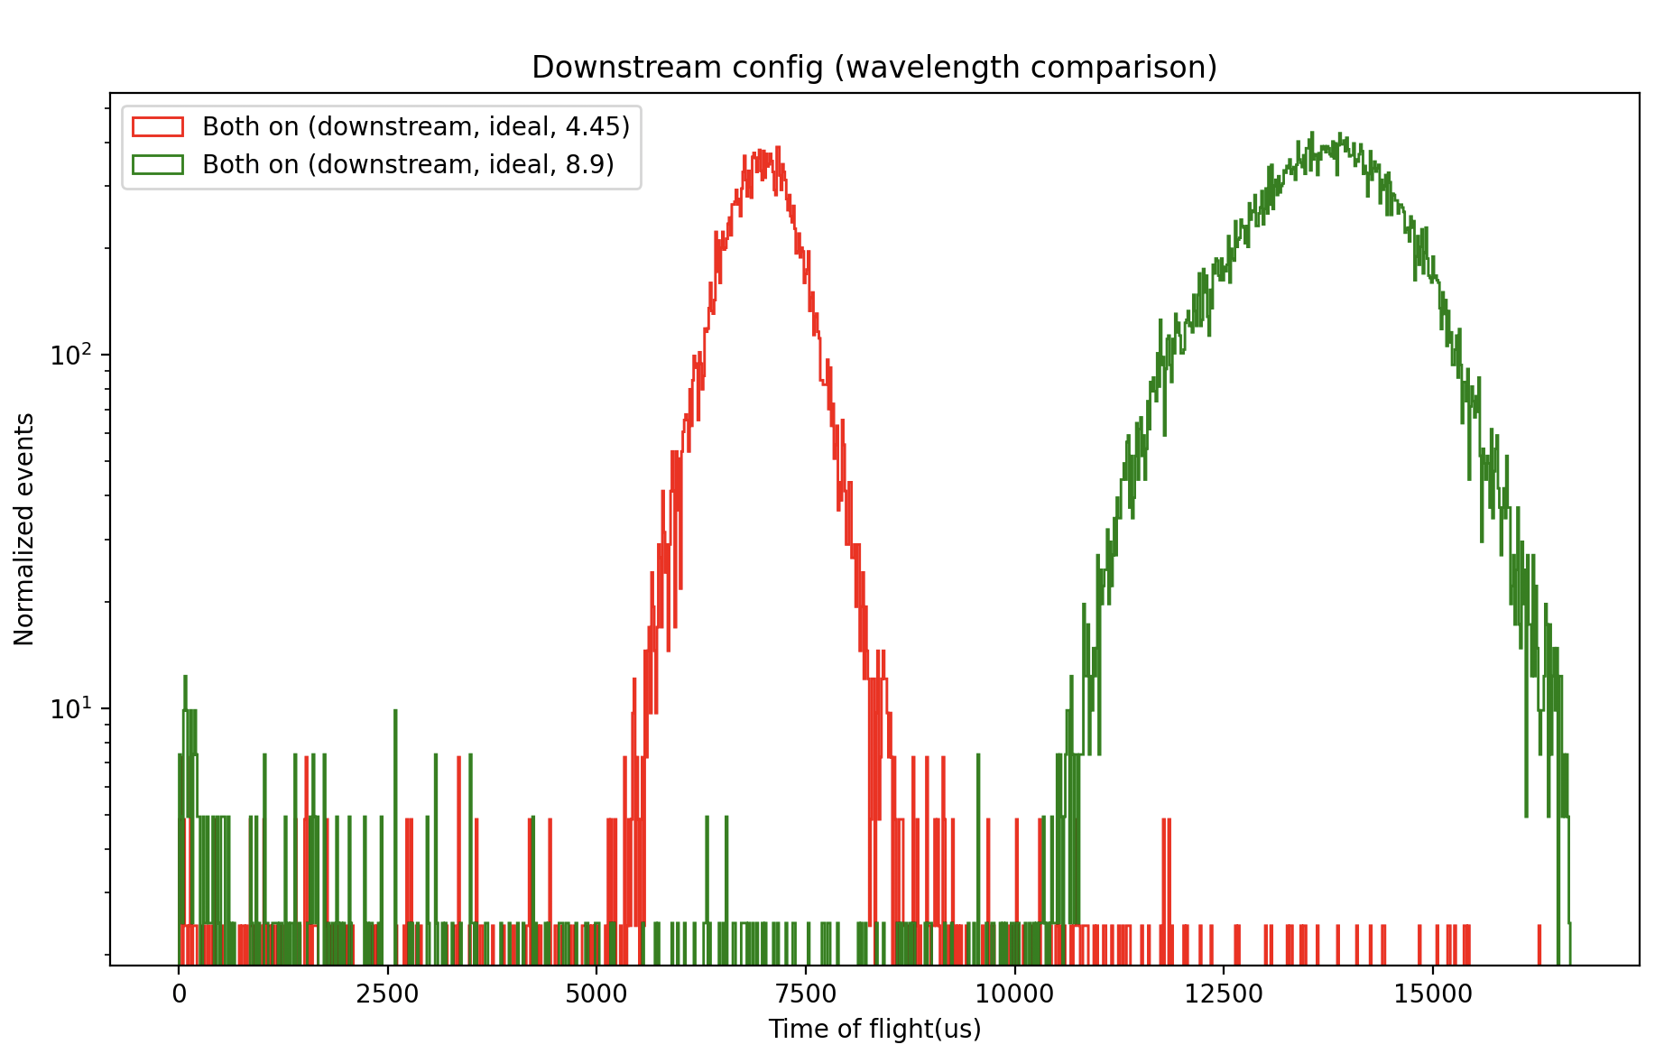
Downstream (4.45 Å and 8.9 Å)

Slide 35
