Slide 1
Preparations at JLab for a Spin Polarized Fusion Program The Polarized ⁷LiD Program for Polarized Fusion Experiments at the DIII-D Tokamak
Xiangdong Wei
9/26/2024

Slide 2
Jefferson Lab Fusion Program Motivations
Power!
Clean Power!!
Sustainable Clean Power!!!
(with least environmental impact)
DOE core mission objectives:
… to promote innovative research in clean energy sources, …
Fossil Fuels, Fission, Hydroelectric, Wind Turbine, Solar, Geothermal, Ocean Current, ……
and finally
Fusion!!!
Ignition Approaches:
ICF (inertial), MCF (magnetic)...

Slide 3
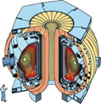
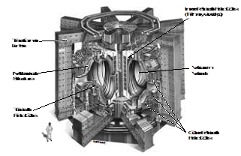
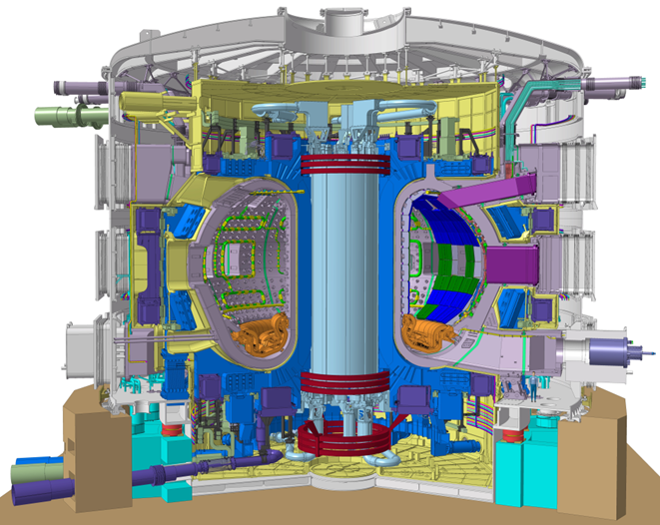
Jefferson Lab Fusion Program Channels and Facilities
DIII-D (USA)
Best instrumented →most diagnostics
20m³, 2.1T, Q<<1
The intended fuel:
D + T $→$α + n
and $D+3He→α+p$
Most research Tokamaks ever built (~30 in operation today) have focused on D+D reactions.
Jump in scale towards a fusion power reactor: the International Thermonuclear Experimental Reactor (ITER) will pave the way to fusion power.
Polarized fuels could enhance the cross section by up to 50%, & the power and Q by 75%, without changing the plasma conditions.
The cost is ~V_{-plasma} x B².
⇒20~40 billion dollars.
$$σ_{cm}=σ_{0}\{1+\frac{1}{2}\vec{P_{D}^{V}}∙\vec{P_{T}}\}$$
JET (UK)
Only one runs tritium
90m³, 3.8T, Q~2/3
ITER (France)
½ GW reactor
700m³, 5.3T, Q>10
(under construction)
Q ≡ P_{out}/P_{in}

Slide 4
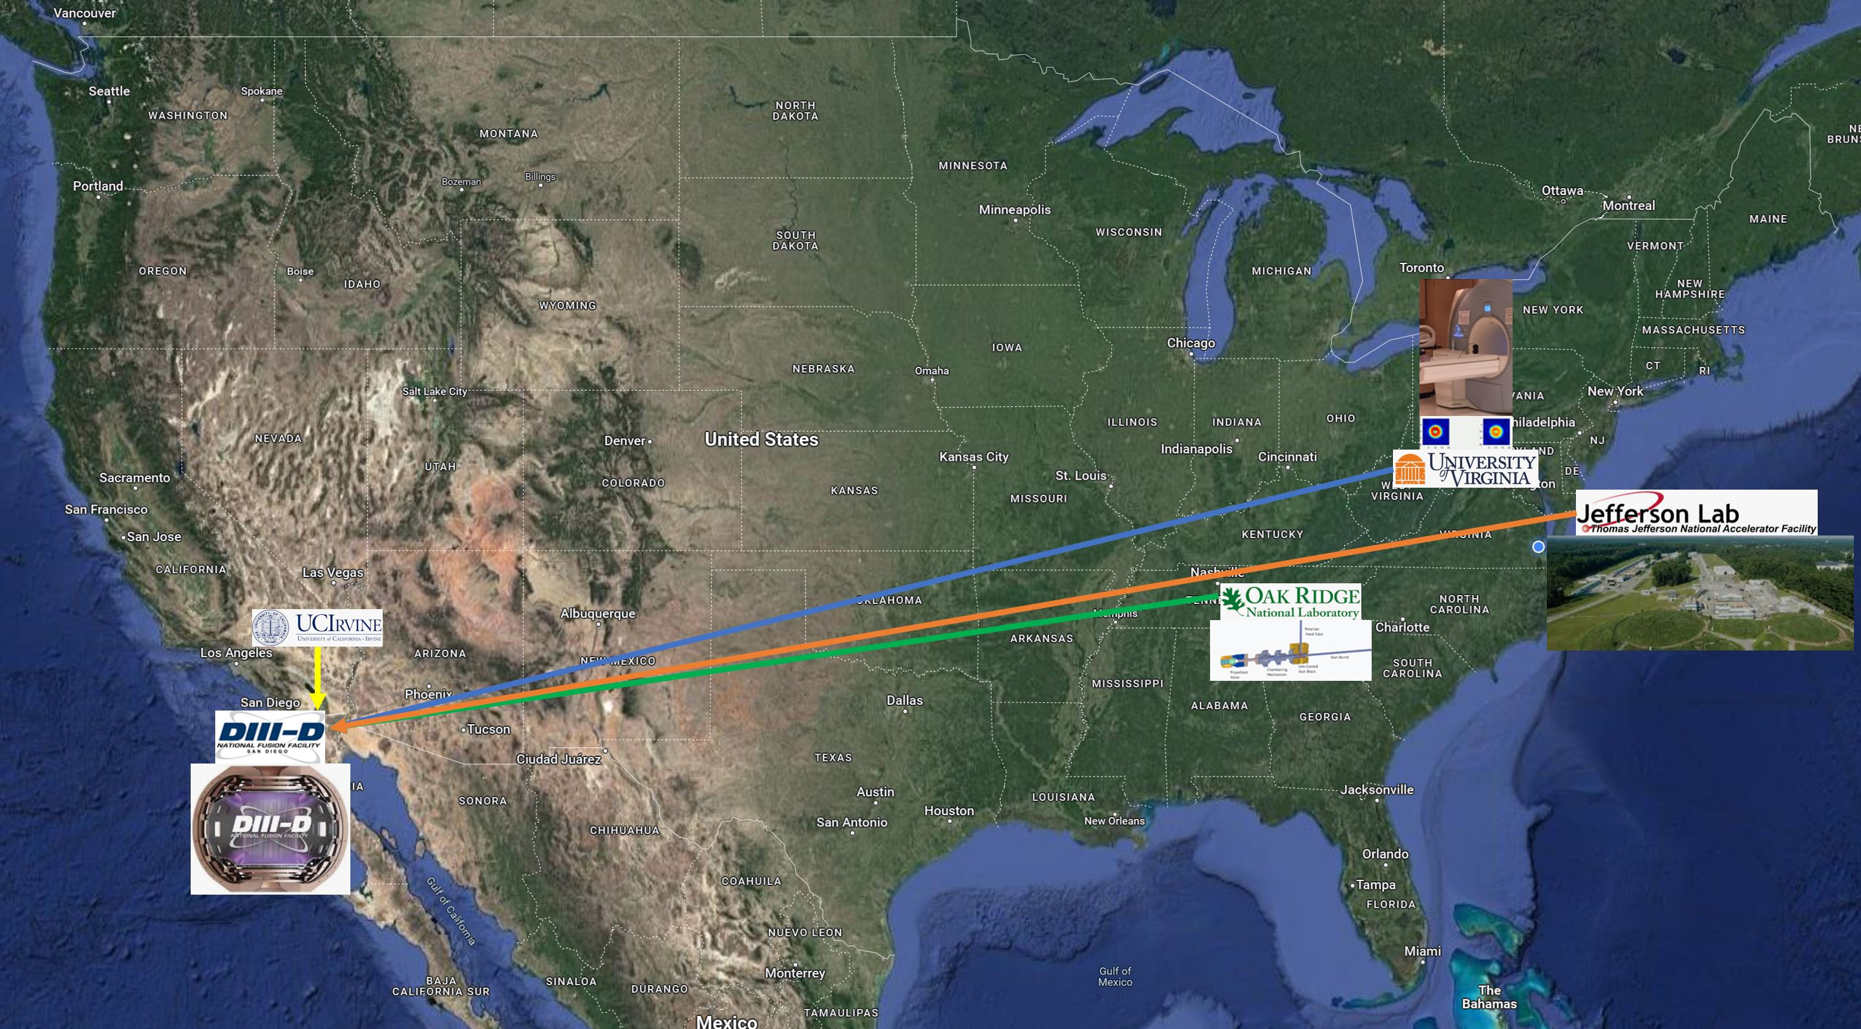
Jefferson Lab Fusion Program SPF Collaboration
Jefferson Lab
(Polarized D Fuel)
X. Wei, P. Dobrenz, D. Williams,…
plus 2 incoming postdocs from UVA
University of Virginia
(Polarized ³He Fuel)
G. W. Miller, A. M. Sandorfi, X. Zheng,…
Oak Ridge National Lab
(Polarized Fuels Delivery) L. Baylor, S. Meitner, …
University of California, Irvine
(Run Preparations and Diagnostics)
W. Heidbrink, …
Ultimate Goal:
Run D + ³He → α + $p$ at DIII-D in FY28-29
First phase, Spin Polarized Nuclei for Injection into DIII-D, has been funded by DOE FES.

Slide 5
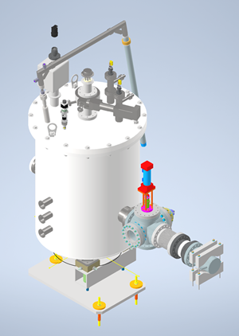
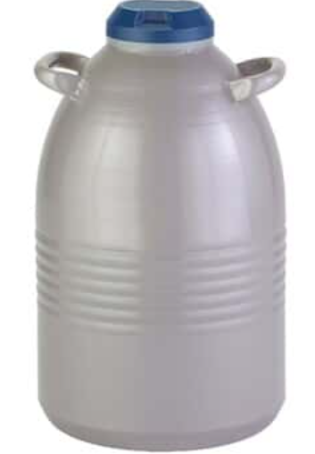
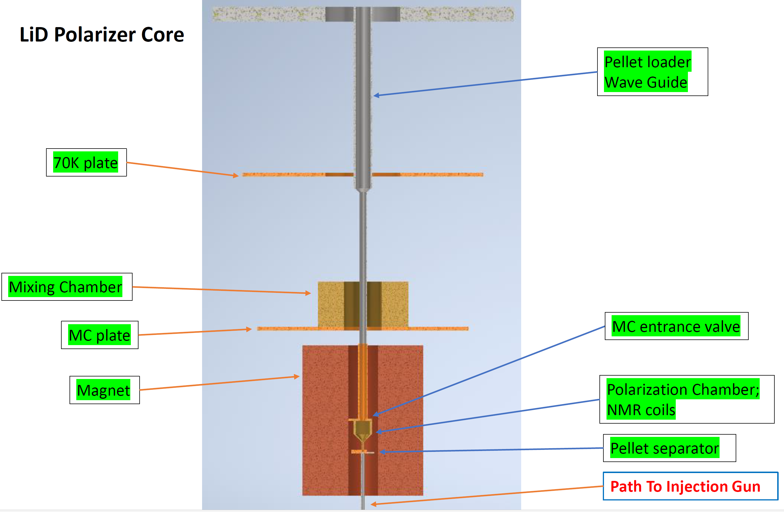
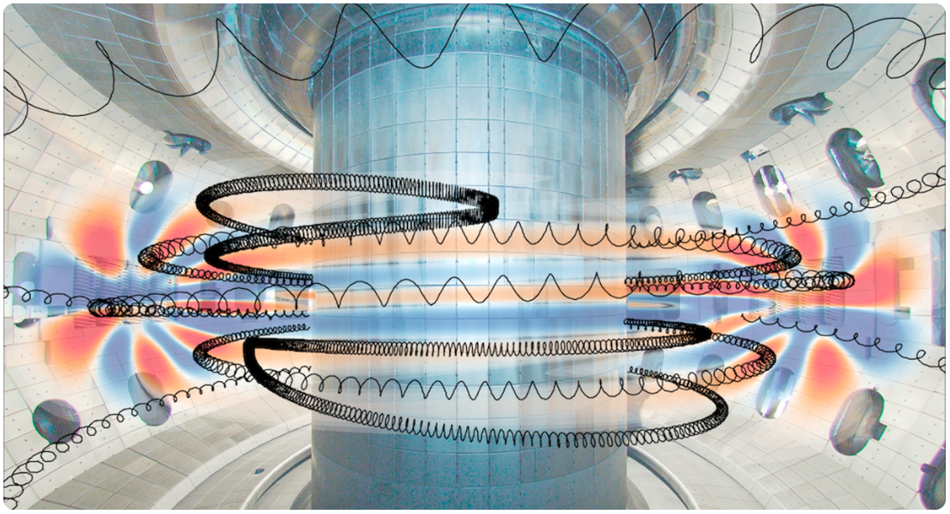
Jefferson Lab Fusion Program Polarized D Fuel at JLab
The life cycle of a polarized ⁷LiD pellet
Fabrication
Irradiation
Storage
Polarization
Extraction
Integration
Shape, size, density…
beamline, cryostat
Commission
LN2 cryostat
DF, pol chamber, pellet loader,
μWave & NMR
D + ³He → α + p
Pellet extractor, (integrated with DF and injection gun)
Integrate pellet polarizer with (ORNL built) injection gun)
Final installation at DIII-D tokamak
DIII-D,
Particles detection,
Data analysis
μWave
Funded for FY24 & FY25
Subsequent
renewals
(for FY26-29)

Slide 6
Jefferson Lab Fusion Program The Program
Ultimate Goal:
Running D + ³He → α + p in DIII-D tokamak with polarized fuels to test polarization survivability.
Approach:
FY24-25 Equipment preparation, Fuel pellet production, ⁷LiD Polarizer designs, Prototype, …
FY26-27 Equipment production, System integration, Polarized fuel production, …
FY28-29 Commissioning, Running spin-polarized fusion at DIII-D.
JLab’s Short Term focus:
Preparing ⁷LiD pellets.
Irradiating ⁷LiD pellets with eBeams to create paramagnetic centers for DNP process.
Preparing μWave and NMR systems for polarization production and monitoring.
Designing a (commercial dilution refrigerator based) DNP polarizer.
Building a prototype Polarization Chamber with pellet handling system.

Slide 7
Jefferson Lab Fusion Program The Unique Challenges
The advantages:
JLab Target Group operates DNP polarized targets routinely.
Polarized LiD targets have been used successfully – eg. CERN COMPASS exp.
JLab PAC approved experiments require polarized ⁷LiD targets.
The challenges:
Precision engineering----Uniform shape and ρ to deliver ~10²⁰ deuterons/pellet.
Cold transporting----Pellet dispensed into 4K tokamak injector with holding field.
Impact resistance----Survives ~20m subsonic injection journey.
Requirements for the polarizer--High cooling-power commercial DF with ~7T magnet.
A pellet manipulation mechanism for loading/dispensing.
A polarizing chamber with NMR coils (V~0.06cc) and tuned waveguide.
Properly anchor components to achieve low operating temp (~100mK with μWave ON).
A 77K entrance interface and a 4K exit interface.

Slide 8
Jefferson Lab Fusion Program Pellets Design
To consistently deliver ~10²⁰ deuterons/shot, the shape, density and edges of the pellet must be well controlled and smoothly fit inside injection gun, for achieving high injection speed.
⁷LiD is chemically unstable, and caustic; must be handled in an inert gas environment.
⁷LiD pellets can be:
fused from powder;
casted;
machined from a solid chunk;
purchased from a vender – preferred; discussions in progress
⁷LiD Pellet size: cylindrical, φ=1.5mm, L=3.0mm.
Totally ~200 ⁷LiD pellets will be used for developing, testing and running the SPF experiment.

Slide 9
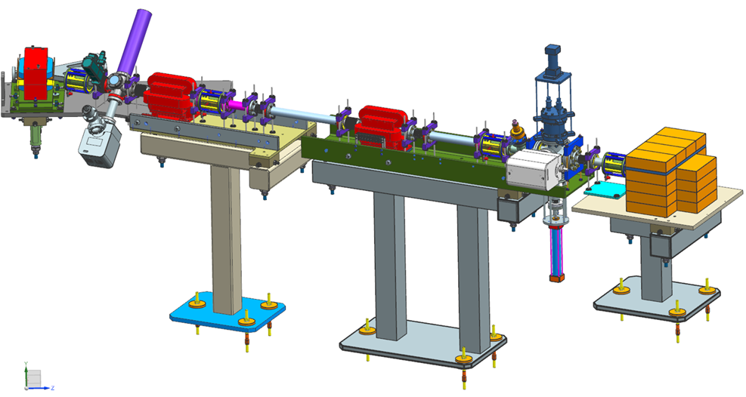
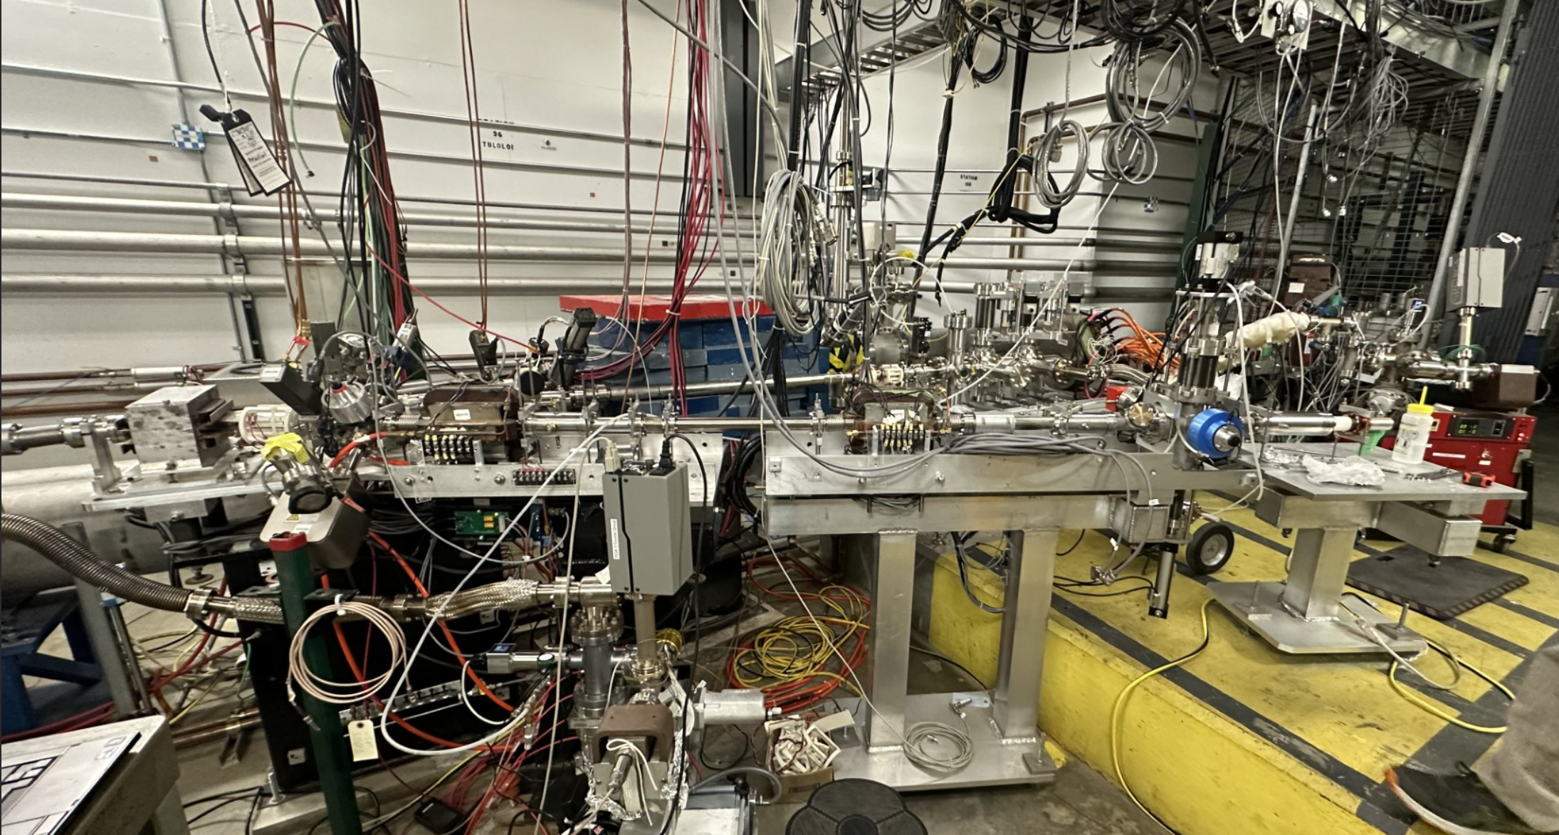
Jefferson Lab Fusion Program Doping ⁷LiD Pellets
Beamline
The ⁷LiD pellets must be irradiated with electron beams to create paramagnetic centers for the DNP process.
The pellets will be irradiated at ~185K with ~10mA electron beams (~9MeV) for several hours and stored/transported under 77K.
CEBAF Injector will be used for the irradiations.
The irradiation beamline has been built by Injector Group and is currently under vacuum.

Slide 10
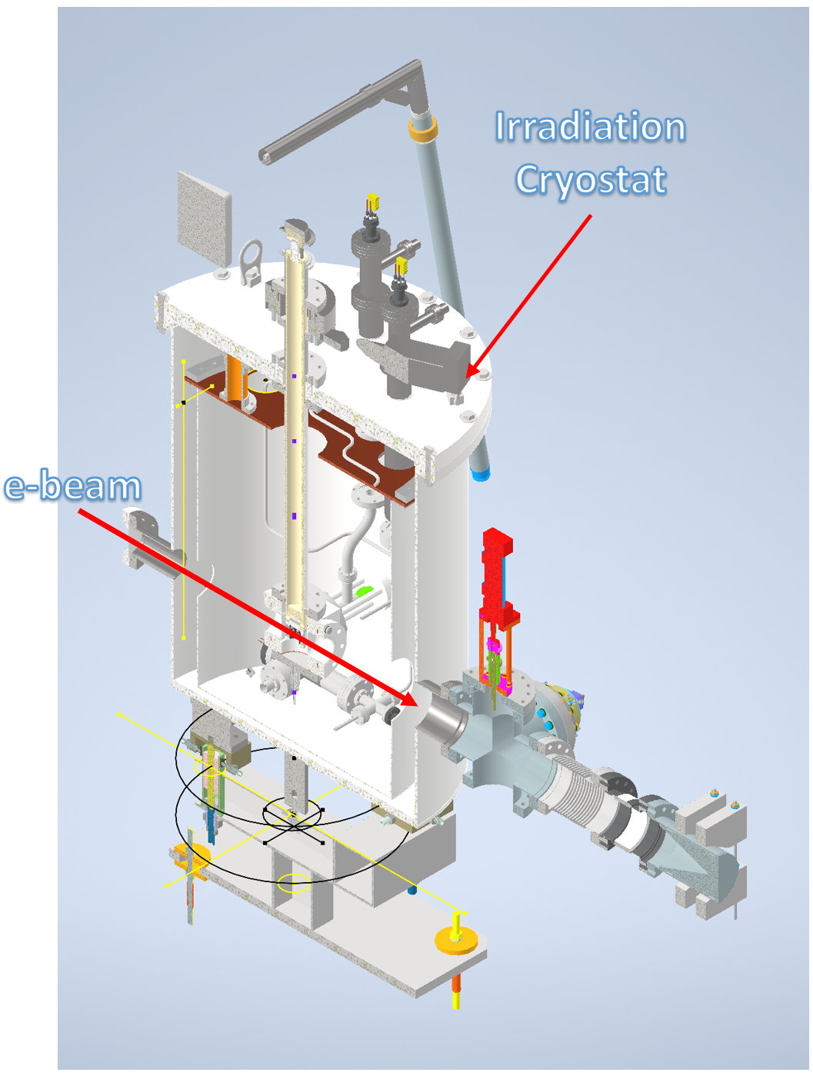
Jefferson Lab Fusion Program Dosing ⁷LiD Pellets
Irradiation Cryostat
The ⁷LiD pellets will be irradiated at ~185K with ~10mA electron beams (~9MeV) for several hours to create ~2x10¹⁷ e- /cm² for the DNP process and stored/transported under 77K. (See Kageya’s talk tomorrow)
The Irradiation Cryostat has been designed by the Target Group and the Fusion Group. Together, we will build it in FY25.
The irradiation results will be validated by measuring achievable polarization with DNP at the onsite Polarized Target Development Lab. (See Brock’s talk on Tuesday)

Slide 11
Jefferson Lab Fusion Program Beamline Simulation
Goals of the Beamline Simulation:
Guide the beamline commissioning;
Guide the target material irradiation runs by predicting the missing electrons with the dump current and viewers data.
Beamline Simulations (samples, UITF runs)

Slide 12
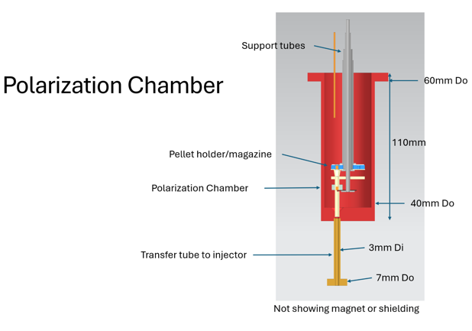
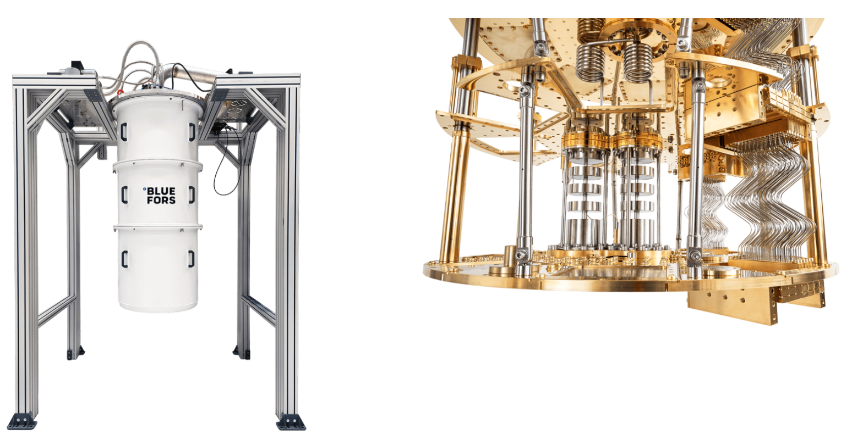
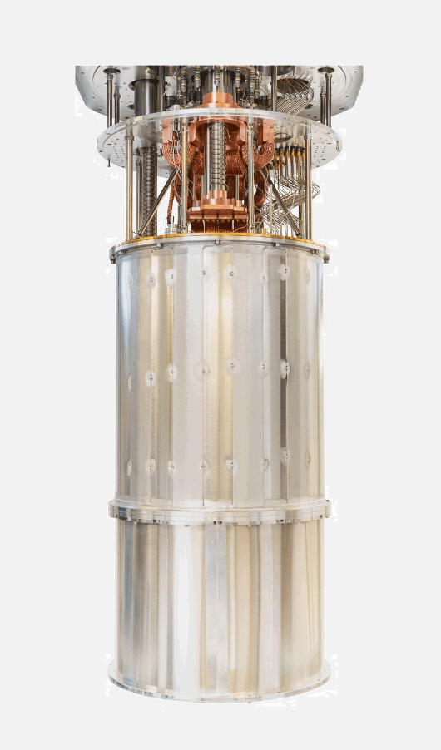
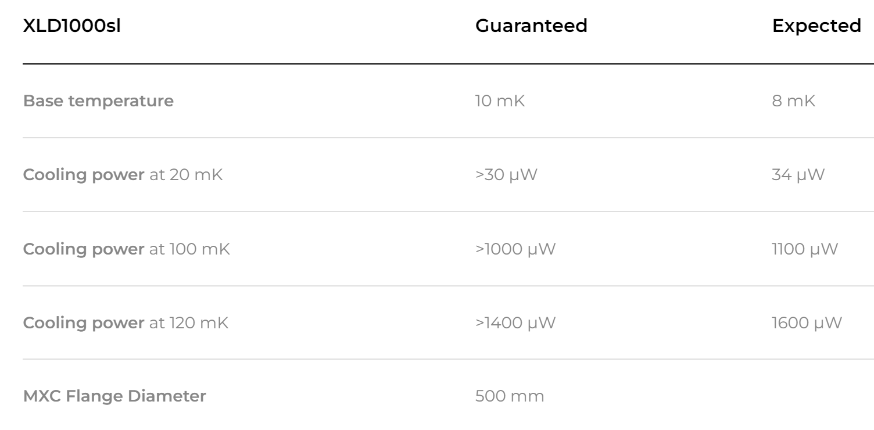
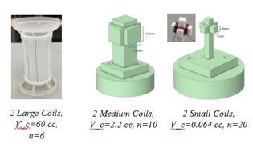
Jefferson Lab Fusion Program NMR coils & Polarizing Chamber
Designing the Polarization Chamber to fit in a commercial DF
(for phase-II funding)
As an example, a standard Commercial Dilution Refrigerator with a 7.5T Magnet can be purchased.
Credit: Bluefors
Sized for 7LiD pellet
Sized for NP target

Slide 13
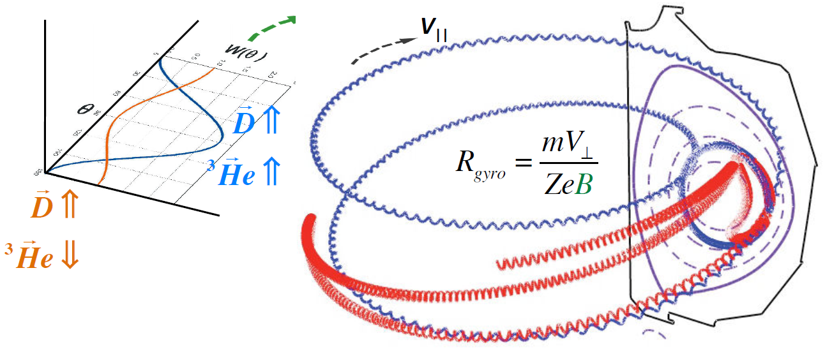
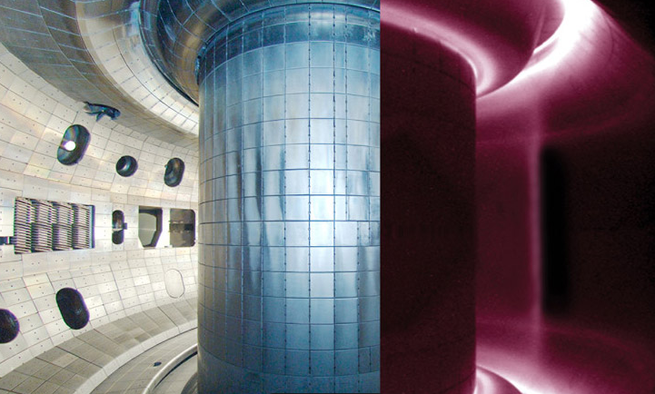
Jefferson Lab Fusion Program Other Places
While JLab is preparing the polarized D fuel:
UVA will build the ³He polarizer.
ORNL will design/build the cold pellet injection gun with continuous magnetic field.
UC-I will study fusion product detection and plasma diagnostics.
All components will be shipped to DIII-D in 2027.
parallel spins ⇒ large $V_{\text{r}}$
anti-parallel spins ⇒ large $V_{\text{q}}$
• Simulations follow secondary reactions to
estimate background yields:
³He + D a α + p (Q = +18.3 MeV) E(p) ~ 15 MeV
9 D + D a ³He+n (Q = + 3.3 MeV)
9 D + D a T + p (Q = + 4.0 MeV) E(p) ~ 3 MeV
9 D + T a α + n (Q = +17.6 MeV)
15 MeV proton orbits are unconfined
⇒Measure $V_{\text{r}}/V_{\text{q}}$ at wall to infer polarization.
⁷LiD
4K Injector
³He
77K Injector

Slide 14
Jefferson Lab Fusion Program The Ultimate Goal
Run D + ³He --> α + p in FY28

Slide 15
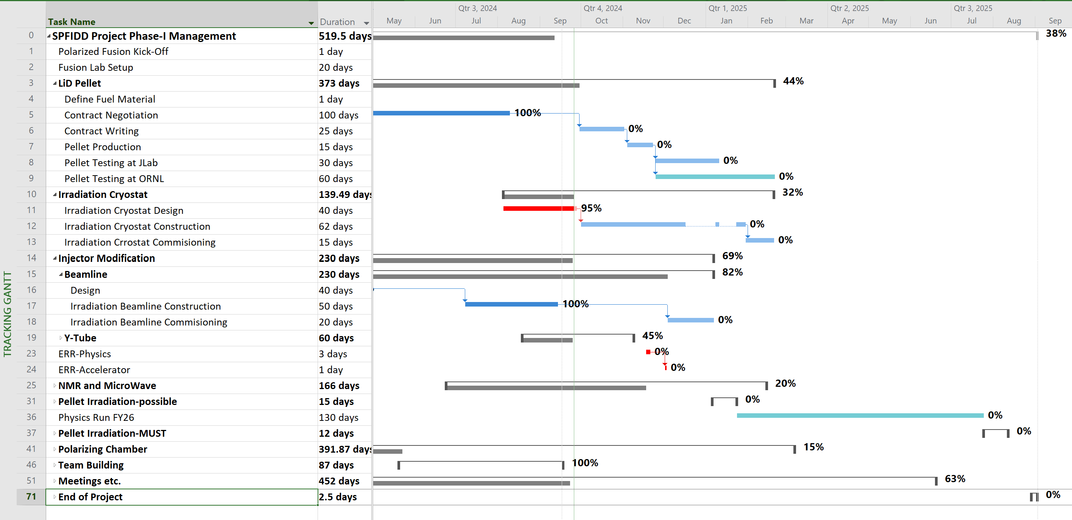
Jefferson Lab Fusion Program Schedule
Expecting to run the D + ³He test within 5-6 years. ​
​
Work at JLab for the current funding cycle:​
FY24: Preparing ⁷LiD pellets, designing/Building Irradiation Cryostat and Beamline.​
FY25: Testing Irradiation Cryostat, Producing Irradiated ⁷LiD pellets.​
In subsequent funding cycles:​
FY26-27: Finishing subsystem constructions and then production test.​
FY28-29: System integration and final assembly.​
Polarized D + ³He fusion at DIII-D!!!

