Slide 1
Electron polarization in the RCS at EIC
Vahid Ranjbar,
Electron Injection System Manager EIC
PSTP 2024
September 22-27, Jefferson Lab

Slide 2
Outline
What is Required and Relevant for Polarization
Review of Spin Mechanics in Accelerators
Spin Resonance Free Lattice (Concept Overview)
Approaches to Optimize Lattice
Assessment of Polarization
Orbit tolerances
Imperfection Bumps

Slide 3
The EIC’s Rapid Cycling Synchrotron (RCS)
Will receive 7nC electrons polarized to ~90% from a 3 GeV LINAC
At injection Both Horizontal and Vertical emittance will be 6.1nm (35 mm-mrad normalized) during Phase I without a wiggler. During Phase II with a wiggler the vertical will become << 1nm
The RCS Polarization Requirements:
Preserve polarization during acceleration from 3 GeV to extraction at 5, 10 and 18 GeV. With losses less < 5%.

Slide 4
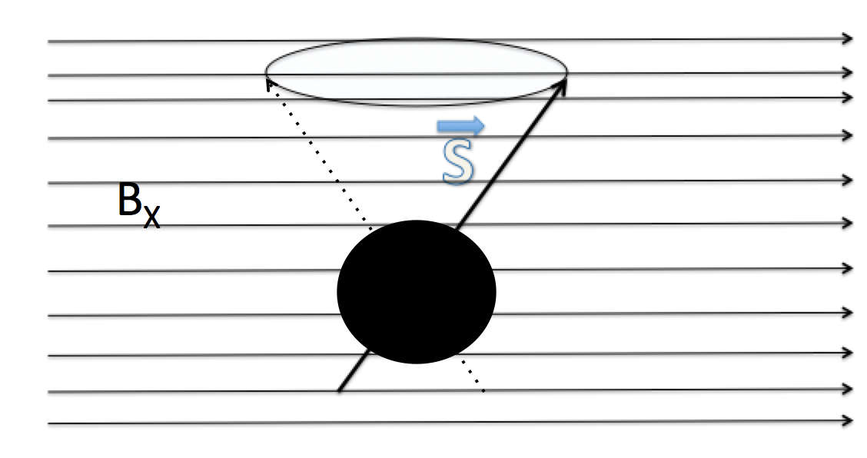
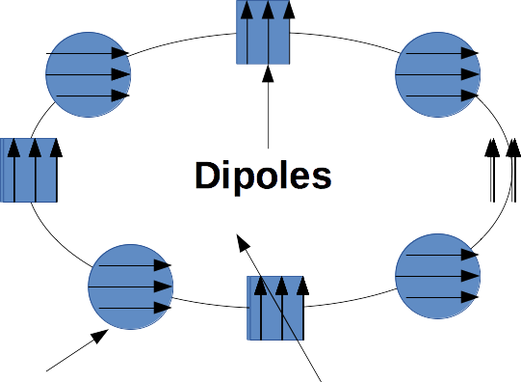
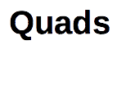
Spin Resonance Review

Slide 5
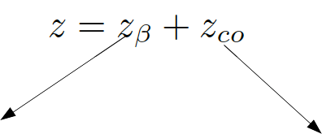
Spin Resonance Driving terms

Slide 6
Concept Overview: Spin Resonance Free Lattice
Both the strong intrinsic and imperfection resonances occur at:
K = nP +/- Qy
K = nP +/- [Qy] (integer part of tune)
To accelerate from 400 MeV to 18 GeV requires the spin tune ramping from
0.907 < Gϒ < 41.
If we use a periodicity of P=96 and a tune with an integer value of 50 then our first two intrinsic resonances will occur outside of the range of our spin tunes
K1 = 50+ν_{y} (ν_{y} is the fractional part of the tune)
K2 = 96 – (50+ν_{y} ) =46-ν_{y}
Also our imperfection will follow suit with the first major one occurring at K2 = 96 – 50 = 46

Slide 7
How to make this work in the RHIC tunnel?
It is easy to accomplish this with a perfectly circular ring. Just construct a series of FODO cells with bending magnets so that we have total periodicity of 96.
The problem is that the RHIC tunnel is not circular and has an inherent six-fold symmetry.
The solution make the spin resonances integrals over the straight sections equal to zero. Or lattice insert where spin kicks between dipoles cancel.

Slide 8
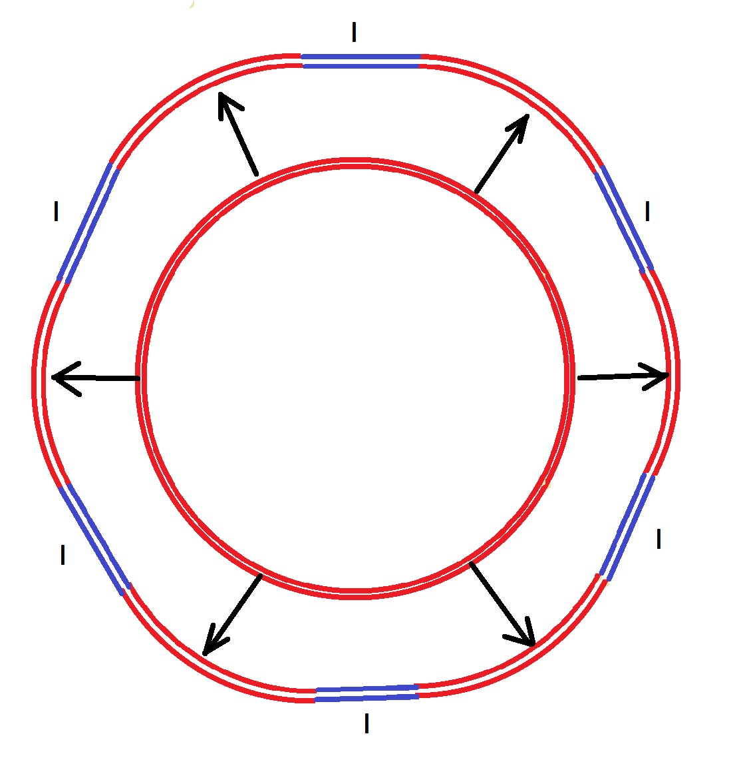
Project onto the RHIC tunnel
RHIC Tunnel
For all the insertion regions between arcs we forced the spin contribution to cancel between the dipoles.

Slide 9
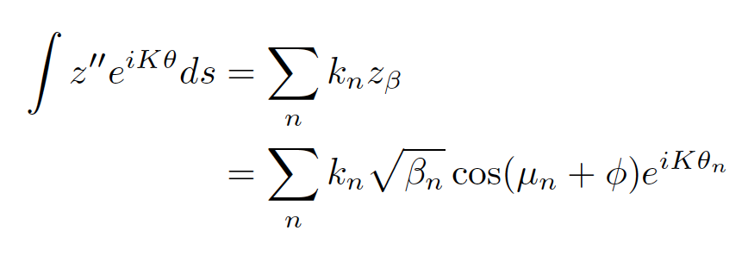
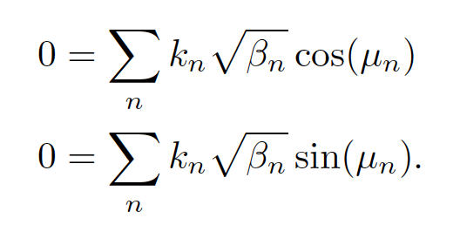
This is accomplished via several possible methods
If there are no dipoles in the straights → make the vertical optical phase advance which breaks the super periodicity unitary.
If there are dipoles in the straights → make quad-induced spin kicks cancel between dipoles i.e.:
Drive Resonances down in Gɣ = K → 0 to 41 with an optimizer coupled with DEPOL spin resonances calculator.
→ 0 between dipoles
Spin resonance free electron ring injector Phys. Rev. Accel. Beams 21, 111003 – Published 27 November 2018

Slide 10
RCS Layout
The current design accommodates detector bypasses and RF physical needs but breaks the symmetry
Two connecting arc designs
Detector→ IP6, IP8
RF, Extraction, Injection
IP10→ RF
IP12→ Extraction
IP2
IP4 → Injection
Achieved bypass at the IP.
Impacts symmetry of the lattice.
However, by optimizing the quad strengths in the bypass region, we can recover low intrinsic and imperfection spin resonance losses.

Slide 11
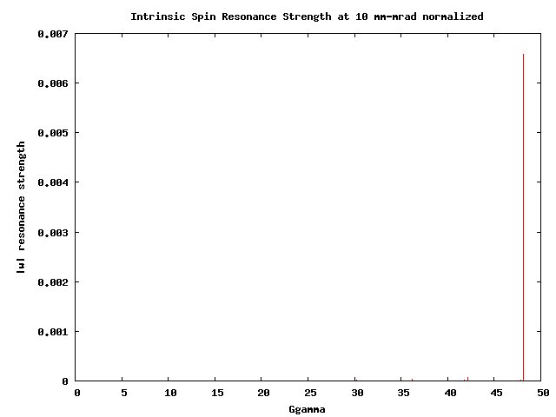
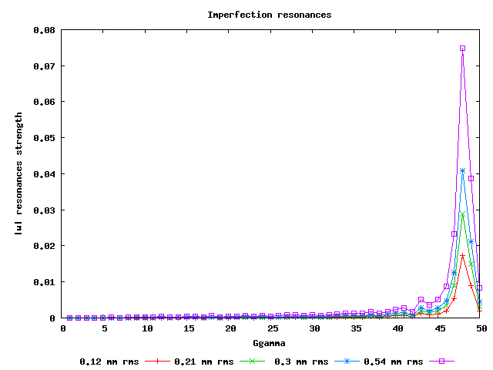
Calculating Spin Resonances
Extraction
Extraction
No polarization loss from cumulative effective of intrinsic spin resonances for distributions over 100 msec ramp.
Issue to control: Imperfection spin resonances ~ vertical rms orbit 0.5 mm to keep losses < 5%.

Slide 12
RCS lattice changes
Since original design RCS lattice has undergone three major revisions and currently just completed a fourth revision
Avoid obstructions of walls and other beamlines
Remove all RCS magnets from the detector hall
Reduce driving terms for Collective instabilities (TMCI) by reducing average beta and gammaT
We have also made room for a possible wiggler magnet

Slide 13
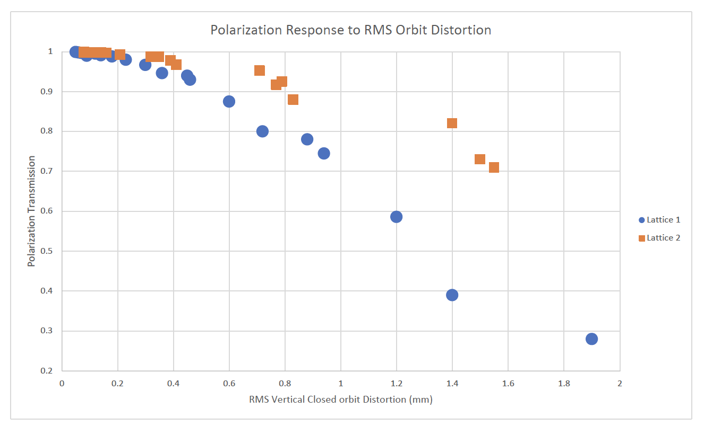
Drivers of Polarization Loss
Emittance will either start out very small or radiate to a small value by the end of the acceleration ramp.
Strong depolarizing resonances are well above 10 GeV when the emittance will be very small due to radiative damping. Thus we don’t expect polarization loss from intrinsics at all.
Imperfection spin resonances will be the primary driver of polarization loss for the RCS.
Strength of the intrinsic spin resonance correlates with the strength of imperfection resonances.
Comparison of polarization transmission due to imperfection spin resonances as function of RMS orbit distortion.
Lattice 1: 15% intrinsic resonance induced losses at RMS emittance 1000 mm-mrad.
Lattice 2: 8% intrinsic resonances induced losses at RMS emittance 1000 mm-mrad

Slide 14
Lattice Response to Intrinsic and Imperfection Spin Resonances
After adjustment to RCS lattice due to the need to move magnets and the needs to address collective effects back in spring, we have recovered high polarization transmission
Can tolerate up to 1000 mm-mrad rms normalized emittance achieving up to 96% transmission. This corresponds to a geometric emittance at injection 170 nm and extraction 28.4 nm
Response to 100 random seeds for different alignment errors. Achieve up to 95% at 0.553 mm rms
Average Orbit RMS (mm) | Average Max Orbit (mm) | Polarization at 5 GeV | Polarization at 10 GeV | Polarization at 18 GeV (%)
0.273 | 1.26 | 99 | 99 | 98.7
0.436 | 2.02 | 99 | 99 | 97
0.553 | 2.53 | 99 | 99 | 95.3

Slide 15
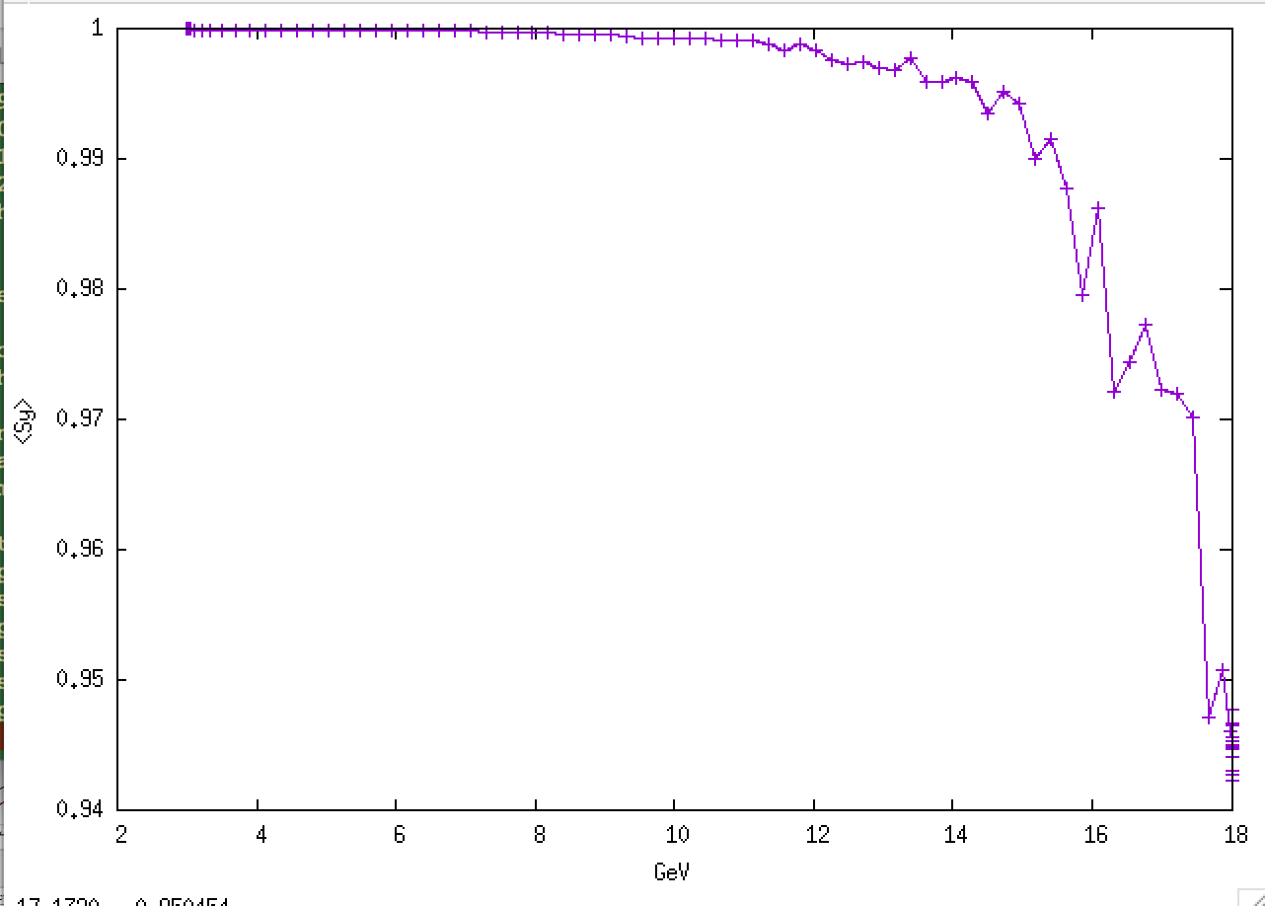
First Spin Tracking Results with New Lattice
Full 6D tracking 1000 particles in BMAD with vertical closed orbit errors of 0.59 mm RMS, including radiation.
Achieved by random misalignment of quads of 2e-5 m with not attempt at correction
Injected emittance 6.1nm in both planes with 2 mm bunch length and 0.2% dp/p rms

Slide 16
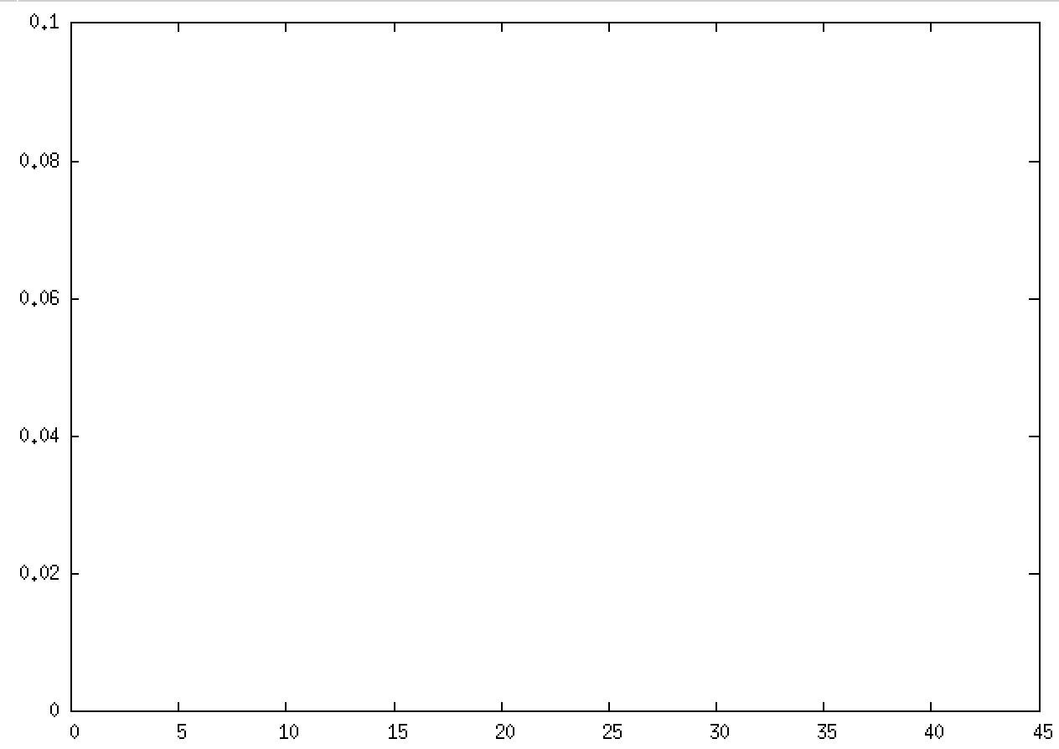
Imperfection Bump
Since the Strong Imperfection Spin resonances occur at the end of the ramp and are few in number they could also be handled using an imperfection bump scheme. (back-up approach)
Similar to harmonic bumps → Sin(10*θ) used in AGS for many years
Get imperfection at every Gɣ=n*10
Using SVD to invert Imperfection to corrector response matrix, I can create resonance “bump” exactly at Gɣ=15 and nowhere else.
|𝝐|
Gɣ

Slide 17
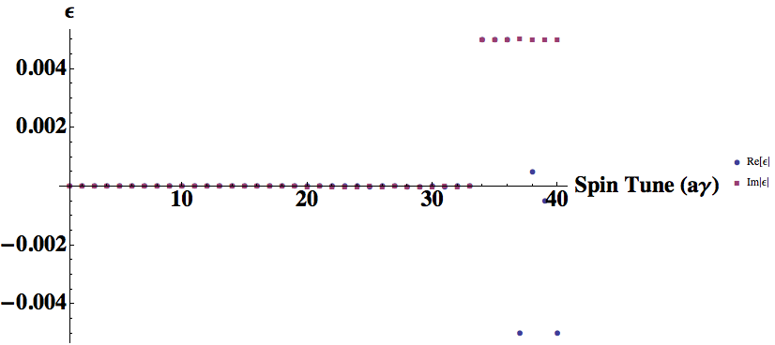
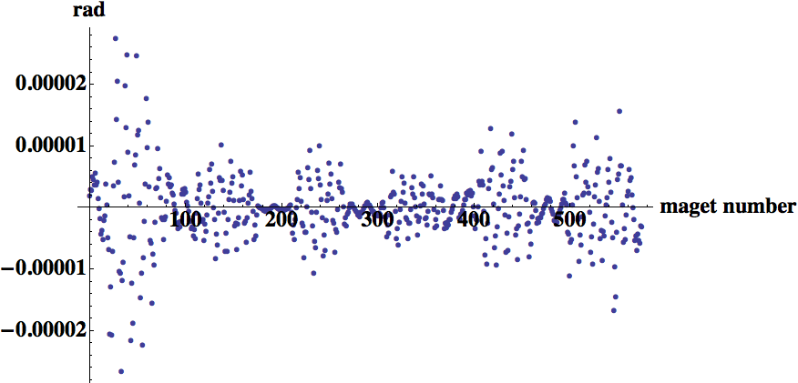
Implementation of Imperfection Bump
Static imperfection bumps at any imperfection resonance location on the ramp.
Bumps are orthogonal to each other and localized in energy space → no required bandwidth beyond what is needed to ramp the dipoles with the energy.
Example Shown on Right: 10 to 15% (0.005 res.) Depolarization Kick Imaginary and Real no kicks anywhere else.

Slide 18
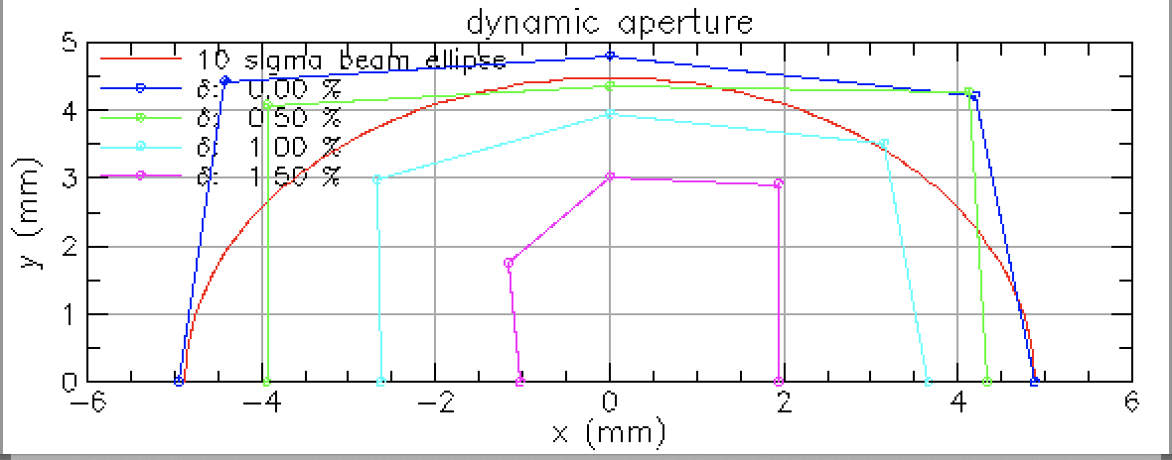
Progress on Dynamic Aperture
Thanks: Will Bergan
With Polarization Transmission recovered we also optimized the sextupoles to recover sufficient off-momentum aperture to accommodate off-momentum injection.
As well at 18 GeV horizontal emittances are large so we need a large enough dynamic aperture to accommodate 27 nm equilibrium emittance.
So far we have > 5 sigma at injection and about 10 sigma at 18 GeV.
With Physical aperture r=17.8 mm

Slide 19
Summary
RCS lattice has had to undergo several modifications to avoid tunnel obstructions and improve response to collective instabilities.
Via optimizing the quad strengths and layout we have recovered high polarization transmission of previous lattices as well as adequate dynamic aperture.
It is also desirable to add wigglers however optics will need more work.

Slide 20
Backup Slides

Slide 21
Electron Injector System Performance Goals
To achieve average polarization of 70% and intensity requirements of the ESR. The EIS will need to achieve the following capabilities:
Accelerate polarized electrons to 5, 10 and 18 GeV
Maintain 95% polarization transmission
Deliver 28 nC bunches at 5 and 10 GeV ( every 1.5 sec)
Deliver 11nC at 18 GeV ( every 1 sec)
Accumulate 28 nC in RCS using 7 nC charge from LINAC.

Slide 22
What ESR requires from RCS
 | Phase I |  | Phase II
Energy (GeV) | 5 | 10 | 5 | 10 | 18
Eh (nm-rad) | 16-24 | 16-24 | 16-24 | 16-24 | 19-29
Ev (nm-rad) | 1.4-2.2 | 1.0-1.6 | 1.4-2.2 | 1.4-2.2 | 1.6-2.4
Long Emit (eV-s) [e-4] | 0.8 – 5 | 1- 5 | 0.8– 5 | 1 -5 | .624 – 5.8
Bunch Charge (nC) | 7 | 7 | 28 | 28 | 11
Number of Bunches per cycle from RCS | 1 | 1 | 3 | 3 | 3
injection cycle (sec) | 1.5 | 1.5 | 1.5 | 1.5 | 1
Phase I of EIC operation bunch charge limited to 7nC and energy 10 GeV
Phase II Bunch charge rises to 28nC and energy to 18 GeV
Transverse and Longitudinal Emittance ranges based on beam-beam simulations in the ESR

Slide 23
RCS Lattice Design
Design driven by polarization transmission needs
Requires high periodicity and tune
Special Spin Resonance Optimization
Design also guided by need for good off-momentum dynamic aperture to facilitate charge accumulation at injection
Design needs low average beta and low gammaT to reduce collective effects that would prevent charge accumulation

Slide 24
Technical Challenges Identified at last mini-MAC
Low Dipole field at injection
Concern about effect of ambient fields a 400 MeV
Solution raising injection energy to 3 GeV and dipole fields to 400 Gauss
Concern about multipolar fields due to eddy currents
Raising injection energy reduces the relative effect and copper-coated stainless steel instead of copper drops the absolute value of the effect.
Concern about Collective effects
Raising injection energy improves stability thresholds and modifications to beta functions and gammaT values of lattice.
Recover high polarization transmission for RCS lattice

Slide 25
Summary of Design Modifications
Raised Injection Energy to 3 GeV
Chose to achieve 3 GeV Injection using SRF 1.3 GHz LINAC after a cost comparison with a 3 GeV Booster option. Initial estimates came out to be very close, so we chose SRF as a more straightforward solution.
Changed from copper beam pipe to stainless steel with a copper coating (cost about the same)
Moved Injection from IP12 to IP4.
Developed off-momentum injection approach to accumulate 28 nC in RCS
No need for RF kickers
No need for Harmonic Cavities used for merging
Will need to add wiggler during phase II or some other radiative damping insert.

Slide 26
Injection/Charge Accumulation Approach
Add wiggler in phase II:
Radiate ~ 390 keV/turn
7nC/bunch → Phase I
3 bunch train of 7nC/bunch → Phase II: charge accumulation in RCS via off-momentum injection into same RF bucker using wiggler for damping
7nC x 4 transfers = 28 nC/bunch
Each shot 3 bunches/transfers
With wiggler
1.3 GHz Linac
RCS
wiggler
7nC for Phase I: single shot

Slide 27
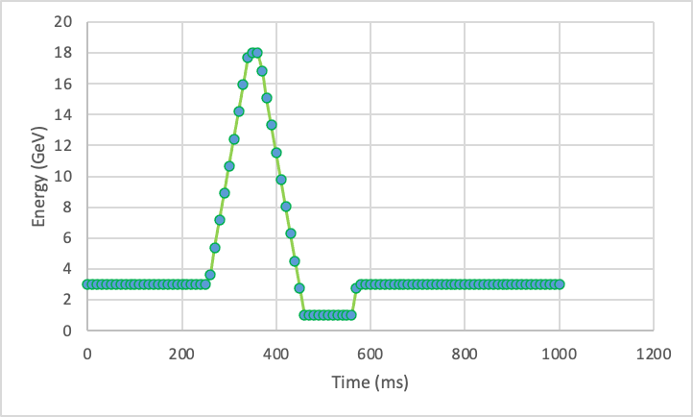
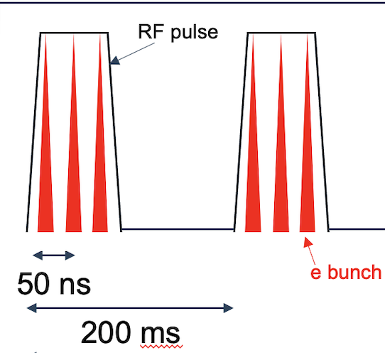
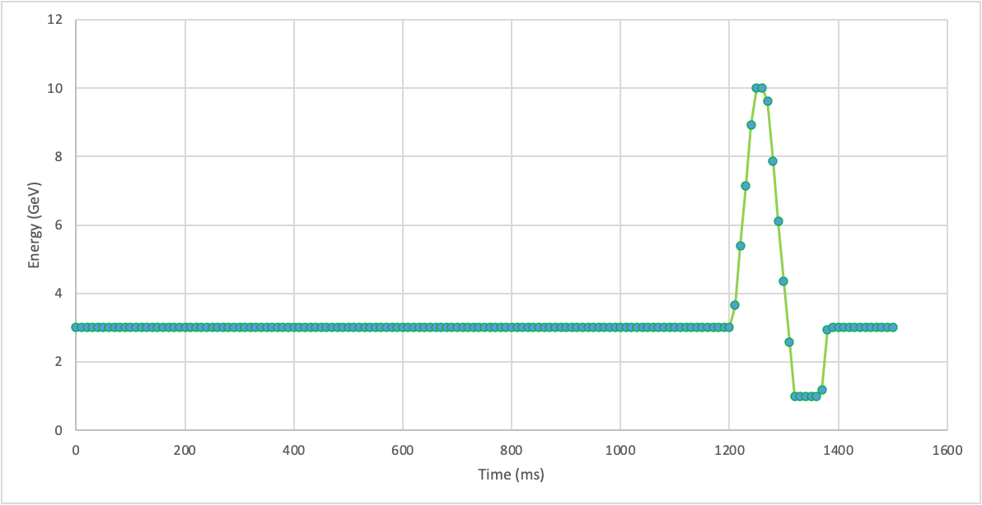
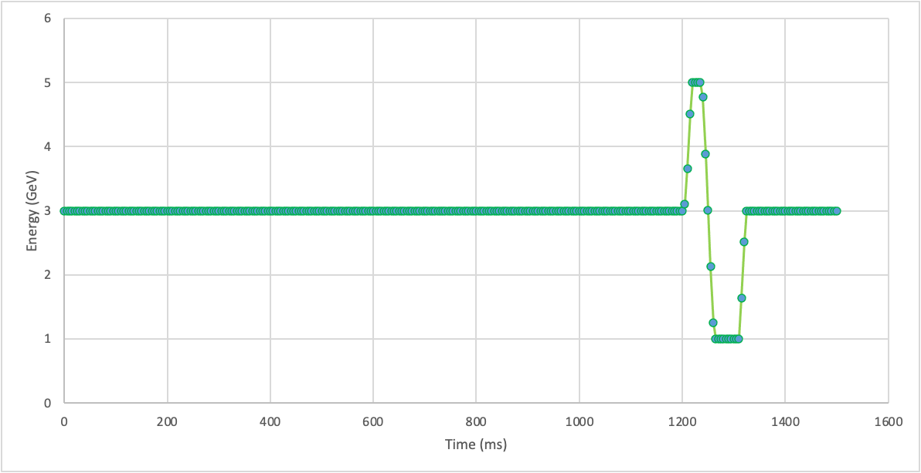
RCS Ramp Cycle (Phase II )
18 GeV mode
Three Physic Operational Machine States
Bunch injection and ramp cycle are shown for accumulating max charge.
10 GeV mode
5 GeV
mode

Slide 28
Momentum stacking with 7nC bunches (with wigglers)
Thanks Mike Blaskiewicz
Before injection, RF gymnastics give the stored beam a coherent synchrotron oscillation. Injection occurs at minimum energy.
A one-turn horizontal bump with ferrite kickers is turned on.
Beam with positive momentum offset is injected onto its closed orbit.
After both beams are in, the bump is dropped.
Bunch-length damping can be used to stop emittance growth to shorten time between injections
Emittances and damping times at 3GeV in the RCS are ε_{x}=0.33 nm, τ_{x}=0.194 s, σ_{E}=0.00085, τ_{E}=0.097 s

Slide 29
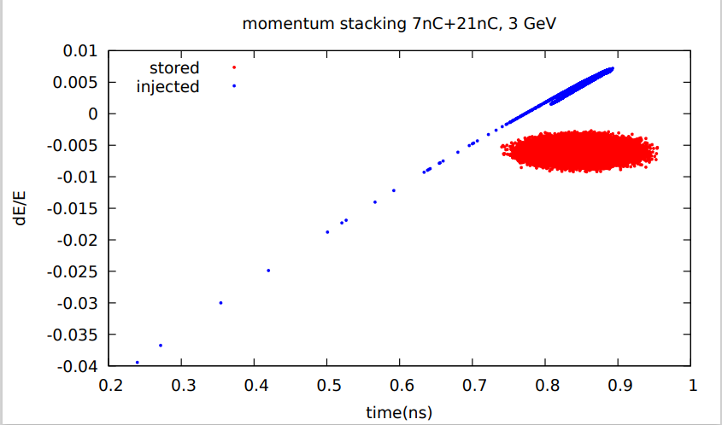
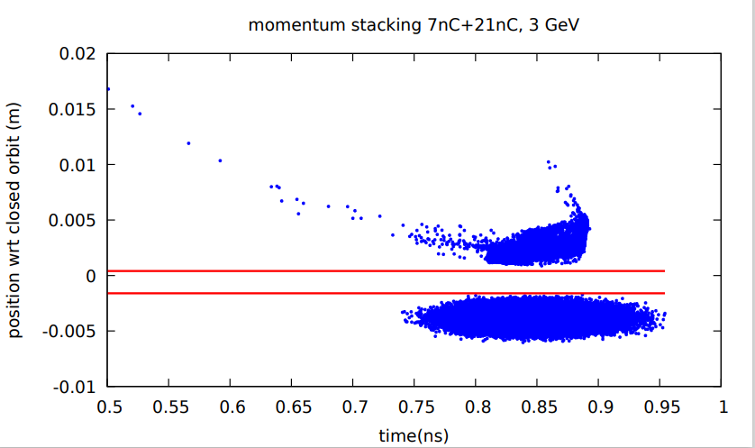
Preliminary Simulations
Snapshot of Last injected bunch after three bunches already stacked.
septum.
About 0.1% of the total beam is lost, mainly on the septum.
After 0.2 seconds the bunch is virtually at equilibrium so we could stack all 7 bunches in 6*0.2 = 1.2 seconds

Slide 30
The Current RCS Extraction Parameters
 | Phase I (no wiggler) |  | Phase II (with wiggler)
Energy (GeV) | 5 | 10 | 5 | 10 | 18
Eh (nm-rad) | 3.6 (16) | 10 (16) | 1.7 (16) | 6.5 (16) | 27
Ev (nm-rad) | 2 | <<1 (1.44) | <<1 (1.44) | <<1 (1.44) | <<1 (1.6)
σ_{δ} (rms %) | 0.03 | 0.06 | 0.103 | 0.12 | 0.14
Long Emit (eV-s) [e-4] | 0.45 (0.8) | 1.4 | 1.15 | 2.4 | 4.76
Bunch Charge (nC) | 7 | 7 | 28 | 28 | 11
Min injection rate (sec) | >7.8 | 7.8 | >7.8 | 7.8 | 1.24
Long Damping Time(sec) | 0.25 | 0.03 | 0.05 | 0.015 | 0.004
Those highlighted in red require the emittance to be blown up to match the ESR’s
(bold black) indicate min acceptable ESR emittance.
We will need to at least blow-up the vertical emittance in all cases except for Phase I at 5 GeV. In this case transverse damping time is <0.5 sec so we can wait till it damps to extract.
We also to blow-up horizontal emittance in most cases
Based on beam-beam analysis we should be okay with this level of longitudinal mismatch.(however need to check 5 GeV case)
We can blow up emittance via kicks as has been done in the SPS. We have performed preliminary BMAD simulations which demonstrate this for 18 GeV vertical emittance. It might also be possible to adjust coupling in some cases to increase vertical emittance.

